Slide 1
Zinkgruvan visit and
Far Detector Design Project
Tord Ekelof
Uppsala University

Slide 2
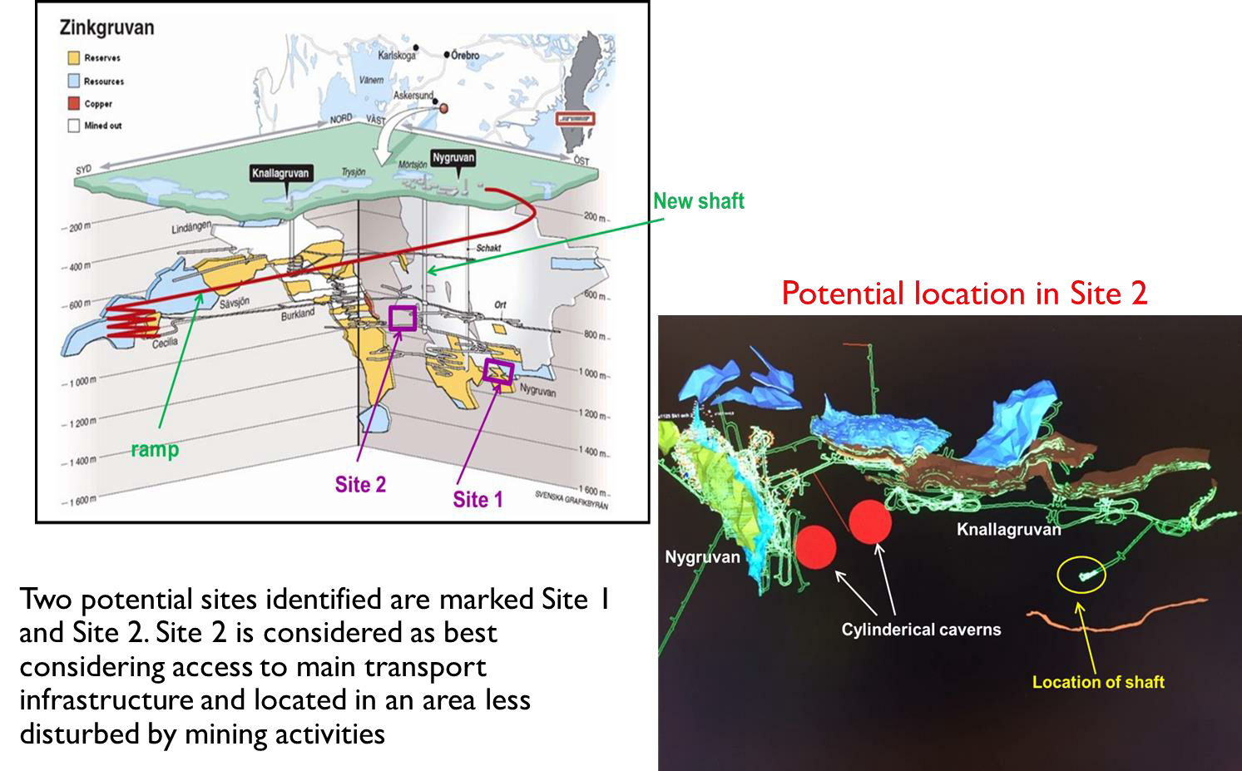
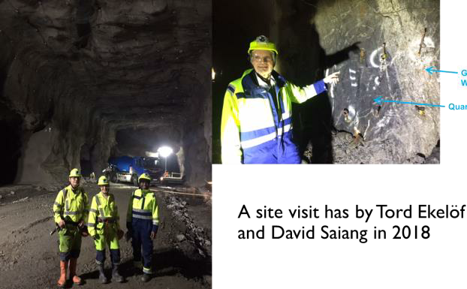
Vistit of ESSnuSB EC to Zinkgruvan mine planned on 16 October 2024 08:15-12:00
Suggested location of ESSnuSB detector by David Saiang 2020

Slide 3
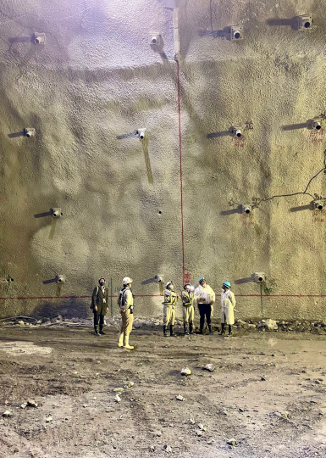
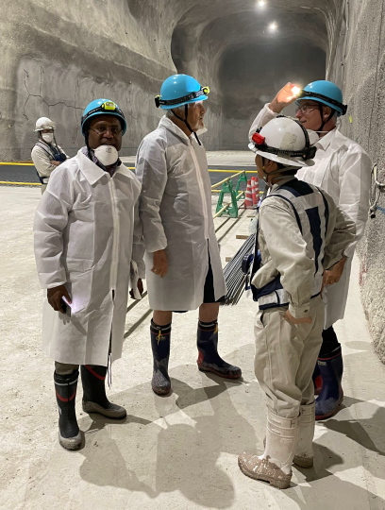
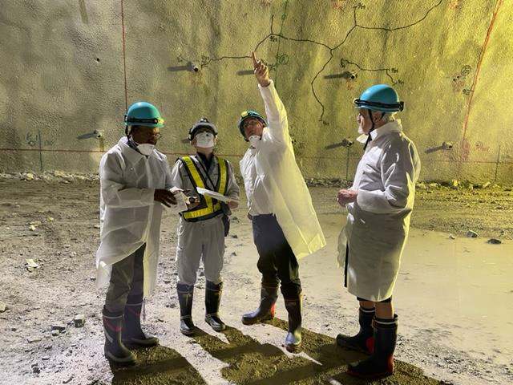
Pictures from the visit of
Craig Griffiths
David Saiang and
Tord Ekelof
To the Hyper-K detector
construction site in Japan
13 September 2023
The HK main cavity top dome
Water purification gallery

Slide 4
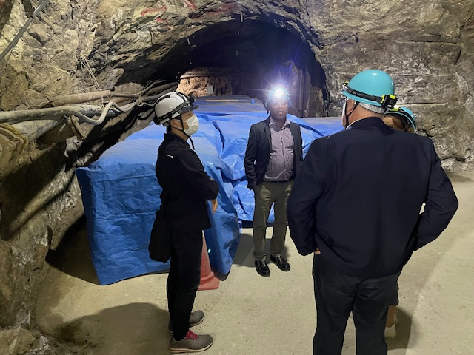
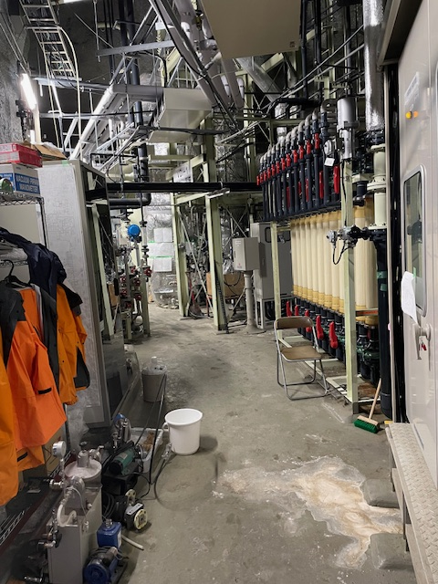
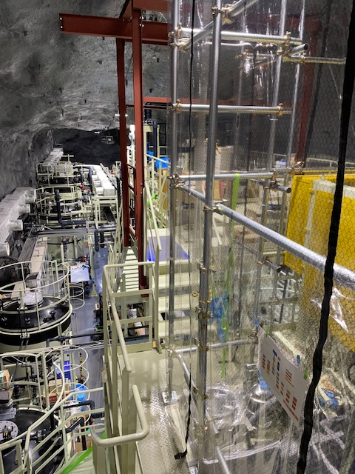
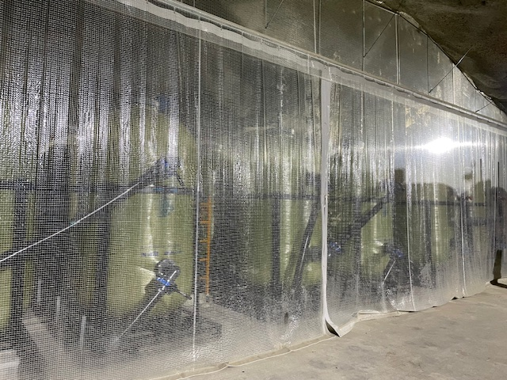
Pictures from the visit of Craig Griffiths, David Saiang and Tord Ekelof
to the Super-K detector in Japan13 September 2023
Super-K water cleaning plant
Super-K Gadolinium mixing plant
Hypr-K Gadolinium sulphate storage
(top) and dissolution plant (bottom)

Slide 5
Persons who have confirmed their participation in the visit to Zinkgruvan 16 October 2026
gfan@IPN.DEMOKRITOS.GR George Fanourakis
natalia.Milas@ESS.EU Natalia Milas
Dawid.Patrzalek@ESS.EU Dawid Patrzalek
mnjtghosh8@GMAIL.COM Monojit Ghosh
marcos.dracos@IN2P3.FR Marcos Dracos
eric.baussan@IPHC.CNRS.FR Eric Baussan
budimir.klicek@IRB.HR Budimir Klicek
david.saiang@LTU.SE David Saiang
andrea.longhin@PD.INFN.IT Andrea Longhin
tamer.tolba@UNI-HAMBURG.DE Tamer Tolba
maja.olvegard@PHYSICS.UU.SE Maja Olvegård
tord.ekelof@PHYSICS.UU.SE Tord Ekelöf
marek.jacewics@PHYSICS.UU.SE Marek Jacewics

Slide 6
Meeting between members of the Management of the Zinkgruvan Mining AB and the members of the ESSnuSB Executive Committee Wednesday 16 October 2024 13:00 – ca 15:00 hrs at the Zinkgruvan Mining AB site
Agenda
Brief presentations of the persons attending the meeting 13:00-13:15 / All
Presentation of the Zinkgruvan Mining AB company 13:15-13:30 / Staffan Sandström
The purpose and organization of the ESSnuSB research project and status of its design study 13:30-13:45/ Marcos Dracos
The design-study of the construction of the detector cavern, of the technical galleries and the access shaft and of the required core drilling program in the mine 13:45-14:05/ David Saiang
The proposed fund request to the EU call HORIZON-INFRA-2025-DEV-01-03 to finance the design study of the construction of the proposed large ESSnuSB neutrino detector in Zinkgruvan, including the core-drilling program 14:05-14:25 / Tord Ekelöf
Planning of the cooperation between Zinkgruvan Mining AB and the ESSnuSB Consortium for the discussed design study 14:25-14:55 / All
Communication 14:55-15:00 / Monika Andersson
Adjourn

Slide 7
In order to make a design study of the two ESSnuSB Far Detector underground caverns and the associated access shaft and service galleries, on the same readiness level as the installations on the ESS site, a collaboration with the Zinkgruvan Mining AB company need to be established.
For this we need to acquire funding for, inter alia, reimbursing Zinkgruvan Mining for the services that we need to ask them to provide, in particular the core drillings to measure the pressure and strength of the the rock in the proposed underground location of the detectors.
A plan for a fund request is therefore being prepared to be submitted to an EU Infrastructure Development (INFRADEV) call that has already been announced. This call will be officially published in 6 May 2025 with the last day for submission on 18 September 2025.

Slide 8
HORIZON-INFRA-2023-DEV-01-03: Consolidation of the RI landscape – Individual
support for evolution and long-term sustainability of pan-European research
Infrastructures
Pages 14-16 at https://indico.cern.ch/event/1443347/attachments/2906084/5097846/_HORIZON-INFRA-2025_06_25_2024.pdf
Total EU budget for the call 40 M€, previewed budget per proposal: 3-4 M€
NEW: An applying consortium must include at least one of the ESFRI Landmarks 16 or European Research Infrastructures Consortia (ERICs), which in our case is ESS.
Outcome of project expected by EU:
• better structured and strengthened European research infrastructure landscape;
• new services available to a wider user community, including participants in other parts
of Horizon Europe, allowing to better tackle scientific and societal challenges;
• increased capacity to address EU policy priorities and/or support EU industry;
• reinforced global competitiveness of the European Research Area;
• increased long-term sustainability of European research infrastructures;

Slide 9
Scope : This topic targets the consolidation of the EU RI landscape through the support,
together with member countries, to the strengthening, long-term sustainability, reorientation
or evolution of ESFRI Landmarks or other European Research Infrastructure Consortia
(ERICs). Activities aimed at ensuring long-term sustainability include enlargement of the
membership or broadening the base of participating countries, international cooperation,
revision of business/funding plan, development of managerial and technical skills for RI staff,
and structuring and strengthening of national nodes
Activities for reorientation or evolution should fill gaps in the RI landscape, enabling the RI to address new research or societal challenges and/or serve new user communities, increasing and improving service capacity and/or integrating new resources/facilities. Proposals should explain any synergies and complementarities with previous or current EU grants.
Prototype work can be included in a project adressing this call
Working title of the Proposal:
UnuDET - Exploring the engineering and usage of large underground spaces for fundamental neutrino oscillation research as well as for for ore finding and energy-storage purposes

Slide 10
Proposed UnuDET Work Packages
WP1 Management
Luleå Technical University
WP2 Site investigation, test drilling and evaluation
Zinkgruvan Mining AB, Luleå Technical University
WP3 Engineering Design of the two 270’000 m³ caverns and service galleriee1000 underground and the access shaft
Zinkgruvan Mining, Luleå and Wroclaw Technical Universities
WP4 Studies of the licencing required for the construction of the underground caverns
European Spallation Source ESS
WP5 Design and installation in the two large caverns of the water Cherenkov-light detector
Uppsala and Hamburg Universities
WP6 Use of the caverns for muon tomography and neutrino detection
Thessaloniki, Strasbourg, Stockholm Universities and Oulo Technical University
WP Future use of the 540’000 m³ cavern volumes for pumped hydro-electricity
Oulu Technical University

Slide 11
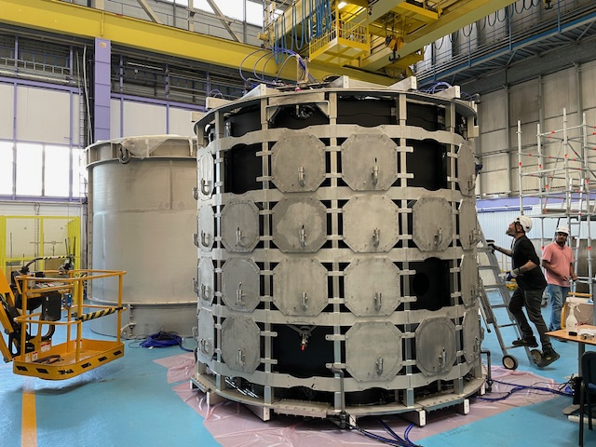
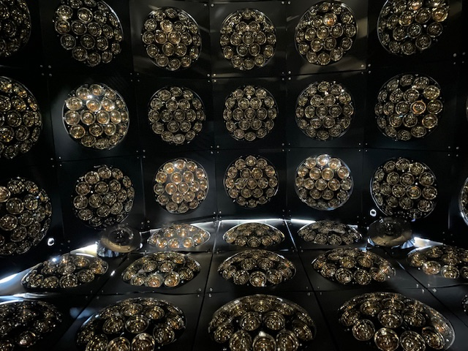
Water Cherenkov Test Experiments in the
Proton Synchrotron East Hall at CERN which take data in the
autumn 2024 and with Gadolinium in the water in the spring 2025
Support cage (in front) for the multiPMs and
the outer water container (in the back)
View inside with the multiPMs
on the cylinder wall

Slide 12
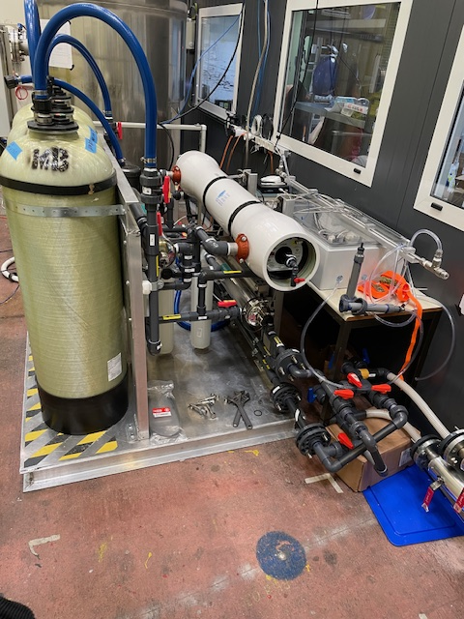
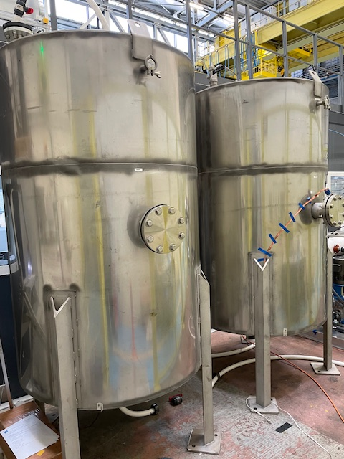
Water Cherenkov Test Experiment services
Water filtering and cleaning system
Tanks for the mixing in and extraction of Gadolinium
(provided by Uppsala University)

Slide 13
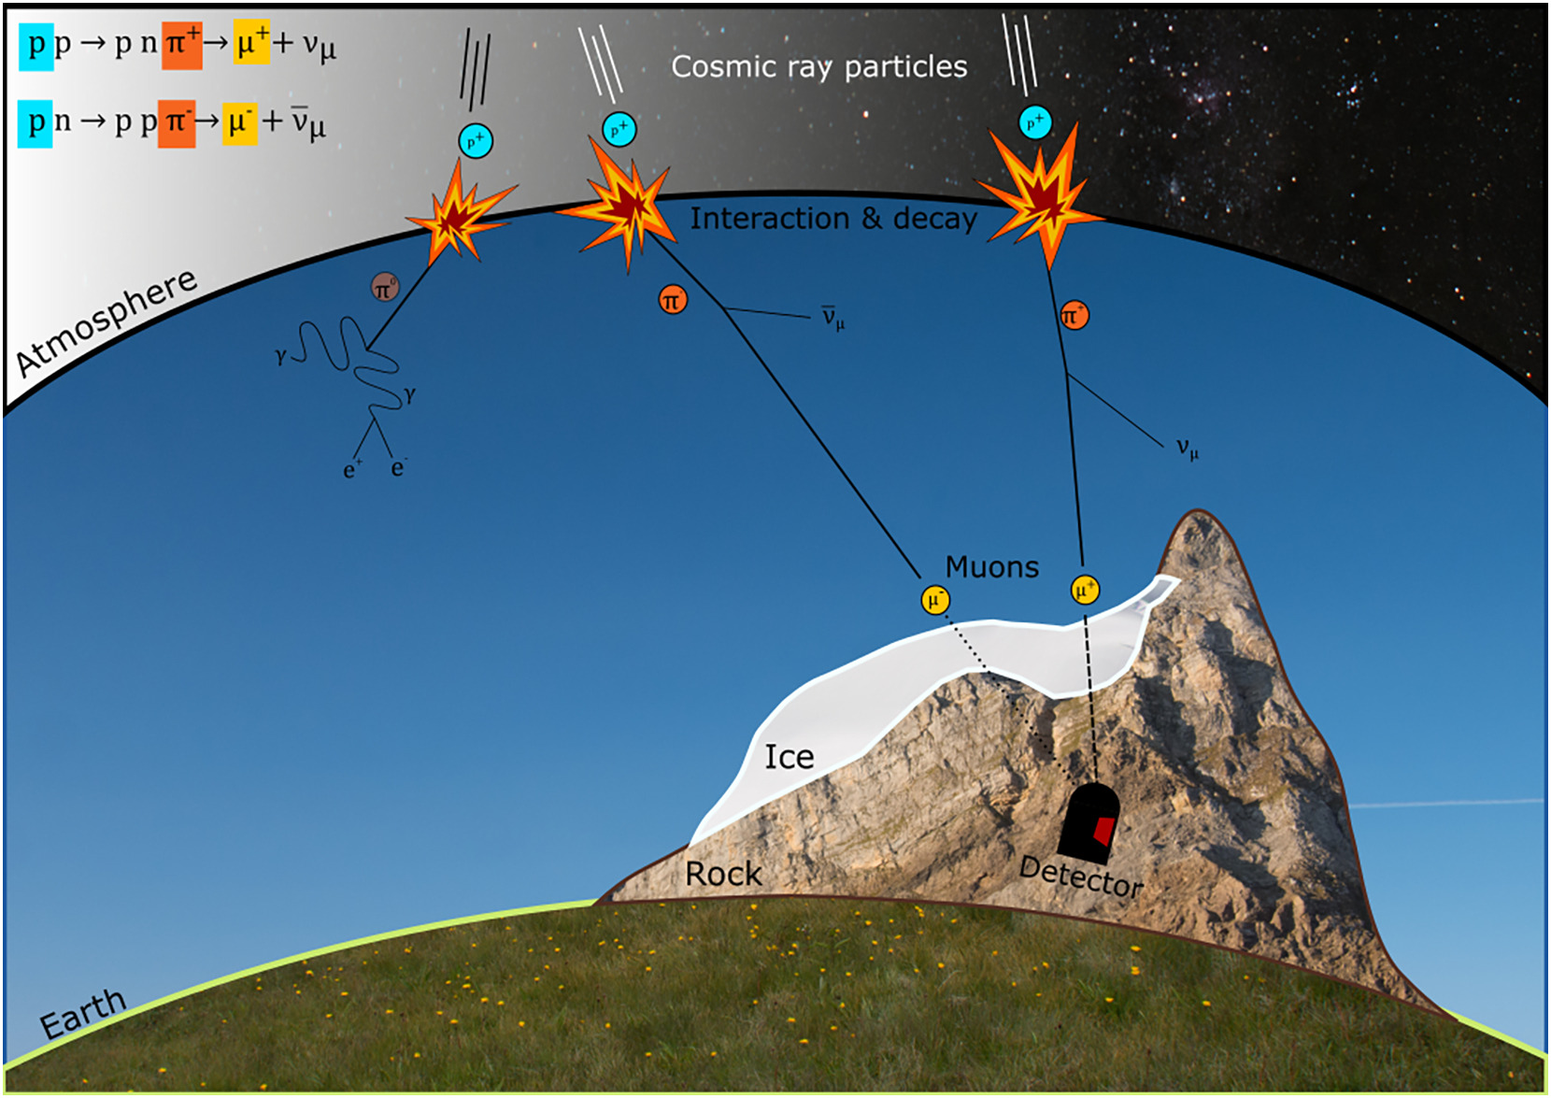
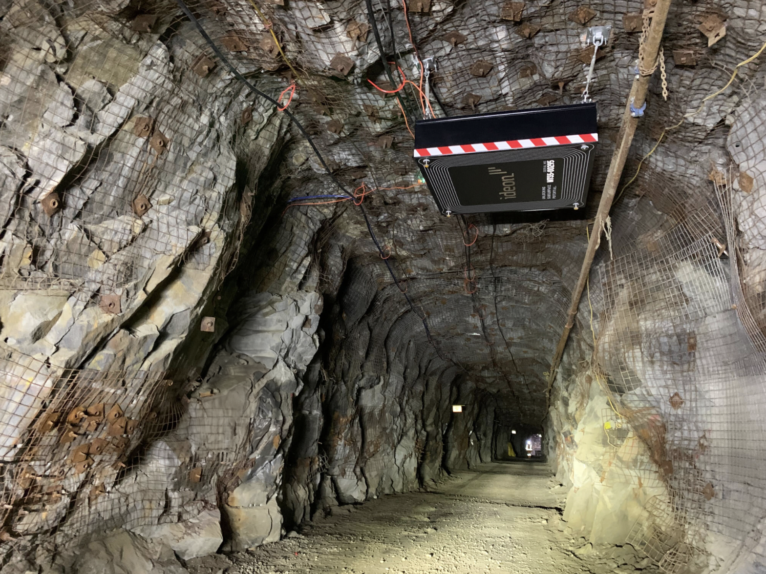
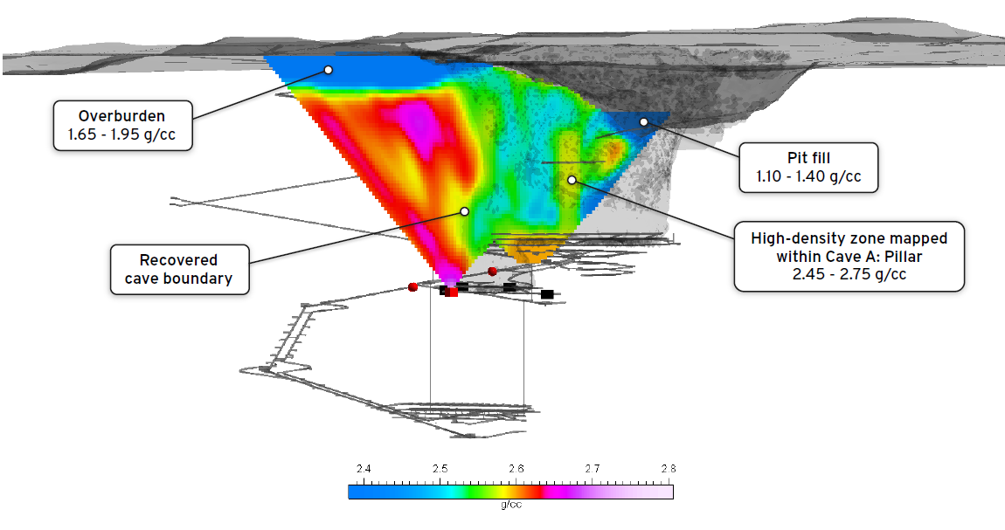
Muon Tomography for ore mapping around mines
Using muon tomography, Ideon remotely
mapped the full cave back at New Afton Mine
to 25 m or less spatial resolution at a depth of
approximately 800 m, using no additional drilling
to image 830 million m3 of earth. Presented at
Internat. Mass Mining Conference and Exhibition
(MassMin) in Kiruna, Sweden September 18 2024.

Slide 14
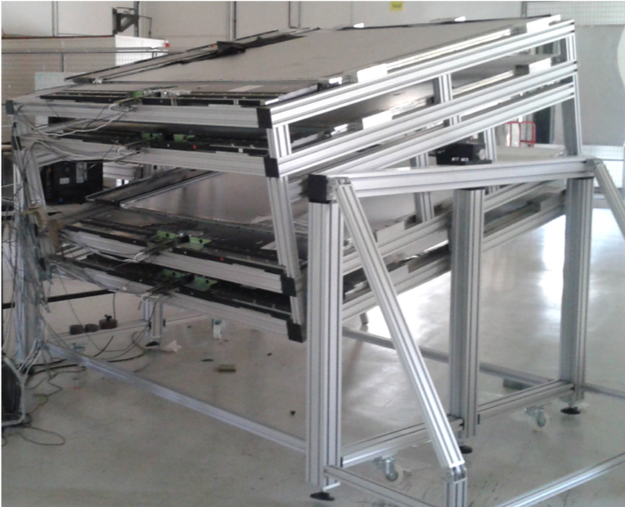
JUNO Top Muon Tracker Prototype at Strasbourg
The Muon Telescope ( JUNO Top Tracker Prototype) consists of 4 XY planes and each XY plane has two crossed modules.
Each modules is made of 64 plastic scintillators strip equipped each with one Wave Length Shifting fibers.
The size of a plastic scintillator bar has a cross section of 10mmx25,6mm and about 1.68m long.
All the 64 fibers are read by a 64 channels multianodes photomultipliers from Hamamatsu.
Coverage 1.68m x 1.68m
Muon track angular resolution 0.85°

Slide 15
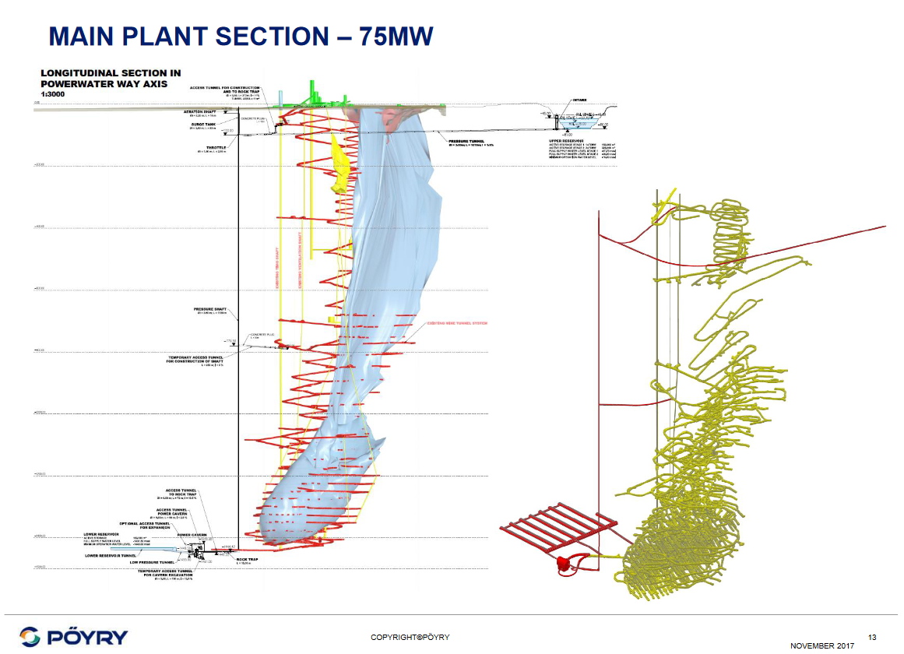
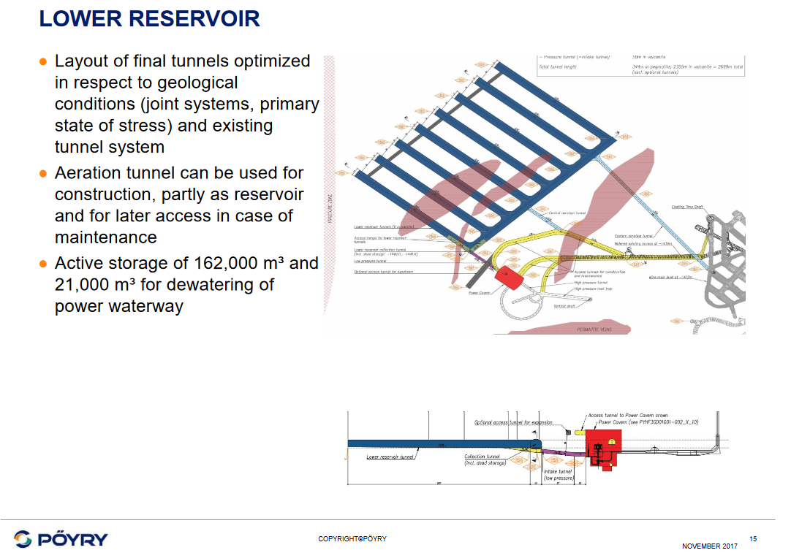
Pyhäsalmi Pumped Energy Storage Project
1400 m

Slide 16
Proposed ESSnuSB strategy for the ESFRI and ESPP processes during the 18 months to come
In order to obtain the support from our national funding authorities for having ESSnuSB included in the ESFRI Roadmap and the European Strategy for Particle Physics, both in 2026, each national ESSnuSB group needs to make contact with its national representatives in the various committees that will influence and participate in the priority decisions. These committees are:
The European Strategy Forum on Research Infrastructures ESFRI 2026
ESFRI Strategy Working Group on Physical Sciences and Engineering SWGPSE
The European Strategy Group for Particle Physics ESG for the update 2026
The CERN Scientific Policy Committee SPC
The European Committee for Future Accelerators ECFA
The Laboratory Directors Group LDG
In the backup slides to the present presentation are listed the mandates and the national memberships of these 6 committees. I will use these slides to discuss ESSnuSBs strategy at the “MT and Task Force Meeting on Thursday 12:30-14:00 hrs as well as in my Report from the Scientific Leader in the Governance Board meeting on Friday 09:45-10:15 hrs.
European Strategy Group (ESG) 2024

Slide 17
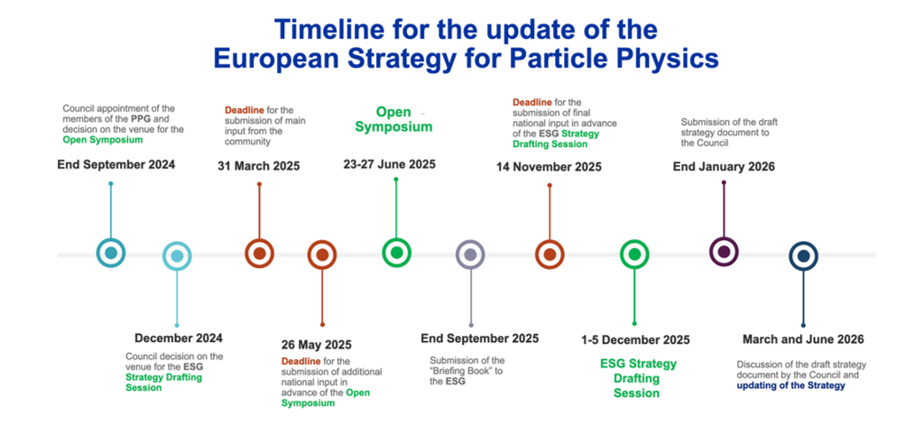
The inputs submitted to the 2020 European Startegy for Particle Physics can be found at
https://indico.cern.ch/event/765096/contributions/3295663/
The timeline for the ESFRI Roadmap is synchronous with that of the ESPP with request for input by March 2025 and publication of the ESFRI Road Map by mid 2026

Slide 18
The meeting at the Zinkgruvan site between the ESSnuSB Executive Committee and the Zinkgruvan Mining AB Management on 16 October will be decisive for establishing a Far Detector site for ESSnuSB
Summary and Conclusion
The preparation of a successful INFRADEV fund request
is a prerequisite för ESSnuSB to finance and obtain a
cooperation with Zinkgruvan Mining AB

Slide 19
Backup Slides

Slide 20
The mandate, composition and our interaction with the
6 European committees that will influence the future of European infrastructure for Particle Physics
The European Strategy Forum on Research Infrastructures ESFRI 2026
ESFRI Strategy Working Group on Physical Sciences and Engineering SWGPSE
The European Strategy Group for Particle Physics ESG for the update 2026
The CERN Scientific Policy Committee SPC
The European Committee for Future Accelerators ECFA
The Laboratory Directors Group LDG

Slide 21
Mandate of the European Strategy for Particle Physics ESPP update 2026
According to the remit of the European Strategy Group (ESG), the aim of the Strategy update is to develop a visionary and concrete plan that greatly advances human knowledge in fundamental physics through the realisation of the next flagship project at CERN; this plan should attract and recognise the value of international collaboration and should allow Europe to continue to play a leading role in the field.
In addition to the input of the particle physics community, the ESG will take into consideration: the status of implementation of the 2020 Strategy update, accomplishments over recent years (including results from the LHC and other experiments and facilities worldwide, progress in the construction of the High-Luminosity LHC, the outcome of the Future Circular Collider Feasibility Study and recent technological developments in accelerator, detector and computing technologies) and the international landscape.
The Strategy update should include the preferred option for the next collider at CERN and prioritised alternatives to be pursued if the chosen preferred option turns out not to be feasible or competitive. It should also indicate priorities for areas of exploration that are complementary to colliders, for other experiments to be considered at CERN and at other laboratories in Europe, as well as for participation in projects outside Europe.

Slide 22
European Strategy Group (ESG) 2024
Austria | Prof. Jochen Schieck
Belgium | Prof. Pierre Van Mechelen
Bulgaria | Prof. Venelin Kozhuharov
Czech Republic | Prof. Rupert Leitner
Denmark | Prof. Jens-Jørgen Gaardhøje
Finland | Prof. Katri Huitu
France | Dr Christelle Roy
Germany | Prof. Klaus Desch
Greece | Prof. Costas Fountas
Hungary | Prof. Dezső Varga
Israel | Prof. Marek Karliner
Italy | Prof. Antonio Zoccoli
Netherlands | Prof. Eric Laenen
Norway | Prof. Heidi Sandaker
Poland | Prof. Tadeusz Lesiak
Portugal | Prof. Mário Pimenta
Romania | Dr Calin Alexa
Serbia | Dr Lidija Zivkovic
Slovakia | Dr Marek Bombara
Spain | Dr Maria Jose Costa
Sweden | Prof. Richard Brenner
Switzerland | Prof. Ben Kilminster
United Kingdom | Prof. Mark Lancaster
CERN Director-General | Dr Fabiola Gianotti
CERN Director-General-Elect | To be appointed in late 2024
Strategy Secretariat Members
Strategy Secretary (ESG Chair) | Prof. Karl Jakobs
SPC Chair | Dr Hugh Montgomery
LDG Chair | Prof. Dave Newbold
ECFA Chair | Prof. Paris Sphicas
Major European National Labs
CIEMAT | Dr Nicanor Colino
DESY | Prof. Beate Heinemann
IJCLab | Prof. Achille Stocchi
IRFU | Prof. Franck Sabatié
LNF | Dr Sandra Malvezzi
LNGS | tbc
NIKHEF | Director of Nikhef
PSI | Prof. Klaus Kirch
STFC-RAL | Prof. Dave Newbold
STFC-Daresbury Lab. | Prof. Jim Clarke

Slide 23
The inputs submitted to the 2020 European Startegy for Particle Physics can be found at
https://indico.cern.ch/event/765096/contributions/3295663/

Slide 24
MANDATE of the European Strategy Forum on Research Infrastructures ESFRI
The European Strategy Forum on Research Infrastructures was set-up following a recommendation of the EU Council in order:
• to support a coherent and strategy–led approach to policy making on research infrastructures in Europe;
• to facilitate multilateral initiatives leading to a better use and development of research infrastructures acting as an incubator for pan-European and global research infrastructures;
• to establish a European Roadmap for research infrastructures (new and major upgrades, pan-European interest) for the coming 10-20 years, stimulate the implementation of these facilities, and update the Roadmap as the need arises;
• to ensure the follow-up of implementation of already on-going ESFRI projects after a comprehensive assessment, as well as the prioritisation of the infrastructure projects listed in the ESFRI Roadmap;
• to implement the ERA Priority 2b: Research infrastructures. In this context, the Forum acts as an informal body, composed of representatives of national authorities responsible for political decision-making and funding of research infrastructures, on issues raised by one or more country delegations and on specific mandates of the EU Council. The Strategy Forum gives national authorities the opportunity to be informed of and to explore (i.e. without a priori commitments) international and national initiatives of European significance. One of the expected outcomes of the Forum are variable geometry negotiations on specific projects supported mainly by Member States, for which the Forum has acted as an incubator.

Slide 25
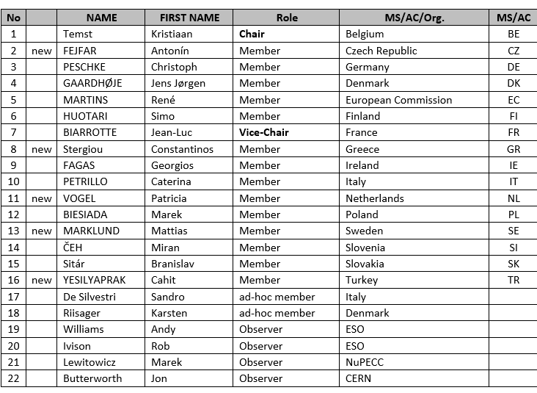
ESFRI Delegates 2024
Country
Austria Daniel WESELKA Karolina BEGUSCH-PFEFFERKORN
Belgium Michele OLEO Laurent GHYS Caroline VOLCKAERT
Bulgaria Ana Iovkova PROYKOVA Karina ANGELIEVA
Czech Republic Marek VYSINKA Jan HRUŠÁK ExCom
Croatia Hrvoje MESTRIC Jelena ILIC-DREVEN
Cyprus Christos ASPRIS Marinos COSTI
Denmark Johnny MOGENSEN Bjarke Stoltze KASPERSEN
Estonia Priit TAMM Aile TAMM Toivo RÄIM
Finland Laura TAAJAMAA Merja SÄRKIOJA ExCom Riitta MAIJALA
France Elena HOFFERT , ESFRI Vice Chair
Germany Friederike TRIMBORN-W. Karsten HESS , ExCom
Greece Elisavet KARAISKOU Spiros H. ANASTASIADIS
Hungary Gyorgyi JUHASZ Peter LEVAI
Ireland Michael RYAN ExCom
Italy Pierluigi CAMPANA Gelsomina PAPPALARDO, ESFRI Vice Chair
Latvia Uldis BERKIS Dmitrijs STEPANOVS
Lithuania Tomas SIMULEVIC Tada JUKNEVICIUS
Luxembourg Robert KERGER Lynn WENANDY
Malta Ian GAUCI BORDA Daniel Dariusz STANIEK
Netherlands Jennifa DORLEIJN Alice DIJKSTRA
Poland Marek STANKIEWICZ Michal RYBINSKI
Portugal Andreia FEIJAO Marta Coelho ABRANTES
Romania Anca GHINESCU Viorel VULTURESCU
Slovak republic Simona FOLTINOVÁ Lubos HALADA
Slovenia Albin KRALJ Karolina Schlegel
Spain Inmaculada Figueroa José Luis MARTÍNEZ PEÑA , ESFRI Chair
Sweden Madeleine DURBEEJ-HJALT Lisbeth Cecilia OLSSON, Swedish Research Council RI Chair
Mebers of the ESFRI Strategy Working Group on Physical Sciences and Engineering
https://www.str-esfri.eu/people/delegates

Slide 26
Mandate of the CERN Scientific Policy Committee SPC
1. To make recommendations to the Council on the priorities of research programmes and the allocation of research effort both within the Laboratories of the Organization and extramurally;
2. to examine and make recommendations to the Council on the annual goals of the various scientific activities of the Organization;
3. to annually assess the achievements of the Organization with regard to the past year annual goals of the various scientific activities;
4. to advise the Council from the point of view of scientific policy on the management and staffing of the Organization, including the visitors programme and the nomination of senior staff;
5. to advise the Council on any other matters which affect the scientific activities of the Organization
Members of the SPC:
Chair
Dr Hugh Montgomery | Thomas Jefferson National Accelerator Facility, Newport News, USA
Members
Prof. Hiroaki Aihara | University of Tokyo, Japan
Prof. Klaus Blaum | Max Planck Institute for Nuclear Physics, Germany
Prof. Philip Burrows | University of Oxford, United Kingdom
Prof. Robert Cousins | University of California, Los Angeles (UCLA), USA
Prof. Nigel Glover | Durham University, United Kingdom
Prof. Pilar Hernandez (Vice-Chair) | IFIC, University of Valencia, Spain
Prof. Gino Isidori | University of ZüriSwitzerland
Prof. Marumi Kado | Max Planck Institute for Physics, Germany
Prof. Fabio Maltoni | University of Bologna (IT) and Université catholique de Louvain (BE)
Prof. Jocelyn Monroe | University of Oxford, UK
Prof. Kate Scholberg | Duke University, Durham, NC, USA
Prof. Marie-Hélène Schune | Université Paris-Saclay, CNRS/IN2P3, IJCLab, France
Prof. Johannes Peter Wessels | Westfälische Wilhems-Universität Münster, Germany
Prof. Akira Yamamoto | KEK, Japan and CERN

Slide 27
Quote from an email 17 September 2024 from Hugh Montgoery, Chair of the SPC, to me:
“Tord,
Thanks for your note. Unfortunately I have made little progress on the Topical Session front.
Due to other pressures on the agenda and the need to hear about the Quantum Technology
Initiative, the High Field Magnet Program, and the European Strategy, we were unable to find
time for a Topical Session in the September Meeting.
Currently, the issues on the table for the upcoming Topical Sessions are:
Discussion of Forward Physics Facility at the LHC
US Academy Study Report “EPP 2024”
“ESSnSB” ESS Neutrino Beam
The AWAKE program
I intend to discuss with my colleagues on the SPC, but I don’t see scheduling the ESSnSB
discussion before Spring 2025.
Regretfully,
Mon”t

Slide 28
Mandata of European Committee for Future Accelerators ECFA
Members of the Restricted ECFA , RECFA
Chair | Prof. Paris Sphicas
Secretary | Dr Lidija Zivkovic
Members
Austria | Dr Thomas Bergauer
Belgium | Prof. Nick van Remortel
Bulgaria | Prof. Mariyan Bogomilov
Croatia | Dr Dinko Ferencek
Cyprus | Prof. Panos Razis
Czech Republic | Dr Jana Bielcikova
Denmark | Prof. Mogens Dam
Finland | Prof. Panja Luukka
France | Dr Gregorio Bernardi
Germany | Prof. Heiko Lacker
Greece | Prof. Dimitrios Sampsonidis
Hungary | Dr Ferenc Siklér
Italy | Dr Sandra Malvezzi
Israel | Prof. Eilam Gross
Netherlands | Prof. Stan Bentvelsen
Norway | Prof. Farid Ould-Saada
Poland | Prof. Justyna Łagoda
Portugal | Prof. Patricia Conde Muino
Romania | Dr Gabriel Stoicea
Serbia | Prof. Lidija Zivkovic
Slovakia | Dr Pavol Stríženec
Slovenia | Prof. Marko Mikuž
Spain | Prof. Celso Martinez Rivero
Sweden | Prof. Arnaud Ferrari
Switzerland | Prof. Rainer Wallny
Türkiye | Prof. Erkcan Özcan
United-Kingdom | Prof. Daniela Bortoletto
Ukraine | Dr Igor Kyryllin
CERN | Dr Richard Hawkings
“The remit of the European Strategy Group (ESG) specifies that it should take into consideration various aspects of the high-energy physics (HEP) landscape, including, very importantly, “the input of the particle physics community. ….. To assist with this, the European Committee for Future Accelerators (ECFA) has drawn up a set of guidelines for the collection of national inputs.”
Questions to be considered by countries/regions when forming and submitting their “national input” to the ESPP:
Which is the preferred next major/flagship collider project for CERN? Should CERN/Europe proceed with the preferred option or should alternative options be considered:
i) if Japan proceeds with the ILC in a timely way?
ii) if China proceeds with the CEPC on the announced timescale?
iii) if the US proceeds with a muon collider?
iv) if there are major new (unexpected) results from the HL-LHC or other HEP experiments?
I have met last springwith the ECFA Chair Paris Sphicas and described to him our ESSnuSB Design Study. ESSnuSB was presented by Valentina Santoro at a RECFA one-day seminar in Lund, Sweden on 16 May 2024, together with neutron fundamental physics proposals HIGBEAM and NNBAR, at ESS part of a programme “Particle Physics at ESS”
https://indico.cern.ch/event/1348498/contributions/5784223/attachments/2857998/5000224/ValentinaSantoro.pdf

Slide 29
The Laboratory Directors Group LDG
Mandate of the Laboratory Directors Group (LDG)
When clicking on this link the reply received is: ”This file is restricted: You must be authorized in order to access this document”
Members of the Laboratory Directors Group:
S. Bentvelsen (Nikhef, Netherlands),
F. Bossi (LNF, Italy),
J. Clarke (STFC/Daresbury Lab, United Kingdom),
N. Colino (CIEMAT, Spain),
F. Gianotti (CERN),
B. Heinemann (DESY, Germany),
D. Newbold (Chairperson; STFC/RAL, United Kingdom),
E. Previtali (LNGS, Italy),
F. Sabatie (CEA/Irfu, France),
M. Seidel (PSI, Switzerland)
A. Stocchi (IJCLab, France)
CERN Officials: M. Lamont, J. Mnich, E. Tsesmelis (summary record)
Observers: H. Montgomery (SPC Chair)

Slide 30
Conclusion
In order to obtain the support from our national funding authorities for having ESSnuSB included in the ESFRI Roadmap and the European Strategy for Particle Physics, both in 2026, each national ESSnuSB group needs to make contact with its national representatives in the various committees that will influence and participate in the priority decisions.
I propose that this process be monitored and followed up as from now on by the Management Team and the Strategy Task Force

