Slide 1
Report on DEB activities in 2024
Tamer Tolba (for the DEB)
ESSnuSB+ 2nd Annual meeting
23.09.2024

Slide 2
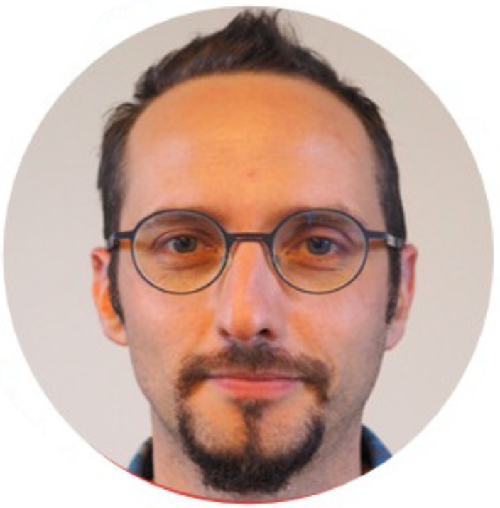
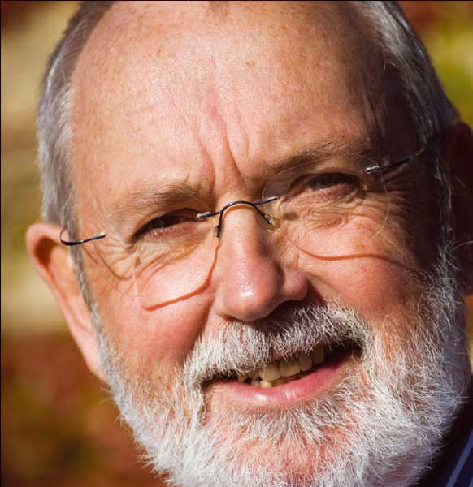
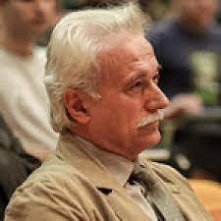
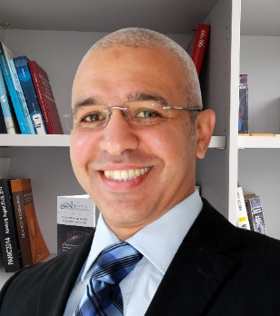
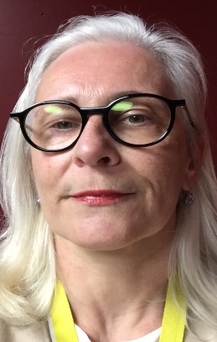
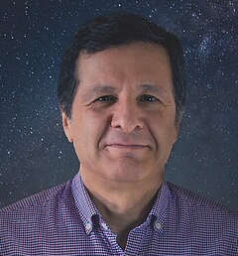
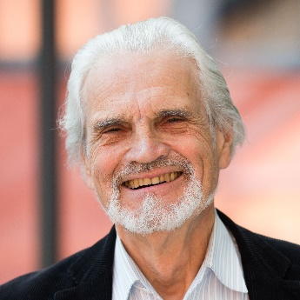
ESSnuSB+ DEB members
Elian BOUQUEREL
Colin CARLILE
Georgios FANOURAKIS
Natalia MILAS
Tamer TOLBA
Marcos DRACOS
Tord EKELÖF
Carole MABROUK
https://essnusb.eu/dissemination-exploitation-board-essnusb/
ESSNUSB-DIS-L@in2p3.fr

Slide 3
Project Dissemination Strategy in 2024
We are still in the visibility phase ➔ be present at as many conferences/workshops as possible
➔ Year 2024 is very important for the ESFRI application, priority goes for EU-based events
➔ so far, project introduction talks are the dominant presentation style!!
➔ we must increase participation in technical conferences, i.e. WP related presentations
Diversity in personnel ➔ all WPs, all institutes and most important students and postdocs must participate
➔ WPs (co)coordinators to distribute the conferences’ calls sent by DEB
➔ WPs (co)coordinators to encourage students and postdocs to participate in conferences
Financing of event participation ➔ each partner institute has allocated traveling money from the EU budget
➔ DEB budget will be used for project dissemination activities
Feedback from WPs (co)coordinators on the DEB performance in 2023 ➔ improve DEB strategy and performance

Slide 4
ESSnuSB+ Conferences’ Attendance in 2023
FOLLOW-UP OF ABSTRACT SUBMISSIONS (updated 14/09/2023)
 | Accronym | Conference | Date of the event | Abstract submission deadline at the conference | Type of Abstract | Approval by the organizers | Proposed author | Submitted | Title | website | Proceeding | Carbon Footprint
1 | CP2023 | International workshop on the Origin of Matter-Antimatter Asymmetry, Les Houches, France | 12-17 Feb. 2023 | 09.12.2022 | Talk | yes | Monojit Gosh, WP5 | yes | Measuring δCP and constraining lepton flavour models at ESSnuSB | https://indico.in2p3.fr/event/27893/ | No Proceeding | 0.45 t CO₂
2 | DPG2023 | German Physics Sciety spring meeting, Dresden, Germany | 20-25 March 2023 | 15.12.2022 | Talk | yes | Tamer Tolba | yes | The ESSvSB(+) design study: Achievements and Prospects | https://skm23.dpg-tagungen.de/ | No Proceeding | 0.008 t CO₂
3 | KITP2023 | KITP Muon Collider Workshop, University of California, Santa Barbara, USA | 27 Feb. - 10 Mar. 2023 | Invited only | Talk | yes | Marcos Dracos | yes | The European Spallation Source neutrino Super Beam and muon synergies | https://www.kitp.ucsb.edu/activities/muoncollider-m23 |  | 3.5 t CO₂
4 | ICPTI2023 | International Conference on the Physics of the Two Infinities, Kyoto, Japan | 27-30 Mar. 2024 | 19.02.2023 | Invited Talk | yes | Marcos Dracos | yes | The European Spallation Source neutrino Super Beam project | https://indico.in2p3.fr/event/28466/ | No Proceeding | 3.2 t CO₂
5 | IPAC2023 | International Particle Accelerator Conference, Venice, Italy | 7-12 May 2023 | 07.12.2022 | Poster | yes | Tamer Tolba | yes | The ESSvSB+ Project | https://www.ipac23.org/ | Published T. Tolba et al., JACoW IPAC2023 (2023) 911 – 914 | 0.01 t CO₂
6 | Blois 2023 | Particle Physics and Cosmology, Blois, France | 14-19 May 2023 | 01.04.2023 | Talk | yes | Eric Baussan | yes | The ESSvSB+ Project | http://blois.in2p3.fr/2023/index.html |  | 0.0 t CO₂
7 | DESY colloquium2023 | DESY Particle and Astroparticle Physics Colloquia, Hamburg, Germany | 23 May 2023 | Invited only | Talk | yes | Marcos Dracos | yes | The European Spallation Source neutrino Super Beam project | https://physikseminar.desy.de/hamburg/colloquia_in_2023/23_may_2023/ | No Proceeding | 0.38 t CO₂
8 | Muon4Future | Muon4Future workshop, Venice, Italy | 29-31 May 2024 | Invited only | Invited Talk | yes | Marcos Dracos | yes | Muon activity at the ESS facility | https://agenda.infn.it/event/33270/ | in progress | 0.008 t CO₂
9 | Fysikdagarna 2023 | The conference of the Swedish Physical Society, Stockholm, Sweden | 14-16 June 2023 | 05.05.2023 | Talk | yes | Maja Olvegård | yes | The nuSTORM project in ESSnuSBplus | https://indico.fysik.su.se/event/7762/ | No Proceeding | 0.0 t CO₂
10 | CRETE2023 | The 2023 International Conference on Applications of Nuclear Techniques, Crete, Greece | 18-24 June 2023 | 28.02.2023 | Talk | yes | Marcos Dracos | yes | The physics performance of the European Spallation Source neutrino Super Beam | https://www.creteconf.org/ | not submitted | 0.65 t CO₂
11 | NSLIE2023 | Neutrino Scattering at Low and Intermediate Energies 2023, Mainz, Germany | 26-30 June 2023 | Invited only | Talk | yes | Joakim Cederkall | yes | The ESSnuSB project | https://indico.mitp.uni-mainz.de/event/324/ |  | 0.45 t CO₂
12 | WIN2023 | The 29th International Workshop on Weak Interactions and Neutrinos, Zhuhai, China | 3-8 July 2023 | 31.05.2023 | Talk | yes | Tamer Tolba | yes | The European Spallation Source neutrino Super Beam plus Project | https://indico.ihep.ac.cn/event/18269/ | in progress | 3.5 t CO₂
13 | NuIF2023 | 19th Rencontres du Vietnam, Neutrino Workshop at IFIRSE, Quy Nhon city, Vietnam | 16-19 July 2024 | 10.06.2023 | Invited Talk | Not yet | Budimir Kliček | Not Yet | Neutrino oscillation prospects with ESSnuSB | https://ifirse.icise.vn/nugroup/nuworkshop2023/index.html |  | 2.7 t CO₂
15 | ICRC2023 | The 38th International Cosmic Ray Conference (ICRC2023), Nagoya, Japan | 26 July - 3 Aug. 2023 | 20.02.2023 | poster | yes | Tsutomu Fukuda | yes | The European Spallation Source neutrino Super Beam project | https://www.icrc2023.org/ | in progress | 0.0 t CO₂
16 | NUFAC2023 | 24th Internartional Workshop on Neutrinos From Accelerators, Seoul, South Korea | 21-26 Aug. 2023 | 21.05.2023 | Talk | yes | Marcos Dracos and Karre Iversen | yes | ESSnuSB+ and summary of the mini workshop (satellite) Classification of muon- and electron neutrino events for the ESSnuSB Near Detector using Graph Neural Networks | https://indico.cern.ch/event/1216905/ | in progress in progress | 2.7 t*6 = 16.2 t CO₂
17 | ESSnuSB+ workshop | ESSnuSB+ dedictaed workshp in NuFact2023, Seoul, South Korea | 19-20 Aug. 2023 | Invited only | Talks | yes | Marcos Dracos, Tamer Tolba, Natalia Milas, Andrea Longhin, George Fanorakis, Kaare Iversen | yes | TBD | https://indico.cern.ch/event/1216905/timetable/#20230820 | 5 * in progress
18 | EPS-HEP2023 | European Physical Society Conference on High Energy Physics, Hamburg | 21-25 Aug. 2023 | 02.06.2023 | Talk | yes | Alessio Giarnetti | yes | ESSnuSB+ project: towards precision measurement of the CP violation at the second neutrino oscillation maximum | https://www.eps-hep2023.eu/ | in progress | 0.54 t CO₂
19 | TAUP 2023 | XVIII International Conference on Topics in Astroparticle and Underground Physics 2023, Vienna, Austria | 28 Aug. - 1 Sept. 2023 | 12.05.2023 | Talk | yes | Vidhya Thara Hariharan | yes | The European Spallation Source neutrino Super Beam plus Project | https://taup2023.hephy.at/ | in progress | 0.01 t CO₂
20 | Matter to the Deepest 2023 | Matter to the deepest: Recent developments in physics of fundamental interactions XLV international conference of theoretical physics (MTTD 2023), Ustroń, Poland | 17 - 22 Spet. 2023 | Invited only | Talk | yes | Monojit Gosh | yes | Present status and future prospects of neutrino oscillation experiments | https://indico.if.us.edu.pl/event/18/ | in progress | 0.34 t CO₂
21 | HB2023 | 68th ICFA Advanced Deam Dynamics Workshop on High-Intensity and High-Brightness Hadron Beams, Geneva, Switzerland | 09-13 Oct. 2023 | 15.07.2023 | Talk | yes | Natalia Milas | yes | TBD | https://indico.cern.ch/event/1138716/ |  | 0.62 t CO₂
22 | ESSnuSB+ annual meeting | ESSnuSB+ first collaboration meeting, TBD | 16-19 Oct. 2023 | No dealline | Talks |  | all ESSnuSB+ members |  |  | https://indico.cern.ch/event/1309436/sessions/502888/#20231019 | No Proceeding
23 | NuTel2023 | The XX International Workshop on Neutrino Telescopes, Venice, Italy | 23-27 Oct. 2023 | 31.05.2023 | Invited Talk | yes | Tord Ekelöf | yes | TBD | https://agenda.infn.it/event/33107/ |  | 0.62 t CO₂
24 | BSM2023 | Beyond Standard Model: From Theory to Experiment, Hurghada, Egypt | 06-09 Nov. 2023 | 15.09.2023 | Talk | yes | Tamer Tolba | yes | Search for the leptonic CP violation with the ESSnuSB(+) project | https://indico.cern.ch/event/1258407/ |  | 1.9 t CO₂

Slide 5
ESSnuSB+ Conferences’ Attendance in 2024
 | FOLLOW-UP OF ABSTRACT SUBMISSIONS (updated 19/09/2024)
 | Accronym | Conference | Date of the event | Abstract submission deadline at the conference | Type of Abstract | Approval by the organisers | Proposed author | Submitted | Title | website | Proceeding
1 | 11th European Networking Event | Successful R & I in Europe 2024 11th European Networking Event, Düsseldorf, Germany | 15 - 16 Feb. 2024 | 12.01.2024 | talk | yes | Tamer Tolba | yes | Towards a Neutrino Beam Experiment in EU | https://horizont.zenit.de/en/events/successful-r-i-in-europe-2024/
2 | DPG2024 | German Physics Society Spring Meeting, KIT, Karlsruhe, Germany | 04 - 08 Mar. 2024 | 15.12.2023 | talk | yes | Tamer Tolba | yes | Search for the leptonic CP violation with the ESSnuSB(+) project | https://karlsruhe24.dpg-tagungen.de/
3 | TIARA 2024 | 26th Meeting of the TIARA Collaboration Council on meeting, CERN, Switzerland | 05 Mar. 2024 | Invitation | talk | yes | Marcos Dracos | yes | Status Report on ESSnuSB 2nd DS | https://indico.cern.ch/event/1385973/
4 | PhD Symposium | 8th PhD Student Symposium, Zagreb, Coartia | 26 - 27 April 2024 | 16.02.2024 | talk |  | Leon Halić & Doris Barčot | no | Detecting CP violation with ESSnuSB experiment & Neutrino oscillations and ESSnuSB project | https://phdss.pmf.unizg.hr/program/
5 | IPAC2024 | International Particle Accelerator Conference, Nashville, USA | 19 - 24 May 2024 | 11.12.2023 | poster | yes | Marcos Dracos | yes | The ESSvSB Project | https://ipac24.org/
6 | FCPC2024 | 22nd Conference on Flavor Physics and CP Violation, Bangkok, Thailand | 27 -31 May 2024 | 22.03.2024 | talk | yes | Alessio Giarnetti | yes | ESSnuSB and the precise measurement of leptonic CP violation at the second neutrino oscillation maximum | https://indico.cern.ch/event/1291023/
7 | Neutrino2024 | 31th International Conference on Neutrino Physics and Astrophysics, Milano, Italy | 16 - 22 June 2024 | Invitiaon | poster, talk | yes | Eric Baussan, Budimir Kliček, Monojit Ghosh, Alessio Giarnetti, Aman Gupta and Tamer Tolba | yes | Investigating Quantum Decoherence in Neutrino Oscillation at ESSnuSB Experiment, The ESSnuSB/ESSnuSB+ detector design, Physics opportunities at the ESSnuSB/ESSnuSB+ setup, Search for the leptonic CP violation with the ESSnuSBplus project, Exploring new physics at ESSnuSB+ | https://neutrino2024.org/
8 | ICHEP2024 | The 42nd International Conference on High Energy Physics, Prague, Czech Republic | 17 - 24 July 2024 | 16.02.2024 | poster, talk | yes | Tamer Tolba, Spyros Tzamarias, Alessio Giarnetti and David Meloni | yes | ESSnsSBplus Target Station Design Study, The European Spallation Source neutrino Super Beam plus Project, ESSnuSB+: non-beam neutrino physics and sterile neutrinos at near detectors, Exploring new physics in neutrino oscilllation at ESSnuSB | https://ichep2024.org/
9 | HAMLET-PHYSICS 2024 | HAMLET-PHYSICS 2024 Conference/Workshop, Copenhagen, Denmark | 19 - 21 Aug. 2024 | 12.07.2024 | talk | yes | Kaare Iversen | yes | GNN Classification of Muon- and Electron Neutrino Events for the ESSnuSB+ Near WC Detector | https://indico.nbi.ku.dk/event/2067/overview
10 | NOW2024 | Neutrino Oscillation Workshop, Otranto, Lecce, Italy | 2 – 8 September 2024 | Invitation | talk | yes | Monojit Ghosh/Joakim Cederkäll | yes | Decoherence in Neutrino Oscillation at the ESSnuSB Experiment | https://home.ba.infn.it/~now/now2024/Fee.html
11 | NuFact2024 | The 25th International Workshop on Neutrinos from Accelerators, Argonne National Laboratory, USA | 16 - 21 Sept. 2024 | 15.07.2024 | talk | yes | George Fanourakis | yes | TBD | https://indico.fnal.gov/event/63406/
12 | LHC Days Split 2024 | 2024 LHC Days Split | 30 Sept. - 04 Oct. 2024 | Invitation | talk | yes | Budimir Kliček | yes | TBD | https://indico.cern.ch/event/1383586/
13 | NBI2024 | 13th International Workshop on Neutrino Beams and Instrumentation (NBI2024), Tokai, Japan | 07 - 10 Oct. 2024 | Invitation | talk | yes | Tamer Tolba | yes | Current status and plans of ESSvSBplus | https://conference-indico.kek.jp/event/270/overview
14 | NuDM2024 | International Conference on Neutrinos and Dark Matter, Cairo, Egypt | 11 - 14 Dec. 2024 | Invitation | talk |  | TBD |  | TBD | https://indico.cern.ch/event/1368274/
15 | PIC2024 | 43rd International Symposium on Physics in Collision, NCSR Demokritos in Athens | 22 – 25 Oct. 2024 | Invitation | talk |  | George Fanourakis | no | TBD | TBD

Slide 6
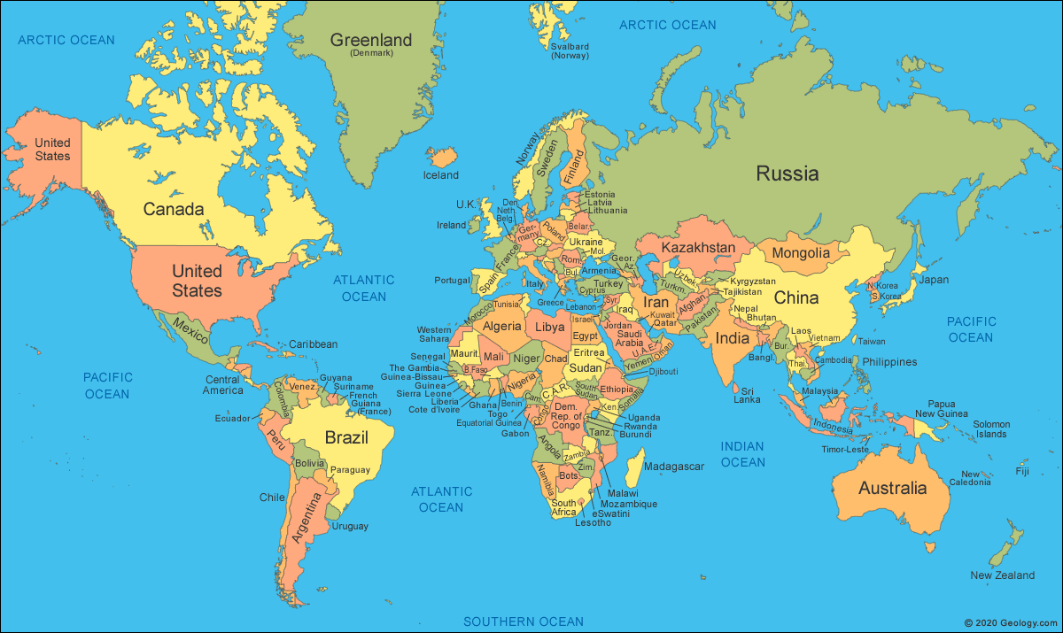
ESSvSB+ conference attendance coverage 2023

Slide 7
ESSvSB+ conference attendance coverage 2024

Slide 8
Some statistics on 2023 participations
Personnel participations in 2023
11 PIs
1 postdoc
2 PhD students
23 participations in 2023
4 invited talks
16 contributed talks
2 posters
1 ESSnuSB+ workshop
WP participations in 2023
WP1
WP2
WP3
WP4
WP5
WP6
Next year more students and postdocs will be encouraged to participate in international conferences!

Slide 9
Some statistics on 2024 participations
Personnel participations in 2024
8 PIs
3
postdoc
3
PhD students
15 participations in 2024
7 invited talks
8 contributed talks
9 posters
2 outreach activity
WP participations in 2024
WP1
WP2
WP3
WP4
WP5
WP6
e.g.,
Neutrino 2024
PIC 2024
NBI 2024
e.g.,
ICHEP 2024
NuFact 2024

Slide 10
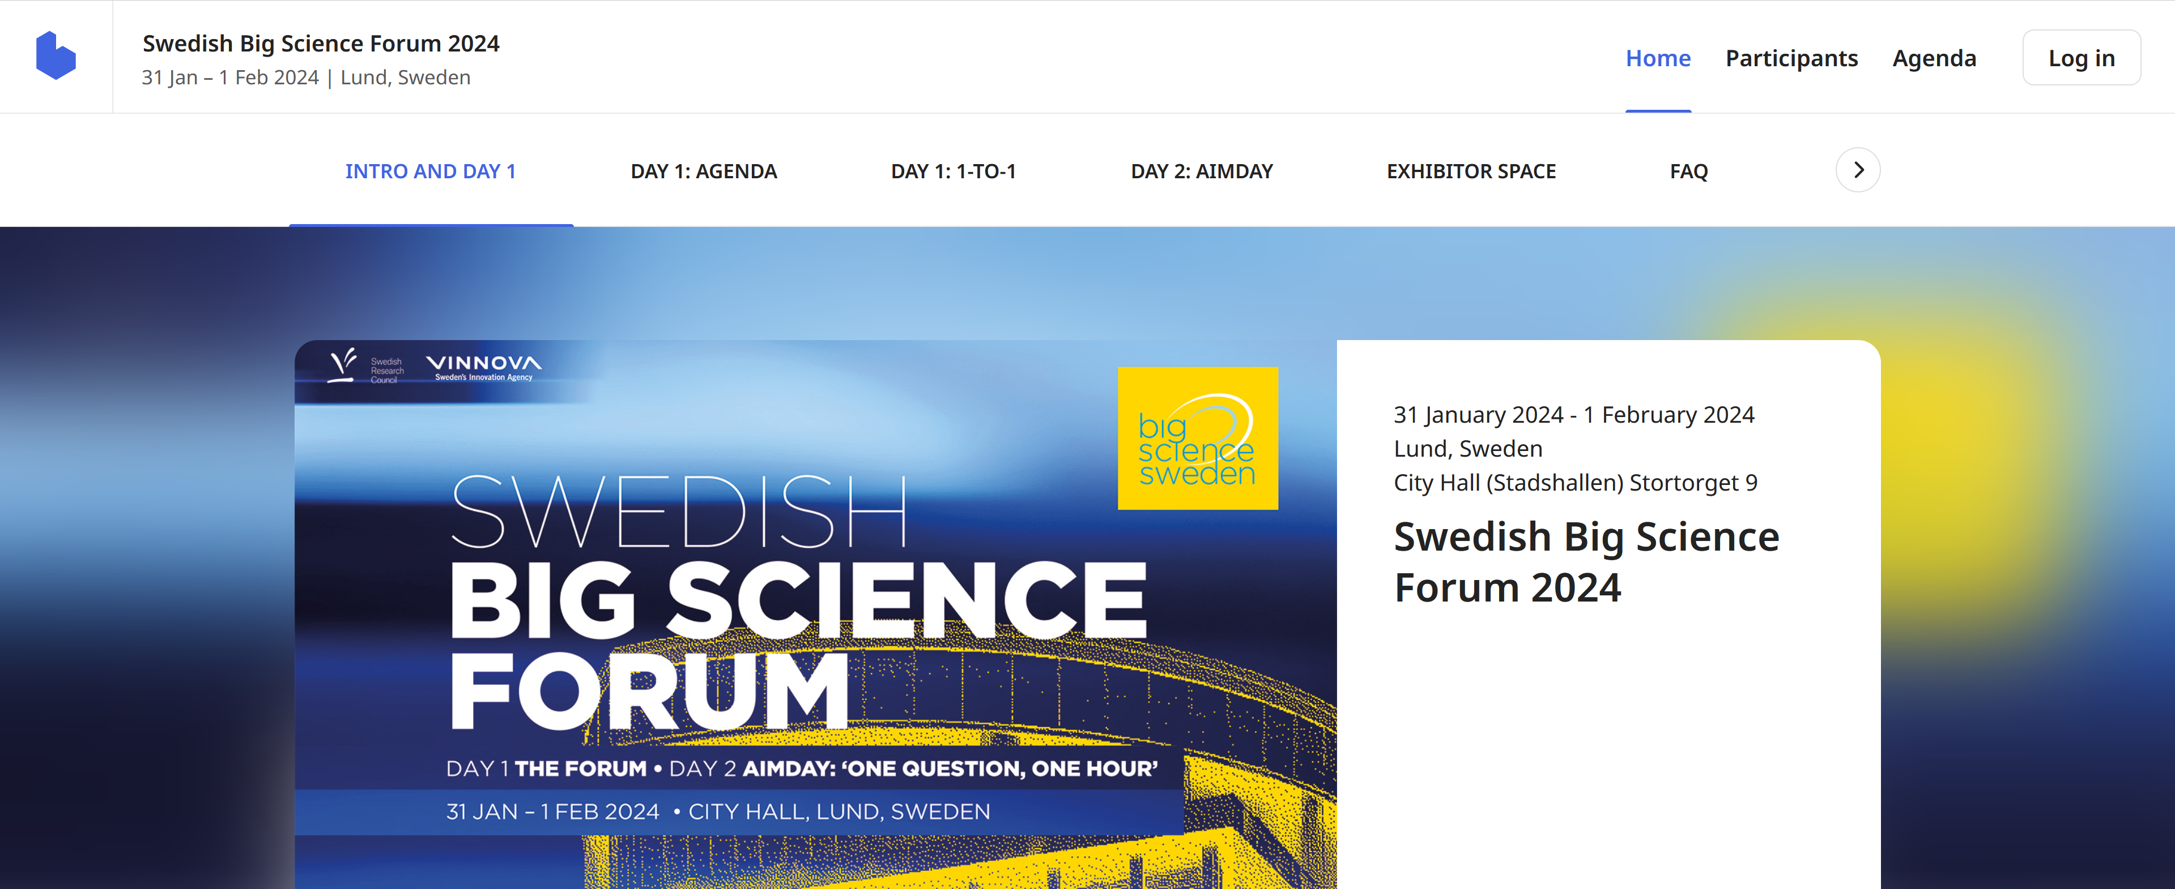
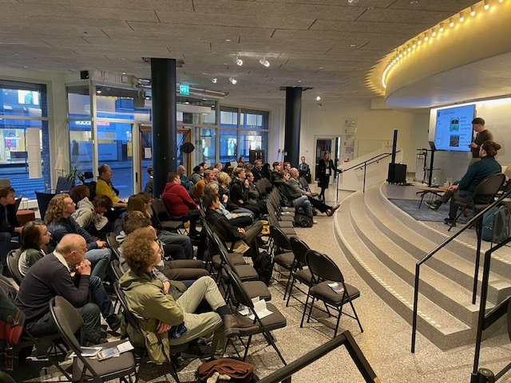
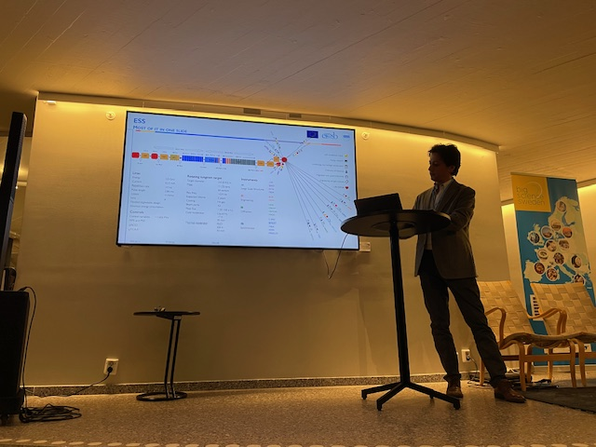
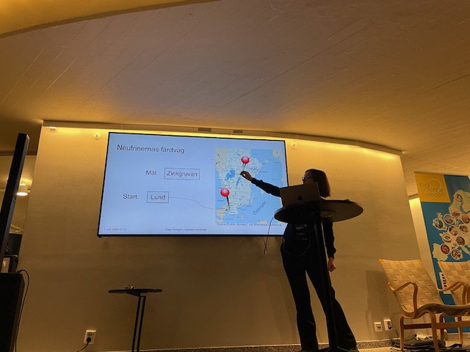
Outreach activity (Big Science Day Sweden)
Big Science Day Sweden 2024:
ESSnuSB+ outreach activity that took place in the Lund’s Stadshallen
on 31.01.2024 as part of the Big Science Sweden event.
A 3-hour workshop with 6 talks of 15 minutes each was organised
and about 50 local persons attended in the “booth”.
Some pictures, the ESSnuSB+ poster, the English text of the poster
and the agenda of the workshop were uploaded onto DocDB.
Marianne Ekdahl, a journalist, had worked for the event preparation and during the event itself and had publicised it.
https://www.b2match.com/e/swedish-big-science-forum-2024
https://essnusb.eu/DocDB/private/DisplayMeeting?conferenceid=423

Slide 11
Outreach activity (Zinkgruvan mine visit )
Wednesday 16 October 2024 13:00 – ca 15:00 hrs at the Zinkgruvan Mining AB site between members of the Management of the Zinkgruvan Mining AB and members of the ESSnuSB Executive Committee
Introduction of the persons attending the meeting 13:00-13:10
Brief presentation of the Zinkgruvan Mining AB company 13:10-13:20
The purpose and organization of the ESSnuSB research project and status of its design study 13:20-13:40
The proposed EU-application for funding of a design study of the construction and operation of the large ESSnuSB neutrino detector in Zinkgruvan 13:40-14:30
The EU HORIZON-INFRA-2024-DEV-01-03 call for applications expected to appear in autumn 2024
The required core drilling program in the mine
The construction design-study of the detector cavern, of the technical galleries and of the access shaft
The design study of the water Cherenkov neutrino detector and its operation
Discussion on possible terms of cooperation between Zinkgruvan Mining AB and the ESSnuSB Consortium for the proposed design study 14:30-14:45
Communication 14:45-14:50
Concluding remarks 14:50-14:00

Slide 12
Publications and Proceedings in 2024
Publications:
ESSnuSBplus: Letters in High Energy Physics (LHEP). Published
A. Aguilar et al., LHEP 517, (2024) 1
“Search for Leptonic CP Violation with the ESSnuSBplus Project”
(Corresponding author: Tamer Tolba)
Phenomenology: Physics Review D. (Internal Ref. George and Budimir). Published
J. Aguilar Phys. Rev. D 109, (2024) 115010
“Study of non-standard interaction mediated by a scalar field at ESSnuSB experiment”
(Corresponding author: Monojit Gosh, Deepak Raikwal, Sandhya Choubey and William Brorsson)
Decoherance studies in ESSnuSB. (Internal Ref. Natalie Jachowicz). Published
J. Aguilar et al., JHEP08(2024)063
“Decoherence in Neutrino Oscillationsat ESSnuSB Experiment”
(Corresponding author: Monojit Gosh, Aman Gupta, Alessio Giarnetti and Davide Meloni)
Atmospheric studies in ESSnuSB (Internal Ref. George Fanourakis and Davide Meloni) Submitted to JHEP and received positive report
J. Aguilar et al., arXiv:2407.21663v1 [hep-ex] (2024)
“Exploring atmospheric neutrino oscillations at ESSnuSB”
(Corresponding author: Sandhya Choubey, Tommy Ohlsson and Sampsa Vihonen)
In 2023 we had 1 publication and 1 proceeding

Slide 13
Publications and Proceedings
Proceedings:
Vidhya Thara Hariharan (for the ESSnuSBplus collaboration) PoS(TAUP2023)339 (2024)
“The European Spallation Source neutrino Super Beam plus Project”
M. Dracos and I. Efthymiopoulos, "The European Spallation Source neutrino super beam", in Proc. IPAC'24, Nashville, TN, May 2024, pp. 2571-2574. doi:10.18429/JACoW-IPAC2024-WEPR37
M. Ghosh, "Present Status and Future Prospects of Neutrino Oscillation Experiments,'' Acta Phys. Polon. Supp. 17 (2024), 2-A18, doi:10.5506/APhysPolBSupp.17.2-A18 (Proceedings for "Matter to the deepest: Recent developments in physics of fundamental interactions, XLV international conference of theoretical physics (MTTD 2023)", Ustron, Poland, September 17 - 22, 2023)

Slide 14
Publication Rules
For the dissemination and publication of the project results we are governed by:
1- The Consortium Agreement, and the grant agreement for details
➔ IN GENERAL (i.e. defines the frame/layout of the internal publication and dissemination policy)
2- Our internal publication policy
➔ IN DETAIL (i.e. defines the internal regulations of the publication procedure, which was agreed on directly by the consortium members)

Slide 15
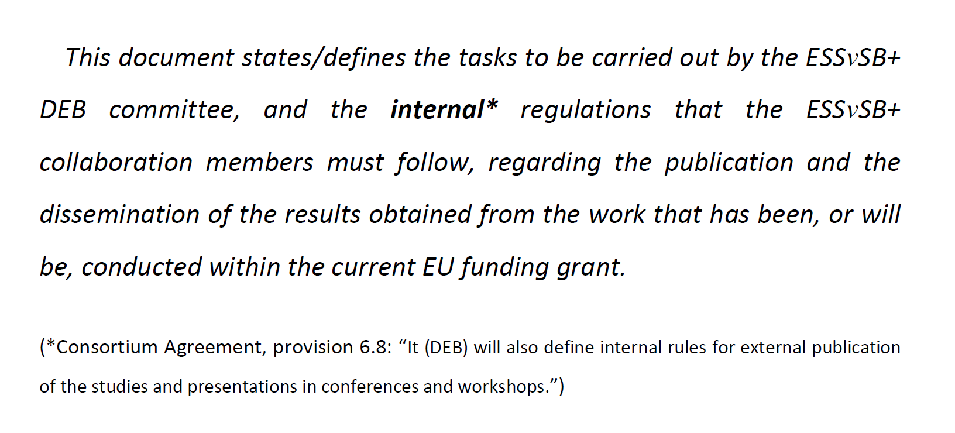
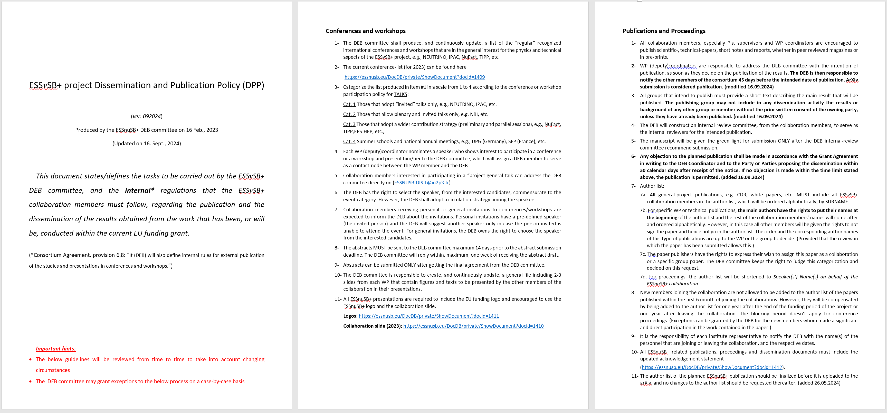
Publication Rules
ESSnuSB+ Dissemination and Publication Policy (DPP)

