Slide 1


ESSnuSB+ 2nd annual meeting
LEnuSTORM ring progress update
PhD: CHOI Ting Wing
24/09/2024

Slide 2
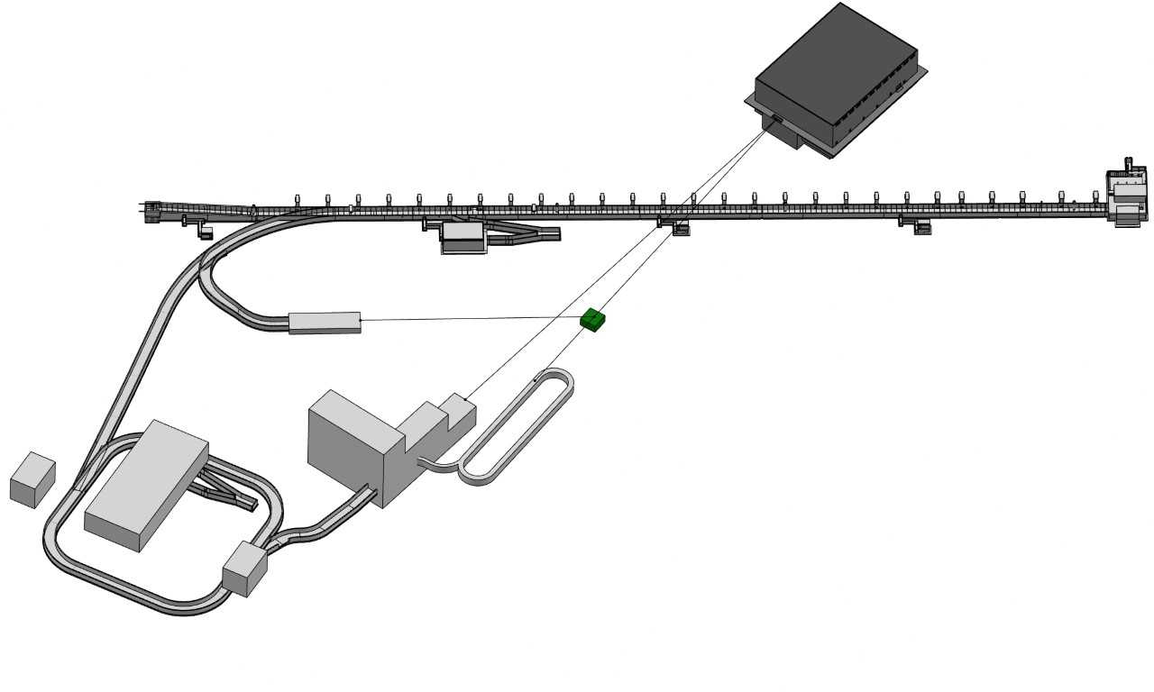



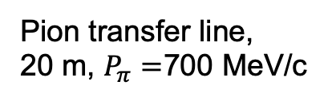
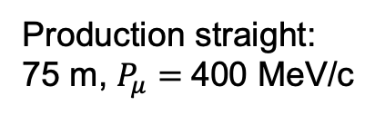
LEMMOND
$υ$, 200 - 400MeV
Particles direction
Arc, < 25 m
Production straight:
75 m, $P_{μ}=$400 MeV/c
return straight
(And their antiparticle)
Pion transfer line,
20 m, $P_{π}=$700 MeV/c
LEnuSTORM (“Low Energy neutrinos from Stored Muons”): a project that uses a muon storage ring to generate low-energy neutrino beams.
- capture, transfer and inject pions, and store muons

Slide 3
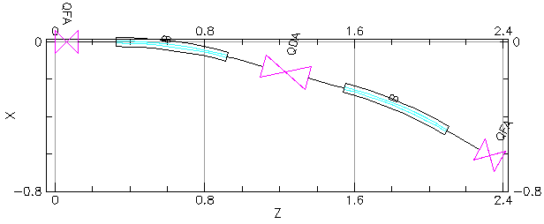
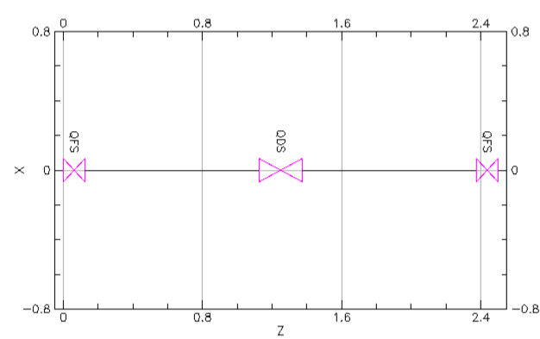
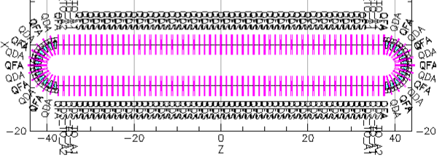

A new ring design
6 * Arc fodo cell; 30 * straight fodo cells
Aperture radius = 0.2 m
Magnetic strength < 1.5 T
A = $8.9$ mmrad
  Max dispersion: 0.8 m
  Beta: 0.5 – 4.5 m

Slide 4
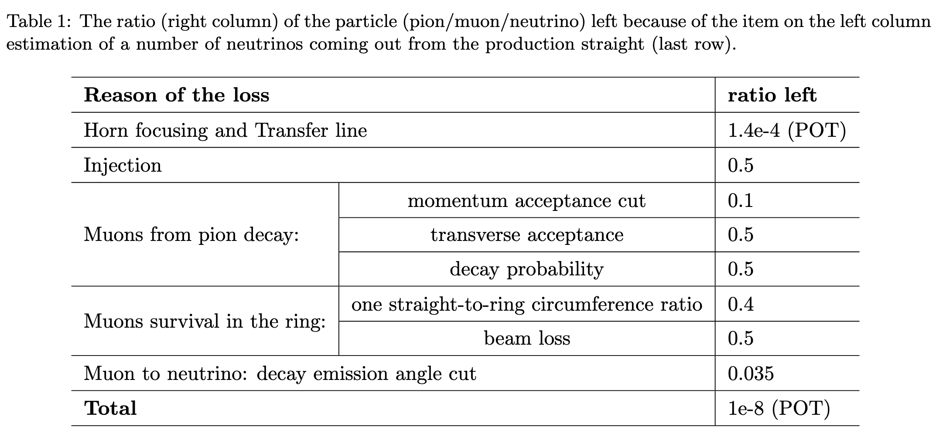
Preliminary flux estimation

Slide 5
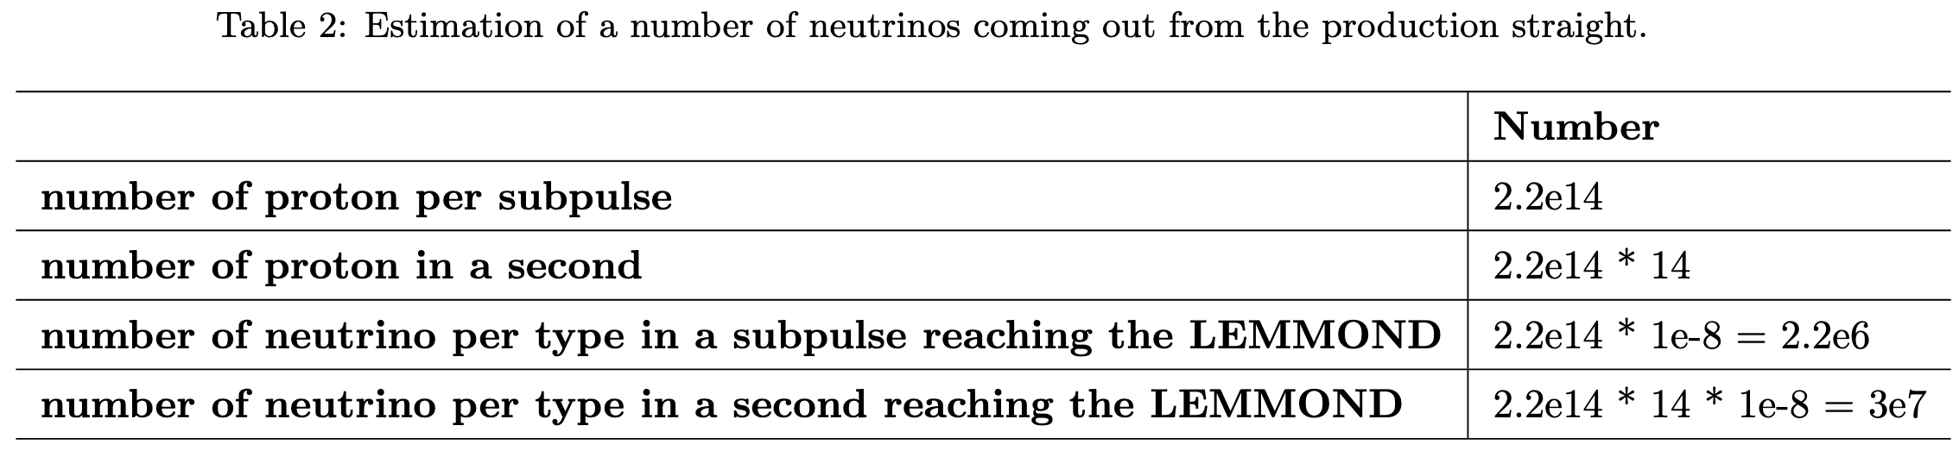
Preliminary flux estimation

Slide 6
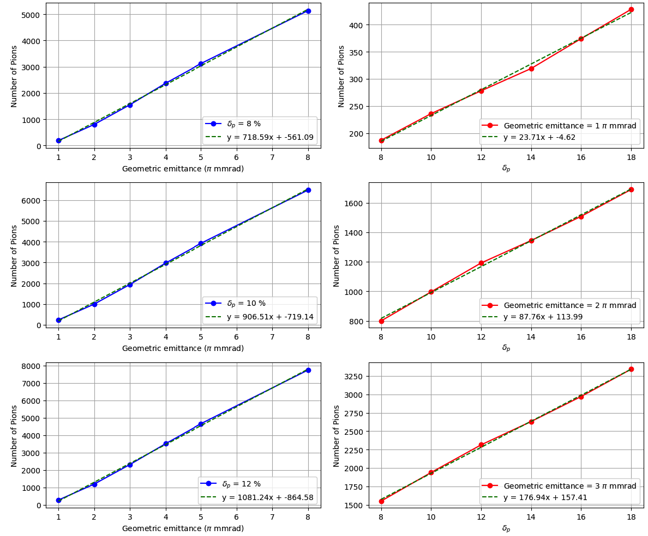
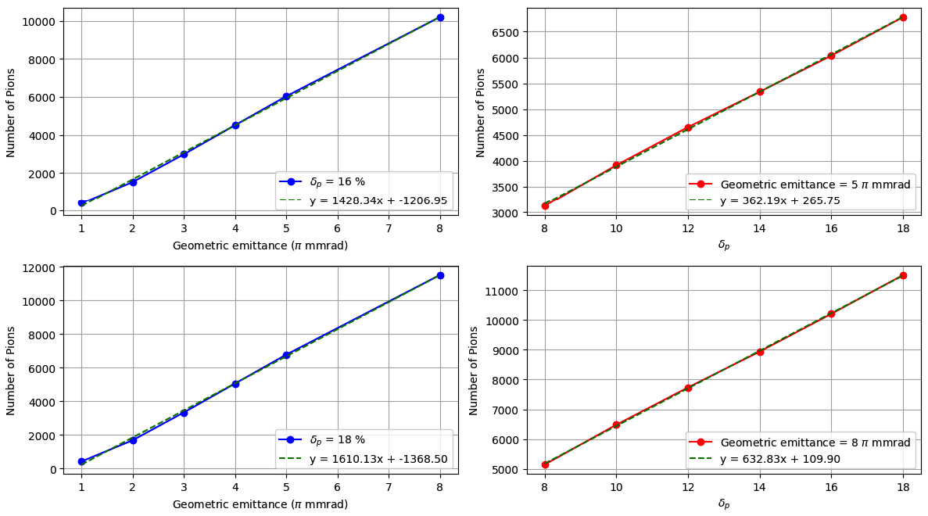
Number of pion with cuts

Slide 7
Back up

Slide 8
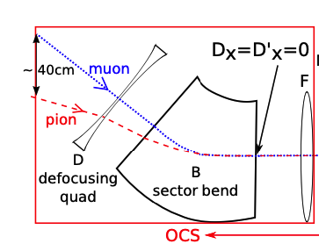
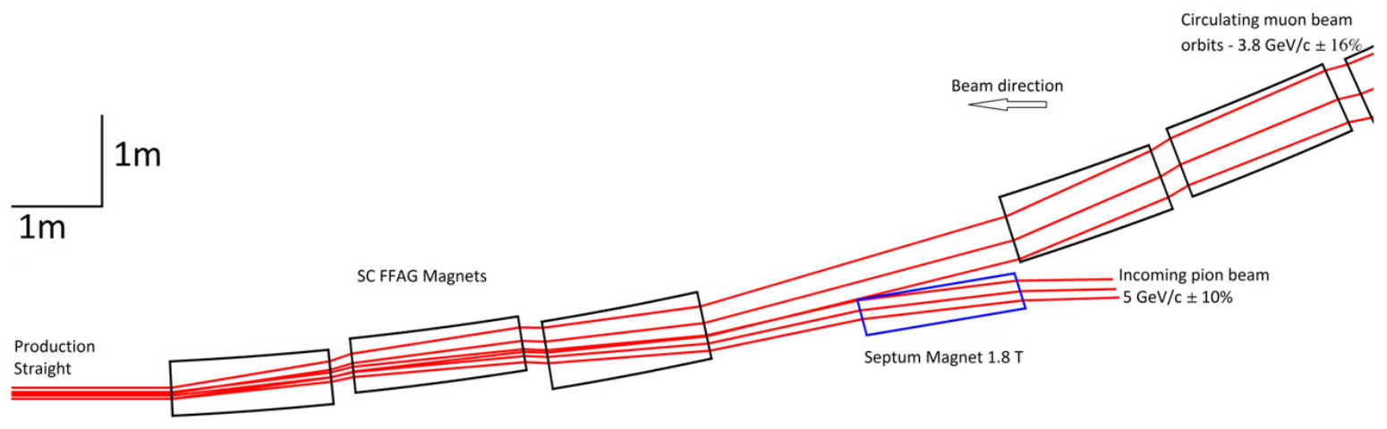
Injection
If stochastic injection:
15m arc
  0.09 -0.276 rad (16º)
  20 cm drift
20m arc
  0.11 - 0.234 rad (13º)
  45 cm drift
Or use septum magnet
J.-B. Lagrange, R. B. Appleby, J. M. Garland, J. Pasternak, and S. Tygier, “Racetrack FFAG muon decay ring for nuSTORM with triplet focusing,” J. Inst., vol. 13, no. 09, p. P09013, Sep. 2018, doi: 10.1088/1748-0221/13/09/P09013.

Slide 9
Outlook
Chromaticity correction
  Sextupole only?
  FFA?
Particle tracking
  With and without decay
Injection
D4.1
…

Slide 10
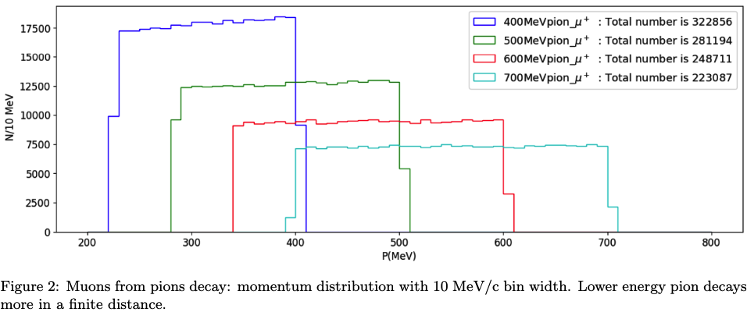

Slide 11
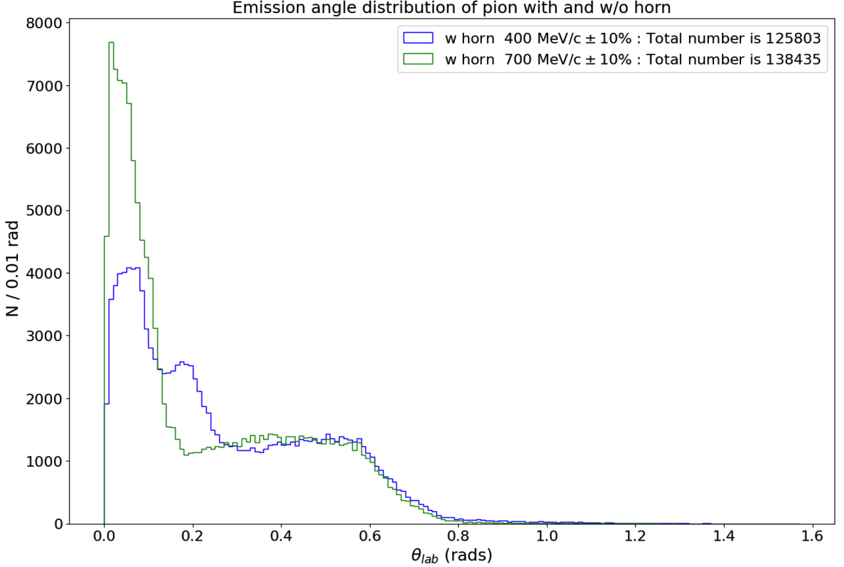

Slide 12
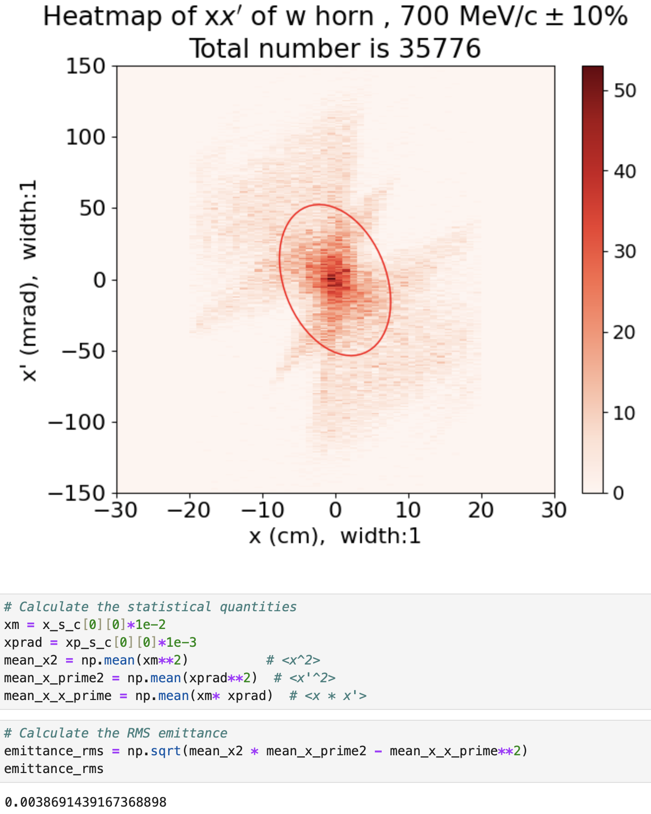
4 pi mmrad

Slide 13
Momentum acceptance

Slide 14
Momentum acceptance

