Slide 1


WP4
Low Energy nuSTORM
Maja Olvegård
Uppsala University
On behalf of WP4

Slide 2
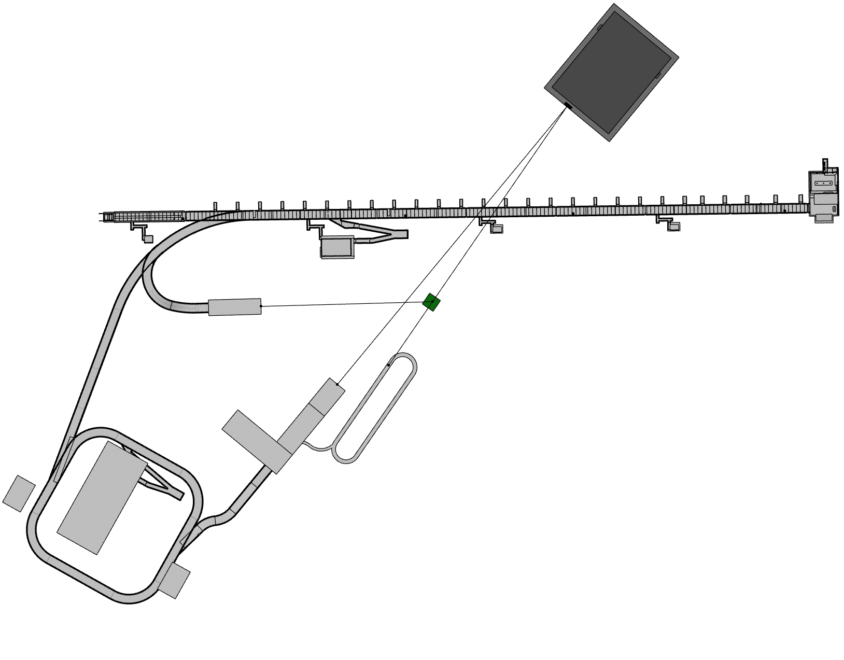
WP4
Linac upgrade
H- transfer line
Muon storage ring
Stay tuned until 2025!
Pion transfer
Accumulator ring
Proton transfer

Slide 3
ESS linac, current plan
Protons on target: end of 2025
User program starting 2028
  800 MeV
  low power, with a slow ramp up to ~800 kW by 2028
All cryomodules needed for 2.0 GeV installed by 2028
  Powering systems until 800 MeV
  3 years needed to upgrade powering systems (once budget approved)
LEMNB
  One low-current pulse per second
  Upgrade linac to operate with low current pulses at 14 Hz.

Slide 4
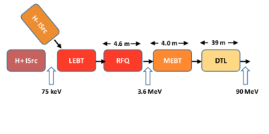
Linac upgrade: RFQ
Injector Alt. 1: merge H- and p immediately after the sources
How far can we push the existing RFQ design toward operatign at 10% duty cycle?
Juan Luis Munoz

Slide 5
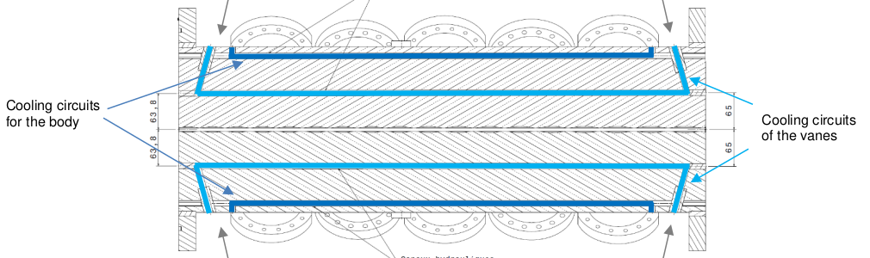
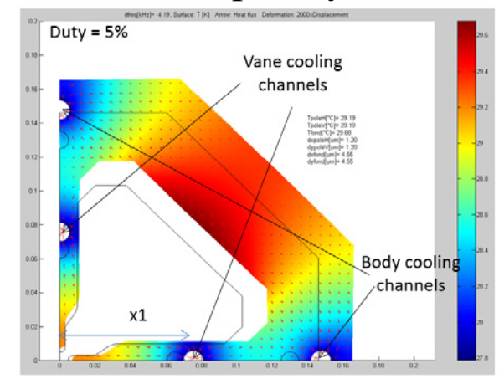
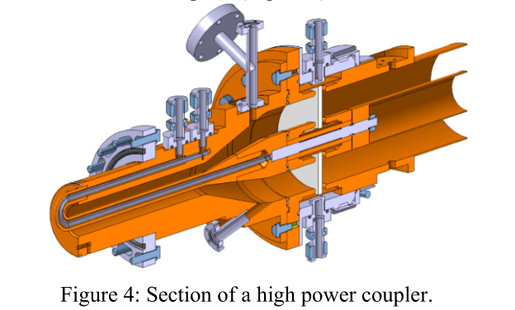
RFQ
RF coupler
Juan Luis Munoz

Slide 6
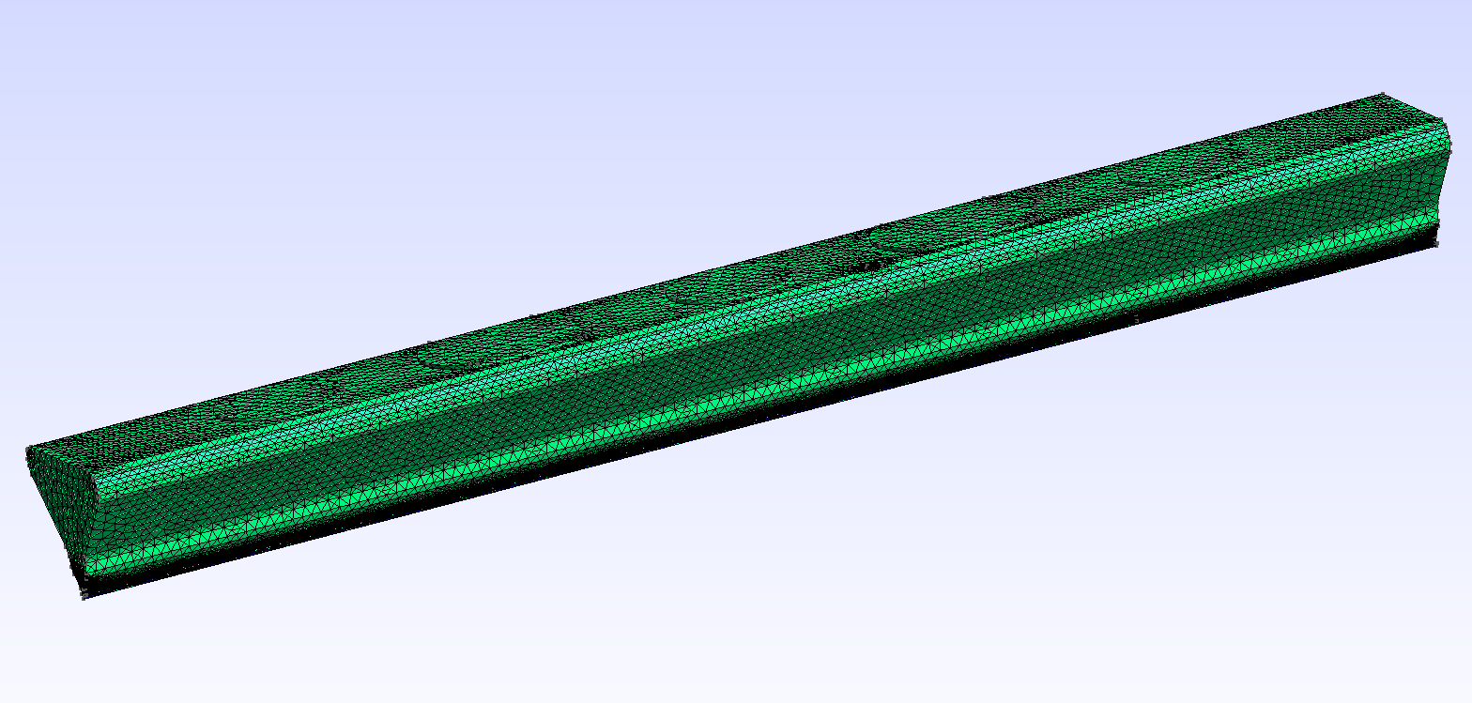
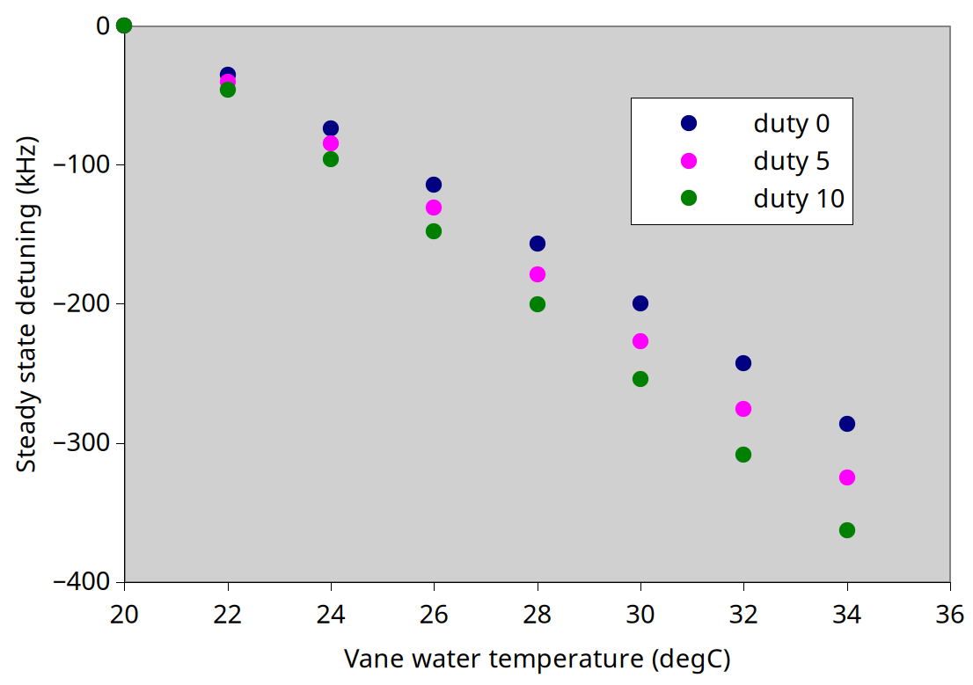
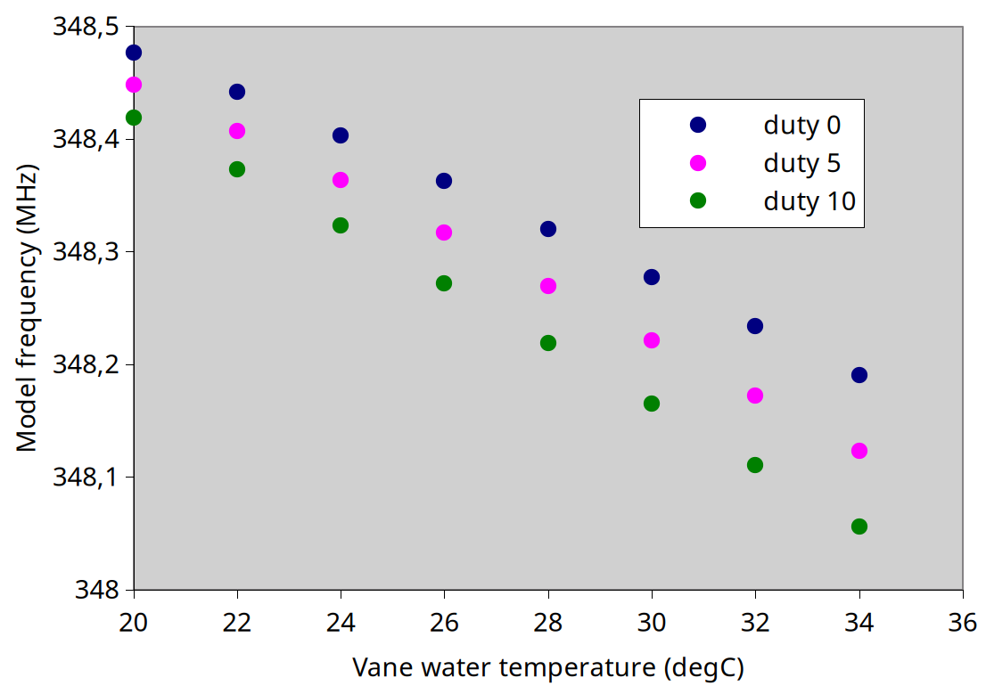
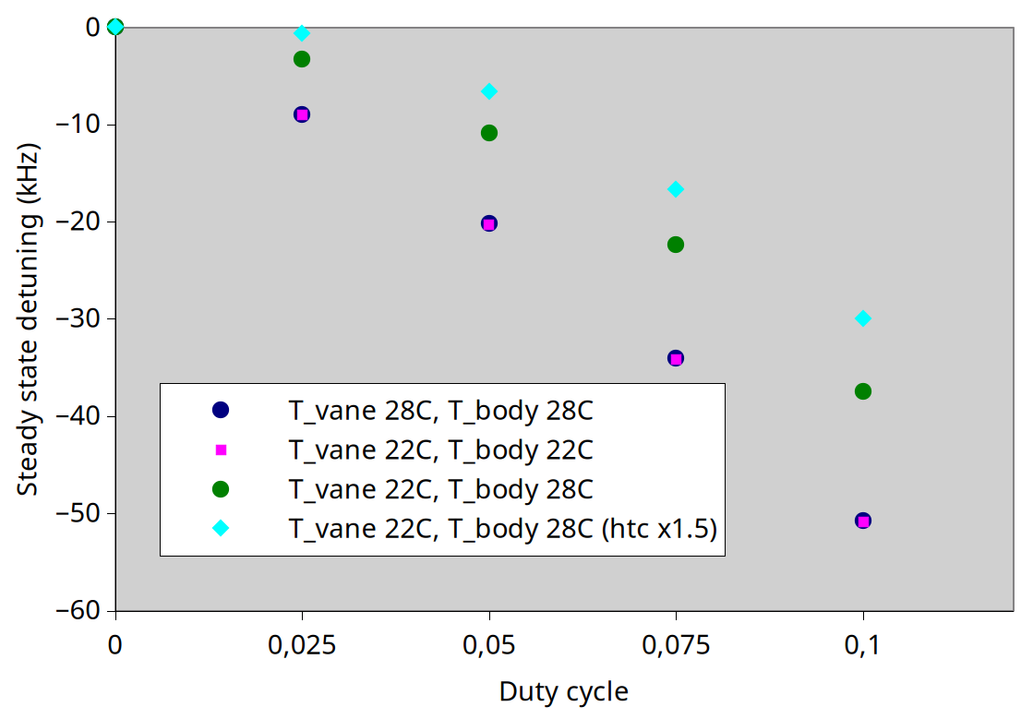
RFQ: Steady state
Juan Luis Munoz

Slide 7
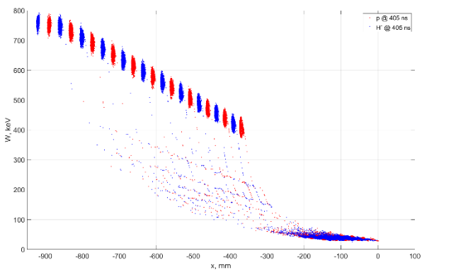
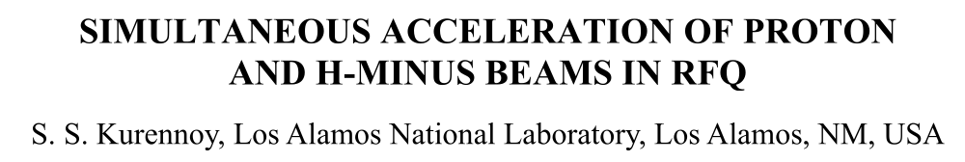
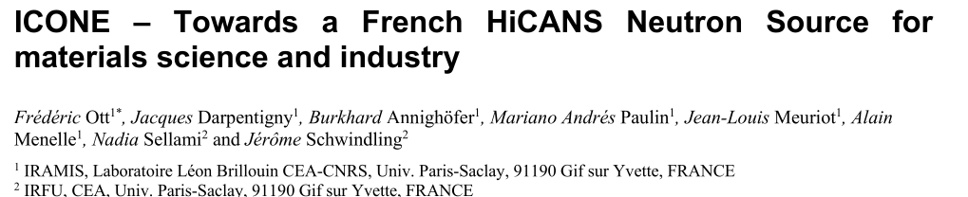
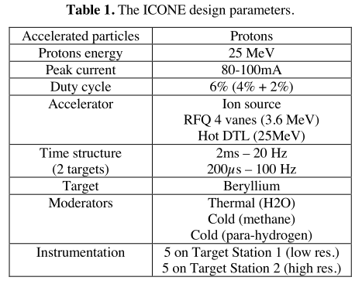
Similar studies ongoing elsewhere
LANSCE (Los Alamos Neutron Science Center)
doi: 10.18429/JACoW-LINAC2024-MOAA007
(and many more references in LINAC24 + IPAC24)
Plan to use ESS-RFQ design, up to 6% duty (9% in other refs.)
https://doi.org/10.1051/epjconf/202328602001
Juan Luis Munoz

Slide 8
New H- transfer line design
Sharper extraction from linac
Fewer magnets
7.6 m depth (old 7.8 m)
Added: matching section for optimal injection
Where to place transverse collimators?
Natalia Milas

Slide 9
LEnuSTORM

Slide 10
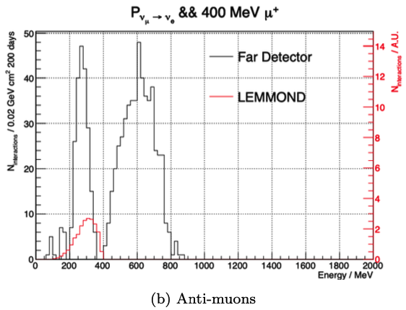
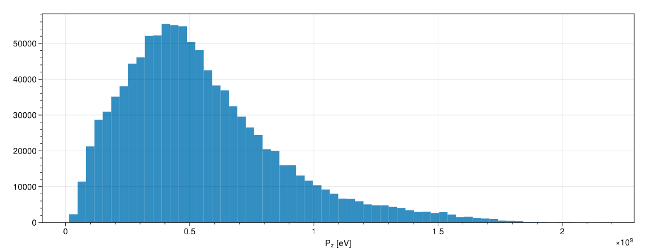
LEnuSTORM: muon momentum
Nominal muon momentum: 400 MeV/c
  Also operate at higher momentum?
  Is it the best energy or do we reach better performance with higher muon momentum?
Investigated using a 30 m straight section.
  How works with 75 m?
Pions from ESSnuSB horn
Ting Wing Choi, Leon Halic

Slide 11
LEnuSTORM: muon and pion momenta
400 MeV/c
700 MeV/c
900 MeV/c
Pion production and collection
  Phase space of such pions
(Useful) muons produced by such pions
  Phase space of such pions
Pions from ESSnuSB horn

Slide 12
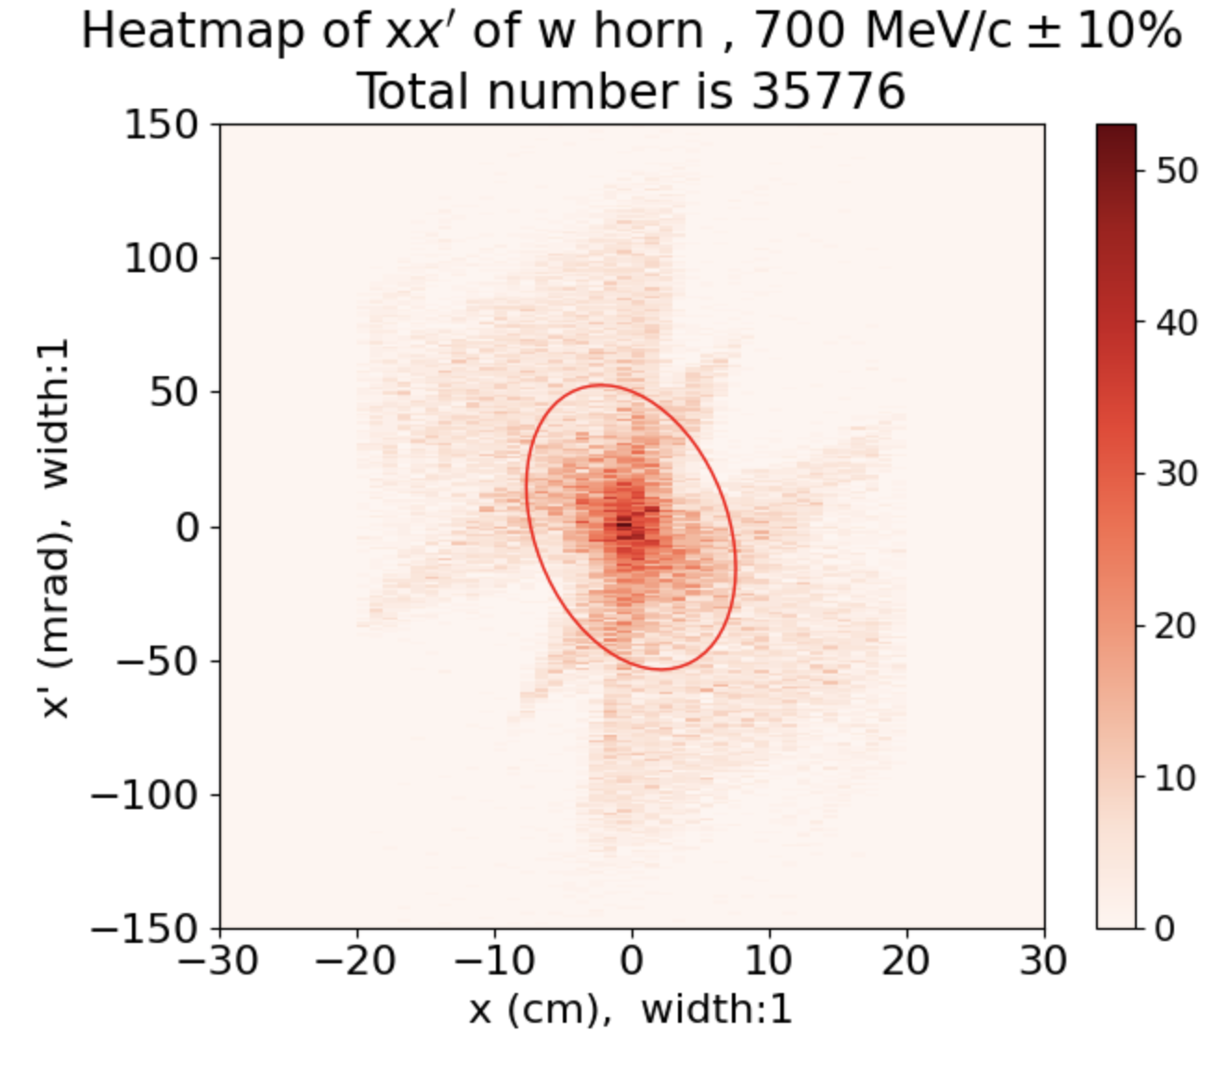
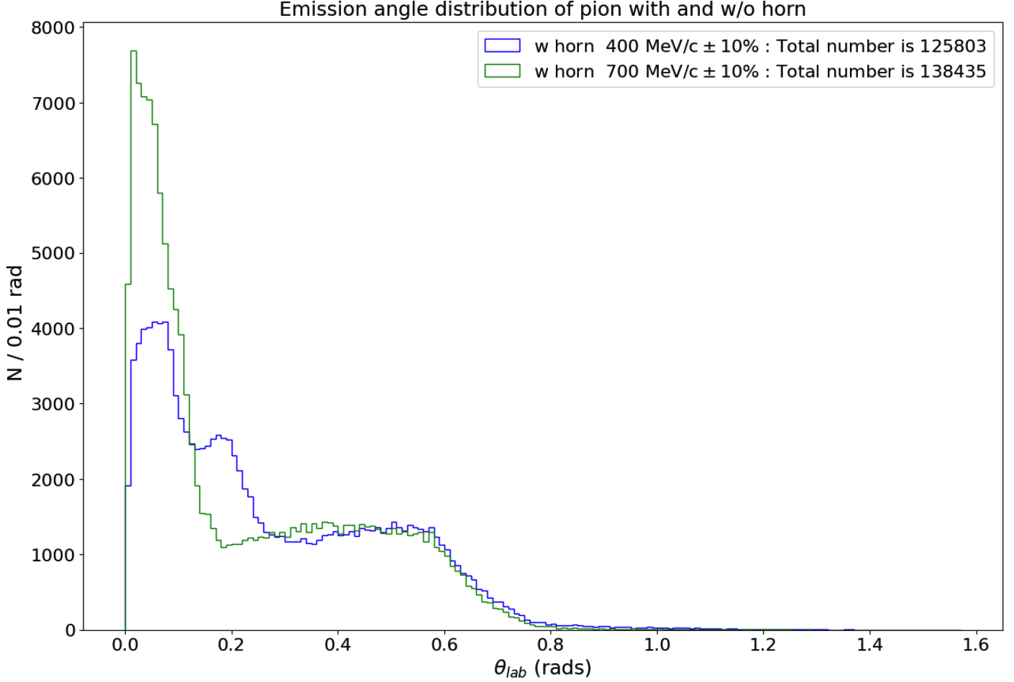
Pion phase space
Phase space of pions at 700 MeV/c ±10%
700 MeV/c
400 MeV/c
Small angle
Ting Wing Choi

Slide 13
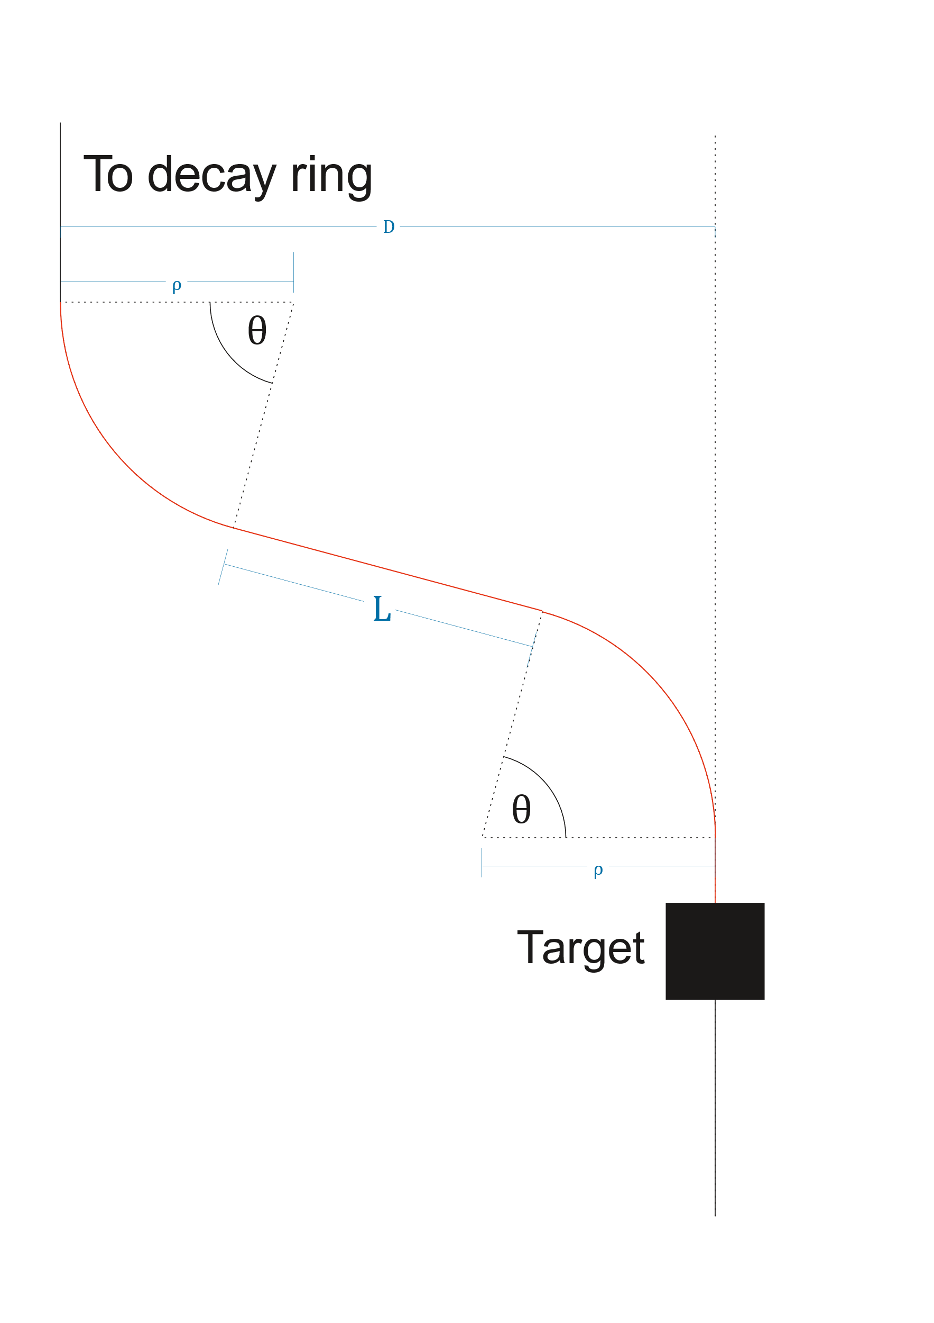
Pion transfer
Design starting point:
  As short as possible
  Large (~ ±10%) momentum acceptance
  Large transverse acceptance
  No dispersion at the end of transfer line
Initial assumptions:
  Lateral separation D > 8 m
  Simple geometry: Two dipoles 0.8 m long, max 1 T.
  At least 20 cm drift spaces
  ±20 cm aperture
Max Topp-Mugglestone

Slide 14
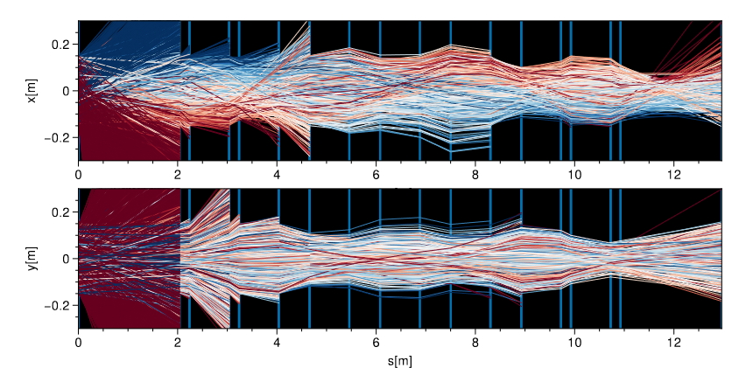
Pion transfer design
  7 quads
  50 degree bends
  Dispersion cancelled at end of line
DIPOLE
Q
Q
Q
Q
Q
Q
Q
DIPOLE
Q
Horizontally focusing quad
Q
Horizontally defocusing quad
…and vice versa in the vertical plane.
Max Topp-Mugglestone

Slide 15
Pion transfer design: next step
Consider the injection into the ring
  Dispersion cancelled in the straight section
Further optimize pion intensity
  Together with horn optimization by WP3
Look at feasibility of magnets, since large aperture
Add higher order multipoles for corrections?
Max Topp-Mugglestone

Slide 16
LEnuSTORM: muon ring

Slide 17
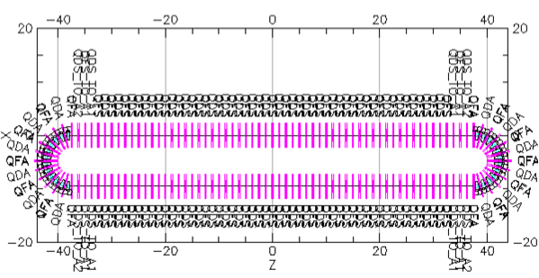
LEnuSTORM: Preliminary ring design
15 m
75 m

Slide 18
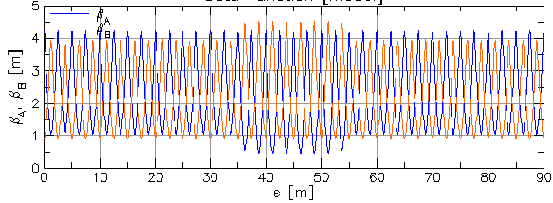
Preliminary ring design
Circumference: 180 m
Tune: 16.58/16.36
Chromaticity: -19.94/-19.50

Slide 19
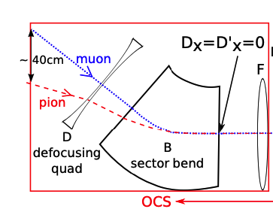
Injection
If stochastic injection, two arc options:
15 m arc
  0.09 -0.276 rad (16º)
  20 cm drift
20 m arc
  0.11 -0.234 rad (13º)
  45 cm drift
Probably we will need to use a septum magnet.

Slide 20
Ring design: next step
Look at real acceptance and survival in the ring
Correct for energy effects
  Higher order multipole magnets
Incorporate injection and extraction
Refine neutrino flux numbers
…
Injection scheme of FNAL nuSTORM

Slide 21
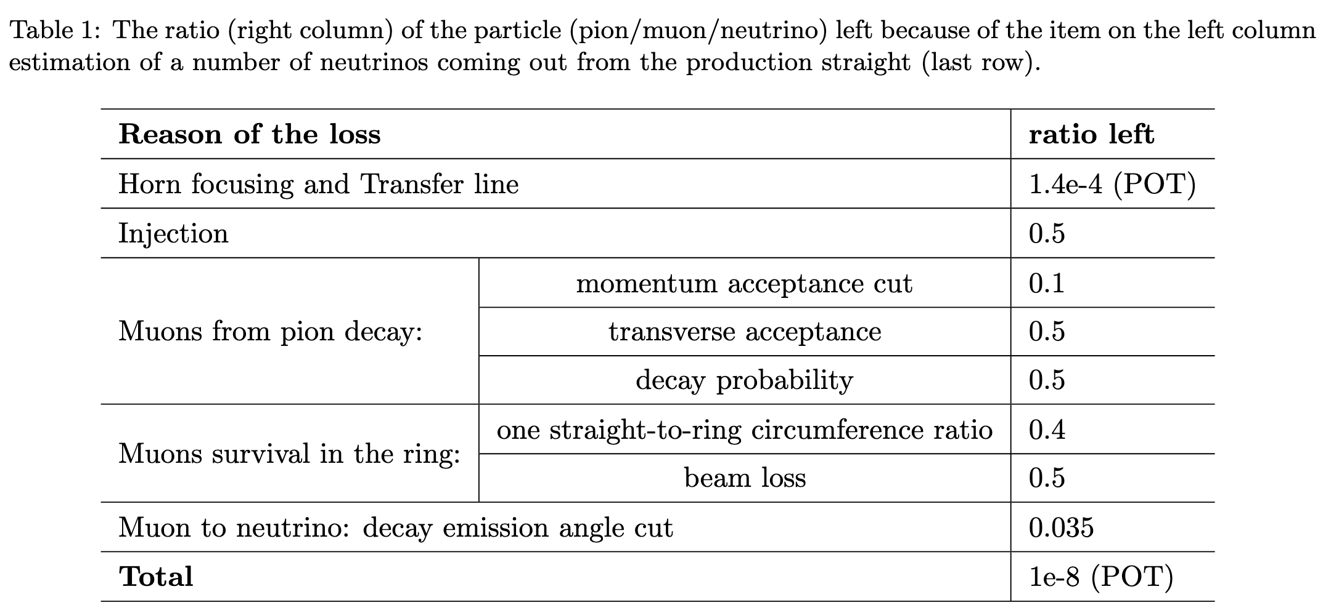
Neutrino flux?

Slide 22
WP4

