Slide 1


WP5 progress (partial summary)
Monojit Ghosh (coordinator)
Ruđer Bošković Institute, Zagreb
George Fanourakis (co-coordinator)
Inst. of Nuclear & Particle Physics, Athens
2st ESSnuSB+ annual meeting
23 September 2024

Slide 2
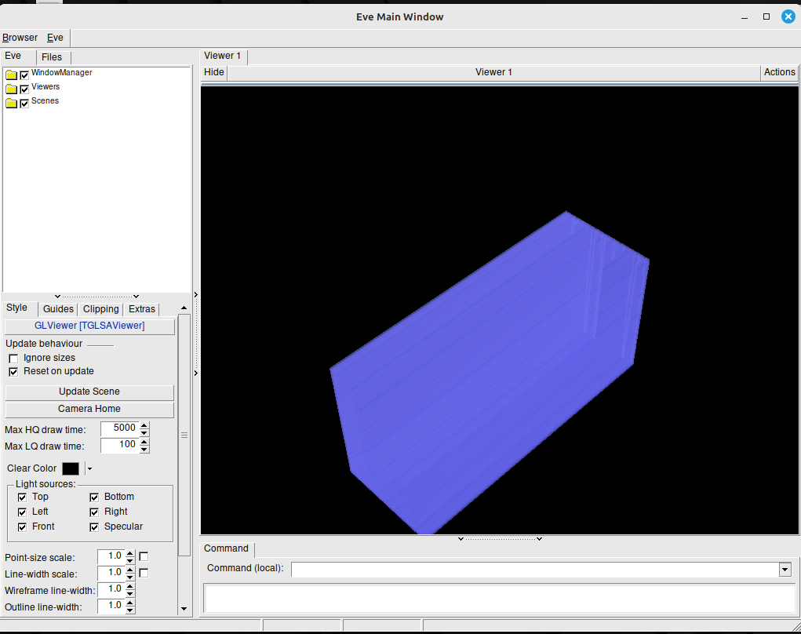
Event visualization framework for sFGD
Georgi Petkov – Sofia Univ.
General framework for the simulation of sFGD events. Based on libraries from:
GENIE: to generate the neutrino events
GEANT4: the main simulation engine
CERN ROOT: for data storage and script development
CERN ROOT is used to define the detector volumes and do the visualization of the detector
Here is the sFGD detector with 980 000 cubes.
The Root Event Window is quite Responsive even with so many elements.

Slide 3
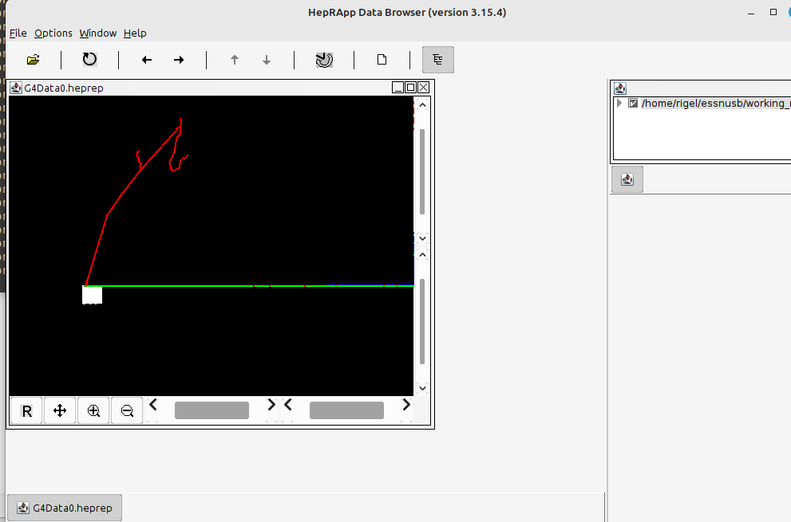
Event visualization by GEANT4
(using HepRapp)
Drivers used:
  OpenGL
  OpenInventor
  Qt3D
  VTK
  ToolSG
  RayTracer

Slide 4
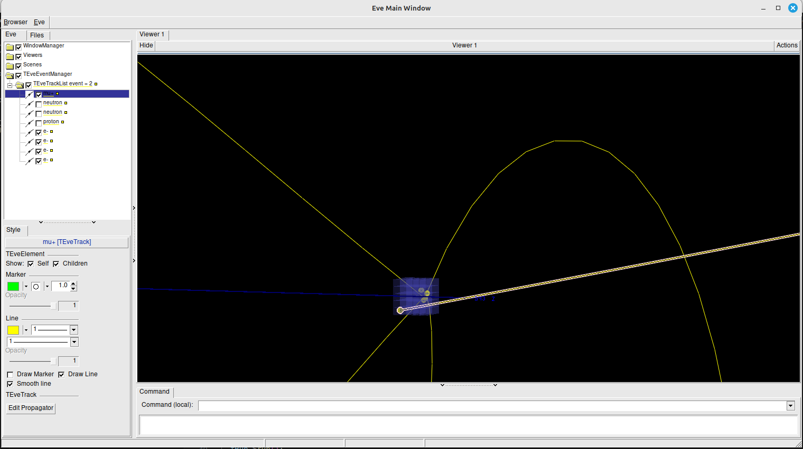
Event visualization by ROOT (using scripts)
Tracks can be turned on/off for better visualization
After running the simulation track data are exported and then for each event the tracks can be visualized.
The user can decide if this data can be used by with a third-party tool to do some other types of visualization of data processing.
Work on GUI in progress
The simulation needs a little more work to become stable.

Slide 5
Classification of ESSnuSB WC Near Detector Events Using Graph Neural Networks
Kaare Endrup Iversen - Lund University
Why GNN ?

Slide 6
Receiver-operating characteristic curve. True positive rate (TPR) vs false positive rate (FPR)
Classifiers that give curves closer to the top-left corner indicate a better performance. As a baseline, a random classifier is expected to give points lying along the diagonal.

Slide 10
Nuclear effects in neutrino-induced pion production
Javier Garcia-Marcos - GENT University

Slide 11
Single pion production (SPP) threshold

Slide 12
Modelling Single pion production on nuclei
They describe the SPP process as a one-nucleon interaction instead of a many-body one, and assume that only one boson is exchanged between leptonic and hadronic systems.
Fully relativistic and quantum mechanical framework
Realistic bound and final states
Can take into account nuclear effects consistently
For the pion production the resonances P33(1232) (Δ-baryon), D13(1520), S11(1535), P11(1440) are taken into account
The nuclear effects are taken into account in the final state
The pion is produced after hyperon (Y ) excitation.
In the low-energy region ΔS = 0 and ΔS = 1 processes are comparable
Only antineutrino reactions in the ΔS = 1 sector are allowed:

Slide 13
Facts to consider

Slide 14
GEANT4 Simulation on Gd doping in water
Mehmet Oglakci - Cucurova University

Slide 18
LEnuSTORM flux at LEMMOND
Leon Halić, Ruđer Bošković Institute
The goal was to obtain flux shape and relative normalization
The absolute value of normalization has NO meaning and does NOT represent expected number of interactions
Initial simulation was a simple decay of muons from a point source (Ting Wing Choi)
The decay vertices were distributed along the straight section of LenuSTORM ring following the exponential decay distribution

Slide 21
Caveats
WP4 mentioned in both this meeting and the recent milestone that the current best value for the length of the straight section of the muon ring is 75 m – this analysis was done with 30 m
The effect of this longer straight section on the neutrino flux should be studied more
Maybe a possibility of putting the LEMMOND closer in the case of a longer muon ring?
To help us reach a conclusive decision, absolute normalization should be known

Slide 22
LEMMOND Design - a progress report
Spyros Tzamarias – Aristotelean University of Thessaloniki
LEMMOND will be a cylindrical, water Cherenkov detector
the optical elements cover the detector surface
the detector’s symmetry axis coincides with the ν-beam axis
exploits photodetector-technologies with spatial and precise (ps?) timing capabilities
This study is based on the detection of leptons produced from the ν CC Quasi elastic interactions and identifies requirements concerning:
the size of the detector given the neutrino fluxes (and assuming a 100% efficient detector)
the track reconstruction of the charged leptons (requirements on timing and spatial resolution)
the particle identification of charged leptons (ν flavor)
the momentum estimation of the charged leptons
the final required detector size (taking into account the neutrino fluxes and the reconstruction efficiency/resolution)
the momentum estimation of the parent neutrino (given the reconstructed lepton tracks)
the neutrino and anti-neutrino identification (Gd studies)

Slide 23
Determining the dimensions of the detector
the optimal dimensions for a given volume of the detector (100 ton or 200 ton) are determined by changing the radius and length of the detector and computing the number of neutrino interactions. Obviously the optimal dimensions are the ones that allow for the detection of the maximum number of events.
for the determination of the number of events observed (assuming 100% detector efficiency) the (anti)neutrino cross sections are used as per Genie weighted by the track length of the neutrino inside the water effective volume.
LEnuSTORM facility: 600 MeV/c (but also many other energies – see later) positive muon decays (about 250,000 muons) along the 30m straight section of the racetrack have been simulated to determine the vertex and the 3-momentum parameters of each neutrino produced (muon antineutrinos and electron neutrinos). By charge conjugation the same sample has been used to simulate muon neutrino and electron antineutrino beams. Assumed a total of 10¹⁷ muon decays.
LEMNB facility: many (5.14x10⁶ ) 1 GeV/c Monte Carlo generated positive pion decays along a 40 m long monitored decay tunnel used to determine the track parameters of each neutrino produced. By charge conjugation the same sample has been used to simulate the muon antineutrino beam.

Slide 24
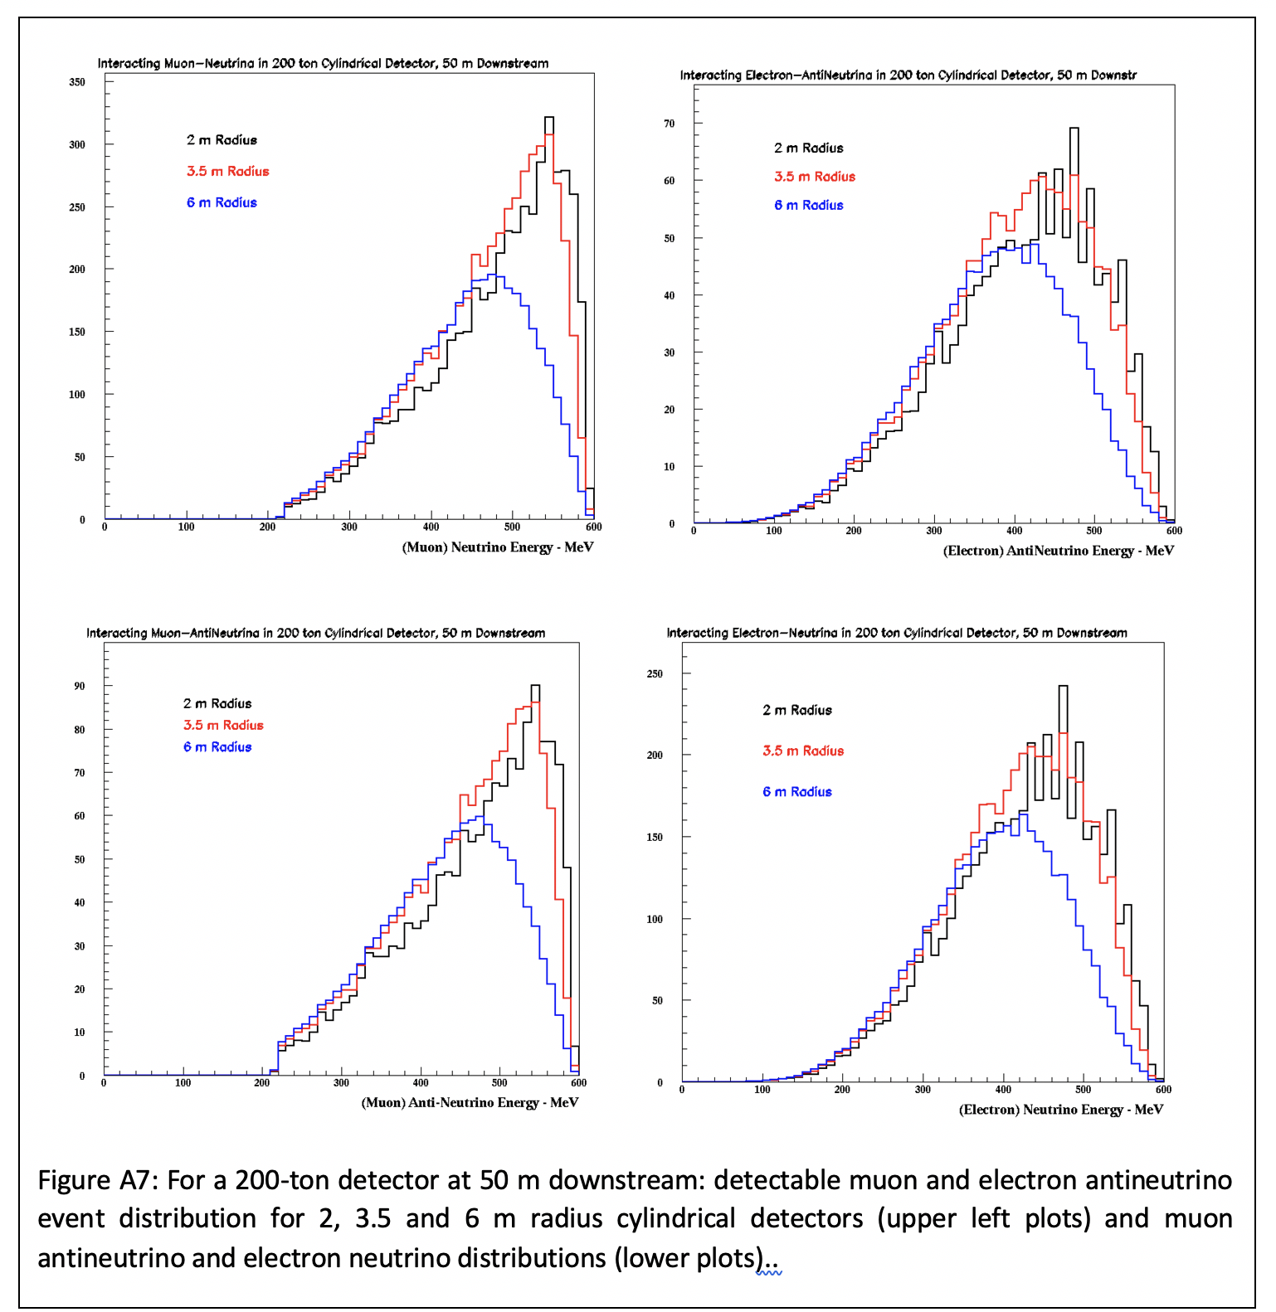
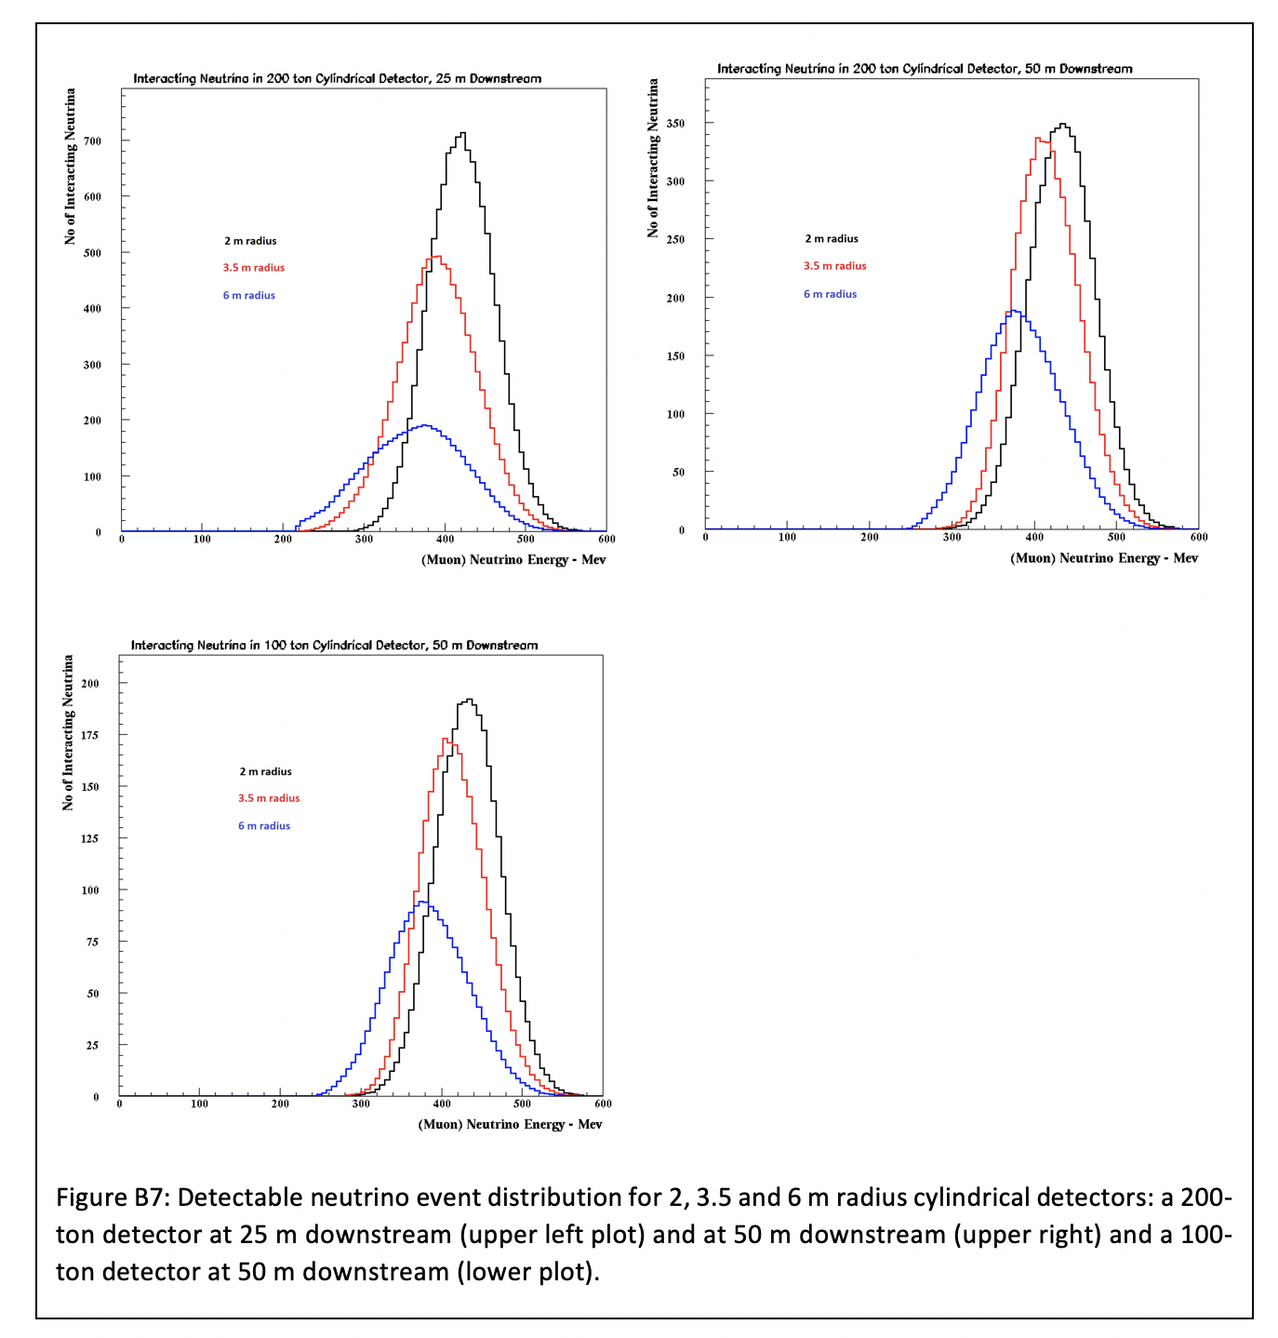
LEnuSTORM
Expected number of interactions of muon and electron (anti)neutrinos in a detector volume of 200 m³
^{600 MeV/c μ beam}
LEMNB
Expected number of interactions of muon (anti)neutrinos

Slide 25
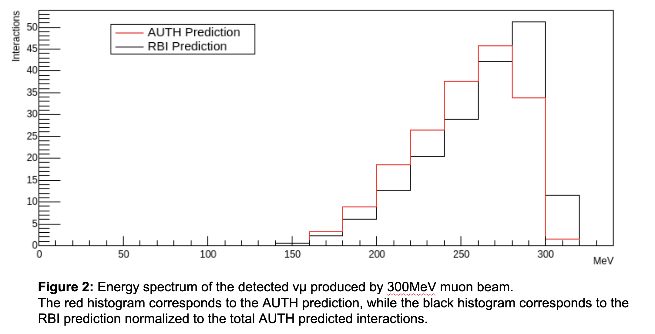
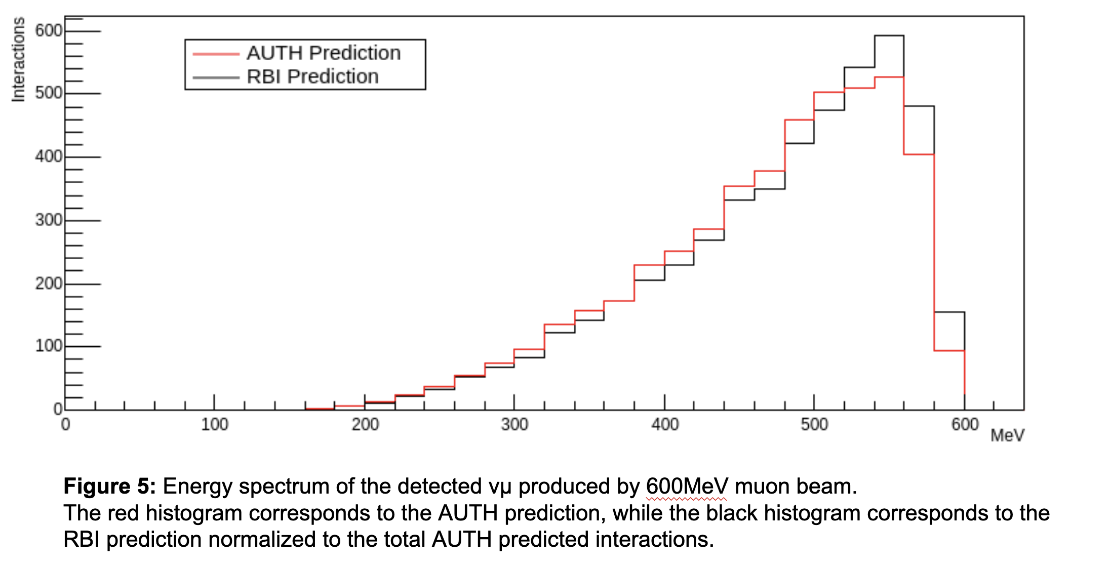
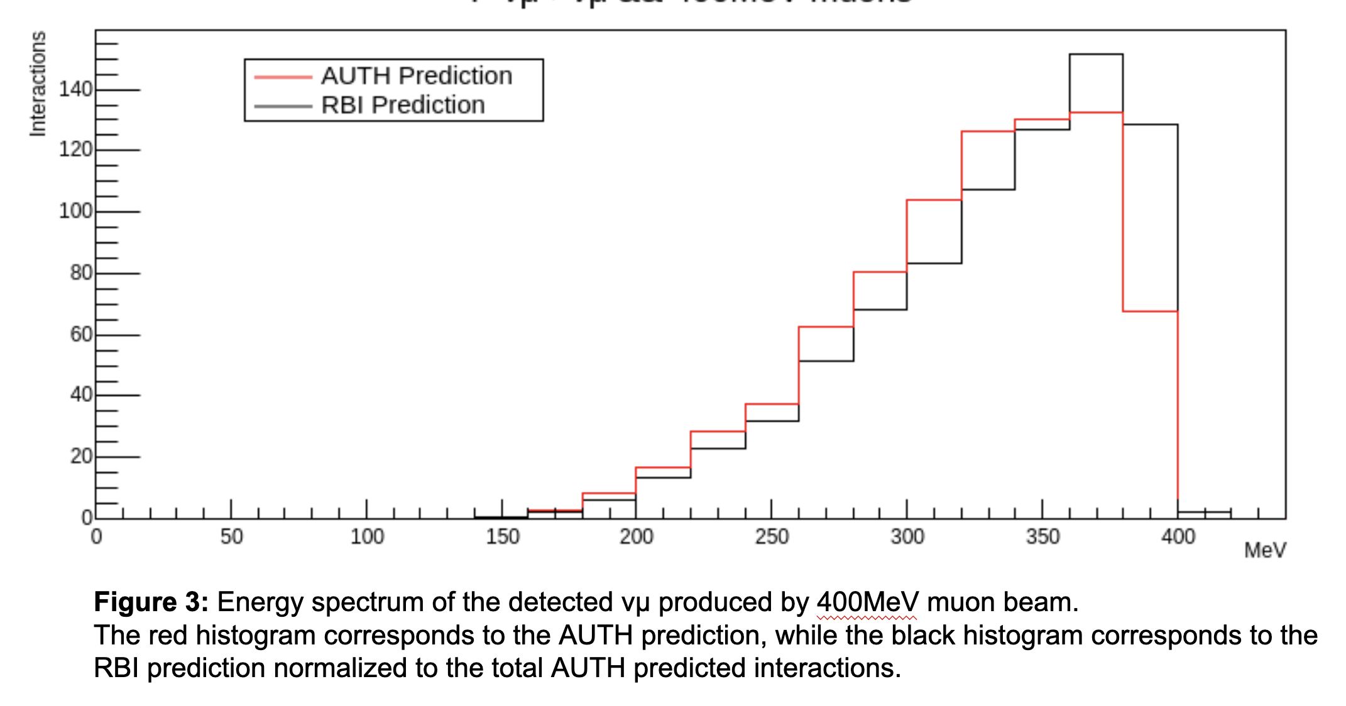
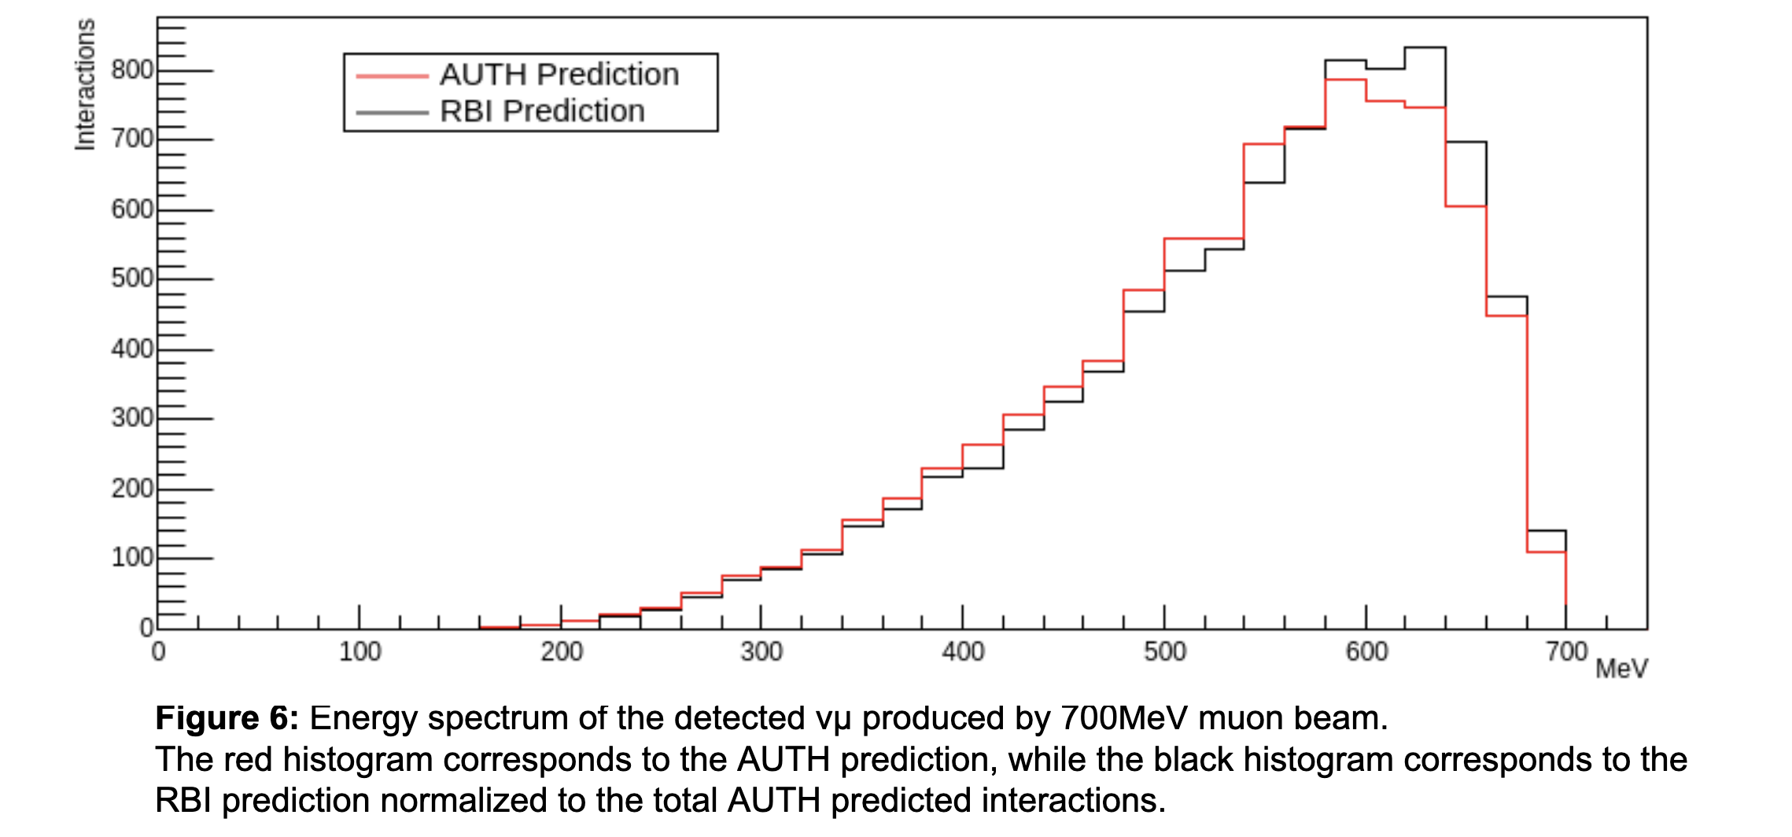
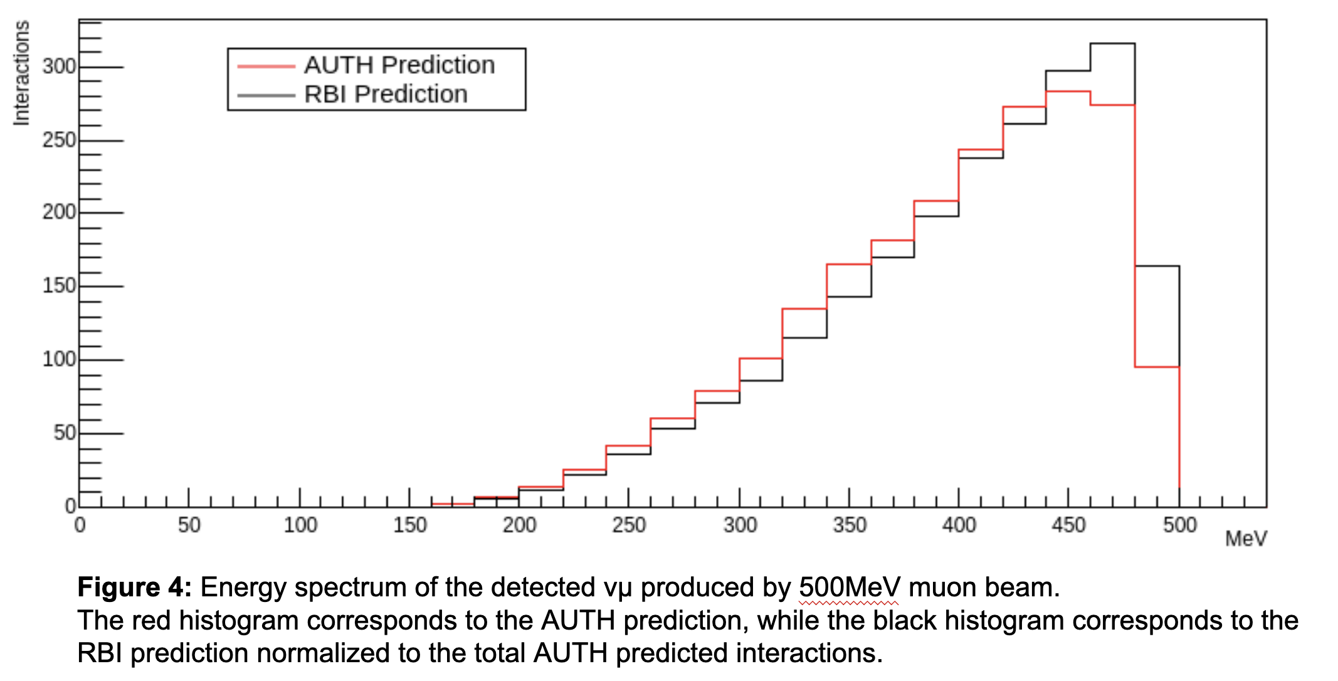
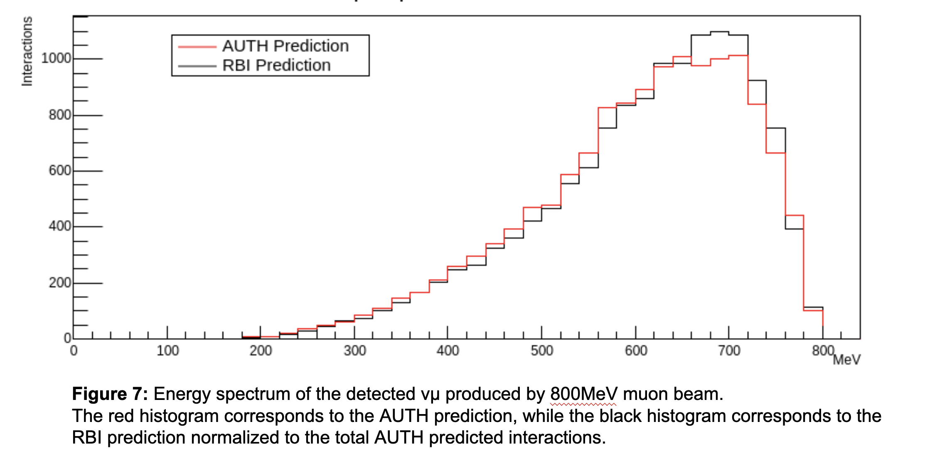

Slide 26
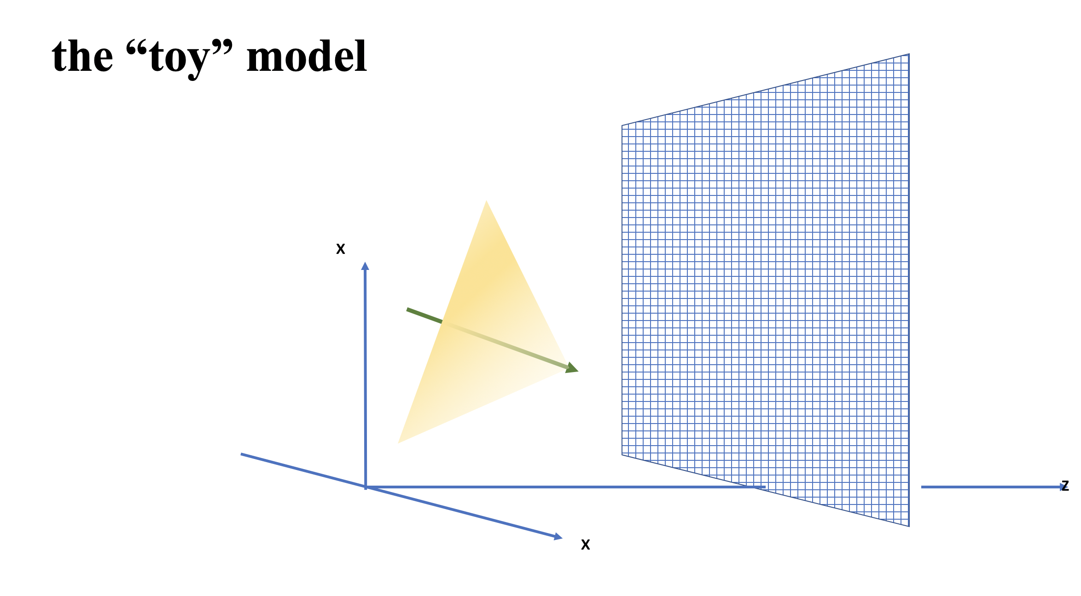
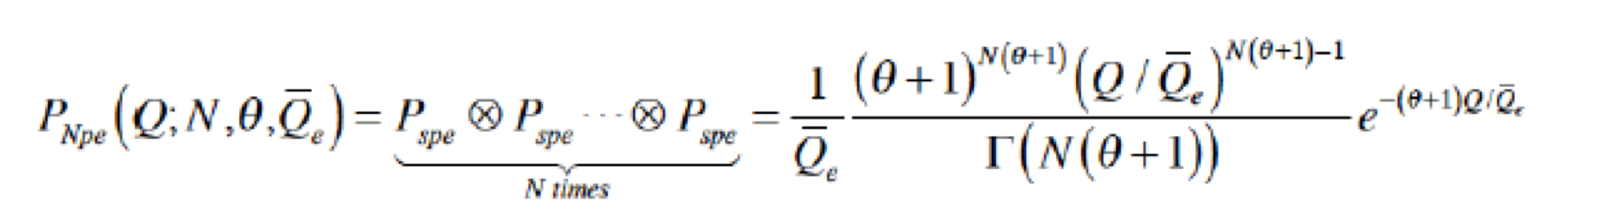
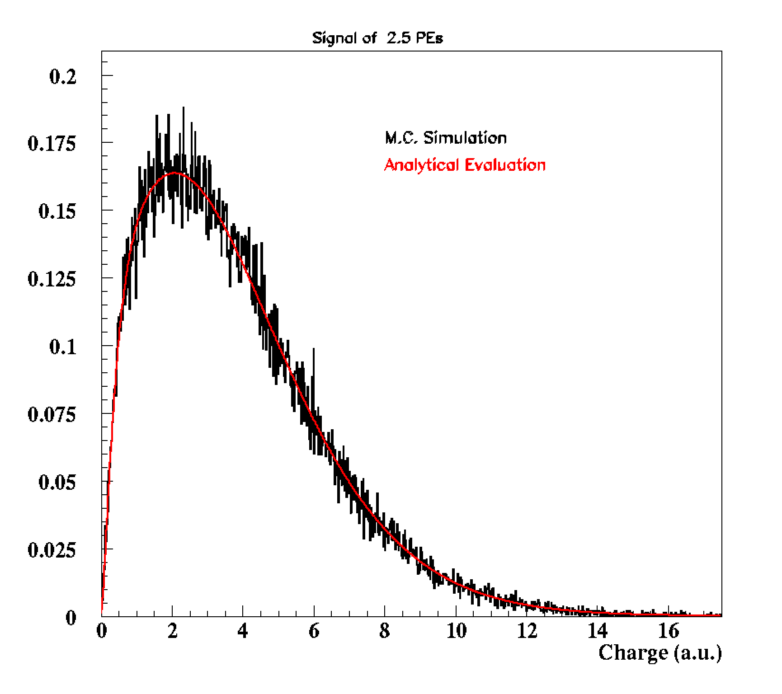
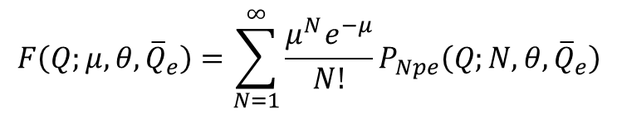
ID and Track Reconstruction of Charged Leptons
A Simulation Study Report
GEANT simulation (all scattering and absorption effects) of tracks, Cherenkov radiation, light transmission and detector response
Simulate the photodetector response (but ignore ambient light in the detector, electronic noise and threshold effects)
The “data” sample comprises of simulated photodetector-signals produced by Cherenkov charged lepton tracks, which have been generated with [θ=0^{ο} or θ=30^{ο} and φ=0^{ο}] initial direction, wrt to the detector frame
Tracks are starting ~200 cm away from the Detector
The detector is a 400 x 400 cm² plane, comprising 6400 5x5 cm² active photodetector elements
Then the probability of observing a detector signal with charge Q, given μ, ${\overline{Q}}_{e}$, and θ, is:
$$F\left(Q;μ,θ,{\overline{Q}}_{e}\right)=\sum_{N=1}^{∞}{\frac{μ^{Ν}e^{−μ}}{Ν!}}P_{Npe}\left(Q;N,θ,{\overline{Q}}_{e}\right)$$
This is the pd.f. used to simulate the detector signal and it is also used in a likelihood estimation of the track parameters (i.e. the lepton track that produced the observed signals).

Slide 27
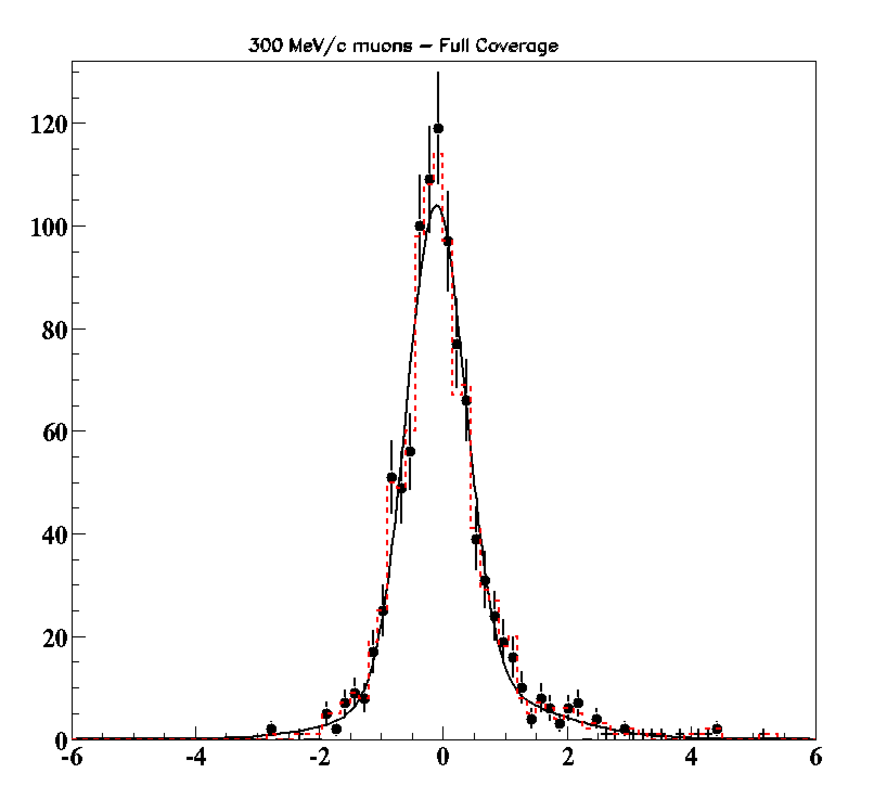
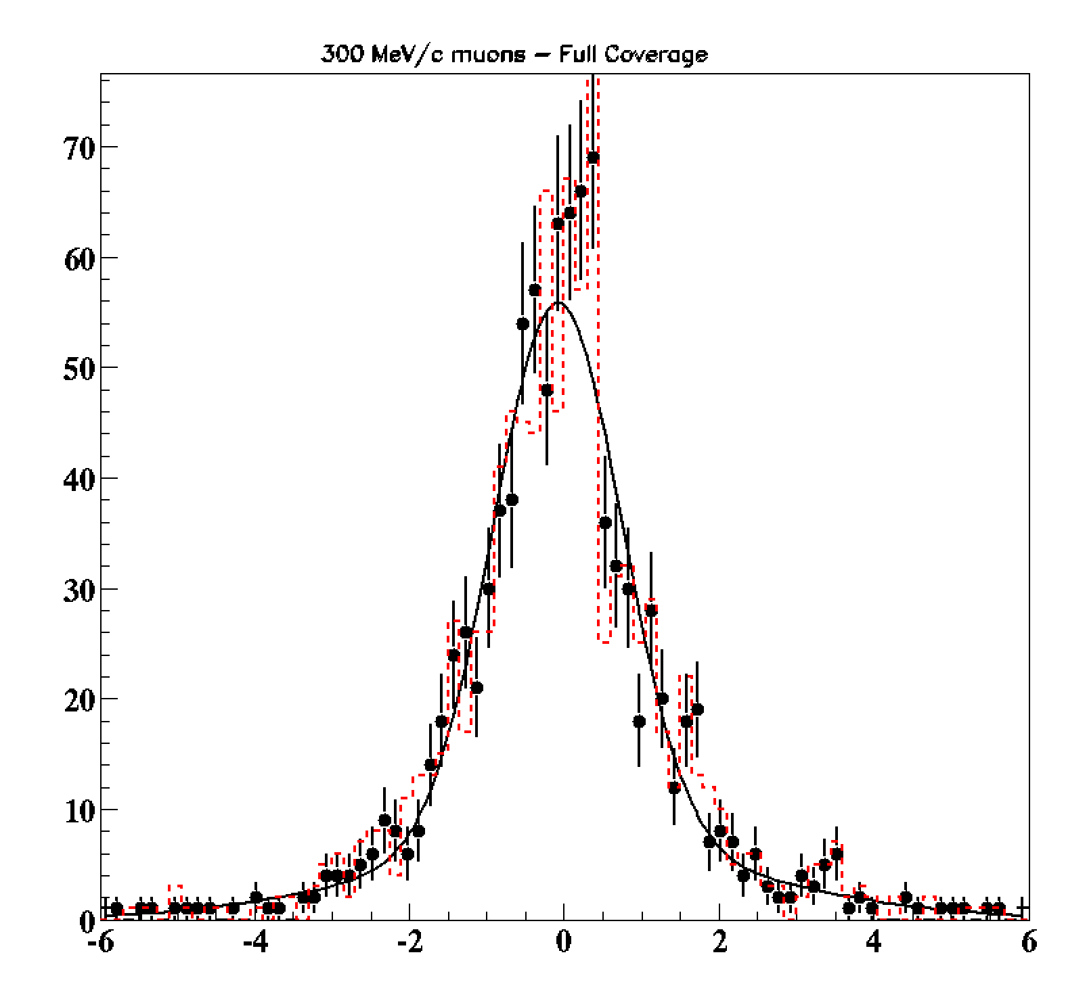
A first evaluation of reconstruction resolution
Study the information carried by the timing
Study the momentum estimation
Study the e-μ identification
RESULTS: 300MeV/c muons
Fit for θ-φ
Full detector coverage
θ_{true}=30º and φ_{true}=0º
Timing resolution: 1.5 ns
Timing resolution: 120 ps
Timing resolution: 1.5 ns
Timing resolution: 120 ps
σ_{θ} = 0.79^{ο}
σ_{φ} = 1.45^{ο}
θ_{estim.} – θ_{true} (Degrees)
φ_{estim.} – φ_{true} (Degrees)

Slide 28
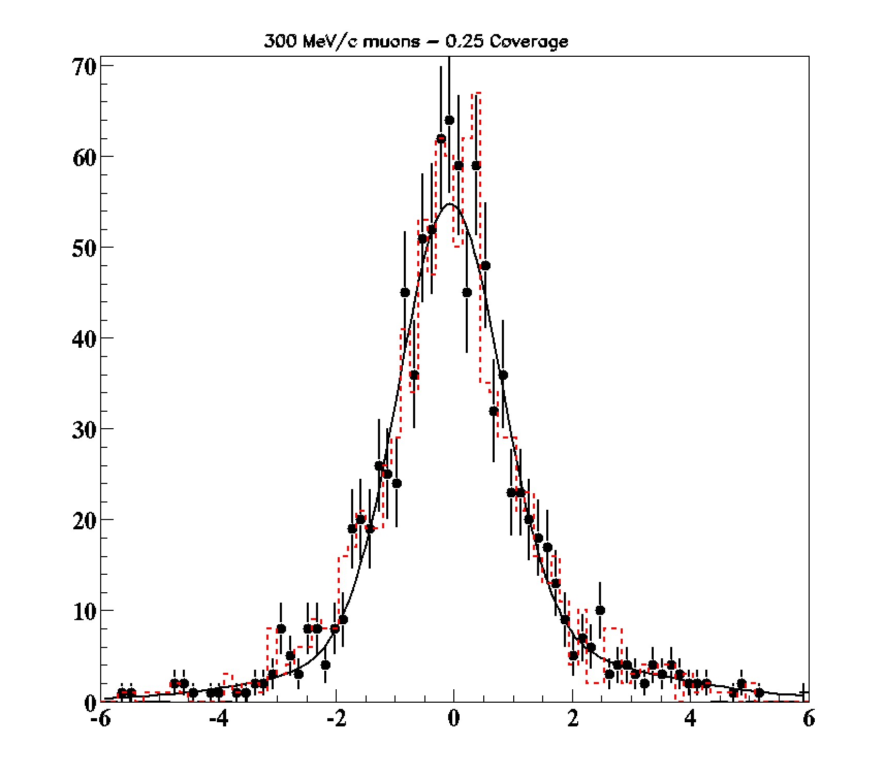
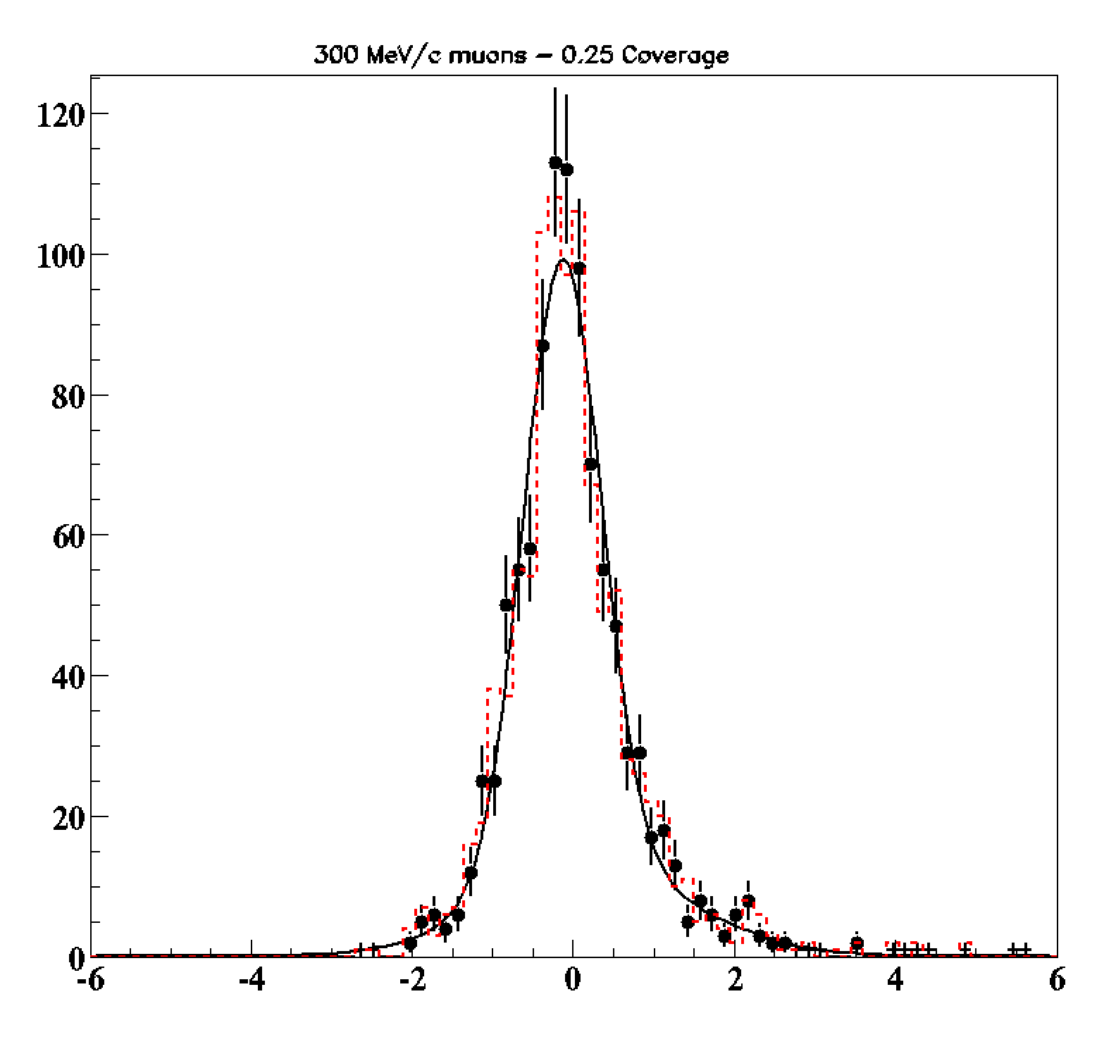
RESULTS: 300MeV/c muons
Fit for θ-φ
25% detector coverage
θ_{true}=30º and φ_{true}=0º
Timing resolution: 1.5 ns
Timing resolution: 120 ps
Timing resolution: 1.5 ns
Timing resolution: 120 ps
σ_{θ} = 0.79^{ο}
σ_{φ} = 1.45^{ο}
θ_{estim.} – θ_{true} (Degrees)
φ_{estim.} – φ_{true} (Degrees)

Slide 29
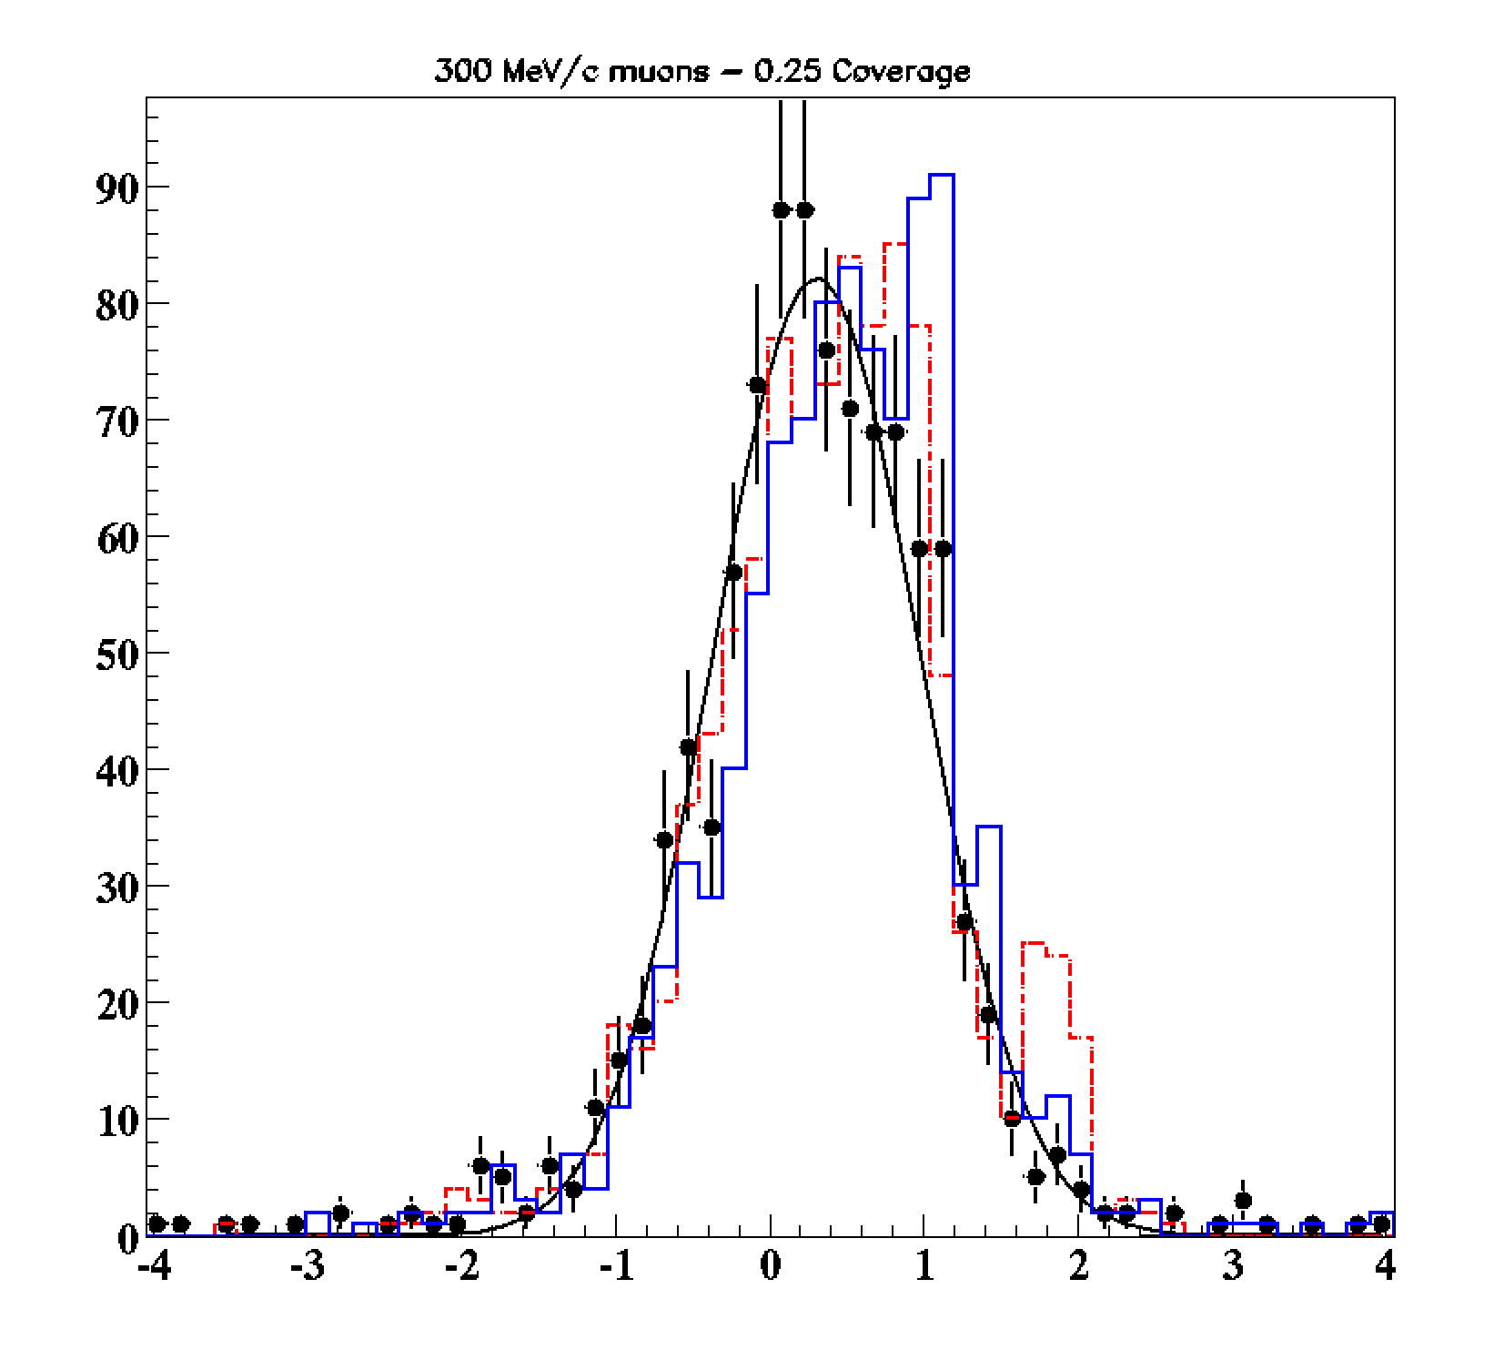
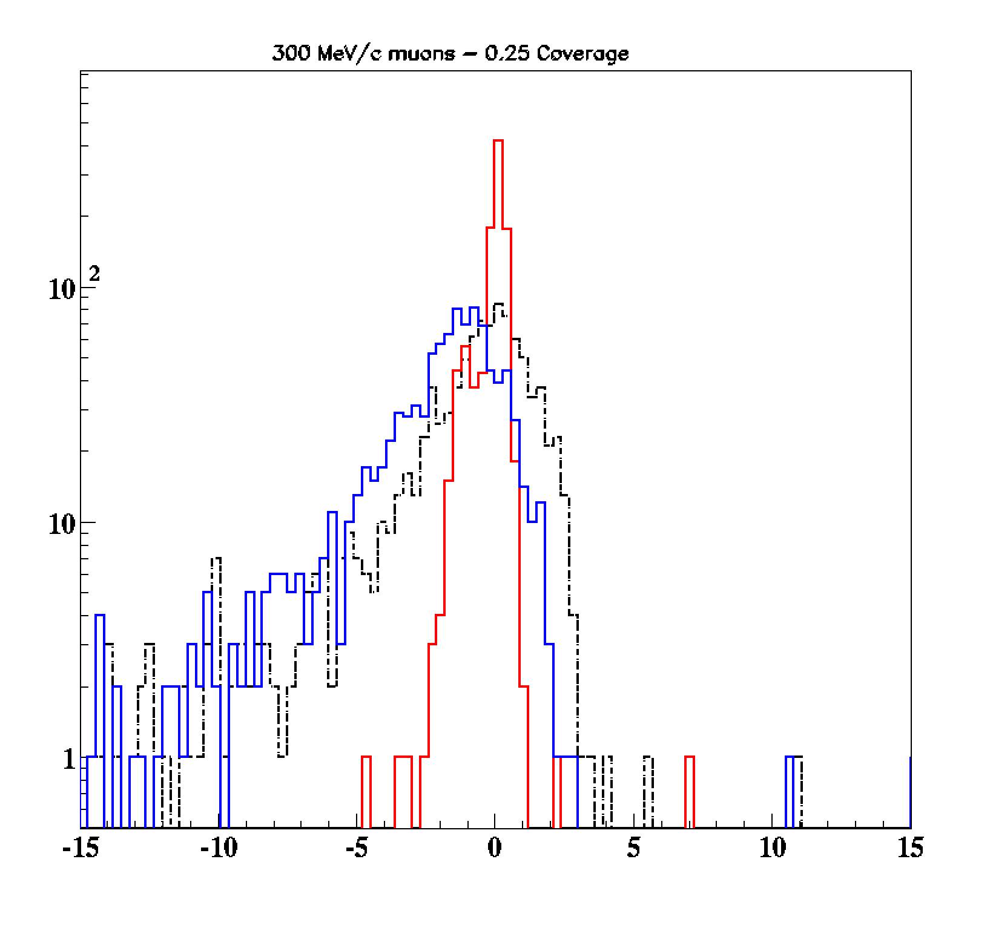
RESULTS: 300MeV/c muons
Fit for θ-Ζ
25% detector coverage
θ_{true}=30º and φ_{true}=0º
Timing resolution: 1.5 ns
Timing resolution: 4.5 ns
Timing resolution: 120 ps
σ_{Ζ} =0.6 cm
σ_{Ζ}= 2.9 cm
σ_{Ζ}= 3.0 cm
Timing resolution: 1.5 ns
Timing resolution: 4.5 ns
Timing resolution: 120 ps
σ_{θ} = 0.68^{ο}
δ_{bias}=0.3^{ο}
Z_{estim.} – Z_{true} (cm)
θ_{estim.} – θ_{true} (Degrees)

Slide 30
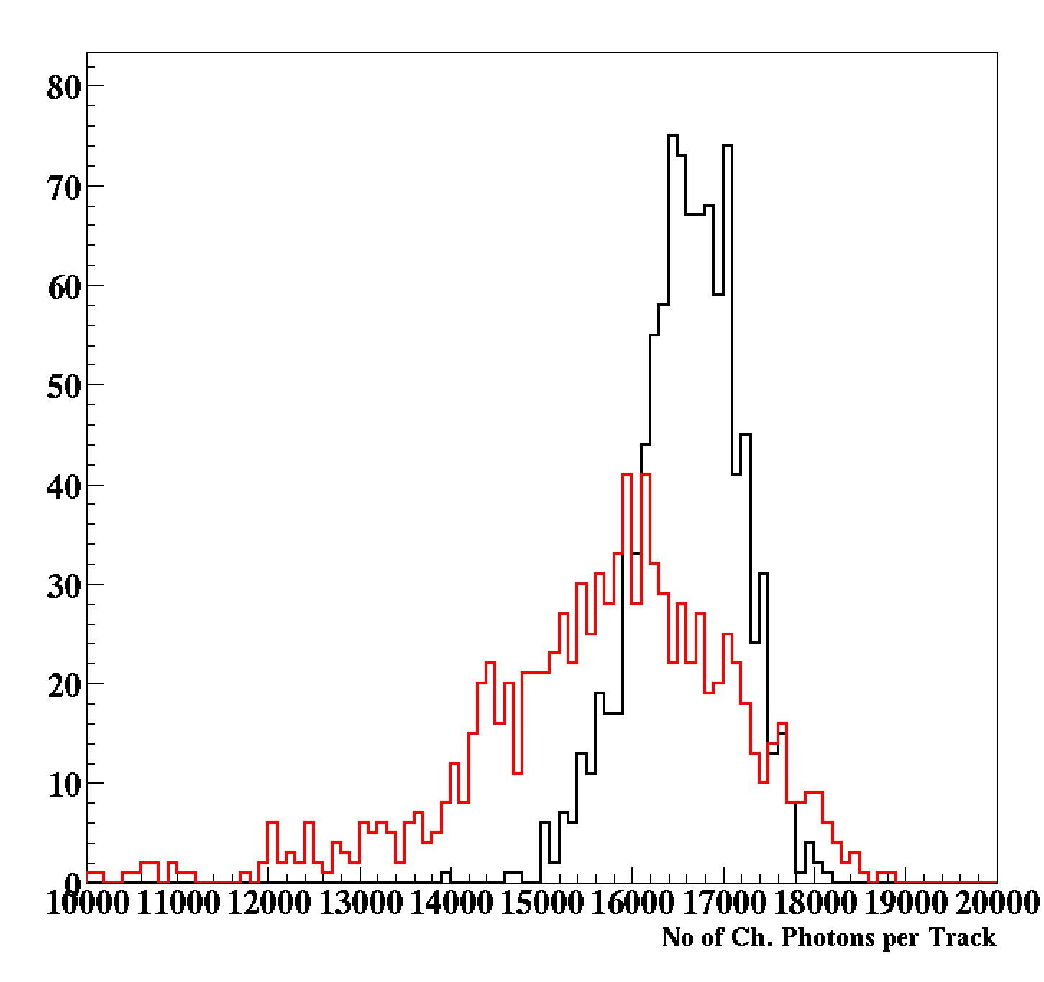
when 300 MeV/c muons
are treated as (105MeV/c) electrons (θ-φ fit)
300 MeV/c muons
105 MeV/c electrons

Slide 31
y=x
-log-Likelihood: when μ’s are treated as e’s

Slide 32
Concluding Remarks (single track reconstruction)
It seems that we do not need very precise timing information (?)
Strong indication for a good resolution in reconstructing direction
Strong indication for a good vertex estimation
Strong indication for momentum estimation
Strong indication for e-μ identification
We need:
All parameters simultaneous fit in realistic conditions
Full detector simulation
A practical reconstruction algorithm
  Use a different way to tabulate the Ch. Photon emission info (ANN?)
Repeat the “toy-model” and full detector studies

