Slide 1
Essnusb+ ANNUAL MEETING
Hamburg – FRIDAY 27TH September 2024
GOVERNING BOARD meeting : 09H00 – 12h00
Chair: Aysel Kayis Topaksu

Slide 2
AGENDA
Chair’s welcome
Approval of the agenda and verification of the presence of two-thirds of the Consortium Participants (quorum)
Report from the Project Coordinator (20', M. Dracos)
Report from the Scientific Leader (20’, T. Ekelöf)
Report from the DEB Coordinator (5’ , T. Tolba)
News from GB members and meeting’s participants (15')
International Advisory Panel : preliminary conclusions (30', IAP Chair)
2025 ESSνSB+ Annual Meeting (10')
Any Other Business

Slide 3
REPORT FROM THE PROJECT COORDINATOR:
PARTICIPATING INSTITUTES
Participant organisation name | Part. short name | Country | Representative
Centre National de la Recherche Scientifique | CNRS | France | E. Bouquerel
Université de Strasbourg | UNISTRA | France
Rudjer Boskovic Institute | RBI | Croatia | B. Kliček
Tokai National Higher Education and Research System, National University Corporation | NU | Japan | T. Fukuda
Uppsala Universitet | UU | Sweden | M. Olvegård
Lunds Universitet | ULUND | Sweden | J. Cederkal
European Spallation Source ERIC | ESS | Sweden | H. Danared
Kungliga Tekniska Hoegskolan | KTH | Sweden | T. Ohlsson
Universitaet Hamburg | UHH | Germany | T. Tolba
University of Cukurova | CU | Turkey | A. Kayis Topaksu
National Center for Scientific Research "Demokritos" | NCSRD | Greece | G. Fanourakis
Aristotelio Panepistimio Thessalonikis | AUTH | Greece | S. Tzamarias
Sofia University St. Kliment Ohridski | UniSofia | Bulgaria | M. Bogomilov
Lulea Tekniska Universitet | LTU | Sweden | D. Saiang
European Organisation for Nuclear Research | CERN | IEIO | I. Efthymiopoulos
Universita degli Studi Roma Tre | UNIROMA3 | Italy | D. Meloni
Universita degli Istudi di Milano-Bicocca | UNIMIB | Italy | F. Terranova
Istituto Nazionale di Fisica Nucleare | INFN | Italy | F. Pupilli
Universita degli Istudi di Padova | UNIPD | Italy
Consorcio para la construccion, equipamiento y explotacion de la sede espanola de la fuente Europea de neutrones por espalacion | ESSB | Spain | F. Sordo Baldin
+ PC, SC

Slide 4
REPORT FROM THE PROJECT COORDINATOR: PREFINANCING
MIM = Mutual Insurance Mechanism
In EUROS |  |  | pre-financing | MIM | sent to institutes
 |  |  | 53.33% | 5.0%
Beneficiary | Requested EU contribution | Maximum grant amount
CNRS | 653 541,00 | 653 541,00 | 348 533,42 | 32 677,05 | 315 856,37
(AE) UNISTRA | 36 243,00 | 36 243,00 | 19 328,39 | 1 812,15 | 17 516,24
RBI | 159 416,00 | 159 416,00 | 85 016,55 | 7 970,80 | 77 045,75
UU | 341 308,00 | 341 308,00 | 182 019,56 | 17 065,40 | 164 954,16
ULUND | 36 444,00 | 36 444,00 | 19 435,59 | 1 822,20 | 17 613,39
ESS | 528 050,00 | 528 050,00 | 281 609,07 | 26 402,50 | 255 206,57
KTH | 115 250,00 | 115 250,00 | 61 462,83 | 5 762,50 | 55 700,33
UHH | 231 260,00 | 231 260,00 | 123 330,96 | 11 563,00 | 111 767,96
CU | 67 350,00 | 67 350,00 | 35 917,76 | 3 367,50 | 32 550,26
NCSR "D" | 60 106,00 | 60 106,00 | 32 054,53 | 3 005,30 | 29 049,23
(AE) AUTH | 54 400,00 | 54 400,00 | 29 011,52 | 2 720,00 | 26 291,52
UNISOFIA | 80 500,00 | 80 500,00 | 42 930,65 | 4 025,00 | 38 905,65
LTU | 134 000,00 | 134 000,00 | 71 462,20 | 6 700,00 | 64 762,20
CERN | 236 000,00 | 236 000,00 | 125 858,80 | 11 800,00 | 114 058,80
UNIROMA3 | 52 206,00 | 52 206,00 | 27 841,46 | 2 610,30 | 25 231,16
UNIMIB | 76 920,00 | 76 920,00 | 41 021,44 | 3 846,00 | 37 175,44
INFN | 73 311,00 | 73 311,00 | 39 096,76 | 3 665,55 | 35 431,21
(AE) UNIPD | 1 612,00 | 1 612,00 | 859,68 | 80,60 | 779,08
ESS BILBAO | 62 083,00 | 62 083,00 | 33 108,86 | 3 104,15 | 30 004,71
 | 3 000 000,00 | 3 000 000,00 | 1 599 900,00 | 150 000,00 | 1 449 900,00
Interim payment 1
204 496,66
18 590,23
45 361,75
133 340,80
39 895,04
58 756,36
2 091,04
35 662,40
15 411,84
38 707,23
7 317,10
23 016,13
13 799,76
852,25
23 214,74
18 662,08
1 117,45
0,00
20 709,78
701 002,64

Slide 5
Report from the project coordinator: DELIVERABLES
4 first Deliverables already submitted
  Data Management Plan (DMP) 30/06/2023 (approved EU)
  Plan for Dissemination and Exploitation (PDE) 30/06/2023 (approved EU)
  Initial Facility Parameters 31/08/2023 (approved EU)
  Optimise the ESSnuSB+ horn design and its pulse generator 30/06/2024
Coming deliverables
WP3 | D3.2 | Design of the pion extraction and focusing systems | UNISTRA | 31/12/2024
WP4 | D4.1 | Review of the LEnuSTORM operation scheme | UU | 31/12/2024
WP5 | D5.1 | Preliminary design of the LEnuSTORM/monitored beam near detector | RBI | 30/11/2024
WP6 | D6.1 | Design of the LEMNB transfer line | UNIMIB | 31/12/2024

Slide 6
Report from the project coordinator: MILESTONES
6 were achieved:
Review of 1st year achievements, deliverables & costs, (all WPs), CNRS;
First design of the hadron collector (WP3), CNRS;
Identification of requirements for LEnuSTORM / monitored beam near detector (WP5, WP4, WP6), RBI;
Identification of the location and layout of the LINAC transfer line (WP6), UNIMIB;
Identification of non-beam physics scenarios (WP5), RBI;
Evaluation of the LEnuSTORM requirements and parameter range (WP5, WP4, WP3), UU.
1 was postponed until 31/03/2025 (month 27) postponement approved by EU:
Implementation of the static focusing system in MADX and G4beamline (WP6), UNIMIB.

Slide 7
Report from the project coordinator:
CHANGES IN Various MEMBERSHIPS
GB:
ESS is now represented by Håkan DANARED;
WP5:
Monojit Ghosh becomes Coordinator and Georgios Fanourakis becomes Co-Coordinator;
EC:
Georgios Fanourakis becomes a new member of the EC;
ESFRI Task Force: Implementation strategy task force
Budimir Kliček becomes Chair of the Task Force and invited member of the Management Team.

Slide 8

CHANGES IN Various MEMBERSHIPS
IAP:
replace Gerardo D'Auria (WP2);
add Mathieu Perrin-Terrin for WP6 assessment (IAP request) ⇒ 6 IAP members?
  CPPM Marseille, https://mperrint.web.cern.ch/
  involved in the KM3NeT the NA62experiments, developing a new experimental method - the tagging - to study neutrinos at particle accelerators.
  opinion of WP6?

Slide 9
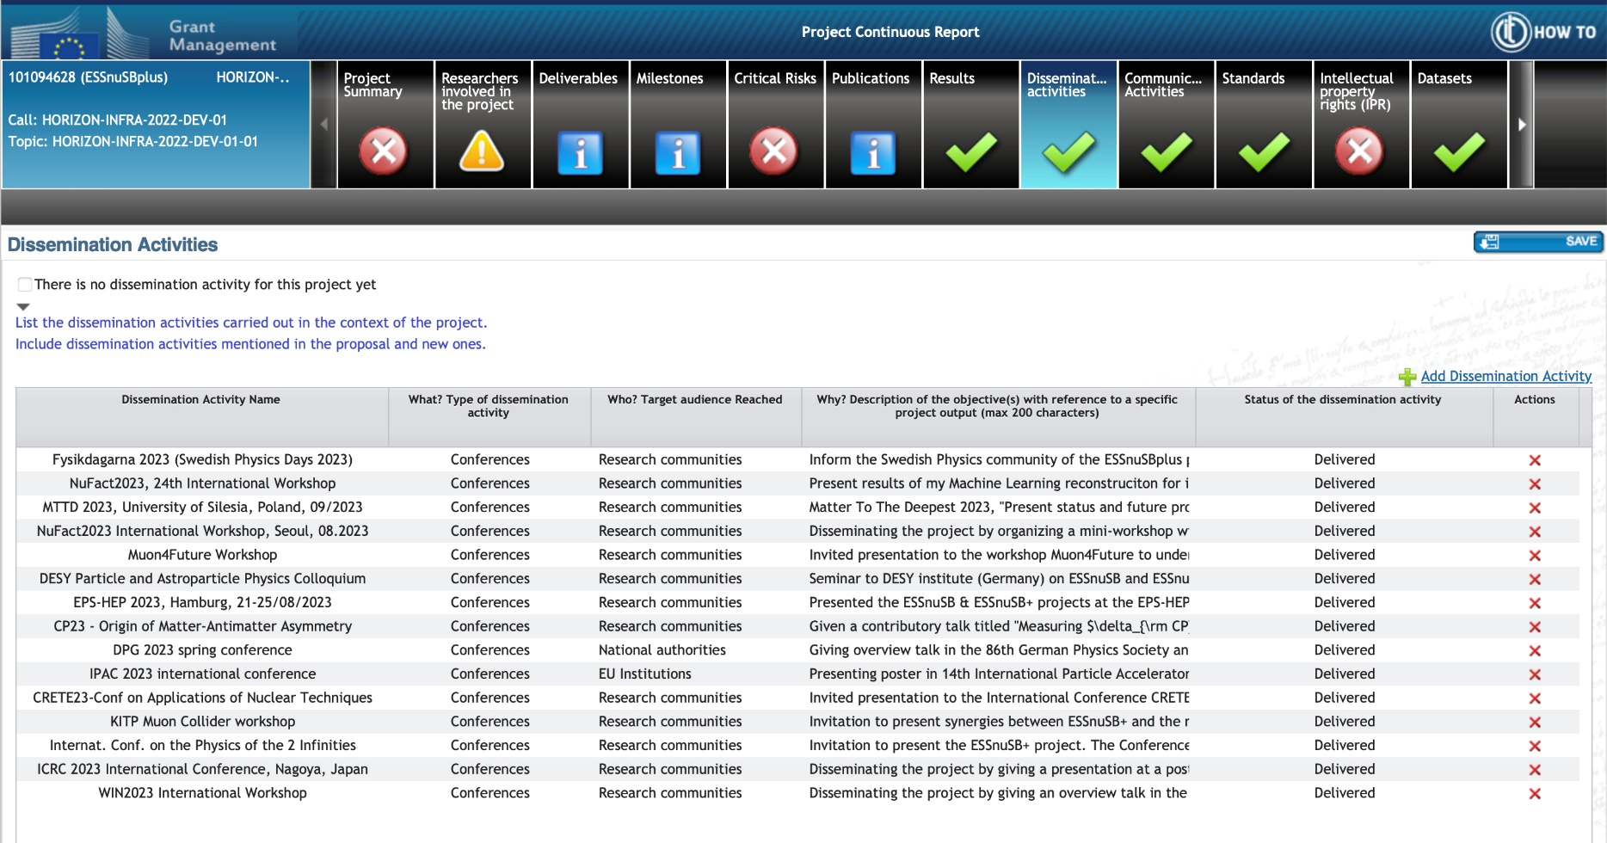
PROJECT Continuous report
REMINDER! in order to complete the EU continuous report (picture below), please send systematically to Carole information about the external events you attended to disseminate the project.

Slide 10
Report from THE Scientific Leader

Slide 11
Report from the DEB Coordinator

Slide 12
NEWS FROM GB MEMBERS & PARTICIPANTS

Slide 13
International Advisory Panel:
Preliminary conclusions

Slide 14
2025 ESSnuSB+ ANNUAL MEETING
  Proposal:
  Where? CNRS, Strasbourg
  When? 13-17 October 2025
any other proposal?

Slide 15
Any other business
  …

Slide 16


