Slide 1
Framework visualization - updates and progression 09.24.2024
Georgi Petkov

Slide 2
A few reminders
The framework is a general designed framework to be used to simulating neutrino events in a detector.
Used in the simulation study of Near Fgd detector.
It can be run as stand alone application or using scripts (ROOT scripts -> dictionary files are generated at compile time)
Main third party libs used are:
Genie – neutrino events generation
Geant4 – main simulation engine
CERN Root – data storage and scripts applied

Slide 3
Content
Visualization of the detector (working volumes)
Geant4 Visualizations of events
Cern Root visualization of events
Data processing and export – third party
GUI working (under design)

Slide 4
Visualization of the detector
The construction of
Sensitive volumes
and geometry volumes is done by using quite long
pieces of code.
For finding mistakes or mistmaches, we use CERN ROOT visualization -> geometry is exported as root file which can than be opened (by scripts).

Slide 5
Visualization of the detector
Here is the FGD detector at
980 000 cubes.
The Root Even Window is quite
Responsive even at so many
elements.

Slide 6
Geant4 Visualization of events
The framework also does validation that the geometry is correct -> the framework does an export from root geometry to gdml format which is than imported to Geant4. Thus transition does also geometry validation for overlapping of geometry volumes, if there are overlapping volumes, they will be listed and the simulation will stop.
When successful, one may need to check a given event what are the particle tracks and compare to the output algorithm.

Slide 7
Geant4 Visualization of events
Geant4 has build in visualization drivers, some come with the framework and some need additional installation of software.
Essnusb v3 comes along with script to facilitate installation (if desired) of the additional packages – the folder name is “addons”

Slide 8
Geant4 Visualization of events
Drivers:
OpenGL
OpenInventor
Qt3D
VTK
ToolSG
RayTracer

Slide 9
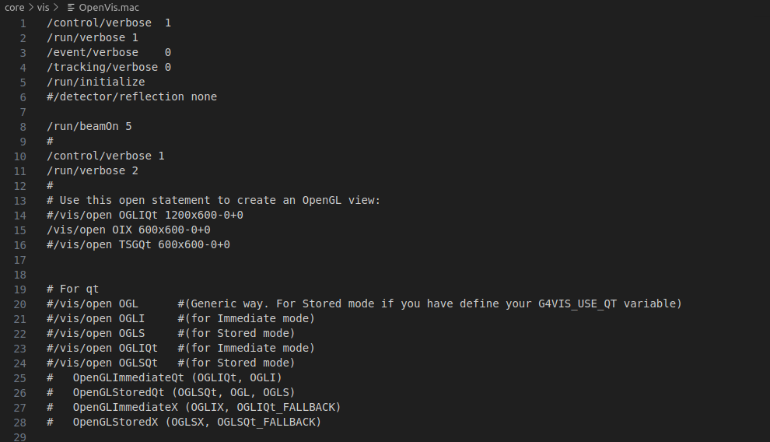
Geant4 Visualization of events
All visualization is made using Geant4 macros

Slide 10
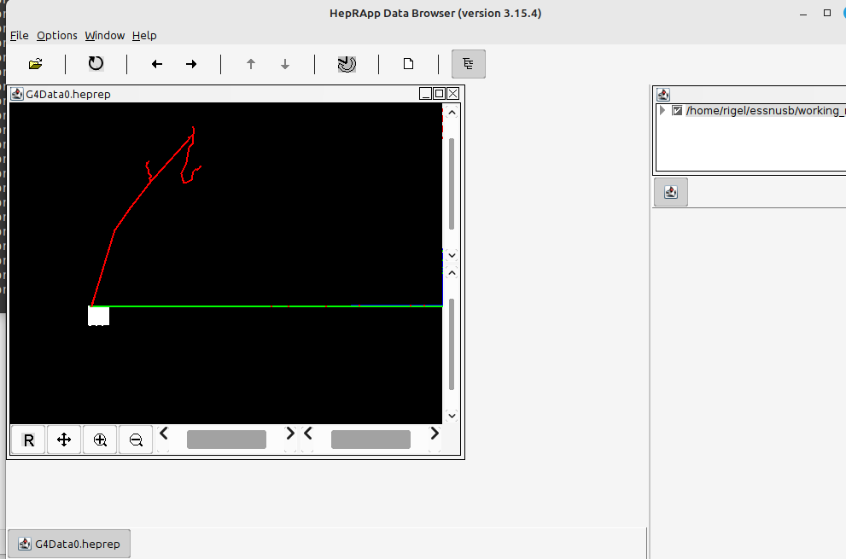
Geant4 Visualization of events - HepRapp

Slide 11
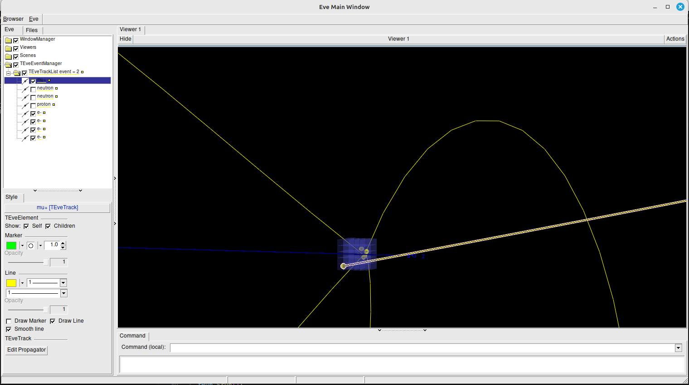
Cern Root visualization of events
They can be turned on/off for better visualization
After running the simulation
Track data is exported and then
For each event the tracks can
Be visualized.s

Slide 12
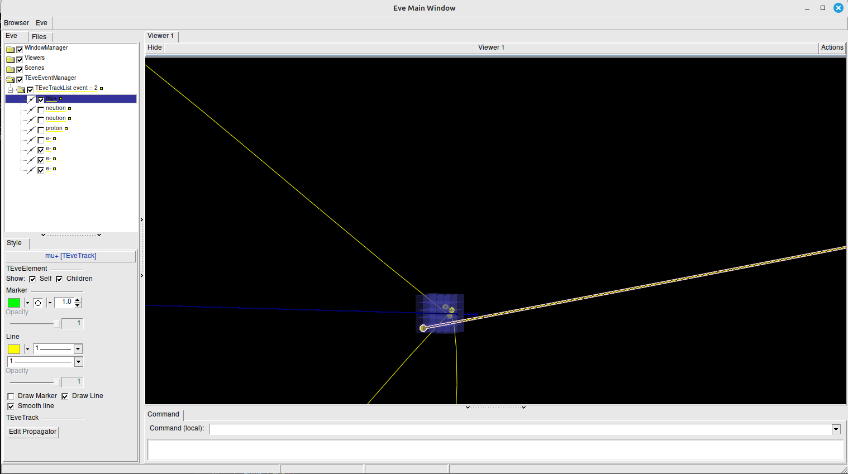
Cern Root visualization of events

Slide 13
Data processing and export – third party
When the simulation is done, data is exported. The user can decide if this data can be used by a third party tool to do some other types of visualization of data processing.

Slide 14
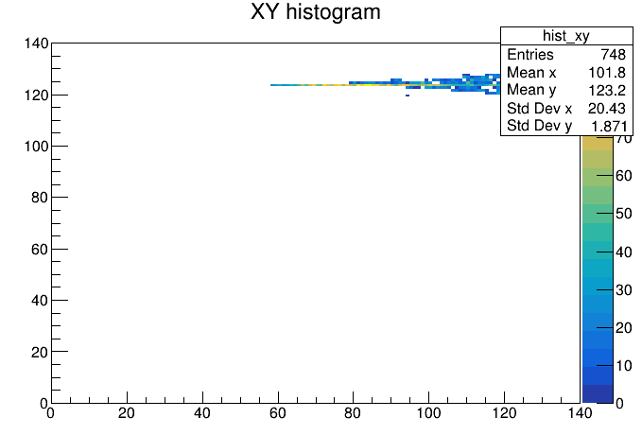
Data processing and export – third party
This is using cern root 3d histogram
A XY view of the detector, showing
The photons registered by the
photomultiplier.

Slide 15
Cern Root visualization of events –a few issues left to resolve
The event manager has to navigate throught the events
The tracks are not always display as expected (some additional points are added)
NOTE: The visualization is not still a 100% reliable

Slide 16
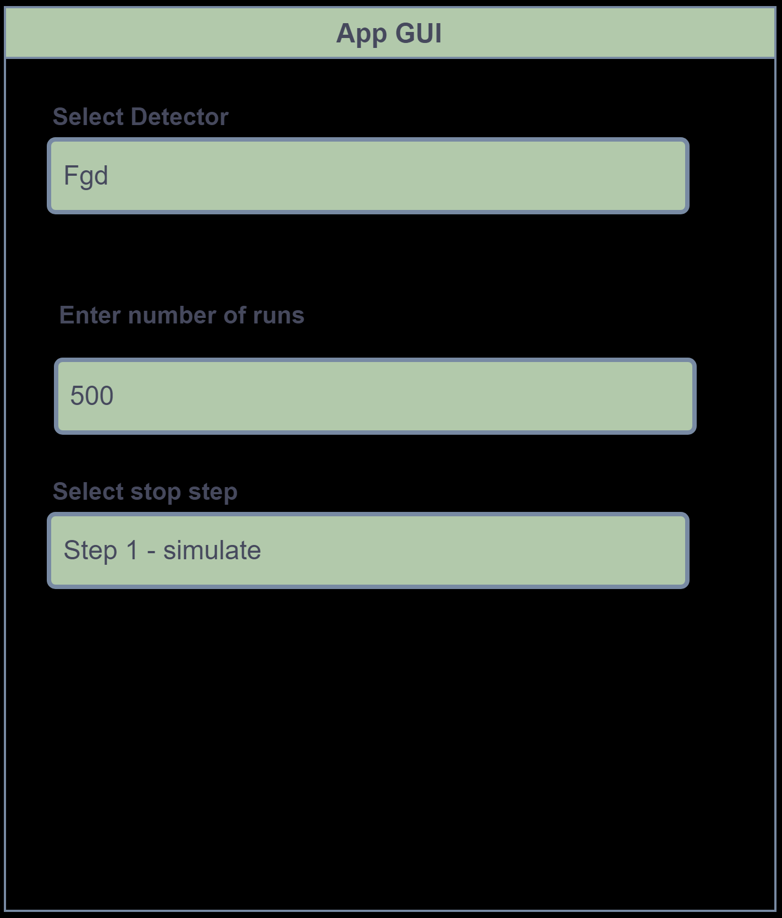
GUI working (under design)
For more easy working with the
framework, a GUI can be added
So that users just add what they
Are interested in not to worry
About setting config pats.
Drawbacks: For each detector added
The GUI may have to be changed
depending on the requirements

Slide 17
Questions?

