Slide 1
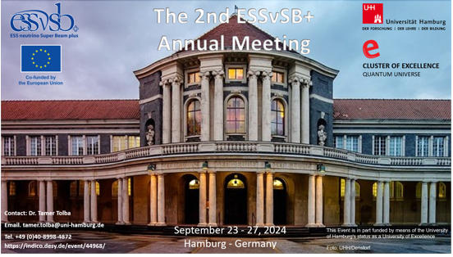
WP2+ Engineering & Infrastructure
ESSnuSB+ 2nd Annual Meeting https://indico.desy.de/event/44968/
Sep 23 – 27, 2024
Status
Dr. Eng. Nick Gazis

Slide 2
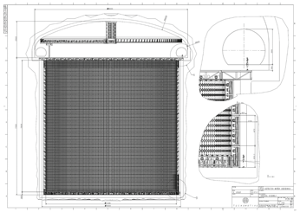
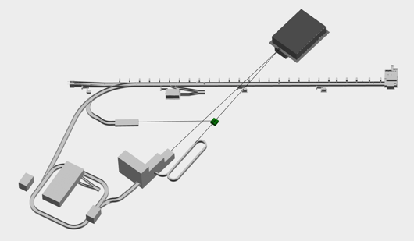
Deliverables
What was delivered and what do we have in front of us?
D2.1 – Conceptual study of civil works
with indicative timeline for ESS Site related activities (month 40)
    Status: undergoing the 5th update incl. updated target, LEMNB & ND
D2.2 – Machine Conceptual Design & Mechanical Design of
Linac, 2nd Target Station, near and far detectors,
auxiliary systems and infrastructure (month 44)
    Status: Machine layout under definition
D2.3 – Deliverables for
the Far Detector
Civil Engineering
Study including
Far Detector site
Feasibility
Report and
Far Detector
Civil Engineering
Study Report (month 46)
    Status by David Saiang presentation
Far Detector at Zinkgruvan site

Slide 3
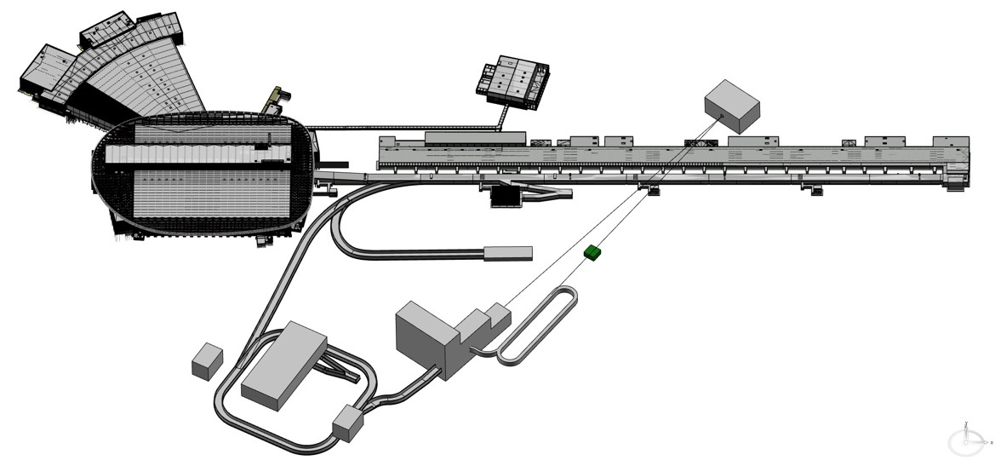
Mechanical Design update
ESS-4965198 (scale 1:1000)
23m
50m
140m
90m
340m
160m
76m
22.5m
43m
115m

Slide 4
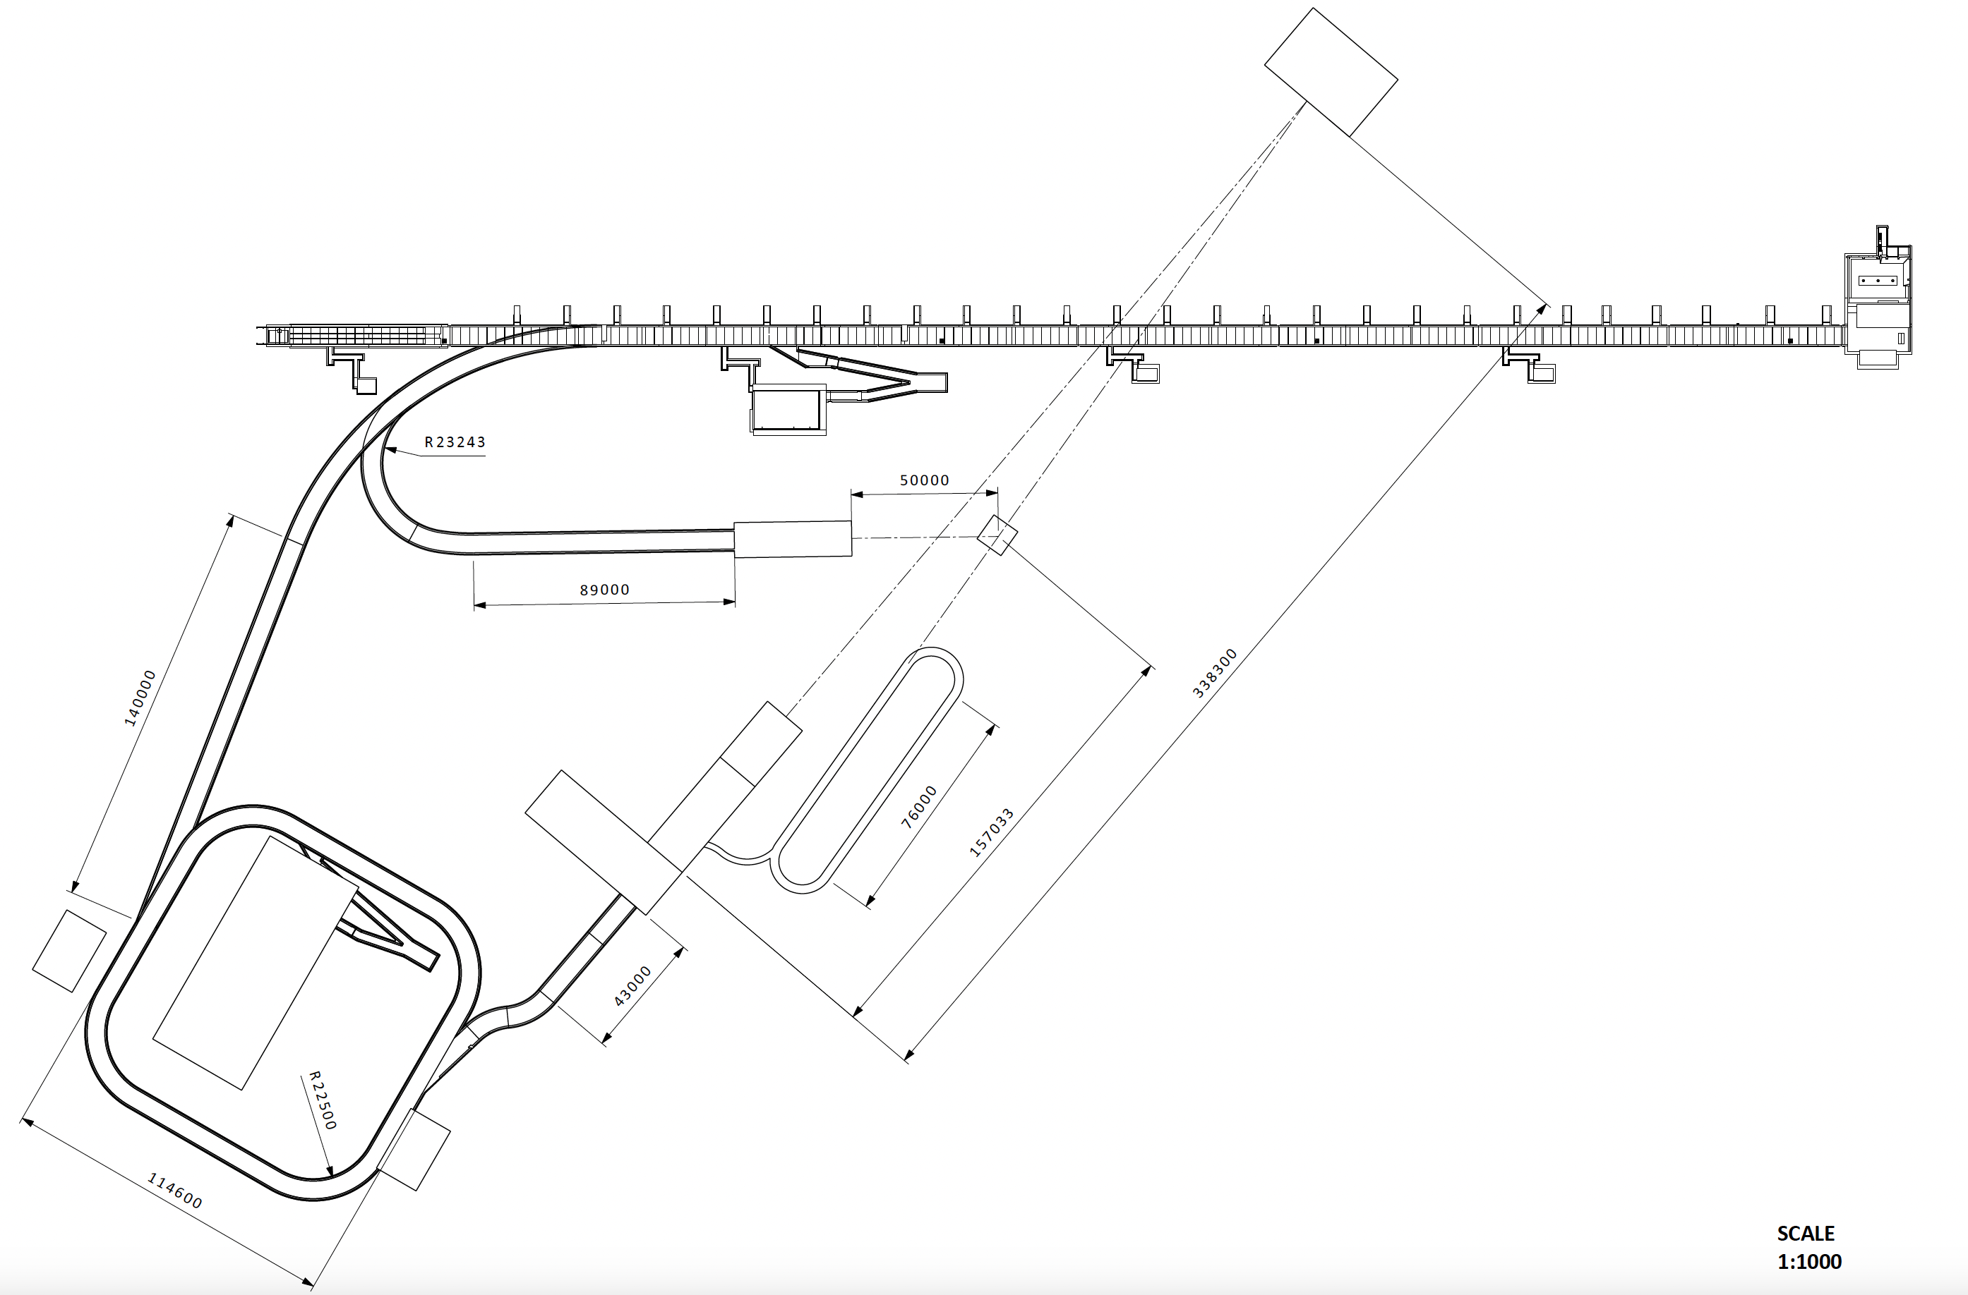
Mechanical Design update
ESS-4965198 (lengths units: mm)

Slide 5
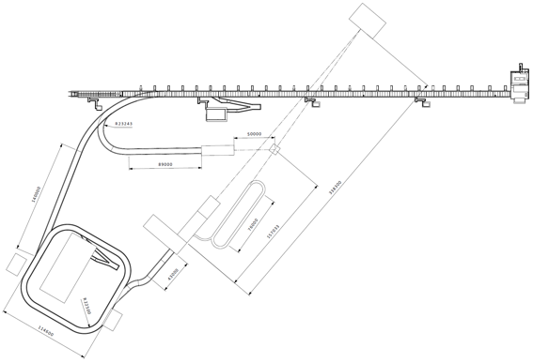
Costing Stages: Dawid Patrzalek talk
ESS is a greenfield project but ESSnuSB+ will not be greenfield
I. ESSnuSB+ Low Energy Monitored Neutrino Beam (Low Power!)
Accumulator not requested
Specific Target Station with instrumented decay tunnel
Rough integration to the the design at the moment
Proton LINAC, 2.0 GeV and 14 Hz (parasitic operation)
< 1 MW
II. ESSnuSB+ Low Energy nuSTORM (1.25 MW)
Accumulator requested
Beam Switchyard (assembled but not fully used)
Hadronic collector based on one Horn
Room for Power Supply Units
Morgue and Hot cell
H- LINAC, 2.5 GeV and 28 Hz
ESS Linac Power
Extraction System
+
Racetrack Ring
1.25 MW
Decay Tunnel
50m long
III. ESSnuSB Target Station (5 MW)
Accumulator requested
Beam Switchyard fully operational
Hadronic collector based on Four Horn
Room for Power Supply Units
Morgue and Hot cell
5 MW

Slide 6
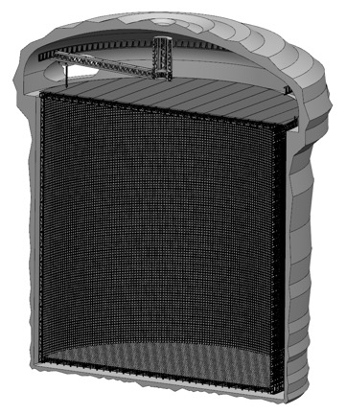
Far Detector: David Saiang talk
Updates & Highlights 2023-2024
Updates & Highlights 2023-2024
  Zinkgruvan Mine Manager (Graig Griffiths) retired
  Some assigned financing (external work) paid to Zinkgruvan
  No activity from Zinkgruvan personnel since March 2024
  Zinkgruvan requires more commitment from ESSnuSB+
  Communication with Zinkgruvan is based on Tord Ekelöf & David Saiang
  LTU studies continue
  The Far Detector study is being benchmarked w.r.t. Hyper-K in terms of engineering and costs

Slide 7
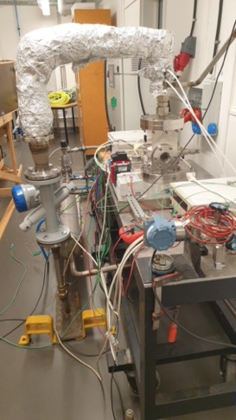
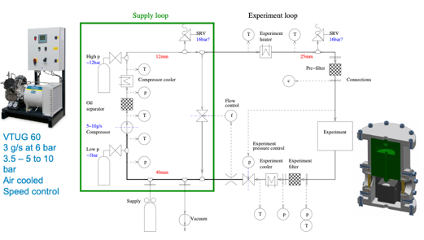
ETHEL testing at ESS MML lab
ESS Target Helium Experiments LTH –ETHEL (ESS-0005924)
A test set-up modelled after ESS target primary cooling system -System 1010.
ETHEL can be used to study the behavior of the new granular target designed for ESSνSB+ made of 3 mm titanium spheres cooled by transverse helium gas cooling.
New off-the-self solution for ETHEL is at 120KEUR. Our proposal is to move ETHEL from LTH to ESS premises in B02 temporarily.
Testing schedule available by T.Tolba.
Circuit & control

Slide 8
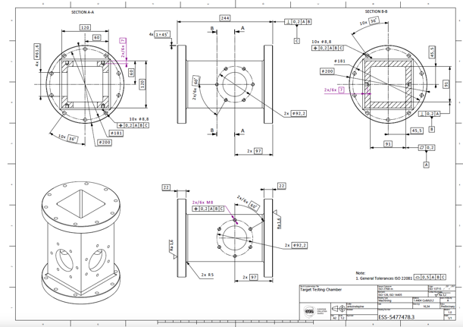
ETHEL testing at ESS MML lab
ETHEL - target testing chamber ESS-5477478
ESS MML has already:
Designed the ETHEL target test chamber
Launched manufacturing of the ETHEL target test chamber
Purchased vacuum flanges and seals for the test chamber
Reserved lab time for the ETHEL tests
ESS MML is ready to:
Contribute lab time and resources (ionized & cooling water, compressed air, etc.) to ETHEL tests
Start with data acquisition, improvements on sensing systems (with focus on temperature sensors), perform online SHM, material analysis, investigation of test impact etc.
ESS MML wishes to:
Participate to WP3 material analysis pre- and post- irradiation at HiRadMat and RADIATE collaboration
Certified for10 bar of absolute He Pressure
Compatible with He gas loop connections

Slide 9
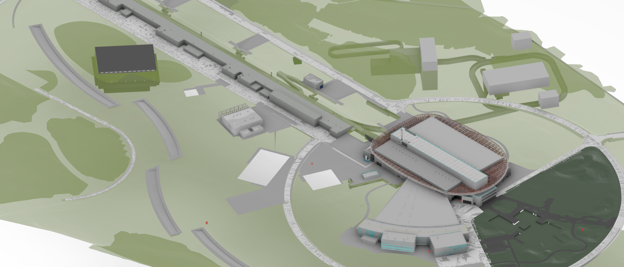
Discussion
For your consideration
IAP member for WP2
other

Slide 11
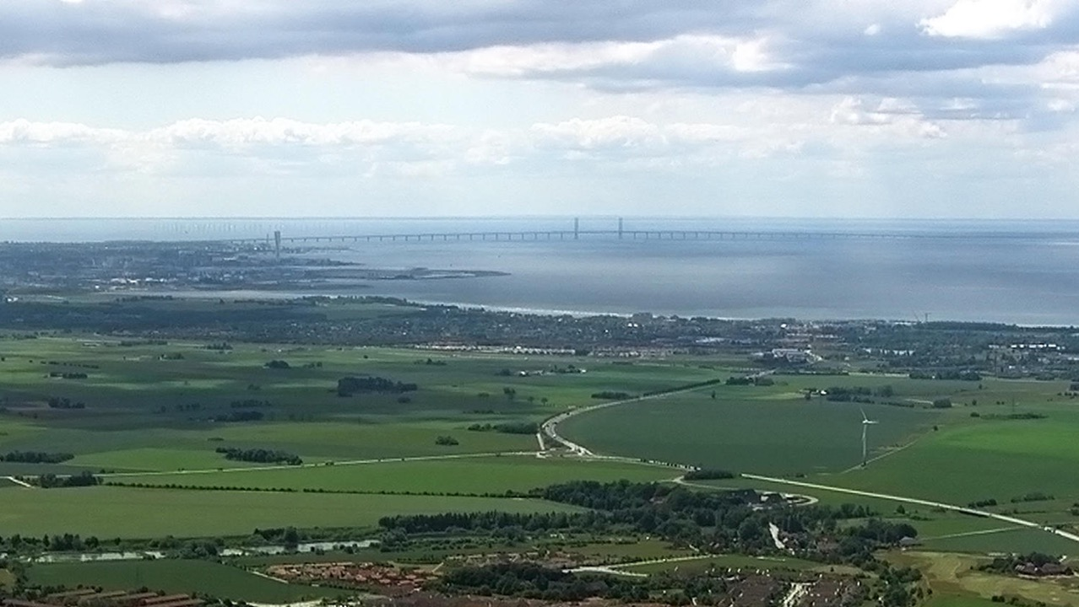
Backup slides

Slide 12

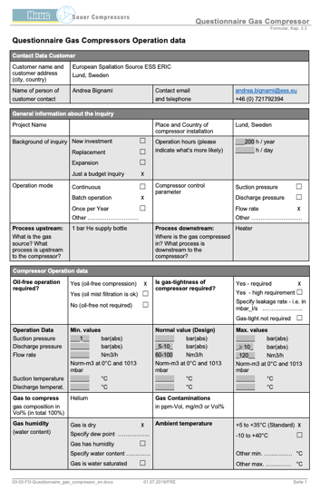
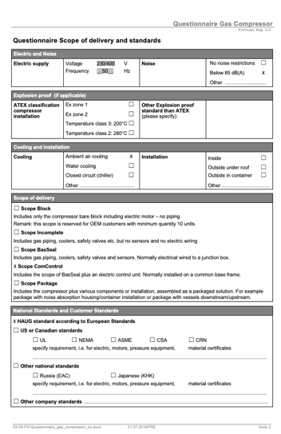
WP2+ status
ETHEL Compressor specs

Slide 13
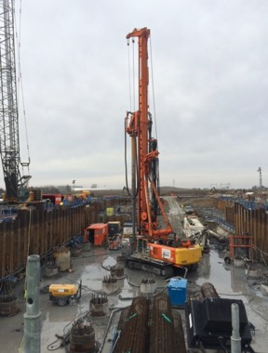
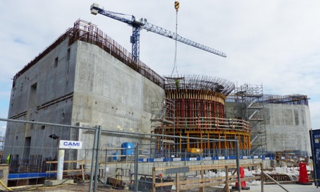
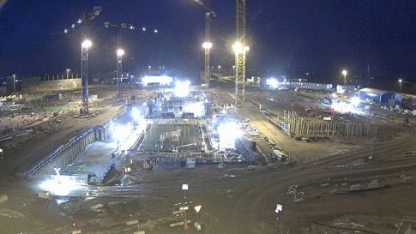
Timeline & Civil Eng
Boris Kildetoft talk – 14:35 on Wed 18 Oct
INDICATIVE TASKS
Legal process, preparation and pre-studies
  Concretize technical design to a level suitable for starting permit process
  Swedish environmental code process
Conceptual design of civil structures and geology
  Desk Pre-study and planning
  Geological investigation on site drilling and radar
  Bedrock investigation with drilling and deformation analysis
Site planning and local issues
  Contracts or agreements for land
  Architectural competition or parallel assignments
  Building permit
  Estimated time aspect 4-10 years
  Estimated time aspect 2-4 years
  Estimated time aspect 2 years

