Slide 2
ESSnuSB+ costing WP2 – Engineering and Infrastructure
PRESENTED BY Dawid Patrzalek

Slide 3
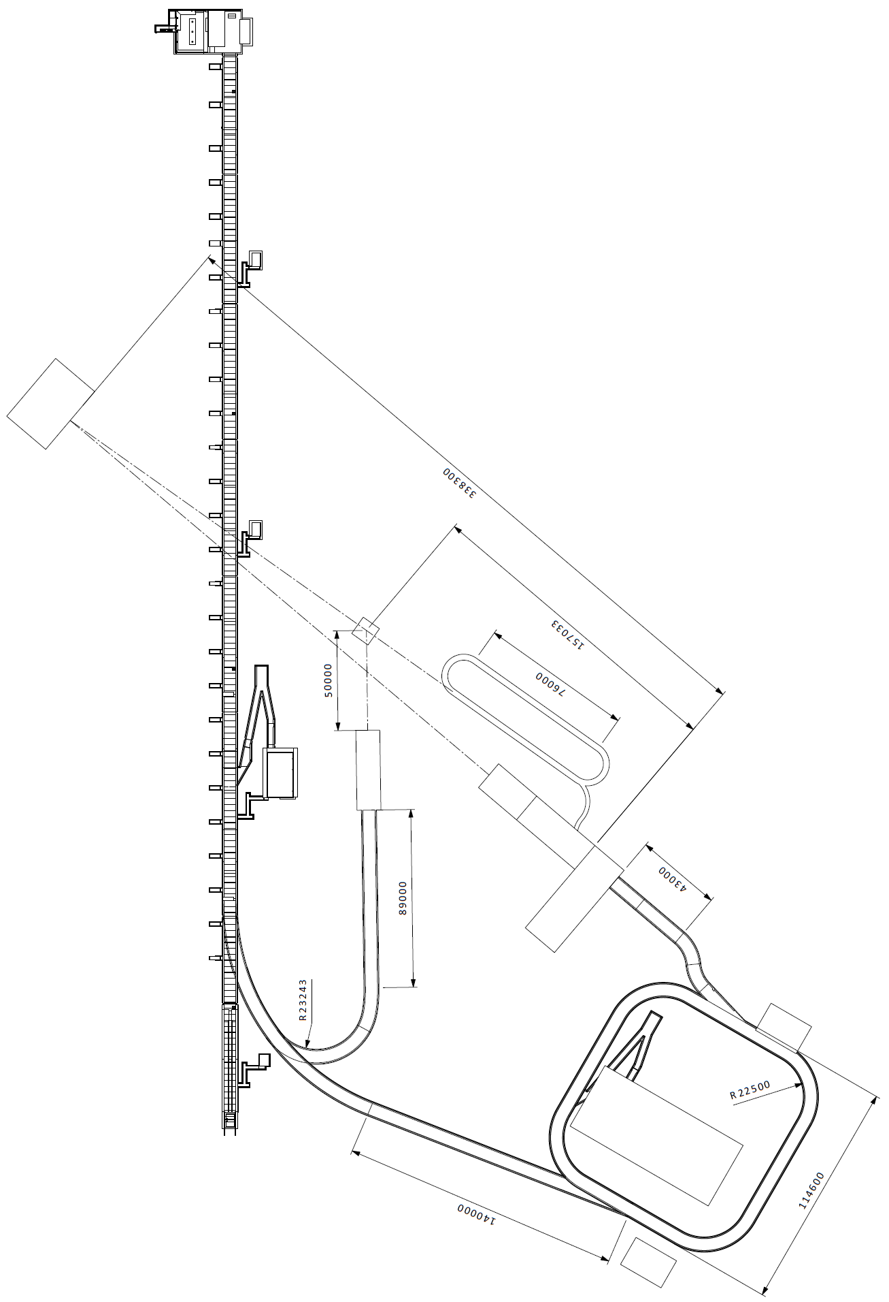
Program’s stages
I. ESSnuSB+ Low Energy Monitored Neutrino Beam (Low Power!)
Accumulator not requested
Specific Target Station with instrumented decay tunnel
Rough integration to the the design at the moment
Proton LINAC, 2.0 GeV and 14 Hz (parasitic operation?)
< 1 MW
II. ESSnuSB+ Low Energy nuSTORM (1.25 MW)
Accumulator requested
Beam Switchyard (assembled but not fully used)
Hadronic collector based on one Horn
Room for Power Supply Units
Morgue and Hot cell
H- LINAC, 2.5 GeV and 28 Hz
ESS Linac Power
Extraction System
+
Racetrack Ring
+
50 m Decay Tunnel
1.25 MW
III. ESSnuSB Target Station (5 MW)
Accumulator requested
Beam Switchyard fully operational
Hadronic collector based on Four Horn
Room for Power Supply Units
Morgue and Hot cell
5 MW

Slide 4
Costing estimation delivered
2023 Annual Meeting homework
WP# | Field | Stage I | Stage II | Stage III
WP1 | Management | N/A | N/A | N/A
WP2 | Engineering and Infrastructure | X | X | X
WP3 | Target Station and Pion Extraction | N/A | X | X
WP4+ | Low Energy nuSTORM | X | X | N/A
WP5 | Detectors and Physics Reach | X | X | X
WP6 | Low Energy Monitored Neutrino Beam | X | N/A | N/A
X – costing delivered
X – costing delivered, but must be updated
X – costing not delivered

Slide 5
Costing estimation
Stage 1
ESSnuSB+ Low Energy Monitored Neutrino Beam (Low Power!)
Accumulator not requested
Specific Target Station with instrumented decay tunnel
Rough integration to the design at the moment
Proton LINAC, 2.0 GeV and 14 Hz (parasitic operation)
Corresponds to ~15% of the total cost of ESSnuSB+

Slide 6
Costing estimation
Stage 2
ESSnuSB+ Low Energy nuSTORM (1.25 MW)
Accumulator requested
Beam Switchyard (assembled but not fully used)
Hadronic collector based on one Horn
Room for Power Supply Units
Morgue and Hot cell
H- LINAC, 2.5 GeV and 28 Hz
Extraction System
Racetrack Ring
Corresponds to ~45% of the total cost of ESSnuSB+
Notes:
Hyper K cost of around 600 MEUR (½ detector size and ½ depth)
Phase I of LBNF/DUNE cost of around 4.5 BEUR

Slide 7
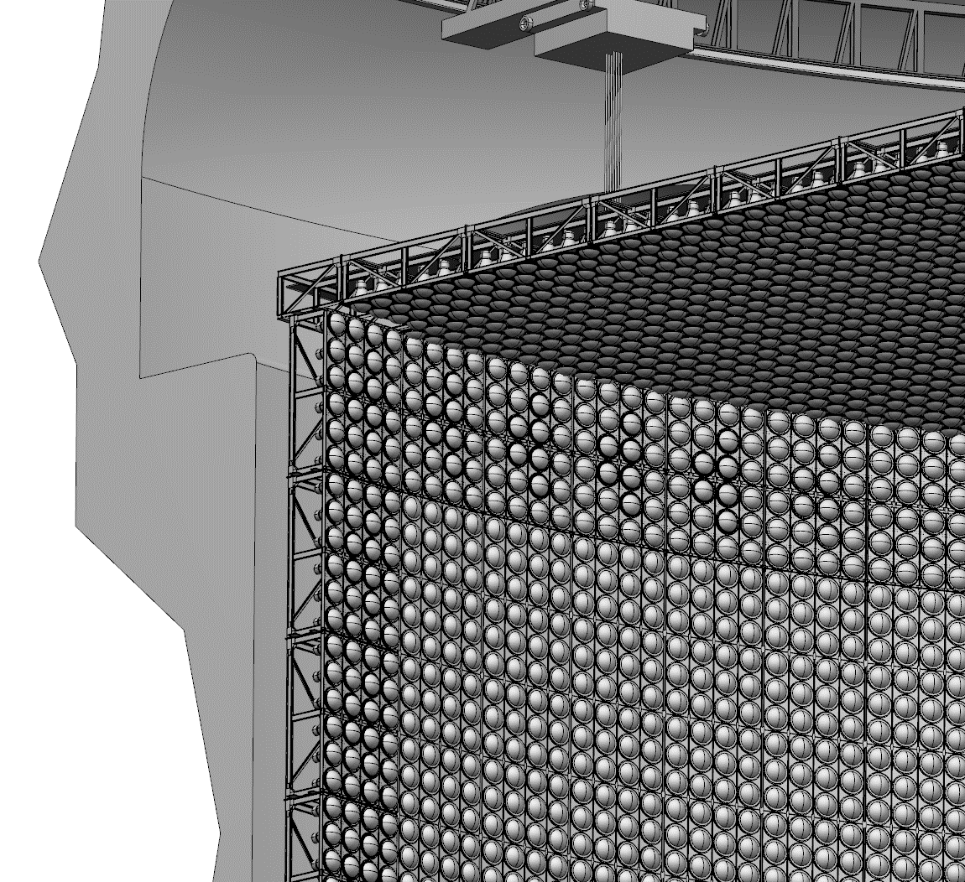
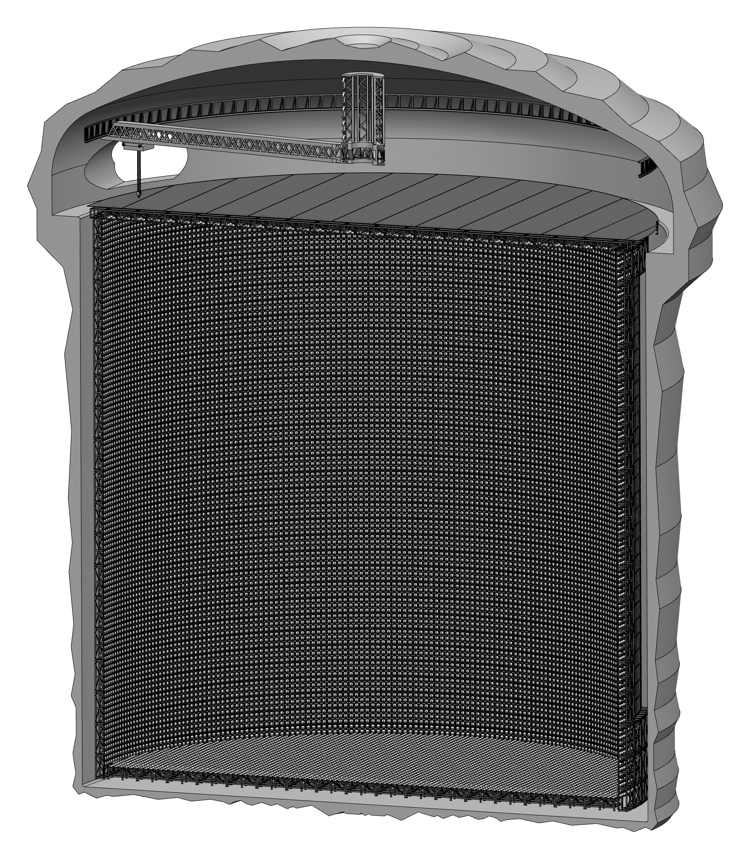
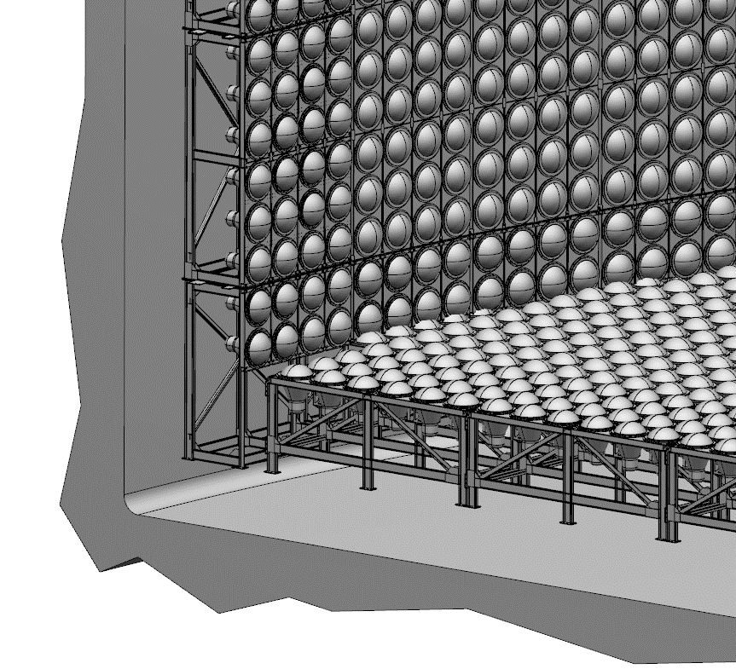
Costing estimation
Stage 3
ESSnuSB Target Station (5 MW)
Accumulator requested
Beam Switchyard fully operational
Hadronic collector based on Four Horn
Room for Power Supply Units
Morgue and Hot cell
Corresponds to ~40% of the total cost of ESSnuSB+

Slide 8
Costing estimation
WPs homework
Every Work Package coordinator shall continue to:
Identify major cost drivers
Review configurations for:
Stage I
Stage II (only upgrade cost from stage I)
Stage III (only upgrade cost from stage II)
Optimize major cost drivers and decide on the scope
Deliver level-4 details Product Breakdown Structure (PBS) with cost estimation

Slide 9
How to provide input
PBS spreadsheet
WP coordinators shall:
Open delivered spreadsheet file
Review Product Breakdown Structure (PBS):
Add necessary entries
Strike through unnecessary entries
Define Stage I baseline in the spreadsheet and state estimated cost
Continue with stage II and stage III upgrades
Indicate all changes in the CMD column:
n(ew), m(odified) or d(eleted) line.
Not to be included in the estimation:
R&D
Pre-Operations
Existing salaries
Existing administration
Existing utilities
Logistics
Etc.

Slide 10
Costing estimation
Further steps to be taken
Once level 4 PBS with cost estimation from each WP is delivered, a more precise cost can be estimated.
Later, the following steps can be taken to validate the costing:
A project planning reviewer can be involved in the project
An External Review for Recommendations can be needed

