Slide 1

ESS-Bilbao contribution to ESSnuSB+ WP4,
2024 Annual Meeting
J. L. Muñoz
ESS-Bilbao
24.Sept.2024

Slide 2
Contents
Review of challenges for increasing duty cycle from 5%→10, 15%
  Comment on other projects with similar challenges
  ESS-RFQ quick review
ESS-Bilbao contribution
  Input sources
  Steady state FEM study
  Transient model study
  Some comments on power coupler
Next activities

Slide 3
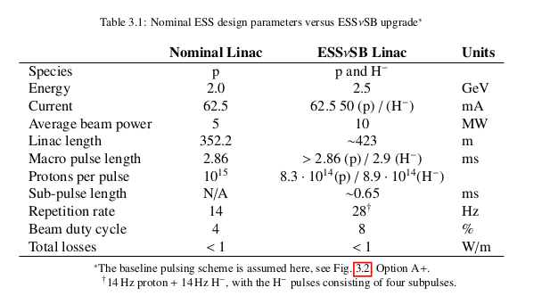
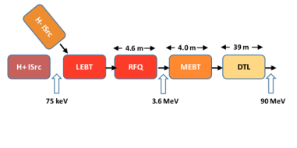
ESSnuSB+ WP4 ESS-Bilbao
For its use with ESSnuSB, the ESS Linac would need to operate at double power, to share the linac between neutron and neutrino production
Beam pulses of H⁻ will be interleaved with the p pulses for the generation of the neutrino superbeam
RFQ is a critical part in this power upgrade
An study of the challenges and possible strategies is the aim of ESS-Bilbao contribution to the project.

Slide 4
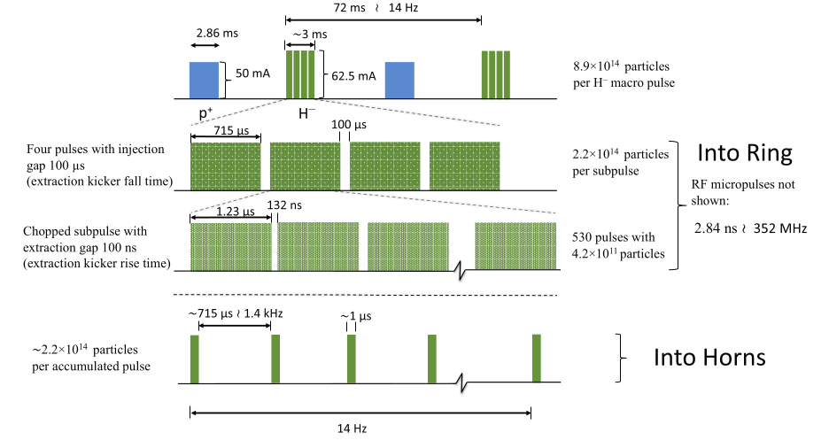
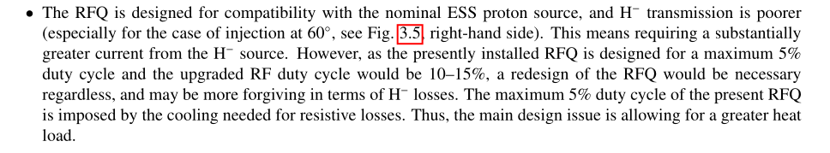
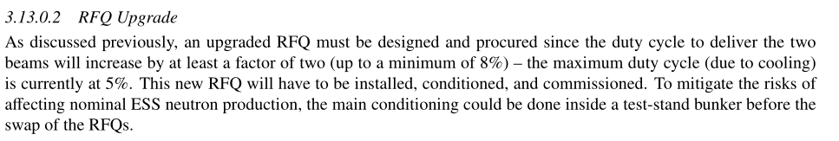
ESSnuSB+ WP4 ESS-Bilbao

Slide 5

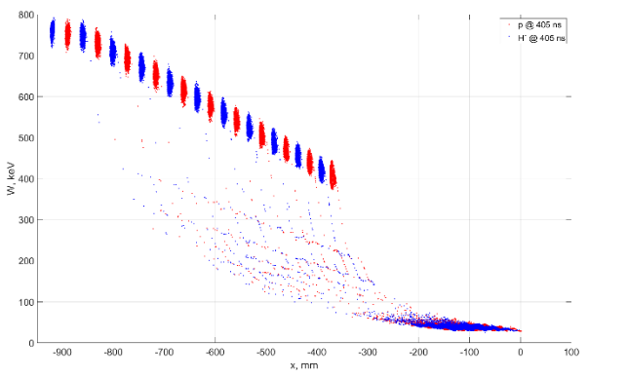
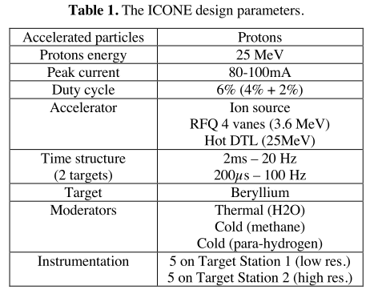

ESSnuSB+ WP4 ESS-Bilbao
Similar circumstances are found in other projects (LA, ICONE):
  LANSCE (Los Alamos Neutron Science Center)
  ICONE (CEA-CNRS)
doi: 10.18429/JACoW-LINAC2024-MOAA007 (and many more references in LINAC24 + IPAC24)
https://doi.org/10.1051/epjconf/202328602001
Plan to use ESS-RFQ design, up to 6% duty (9% in other refs.)

Slide 6
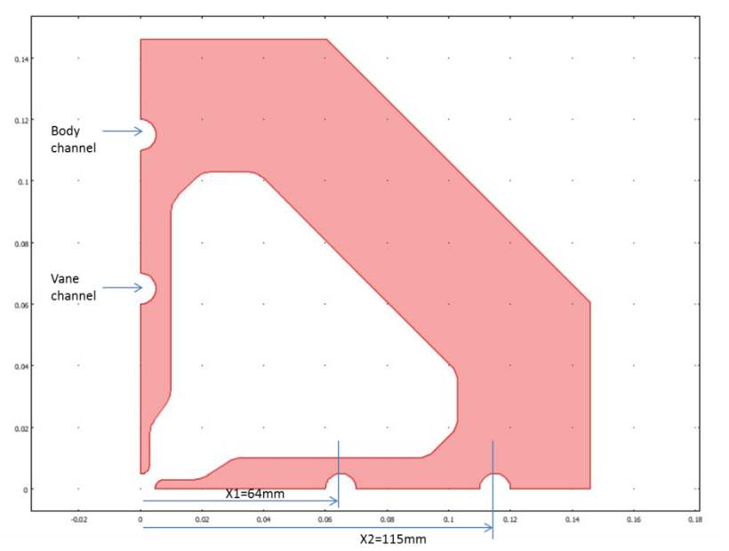
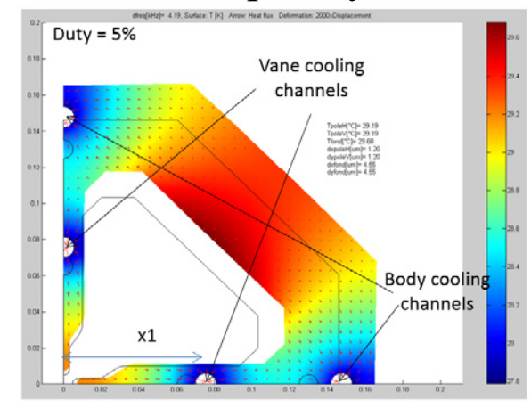
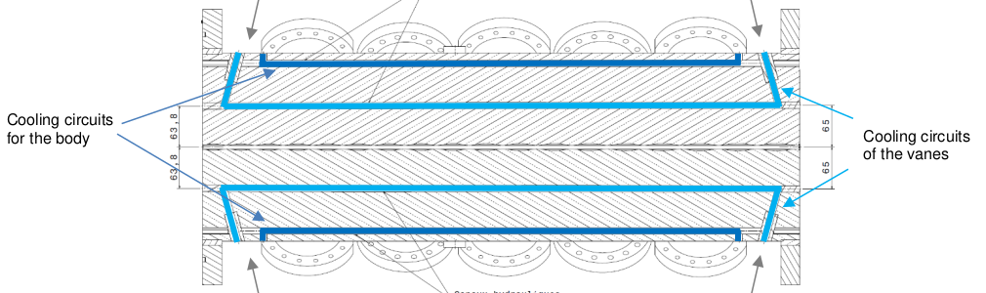
ESS RFQ quick review
Necessity for new RFQ cooling for high power:
  Every RF cavity needs some means to change frequency (tuning), because conditions when cold and empty (no RF power, no beam) are different from conditions during operation.
  Normally this is done by mechanical means (plunger tuners, cavity deformation,…), but in an RFQ this is generally not possible
  Plunger tuners compensate fabrication/expected thermal deviations
  Tuning is done by controlling cooling water or using LLRF

Slide 7
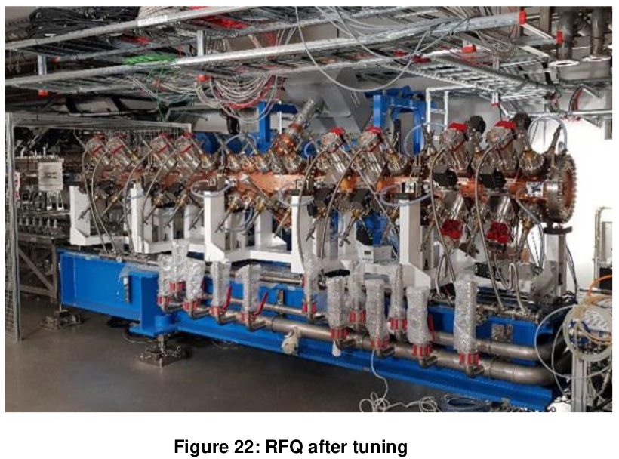
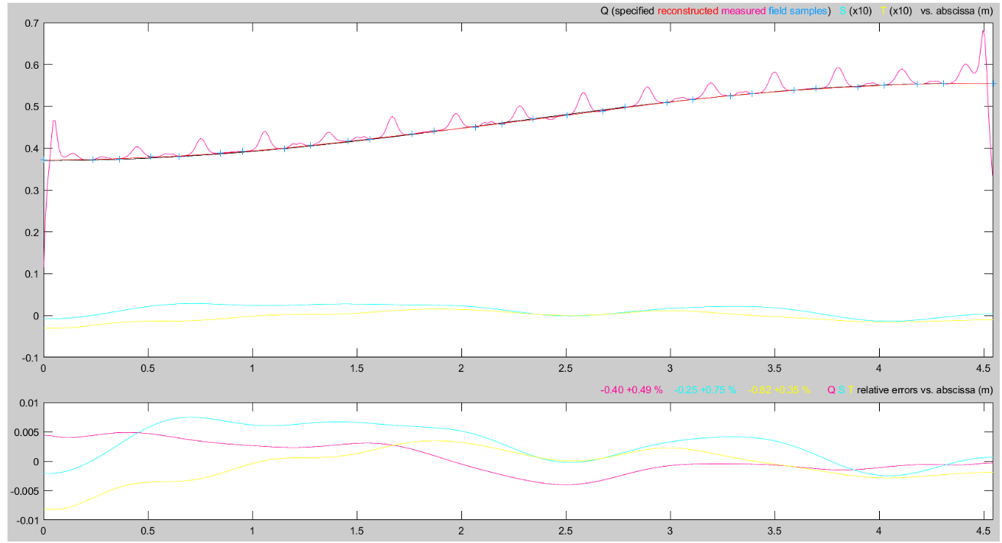
ESS RFQ quick review
Plunger tuners are used to compensate deviations in order to get the desired electric field profile along the beam axis. Tuners also set the adequate frequency in the cavity.
  This is a static tuning of the RFQ. Once all the tuners penetration are frozen, they do not change during operation. (A change in a tuner will change ω, but also Ez(z))
Dynamic tuning (frequency deviations correction during operation) is done by controlling the cooling water temperature or LLRF frequency tracking.

Slide 8
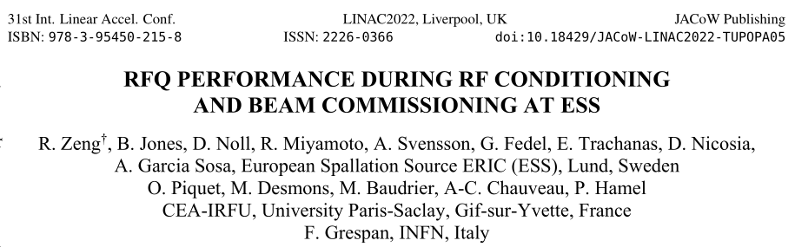
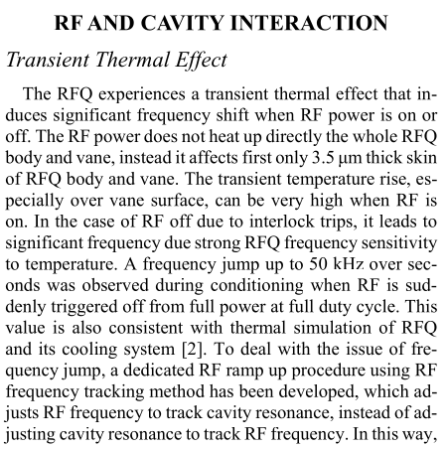
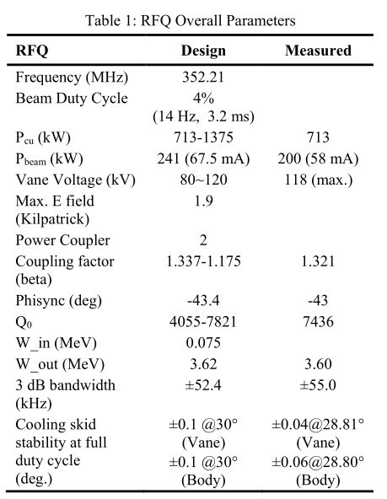
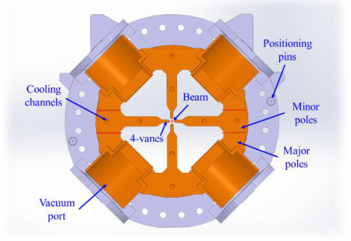
ESS RFQ quick review
ESS-RFQ is designed for operation at 5%

Slide 9
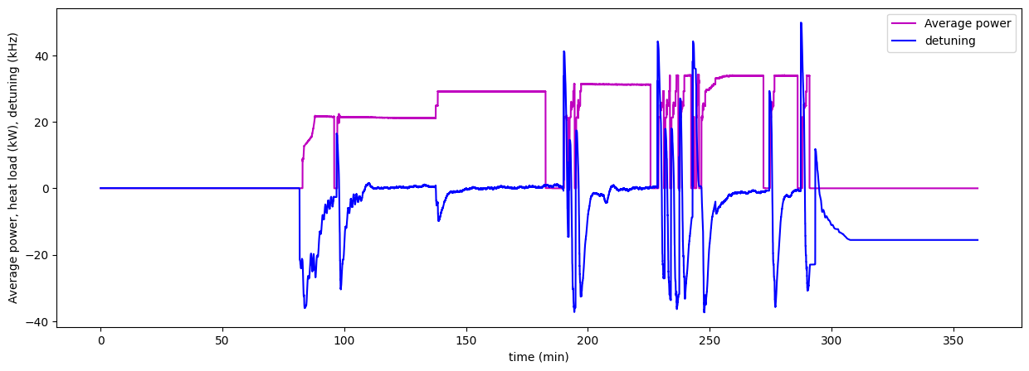
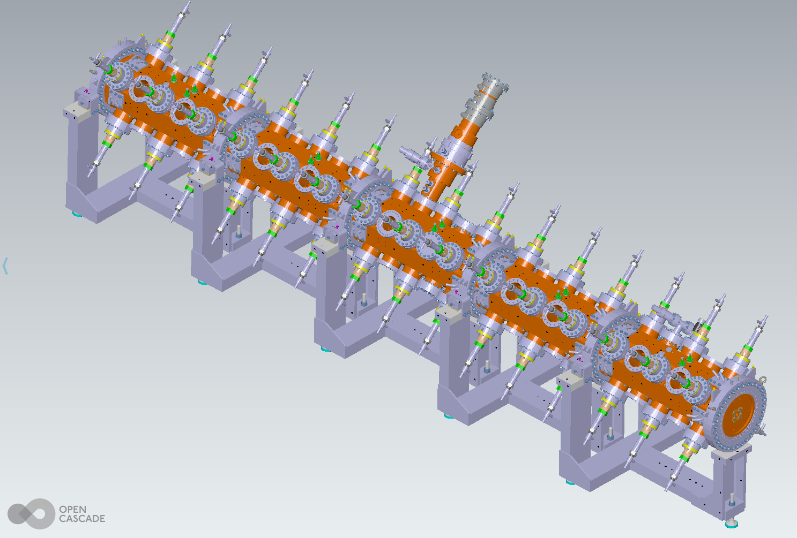
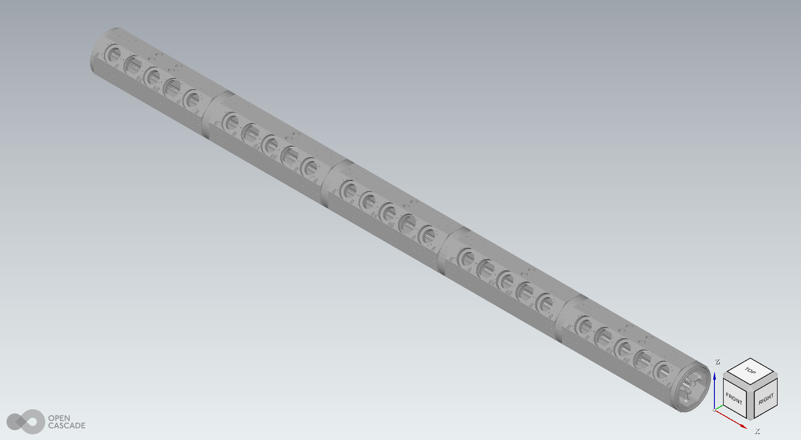
ESSnuSB+ WP4 ESS-Bilbao
Up to now, for ESS-Bilbao contribution to ESSnuSB+ WP4, we have considered three different inputs for RFQ optimization:
  ESS+CEA_IRFU RFQ publications/reports
    (i.e. “HIGH POWER RF CONDITIONING OF THE ESS RFQ”, O. Piquet et al., doi:10.18429/JACoW-IPAC2022-TUPOTK003, and references therein)
  ESS operational data (conditioning, operation)
  CAD models of ESS-RFQ (not directly suitable for simulations)

Slide 10
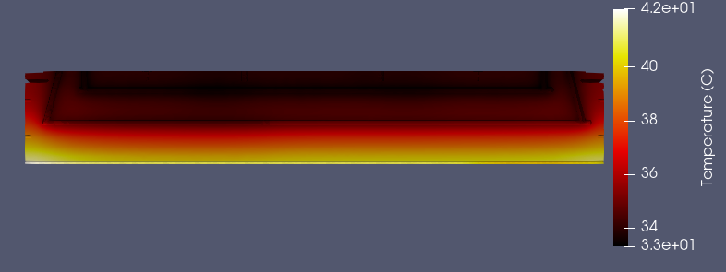
RFQ steady state
Steady state operation:
  In the change from a no-power state to a nominal-power state, the cavity will deform and there will be a frequency change (detuning)
  The power on detuning will depend on the cooling channels positions and diameters (fixed for the built RFQ), water flows, water temperature, etc.
  To compensate the detuning (in the steady state) only is needed to take into account the required vane channel water temperature change (LLRF will follow the cavity frequency)
Simulations done with ELCANO.
Body and vane channels water temperature = 28 degC
Channels HTC: 7000 W/m2K
Convection, radiation to 22 degC ambient

Slide 11
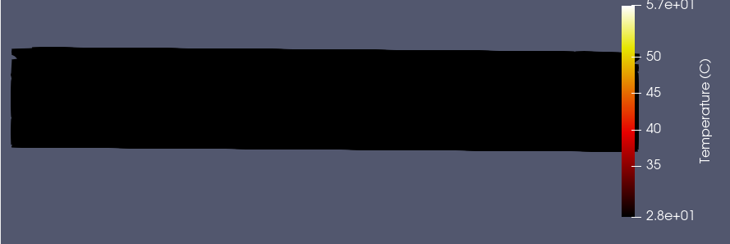
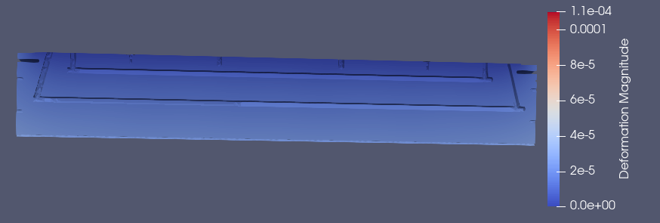
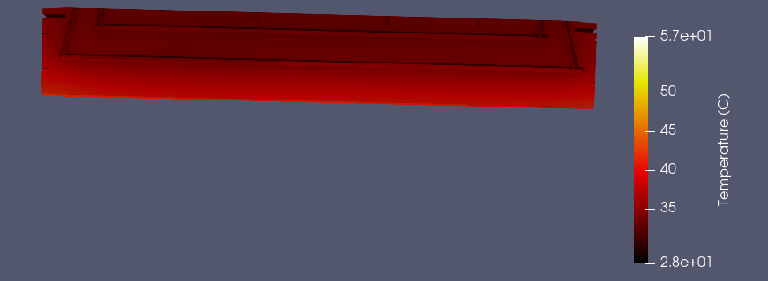
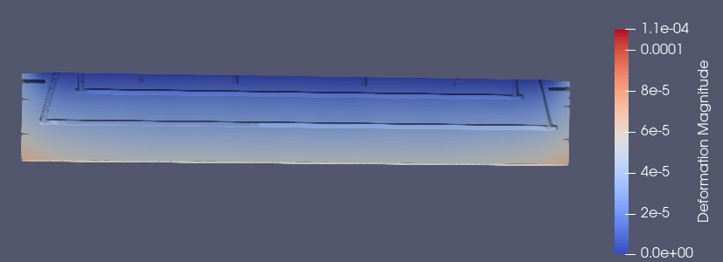
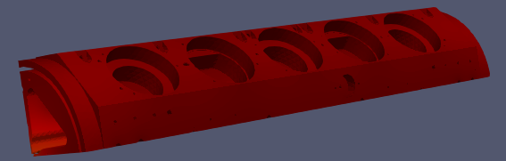
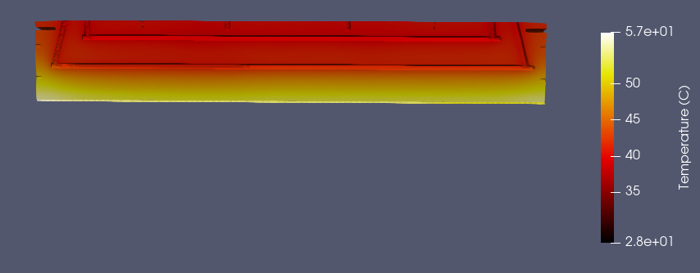
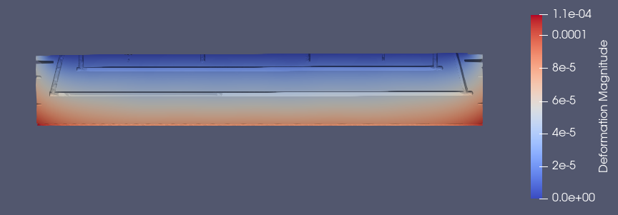
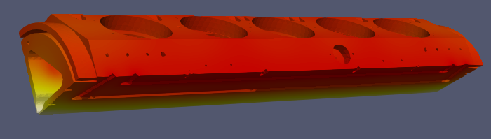
RFQ steady state
Steady state operation:
duty 0
Duty 0.05
Duty 0.10

Slide 12
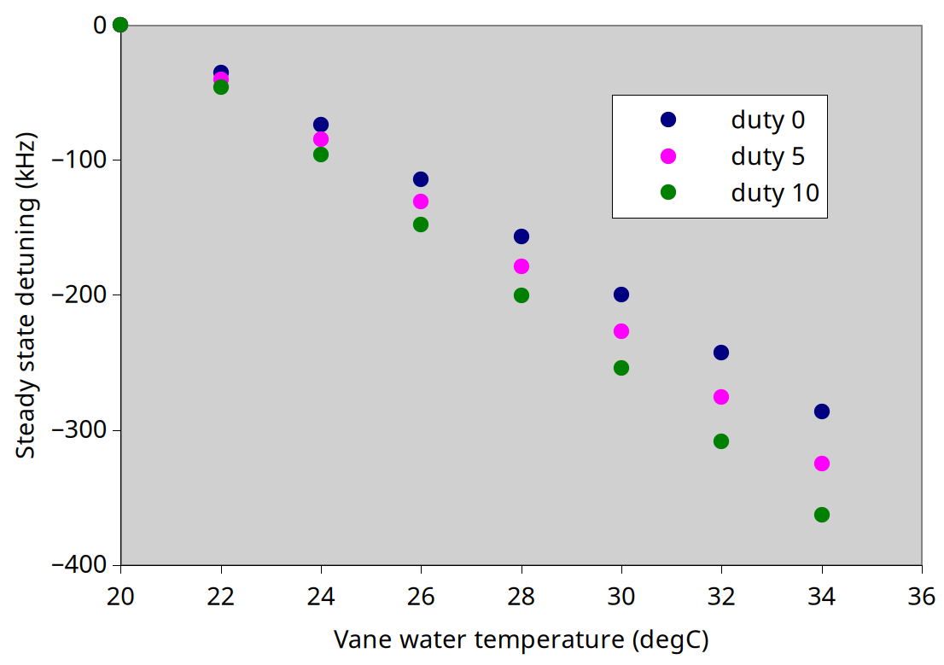
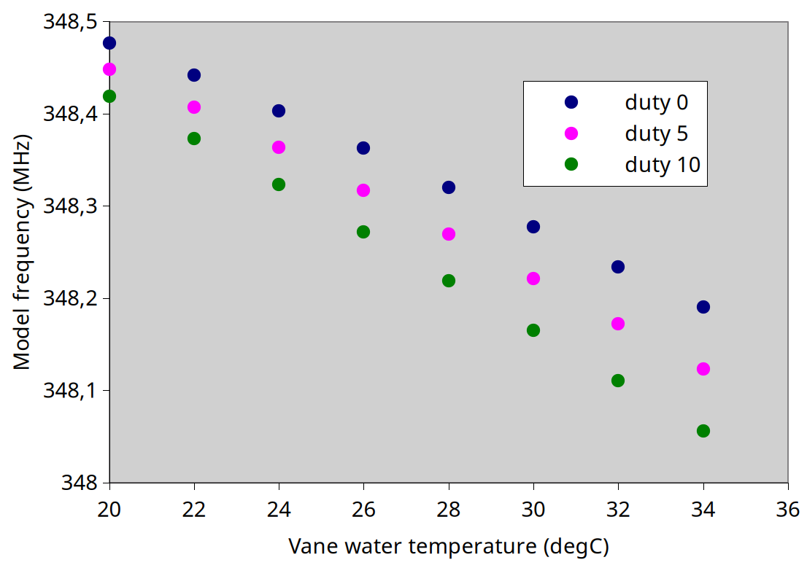
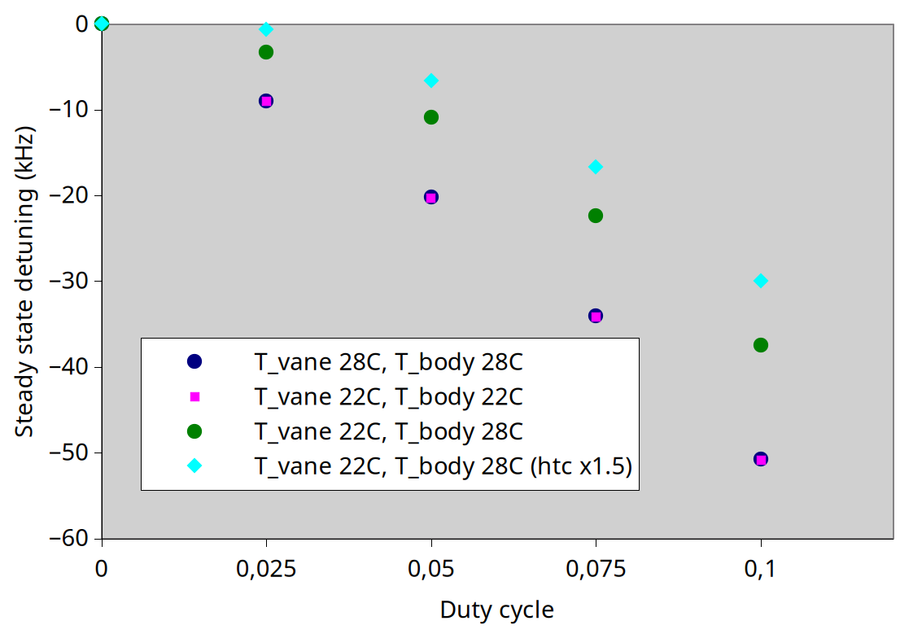
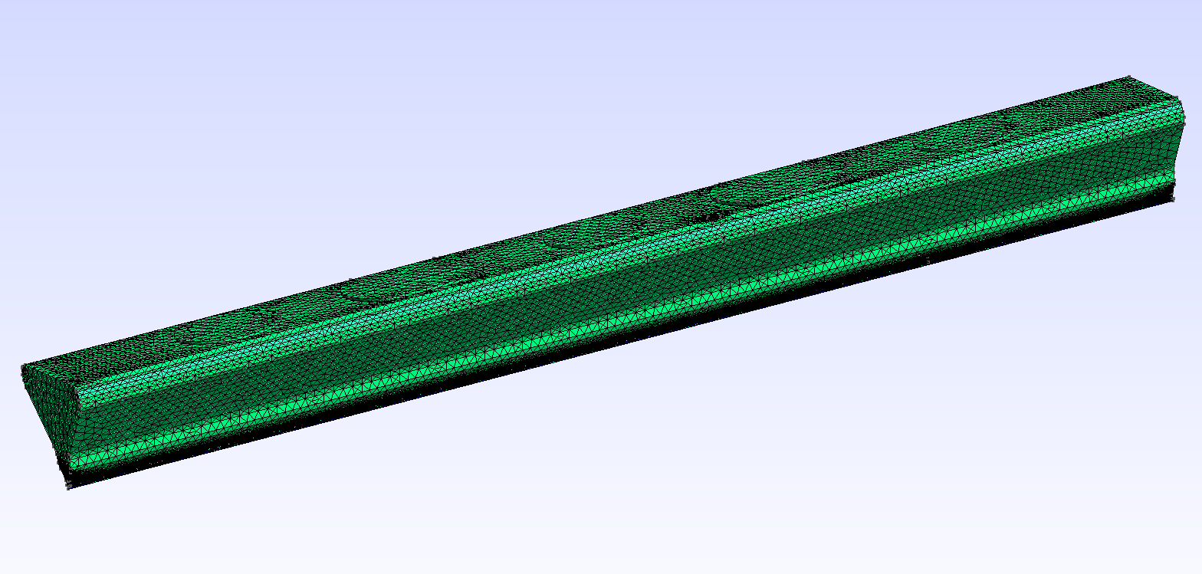
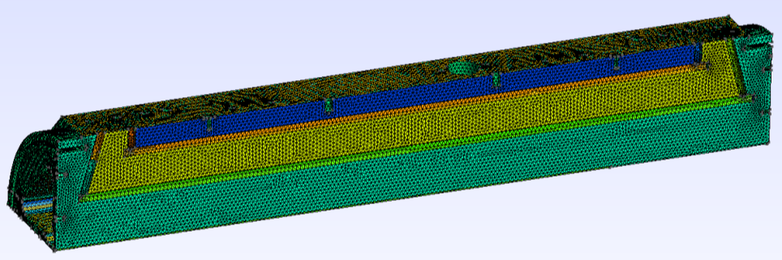
RFQ steady state
Steady state operation:
(Simple FEM model, no tuners, 1 quarter, 1 segment (#2))

Slide 13
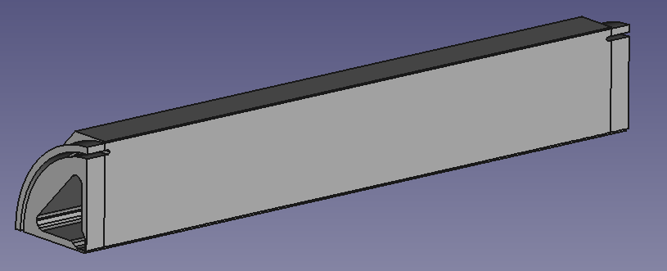
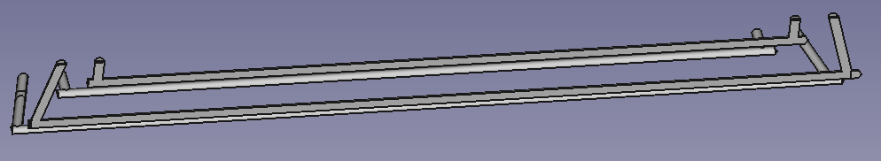
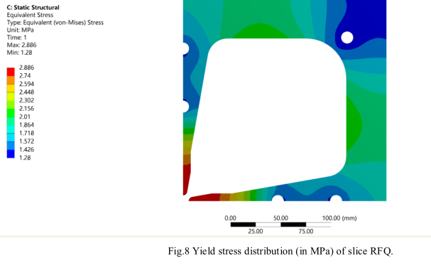
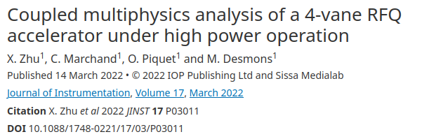
RFQ steady state
Steady state operation:
Tasks to consider for next weeks/months:
- Minimize frequency sensitivity to power change by modifying cooling channels position, diameter, as well as water flow.
Additional body channel
(Study done for other similar design RFQs:)

Slide 14
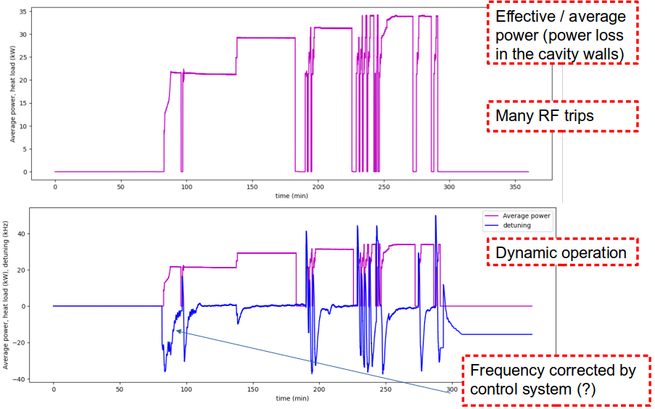
RFQ dynamic operation
RFQ data at max. 5% duty cycle, conditioning phase

Slide 15
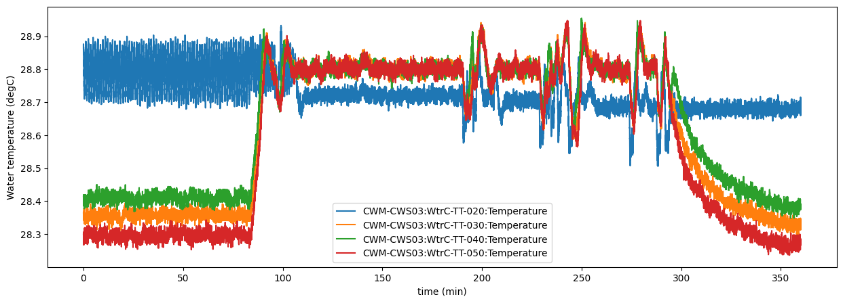
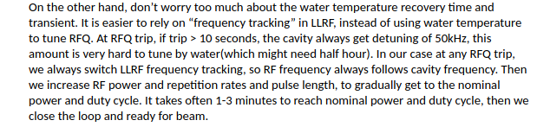
RFQ dynamic operation
RFQ data at max. 5% duty cycle, conditioning phase
Water temperature constant
Control carried out by LLRF frequency tracking

Slide 16

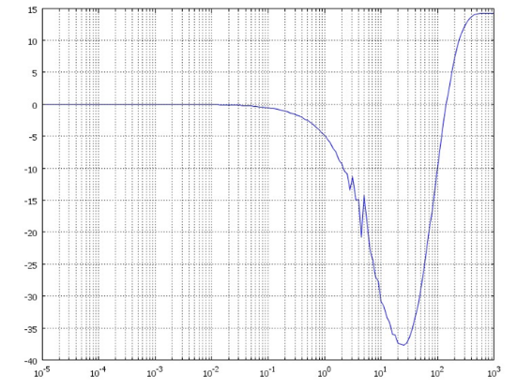





ESS RFQ stability (power on)
Ideal data: transient variation measured in RFQ after a power breakdown, not available due to frequency tracking by LLRF. Using literature/simulated data.
Initial state
Operation level
Peff = 0
T_water = T_0 ºC
fcav = fRF-Δf
Increase power
Peff = duty x Ppp
T_water = 28 ºC
fcav = fRF
Unit step
response function
Laplace transform
Transfer function

Slide 17
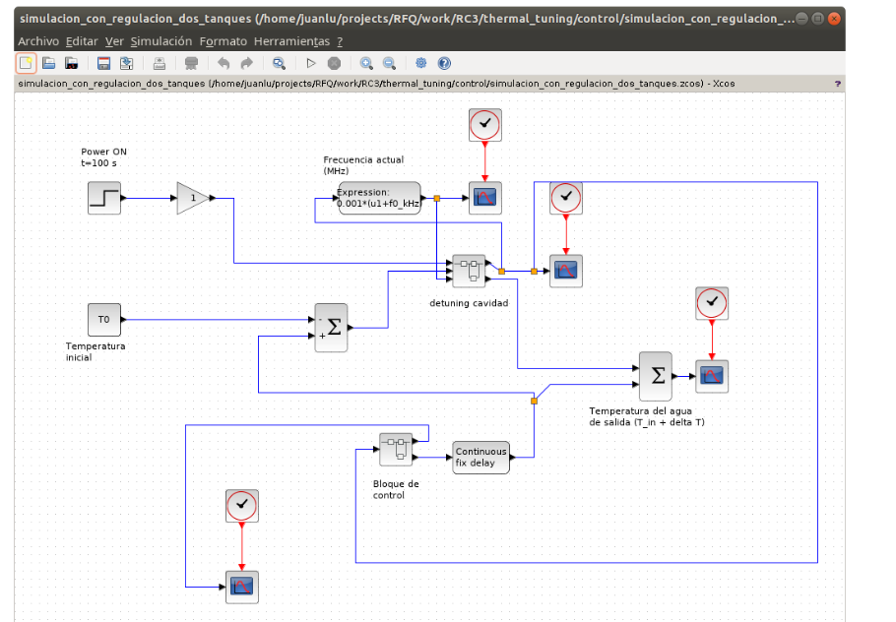
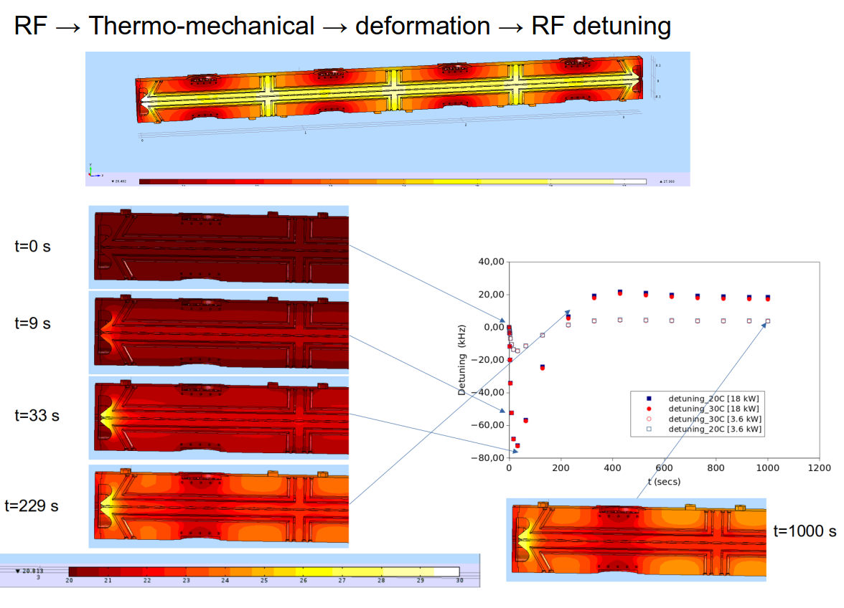
ESS RFQ stability (power on)
From no power to operational level power
From dynamic transfer-function models, the action on the active cooling channel that compensates the dynamic changes can be computed.
This is how RFQ dynamic tuning operates.
(ESS-Bilbao RFQ as example)

Slide 18
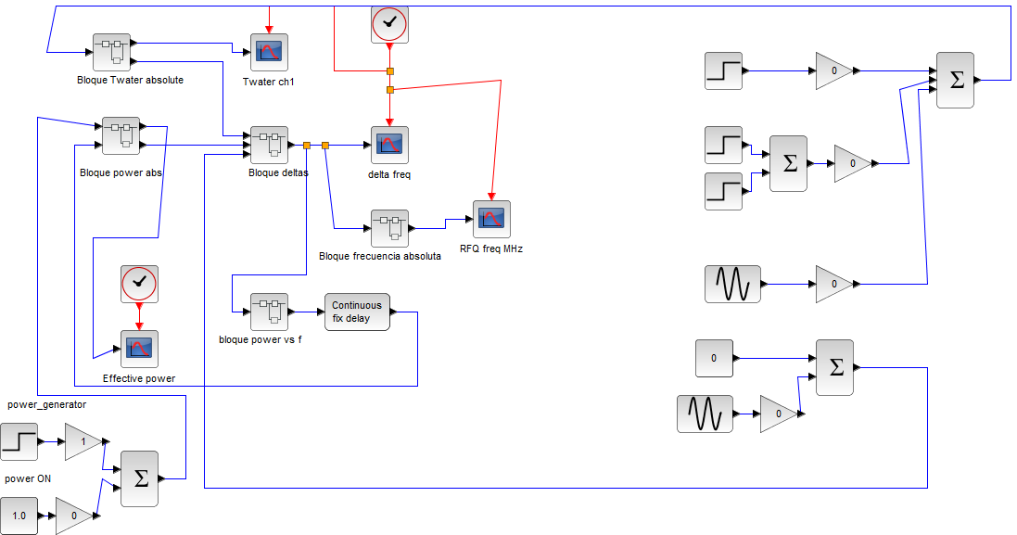
ESS RFQ stability (power on)
Control model (Scilab)

Slide 19
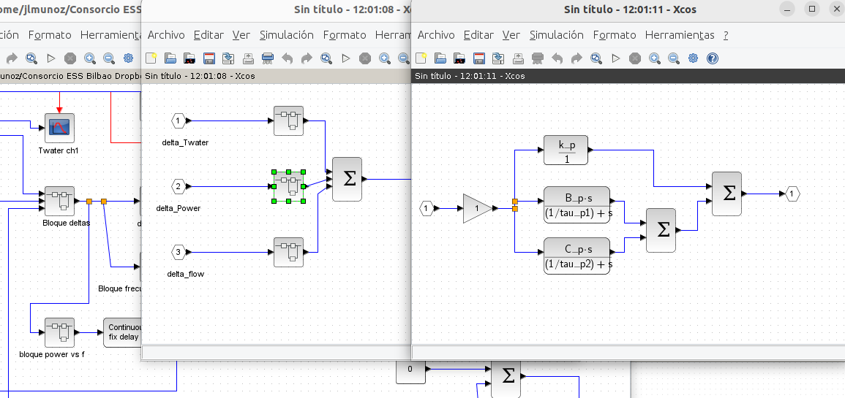
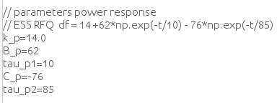
ESS RFQ stability (power on)
Control model (Scilab)

Slide 20
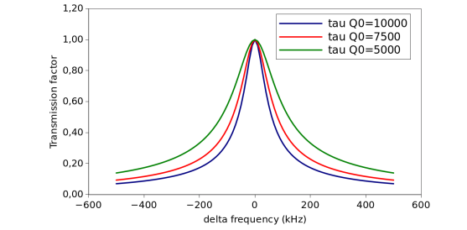
ESS RFQ stability (power on)
Control model (Scilab)
When cavity frequency is different from RF input frequency, part of the RF wave reflects and less power transmit into the RFQ.
With LLRF frequency tracking this does not happen, but it is not possible during beam operation.

Slide 21
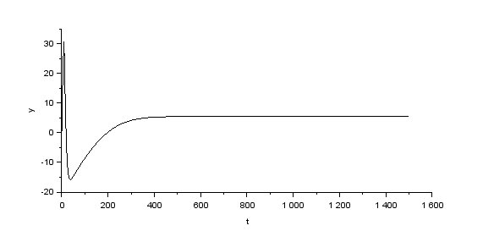
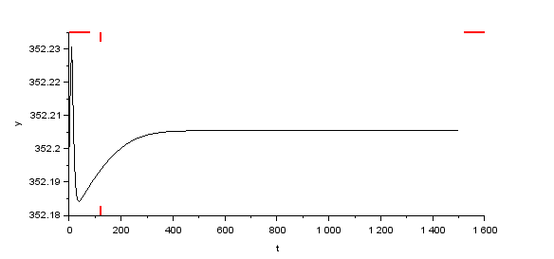
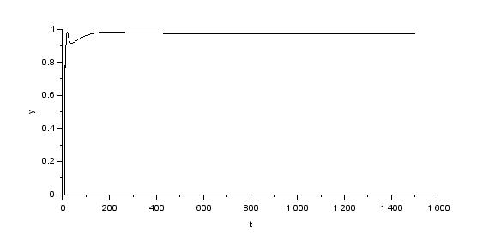
ESS RFQ stability (power on)
Simple case, power ON to nominal power, stability analysis
Control model (Scilab) → Results for duty = 5%, power ON
delta_f (kHz) vs time (seconds)
RFQ frequency vs time (seconds)
Effective power (wrt 5%) vs time (seconds)

Slide 22



ESS RFQ stability (power on)
Simple case, power ON to nominal power, stability analysis
Control model (Scilab) → Results for duty = 7.5%, power ON
delta_f (kHz) vs time (seconds)
RFQ frequency vs time (seconds)
Effective power (wrt 5%) vs time (seconds)

Slide 23



ESS RFQ stability (power on)
Simple case, power ON to nominal power, stability analysis
Control model (Scilab) → Results for duty = 10%, power ON (unstable)
delta_f (kHz) vs time (seconds)
RFQ frequency vs time (seconds)
Effective power (rel. To 5%) vs time (seconds)

Slide 24




ESS RFQ stability (power on)
Tweaking transient response...:
(steady
state delta)
It is possible to stabilize the transient behavior by changing channels geometry, position and/or water flows.

Slide 25



ESS RFQ power couplers
Tested and conditioned at 1 MW peak power and 3.6 ms for the pulse width at the repletion rate of 14 Hz (duty cycle 5%).
Couplers should be studied at higher effective power.

Slide 26
Task for next months...
RFQ (segment 2 model) simulations to minimize static deformations
Working to get a full-lenght model of the RFQ
Transient FEM simulations (RF → TH-Mech → Deformation → RF), to optimize channels geometry
Analyze the work for other projects (LANCSE, ICONE)
Power couplers thermo-mechanical study

Slide 27


Task for next months...
Additionally, ESS-Bilbao RFQ is finally built, so some tests could be done to validate simulations models...
RFQ fabrication finished. Alignment, low power RF tests done. Vead pull in progress

Slide 28
ESSnuSB+ WP4 ESS-Bilbao
Thank you for your attention!

