Slide 1
ESSnuSB+ Pion Transfer Line
Max Topp-Mugglestone
max.emil.topp-mugglestone@cern.ch
Ilias Efthymiopoulos
ilias.efthymiopoulos@cern.ch

Slide 2
Contents
Introduction
Pion momentum selection
Transfer line design objectives
Transfer line geometry optimisation
Transfer line tracking in Xsuite
Conclusions
Further study

Slide 3
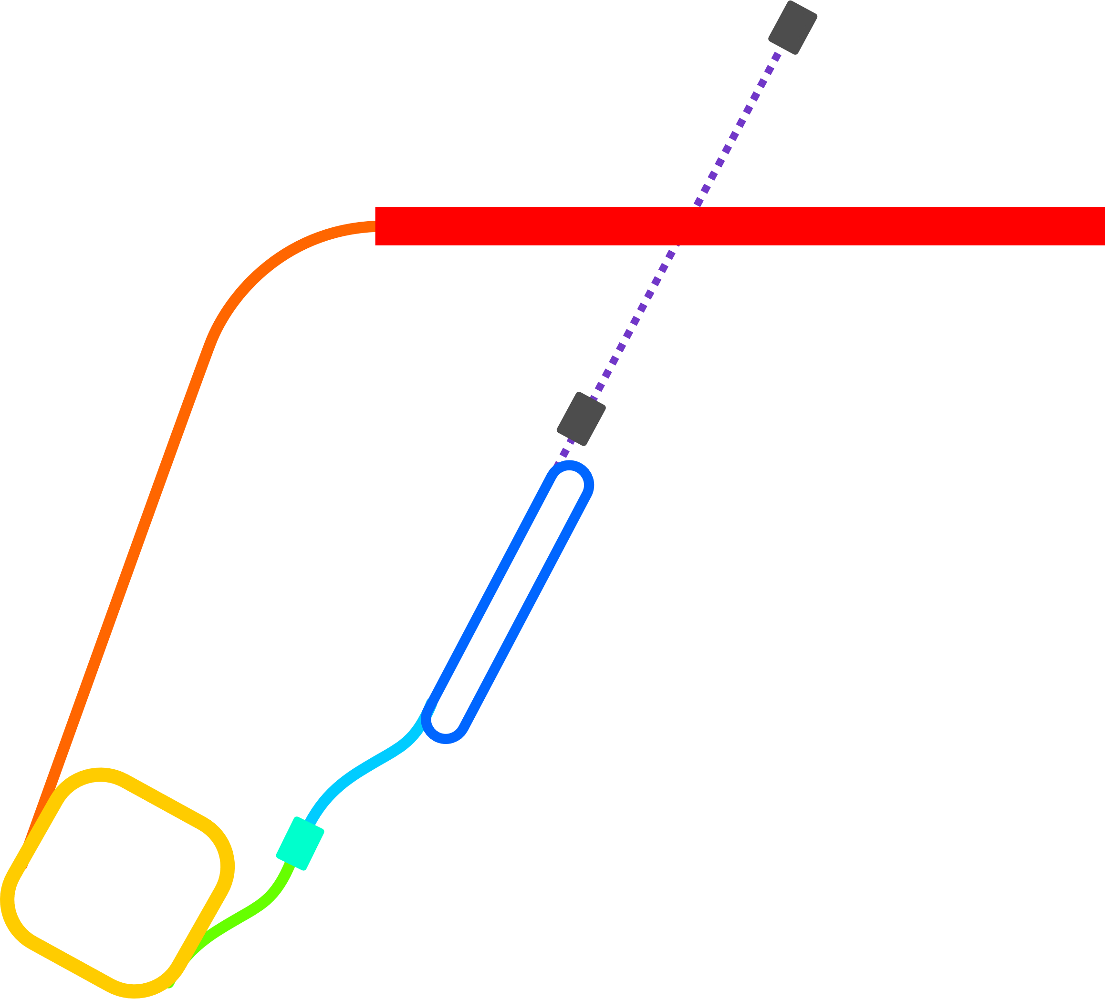
Pion transfer in ESSnuSB+
Protons from ESS Linac arrive after compression in the accumulator ring, at target station where they collide with a target to make a shower of secondaries.
Secondaries (including pions) are focused forwards using a magnetic horn.
Pion transfer line transports pions of desired momentum to decay ring
Pions circulating in decay ring decay to muons to produce neutrino beam
Beam parameters
Proton energy | 2.5 | GeV
Pulse intensity | 2.23 10¹⁴ | protons/pulse
Repetition rate | 14 | Hz
Pulse energy | ~90 | kJoules
Beam power | 1.25 | MWatt

Slide 4
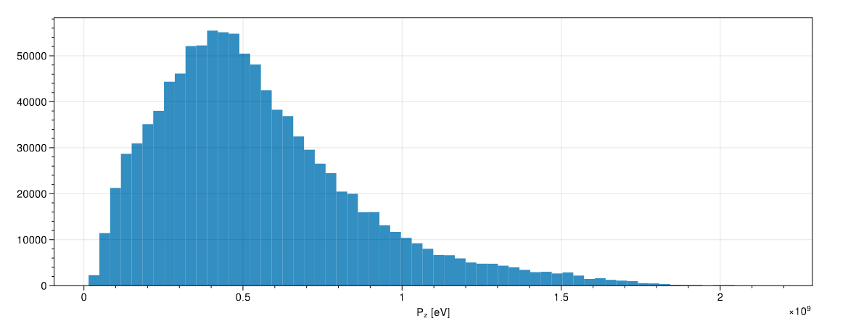
Pion momentum selection
400 MeV muon energy identified as optimum (see next presentation)
What pion momenta should we select from the horn to optimize the muon yield at this energy?
Pions produced from ESSnuSB horn

Slide 5
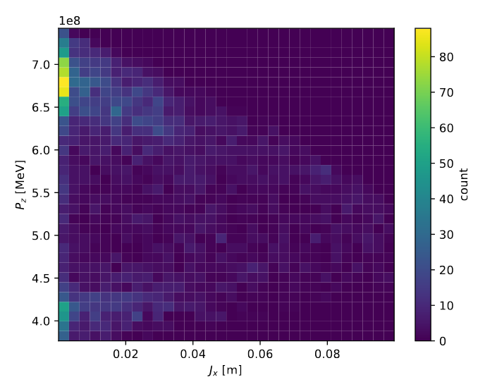
Muon production
10^4 pions in 700 MeV pencil beam
  Uniform momentum distribution of +-10%
Simulate production straight of LEnuSTORM ring and count muons at the end
Low-amplitude muons are found at 670 MeV and around 420 MeV

Slide 6
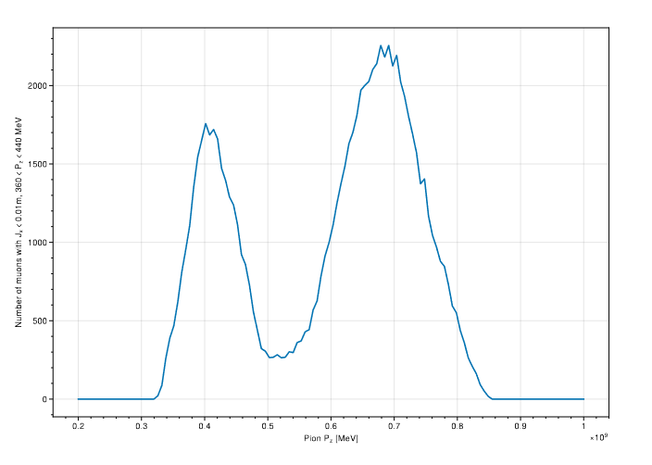
Pion momentum selection
Use FLUKA simulation of target+horn assembly
Select a given target momentum of pions and transport through a transfer line of perfect transverse acceptance and 10% momentum acceptance
Inject surviving pions into production straight, count muons at the end
Low-amplitude muons at 400 MeV ±10%
Pion momentum [MeV]
Optimum pion momentum: ~690 MeV

Slide 7
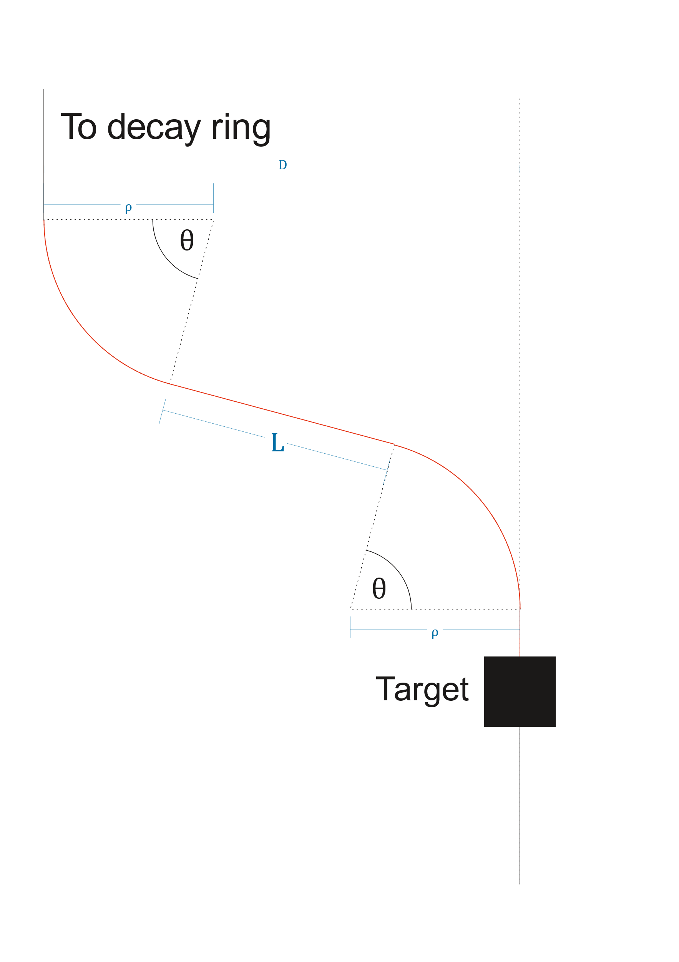
Pion transfer line design criteria
Transport pions from target station to decay ring
  Species and momentum selection
  Large transverse acceptance
  Appropriate momentum acceptance
Target station is MW-class environment
  Lateral separation must be created from target station to decay ring
  Shielding, radiation protection
Pions decay in flight
  Transfer line must be as short as possible
  Note: 700 MeV pions have a mean decay length of ~42m – the LEnuSTORM production straight is already some 75 m (tbc)!
For given bending radius ρ, lateral separation D, shortest possible line geometry can be computed analytically for a specified bending angle θ

Slide 8
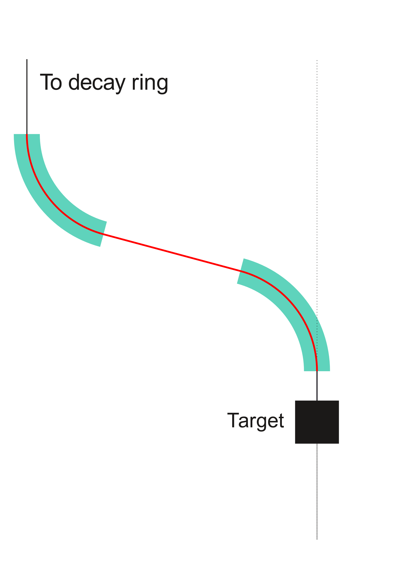
Pion transfer line design
Desired bending achieved with dipoles

Slide 9
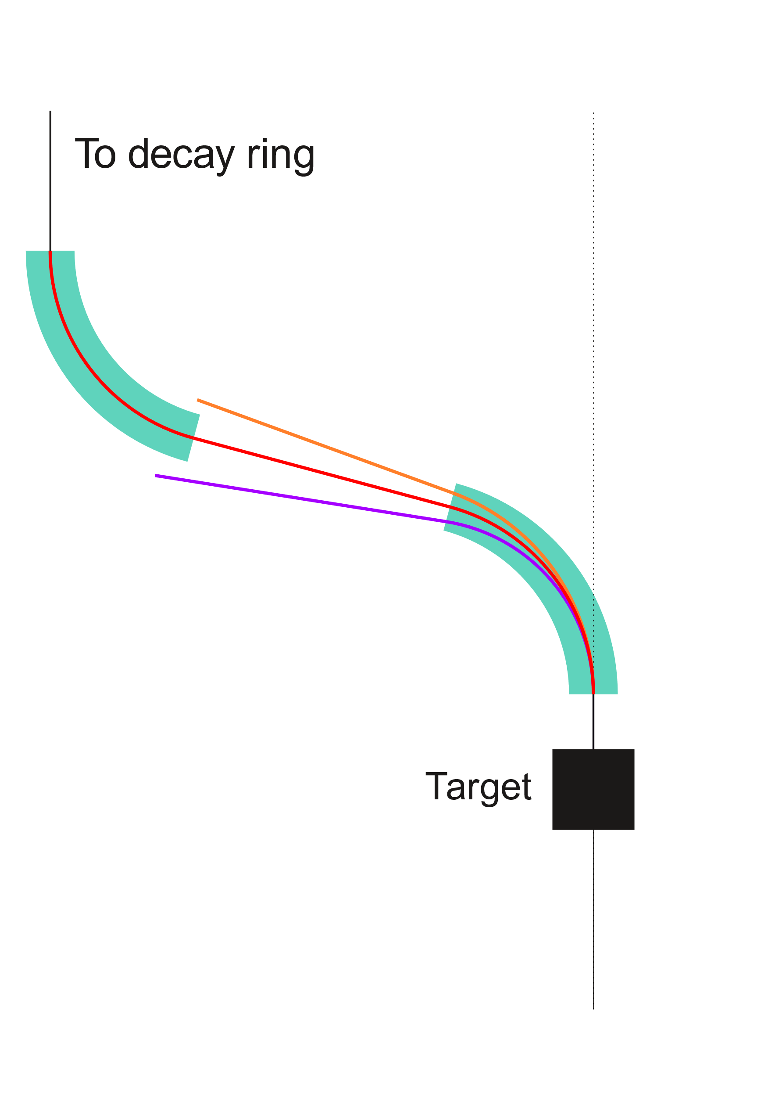
Pion transfer line design
Desired bending achieved with dipoles
  However, momentum spread causes dispersion
  The higher the bending angle, the more dispersion
We require that dispersion at the end of the transfer line is zero (all pion momenta injected into the decay ring on-axis)

Slide 10
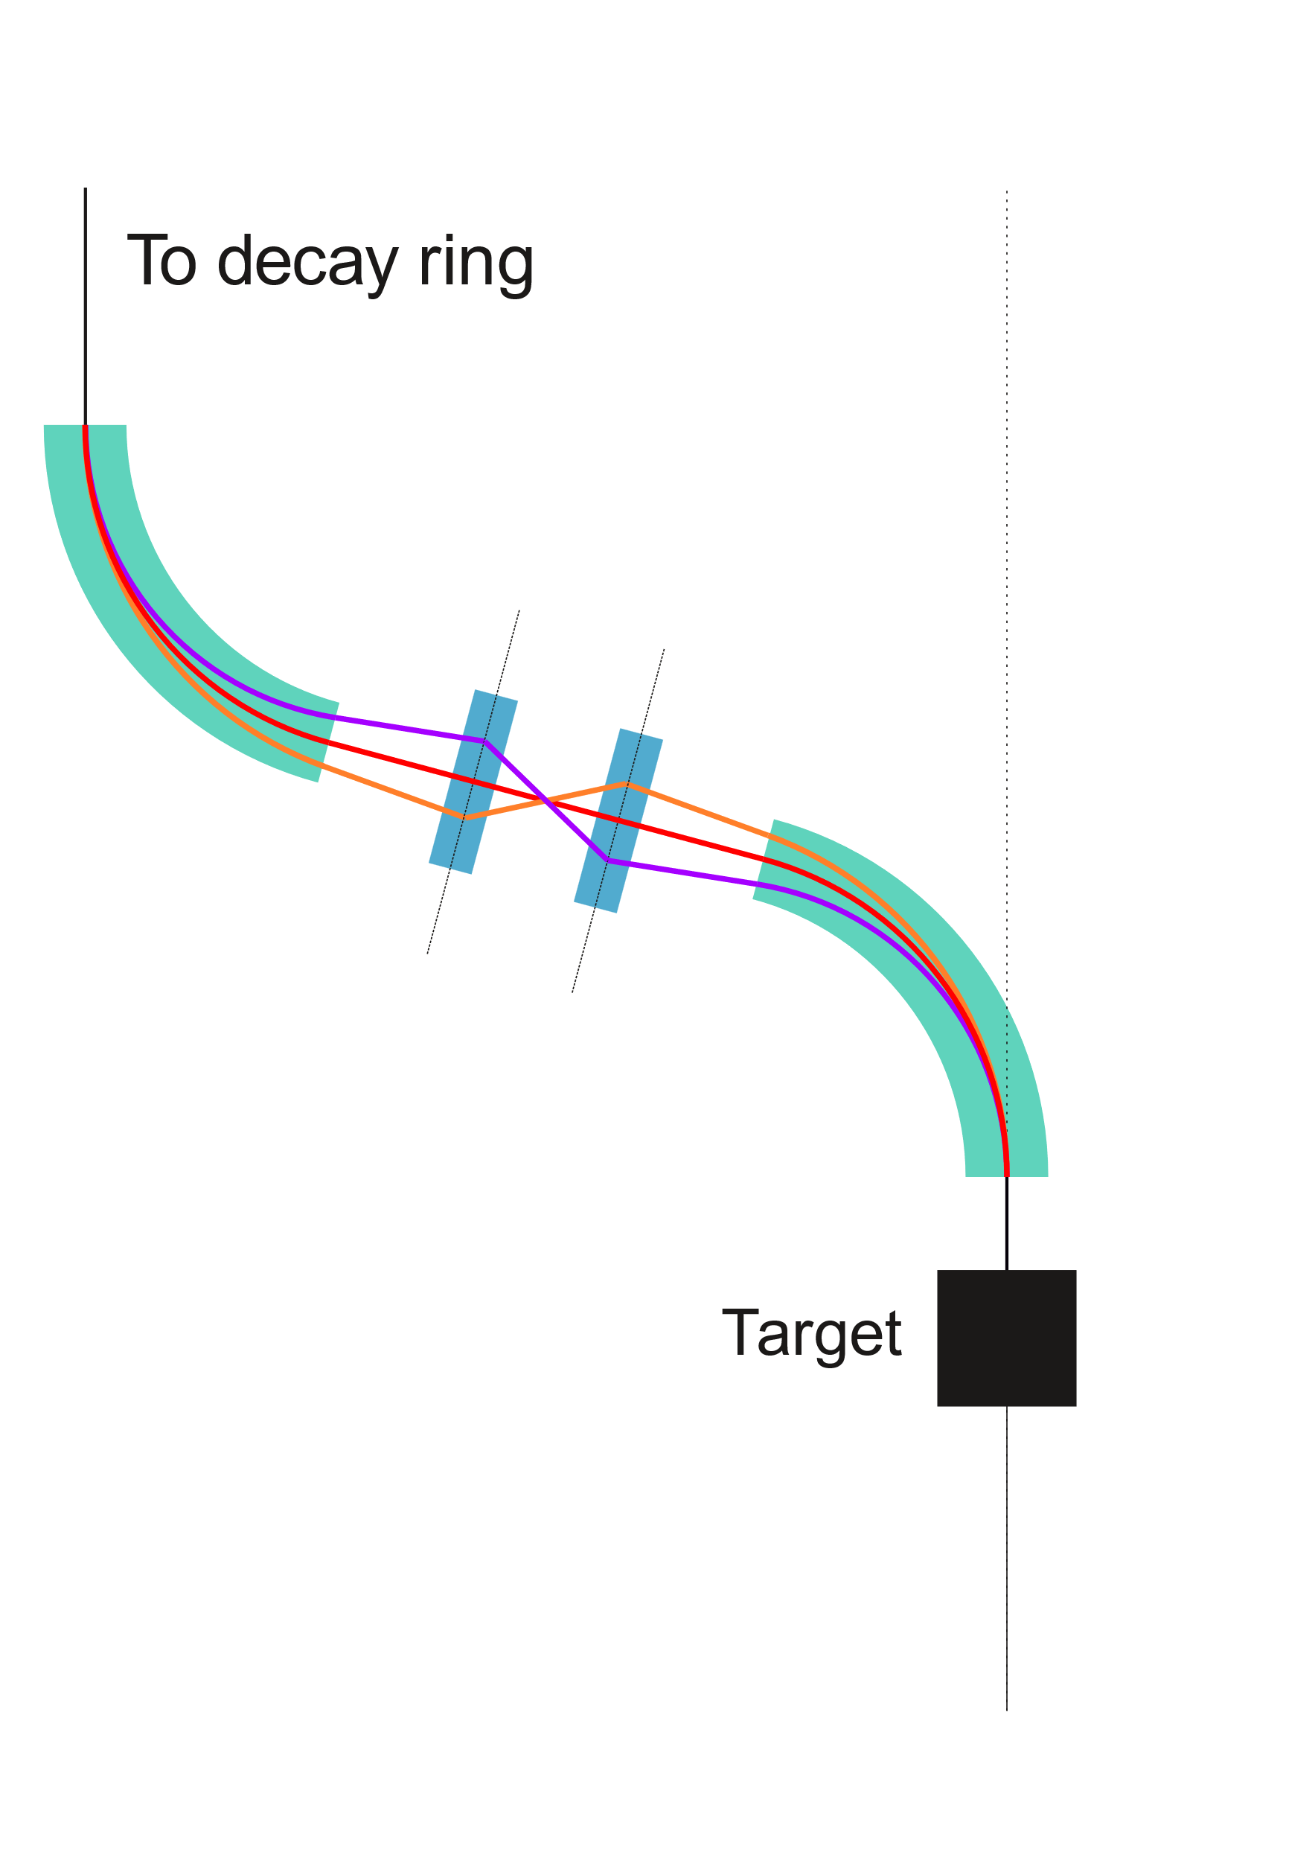
Pion transfer line design – dispersion
Desired bending achieved with dipoles
Horizontally-focusing quadrupoles correct dispersion
  Momentum acceptance of line is determined by
    Quadrupole aperture
    Dipole bending angle
However, horizontally-focusing quads defocus in the vertical plane

Slide 11
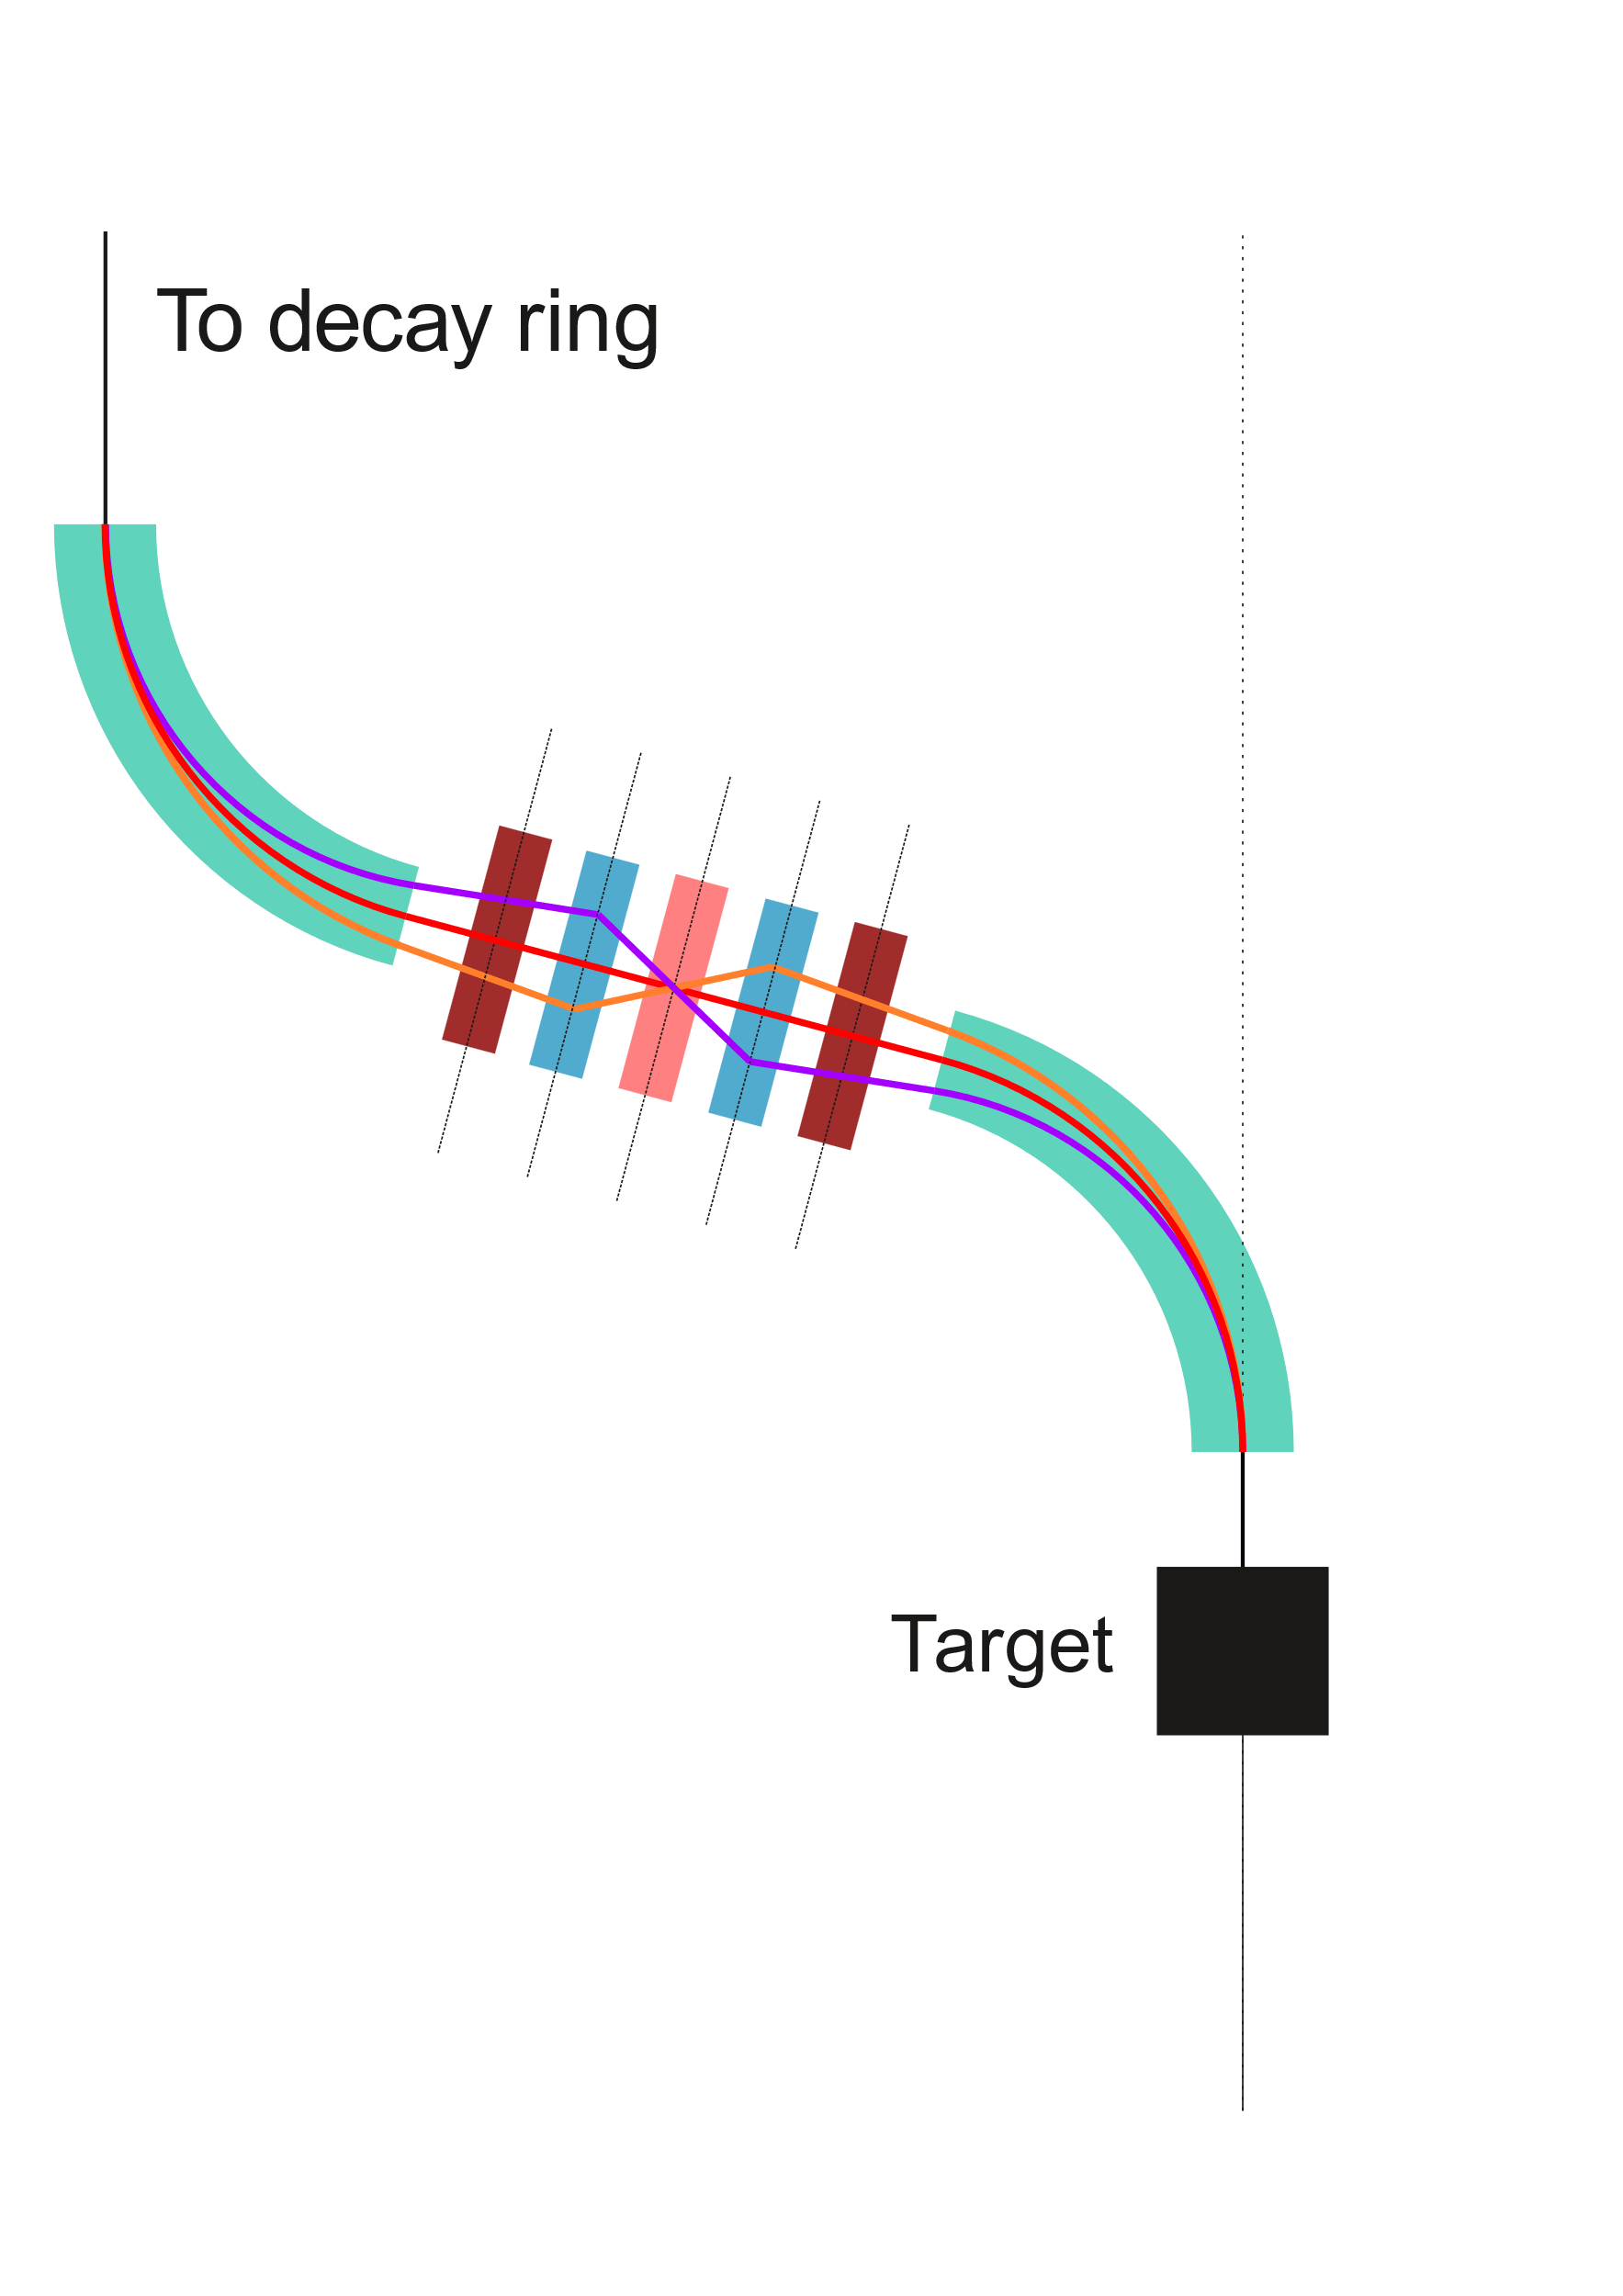
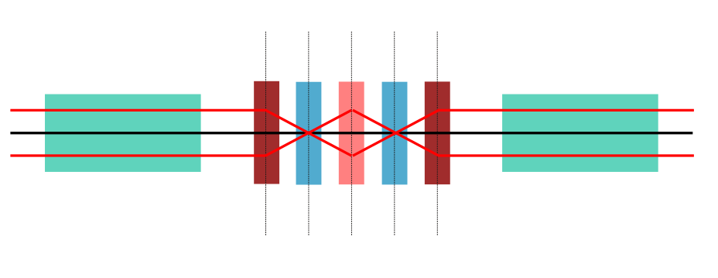
Pion transfer line design – vertical focusing
Desired bending achieved with dipoles
Horizontally-focusing quadrupoles correct dispersion
Vertically-focusing quadrupoles constrain particles in vertical plane
(Projected onto
vertical plane)

Slide 12
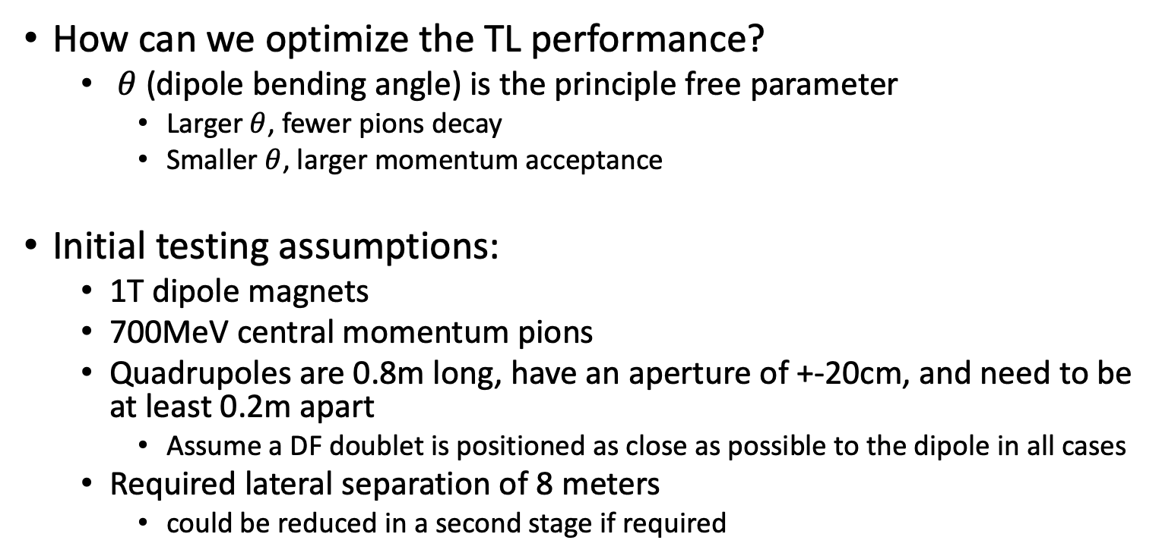
Pion transfer line design – optimisation
How can we optimize the TL performance?
  $θ$ (dipole bending angle) is the principle free parameter
    Larger $θ$, fewer pions decay
    Smaller $θ$, larger momentum acceptance
Initial testing assumptions:
  1T dipole magnets
  700MeV central momentum pions
  Quadrupoles are 0.8m long, have an aperture of +-20cm, and need to be at least 0.2m apart
    Assume a DF doublet is positioned as close as possible to the dipole in all cases
  Required lateral separation of 8 meters
    could be reduced in a second stage if required

Slide 13
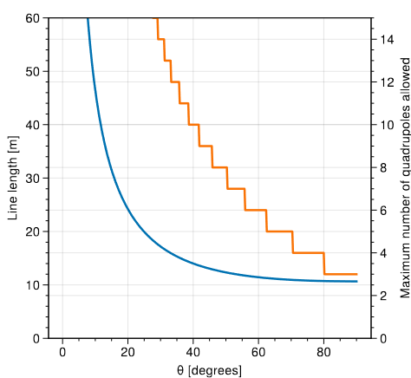
Pion transfer line design – Choice of theta
Theta determines line length
  Fraction of decaying pions
  Available space for magnets
(Assuming 0.8m magnets with 0.2m empty space required either side)

Slide 14
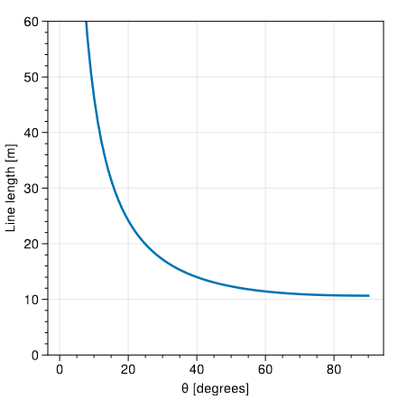
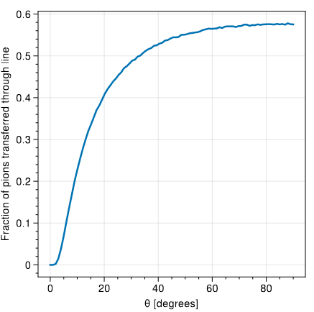
Pion transfer line design – Choice of theta
*(assuming perfect transverse and momentum acceptance – pions are only lost to decays)

Slide 15
Pion transfer line design – Choice of theta
This shows that maximising theta is critical to ensuring maximum pion transmission
Diminishing returns above ~40 degrees
What is the effect on momentum acceptance?

Slide 16
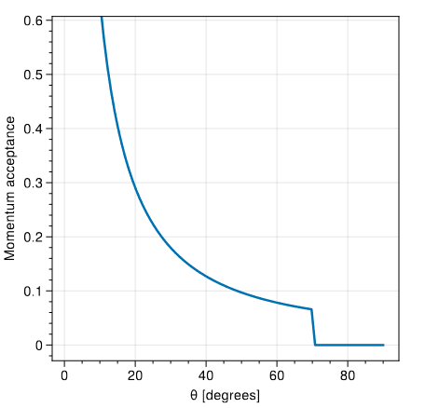
Pion transfer line design – Choice of theta
Momentum acceptance increases rapidly as theta decreases
However, we are only interested in pions that produce low-amplitude muons at the right momenta
  Momentum acceptance larger than ~10% is likely to yield diminishing returns

Slide 17
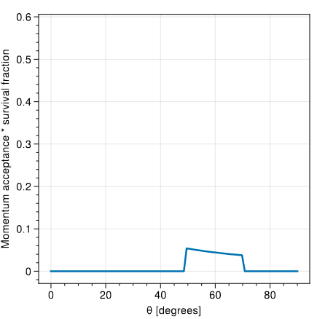
Pion transfer line design – Choice of theta
Assuming pions are roughly evenly distributed in momentum around chosen momentum, multiplying the momentum acceptance by the transmittance gives an estimate of the optimum geometry for pion yield at the end of the line.

Slide 18
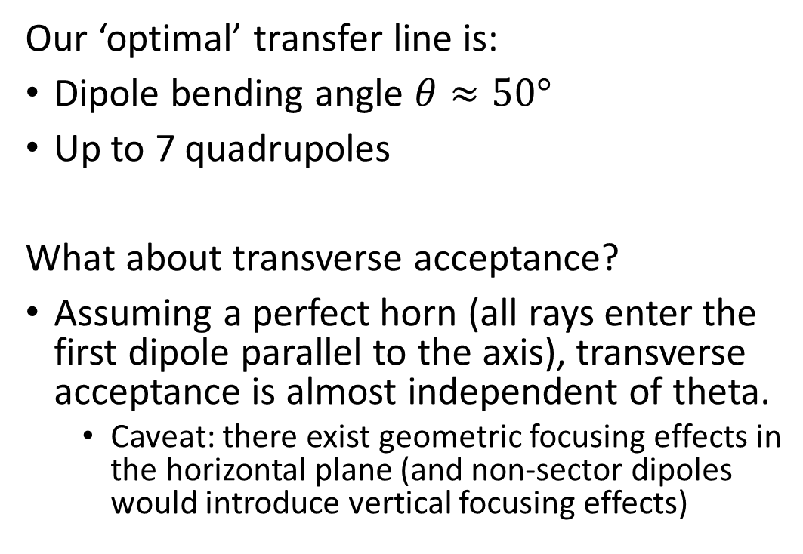
Pion transfer line design
Our ‘optimal’ transfer line is:
Dipole bending angle $θ≈50°$
Up to 7 quadrupoles
What about transverse acceptance?
Assuming a perfect horn (all rays enter the first dipole parallel to the axis), transverse acceptance is almost independent of theta.
  Caveat: there exist geometric focusing effects in the horizontal plane (and non-sector dipoles would introduce vertical focusing effects)

Slide 19
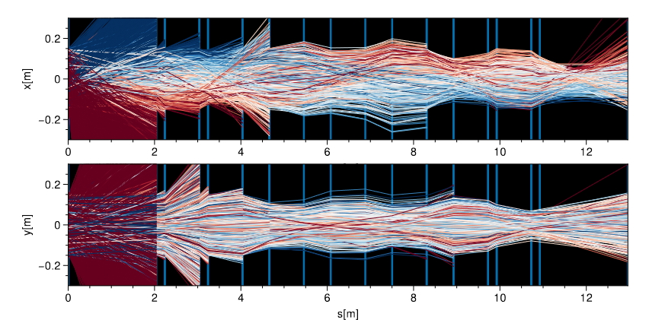
Pion transfer line design
Test simulation of example line
  7 quads
  50 degree bending angle
  Dispersion created in initial dipole is cancelled at end of line
Swapped horizontal/vertical quads compared to initial assumption
  Better momentum acceptance, better horizontal acceptance, worse vertical acceptance
DIPOLE
Q
Q
Q
Q
Q
Q
Q
DIPOLE

Slide 20
Conclusion
Basic transfer line has been studied based on simple quadrupole/dipole line
Simplest-possible case from accelerator physics perspective
  Dipole requirements may be the limiting factor for such a design
Baseline established: 1.4e-4 pions to production straight per proton on target ⇒ 3.2 10¹⁰ pions/pulse !!!
Pion transport must be optimized as much as possible to ensure maximum number of muons
Final optimization must include injection and production straight – target parameter is number of muons at end of productions straight

Slide 21
Further steps
Study feasibility of dipole requirements
Zero-dispersion ideal on entry into production straight
  Final geometry must be optimized INCLUDING the injection optics
Consider possible acceptance improvement with an optimized pion capture in particular for the vertical plane
  Optimizing the capture towards a focal point in the transfer line or adding upstream focusing elements
Investigate benefits from higher order multipoles in transfer line
Examine possibility of tweaking dipole geometry to take advantage of edge focusing in vertical plane

