Slide 1
Status Report

Slide 2
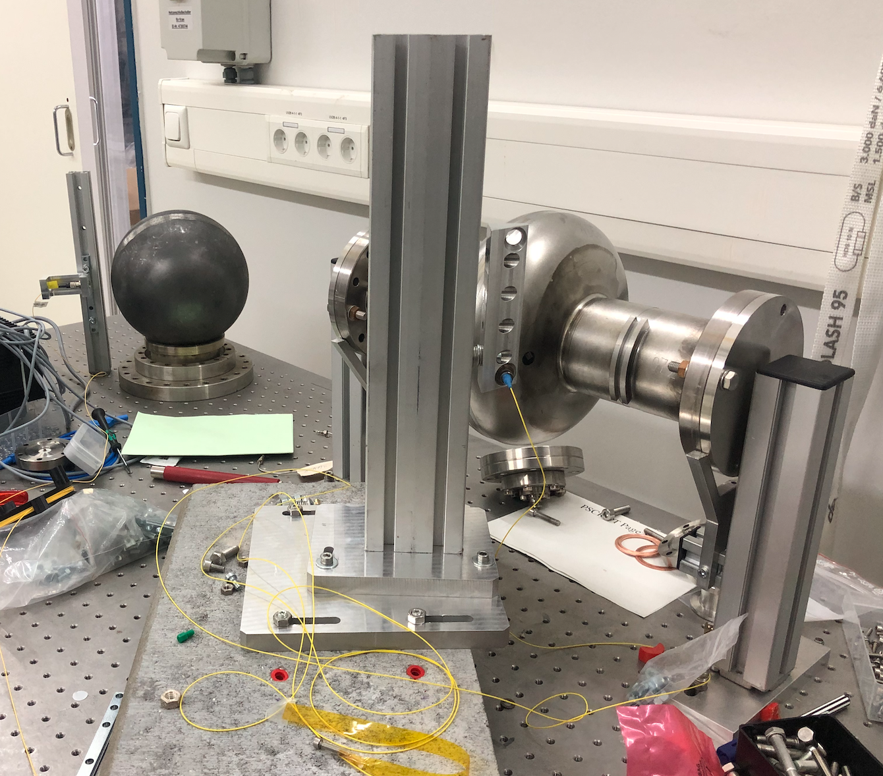
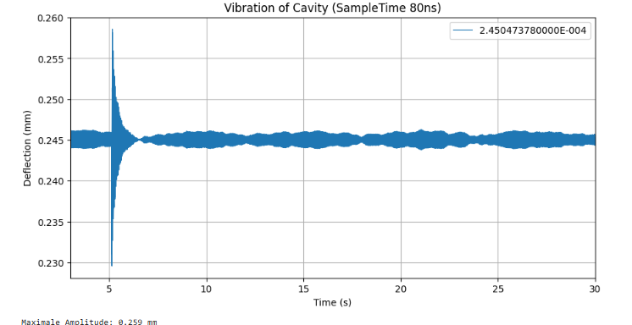
The current Setup of the Experiment

Slide 3
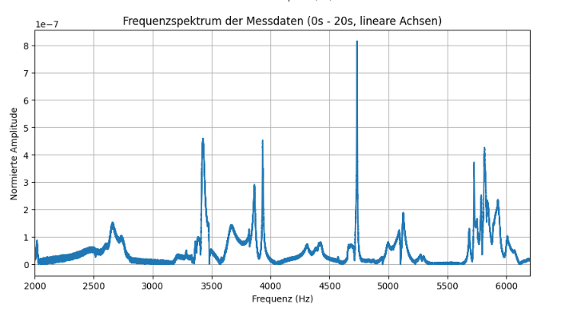
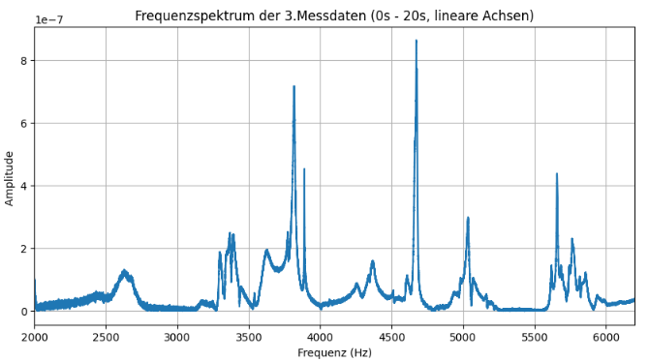
Spectrum of the single cavity
Results are reproducible
Peak at 3890Hz is still there
- Only one point of measuring

Slide 4
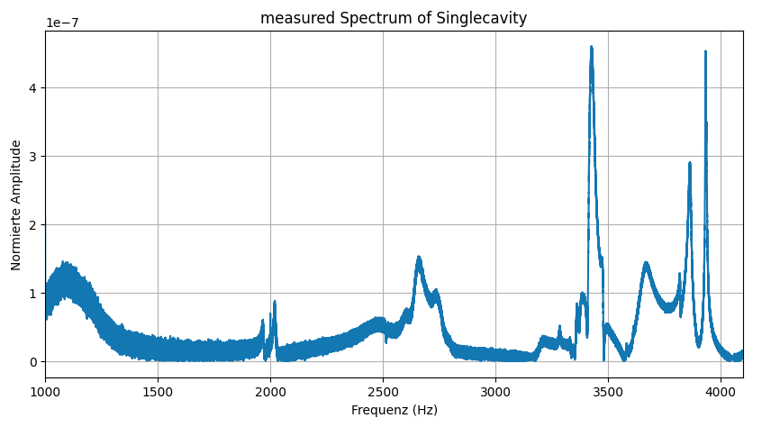
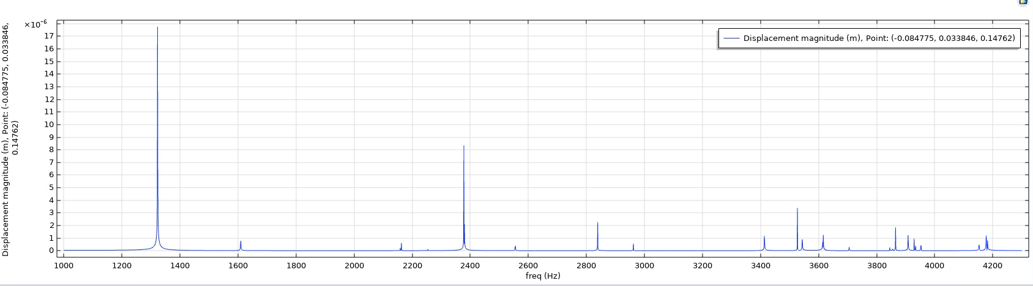
Compare Measurements with simulation

Slide 5
Objective
Examing Peak at 3890Hz
Does it appear in every measurement?
Optimize Cavity support
Flange open/closed
Control Measurement in FS
Optimize excitment method
„Frequencyshaker“ (only 159.4Hz)
Audio Speaker
Other Methods
Simulation in Comsol (Cavity and Sphere)

Slide 6
Back up

Slide 7
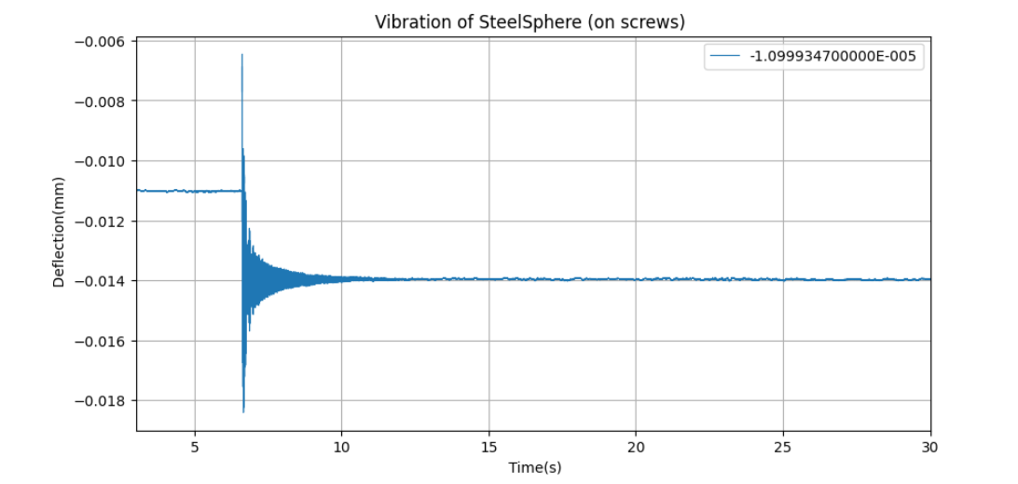
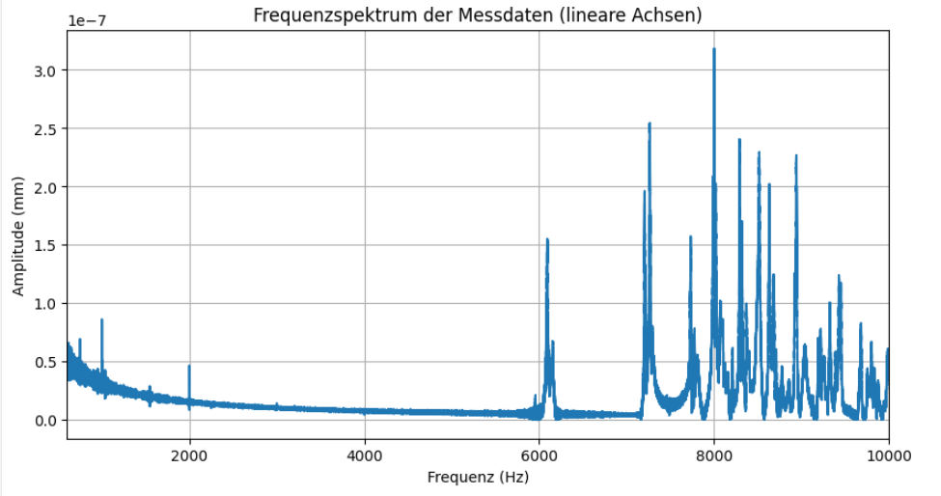
Spectrum of Steel Ball (10cm radius)

Slide 8
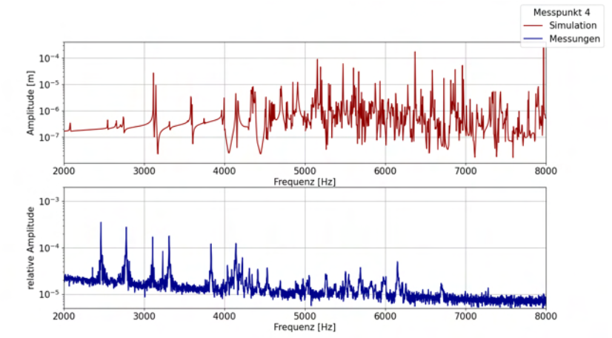
Zusammenfassung Michel:
Quelle: Paulsen - 2023 - Untersuchung mechanischer Eigenschaften der MAGO-Kavität im Bezug auf Gravitationswellendetektion

Slide 9
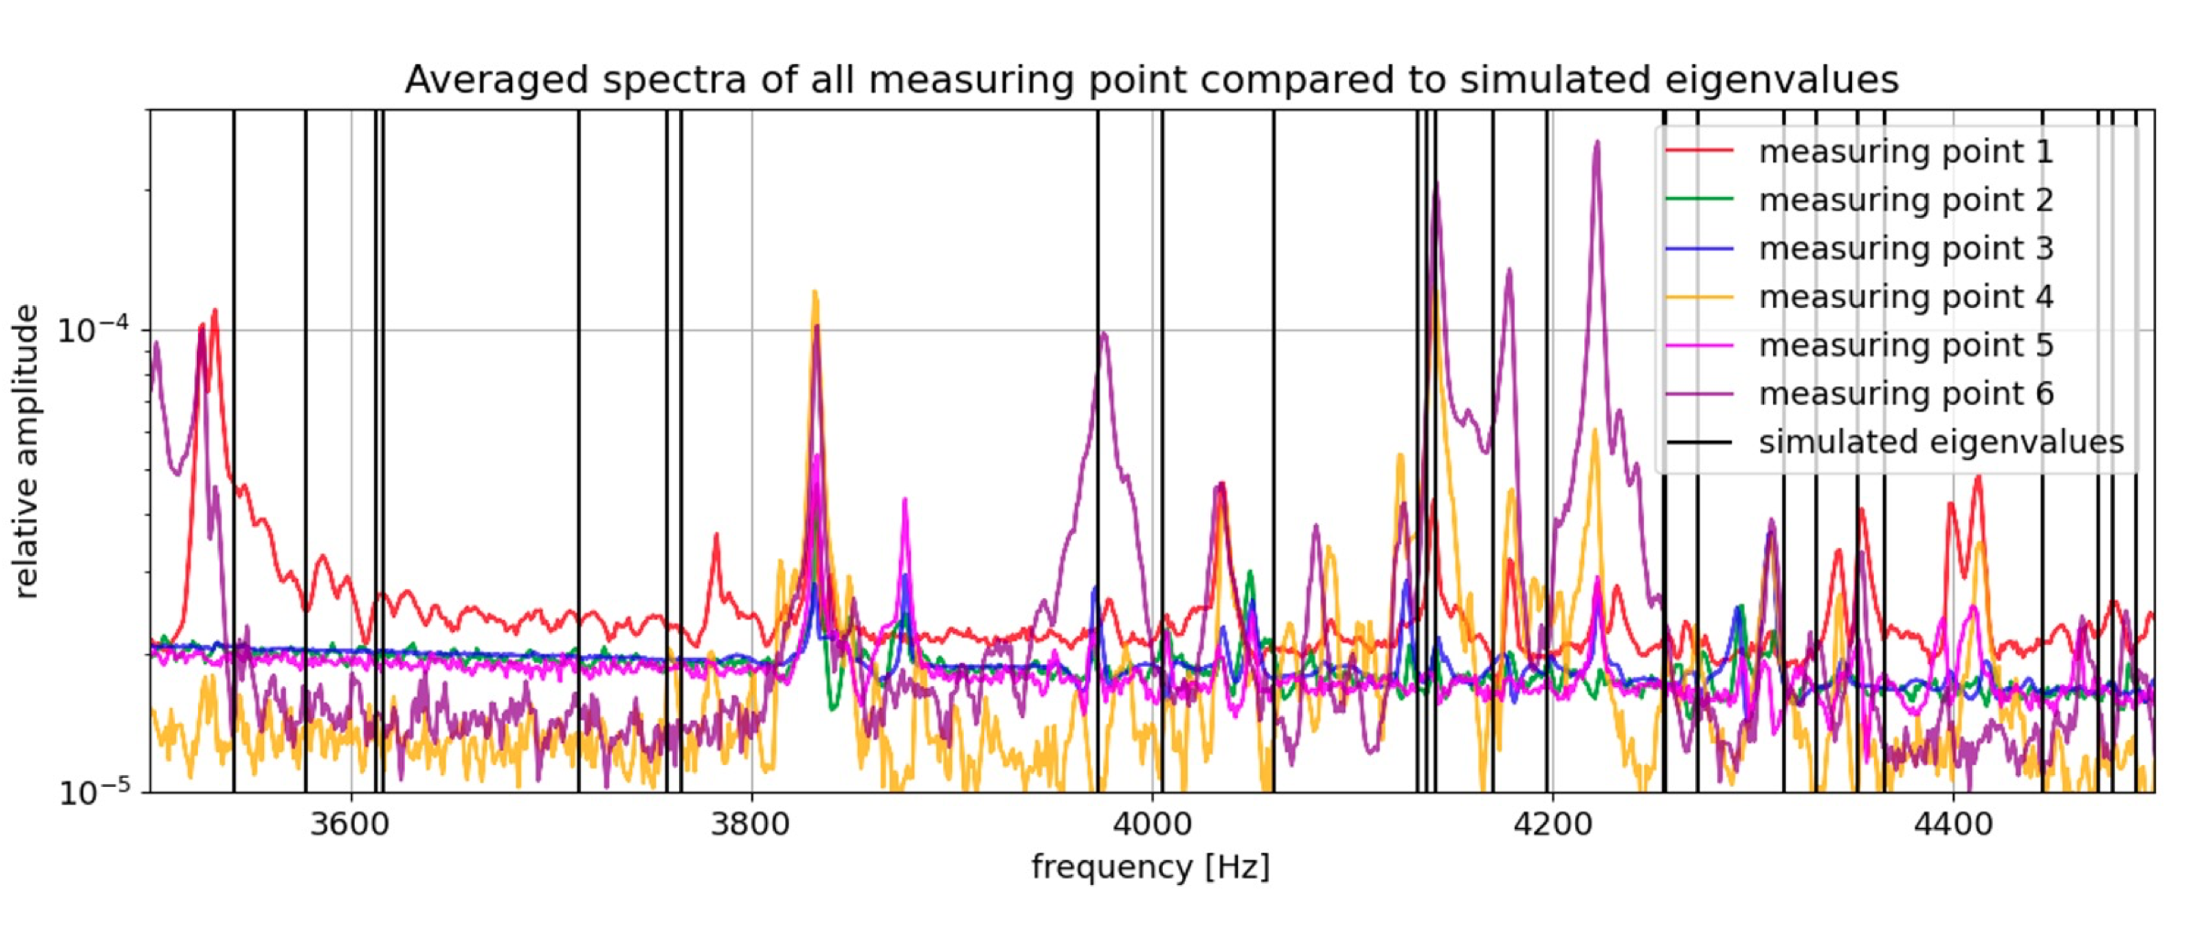
Zusammenfassung Michel:
Paulsen - 2023 - Untersuchung mechanischer Eigenschaften der MAGO-Kavität im Bezug auf Gravitationswellendetektion

