Slide 1
Monitoring and Analysis of Publication Costs – The Austrian Approach
Christian Kaier, University of Graz
Melanie Stummvoll, University of Vienna
openCost Workshop October 8th, 2024
Dieses Werk ist lizenziert unter einer Creative Commons Namensnennung 4.0 International Lizenz
Ausgenommen von der Lizenzierung sind Abbildungen, Screenshots und Logos

Slide 2
Austrian Transition to Open Access 2 (AT2OA²)
Transformative Agreements (SP1)
Austrian Datahub (SP2)
Establishment of a national Datahub for Open Access Negotiations and Monitoring
Negotiation of agreements with scholarly publishers
Altmetrics (SP5)
Publication Costs (SP3)
Investigating the visibility of OA publications using alternative metrics
Analysis of publication costs at Austrian universities
Predatory Publishing (SP4)
Predatory publishing in context of the changing landscape of scientific communication
Notes:
2021-2024
Goal: to support the transition to OA in Austria
24 partners – incl. all public universities
More than 80 experts working in 5 subprojects

Slide 3
Initial situation
A challenging situation
Publication costs outside the library
Lack of clarity in SAP accounting texts
Challenges in allocating costs within transformative agreements
New pricing and financing models
Cost splitting
Result
Little cost transparency
No complete overview of publication costs on an institutional level

Slide 4
Goals
Strengthen the cooperation between accounting – libraries –research services – faculties/departments
Disseminate expertise on publication costs across the entire institution
Improve the monitoring of different publication cost types
Enable the institution to get an overview of all publication costs

Slide 5
Activities
Providing recommendations and information material
Surveys on how institutions deal with publication costs
Exchange on the implementation of the Austrian Science Fund’s new open access block grant system
Sharing and analyzing SAP reports
Organizing a workshop
Networking with similar initiatives

Slide 6
Non-Activities
Developing metadata standards for cost monitoring
Further technical development of repositories and CRIS-systems
Standardization of publishers/creditors
Working on a comprehensive information budget

Slide 7
Recommendation on Collecting, Analyzing and Managing Open Access Publication Costs
Goal: To highlight the advantages of and measures for open access cost monitoring
Target groups: University management, finance, controlling and accounting departments, libraries
DOI: 10.5281/zenodo.7599784

Slide 8
Guidance
Goal: To provide support in identifying and recording publication costs correctly
Target groups: Accounting, controlling and colleagues at decentralized departments
Purpose: To support colleagues who aren’t familiar with open access, but are responsible for booking publication costs

Slide 9
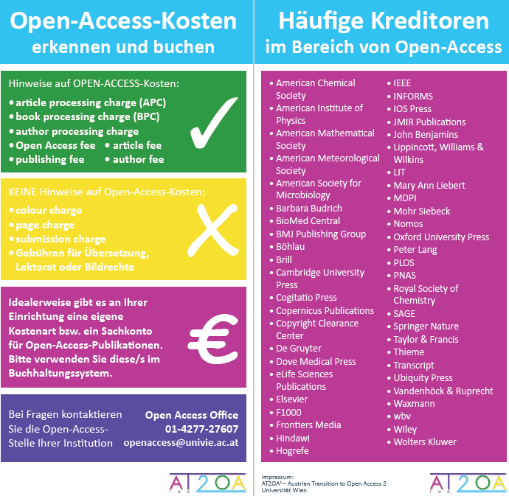
Guidance
Video
Folder
Mousepad

Slide 10
Recommendation on the Documentation of Publication Costs in Statistics
Status quo: Incomplete and inconsistent records of open access costs in statistical reports
Goal: Improvement and Standardization e.g. in library statistics
DOI: 10.5281/zenodo.8182790

Slide 11
Categories
APCs, BPCs, Crowdfunding
Print subsidies, Page Charges etc. having no relation to Open Access
All Expenses for Open Access Agreements
Funding for Infrastructures
Expenses for Journal Hosting, University Press

Slide 12
Workflows for the Documentation and Monitoring of Publication Costs
Workflows for selected publication cost categories:
APCs, BPCs, crowdfunding
Print subsidies, page charges etc. that are not related to open access
Goals: Basis for establishing and further refining cost monitoring; knowledge documentation
Target groups: Colleagues at libraries and research services
DOI: 10.5281/zenodo.11191724

Slide 13
Workflows for the Documentation and Monitoring of Publication Costs
Process Steps
Data collection from various sources
Data aggregation & editing
Quality check
Data analysis, evaluation and presentation
Data reporting

Slide 14
Survey "Publication Cost Monitoring in Austria 2024"
An initial survey was conducted in 2021
18/24 project partners participated in the 2024 survey
DOI: 10.5281/zenodo.13150803

Slide 15
Survey "Publication Cost Monitoring in Austria 2024"
What has changed since the start of the project?
Increase in collaboration with other departments
Regular monitoring and centralized evaluation on an institutional level
More cost transparency
Development and Dissemination of expertise regarding publication costs across the entire institution
Different SAP cost types for open access and other publication costs
Increasing professionalism in data collection & monitoring

Slide 16
Survey "Publication Cost Monitoring in Austria 2024"
Where do you see room for improvement?
Compilation of publication costs from global and third-party funding budgets
Direct access to relevant cost types
Standardization of SAP booking texts
More precise querying options in the accounting system
Better coordination of the involved departments

Slide 17
Survey "Publication Cost Monitoring in Austria 2024"
Further ideas & suggestions
More awareness on management level
Mandate for publication cost monitoring from management
Standardized wording on publishers invoices
Standardized wording for SAP booking texts
Centralization of invoice processing
Atomization of data exchange, e.g. with FIS/CRIS system

Slide 18
Conclusions
What do we need?
Standardizing data collection and monitoring
Communicating benefits of open access cost monitoring
Information material
Continuous exchange with management, accounting, libraries, research service, faculties/departments etc.
Inter-/national exchange

Slide 19
And Now?
Continuing the exchange on cost monitoring within the Austrian “Publication Fund Managers Network” and other working groups
Giving impulses for the further refinement of library statistics
Observing the discussion on an information budget

Slide 20
Questions

Slide 21
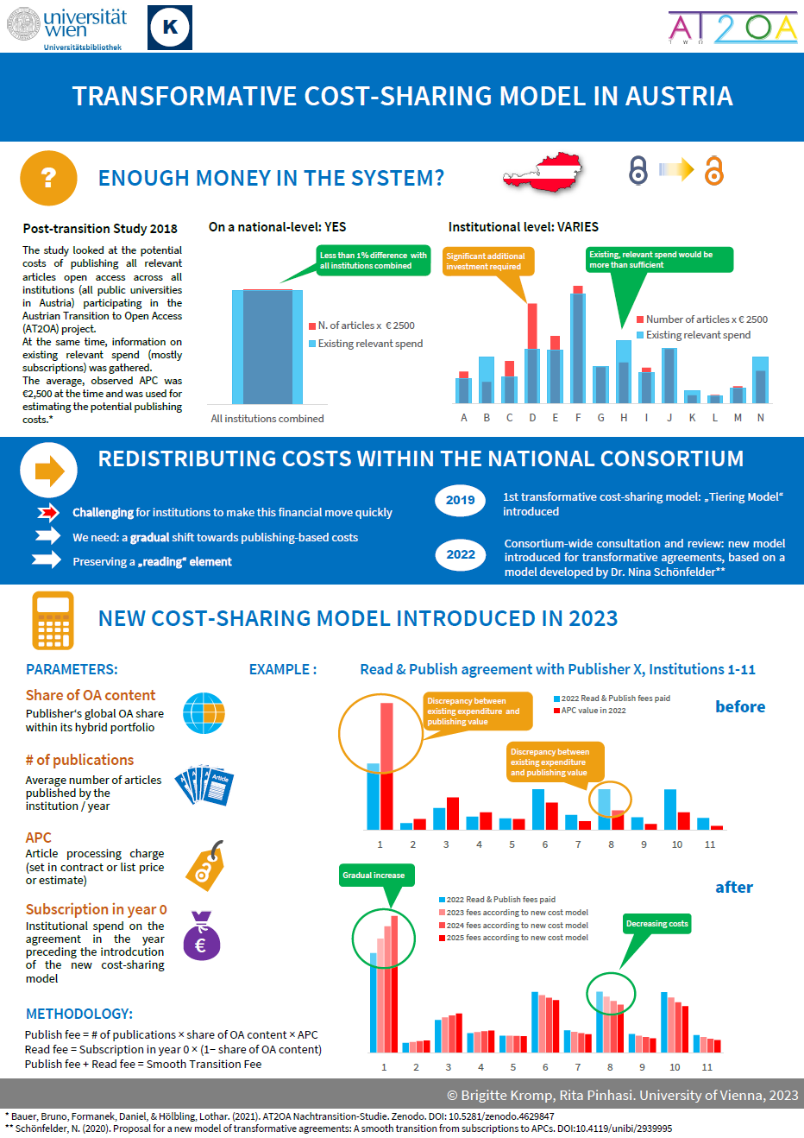
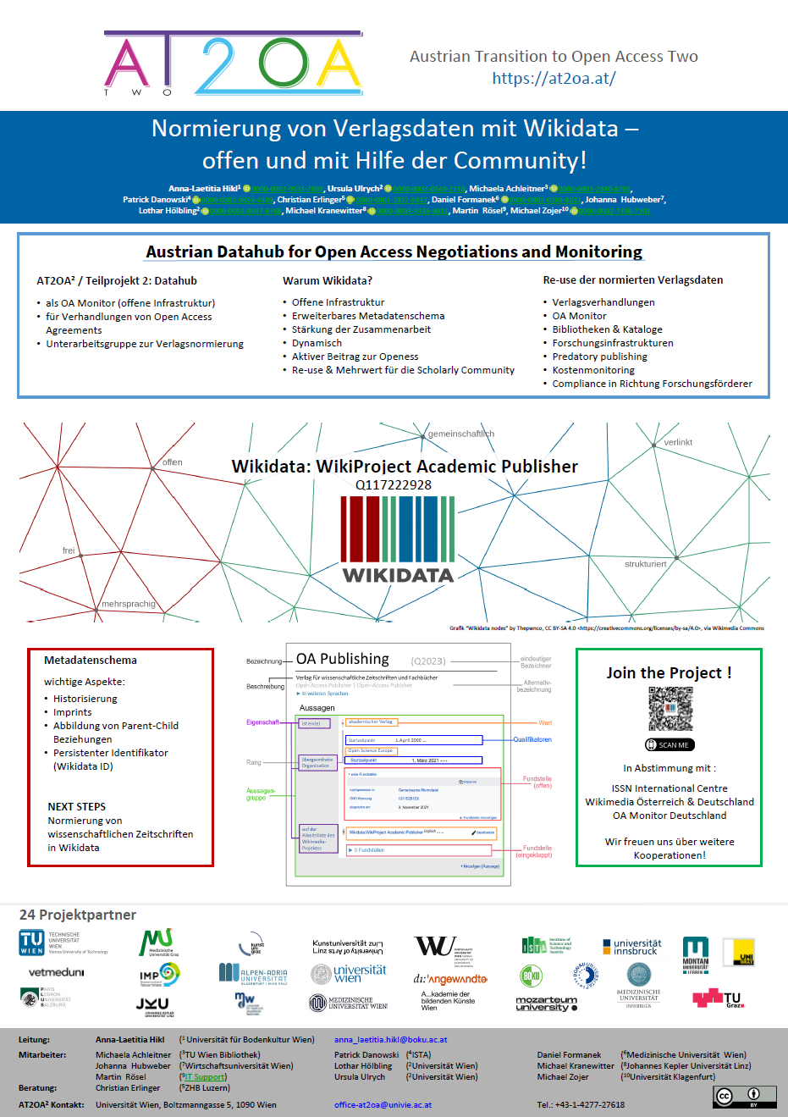
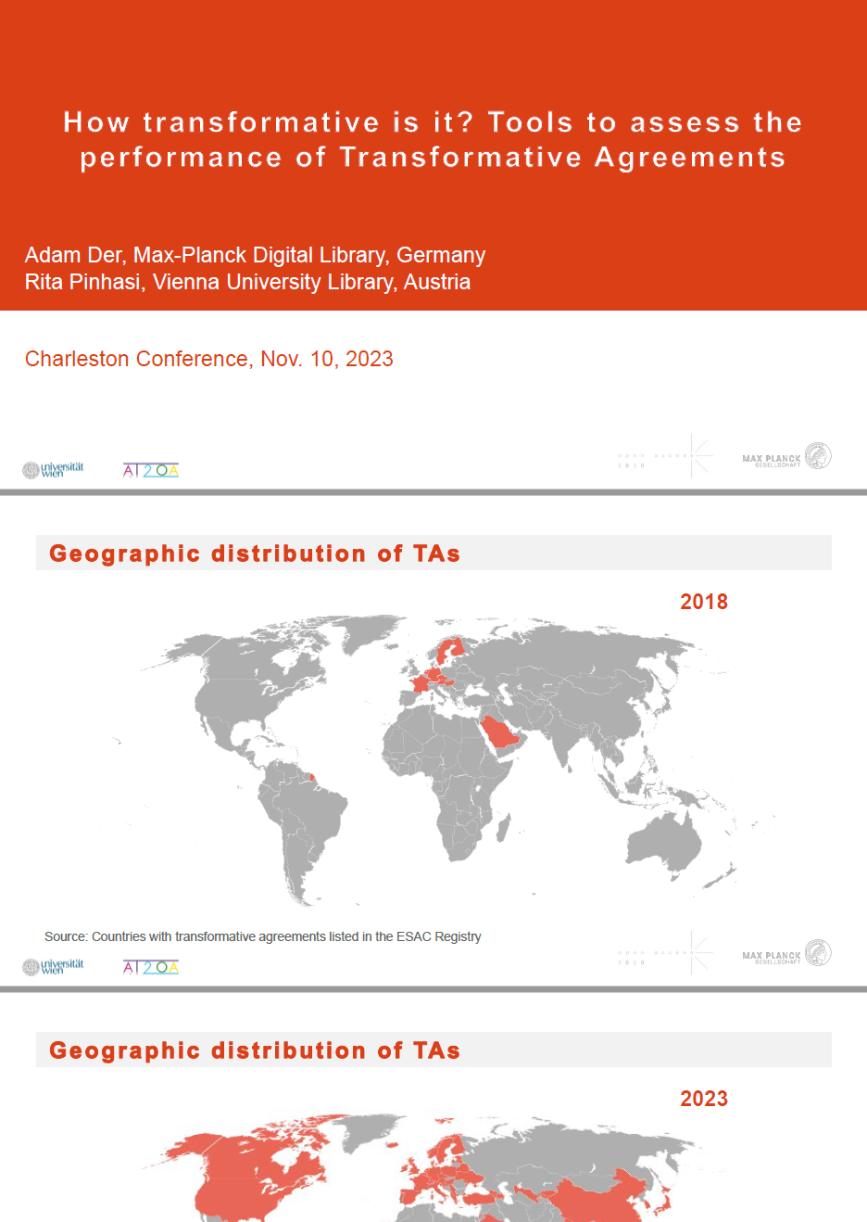
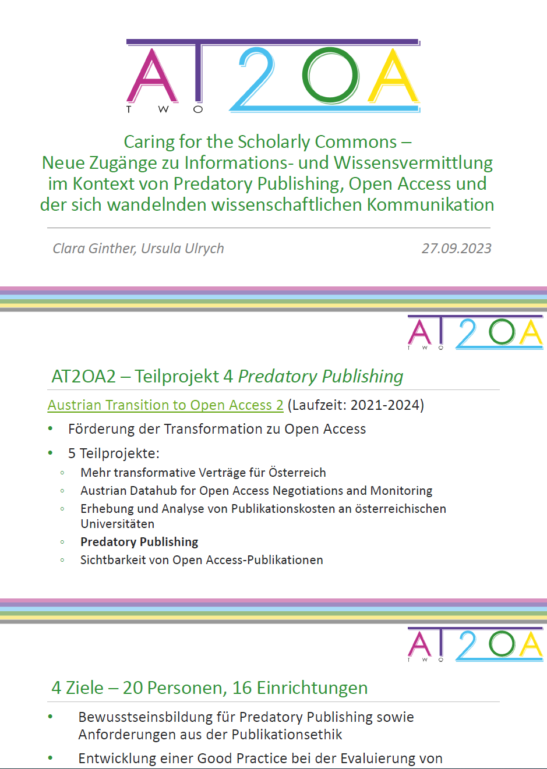
Publications
All activities & publications can be found on our project website: www.at2oa.at/en

Slide 22
Many thanks …
Get in touch with:
Christian Kaier christian.kaier@uni-graz.at
Melanie Stummvoll melanie.stummvoll@univie.ac.at

