Slide 1
Negotiating Transformative Agreements – Standards and Variation, Achievements and Challenges
Dr. Hildegard Schäffler, Bavarian State Library, Munich
9 Oct 2024

Slide 2
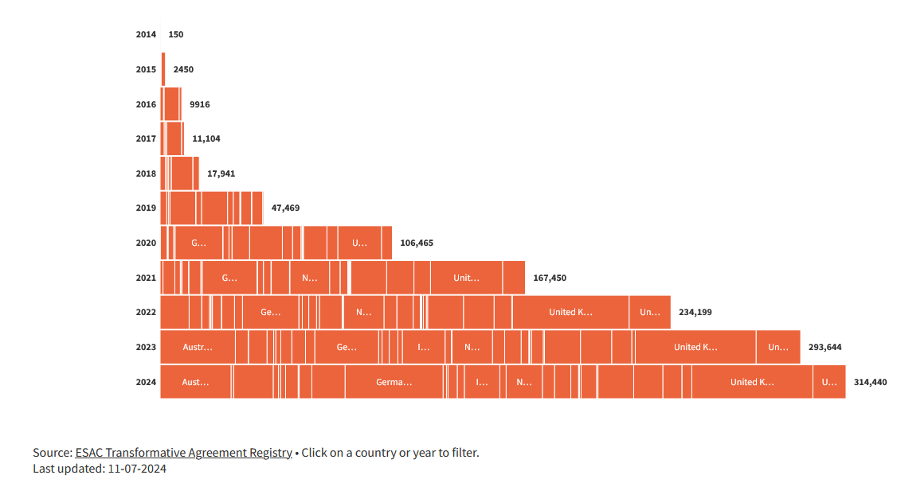
Transformative Agreements - Facts and Figures
ESAC Transformative Agreement Registry (Oct 2024)
543 current agreements (of 1093 agreements listed since 2014)
Approx. 326,000 OA publications in 2024
58 publishers
69 countries
https://esac-initiative.org/about/transformative-agreements/agreement-registry/

Slide 3
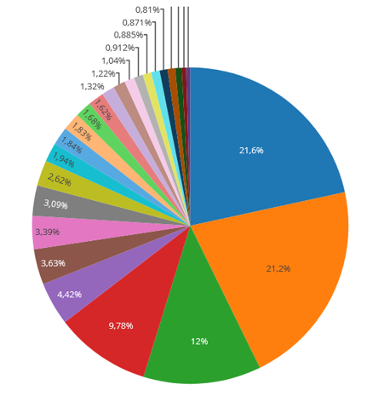
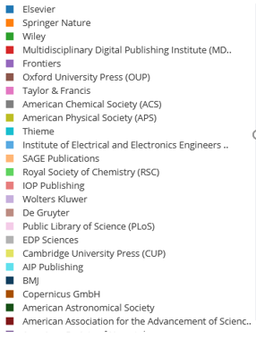
The Situation in Germany
ESAC Transformative Agreement Registry (Oct 2024)
64 current agreements (of 128 agreements listed since 2015)
Approx. 45,700 OA publications in 2024
33 publishers
Article publications of German institutions (2020 – 08/2024); Source: https://open-access-monitor.de/publications
A substantial share of article publication in Germany is covered by transformative agreements.
Negotiations are mainly led by
the DEAL Consortium for Elsevier, Springer Nature and Wiley (https://deal-konsortium.de/)
an expert group of independent negotiators, representing (regional & other) consortia, organised in the Forum 13+ group (https://forum13plus.de)

Slide 4
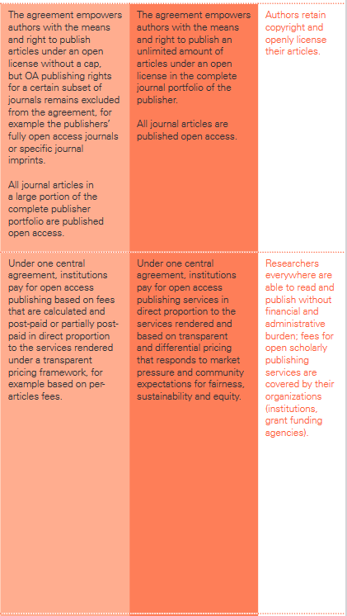
Standards and Evaluation Tools
ESAC Reference Guide to Transformative Agreements
https://esac-initiative.org/wp-content/uploads/2023/03/ESAC_Reference_Guide_to_TAs.pdf
„Forum 13+“-Spektrum zur Bewertung von Open Access-Transformationsverträgen und Verlagsangeboten
https://publications.goettingen-research-online.de/bitstream/2/99900/1/Forum13Plus_Spektrum_Okt2021_final.pdf
Adapted version included in ESAC Reference Guide (“How transformative is it”)
“For each transformation driver, the spectrum starts (at the left) with the overarching negotiation objective, contrasted by a description of conditions under the subscription paradigm. The spectrum then progresses through different agreement iterations toward the envisioned characteristics of an open scholarly publishing paradigm.” (ESAC Reference Guide, p. 16; Version March 16, 2023)
Pampel, H. et al. (2022): Recommendations for transformative journal contracts
https://www.transform2open.de/ressourcen/empfehlungen-fuer-transformative-zeitschriftenvertraege/kriterien-criteria-criteres

Slide 5
How transformative is it?
ESAC Reference Guide to Transformative Agreements, p. 17; Version March 16, 2023

Slide 6
Types of Transformative Agreements (Journals and Beyond)
Type | Definition | Comments & Examples
Transformative publish&read agreements | Combining publishing in OA with the reading of pay-wall content | cf. ESAC Registry
Gold OA agreements | Negotiating publishing conditions for pure gold OA journals | cf. ESAC Registry
Subscribe to Open (S2O) | Continued payment of subscription fees by a sufficient number of subscribers leads to (reversible) full open access | e.g. De Gruyter Brill to focus on S2O Preferred model for the humanities and/or smaller publishers?
Crowdfunding | Libraries actively contribute to the OA transformation of books | e.g. pledging system of Knowledge Unlatched and library initiatives
Purchase to Open (P2O) | OA conversion once book sales reach a certain threshold | e.g. concept of the ENABLE! initiative; e.g. „Flip it Open“ model of Cambridge University Press (CUP)

Slide 7
Some Negotiation Parameters (P&R Journal Agreements)
Negotiation Parameters | Variation | Comments & Examples
Cost as related to previous spend (at both the consortium and the participant levels; mainly for hybrid) | Ideally cost-neutral at the consortium level Previous spend can include subscription + former APC spend | Increase/decrease at the participant level possible Cost development will depend on whether the overall cost is capped or not
OA types included | Hybrid and gold treated separately Hybrid and gold covered in one and the same model Green OA | e.g. DEAL agreements e.g. BSB consortia with CUP and Karger: one single flat fee, which also provides for a smooth flipping scenario e.g. Couperin agreement with ACS: green OA with no embargo

Slide 8
Some Negotiation Parameters (P&R Journal Agreements)
Negotiation Parameters | Variation | Comments & Examples
Publication coverage | Ideally unlimited number of articles can be published Capped publishing, but effectively unlimited Tokens / capped publishing | e.g. German Taylor&Francis consortium Difficult to communicate and extra cost if additional tokens are purchased
Flat fee or publication-based payment | Capped price independent of the actual number of publications Pay-as-you publish | Leads to cost predictability; ideally combined with uncapped publishing e.g. DEAL agreements; cost development uncapped, but most consistent with the transformative idea

Slide 9
Internal Cost Allocation in a Consortium (P&R Journal Agreements)
Model | Definition | Comments & Examples
Previous spend remains | Previous spend covers both reading & publishing with no re-allocation of costs according to publication output | Maximum cost predictability, but no relation to publication output
Migration path to a publication-based cost allocation | Gradual transition towards a more publication-based approach | Cost increases for some members, but also decreases for others; will allow time for internal budget reallocation and structural changes; e.g. DEAL 1; BSB consortium with CUP
Pay-as-you publish | Purely publication-based cost allocation | Usually a challenge for members with high publication output; closest to a publication-based logic; e.g. DEAL 2 requires options for read-only members

Slide 10
How Transformative is it?
“Working in tandem with other efforts to support a multiplicity of venues for the open dissemination of research, transformative agreements are a temporary and transitional framework for institutions to convert the resources currently spent on journal subscriptions into funds to support sustainable OA business models, [….].” (https://esac-initiative.org/market-watch/)
Transformative agreements and general OA commitments of publishers proliferate… | … but flipping doesn‘t.
Transformative agreements lead to a significant increase of OA content, which is transformative in itself… | … but an equally significant share of pay-wall content remains.
A few publishers actively flip a significant number of journals… | … but not necessarily mainly triggered by transformative agreements.
Some smaller publishers, e.g. German-language focussed, have a high transformation potential… | … but are therefore in need of an economically more sustainable model than Publish&Read.

Slide 11
Thank you very much for your attention!
9 Oct 2024

