Slide 1
1
High-field magnets & FCC-hh scenarios
Frank Zimmermann
German Strategy Meeting, DESY & zoom, 28 November 2024
Warm thanks to Bernhard Auchmann, Amalia Ballarino, Michael Benedikt, Massimo Giovannozzi, Michelangelo Mangano, and Ezio Todesco

Slide 2
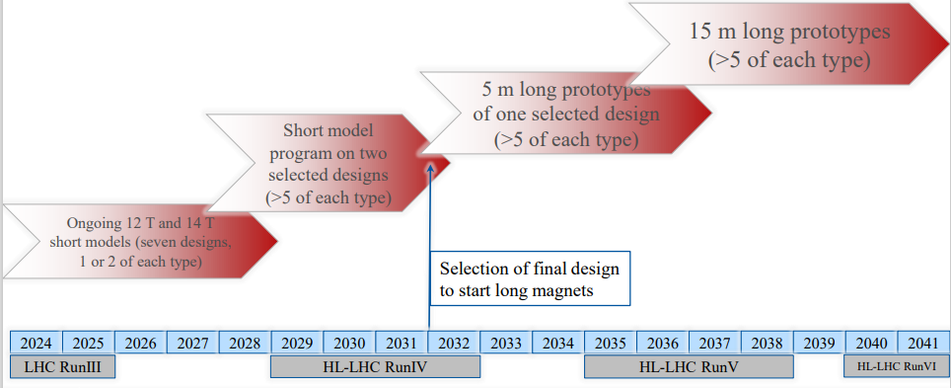
14 T Nb₃Sn “accelerated” roadmap: short models & scaling in length
assuming 10 years to make the scaling in length from 1.5 to 15 m
does not consider involving industry during length scaling, to save costs (this implies 5 additional years to make transfer to industry)
E. Todesco, B. Auchmann

Slide 3
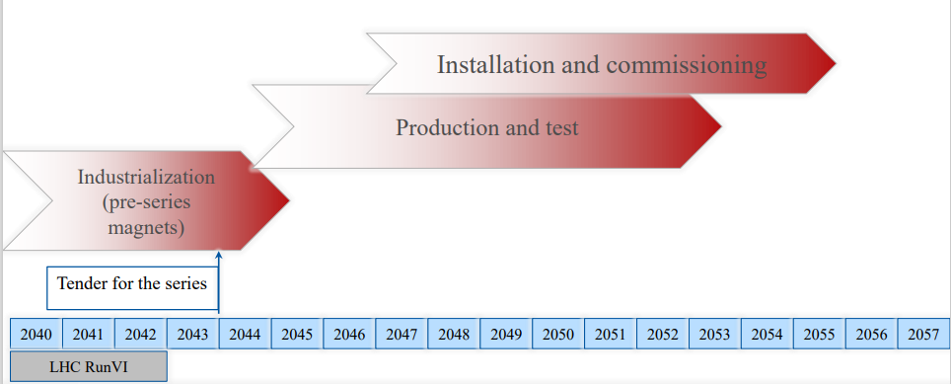
14 T Nb₃Sn “accelerated” roadmap: Industrialization, production, & commissioning
this roadmap indicates 2055 as possible date for FCC-hh start as a standalone project
E. Todesco, B. Auchmann

Slide 4
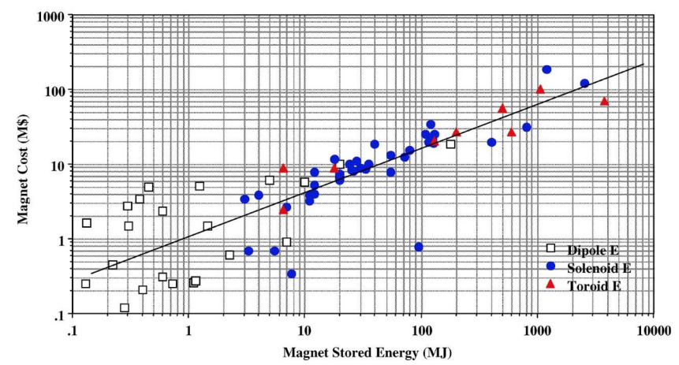
Magnet cost scaling
In 2008, M. Green and B. Strauss et al. presented a scaling law for the magnet cost: cost proportional to square root of energy (to be more precise, U^{0.60} )
Cost versus magnet stored energy (B. Strauss, M. Green, IEEE TAS 18 (2008))
E. Todesco

Slide 5
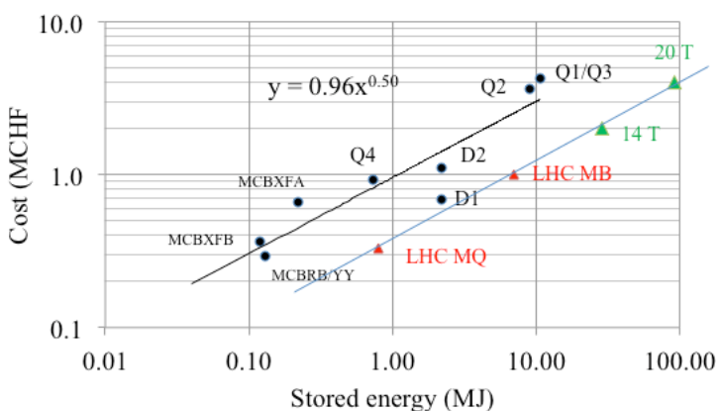
Cost of Nb₃Sn and HTS magnets – “crystal ball”
At the 1st HL-LHC C&S review (March 2015) the first estimate of IR magnet cost was presented, and compared to the scaling • Surprise: the offset does not depend on technology • HL-LHC has 2.5x higher cost than LHC due to the small series
LHC magnets
HL-LHC magnets
FCC-hh forecast
FCC-hh needs 4464 dipoles
of 14.2 m length
Cost versus magnet stored energy, update with 14 T operational field
E. Todesco, M. Giovannozzi

Slide 6
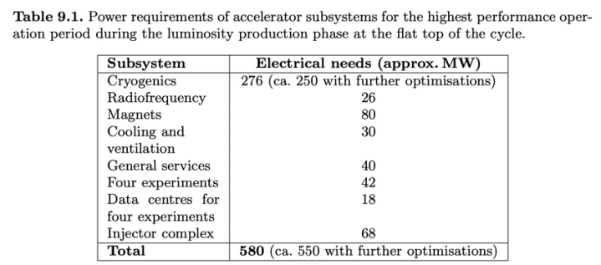
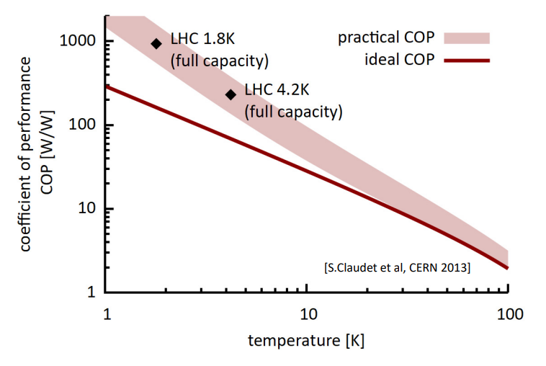
FCC-hh power consumption
FCC-hh CDR (2020): magnet system (16 T) at 1.9 K to save conductor cost, and beamscreen temperature of 50 K for intercepting synchrotron radiation
• Cryogenics responsible for half of ~580 MW power consumption.
• Magnet ramp losses buffered into He-II bath with minimal temperature excursions thanks to lambda peak in He-II heat capacity.
Power-consumption could be significantly reduced:
• Reducing magnetic field requirement from 16 to 14 T lower SR power and also makes SC coils more compact
4.5 K magnet temperature improves cryogenic efficiency
in parallel beam screen temperature increased, to ~70 K.
• Ramp losses need to be minimized and buffered in dedicated locations along the cryo circuit.
• An addt’ low-cryogen-inventory option under study, where a heat-exchange pipe is routed directly through/along the coils of an otherwise dry coldmass.
• The HFM Programme prepares a number of demonstrator magnets to be tested at 1.9 K and 4.5 K.
B. Auchmann

Slide 7
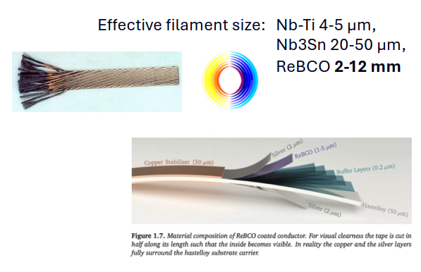
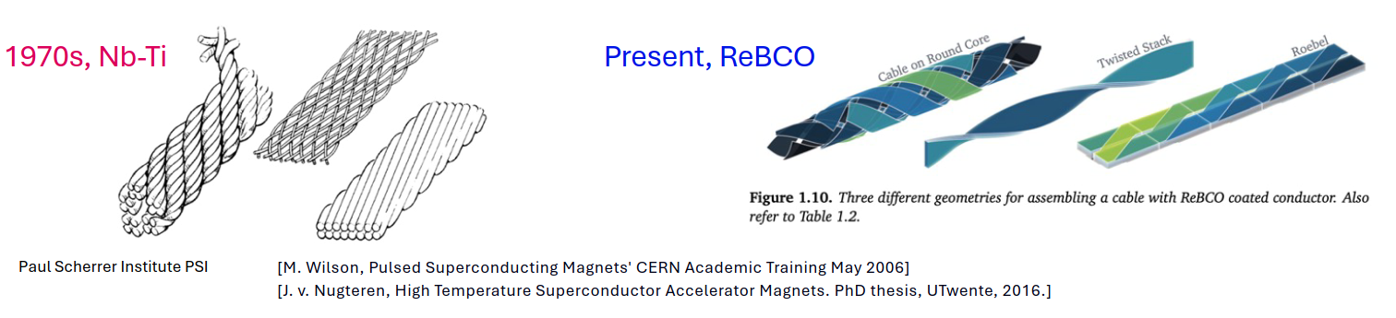
HTS ReBCO Option at 20 K
• Higher magnet temperature further improves power consumption for static and beam-induced losses.
• Higher fields and collision energies could be envisaged but main cryo load for FCC-hh is synchrotron radiation (SR) on the beam screen.
• SR power scales ∝ 𝐵⁴!
• Higher collision energy enabled by HTS cannot be more power efficient than energies attainable with LTS.
• In addition, increased ramp losses may (at least) in part cancel the improved cryogenic efficiency at 20 K.
HFM is in the progress to set max. ramp-loss targets to guide the magnet R&D. The goals are to based on:
1. An HTS accelerator at 20 K should operate more sustainably than an LTS accelerator at 4.5 K at
equivalent magnet field (e.g., 14 T). 2. The cryogenic installation + magnet should fit into the FCC-ee tunnel.
Initial estimates indicate a 4-8x increase in ramp losses wrt. Nb₃Sn state of the art, which may fall within the
above Target (1). Work in progress …
B. Auchmann

Slide 8

ReBCO production plan in China – Shanghai Superconductors
>5x rest of the world
Amalia Ballarino, Bai Song

Slide 9
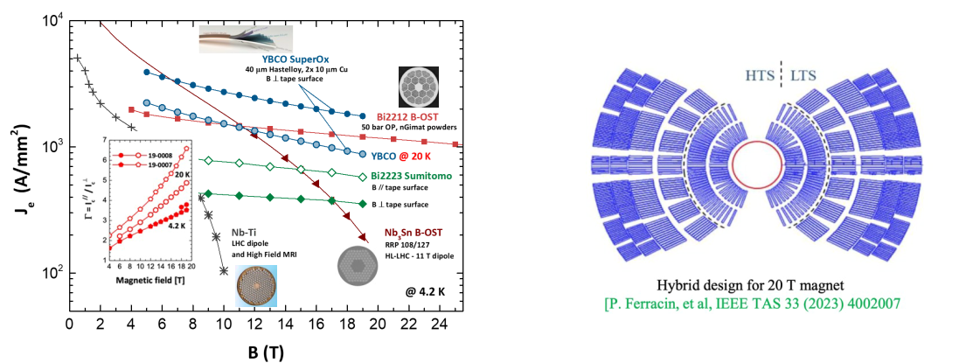
Bi-2212 as alternative
technically mature HTS material
a filamented conductor like LTS, Bi-2212 may best be utilized at 4.5 K, in a hybrid configuration with Nb³Sn low-field layers
B. Auchmann

Slide 10
Assumptions for FCC-hh scenarios & possible parameter range
With present layout of the FCC, and after diligent optimization (by Massimo, Gustavo, and Thys), the following energies can be reached according to the dipole field:
Dipole field [T] | c.m. energy | Comment
12 | 72 | not far above peak field of HL-LHC Nb₃Sn quadrupoles
14 | 84 | Nb₃Sn or HTS
17 | 102 | HTS
20 | 120 | HTS
Increasing the c.m. energy beyond ~100 TeV, we assume that the synchrotron-radiation power could not increase, beyond a total of about ~4 MW (which must be removed from inside the cold magnets)
On the other hand, when decreasing the beam energy, one can hold either the synchrotron-radiation power (increasing current up to HL-LHC values) or the beam current constant. Also, the pile-up might need to be limited, e.g. to ~1000 events/crossing. We thus consider three scenarios for 12 T (0.5 A and 1.12 A beam current, the latter without or with pile-up levelling).
Finally, further overall lowering the synchrotron radiation power, by reducing the number of bunches, in order to restrict the total power consumption of the future FCC-hh, would decrease peak and integrated luminosity by the same factor.

Slide 11
Six scenarios
A machine based on 12 T dipoles, with a beam current of 0.5 A as considered for the 16 T FCC-hh machine (F12LL).
A machine based on the same 12 T technology close to deployment, but with a higher beam current of 1.1 A, as considered for the HL-LHC (F12HL).
The same case as F12HL but limiting the pile up not to exceed a value of 1000 (F12PU).
A machine based on 14 T dipoles, and 0.5 A current (F14).
A machine based on High Temperature Superconductor (HTS) dipole magnets with a field of 17 T, just exceeding 100 TeV c.m., still with 0.5 A (F17).
A machine also based on High Temperature Superconductor (HTS) dipole magnets with a field of 20 T, and a beam current of 0.2 A, so that the synchrotron-radiation power is limited to about 2 MW / beam (F20).

Slide 12
Discarded proposals
6 T Nb-Ti magnets:
high energy consumption due to 1.9 K operation
lack of technological incentive (old technology, “HERA magnets” 50 years later)
10 T Nb₃Sn magnets:
not much difference in terms of cost between 12 and 14 T Nb₃Sn
→ little cost advantage expected from going down to 10 T Nb₃Sn;
10 T also very close to 9 T ultimate field for Nb-Ti

Slide 13
Parameter | Unit | F12LL | F12HL | F12PU | F14 | F17 | F20 | (HL-)LHC
c.m. energy | TeV | 72 | 72 | 72 | 84 | 102 | 120 | 14
dipole field | T | 12 | 12 | 12 | 14 | 17 | 20 | 8.33
beam current | A | 0.5 | 1.12 | 1.12 | 0.5 | 0.5 | 0.2 | (1.12) 0.58
bunch popul. | 10¹¹ | 1.0 | 2.2 | 2.2 | 1.0 | 1.0 | 0.4 | (2.2) 1.15
bunches/beam |  | 9500 | 9500 | 9500 | 9500 | 9500 | 9500 | (2760) 2808
rf voltage | MV | 30 | 30 | 30 | 35 | 43 | 50 | (16) 16
longit. emit. | eVs | 6.9 | 6.9 | 6.9 | 8.1 | 9.7 | 11.4 | 2.5
norm. tr. emit. | μm | 2.5 | 2.5 | 2.5 | 2.5 | 2.5 | 2.5 | (2.5) 3.75
IP beta* | m | 0.22 | 0.22 | 0.65 | 0.26 | 0.31 | 0.37 | (0.15) 0.55
initial σ* | μm | 3.8 | 3.8 | 6.5 | 3.8 | 3.8 | 3.8 | (7.1 min) 16.7
initial L | nb⁻¹s⁻¹ | 175 | 845 | 286 | 172 | 209 | 39 | (50, lev’d) 10
initial pile up |  | 580 | 2820 | 955 | 590 | 732 | 141 | (135) 27
ΔE / turn | MeV | 1.3 | 1.3 | 1.3 | 2.4 | 5.3 | 10.1 | 0.0067
SR power/beam | kW | 650 | 1450 | 1450 | 1200 | 2670 | 2020 | (7.3) 3.6
tr.ε damp’g time | h | 0.68 | 0.68 | 0.68 | 0.43 | 0.24 | 0.15 | 25.8
init p-burnoff time | h | 5.1 | 2.3 | 6.9 | 5.1 | 4.0 | 8.4 | (15) 40
Key parameters

Slide 14
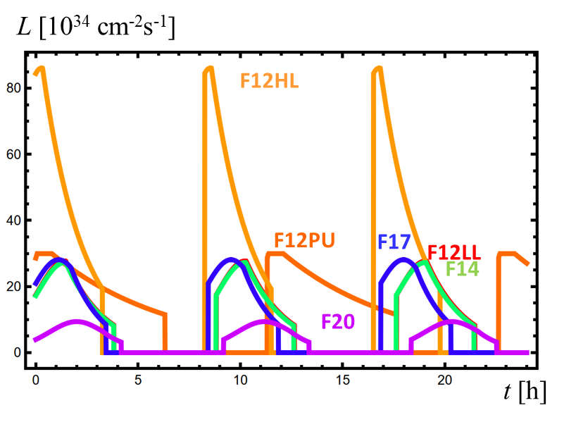
Luminosity over 24 h
Parameter | Unit | F12LL | F12HL | F12PU | F14 | F17 | F20 | (HL-)LHC
initial L | nb⁻¹s⁻¹ | 175 | 845 | 286 | 172 | 209 | 39 | (50, lev’d) 10
initial pile up |  | 580 | 2820 | 955 | 590 | 732 | 141 | (135) 27
opt. run time | h | 3.8 | 3.3 | 6.3 | 3.8 | 3.4 | 4.2 | (18-13) ~10

Slide 15
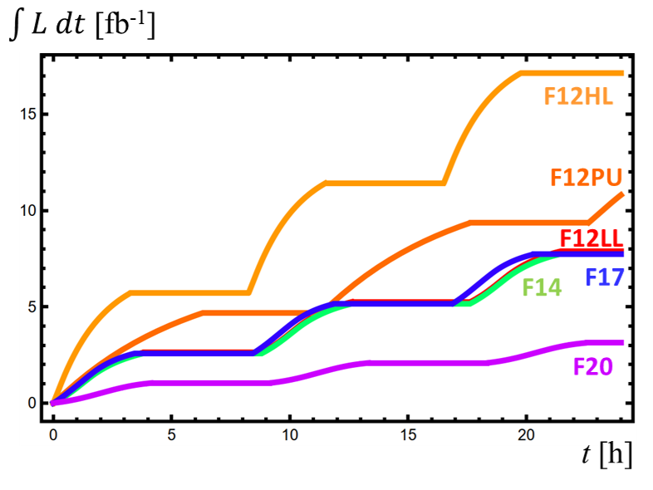
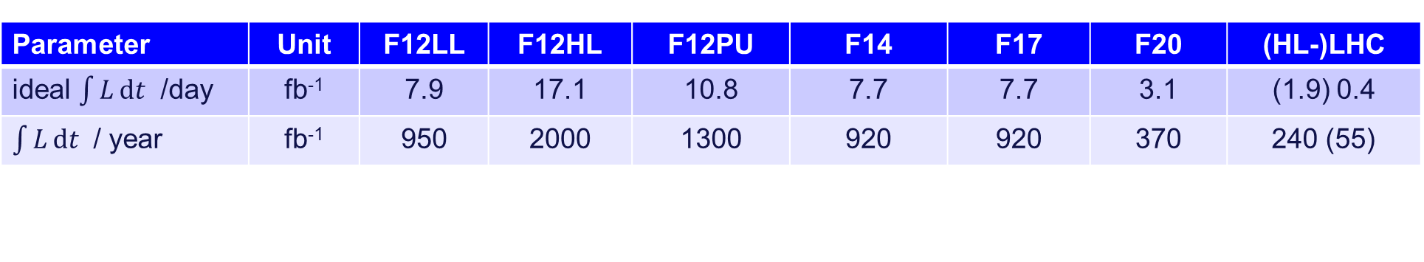
Ideal integrated luminosity per day
Parameter | Unit | F12LL | F12HL | F12PU | F14 | F17 | F20 | (HL-)LHC
ideal $\int{L}dt$ /day | fb⁻¹ | 7.9 | 17.1 | 10.8 | 7.7 | 7.7 | 3.1 | (1.9) 0.4
$\int{L}dt$ / year | fb⁻¹ | 950 | 2000 | 1300 | 920 | 920 | 370 | 240 (55)

Slide 16
Options
16
Energy, luminosity, operation scenarios - UPDATE
Staging scenarios for FCC-hh to reduce initial cost ?
– 1. missing dipole scheme as proposed for SPS and LHC,
and studied for HE-LHC, e.g. with initially two 12 T dipoles
per cell, later adding 14 T dipoles in empty slots
– 2. lower field 12 T complete machine, later 20 T magnets
Top-up injection ?
– higher efficiency & higher integrated luminosity
– may allow reducing power consumption
(beam current and β*) at constant instantaneous luminosity
– needs a “fast” cycling full-energy injector
Frank Zimmermann
FCC-hh/magnets meeting, 3 October 2024
Thanks to Michael Benedikt, Michelangelo Mangano, Ezio Todesco

Slide 17
A few conclusions
FCC-hh based on 14 T Nb₃Sn magnets could start operation in ~2055, centre-of-mass energy ~84 TeV
Higher magnet temperature of 4.5 K, or even 10 K (HTS), could reduce the electrical power required
Worldwide HTS conductor development, driven by other fields & applications, is expected to lower the cost of future HTS magnets

