Slide 1

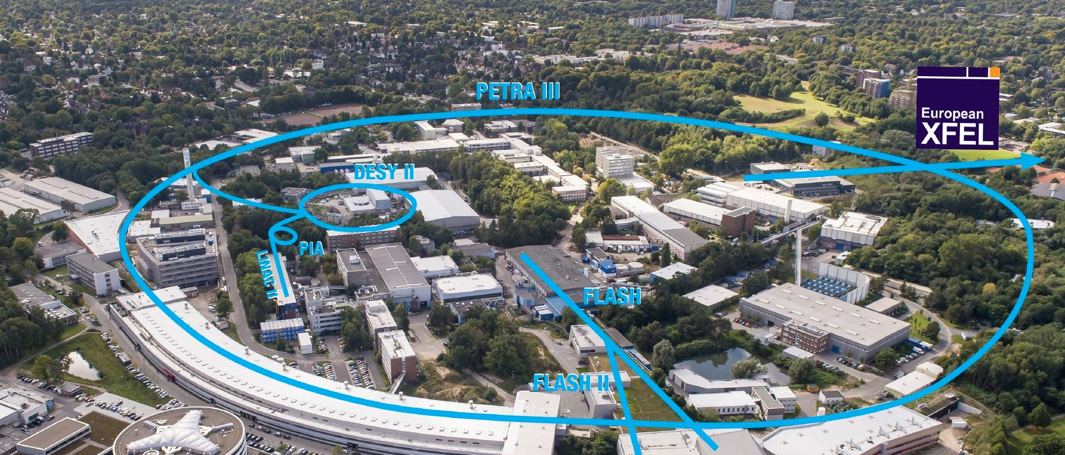
DESY. The Decoding of Matter
Beate Heinemann
DESY Director in charge of Particle Physics
KET Meeting, 21/22 November 2024

Slide 2
DESY: Overview and Status
DESY is a multidisciplinary laboratory with many responsibilities
Operate user facilities for more than 4000 users each year
Operate large computing infrastructure for research to understand structure and dynamics of matter
Facilitate national contributions to large international experiments (ATLAS, CMS, Belle-II, CTA, IceCube, ..)
Finances are tight at DESY
Salary increases and inflation larger than annual budget increase
PETRA IV project not yet approved but highest priority
Energy costs still about 30% higher than before 2022
Consequences for HEP at DESY
Reduction of early career researchers by about 30% and very selective replacement of retirees
Ambitious on-site particle physics programme can only be realized with significant external resources
Important near term milestones for DESY
FIS prioritization process to converge in summer 2025 => PETRA IV decision?
POF evaluation 2025-2026 important for future funding

Slide 3
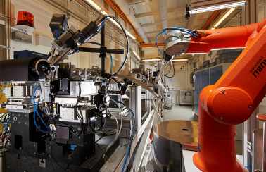
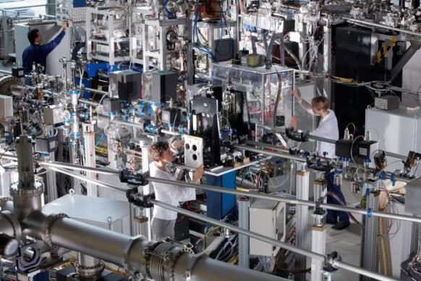
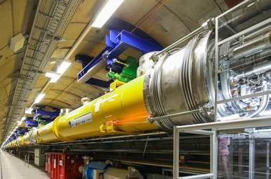
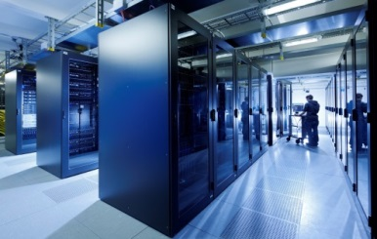
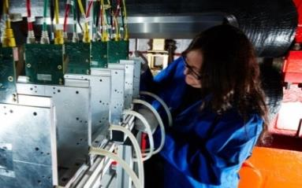
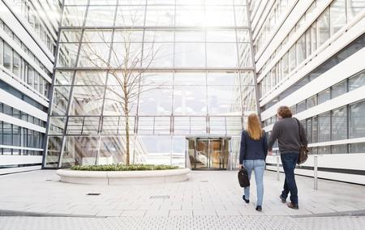
Modern research infrastructures @DESY
PETRA III World‘s largest synchrotron X-ray source
FLASH World’s first free electron laser
EU-XFEL world‘s most powerful free electron laser
Large Computing Center
Test facilties for detectors
Interdisciplinary Research Centers

Slide 4
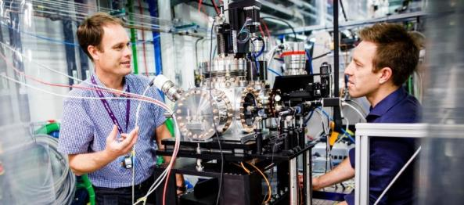
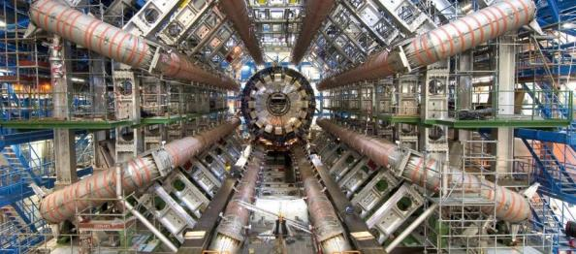

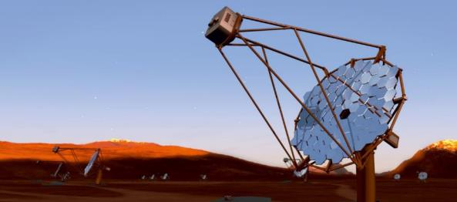
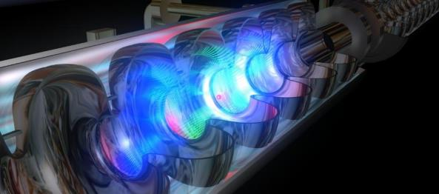
DESY – Areas of Research
Nearly 3000 employees in Hamburg and Zeuthen
Accelerators
Particle Physics
Photon Science
Astro
Particle Physics

Slide 5
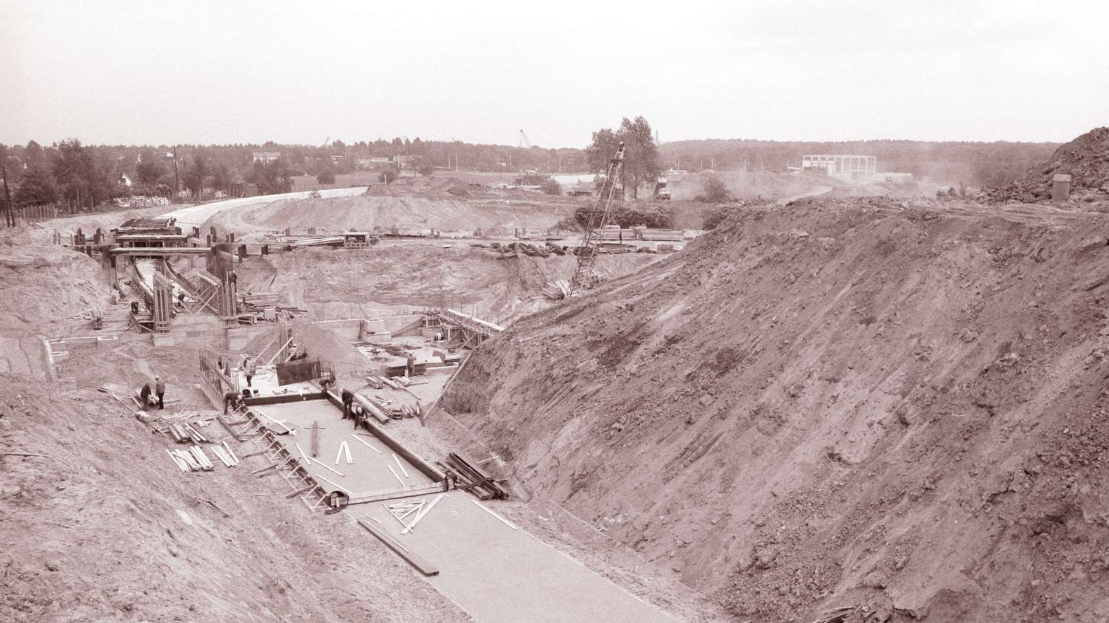
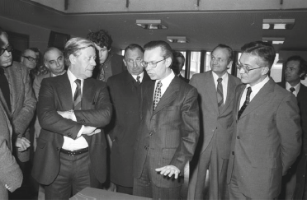
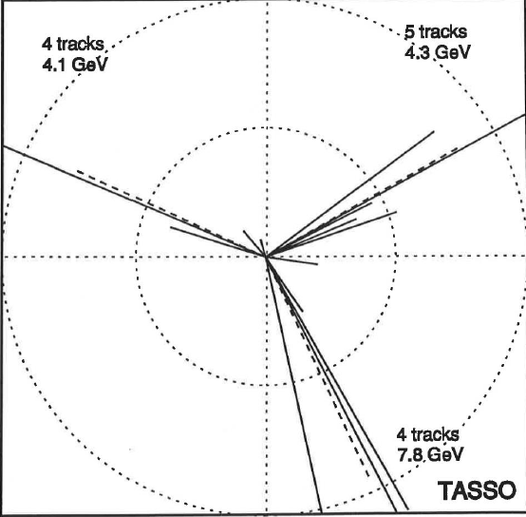
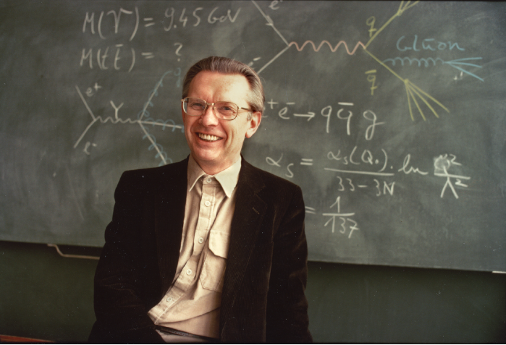
Happy 100th birthday Herwig Schopper
DESY Head of Directorate 1973-1980, CERN Director General 1981-1988

Slide 6


Happy 100th birthday Herwig Schopper
DESY Head of Directorate 1973-1980, CERN Director General 1981-1988

Slide 7
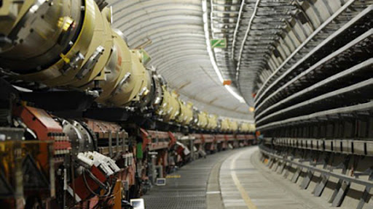
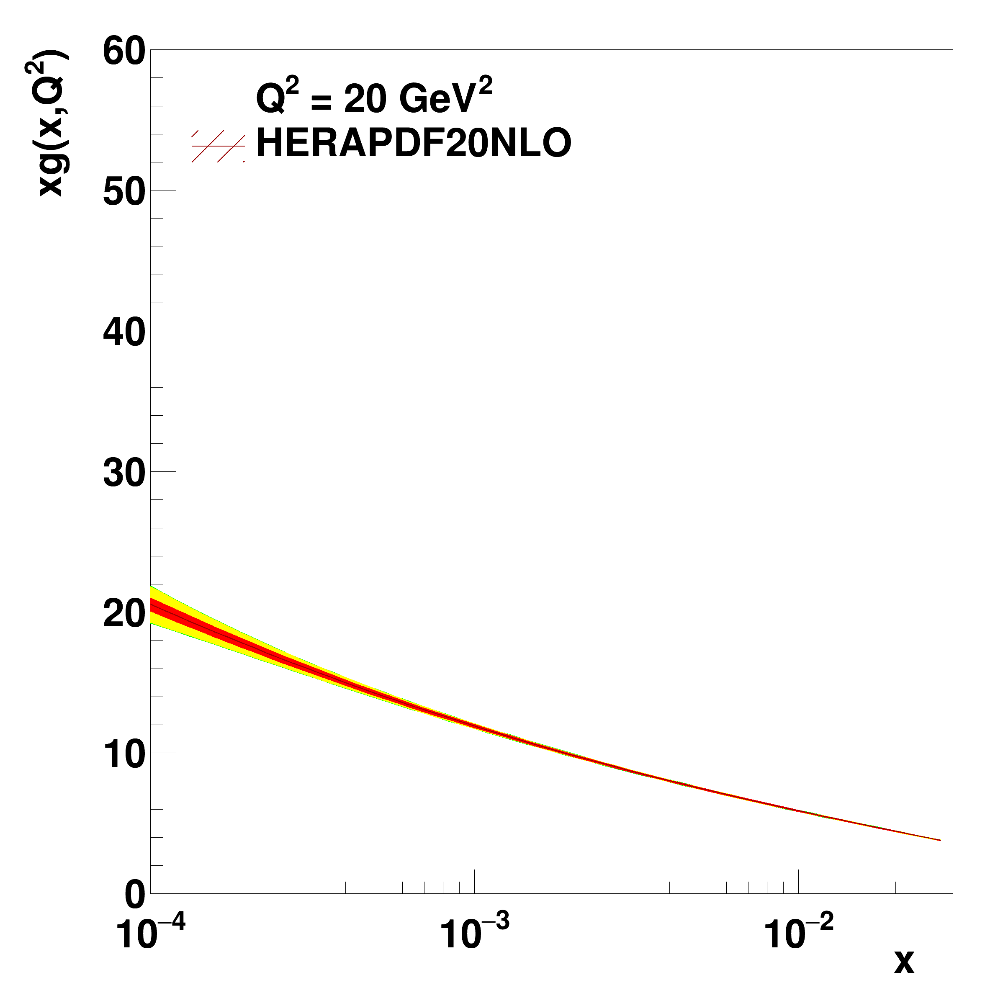
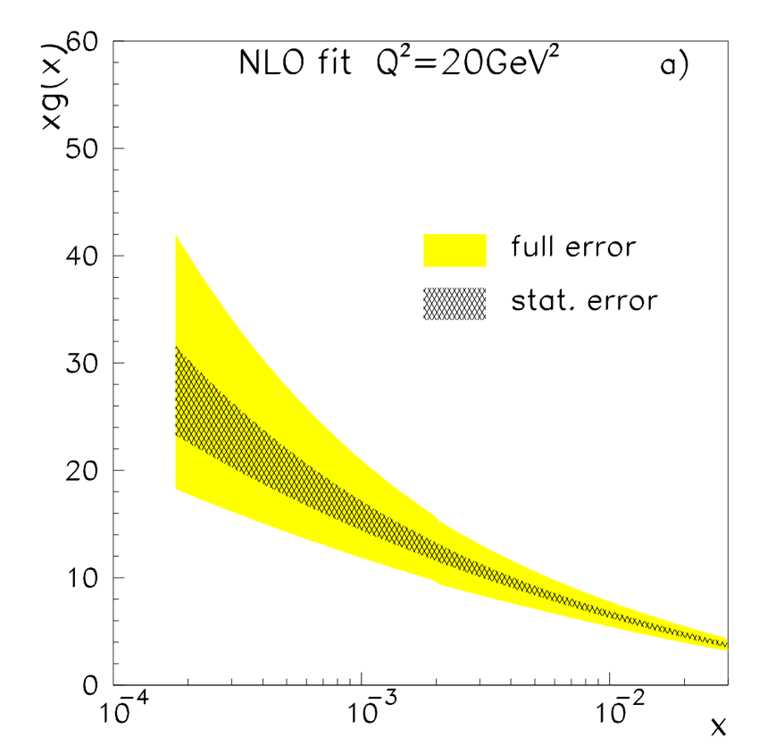
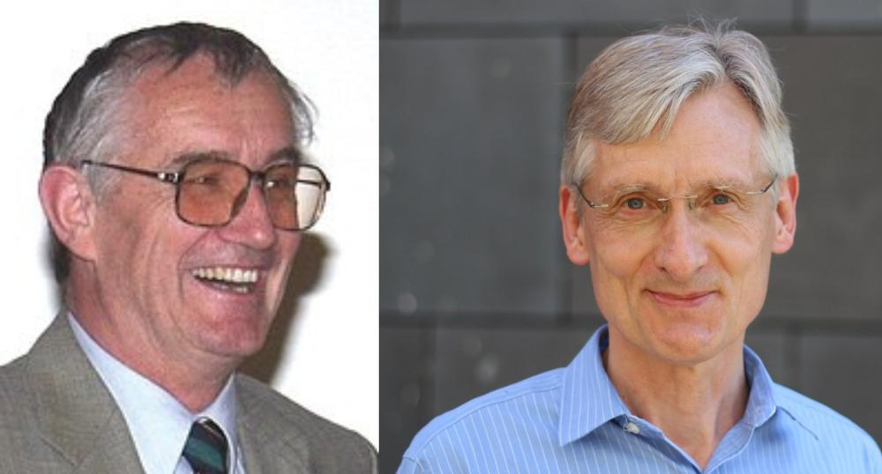
Panofsky Prize of APS 2025
Eckhard Elsen and Robert Klanner
For pioneering work in establishing the HERA physics program and detectors, leadership in HERA physics exploitation resulting in the measurement of the proton's structure in new kinematic regions of vital importance in confronting new aspects of quantum chromodynamics, and enabling discoveries at the Large Hadron Collider.
Robert Klanner (UHH, DESY) and Eckhard Elsen (DESY)

Slide 8
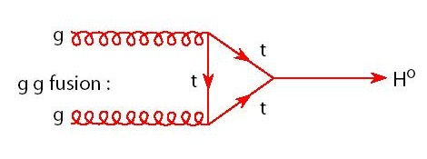
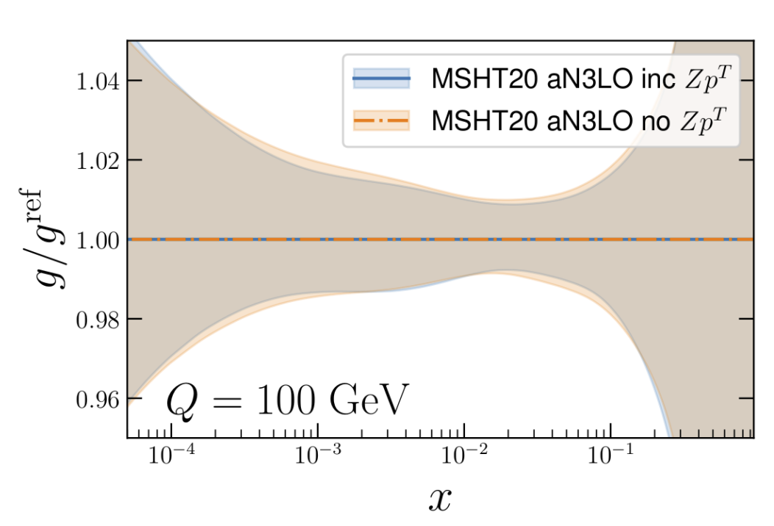
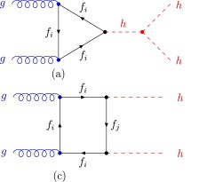
The gluon density
HERAs contribution to LHC physics
T. Cridge, L. A. Harland-Lang, R. S. Thorne, arXiv:2312.12505

Slide 9
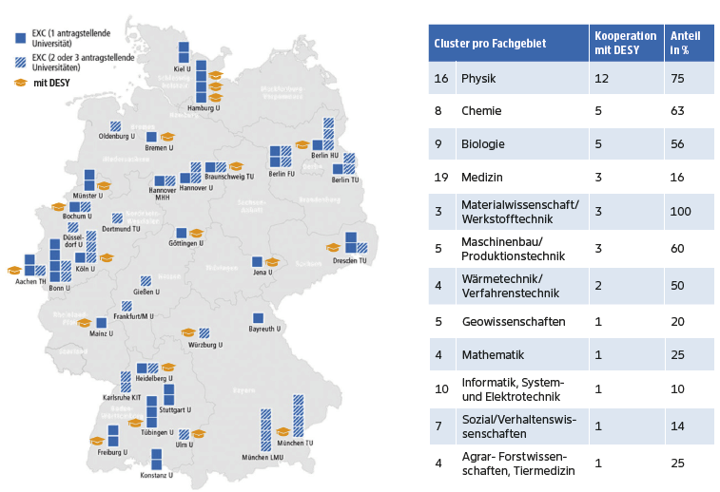
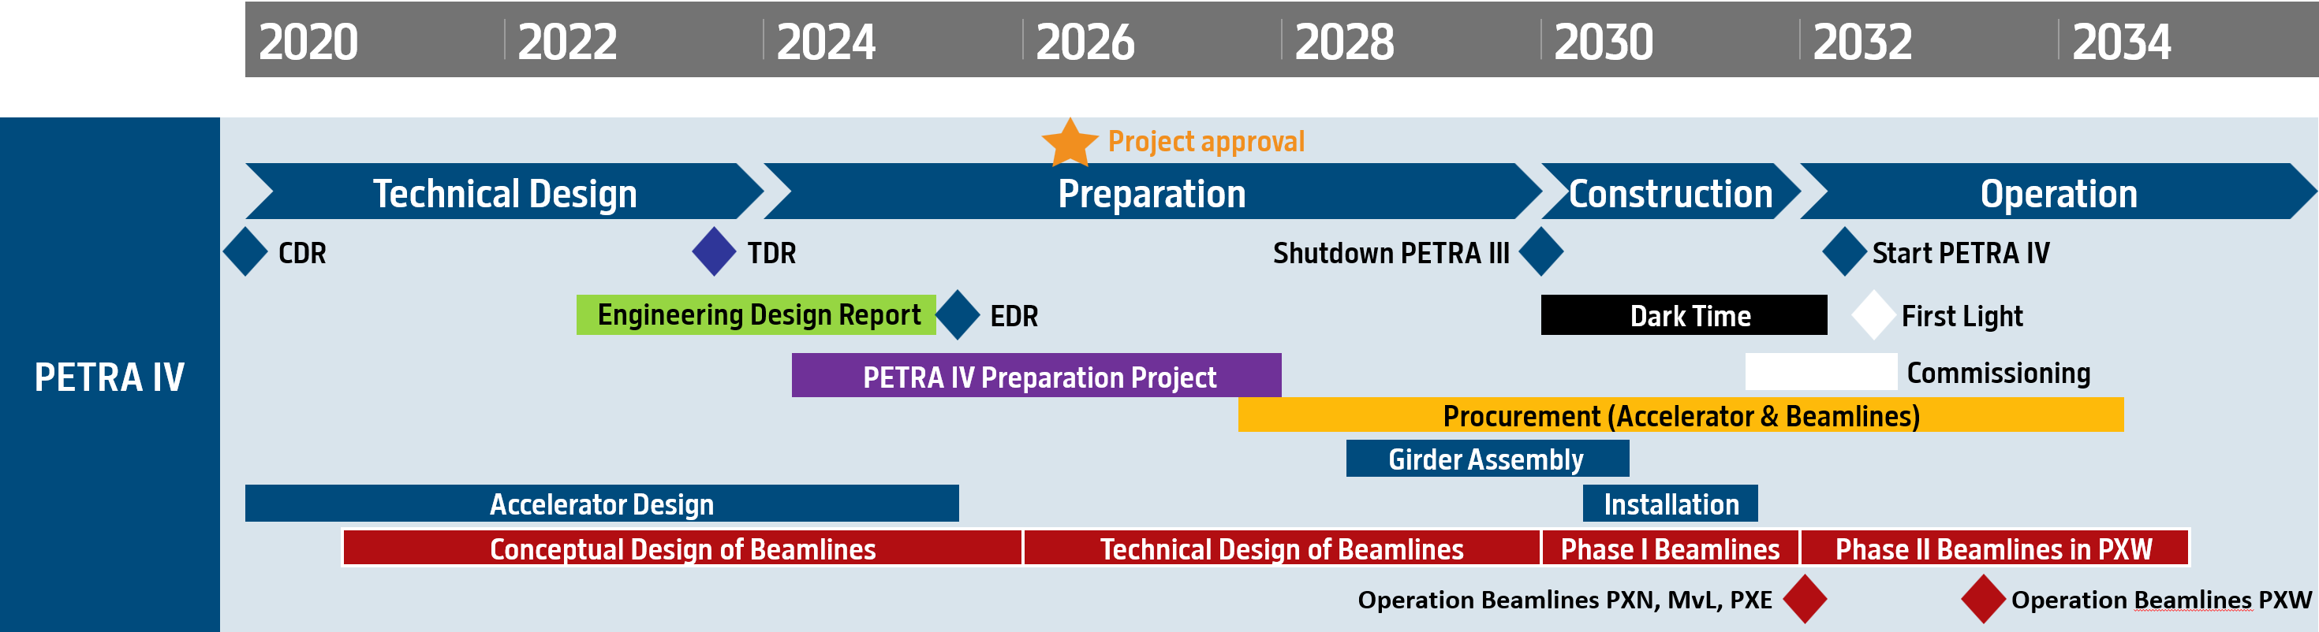
The world‘s best X-ray microscope
50% of all excellence clusters in science&technology use PETRA III
PETRA IV: DESY‘s highest priority future project
National roadmap
  Submitted PETRA IV proposal on Oct. 25th
  3-5 projects selected as high priority by summer 25
  Funding decided by next government
PETRA IV construction planning
  Shutdown planned for 2030/2031
  DESY II/test beam will continue to run until 2029

Slide 10
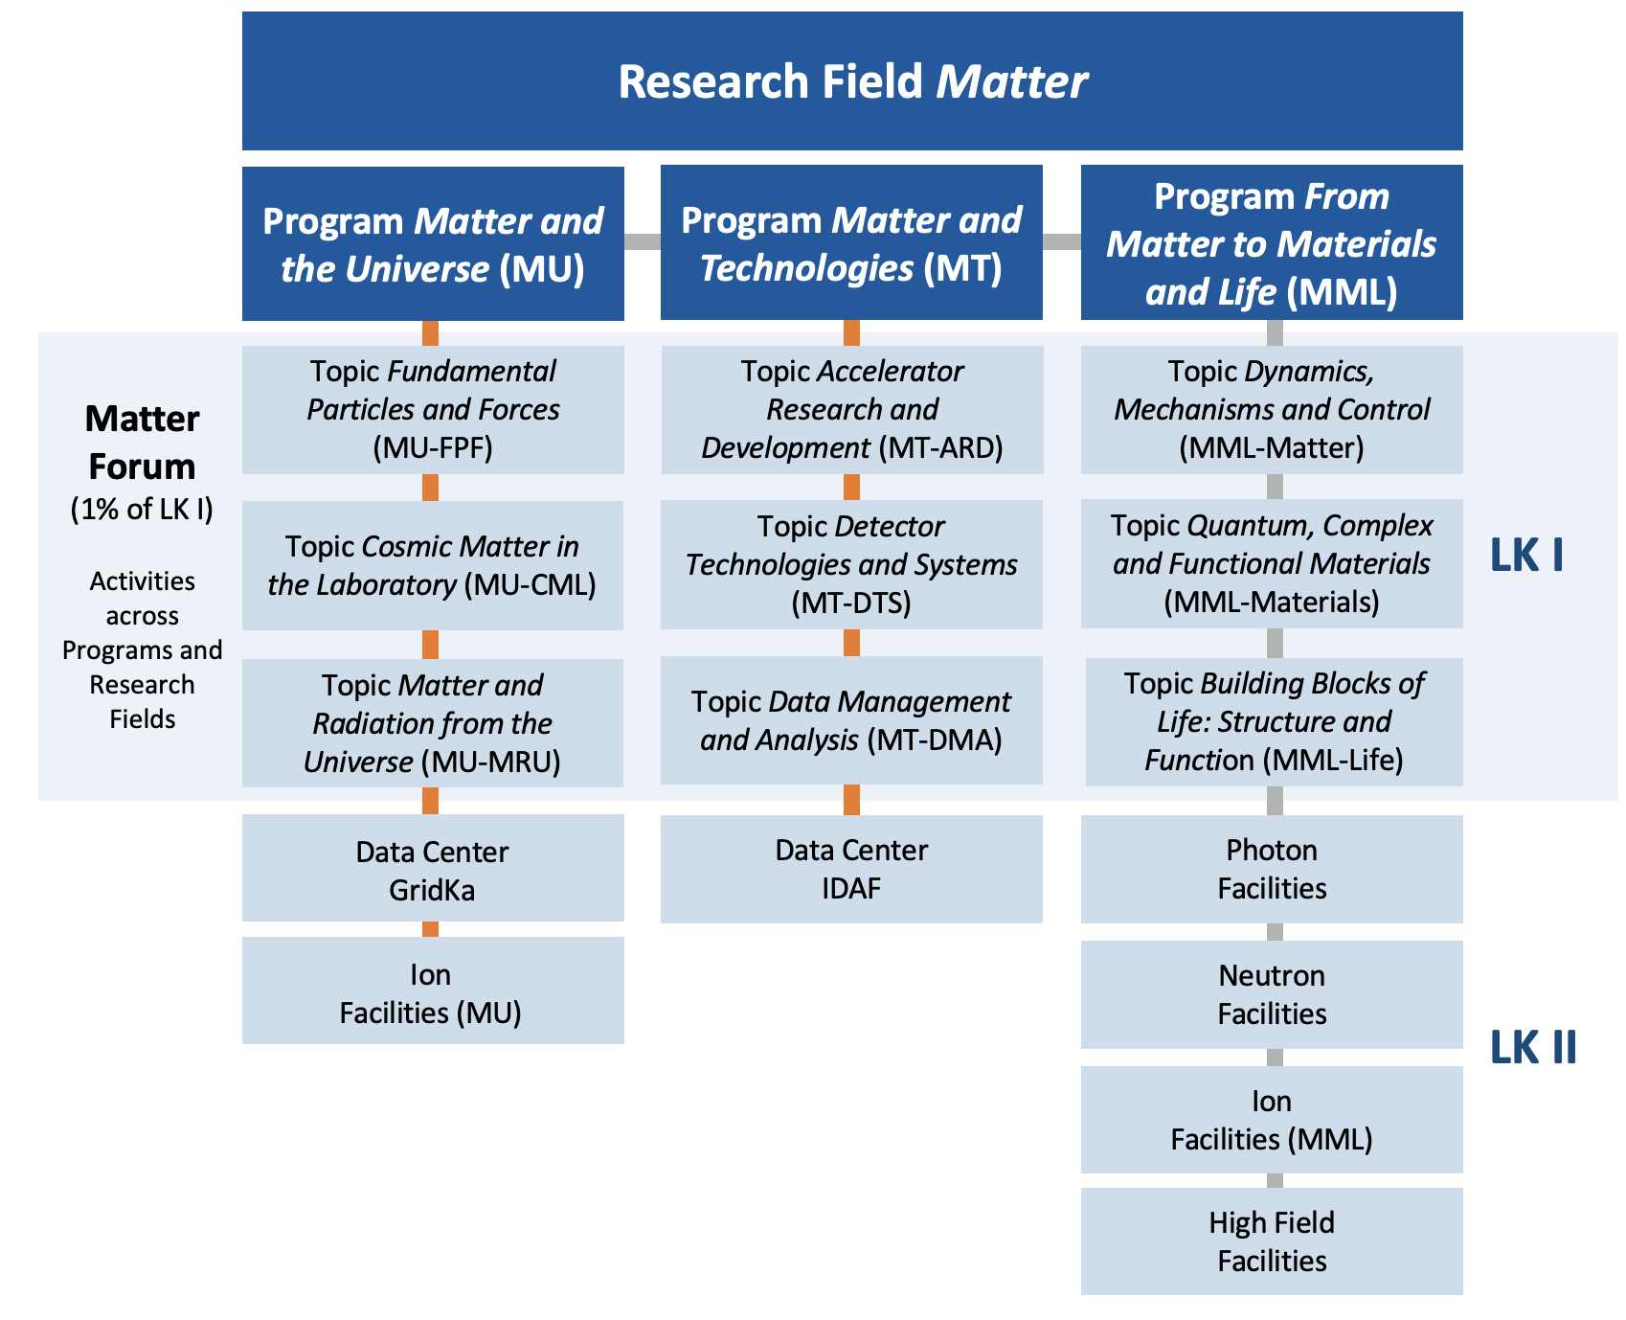

PoF^{(*)} Preparations
The next 7-year funding round starts 2028
(*) PoF= Programme oriented Funding
Evaluation by international expert panel:
Scientific evaluation: Feb. 2025
Strategic evaluation: early 2026
Notes:
Put only DESY, OK?

Slide 11

Particle Physics at DESY

Slide 12


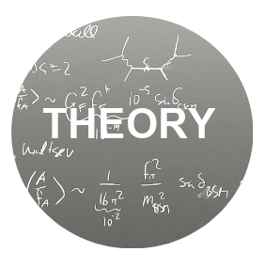

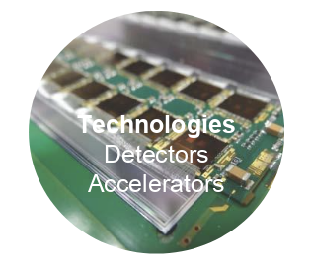
Four pillars of particle physics at DESY
?
Key contributions to global projects at CERN and KEK
HL-LHC
Belle II
Closely work with German universities (natl. hub)
  Establish WPC as world-leading interdisciplinary centre for theoretical physics
  Idea factory for future science endeavours
  ALPS II: first data 2023
  BabyIAXO, LUXE MADMAX: >2028
  New ideas: VMB @ ALPS II, R&D on HF GW local exp’ts (complements ET)
  Strengthen innovation in detectors and computing
  Increase 3rd party funding
  Strengthen exchange across divisions
  Work closely with German universities

Slide 13
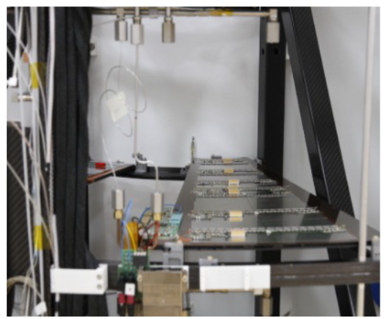
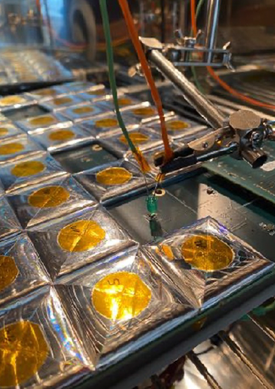
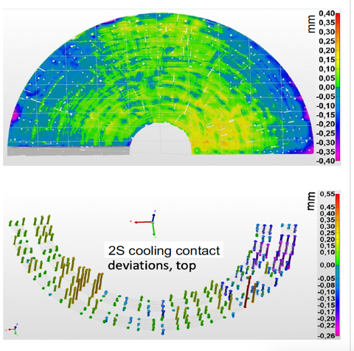
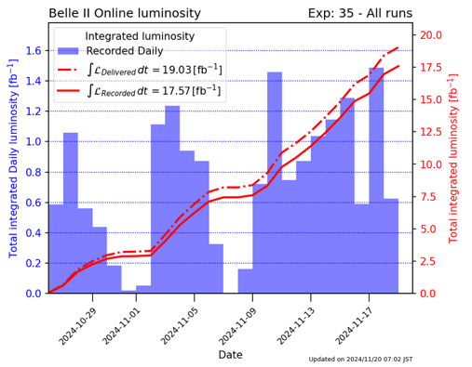
Construction Projects at International Facilities
Major contributions by the lab and together with German and other partners. HL-LHC as priority!
Encountering issues:
ATLAS module cracking
CMS front-end hybrid quality
lpGBT ASIC issue
HL-LHC schedule shift by 7.5 months, LS longer by 4 months → binds manpower
SuperKEKB: accelerator problems – hindering lumi goals and endangering detector
PXD2 currently off.
Run 2024c since 26 Oct
Int’l expert group with DESY working on problems
Building endcaps for ATLAS and CMS
Pre-production ongoing
ATLAS skeleton about to arrive from NIKHEF
ATLAS petal testing ongoing
CMS good progress in services, testing, tooling
CMS HGCAL moving from testing to production: 170.000 SIPMs received, first pre-pro-duction tiles received and wrapped
KET Meeting | 21/22 November 2024 | DESY Particle Physics | BH

Slide 14
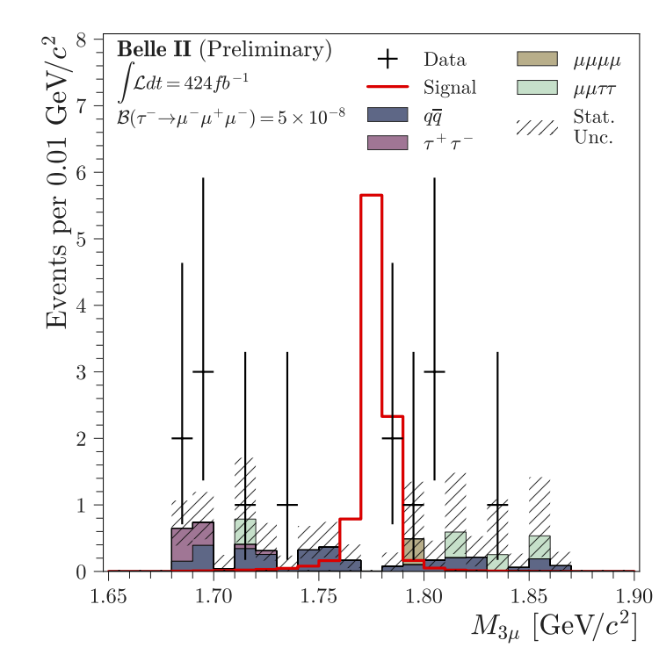
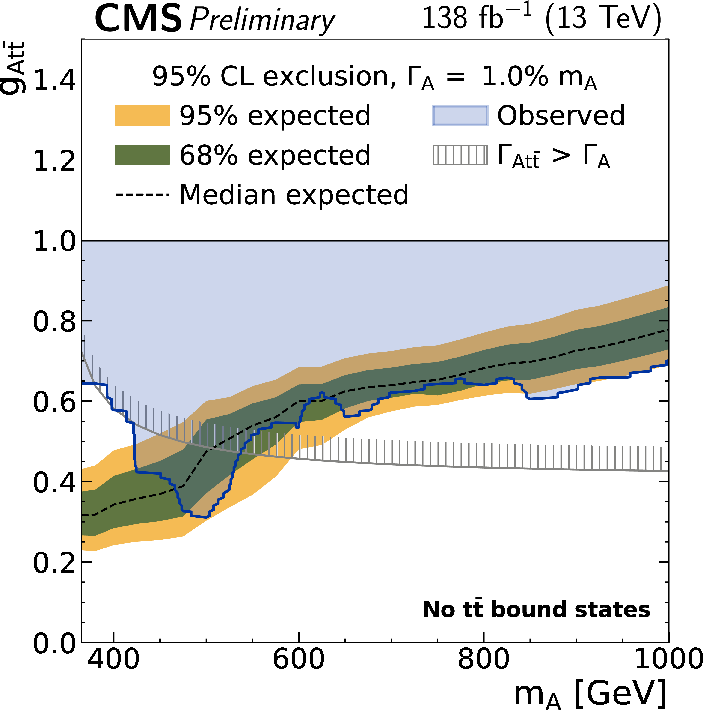
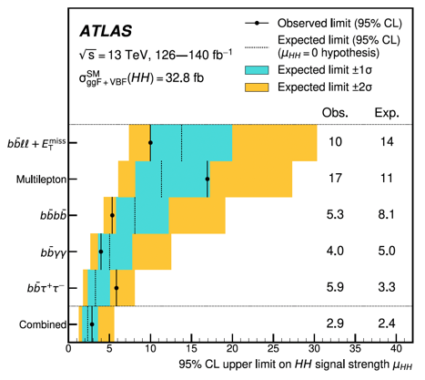
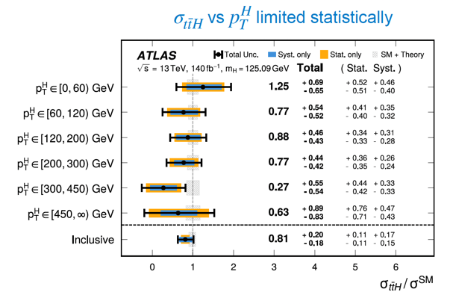
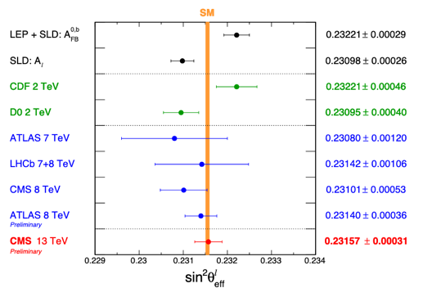


ATLAS, CMS and Belle II Scientific Harvest
Recent Physics Highlights with major DESY contributions
Belle II $τ→μμμ$
arXIv:2405.07386
CMS ttbar resonance search:
CMS-PAS-HIG-22-013
ATLAS di-Higgs search comb.
PRL 133 (2024) 101801
ATLAS ttH(bb) measurement
arXiv:2407.10904
CMS $\sin^{2}θ_{eff}^{l}$ measurement
CMS-PAS-22-010
KET Meeting | 21/22 November 2024 | DESY Particle Physics | BH
Notes:
Hier koennte man “mockingly” sagen, dass DESY nicht nur Kram baut und fuer andere da ist und selber massivven output generiert. :
Di_Higgs ATLAS: Most stringent constraints on HH production and • Limit on driven by and channels κλ
Dazu noch Belle II R(D*) und BR fradtions of taus?

Slide 15

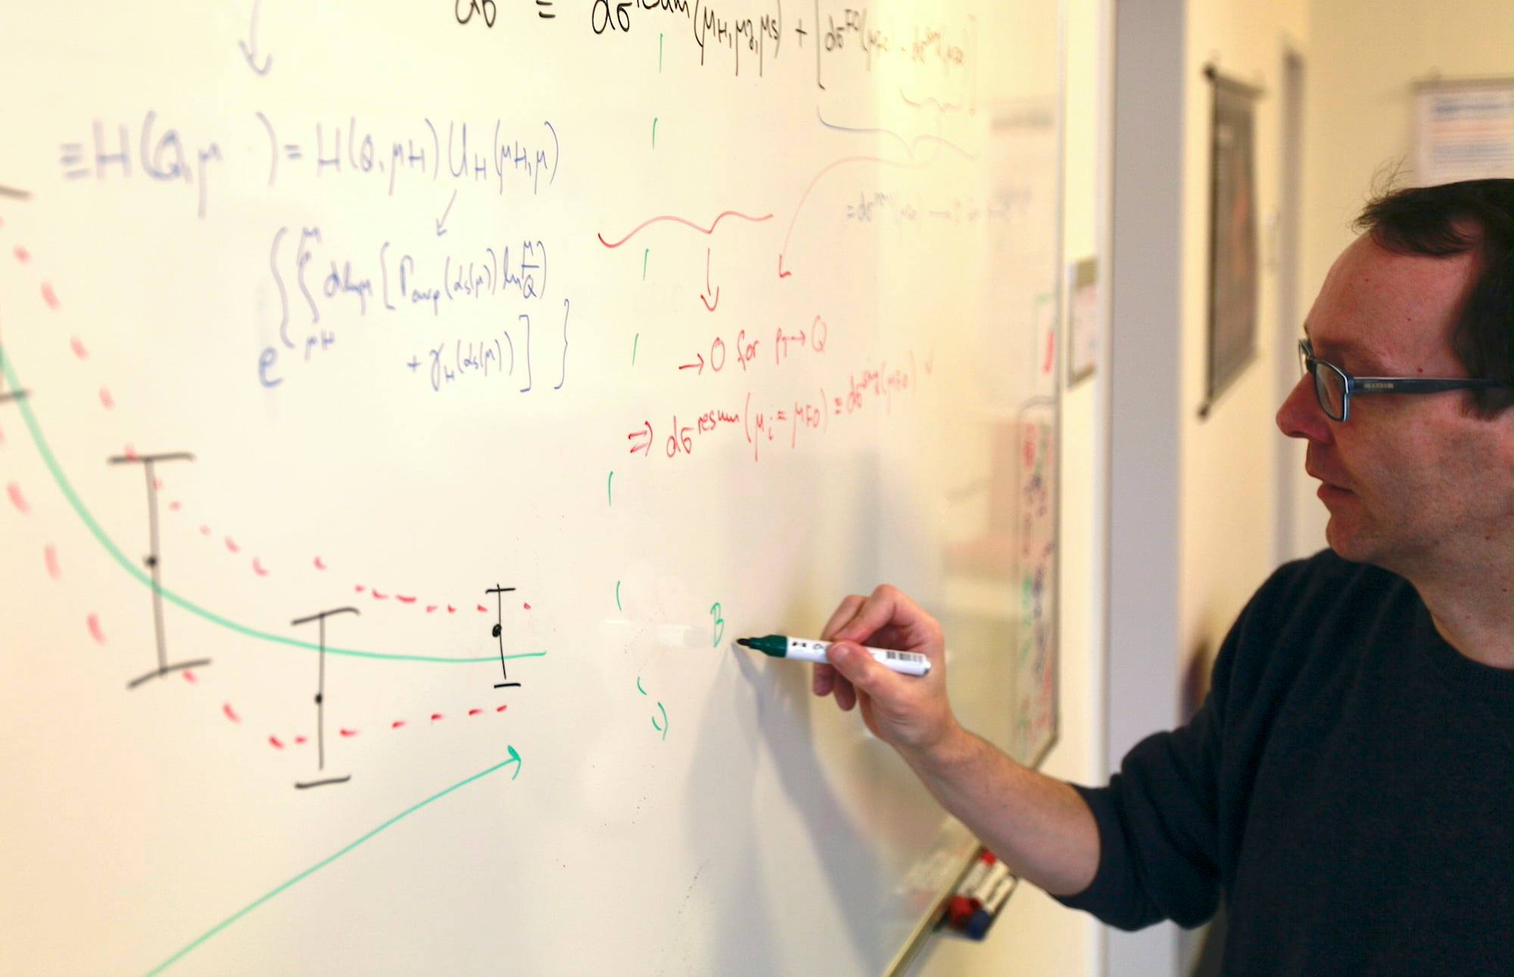
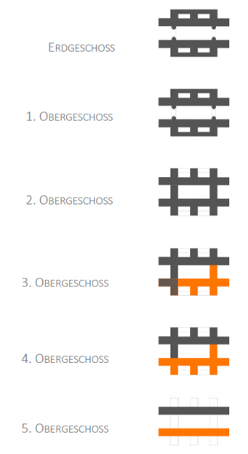
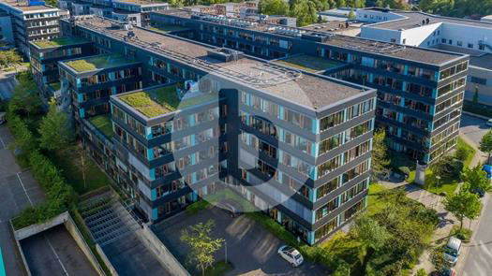
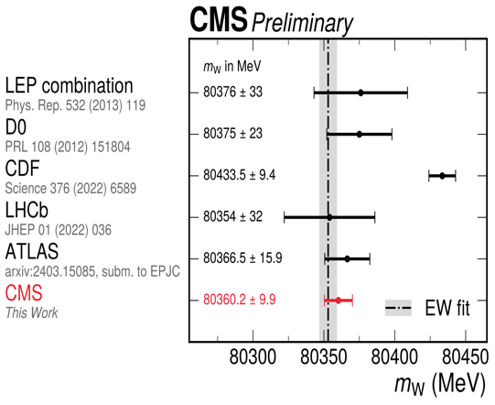
A Strong and Broad Theory Group
Frank Tackmann:
Novel approach
to constraining
theory nuisance
parameters for
W mass
Wolfgang Pauli Center: Plans for “Double-H” building being discussed with architects
Date of final move not yet known
Worked out priority list:
DESY and UHH under 1 roof
Central auditorium (100+)
Central atrium next to it
Research hostel
Visitor centre
KET Meeting | 21/22 November 2024 | DESY Particle Physics | BH
Notes:
BH: Can I have the text in the “Nots” and instead of words on the side, can we have something on WPC? Aus den Folien von Christophe in der closed session des PRC könnte man da etwas basteln, das die Infos, was wir dann als Fläche haben usw. erzählen.
“Listening” to the very early universe:
gravitational waves
Early universe goes through phase transitions
(e.g., electroweak phase transition)
Idea: as in boiling water, transition starts in small bubbles in space that gradually expand and finally fill the entire space.
Relativistic hydrodynamic simulations predict conversion of latent heat into sound waves and finally into gravitational waves
These are distributed stochastically and appear as a “background” of gravitational waves, not tied to individual sources
Could be detected by e.g. LISA;
first signs may have been found by NANOGrav.

Slide 16



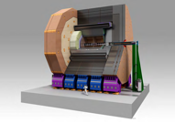



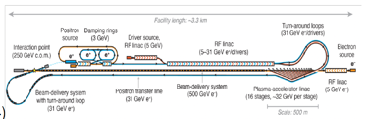



DESY’s contributions to European Strategy for Particle Physics
https://cds.cern.ch/record/2721370/
The stratey update should include the preferred option for the next collider at CERN and prioritised alternative options to be pursued if the chosen preferred plan turns out not to be feasible or competitive. The stratey update should also indicate areas of priority for exploration complementary to colliders and for other experiments to be considered at CERN and at other laboratories in Europe, as well as for participation in projects outside Europe.
Feasibility study
contributions
ILC in Japan (via IDT)
LUXE (and SF-QED?)
Conclusions:
DESY involved numerous inputs, roles from “contributing” to “leading”
Retaining strong role in future of the particle physics
ALPS-II.
Baby
Contributions to ECFA study, co-coordination
ILD for ILC and beyond
Axion platform at DESY
HALHF Concept
LCVision: versatile LC facility (also at CERN)
Inputs to Muon Collider, LHeC …
Dark Matter
Techn. Net.

Slide 17
Nov. 2nd 2024

Slide 18
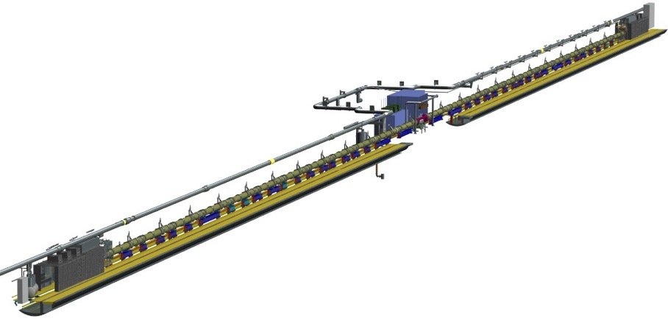
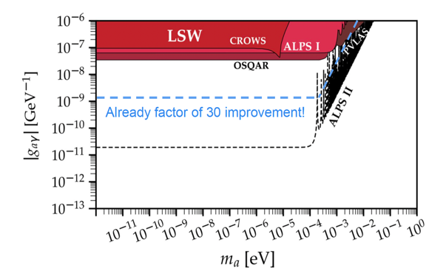
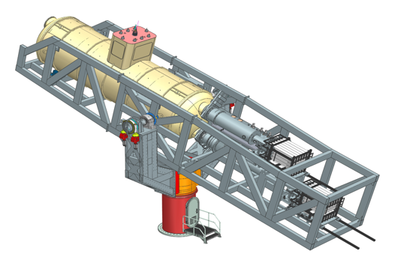
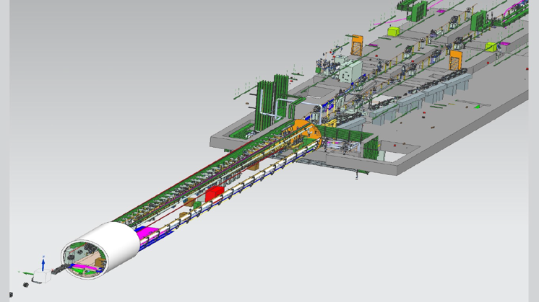
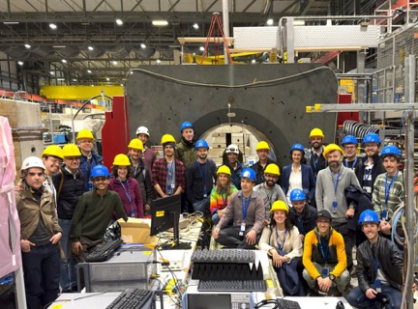
On-Site Experiments: an important contribution to scientific diversity
ALPS II running, progress for MADMAX and BabyIAXO and strong-field QED (LUXE)
ALPS II up and running, producing first results.
Next steps: production cavity
LUXE challenges: extraction beamline and laser!
U Jena to give JETI40 (10 TW) laser to LUXE
Extration: EU infrastructure grant ELBEX: delivering the XFEL e⁻ beam to LUXE
  Working on funding &timeline for realisation later in the decade
BabyIAXO: magnet design advanced. Cable samples to be tested soon.
MADMAX: Cold and warm prototypes tested in MORPURGO magnet (CERN) and in SHELL (UHH). Future CERN runs approved, discussions at FNAL
CAD drawing of ELBEX extraction beamline
Notes:
==========================
==========================
Main issues: extraction beamline and laser!
Laser: U Jena to give JETI40 (10 TW) laser to LUXE
Extration: EU infrastructure grant ELBEX: delivering the XFEL e⁻ beam to LUXE
Consortium agreement with DESY, European XFEL, Manchester, INFN, Valencia being worked on.
Working on funding &timeline for realisation later in the decade
Progress on detector development – examples!
Note Matthew as spokesperson
Note LUXE TDR published in EPJ Special Topics
Strong-field QED workshop, 2−3 Dec
➔ AlSO MENTION EXPANDING OF PHYSICS CASE – NPOD ETC.?
=============================
Make remark on GW efforts?

Slide 19
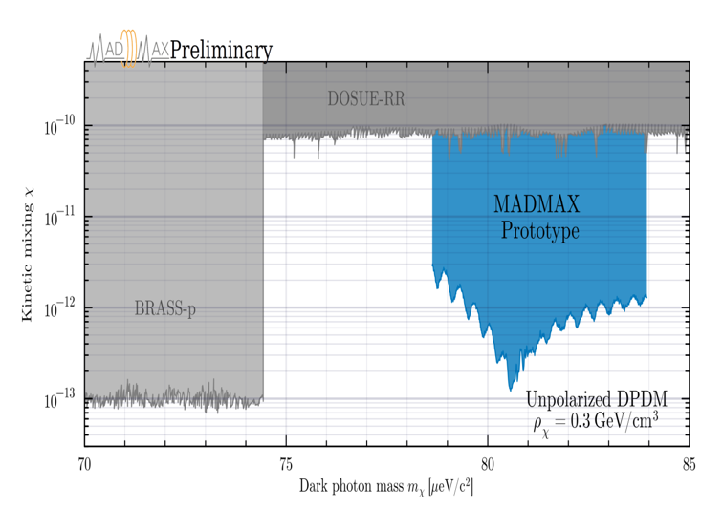
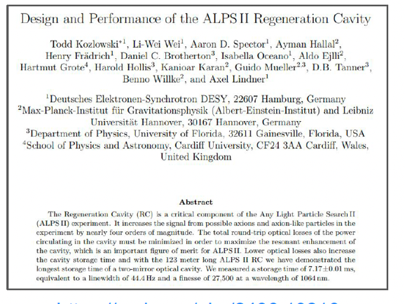
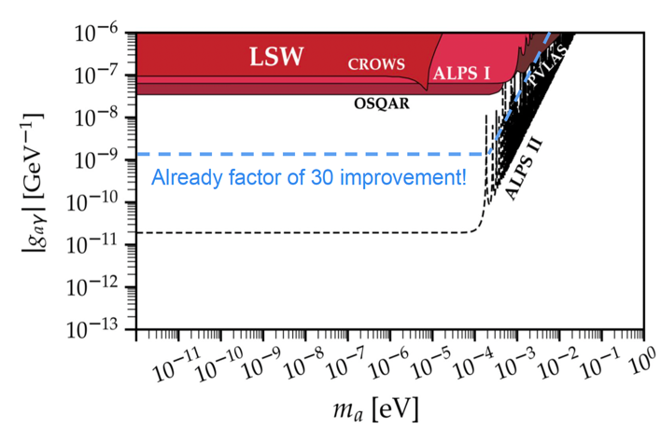
First Axion Results from ALPS II and MADMAX!
First preliminary results
arXiv:2408.13218
ALPS II preliminary
ALPS II design sensitivity
95% CL limits scalars (1.6・10⁻⁹ GeV⁻¹) and pseudo-scalars (1.3・10⁻⁹ GeV⁻¹) were derived → factor 30 improvement wrt OSQAR
Lessons learned and use of production cavity improve sensitivity by another factor 100
MADMAX: World-leading limits for dark photon DM and axion DM achieved
(2409.11777, 2408.02388).
Notes:
Erklaerung: Faktor 30 Verbesserung auf das Limit der Axion-Photon Kopplungsstärke relativ zum besten vorherigen Licht-durch-die-Wand Experiment (OSQAR am CERN). Wir streben hier insgesamt einen Faktor 1000 an (mit der Regeneration Cavity and Lessons learned aus dem ersten Run). In Signal/Noise sind das 12 Größenordnungen.

Slide 20

LHC Computing and IT at DESY
Federal funding scheme change: WLCG migration of resources
Compute: University Tier-2 to NHR
University storage → DESY and KIT
Available resources & news + highlights
Facilities at DESY
  National Analysis Facility (NAF): 9k CPU cores, local storage (~2.6 PB)
  Tier-2 WLCG grid site with 23 PB dCache storage
  Recent migration to RHEL 9 linux essentially done
  P. Neumann as new DESY IT head
  with new research group for computional methods
  Ongoing sustainability discussions for data centres
  Machine upgrades
  new architectures
  move to GPUs and FPGAs
  cluster shaping based on green energy availability,
  Education / teaching of good practices, …
  …
To be resolved: increased requirements on storage, network, personnel, data management at NHRs
➔ application to HGF planned for 2025,
bridge funds received.
Notes:
National Analysis Facility (NAF)
9k CPU cores, local DUST storage (~2.6 PB)
Grid computing – DESY is a TIER-2 WLCG site
dCache storage: 20 PB of data in HH, ~3 PB in ZN, easily accessible on NAF → efficient analysis of large data sets
Migrations to RHEL 9 linux (EL9) essentially done
CentOS 7 (EL7) reached end of support in June 24.
P. Neumann as new DESY IT head: Started new working group on scientific computing with European XFE, and started research grop for computional methods @ DESY.
Sustainability discussions: e.g. minimise use of energy from
non-renewable sources in data centres etc.
Efforts: machine upgrades, new architectures, move to GPUs and FPGAs, cluster shaping based on green energy availability, teaching of good practices, …
Currently, several universities operate Tier-2 centres
Because of federal funding : WLCG migration of resources
Migration from university Tier-2 to NHR (compute) and
KIT/DESY sites (storage) – focus on computing power.
Application to HGF planned for next year (bridge funding received)
To be resolved: data management at NHR sites
DESY ready to take leading role for caching solution (prototype development ongoing)
Also more storage and networking load at DESY

Slide 21



Test Beam Operations
The 2024 Run is still ongoing ….
2024: a record year with more than 450 users
Incident on 30 October: a fire at DESY II: a power supply
  No harm or danger to humans
  But damage to equipment, and necessary clean-up
  Resumed operations on 20 November!
2024 users
  Education and outreach key part of the facility concept
  Beamline4Schools 10th edition this year (5th with DESY)
  US school from Andover/MA: Smith-Purcell radiation
Reisman School
Schwartz-Weizmann
School
Central issue for HEP community:
Can test beam facility run in the PETRA IV era?
KET Meeting | 21/22 November 2024 | DESY Particle Physics | BH

Slide 22



Terascale Alliance
Going strong: Schools, workshops, …
#students
44
101
28
69
152
Schwartz-Weizmann
School
High-RR School

Slide 23


DESY Summerstudentships
Applications are open for 2025!
2024 edition:
112 students from 27 countries
14 students from Ukraine (special support)
See https://summerstudents.desy.de/
Schwartz-Weizmann
School
High-RR School

Slide 24



Events
Concert on Big Bang
in Berlin (CERN70)
… a few selected ones …
ICFA seminar: Nov. 23
Plus …
1st workshop on Large Language Models in Physics (LIPS) Feb ‘24
Axion Symposiuum, Jan. ‘24
…
Sep. 24: CERN computing school
Participant ranking: 4.77/5
High-RR School

Slide 25


The times they are changing….
Changing habits towards more sustainability
Flight
Train
Car
Other
Particle physics division: main travel method
Trend similar for all of DESY

Slide 27
Thank you!
Beate Heinemann
DESY-FH
E-Mail: beate.heinemann@desy.de
Phone: +49 40 8998 1446 / 1921 / 3023

