Slide 1
Coordinated Outreach and
Promoting Young Talents in Netzwerk Teilchenwelt
Annual Meeting 2024 of Particle Physics
Bad Honnef, 21./22.11.2024
Michael Kobel, TU Dresden
Notes:
Aachen, Bochum, Bonn, Dortmund, Freiburg, Heidelberg, Siegen + Max-Planck-Institut für Kernphysik in Heidelberg

Slide 2
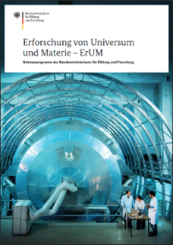
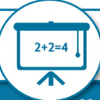

BMBF Framework program ErUM (Exploration of the Universe and Matter)
4 Fields of action
  Large Scale Facilities
  Networking
  STEM young scientists
  Transfer & participation
Explicitly supported via KleT³ project
  KleT³: Kleinste Teilchen: Teilhabe und Talente (2024-27)
  2018-2021: KONTAKT, 2021-2024: KONTAKT2
→ Outreach is integral part of research
within the framework program ErUM
More outreach via LHC ErUM-FSP office,
other funding sources (SFBs, EXC etc.), ...
MINT Nachwuchs
Nachwuchs für MINT Fächer faszinieren
Wissenschaftlichen Nachwuchs qualifizieren
Karriereperspektiven schaffen
Transfer und Partizipation
Wissenschaftstransfer von Forschung in
Wirtschaft und Gesellschaft anregen
Dialog zwischen Forschung und
Bürgerinnen und Bürgern intensivieren

Slide 3
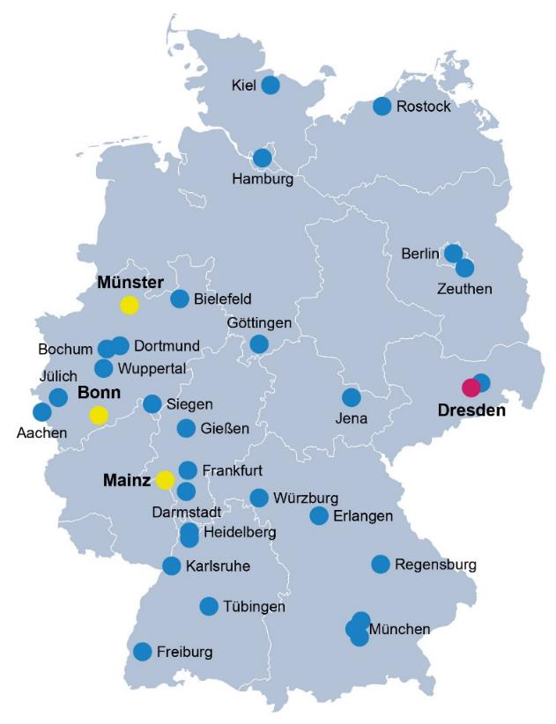
Netzwerk Teilchenwelt
34 universities/research labs
Covering both Particle Physics and Hadrons&Nuclei
Teilchenwelt contact person at each institute
Joint outreach for Particle Physics since 2010 (H&N since 2018)
  Bundle existing activities
  Share structures and programs
  Synergy effects
  High visibility and impact of outreach
Target groups: high school students, young university students, teachers, broad public
Project team: TU Dresden + hubs at Bonn, Mainz, Münster
Collaboration with LHC ErUM-FSP office

Slide 4
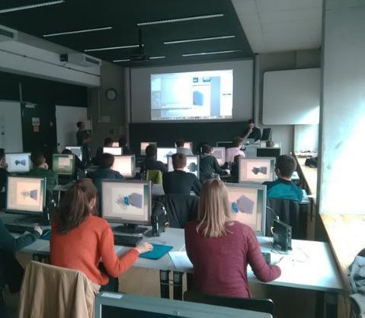
Masterclasses
Project day in school or university or online
  International Masterclasses, International Day of Women and Girls in Science
Talks and Q&A with researchers
Own measurements and analysis of original data
Diverse and very broad range
  LHCb , ALICE, ATLAS, CMS, Belle II
  Machine Learning, Theoretical Methods
  Hadron Therapy
  CBELSA/TAPS, Nuclear Astrophysics
  IceCube, Auger, Cosmic@Web, LAT-Fermi
High school students do research supported by young scientists
© Sebastian Neubert

Slide 5
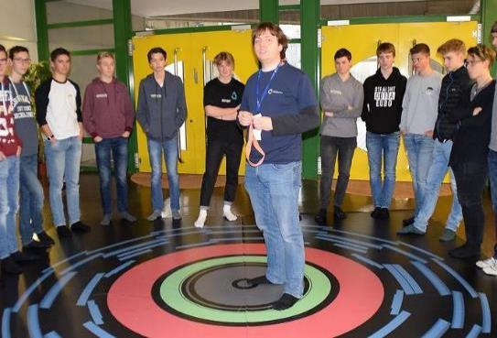
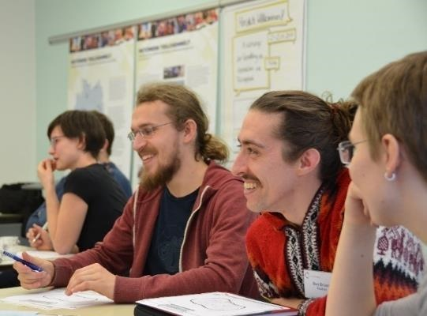
Facilitators
~150 PhD and Master students from all institutes engaged
guide Masterclasses, supervise students´ research projects
get central reimbursement of expenses and travel cost*
yearly science communication and outreach training
  German or English
  Recent Workshop (German): 11.-13.11.2024 in Fulda
  Fully funded by Heraeus foundation, except travel cost
(online) onboarding events, every 3 months
→ PhDs acquire soft skills, for personal and professional development
@Supervisors: Please support this important task!
ATLAS Masterclass in Bonn
* currently suspended due to funding cuts
Outreach workshop in Fulda

Slide 6
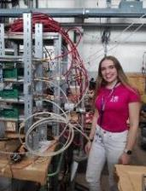
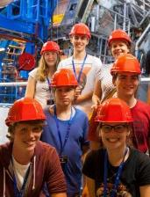


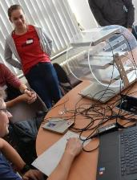
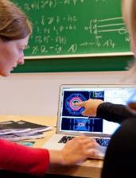
Masterclasses – first level of a multi-step program
CERN project weeks*, research projects at institutes
List of 156 essays, incl. 46 awards
CERN workshops*, Particle physics academy in Mainz
Active engagement, detector projects
Masterclasses
150 Fellows, 50% female
experienced talents,
mainly studying physics or shortly before
15
50% female
75
SCHOOL
RESEARCH GROUPS
High proportion of women on higher levels
250
Female share in physics exams 2023:
22% Bachelor
25% Master
22% PhD
3500
Number of students per year
* currently suspended due to funding cuts

Slide 7
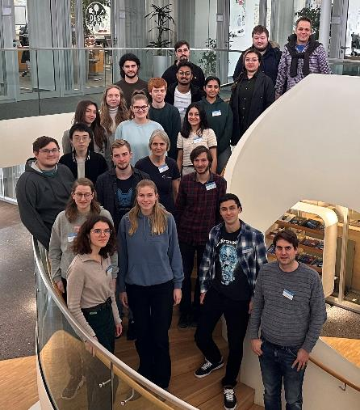
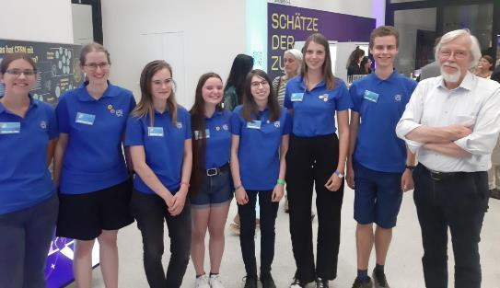
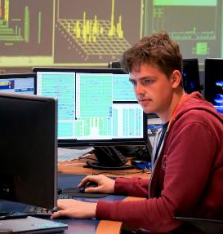
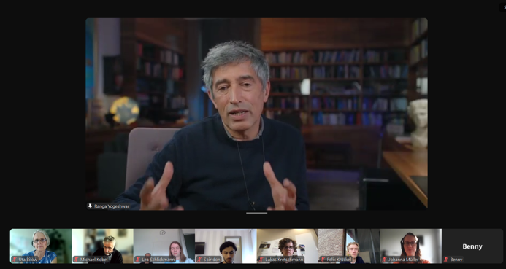
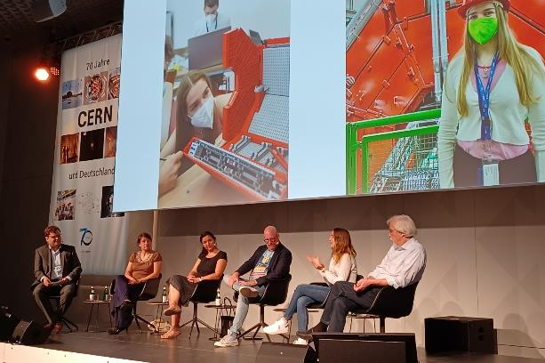
Fellows in science and outreach
Central offers: yearly Fellow physics school,
frequent online events Ask the expert (research highlights, career development),
yearly Fellow meeting*, invitation to national physics conferences*
Local offers: internships, invitation to group events (scientific, outreach, social), ..
* currently suspended due to funding cuts
School Introduction to the Terascale
for Fellows and B.Sc.students
Fellow Lukas: From internship to authorship ATLAS blog
Win for Fellows: Close and early connection to research, extra training, networking
Win for groups: highly motivated, well trained students, support in science and outreach
Fellows invite prominent speakers for Ask the expert: Ranga Yogeshwar, Reinhard Genzel...
Fellow Julia Els
in panel discussion at CERN70 LinkedIn

Slide 8
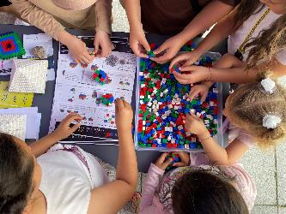
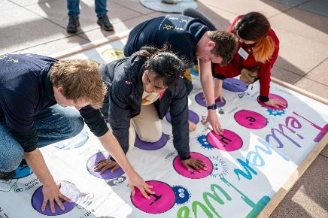
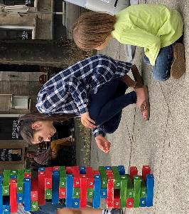
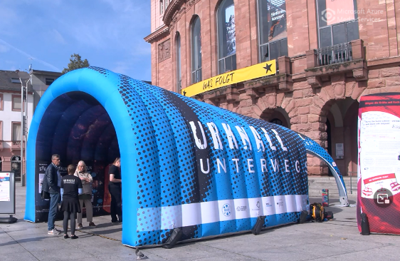
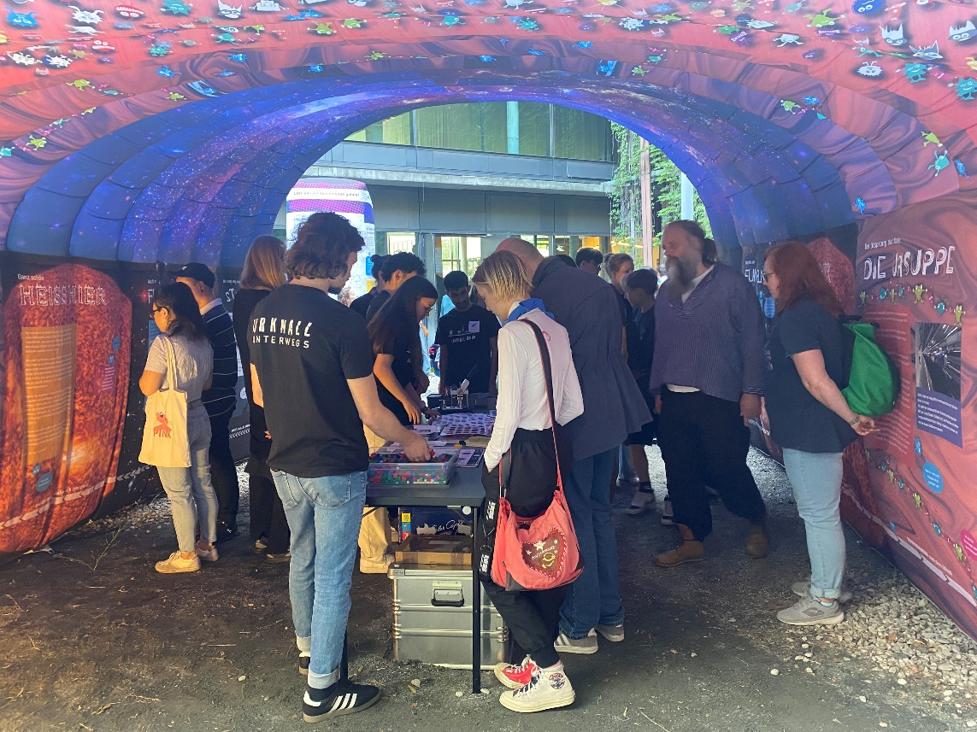
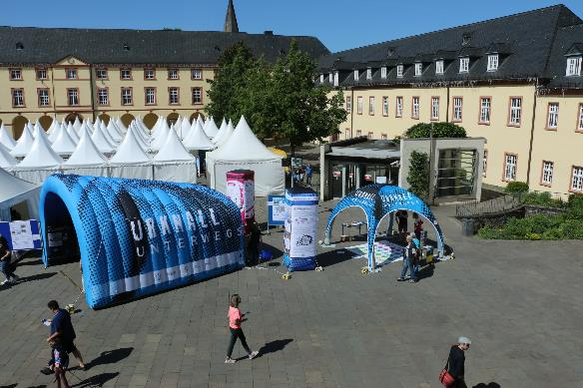
Urknall unterwegs
25+ places visited since 2022 (photo gallery)
tour manager*, no transportation costs*
Now on loan from Mainz
institutes: carry complete setup and transportation costs
* currently suspended due to funding cuts
© Uni Siegen
Notes:
Target group broad public:

Slide 9
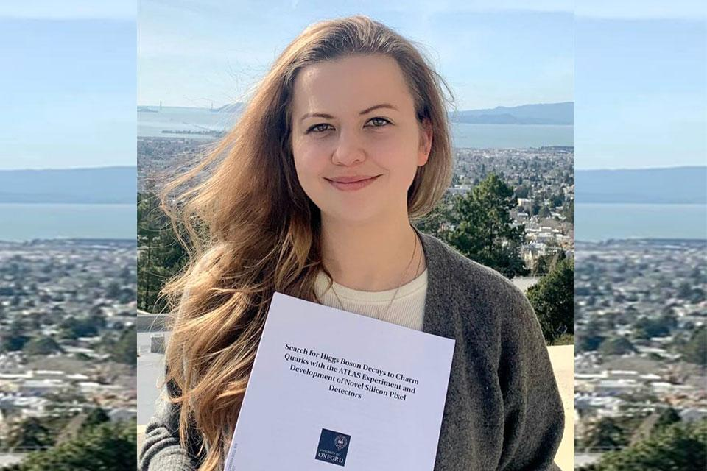
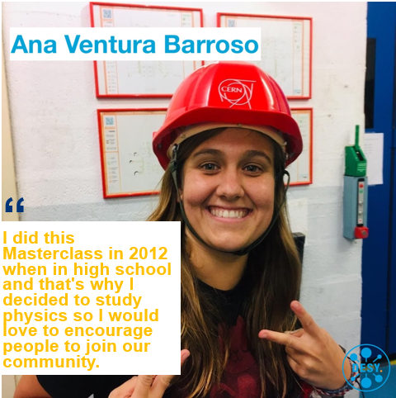
Success story since 2010
Maria M., PostDoc at Berkeley Lab.
ATLAS thesis award 2022
CERN workshop & project weeks in 2013
Talent pipeline: next generation for research
50% female participants on upper levels (CERN workshop and beyond) and in Fellow program
strengthens study decision and self-concept
Sustainable program: 38% facilitators have participated in a Masterclass as high school student (data from May 2024)
„Netzwerk Teilchenwelt has changed my study plans in particular and given me the opportunity to get to know modern research."
RECFA visit 2022: „impressive and well-structured outreach and education programmes …a diverse set of high-impact outreach activities is carried out… In particular, we would like to mention the very successful activities reaching out to secondary-school students (Masterclasses).

Slide 10
Summary and Plan for (temporary) „low flame“ program
Running Netzwerk Teilchenwelt w/o coordination in current funding period (7/24-6/27)
is a bit like running LHC-Experiments w/o beam …
  TU Dresden: 3.4 FTE (incl. personnel at CERN & DESY) → 0.85 FTE, no travel or facilitator funds
  Each hub 0.5-0.67 FTE, but PhD students for specific tasks (DIY Detectors, Cosmic Watch, …)
Emergency workaround: share coordination tasks and reorganize Verbund
  → Bonn: facilitators, communication
  → Mainz: Urknall unterwegs
  → Münster: pilot CERN workshop with external funding (to be applied for)
Maintain established structures, cultures, competencies, and contacts
  Raise external funds to a limited extent, e.g. Heraeus foundation
Secure expertise of Netzwerk Teilchenwelt for better funding in the next funding period

Slide 11
BACKUP ON FUNDING

Slide 12
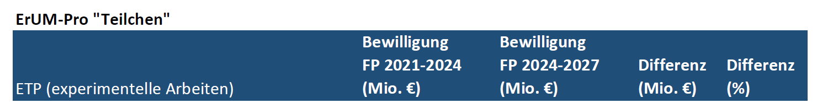
Funding situation for FP 2024-27
Netzwerk Teilchenwelt (DD + 3 hubs) 1,9 0,9 -1,0 -51%
Dresden 1,3 0,3 -1,0 -80%
Dresden until 06/24: central coordination and communication, nationwide offers for all target groups for all locations, incl. personnel at CERN (for CERN programs) and at DESY (for mobile exhibition Urknall unterwegs)
BN, MS, MZ hubs: specific tasks (0,5-0,67 PhD each)
Cuts concern, among other things, all funds that have been returned to the Standorte (fees and travel expenses for facilitators) and all travel expenses for high school students and young students
Notes:
To fully understand the effects of the cuts one has to look at the structure of the project
Dresden: mainly non-scientific personnel
Hubs: extend the offers of the central project coordination in Dresden thematically with their respective expertise,
act as interfaces to further groups or communities and take over specific tasks for the sites within the project
Sum in table from PT.DESY includes Maria Laach School and ECT* program in Trento

Slide 13
Target group high school students
Masterclasses
No central remuneration and travel expenses for facilitators (holding Masterclasses, supervising high school students´ research projects, e.g. Jugend forscht)
  established procedure in the Dresden administration, difficult/impossible at other locations
Continued: Masterclasses (smaller number)
Less Masterclasses, less talents attracted
CERN programs
No Project associate at CERN, no travel expenses for high school students
No CERN programs for high school students
Talent pipeline (multi-step program) interrupted
Notes:
What are the effects of the reduced funding?
Which offers are still available, which will be cancelled?
Stufenprogramm an den Standorten, aber keine Honorare → weniger Engagement. Standorte können i.d.R. keine Honorare zahlen.
keine d-weiten zentral organisierten Vertiefungen für Jugendliche, außer TP-Akademie Mainz. Keine Person am CERN, wurde aus anderen Projekten TUD aufgestockt. Pipeline unterbrochen,
Weniger JuFo-Arbeiten, weniger Preise.

Slide 14
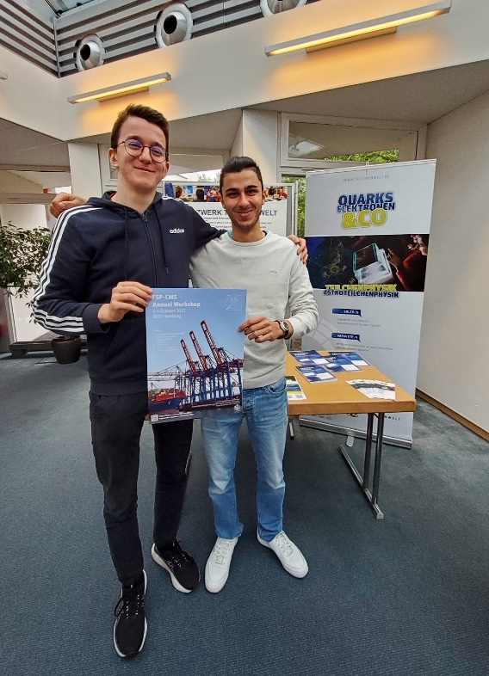
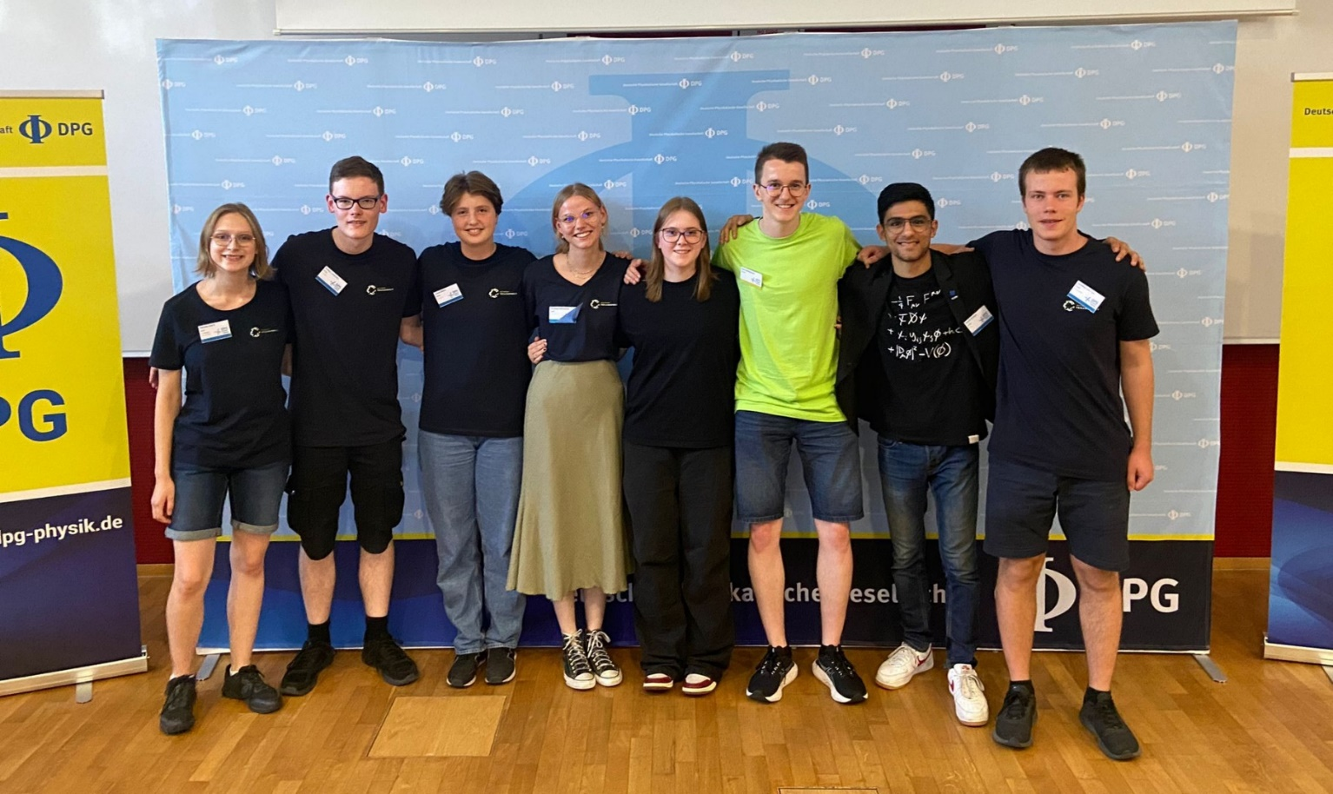
Target group Fellows (young students)
No travel expenses for Fellows (FSP-Meetings, DPG conference)
No annual Fellow meeting
Continued:
  Online offers, e.g. „Ask the expert“
  Fellow school „Introduction to the Terascale“
Fellow program will deplete without CERN programs for high school students

Slide 15
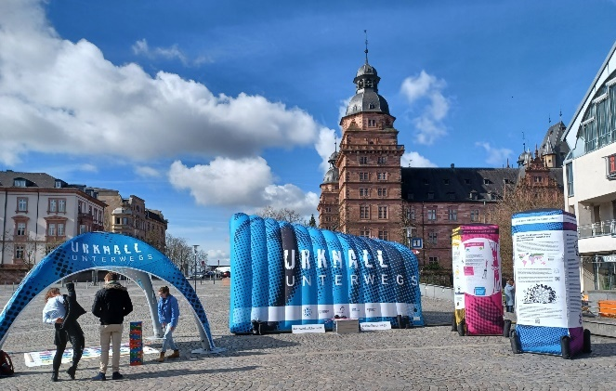
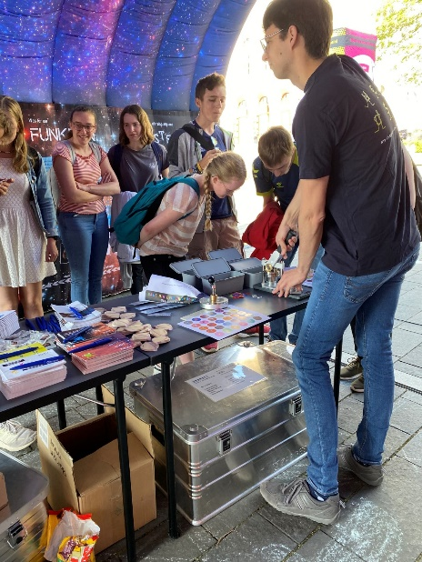
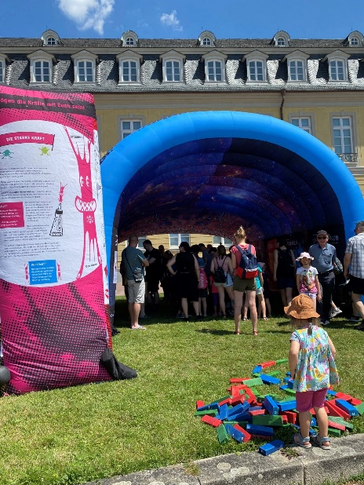
Target group Broad Public
Urknall unterwegs
No tour manager
No remuneration for guides
No funding for tour
Continued: Loan to institutes
Notes:
Everyone has to take care of the authorisations with the city, electrical connection, transport, etc. themselves.
Ausleihe auf Selbstkostenbasis und um alles kümmern, Standgenehmigung, Stromanschluss, guides

Slide 16
Summary
Severe cuts on central coordination and communication (Dresden)
  3.4 FTE (incl. personnel at CERN and DESY) → 0.85 FTE
  No funding for CERN programs for high school students and for Fellow programs
    Central steps missing in multi-step program
    Interrupted talent pipeline
  No funding for mobile exhibition Urknall unterwegs
Moderate cuts at hubs in BN, MS, MZ
  Each hub 0.5-0.67 FTE for specific tasks (PhD students)

Slide 17
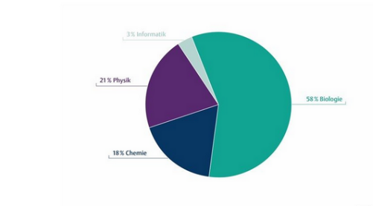
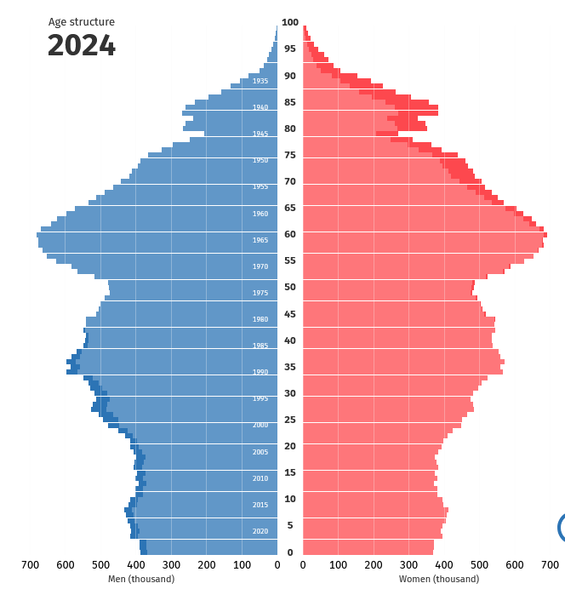
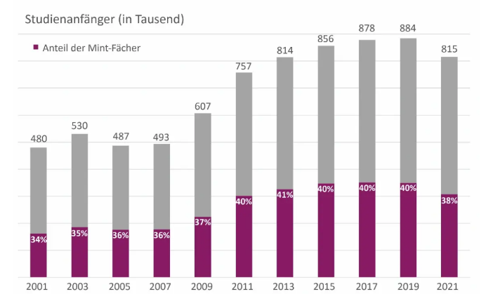
German population and study choice
Only 20% of high school students choose science on a higher level (advanced course or “Leistungskurs”)
Specialization decisive for choice of field of study and professional development
Number of university students in STEM studies going down (share is stable)
Physics
Biology
Chemistry
First-year students (in thousands)
Share of STEM
Statistisches Bundesamt
MINT Nachwuchsbarometer + Statistisches Bundesamt
Notes:
Birth rate going down
Number of working-age persons is decreasing
Shortage of STEM specialists (Fachkräftemangel)

