Slide 1
Automatic Differentiation Near-Field Ptychography
Zhang Yiwei , DESY CFEL
September 4, 2024

Slide 2
Table of Contents
01 Introduction
02 Simulation and results
- structured illumination
03 Summary

Slide 3
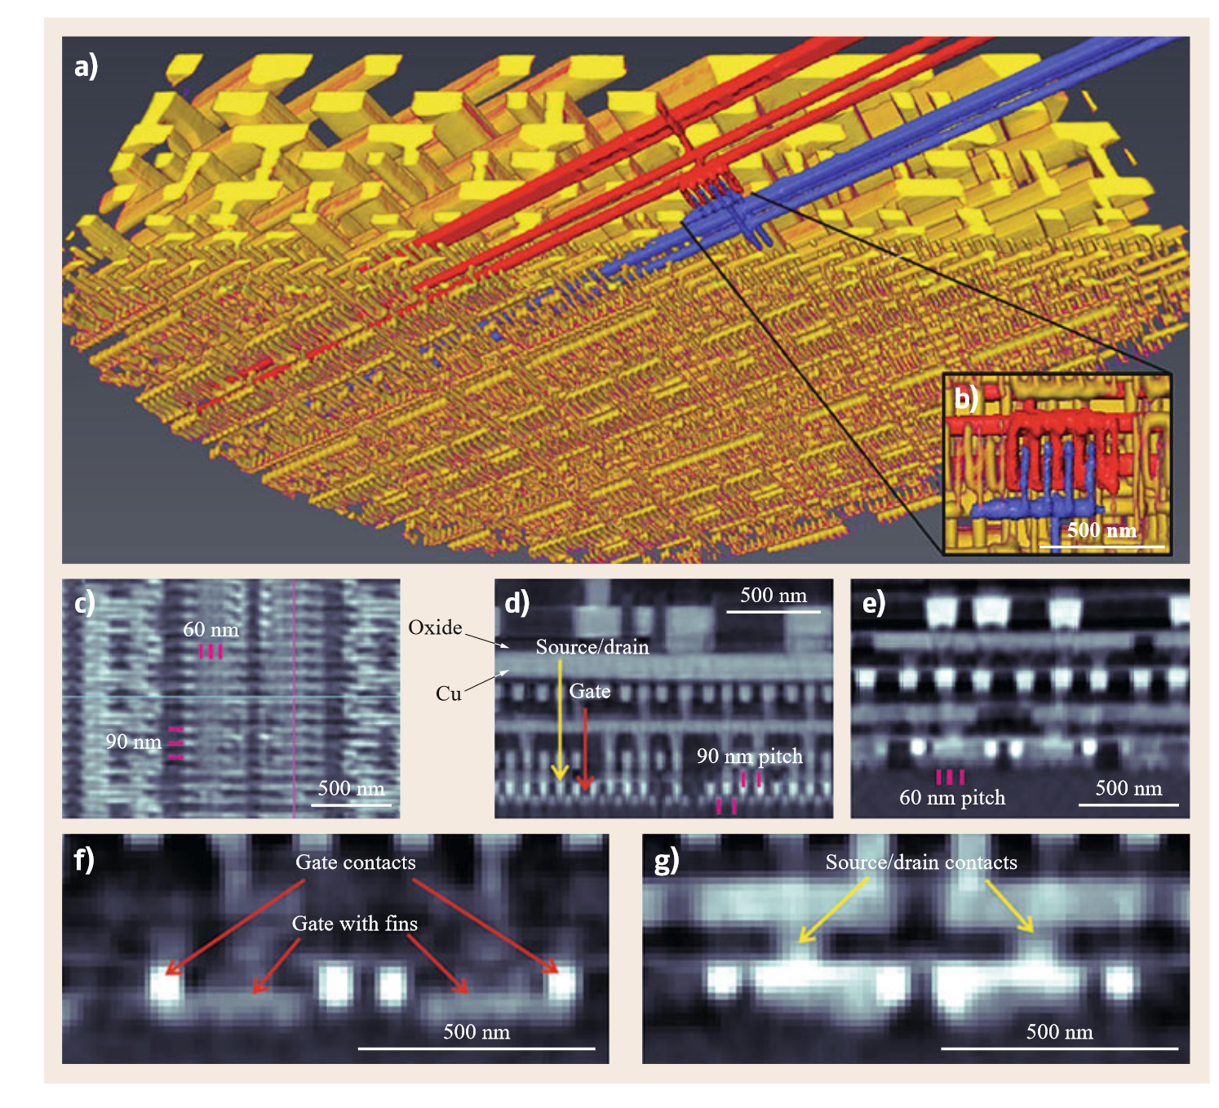
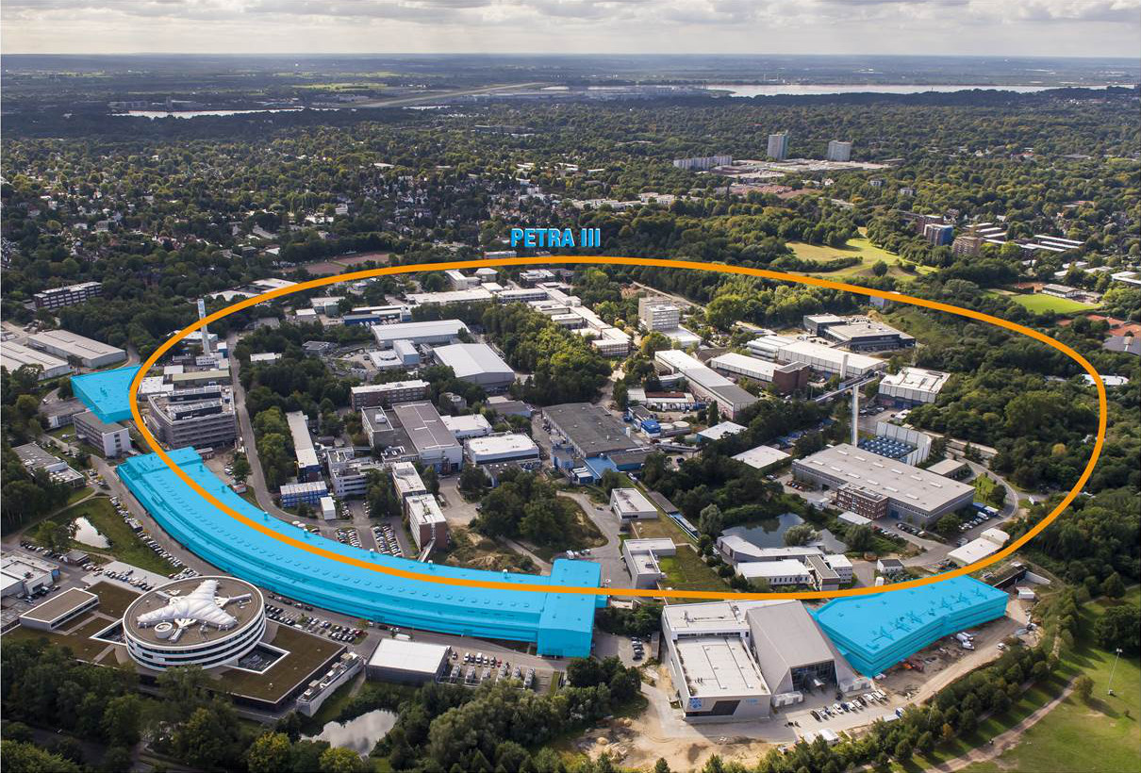
Background
A high-resolution imaging
method is needed
Materials Science
Biological Imaging
Semiconductor Industry
……
Advancement of third generation synchrotrons like PETRA III excites a big interest on X-ray ptychography.
The picture shows ptychographic
reconstruction of an integrated circuit (IC).
M. Holler, M. Guizar-Sicairos, E.H. Tsai, R. Dinapoli, E. Müller, O. Bunk, J. Raabe, G. Aeppli: High-resolution non-destructive three-dimensional imaging of integrated circuits, Nature 543(7645), 402–406 (2017)

Slide 4
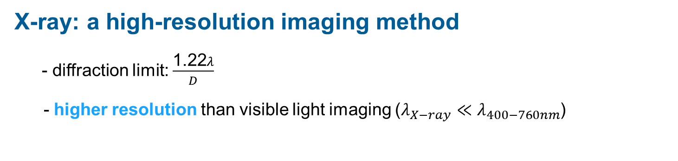
Introduction — Challenges of traditional X-ray
X-ray: a high-resolution imaging method
  - diffraction limit: $\frac{\text{1.22}λ}{D}$
  - higher resolution than visible light imaging ($λ_{X−ray}≪λ_{400−760nm}$)
Why is it challenging for X-ray to be imaged by lens?
  - high quality and high NA of lens is challenging to make
Ptychography

Slide 5
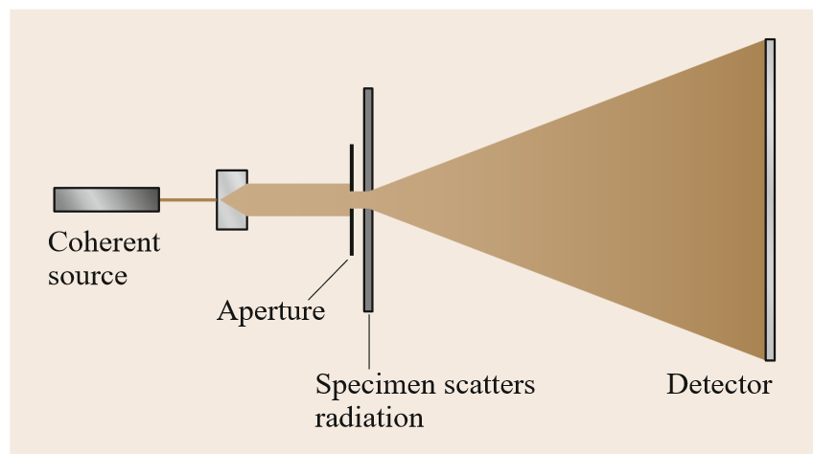
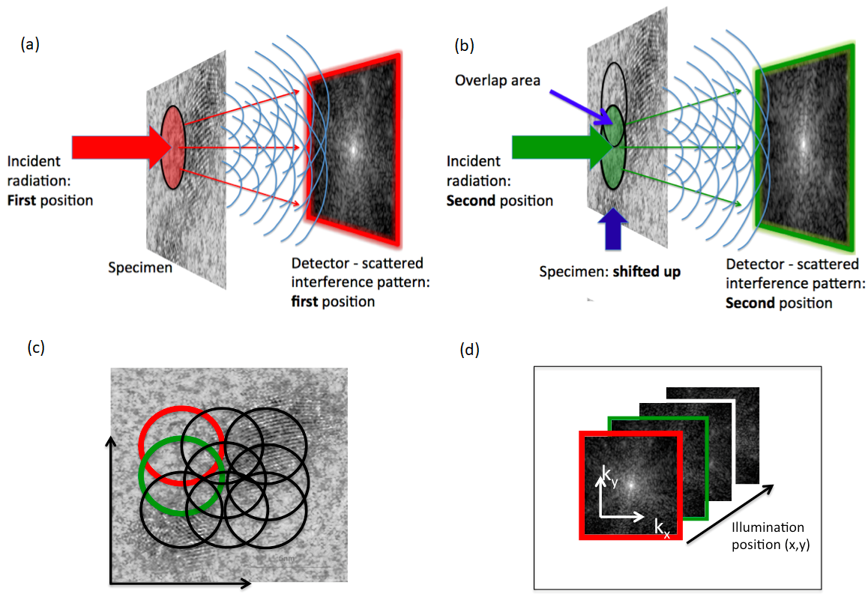
Ptychography
Greek word ‘ptycho’ means ‘fold’
Principle :
Illumination probe scans over the specimen with
sufficient overlap
2. Intensity of diffraction pattern is recorded
3. Use algorithm to reconstruct the sample and probe
Sufficient Overlap in illumination between adjacent positions to recover the lost phase information
Springer Handbook of Microscopy. (Springer International Publishing, Cham, 2019).
https://en.wikipedia.org/wiki/Ptychography

Slide 6
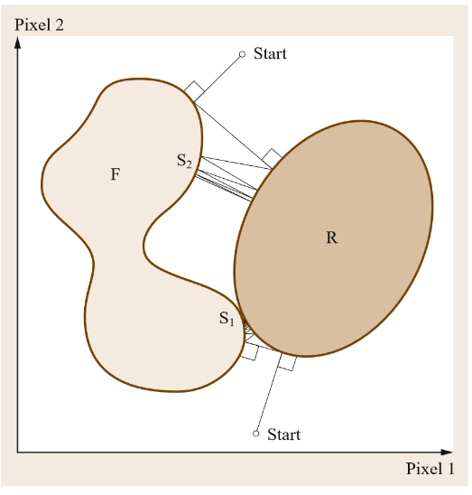
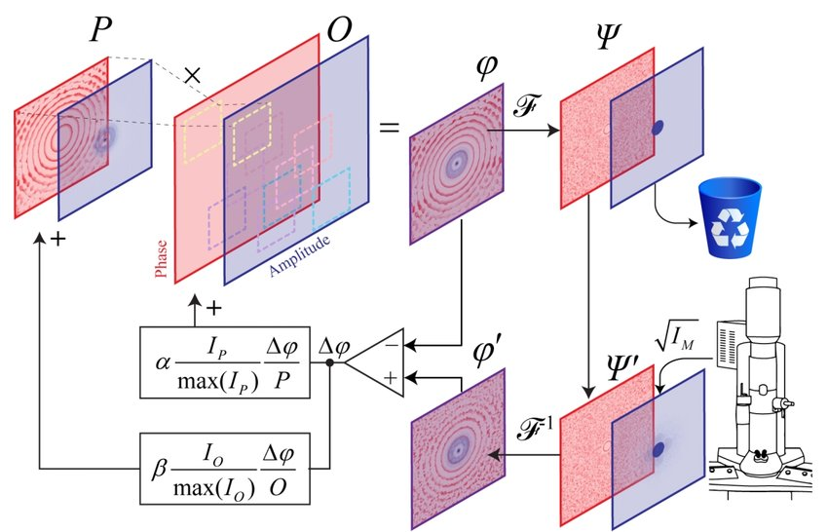
Conventional Algorithms
1、PIE family：mPIE, ePIE……
2、Alternating projections scheme: DM, RAAR
Springer Handbook of Microscopy. (Springer International Publishing, Cham, 2019).

Slide 7



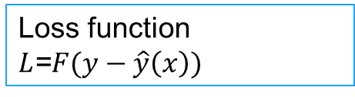

Drawbacks
Of Conventional Algorithms
Gradient Descent Method
Inflexible:
Change of the experimental
condition
need
manual re-derivation of the calculation strategy
Flexible
Ground truth$x$
Observed results $y$
Guess$x$
Results $\hat{y}(x)$
—
Forward propagation
Loss function
$L$=$F(y−\hat{y}\left(x\right))$
Back propagation——
Gradient descent

Slide 8
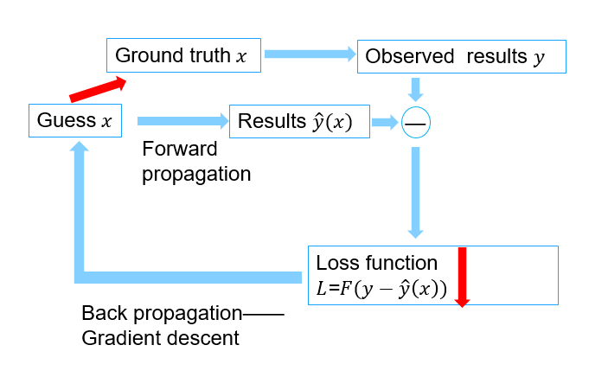
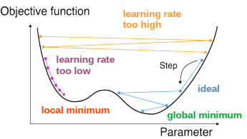
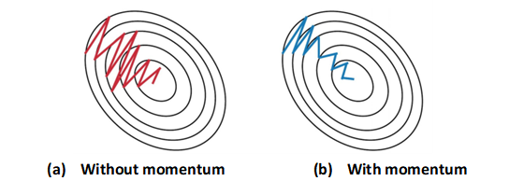
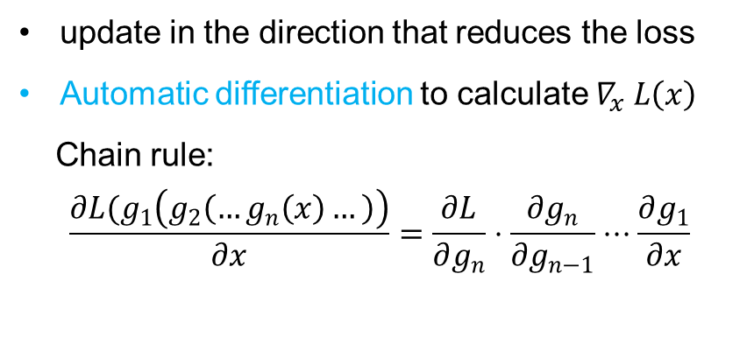

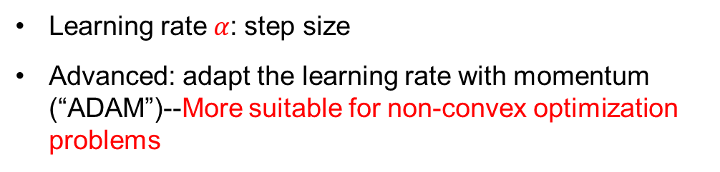
How does gradient descent actually work?
$$x_{new}=x_{old}−α⋅∇_{x} L\left(x\right)$$
Learning rate$α$: step size
Advanced: adapt the learning rate with momentum (“ADAM”)--More suitable for non-convex optimization problems
update in the direction that reduces the loss
Automatic differentiation to calculate $∇_{x} L\left(x\right)$
Chain rule:
$$\frac{∂L{(g}_{1}\left(g_{2}\left(…g_{n}\left(x\right)…\right)\right)}{∂x}=\frac{∂L}{∂g_{n}}⋅\frac{∂g_{n}}{∂g_{n−1}}⋅⋅⋅\frac{∂g_{1}}{∂x}$$

Slide 9
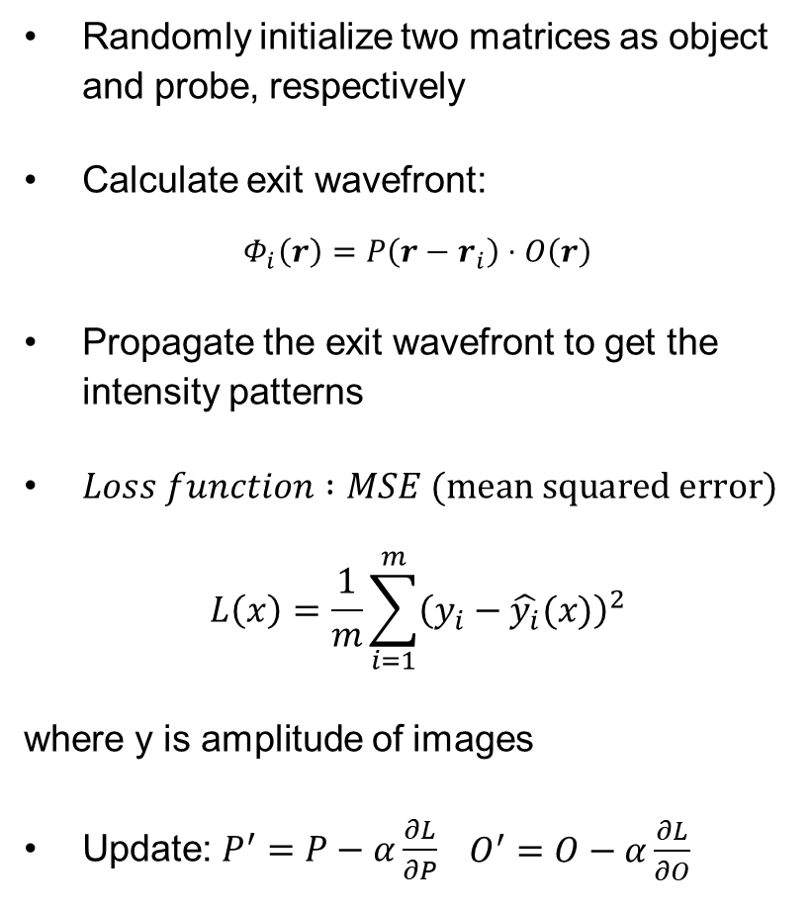
Framework of simulation
Randomly initialize two matrices as object and probe, respectively
Calculate exit wavefront:
$$Φ_{i}\left(r\right)=P\left(r−r_{i}\right)⋅O\left(r\right)$$
Propagate the exit wavefront to get the intensity patterns
$Loss function :MSE (mean squared error)$
$$L\left(x\right)=\frac{1}{m}\sum_{i=1}^{m}{{\left(y_{i}−\hat{y_{i}}(x)\right)}^{2}}$$
where y is amplitude of images
Update: $P^{′}=P−α\frac{∂L}{∂P}$ $\begin{aligned}O^{′}=O−α\frac{∂L}{∂O}\end{aligned}$
Notes:
Tvloss helps to maintain smoothness and reduce noise.

Slide 10
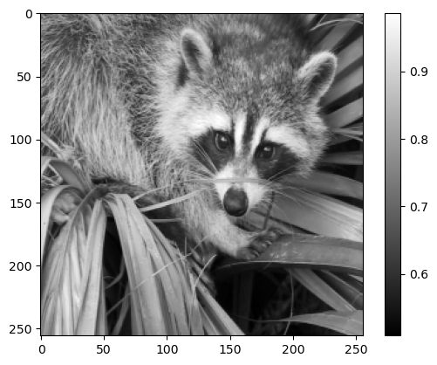
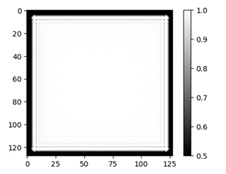
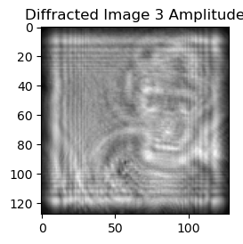
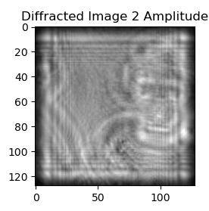
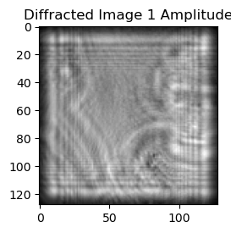
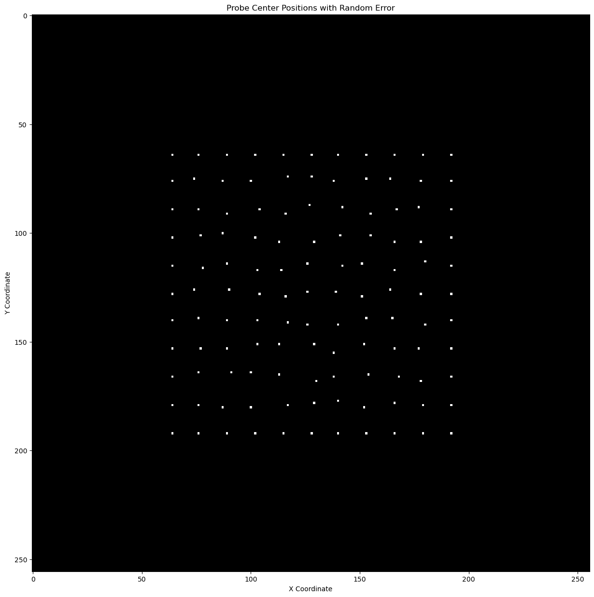
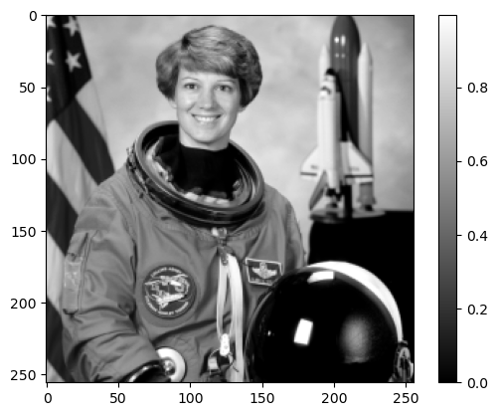
How to generate digital data as ground truth for testing?
Probe size(128×128)
Object size(256×256)
Probe overlap:90%
Probe
propagation
Amplitude
Amplitude
Phase
Diffraction images
Scan positions with randomness

Slide 11
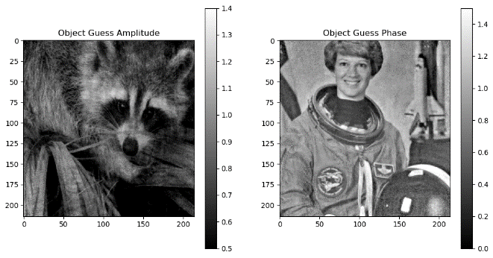
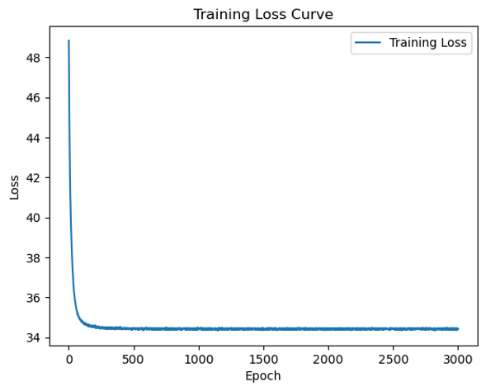
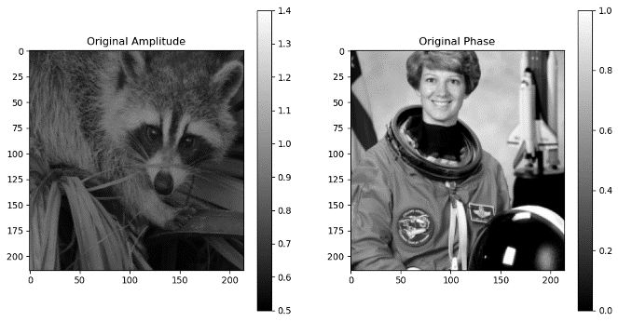
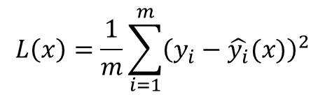
Result
Under high overlap conditions(90%), the reconstruction quality is acceptable
Initial learning rate=0.01
Iteration = 3000
Reconstructed object
amplitude
phase
$$L\left(x\right)=\frac{1}{m}\sum_{i=1}^{m}{{\left(y_{i}−\hat{y_{i}}(x)\right)}^{2}}$$
Ground truth object
amplitude
phase

Slide 12
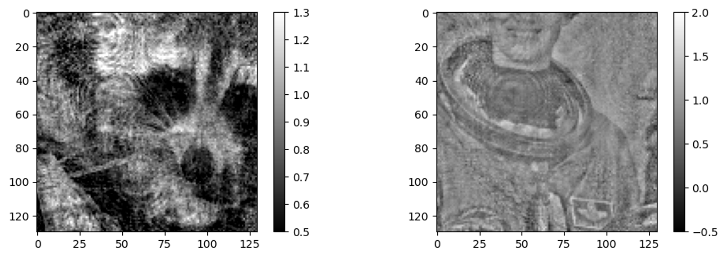
Result
Initial learning rate=0.01
Iteration = 3000
solution
Structured illumination
– to add some diversity to the data
Under low overlap conditions(70%), the reconstruction quality becomes worse
Reconstructed object
amplitude
phase

Slide 13
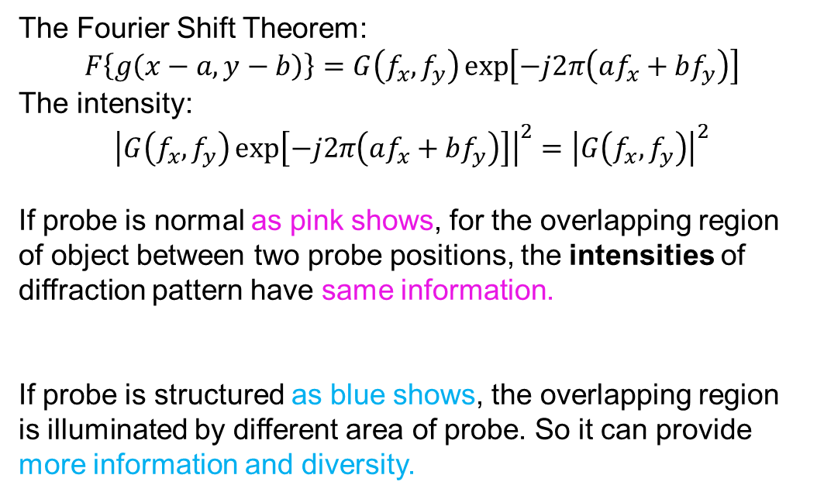
Why diversity is provided ?
$$Exit wavefront =O(r)∗P\left(r−r_{i}\right)$$
The Fourier Shift Theorem:
$$F\left\{g\left(x−a,y−b\right)\right\}=G\left(f_{x},f_{y}\right)\exp\left[−j2π\left(af_{x}+bf_{y}\right)\right]$$
The intensity:
$${\left|G\left(f_{x},f_{y}\right)\exp\left[−j2π\left(af_{x}+bf_{y}\right)\right]\right|}^{2}={\left|G\left(f_{x},f_{y}\right)\right|}^{2}$$
If probe is normal as pink shows, for the overlapping region of object between two probe positions, the intensities of diffraction pattern have same information.
If probe is structured as blue shows, the overlapping region is illuminated by different area of probe. So it can provide more information and diversity.

Slide 14
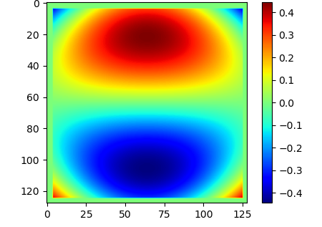
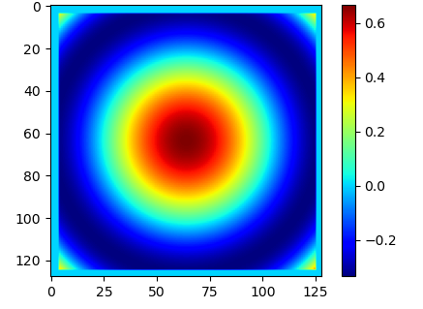
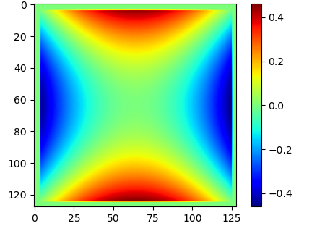
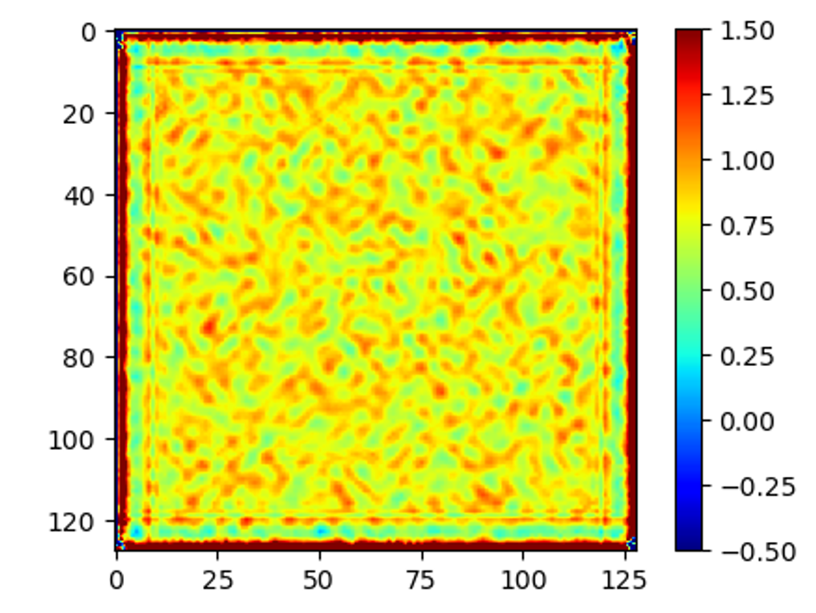
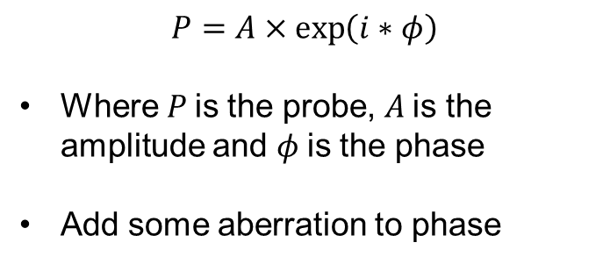
Add some aberration
Coma
Spherical
Astigmatism
$$P=A×\exp\left(i∗φ\right)$$
Where $P$is the probe, $A$is the amplitude and $φ$is the phase
Add some aberration to phase
Try Zernike aberration but reconstruction doesn’t become better
Diffuser
Diffuser improves reconstruction

Slide 15
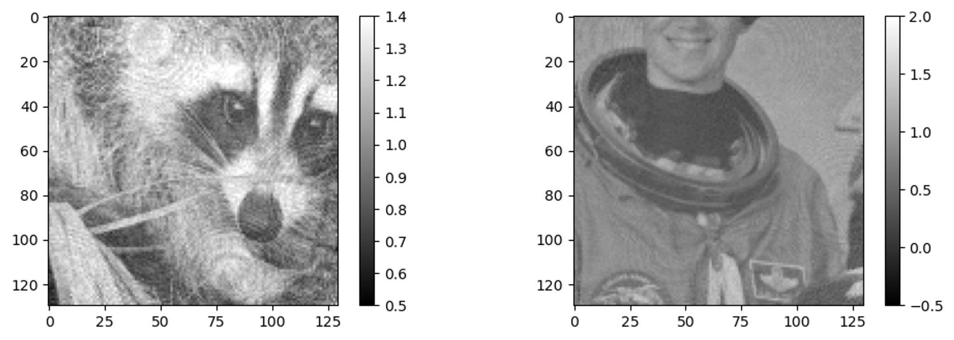
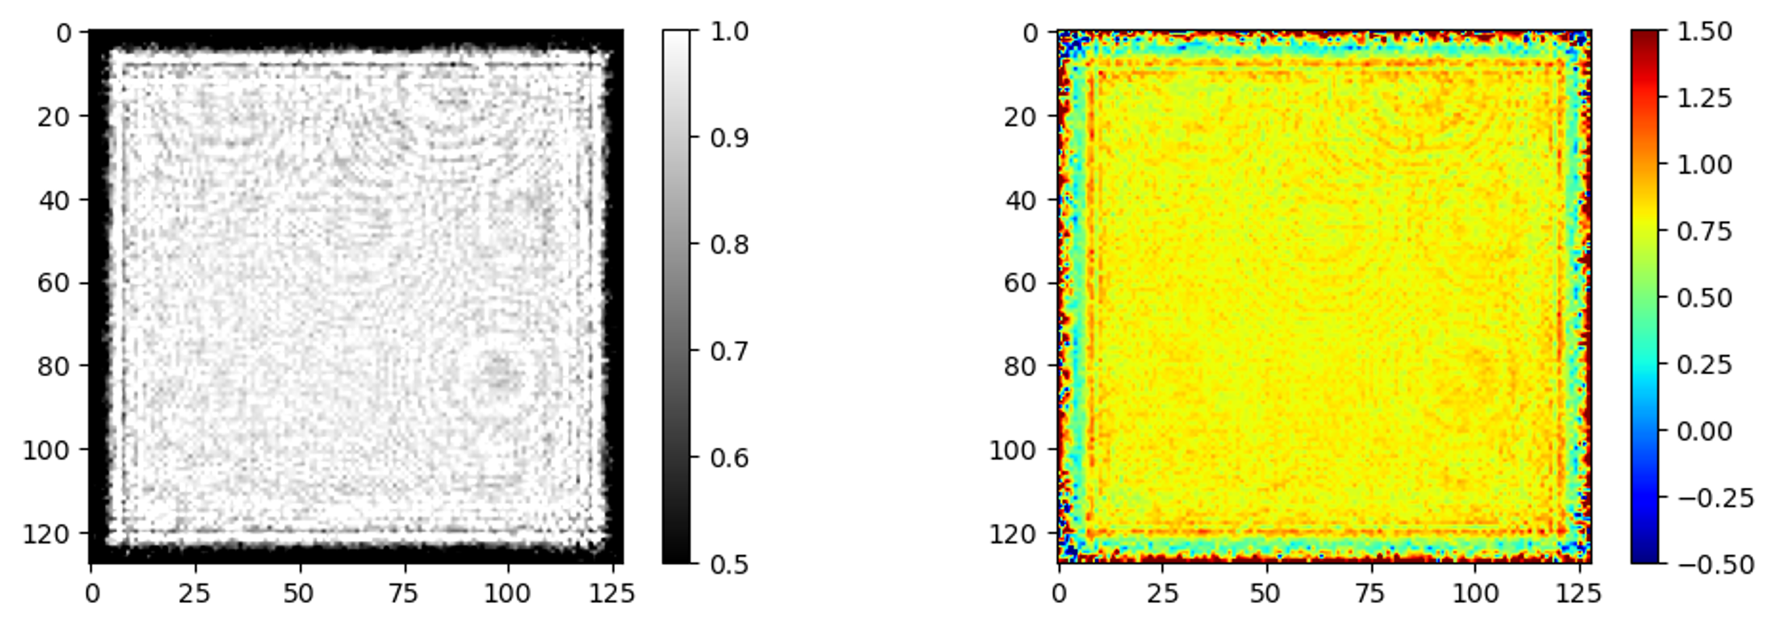
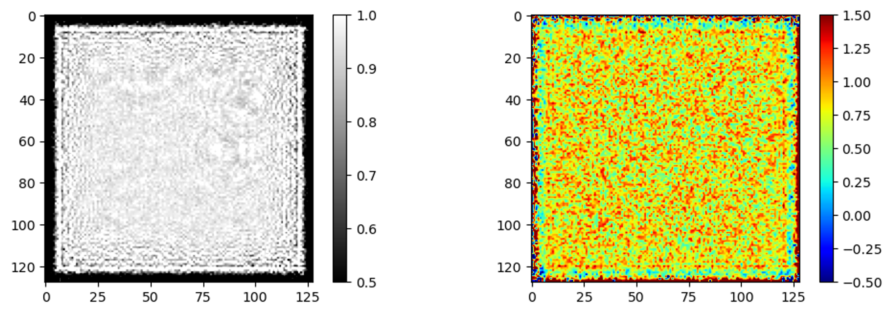
Improvement
The overlap rate is 70%
The improvement is quite significant
Without diffuser
With diffuser
Reconstructed object
Reconstructed object
Reconstructed probe
Reconstructed probe

Slide 16
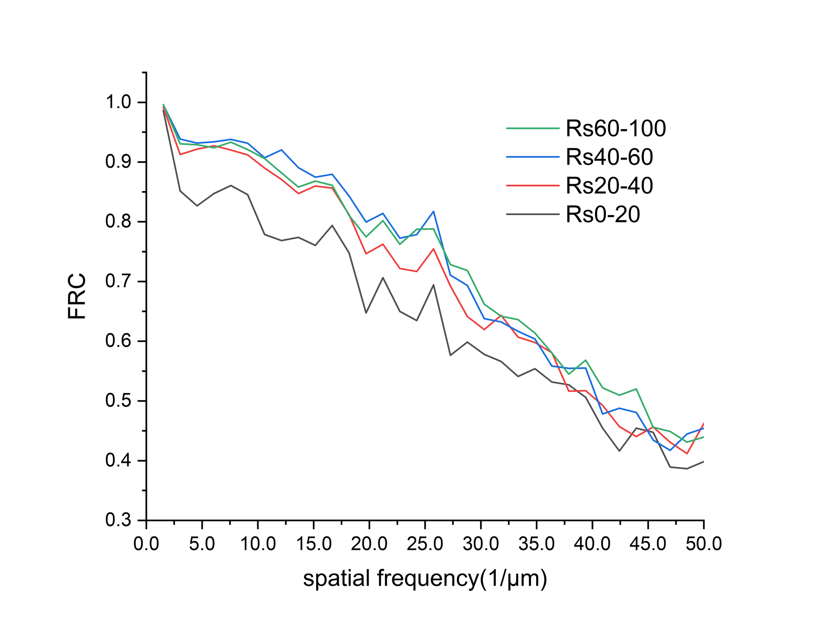
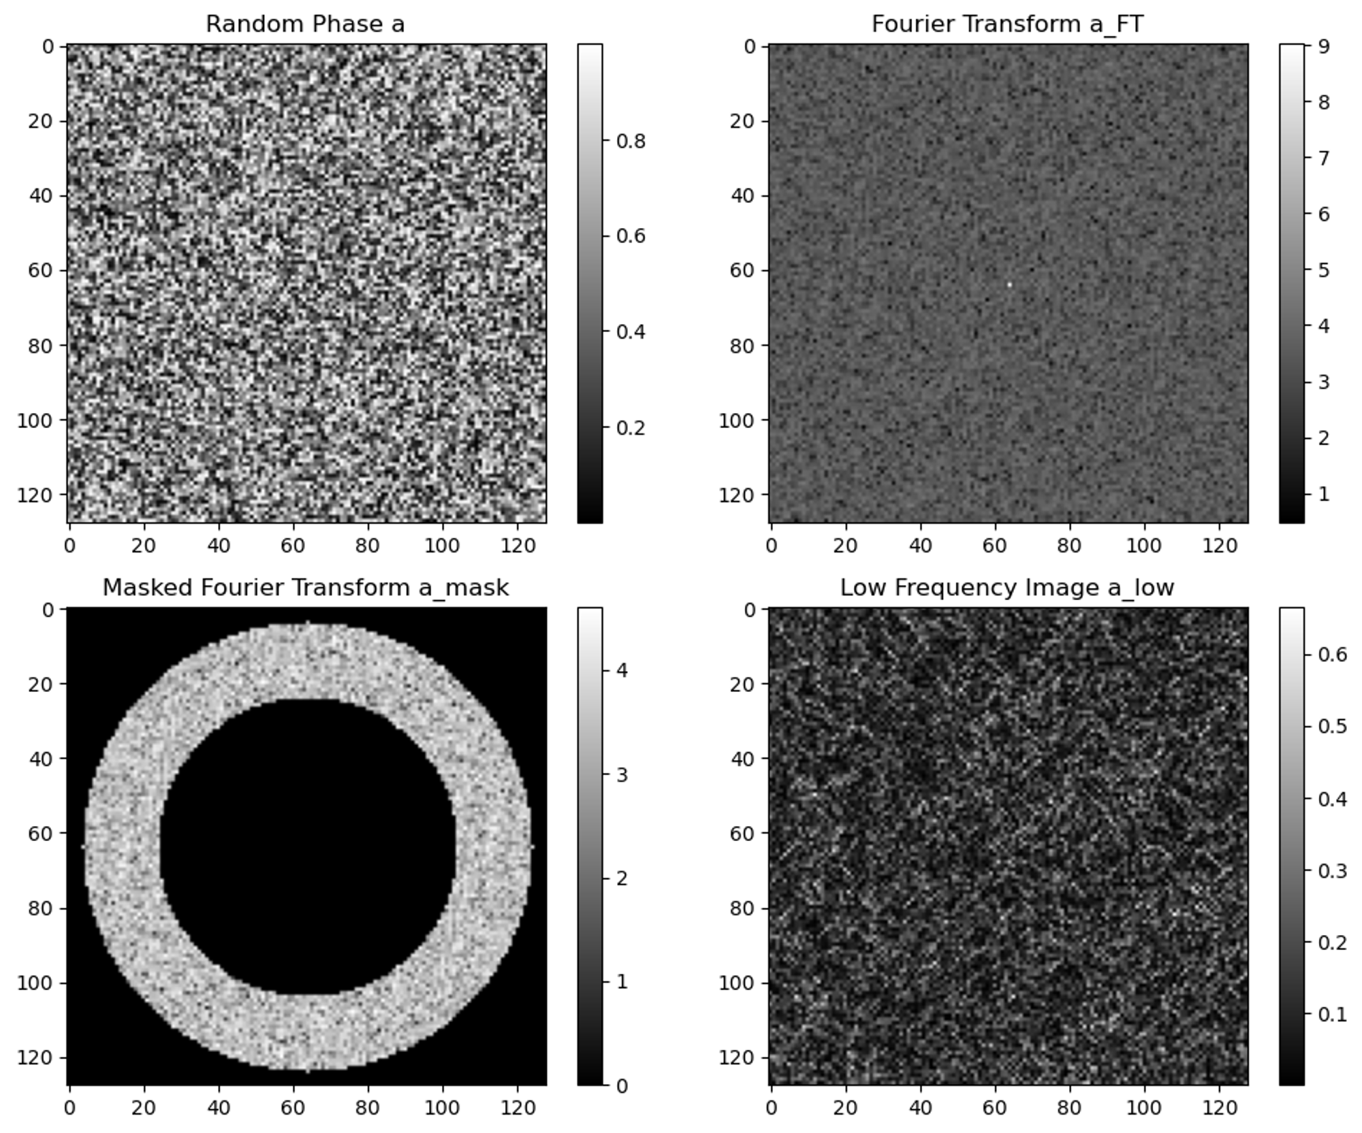



Aberration with different spatial frequency components
Draw FRC(fourier ring correlation curve) of different radius of ring mask
Put a ring mask to select specific frequency components
Phase $φ$ of the diffuser
FFT of $φ$
Put a ring mask
IFFT--Phase $φ$’
The results are improved with more high spatial frequency components.

Slide 17
Summary
Ptychography:
Conventional Algorithms: PIE\projection
Gradient Descent:
Update in the opposite direction of gradient
Use AD to calculate gradient
Simulation result:
Work with high overlap rate
Bad when overlap rate is low
Structured illumination :
diversity
higher frequency plays an important role
More flexible and adaptive

Slide 18
Thank you
Zhang Yiwei
yiwei.zhang@desy.de

