Slide 1
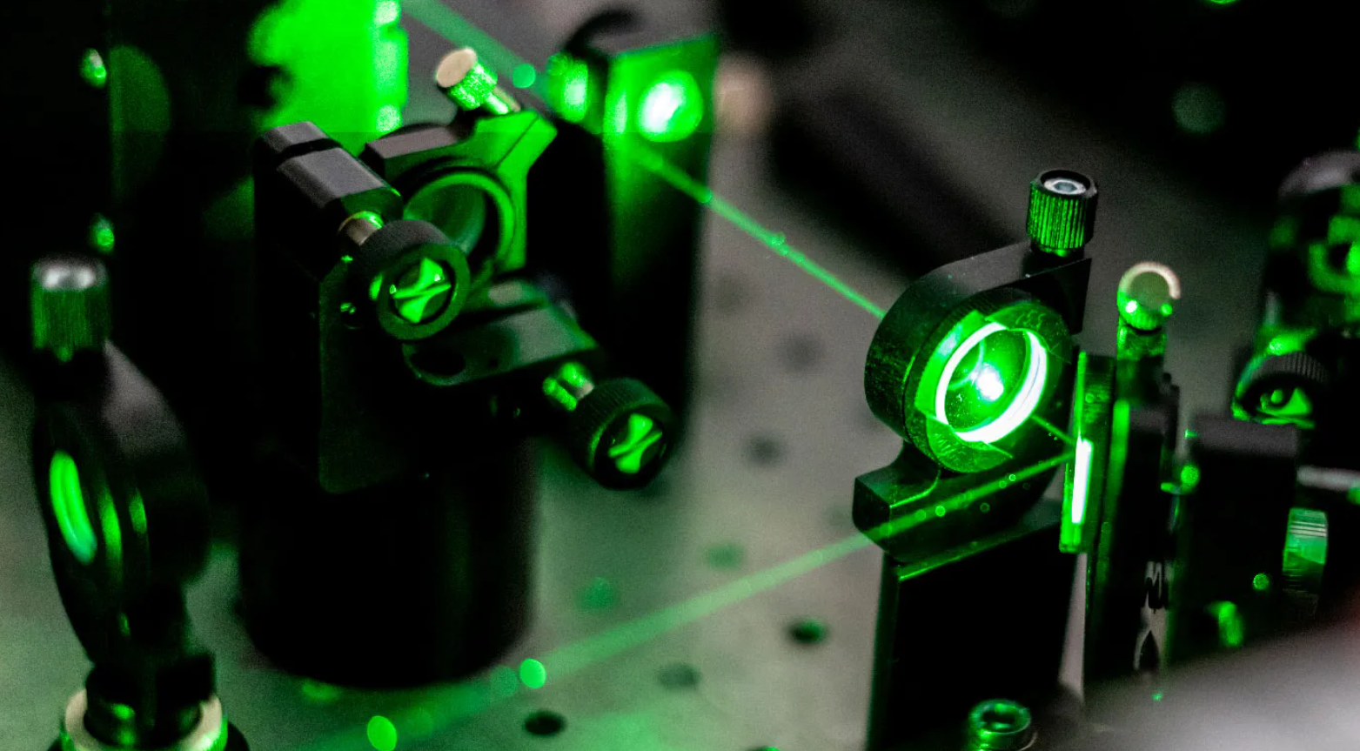
Application of machine-learning in pulse train tuning for multicycle THz generation
Marcos Puerto Matías
Christian Rentschler
Nicholas Matlis
SUMMER STUDENT
SUPERVISORS

Slide 2
Which is the objective of AXSIS?
Electrons accelerated by THz radiation:
Reduced size, cost and complexity
Objective of
Compact X-ray light source using THz pulses

Slide 3
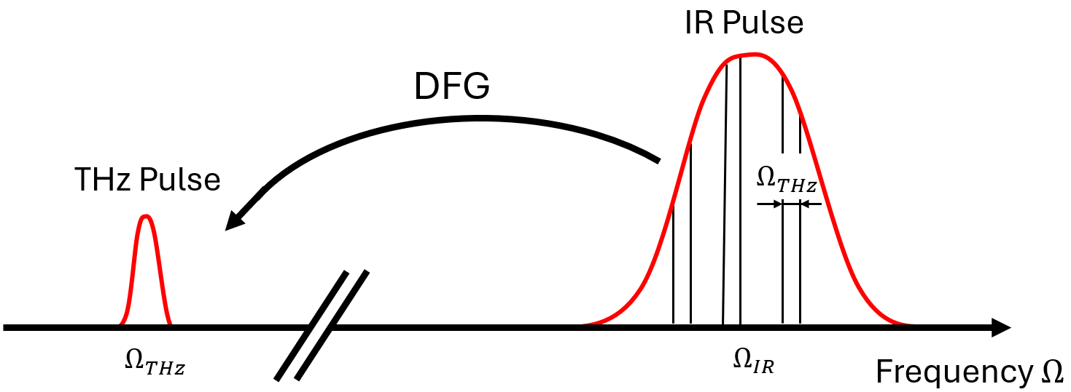
Multicycle THz generation: Single pulse

Slide 4
Multicycle THz generation: Single pulse
But phase-matching is not satisfied:
$$Δk=k\left(Ω_{IR}+Ω_{THz}\right)−k\left(Ω_{IR}\right)−k(Ω_{THz})≠0$$
$⇒$ Quasi phase-matching! (QPM)

Slide 5
Multicycle THz generation: Single pulse
$$Δk=k\left(Ω_{IR}+Ω_{PM}\right)−k\left(Ω_{IR}\right)−k\left(Ω_{PM}\right)+k_{PPLN}=0$$
QPM fixes THz frequency: $Ω_{THz}=Ω_{PM}=346 GHz$

Slide 6
Multicycle THz generation: Train of pulses
Train of pulses $Ω_{tr}=Ω_{PM}$
Train of pulses $Ω_{tr}≠Ω_{PM}$

Slide 7
Multicycle THz generation: Train of pulses
$$Ω_{tr}=Ω_{PM}$$
PPLN: DFG + QPM
$$↑$$
$$↓$$
$$↑$$
$$↓$$
$$↑$$
$$↓$$
Coherent sum
High THz energy
Train of pulses $Ω_{tr}=Ω_{PM}$
$$Ω_{tr}=Ω_{PM}$$
PPLN: DFG + QPM
$$↑$$
$$↓$$
$$↑$$
$$↓$$
$$↑$$
$$↓$$
Incoherent sum
Low THz energy
Train of pulses $Ω_{tr}≠Ω_{PM}$

Slide 8
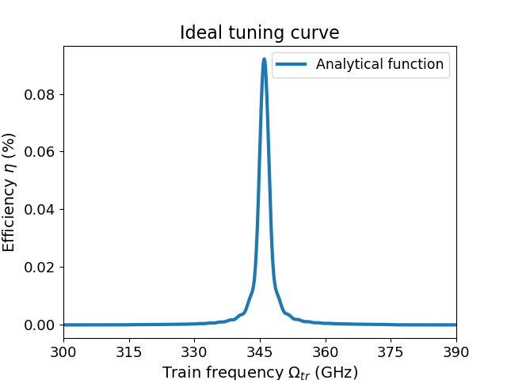
Experimental setup: Pulse divider
Eight Michelson interferometers: 256 pulses
Efficiency as function of $Ω_{tr}$
Motorized stage
$$∆x$$
<
<
s-polarized
$$Ω_{tr}=\frac{1}{Δt}$$
p-polarized
p & s-polarized

Slide 9
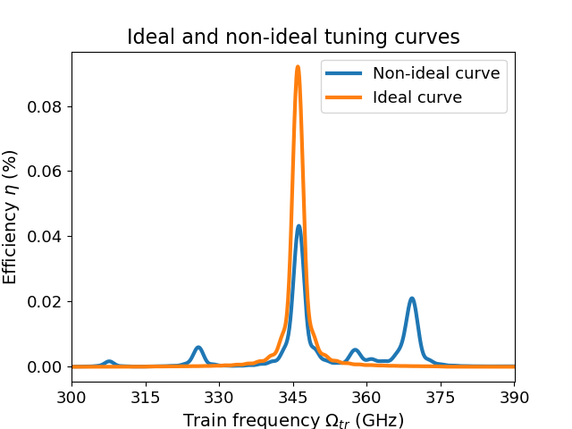
How is the curve affected by time errors?
The pulses can be displaced by $δt$
We obtain lower THz efficiency
Motorized stage
$$∆x+δx$$
<
<
s-polarized
$$∆t→∆t+δt$$
p-polarized
p & s-polarized

Slide 10
Application of ML algorithm: Methodology
The input is a non-ideal tuning curve and the output is the set of eight time errors.
ML algorithm
Eight delays ${δt}_{i}$
Tuning curve ($η_{input}$)
Corrected tuning curve
$\text{Fitness}\text{(}δt_{i}\text{)}=\sqrt{\sum_{k}{{\left(η_{input,k}−η_{k}\text{(}δt_{i})\right)}^{2}}}$ The algorithm has to find the minimum

Slide 11
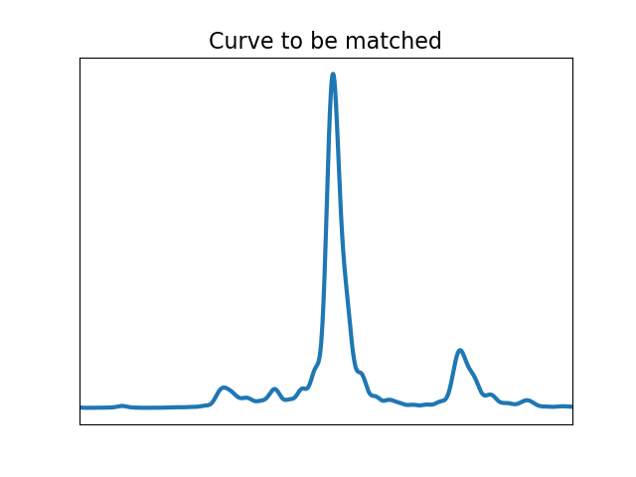
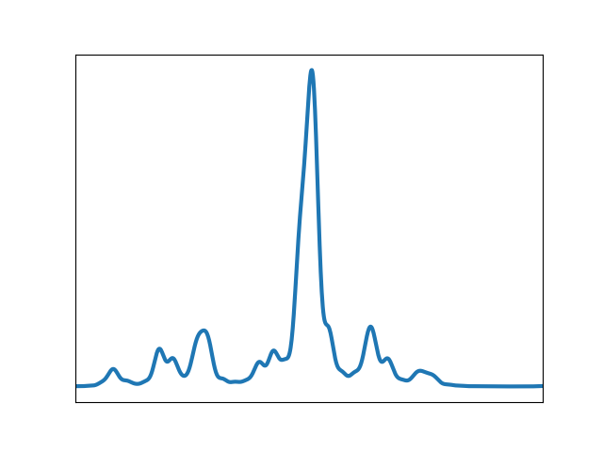
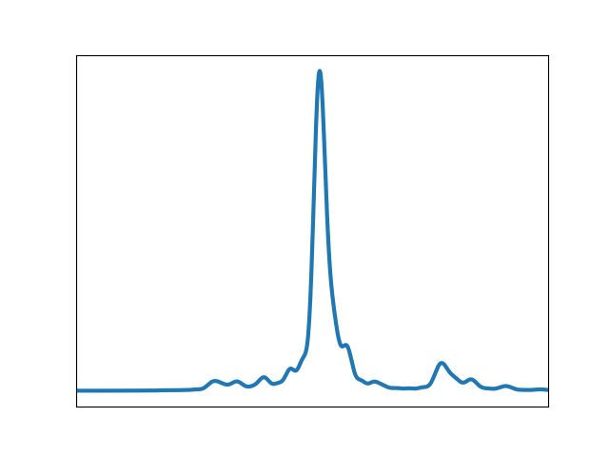
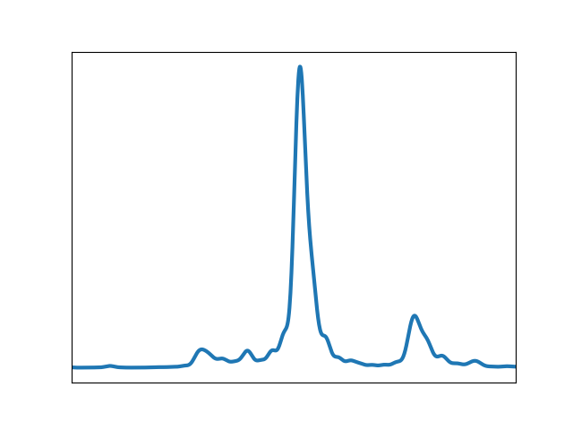
Application of ML algorithm: DE algorithm
Starts with an initial population and evolves it using the best individual
Iteration 1
Iteration 10
Iteration 100

Slide 12
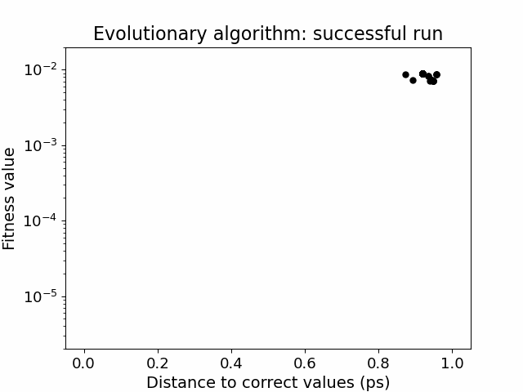
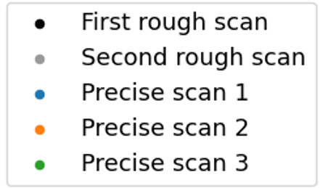
Application of ML algorithm: Simulated data
To avoid local minima $⇒$ two rough scans and a precise scan into each minimum
Success rate: 70%, but in the other 30% we know the global minimum was not reached looking at the fitness, so we can run it again!
Average runtime: 25 minutes, precise scans can be done in parallel for faster convergence

Slide 13
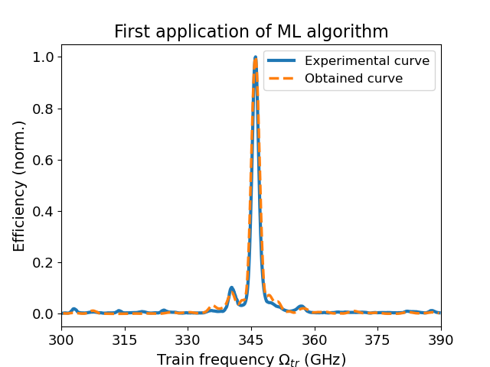
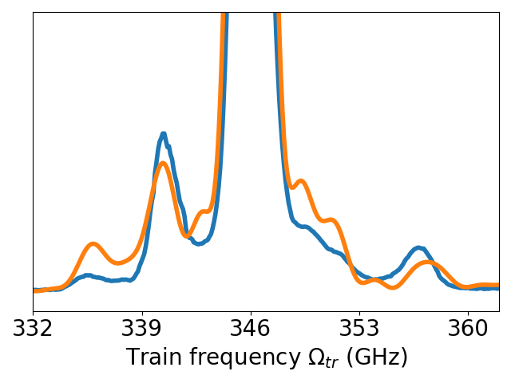
Application of ML algorithm: Experimental data
First application to experimental curve. Scan range: 300 – 390 GHz
Convergence not as good as expected

Slide 14
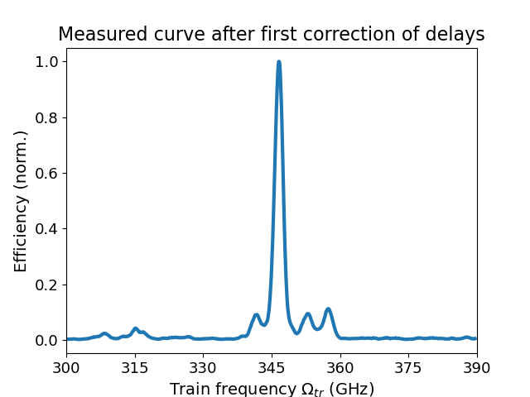
Application of ML algorithm: Experimental data
Two corrections were applied. Results are not conclusive, more runs have to be done

Slide 15
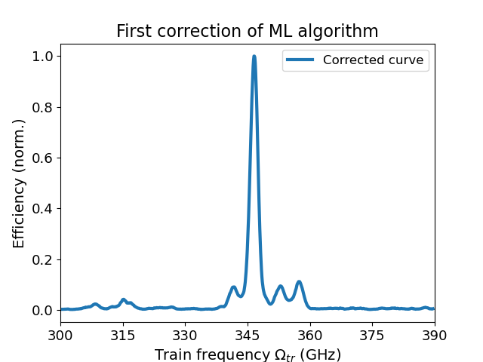
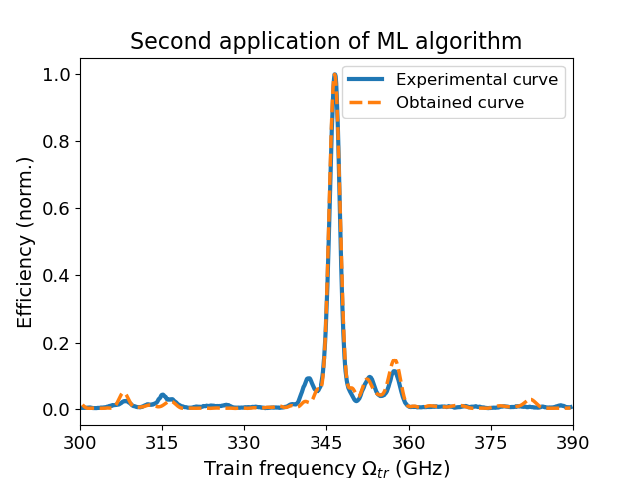
Application of ML algorithm: Experimental data
Two corrections were applied. Results are not conclusive, more runs have to be done

Slide 16
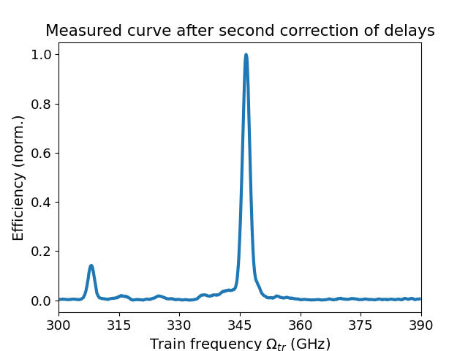
Application of ML algorithm: Experimental data
Two corrections were applied. Results are not conclusive, more runs have to be done

Slide 17
Conclusions
Simulation of non-ideal tuning curves using eight time errors
Created a ML algorithm able to identify those time delays
Algorithm successfully applied to simulated data
Application to experimental data is promising but not effective yet

Slide 18
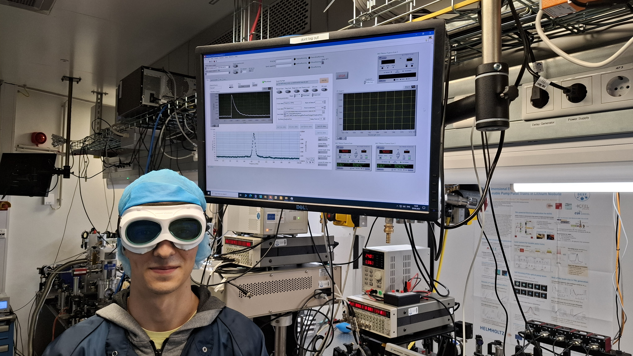
Thank you for your attention

Slide 19
Backup figures

Slide 20
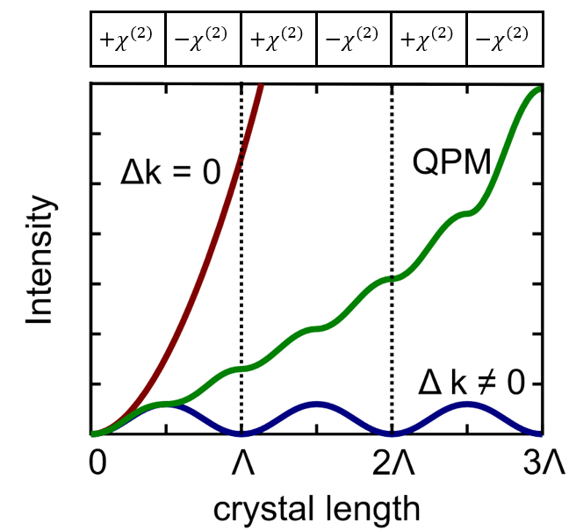

Slide 21
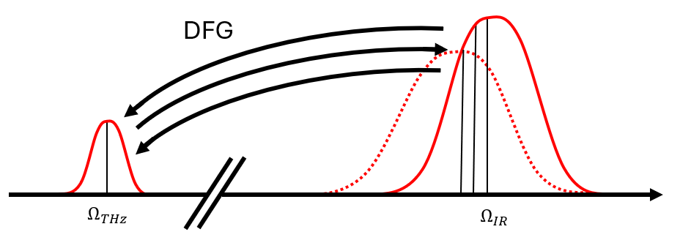

Slide 22
$$η_{THz}\left(L,Ω_{tr}\right)=\frac{\left(χ_{0}^{\left(2\right)}\right)L^{2}F_{0}n(Ω_{PM})}{π^{4}c^{3}ε_{0}n^{2}(ω_{IR})N_{pulses}^{2} }\int_{−∞}^{+∞}{\frac{Ω^{2}}{n^{2}\left(Ω\right)}g_{PPLN}(Ω,L)g_{opt}(Ω,Ω_{tr})dΩ}$$
$$Ω_{PM}=\frac{ck_{PPLN}}{n\left(Ω_{PM}\right)−n_{g}(ω_{IR}) }$$
$$δL=−\frac{c×δt}{2 }$$

Slide 23
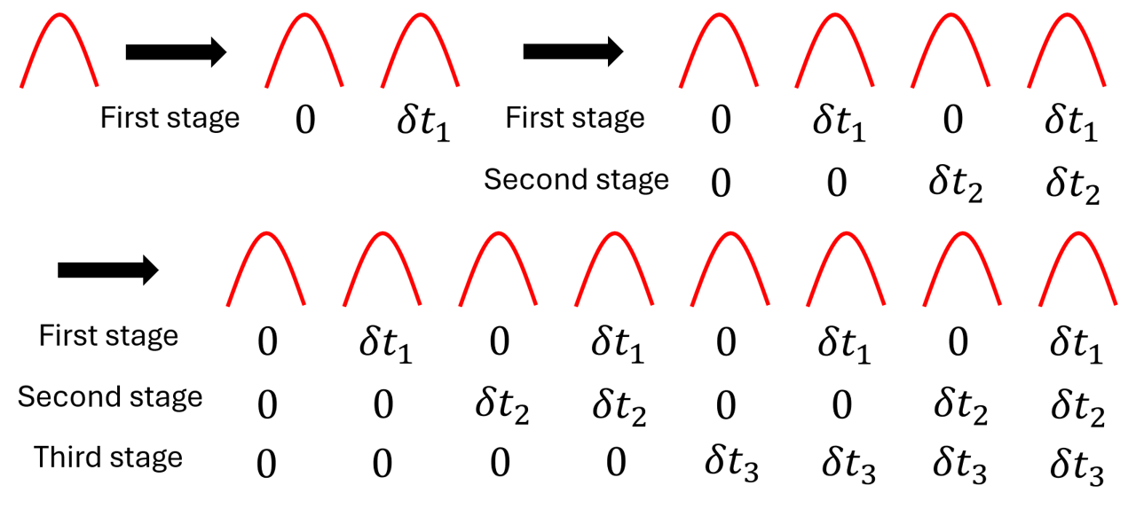

Slide 24
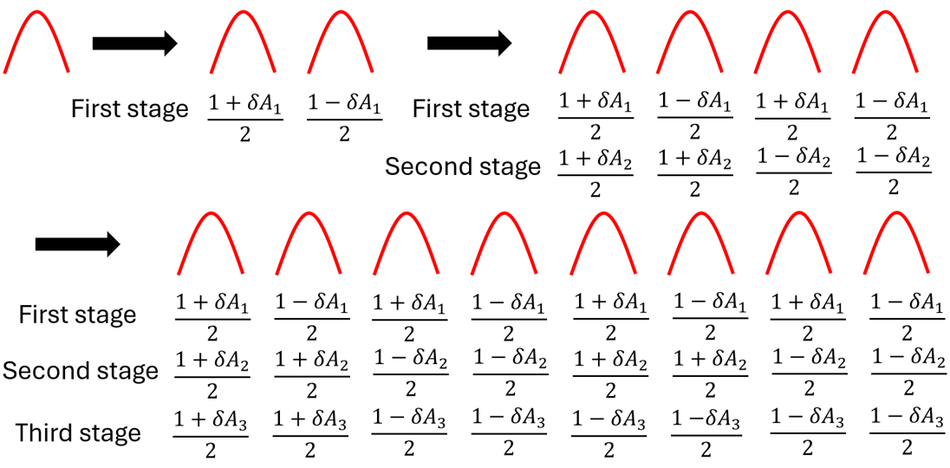

Slide 25
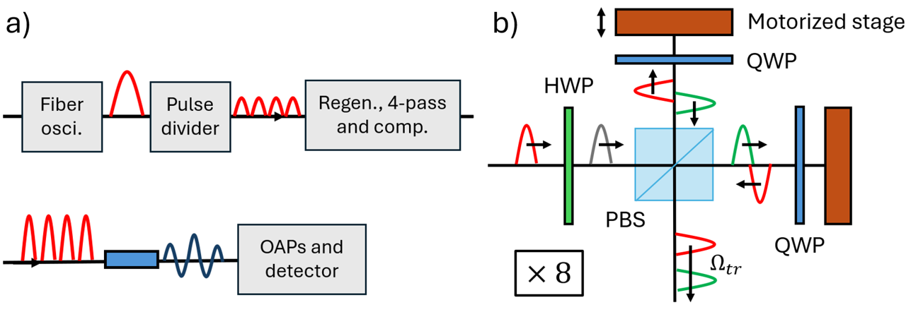

Slide 26
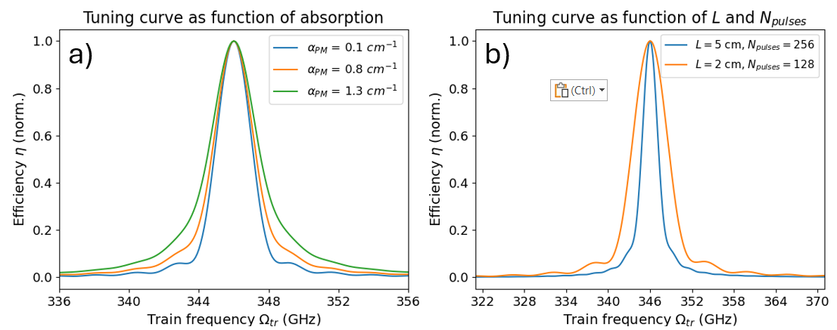

Slide 27
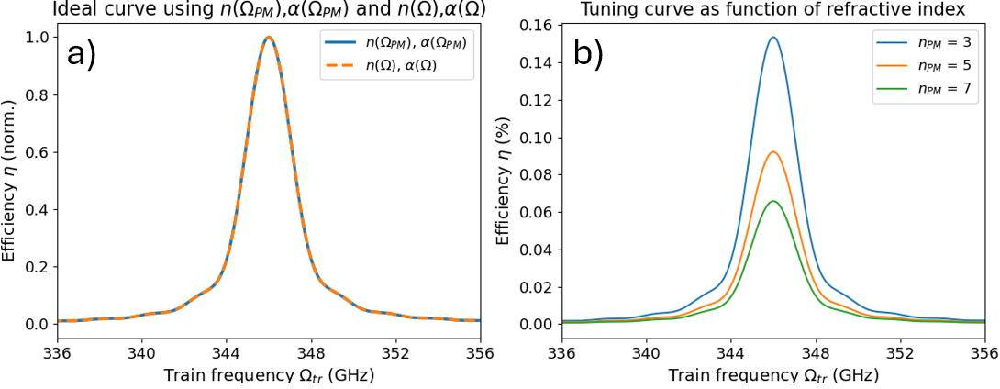

Slide 28
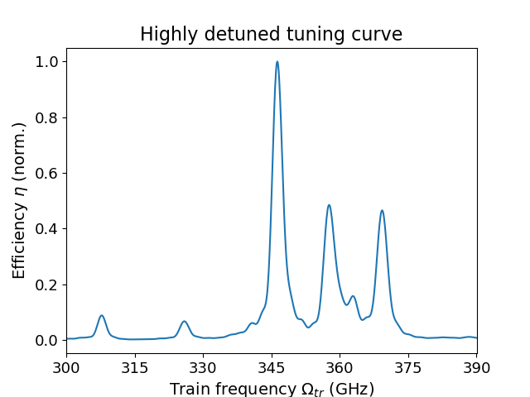
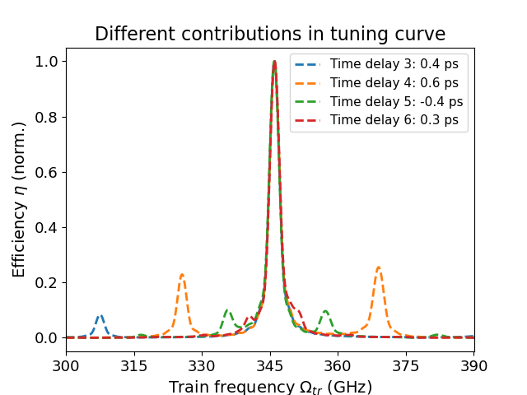

Slide 29
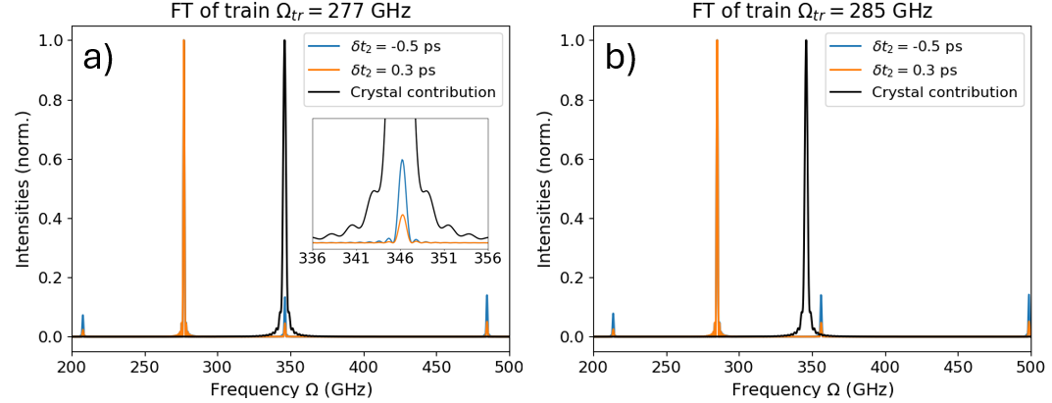

Slide 30
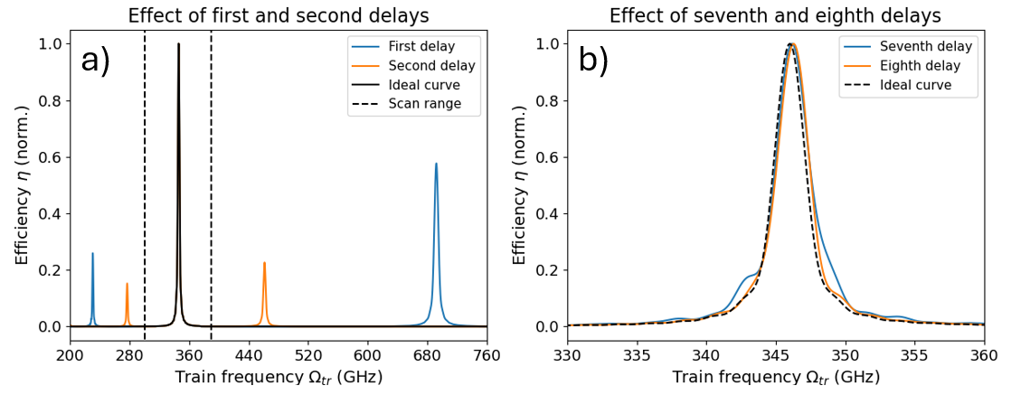

Slide 32
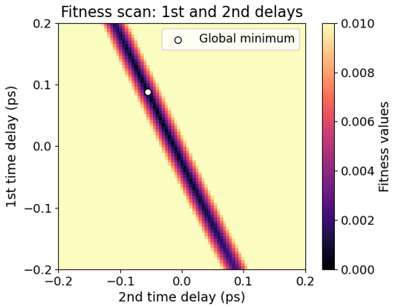

Slide 33
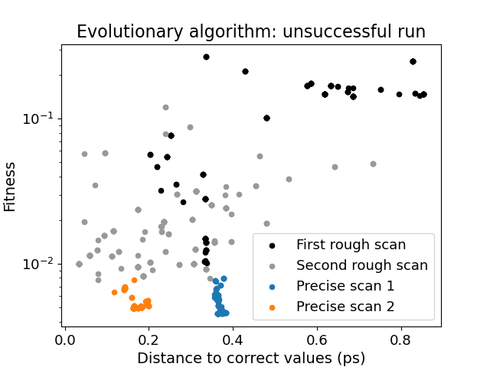
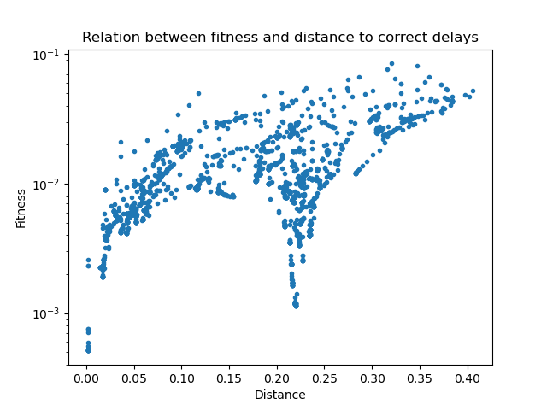

Slide 34
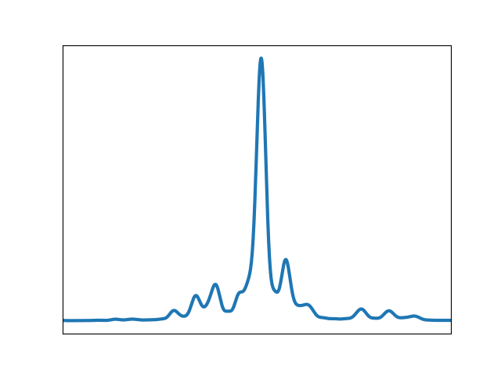
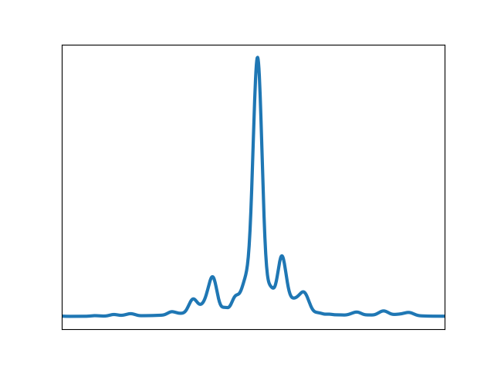
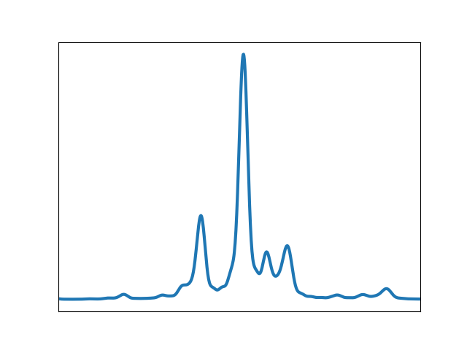
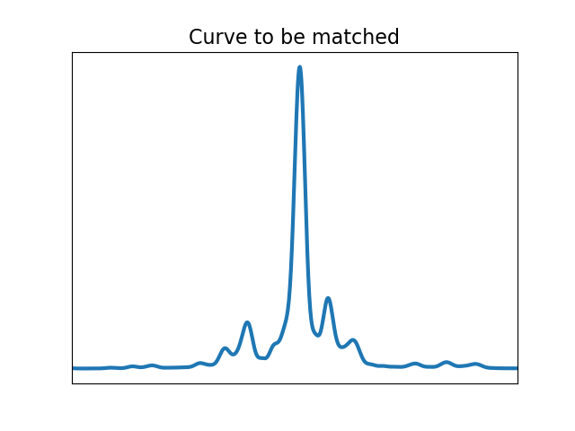
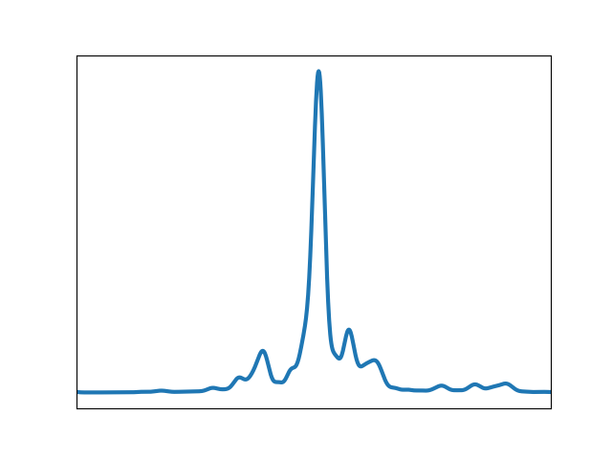
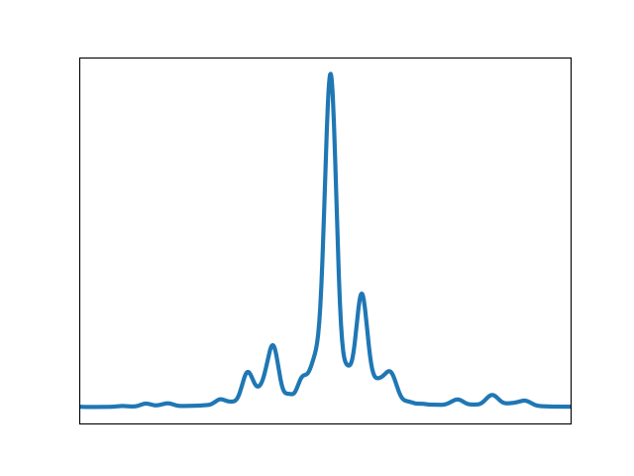
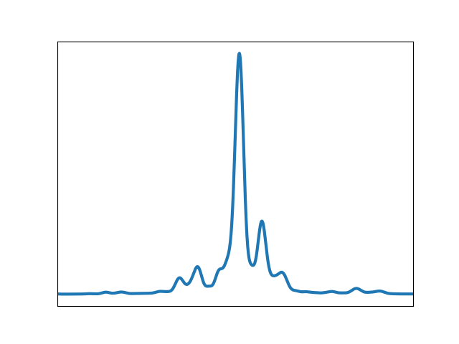
Application of ML algorithm: DE algorithm
Starts with an initial population and evolves it using the best individual
Iteration 100:

Slide 35
Multicycle THz generation
PPLN: DFG + QPM
$$↑$$
$$↓$$
$$↑$$
$$↓$$
$$↑$$
$$↓$$
IR Pulse

