Slide 1
Data challenges in scientific computing
Physics is overrated
João Alvim, Anton Schwarz, Konrad Kockler
DESY Hamburg, 04.09.2024

Slide 2
Scientific Data Challenges
Data processing
Ingest
High data ingest rate
Multiple parallel streams
High durability
Effective handling of large number of files
Sharing & Exchange
3rd party copy
Effective WAN Access
In-flight data protection
Identity federation
Access control
Long Term Preservation
High Reliability
Self-healing
Automatic technology migration
Persistent identifier
Analysis
High CPU efficiency
Unstructured access patterns
Standard access protocols
Access control
Local user management

Slide 3
Improving ASAP::O Monitoring
João Alvim, Mikhail Karnevskiy

Slide 4
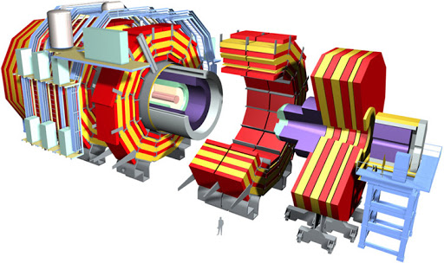
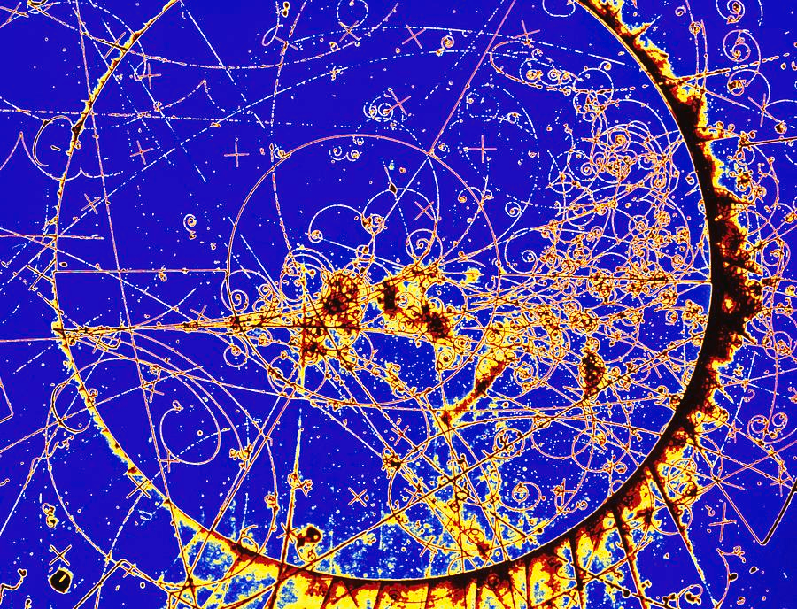
ASAP::O
What is it?
High performance distributed streaming platform
Provides API to ingest/retrieve data to the system

Slide 5
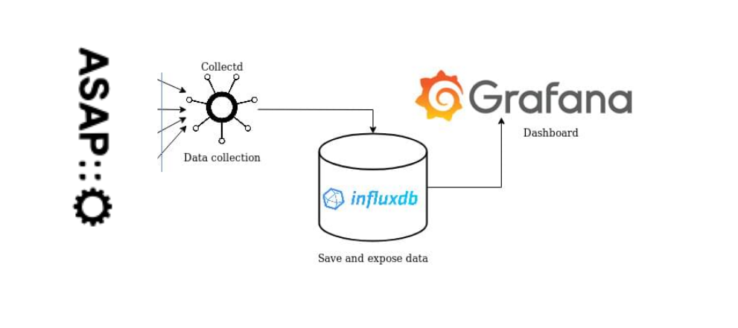
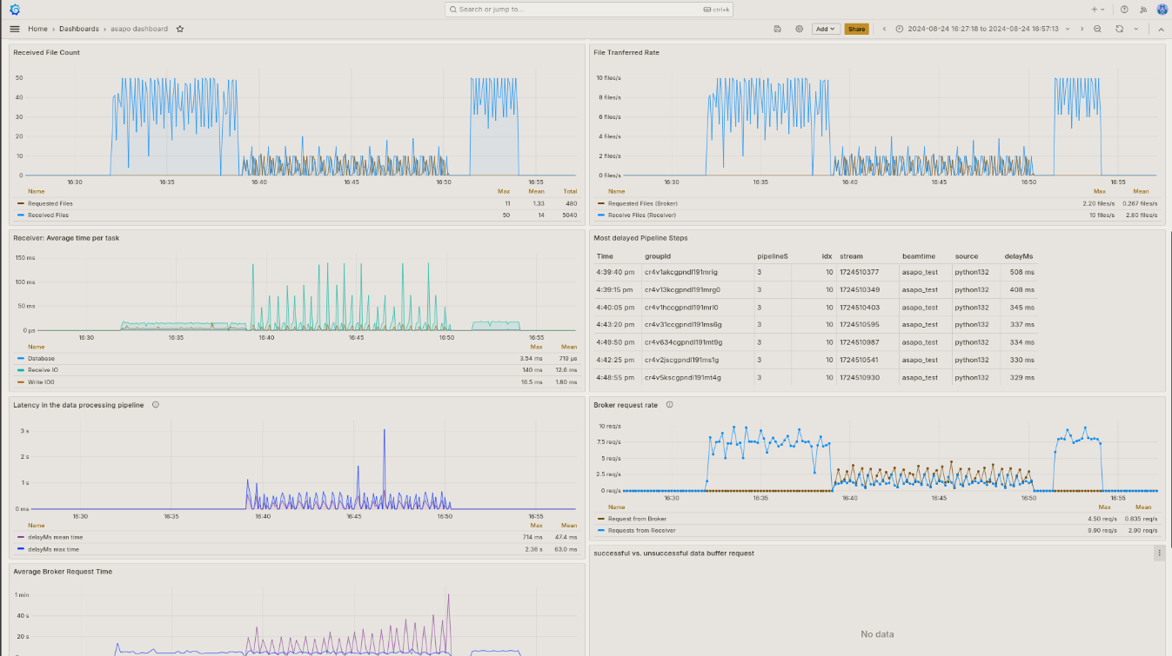
Monitoring Improvements
New Approach
Grafana
flexibility, built in components
reliable
bugs
Collect new metrics

Slide 6
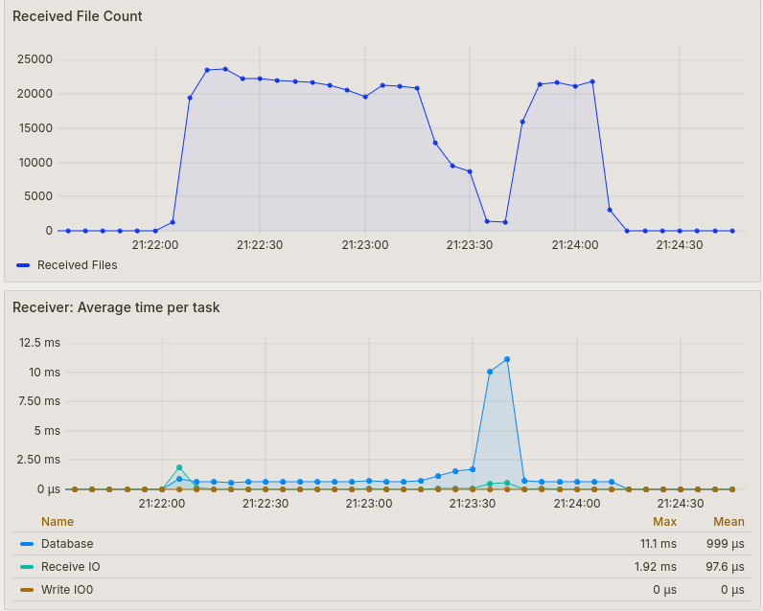
Example case
Amount of received files dropped significantly, because the time to access database increased
Raise Suspicion
Potential Bottleneck
=> More Reliable Software

Slide 7
Scientific Data Management with dCache
Anton Schwarz, Tigran Mkrtchyan

Slide 8
dCache
A System to Store and Retrieve Data
•System for storing and retrieving data
•Data is distributed over many servers
•In full production since 2001
•Written in Java
•Authentication and Authorisation

Slide 9
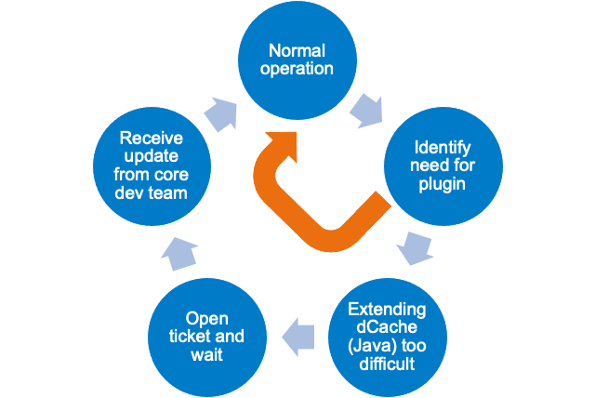
Adapting the Authentication Process
Motivation for my project
Allow users to extend the authentication process with their own plugins

Slide 10
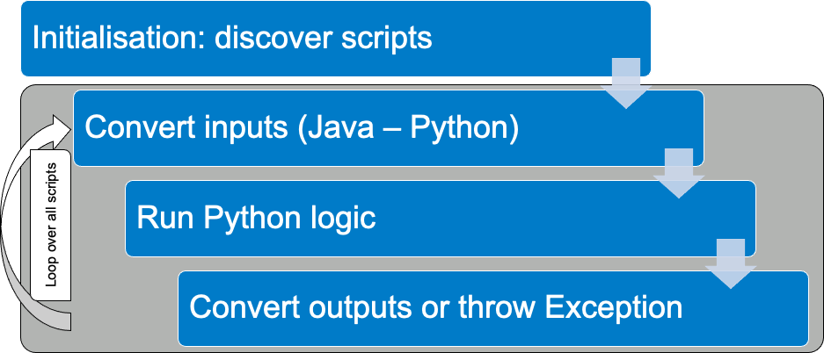
Implementation

Slide 11
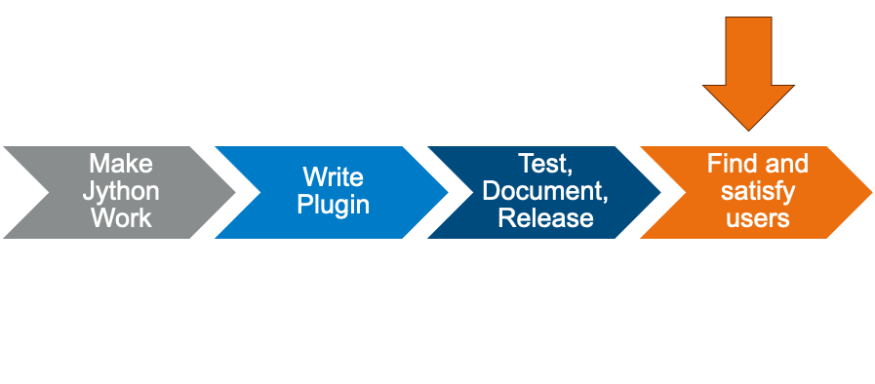
Timeline
Where are we?

Slide 12
Research facility 2.0 Sustainable computing
Konrad Kockler, Martin Gasthuber

Slide 13
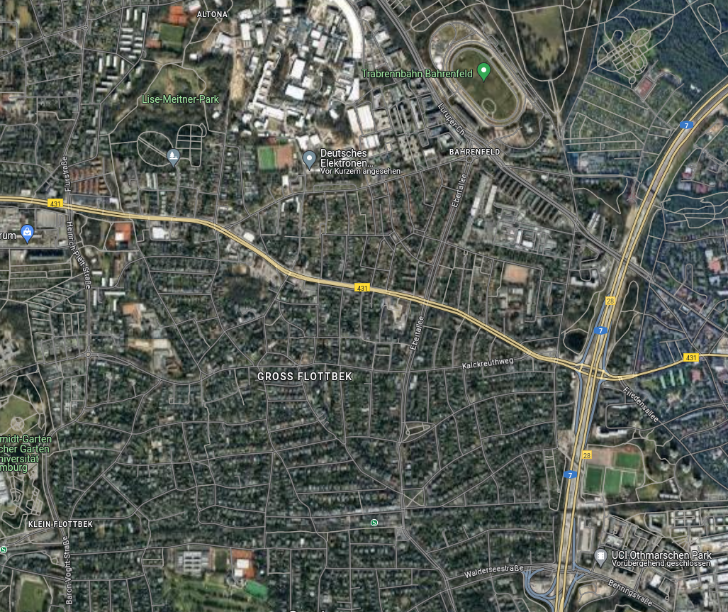
Current energy consumption
DESY computing center
Per year (2023):
12.9GWh
5160 tCO₂
Groß Flottbek
This is:
250 000 trees
3 700 Single-family homes
1 Groß Flottbek
Source: maps.google.com

Slide 14
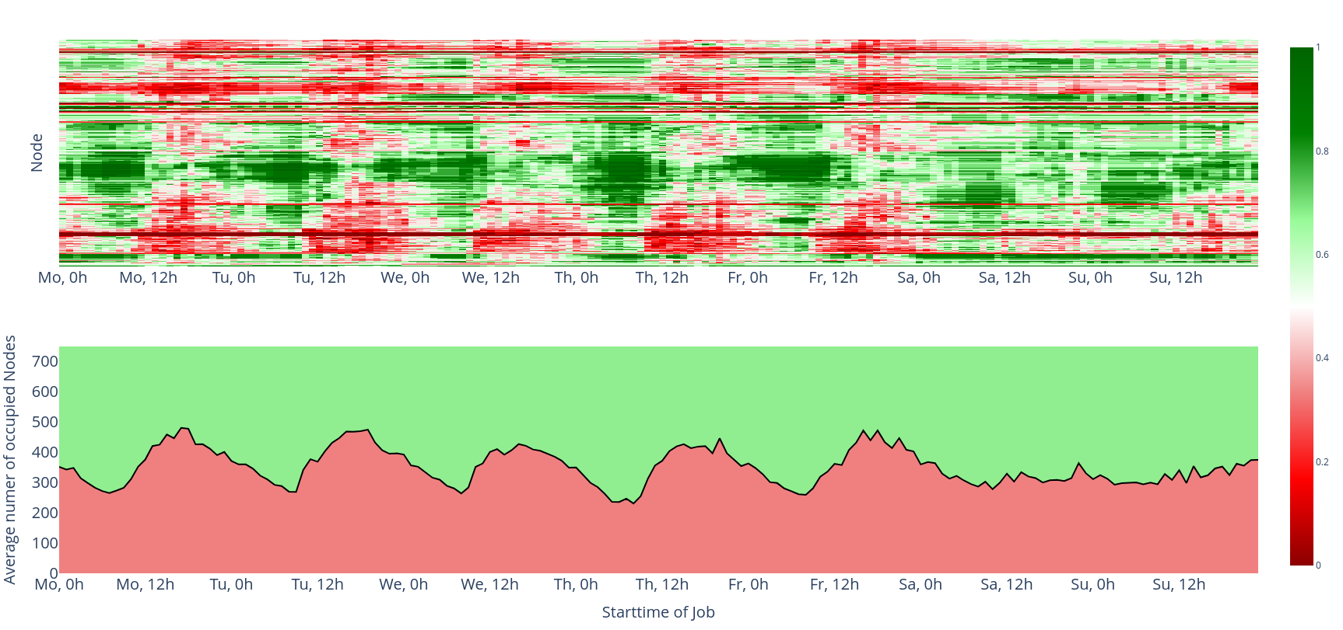
How much is actually used?

Slide 15
Increasing the energy and CO₂ efficiency of the Maxwell cluster
1. More efficient utilization
2. Switching off idle nodes
3. Throttling CPUs
Put jobs from other grids on Maxwell
Up to 20% savings without the user noticing
Save Electricity at night, when it has a high Carbon intensity
Huge savings potential!
Save ~30% in Carbon emissions

Slide 16
How my simulation worked
Repeat with different parameters
Read in jobs from Maxwell
Start/end jobs
Simulation
Put jobs that can’t be started into queue
Timestep
Start up/shut down machines
Get optimal results

Slide 17
João Alvim - joao.alvim@desy.de
Anton Schwarz - anton.schwarz@desy.de
Konrad Kockler - konrad.kockler@desy.de
Scientific Computing

