Slide 1
Simulation Software
for Automated Beamline Alignment
European XFEL - Data Analysis
Isaac Chan
Supervisors: Egor Sobolev, Danilo Ferreira de Lima, Luca Gelisio
Notes:
Hello everyone, my name is Isaac Chan, I’ve been working with the Data Analysis group at XFEL, and I am here to discuss my project of creating simulation software for automated beamline alignment

Slide 2
Introduction
The largest free-electron laser in the world
Facilitates critical research in physics, chemistry, biology, and material science
Open to internal and external research groups
Competitive application for beamtime
Notes:
The EuXFEL home to what is currently the largest free electron laser in the world
Facilitates critical research in areas such as physics, chemistry, biology, and material science
This facility is open to researchers from across the world, to both internal and external research groups
With a competitive application process for access to the facility, experimental time at XFEL is an expensive and scarce resource, so it is crucial that it is used optimally

Slide 3
Simulation Software for Automated Beamline Alignment
Isaac Chan, DESY Summer Student Program, 5.9.2024
Final Model Prediction
Pulse Intensity
Beam-Jet Intersection
Pulse: a single flash of the X-ray beam
Train: a rapid sequence of pulses, delivered 220 ns apart
Image source : Wiedorn et al, 2018 [1]
Notes:
One of the challenges to optimal beamtime use is aligning the components of the beam and the jet, both of which are not only very small in size, but also subject to random fluctuations
In this image here we can see a depiction of the setup for the serial crystallography experiment
We see the beam source to the left, and the jet, which delivers the liquid sample as a stream,
One pulse represents a single flash of the beam, and a train is a rapid sequence of pulses, delivered 220 nanoseconds apart
The results of our experiment, the interaction between the beam and the jet, is captured by the AGIPD detector at the back.
For our project, the goal was to develop software that simulates the interaction between the beam and the jet, with variations in the pulse intensity, pointed to on the left
and the position of the jet, pointed to in the middle as the beam-jet intersection,
And then we want to observing how these factors impact the brightness of the image from the AGIPD detector, which is our target of optimization

Slide 4
Overview of Our Model
Simulation Software for Automated Beamline Alignment
Isaac Chan, DESY Summer Student Program, 5.9.2024
Beam-Jet Intersection length
Multiplied
x
Pulse Intensity
Pixel Intensity on Detector
(brightness of image)
Notes:
With two main components to this model, we designed a new piece of object-oriented software to model each part, one class for the pulse simulation, and one for the beam-jet intersection.
Our final model is the product of the two classes’ results. It is a number that represents the pixel intensity on the detector, and we use this number to represent how well aligned the beam and jet are.
In general, we want to optimize the positioning such that this number is as high as possible

Slide 5
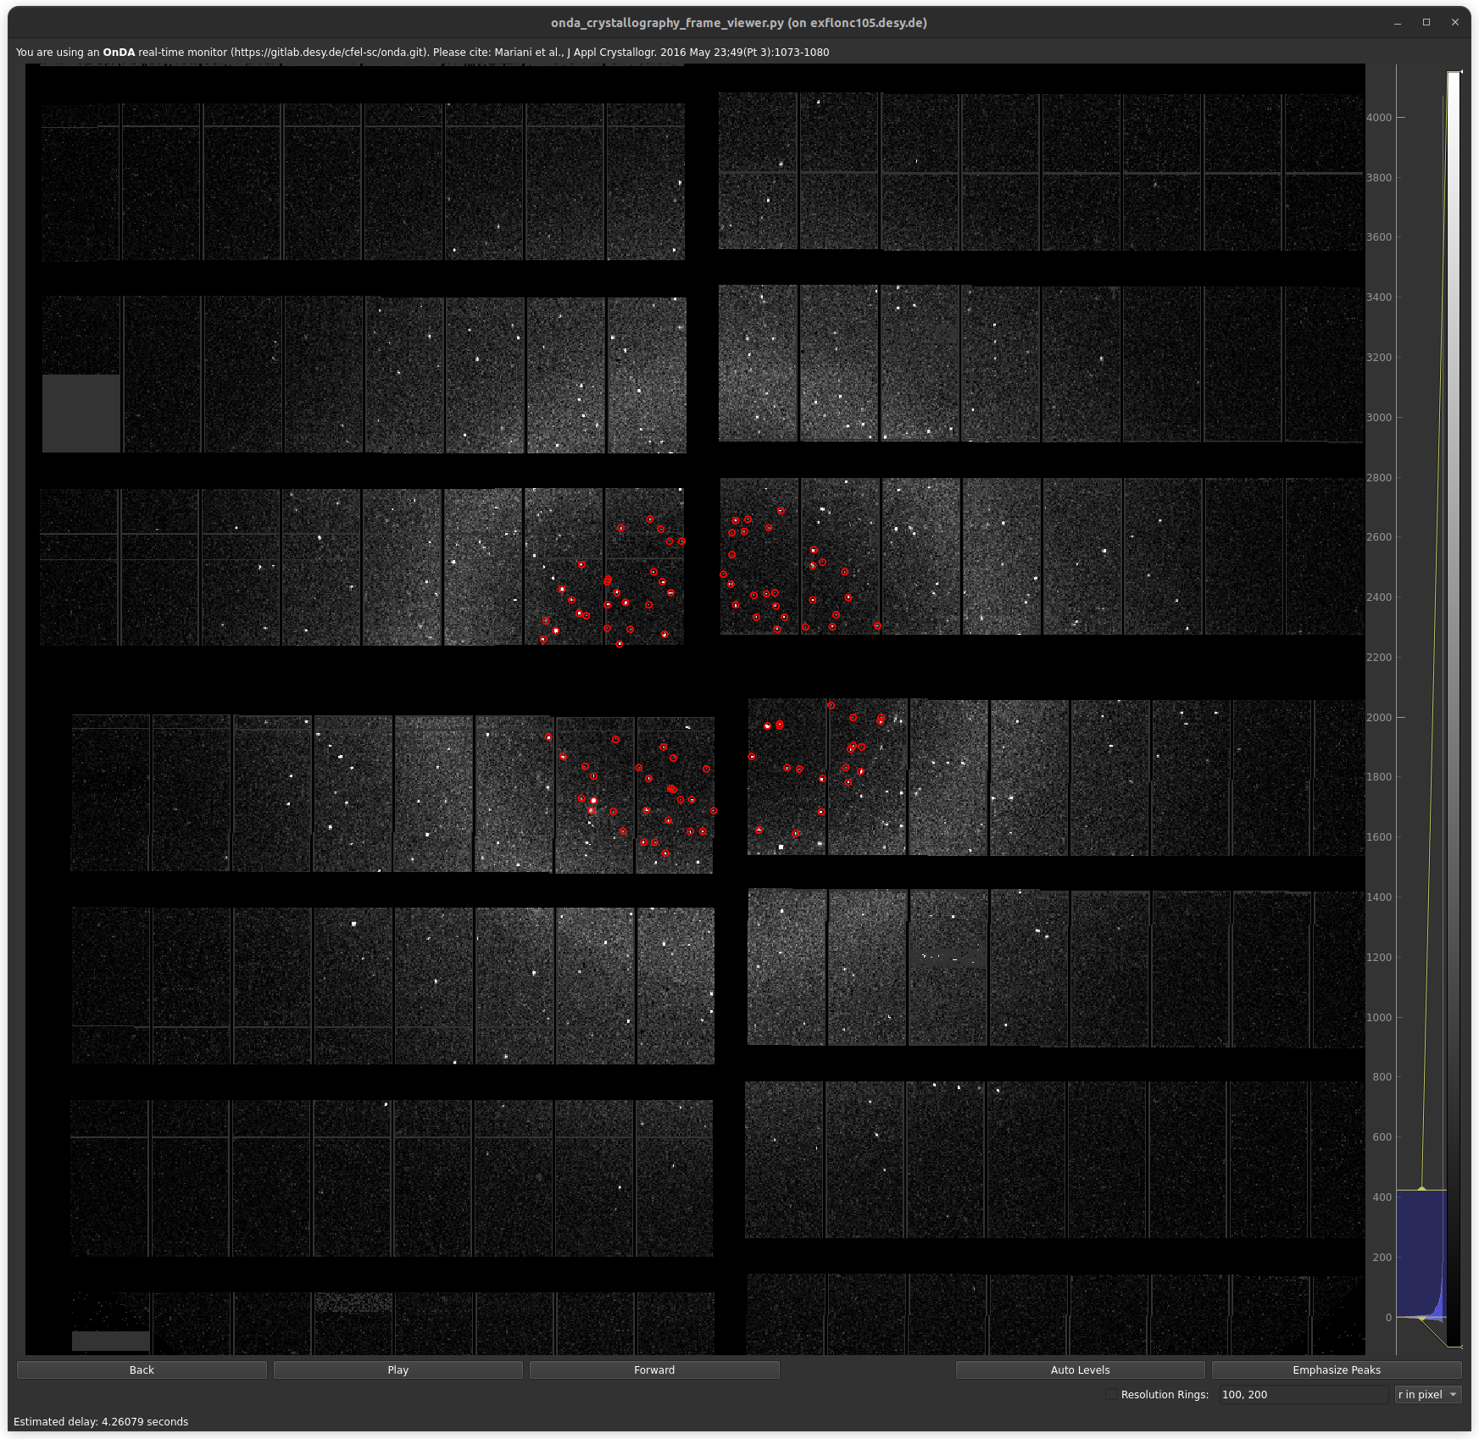
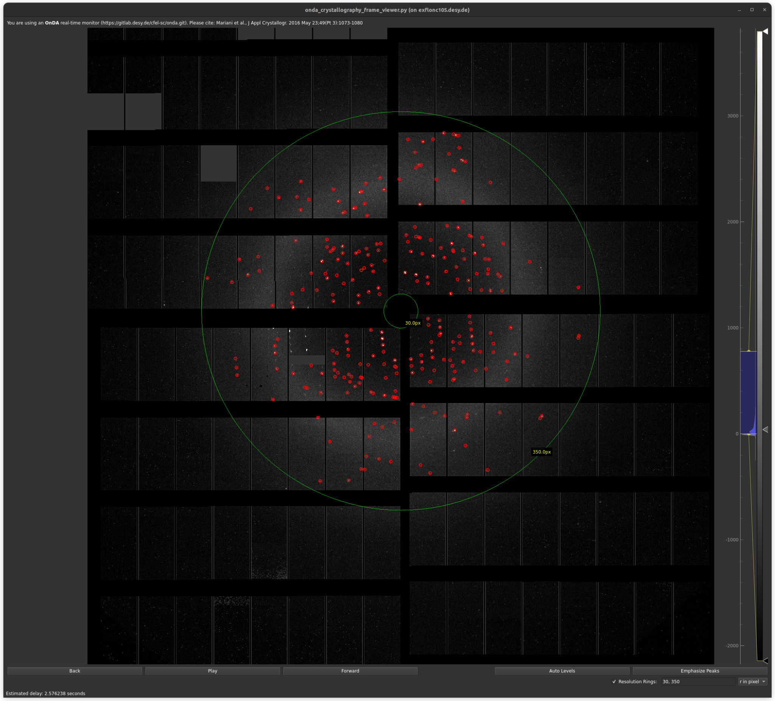
Good Detector Images
Simulation Software for Automated Beamline Alignment
Isaac Chan, DESY Summer Student Program, 5.9.2024
Notes:
Here are two examples of good and usable detector images,
A poorly aligned experiment would have been completely dark
Given the dim conditions by default, you can imagine that every bit of brightness counts towards making our images viable for analysis, which is why we’ve chosen to focus on this for our project

Slide 6
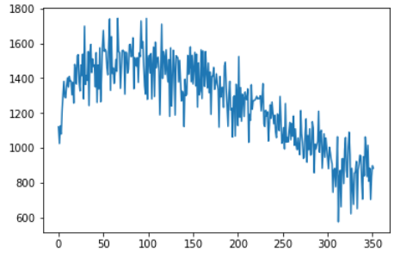
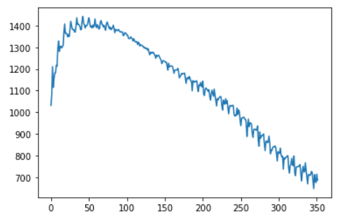
Developing Pulse Intensity Model - First Steps
Simulation Software for Automated Beamline Alignment
Isaac Chan, DESY Summer Student Program, 5.9.2024
Pulse Intensity
Pulse Intensity
Pulse Number
Pulse Number
Single train example
Average across all trains (~2700) in a run
Notes:
So we start off with our first class, modeling our pulse intensity.
Pulse intensity is something that naturally varies across a train, but in a generally consistent and observable pattern
So we created our model based on existing observed datasets from XFEL
On the left is an example of a typical train
On the right is where we took an average of all trains in a run, approximately 2700 trains
the purpose was to find the more underlying pattern by taking out a lot of the noise

Slide 7
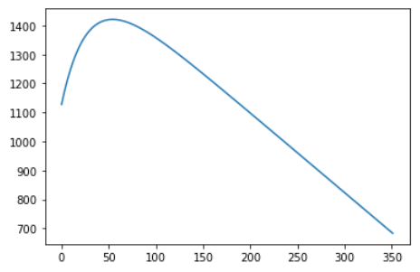
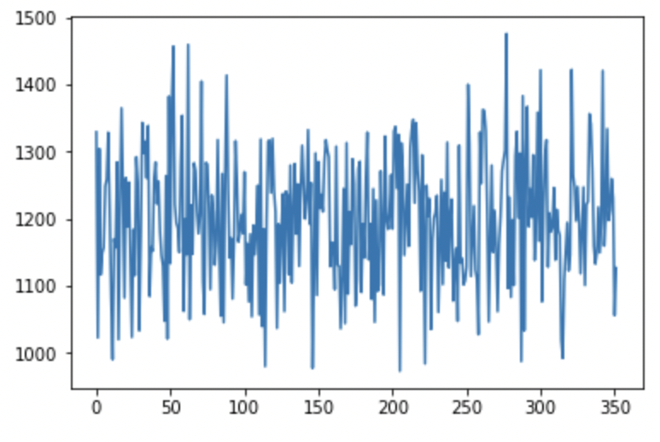
Developing Pulse Intensity Model - Analyzing Behavior
Simulation Software for Automated Beamline Alignment
Isaac Chan, DESY Summer Student Program, 5.9.2024
Pulse Intensity
Pulse Number
Fitted to equation:
y = −ax − ce^{−bx} + d
Random numbers to represent fluctuations
Notes:
With this in mind, we took the average out data and fitted it to the following equation
Which serves as the baseline pattern for our model
But we also can’t forget the fluctuations either
So those are added by generating random numbers, with the standard deviation taken from the input parameters

Slide 8
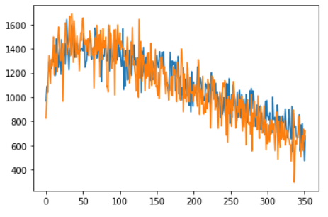
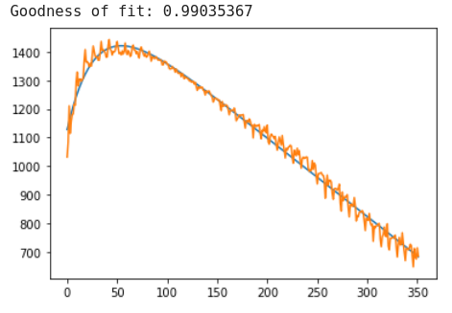
Developing Pulse Intensity Model - Results
Simulation Software for Automated Beamline Alignment
Isaac Chan, DESY Summer Student Program, 5.9.2024
Pulse Intensity
Pulse Intensity
Pulse Number
Pulse Number
Simulated train (blue) vs. observed train (orange)
Fit line vs. Data
Notes:
With those in mind, these are the results generated by our pulse intensity class
On the left, we have a single simulated train in blue, versus an observed train in orange,
So our simulations do match up quite well with the observed data
And on the right, this is a comparison of the averaged out pulse intensity, and a goodness of fit comparison for our equation, with a number that we are satisfied with

Slide 9
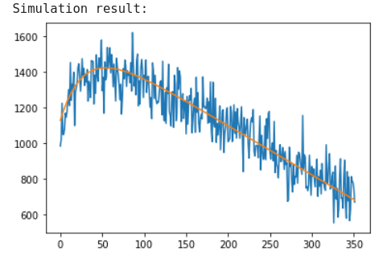
Pulse Intensity Class Features
Simulation Software for Automated Beamline Alignment
Isaac Chan, DESY Summer Student Program, 5.9.2024
Initialize with variable values fit of function
Default values available for all parameters
simulate() - Run simulation
plot_results() - Plot simulation results in a graph
plot_fit_line() - Plot the fit line in the graph
fit() - User creates own simulation model
Pulse Intensity
Pulse Number
Notes:
And as a summary of our pulse intensity class,
Each object is initialized with the variable values for the function
But recognizing that this might not be something that the user has on hand, these are not required from the user however, Default values available for all parameters, and they are the same as those taken from our original data fit
We have our most important function, simulate() - as the name suggests, this is used to run the simulation, it produced one train by default, but it takes in an optional parameter if users want more
We can plot the results like here on the right
And also display the fit line, which is in orange
Finally, we allow the user to fit a simulation to their own data

Slide 10
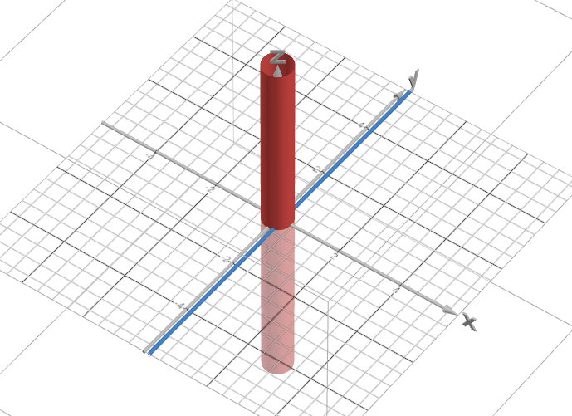
Jet-Beam Intersection Model - Concept
Simulation Software for Automated Beamline Alignment
Isaac Chan, DESY Summer Student Program, 5.9.2024
Jet flow
FEL Pulse
Real image
Our model
Notes:
Now for the second part of our model
The second thing main factor is how much of the beam actually hits the jet, in some cases, it is possible for it to miss entirely
On the left are real images of the jet
On the right is a representation of how our model works
The jet flow is treated as a cylinder, the size which is set by the user
And the beam is modeled as a straight line on the x-axis
We calculate the length of intersection to determine how much interaction we will have

Slide 11
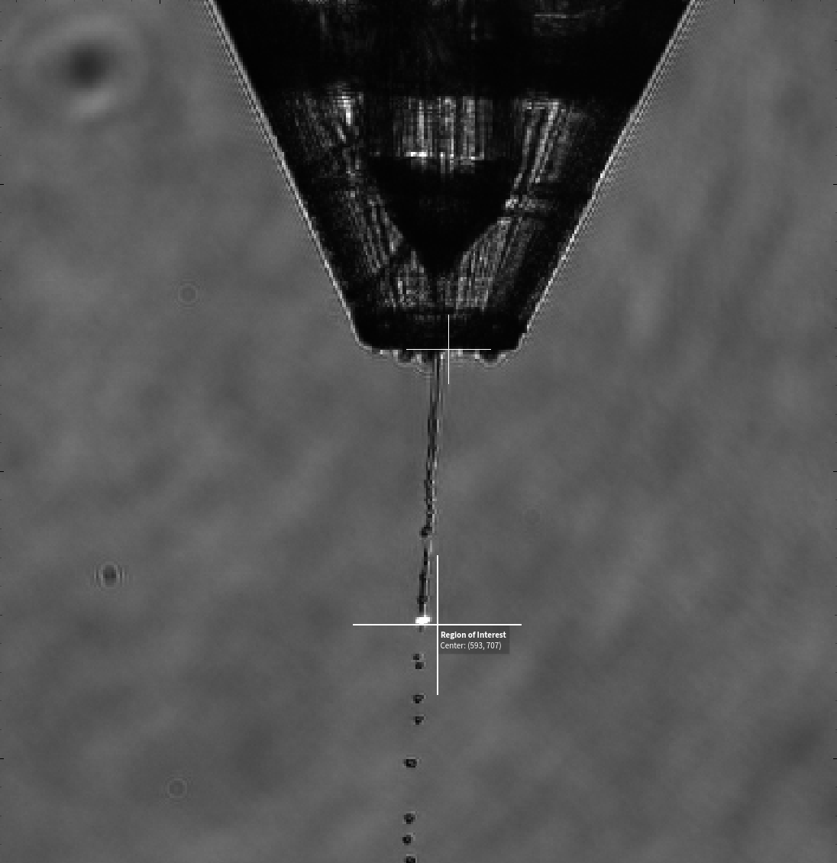
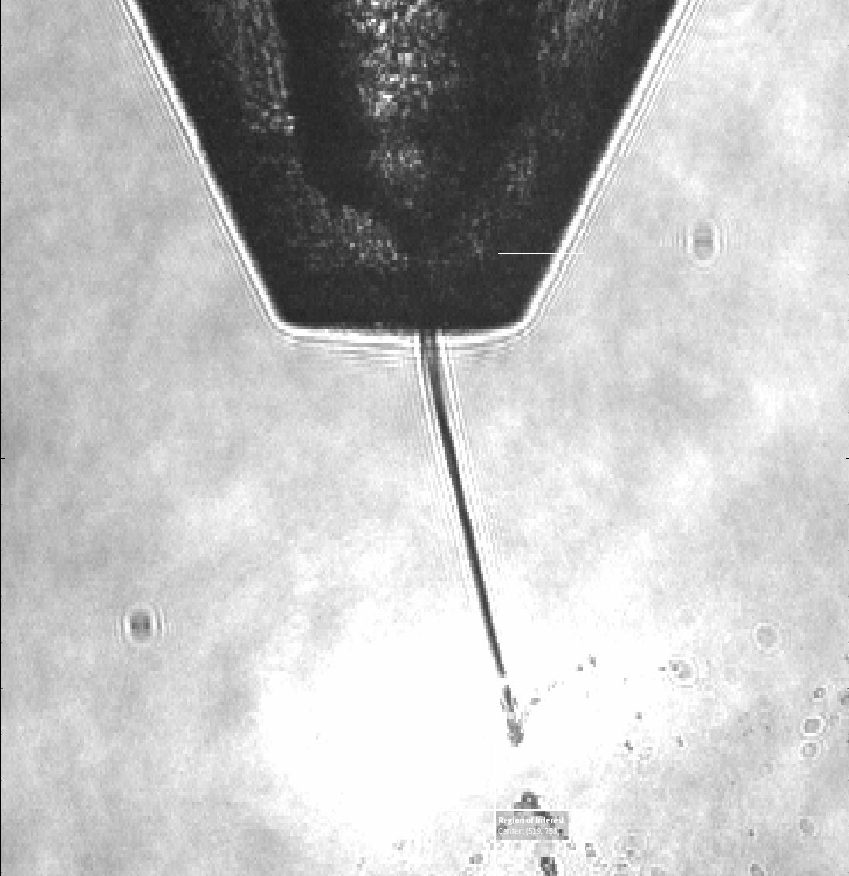
Jet-Beam Intersection Model - Real Image Examples
Simulation Software for Automated Beamline Alignment
Isaac Chan, DESY Summer Student Program, 5.9.2024
Notes:
Here are some more closeup examples of the jet
On the left you have an almost perfectly straight one
Whereas on the right, you see a very obvious tilt,
A setup that is much more difficult to align well with the beam

Slide 12
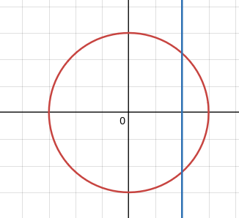
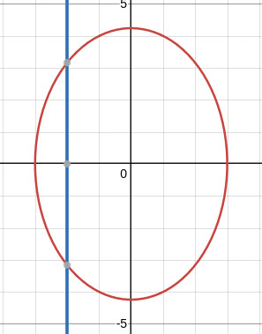
Jet-Beam Intersection Model - Cross-Section View
Simulation Software for Automated Beamline Alignment
Isaac Chan, DESY Summer Student Program, 5.9.2024
y
y
Jet cross-section
x
x
Beamline
No incline
Inclined Jet
Notes:
we can look at the intersection as the cross section of the cylinder and the line
With a completely straight jet, the cross section is a circle
But the cases of an inclined jet, the result is an oblique cylinder, and the cross section ends up being an ellipse instead
In either case, the amount of intersection is calculated as the length of the beamline that rests within the circle or ellipse

Slide 13
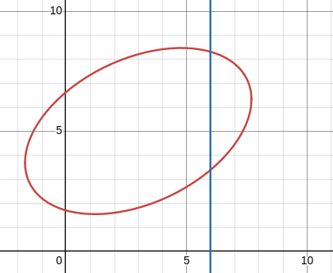
Jet-Beam Intersection Model - Single Value
Simulation Software for Automated Beamline Alignment
Isaac Chan, DESY Summer Student Program, 5.9.2024
y
Intersection Length
x
Notes:
Here is an example of our class in action
In the example, we have a jet that was tilted, and thus it is an ellipse not centered at the origin
Using the find_intersect() function of this class, it return a single number as to the length pointed to in green

Slide 14
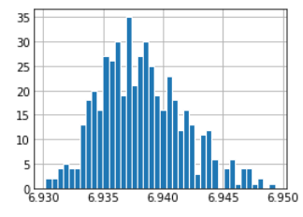
Jet-Beam Intersection Model - Multiple Values
Simulation Software for Automated Beamline Alignment
Isaac Chan, DESY Summer Student Program, 5.9.2024
# Times Encountered
Intersection Length
Notes:
But our goals was to do more than just a numerical calculation of a set intersection
To make a realistic model of this behavior, our simulate() function adds random fluctuations to the jet position
In a simulation of 500 trials, this is a histogram of the most common intersection lengths
We get these results by adding only minor changes in the jet position, without change to the beam position

Slide 15
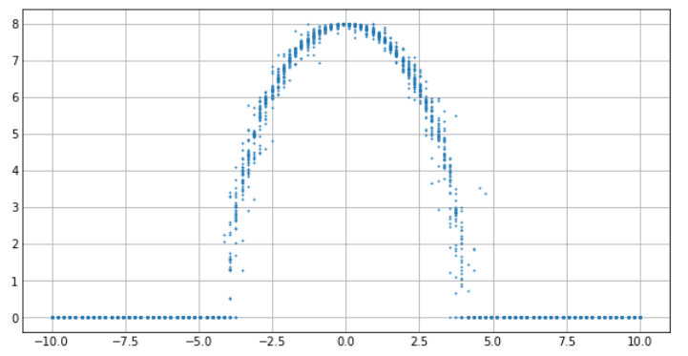
Beam-Jet Intersection Class Features
Simulation Software for Automated Beamline Alignment
Isaac Chan, DESY Summer Student Program, 5.9.2024
Initialize with position and size of the jet
find_intersect() - Finds intersecting length
simulate() - Run simulation by calling find_intersect() with added random parameters
scan_x() - Run simulation across a given range of x values
Intersection Length
X-position of Beam
Notes:
Now for a summary of the class,
We initialize it with position and size of the jet
The aforementioned find_intersect calculates the intersecting length at a single given position
And simulate calls find_intersect repeatedly with added random parameters
And finally, we have Scan_x, the results which you see on the left, showing a simulation that was run across a range of x values, as if we were moving the beam horizontally

Slide 16
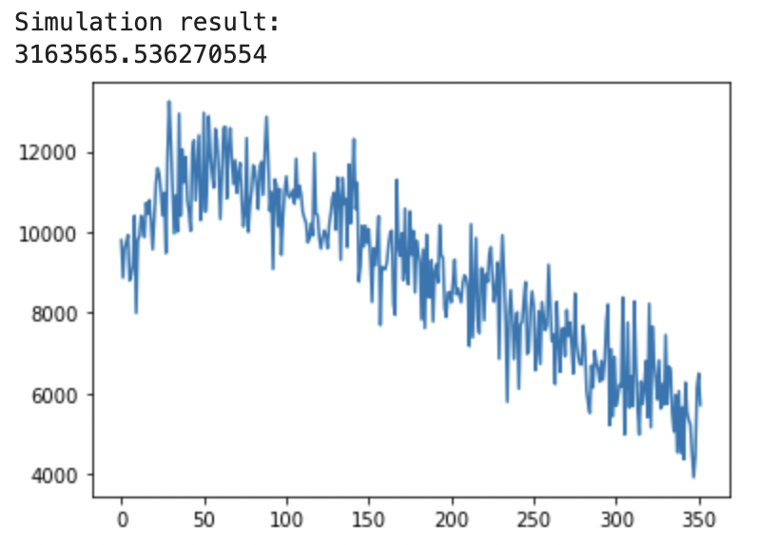
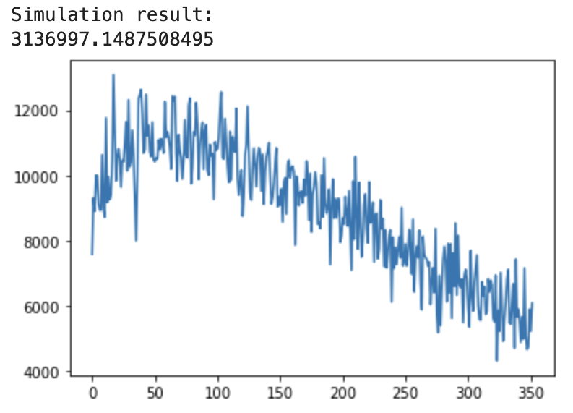
Final Model - Single Train
Simulation Software for Automated Beamline Alignment
Isaac Chan, DESY Summer Student Program, 5.9.2024
Pixel Intensity
Pixel Intensity
Pulse Number
Pulse Number
Jet incline = 1 degree
Jet incline = 5 degrees
Notes:
Combining the two, we get our final model
Where the pulse intensity is multiplied by the length of intersection
And the result represents our pixel intensity
Plotted here is the number representing the pixel intensity at each pulse across a train
On the left, with a jet incline of one degree, and on the right at, 5 degrees, and all other values are identical for these simulations
We also display the total sum of all of the plotted values, and see that the simulation shows the one with a one degree incline allows for a greater pixel intensity

Slide 17
Final Model - Results Across X-Axis
Simulation Software for Automated Beamline Alignment
Isaac Chan, DESY Summer Student Program, 5.9.2024
Pixel Intensity
Pixel Intensity
X-position of Beam
X-position of Beam
Jet incline = 0
Jet incline = 3 degrees
Notes:
Here are the results from plotting with scan_x, where we also held all values as constant except for the jet incline, and we observe how the results for a 0 degree jet incline are quite consistent, aligning the beam at the very center will consistently provide the greatest pixel intensity,
but when you have some incline, the results are much more varied as less predictable
Overall, we did meet our original goal of creating a simulation program that took in information about the variations in the beam and jet, to show how well the beam was aligned

Slide 18
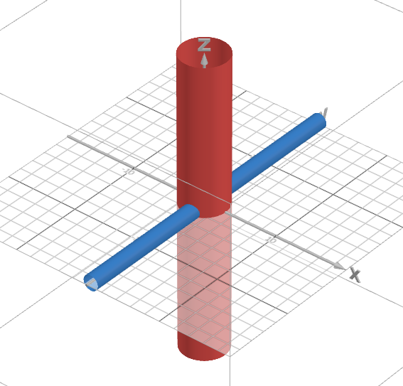
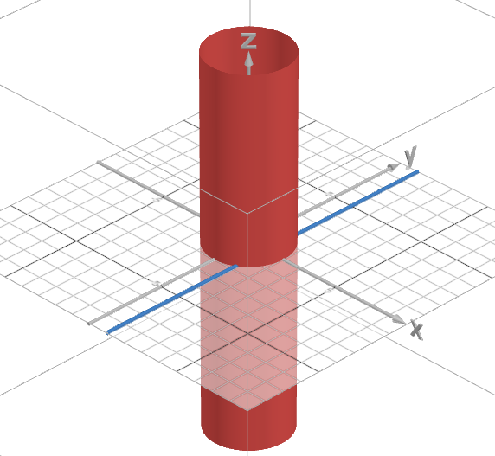
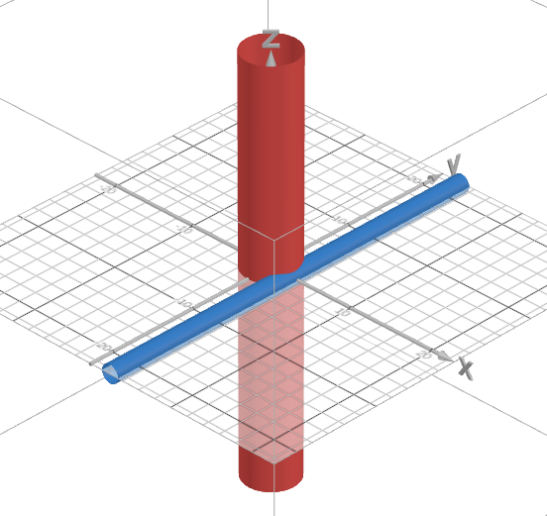
Future Work - Beam-Jet Intersection
Simulation Software for Automated Beamline Alignment
Isaac Chan, DESY Summer Student Program, 5.9.2024
Current Model
Improved Model
Notes:
For future work, there are a few things that we’d like to add that can further improve the accuracy and realism of the simulation program
Currently, we model the beam line as a straight line with negligible size, instead of a another cylinder, which would be a more accurate representation
We chose to simplify this, as otherwise we would have to calculate the intersection of two cylinders with different radii, one of which may be titled on an angle, a much more complex problem
the main difference between our simulated and real data is the lack of partial intersection at the edges of the jet stream
We see a much sharper drop-off in intersection length at the edges in the simulations, which is not necessarily true for the observed data
As such, we see this as a significant next step to further improving the program

Slide 19
Summary
Satisfied original goal of modeling basic beam and jet interaction
Will be used towards developing automated beam alignment tools
Software was written in accordance to best practices
Future work planned and expected to produce even more realistic results
Notes:
In summary,
With this project, we satisfied our original goal of modeling basic beam and jet interaction
And we expect that this software will play a vital role in the efforts of developing automated beam alignment tools
We also wrote this software with best practices in mind, of having clean code, documentation, and ensuring maintainability for the future
And finally, we have specific aspects of future work planned, that we expect to produce even more realistic results

Slide 20
Acknowledgements
Special thanks to:
Supervisors: Egor Sobolev, Danilo Ferreira de Lima, and Luca Gelisio
XFEL Data Analysis Group
DESY Summer Student Program Organizers and Cohort

Slide 21
Sources
[1] Wiedorn, M.O., Oberthür, D., Bean, R. et al. Megahertz serial crystallography. Nat Commun 9, 4025 (2018). https://doi.org/10.1038/s41467-018-06156-7

Slide 22
Questions?

