Slide 1
Induced Gravitational Waves After Ultra Slow-Roll Inflation.
Juan Álvarez
Supervisor: Julián Rey
Theory group
Hamburg, 05/09/2024

Slide 2
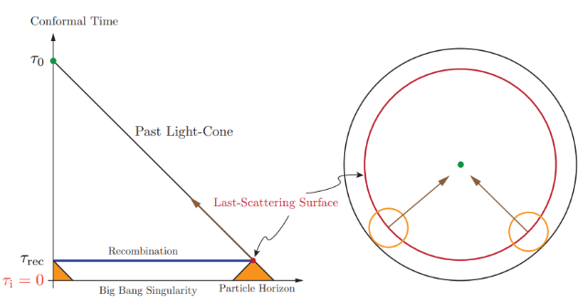
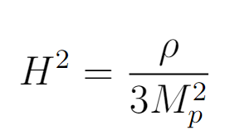
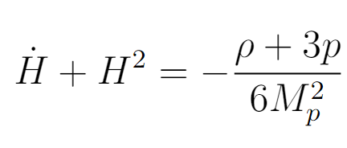
Why Inflation?
Daniel Baumann. Tasi lectures on inflation, 2012.

Slide 3
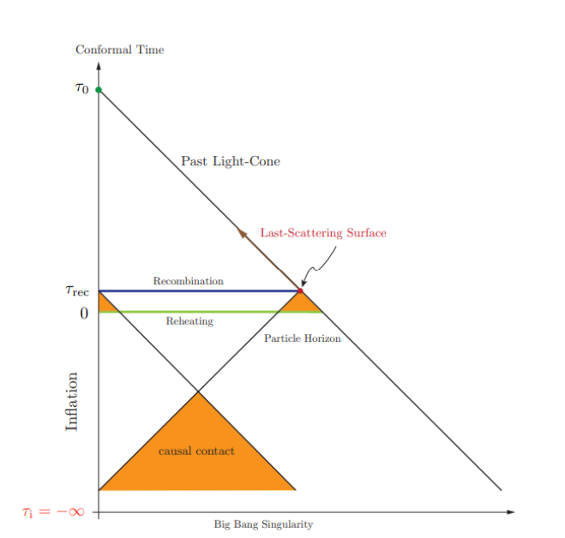
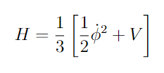
How can we have Inflation?
Slow-roll conditions.
Single-field inflaton weakly coupled to gravity.
Daniel Baumann. Tasi lectures on inflation, 2012.

Slide 4
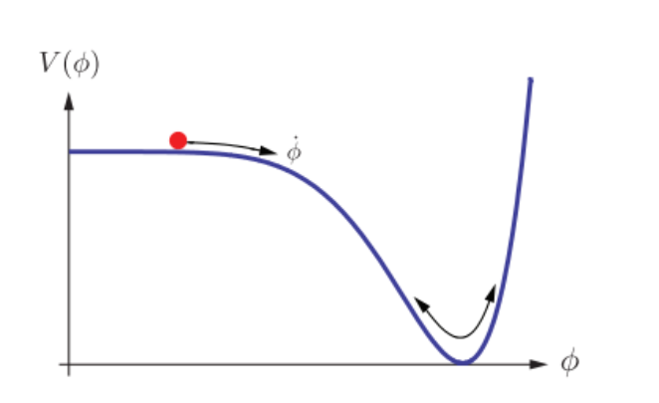
How can we have Inflation?
Slow-roll conditions.
Single-field inflaton weakly coupled to gravity.
Daniel Baumann. Tasi lectures on inflation, 2012.

Slide 5
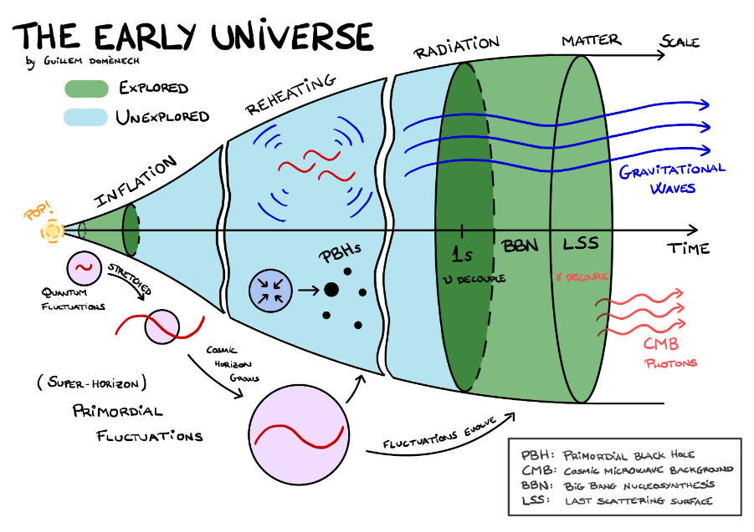
Why Ultra Slow-Roll Inflation?
Enhancement of the power spectrum after inflation on a certain length scale.
Production of Primordial Black Holes as a consequence of density perturbations
https://domenechcosmo.netlify.app/post/induced-gws/

Slide 6
Gravitational wave two-point function.
Green’s function method.
Perturbed metric.
Comoving curvature perturbation and Transfer function.
Second order expansion of Einstein Eqs. in Fourier space.
s=(+, ×)
Projector
Source term

Slide 7
Gravitational wave two-point function.
GW compact solution.
Transfer function term.
GW density.
Quantization.
GW density parameter.
Power spectrum definition.
Entropy conservation.

Slide 8
Cosmological Feynman Diagrams.
To calculate the 2 point function of GW we need the 4 point function of $R$.
We can represent our fields with the following lines.

Slide 9
Cosmological Feynman Diagrams.
Conversion between tensor perturbations h and comoving curvature perturbations $R$.

Slide 10
Cosmological Feynman Diagrams.
If we allow a non linear relation between $R$ and φ we have non gaussianities.

Slide 11
Cosmological Feynman Diagrams.
The φ propagator gives de dimensionless power spectrum of $R$.

Slide 12
Cosmological Feynman Diagrams.
If we don’t assume φ is a Gaussian variable and admit self interactions we will have intrinsic non gaussianities.
In-In Formalism

Slide 13
Two point function up to 2 loops.
We have to consider all posible diagrams that fit inside the black box.
At leading order we have the Gaussian contribution.

Slide 14
Two point function up to 2 loops.
We have 5 diagrams that violate helicity conservation.
Not connected or Tadpole diagrams don’t contribute
We also have 5 one-loop corrections to the propagator.
Their contributions have to be renormalized in some cases

Slide 15
Two point function up to 2 loops.
We have 4 diagrams that contribute (C,Z,X,M).

Slide 16
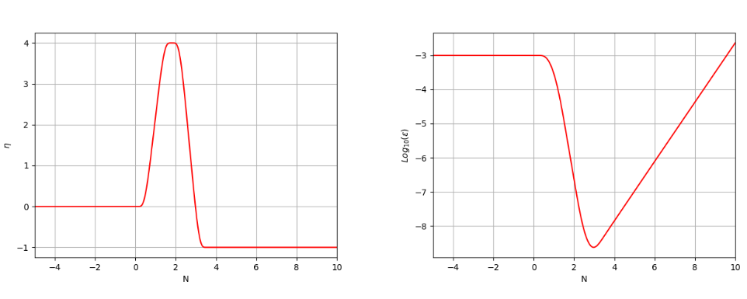
Slow-Roll parameter Model.
Smooth transition function between phases.
Inflation model considered.

Slide 17
Slow-Roll parameter Model.
Evolution of the field is given by Mukhanov-Sasaki equation.
With Bunch-Davis Vacuum solution as Initial condition.

Slide 18
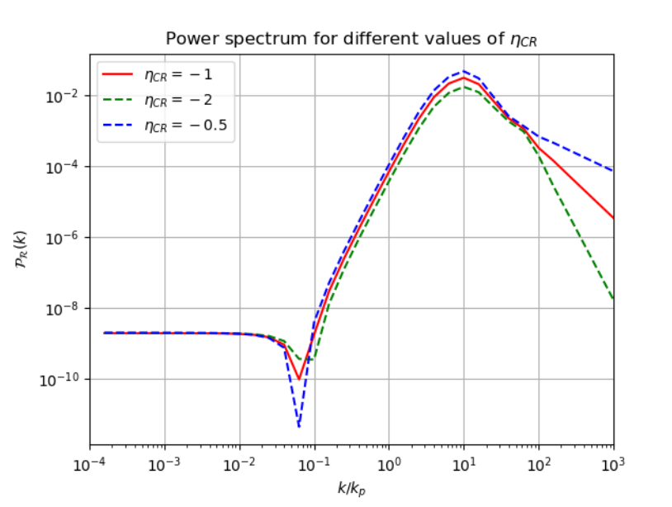
Slow-Roll parameter Model.
We calculate the power spectrum of $R$ at late times.

Slide 19
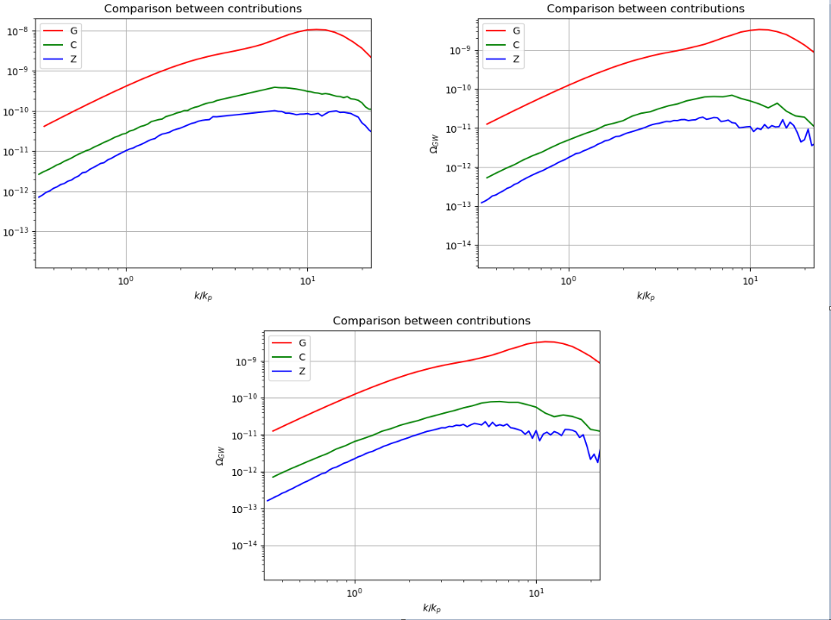
Contributions of G,C and Z diagrams to the density parameter.

Slide 20
Conclusions
Systematic method for two point functions with posiblity to calculate n-point functions if you are patient enough.
Tested with some non Gaussian corrections to a specific slow-roll parameter model.

Slide 21
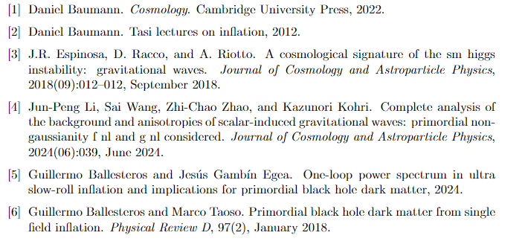
References

Slide 22
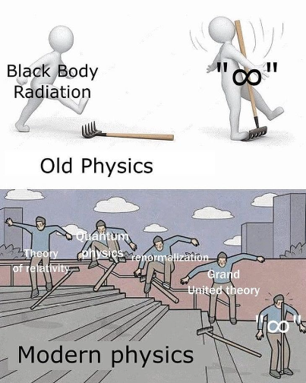
Thank you for your atention

Slide 23
Juan Álvarez
Theory Group
Juan.alvarez.ruiz03@gmail.com

