Slide 1
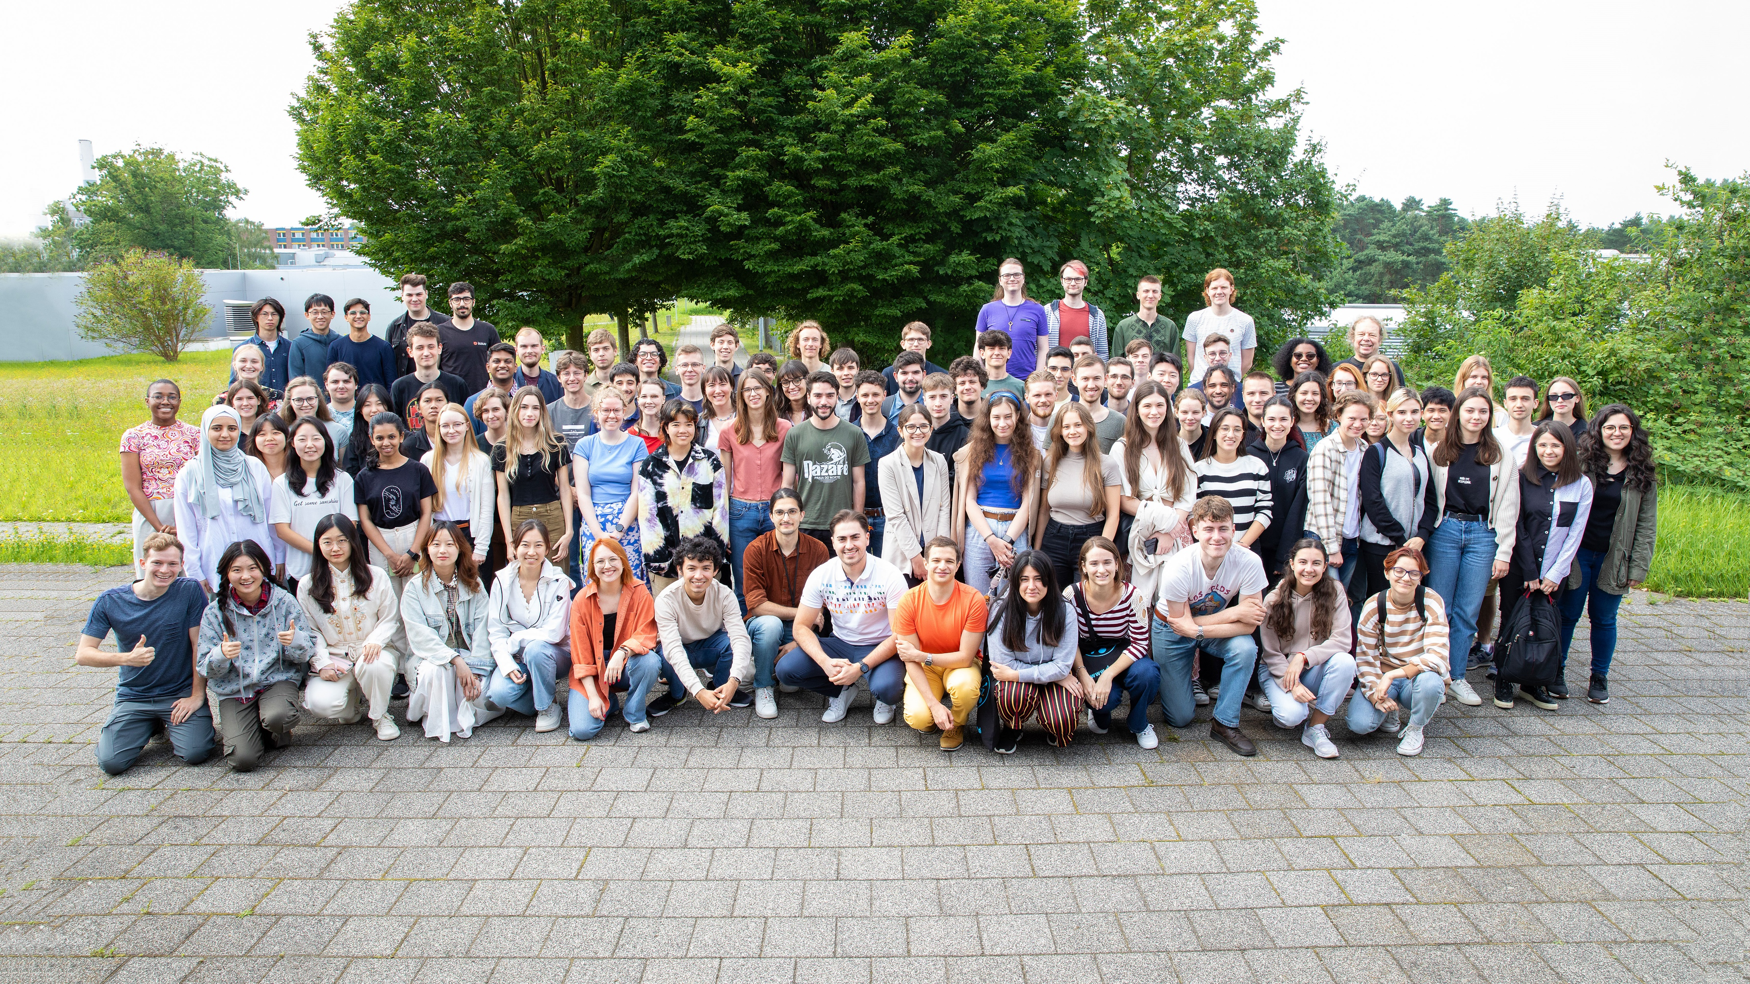
DESY Summer Student Programme 2024
Summary of the Evaluation and Farewell
Friederike Januschek for the organisers
Hamburg, September 5th 2024
DESY Summer School 2024 combined with

Slide 2
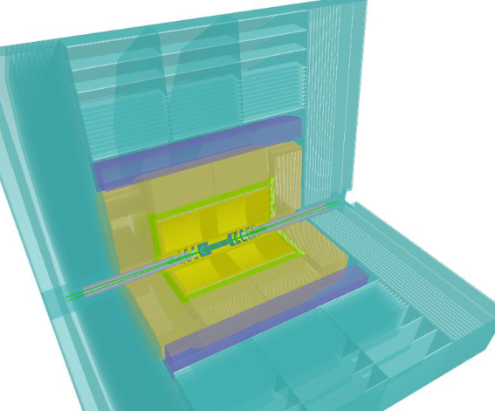
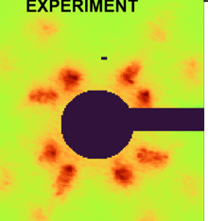
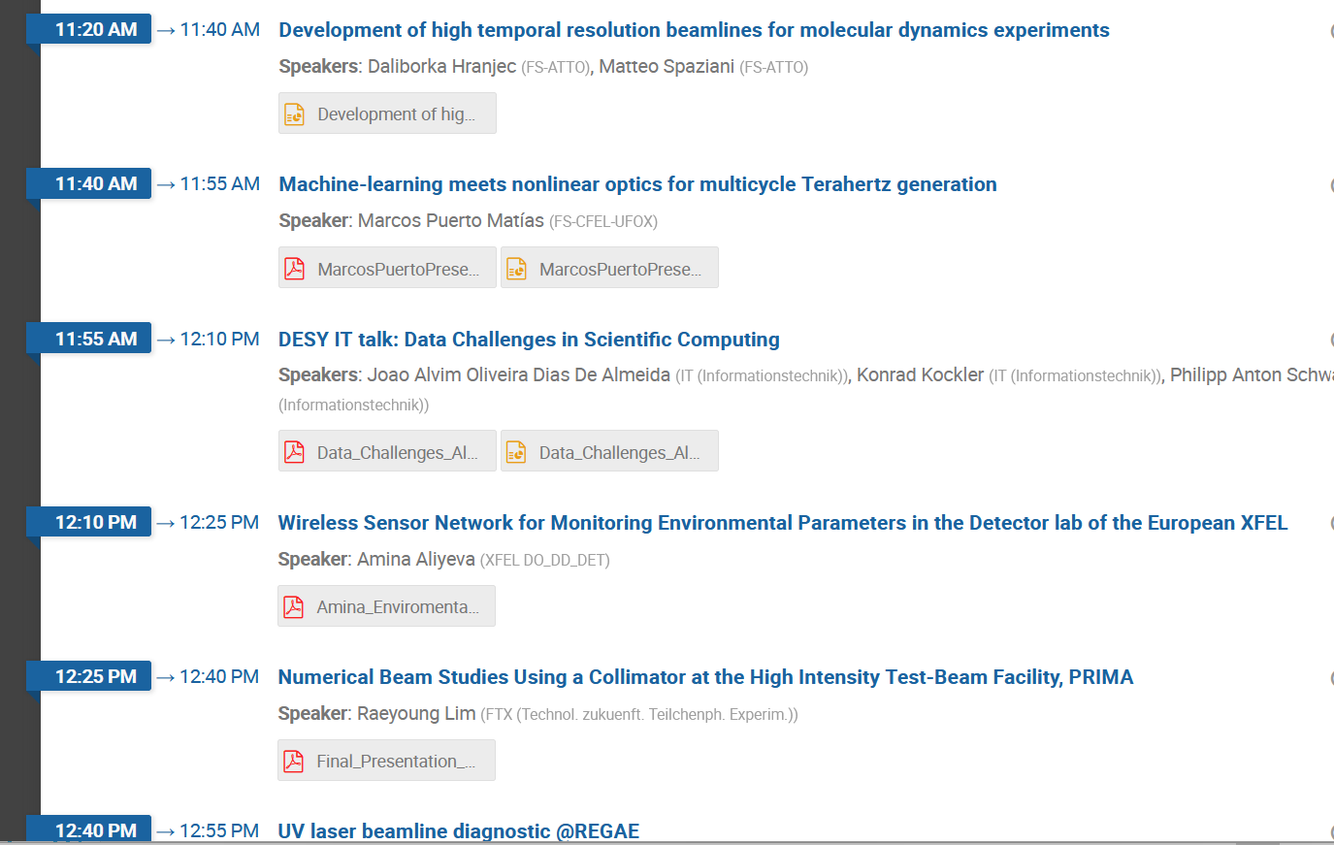
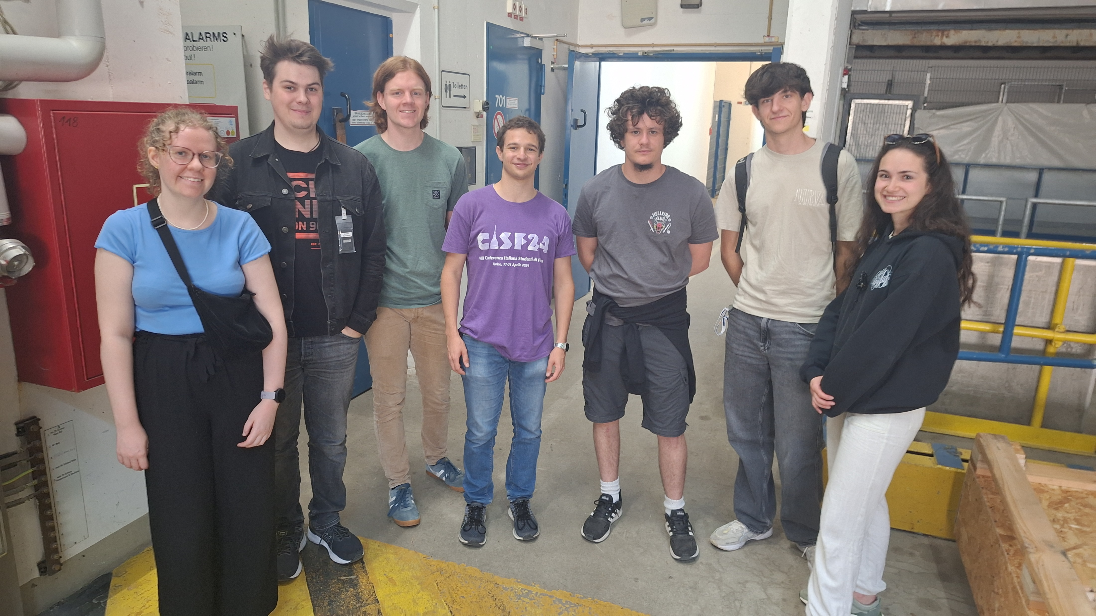
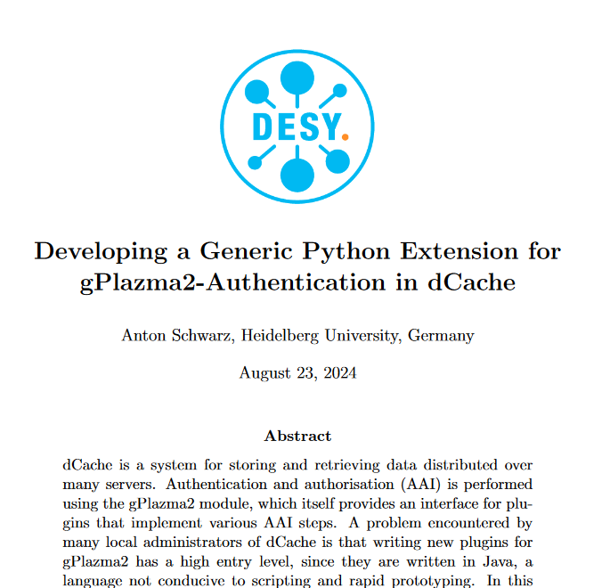
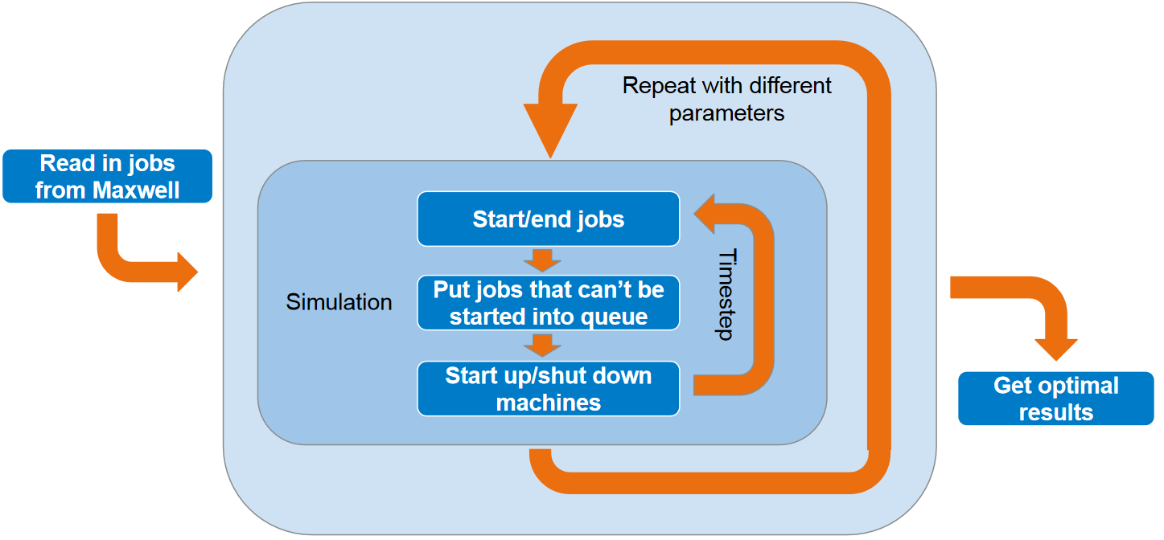
Results
First of all: nice scientific results examples of which you have just presented in the last two mornings ➔looking forward to your reports.
Hopefully: A glimpse into how we do science at DESY
Lectures about a broad range of topics
But also: Contacts to scientists at DESY and other students from all over the world
Fun and Friends
Fun and Friends ☺

Slide 3
Survey: Project Work
Please rate how you overall liked your project work
Please rate how well your project was defined and easy to start with

Slide 4
Survey: Project Work
Comments on project work
Please rate the quality of the supervision of the work project
“I loved the experience and I learned a lot in my project.”
“The project itself could have been a bit better structured and better defined from the beginning. Maybe a Zoom Call with the supervisors before coming to DESY might be a good idea.”
“The project was very interesting, sufficiently demanding to be a challenge, but not so much, that it would be impossible to finish it in time”
“My summer project was not what I expected, but it was fun nonetheless.”

Slide 5
Survey: Lectures
“the idea of lecture is good but the fact that everyone has different background makes difficult to do lectures that are interesting for everyone.”
Feedback on the lectures varies:
Topics
Difficulty level
Length/breaks
Amount
“I would like that the lectures communicate with each other so that parts are not redundant and are referenced”
“I feel like there was a huge variance on the difficulty level of the lectures, some of them being too introductive and some other being to specific.”
Please rate the overall quality of the lecture programme

Slide 6
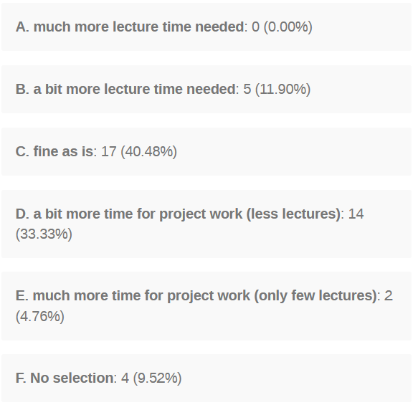
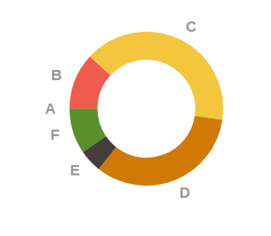
Survey: Lectures
The slight reduction of lecture time is well liked, possibly even a bit less lectures in the next years?
“but it would be great to have more time to work on the project, and maybe cut a few lectures or other events to accomplish that, or extend the programme for a week or so.”

Slide 7
Survey: Guided Tours

Slide 8
Survey: Smaller Guided Tours „Campus Tours“
“I participated in several smaller tours and all were really interesting, аnd they should definitely become a regular part of the program.”
“I liked the tours very much, the only problem I found with them was that they were happening in the work time.”
“The idea of the tours is very good, the organization was very well, but in some tours the people that guided it didn’t know much about some staff of the experiments.”
“I loved how excited the people were about their projects in the smaller tours, I believe that it was the most interesting part of the DESY tours. I only wish I could have joined all of them.”

Slide 9
Survey: Accommodation & Organisation
Please rate the overall quality of the information provided on the DESY summer student programme
Hostel in general well liked. ➔We will relay this and your detailed feedback to the DESY hostel.
“More kitchen equipment could be useful.”
“Get rid of the hornet nest near the building, please!”

Slide 10
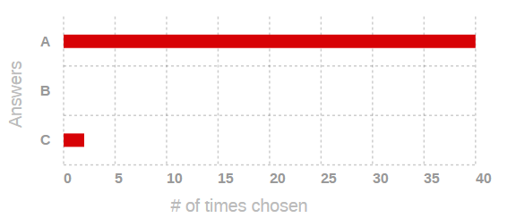
Survey: General Feedback
„Literally everything. Exposure to research world, great atmosphere to work, amazing summies, adventure, and most importantly, HAMBURG!”
„The canteen food“
„I loved my project“
“working until 7.30 p.m.”
“Meeting new people from around the world and being able to work in a real laboratory”
„Going back home :)“
Would you recommend the DESY summer student programme to a friend?
yes
no
not sure

Slide 11
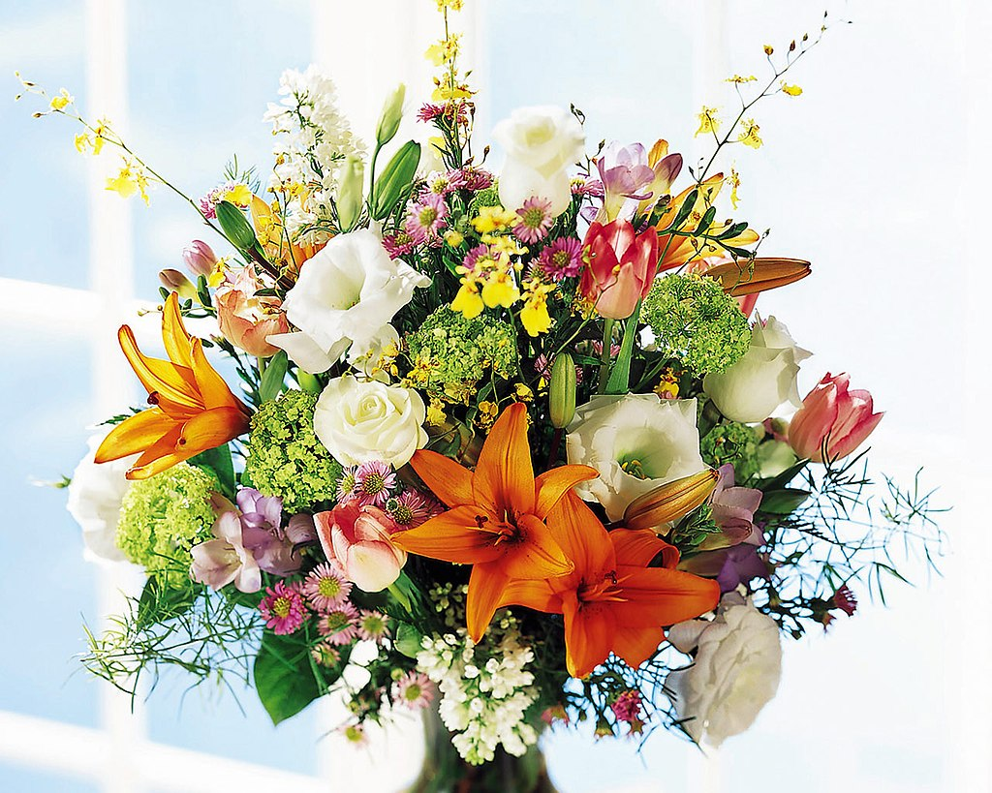
Thank you!
A big Thank you to the supervisors, who made this possible!
Another big Thank you to the lecturers who really went through a lot of effort to give these overview lectures.
Thank you to many others for administrative and technical help.
Thank you to my fellow organisers
Olaf Behnke, Gernot Maier, Andreas Przystawik, Nicholas Styles and in particular
Carolin Grötzinger and Britta Niemann

Slide 12
Thank you!
Thank you, DESY Summies 2024, for your enthusiasm, curiosity and great work! This is what creates the spirit and value of the program.

Slide 13
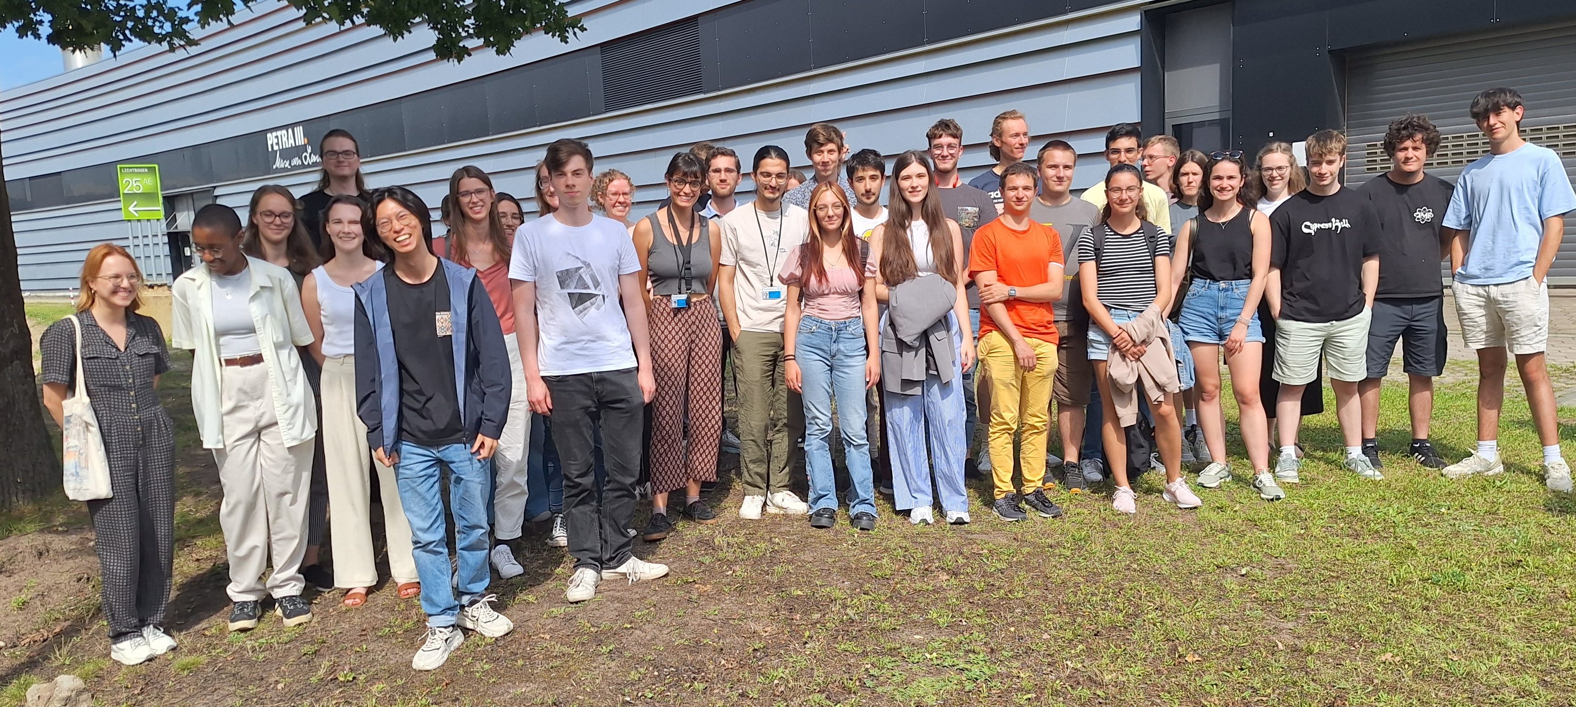
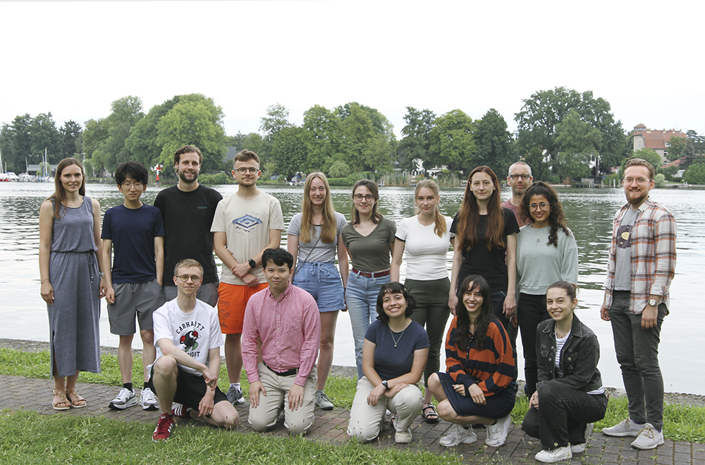
Thank you All!
It was great having you here!

Slide 14
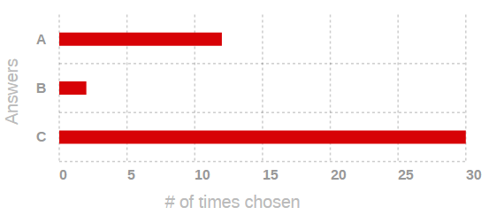
Thank you All!
We hope to welcome you back!
yes
no
maybe

Slide 15
The Future
If you would like to come back
About 40% of the DESY Summies return to DESY e.g. for doing their PhD.
If you want to be one of them: Stay in touch or get back in touch with your supervisors and other people at DESY.
There are different graduate schools and other initiatives at DESY, e.g. DASHH, Helmholtz Weizmann Multimessenger Astronomy Research School, PIER; to some of them you can apply directly
Also: check again the talks about our graduate schools https://indico.desy.de/event/45440/ as well as the webpages: https://www.desy.de/career/career_programs/index_eng.html
Alumni network https://connect.desy.de/index_eng.html
Please stay in touch, we‘ll be happy to hear from you!

