Slide 1
REGAE GUN laser diagnostic upgrade
Theory
Experiment
Speaker：Nengyuan Zhang
Supervisor：Max Hachmann

Slide 2
Outline
Theory
· Introduction of REGAE
· Introduction of photocathode
· Concept of virtual cathode
Experiment
· Virtual cathode of REGAE
· How to setup new diagnostic system
· Scan at virtual mirror
· What could we do in the future

Slide 3
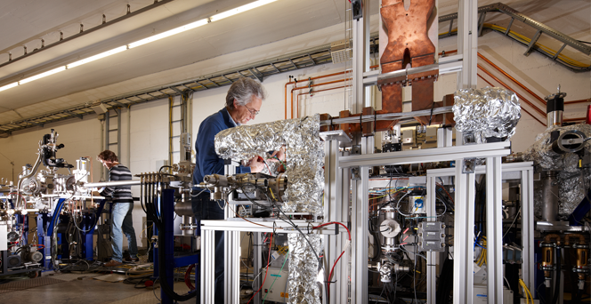
Introduction of REGAE
Relativistic Electron Gun for Atomic Exploration
Good diffraction quality need good electron bunch
Smaller emittance allows smaller beam diameters and a shorter pulse length
High bunch charge for good signal-to-noise
Higher bunch charge means higher space-charge forces on cathode -> worse emittance
5 MeV injector for Ultrafast Electron Diffraction (UED)
REGAE - Deutsches Elektronen-Synchrotron DESY
Hirscht, J., Mazurenko, D. A., Zhang, D., Hada, M., Bayesteh, S., Delsim-Hashemi, H., ... & Miller, R. J. (2011). REGAE: New Source for Atomically Resolved Dynamics.
Notes:
REGAE is a 5 MeV electron injector for ultrafast electron diffraction. To achieve this goal need high quality electron bunch. Smaller emittance is good for diffraction and reasonably high bunch charge is good for signal-to-noise.

Slide 4
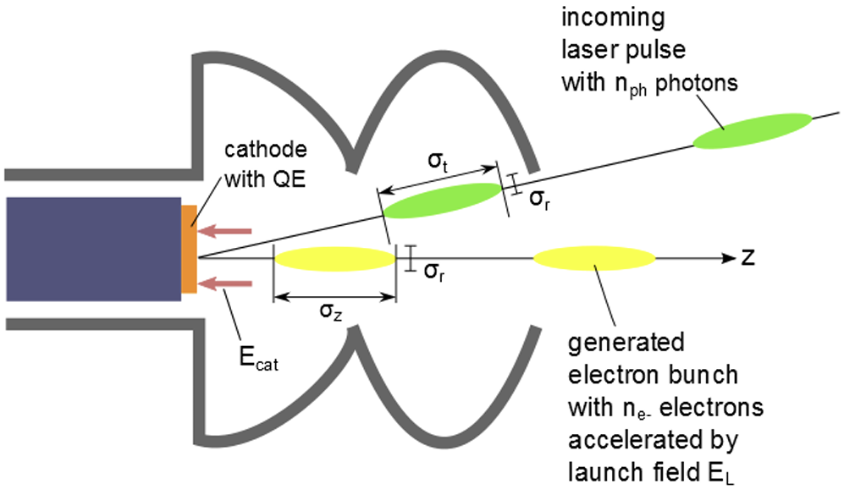
Introduction of photocathode
Transverse dimension
Initial emittance
Space charge phenomena
Laser spot size on the photocathode
Laser pulse intensity
Bunch charge
Electron bunch length
Peak current
Laser pulse length
Panofski, E., et al. "VIRTUAL CATHODE DIAGNOSTICS WITH A LARGE DYNAMIC RANGE FOR A CONTINUOUS WAVE SRF PHOTOINJECTOR."
Notes:
This is the sketch of photocathode. The photocathode electron gun utilizes the photoelectric effect to generate electrons. A UV light laser beam is directed onto the surface of the photocathode material, providing the surface electrons with sufficient energy to escape and form an electron beam. This electron beam is then accelerated and focused. Laser parameters have strong connection with electron beam parameters. The laser spot size on the photocathode determines the transverse dimension of the electron bunch and hence the initial emittance. Further, the spot size contributes to space charge phenomena. The bunch charge, is directly dominated by the laser pulse intensity, while it is indirectly affected by the dependency of quantum efficiency from the photon energy. The temporal pulse length determines the electron bunch length. Besides the electron bunch length, the laser pulse length affects the peak current of the electron beam.

Slide 5
Why we need virtual cathode
beam splitter
Close relationship between laser and generated electron bunch requires continuous monitoring
Laser
UV light
cathode
High diffraction quality
CCD
High quality electron beam
camera
Determine & Control laser parameter
Panofski, E., et al. "VIRTUAL CATHODE DIAGNOSTICS WITH A LARGE DYNAMIC RANGE FOR A CONTINUOUS WAVE SRF PHOTOINJECTOR."
Notes:
This sketch shows the basic concept of virtual cathode, a laser beam separate to 2, one hit the cathode, generate electron bunch, one be captured by camera, determine the parameter of laser. The close relationship between the laser and the generated electron bunch requires continuous monitoring. For REGAE, high diffraction quality need high quality electron beam, so determine and control laser parameter is important.

Slide 6
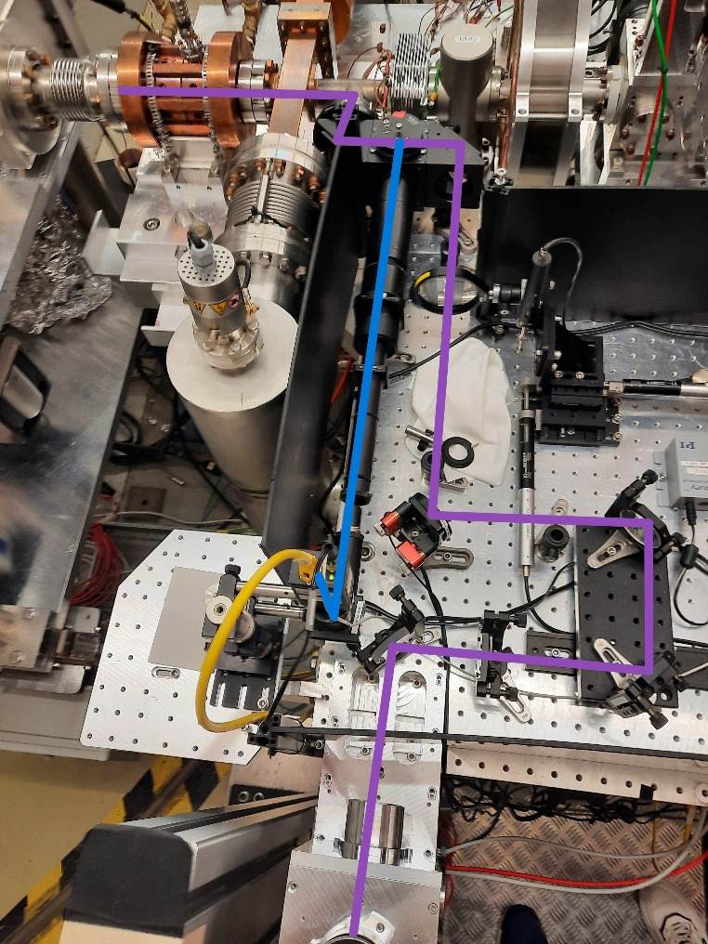
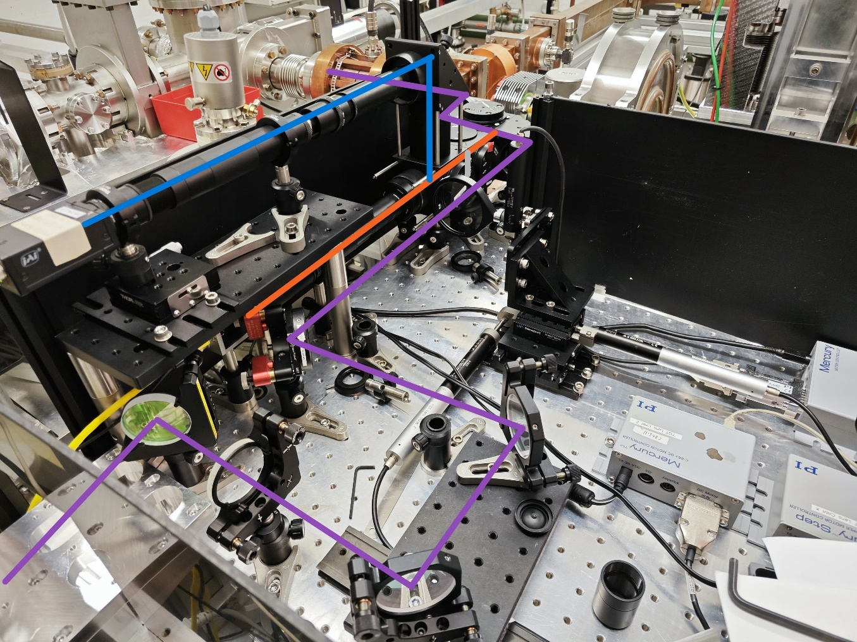
Virtual cathode of REGAE
OLD
NEW
Notes:
This 2 photographs depict the original and newly constructed diagnostic systems, respectively. In these images, the purple color signifies the primary optical path, the blue represents the path of light incident on the virtual photocathode, and the orange indicates the newly integrated diagnostic path for the virtual mirror. To conserve space, a stacked design has been adopted. The first layer of the optical platform features a new UV camera, which serves as a virtual mirror, while the second layer continues to use the original camera as a virtual cathode.

Slide 7
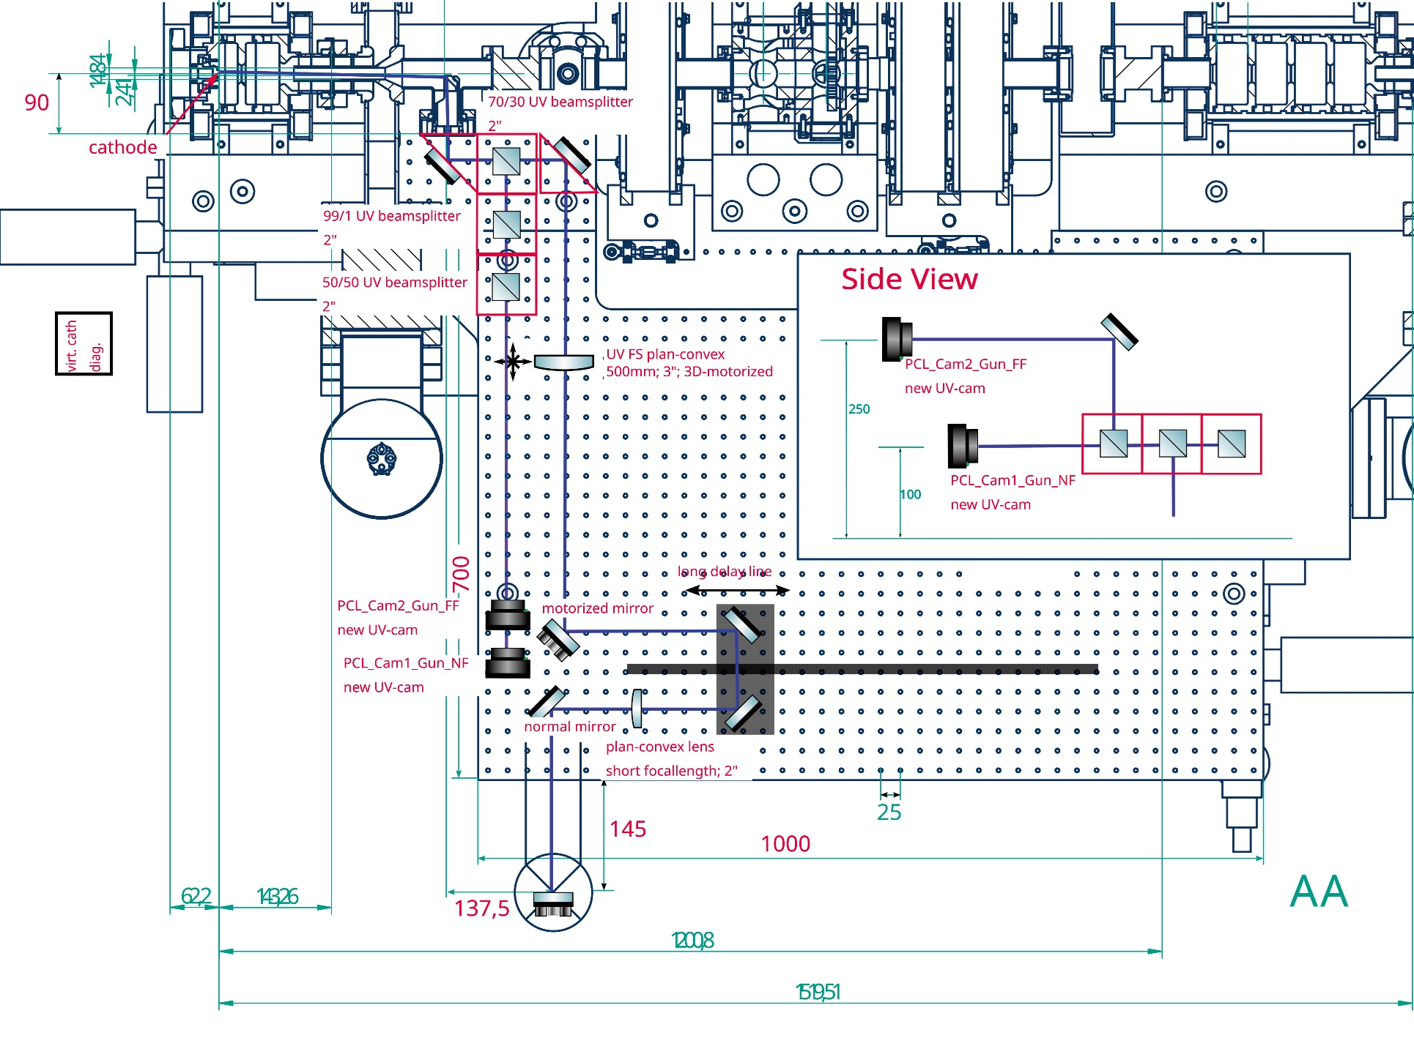
How to setup new diagnostic system
Notes:
This is the design of the new diagnostic system. The small mirror in red circle is the mirror we are imaging with the virt. Mirror camera. This mirror is in-vacuum, not movable and that the incoupling onto cathode is really narrow and limited by apertures. Therefore the alignment onto cathode is crucial.
The 2 mirrors and 1 lens in blue box is motorized, and can be used to control beam position and angle. This setup can be used to stabilize the alignment of this laser beamline section.

Slide 8
How to setup new diagnostic system
2
3
4
1
Notes:
This slides illustrates the process of dismantling the existing diagnostic system and setting up a new one. Here are the steps:
Step 1: Illuminate the photocathode from another side window of conduit. Place an additional camera on the platform next to the original camera, adjusting its position to obtain a clear image of the photocathode.
Step 2: Place an iris in the position of the original camera and illuminate with parallel light. Adjust the position of the iris so that temporary camera can capture a clear image. At this point, since the temporary camera can see both a clear image of the photocathode and a clear iris image, it indicates that the distance from the iris to the beam splitter is equivalent to the distance from photocathode to beam splitter. It can be assumed that collimating with the iris is equivalent to collimating with the actual photocathode.
Step 3: Now use parallel light to illuminate the iris. Setup new diagnositc system and adjust position of cameras to get clear image of iris, that means cameras could get image of cathode. The steps is the same to the virtual mirror.
Step 4: Reset the UV laser light and use it for final alignment of cameras. Different optics of cameras need to be set. Virt. Mirror need de-magnification and virt. Cathode need magnification.

Slide 9
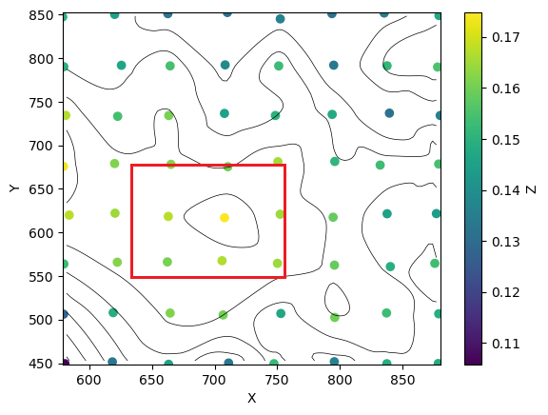
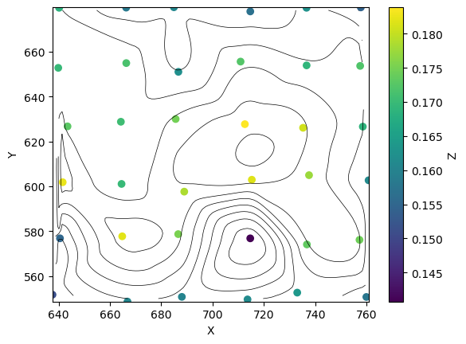
Scan at virtual mirror
/ pixels
/ pC
/ pixels
/ pC
/ pixels
/ pixels
Notes:
Now all hardware are set down, we could use beamstablizer to fix the position on the cathode and scanned the position on the mirror. This two figures presents the results of two scans. The first scan covers as large an area on the mirror as possible while the beam stabilizer program can still control the beam position. The second scan targets the area with the highest charge signal from the first scan, which is the region enclosed by the red square. Each point in the figure represents the collection of charge signal at the current position, with the darkness of the color indicating the magnitude of the charge. It can be observed from the figure that, while maintaining the position of incidence on the photocathode, changes in the angle of incidence, i.e., the position of the laser on the mirror, have a significant impact on the charge quantity. Interpolation processing is applied to the discrete data points, and a contour plot is superimposed on the data points. It can be seen that the final contour plot roughly takes on a mountain-like shape, and within a certain area, better results can be achieved. A more detailed scan of the red square area in Figure 9(a) reveals that there is only a small area capable of transmitting the highest intensity.

Slide 10
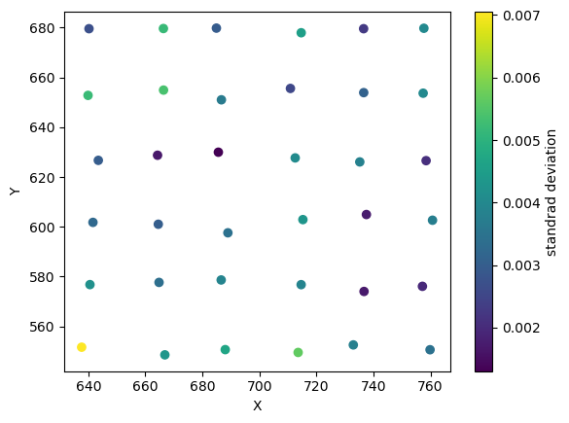
Scan at virtual mirror
/ pixels
/ pC
/ pixels
/ pixels
Notes:
it can also be noted that there are some points with strong signal records at the edge of the image. Since all signals are recorded, the standard deviation of the signal at each point can be calculated, as shown in left figure. It can be seen that the variance of the signal is larger at some positions. This may be due to jitter in the laser at a certain location; if the position of the laser jitters, the beam intensity on the photocathode will also jitter, leading to more significant fluctuations in the measured charge quantity. Although this does not explain why there are also points with high signal values at the edges in right figure, it can serve as a direction for future improvement, by collecting data over a longer period to counteract the effects of jitter.

Slide 11
What could we do in the future
beam splitter
mirror
Laser
beam splitter
In future plans, the position of the beam on the mirror can be fixed, and the position focused on the photocathode can be varied to measure the quantum efficiency at different incidence points, thereby creating a quantum efficiency topographical map of the photocathode.
cathode
CCD
CCD
Virt. mirror
Virt. cathode

Slide 12
Thank you for your attention

