Slide 1


A Teaser for the Annual Meeting
PUNCH4NFDI Annual Meeting 2024
Bonn, 27-29 November 2024

Slide 2
Findings
Findings in black
  Conclusions / consequences in blue
1. Need to go from develoment to operation and production
  Any given position MUST cover at least two of the three layers: development – operation – NFDI
  Requires different mindset: service providers!
2. Investment in a number of activities that are today obsolete or not / less NFDI-relevant
  → Concentrate on DRP, SDP, data management and federated infrastructures (later slides)
3. In future, difficult to work with too many Ph.D. students
  Concentrate on postdocs or even technical personnel whereever available
4. Typical distributed-project feature: Money distribution fixed at the beginning, and too much dispersed over too many partners (sub-critical at many institutes)
  In future / funding round 2 very strongly reduced number of receiving institutions (10 instead of 20, with possibility of ”Weiterweiterleitung” in the responsibility of the relevant co-applicant)
  retain some flex funds to be distributed by management
5. MB not sufficiently “powerful”, and PUNCH too weak on management and communication
  Rethink management and meeting structure
  Foresee more resources for project management, communication, …
PUNCH4NFDI Annual Meeting | Teaser – 27 Nov 2024 | TS

Slide 3
Conclusions:
For PUNCH-2.0, with proposals due on 6 August 2024, a re-thinking and re-alignment is needed for the consortium. This will address both the topics and probably also the involved partner institutions.
Taking into account NFDI overall goals: creation of community-overarching, generalisable and sustainable RDM services
Definition service (a la Base4NFDI): A service is a technical-organizational solution which typically includes
storage and computing services;
software, processes and workflows;
personnel support
A service creates added value, is characterized by scalability and sustainable operating models, and must be effective over time and in terms of usage (trackable by KPIs)
PUNCH4NFDI Annual Meeting | Teaser – 27 Nov 2024 | TS

Slide 4
NFDI, Sections, Communities
Here are the users
Service
Development
Addressing finding 1. :
We need to move from more or less pure development (the fun stuff?) to service deployment, operation, support.
And we need to “sell” better to the NFDI (Base4NFDI proposals?)
PUNCH4NFDI Annual Meeting | Teaser – 27 Nov 2024 | TS

Slide 5
…
NFDI and Sections
Need to get better here!
Service
Development
…
Addressing findings 1. and 3.:
We need persons that are simul-taneously involved in develop-ment, operations and NFDI / sections business.
Our hiring needs to be different from PUNCH 1.0.
Institute A
Institute Z
Institute B
Institute C
PUNCH4NFDI Annual Meeting | Teaser – 27 Nov 2024 | TS

Slide 6
Management
NFDI, Sections, Communities
Communication
Financial
Legal
Reporting
Networking
Web
Results page
Training & education
Service
Development
Addressing finding 5:
Scientific and technical TAs need stronger support from management, and better communication (inside PUNCH, to NFDI, communities, users, …)
PUNCH4NFDI Annual Meeting | Teaser – 27 Nov 2024 | TS

Slide 7
Discussions in EB, CB, UC
Toolbox
(services)
Pillars of the SDP
(infrastructures and services)
Teach & Sell
REANA
doi minting
Metadata factory
Data converters
Real-time
Software
Visualisation?
…
Results page
Helpdesk
“Training”
Connections
…
Federated
infrastructures
Data
management
SDP &
DRP
AAI
C(4P)
S(4P)
(Meta)data
Catalogue(s)
MD schema(ta)
DRP
RPR
Easier to connect
to Base / NFDI etc.
Connections to ErUM-Data currently being discussed.
PUNCH4NFDI Annual Meeting | Teaser – 27 Nov 2024 | TS

Slide 8
Oct 2021
PUNCH begins
Nov 2024
Today
Oct 2026
End / begin
27-29 Nov 24
Annual meeting
18 Feb / 4 Mar 25
In-person meetings
18 June
letter of intent
11 Feb 25
Evaluation
April 25
Concept fixed
6 Aug 25
Proposal deadline
A long way to go in PUNCH-1.0
PUNCH4NFDI Annual Meeting | Teaser – 27 Nov 2024 | TS

Slide 9
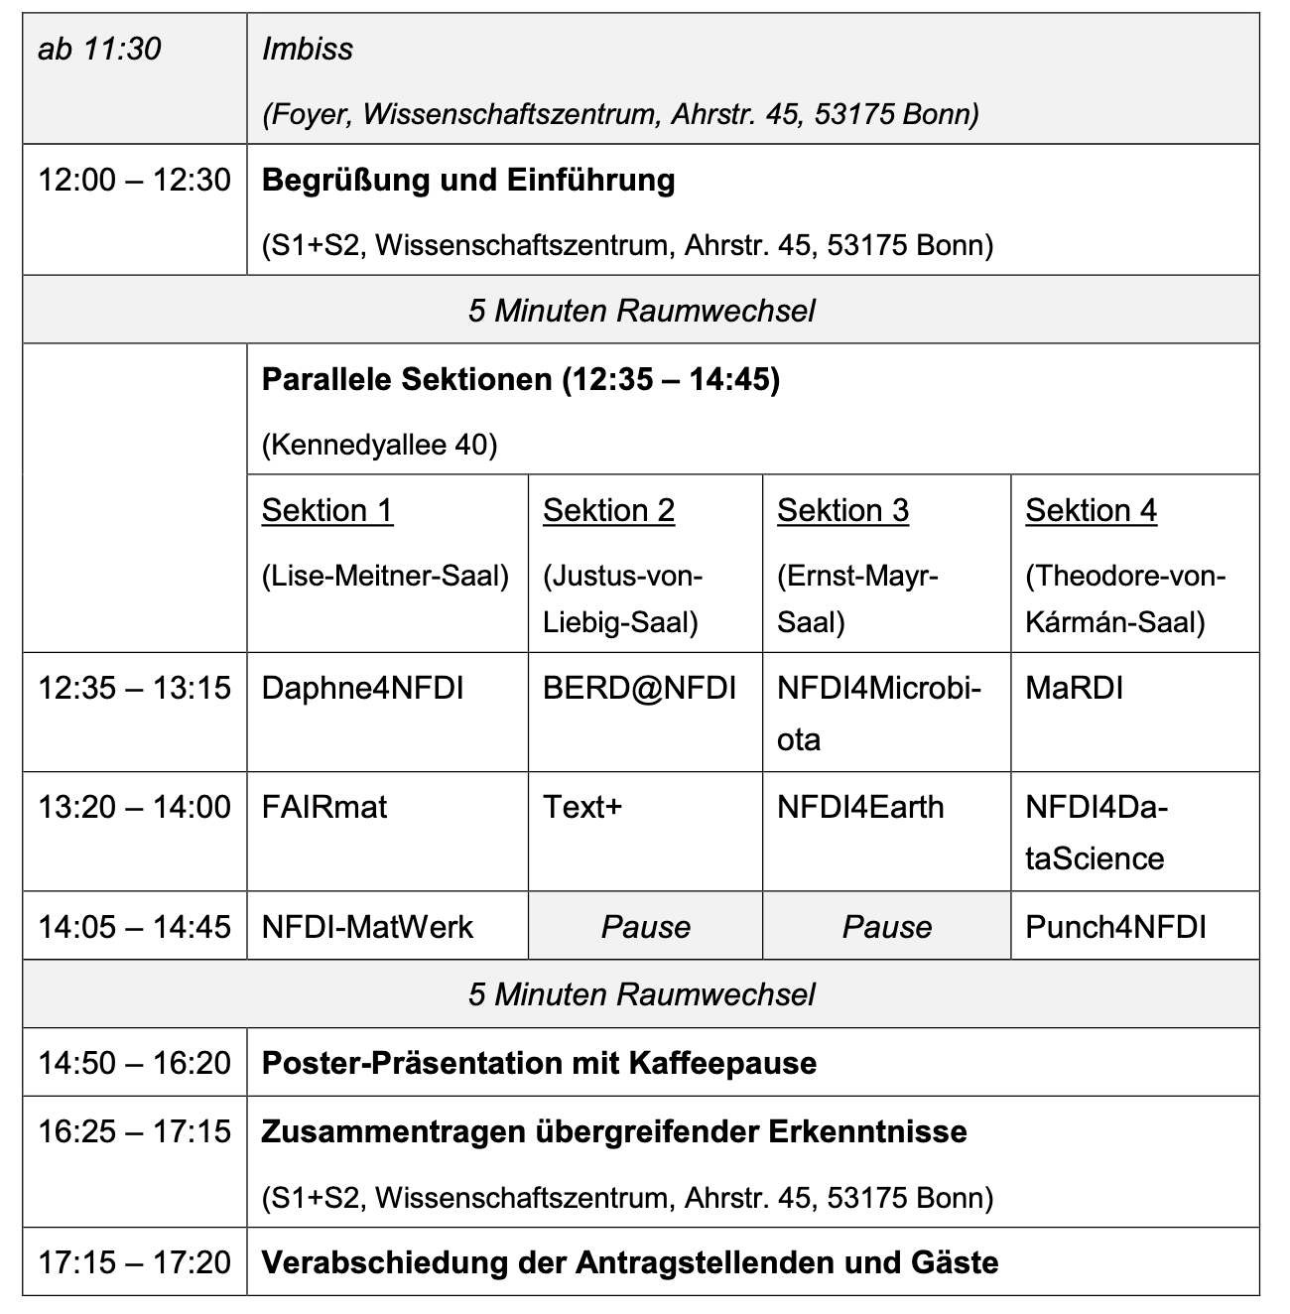
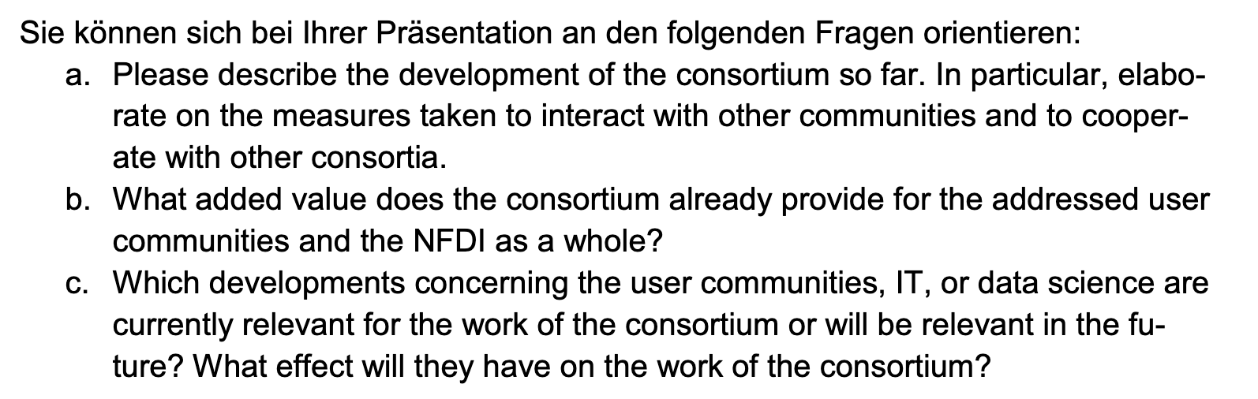
Evaluation
11 Feb 2025, in one session with MaRDI and NFDI4DataScience
15’ presentation and 25’ discussion
Plus poster presentation: overall view and one use case
Plus mini-display for showing off use cases
5 PUNCH people from EB will represent the consortium
CB | PUNCH4NFDI Annual Meeting | 29 Nov 2024

Slide 10
Today
A first teaser discussion into the future of the consortium
Tomorrow
Take stock of what we have achieved (use cases), and get into discussion with communities.
Look around and try to get in touch with other consortia.
Friday
In-depth discussion of future and of interests of current and future partners
PUNCH4NFDI Annual Meeting | Teaser – 27 Nov 2024 | TS

Slide 11

Thank you!
Especially to Joe, Thomas, Ilana, Eleni and the rest of the team in Munich for hosting us!
The PUNCH4NFDI Consortium
Spokespersons
PD Dr. Thomas Schörner (BLV, DESY, thomas.schoerner@desy.de)
Dr. Andreas Haungs (Satzung, KIT, andreas.haungs@kit.edu)
Dr. Christiane Schneide (deputy Satzung, DESY, christiane.schneide@desy.de)
Contact
Mail: punch4nfdi@desy.de
Web: www.punch4nfdi.de
Mastodon: @punch4nfdi@nfdi.social
PUNCH4NFDI | 8th General Meeting | 6 Feb 2024 | CS

Slide 12



Acknowledgements
Funded in parts by the Deutsche Forschungsgemeinschaft (DFG, German Research Foundation) – project number 460248186 (PUNCH4NFDI).
PUNCH4NFDI | 8th General Meeting | 6 Feb 2024 | CS

