Slide 1


Measuring Proton Structure Functions with xFitter
Philip Antonopoulos
DESY Summer Student
Supervisors
Sasha Glazov & Sasha Zenaiev

Slide 2
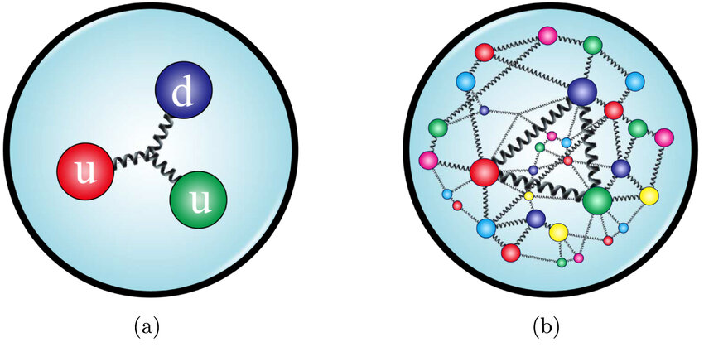
Proton is made up of two up and one down valence quarks.
The proton, when probed, exhibits non-trivial internal structure:
Valence quarks
Sea of quarks
Gluons
Chen, Hua-Xing & Chen, Wei & Liu, Xiang & Liu, Yan-Rui & Zhu, Shi-Lin. (2022). An updated review of the new hadron states. Reports on Progress in Physics. 86. 10.1088/1361-6633/aca3b6.

Slide 3
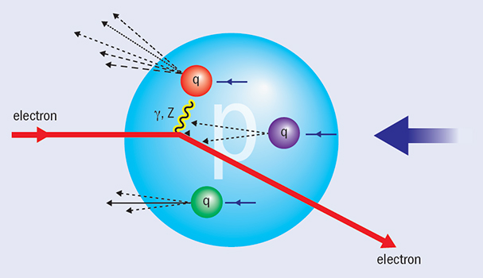
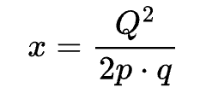
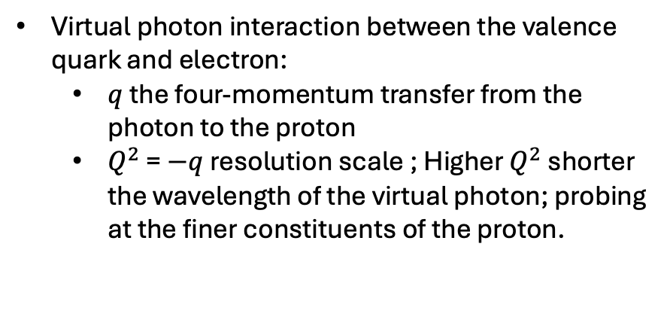
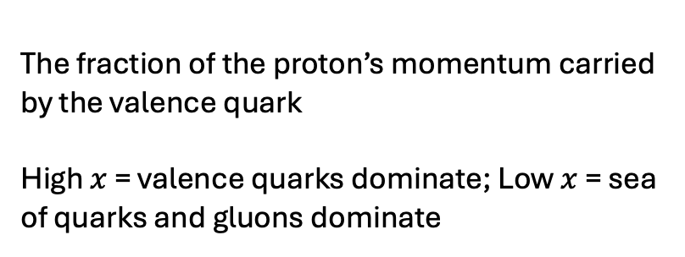
Virtual photon interaction between the valence quark and electron:
$q$ the four-momentum transfer from the photon to the proton
$Q^{2}$ = $−q$ resolution scale ; Higher $Q^{2}$ shorter the wavelength of the virtual photon; probing at the finer constituents of the proton.
The fraction of the proton’s momentum carried by the valence quark
High $x$ = valence quarks dominate; Low $x$ = sea of quarks and gluons dominate
CERN Courier, The most precise picture of a proton, 25 Sep 2015, Electron-proton scattering neutral current

Slide 4
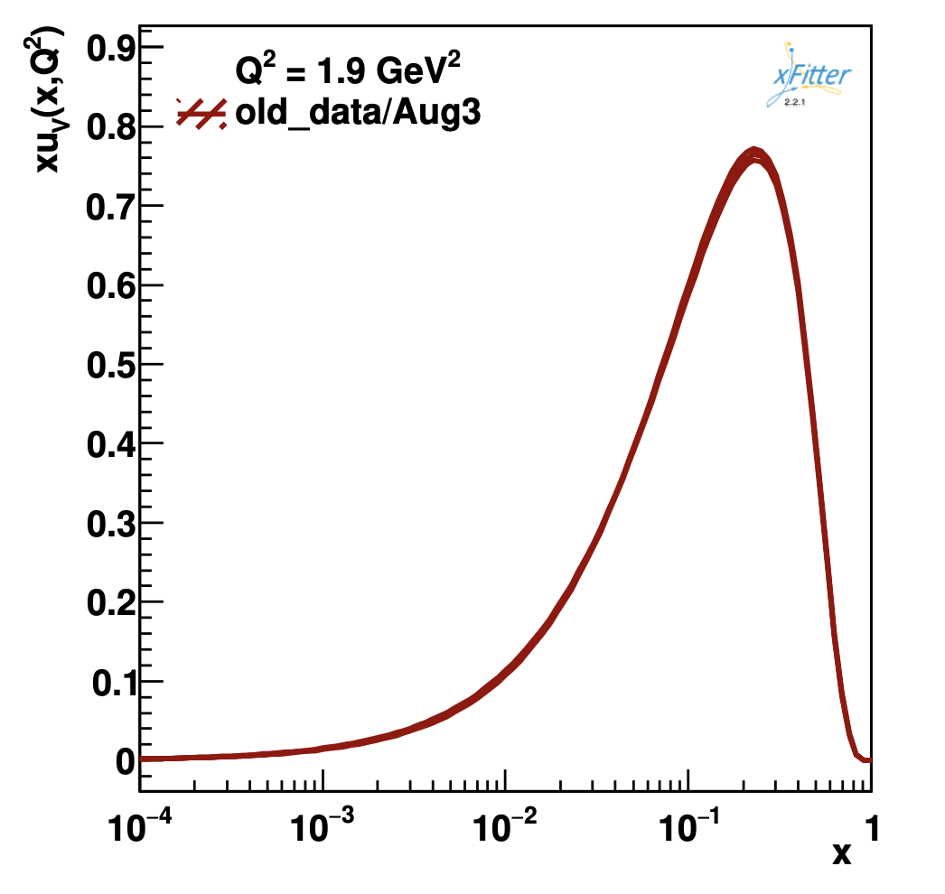
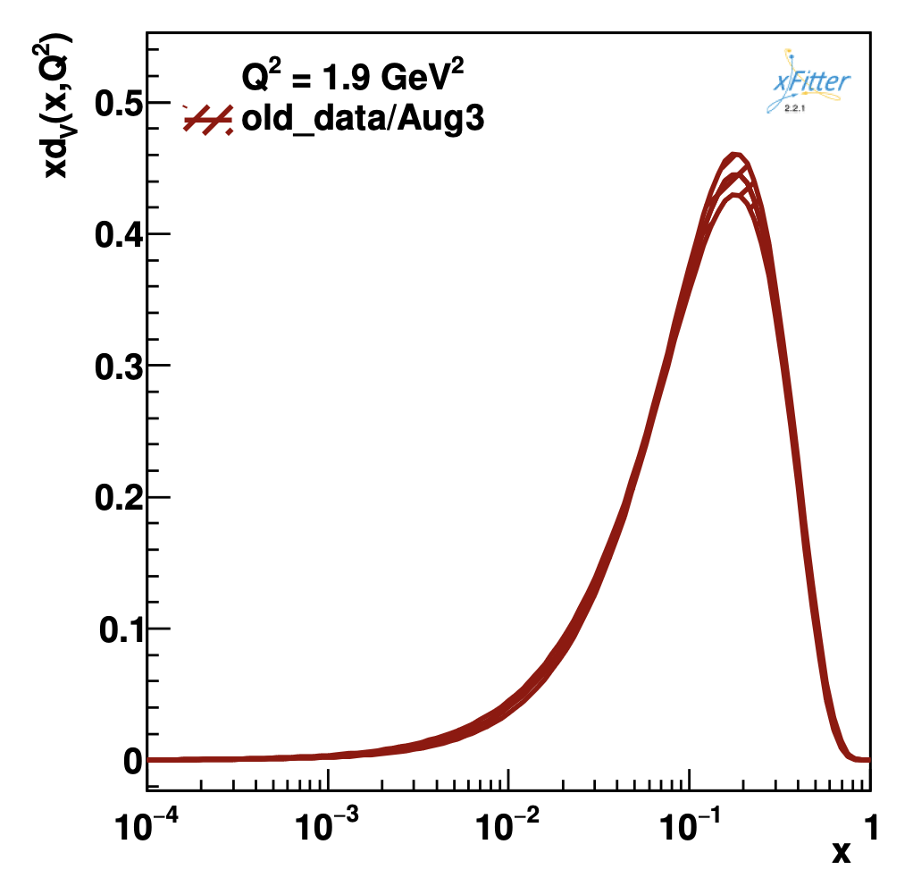
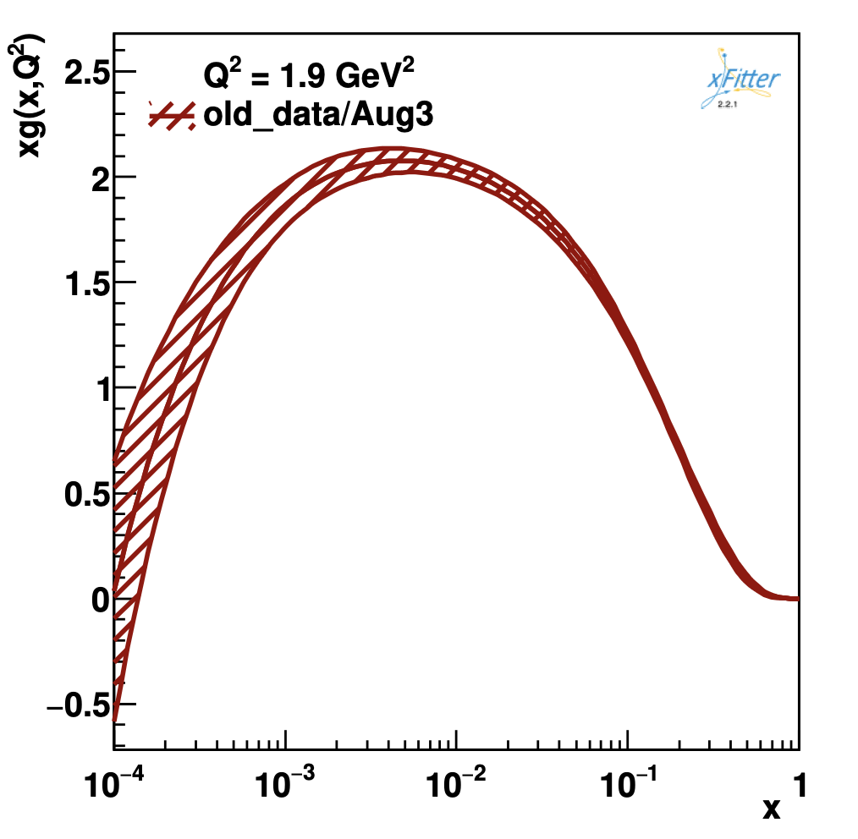
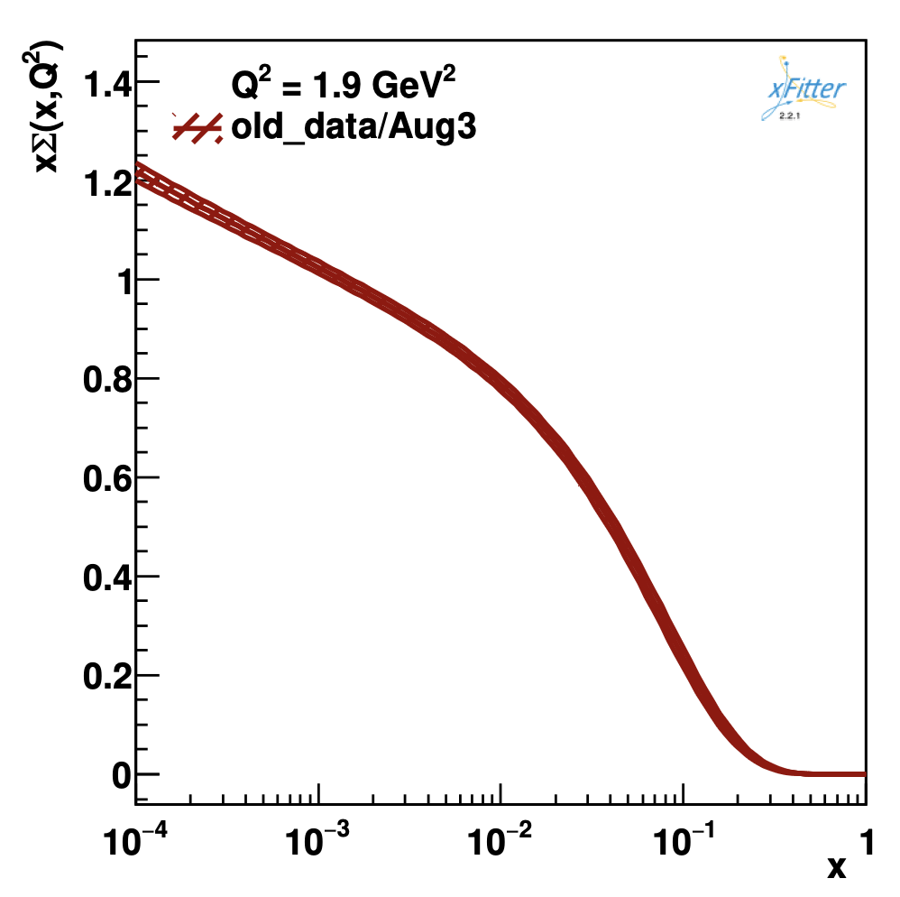
HERA electron-proton collision fits with xFitter
Showcase u-valence d-valence and gluon distributions at set energy as a function of the momentum transfer.
Notes:
Add c quark

Slide 5

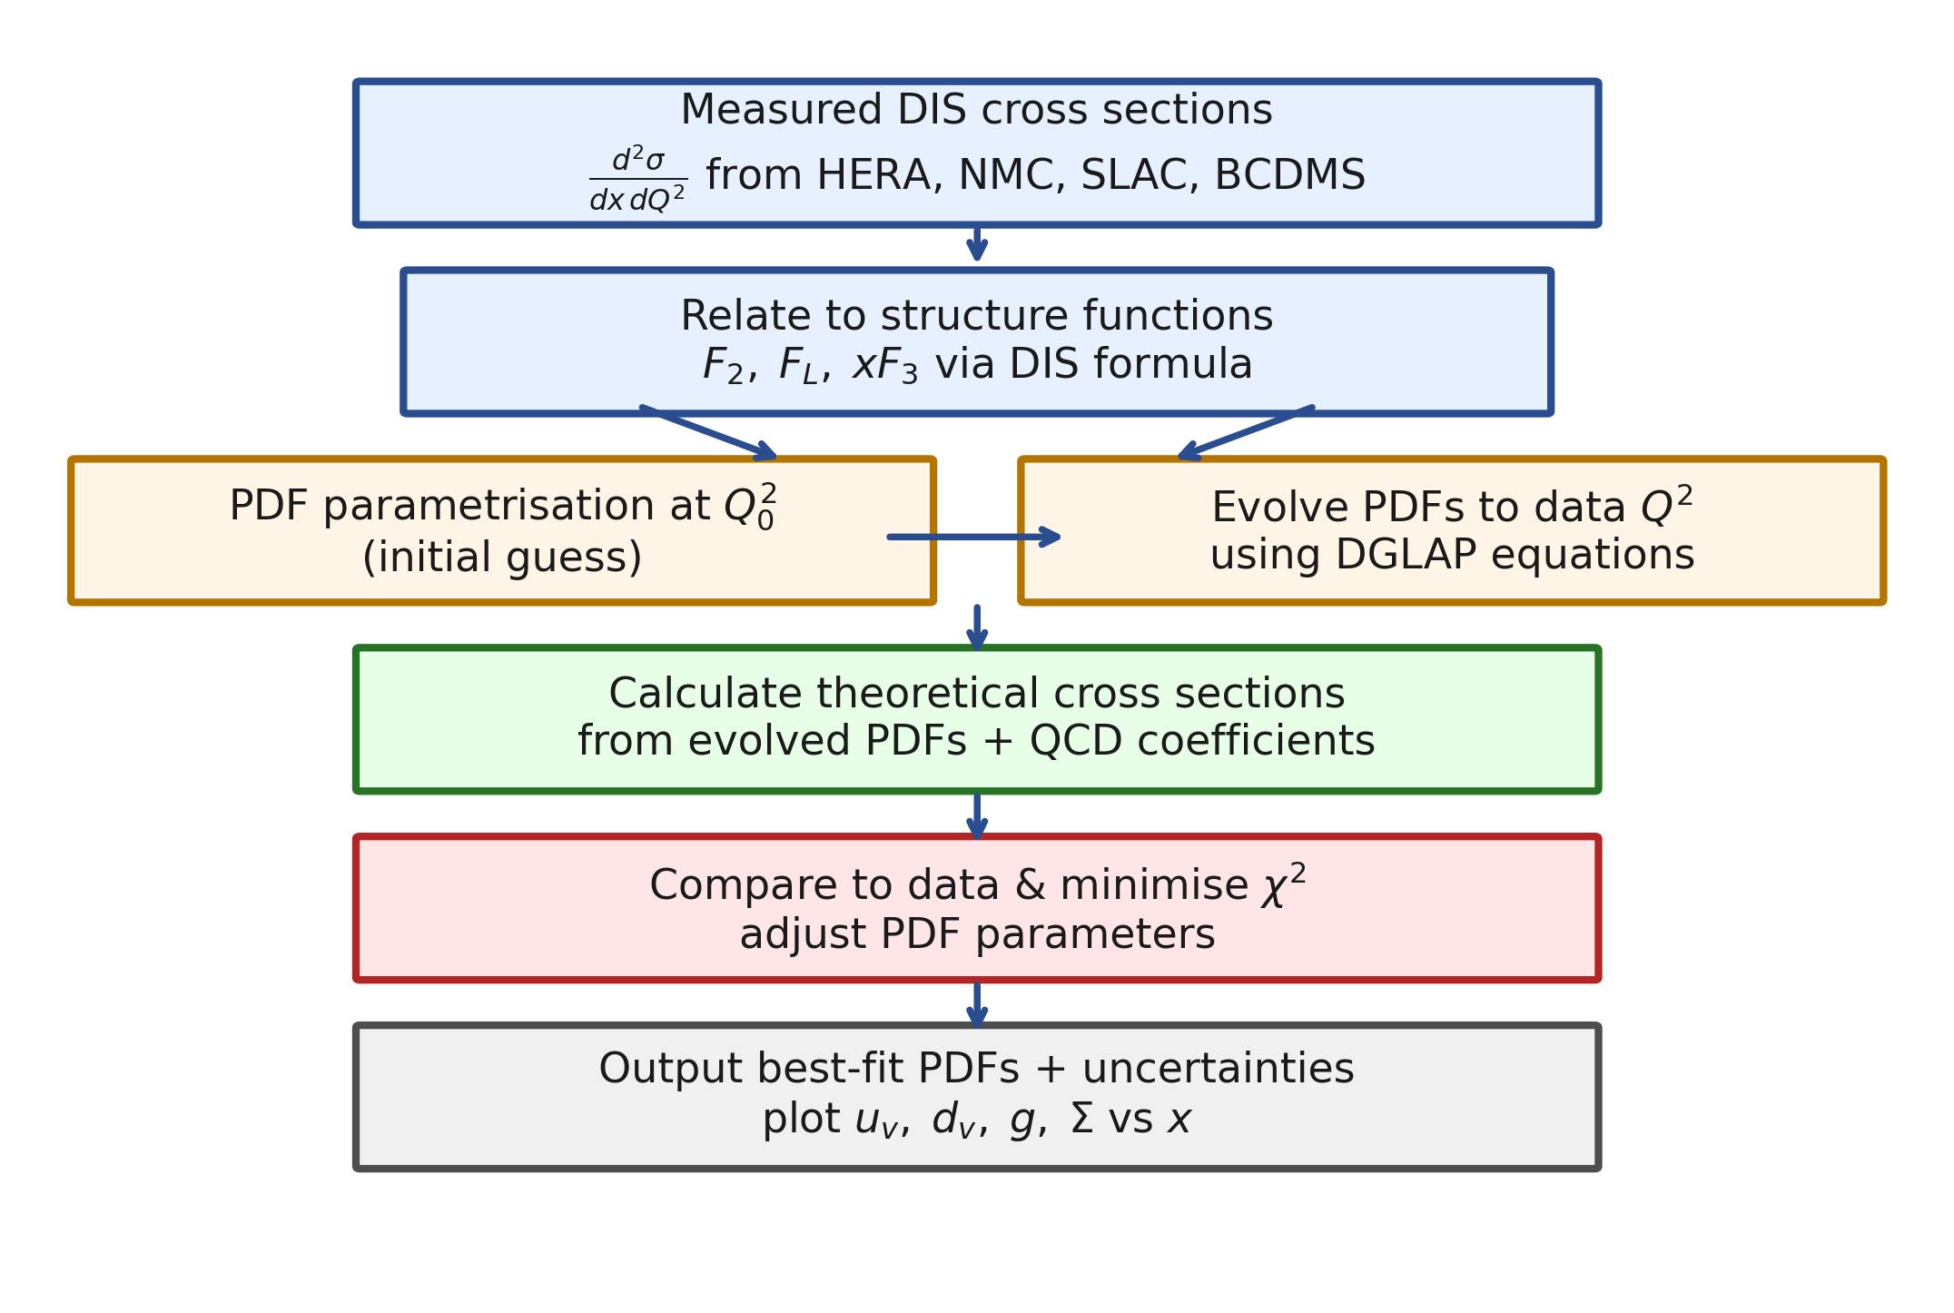

Slide 6
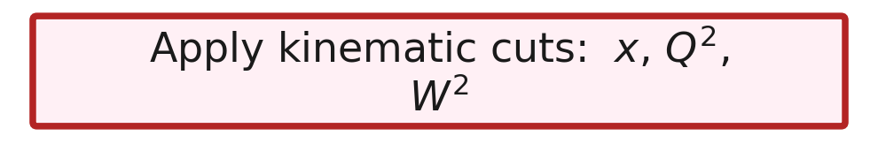
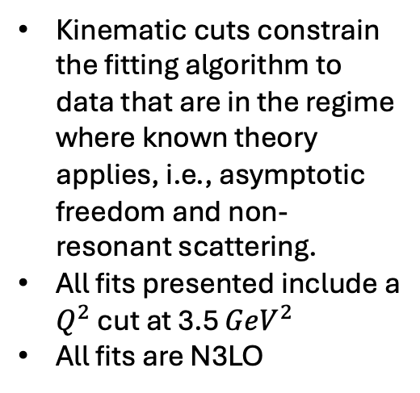
Kinematic cuts constrain the fitting algorithm to data that are in the regime where known theory applies, i.e., asymptotic freedom and non-resonant scattering.
All fits presented include a $Q^{2}$ cut at 3.5 ${GeV}^{2}$
All fits are N3LO

Slide 7
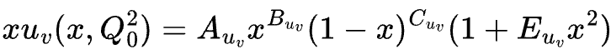

Slide 8
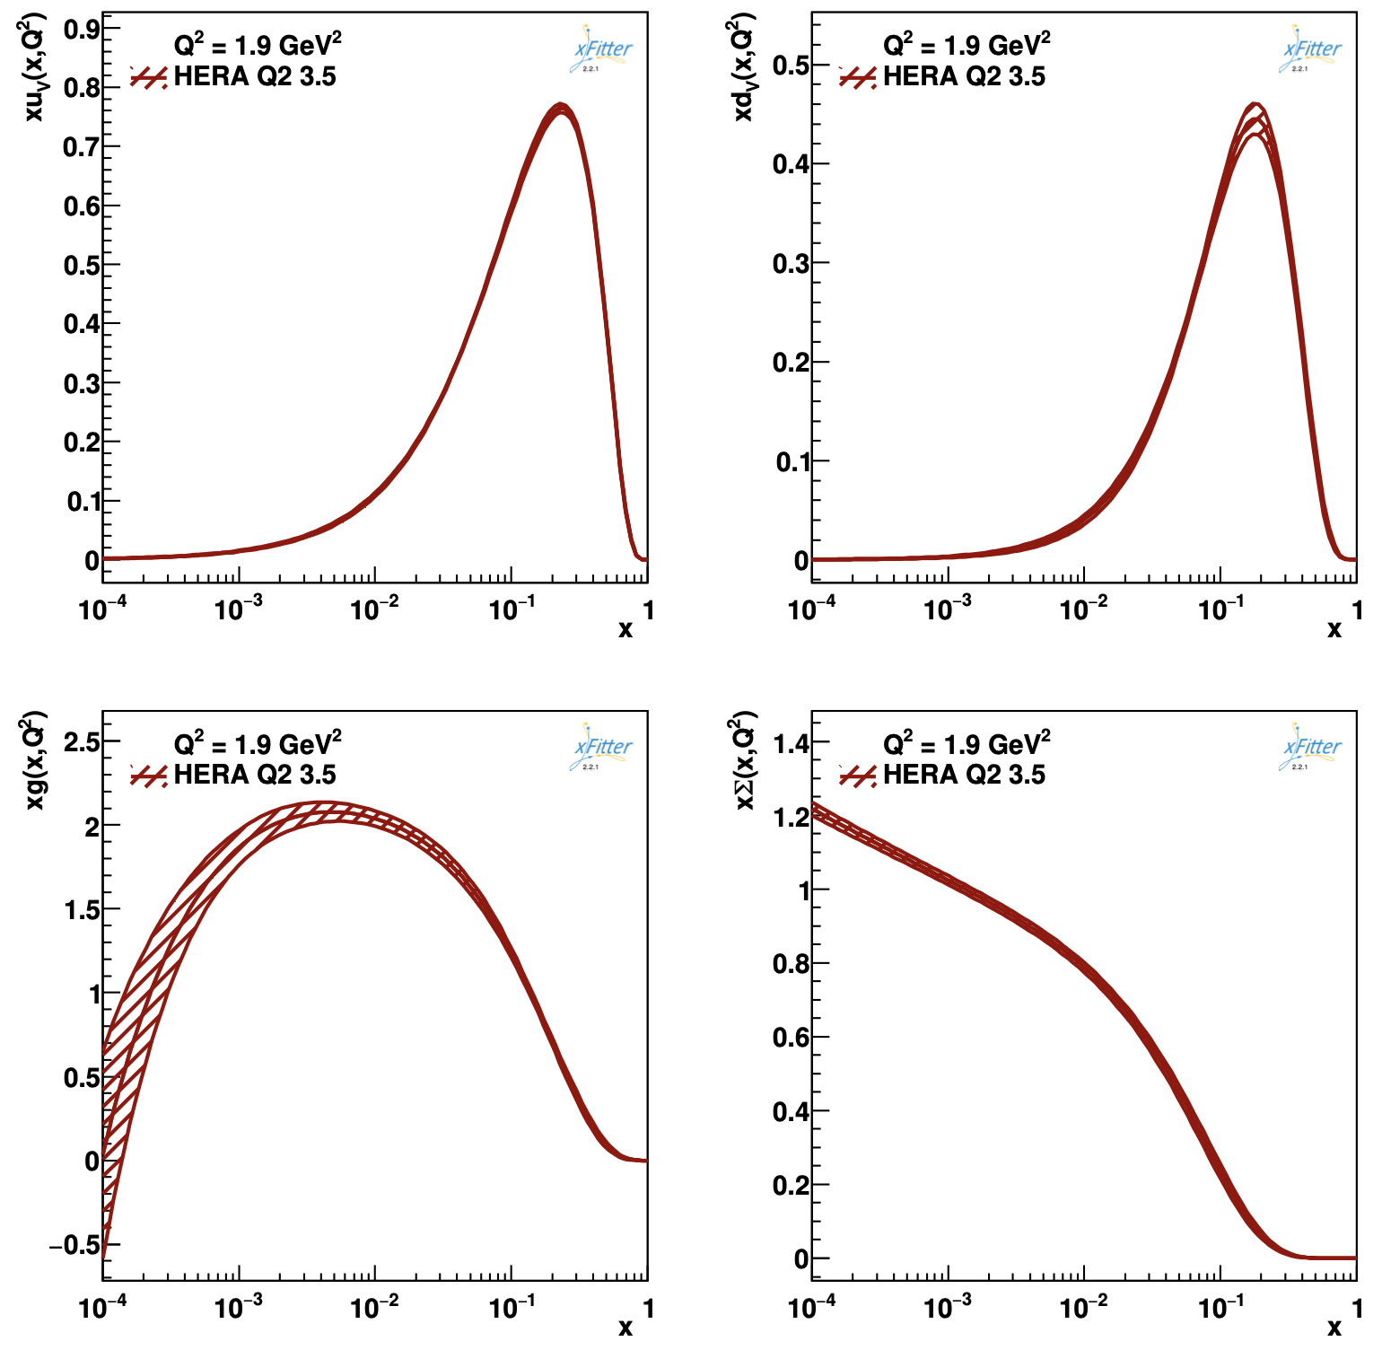
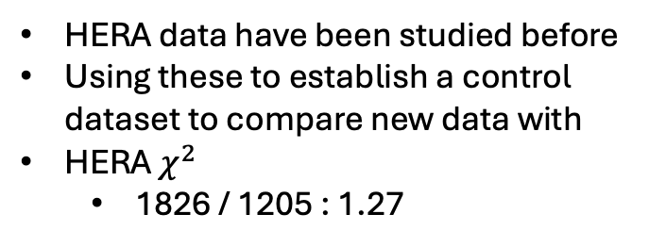
Revisiting HERA
HERA data have been studied before
Using these to establish a control dataset to compare new data with
HERA $χ^{2}$
1826 / 1205 : 1.27

Slide 9
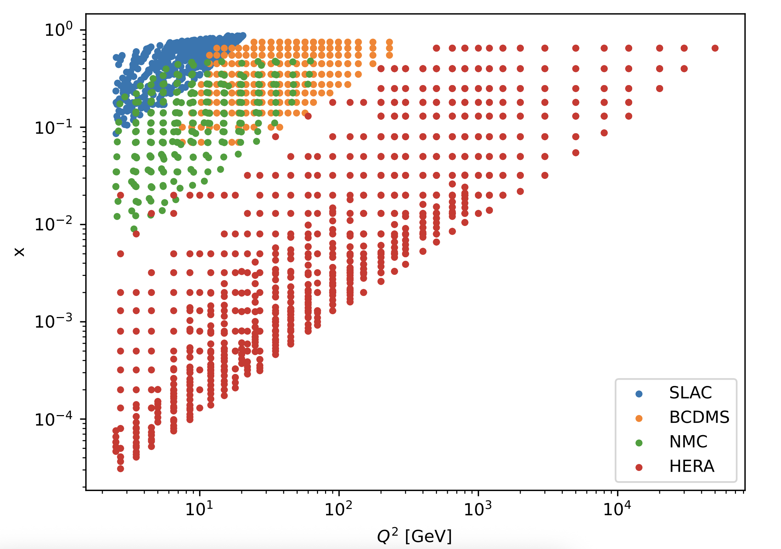
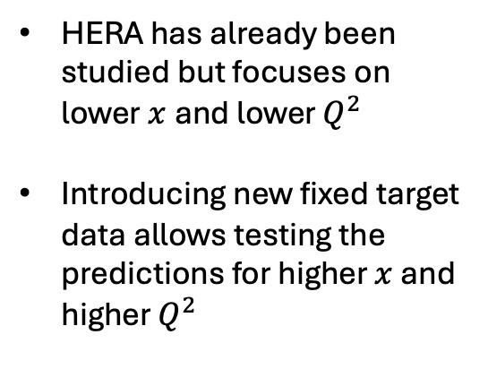
Need for more data
HERA has already been studied but focuses on lower$x$and lower $Q^{2}$
Introducing new fixed target data allows testing the predictions for higher $x$ and higher $Q^{2}$

Slide 10
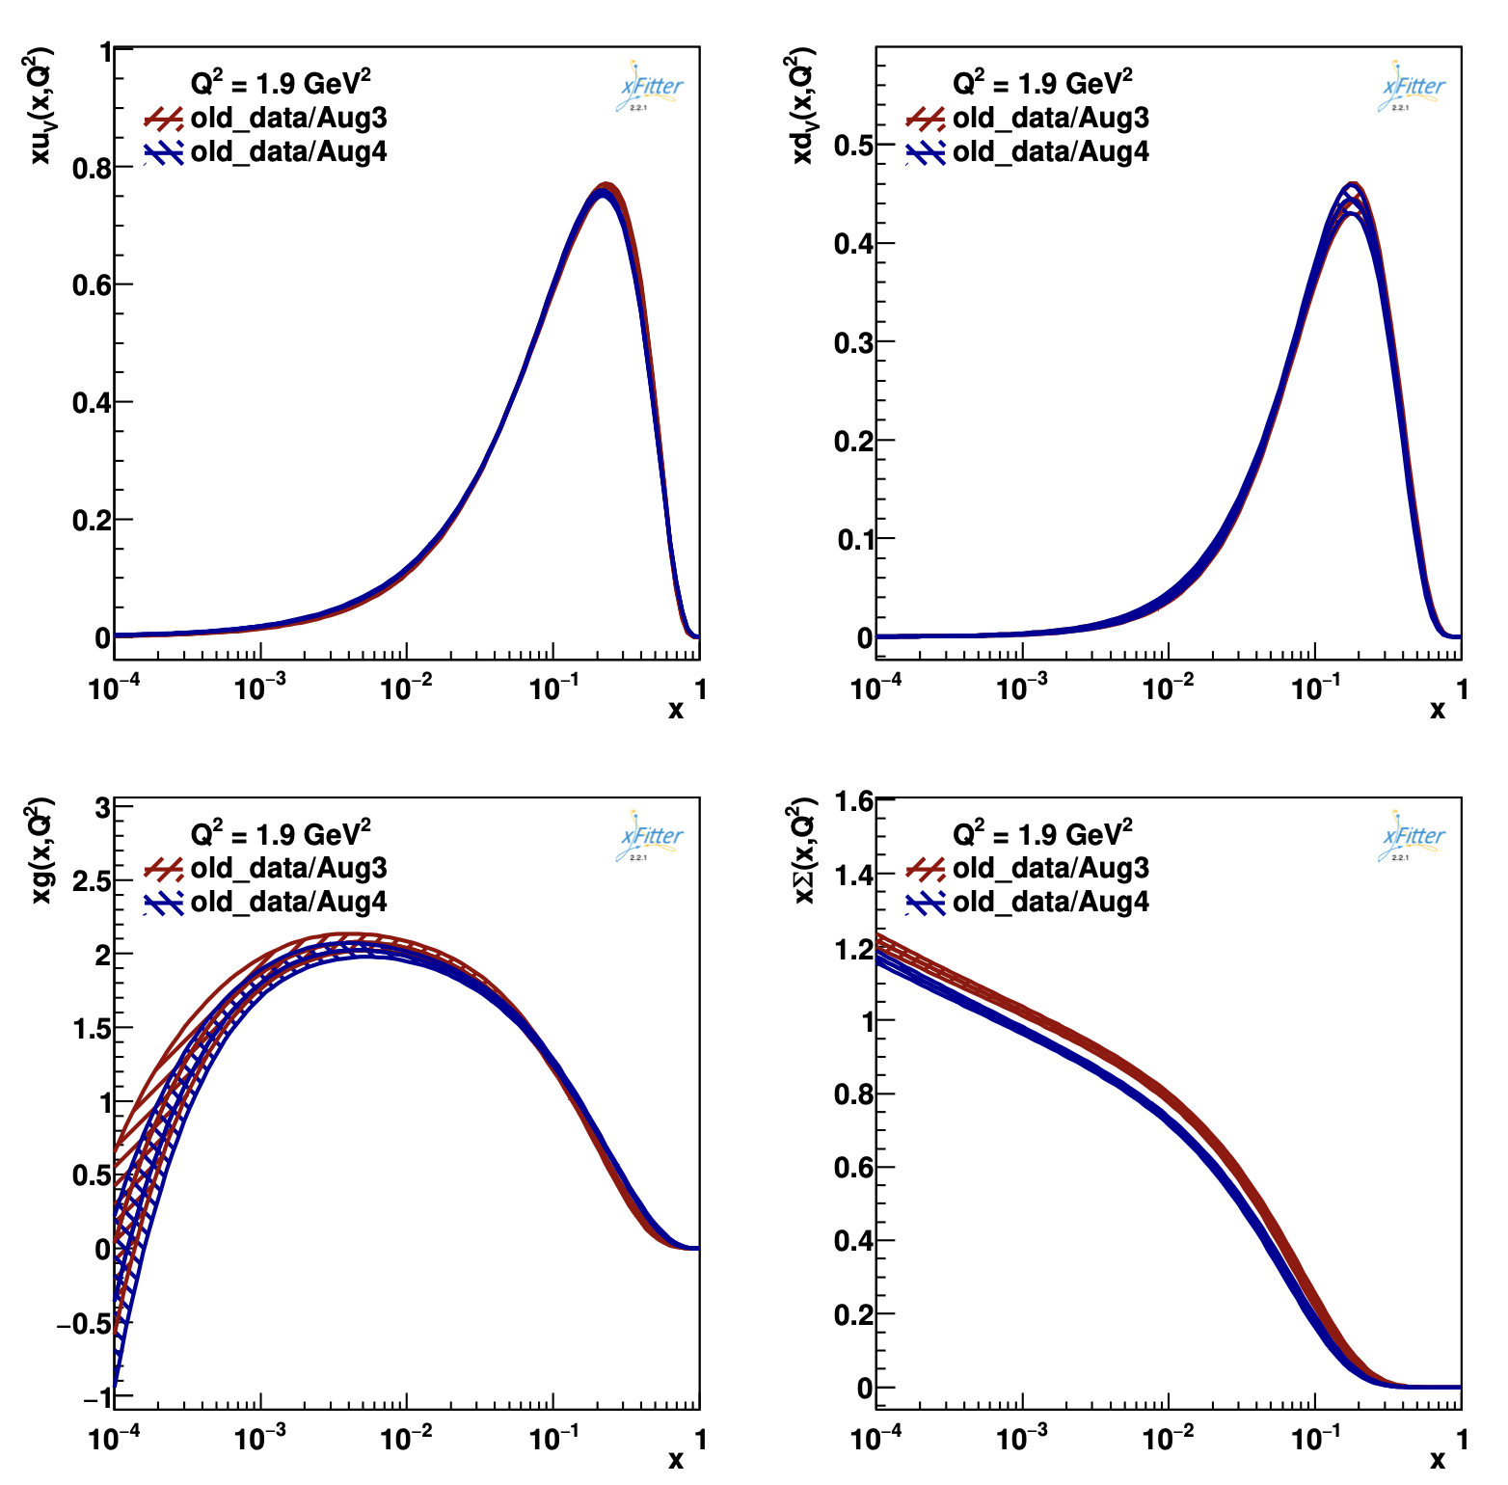
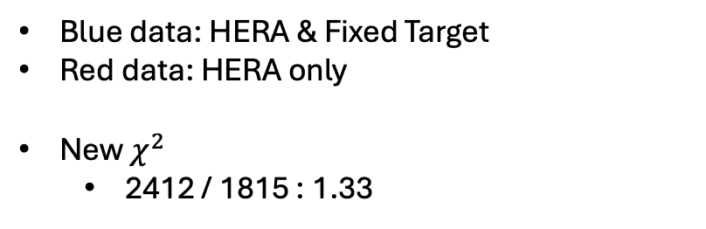
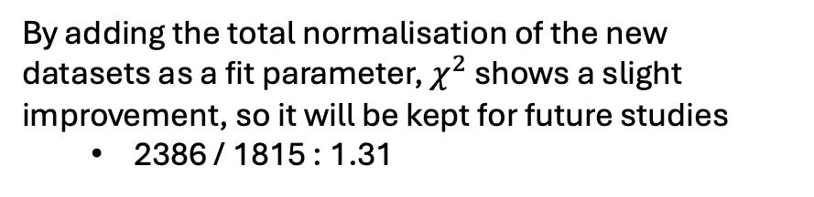
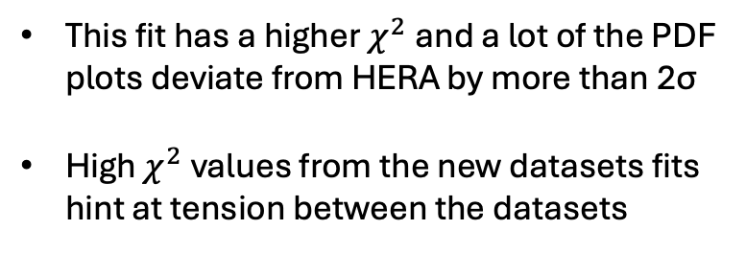
HERA & Fixed Target Data
Blue data: HERA & Fixed Target
Red data: HERA only
New $χ^{2}$
2412 / 1815 : 1.33
This fit has a higher $χ^{2}$and a lot of the PDF plots deviate from HERA by more than 2σ
High $χ^{2}$values from the new datasets fits hint at tension between the datasets
By adding the total normalisation of the new datasets as a fit parameter, $χ^{2}$ shows a slight improvement, so it will be kept for future studies
2386 / 1815 : 1.31

Slide 11
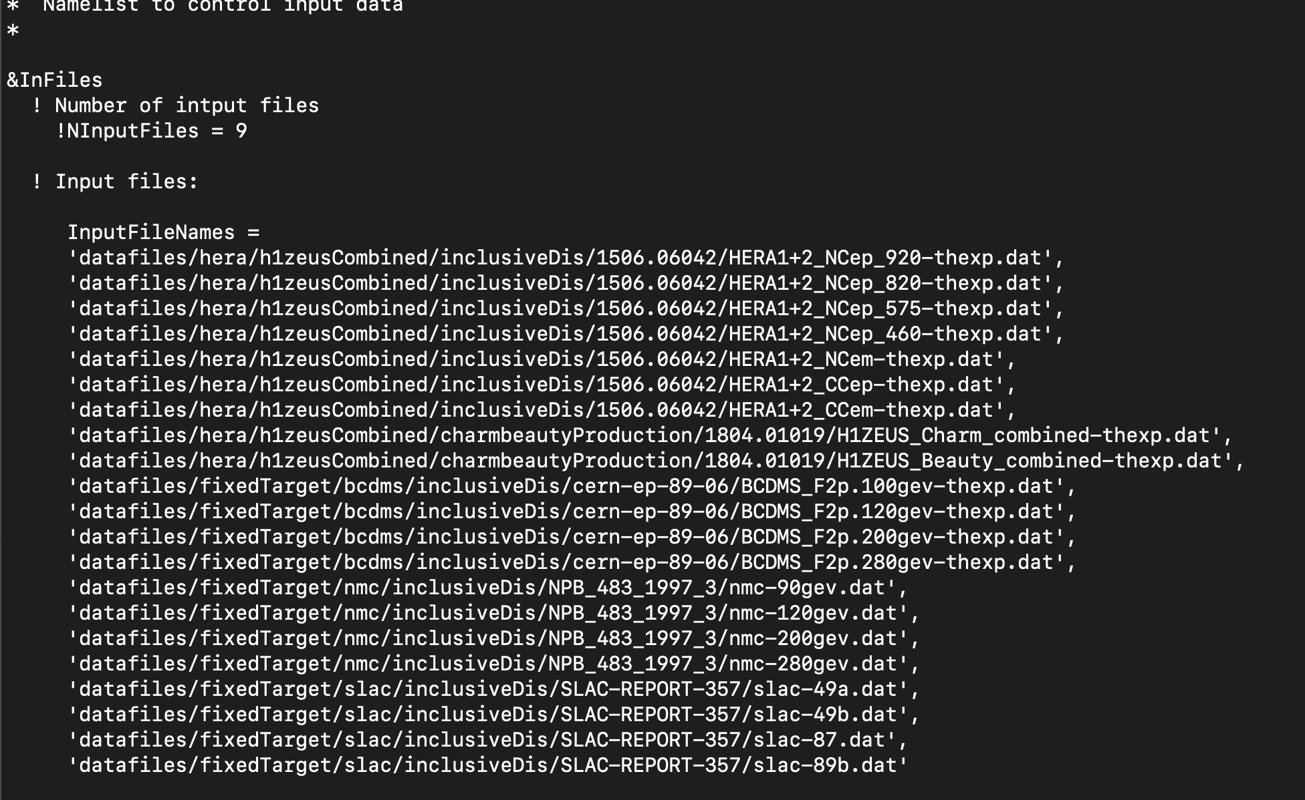
Steering.txt changes

Slide 12
Steering.txt changes

Slide 13
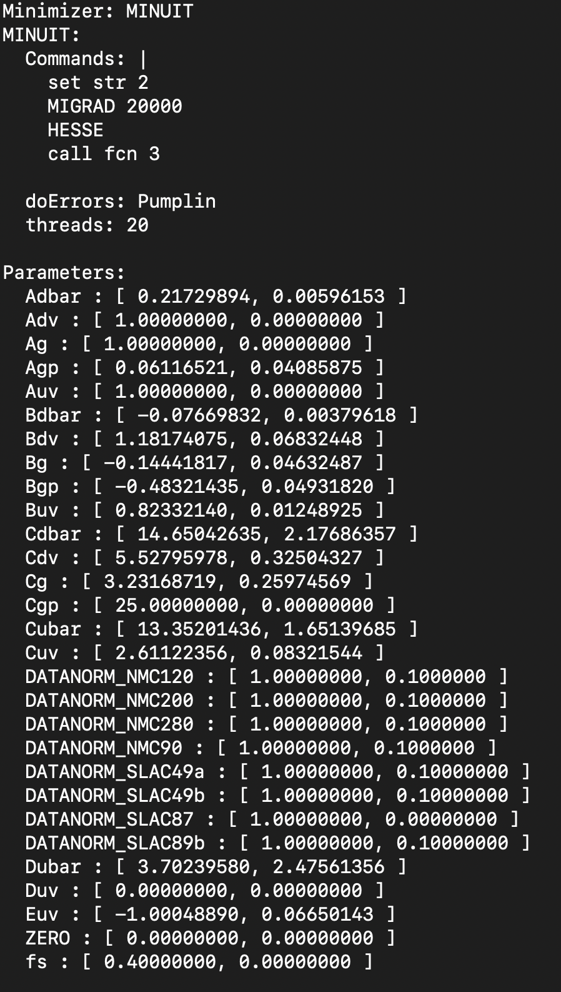
Parameters.yaml

Slide 14
Parameters.yaml

Slide 15
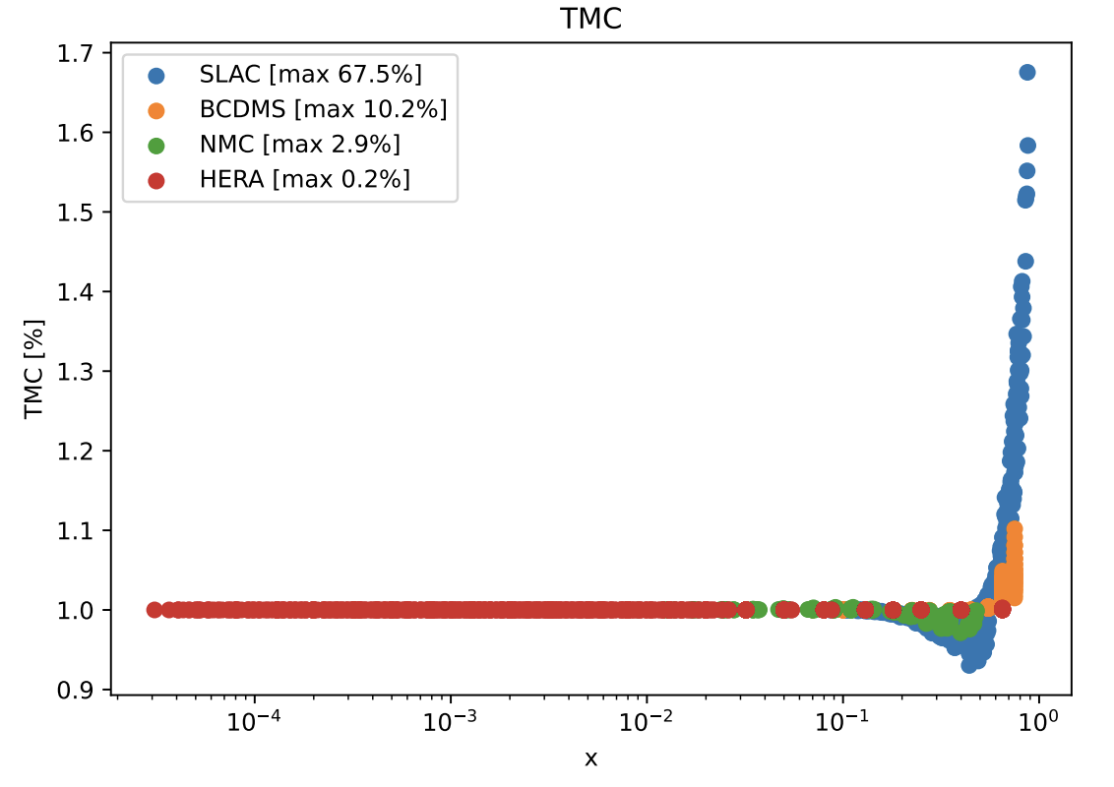
Probable Cause : Target Mass Correction
At large Bjorken x the fact that the proton cannot be treated as a point-like particle produces systematic errors
SLAC data exhibit a high mass correction at large x
TMC also present to a lesser extent in BCDMS and NMC

Slide 16
Proposed Modifications : Target Mass Correction
Two main solutions:
Add additional polynomial terms to the fit, retaining all data points
Introduce new cuts to the data to eliminate data points that are in the non-ideal regime

Slide 17
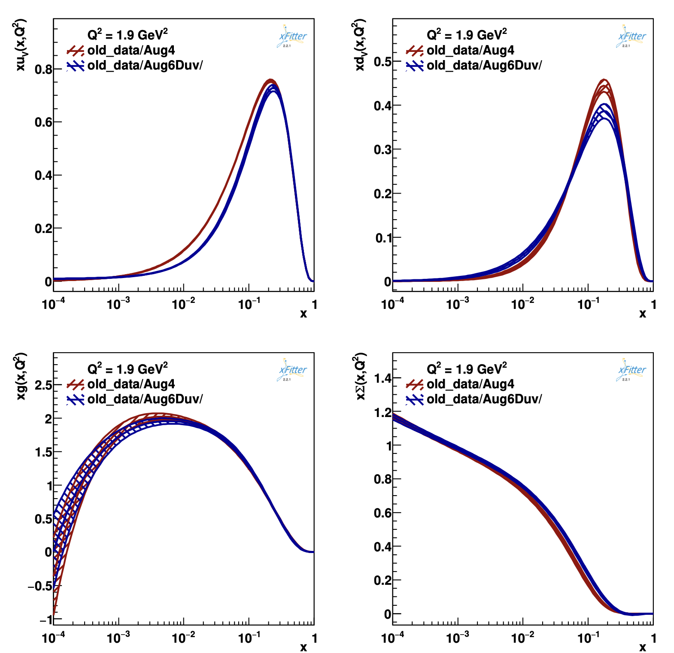

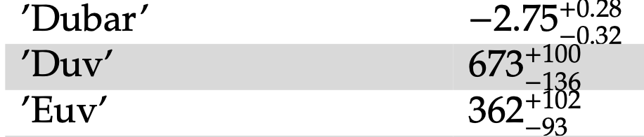
Adding additional polynomial terms
Produces inexplainable shifts and reductions in the peaks of the u and d valence PDFs compared to the all data fit(in red)
New parameter unphysically high, indicating possible convergence at local minimum.
Tests could be conducted with higher order terms, but would be very time-intensive as fitting code converges in ~7h

Slide 18
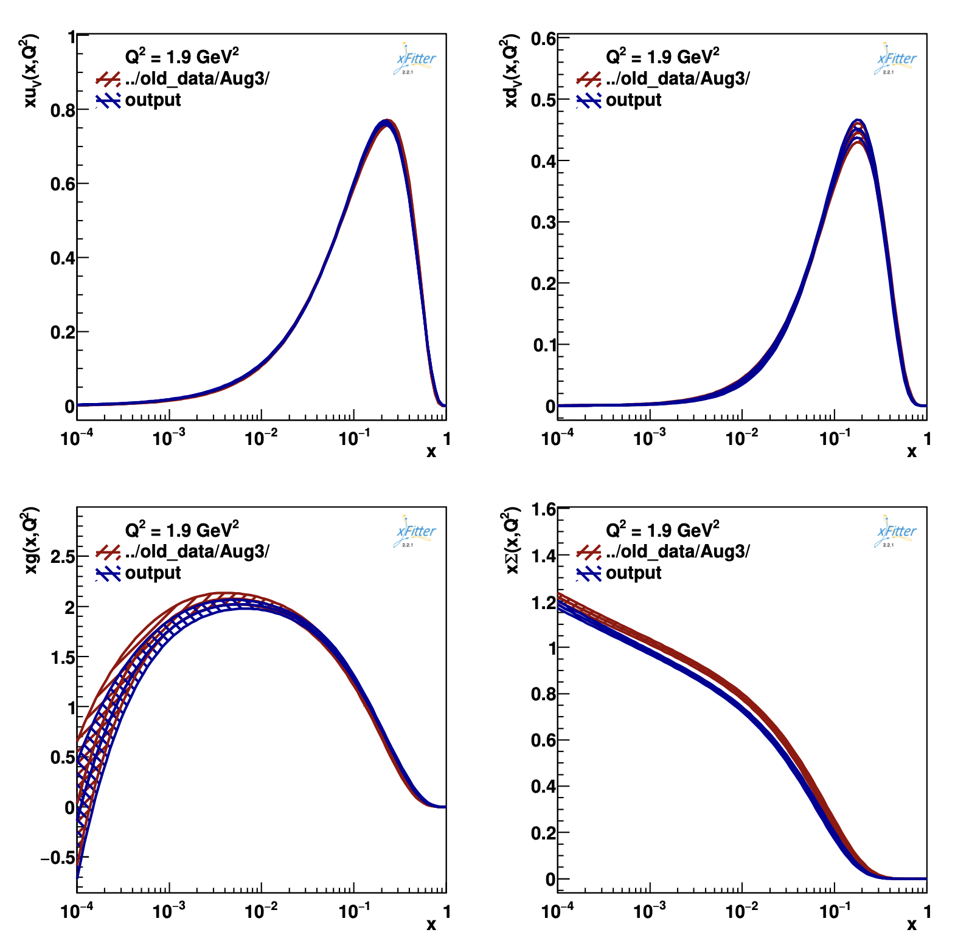
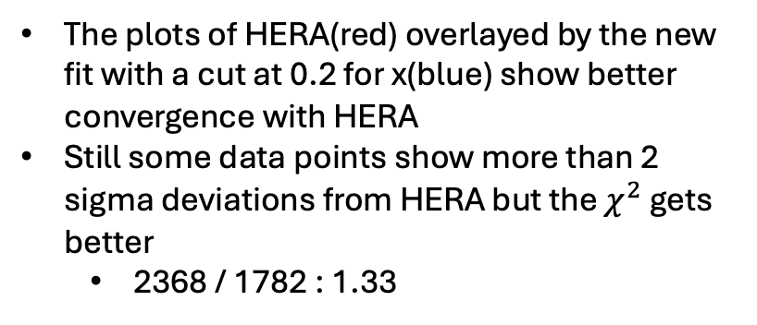
Introducing new cuts to remove TMC signature : Bjorken x
The plots of HERA(red) overlayed by the new fit with a cut at 0.2 for x(blue) show better convergence with HERA
Still some data points show more than 2 sigma deviations from HERA but the $χ^{2}$ gets better
2368 / 1782 : 1.33
This cut doesn’t produce the necessary improvement.

Slide 19
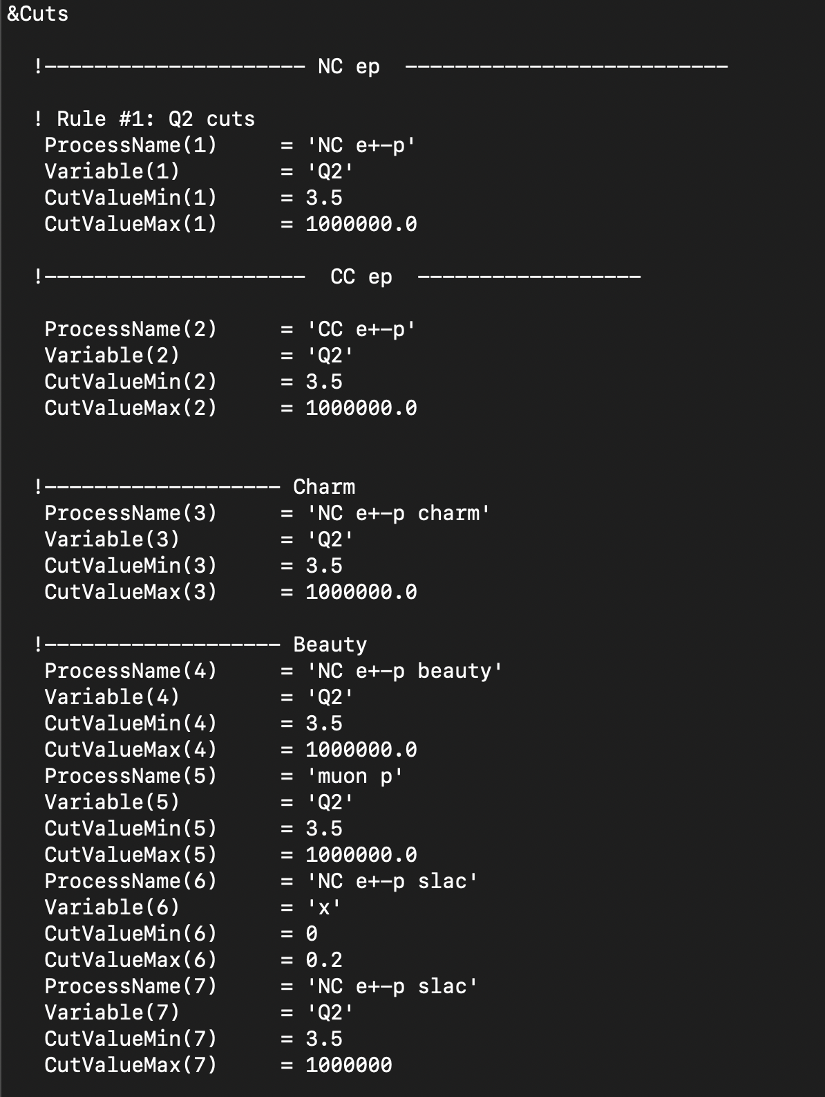
Steering.txt changes

Slide 20
Steering.txt changes

Slide 21
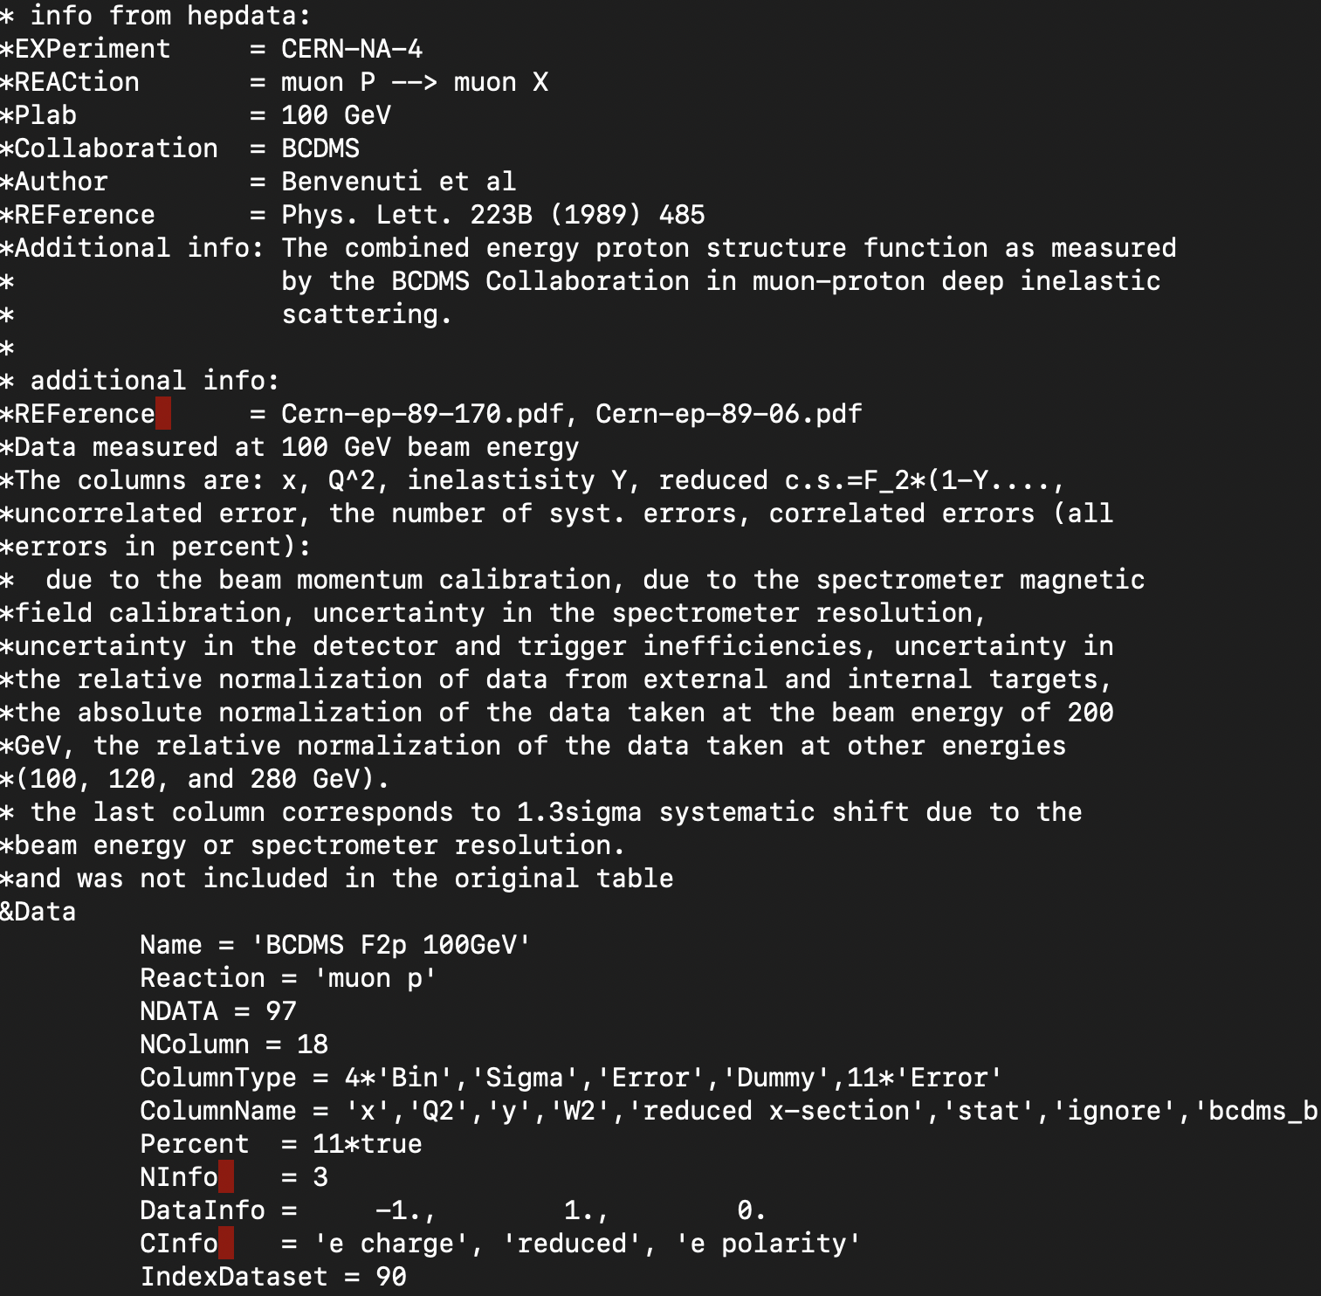
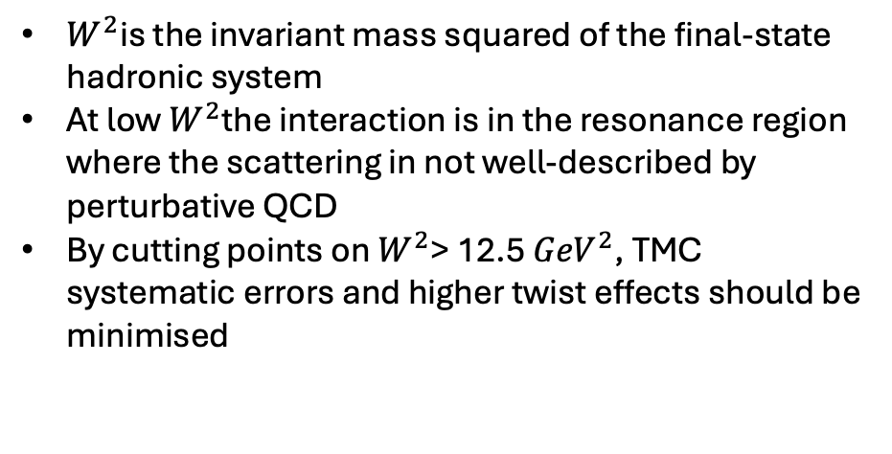
Introducing new cuts to remove TMC signature : W2
$W^{2}$is the invariant mass squared of the final-state hadronic system
At low $W^{2}$the interaction is in the resonance region where the scattering in not well-described by perturbative QCD
By cutting points on $W^{2}$> 12.5${ GeV}^{2}$, TMC systematic errors and higher twist effects should be minimised

Slide 22
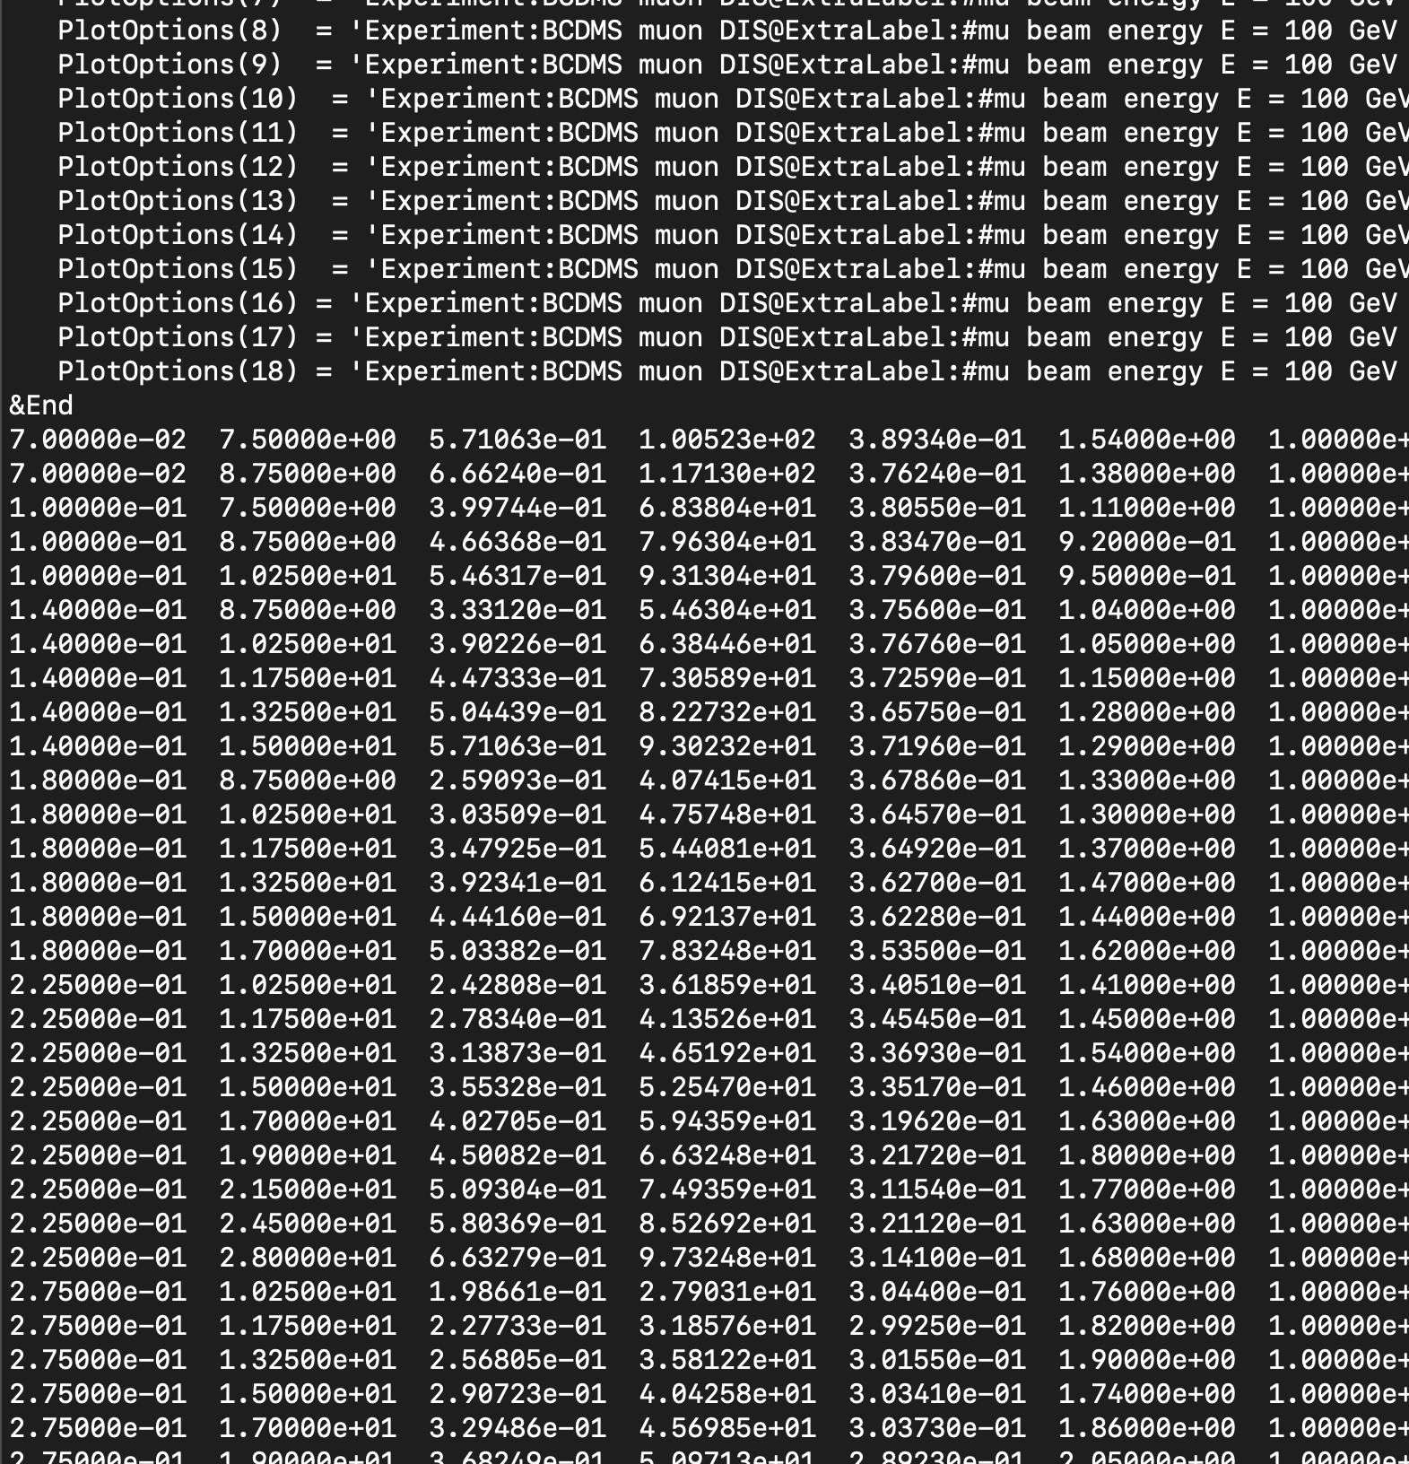
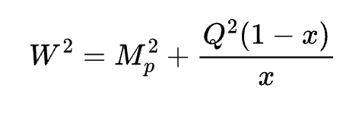
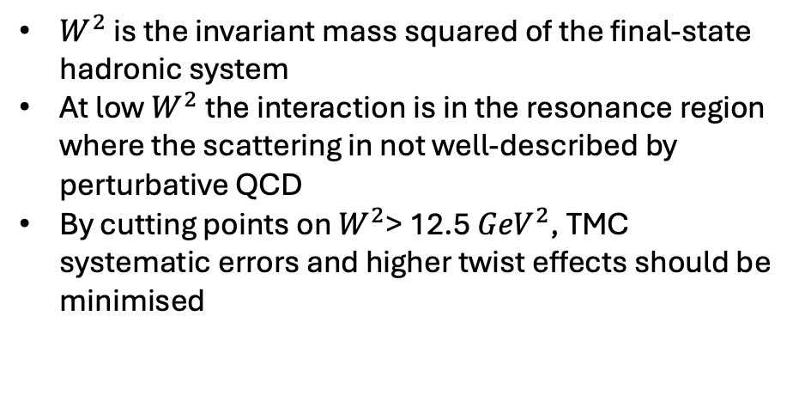
Introducing new cuts to remove TMC signature : W2
$W^{2}$ is the invariant mass squared of the final-state hadronic system
At low $W^{2}$ the interaction is in the resonance region where the scattering in not well-described by perturbative QCD
By cutting points on $W^{2}$> 12.5${ GeV}^{2}$, TMC systematic errors and higher twist effects should be minimised

Slide 23
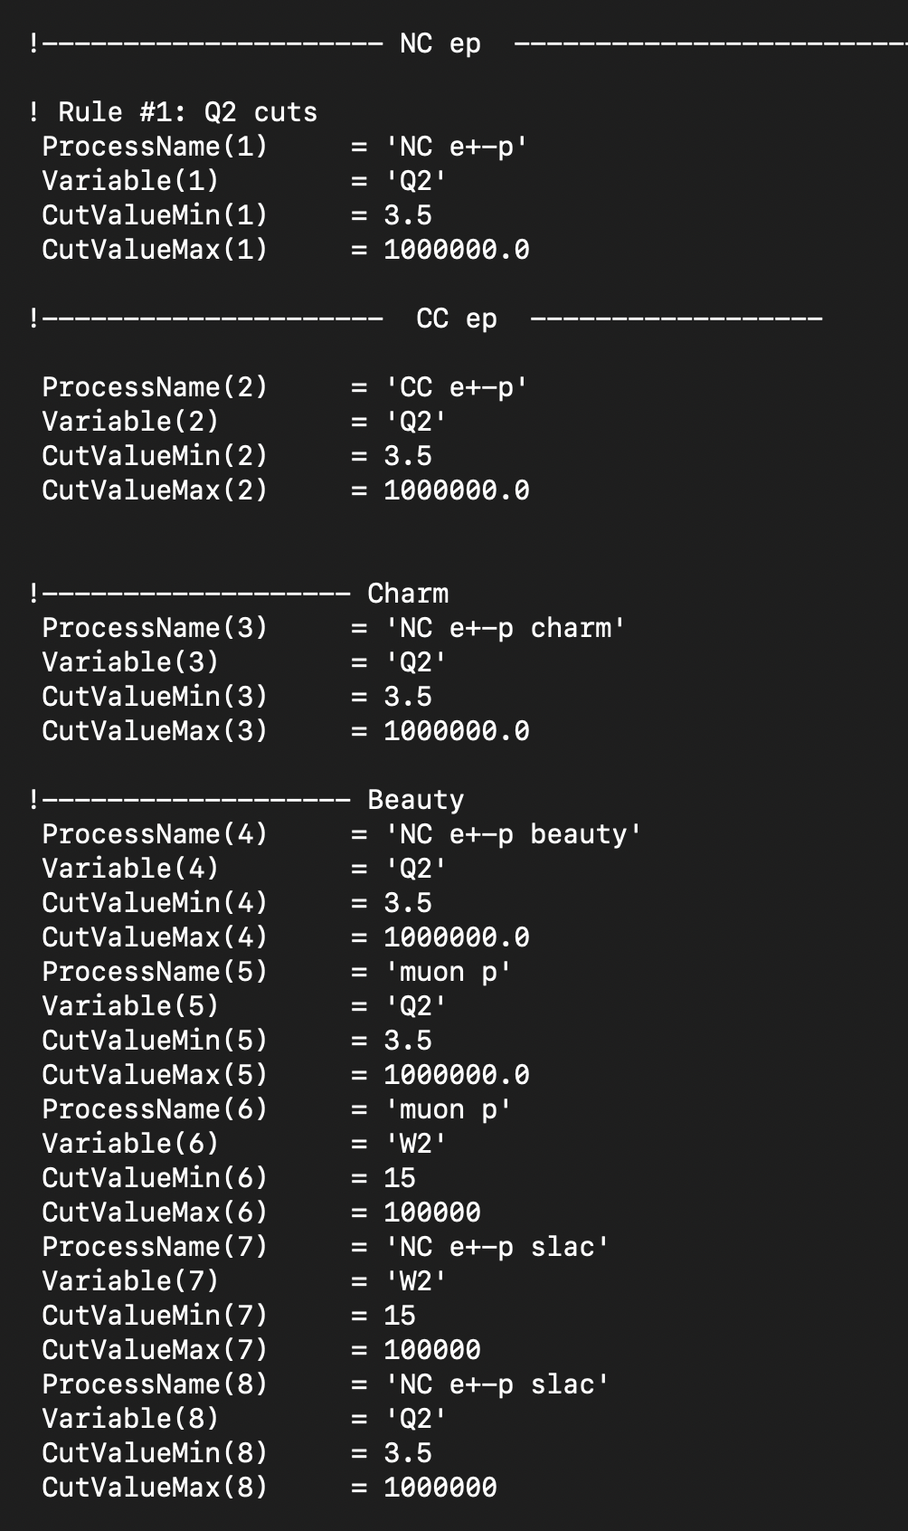
Introducing new cuts to remove TMC signature : W2
$W^{2}$ is the invariant mass squared of the final-state hadronic system
At low $W^{2}$ the interaction is in the resonance region where the scattering in not well-described by perturbative QCD
By cutting points on $W^{2}$> 12.5${ GeV}^{2}$, TMC systematic errors and higher twist effects should be minimised

Slide 24
Introducing new cuts to remove TMC signature : W2
$W^{2}$ is the invariant mass squared of the final-state hadronic system
At low $W^{2}$ the interaction is in the resonance region where the scattering in not well-described by perturbative QCD
By cutting points on $W^{2}$> 12.5${ GeV}^{2}$, TMC systematic errors and higher twist effects should be minimised

Slide 25
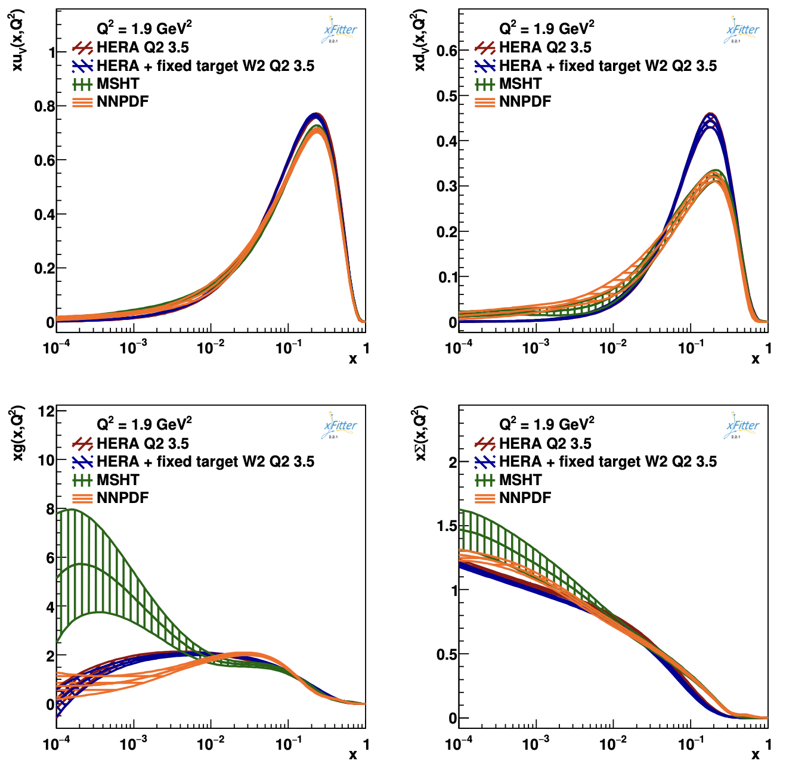
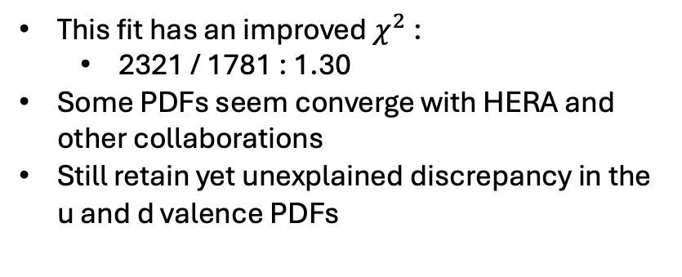
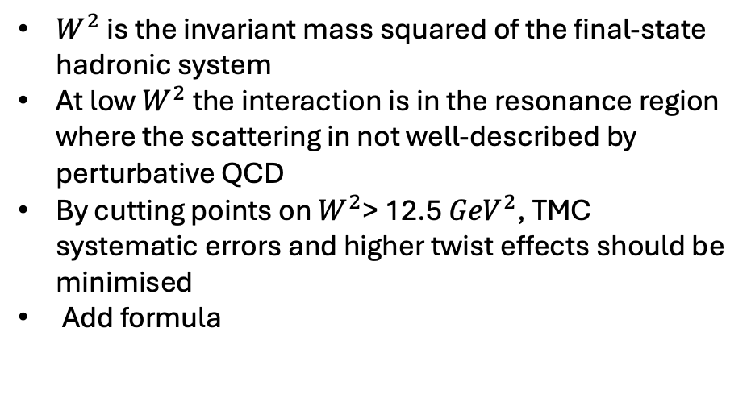
Introducing new cuts to remove TMC signature : W2
$W^{2}$ is the invariant mass squared of the final-state hadronic system
At low $W^{2}$ the interaction is in the resonance region where the scattering in not well-described by perturbative QCD
By cutting points on $W^{2}$> 12.5${ GeV}^{2}$, TMC systematic errors and higher twist effects should be minimised
Add formula
This fit has an improved $χ^{2}$:
2321 / 1781 : 1.30
Some PDFs seem converge with HERA and other collaborations
Still retain yet unexplained discrepancy in the u and d valence PDFs

Slide 26
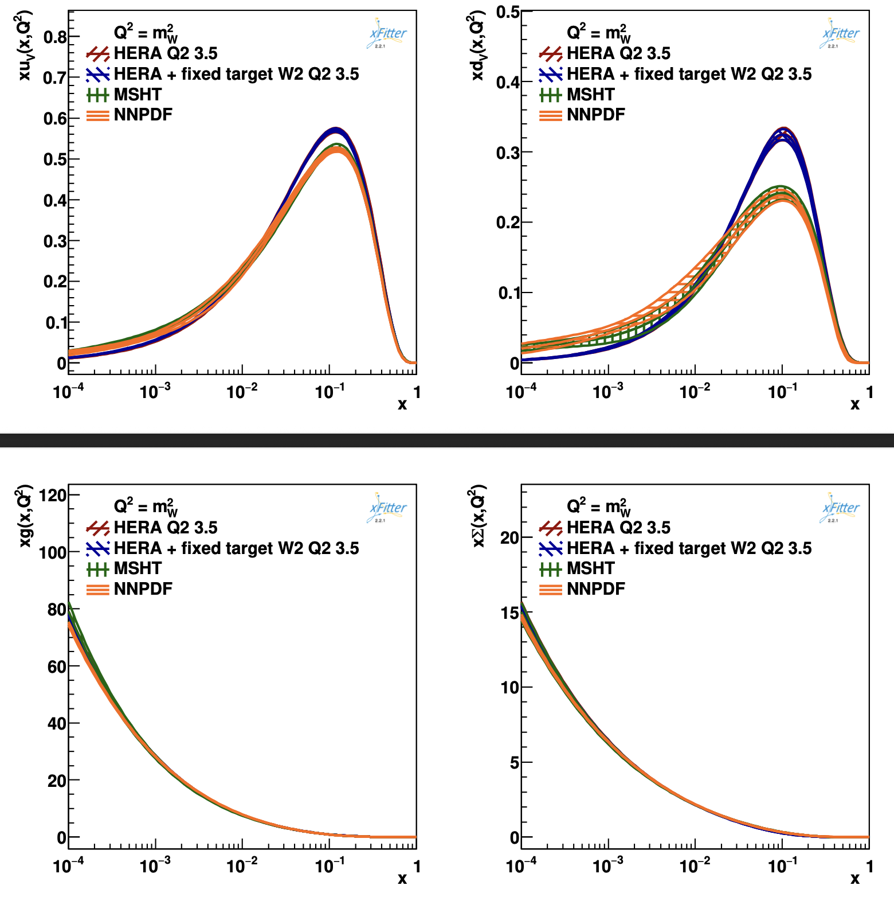
Introducing new cuts to remove TMC signature : W2
$W^{2}$ is the invariant mass squared of the final-state hadronic system
At low $W^{2}$ the interaction is in the resonance region where the scattering in not well-described by perturbative QCD
By cutting points on $W^{2}$> 12.5${ GeV}^{2}$, TMC systematic errors and higher twist effects should be minimised
Add formula
This fit has an improved $χ^{2}$:
2321 / 1781 : 1.30
Some PDFs seem converge with HERA and other collaborations
Still retain yet unexplained discrepancy in the u and d valence PDFs

Slide 27
Next steps
Vary the Q2 cut to determine whether this deviation is dependent on the quality factor
Plot pull as a function of Bjorken x to study the impact of individual datasets and whether there are specific problematic data points
Conduct more tests to figure out whether the deviation in the valence quark PDFs is a new result or an artefact of the fit.

