Slide 1

Follow up on SciCatCON24
Highlighting discussions where DESY was involved.
Regina Hinzmann
2024-07-22

Slide 2
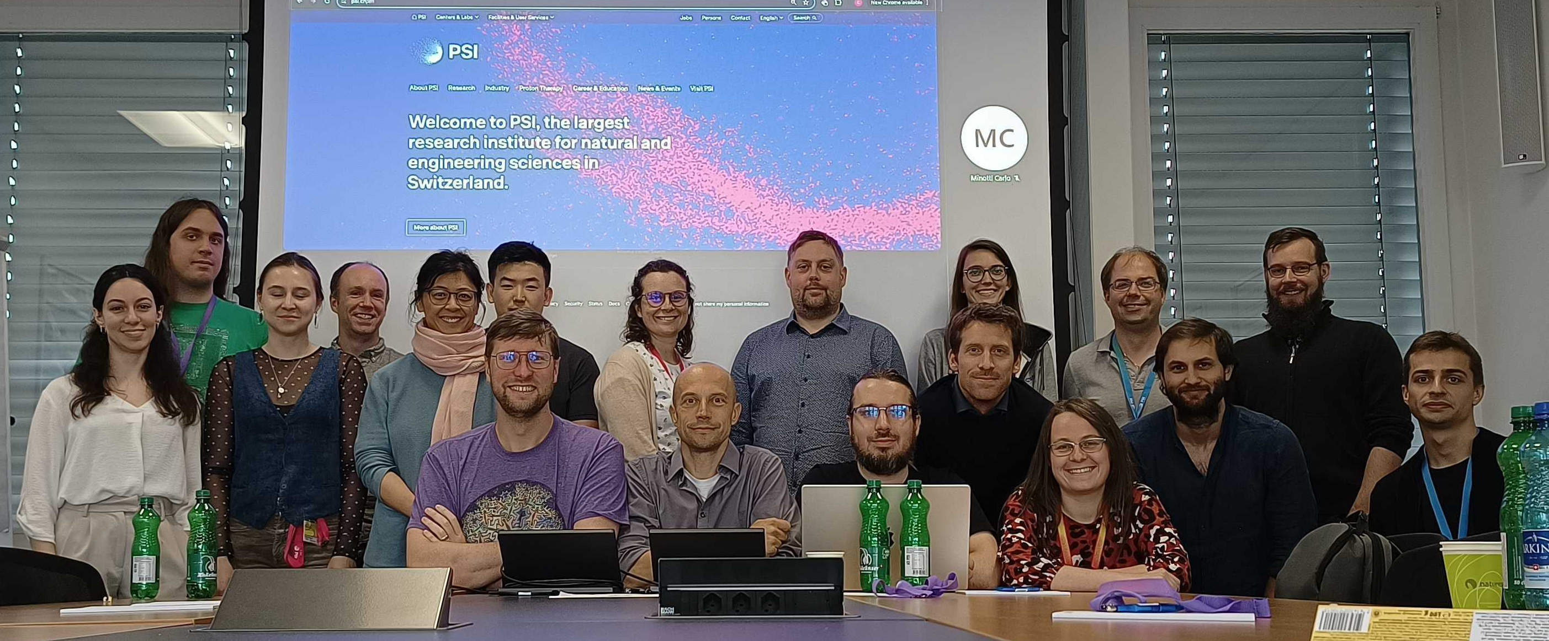
Overview
Reports.
SciCatCON spilt in
Talks: release updates + facillity updates + PSI use cases + grants
Discussions: hands-on brainstorming sessions according to voted topics.
Conclusion for DESY topics.
Next SciCatCON
SciCatCON24 2.- 4. July at PSI
https://indico.psi.ch/event/15861/

Slide 3
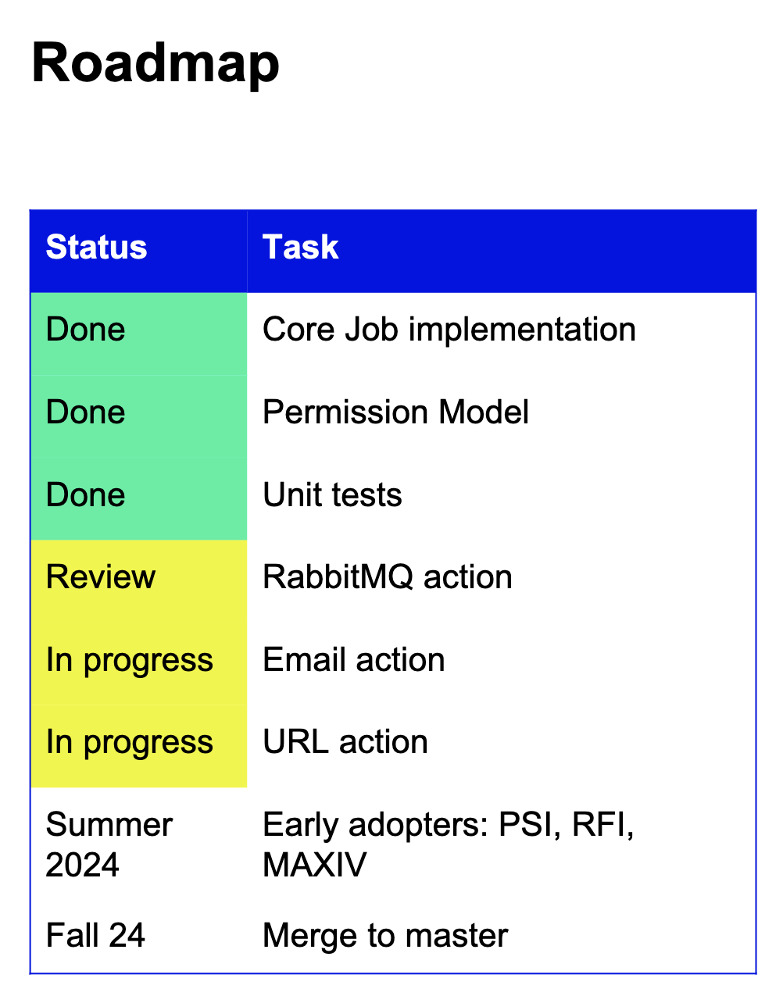
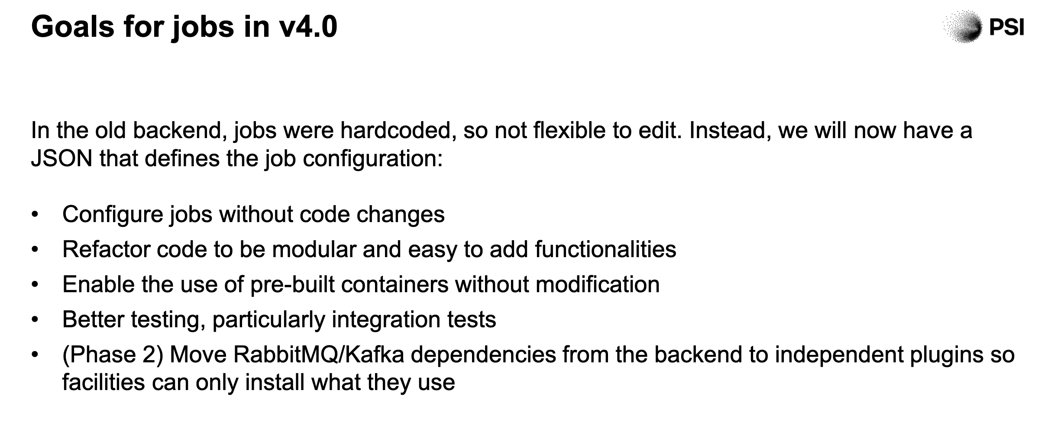
Talks
Release status. Facility updates. PSI use cases.
Spencers slides see Day 1 https://indico.psi.ch/event/15861/

Slide 4
Talks
Release status. Facility updates. PSI use cases.
From several facility update’s/conversations I got the impression that indeed many issues or what they’re struggeling overlap with ours. Some examples:
Integrate scicat within their system in an efficient way to beamlines (e.g. MaxIV, SOLEIL)
Ingestion and authentication (ESS): registered with ingestor account but want to add proposal.
Many presentations (all?) use Kubernetes deployment.
Spencers OpenEM project (goal: one scicat for all Swiss EM use cases) interests as at DESY: meta data validation; web-ingestor
From PSI use cases I learned
Within the same user community of x-ray tomography scattering they’re interested in both, raw and processed data.
Point raised: scope of SciCat also reproducibility? Becomes cheaper to redo an experiment than to save the actual data, their data estimate is ~26 PB/yr of SLS operation..

Slide 5
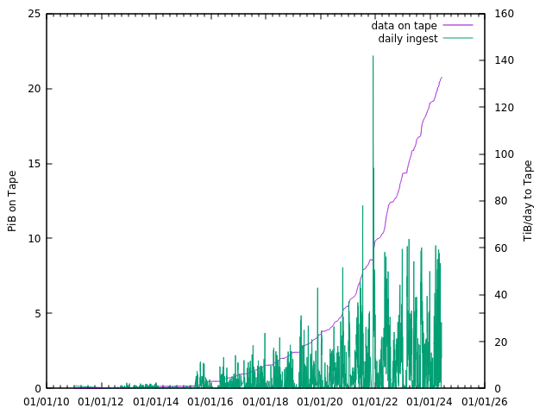
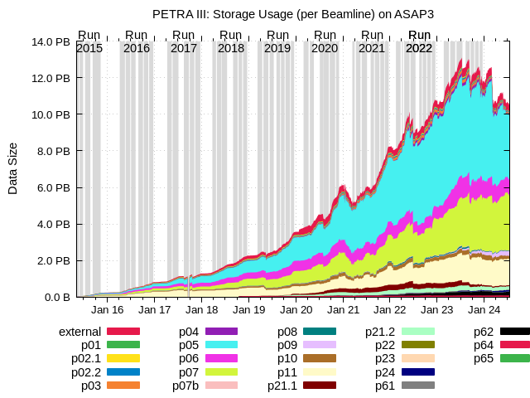
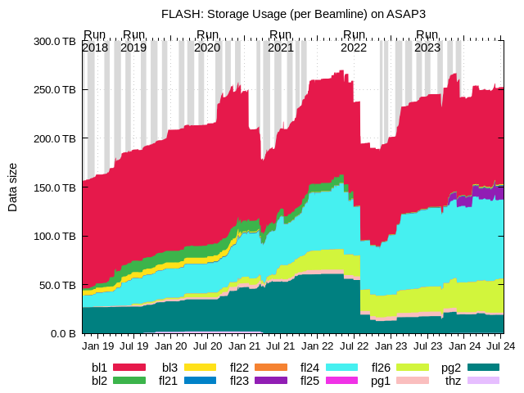
How much photon data is produced at DESY?
PetraIII and Flash
file sizes at FLASH
data on tape after interim
storage on dCache
file sizes at
PETRAIII
ASAP3 (GPFS) storage on limit is 15 PiB.
Data on tape: passed 20 PiB.

Slide 6


DESY FS and IT Plans for SciCat in upcoming year.
shown slide
Make SciCat useful to the user
All work targets concretely this goal: Have SciCat run and operated in production.
We’d like to have an idea how to setup SciCat such that it becomes available at all DESY beamlines. Readiness for PETRA IV (DESYs next generation synchrotron).
This year’s main goals
  An example: Make it easier to find datasets (currently use grep of part of filename strings in ls directory). Thanks to elastic search this feature makes our users happy.
  Setup of a DOI minting service for datasets just like PSI has done.
Very helpful collaboration with PSI -- Thank you, Carlo!
Next years goal:
  Now (2024) they are not yet connected amongst each other.
  Set up of a performant, reliable system requires installation of monitoring tools NOW. Users do complain about “slow down due to the currently massif metadatasets”. Need of quantified figures. Install monitoring tools.
Infrastructure of performant and reliable systems (helm, Kubernetes, OpenStack + monitoring tools).

Slide 7
Summary of discussion points
~shown slide
How do other labs…
Priorties for this and next year
Landing page prototyping
Github issues (most relevant maybe atomic patches)
Performance monitoring large scale setup.
…view some of our issues mentioned, how useful would they be for you? Eg.
  update of proposal class,
  introduction of DatasetCollection,
  extend DOI fields according to DataCite
Do we want a PID/DOI also for proposals?
  Would it have an impact on dataset DOIs?
  What is scientifically significant for having PIDs for proposals?
Where do other labs see the role of a data curator?
We have a lot in the pipeline with very little expertise (and man power) yet.
Max answer regarding DataCollection:
If the institute thinks and implements its use case, there there will be progress.

Slide 8
Hands-on brainstorming sessions
2 rounds. 6 most wanted topics.
visualisation plugins, web-ingestor/validation, pyScicat or SDK and openAPI development
documentation, group/user mgt system, FE UX review
other discussed topics
mono repository: no obvious disadvantage compared to many (immediate and obvious) benefits
..
Procedure:
After identifying 6 topics, the groups brainstormed/identified the toDo’s necessary to solve it. This took two sessions…

Slide 9
Group: pySciCat turned into SDK development
What is an SDK and why is this so important?
Goal: autogenerate software development kits (SDKs) for different languages using openAPI generators (language priorities 1. ts, 2. py, 3. other: go, java)
What is an SDK and why do we want it? source is this.
Is a set of tools written in one or more programming languages that make it easier to use a service or API.
An SDK is a great abstraction layer. It is written in the language the developer uses, and provides language idiomatic ways to call the API, managing things like HTTP calls, the mapping of JSON to objects, authentication, retries, etc.
A good SDK drastically reduces the code you have to write.
Procedure for SDK dev in SciCat:
see https://github.com/orgs/SciCatProject/projects/16

Slide 10
Groups: meta data validation and visualisation
What is an SDK and why is this so important?
Spencer and Linus and others had a good conversation, we potentially hear about it later. Linus, thus DESY, committed to contributions by the work of Anjali A and potentially Julia K (CAU).

Slide 11
Groups: meta data validation and visualisation
Commitment to contributions by Linus (FS-EC) and Igor (FS-SC)
meta data validation
led by Spencer B
visualization
led by ? (Ian B or Laura S)

Slide 12
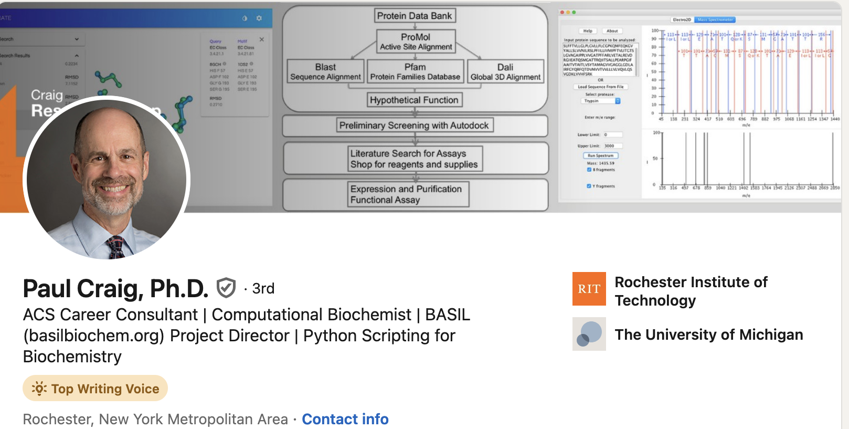
General Updates
Since 2024-07-17 we run at P08 with the new way providing IDs:
old: beamtimeID
new: DOOR_proposalID.beamtimeID
I’d like to extend it as default at other beamlines, especially FLASH, as well
– yes?
SciScat survey
users wanted who have an opinion on SciCat usage. Please come forward! Deadline: Mid September 2024.

