Slide 1
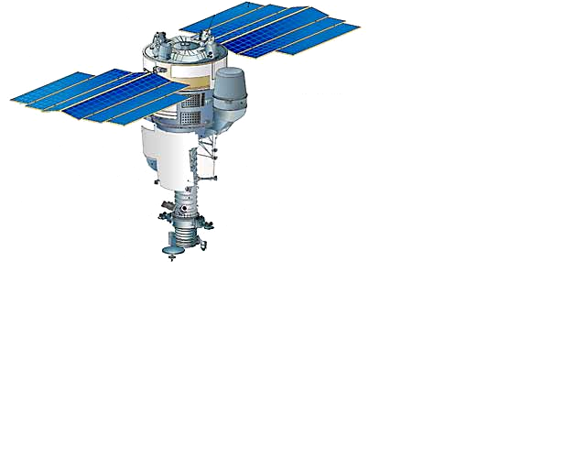
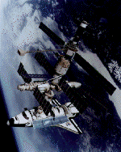
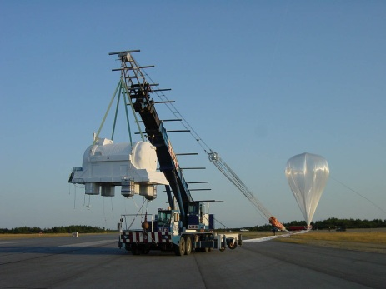
Direct measurements of cosmic rays in space
Roberta Sparvoli
Rome “Tor Vergata” University
and INFN, ITALY
ISVHECRI 2012 – Berlin - Germany

Slide 2
Primary and secondary CR’s
Astroparticle physics in space is performed by the detection and analysis of the properties of Cosmic Rays.
The primary Cosmic Rays reach the top of the atmosphere, without interacion.
The atmosphere acts as a convertor: the interaction of the CR’s with the nuclei in atmosphere produces showers of secondary particles (secondary Cosmic Rays).
The primary radiation can be studied directly only above the terrestrial atmosphere.
The primary cosmic radiation is affected by the effect of the Solar System magnetic fields: the Earth’s magnetic field and the Solar magnetic field.

Slide 3
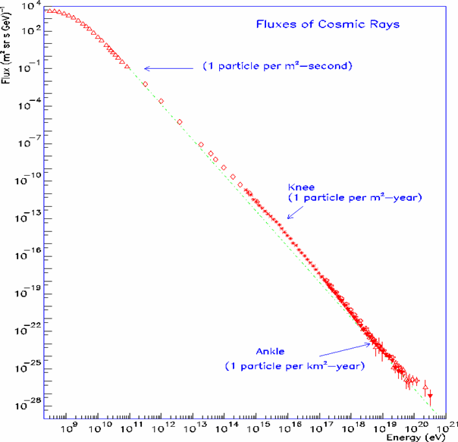
How to measure cosmic rays
Directly, E<10¹⁴ eV
  High Z particles
  Antiparticles
  Light Nuclei and isotopes
  Composition below the knee
Indirectly, E>10¹⁴ eV
  Composition at the knee
  UHECR
Notes:
Descrizione dello spettro
Lo avete visto innumerevoli volte
Si distinguono tre regioni...
Ci concentreremo sulla terza, altissime energie, sopra i 10¹⁹ eV, dove non è chiaro:
COME siano accelerati
DOVE siano le sorgenti
Addirittura PERCHè riusciamo a vederli

Slide 4
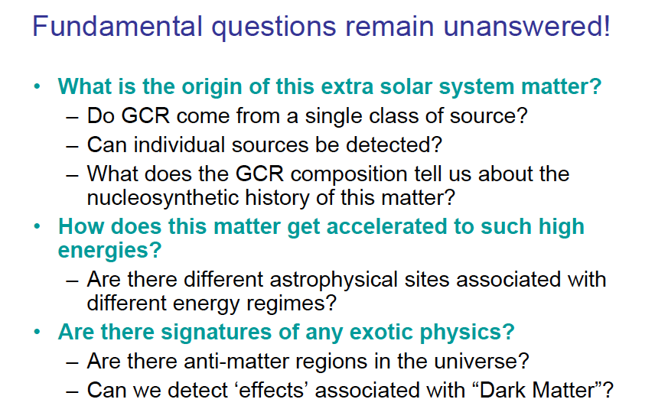

Slide 5
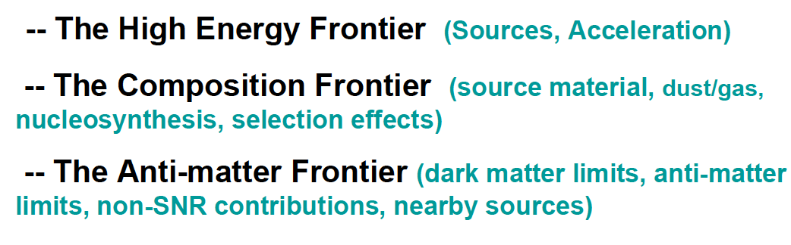
Main physics research lines
According to the physics line, different platforms and detections techniques have been adopted.

Slide 6
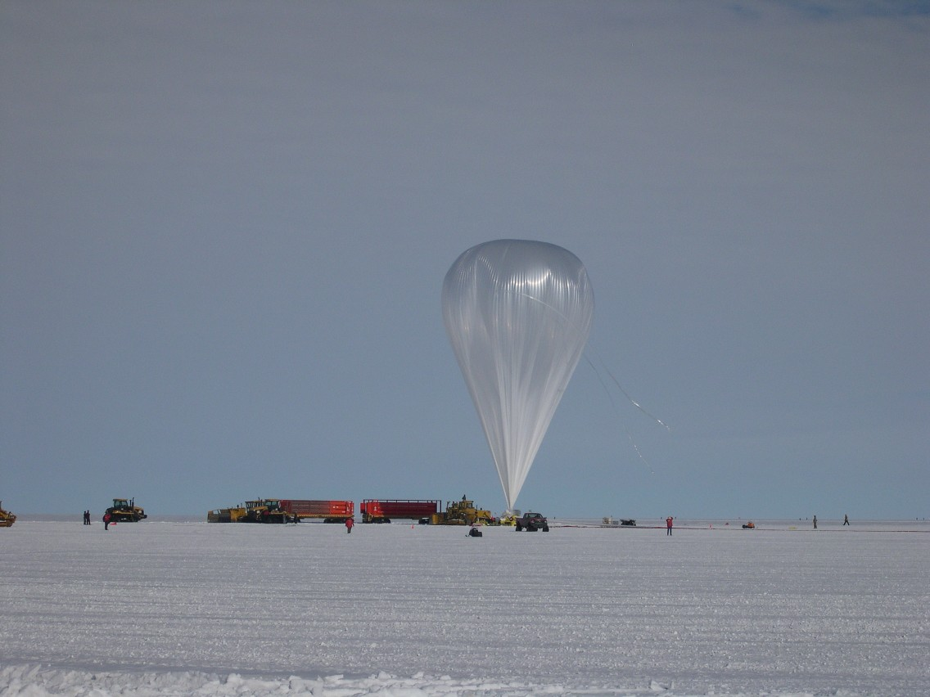
Stratospheric balloons

Slide 7
The antimatter balloon flights: overview
Aim of the activity is the detection of antimatter and dark matter signals in CR (antiprotons, positrons, antinuclei) for energies from hundreds of MeV to about 30 GeV, and measurements of primary CR from hundreds of MeV to about 300 GeV.
6 flights from the WIZARD collaboration: MASS89, MASS91, TRAMP-SI, CAPRICE 94, 97, 08. The flights started from New Mexico or Canada, with different geomagnetic cut-offs to optimize the investigation of different energy regions. The flights lasted about 20 hours.
4 flights from the HEAT collaboration: 2 HEAT-e+, in 1994 and 1995, and 2 HEAT-pbar flights, in 2000 and 2002

Slide 8
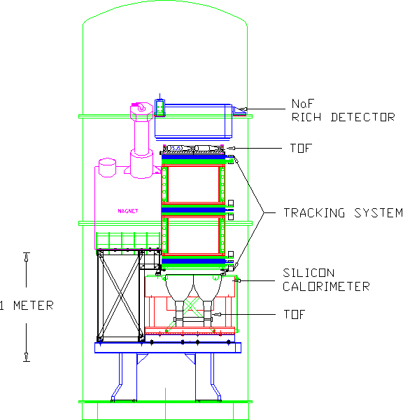
  Charge sign and momentum determination;
  Beta selection
  Z selection
  hadron – electron discrimination
CAPRICE-94

Slide 9
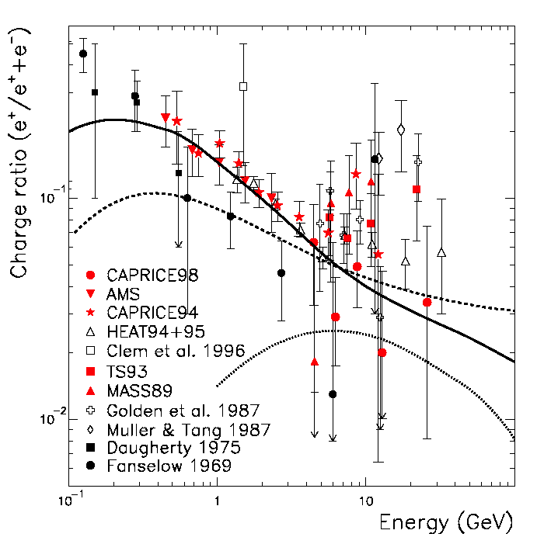
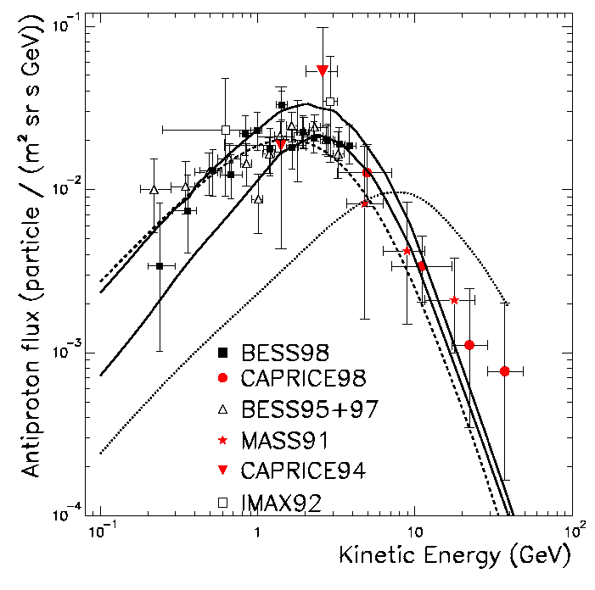
Results from MASS/TrampSI/CAPRICE/HEAT: Positrons & antiprotons
Excess ??
Highest energetic points available from balloons

Slide 10
The BESS program
The BESS program had 11 successful flight campaigns since 1993 up to 2008.
Aim of the program is to search for antimatter (antip, antiD) and to provide high precision p, He, μ spectra.
A modification of the BESS instrument, BESS-Polar, is similar in design to previous BESS instruments, but is completely new with an ultra-thin magnet and configured to minimize the amount of material in the cosmic ray beam, so as to allow the lowest energy measurements of antiprotons.
BESS-Polar has the largest geometry factor of any balloon-borne magnet spectrometer currently flying (0.3 m²-sr).

Slide 11








BESS Collaboration
High Energy Accelerator
Research Organization(KEK)
National Aeronautical and
Space Administration
Goddard Space Flight Center
BESS
Collaboration
The University
of Tokyo
University of Maryland
Kobe University
University of Denver
(Since June 2005)
Institute of Space and
Astronautical Science/JAXA

Slide 12
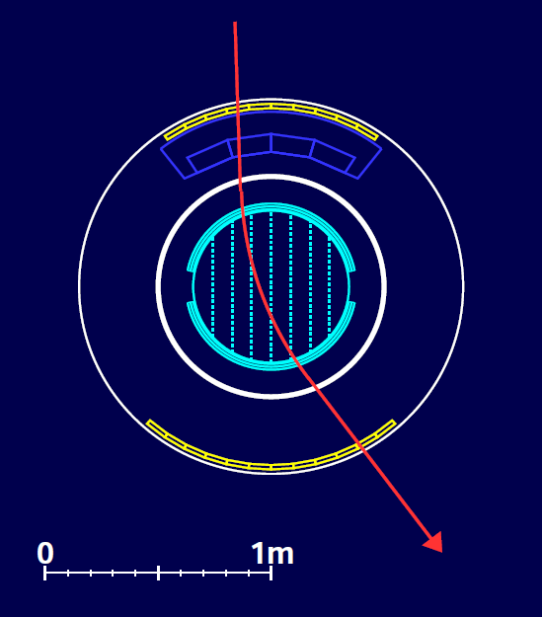
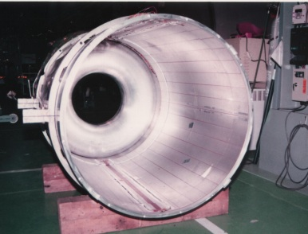
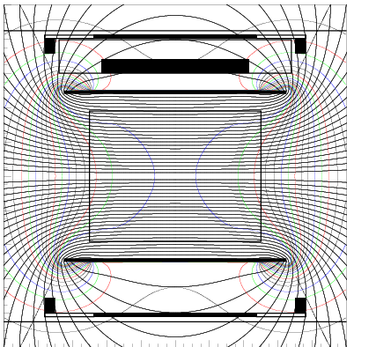
BESS Detector
  JET/IDC
  Rigidity
  Rigidity measurement
  SC Solenoid (L=1m, B=1T)
    Min. material (4.7g/cm²)
    Uniform field
    Large acceptance
  Central tracker
    Drift chambers (Jet/IDC)
    δ ~200 μm
  Z, m measurement
  R,β --> m = ZeR 1/β²-1
  dE/dx --> Z
TOF
β, dE/dx
√

Slide 13
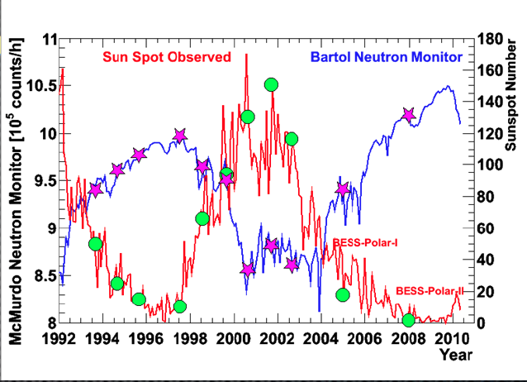
BESS-Polar I and II
  Long duration flights of total 38 days with
  two circles around the Pole

Slide 14
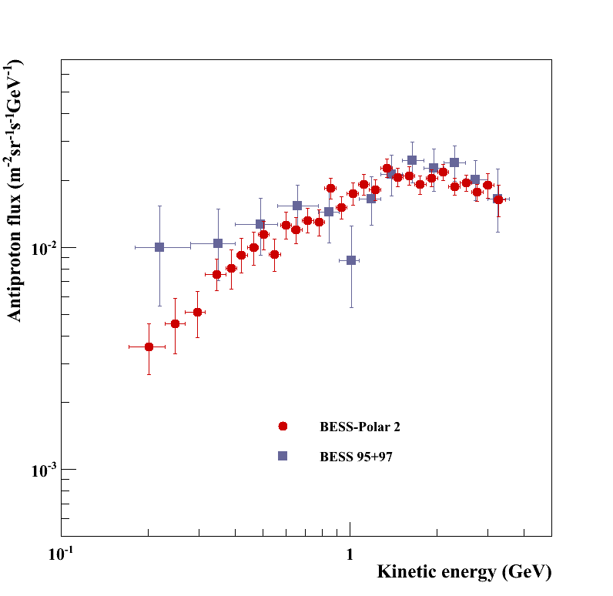
BESS-Polar II Antiproton Spectrum
Compared with
BESS’95+’97:
x 14 statistics at < 1 GeV
Flux peak consistent at 2 GeV
Spectral shape different at low energies.
BESS-Polar II results
generally consistent with
secondary p-bar
calculations under solar minimum conditions.
NO low energy enhnacement due to PBH
Ref. for BESS’95+’97:
S. Orito et al. PRL, Vol. 84, No, 6, 2000

Slide 15
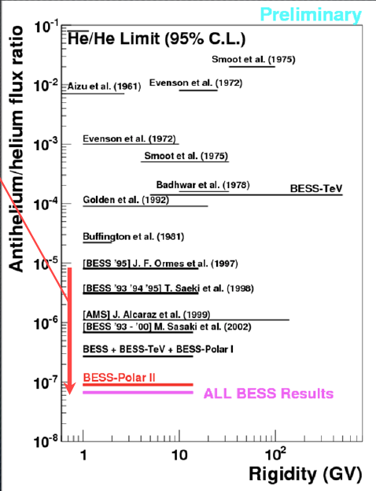
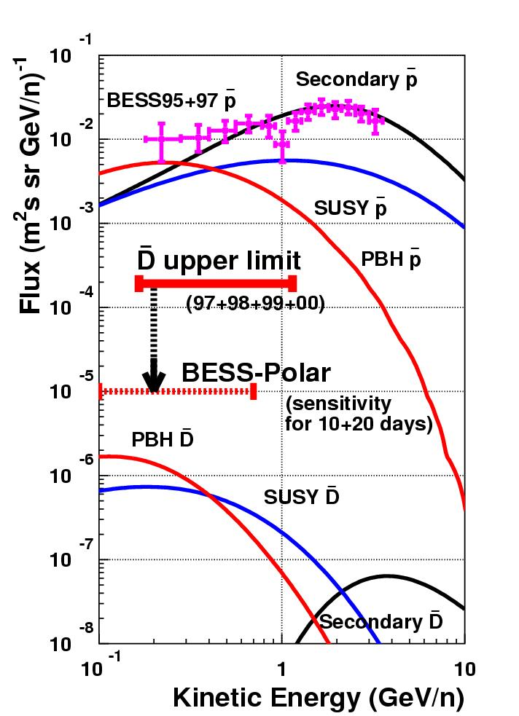
Limits on antimatter (antiHe and antiD)
100 times improvement

Slide 16
CREAM – Overview
Aim is the study of CR from 10¹² to 5x10¹⁴ eV, from proton to Iron, by means of a series of Ultra Long Duration Balloon (ULDB) flights from Antarctica.
6 flights up to now: 2004, 2005, 2007, 2008, 2009, 2010.
The instrument is composed by a sampling tungsten/scintillating fibers calorimeter (20 r.l.), preceded by a graphite target with layers of scintillating fibers for trigger and track reconstruction, a TRD for heavy nuclei, and a timing-based segmented charge device.
A fundamental aspect of the instrument is the capability to obtain simultaneous measurements of energy and charge for a sub-sample of nuclei by calorimeter and TRD, thus allowing an inter-calibration in flight of the energy.

Slide 17
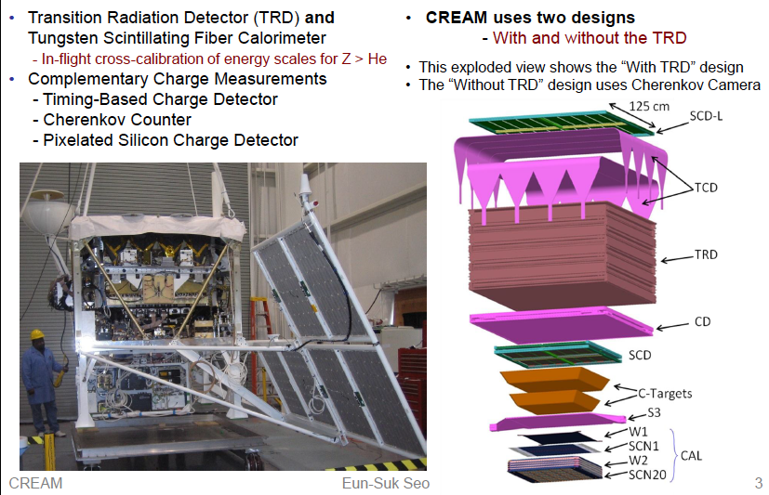
The CREAM instrument
Collecting power: 300 m2-sr-day for proton and helium, 600 m2-sr-day nuclei

Slide 18
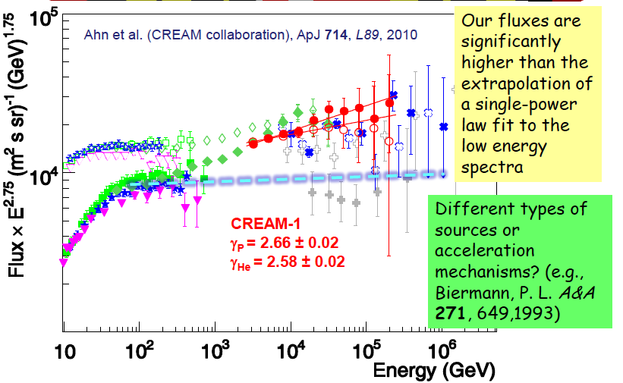
Protons and heliums

Slide 19
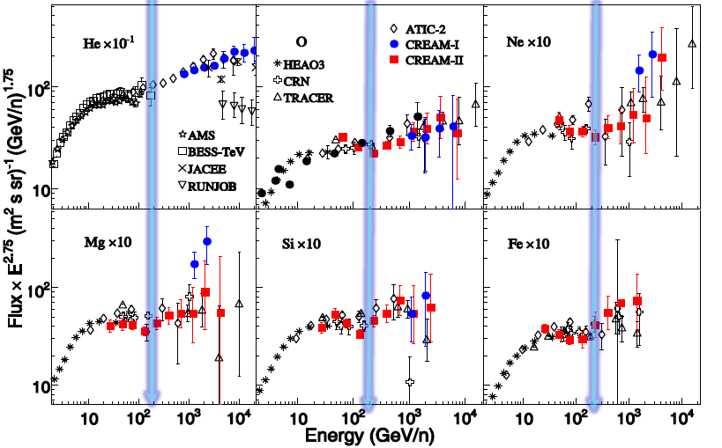
Heavier elements: hardening

Slide 20
Advanced Thin Ionization Calorimeter (ATIC)
ATIC COLLABORATION:
Institute for Physical Science and Technology, University of Maryland, College Park, MD, USA
Marshall Space Flight Center, Huntsville, AL, USA
Skobeltsyn Institute of Nuclear Physics, Moscow State University, Moscow, Russia
Purple Mountain Observatory, Chinese Academy of Sciences, China
Max Planck Institute for Solar System Research, Katlenburg-Lindau, Germany
Department of Physics, Southern University, Baton Rouge, LA, USA
Department of Physics and Astronomy, Louisiana State University, Baton Rouge, LA, USA
Department of Physics, University of Maryland, College Park, MD, USA
The ATIC balloon flight program measures the cosmic ray spectra of nuclei:
1 < Z < 26
between 10¹¹ eV and 10¹⁴ eV.
ATIC has had three successful long-duration balloon (LDB) flights launched from McMurdo Station, Antarctica in 2000, 2002 and 2007.

Slide 21
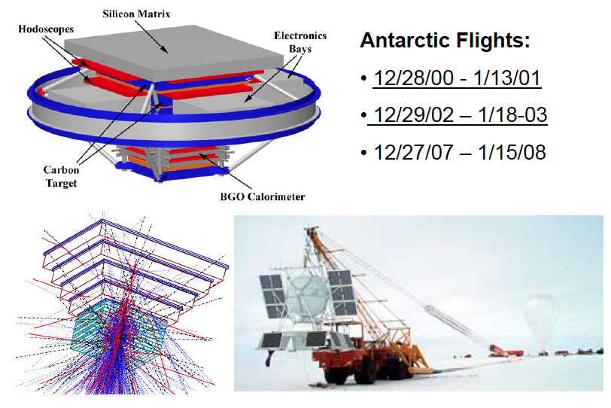
ATIC Instrument Details

Slide 22
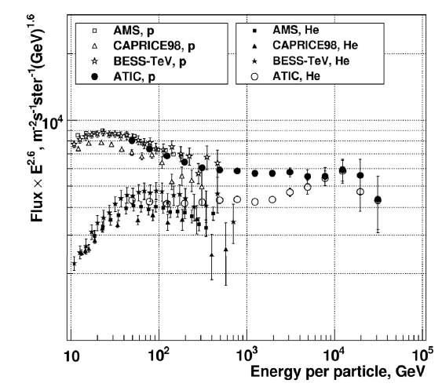
Protons and heliums

Slide 23
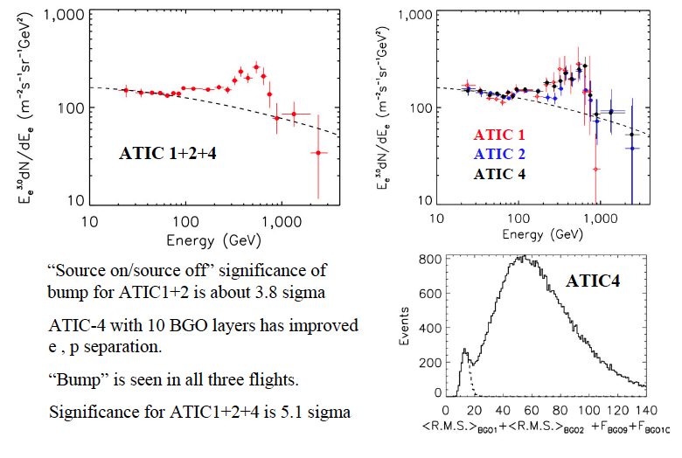
The ATIC “bump” in the all-electron spectrum

Slide 24
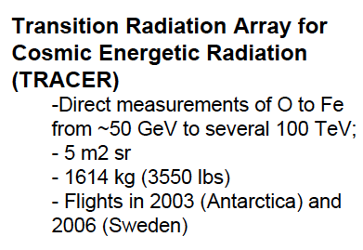
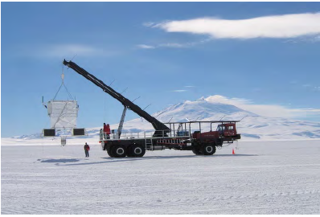
TRACER balloon flights
TRACER and TIGER

Slide 25
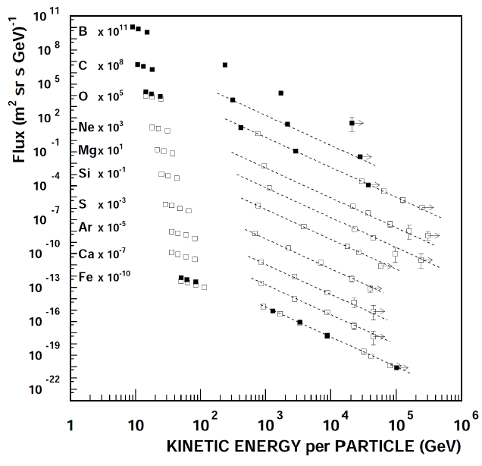

CR energy spectra
TRACER 2 flights data:
POWER_LAW fit above 20 GeV/n:

Slide 26
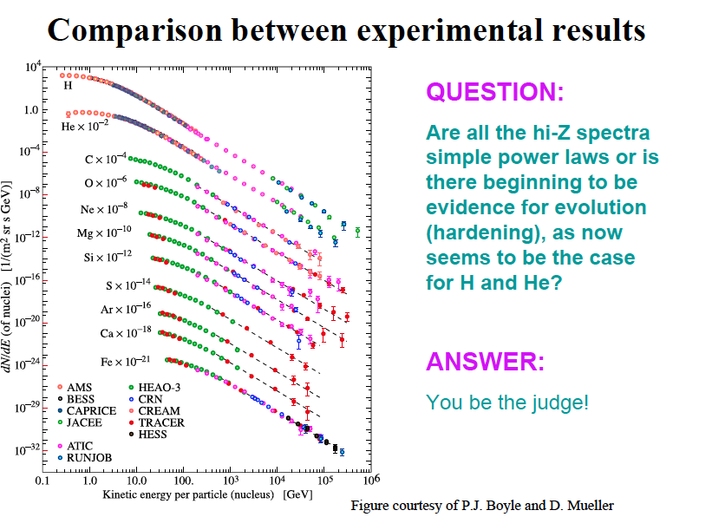

Slide 27
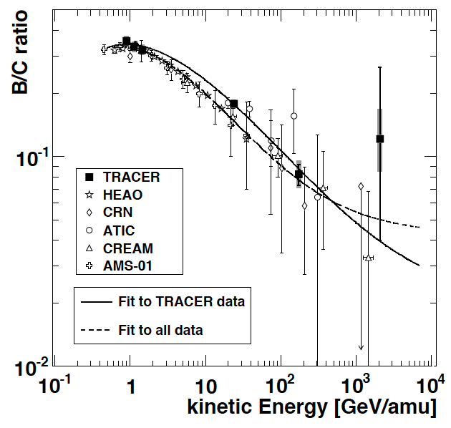






B/C ratio
GALPROP fit with reacceleration:
GALPROP fit without reacceleration:
Leaky Box:

Slide 28
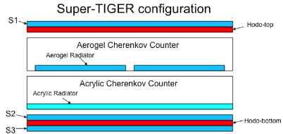
TIGER and SuperTIGER balloon flights
Super-TIGER builds on the smaller Trans-Iron Galactic Element Recorder (TIGER), flown twice on balloons in Antarctica in Dec. 2001 and 2003.
TIGER yielded a total of 50 days of data and producing measurements of elemental abundances of the elements ₃₁Ga, ₃₂Ge, and ₃₄Se, and an upper-limit on the abundance of ₃₃As.
Excellent charge resolution in the 10≤Z≤38 charge range.
SUPERTIGER: 30≤Z≤42

Slide 29
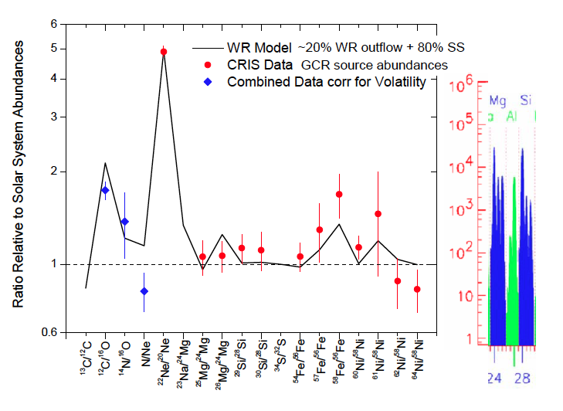
It is known by ACE_CRIS data that the abundance of 22Ne points towards
a contribution from outflow of massive starts (Wolf-Rayet stars).
TIGER and SuperTIGER search for the enrichments of heavy elements
expected from nucleosynthesis in massive stars.

Slide 30
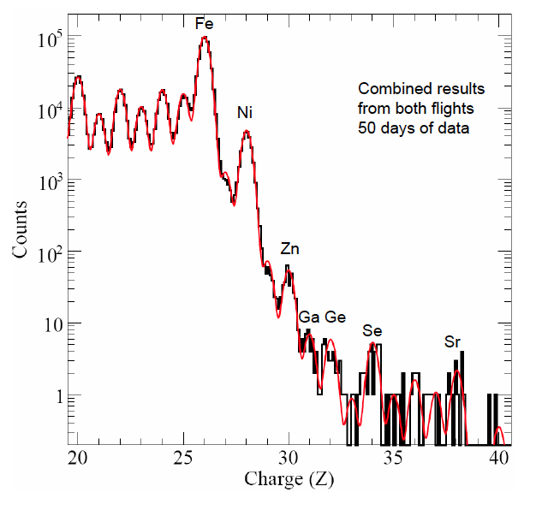
TIGER 1 and 2 combined results

Slide 31
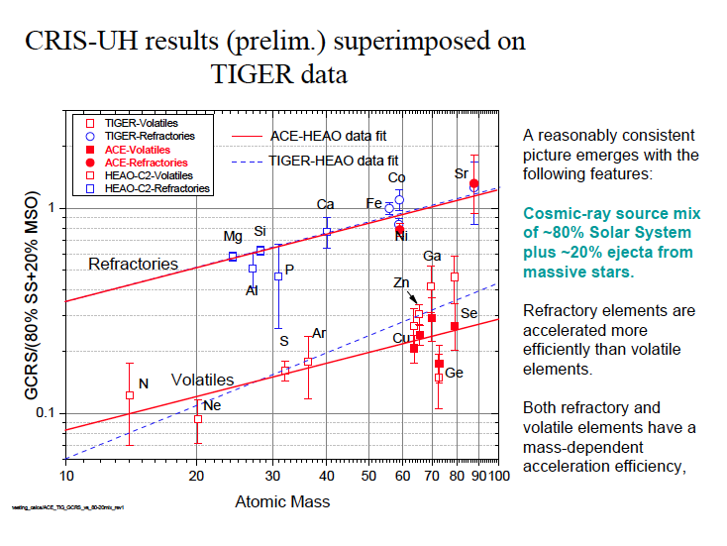

Slide 32
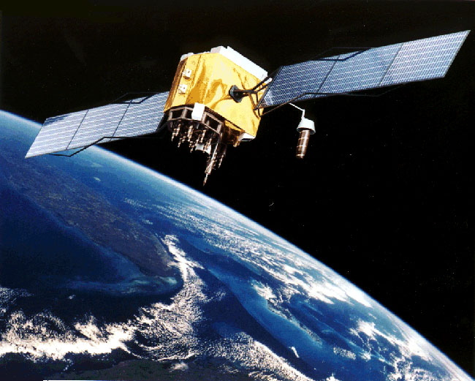
Satellite flights

Slide 33
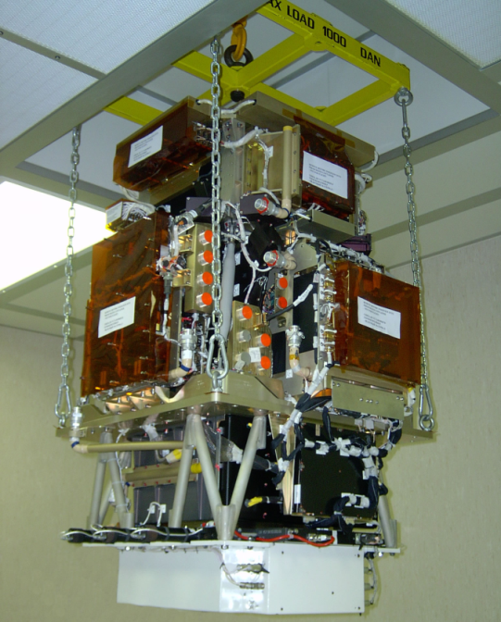
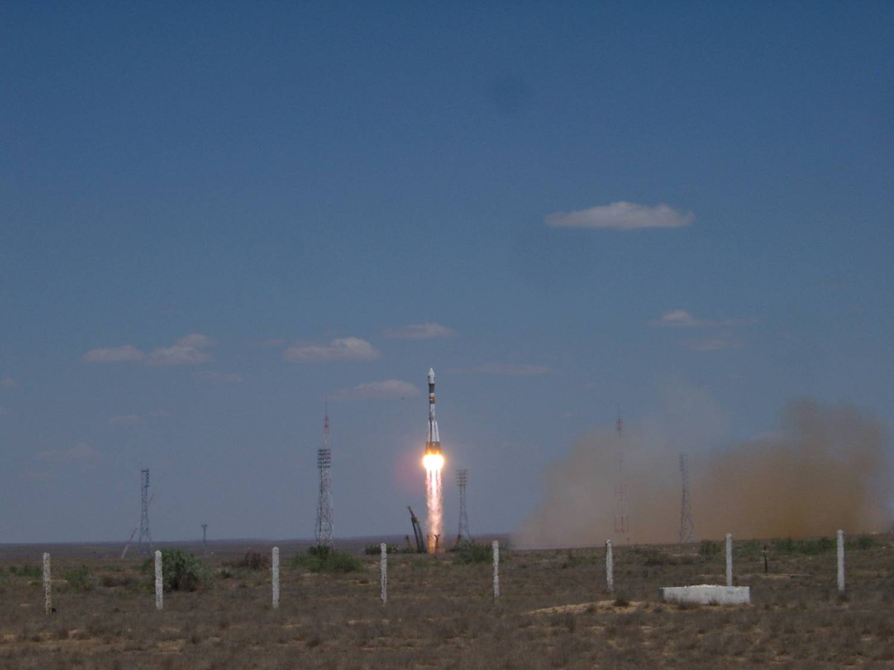
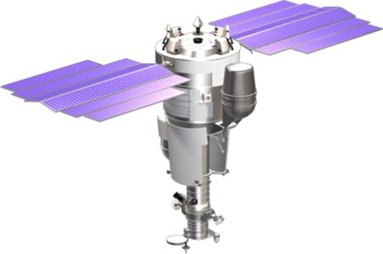
PAMELA
Payload for Matter/antimatter Exploration and Light-nuclei Astrophysics
Direct detection of CRs in space
Main focus on antiparticles (antiprotons and positrons)
PAMELA on board of Russian satellite Resurs DK1
Orbital parameters:
  inclination ~70º (⇒ low energy)
  altitude ~ 360-600 km (elliptical)
  active life >3 years (⇒ high statistics)
Launch from Baykonur
→ Launched on 15th June 2006
→ PAMELA in continuous data-taking mode since then!

Slide 34
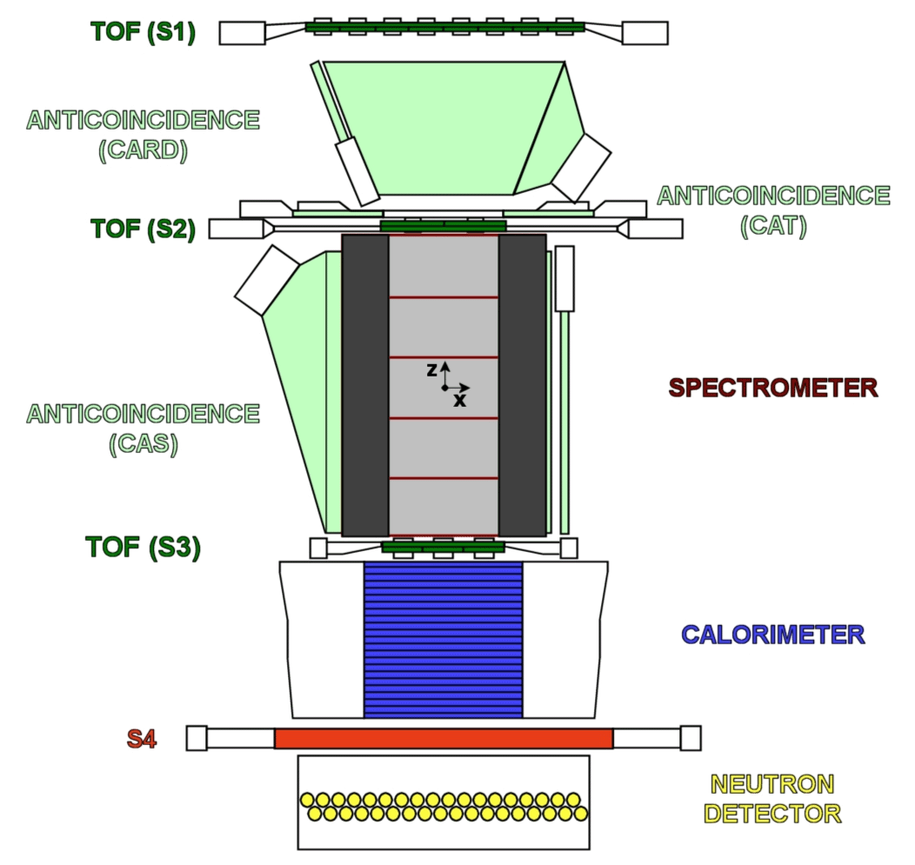
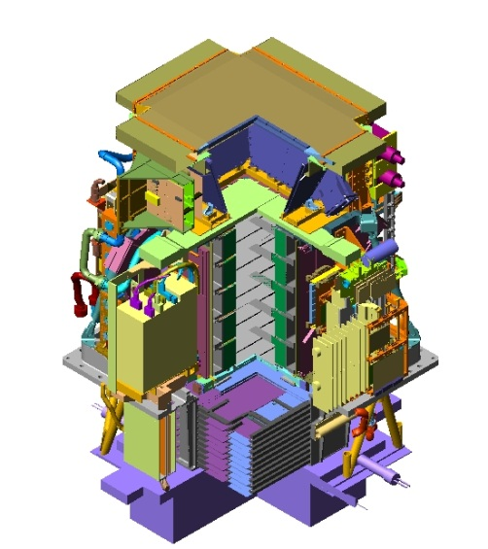
PAMELA detectors
+ -
Time-Of-Flight
plastic scintillators + PMT:
Trigger
Albedo rejection;
Mass identification up to 1 GeV;
- Charge identification from dE/dX.
Electromagnetic calorimeter
W/Si sampling (16.3 X0, 0.6 λI)
Discrimination e+ / p, anti-p / e⁻
(shower topology)
Direct E measurement for e⁻
Neutron detector
36 He³ counters :
High-energy e/h discrimination
Main requirements:
- high-sensitivity antiparticle identification
- precise momentum measurement
Spectrometer
microstrip silicon tracking system + permanent magnet
It provides:
  - Magnetic rigidity → R = pc/Ze
  Charge sign
  Charge value from dE/dx
GF: 21.5 cm² sr Mass: 470 kg
Size: 130x70x70 cm³
Power Budget: 360W
Notes:
Overview of the apparatus

Slide 35
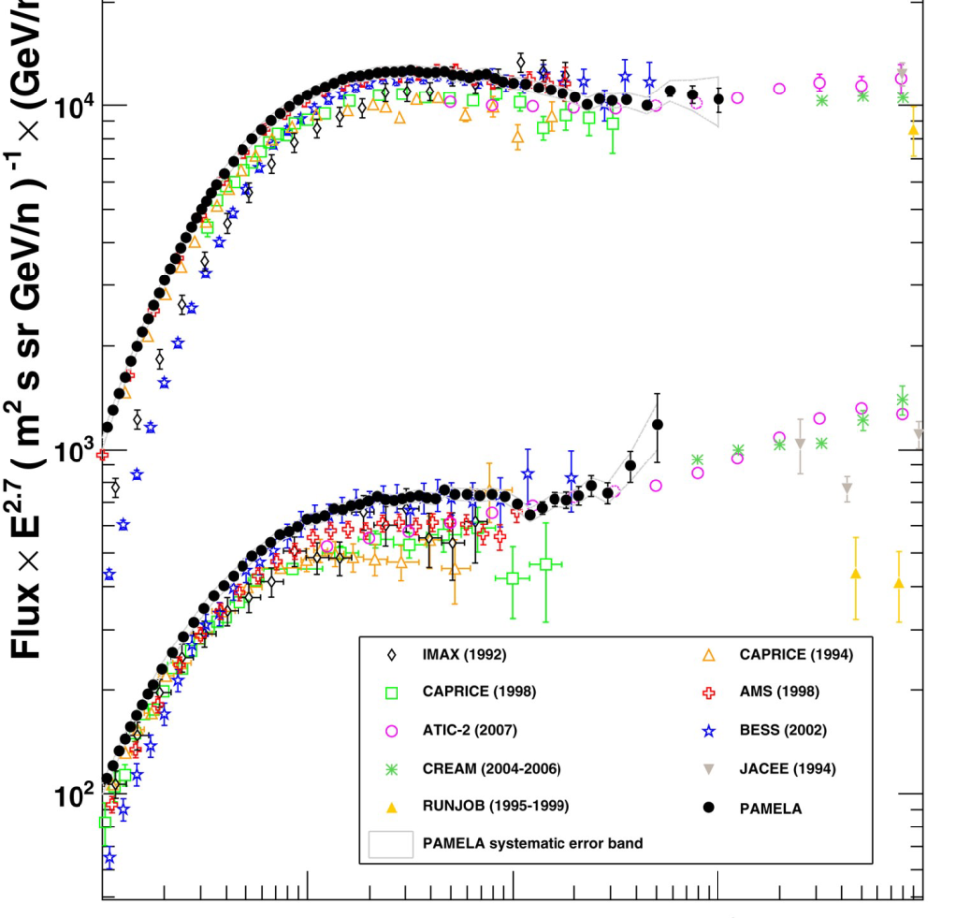
H & He absolute fluxes
Adriani et al. , Science 332 (2011) 6025
First high-statistics and high-precision measurement over three decades in energy
Dominated by systematics (~4% below 300 GV)
Low energy → minimum solar activity (φ = 450÷550 GV)
High-energy → a complex structure of the spectra emerges…

Slide 36
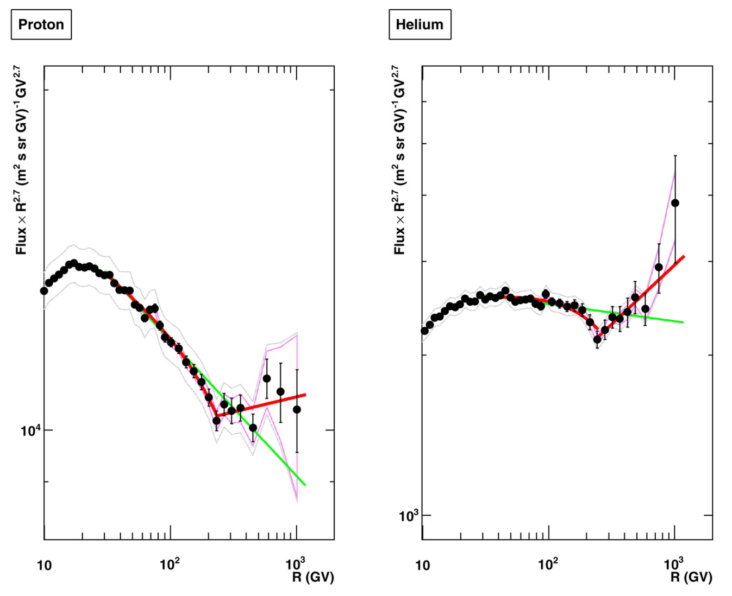
P & He absolute fluxes
@ high energy
Spectral index
2.85
2.77
2.48
2.67
Deviations from single power law (SPL):
Spectra gradually soften in the range 30÷230GV
Abrupt spectral hardening @ ~235GV
Eg: statistical analysis for protons
  SPL hp in the range 30÷230 GV rejected @ >95% CL
  SPL hp above 80 GV rejected @ >95% CL
232 GV
243 GV
Solar modulation
Solar modulation

Slide 37
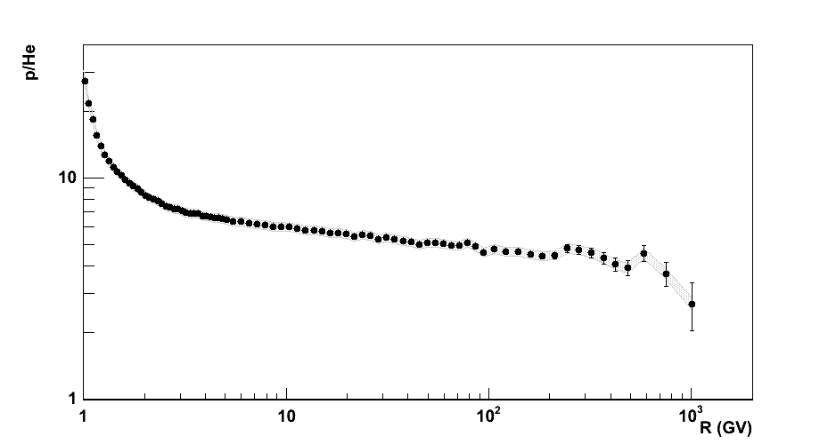
H/He ratio vs R
Instrumental p.o.v.
Systematic uncertainties partly cancel out (livetime, spectrometer reconstruction, …)
Theoretical p.o.v.
Solar modulation negligible → information about IS spectra down to GV region
Propagation effects (diffusion and fragmentation) negligible above ~100GV → information about source spectra
(Putze et al. 2010)

Slide 38
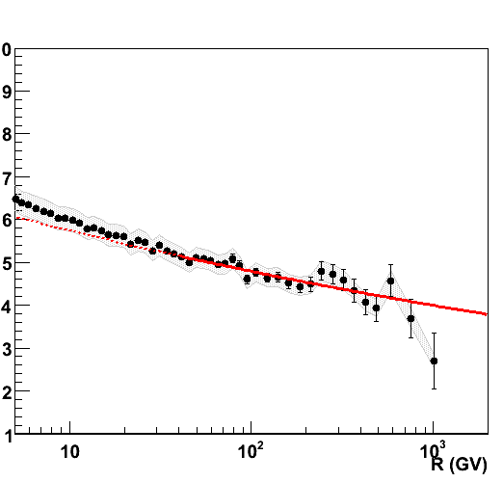
P/He ratio vs R
First clear evidence of different H and He slopes above ~10GV
Ratio described by a single power law (in spite of the evident structures in the individual spectra)
α_{P}-α_{He} = 0.101 ±0.0014
χ²~1.3

Slide 39
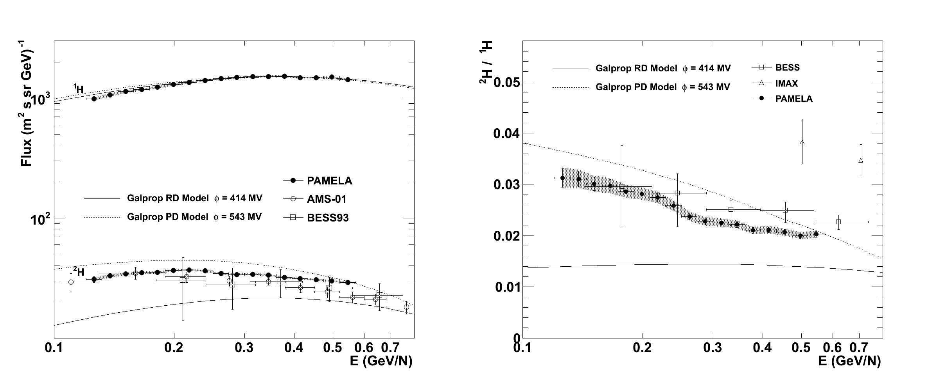
²H and ¹H flux ²H/¹H
Preliminary

Slide 40
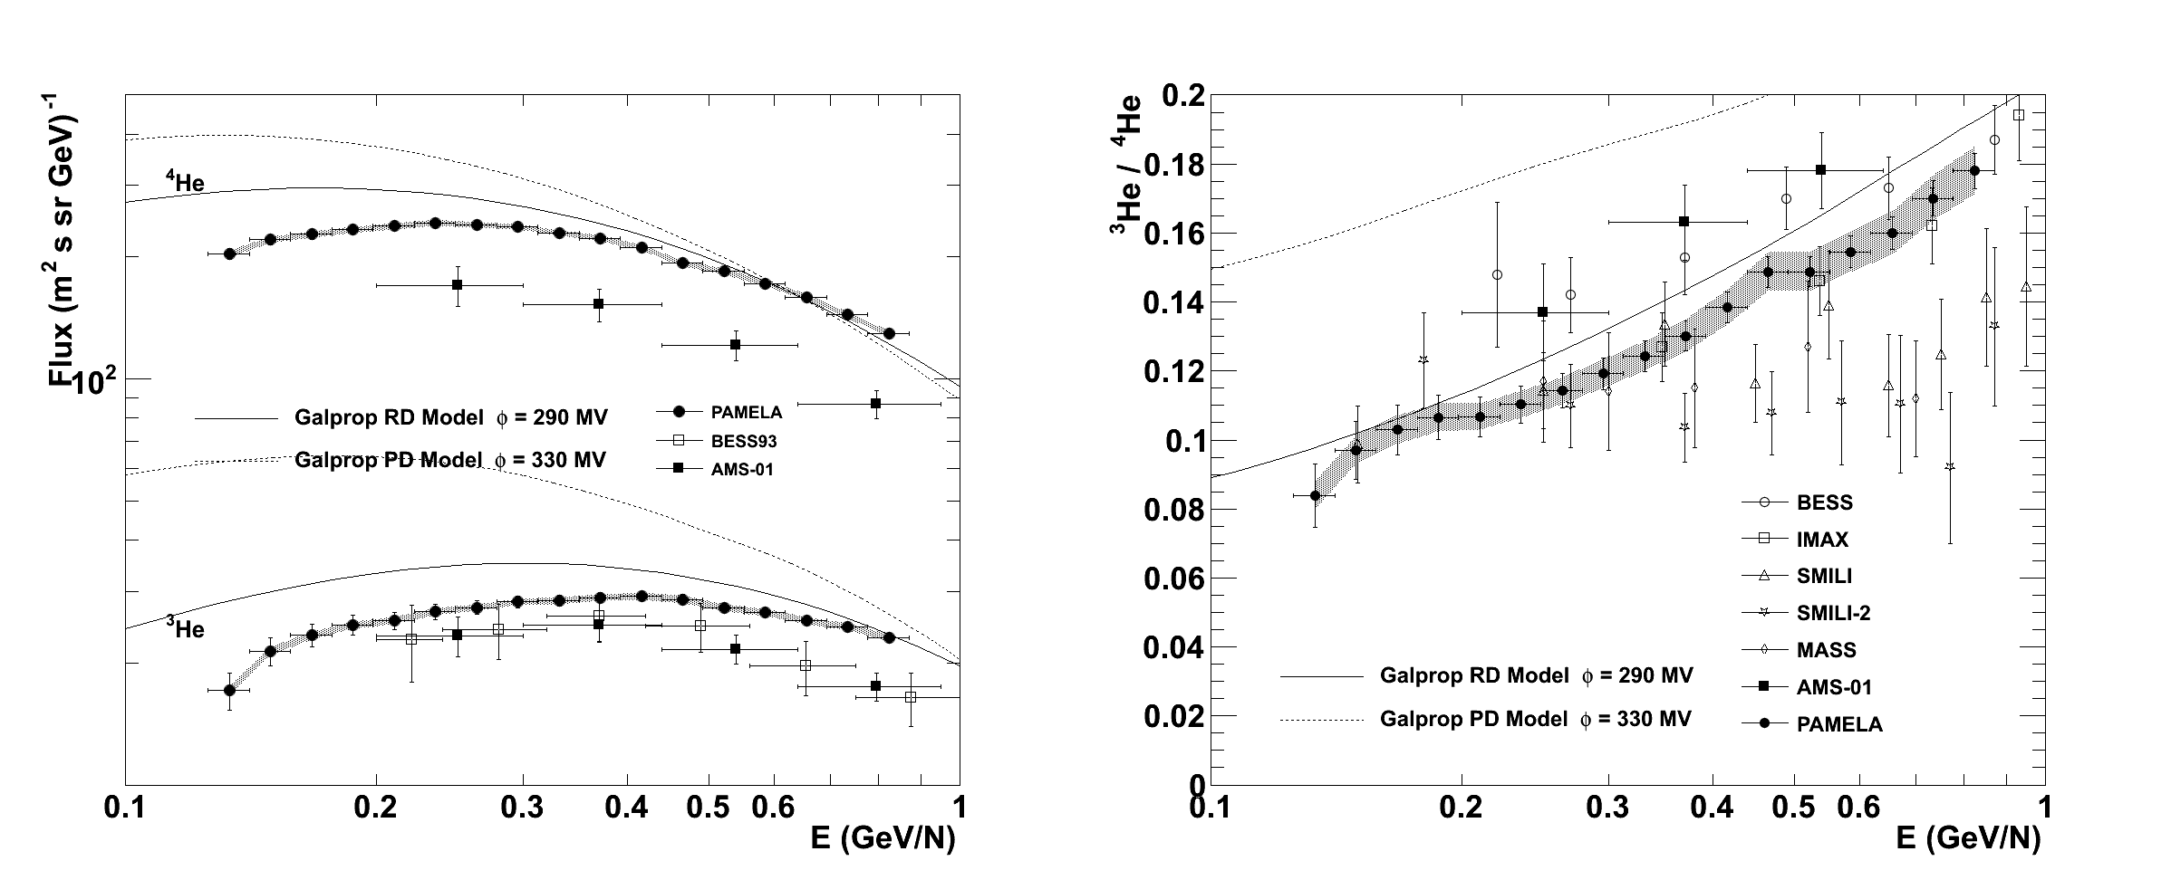
³He and ⁴He flux ³He/⁴He
Preliminary

Slide 41
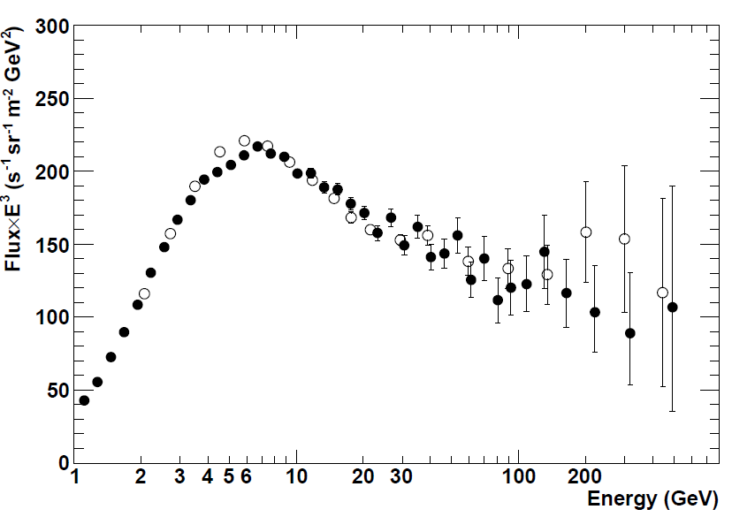
Electron energy measurements
Adriani et al. , PRL 106, 201101 (2011)
spectrometer
Two independent ways to determine electron energy:
Spectrometer
  Most precise
  Non-negligible energy losses (bremsstrahlung) above the spectrometer → unfolding
Calorimeter
  Gaussian resolution
  No energy-loss correction required
  Strong containment requirements → smaller statistical sample
calorimeter
Electron identification:
Negative curvature in the spectrometer
EM-like interaction pattern in the calorimeter

Slide 42
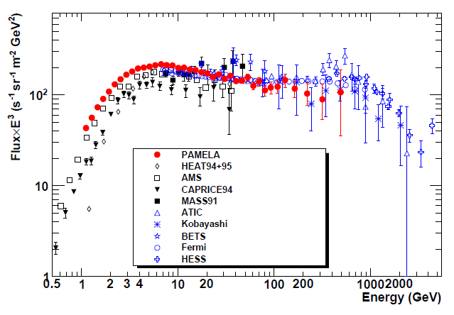
Electron absolute flux
e⁻
e⁺ +e⁻
Adriani et al. , PRL 106, 201101 (2011)
Largest energy range covered in any experiment hitherto with no atmospheric overburden
Low energy
minimum solar activity (φ = 450÷550 GV)
High energy
  No significant disagreement with recent ATIC and Fermi data
  Softer spectrum consistent with both systematics and growing positron component
Spectrometric measurement
Calorimetric measurements

Slide 43
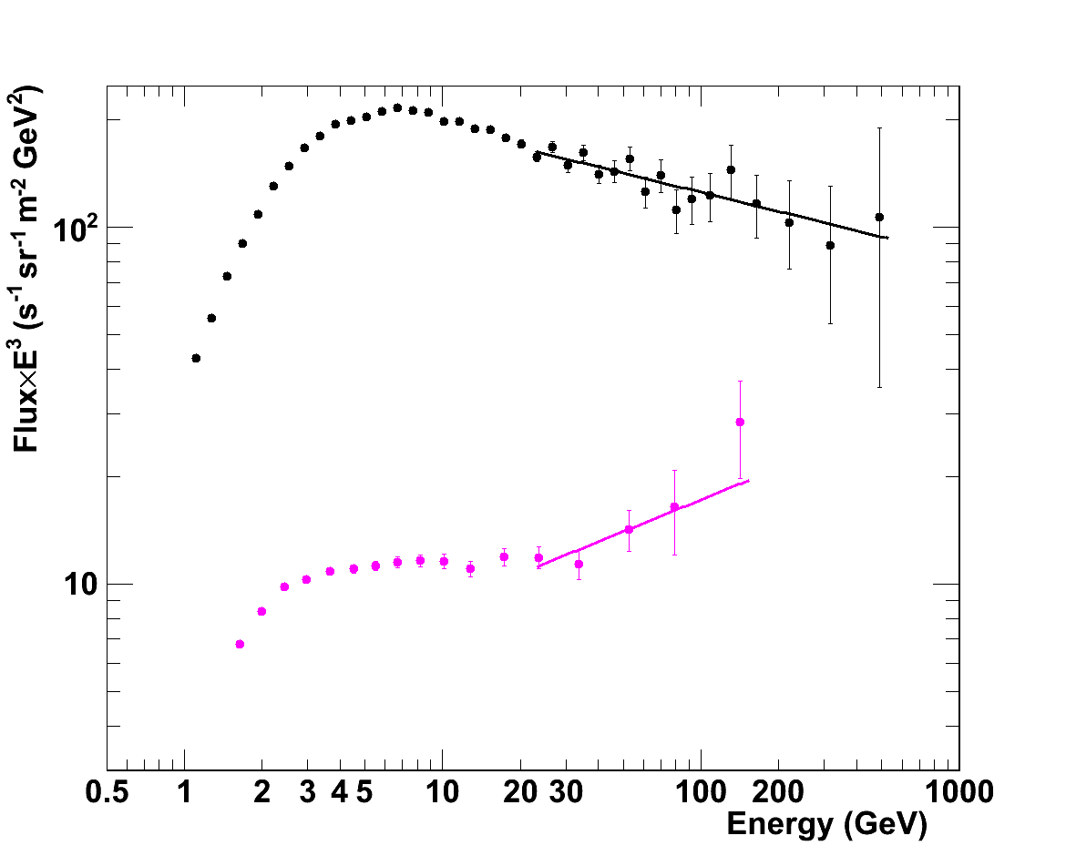
New data: PAMELA Electron &
Positron Spectra
Preliminary
Flux=A • E^{-γ}
γ = 3.18 ±0.04
Flux=A • E^{-γ}
γ = 2.70 ±0.15

Slide 44
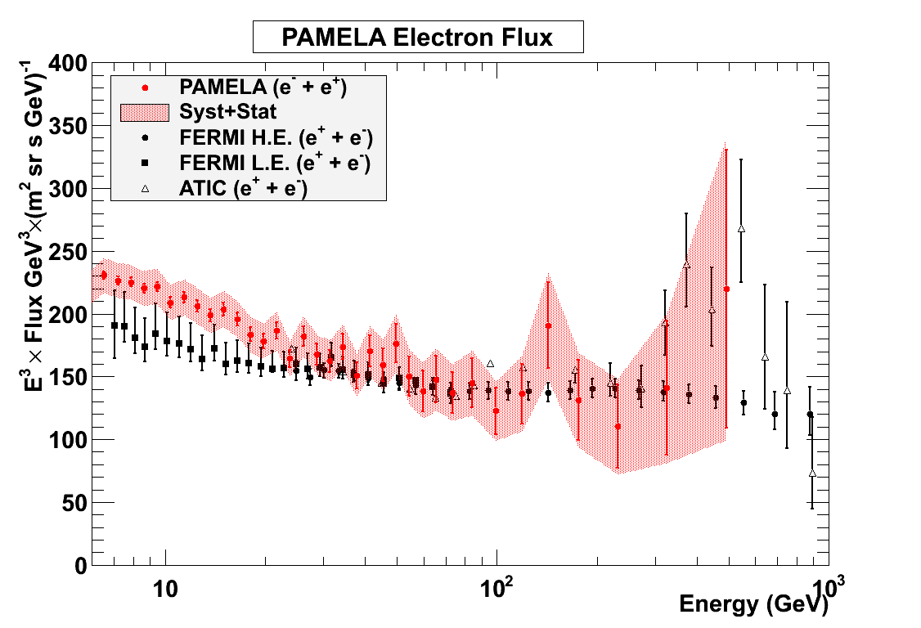
(e⁺ + e⁻ ) absolute flux
ONLY AN EXERCISE ……..
Compatibility with FERMI (and ATIC) data
Beware: positron flux not measured but extrapolated from PAMELA positron flux!
Low energy discrepancies due to solar modulation

Slide 45
(e⁺ + e⁻ ) absolute flux
ONLY AN EXERCISE ……..
Compatibility with FERMI (and ATIC) data
Beware: positron flux not measured but extrapolated from PAMELA positron flux!
Low energy discrepancies due to solar modulation

Slide 46
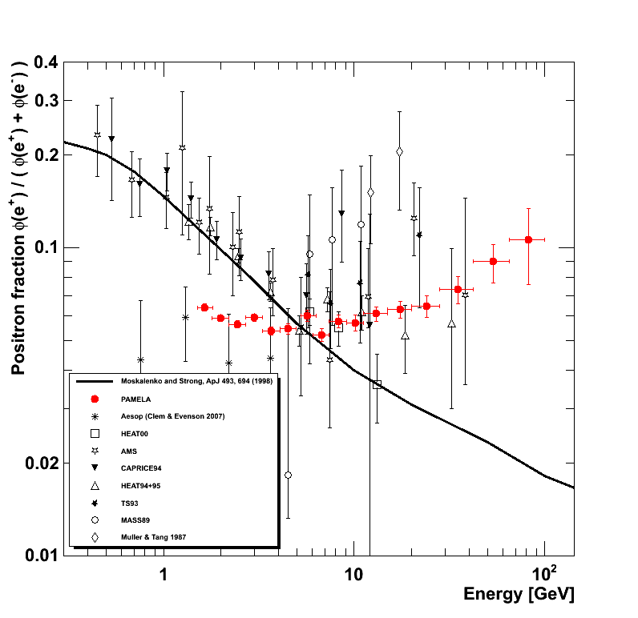
Positron fraction
Adriani et al. , Nature 458 (2009) 607
Adriani et al., AP 34 (2010) 1 (new results)
Low energy → charge-dependent solar modulation (see later)
High energy → (quite robust) evidence of positron excess above 10GeV
(Moskalenko & Strong 1998)
GALPROP code
Plain diffusion model
Interstellar spectra

Slide 47
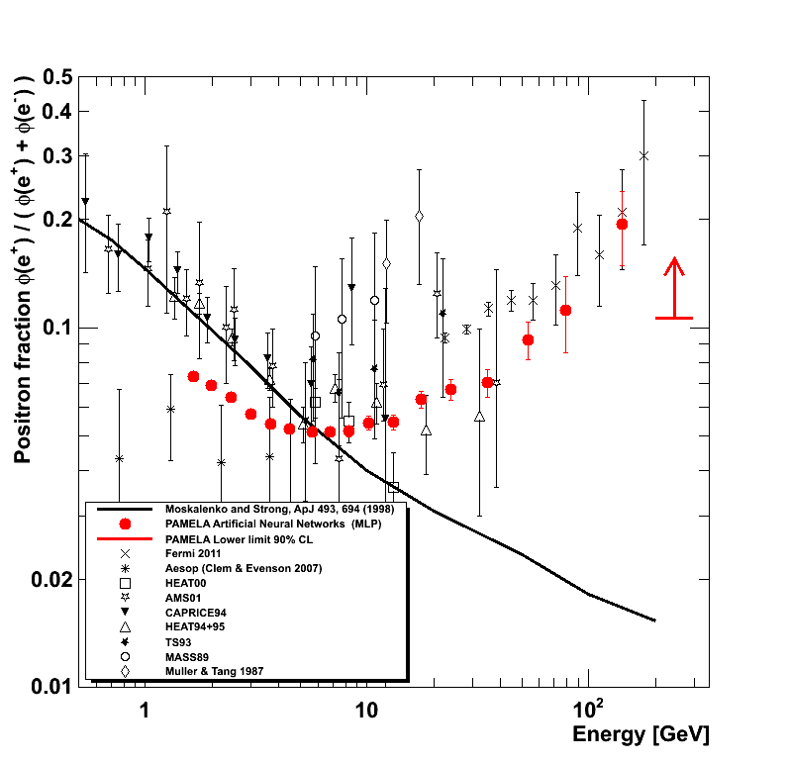
New positron fraction data
Preliminary
Using all data till 2010 and multivariate classification algorithms about factor 2-3 increase in respect to published analysis

Slide 48

Antiproton flux
(Donato et al. 2001)
Diffusion model with convection and reacceleration
Uncertainties on propagation param . and c.s.
Solar modulation: spherical model ( φ=500MV )
Largest energy range covered hiterto
Overall agreement with pure secondary calculation
Experimental uncertainty (stat⊕sys) smaller than spread in theoretical curves → constraints on propagation parameters
Adriani et al. - PRL 105 (2010) 121101
(Ptuskin et al. 2006) GALPROP code
Plain diffusion model
Solar modulation: spherical model ( φ=550MV )
Notes:
Dotted lines: (Donato et al 2001) uncertainty band of propagation parameters for different diffusion models
Dashed lines: (Donato et al 2001) uncertanty band of production cross section
Solid line: (Ptuskin et al 2006) plain diffusion model

Slide 49

Antiproton-to-proton ratio
Adriani et al. - PRL 105 (2010) 121101
Overall agreement with pure secondary calculation

Slide 50

New antiproton/proton ratio
Preliminary
Using all data till 2010 and multivariate classification algorithms 20-50% increase in respect to published analysis

Slide 51
A challenging puzzle for CR physicists
Antiprotons
→ Consistent with pure secondary production
Positrons
→ Evidence for an excess

Slide 52



Positron-excess interpretations
(Cholis et al. 2009)
Contribution from DM annihilation.
Dark matter
boost factor required
lepton vs hadron yield must be consistent with p-bar observation
Astrophysical processes
known processes
large uncertainties on environmental parameters
(Blasi 2009)
e+ (and e-) produced as secondaries in the CR acceleration sites (e.g. SNR)
(Hooper, Blasi and Serpico, 2009)
contribution from diffuse mature & nearby young pulsars.

Slide 53
All particles
PAMELA results
Results span 4 decades in energy and 13 in fluxes

Slide 54

FERMI OBSERVATORY

Slide 55


Slide 56


Slide 57


Slide 58


Slide 59


Slide 60


Slide 61


Slide 62


Slide 63


Slide 64

Orbiting Space Station

Slide 65


ALPHA MAGNETIC SPECTROMETER
→Search for primordial anti-matter
Indirect search of dark matter
High precision measurement of the energetic spectra and composition of CR from GeV to TeV
AMS-01: 1998 (10 days) - PRECURSOR FLIGHT ON THE SHUTTLE
AMS-02: Since May 19th, 2011, safely on the ISS. Four days after the Endeavour launch, that took place on Monday May 16th, the experiment has been installed on the ISS and then activated.
COMPLETE CONFIGURATION FOR >10 YEARS LIFETIME ON THE ISS

Slide 66

AMS-02 : the collaboration
FINLAND
RUSSIA
HELSINKI UNIV.
UNIV. OF TURKU
I.K.I.
ITEP
KURCHATOV INST.
MOSCOW STATE UNIV.
DENMARK
NETHERLANDS
UNIV. OF AARHUS
ESA-ESTEC
NIKHEF
NLR
GERMANY
RWTH-I
RWTH-III
MAX-PLANK INST.
UNIV. OF KARLSRUHE
KOREA
USA
EWHA
KYUNGPOOK NAT.UNIV.
A&M FLORIDA UNIV.
JOHNS HOPKINS UNIV.
MIT - CAMBRIDGE
NASA GODDARD SPACE FLIGHT CENTER
NASA JOHNSON SPACE CENTER
UNIV. OF MARYLAND-DEPRT OF PHYSICS
UNIV. OF MARYLAND-E.W.S. S.CENTER
YALE UNIV. - NEW HAVEN
FRANCE
ROMANIA
CHINA
BISEE (Beijing)
IEE (Beijing)
IHEP (Beijing)
SJTU (Shanghai)
SEU (Nanjing)
SYSU (Guangzhou)
SDU (Jinan)
GAM MONTPELLIER
LAPP ANNECY
LPSC GRENOBLE
ISS
UNIV. OF BUCHAREST
SWITZERLAND
ETH-ZURICH
UNIV. OF GENEVA
TAIWAN
SPAIN
CIEMAT - MADRID
I.A.C. CANARIAS.
ITALY
ACAD. SINICA (Taiwan)
CSIST (Taiwan)
NCU (Chung Li)
NCKU (Tainan)
NCTU (Hsinchu)
NSPO (Hsinchu)
ASI
CARSO TRIESTE
IROE FLORENCE
INFN & UNIV. OF BOLOGNA
INFN & UNIV. OF MILANO
INFN & UNIV. OF PERUGIA
INFN & UNIV. OF PISA
INFN & UNIV. OF ROMA
INFN & UNIV. OF SIENA
MEXICO
UNAM
PORTUGAL
LAB. OF INSTRUM. LISBON
» 500 physicists, 16 countries, 56 Institutes
Y96673-05_1Commitment

Slide 67

The AMS-02 detector

Slide 68

AMS first events
42 GeV Carbon nucleus

Slide 69
AMS first events
42 GeV Carbon nucleus

Slide 70
Future experiments

Slide 71

CALET: Calorimetric Electron Telescope
Main Telescope: Calorimeter (CAL)
Electrons: 1 GeV – 20 TeV
Gamma-rays: 10 GeV – 10* TeV
(Gamma-ray Bursts: > 1 GeV)
Protons and Heavy Ions:
several tens of GeV – 1,000* TeV
Ultra Heavy Ions： over the rigidity cut-off
Gamma-ray Burst Monitor (CGBM)
X-rays/Soft Gamma-rays: 7keV – 20MeV
(* as statistics permits)
CGBM
CAL
Science objectives:
Nearby cosmic-ray sources through electron spectrum in the trans-TeV region
Signatures of dark matter in electron and gamma-ray energy spectra in the 10 GeV – 10 TeV region
Cosmic ray propagation in the Galaxy through p – Fe energy spectra, B/C ratio, and UH ions measurements
Solar physics through electron flux below 10 GeV
Gamma-ray transient observations

Slide 72


CALET Payload Overview
CGBM/SGM
FRGF( Flight Releasable Grapple Fixture)
CGBM/HXM
ASC (Advanced Stellar Compass)
CAL/CHD
GPSR (GPS Receiver)
Launch carrier: HTV-5
Launch target date: CY 2014
Mission period: More than 2 years
  (5 years target)
MDC (Mission Data Controller)
CAL/IMC
CAL/TASC
Data rate:
  Medium data rate: 300 kbps
  Low data rate: 20 kbps
Mass: 650kg (Max)
Standard Payload Size
Power: 500W (Max)

Slide 73

Main Telescope: CAL (Calorimeter)
450 mm
CHD (Charge Detector):
Double layer segmented plastic scintillator array (14 x 2 layer with a unit of 32mm x 10mm x 450mm)
Charge measurement (Z=1 – 40)
Shower particles
IMC (Imaging Calorimeter):
7 layers of tungsten plates with 3 r.l. separated by 2 layers of scintillating fiber belts which are readout by MA-PMT.
Arrival directions, Particle ID
TASC (Total Absorption Calorimeter):
12 layers of PWO logs (19mm x 20mm x 326mm) with total thickness of 27 r.l. The top layer is used for triggering and readout by PMT. Other layers are readout by PD/APD.
Energy measurement, Particle ID

Slide 74
Gamma-400 on Russian satellite
It will combine for the first time photon and particle (electrons and nuclei)
detection in a unique way
Excellent Silicon Tracker (30 MeV – 300 GeV),
  breakthrough angular resolution 4-5 times better than Fermi-LAT at 1 GeV
  improved sensitivity compared with Fermi-LAT by a factor of 5-10 in the energy range 30 MeV – 10 GeV
Heavy Calorimeter (25 X₀) with optimal energy resolution and particle discrimination
  Electron/positron detection up to TeV energies
  Nuclei detection up to 10¹⁵ eV energies

Slide 75


Slide 76
ISS-CREAM
The idea is to put the CREAM detector, developed as a Long Duration balloon experiment, onboard the ISS, at the Japanese Experiment Modules Exposed Facility (JEM-EF) KIBO.
The 1,200 kg estimated mass of the payload is over twice the mass of any previously launched payload using the JAXA’s HTV. The development team will modify the existing instruments to meet the new requirements of the launch vehicle and ISS.
Very good chance to reach 10¹⁵ eV.

Slide 77
Conclusions
High energy line
H and He spectra are different
H and He spectra harden with energy (230 GV)
Hi-Z spectra might show similar hardening
Energy dependance of propagation still undecided
Composition line
Source matter must be a composition of old ISM with newly sinthetized matherial, in percentage 80%-20% (sites of acceleration rich in massive stars?)

Slide 78
Conclusions
Antimatter line
All electron spectrum shows enhancement at high energy (hundreds GeV). Nearby source?
Positrons show enhancement in the E>10 GeV region (new e+ e- source. Correlated to previous?)
No antiproton excess observed both at low and high energy (several DM models and exotics ruled out)
No heavier anti-nucleus observed (very stringent limits)
New fresh data from AMS-02 could improve the understanding of some of the still open issues in the direct measurements sector
THANK YOU!

