Slide 1
Evidence of a new phenomenon in Ultrahigh Energy Collisions
Glennys R. Farrar and Jeff Allen
New York University
with thanks to the Pierre Auger Collaboration

Slide 2
For today:
Prove that some new phenomenon is needed to explain UHECR showers
Problem is not inadequate implementation of already-seen physics
Need suppression of π⁰ (production or decay) above 10¹⁷ eV
Existence proof that phenomena can be explained
Chiral Symmetry Restoration Model (CSR)
Proton primary works (show how model details can be tested)
Show extension of model to mixed composition
Other models
Lorentz Invariance Violation (matter-induced?)

Slide 3
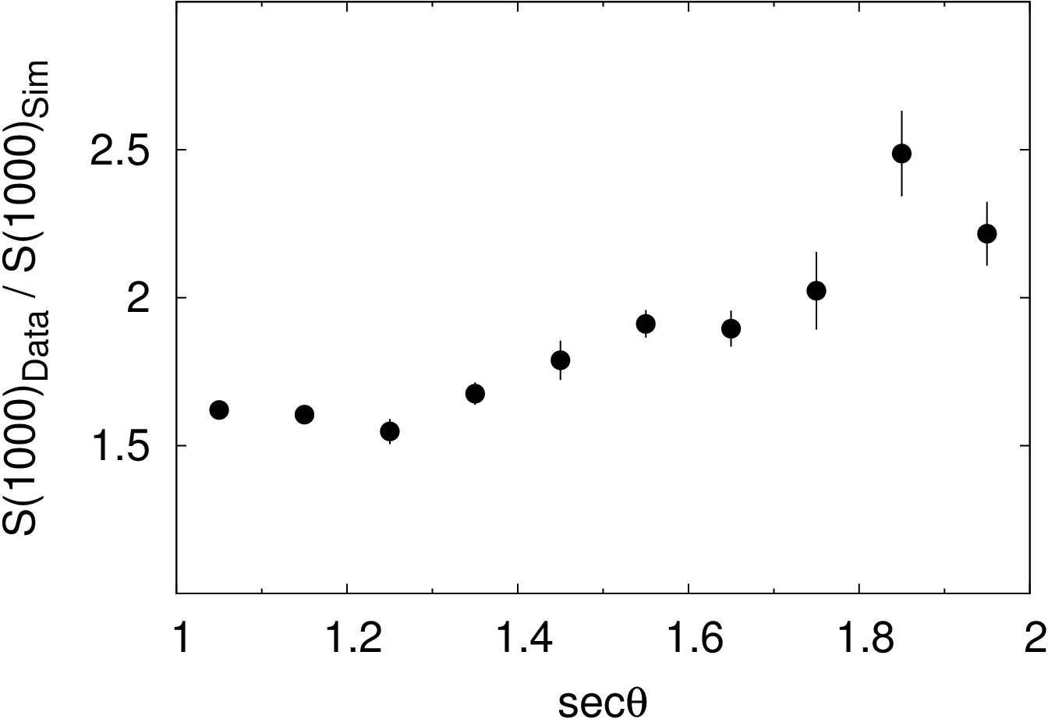
Data versus Simulations
~ 2x more muons observed than expected
(c.f., J. Allen talk)
Must fit
<X_{max}> and RMS(X_{max}) versus energy
S₁₀₀₀ versus zenith angle

Slide 4
Reverse Engineering & Shower Mechanics
E_{UHECR} = E_{EM shower} + E_{hadronic shower}
To increase detected muons, must either:
✖ Throw given muons to larger radii (flatten LDF) or
Increase total number of muons
N_{mu} ≈ E_{had shower} / 100 GeV
=> must transfer energy from EM -> hadronic shower
E_{had} ≈ 10% E_{EM} so diverting 10% of EM energy ≈ doubles N_{mu}

Slide 5
Schematic of a proton shower
≈20 km X₁ ≈ λ_{CR-Air} ≈ 40 g/cm²
≈ 5 km [X_{μ,max} ≈ 550 g/cm² ] not visible via FD
X_{max} ≈ 700-800 g/cm² (primarily EM)
Most produced particles are pions
π⁰ -> ϒ ϒ at all energies
π± above ≈ 100 GeV interact
π± below ≈ 100 GeV decay before interacting
(producing the muons)
muons continue in direction of parent pion

Slide 6
Throwing muons to larger radii does not work (details on following slides)
X_{mu,max} & X_{max} mainly determined by interactions E>10¹⁶ eV)
Properties of ground shower (for fixed X_{max})
Determined by low energy physics
Shape of Lateral Distribution Function ⬄ O(100 GeV) physics
S₁₀₀₀ vs. zenith angle (for observed X_{max}): present models pretty good
Can’t increase S_{mu} (muon ground signal) by flatter LDF
MUST LOOK TO UHE PHYSICS FOR SOLUTION
to the muon problem

Slide 7
Pions giving Muons @~1km
Produced in 10-100 GeV collisions
Point toward muon detection point

Slide 8
Mixed Composition, pt-boosted model
Mixed Composition
Fits X_{max} at 10 EeV, maximizes muons
20% p + 50% C + 30% Fe
Use EPOS but boost pt to fit S₁₀₀₀ for vertical showers
Less of an increase for higher zenith-angle showers because longer pathlength =>1000m muons are produced at smaller angles.

Slide 9
Boosted pt STRATEGY FAILS: WRONG CIC (constant intensity cut plot)
Must fit BOTH X_{max} and CIC
Flatter LDF gives
too-steep CIC
Deeper X_{max} gives
flatter CIC
(So don’t be impressed by a good CIC fit if X_{max} is not right!)
MUST LOOK TO UHE PHYSICS
for the solution to the muon problem

Slide 10
And strategy is excluded by accelerator constraints, too!
p_{158 GeV} C (NA49) & p_{31 GeV} C (NA61) data compared to models
New NA61 pt spectrum higher than models, but not enough to make a difference to N_{mu}
Blue-dotted line:
pt-boosted model

Slide 11
Increasing N_{mu}
E_{had} ~ (1 – f_{EM})^{Ngen}
TO PRESERVE ENERGY IN HADRONIC SHOWER
need to reduce N_{gen} or reduce f_{EM}
MUST GET THE X_{max} distribution RIGHT
Strong constraint on allowed changes to model, E>10¹⁶ eV

Slide 12
Searching for UHE solution, note that…
10 EeV = 10¹⁹eV ⬄ s_{NN}^{½} = 140 TeV
Average 10¹⁹ eV shower has
≈2 ≈20 ≈200 secondary interactions
above 10¹⁸ 10¹⁷ 10¹⁶ eV
A substantial extrapolation beyond constrained physics…

Slide 13
Event Generators differ substantially
Replacing QGSJet II-03 with EPOS below 10¹⁶ eV increases S_{mu} of 10 EeV protons by 10-15%.
Difference in muon signal stems mainly from larger baryon/meson ratio in EPOS and Sybill =>
Pi-0 energy fraction:
QII EPOS Sybill
f_{π0} 0.21 0.15 0.14
J. D. Allen & GRF, in preparation

Slide 14
What knobs can be turned?
(table refers to direct effects only)
Reducing the π⁰ fraction is the only way to increase E_{had-shower} without a too shallow X_{max} distribution

Slide 15
Conventional physics does not allow the π⁰ fraction to be changed much
Isospin invariance => π⁰ = π⁺= π⁻
Isospin breaking (e.g., from resonance production and decay) is small
Pion fraction is nearly universal
Z⁰-decay
Final states of hadron collisions (central region)
Even QGP
If accounting for UHECR showers requires significantly lower π⁰ fraction, that means it requires New Physics!

Slide 16
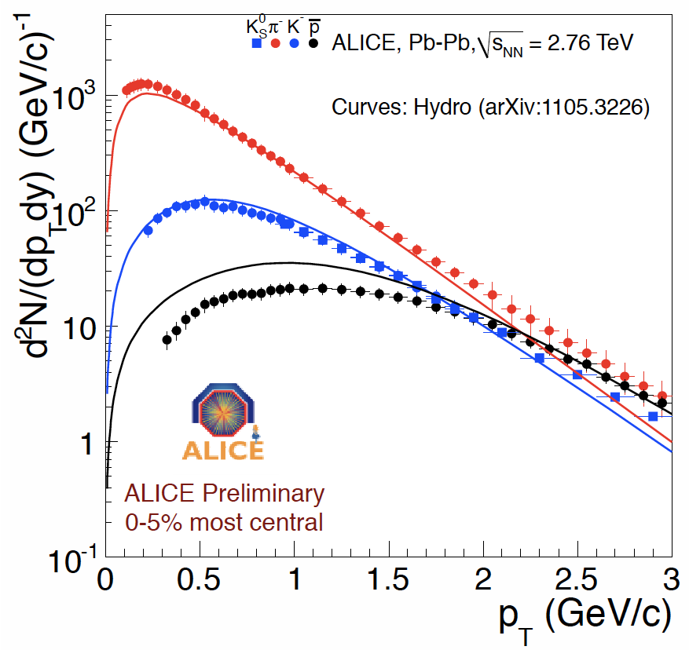
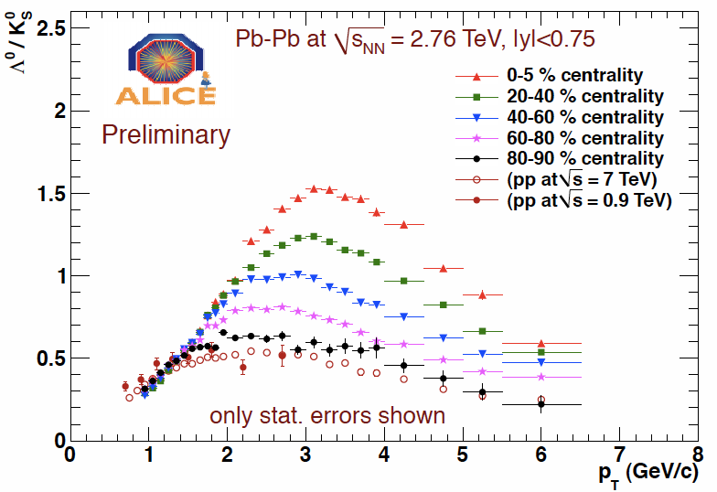
Quark Gluon Plasma (ALICE Pb-Pb)
At factor-2 level, important
particle ratios are same as in pp
K/π ~ 0.12-0.15
p/π ~ 0.05- 0.08
In central collisions,
multiplicity much increased
Baryon enhancement at hi p_{t}
Lots to be understood, interesting puzzles, etc.,
but no evidence of π⁰ suppression
plots from Floris for ALICE, arXiv:1108.3257

Slide 17
Possible mechanism for meson suppression via Chiral Symmetry Restoration
Outside, mesons are very light
q-qbar wavefunctions don’t match at boundary => mesons only produced after CSR phase evaporates.
Meson wavefunctin
Inside, q-qbar is loosely bound and heavy.
Hi T: CSR phase
Baryon wavefunctions
inside and outside match,
so baryons can escape
Low Temperature Phase:
chiral symmetry spontaneously broken

Slide 18
Chiral Symmetry Restoration(-inspired) Model
Peripheral collision:
Standard Physics
f_{el} > f_{min}(E) -- use EPOS
Chiral Symmetry Restored Phase
Convert fraction f_{mes} of mesons to nucleon or anti-nucleon
Increase multiplicity by factor f_{mult}
Lattice QCD predicts Chiral Symmetry is restored at T_{CS} ≥ T _{deconf} = T _{QGP}
Central collision:
Chiral Symmetry Restored
f_{el} < f_{min}(E) – use CSR

Slide 19
“Chiral Symmetry Restoration” model gives an excellent fit at 10 EeV
Ground signal at 10 EeV
X_{max} distribution at 10 EeV
Note improved shape of X_{max} distribution.

Slide 20
CSR also fits energy evolution < X_{max} >, RMS_{Xmax} (and it’s pure proton!)
Elongation Rate
Width of X_{max} Distribution

Slide 21
No-free-parameter FD-SD calibration!

Slide 22
Preliminary CSR implementation
Centrality inferred from elasticity
Adjustable parameters
multiplicity in CSR
fraction of events in CSR vs E
σ_{p-Air}(E)
Turn-on at √s = 14 TeV
chosen arbitrarily

Slide 23
Alternate CSR implementation
Centrality inferred from multiplicity
Adjustable parameters
multiplicity in CSR
fraction of events in CSR vs E
σ_{p-Air}(E)
Turn-on at √s = 14 TeV
chosen arbitrarily

Slide 24
CSR for heavy primaries
Estimate N_{CSR} = # nucleons
within UHECR nucleus that overlaps Air nucleus; E_{N} == E_{CR} / A
Take CSR parameters from proton CSR model.
Event = superposition of CSR(E_{eff} = N_{CSR} × E_{N}) + nuclear remnant
Simple substitute for real impact parameter treatment:
Assume N_{CSR} = A - number of spectator nucleons (having E ≈ E_{N})
Using 20-50-30 p-C-Fe mixed composition at 10 EeV, get virtually identical predictions for muon signal as for CSR-proton!
Carries E_{eff}
b

Slide 25
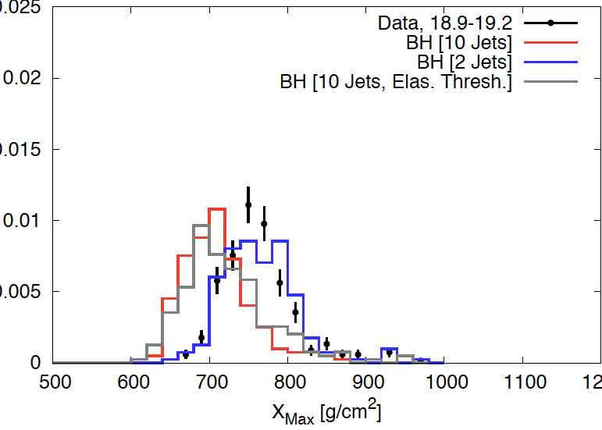
Extra-Dimensional Black Holes
Choose BH final state to maximize ground signal
Ignore predicted too-low BH production cross section
BLACK HOLE CREATION
DOES NOT FIT observations

Slide 26
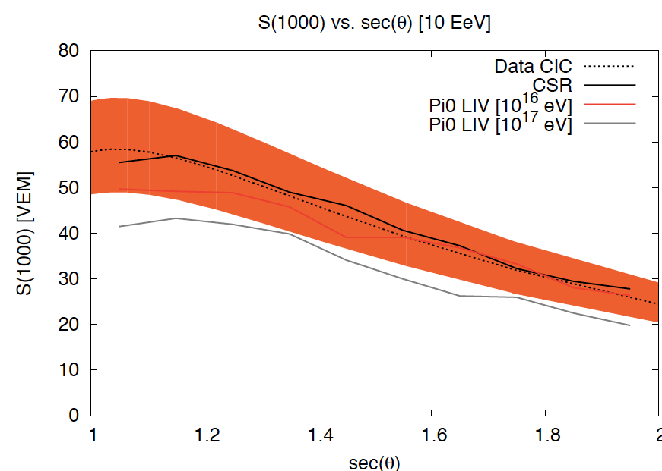
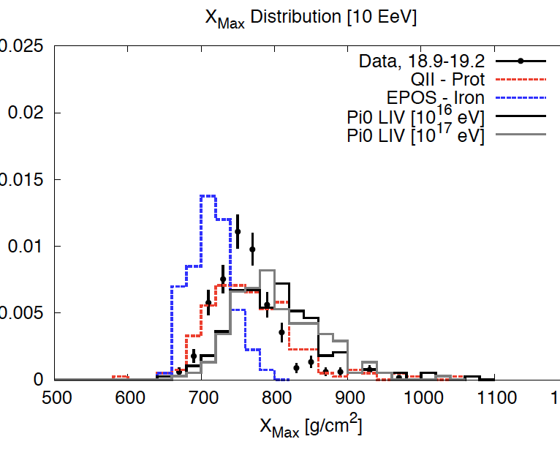
Suppressing π⁰ decay? Lorentz Invariance Violation? (Coleman Glashow) Quantum Decoherence? (quark interaction with geomagnetic field? – no)
LIV parameters seem artificial
C_{γ} - C_{π} > 10⁻¹⁶ vs
C_{γ} - C_{p} < 10⁻²³ for protons
-- can it be a “matter effect”? (Dvali)
X_{max} too deep; mixed composition?

Slide 27
No other New Physics works (so far)
New physics must
impact almost all events
affect almost all the final state energy
QGP a la LHC: Multiplicity increase, no significant reduction in pions => X_{max} becomes narrow and shallow without sufficient increase in S_{mu} .
SUSY or other exotic particle production:
[Predicted rates too low (only produced in tiny fraction of events)]
Missing energy not helpful!
Decays to SM quanta => standard π⁰ fraction => no significant increase in S_{mu}
Extradimensional Black Hole production:
Increase in S_{mu} is too small, even for most optimistic assumptions (next p)

Slide 28
TA test of CSR model
TA surface detector
primarily sensitive to EM ground signal at 800 m
E_{SD} is inferred from S₈₀₀ QGSJet-II proton simulation
Hybrid events: E_{SD} should be reduced by 27% to match E_{FD}
=> S₈₀₀^{true} ≈ S₈₀₀^{QII} for a given observed FD signal
CSR
for a given E^{true}, the FD signal is reduced by 10%: E_{FD} = 0.9 E^{true}
=> SD signal reduced by 10%
Any additional impact of CSR on EM signal at 800 m???
Analysis by TA using our CSR shower library is planned.

Slide 29
Auger hybrid events can discriminate models

Slide 30
Hybrid events can discriminate models…
CSR proton, centrality from elasticity

Slide 31
Hybrid events can discriminate models…
CSR mixed composition

Slide 32
Hybrid events can discriminate models…
CSR proton vs mixed composition

Slide 33
Hybrid events can discriminate models…
CSR , centrality from multiplicity

Slide 34
Hybrid events can discriminate models…
centrality from elasticity vs multiplicity

Slide 35
Hybrid events can discriminate models…
Pure vs mixed composition in conventional models

Slide 36
Hybrid events can discriminate models…
CSR vs. conventional mixed composition

Slide 37
Hybrid events can discriminate models…
CSR vs. conventional – both mixed composition

Slide 38
Summary of CSR fit
Pure proton, or mixed composition are
indistinguishable with current observations
Different implementations distinguishable
using S_{1ooo} vs X_{max}

Slide 39
Theory Needed
CSR model
Mechanisms for π⁰ suppression
Properties of CSR phase
Onset of CSR phase
Associated cross section growth?
Evidence or implications at LHC?
π⁰ stabilization?
matter-induced?
quantum-coherence?
(geomagnetic field huge in π⁰ rest frame)

Slide 40
Conclusions
Something significant is missing in present models of UHE physics.
Conventional interpretation that Auger X_{max} evolution => heavy composition may be misleading.
Models must account fully for observations:
X_{max} distribution (shape and energy evolution) AND
ground signal (magnitude and zenith angle dependence)
Toy model based on fantasies about Chiral Symmetry Restoration
Excellent fit to all data analyzed so far
Additional predictions to test by Auger and TA
Several models have now been constructed, which can fit current data
can be discriminated by S₁₀₀₀ vs X_{max}

Slide 41
Testing CSR with UHECR data
Hybrid events:
S₃₈ vs X_{max} distribution
Golden Hybrid analysis
(simultaneous SD-FD simulations for individual events)
Ground muons
Test predictions for horizontal showers
Repeat muon deficit analyses with CSR model
Test shape of predicted LDFs in detail
Study how event properties evolve with energy
Does optimized Auger model give good fit to TA data?

