Slide 1
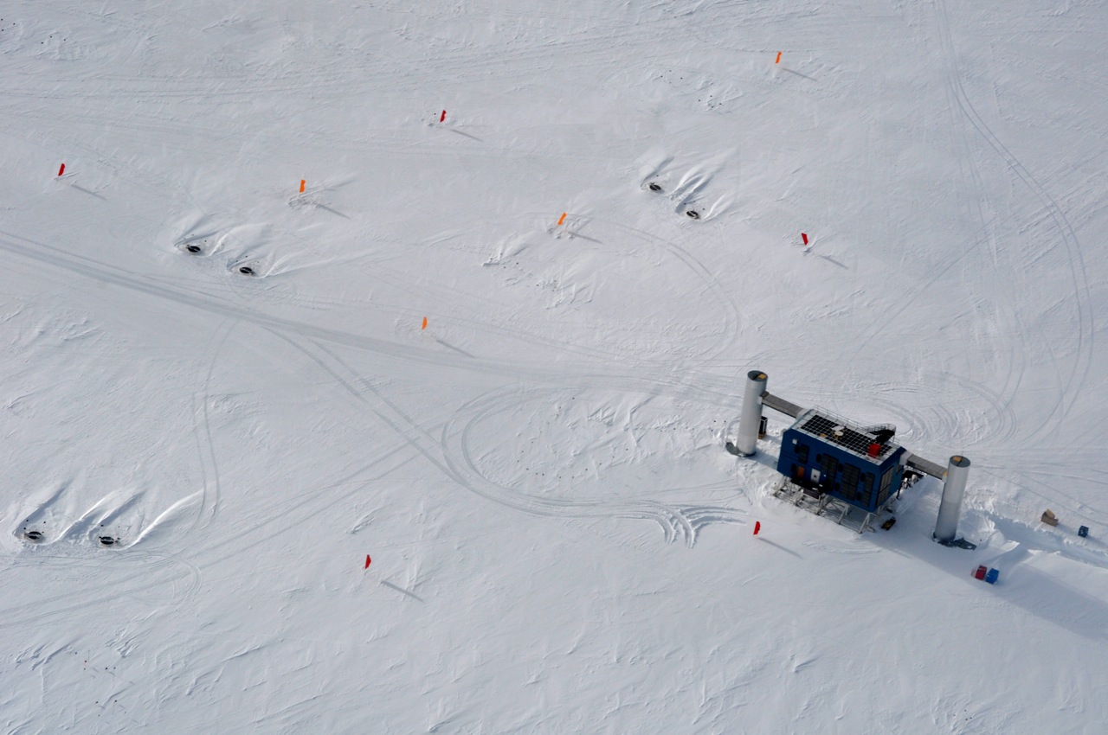
Results on the Spectrum and Composition of Cosmic Rays
from the IceTop air shower array of the IceCube Observatory
Serap Tilav, University of Delaware
for the IceCube Collaboration
ISVHECRI, 10-15/Aug/2012, Berlin

Slide 2
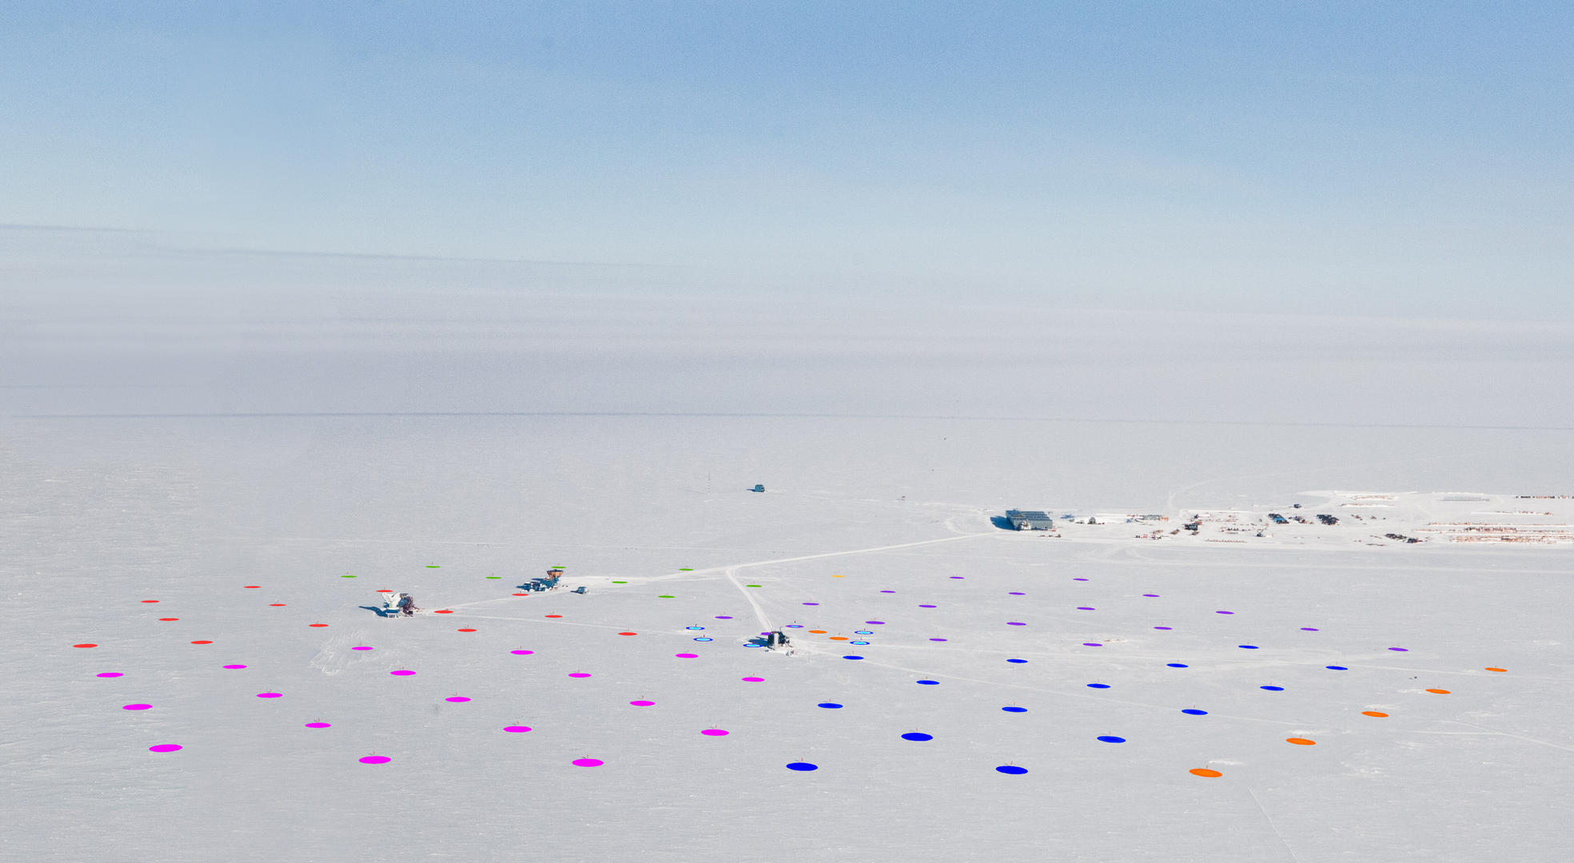

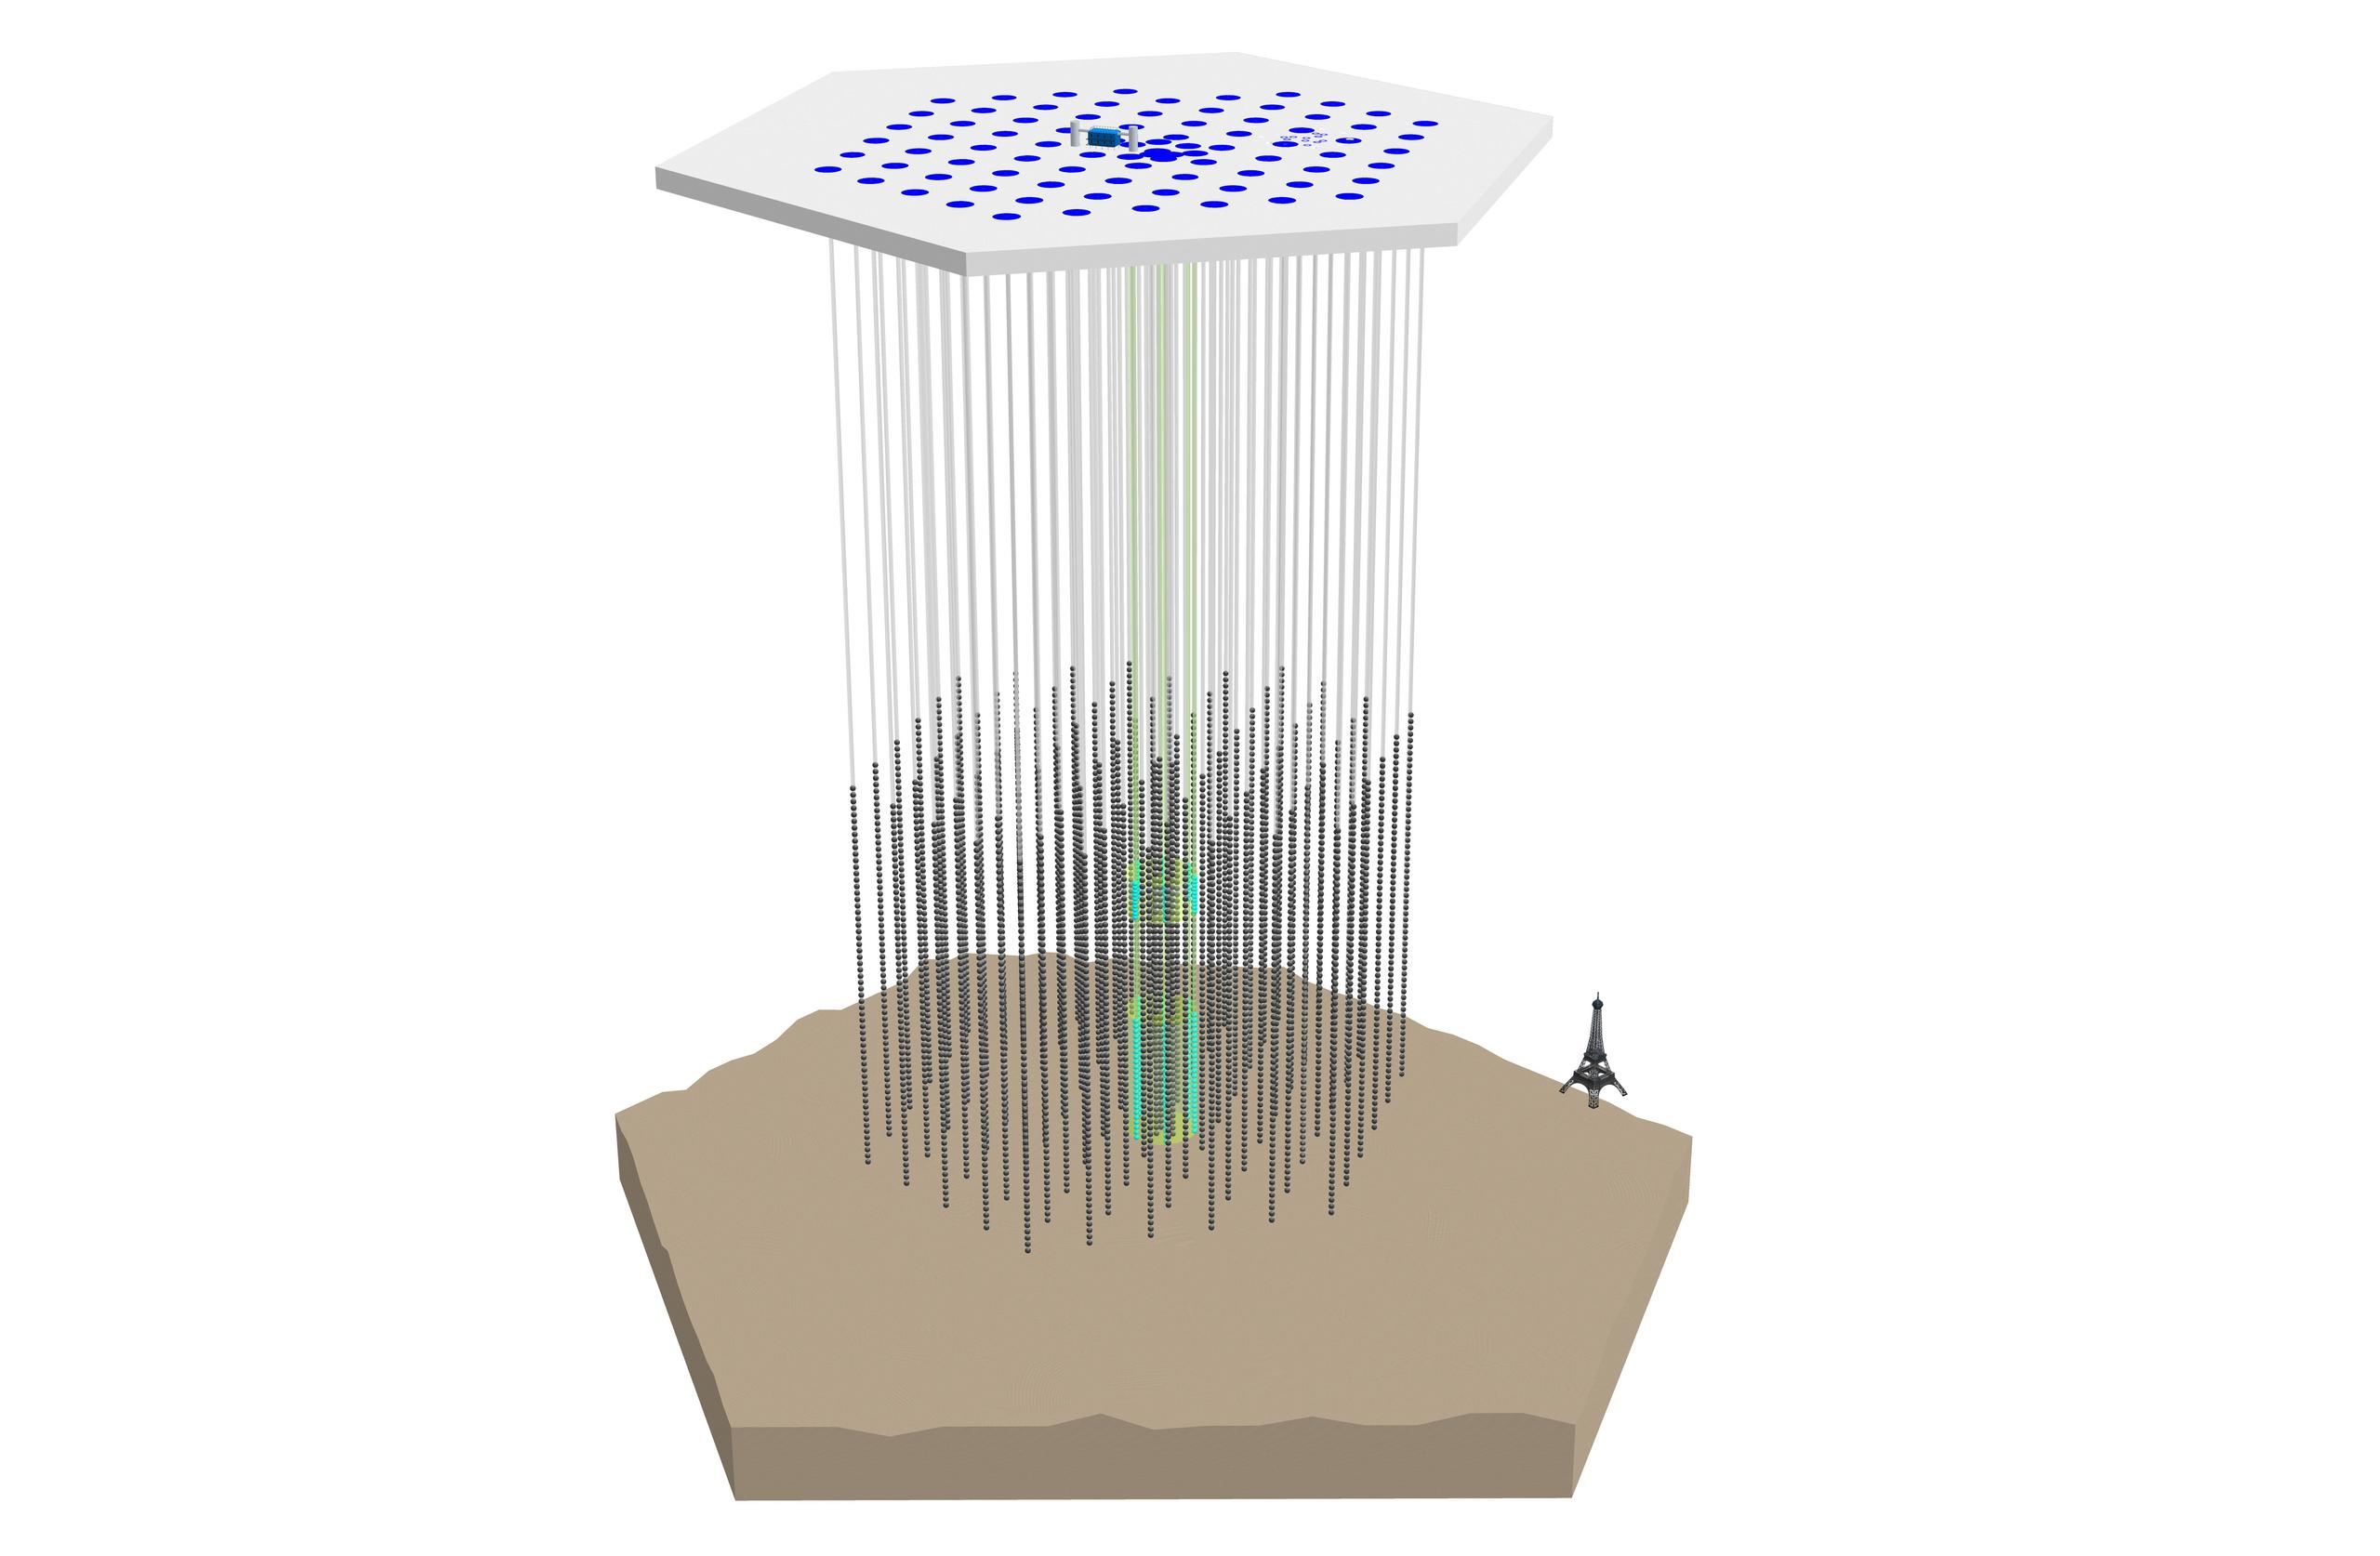
Deployed in 7 Austral seasons
Completed in 2010-2011 season
IceTop Array
81 Stations on the surface
2 Ice Cherenkov Tanks per Station
2 Digital Optical Modules per Tank
Season | No. strings/No. stations | Array config.
2004-2005 | 1 string + 4 stations
2005-2006 | 9 strings + 16 stations
2006-2007 | 22 strings + 26 stations | IT26/IC22
2007-2008 | 40 strings + 40 stations | IT40/IC40
2008-2009 | 59 strings + 59 stations | IT59/IC59
2009-2010 | 79 strings + 73 stations | IT73/IC79
2010-2011 | 86 strings + 81 stations | IT81/IC86
1450 m
IceCube Array
86 Strings @1450-2450 m depth in ice
60 Digital Optical Modules per String
2450 m

Slide 3
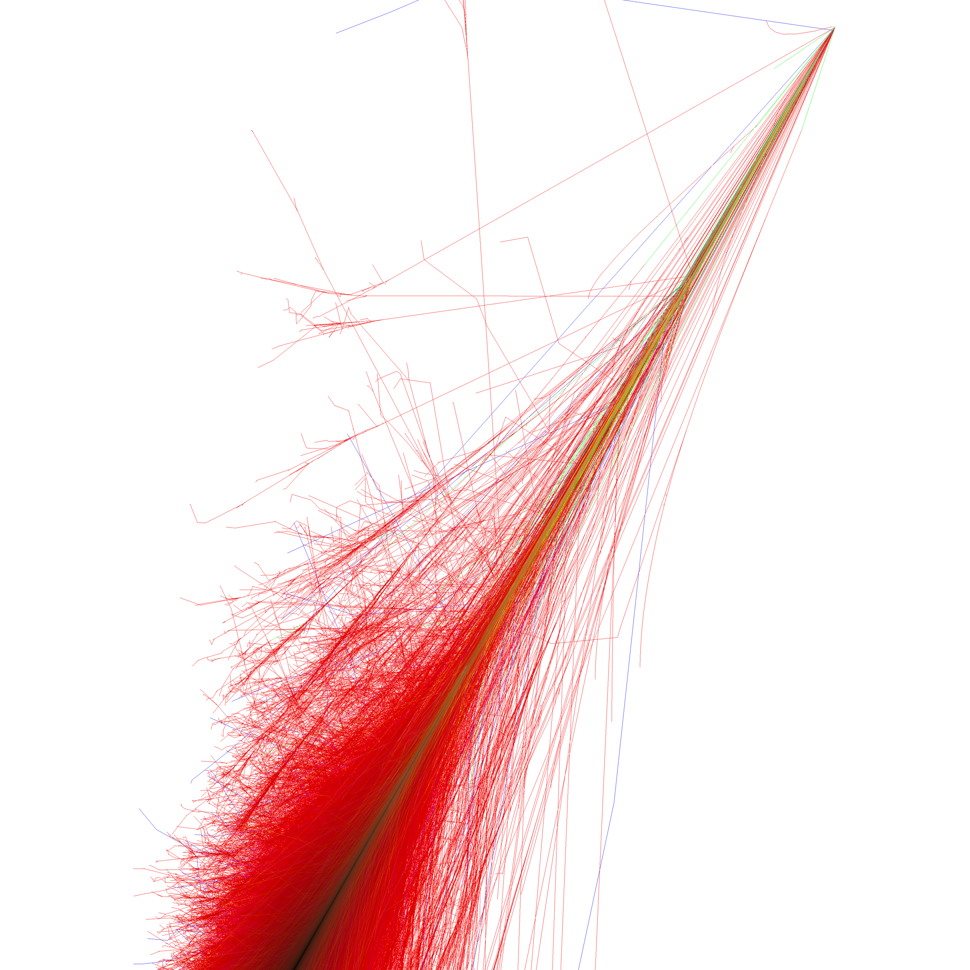
Neutrino Telescope & 3D Cosmic Ray Detector
Air shower detection
@ 2835m altitude (680 g/cm²)
IceTop
EM component near shower max
shower size & arrival times over 1km²
1450 m
IceCube
Muonic component @ 1450m-2450m depth in ice
muon bundle energy over 1km
2450 m

Slide 4
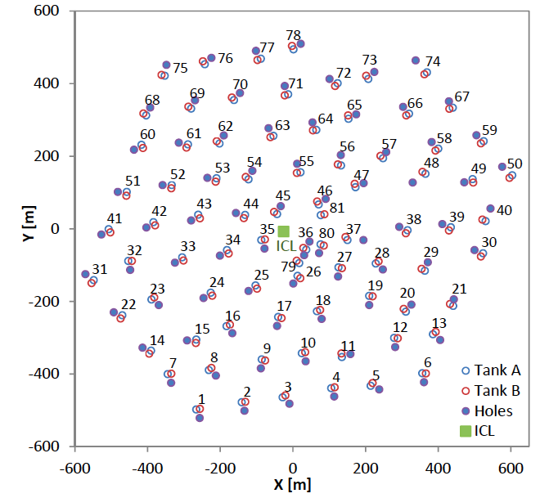
IceTop Array: Geometry and Energetics
125m
10m
~300 TeV showers
~100 TeV showers
Dense Core
Current results
5+ stations
~30 TeV showers
Work in progress
3+ stations

Slide 5
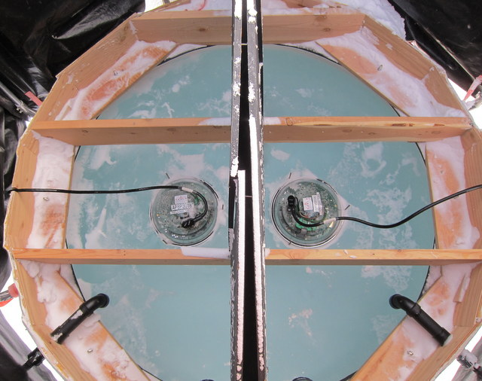
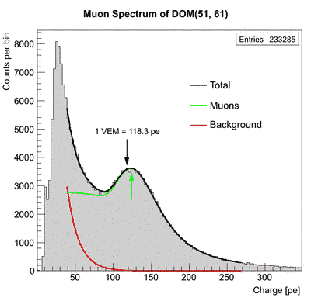
IceTop Array: Triggering & Calibration
Tank A
Single hits (1 DOM) or SLC
(muon detection + veto of air showers for in-ice studies)(1600 Hz)
Station trigger
HG-HG or HG-LG coincidence in 1 μs (30 Hz)
IceTop trigger
3+ stations in +/- 10 μs (35Hz)
High Gain
@5.E6
Low Gain
@1.E5
Calibration: Vertical Equivalent Muon
DOM 51-61
High Gain
@5.E6
Low Gain
@1.E5
Tank B
Tank B
Notes:
Just say, 1HLC= when 1 DOM of one tank and another from the other are hit within 1 mus
1VEM ~ 1 vertical muon at < 1 GeV

Slide 6
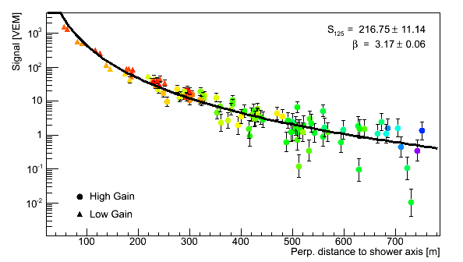
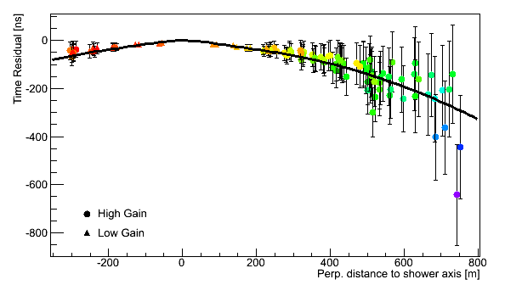
IceTop Shower Reconstruction
β
S₁₂₅
S₁₂₅ Shower size at 125m
β Slope of LDF at 125m
κ Fixed at 0.3
S₁₂₅ : signal at r = 125m
β : slope at r = 125m
κ = 0.303 fixed
Arrival times
Notes:
If ATW0 and 1 are saturated in the HG DOM, the LG DOM ATWD that is not saturated is used. There is a crossover for saturation. The PMT can be also saturated if ATWD0 and 1 (digitized signals) are saturated and ATWD2 looks saturated (not peaked…)
Beta gives the shape, kappa the curvature of the ldf. It’s not an nkg fit

Slide 7
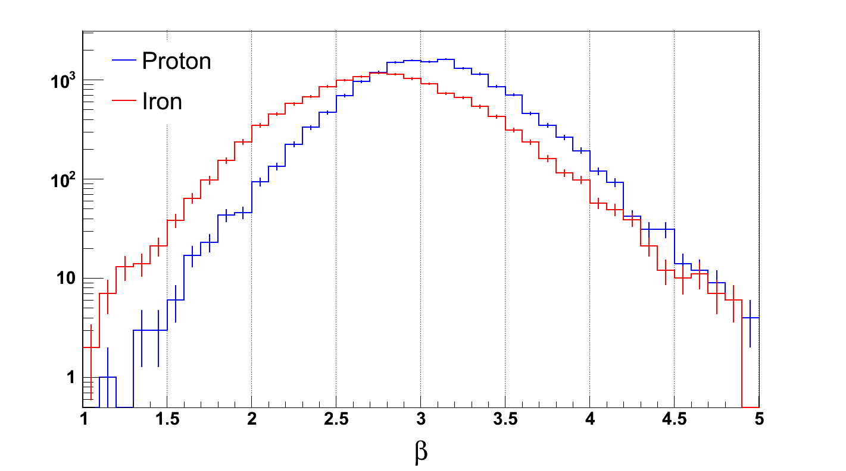
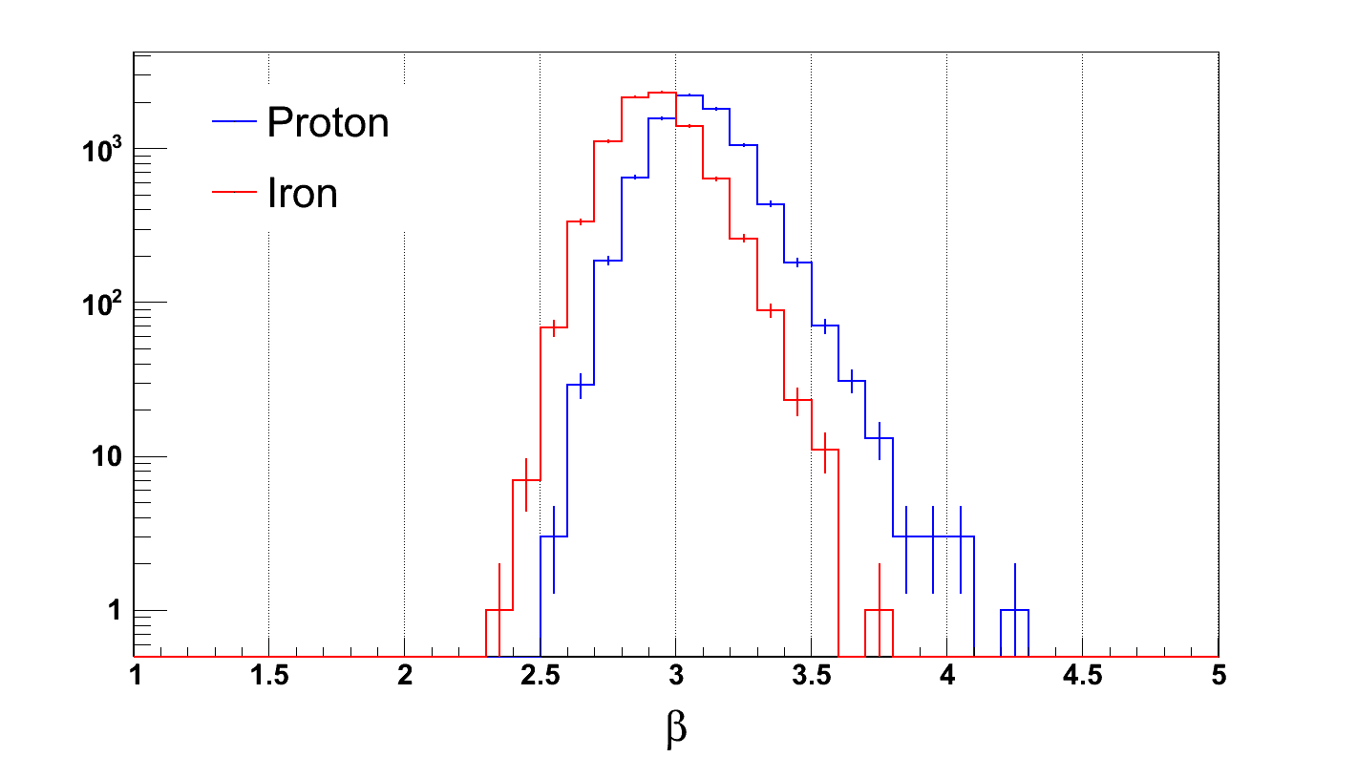
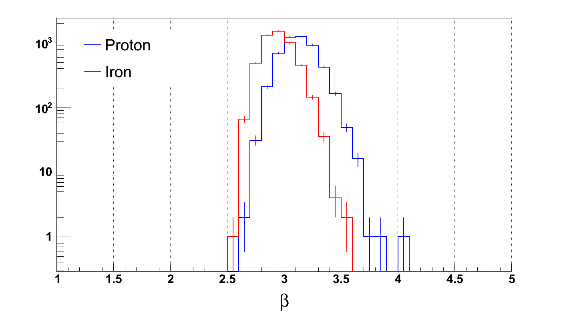
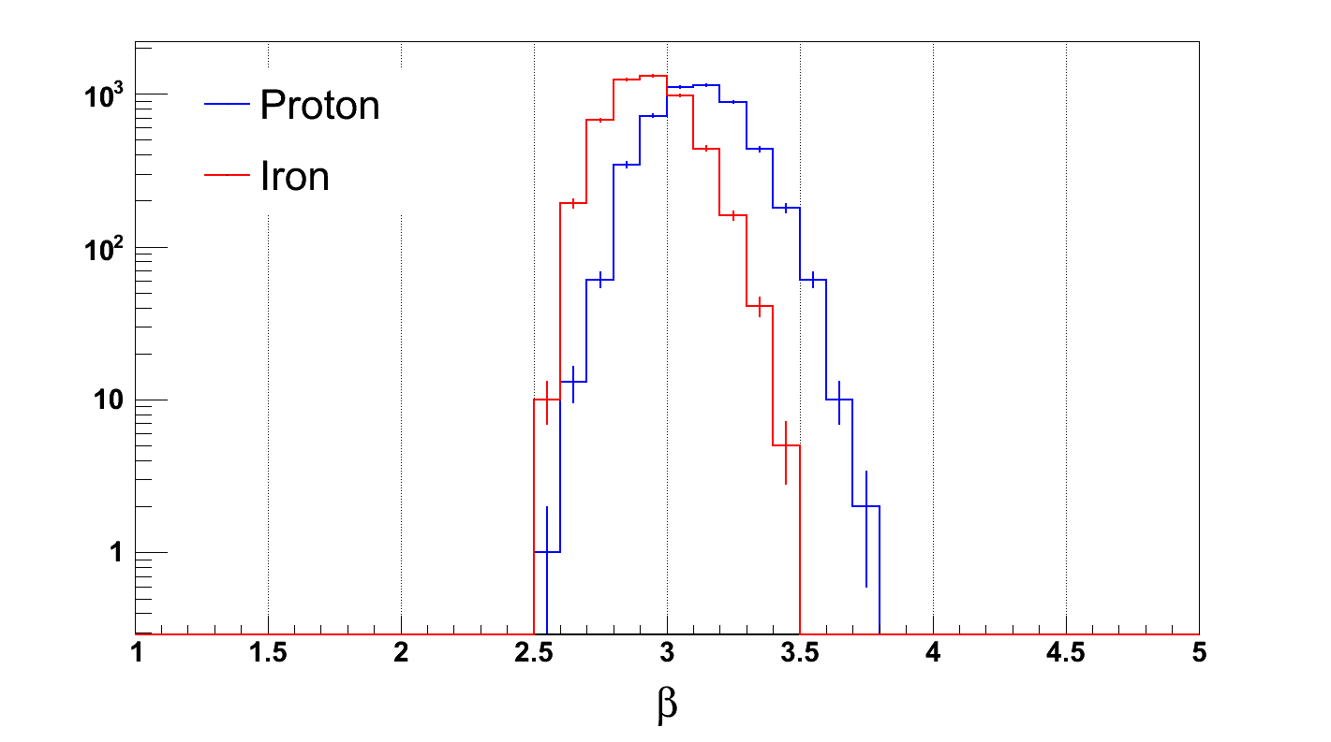
IceTop Shower Size: S₁₂₅ & Beta parameter
( IceTop-73 data) ( IceTop-73 simulation)
E=1 PeV
E=10 PeV
E=50 PeV
Mass invariance is assumed for S₁₂₅
Beta shows composition sensitivity
E=90 PeV

Slide 8
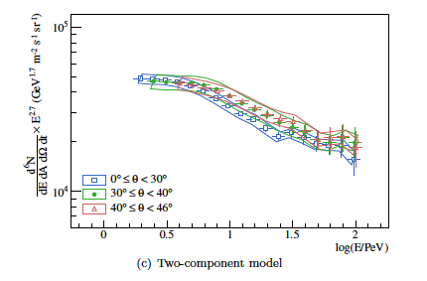
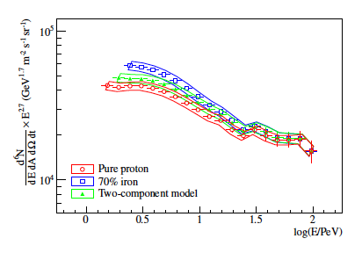
IceTop-26 All Particle Spectrum 1-100 PeV
Submitted to Astrop. Phys.
(arXiv:1202.3039)
Composition sensitivity of shower attenuation with zenith angle
Knee at 3.2 PeV
γ -2.5 below, -3.08 above the Knee
Flattening of spectrum
~22 PeV
with γ -2.85
Knee at 4.3 PeV
γ -2.76 below, -3.11 above the Knee
All Particle Spectrum for ϑ > 30°
Notes:
Shift in beta observed in simulations. Beta gives hint on composition. Playing with the curvature kappa also is under investigation.
Plot weighted for gamma1=-2.7 before the knee, assumed to be at E=3PeV, and gamma2=-3.0. Containment and normalization due to different resampling areas
Obviously it was checked that there is no correlation between S125 and beta
Ra can be related to the shower energy, so for many showers at a given energy (that can reach different distances) you can accumulate VEMs and calculate SSLC
(This is 0-40 deg). Muon signal/e.m background
Based on the assumption of an isotropic flux, the three individual spectra (at different zeinth angles) should agree. Assuming pure iron, the individual spectra for the three different zenith
bands clearly disagree at low energies while they start to converge toward higher energies. Anyway everything is within systematic uncertainties

Slide 9
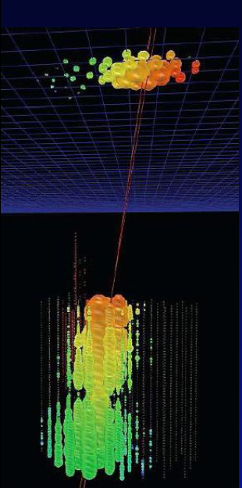
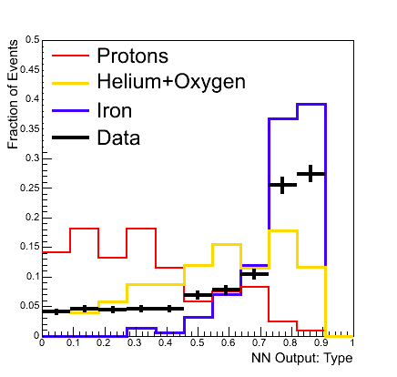
IceTop-40/IceCube-40 Composition Method
Neural Network Analysis:
Input: S125, K70 from 1 month of data
Output: Primary E & <lnA>
Sept 17, 2010
run 116545
E_{prim}~290 PeV
ϑ =11.5 °
φ=33°
K70 is a measure of muon bundle size in IceCube
(analogous to S125 on the surface).
Pure Iron
In-ice
Pure proton
IceTop
Notes:
Overlap is less and less. We can distinguish proton and iron at higher energies. Make composition…
A paper is going to be published with detailed calculation of all systematic uncertainties. This is the starting point to improve our analysis with a bigger detector
Still systematics dominates here but now under control for newer detector
Shaded area parallel to energy!

Slide 10
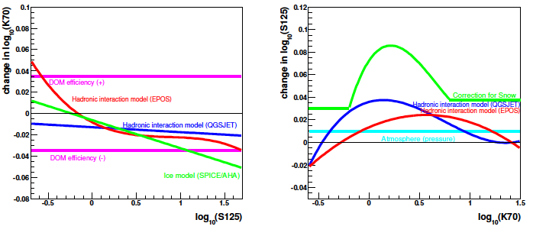
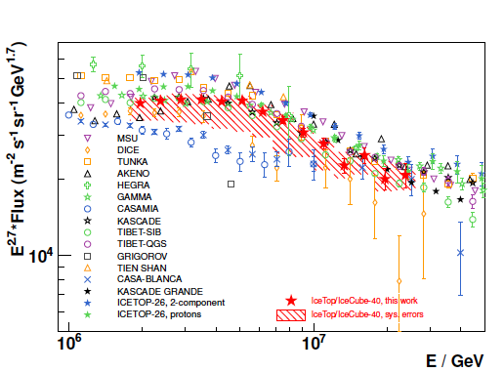
IceTop-40/IceCube-40 Spectrum & Composition 1-30 PeV
Submitted to Astrop. Phys. arXiv:1207.6326
systematics

Slide 11
IceTop-73/IceCube-79 Analysis
exploiting
additional mass sensitive observables
Muon stochastic loss
Avg. muon energy loss
IT73/IC79
In-ice
IceTop

Slide 12
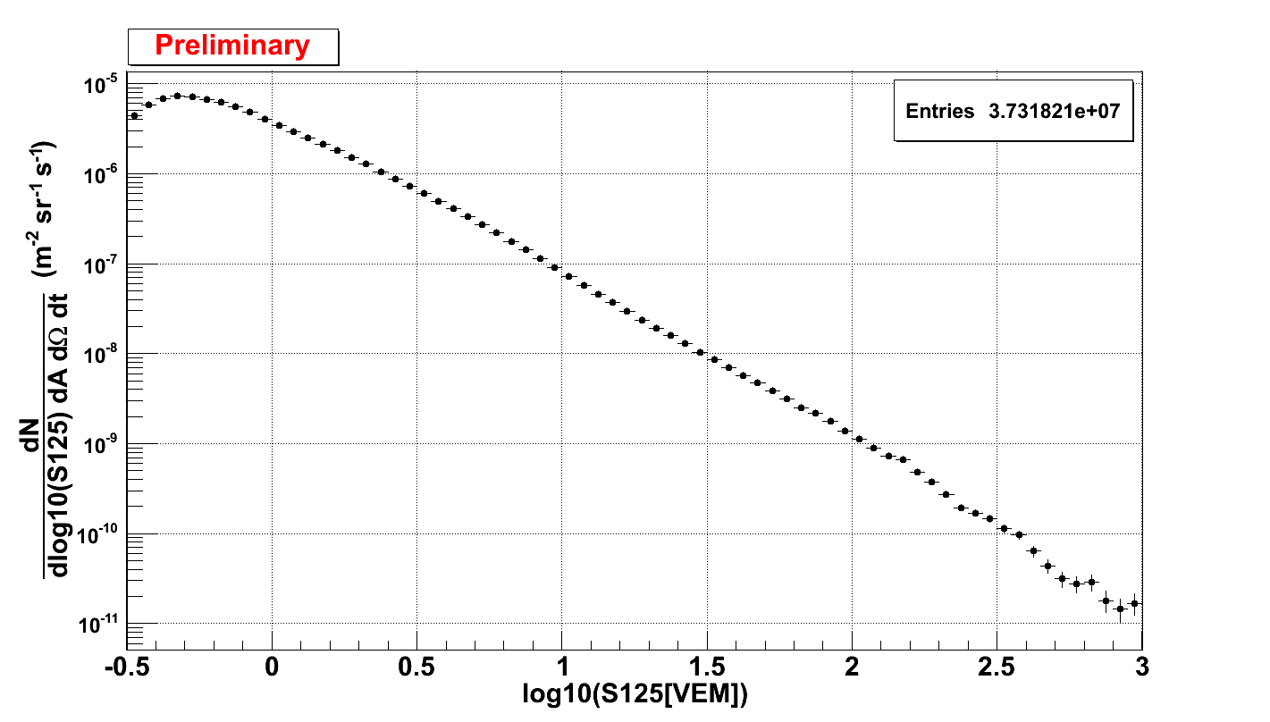
IceTop-73 Data: 326 days live time Jun 2010-May 2011
5+ Stations
cos𝛉>=0.8
~ 10 PeV Proton
2077 events/yr per bin
~ 260 PeV Proton
26 events/yr per bin
Threshold of this analysis
Notes:
Weighted by E**-2.7
IceTop is not statistics limited
Obtained with 5+ stations
S125*log10*dN/dS125
Ex: 365*24*60*60*(3e-9/(pow(10,1.8)*log(10)))*52e5*0.5*(1+0.8)*2.*3.1416*(1-0.8)

Slide 13
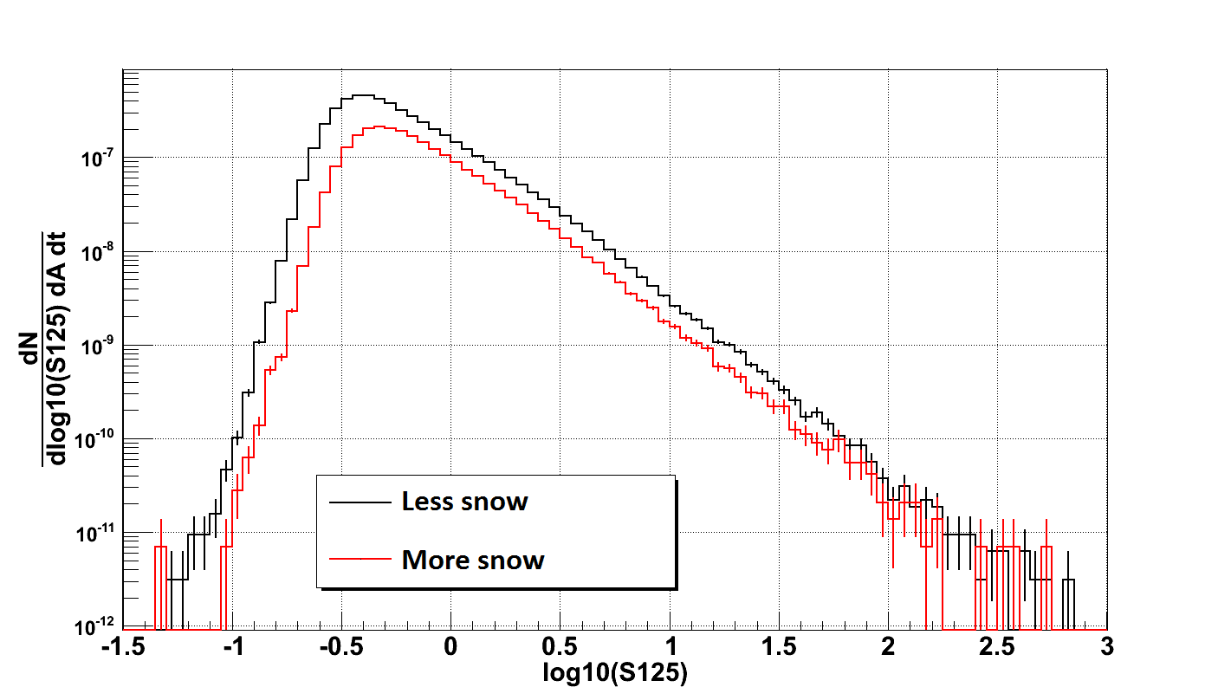
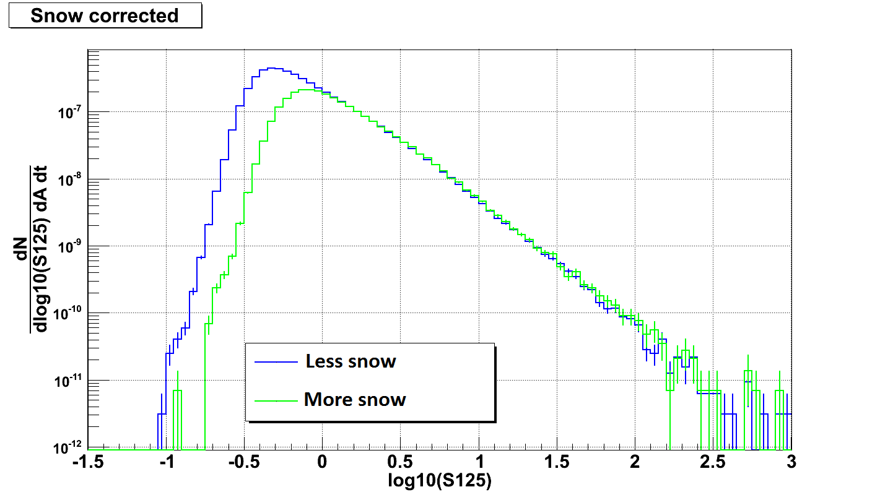
IceTop-73 Data: Systematics due to snow build up
Feb. 2012
Events selected by
core location
Snow corrected
A. Tamburro – CR Spectrum and Composition with IceCube

Slide 14
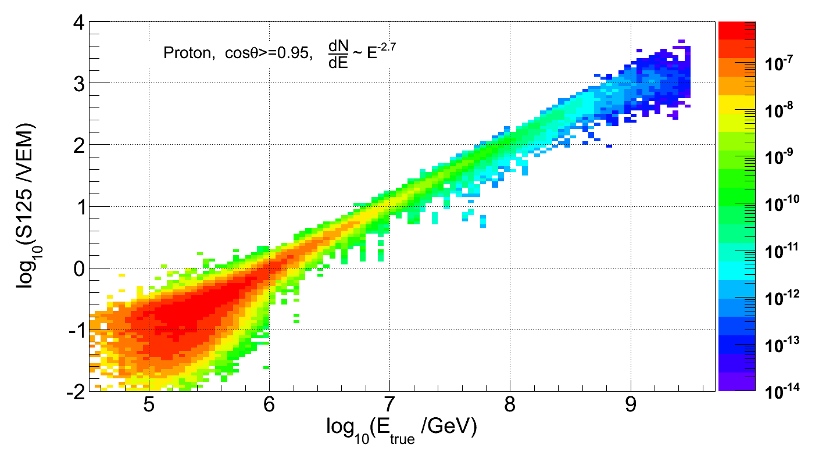
IceTop-73 Data: Energy Estimator
Mean Energy from
measured S125
in
log₁₀(S₁₂₅) = 0.05 bins
Still working on log₁₀(S125) < 0
Notes:
Notes: Snow corrected because simulation includes snow; The smaller DeltaS125 is the less dependent on gamma we are. What is the best DeltaS125? NO QUANTITATIVE TEST PERFORMED
Each point is 1 shower (HOW MANY SHOWERS DO WE HAVE?); Broader gaussians at lower energies…
Here shown 3+ stations (for 3 station). We’ll use between -1.5 and 3 in S125

Slide 15
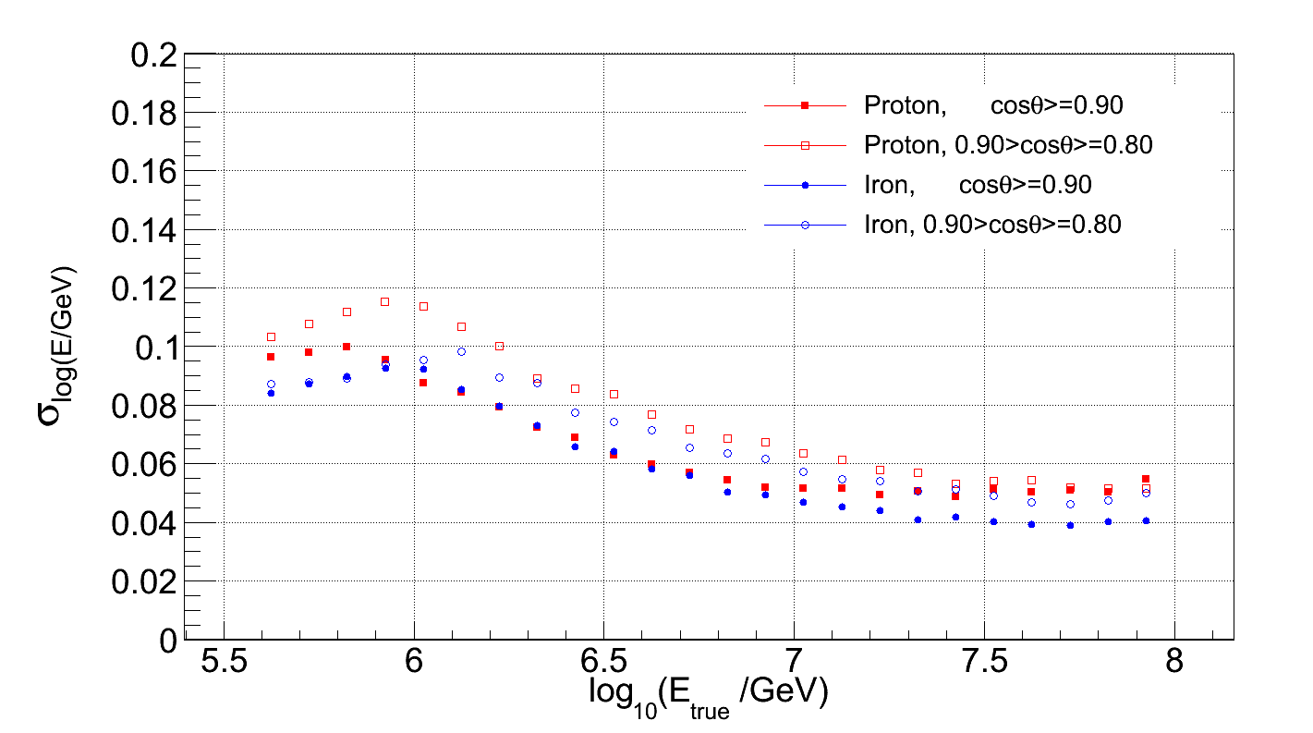
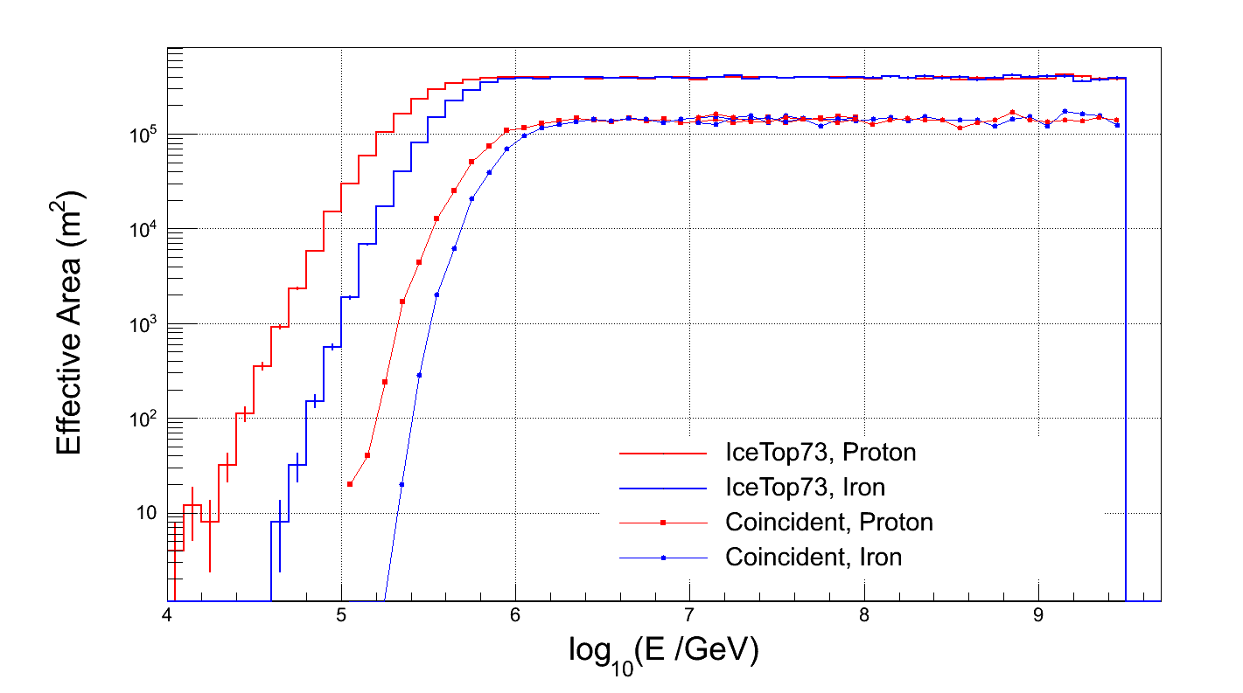
IceTop-73 Data: Resolution & Efficiency
Core Resolution
Direction Resolution
Eff. ~ 1
Energy Resolution

Slide 16
IceTop-73 Data: Preliminary Energy Spectrum
Structure above ~20 PeV
broken power law
Preliminary

Slide 17
IceTop Results compared with each other
Preliminary

Slide 18
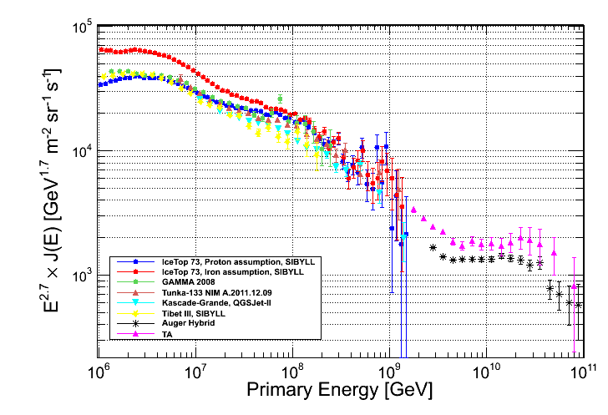
IceTop-73 Preliminary Results in a big picture
IceTop-73 Preliminary

Slide 19
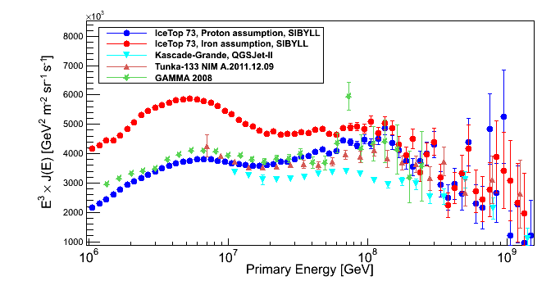
Complex structure beyond the Knee
is well
established by
several recent
measurements
challenge for classical
Rigidity cut off models
<lnA> exceeds 3.4
(heavier than
Si-like element)
above ~ 20 PeV

Slide 20
Stay tuned:
* IceTop-59/IceCube-59 Coincidence Analysis
- alternative air shower reconstruction method - builds up LLH for each event from multi-variable tables
* IceTop-73/IceCube-79 Coincidence Analysis
- Neural Network method
- finalized by Dec 2012
* New Methods for the Full Array Data:
separate EM & Muons in LDF
========== * ==============

