Slide 1
Cosmic rays measurements around the knee of the primary spectrum
Andrea Chiavassa
Universita` degli Studi di Torino
International Symposium on Very High Energy Cosmic Ray Interactions
Berlin, 10-15 August 2012

Slide 2
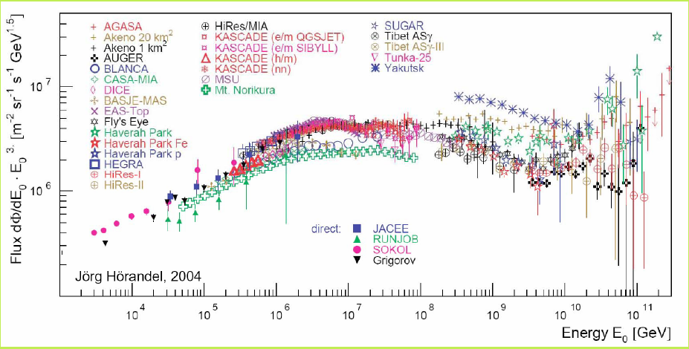
Energy range covered by EAS experiments
1990 - 2005 → 10¹⁴ < E < 5x10¹⁶ eV 2000 - → 10¹⁶ < E < 10¹⁸ eV
(showing selected results) (discussing the experimental status)
All particle Spectrum
Chemical Composition (elemental groups spectra)
Anisotropies

Slide 3
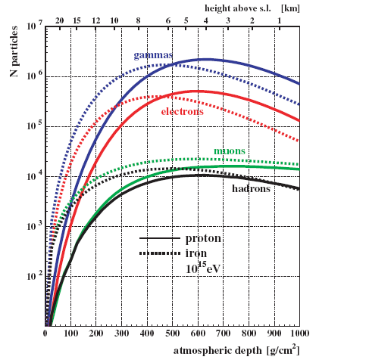
Longitudinal EAS profile measurements are not possible in this range
Experiments observe EAS at one altitude, primary particle characteristics inferred through EAS simulations
EAS maximum:
  Ne(H) ~ Ne(Fe)
  Small fluctuations
Below EAS maximum:
  Ne(H) > Ne(Fe)
  Big fluctuations
10¹⁵ eV N_{μ}/N_{e}
X(g cm⁻²) H Fe
600 ~0.03 ~0.08
800 ~0.05 ~0.13
1000 ~0.10 ~0.31

Slide 4
EAS arrays measure several EAS components
  e/γ (scintillators) + μ (scintillators and/or tracking detectors)
    Tibet III (4300 m a.s.l.)
    KASCADE/KASCADE-Grande (110 m a.s.l.)
    CASA-MIA (~1800 m a.s.l.)
    EAS-TOP (2000 m a.s.l.)
    GAMMA (3200 m a.s.l.)
    GRAPES-3 (2200 m a.s.l.)
  Hadrons → calorimeter
    KASCADE
  Cherenkov light in atmosphere
    TUNKA-133 (675 m a.s.l.)
  Cherenkov light in water or ice
    PAO (1400 m a.s.l.)
    Ice TOP (2835 m a.s.l.)

Slide 5
Hadronic interactions models independent results

Slide 6
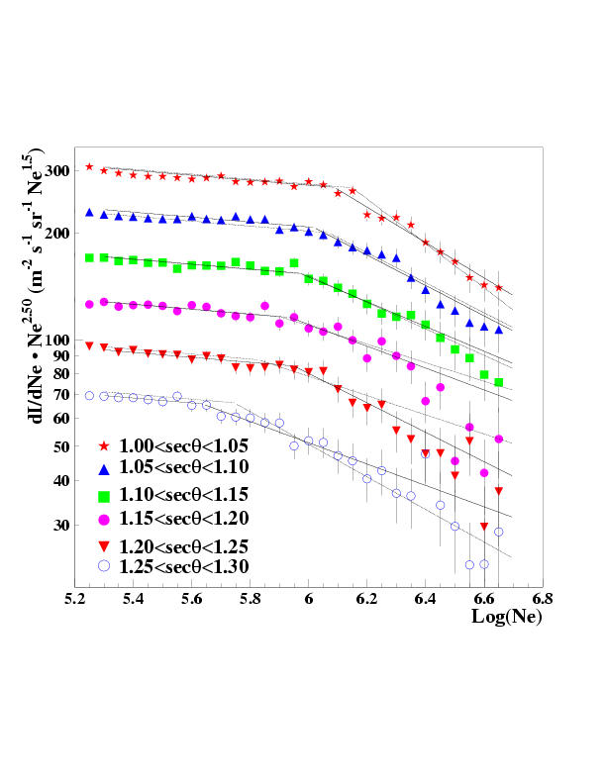
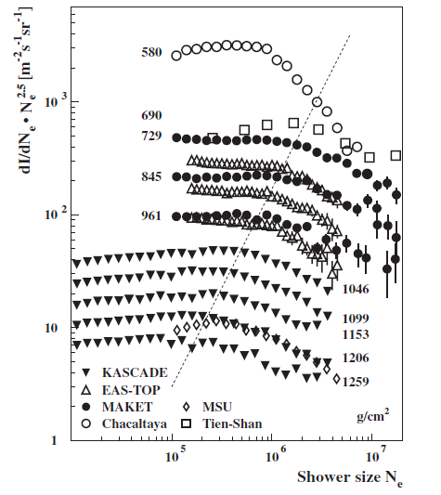
Shower size (Ne) spectra: measured at different zenith angles and at different altitudes.
Change of slope observed in all spectra
Ne_{knee} decreases with atmospheric depth
EAS-TOP

Slide 7
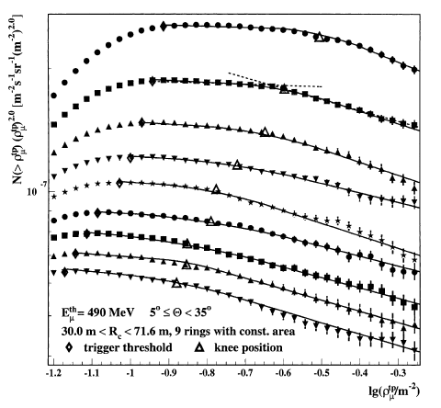
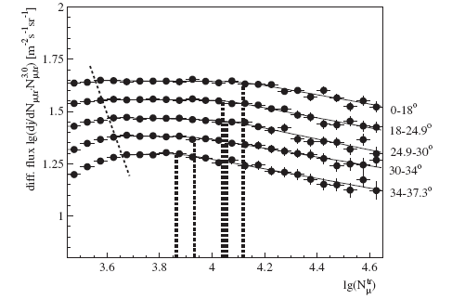
Knee observed in the spectra of the EAS μ component
KASCADE
Truncated μ number (N_{μ})
E_{μ}^{th} = 230 MeV
KASCADE
μ densities at different core distances.

Slide 8
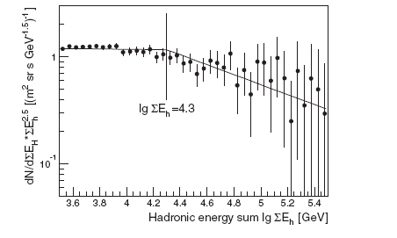
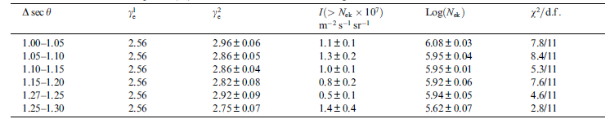
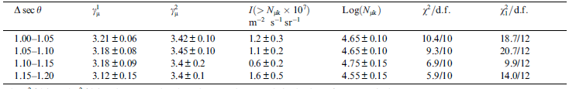
EAS hadronic component
shows the change
of slope
KASCADE
Same integral fluxes above the knee
EAS-TOP

Slide 9
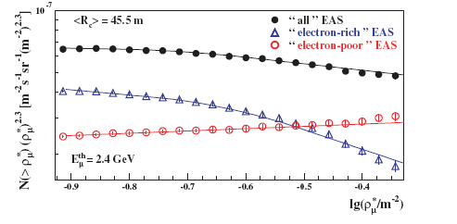
Spectra of μ densities measured at fixed core distance for electron rich and electron poor event sample
Y = lg N^{tr}_{μ}(θ_{ref})/lg N_{e}(θ_{ref})
Spectrum of the electron rich events shows a change of slope
KASCADE
Y<0.75
Y>0.75

Slide 10
Hadronic interactions models dependent results

Slide 11
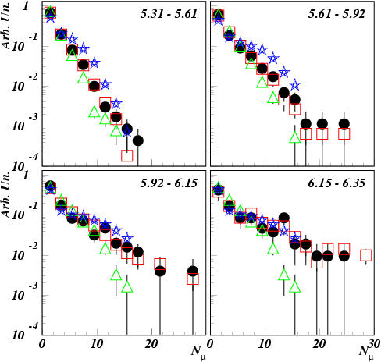
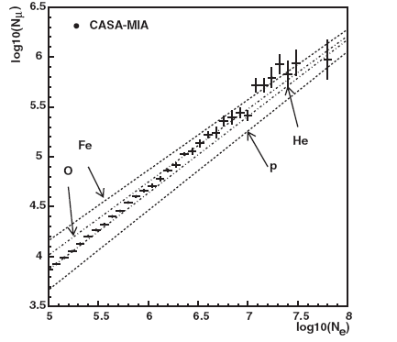
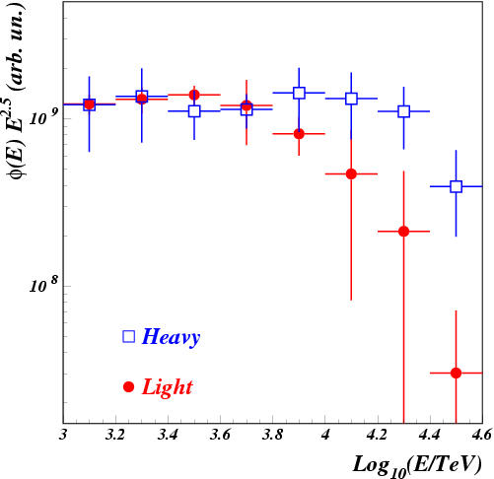
N_{μ} vs N_{e} → composition getting heavier crossing knee energies
EAS-TOP+MACRO

Slide 12
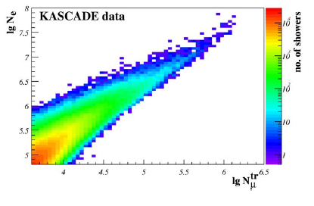
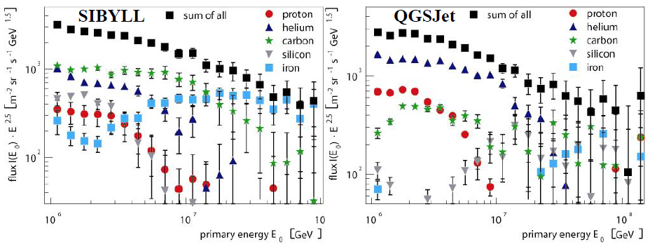
Unfolding N_{e} vs N_{μ} spectra

Slide 13
Previous results attribute the knee observed at 3-4x10¹⁵ eV to light primaries. If the knee energy scales with Z (or A) the same feature for heavy primaries is expected around 10¹⁷ eV
Actually running experiments
Mainly measuring in the 10¹⁶ < E < 10¹⁸ eV energy range
Main goal: detection of a change of slope of the primary spectra of heavy elements

Slide 14
All particle Cosmic Rays Energy Spectrum

Slide 15
Sibyll
Epos
Same data as previous plot,
results are grouped by the
interaction model used
to convert the experimental
observable(s) to primary energy
QGSJet
Flux differences can mainly be
attributed to hadronic interaction
used to convert to primary energy

Slide 16
This difference mainly concerns the absolute energy scale
2. Structures are visible in
most of the spectra
Structure enhanced using the range above the concavity claimed by the KG experiment (1.7x10¹⁶-1.3x10¹⁷ eV)

Slide 17
Approaches to Chemical composition
X_{max} measurement through cherenkov light detection
  TUNKA-133
Correlation between a parameter connected with the μ EAS component and one reflecting the electromagnetic EAS component
  GRAPES-3
    MMD (muon multiplicity distributions)
    N_{e}
  Ice Top and Ice Cube
    S₁₂₅ (VEM signal at 125 m from the core)
    K₇₀ (Ice Cube ldf parameter evaluated at a reference slant depth of 1950m and a perpendicular distance of 70 m)
  KASCADE-Grande
    N_{μ}
    N_{ch}

Slide 18
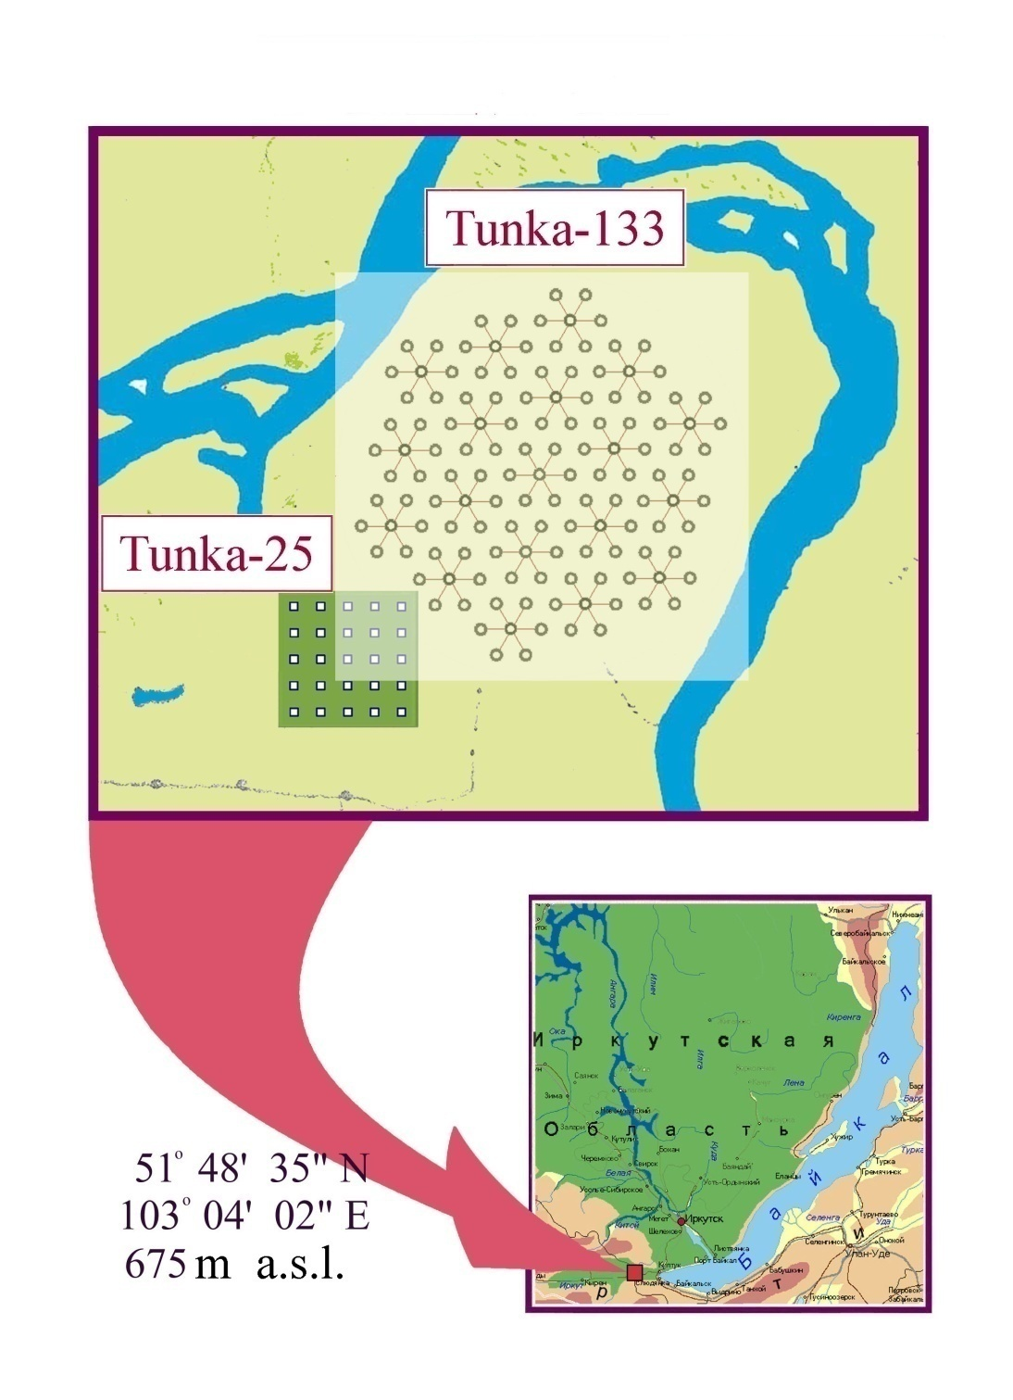
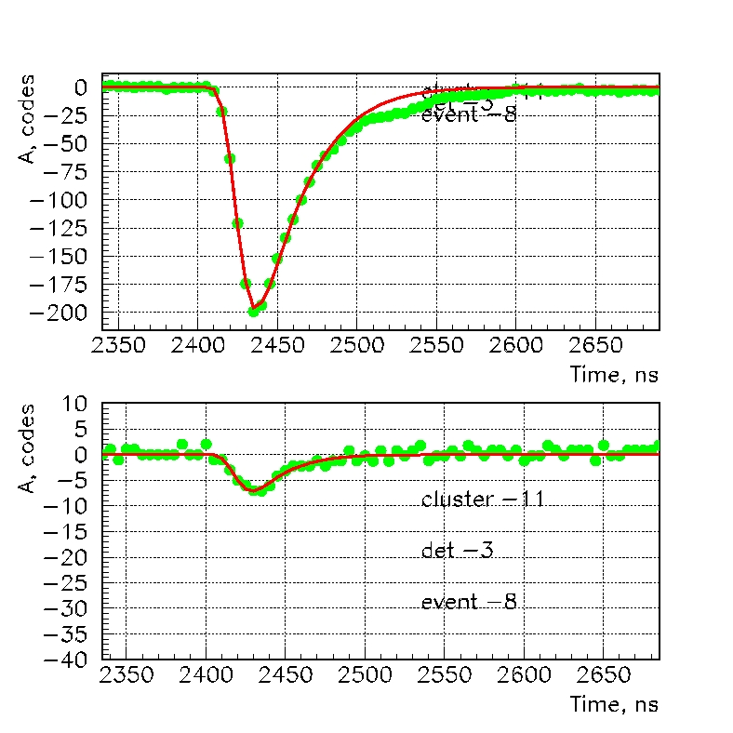
TUNKA-133
Tunka-133 – 1 km² “dense” EAS Cherenkov light array
133 wide-angle optical detector (PMT EMI9350, 20 cm diameter photocatode)
detector distance 85 m
Accuracy: core location ~ 10 m
Energy resolution ~ 15%
δ X_{max} < 25 g∙cm⁻²
Pulse waveform recorded for each detector
`

Slide 19
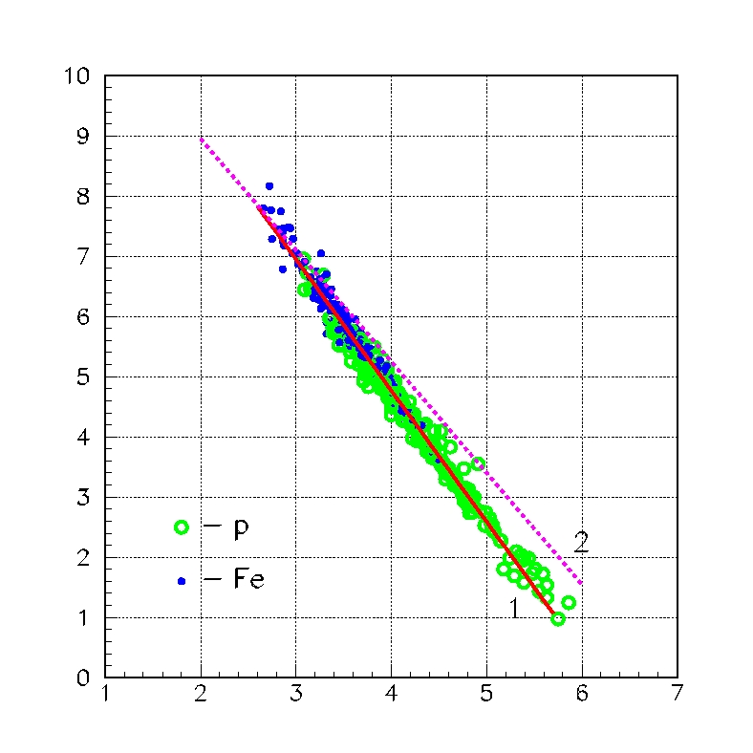
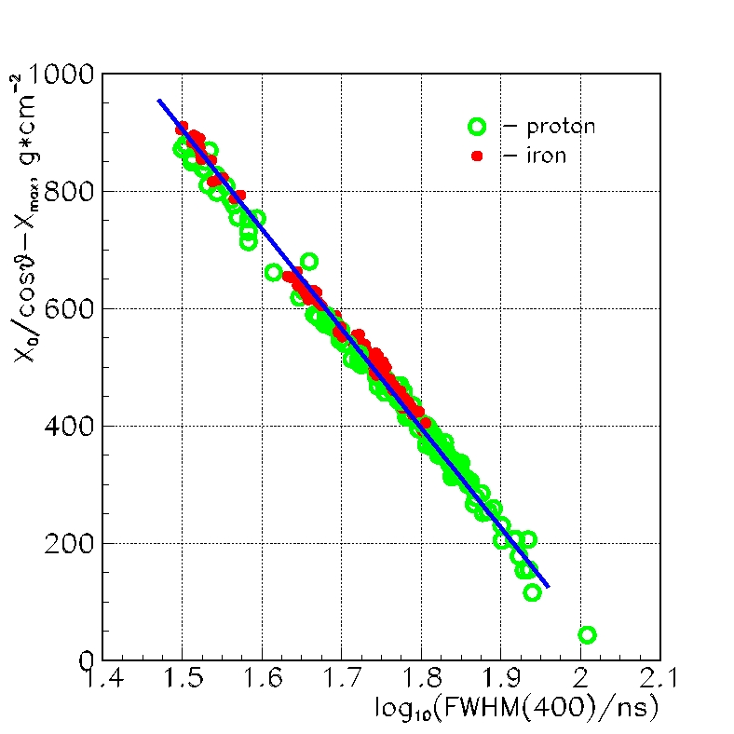
Two methods to determine X_{max} were developed:
Correlation between the steepnees
parameter (P, derived from the LDF)
and the distance from shower maximum
W-method. Based on the sensitivity of
the pulse width at fixed core distance to
the position of the EAS maximum
H_{max} (km)
Steepnees P
Simulations for H and Fe primaries with
fixed energies (10, 30 PeV) and fixed zenith angles (0°, 30°, 45°)
arXiv:1201:2122v1

Slide 20
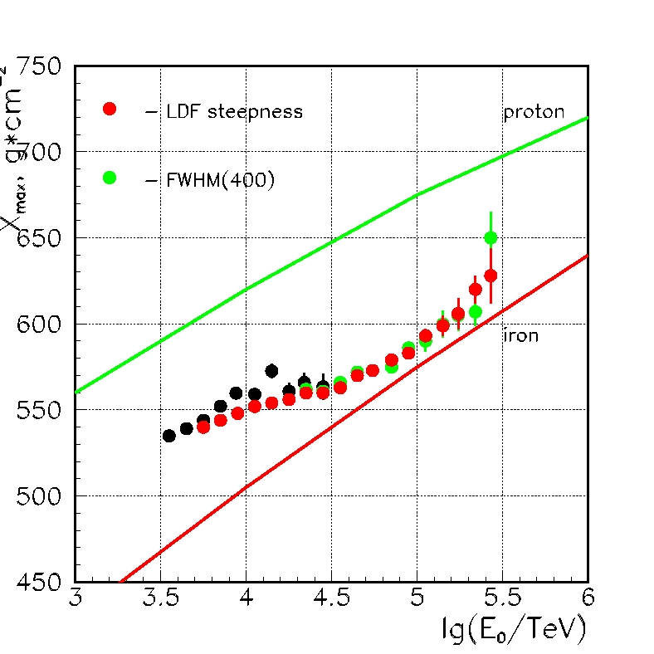
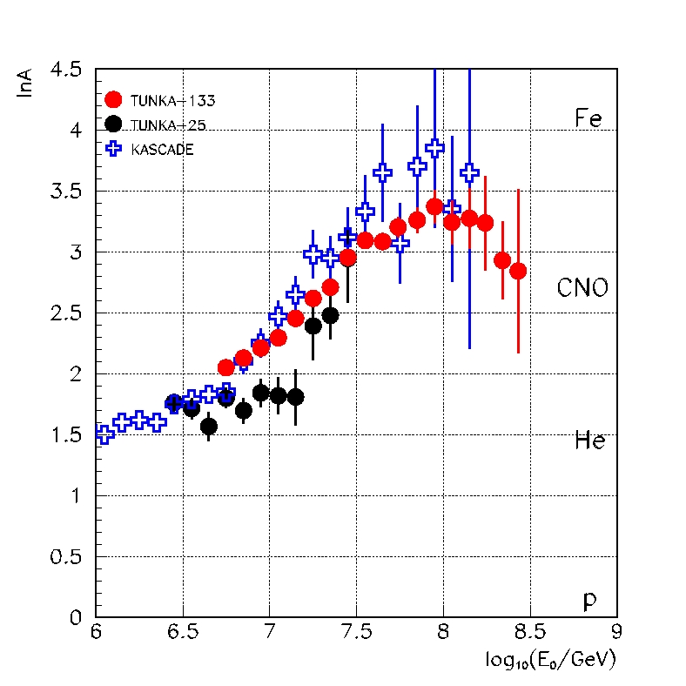
TUNKA results
• - Tunka-25
QGSJET-01
Heavier composition from the knee to 10¹⁷ eV
arXiv:1201:2122v1

Slide 21
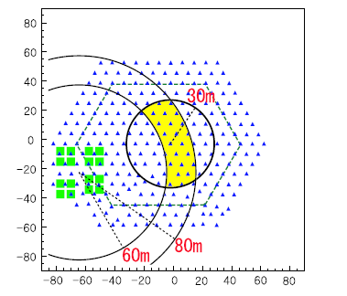
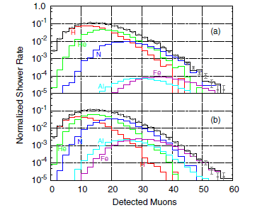
GRAPES-3
Ooty (India) – 2200 m a.s.l.
257 scintillators, 1 m² each
8 m separation
16 μ tracking modules, 35 m² each.
Measured MMD distributions in Ne intervals
(Δ LogNe=0.2) fitted (single elements relative
abundances as free parameters) with distributions
obtained from a complete EAS and detector
simulation: a) QGSJet01 b) SIBYLL2.1.
J. Phys. G: Nucl. Phys. 39 (2012) 025201

Slide 22
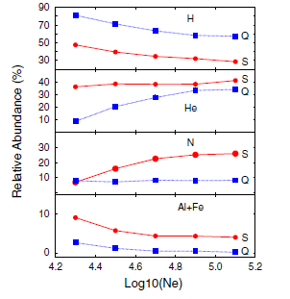
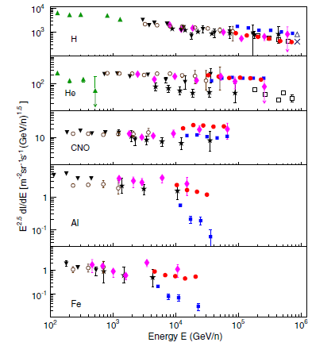
QGSJET 01
SIBYLL 2.1
Abundances → Element spectra
Comparison with direct measurements:
good agreement with JACEE, SOKOL, CREAM
H more abundant for QGSJET
Heavy more abundant for SIBYLL
H abundance decrease for both models
He increases for QGSJET, constant for SIBYLL
Reverse for N
Similar behavior for heavy masses
J. Phys. G: Nucl. Phys. 39 (2012) 025201

Slide 23
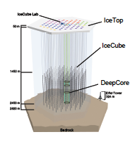
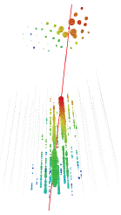
Ice Top and Ice Cube
Ice Cube
  Digital Optical Modules frozen into ice along strings on a triangular grid separated by 125 m
  E_{μ} > 500 GeV
Ice Top
  each tank 1.8m diameter, 1.3 m high. 2 DOMs
  Each module: 2 tanks
  Distance between modules 125 m
April 2008 – May 2009:
  40 strings
  40 stations
Shown results:
  30 days
  August 2008

Slide 24
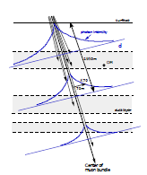
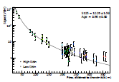
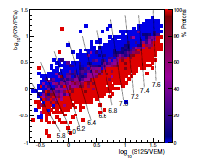
Ice Top event reconstruction
Ice Cube event reconstruction
μ bundle crossing the ice.
Intensity of cherenkov photons depends
Slant depth
distance from the center of the bundle
K₇₀ ldf parameter, slant depth 1950 m,
perpendicular distance 70 m.
K₇₀ vs S₁₂₅ → blue Fe, red H events
arXiv: 1207.3455v1

Slide 25
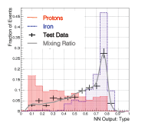
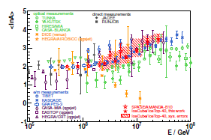
Neural network analysis produces a distribution of “mass outputs”.
Mass output templates for energy intervals
Same histogram for experimental data → fitted to obtain the abundances of each element.
Fitting with three species
  H
  50% He + 50% O
  Fe
arXiv: 1207.3455v1

Slide 26
KASCADE-Grande
Detector | Detected EAS component | Detection Technique | Detector area (m²)
Grande | Charged particles | Plastic Scintillators | 37x10
KASCADE array e/γ | Electrons, γ | Liquid Scintillators | 490
KASCADE array μ | Muons (Eμ^{th}=230 MeV) | Plastic Scintillators | 622
MTD | Muons (Tracking) (Eμ^{th}=800 MeV) | Streamer Tubes | 4x128
Shower core and arrival direction
  Grande array
Shower Size (N_{ch} number of charged particles)
  Grande array
    Fit NKG like ldf
μ Size (E_{μ}>230 MeV)
  KASCADE array μ detectors
    Fit Lagutin Function
μ density & direction (E_{μ}>800 MeV)
  Streamer Tubes

Slide 27
N_{ch}-N_{μ} unfolding
H
He+C+Si
Fe
D. Fuhrmann PhD Thesis
(2012) Wuppertal University

Slide 28
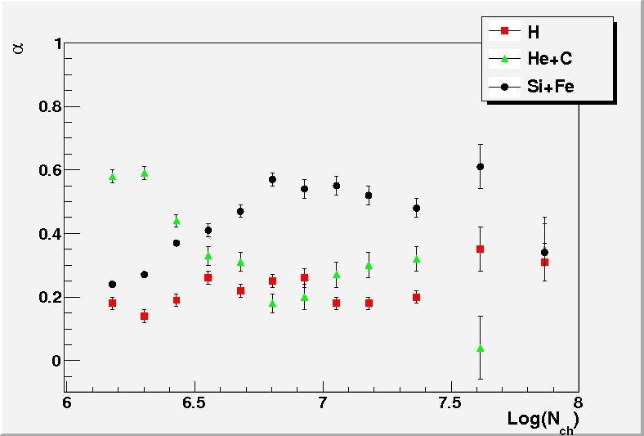
Measured and simulated
N_{μ} distributions in N_{ch} intervals
2) Element abundances (α_{i}) fitted in
each N_{ch} interval
3) Elemental spectra derived from α_{i}
E. Cantoni et al. ICRC 2011 #0504

Slide 29
Events divided in two samples according to the ratio:
Y = ln N_{μ}(θ_{ref})/ ln N_{ch}(θ_{ref})
Primary energy evaluated for each event
E = f (N_{ch}, N_{μ})
MC based on QGSJet02
knee-like structure for heavy
primaries at 8-9 · 10¹⁶ eV
steepening significance → 3.5 σ
Phys. Rev. Lett. 107 (2011) 171104

Slide 30
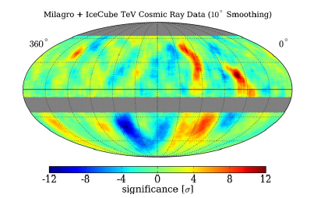
Anisotropy
Anisotropy claimed, at median energy 1 TeV, by the MILAGRO experiment
Later confirmed by ARGO-YBJ
Ice Cube, at median energies 20 and 400 TeV
    (7.9±0.1_{stat}±0.3_{syst}) x 10⁻⁴
    (3.7±0.7_{stat}±0.7_{syst}) x 10⁻⁴
EAS-TOP @400 TeV
    A^{I}=(6.4±2.5) x 10⁻⁴
At higher energies only upper limits

Slide 31
Conclusions (1)
Knee observed in the spectra of all EAS components, same integral fluxes above such features
Knee at 3-5x10¹⁵ eV attributed to light primaries
  (Tibet-Asγ exception, Huang talk this session)
All particle spectra above the knee: similar shapes. Energy shifts mainly due to hadronic interaction models
Knee-like feature of the heavy component spectrum observed by KASCADE-Grande at
8-9x10¹⁶ eV

Slide 32
Conclusions (2)
QGSJET-01
  KASCADE (Sing. Had.)
  EAS-TOP (Hadron)
SIBYLL
  GRAPES-3
QGSJET-02
  ARGO-YBJ
  KASCADE (unfolding)
  KASCADE-Grande
Mass groups spectra are the powerful tool to further investigate this energy range
  Connection with direct measurements
  Reduce uncertainties due to hadronic interaction model (LHC results!)
Searches for anisotropies. Possibly for different mass groups

