Slide 1
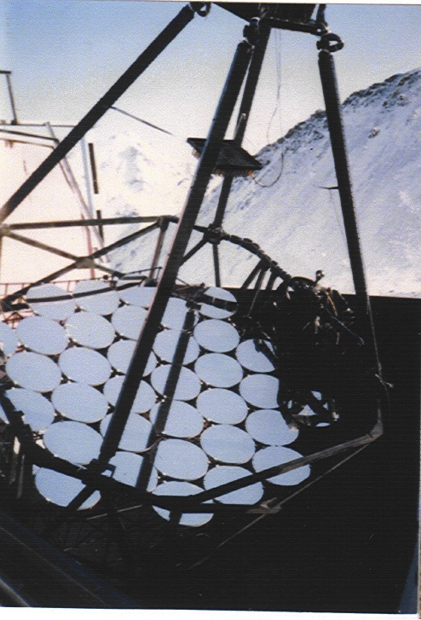

Generation of Cosmic rays in
Historical Supernova Remnants
V.G. SINITSYNA, V.Y. SINITSYNA
P. N. Lebedev Physical Institute,
Leninsky prospect 53, Moscow, 119991 Russia
Notes:
1

Slide 2
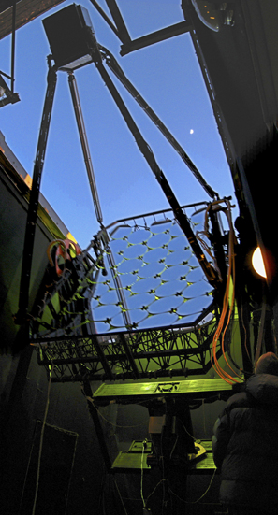

Cosmic ray production in
Historical Supernova Remnants
We present the results of observations of two types of Galactic supernova remnants with the SHALON mirror Cherenkov telescope of Tien-Shan high-mountain Observatory: the shell-type supernova remnants Cas A, Tycho and IC 443; plerions Crab Nebula, 3c58(SN1181) and Geminga (probably plerion) . The experimental data have confirmed the prediction of the theory about the hadronic generation mechanism of very high energy (800 GeV - 100 TeV) γ-rays in Tycho's supernova remnant. The data obtained suggest that the very high energy γ-ray emission in the objects being discussed is different in origin.

Slide 3
Notes:
3
3

Slide 4
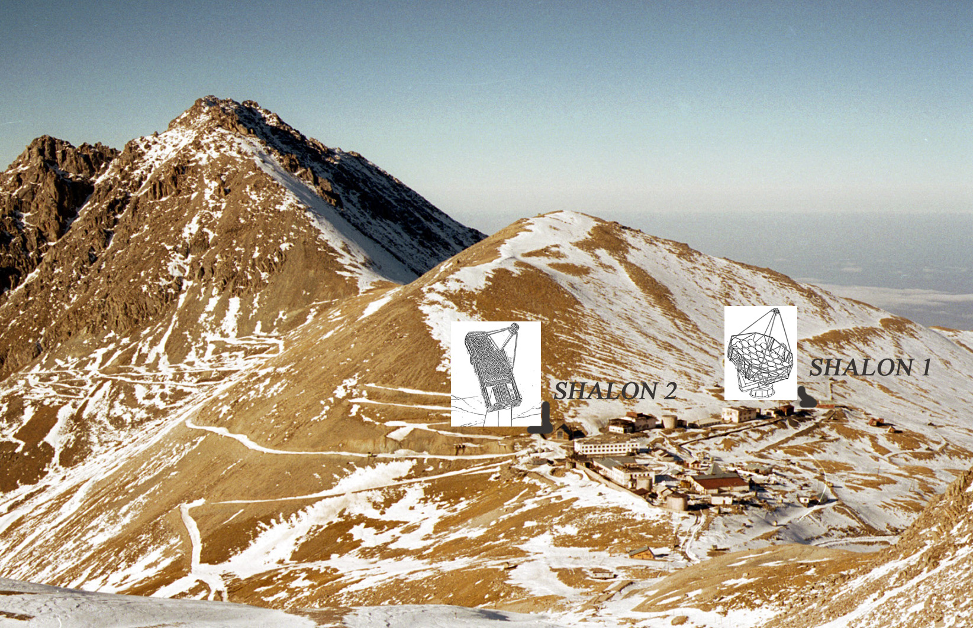
Notes:
4

Slide 5
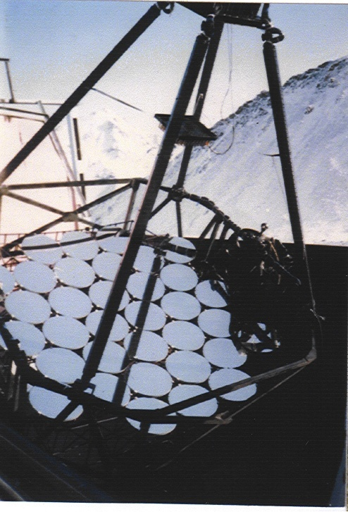
HIGH MOUNTAINOUS OBSERVATORY SHALON ALATOO
SHALON mirror Cherenkov telescope created at Lebedev Physical Institute and stated in 1991 - 1992
Total area of spherical mirror — 11.2 m²
Radius of mirror curvature — 8.5 m
The angle range of telescope turn:
azimuth — 0^{о}-360^{о}
zenith — 0^{о}-110^{о}
The accurace of telescopic
axis pointing — ≤0.1^{о}
The photomultiplier tube camera (12х12) — 144 elements
Field of view > 8^{о}
Weigth 6 ton
altazimuth mounting
It is essential that our telescope has a large matrix with full angle >8º that allows us to perform observations of the supposed astronomical source (ON data) and background from extensive air showers (EAS) induced by cosmic ray (OFF data) simultaneously. Thus, the OFF data are collecting for exactly the same atmospheric thickness, transparency and other experimental conditions as the ON data.
Notes:
5

Slide 6
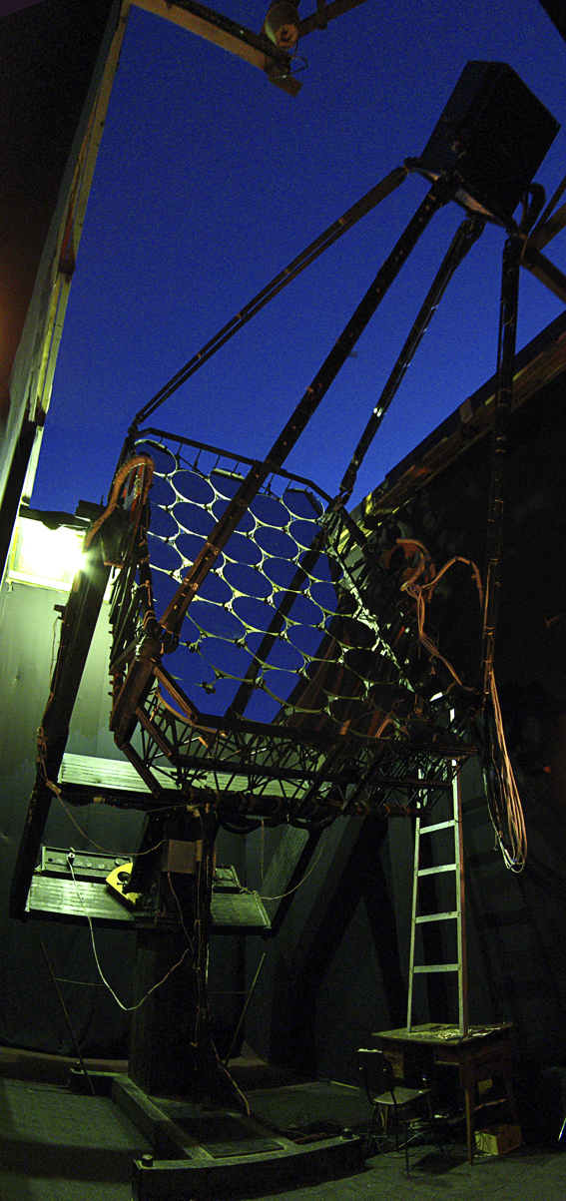
HIGH MOUNTAINOUS OBSERVATORY SHALON ALATOO
SHALON mirror Cherenkov telescope created at Lebedev Physical Institute and stated in 1991 - 1992
Total area of spherical mirror — 11.2 m²
Radius of mirror curvature — 8.5 m
The angle range of telescope turn:
azimuth — 0^{о}-360^{о}
zenith — 0^{о}-110^{о}
The accuracy of telescopic axis pointing — ≤0.1^{о}
The photomultiplier tube camera (12х12) — 144 elements
Field of view > 8^{о}
Weigth 6 ton
parallactic mount
Notes:
6

Slide 7
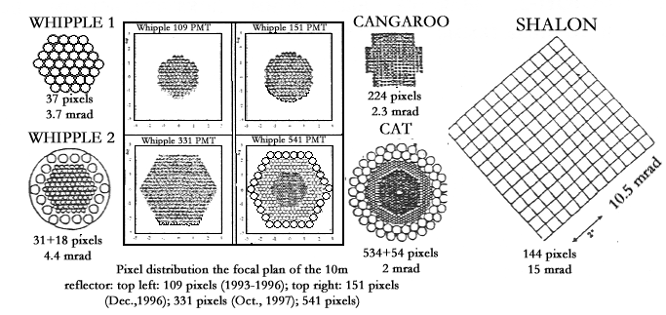
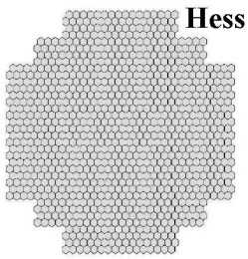
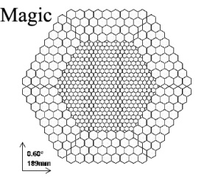
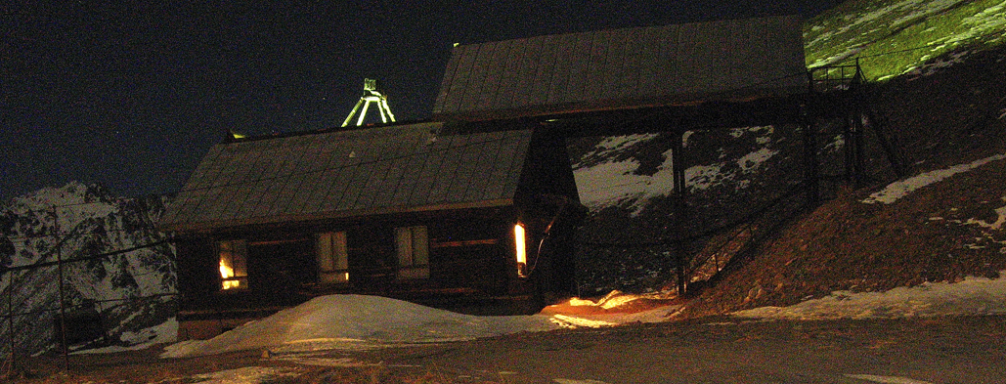
Evolution of photomultiplier arrays to record images seen in Cherenkov light
5º
3.6º
Notes:
7

Slide 8
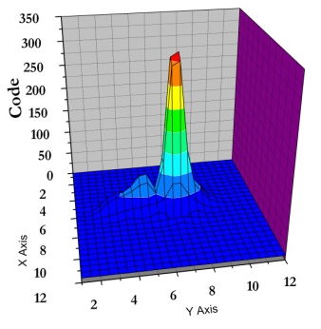
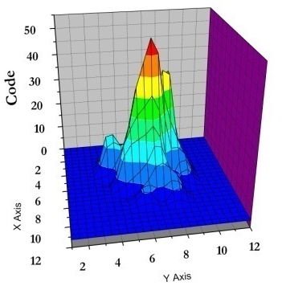
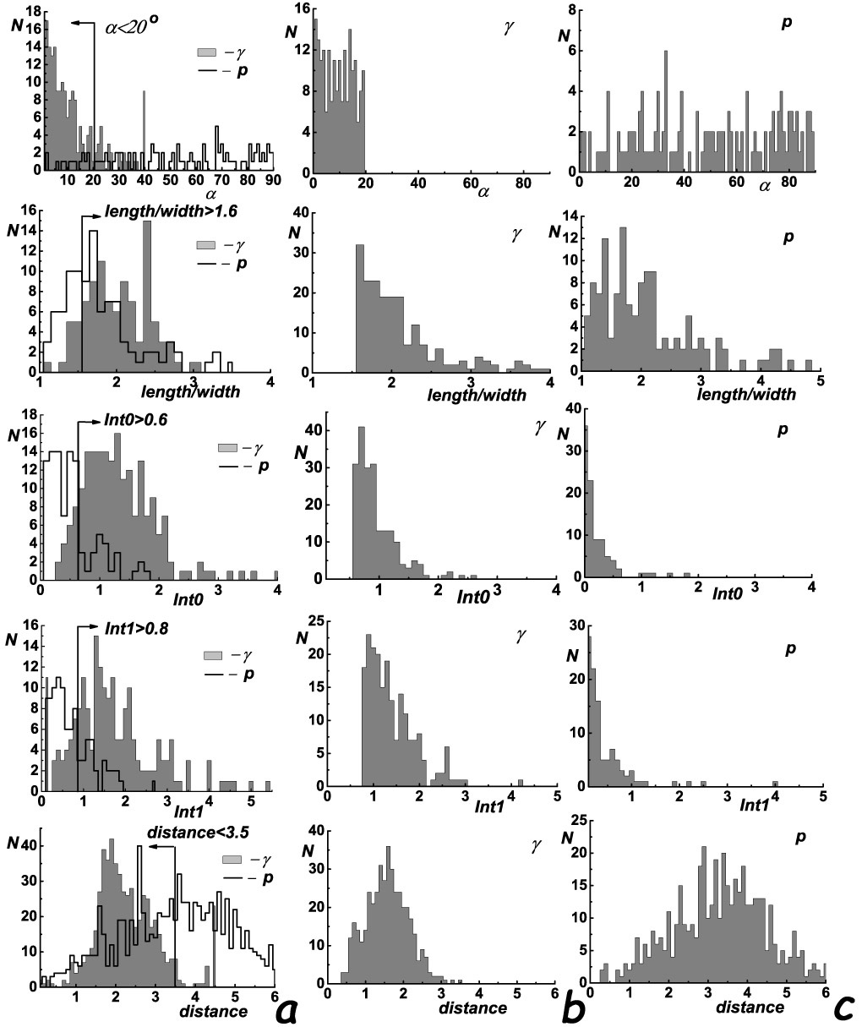
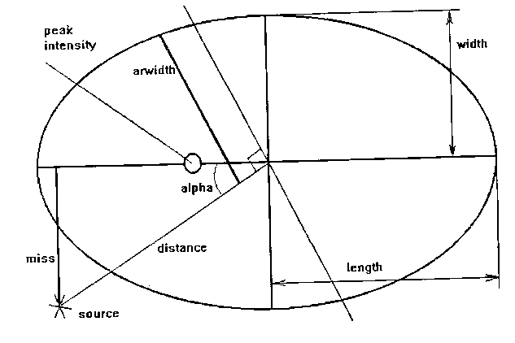
Criteria
The selection of gamma-initiated showers from the background of proton showers is performed by applying the following criteria:
1) α < 20º; 72% rejection
2) length/width > 1.6; 49% rejection
3) the ratio INT0 of Cherenkov light intensity in pixel with maximum pulse amplitude to the light intensity in the eight surrounding pixels exceeds > 0.6; 92% rejection
4) the ratio INT1 of Cherenkov light intensity in pixel with maximum pulse amplitude to the light intensity in the in all the pixels except for the nine in the center of the matrix is exceeds > 0.8; 88% rejection
5) distance is less than 3.5 pixels. 50% rejection
It is essential that our telescope has a large matrix with full angle >8º that allows us to perform observations of the supposed astronomical source (ON data) and background from extensive air showers (EAS) induced by cosmic ray (OFF data) simultaneously.
Using these criteria the background is rejected with 99.92% efficiency, whereas gamma’s rejection is no more than 35% (that is taking into account) and the amount of background gamma-like events is less than 10%.
Notes:
8

Slide 9
TeV GAMMA-RAY EMISSION from GALACTIC SOURCES
The gamma – astronomical researches are carrying out with SHALON since 1992. During the period 1992–2012 SHALON has been used for observations of metagalactic sources: Mkn 421, Mkn 501, Mkn 180, NGC 1275, SN2006gy, 3c454.3, 1739+522 and galactic sources: Crab Nebula, Cyg X-3, Tycho's SNR, Cas A, Geminga, 2129+47XR etc.
SHALON catalogue of galactic gamma -quantum sources
Source | Observable flux, cm⁻²s⁻¹ | Distance, kpc
Crab Nebula | (2.12±0.11)×10⁻¹² | 2.0
Geminga | (0.48±0.07)×10⁻¹² | 0.25
3c58(SN1181) | (0.84±0.33)×10⁻¹² | 2.6 - 3.2
Tycho's SNR | (0.52±0.04)×10⁻¹² | 3.1 - 3.5
Cas A | (0.68±0.13)×10⁻¹² | 3.1
IC 443 | (1.69±0.58)×10⁻¹² | 1.5
Cygnus X-3 | (0.68±0.05)×10⁻¹² | 10
Her X-1 | (0.65±0.46)×10⁻¹² | 6.6
2129+47XR | (0.19±0.06)×10⁻¹² | 6.0
PSR1953+29 | (0.21±0.09)×10⁻¹² | 3.5 – 5.0
M57 | (0.30±0.17)×10⁻¹² | 0.7
Notes:
9

Slide 10
TeV GAMMA-RAY EMISSION from GALACTIC SOURCES
The hypothesis that Supernova Remnants (SNRs) are unique candidates for cosmic-ray sources [1, 2] has been prevalent from the very outset of cosmic-ray physics. Recent observations of several SNRs in X-rays and TeV gamma-rays will help in solving the problem of the origin of cosmic rays and are key to understanding the mechanism of particle acceleration at a propagating shock wave. A number of nearby Northern Hemisphere SNRs (see table) of different types has been observed in TeV energies with SHALON Cherenkov telescope; some of them have been studied in details and the results of observations are presented here.
SNRs observed by SHALON at energies > 800 GeV
Sources | Type | Observable flux, (cm⁻²s⁻¹) | Distance, (kpc)
Crab Nebula | Plerion | (2.12±0.11)×10⁻¹² | 2
Geminga | Radioweak pulsar/PWN | (0.48±0.07)×10⁻¹² | 0.25
3c58(SN1181) | Plerion | (0.84±0.33)×10⁻¹² | 2.6 - 3.2
Tycho's SNR | Shell-type SNR | (0.52±0.04)×10⁻¹² | 2.5 - 3.5
Cas A | Shell type SNR | (0.68±0.13)×10⁻¹² | 3.1
IC 443 | Shell-type SNR | (1.69±0.58)×10⁻¹² | 1.5

Slide 11
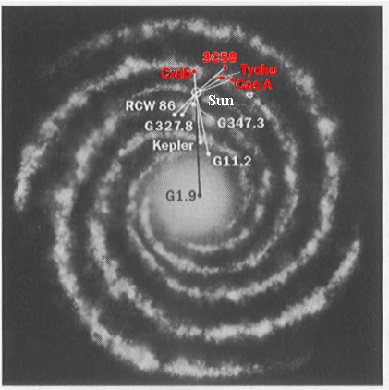
Historical supernova remnants
Position of the supposed supernova remnants exploded in the last 2000 years in the Galaxy disk

Slide 12
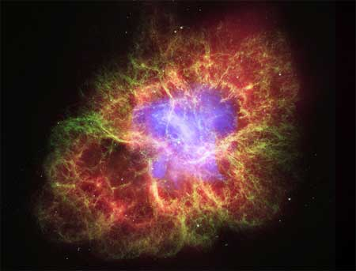
TeV gamma-rays from Galactic sources:
Crab Nebula (1054yr)
As in many other bands of electromagnetic spectrum, the Crab Nebula has become the standard candle for TeV gamma-ray astronomy. It is available as steady source to test and calibrate the telescope and can be seen from both hemispheres. However, quite recently, the AGILE [7] and Fermi LAT [8] satellite experiments have reported on a flare exceeding the nominal flux from the Crab in the energy range from 100MeV to 2-5 GeV by a factor of 4, which was assumed to be absolutely stable and, consequently, was used as a "standard candle". No flux increase was detected in the observations of the MAGIC [9] and VERITAS [10] ground-based telescopes in the same period. Since the first detection with ground based telescope the Crab has been observed by the number of independent groups using different methods of registration of gamma-initiated showers.
The Crab Nebula, most famous supernova remnant, pays an important role in the modern astrophysics. No other space object has such impact on the progress and development of the modern experimental and theoretical astrophysics methods. Pulsar located at the centre of the Crab Nebula is the first who’s optical, X-ray and gamma-emission has been detected.
Notes:
12

Slide 13
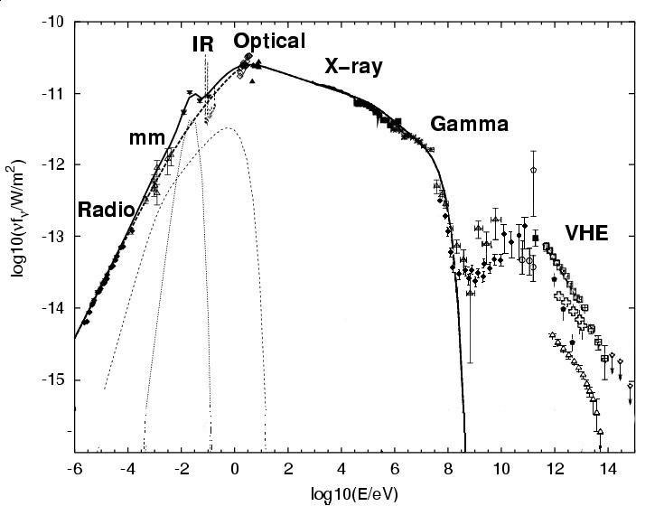
TeV gamma-rays from Galactic sources:
Crab Nebula (1054y)
As in many other bands of electromagnetic spectrum, the Crab Nebula has become the standard candle for TeV gamma-ray astronomy. It is available as steady source to test and calibrate the telescope and can be seen from both hemispheres. Since the first detection with ground based telescope the Crab has been observed by the number of independent groups using different methods of registration of gamma-initiated showers.
The Crab Nebula, most famous supernova remnant, pays an important role in the modern astrophysics. No other space object has such impact on the progress and development of the modern experimental and theoretical astrophysics methods. Pulsar located at the centre of the Crab Nebula is the first who’s optical, X-ray and gamma-emission has been detected.
Notes:
13

Slide 14
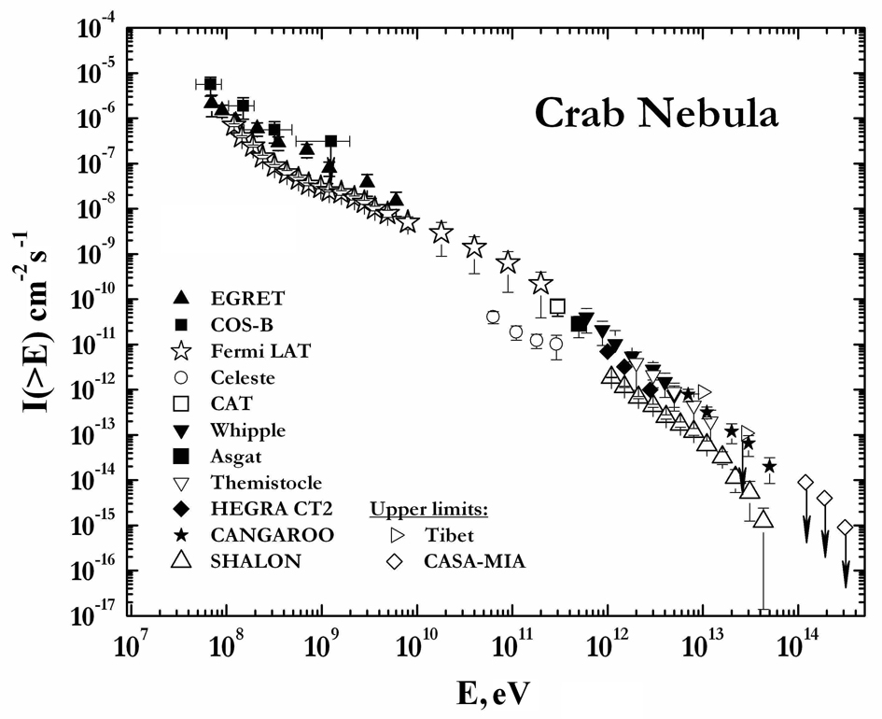
Since the first detection with ground based telescope the Crab has been observed by the number of independent groups using different methods of registration of gamma-initiated showers.
The Crab Nebula gamma-quantum integral spectrum by SHALON in comparison with other experiments.
The spectrum indices for Crab Nebula obtained by Whipple, SHALON, CANGAROO, CAT, HEGRA atmospheric Cherenkov telescopes and Tibet are presented in the table.
Notes:
14

Slide 15
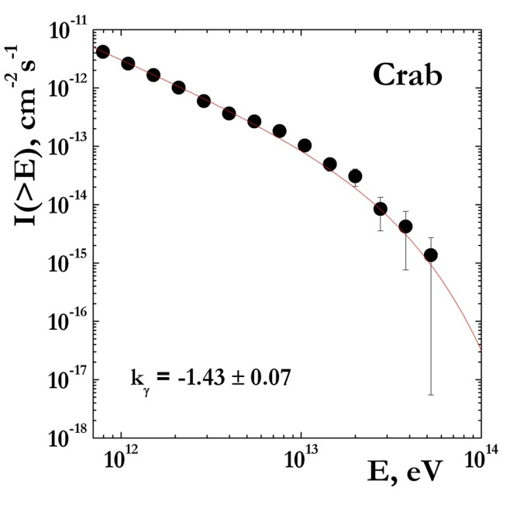
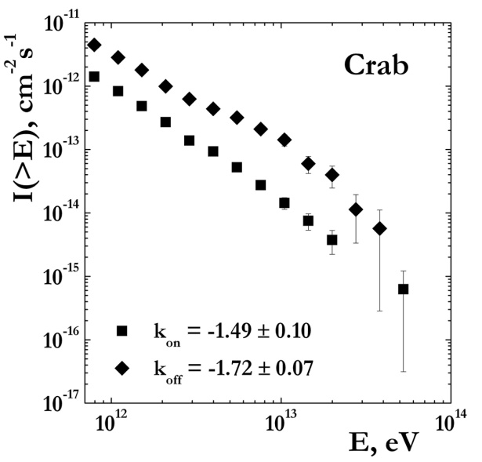
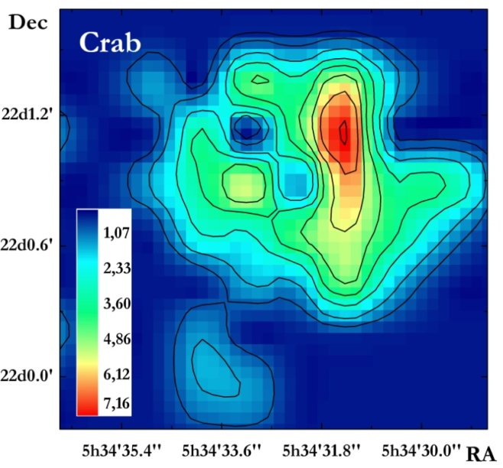
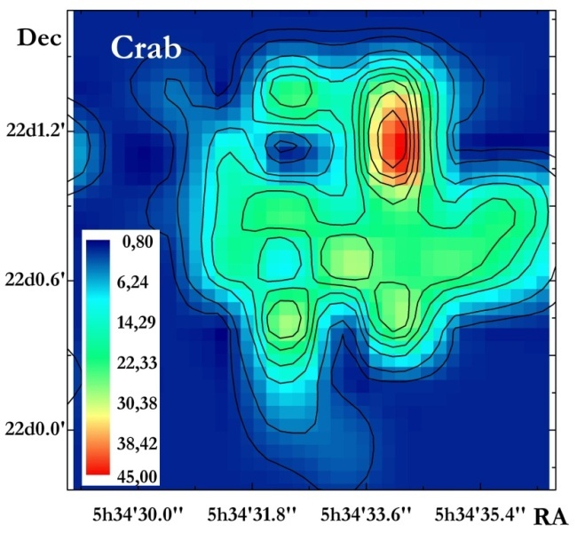
Crab Nebula
The spectrum of gamma-rays from the Crab has been measured in the energy range 800 GeV to 30 TeV at the SHALON telescope [3 - 6] [3, 4, 5] with a statistical significance [11] of 36.1σ.
The integral energy spectrum is well described by the single power law I(> E_{γ}) ~E _{γ} ^{-1.43 ± 0.07}
To made a description of the intensity and spectral shape in the TeV region, the model of Inverse Compton (IC) scattering of the ambient photons in the nebula in the Ref. [6] is used.
The Crab γ-quantum spectrum with power index k_{γ}=-1.43 ± 0.07
The images of Crab Nebula by SHALON. right – energy image of Crab.
The event spectrum from Crab with background k_{ON}=-1.49 ± 0.10
and spectrum of background events k_{OFF}=-1.72 ± 0.07
Notes:
15

Slide 16
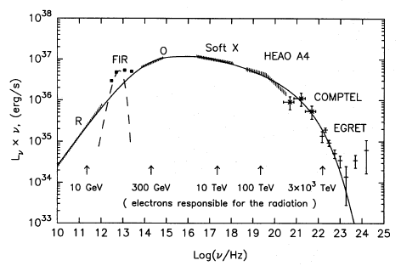
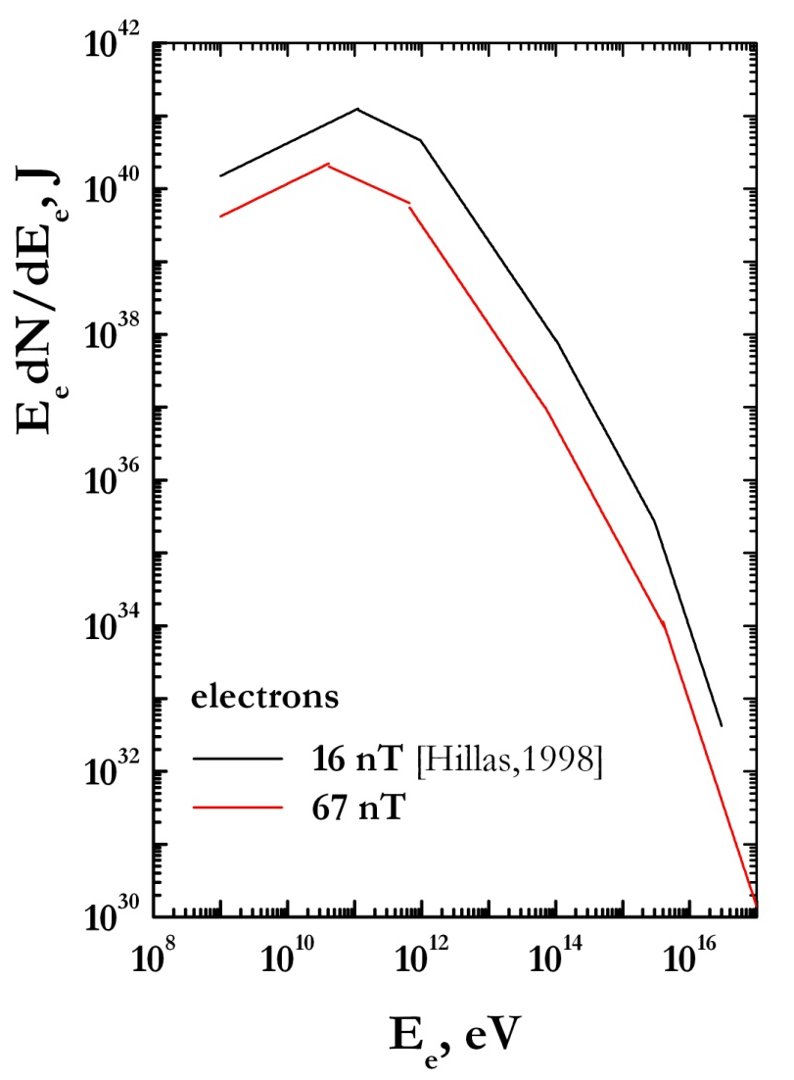
For the purpose of calculating the Inverse Compton scattered radiation, the complete spectrum (from radio- to gamma-rays) of Crab Nebula need to be taken into account to deduce the spectrum of relativistic electrons.
Crab Nebula has an extraordinary broad spectrum, attributed to synchrotron radiation of electrons with energies from GeV to PeV. This continuous spectrum appears to terminate near 10⁸ eV and photons, produced by relativistic electrons and positrons (10¹⁵ eV) via Inverse Compton, form a new component of spectrum in GeV – TeV energy range. To made a description of the intensity and spectral shape in the TeV region of >0.8 TeV, the model of inverse Compton scattering of the ambient photons in the nebula [Hillas et al. 1998] is used.
Notes:
16

Slide 17
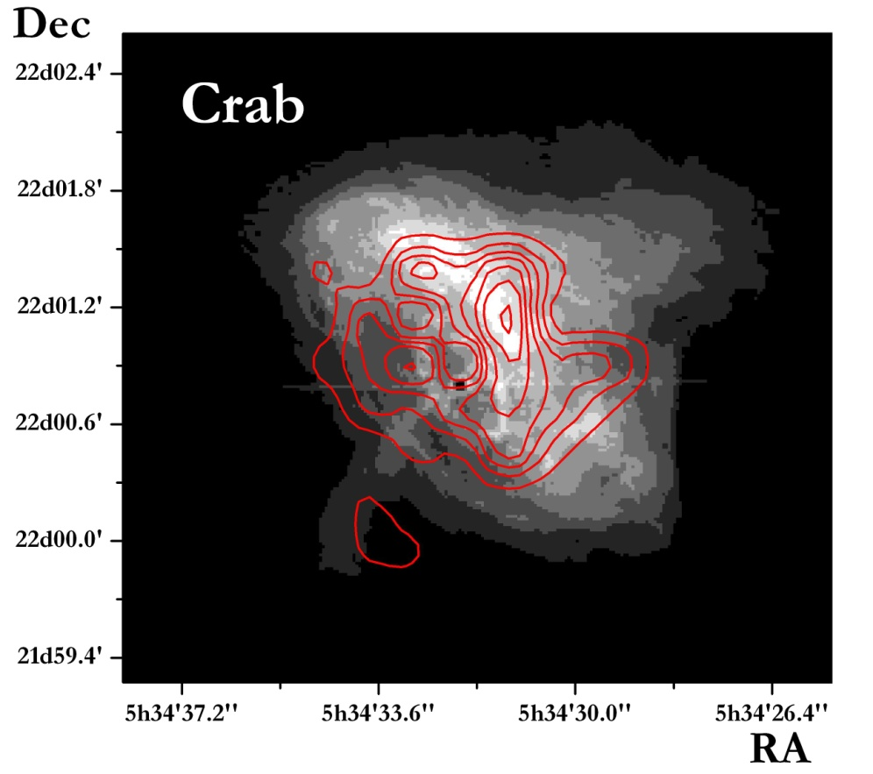
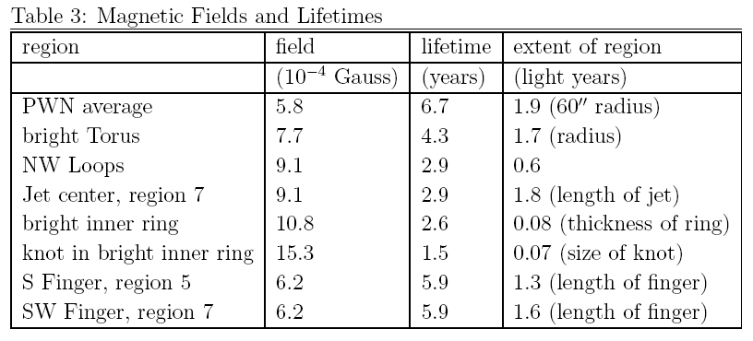
A Chandra X-ray image of Crab Nebula.
The Crab PWN in the energy range 0.2 -4.1 keV. Image of the central 200’’×200’’ of the Crab Nebula. In this energy band most of the PWN X-rays come from a torus surrounding the pulsar. The red contour lines show the 0.8 – 30 TeV - structure by SHALON observations . The most part of TeV energy gamma-quanta come from the region of bright torus whereas the contribution of energy gives the region of the southern jet.
Magnetic fields and lifetimes of representative regions of Chandra image. [F. D. Seward et al.]
Additionally, we need the assuming about magnetic field strength in the region of emission.; The average magnetic field in the region of VHE gamma-ray emission is extracted from the comparison of 0.8 – 30 TeV (SHALON data) and X-ray (Chandra data) emission regions.
Notes:
17

Slide 18
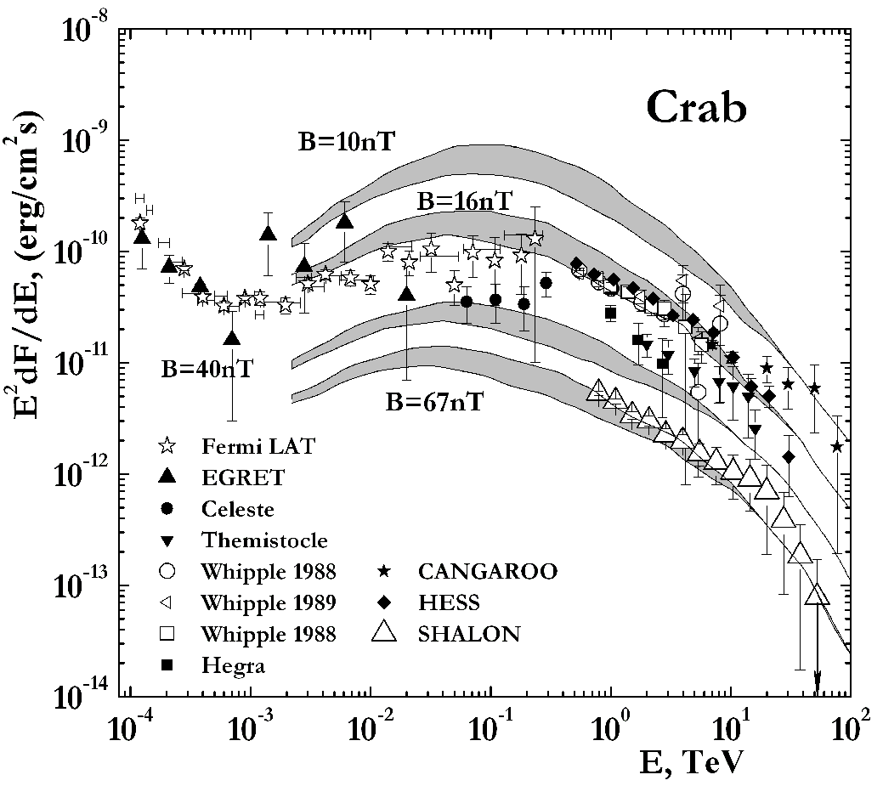
Then using the complete spectrum of the Crab Nebula, the spectrum of relativistic electrons is deduced, and the spectrum of the inverse Compton emission that they would generate is in good agreement with the observed by SHALON gamma-ray flux, if the average magnetic field in the region where these scattered photons originate is 67nT.
The TeV gamma-quantum spectrum of Crab by SHALON (open triangles) in comparison with other experiments: Whipple, EGRET, CANGAROO Lines show predicted inverse Compton spectrum for four different field strengths: 10nT, 16nT, 40 nT [Hillas, 1998] and 67nT (this work)
The TeV gamma-quantum spectrum of Crab by SHALON is generated via Inverse Compton of soft, mainly optical, photons which are produced by relativistic electrons and positrons, in the nebula region around 1.5’ from the pulsar with specific average magnetic field of about 67nT.
Notes:
18

Slide 19
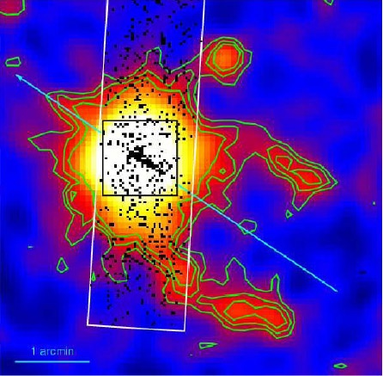
Geminga (age ~3.4×10⁵yr)
A neutron star in the constellation Gemini is the second brightest source of high-energy gamma-rays in the sky, discovered in 1972, by the SAS-2 satellite. For nearly 20 years, the nature of Geminga was unknown, since it didn't seem to show up at any other wavelengths. In 1991, an regular periodicity of 0.237 second was detected by the ROSAT satellite in soft X-ray emission, indicating that Geminga is almost certainly a pulsar. Geminga is the closest known pulsar to Earth. It is one of the brightest source of MeV - GeV gamma-ray, but the only known pulsar that is radio-quiet.
Also this object it suggested to be a Geminga supernova remnant with expected age of ~3.4×10⁵ yr [13, 14]. The extended VHE emission from Geminga (in Fermi observations) could arise from the Pulsar Wind Nebula associated with the Geminga SNR remnant.

Slide 20
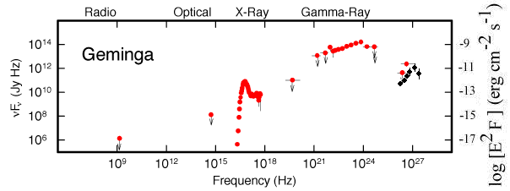
Geminga
A neutron star in the constellation Gemini is the second brightest source of high-energy gamma-rays in the sky, discovered in 1972, by the SAS-2 satellite. For nearly 20 years, the nature of Geminga was unknown, since it didn't seem to show up at any other wavelengths. In 1991, an regular periodicity of 0.237 second was detected by the ROSAT satellite in soft X-ray emission, indicating that Geminga is almost certainly a pulsar. Geminga is the closest known pulsar to Earth; and it's the only known pulsar that is radio-quiet.
The broadband energy spectrum of Geminga. Upper limits correspond to that of pulsed flux whereas the data points represent the total flux [M.S. Jakson, J.P. Halpern and E.V. Gotthelf, ApJ, 578 (2002) 935]. Black points are SHALON data.
Notes:
20

Slide 21
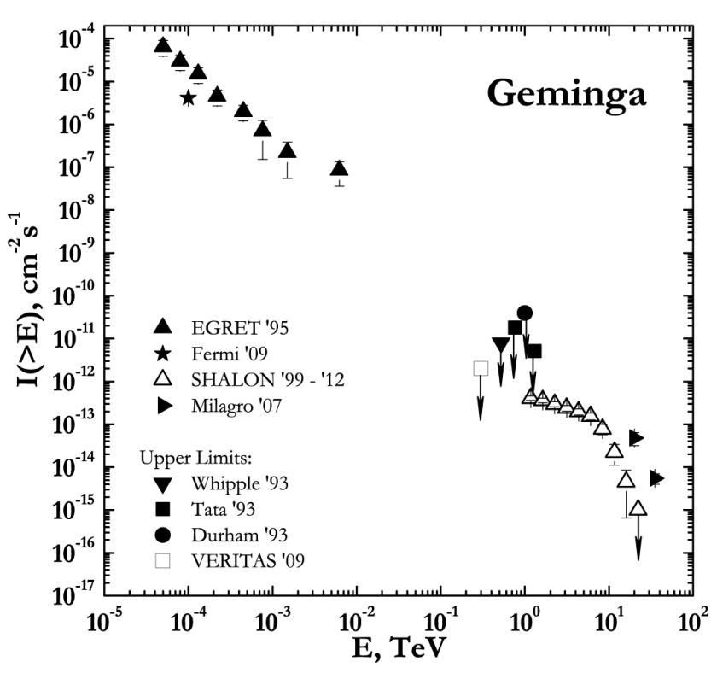
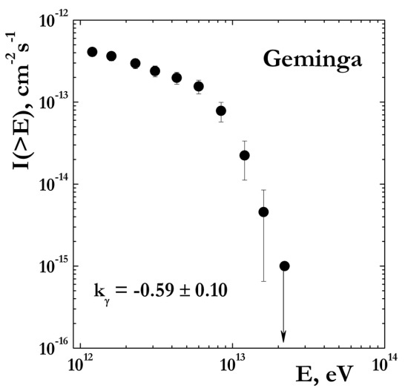
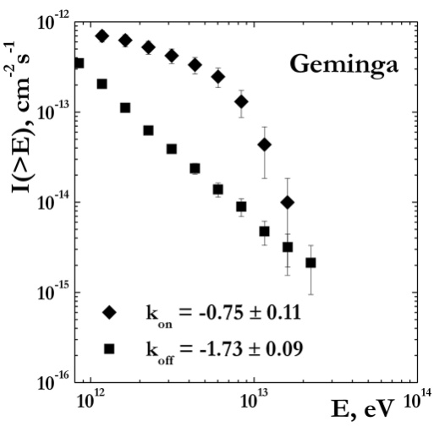
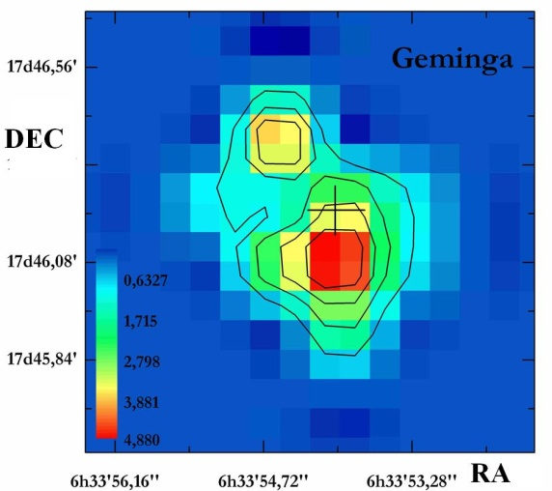
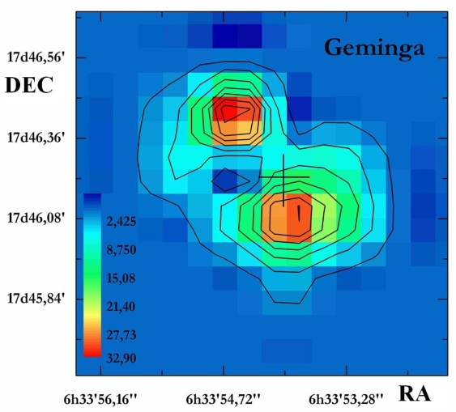
Geminga has been the object for study at TeV energies with upper limits being reported by three experiments Whipple'93, Tata'93 and Durham'93 and very recently by VERITAS (2009). Also Geminga has observed with Milagro at energies of 20TeV and 35 TeV (2007) and Fermi LAT at energies 30MeV - 200GeV (2009). The spectrum by Fermi is fitted with a power law with exponential cutoff in the form: dN=dE = N0× (E^{-γ})exp(-E/E₀), where N₀ = (1.19 ± 0.08) × 10⁻⁶GeV⁻¹cm⁻²s⁻¹, γ= 1.3 ± 0.05, E₀ = (2.47±0.19) GeV . The images of gamma-ray emission from Geminga by SHALON telescope are presented. The value Geminga flux obtained by SHALON (1999-2011) is lower than the upper limits published before. Its integral gamma-ray flux is found to be (0.48 ± 0.07)×10⁻¹² cm⁻²s⁻¹ at energies of > 0.8 TeV [3]. Within the range 0.8 - 6 TeV, the integral energy spectrum is well described by the single power law I(>Eγ) ∝ Eγ^{-0.59±0.10}. The energy spectrum of supernova remnant Geminga F(E_{O} > 0.8TeV ) ∝ E^{k} is harder than Crab spectrum.
The gamma-ray flux detected by SHALON (1999 - 2010) from this source is
F_{Geminga}(EO>0.8 TeV) = (0.48 ± 0.07)×10⁻¹² cm⁻² s⁻¹ (7.6σ Li&Ma)
The Geminga γ-quantum spectrum with power index
k_{γ}=-0.59 ± 0.10
The event spectrum from Geminga with background k_{ON}=-0.75 ± 0.11 and spectrum of background events –
k_{OFF}=-1.73 ± 0.09
The images of Geminga by SHALON

Slide 22
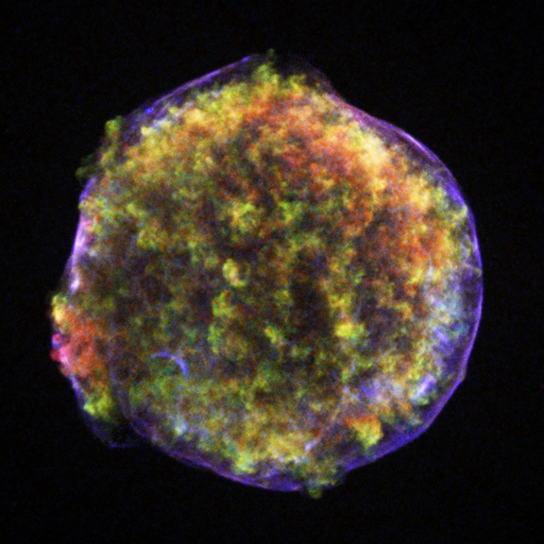
Tycho’s SNR (1572yr)
A Chandra image of Tycho’s SNR (X-ray);
This image of the supernova remnant shows an expanding bubble of multimillion degree debris (green and red) inside a more rapidly moving shell of extremely high energy electrons (filamentary blue). The supersonic expansion of the stellar debris has created two X-ray emitting shock waves - one moving outward into the interstellar gas, and another moving back into the debris. These shock waves produce sudden, large changes in pressure and temperature.
Kinetic nonlinear theory of diffusive CR acceleration in SNRs [23 - 25] connects the gas dynamics of the explosion with the particle acceleration.
Tycho’s SNR has long been considered as a candidate to cosmic ray hadrons source in Northern Hemisphere.
Tycho’s SNR have been detected with SHALON mirror Cherenkov telescope at TeV region. The integral gamma-ray flux above 0.8 TeV was estimated as (0.52 ± 0.04)×10⁻¹² cm⁻²s⁻¹

Slide 23
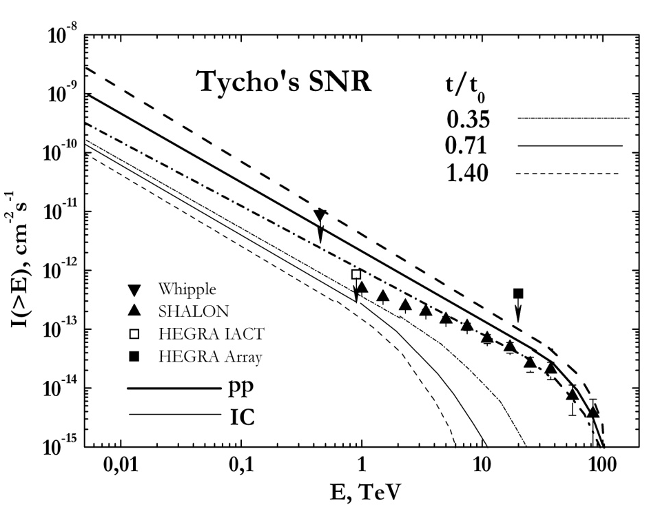
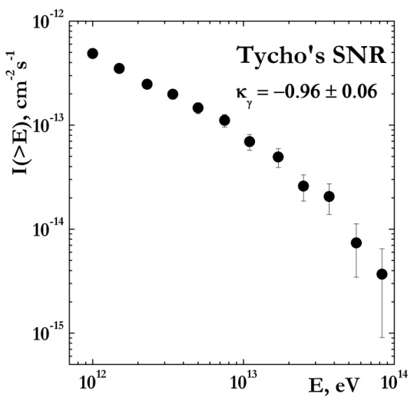
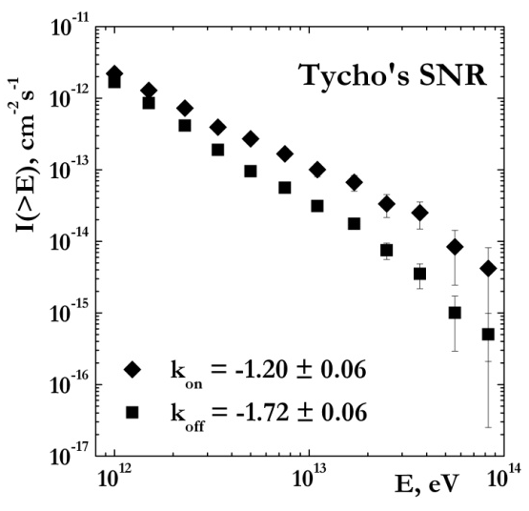
The nonlinear kinetic model for cosmic ray acceleration in SNR has been applied to Tycho’s SNR in order to compare the model results with the recently found very low observational upper limits in the TeV energy range. In fact, HEGRA dad not detect Tycho’s SNR, but established a very low upper limit at energies >1 TeV. The HEGRA’ s limit is consisted with that previously published by the Whipple collaboration, being a factor 4 lower (the spectral index was assumed to be -1.1 for this comparison). The π^{O} - decay gamma-quantum flux turns out to be greater than the Inverse Compton flux at 1 TeV and becomes strongly dominating at 10 TeV. The predicted gamma flux is consistent with the upper limits published Whipple and HEGRA collaborations.
The integral average gamma-ray flux above 0.8 TeV was estimated as
I_{Tycho} = (0.52±0.04)×10⁻¹² cm⁻²s⁻¹
The expected π^{O}-decay gamma-quantum flux F_{γ}∝E_{γ}⁻¹ extends up to ~80 TeV, whereas the Inverse Compton gamma-ray flux has a cutoff above the few TeV. So, the detection of gamma-rays at energies of ~ 10-80 TeV by SHALON telescope is the evidence of hadron origin.

Slide 24
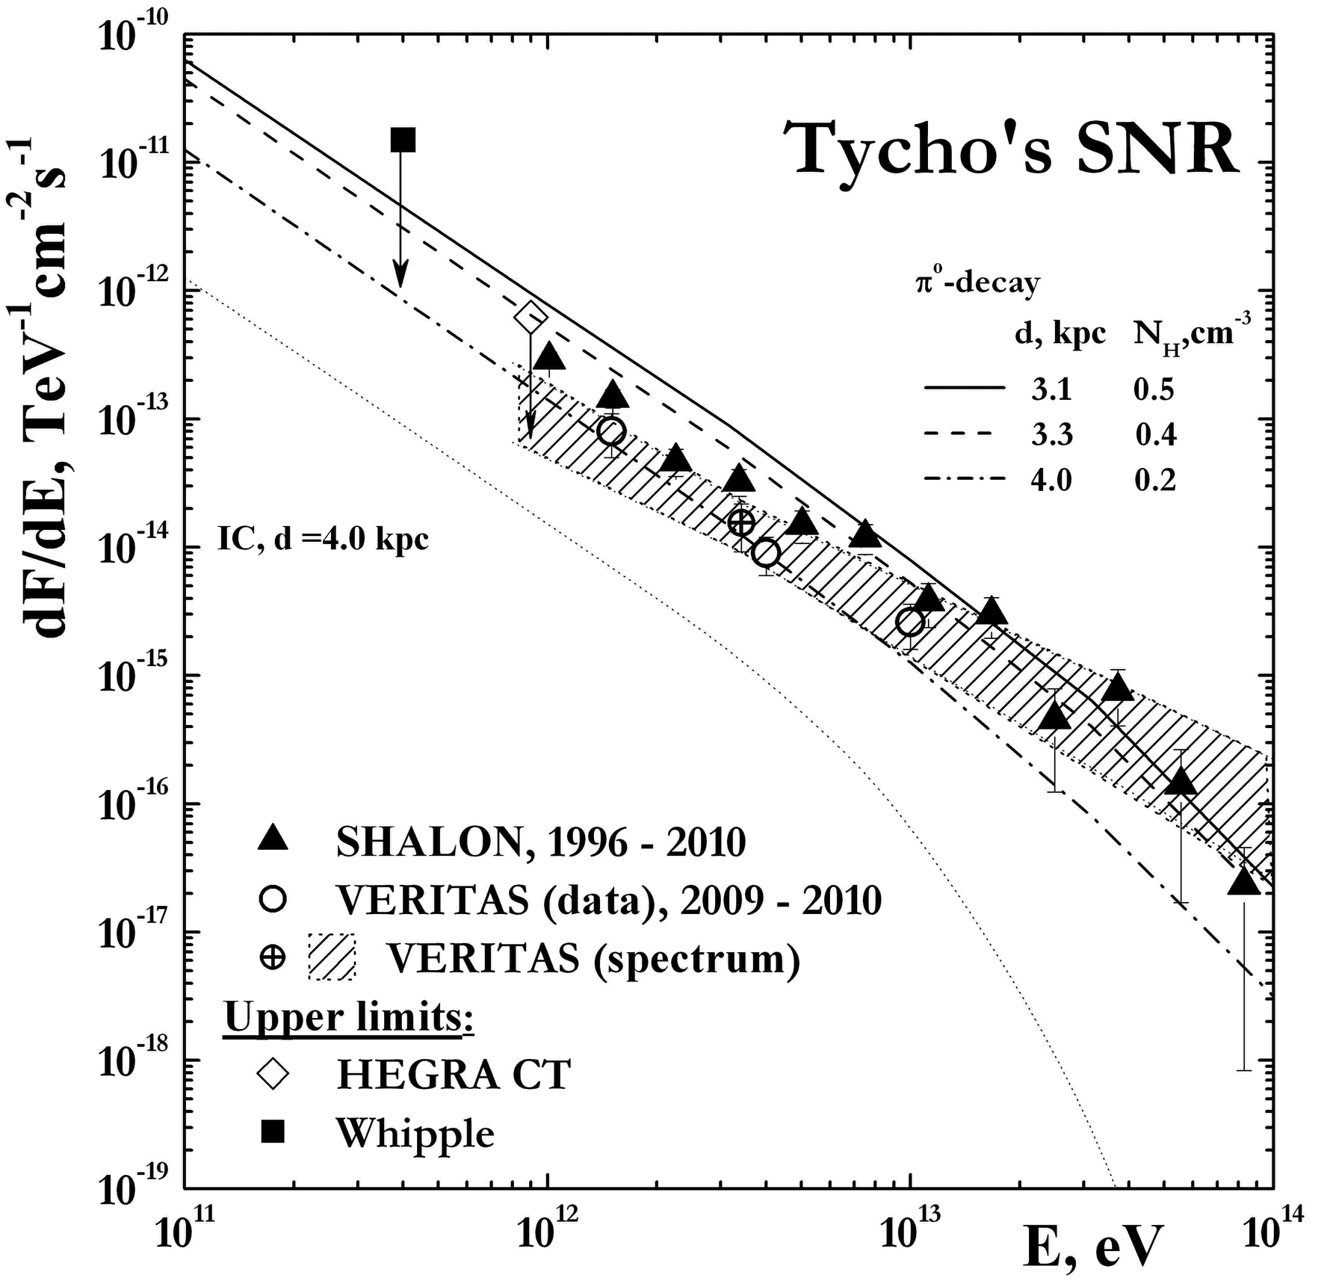
Tycho’s SNR was observed by SHALON since 1996 up to 2010, for a total of 123 hours, during moonless nights at zenith angles ranging from 16º to 35º.
All observations were made with the standard procedure of SHALON experiment, collecting ON data and OFF data simultaneously.
After the standard analysis the gamma-ray source associated with the Tycho’s SNR was detected above 800 GeV with a statistical significance of 17σ Li&Ma
The gamma-ray integral spectrum by SHALON in the energy range of 0.8 – 80 TeV is fitted by a power law with exponential cut-off:
Recently, Tycho’s SNR was also confirmed with VERITAS telescope in observations of 2008 - 2010 years. The Tycho’s SNR differential spectrum by SHALON (1996 - 2010) comparing with VERITAS (2009) data and theoretical models [23 - 25].
I(>E_{γ})=(0.42±0.04)×10⁻¹²×E_{γ}^{-0.93±0.09}exp(-E_{γ}/35TeV)

Slide 25
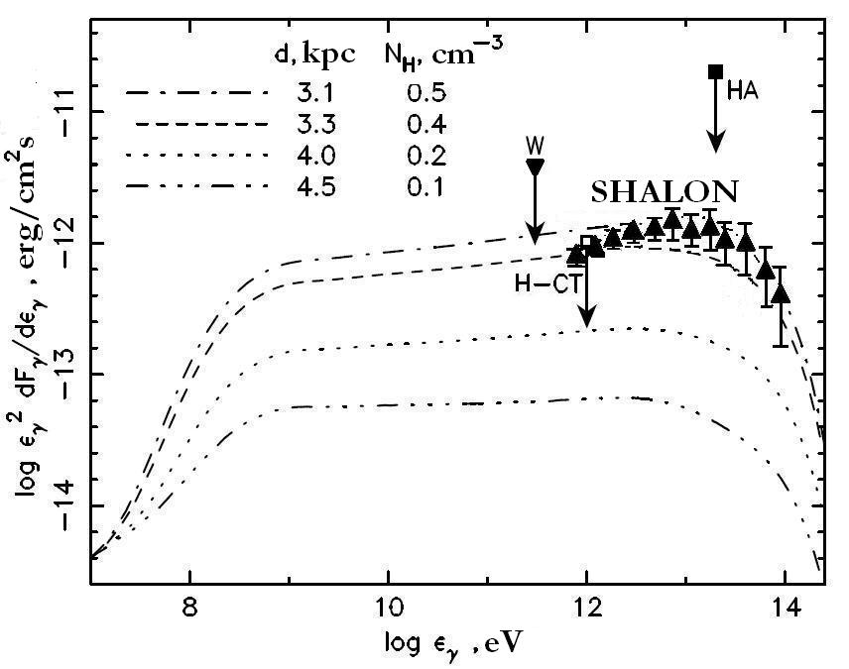
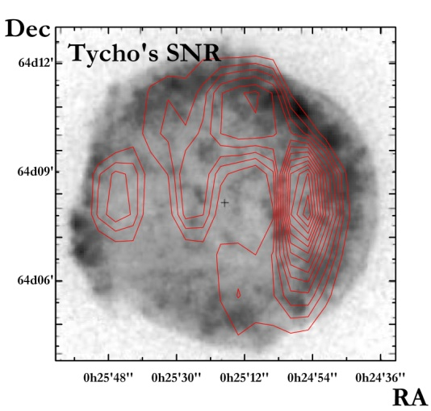
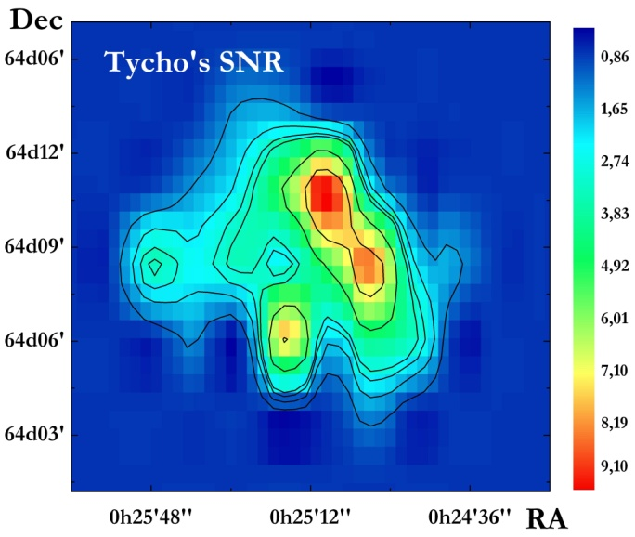
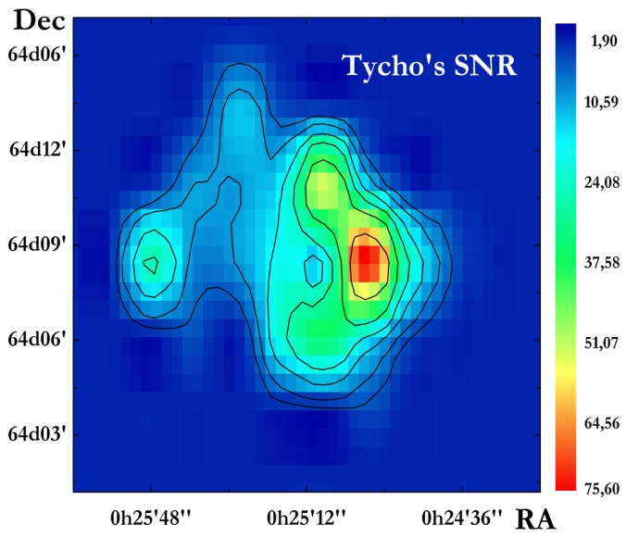
Tycho’s SNR
Spectral energy distribution of the γ-ray emission from Tycho’s SNR, as a function of γ-ray energy ε_{γ} , for a mechanical SN explosion energy of E_{sn} = 1.2×10⁵¹ erg and four different distances d and corresponding values of the ISM number densities N_{H}. All cases have dominant hadronic γ-ray flux [L. T. Ksenofontov, H.J. Vöek, E.G. Berezhko in The Multi-Messenger Approach to High Energy Gamma-ray Sources, Barcelona, July 4-7, 2006].
The additional information about parameters of Tycho’s SNR can be predicted (in frame of this theory) if the TeV gamma-quantum spectrum of SHALON telescope is taken into account: a source distance 3.1 - 3.3 kpc and an ambient density N_{H} 0.5 - 0.4 cm⁻³ and the expected π⁰-decay gamma-ray energy extends up to about 100 TeV.
ROSAT HRI image of Tycho’s SNR (X-ray); The contour lines show the TeV - image by SHALON observations.
Notes:
25

Slide 26
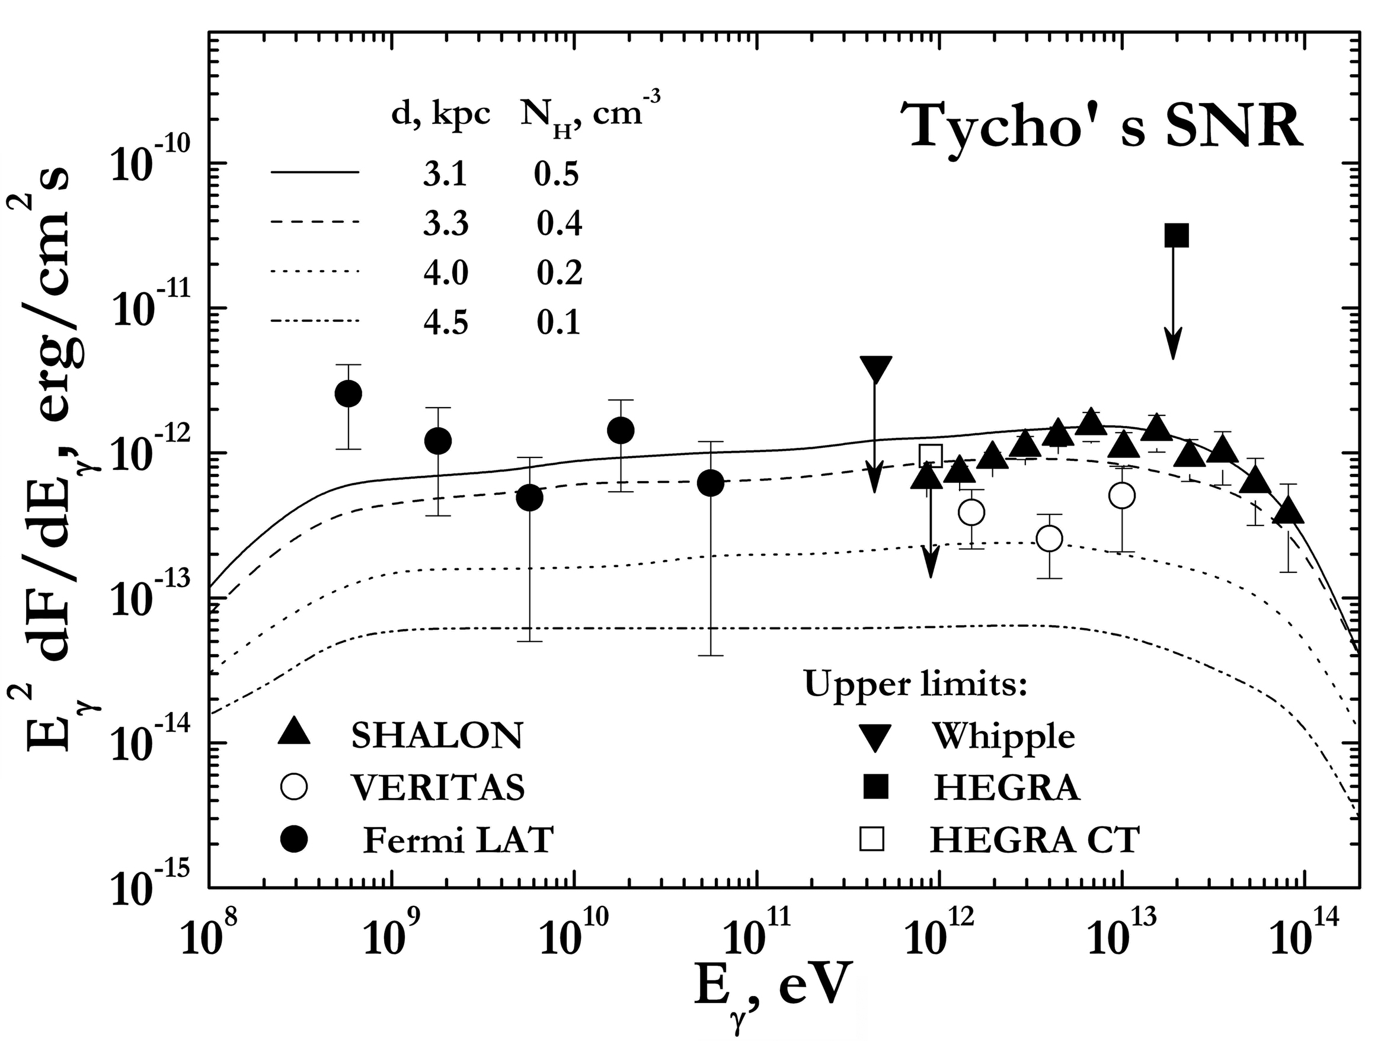


Tycho’s SNR
The additional information about parameters of Tycho’s SNR can be predicted (in frame of this theory) if the TeV gamma-quantum spectrum of SHALON telescope is taken into account: a source distance 3.1 - 3.3 kpc and an ambient density N_{H} 0.5 - 0.4 cm⁻³ and the expected πº-decay gamma-ray energy extends up to about 100 TeV
Recently, Tycho’s SNR was also detected at GeV energy range by Fermi LAT (●) (2010, 2011). The Tycho’s SNR spectral energy distribution by SHALON () (1996 - 2010) comparing with VERITAS (○) (2009), Fermi LAT (●) (2010, 2011) and theoretical models .
The images of Tycho’s SNR by SHALON
The spectral energy distribution of the gamma-ray emission from Tycho’s SNR by SHALON () in comparison with other experiment data Fermi LAT, HEGRA, VERITAS, Whipple and with theoretical predictions [23 - 25].

Slide 27
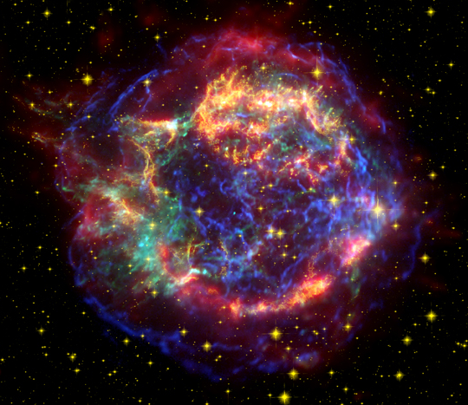
Cassiopeia A (1680 yr.)
Cassiopeia A (Cas A) is the youngest of historical supernova remnant in our Galaxy. The supernova explosion that gave rise to Cas A occurred around 1680. Its overall brightness across the electromagnetic spectrum makes it a unique object for studying high-energy phenomena in SNRs.
Cas A was detected in TeV gamma-rays, first by HEGRA (2001) and later confirmed by MAGIC (2007) and VERITAS (2010). The high energy gamma-ray emission from Cas A was detected with Fermi LAT (2010) in the range 500 MeV - 50 GeV.
The composite image of Cas A SNR.
Infrared data from the Spitzer Space Telescope
are colored red;
Optical data from the Hubble Space Telescope
are yellow;
X-ray data from the Chandra X-ray Observatory
are green and blue.
Notes:
27

Slide 28
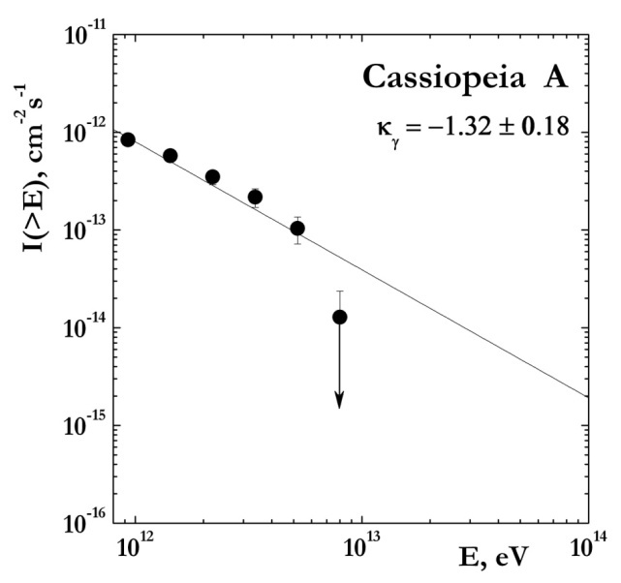
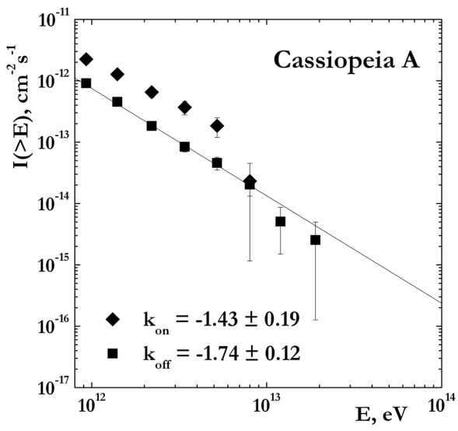
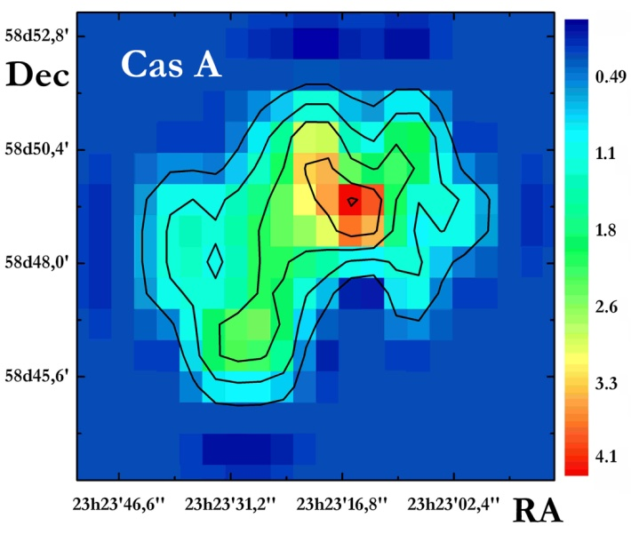
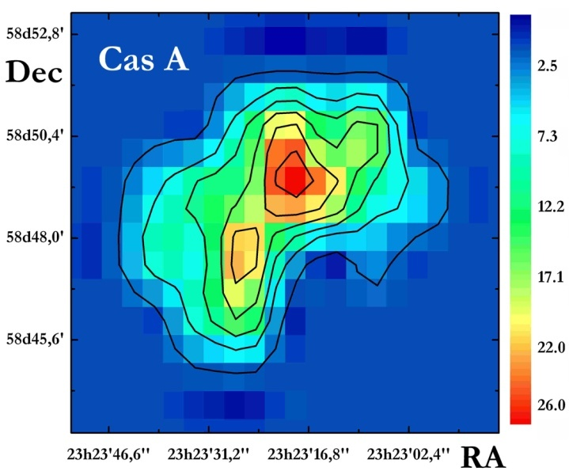
Cassiopeia A
Cas A was observed with SHALON telescope during the 27 hours of autumn 2010. All observations were made with the standard procedure of SHALON experiment during moonless nights with zenith angles from 13 to 35 degree. The gamma-ray source associated with the SNR Cassiopeia A was detected above 800 GeV with a statistical significance of 7.1σ Li&Ma with a gamma-quantum flux above 0.8 TeV:
I_{CasA}(>0,8TeV) = (0,68±0,13)•10⁻¹² cm⁻²s⁻¹
The γ-ray integral spectrum by SHALON in the energy range of 0.8 – 8 TeV is compatible with a power law: I(>E_{γ})∝E_{γ}^{-1,32± 0,18}
The event spectrum from Cas A with background k_{ON}=-1.43 ± 0.19 and spectrum of background events – k_{OFF}=-1.74 ± 0.12
The images of Cas A by SHALON
Notes:
28

Slide 29
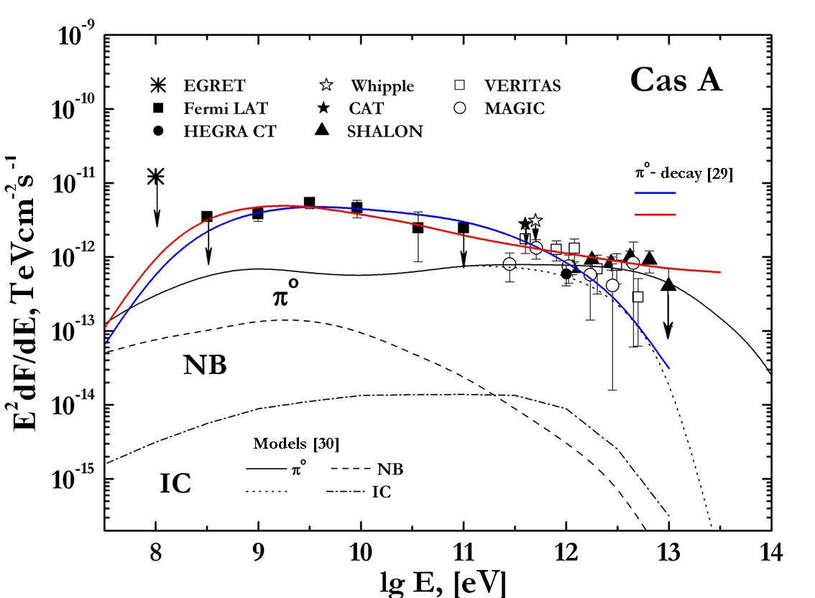
Cassiopeia A
The favored scenarios in which the gamma-rays of 500 MeV – 10 TeV energies are emitted in the shell of the SNR like Cas A are Inverse Compton scattering and πº-decay. The gamma-ray emission could be produced by electrons accelerated at the forward shock through relativistic bremsstrahlung (NB) or IC. Alternatively, the GeV gamma-ray emission could be produced by accelerated CR hadrons through interaction with the background gas and then πº-decay.
Solid lines show the very high energy gamma-ray spectra of hadronic origin. Dash-and-dot line presents the gamma-ray spectrum of the IC emission [30]. The leptonic model with B = 0.12 mG and B = 0.3mG also proposed in [29, 30]. It was shown that leptonic model with B = 0.3 mG predicts a 5 - 8 times lower gamma-ray flux than the observed; the model with B = 0.12 mG, which can broadly explain the observed GeV flux predicts the TeV spectrum with cut-off energy about 10 TeV.
The spectral energy distribution of the gamma-ray emission from Cas A by SHALON () in comparison with other experiment data Fermi LAT, HEGRA, MAGIC, VERITAS, EGRET, CAT, Whipple and with theoretical predictions [29, 30].
The detection of very high energy gamma-ray emission at 5 - 10 TeV and the hard spectrum below 1 TeV would favor the πº-decay origin of the gamma-rays in
Cas A SNR.

Slide 30
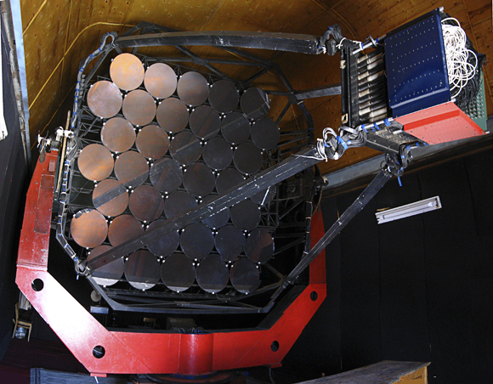

Cosmic ray production in Historical Supernova Remnants
We present the results of our observations of two types of Galactic supernova remnants with the SHALON mirror Cherenkov telescope: the plerion Crab Nebula, Geminga (probably plerion) and the shell-type supernova remnants Cassiopeia A and Tycho. The experimental data have confirmed the prediction of the theory about the hadronic generation mechanism of very high energy (0.8–100 TeV) gamma rays in Tycho’s supernova remnant. The data obtained suggest that the very high energy gamma-ray emission in the objects being discussed is different in origin.

Slide 31
[1] Berezhko E G and Krymskii G F 1988 Usp. Fiz. Nauk 154(1) 49
[2] Reynolds S P 2008 Ann. Rev. Astron. Astrophys. 46 89
[3] Sinitsyna V G 2000 AIP (Conf. Proc.) 515 205, 293
[4] Sinitsyna V G et al. 2009 Nucl. Phys. B (Proc.Suppl.) 196 437; ibid. 2008 175-176 455; ibid. 2006 151 112;
ibid. 2003 122 247, 409; ibid. 2001 97 215, 219; ibid. 1999 75A 352
[5] Sinitsyna V G and Sinitsyna V Yu 2011 Astron. Lett. 37(9) 621.
[6] Hillas A M et al. 1998 Astrophys.J. 503 744
[7] Tavani M et al. 2010 Science 331 736
[8] Abdo A A et al. 2010 Science 331(6018) 739
[9] Mariotti M Astron. Telegramm No. 2967
[10] Ong R. 2010 Astron. Telegramm No. 2968
[11] Li T-P and Ma Y-Q, 1983 Astrophys. J. 272 317
[12] Seward F D, Tucker W H and Fesen R A 2006 Astrophys. J. 652 1277
[13] Salvati M, Sacco B 2008 Astron.&Astrophys. 485 527
[14] Salvati M 2010 Astron.&Astrophys. 513 A28
[15] Akerlof C W et al. 1993 in Proc. 23rd ICRC, Calgary 1 305
[16] Vishwanath P R et al. 1993 Astron.&Astrophys. 267 L5
[17] Bowden C C G et al. 1993 J. Phys. G: Nucl. Part. Phys. 19 L29
[18] Finnegan G 2009 in Proc. of the 31st ICRC, Lodz
[19] Ado A A et al. arXiv:0904.1018v1; arXiv:0705.0707v1;
[20] Celik O 2009 in Proc. of the 31st ICRC, Lodz
[21] Acciari V A et al. arXiv:astro-ph/ 1102.3871v1.
[22] Giordano F. et al. arXiv:astro-ph/ 1108.0265v.
[23] Völk H J et al. 2001 in Proc. 27th ICRC, Hamburg, 2 2469
[24] Berezhko E. G. et al. 2007 Astrophys. Space Sci. 309 385
[25] Völk H J, Berezhko E G, Ksenofontov L T 2008 Astron.&Astrophys. 483(2) 529
[26] Aharonian F et al. 2001 Astron.&Astrophys. 370 112
[27] Albert J et al. 2007 Astron.&Astrophys. 474 937
[28] Acciari V A et al. 2010 Astrophys. J. 714 163
[29] Abdo A A et al. 2010 Astrophys. J. 710 L92
[30] Berezhko E G, Pühlhofer G, Völk H J 2003 Astron.&Astrophys 400 971

