Slide 1
Heavy neutrino decay at SHALON
V. G. SINITSYNA¹, M. MASIP², S. I. NIKOLSKY¹, V. Y. SINITSYNA¹
¹P. N. Lebedev Physical Institute,
Leninsky prospect 53, Moscow, 119991 Russia
²CAFPE and Departamentode Fosica Teoreticay del
Cosmos Universidadde Granada,E-18071 Granada Spain

Slide 2
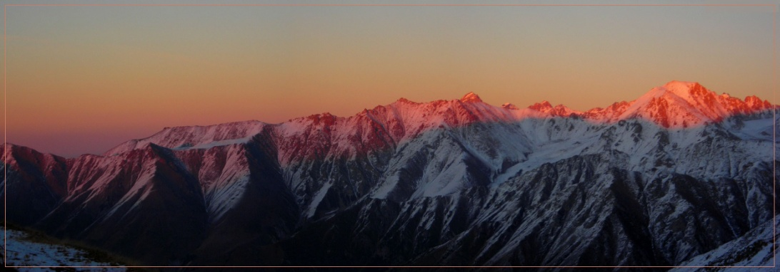
Search for neutrino decay at SHALON
A neutrino telescope detects the Cherenkov radiation generated in water or ice by passage of relativistic charged particles produced by neutrino collisions with nucleons in the detector volume. Because of weakness of neutrino interaction the very large detector volume is required. Some alternative approaches have been proposed. One of them is using a earth matter or mountain as a target volume for conversion neutrinos to leptons which then initiate extensive air shower (EAS) in the atmosphere, then showers can be detected by Cherenkov telescope. Observations of neutrino initiated EAS at the mountain shadow seems attractive because of mountain valley screened from background showers of cosmic rays and the only particles that can survive are neutrinos with energies > 10¹³ eV came under the horizon. The cascades with energy > 10¹³ eV are generated by neutrino in the ground of mountain on the thickness <300 g/cm². The Cherenkov radiation of the hadron cascades will be observed along the direction of neutrino by gamma-telescope placed on the distance about 7 kms from a mountain slope in area of more than 7×10⁵m². So, UHE neutrinos may be searched in observations at large zenith angle.

Slide 3
HIGH MOUNTAINOUS OBSERVATORY SHALON ALATOO
SHALON mirror Cherenkov telescope created at Lebedev Physical Institute and stated in 1991 - 1992
Total area of spherical mirror — 11.2 m²
Radius of mirror curvature — 8.5 m
The angle range of telescope turn:
azimuth — 0^{о}-360^{о}
zenith — 0^{о}-110^{о}
The accurace of telescopic
axis pointing — ≤0.1^{о}
The photomultiplier tube camera (12х12) — 144 elements
Field of view > 8^{о}
Weigth 6 ton
altazimuth mounting
It is essential that our telescope has a large matrix with full angle >8º that allows us to perform observations of the supposed astronomical source (ON data) and background from extensive air showers (EAS) induced by cosmic ray (OFF data) simultaneously. Thus, the OFF data are collecting for exactly the same atmospheric thickness, transparency and other experimental conditions as the ON data.
Notes:
3

Slide 4
Notes:
4

Slide 5
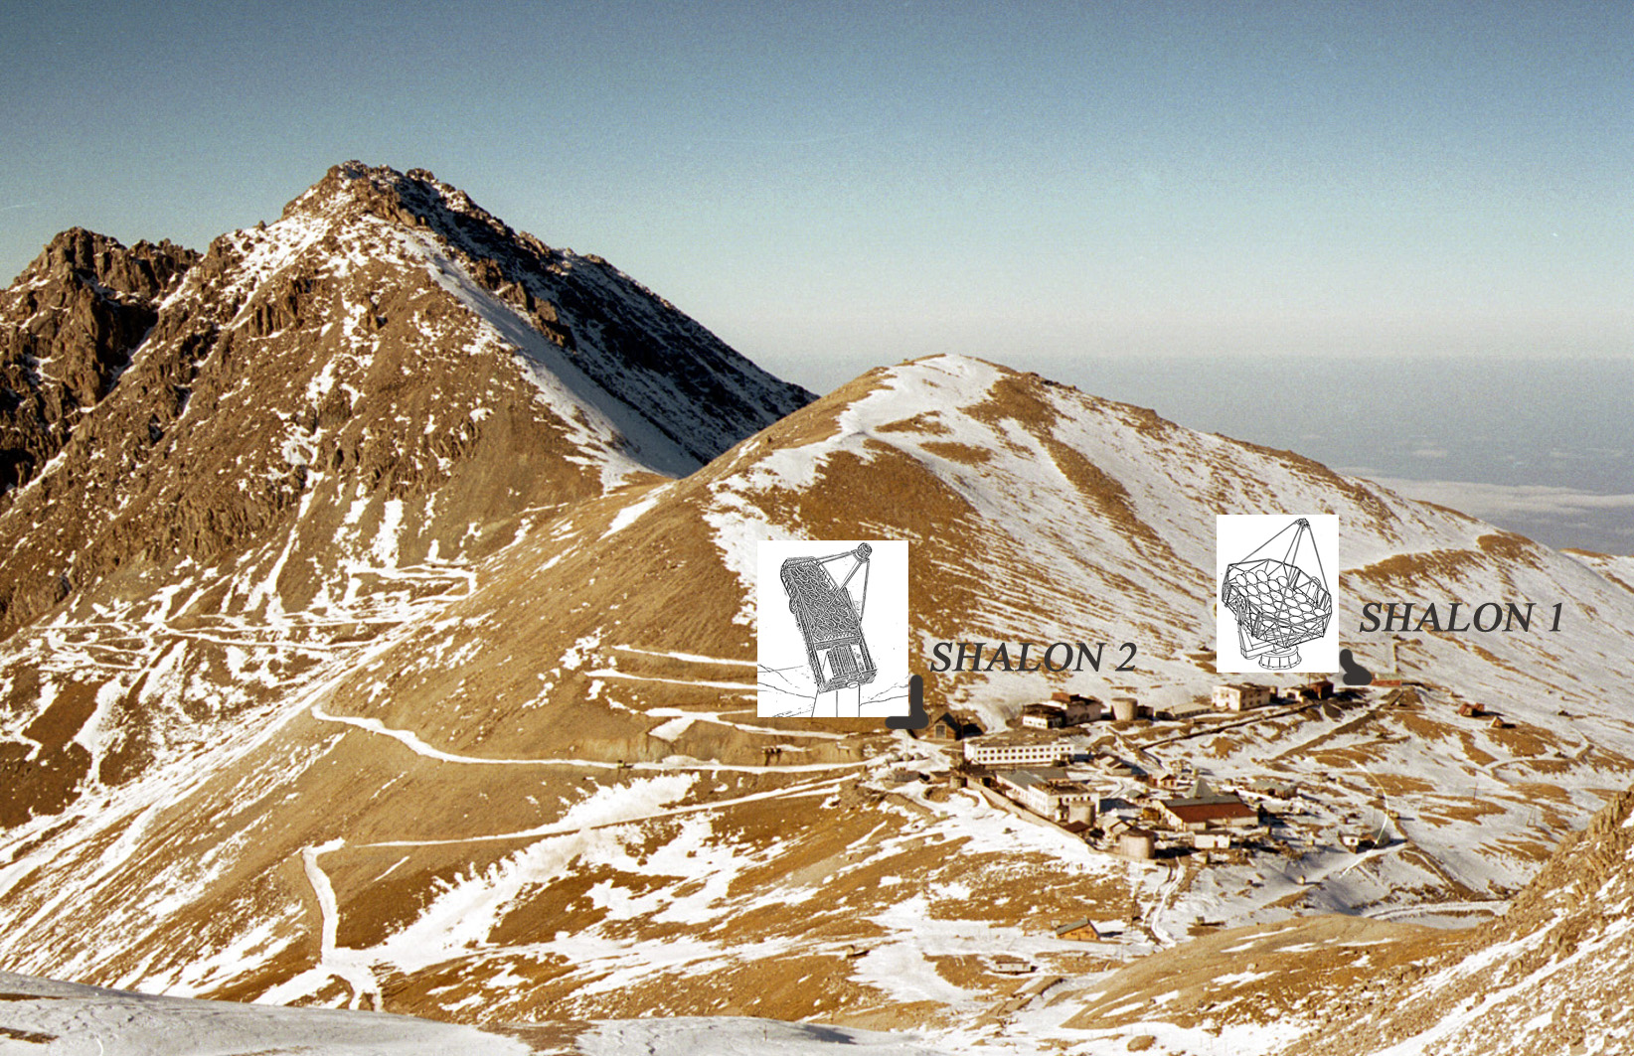
Notes:
5

Slide 6
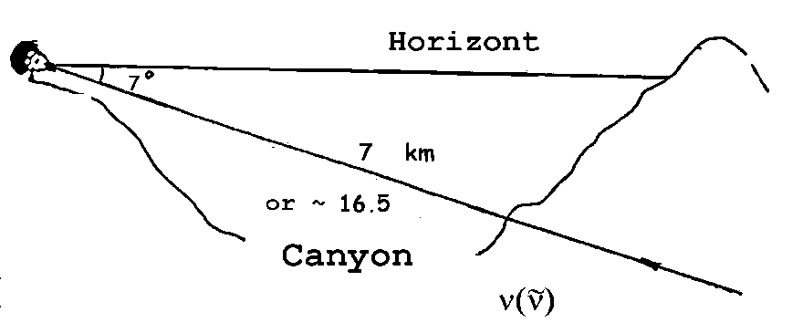
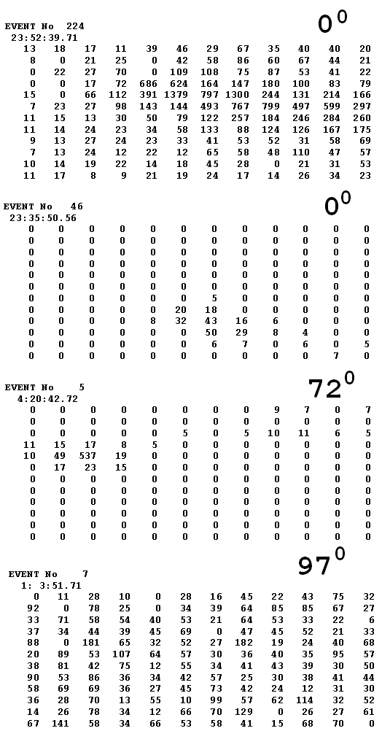
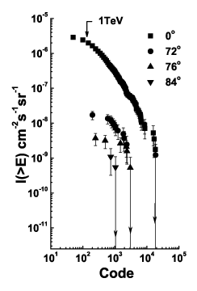
Extensive Air Showers under a Large Zenith Angle
SHALON is located at 3340 meters a.s.l. in the Tien-Shan mountain station. It has a mirror area of 11.2 m² and a large field of view above 8º, with an image matrix of 144 PMT and < 0,1º angular resolution. The recording of Cherenkov light is performed in 50 nsec intervals, which is enough to acquire complete information about the air shower while preventing additional light-striking. The SHALON telescope is calibrated according to the observations of EAS of cosmic ray at 0º - zenith angle. The cosmic ray shower image detected in the SHALON telescope, generally is elliptic spot in the light receiver matrix, written in the QADC counts (CODE).
Observations at large zenith angles have been aimed on study of spectra of the air showers induced by cosmic rays crossing through different atmosphere thickness and events accompanying the passing of EAS and cosmic ray particles near horizon. The observation at large zenith angles 72º, 76º, 84º showed that the efficiency of Cherenkov light detection drops essentially as a zenith angle increases, perhaps because of dissipation and absorption in the atmosphere. So, the comparison of observation results shown that at the zenith angle 84º the number of observed showers is ~ 25 times less than expected by estimation with neglecting by absorption and dissipation of Cherenkov photons in the atmosphere.

Slide 7
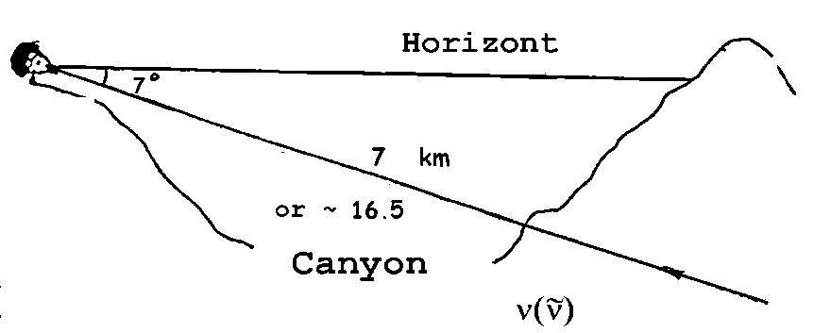
Extensive Air Showers under a Large Zenith Angle
The analysis of the observations allows one to make the following conclusion. At first, a night star sky doesn't produce any background events, preventing the observations of electron-photon cascades coming from under the earth surface. Secondary, the observation of Cherenkov bursts from extensive air showers under the large zenith angles, for example using of horizontal extensive air showers for investigation of an energy spectrum of ultra-high energy cosmic rays is complicated by absorption of Cherenkov photons by a large atmosphere thickness.
The spectra of showers observed under
0º, 72º, 76º and 84º
zenith angles
The amplitude of gray - scale shower image is propotional to the QADC count. The number, named CODE, shows the range of detected signals in the QADC counts, which are propotional to shower energy.

Slide 8
The observations of Cherenkov bursts under the 97 deg zenith angle
SHALON Cherenkov mirror telescope is located at 3340 m a.s.l. The mountain range lies in the east direction and is more than 4300 m a.s.l. The mountain range is about 20 km long. The mountain slope has a structure which is irregular on the scales less than typical shower size; it is covered with the forest. The thickness of matter in the telescopic field of view is from 2000 to 800 kms; viewed mountain slope area is > 7 × 10⁵ m². For telescope located about 7kms away from the mountain slope horizontally, the shadow of mountain is about 7º in elevation.
In actual conditions the mirror telescope placement the distance till the opposite slope of the gorge is ~7 km or ~ 16.5 radiation units of length, that is quite enough for the development of an electromagnetic cascade till the structure characteristic for the rarefied atmosphere. Observations at 97º zenith angle have been done in cloudless nights in absence of artificial lights and dry air. Reconstruction of shower coming direction using the analysis of shower shape and position of shower maximum (in case of non-gamma shower) is performed with accuracy < 0,5º which is enough to judge on whether it upward shower or near horizontal. Horizontal and down going shower is out of field of view because of narrow-beaming of Cherenkov telescope relative to ice or water neutrino telescopes.

Slide 9
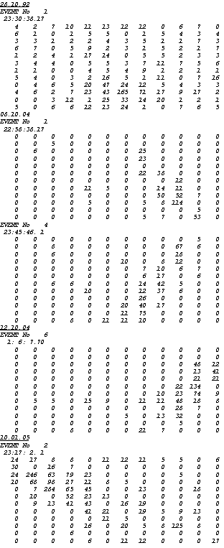
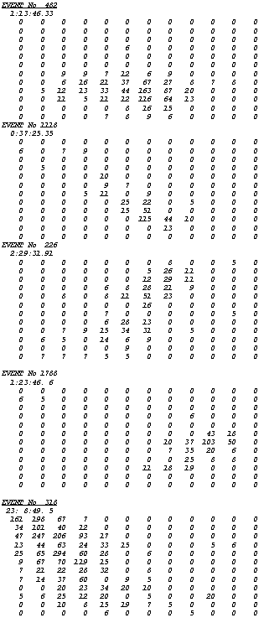
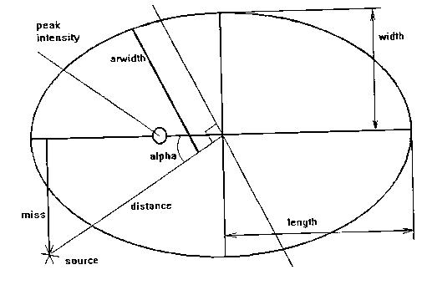
The observations of Cherenkov bursts under the 97 deg zenith angle
97^{о}
0^{о}
During 324 hours of observation at 97º zenith angle 323 short-range bursts were recorded. In accordance with the existing ideas and estimations [5, 11, 10] an appearance of electron-photon cascade from upward direction in current SHALON experiment conditions, which are above described, can be connected with passing of weakly interacting particles through rock and earth matter. The identity of upward neutrino initiated showers to cosmic ray ones in frames of concerning experiment has been performed in accordance to the following parameters used in the gamma-ray astronomy. The parameters used to characterize the shower image are image maximum position (xmax, ymax); length, width; the relation of two previous described Hillas parameters: Length/Width; two parameters sensible to the shower shape: Int0, Int1; The Int0 is the ratio of Cherenkov light intensity in pixel with maximum pulse amplitude to the light intensity in the eight surrounding [8]; The Int1 is the ratio of Cherenkov light intensity in pixel with maximum pulse amplitude to the light intensity in the in all the pixels except for the nine in the center of the matrix. In addition, the selection criteria we are using (Int0, Int1, Length/Width) are of the relative nature to describe 2-D shower structure, which is also different in current experiment conditions from vertical one by less than 10%. The parameter proportional to the energy of the shower is Code. The SHALON databank (since 1992) contains a millions of verified showers from vertical cosmic ray observations with their parameters, so the selection of the showers with a set of parameters of any sample can be performed.

Slide 10
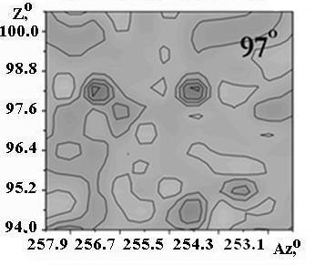
A search for upward UHE neutrinos with SHALON atmospheric Cherenkov telescope
97^{о}
0^{о}
During 324 hours of observations 5 events were detected (figs. left) which have expected angular characteristics of a light burst of an electron-photon cascade developing within a telescope observation angle. These showers have energy in the range of about 6 - 17,5 TeV. These 5 events have form characteristics and parameters similar (within 10% error) to those observed at 0º zenith angle (figs. right). These cascades look like the usual extensive air showers generated in atmosphere with narrow light shape. The background for this events can be some reflections of cosmic ray EAS in the mountain slope. First of all it could be a reflection of showers initiated by particles born in interaction of very high energy cosmic rays and rock matter nucleons. The energy of detected showers is more than 6 TeV. There is no albedo particles of such high energies. One more source of particles with high transverse energy is jet production. The probability of hadronic jet production with energy of observed showers is ten orders of magnitude less than one for detection of shower generated by secondary particles of UHE neutrino interaction. The reflection from snow which can mimed the EAS shape is excluded due to the irregular and woody structure of opposite slope (in addition: there is no snow there till the start of November).
All other 318 events of detection of short-range light bursts in the atmosphere have not a narrow angle light direction and are chaotically distributed along the whole matrix or its part of a light-receiver (see fig. right for 97º), no other type of shower image were found among the 318 mentioned pictures). These events may be interpreted as a reflection of a Cherenkov burst from a snow mountain slope or as an ionization luminescence of the atmosphere while an extensive air showers transition within a telescope observation angle.

Slide 11
Squares show the telescopic field of view at the moments of events coming;
Sky map of neutrino candidate events (cascade maxima) – red points;

Slide 12
Extensive Air Showers undera Large Zenith Angle
An possibility that can be readily excluded is the decay in the air of a muon or a tau lepton produced inside the rock. A 10 TeV muon could emerge if it is produced ≈ 1 km inside the rock [C. Amsleret al., 2008] (one out of 10⁵ incident neutrinos will produce a muon there). However, the muon decay length at TeV energies is around 10⁴km, so the probability that it decays in the air in front of the telescope is again too small. The neutrino fluxes required to explain the events from μ decays or from ν interactions are then similar (and excluded). The probability for tau lepton production in the rock and decay in the air is not higher. The tau becomes long-lived at ≈ 10⁸GeV. At 10 TeV it should be produced within the last meter of rock (cτγ≈ 0.5 m), which reduces very much the number of events.
Heavy neutrino decay
Therefore, we have to explore possible explanations based on new physics (SinitsynaV .G., Masip M., Nikolsky S.I., Sinitsyna V.Y arXiv:903.4654v1[hep-ph]). The ideal candidate should be a long-lived massive particle, neutral, frequently produced in air showers, and very penetrating: able to cross 1000 km of rock and decay within the 7 km of air in front of the telescope. If this particle has (possibly suppressed) couplings to the W and/or Z bosons, its mass m_{h} should be larger than m_{μ} (to decay in the last 7 km of air) and smaller than m_{τ} (to cross 1000 km of rock without decaying). Notice that if its decay length at 10 TeVis cτγ≈ 1000 km, at GeV energies it will tend to decay far from the detectors in colliders.
A first h model that we would like to discuss has been recently proposed by [Gninenko, 2009] to explain an anomaly at MiniBooNE [Aguilar-ArevaloA. A. etal.2007]. He claims that the excess of electron-like events in the interactions of the <E> ≈ 800 MeV ν_{μ} beam could be caused by the decay of a heavy neutrino if m_{h} ≈ 0.5 GeV, cτ_{h}≤ 30 m, and |U_{μh}|² ≈ 10⁻³μ_{B}. This explanation requires a large transition magnetic moment [R. N. Mohapatraand P. B. Pal, 1998], μ_{tran}≈ 10⁻¹⁰μ_{B}, which implies a dominant decay Mode ν_{h}→ γν. The final photon would convert into a e+e− pair with a small opening angle that would be indistinguishable from an electron in MiniBooNE. It is easy to see that such a particle could have an impact on the SHALON events. At 10 TeV its decay length is λ_{h}≈ 600 km. If ν_{h} is produced in the atmosphere with that energy, the probability that it crosses λ≈ 1000 km of rock and decays within the Δλ≈ 7 km of air in front of the telescope is p = e^{−λ/ λh}( 1 − e^{− Δλ/ λh}) ≈ 0.002. This implies that the atmospheric flux of heavy neutrinos should be a 1/1000 fraction of the TeV flux of primary cosmic rays. A slightly more frequent production rate could be expected in a second model, where h has a sizeable component along the tau neutrino. The dominant decay channels would be into ν_{τ}πº and into ν_{τ}ee, ν_{τ}μμ. If its decay length at the TeV energies of the sub-horizontal events is around 1000 km, then the probability of decay in the air in front of SHALON is ≈ 0.003.

Slide 13
97^{о}
0^{о}
A search for upward UHE neutrinos with SHALON atmospheric Cherenkov telescope
Conclusion
It is supposed to overcome the main difficulty of observation of EAS, generated by neutrino in conditions of high mountainous observations, connected with the small cross section of neutrino-nuclei inelastic collisions. Two facts allow to carry out the search experiments. The hadron cascades with energy > 10¹³ eV are generated by neutrino in the ground of mountain on the thickness <300g/cm². The Cherenkov radiation of the hadron cascades will be observed along the direction of neutrino by gamma-telescope placed on the distance about 7kms from a mountain slope in area of more than > 7×10⁵ m². These cascades look like the usual extensive air showers generated in atmosphere with narrow light shape. Presently, the fluxes of galactic gamma-quantum sources Cygnus X-3, Tycho's SNR, Geminga of <10⁻¹⁴cm⁻²s⁻¹ are observed by SHALON. The appearing of one shower per >100 observation hours is expected if the flux of neutrino from local sources is 10⁻¹⁵cm⁻²s⁻¹. During 324 hours of observations 5 events were detected which have expected angular characteristics of a light burst of an electron-photon cascade developing within a telescope observation angle.

Slide 14
97^{о}
Conclusion
When a cosmic ray enters the atmosphere it produces an extended air shower with thousands of secondary particles. Obviously, if there is any new physics it will be contained in a fraction of these events. Now, if this exotic physics includes a long-lived particle, we think that there is the potential for its discovery in cosmic ray experiments. Generically, to be detectable the particle must survive after the rest of the shower has been absorbed by the atmosphere (e.g., a long-lived gluino in horizontal air showers [J. I. Illana, M. Masipet al., 2007]) or the ground (as tau in neutrino telescopes [M. Ahlers, J. I. Illana, M. Masipand D. Meloni, 2007]). In particular, a long-lived neutral particle could propagate to the centre of a neutrino telescope and start there a contained shower when it decays. However, this event would look indistinguishible from a standard neutrino interaction. In this paper we discuss several air showers obtained at SHALON in a configuration where the expected number of events is zero. Around 1000 km of rock absorb 6 the atmospheric flux of any standard particles but neutrinos. Neutrino interactions in the rock are frequent, but they are not observable as they disappear in just half a meter of soil. A few muons could be produced during the last km and emerge from the rock, but then the probability of muon decay within the 7 km of air in front of the telescope is too small. The crucial difference with a neutrino telescope is that here the probability of a visible interaction (in the air or the last centimetres of rock) is negligible. We argue that these events may correspond to the decay of a neutral particle after it is produced in the atmosphere and has crossed 1000 km of rock. We have studied a couple of models where this particle is a heavy neutrino, and have concluded that although the required production rate seems higher than the expected one, due to a number of uncertainties on the flux and the energy of the exotic events oron the production of charmed particles in the atmosphere, none of these possibilities should be excluded. As a possible explanation, we discuss two scenarios with an unstable neutrino of mass m ≈0.5GeV and cτ≈30m. Remarkably, one of these models has been recently proposed to explain an excess of electron-like neutrino events at MiniBooNE.

Slide 15
97^{о}
0^{о}

Slide 16
[1] T. C. Weekes, arXiv:0811.1197 [astro-ph].
[2] H. J. V¨olk and K. Bernloehr, arXiv:0812.4198 [astroph].
[3] A. Achterberg, et al. [IceCube Collaboration],: Astropart. Phys. 2006, 26: 155.
[4] J. Abraham, et al., [Pierre Auger Collaboration],: Nucl. Instrum. Meth. A, 2004, 523: 50.
[5] V. G. Sinitsyna [SHALON Experiment],: in Proc. of Toward a Major Atmospheric Cherenkov Detector-II, Calgary, July 17-18 1993, ed. R. C. Lamb, 91, 1993.
[6] S. I. Nikolsky and V. G.Sinitsyna [SHALON Experiment],: VANT, Ser. TFE, 1987, 1331, 30.
[7] V. G. Sinitsyna, Prepared for 6th GeV - TeV Gamma Ray Astrophysics Workshop: Toward a Major Atmospheric Cerenkov Telescope, Snowbird, Utah, 13-16 Aug 1999.
[8] V. G. Sinitsyna et al., [SHALON Experiment],: Nucl. Phys. Proc. Suppl. 2003, 122: 247 ; Nucl. Phys. Proc. Suppl. 2008, 175-176: 455, 544; Nucl. Phys. Proc. Suppl. 2009, 196: 251, 433, 437, 442.
[9] V. Y. Sinitsyna et al., [SHALON Experiment],: in Proc. of the 28th International Cosmic Ray Conference, July 31-August 7, 2003. Trukuba, Japan. Editors: T. Kajita et al., 2369, 2004.
[10] L.K. Resvanis, Nucl.Phys.B (Proc. Suppl.), 2006, 151: 279.
[11] D. Fargion, ApJ, 2002, 570: 909.
[12] C. Amsler et al., [Particle Data Group],: Phys. Lett. B, 2008, 667: 1.
[13] C. G. S. Costa Astropart. Phys. 2001,16: 193. [14] S. N. Gninenko, “The MiniBooNE anomaly and heavy neutrino decay,” arXiv:0902.3802 [hep-ph].
[15] A. A. Aguilar-Arevalo et al., [The MiniBooNE Collaboration],: Phys. Rev. Lett. 2007, 98: 231801.
[16] R. N. Mohapatra and P. B. Pal: “Massive neutrinos in physics and astrophysics. Second edition,”World Sci. Lect. Notes Phys. 1998, 60; 1.
[17] A. M. Cooper-Sarkar et al. [WA66 Collaboration],: Phys. Lett. B, 1985, 160: 207.
[18] F. Bergsma et al. [CHARM Collaboration],: Phys. Lett. B, 1986,166: 473.
[19] P. Vilain et al., [CHARM II Collaboration],: Phys. Lett. B, 1995, 343: 453.
[20] P. Astier et al., [NOMAD Collaboration],: Phys. Lett. B, 2001, 506: 27. [arXiv:hep-ex/0101041].
[21] A. D. Dolgov, S. H. Hansen, G. Raffelt and D. V. Semikoz, Nucl. Phys. B, 2000, 590: 562.
[22] O. Adriani et al., [L3 Collaboration],: Phys. Lett. B, 1992, 295: 371.
[23] J. I. Illana, M. Masip and D. Meloni, Phys. Rev. D, 2007, 75: 055002.
[24] M. Ahlers, J. I. Illana, M. Masip and D. Meloni JCAP, 2007, 0708: 008.

