Slide 1
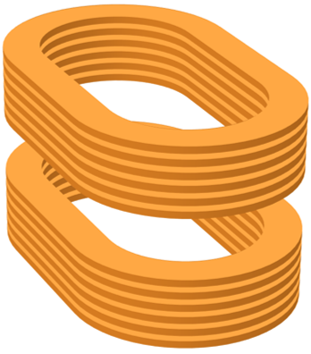
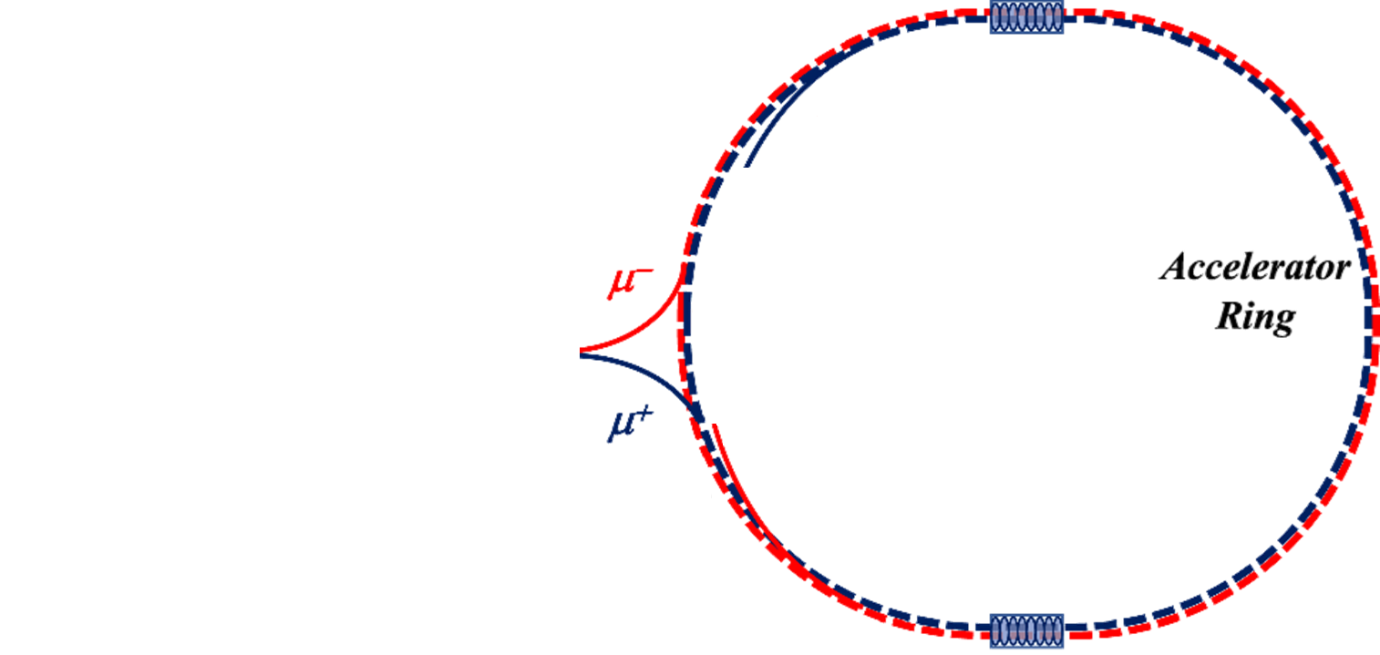
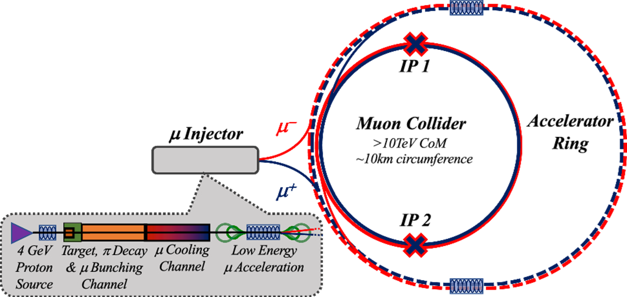
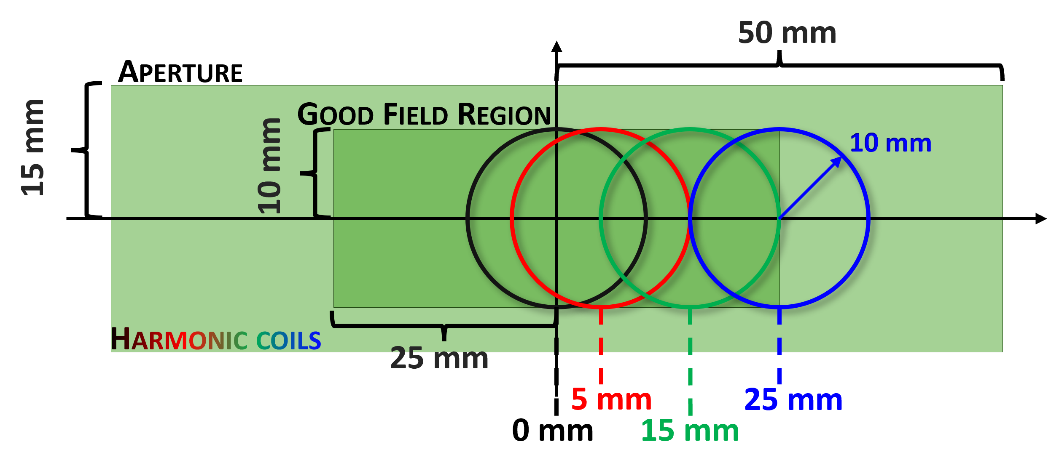
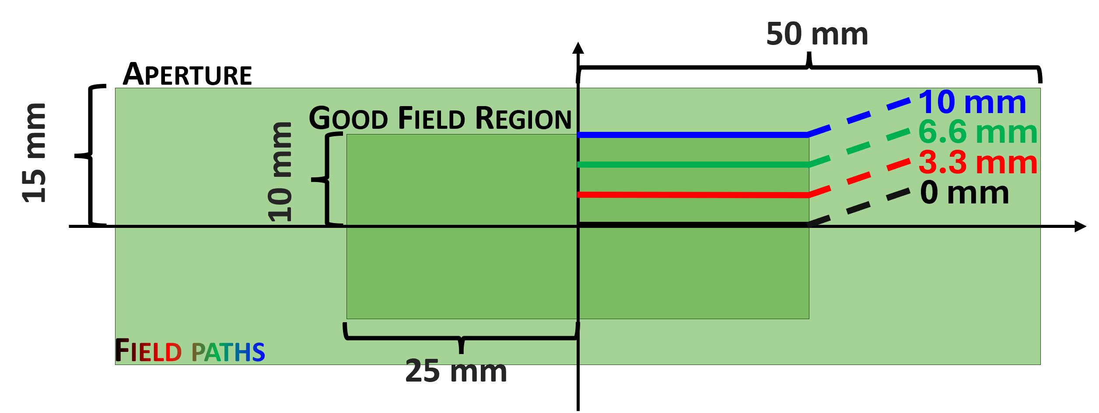
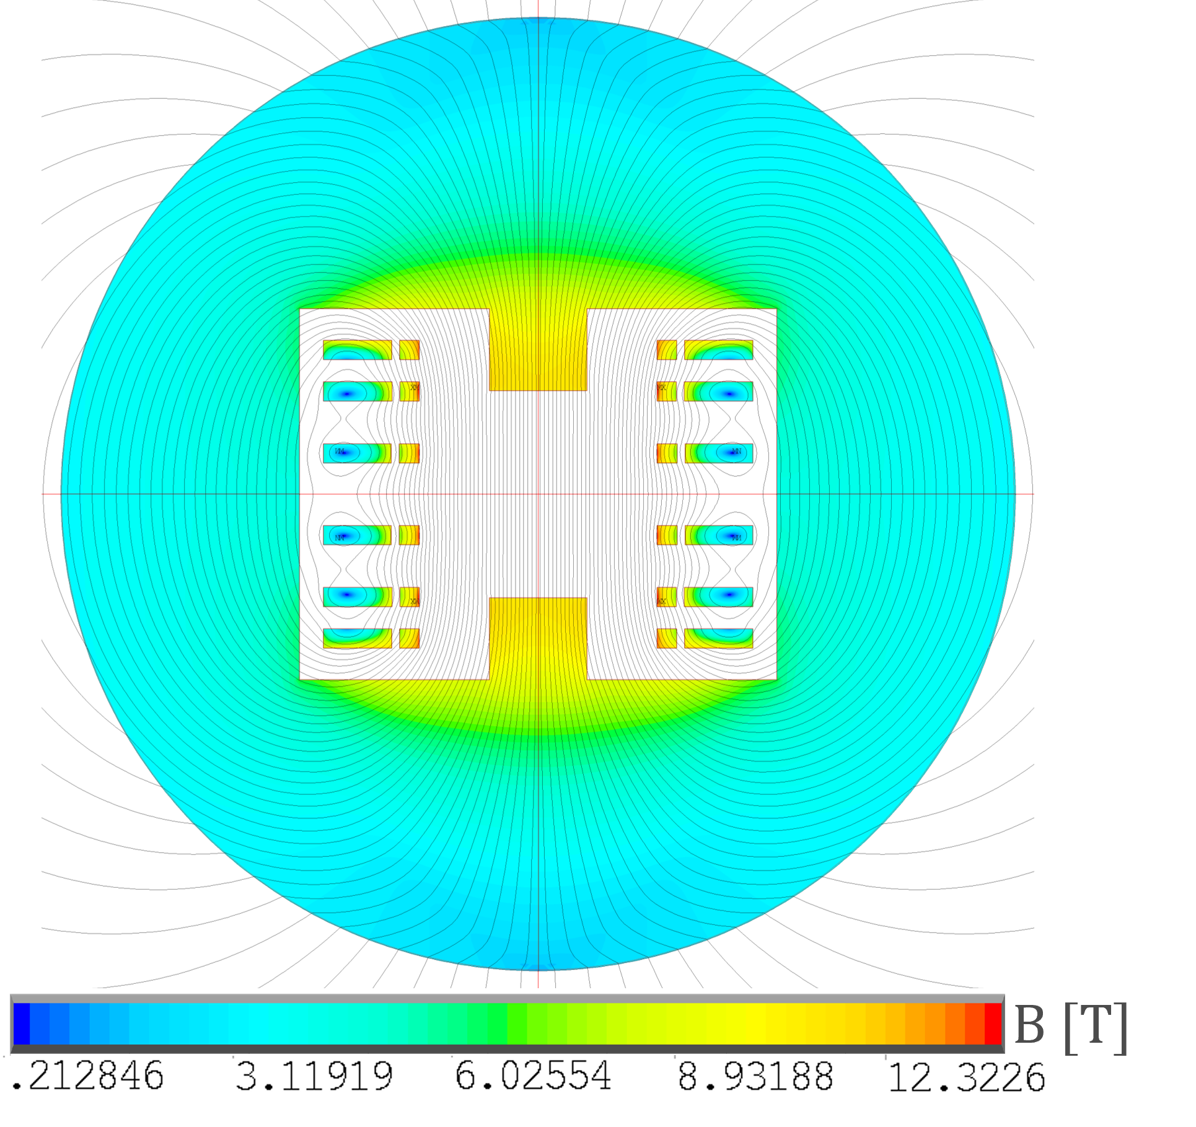
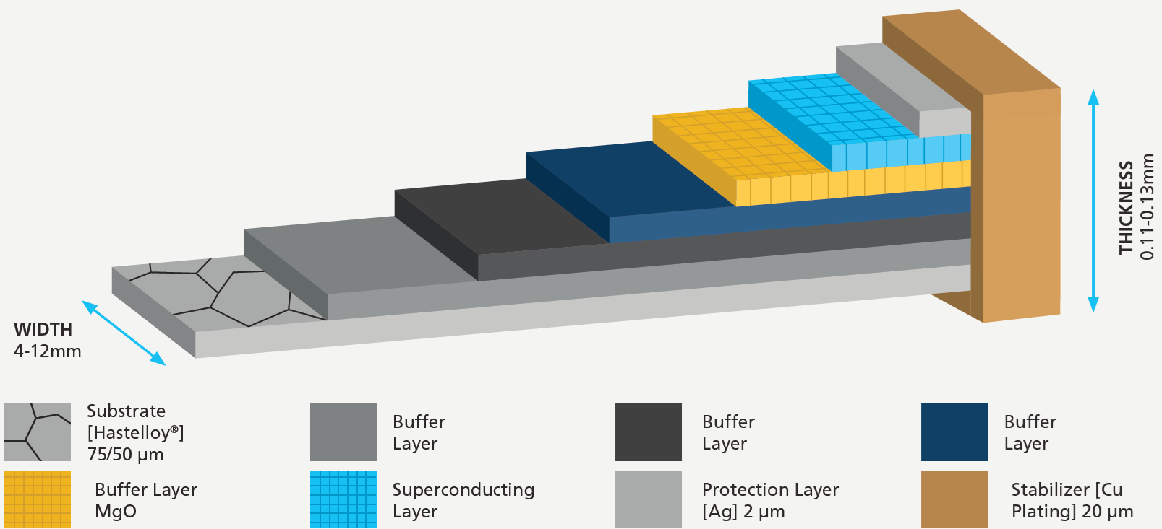
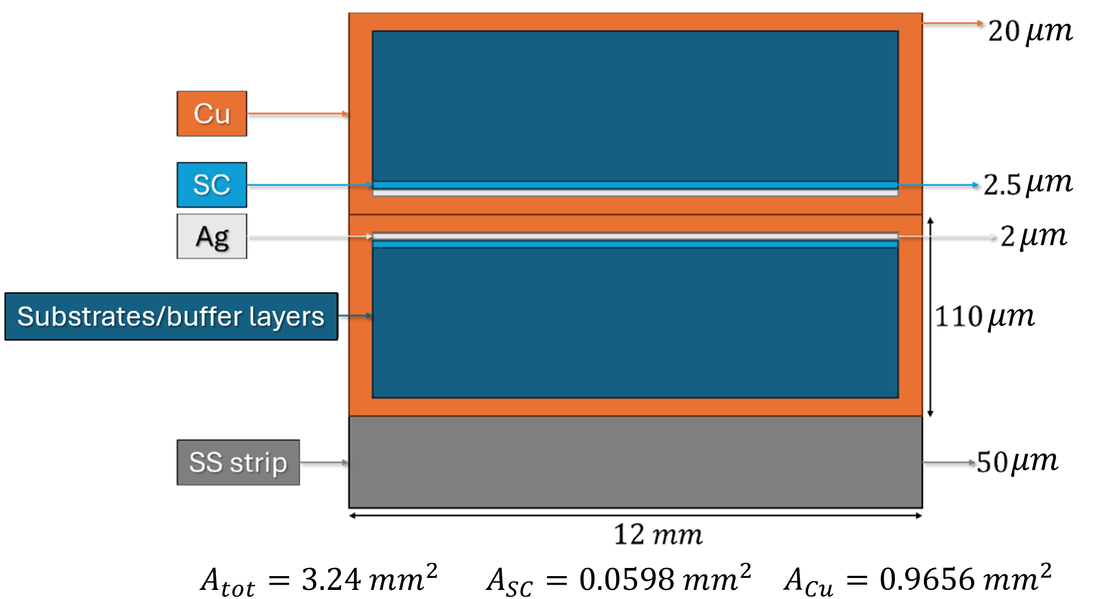
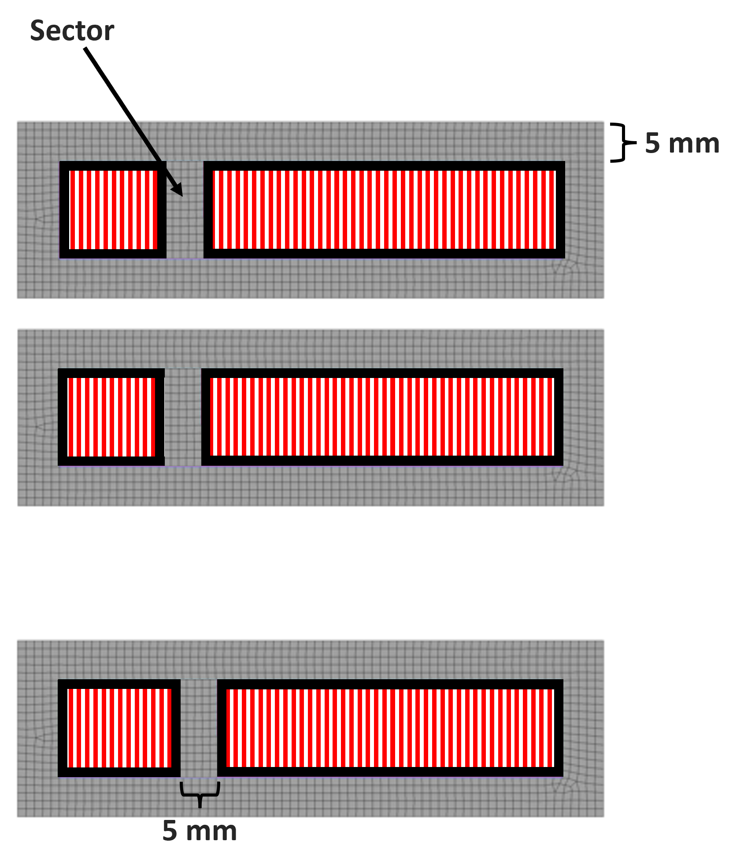
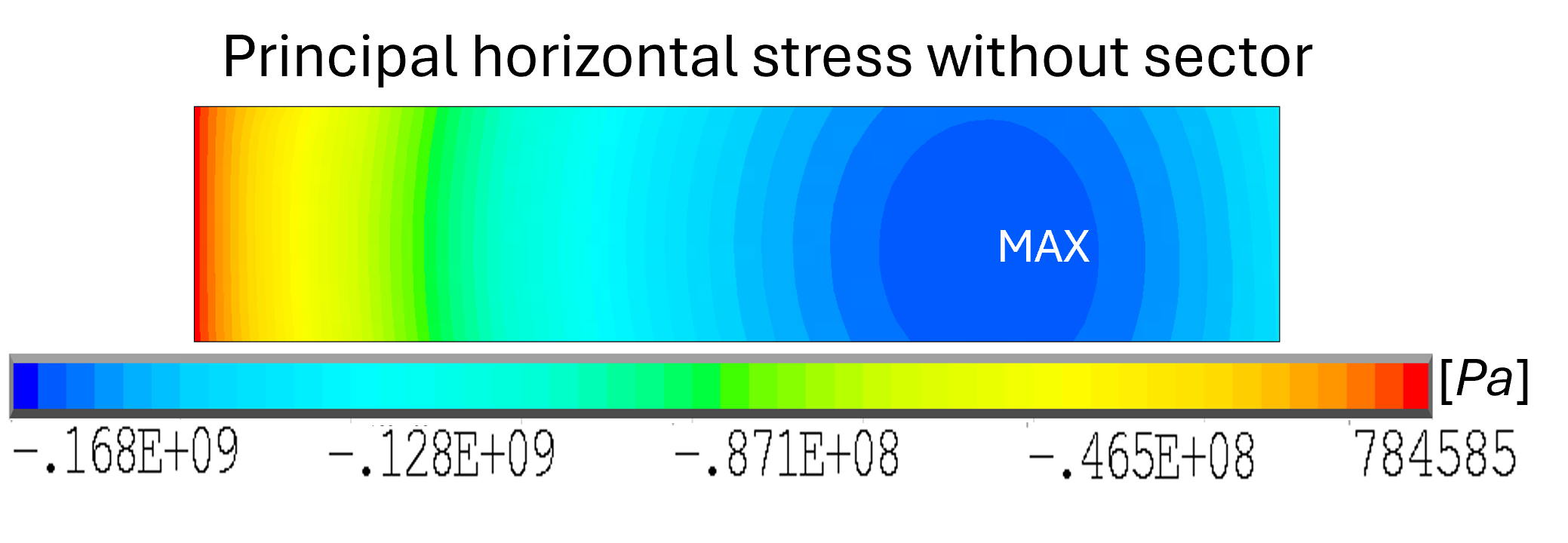
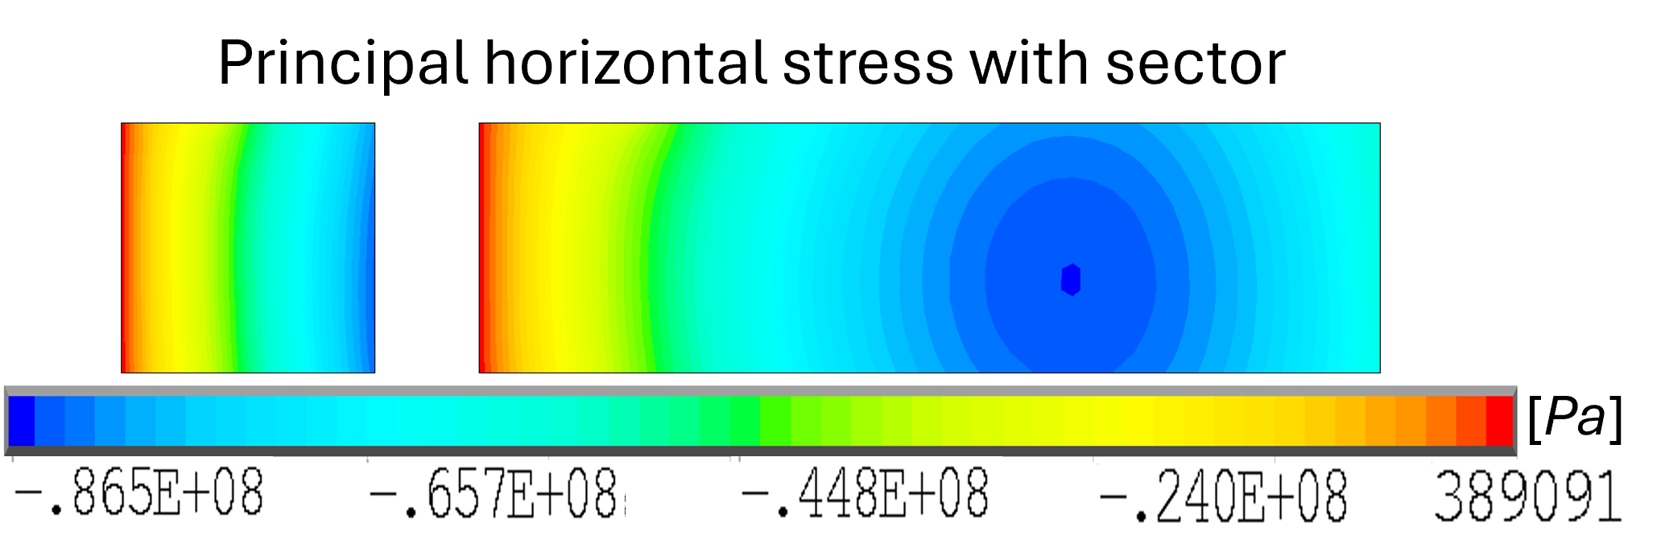
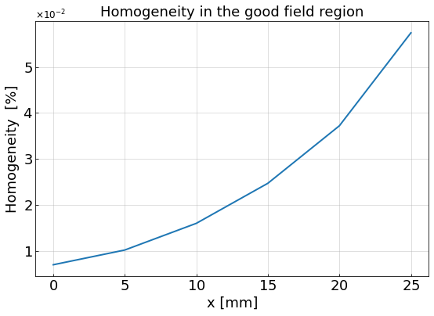
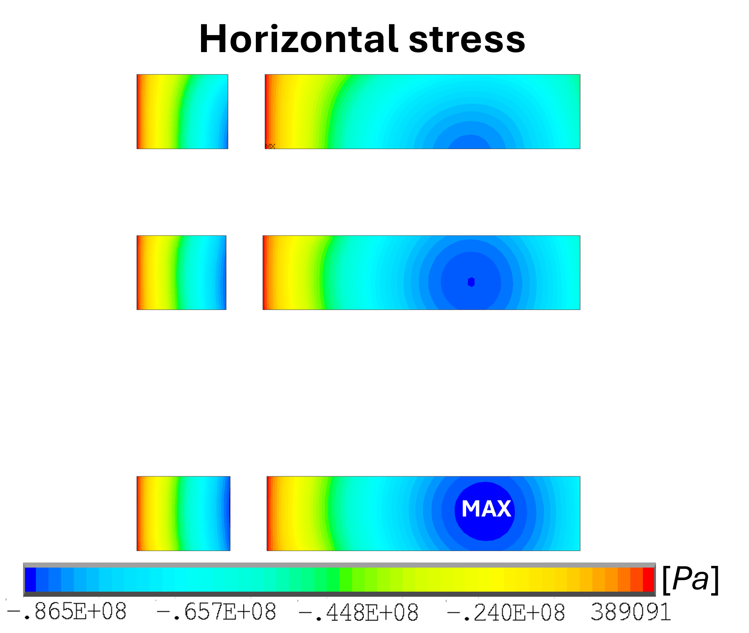
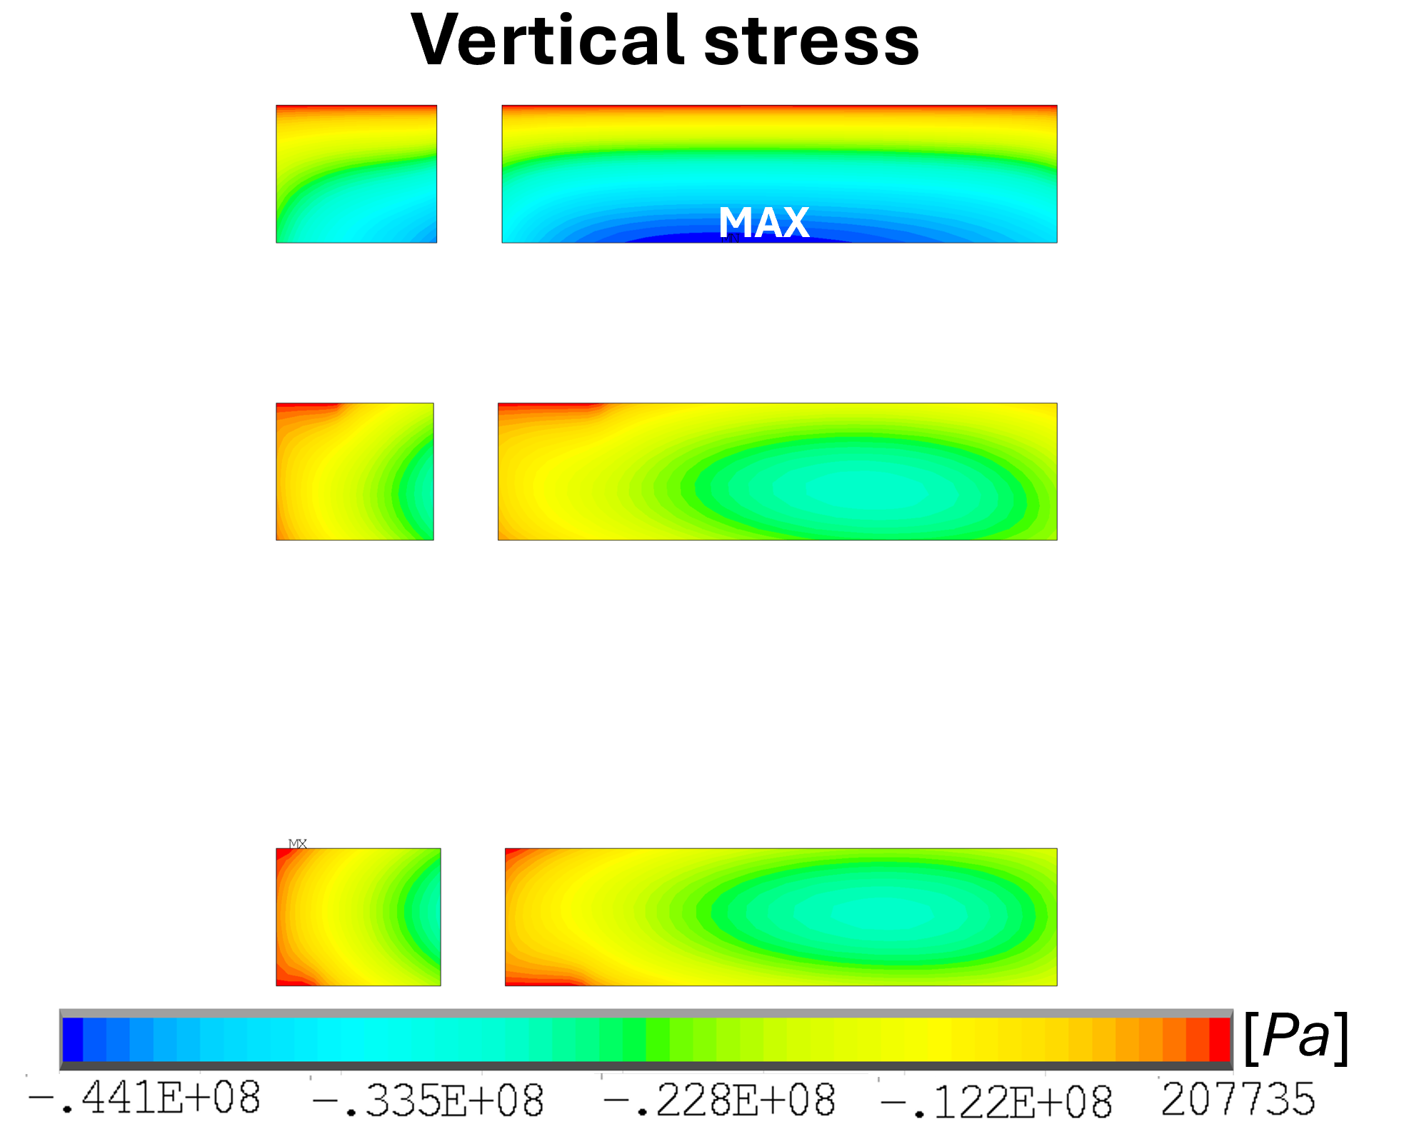
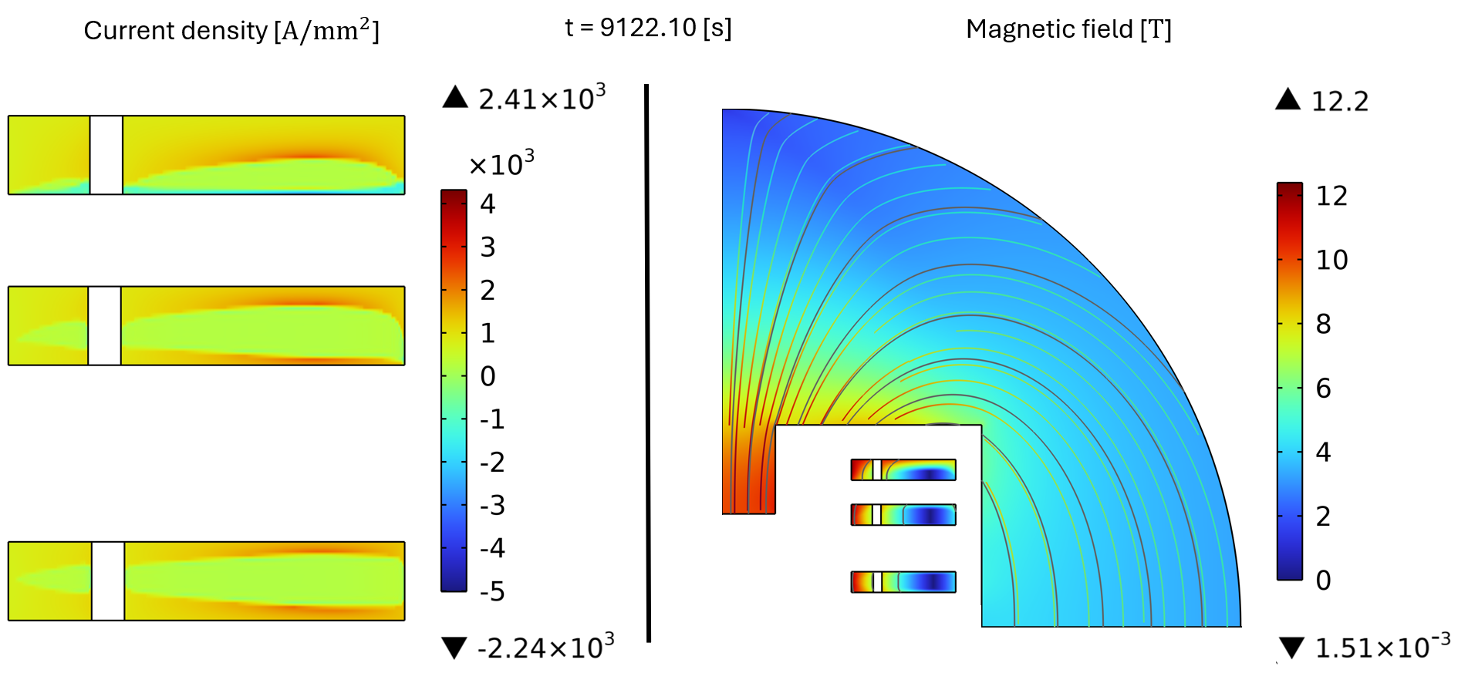
Magnetic and Mechanical Design of Large Aperture HTS Superconducting Dipole for the Muon Collider Accelerator Ring
A. Pampaloni^{1,5}, L. Alfonso¹, L. Balconi^{2,3}, A. Bersani¹, L. Bottura⁴, B. Caiffi¹, S. Fabbri⁴, S. Farinon¹, A. Gagno¹, F. Levi¹, T. Maiello¹, F. Mariani^{2,5}, S. Mariotto^{2,3}, D. Novelli^{1,5}, C. Santini², S. Sorti^{2,3}, M. Statera²
¹ INFN – Genova, ² INFN – Milano, ³ Università degli Studi di Milano, ⁴ CERN, ⁵ Sapienza Università di Roma
Main requirements of the dipole:
Large rectangular aperture (w x h): 100 x 30 mm;
Rectangular good field region (GFR) 50 x 20 mm;
Open midplane configuration;
10 T in the centre of the aperture;
Magnetic field harmonics $≤$ 10 units in the GFR;
Magnetic field homogeneity $≤$ 1 % in the GFR;
Operating temperature: 20 K;
Margin in temperature $≥\text{2}\text{.5} \text{K}$;
HTS REBCO cable;
Racetracks coils.
The Muon Collider complex
Magnetic design
I [A] | J $\left[\frac{A}{{mm}^{2}}\right]$ | B₀ [T] | B_{p} [T] | T_{op} [K] | Margin [K] | Cost $\left[\frac{k\text{€}}{m}\right]$
2381.13 | 734.92 | 10.00 | 12.32 | 20 | >2.5 | 196.24
Cable assumptions
# racetrack | # cond. left | # cond. right | # tot. cond.
1 | 47 | 158 | 205
2 | 45 | 160 | 205
3 | 46 | 159 | 205
3
2
1
Mechanical assumptions:
Infinitely rigid mechanical structure;
Homogenous material for racetracks: $E=150.3 GPa, ν=0.3$;
Maximum horizontal stress 400 MPa and maximum vertical stress 100 MPa;
Frictionless system;
Use of the sectors to reduce stress.
Magnetic results
MAX
${|b}_{n }|≤0.003, n>7$
Mechanical results
Cost
$$Cost$$
Conductor [k€/m] | 159.41
Iron yoke [k€/m] | 13.65
Mechanical structure [k€/m] | 3.18
Assembly [k€/m] | 20.00
Total cost [k€/m] | 196.24
Magnetization
$$ρ_{cond}=8000\frac{kg}{m^{3}}$$
$$C_{cond}=2500\frac{\text{€}}{kg}$$
Using T-A formulation, it is possible to make a model that simulates the charging phase of the magnet.
$$ρ_{iron}=7800\frac{kg}{m^{3}}$$
$$C_{iron}=8\frac{\text{€}}{kg}$$
Assumption:
$$ρ_{SS}=7800\frac{kg}{m^{3}}$$
$$C_{SS}=10\frac{\text{€}}{kg}$$
$$J_{x}=0$$
$$J_{y}=0$$
$$T_{y}=0$$
$$T_{z}=0$$
$$q_{tot}=\text{4}9.35 \frac{kJ}{m}$$
$$q_{peak}=\text{878.85} \frac{W}{m}$$
Magnetization of the cable causes a different current distribution that generates a different magnetic field map
The charging phase is characterized by a slope of 20 $\frac{A}{s}$ until the peak current of $I_{max}=2399.48 A$ and the current stays constant for $9000 s$
IMCC and MuCol annual meeting 2025

