Slide 1
Bunch rotation experiments and benchmarking at SNS
Austin Hoover, Vasiliy Morozov
IMCC and MuCol Annual Meeting
Hamburg, Germany
May 13, 2025

Slide 2
Outline
SNS resembles IMCC proton driver concept
SNS has unique capabilities (bunch intensity, energy flexibility, phase space painting, diagnostics)
Feasibility of bunch compression using existing hardware
Preliminary simulations and experiments

Slide 3
Overview of SNS accelerator and comparison to IMCC design

Slide 4
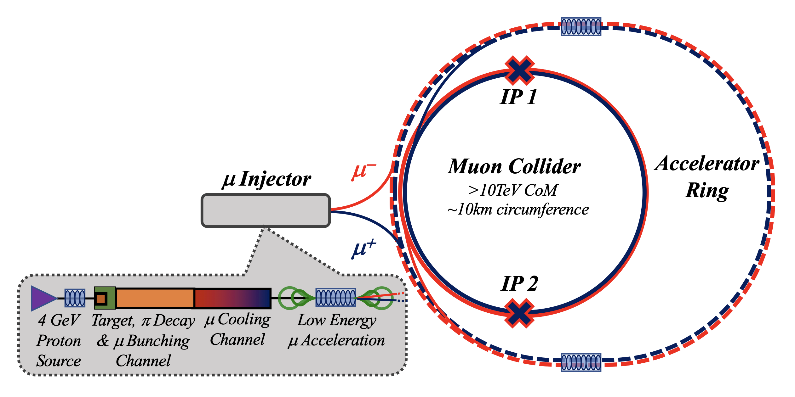
https://arxiv.org/abs/2303.08533

Slide 5
https://arxiv.org/abs/2303.08533

Slide 6
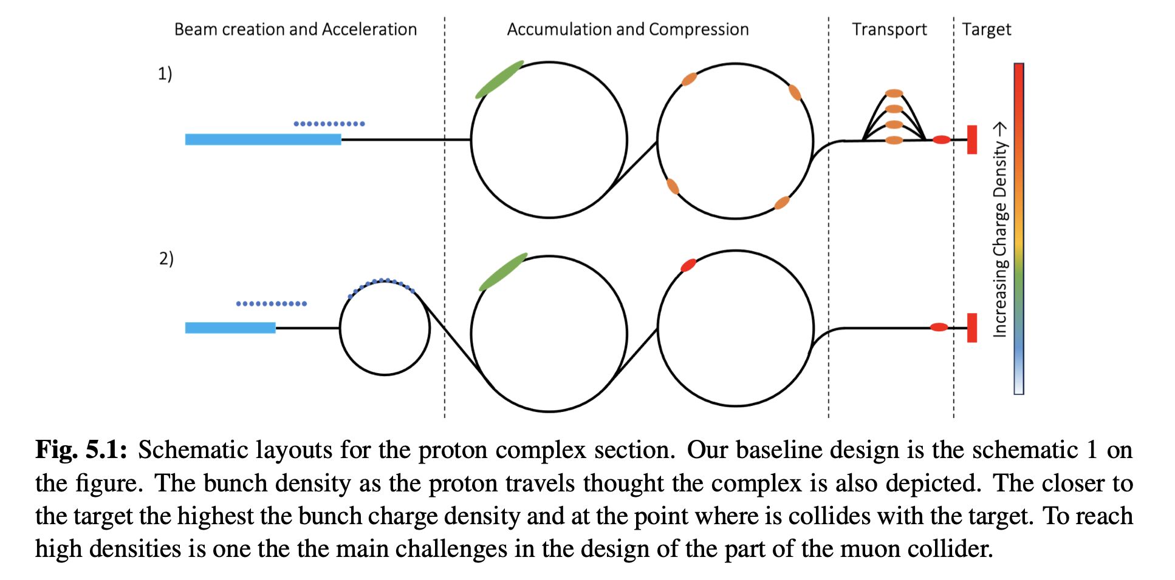
https://arxiv.org/abs/2407.12450

Slide 7
2-4 MW
5-10 GeV
10 Hz
2 ns
https://arxiv.org/abs/2407.12450

Slide 8
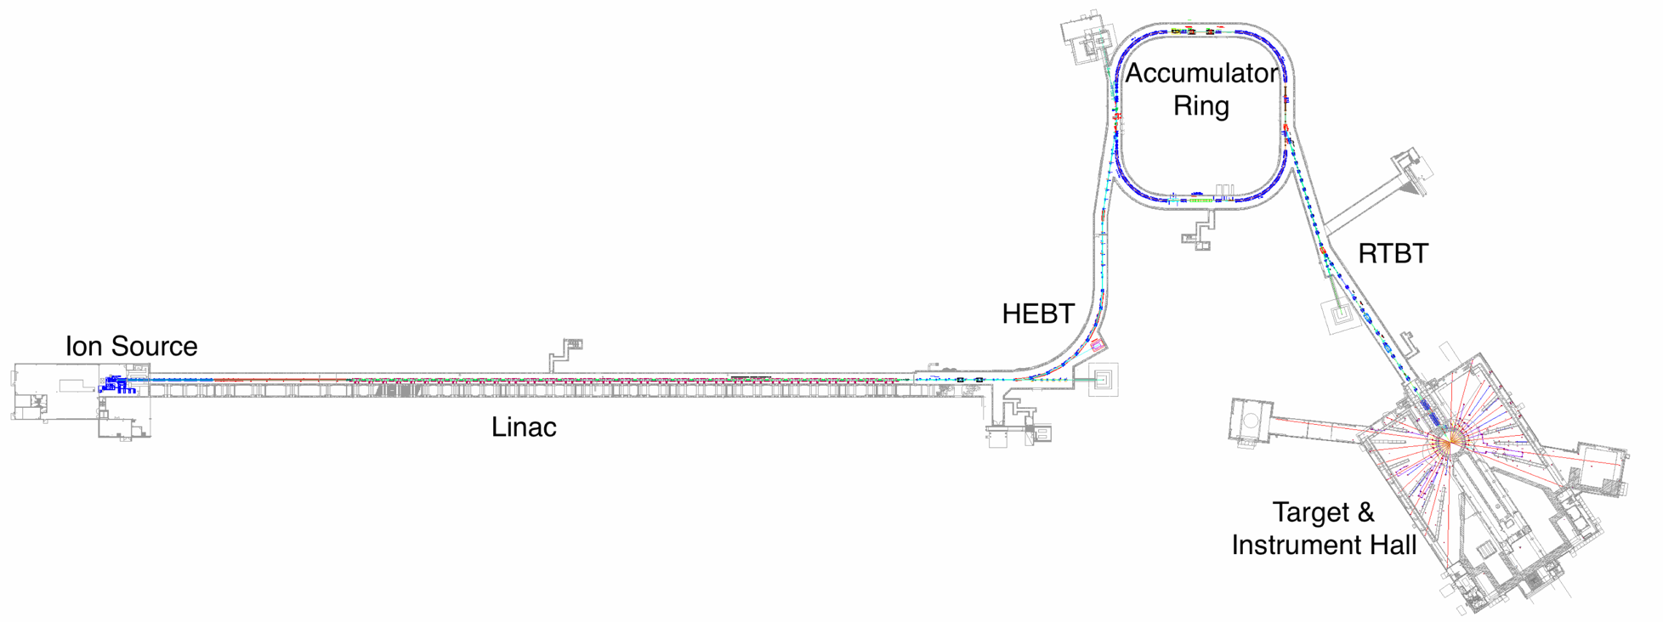
Front end forms 1ms chopped H- beam (~42 mA)
2.5 MeV
RFQ
MEBT
Ion Source

Slide 9
Front end forms 1ms chopped H- beam (~42 mA)
Linac accelerates to 1.3 GeV
2.5 MeV
86.8 MeV
186 MeV
387 MeV
1050 MeV
RFQ
MEBT
DTL
CCL
SRF $β=0.61$
SRF $β=0.81$
Ion Source

Slide 10
Accumulator ring compresses 1 ms pulse to 700 ns
Charge exchange + painting
Front end forms 1ms chopped H- beam (~42 mA)
Linac accelerates to 1.3 GeV
RF (h=1,2)
2.5 MeV
86.8 MeV
186 MeV
387 MeV
1050 MeV
RFQ
MEBT
DTL
CCL
SRF $β=0.61$
SRF $β=0.81$
Ion Source
Notes:
No acceleration in ring; rf maintains extraction gap

Slide 11
Accumulator ring compresses 1 ms pulse to 700 ns
Charge exchange + painting
Front end forms 1ms chopped H- beam (~42 mA)
Linac accelerates to 1.3 GeV
RF (h=1,2)
2.5 MeV
86.8 MeV
186 MeV
387 MeV
1050 MeV
RFQ
MEBT
DTL
CCL
SRF $β=0.61$
SRF $β=0.81$
Ion Source
1.8 MW @ 60 Hz

Slide 12
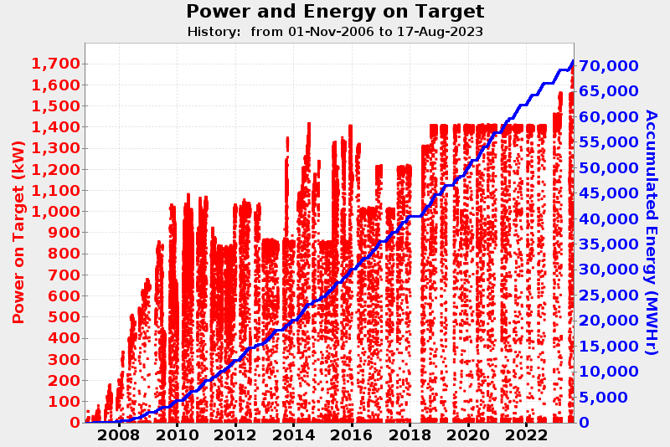

Slide 13
2.8 MW

Slide 14
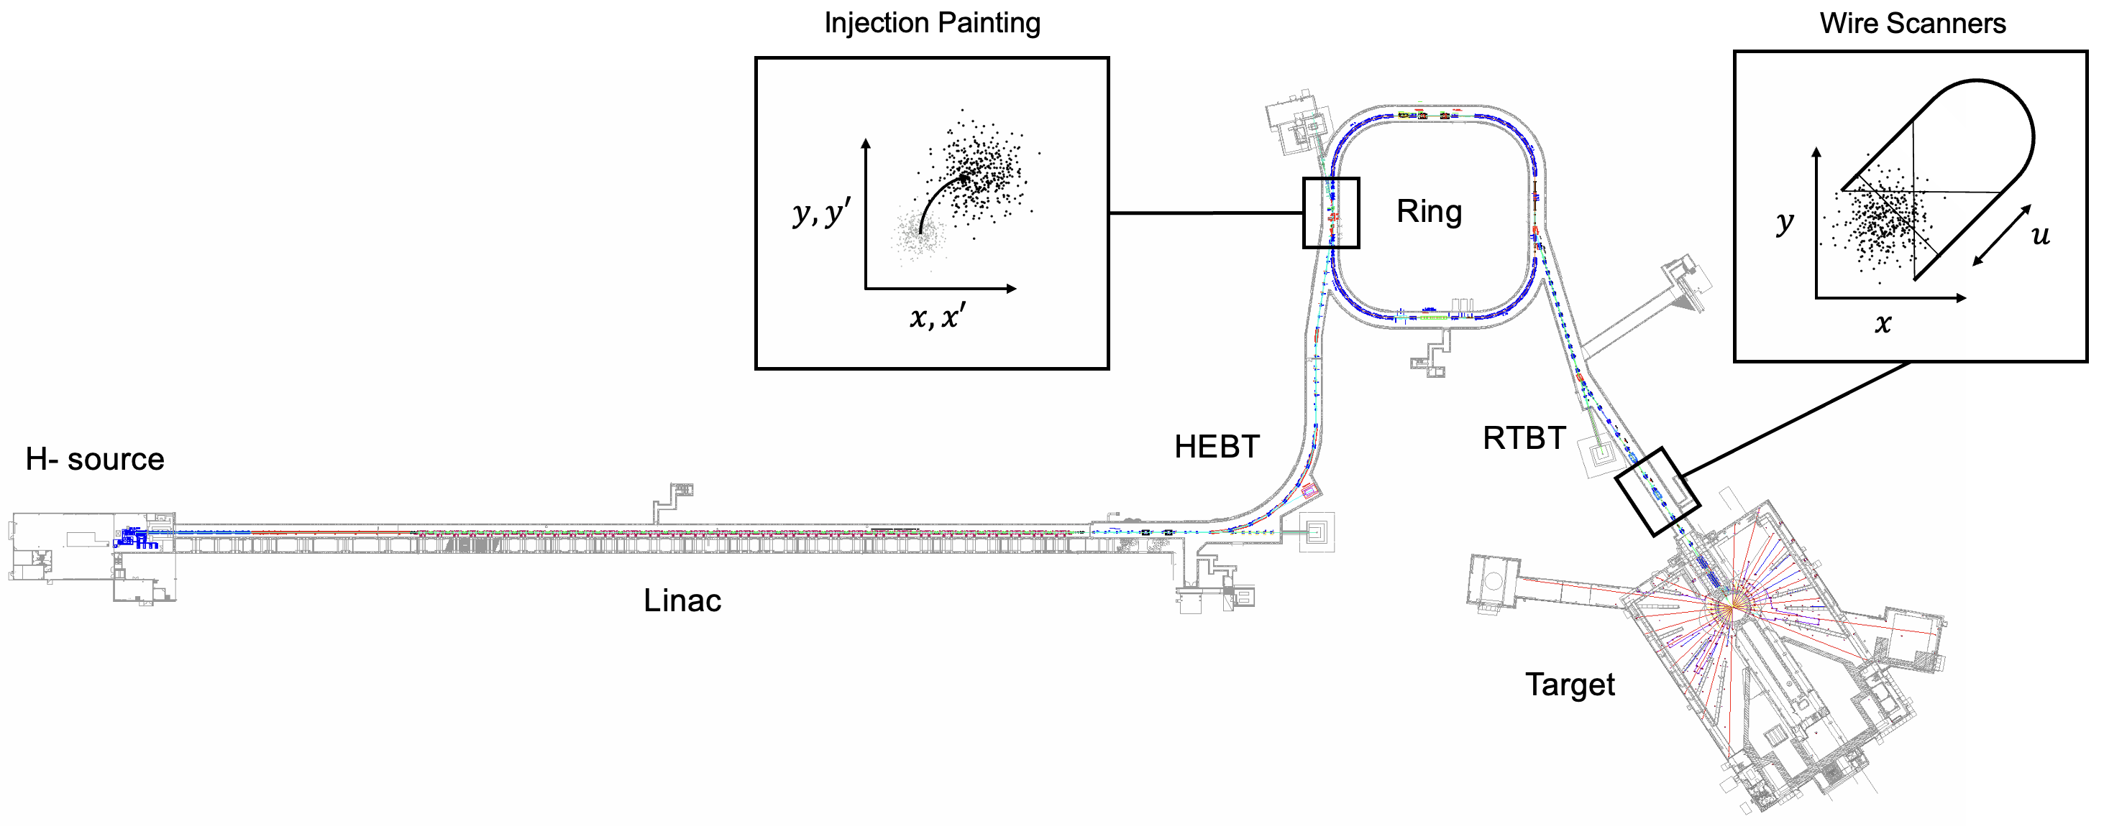
Collective effects can be amplified using phase space painting

Slide 15
Collective effects can be amplified using phase space painting and beam energy reduction
Turn off cavities to lower energy (1.3 → 0.8 GeV)
$$γ_{1}/γ_{2}≈1.29$$

Slide 16
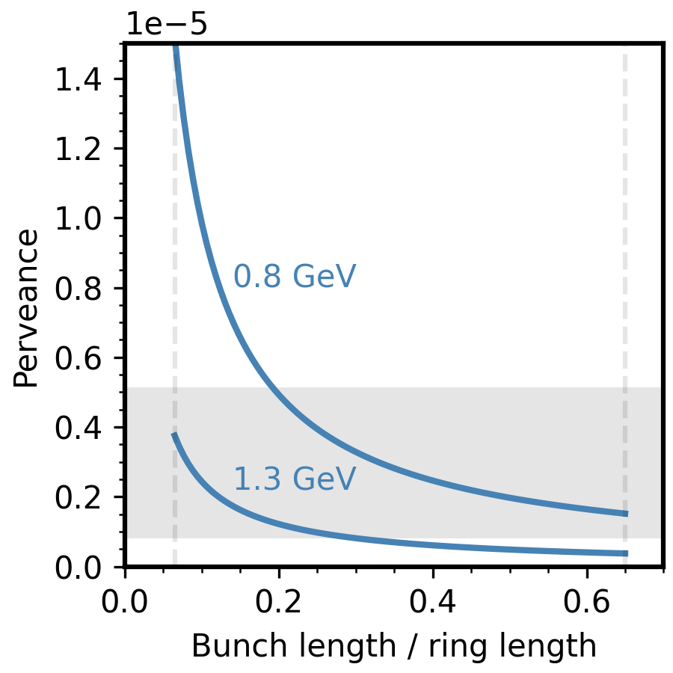
With strong compression, SNS could probe MC space charge regime
SNS 2.8 MW
$$Q\sim \frac{λ}{{β^{2}γ}^{3}}$$
5 GeV, 2 MW
MC (~2 ns bunch)
10 GeV, 4 MW
Notes:
Right vertical line shows nominal bunch length relative to 250 meter SNS ring length. This assumes a uniform density bunch.
Left vertical line shows factor of 10 compression, which would be the absolute

Slide 17
Diagnostics available to measure turn-by-turn particle distribution
Diagnostic | Measured Quantity | Operational? | Speed
Ring instability monitor (RIM) | $$FFT\left\{ \overline{x}\left(z,t\right), \overline{y}\left(z,t\right) \right\}$$ | Yes | Instant
Beam position monitors (BPM) | $$\left\{\overline{x}\left(t\right),\overline{y}(t)\right\}$$ | Yes | Instant
Beam current monitor (BCM) | $$ρ(z,t)$$ | Yes | Instant
Wire scanners (WS) | $$\left\{ρ\left(x \right),ρ\left(y\right),ρ(x−y)\right\}$$ | Yes | 5-15 mins
Electron scanner (ES) | $$\left\{ρ\left(x,z,t\right),ρ(y,z,t)\right\}$$ | No… | Instant

Slide 18
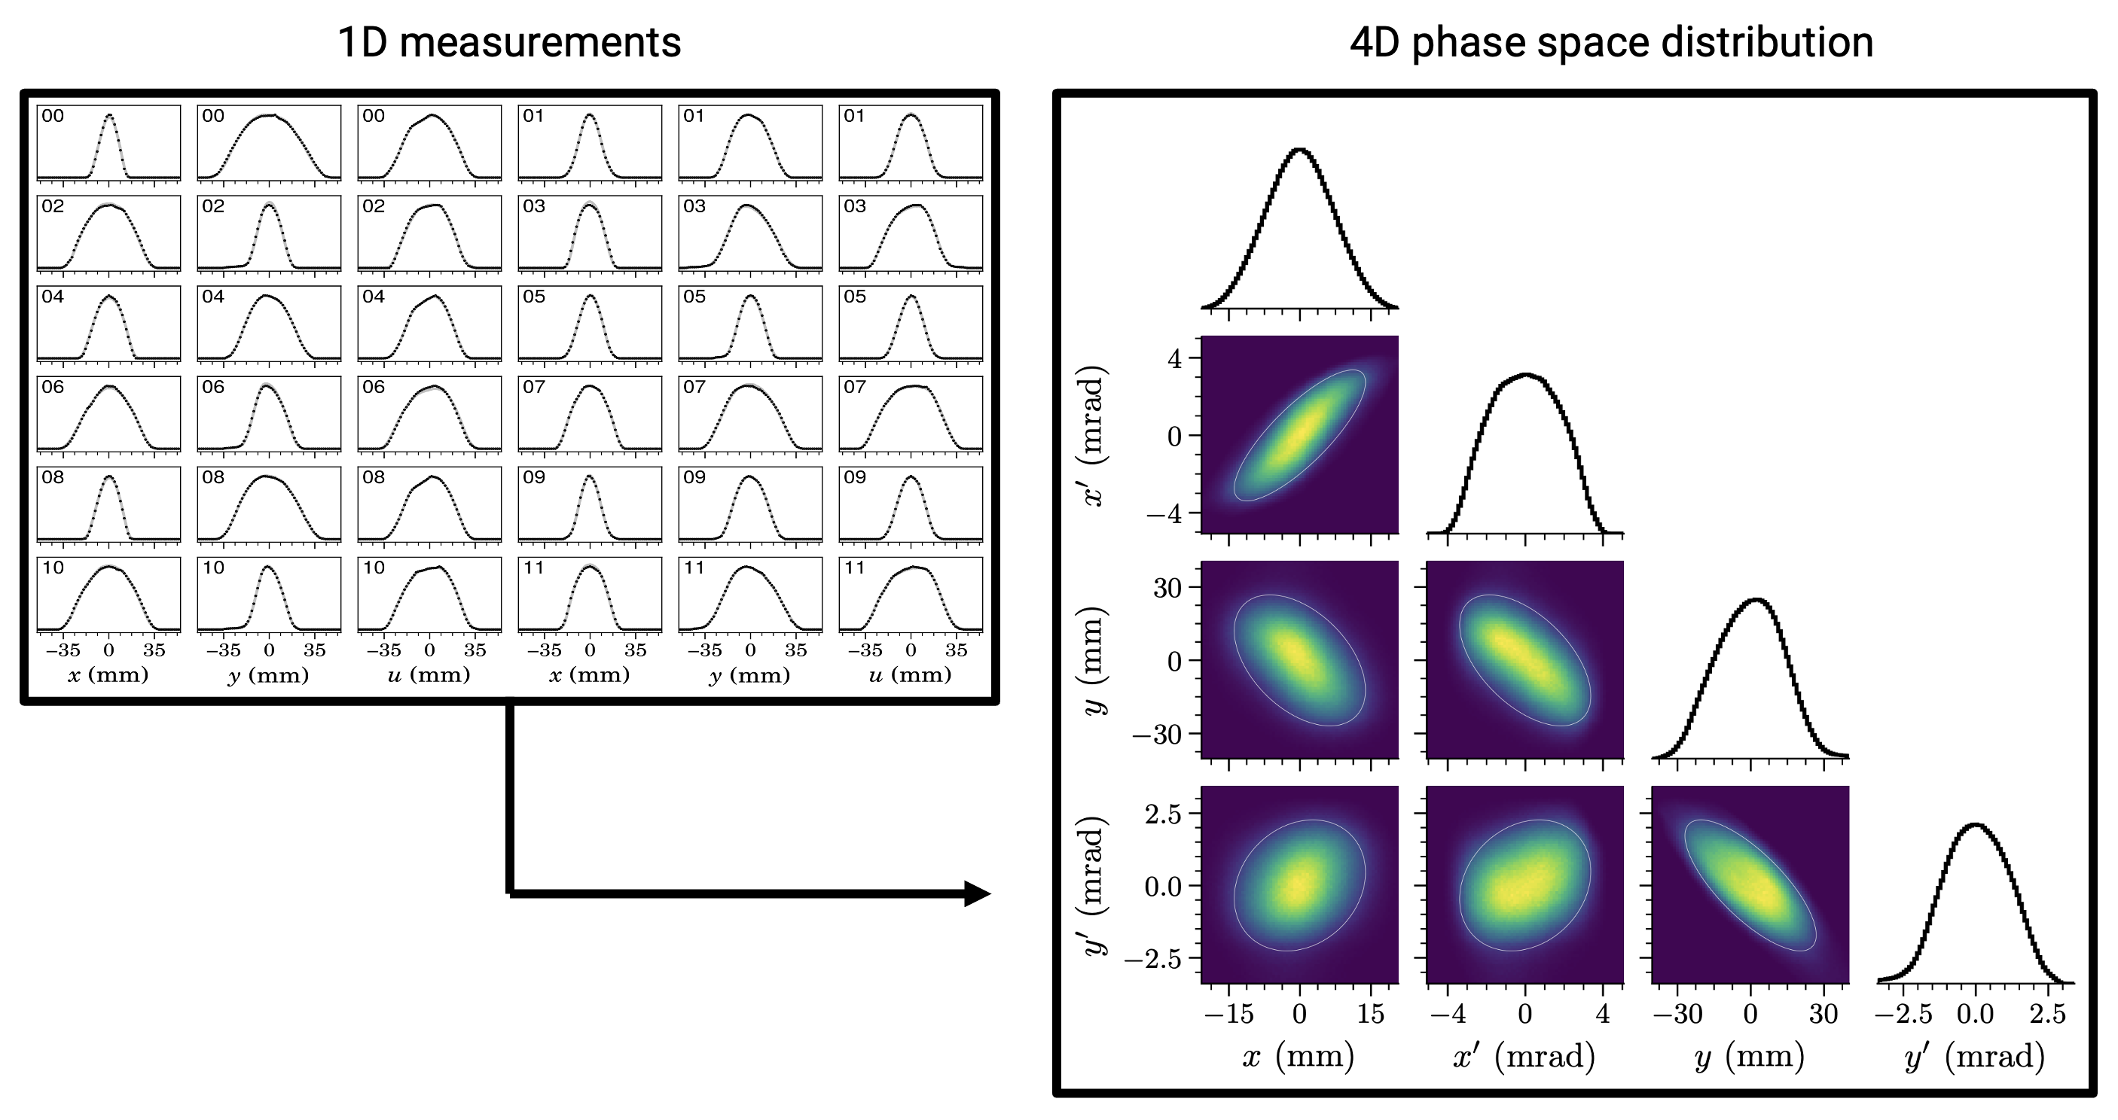
1D measurements constrain 2D/4D phase space density of accumulated bunch
Phys. Rev. Accel. Beams 27, 122802 (2024)
Notes:
https://doi.org/10.1103/PhysRevAccelBeams.27.122802
Can measure different turns

Slide 19
Feasibility of bunch compression at SNS
Notes:
Can we compress the bunch using available RF power?

Slide 20
Goal 1: Accumulate with barrier waveform
Barrier
$$dE [MeV]$$
Barrier
$$z [m]$$
Notes:
Problem: no barrier cavities

Slide 21
Goal 2: Compress with single-harmonic waveform
H=1
$$dE [MeV]$$
Barrier
$$z [m]$$
Notes:
Problem: waveforms must change mid-cycle
Problem: weak RF and limited storage time
Problem: significant beam-cavity interaction
…

Slide 22
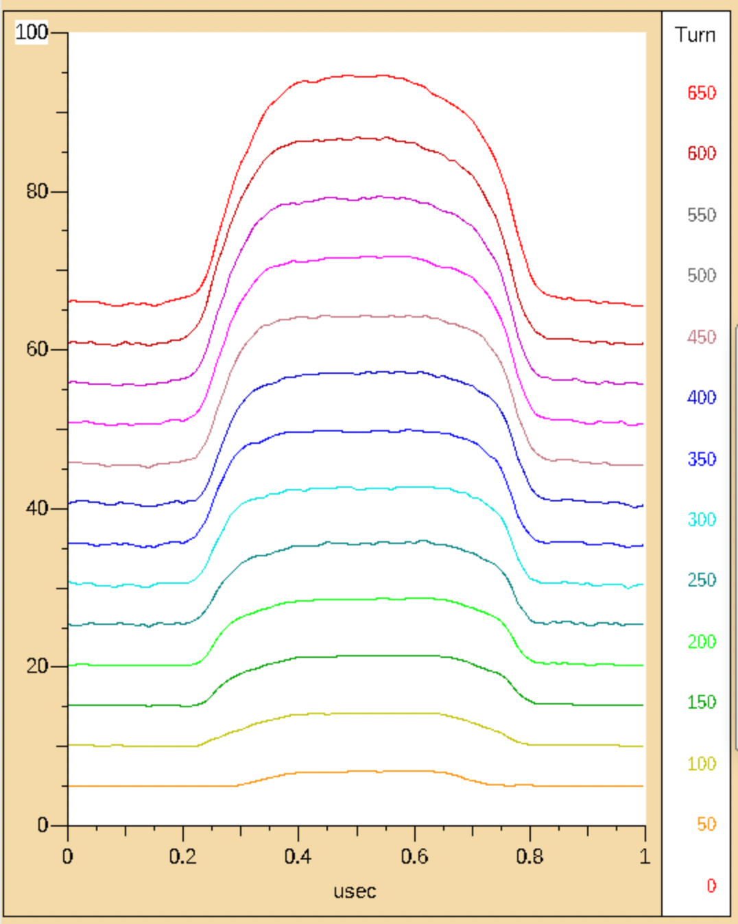
SNS uses dual-harmonic RF to maintain extraction gap and reduce peak density
H=1,2
Barrier
Notes:
Problem: waveforms must change mid-cycle
Problem: weak RF and limited storage time
Problem: significant beam-cavity interaction
…

Slide 23
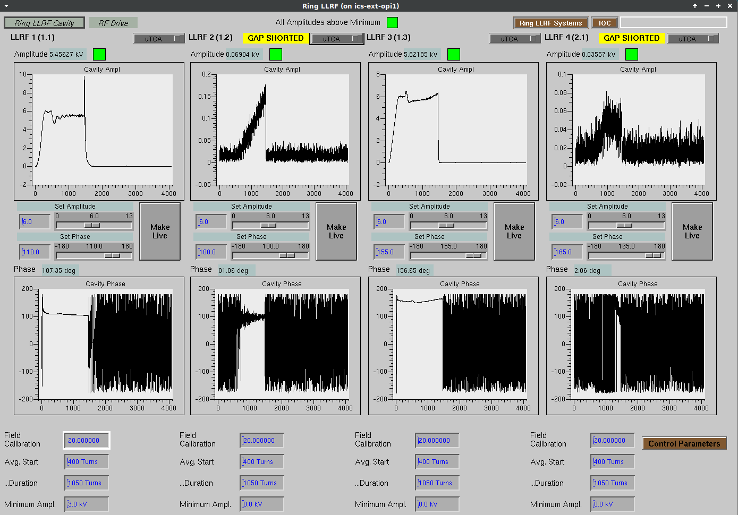
2/4 cavities used during production (6/13 kV)
RF1
RF2
RF3
RF4
H=1
H=1
H=2
H=2
Amp
Phase

Slide 24
Feedback system modifies phases/amplitudes
RF1
RF2
RF3
RF4
Injection
Extraction
Amp
Phase

Slide 25
Question 1: Can we approximate barrier waveforms during accumulation?
Barrier
Barrier

Slide 26
Question 1: Can we approximate barrier waveforms during accumulation?
Idea 1: Turn off cavities

Slide 27
Question 1: Can we approximate barrier waveforms during accumulation?
Idea 1: Turn off cavities
Idea 2: Force zero net voltage using RF feedback system

Slide 28
Set = 1.5 kV
Set = 0.5 kV
Set = 0 kV
Notes:
Beam was injected for 100 turns and then stored for 800 turns.
Initial ramp and flat-top is before beam starts injecting.
Initial spike is cased by beam; voltage/phase adjust to maintain voltage.
Want to test if this could work with higher beam intensity.
Could try using feedforward control loop to damp initial spike.

Slide 29
Question 1: Can we approximate barrier waveforms during accumulation?
Idea 1: Turn off cavities
Idea 2: Force zero net voltage using RF feedback system
Idea 3: Approximate barrier waveforms using additional harmonics

Slide 30
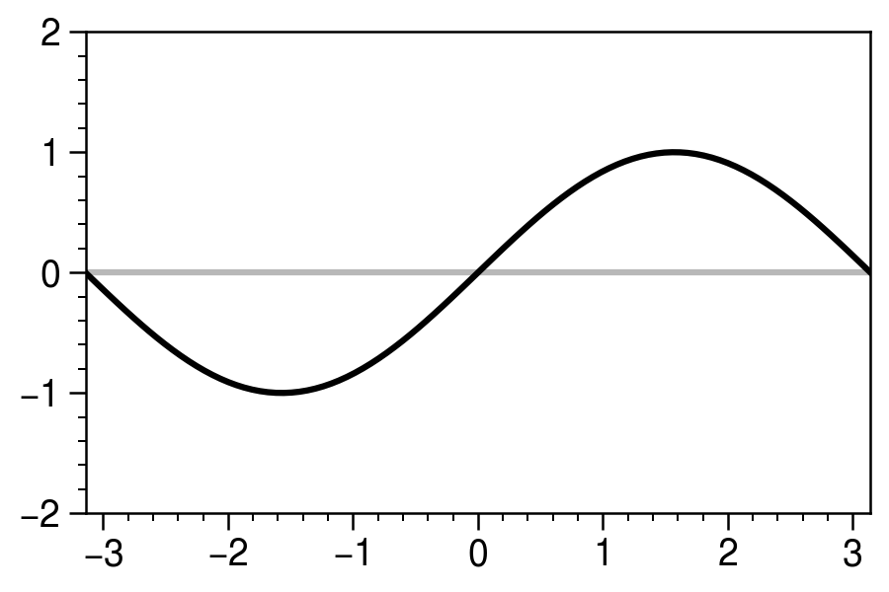
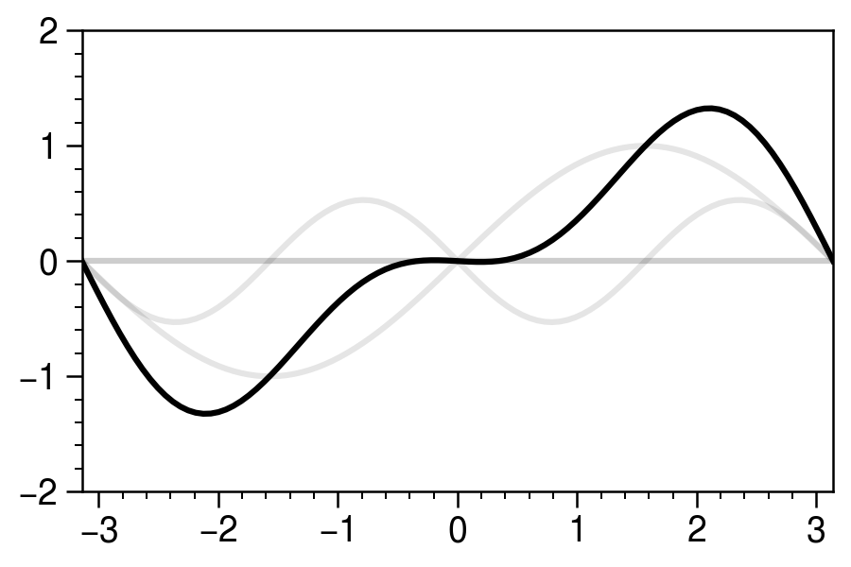
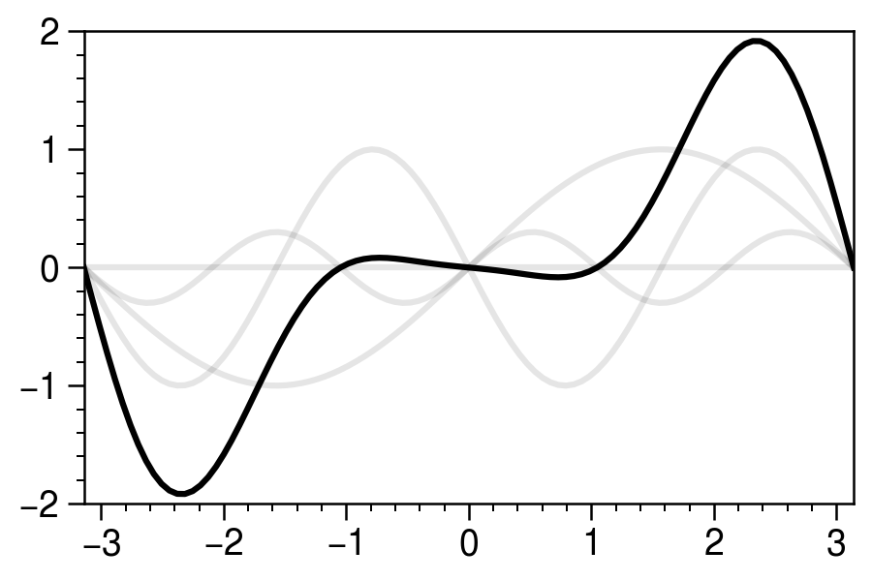
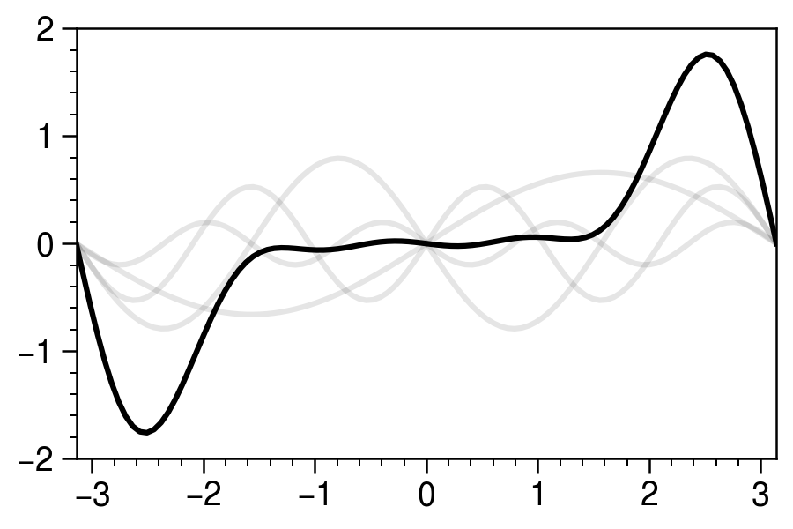
Four harmonics are enough for ~flat waveforms
Notes:
There is probably an exact solution; I found these by messing around with the amplitudes.

Slide 31
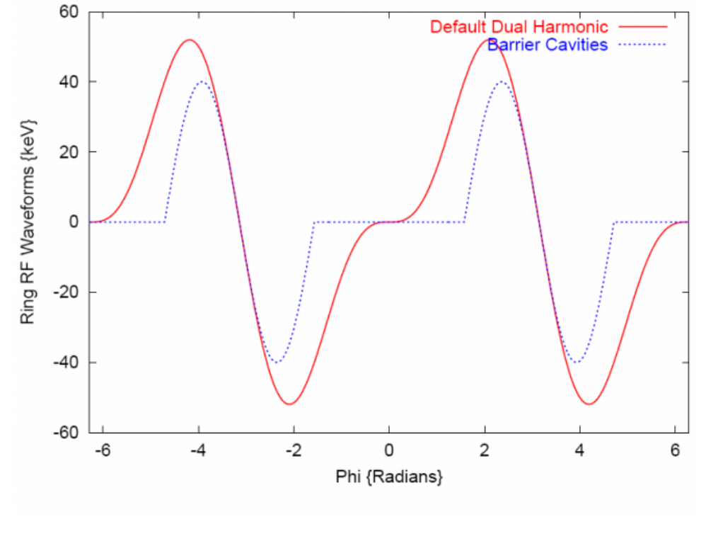
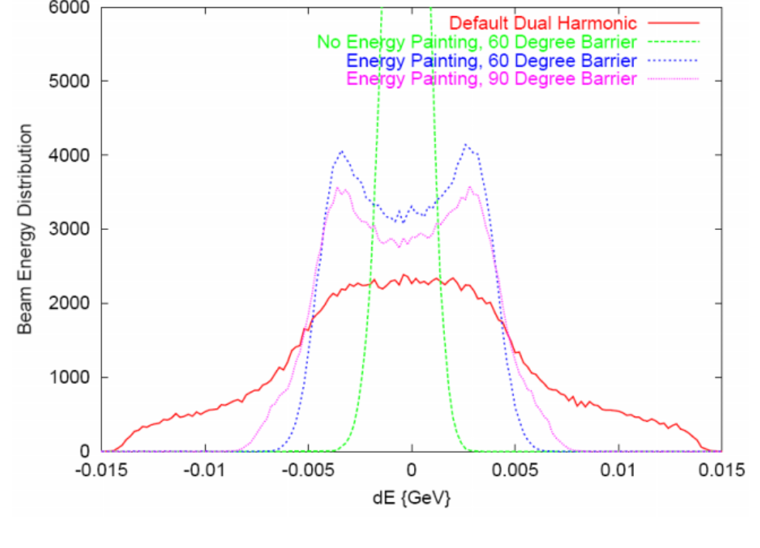
Old simulations show influence of barrier waveforms on longitudinal distribution
Waveforms
Energy distribution
Old
New
Holmes et al., HB 2006

Slide 32
Unclear if higher harmonics are possible with existing hardware
Unsuccessful initial attempt to reach h=3 with custom waveform generator and tuning current.
Reaching h>2 may require new ferrite rings.

Slide 33
Question 1: Can we approximate barrier waveforms during accumulation?
Idea 1: Turn off cavities
Idea 2: Force zero net voltage using RF feedback system
Idea 3: Approximate barrier waveforms using additional harmonics
Idea 4: Install new barrier cavities [$$$]

Slide 34
Question 2: Can we compress the bunch?
H=1
Barrier

Slide 35
Question 2: Can we compress the bunch?
Max voltage ~ 20 kV (with 2 cavities).
Synchrotron period ~ 2000 turns (at 1.3 GeV)
New custom waveform generator should allow switching waveforms mid-cycle.
Limited storage time — try to extend.
Optimal RF settings accounting for collective effects?
Notes:
The RF during accumulation will determine final compression ration

Slide 36
Initial experiment and simulation benchmarking

Slide 37
Initial experiment injected 300 turns into 10-kV RF voltage (closed loop)
Notes:
Injection time ~ 1/2 rotation time

Slide 38
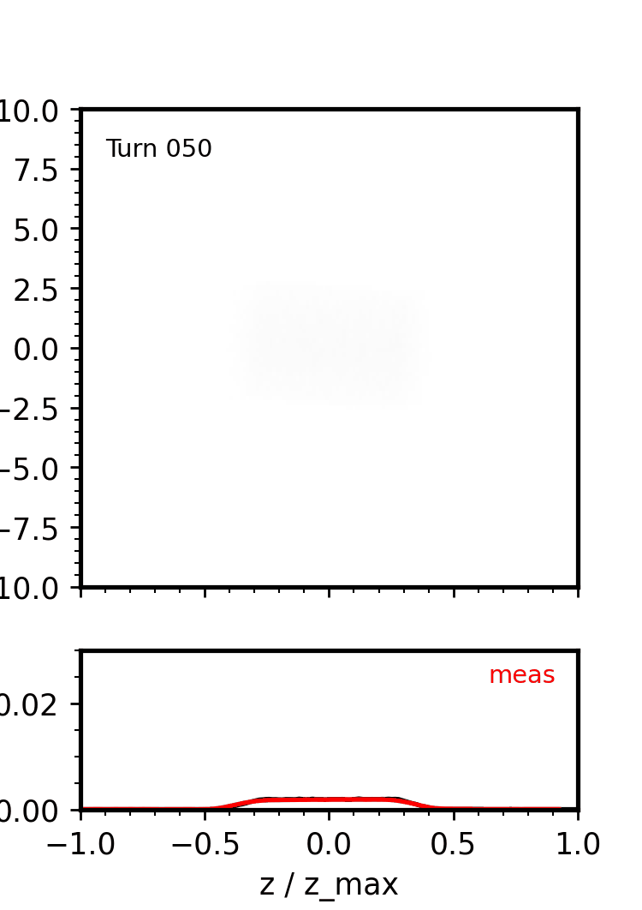
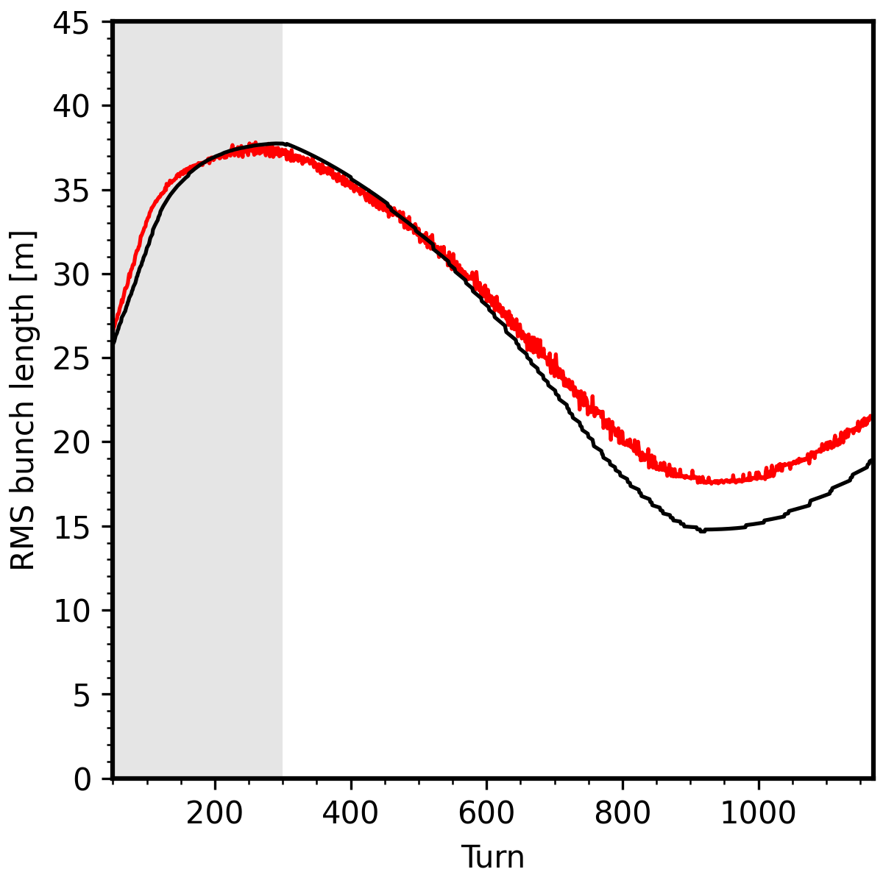
1D simulation shows reasonable agreement with initial experiment
TBT profiles
RMS length (10% thresh)
$dE$ [MeV]
$$z/z_{max}$$
Notes:
Assumed ~uniform z profile; fit width of first few measured pulses.
Assumed Gaussian dE profile; adjusted by eye for closer agreement with measured rms bunch lengths.
Injected zlim ramps from 18/64 to 38/64 in first hundred turns.
Included 1D longitudinal space charge and impedance models.
Space chargeIntensity is 30% of full pulse.
Space
Initial energy spread/bunch length not optimized.
Rotation during injection leads to growth in initial energy spread.

Slide 39
Future modeling/benchmarking considerations
Codes: (PyORBIT, ImpactX, Xsuite)
Space charge solver (3D/2.5D/2D/1D)
Wake fields, beam-cavity interaction, feedback system
Electron cloud
Cousineau et al., ECLOUD 2007
Notes:
Will be more important at higher perveance
Usure if ecloud affected by short bunch length

Slide 40
Example: tomographic measurement of space-charge-driven 4th order resonance
Measure?

Slide 41
Example: are nonlinear space charge forces resolved properly?
Notes:
Can run tomography algorithms to reconstruct z-dE, dependent on model assumptions.

Slide 42
Conclusion
Bunch compression experiments ongoing at SNS.
Success may depend on RF engineering/hardware upgrades.
Future work: explore limits of current setup and develop simulation benchmarks.
Acknowledgements: Chip Piller, Amith Narayan, Nick Evans, Wim Blokland.

Slide 44
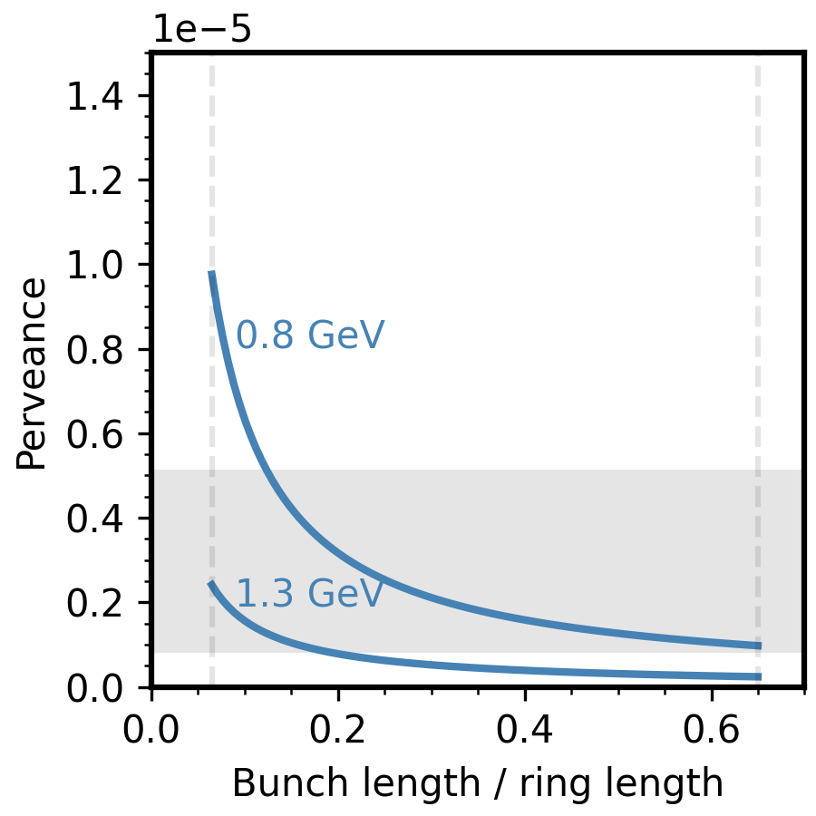
With strong compression, SNS could probe MC space charge regime
SNS 1.8 MW
$$Q\sim \frac{λ}{{β^{2}γ}^{3}}$$
5 GeV, 2 MW
MC (2-ns bunch)
10 GeV, 4 MW

Slide 45
With strong compression, SNS could probe MC space charge regime
SNS 2.8 MW
$$Q\sim \frac{λ}{{β^{2}γ}^{3}}$$
5 GeV, 2 MW
MC (2-ns bunch)
10 GeV, 4 MW

Slide 46
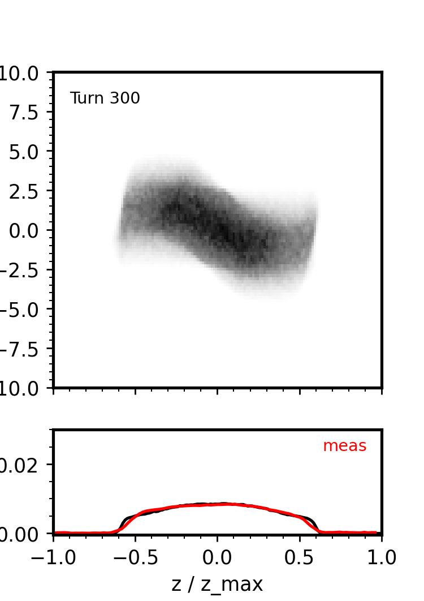
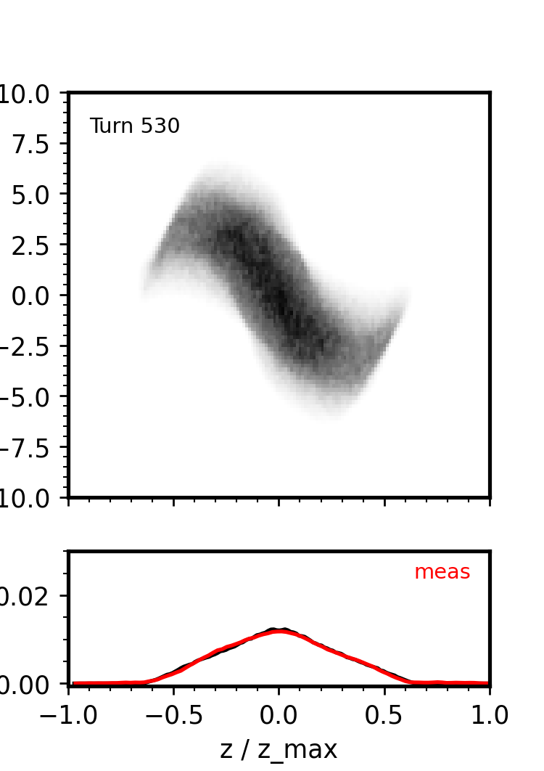
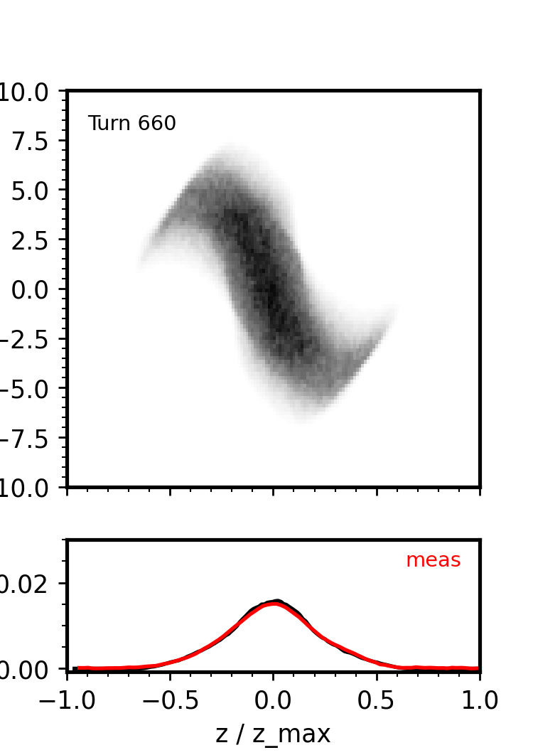
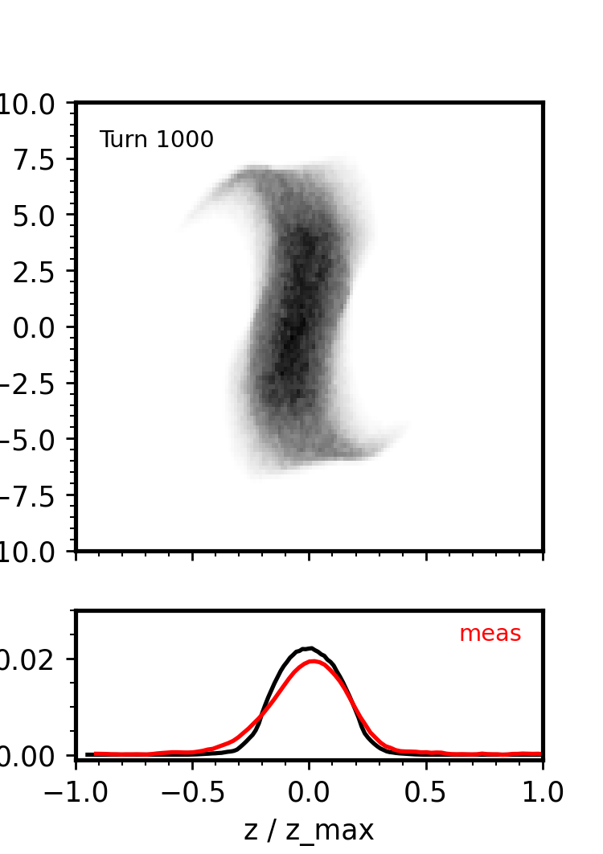
1D simulation shows reasonable agreement with initial experiment
$dE$ [MeV]
$$z/z_{max}$$
Notes:
Assumed ~uniform z profile; fit width of first few measured pulses.
Assumed Gaussian dE profile; adjusted by eye for closer agreement with measured rms bunch lengths.
Injected zlim ramps from 18/64 to 38/64 in first hundred turns.
Included 1D longitudinal space charge and impedance models.
Space chargeIntensity is 30% of full pulse.
Space
Initial energy spread/bunch length not optimized.
Rotation during injection leads to growth in initial energy spread.

Slide 47
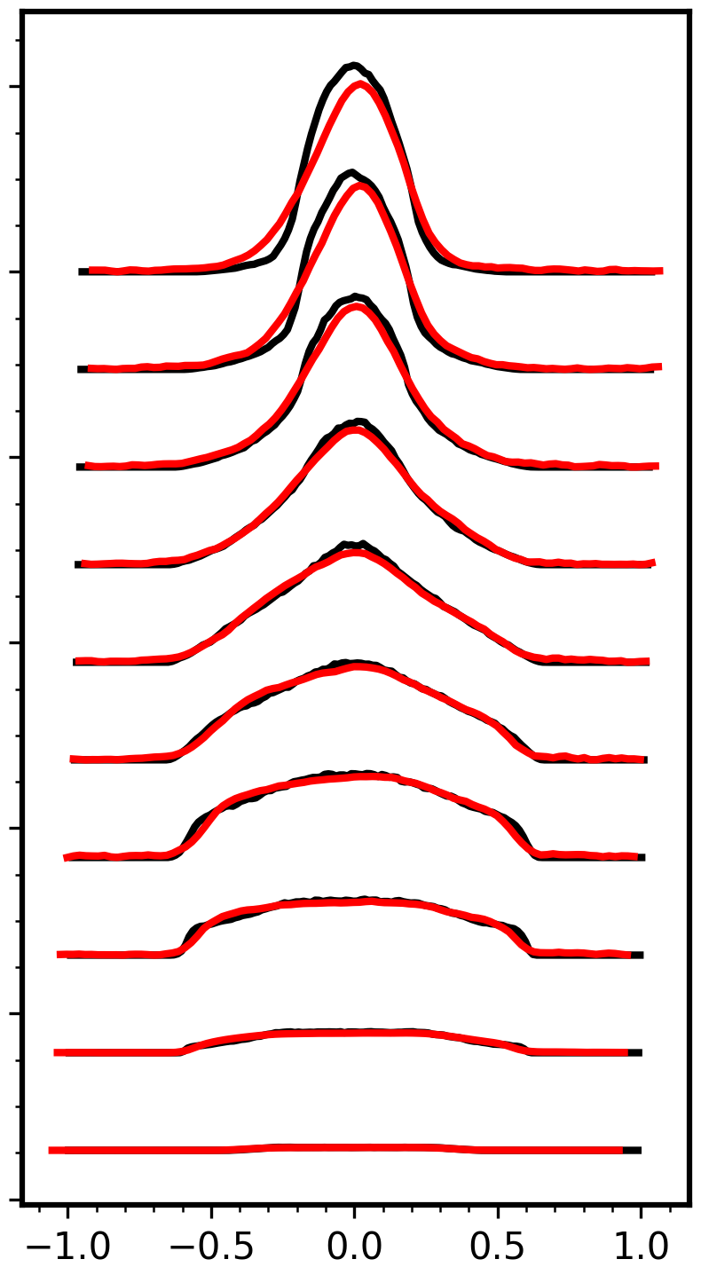
1D simulation shows reasonable agreement with initial experiment
TBT profiles
RMS length (10% thresh)
Turn 1100
Turn 300
$$z/z_{max}$$
Notes:
Injected 300 turns with synchrotron period ~ 2000 turns.
Stored beam for ~800 turns.

Slide 48
16.7 ms (1/60 Hz)
Macro-pulse
(ion source)
15.7ms
1ms
945 ns (1/1.059 MHz)
Mini-pulse
(chopper)
645 ns
300 ns
260 micro-pulses
Micro-pulse
(RFQ)
2.4845 ns (1/402.5 MHz)

Slide 49
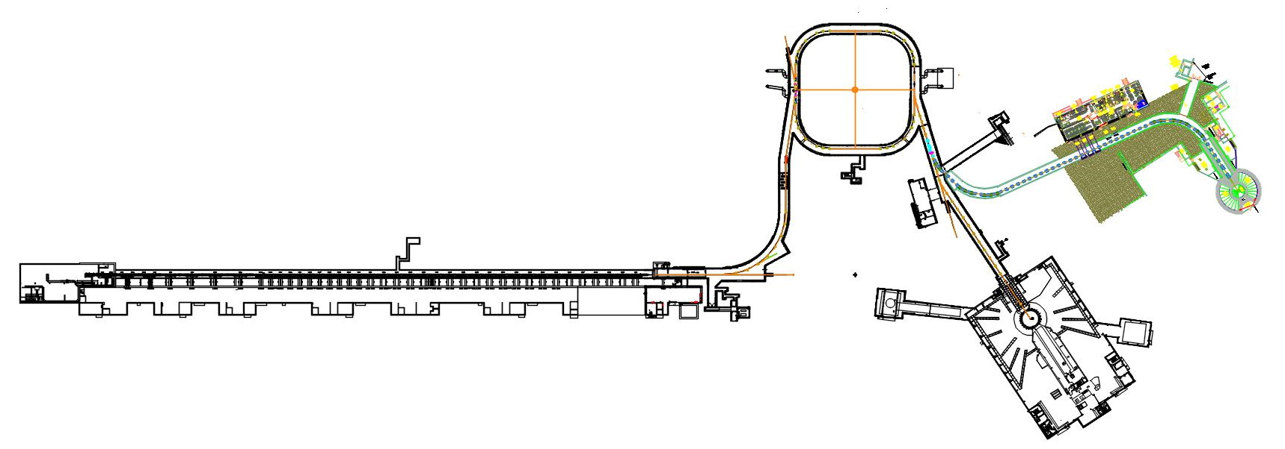
SNS today: $1.55 ×{ 10}^{14}$ protons per pulse
Experiments possible at full intensity (1 Hz)
1.7 MW @ 60 Hz

Slide 50
SNS soon: $2.25 ×{ 10}^{14}$ protons per pulse
Experiments possible at full intensity (1 Hz)
2.8 MW @ 60 Hz (capable)
2.0 MW @ 60 Hz (target limit)

Slide 51
SNS in 10-15 years: Second Target Station
$2.25×{10}^{14}$ protons
0.7 MW @ 15 Hz
Experiments possible at full intensity (1 Hz)
2.0 MW @ 45 Hz

Slide 52
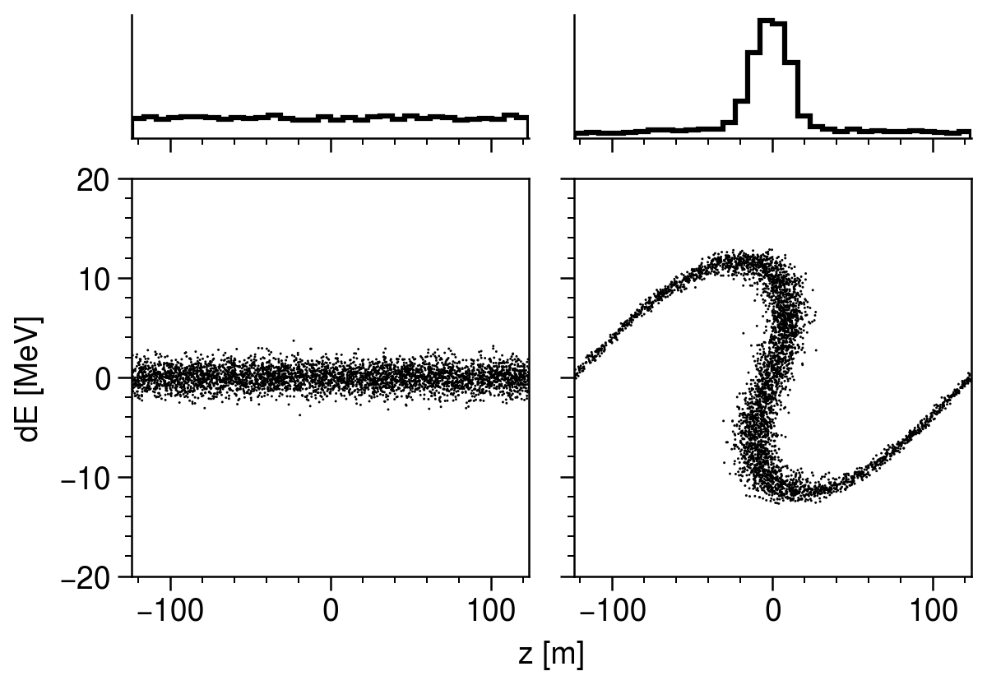
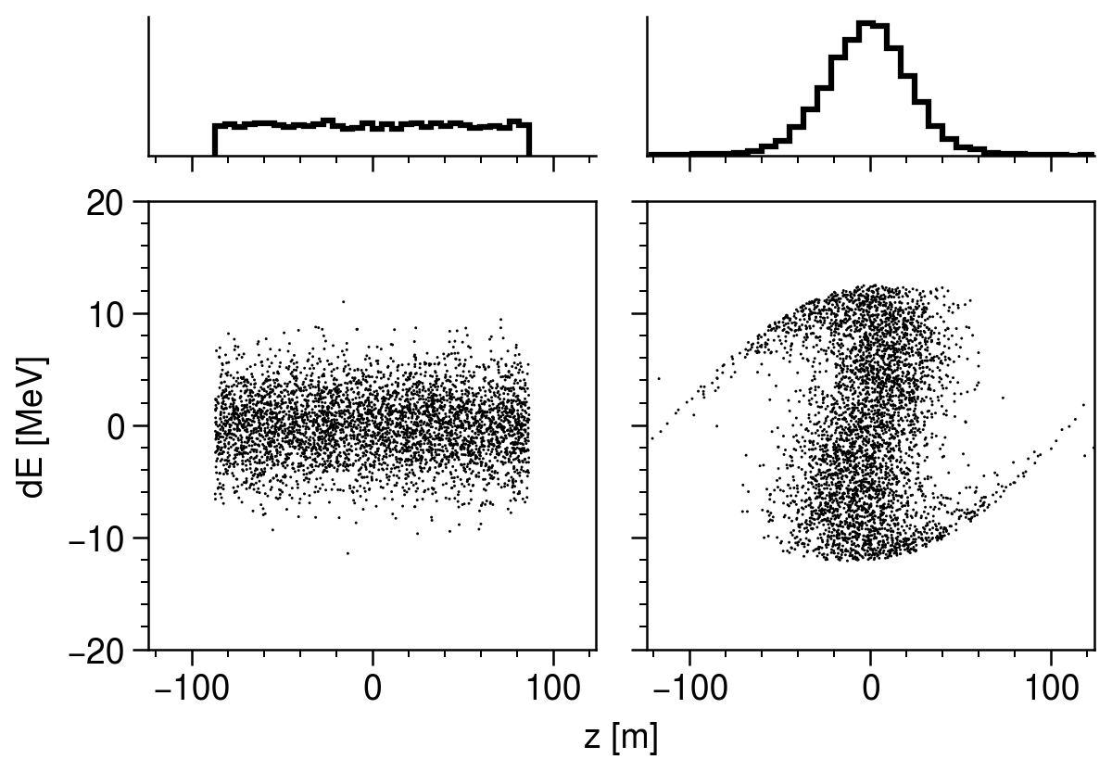
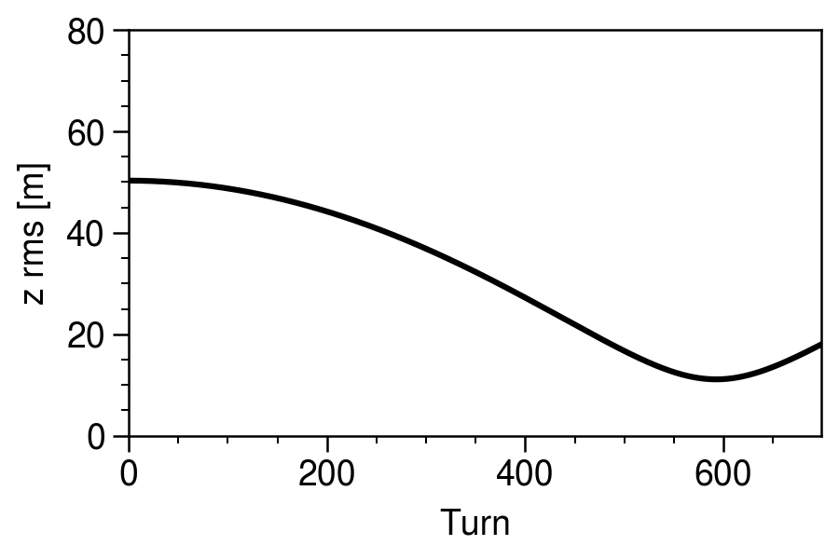
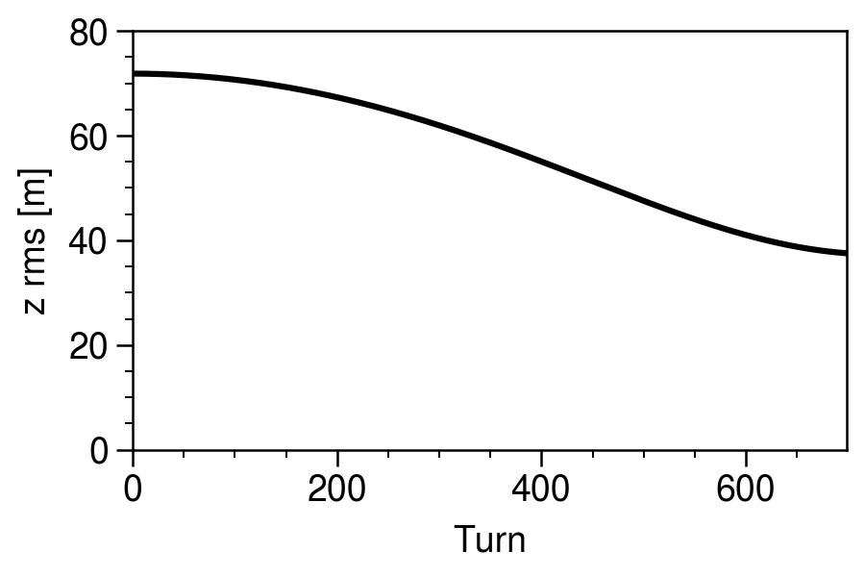
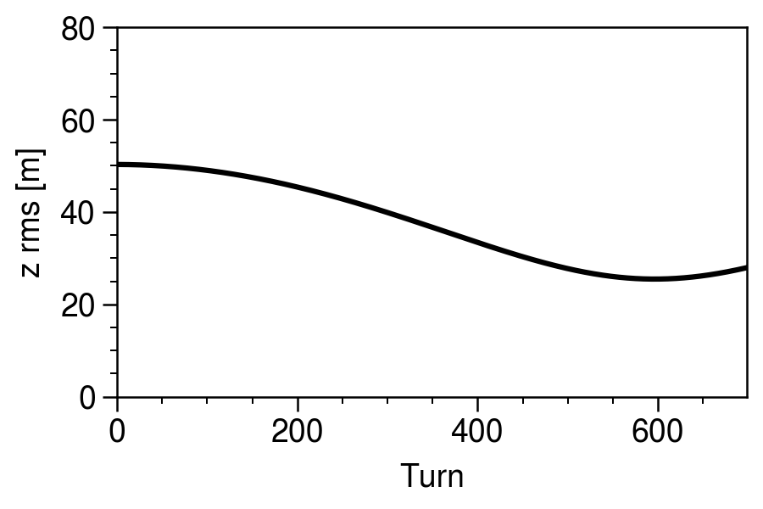
Zero-space-charge simulation shows moderate compression for realistic energy spread
Notes:
Zero space charge; instant RF ramp; 1.3 GeV beam energy.
[1] Minimum energy spread of 1 MeV from Holmes simulations.
[2] Zero RF voltage during accumulation (not even beam-induced voltage)
[3] Larger energy spread of 3 MeV
Conclusion: given synchrotron tune and good initial bunch, it could be possible to reach significant compression factor.

Slide 53
Zero charge
$$δE [MeV]$$
$$z [m]$$
Full charge
Notes:
This simulation uses a uniform z distribution and Gaussian energy distribution. I assume the full 2.8 MW beam intensity (2.25e+14).

Slide 54
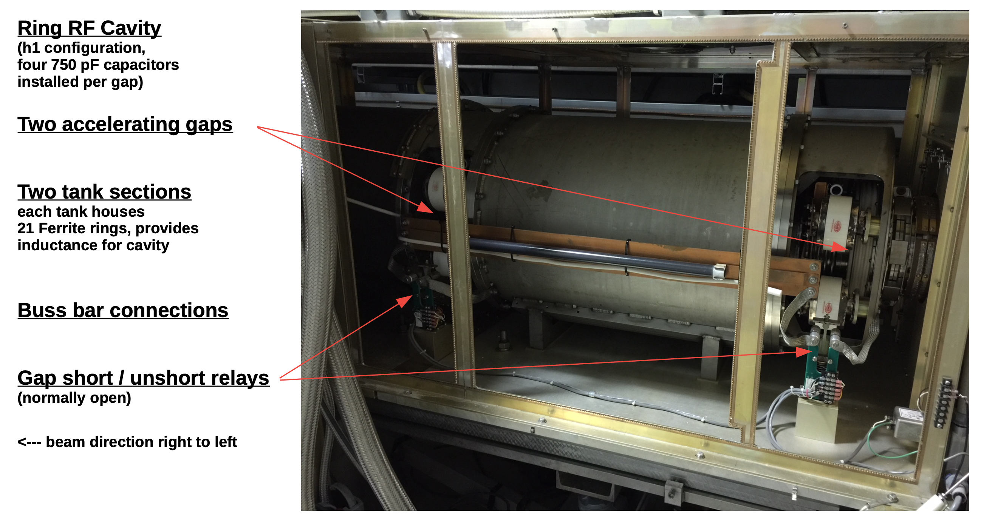
Notes:
Supplied by Chip Piller (ORNL), RF engineer
I am not an RF engineer and am just starting to learn about the system.

Slide 55
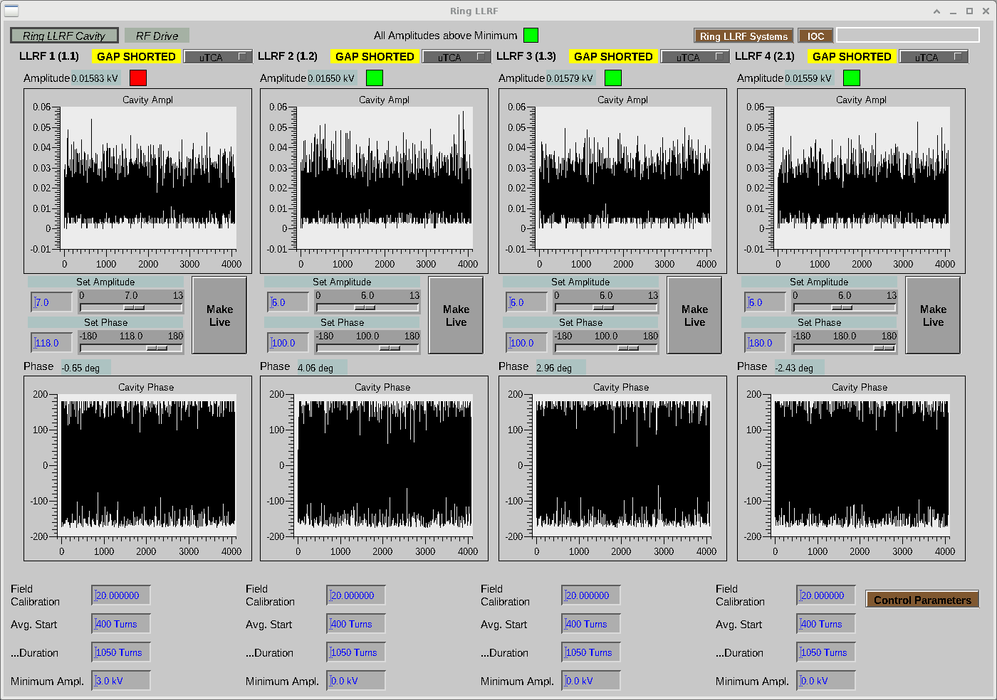
Shorting cavities works, but can’t unshort after accumulation
Notes:
Currently use mechanical relay to short cavities.
Would need some type of solid-state relay to switch mid-cycle.

Slide 56
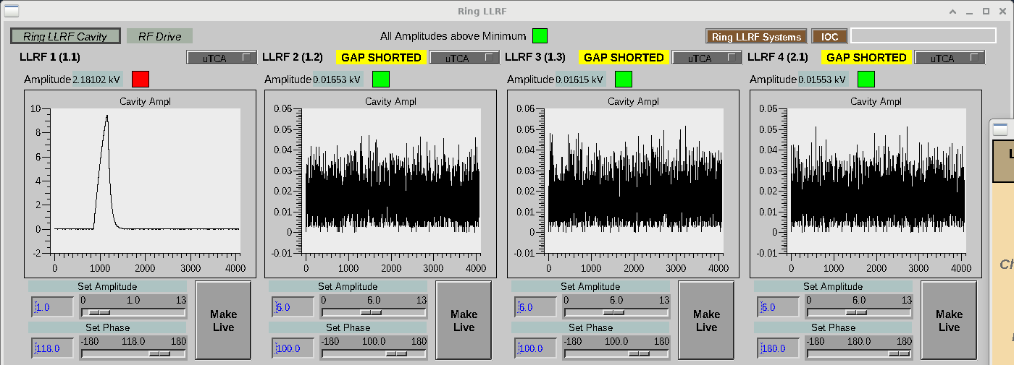
Beam-induced voltages limit beam intensity when operating cavities in open-loop
300-turn accumulation. Approaching 12 kV limit.

Slide 57
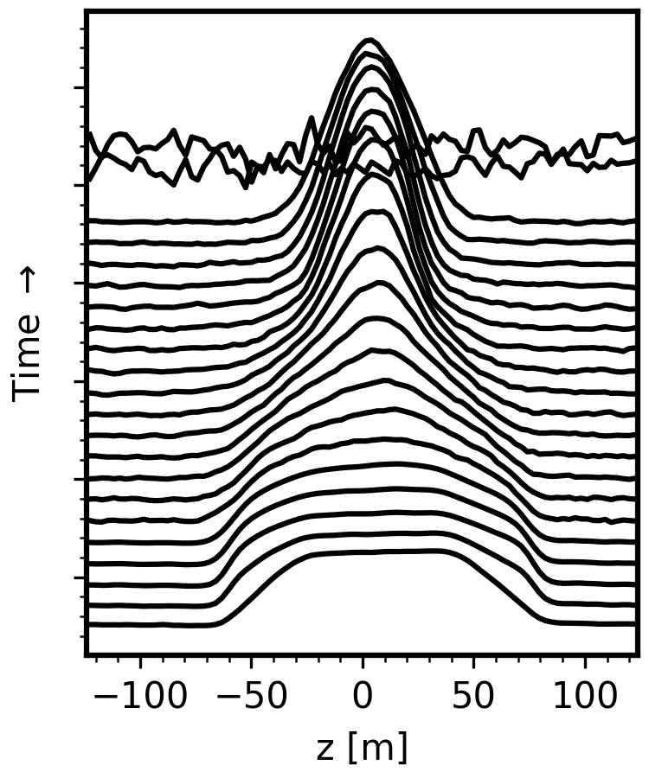
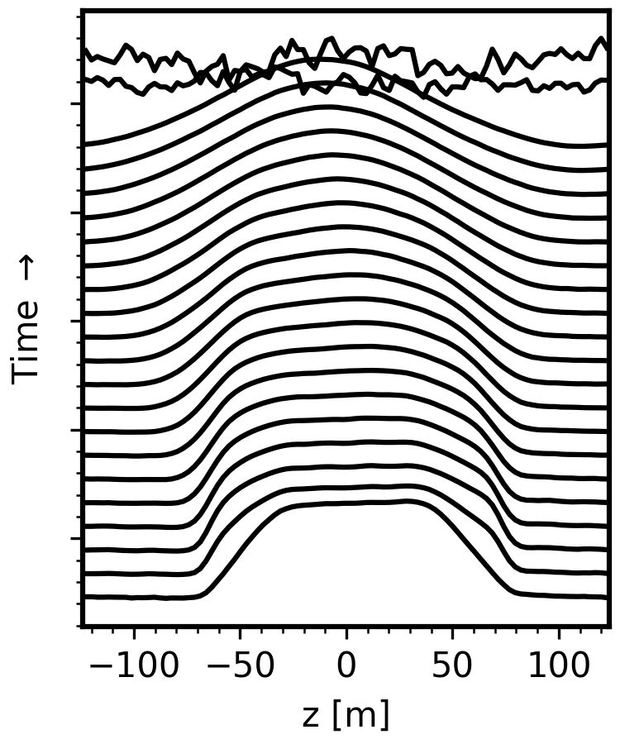
Can we use multiple cavities same frequency but different phases?
$$φ_{1}=φ_{2}$$
$$φ_{1}=φ_{2}+π$$
Notes:
Inject 100 turns with two cavities at 5 kV.
Left: same phase (approximate bunching phase)
Right: 180-degree phase shift.
Should repeat for higher intensity beam.

