Slide 1
Baseline configurations, options, power and cost
C. Rossi – 15th May 2025

Slide 2
OUTLINE
Recap of the Muon Collider preliminary cost study
What is missing
Directions from the cost analysis
Critical spots and possible issues at the interfaces
Concluding remarks

Slide 3
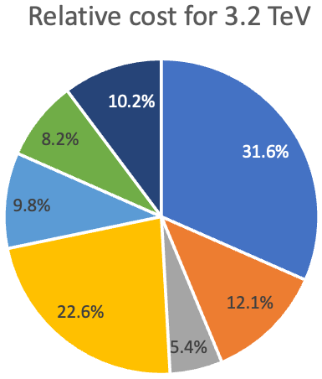
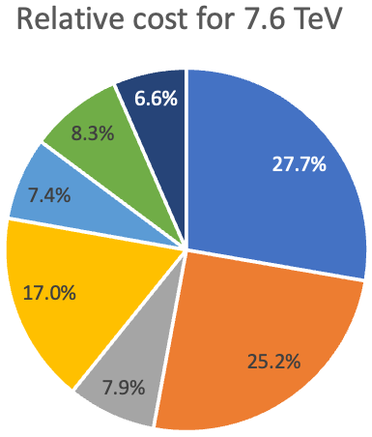
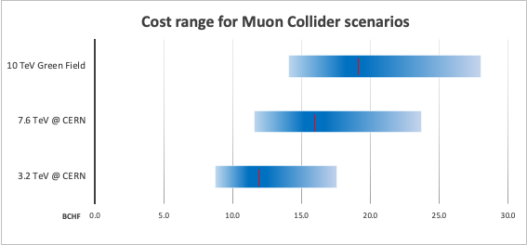
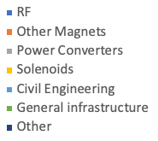
Muon Collider preliminary cost study
The cost range for the different configurations was evaluated and compared to the Green Field scenario, where a cost for Civil Engineering of 50kCHF/m was assumed in the absence of a detailed study.

Slide 4
The ITF estimate
A previous estimate was done in the frame of the Snowmass exercise in 2022, by using a multi-parameter cost model and starting from estimates provided by project proponents (B$ in the scale below).

Slide 5
Configurations
As for costing, we intend to stay with the CERN scenario and try to complete the cost and power analysis as much as possible before the end of 2025.

Slide 6
What are we missing (machine)
Exclusion of the Accumulator and Compressor Rings
Final Cooling: only solenoids are considered
RLA1&2 limited to RF
Accumulator and compressor Rings (they will be estimated in the next months)
Muon charge separation and merging
Final cooling (conceptual)
SC Linac
Collider ring : Beam dynamics and realistic magnets. Field-free length.

Slide 7
What are we missing (systems)
Exclusion of the Accumulator and Compressor Rings
Final Cooling: only solenoids are considered
RL1&2 limited to RF
Decay channel shielding, solenoids ? (my figures may be incomplete)
Final cooling RF
RLAs magnets
Magnet cryostats ? (for RF this was included)
Vacuum in general (is 20kCHF/m a reasonable estimate ?)

Slide 8
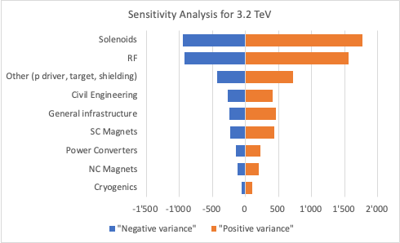
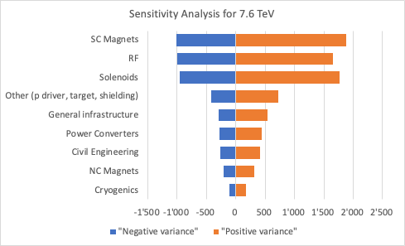
Cost sensitivity
In the two configurations, the same technologies weigh differently on the cost uncertainty, showing the path for some risk mitigation and priorities in case of energy staging.
MCHF
MCHF

Slide 9
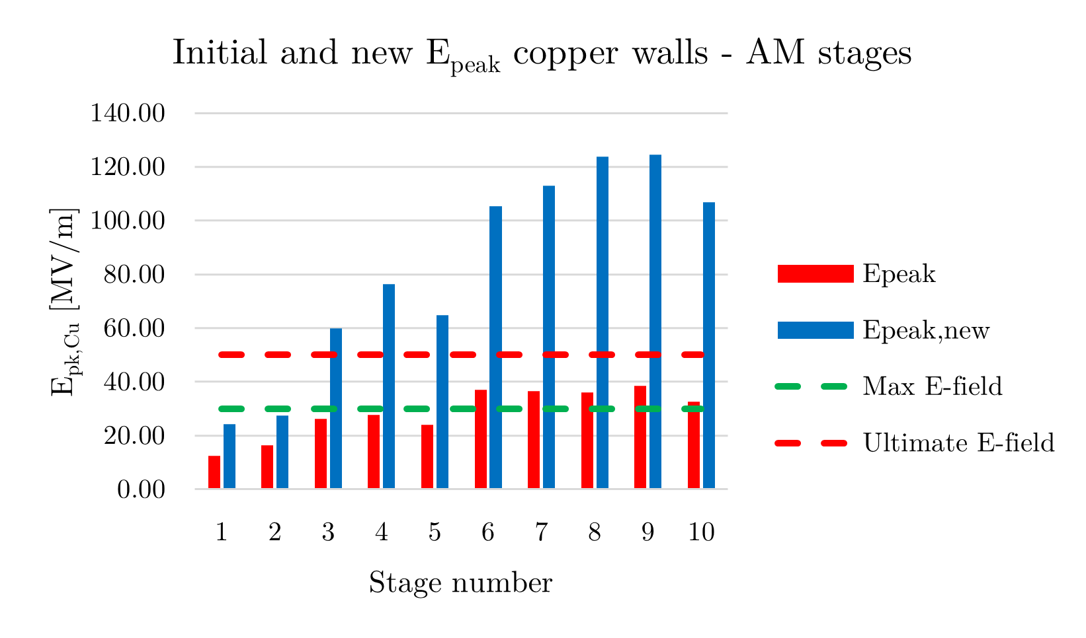
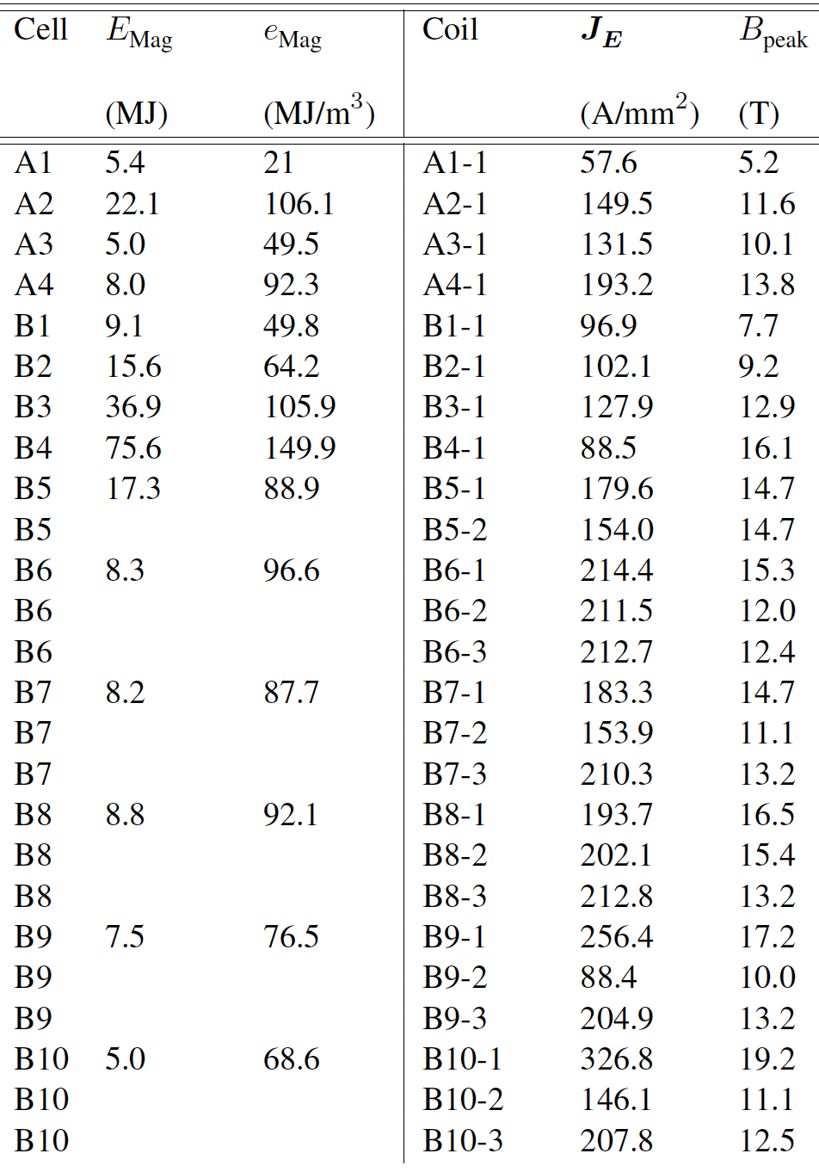
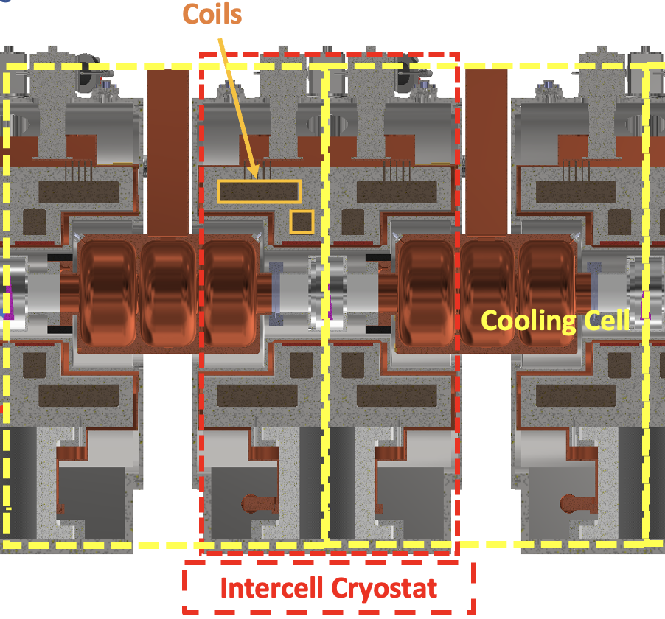
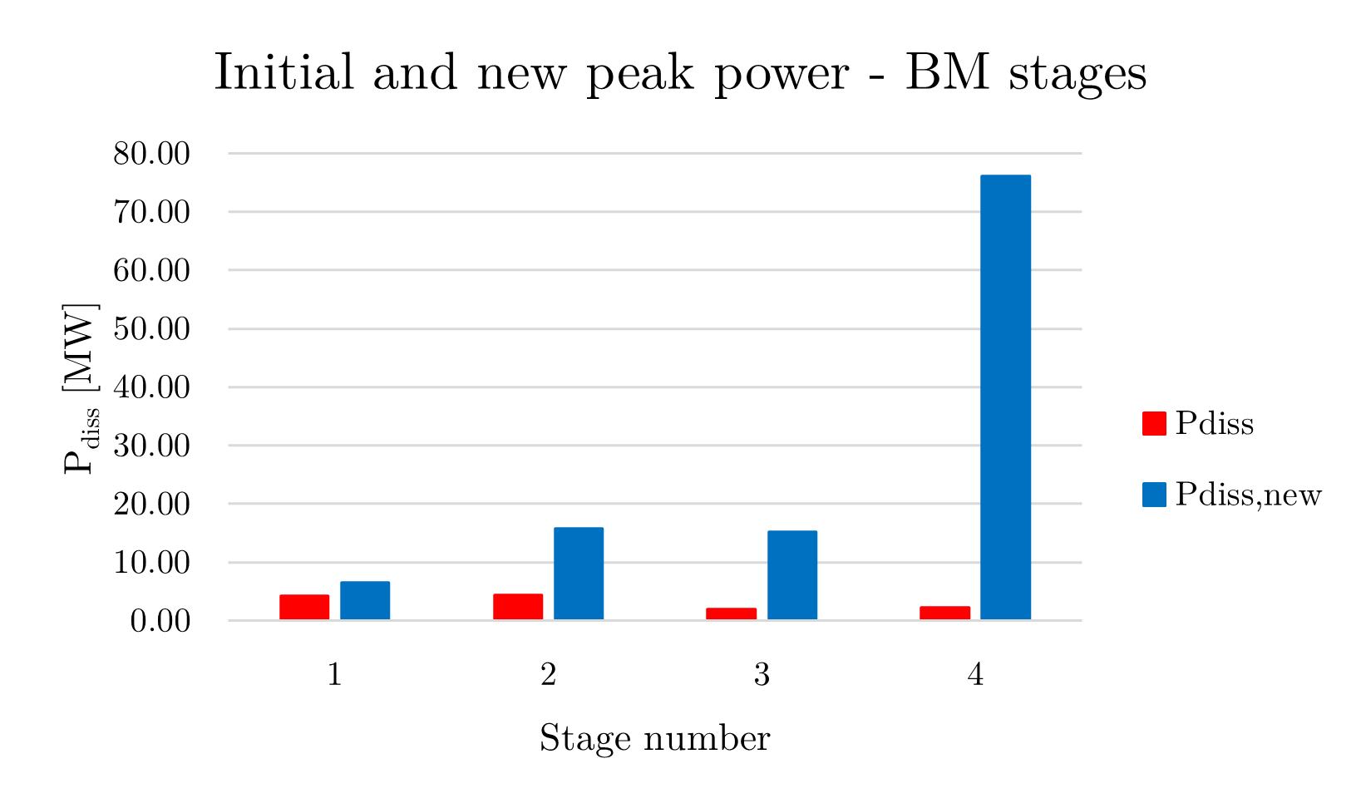
The Cooling Channel challenge
From L. Rossi presentation
Expect changes in the beam dynamics and cavity design.
From C. Barbagallo
Modular design and standardization may help to adapt to changes

Slide 10
The Cooling Channel challenge
Integrate the absorbers
Interface to cryogenics
Alignment tolerances and strategy for alignment
Admissible alignment tolerances by the beam dynamics team
Beam instrumentation
Preliminary layout of the required beam instrumentation by the beam dynamics team, possibly provide dynamic range and bandwidth
INFN cell demonstrator

Slide 11
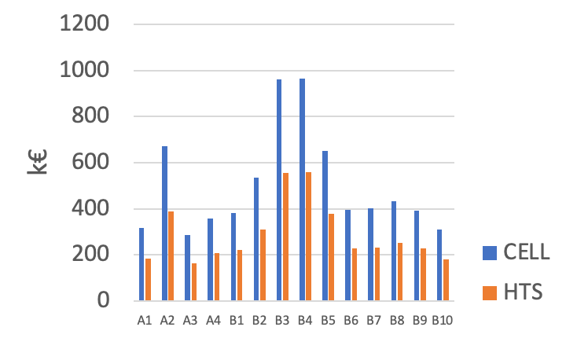
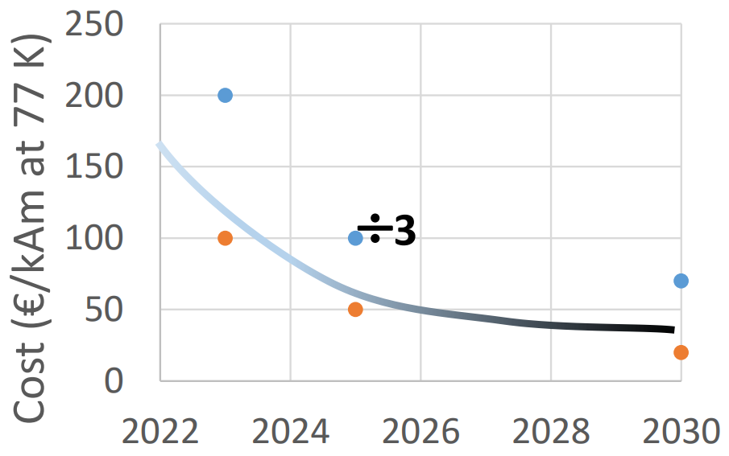
Solenoid cost
From the magnet session → Solenoids - M. Statera
Conclude on the most appropriate metrics to apply, try to include a notion of technical risk.

Slide 12
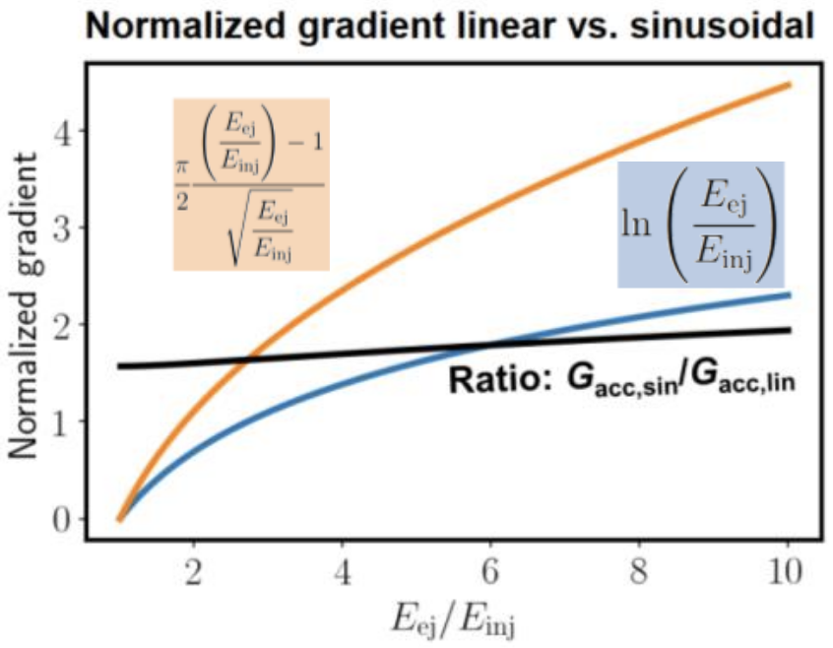
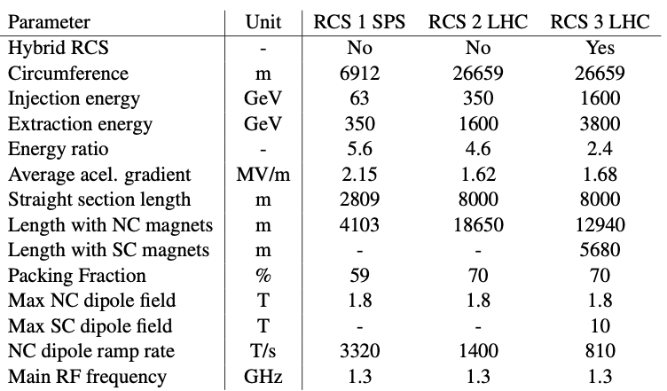
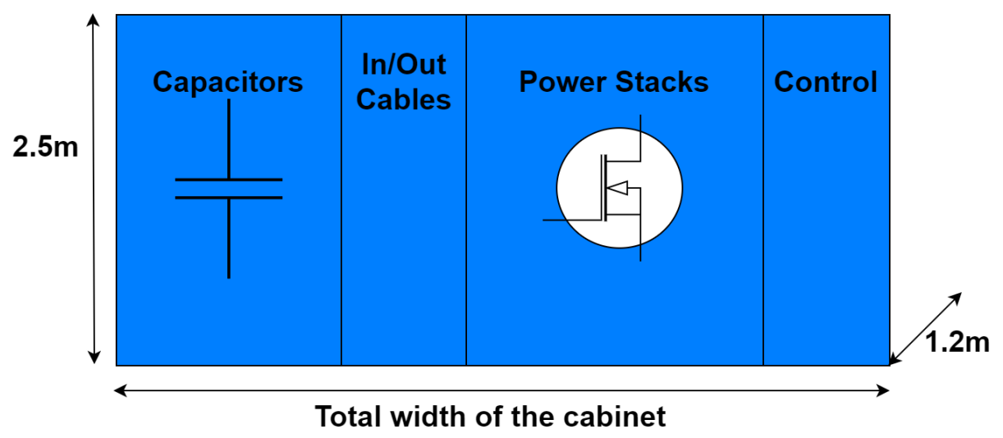
RCS Magnets and powering
Cost and implications of the different options for the RCS magnet powering may affect the CE and General Infrastructure design.
Linear ramp adopted for the CERN installation.
Fast ramping NC magnets and power converters

Slide 13
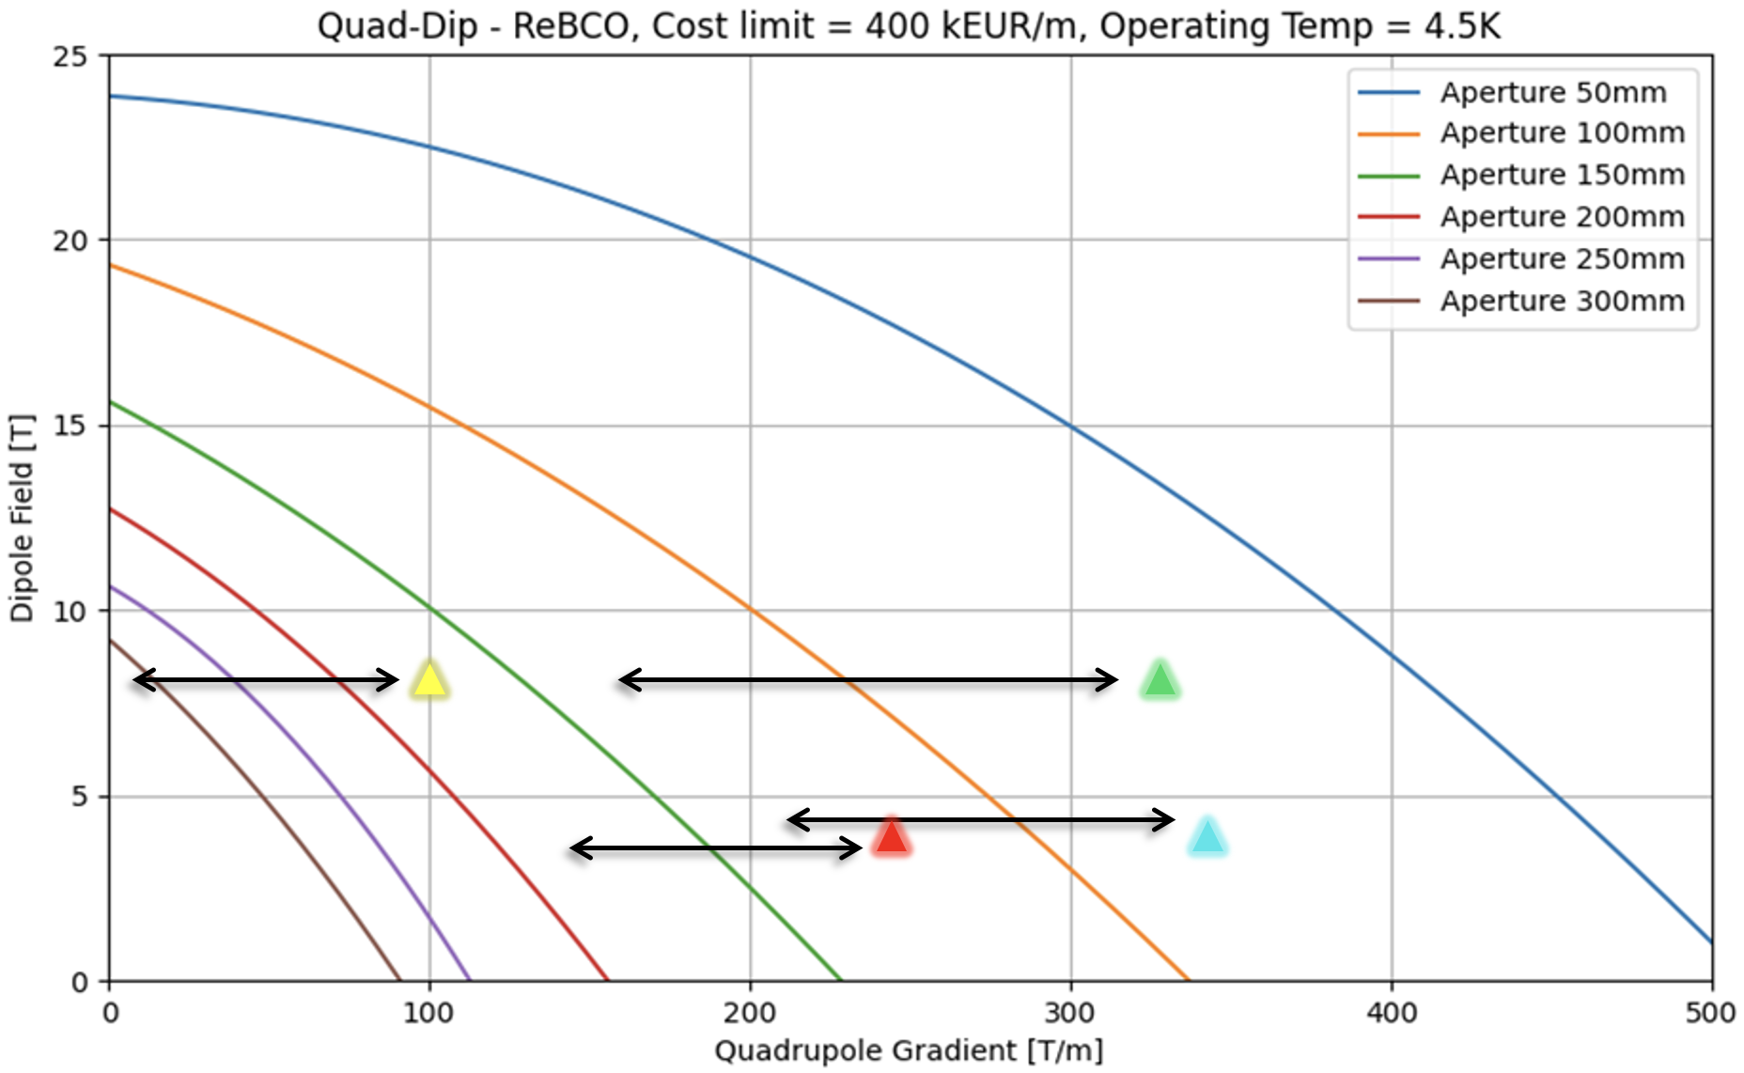
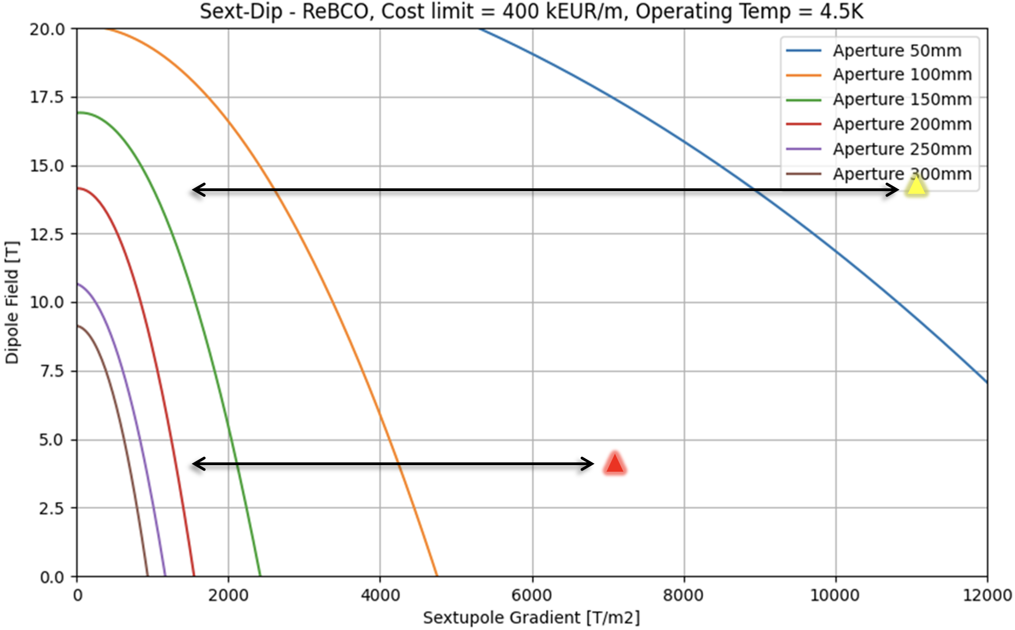
Collider Ring
Combined Function Magnets
D. Novelli
The large gap in the B-G plots between the requested performance (triangles) and what appears as achievable today imposes an iteration with the design team.
New input provided to the beam physicists.

Slide 14
Concluding remarks
A close interaction / coordination among the design team and the WPs in charge of the technical systems is necessary for an effective progress in the selection of the most appropriate options.
The cost and power exercise will be properly documented to allow the continuation of this work.
A kind of quality assurance system concerning parameters and configurations would be beneficial in assuring consistency and tracking of the different efforts.
Permanently include cost and power considerations into the facility design may help with the selection of technical options.

