Slide 1

Dynamic Analysis of
Normal-Conducting Magnets
D. Moll¹, P. Viarouge², H. De Gersem¹,
M. Breschi³, A. Macchiagodena³, P. L. Ribani³,
F. Boattini⁴, L. Bottura⁴ , E. Simoni⁵
¹Technical University Darmstadt, Germany,
²Université Laval, Canada,
³University of Bologna, Italy, ⁴CERN, Switzerland, ⁵HEIA-FR, Switzerland
IMCC and MuCol Annual Meeting
May 2025

Slide 2
Outline
Time-domain analysis of normal-conducting magnets
  Field quality evaluation
  Excitations with higher duty cycles
Frequency-Domain Analysis & Equivalent Circuit Modeling
  Frequency- Domain Loss Evaluation Method
  Equivalent Circuit & Nonlinear Dynamic Modeling
  Cross-Validation :Simplified Time-Harmonic & High-Fidelity Transient FEA Model

Slide 3
Outline
Time-domain analysis of normal-conducting magnets
  Field quality evaluation
  Excitations with higher duty cycles
Frequency-Domain Analysis & Equivalent Circuit Modeling
  Frequency- Domain Loss Evaluation Method
  Equivalent Circuit & Nonlinear Dynamic Modeling
  Cross-Validation :Simplified Time-Harmonic & High-Fidelity Transient FEA Model

Slide 4
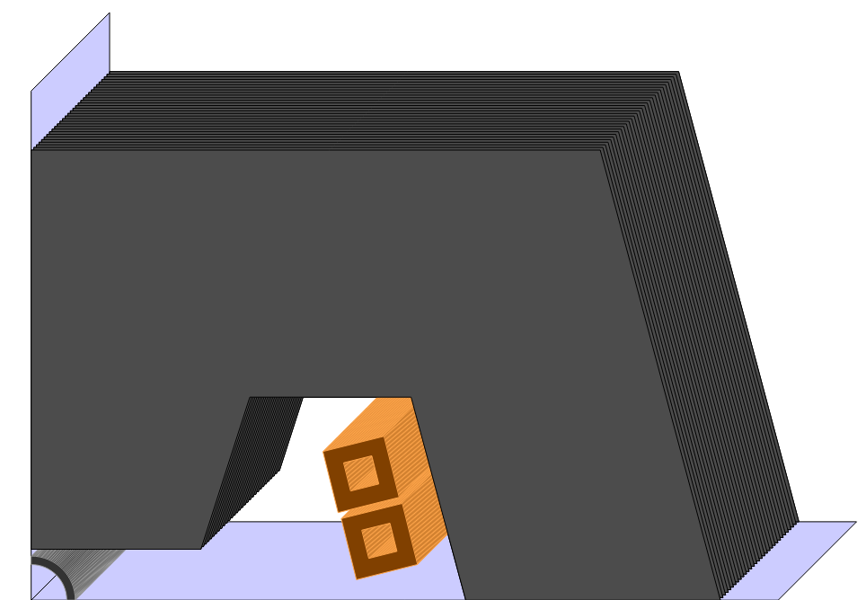
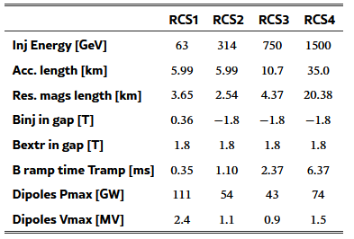
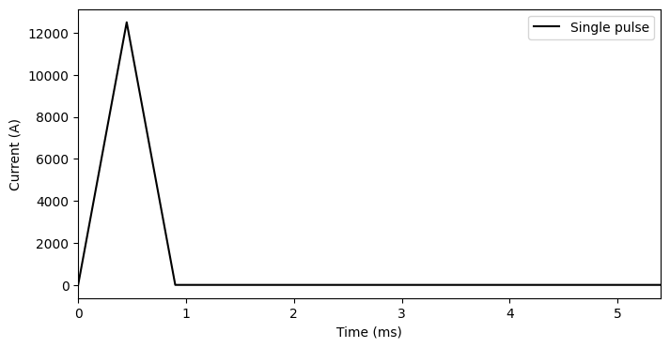
Fast ramping magnets
Main components:
  Laminated iron core: nonlinear, hysteretic
  Conductors: skin- & proximity effects
    Cooling system?
  Beam pipe: induced currents
Different operation modes:
  RCS 2,3,4: zero mean operation
  RCS 1 with DC offset
  Duty cycle ~ 1%
IMCC Interim report, 2024

Slide 5
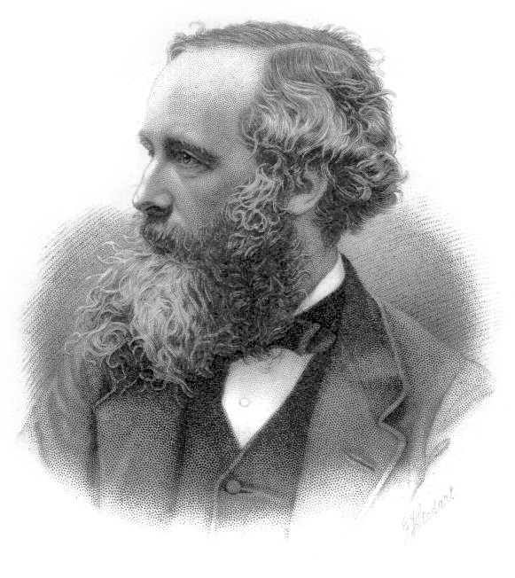
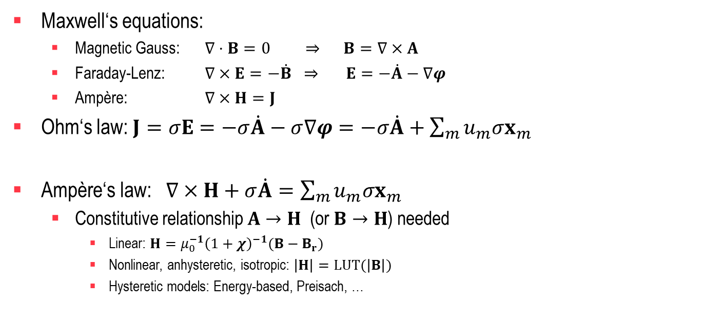
Numerical modeling - Maxwell
Maxwell‘s equations:
  Magnetic Gauss: $∇⋅B=0 ⇒ B=∇×A$
  Faraday-Lenz: $∇×E=−\dot{B} ⇒ E=−\dot{A}−∇φ$
  Ampère: $∇×H=J$
Ohm‘s law: $J=σE=−σ\dot{A}−σ∇φ=−σ\dot{A}+\sum_{m}{{u_{m}σx}_{m}}$
Ampère‘s law: $∇×H+σ\dot{A}=\sum_{m}{{u_{m}σx}_{m}}$
  Constitutive relationship $A→H$ (or $B→H$) needed
    Linear: $H=μ_{0}^{−1}{\left(1+χ\right)}^{−1}(B−B_{r})$
    Nonlinear, anhysteretic, isotropic: $\left|H\right|=LUT(\left|B\right|)$
    Hysteretic models: Energy-based, Preisach, …
Distribution functions
Voltages of every conductor

Slide 6
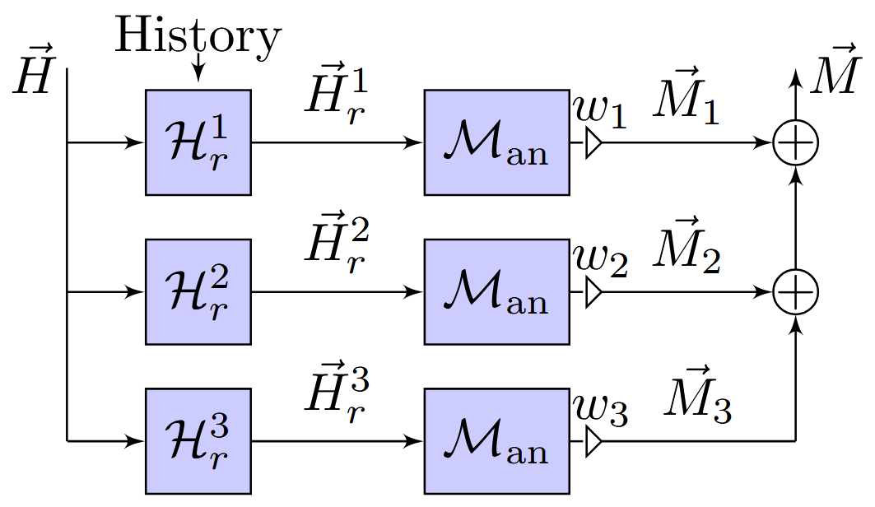
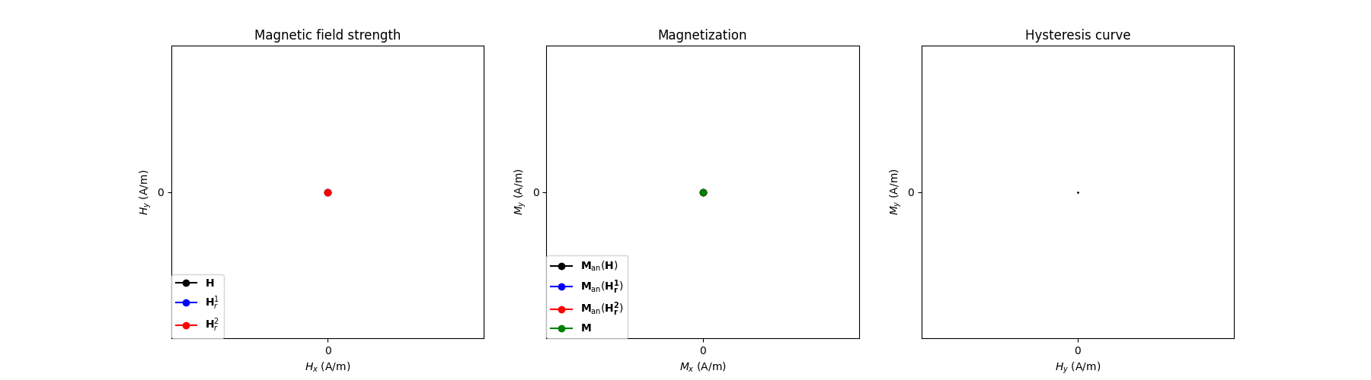
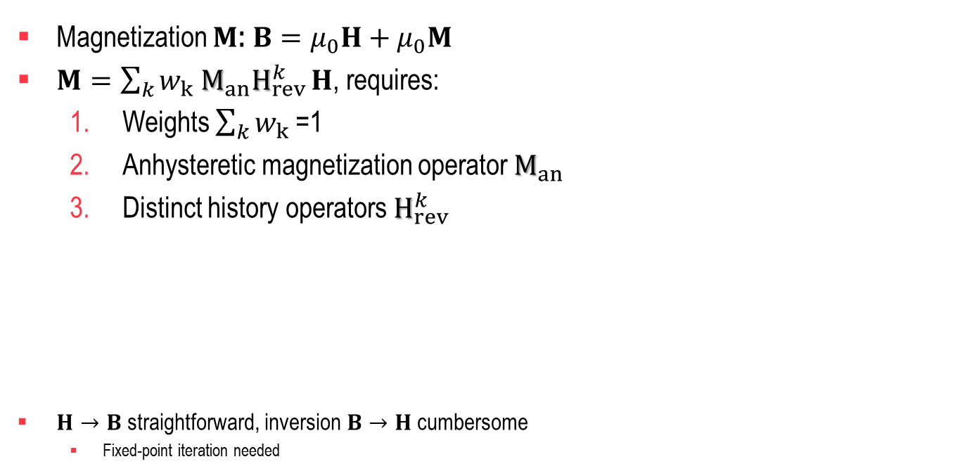
Hysteretic magnetic material model
Magnetization $M$: $B=μ_{0}H+$ $μ_{0}M$
$M=\sum_{k}{w_{k} M_{an}H_{rev}^{k}}H$, requires:
  Weights $\sum_{k}{w_{k} }$=1
  Anhysteretic magnetization operator $M_{an}$
  Distinct history operators $H_{rev}^{k}$
$H→B$ straightforward, inversion$B→H$ cumbersome
  Fixed-point iteration needed
A. Bergqvist, ”Magnetic vector hysteresis model with dry friction-like
pinning”, Physica B, 233:342–347, 1997
F. Henrotte et al., ”An energy-based vector hysteresis model for ferro-
magnetic materials”, COMPEL, 25:71–80, 2006.

Slide 7
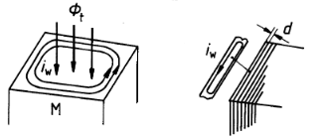
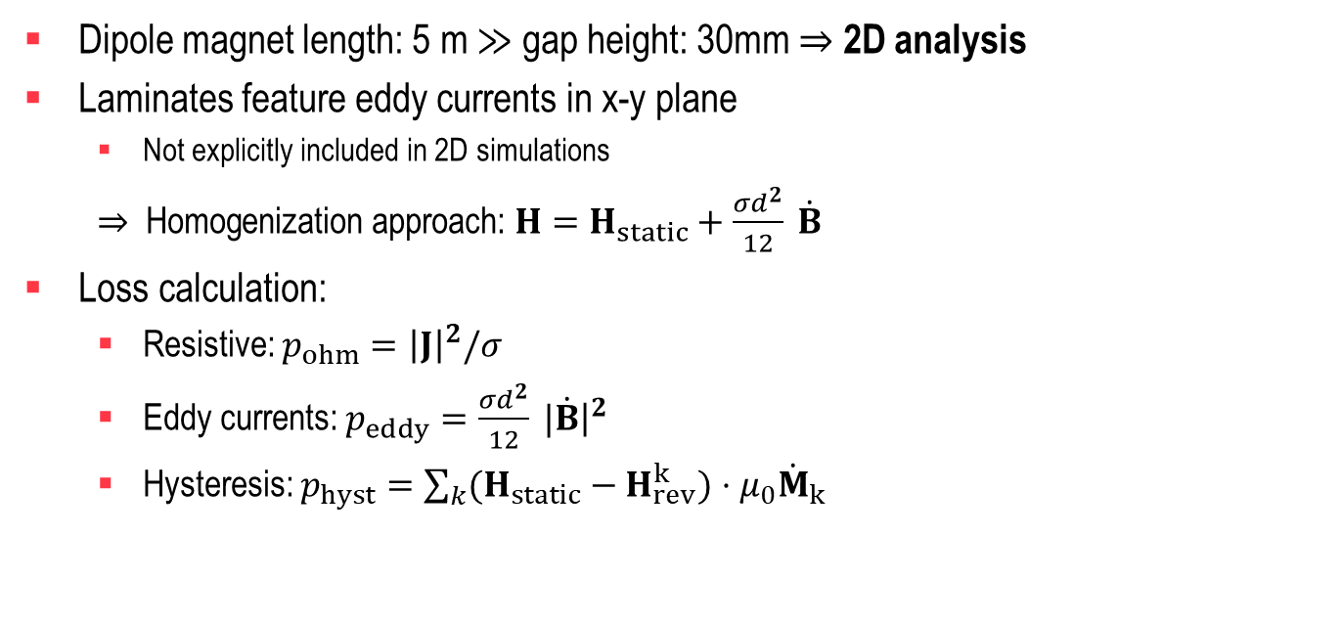
Ferromagnetic material model – Eddy currents
Dipole magnet length: 5 m $≫$ gap height: 30mm $⇒$ 2D analysis
Laminates feature eddy currents in x-y plane
  Not explicitly included in 2D simulations
  $⇒$ Homogenization approach: $H=H_{static}+\frac{σd^{2}}{12} \dot{B}$
Loss calculation:
  Resistive: $p_{ohm}={\left|J\right|}^{2}/σ$
  Eddy currents: $p_{eddy}=\frac{σd^{2}}{12} |\dot{B}{\left.​\right|}^{2}$
  Hysteresis: $p_{hyst}=\sum_{k}{(H_{static}−H_{rev}^{k})}⋅μ_{0}{\dot{M}}_{k}$
P. Dular et al., “A 3-D magnetic vector potential formulation taking
eddy-currents in lamination stacks into account”, IEEE Trans. Magn.,
vol. 39, no. 3, pp. 1424–1427, 2003

Slide 8
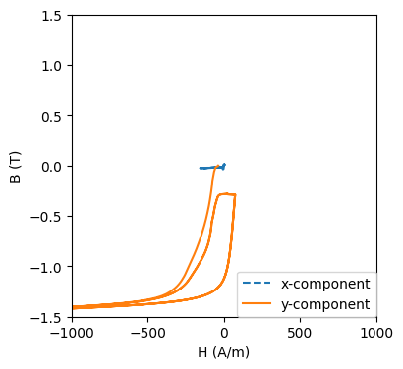
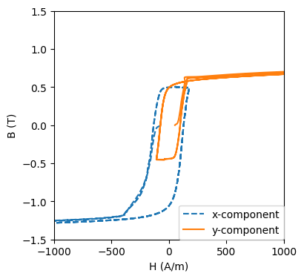
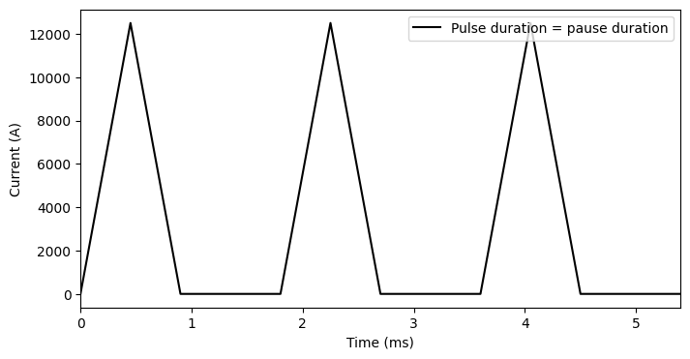
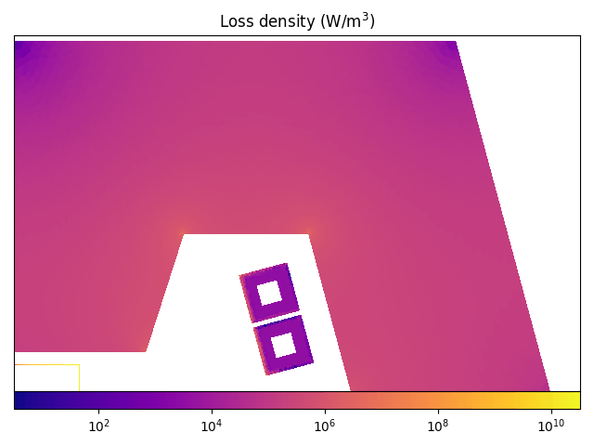
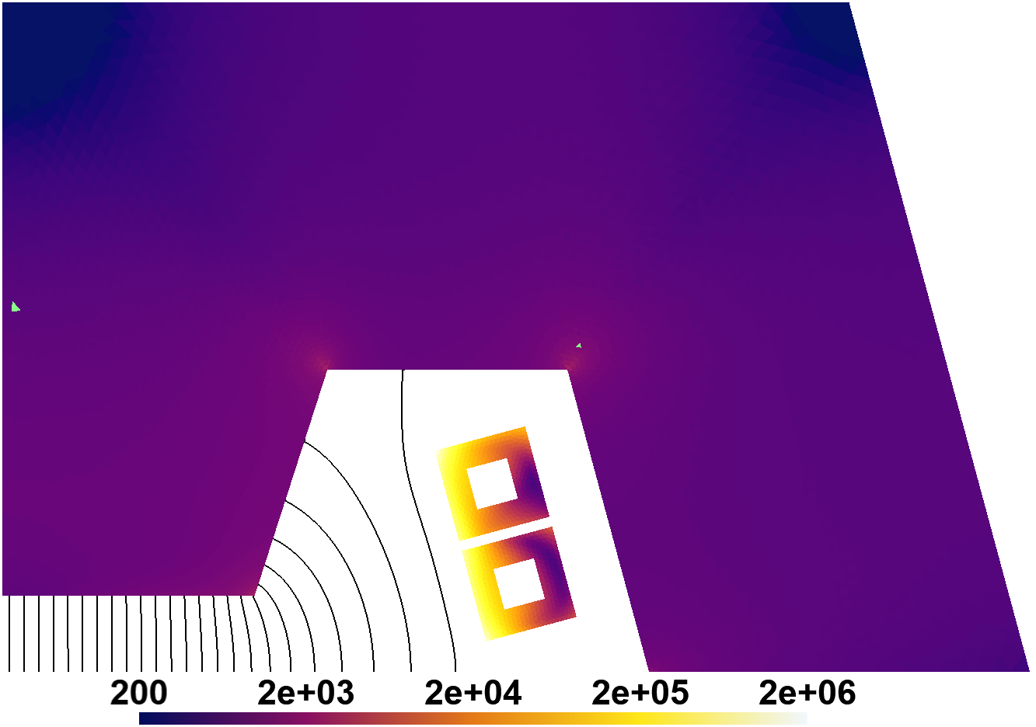
Insights of FEM analysis
First cycle differs due to
wrong initial state
Peak excitation current: 50kAt (12.5kA per bar)
Loss density of single pulse (J/m³)

Slide 9
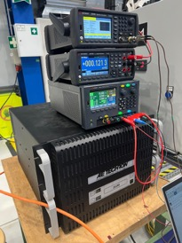

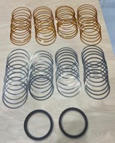
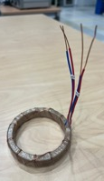
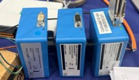
Material Properties for Accelerator Magnets
Courtesy Nicholas Sammut, Marco Buzio
Keysight 33500B
Waveform Generator
ring stack
Two laminated FeCo permeameter ring samples
with/without interleaved Kapton rings
50 µm Kapton rings
Keithley multimeter
DCCT power supply
AE Techron 2120
current amplifier
NI USB6451
DCCT Zero-Flux MACC
300 µm steel rings
First results: 54 different current pulses up to 1.2 T, 28 kT/s
Example: 100 A, 16 ms current pulse, FeCo rings only
excitation/detection windings
τ
τ ≈ 0.4∼0.7 ms
Low-field eddy current
time constant τ

Slide 10
Outline
Time-domain analysis of normal-conducting magnets
  Field quality evaluation
  Excitations with higher duty cycles
Frequency-Domain Analysis & Equivalent Circuit Modeling
  Frequency- Domain Loss Evaluation Method
  Equivalent Circuit & Nonlinear Dynamic Modeling
  Cross-Validation :Simplified Time-Harmonic & High-Fidelity Transient FEA Model

Slide 11

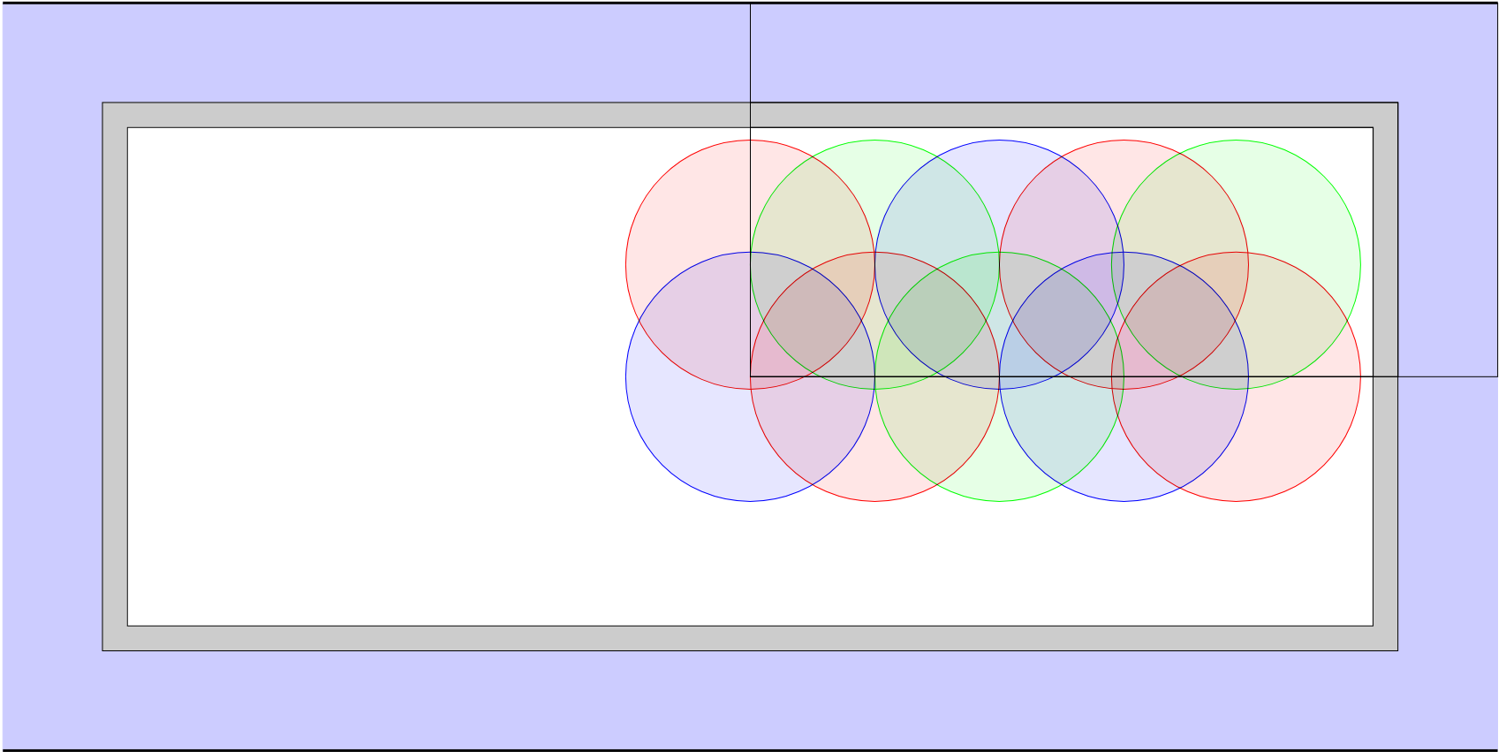

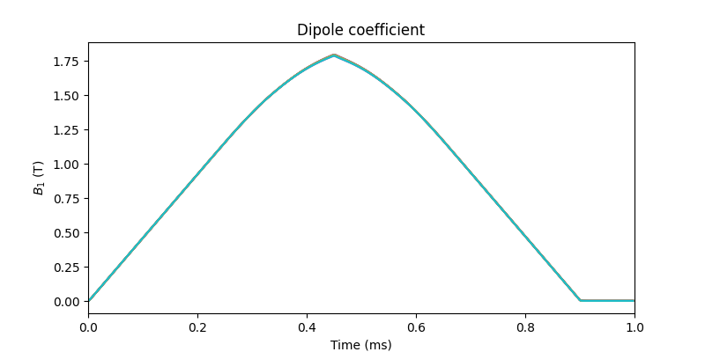

Field quality analysis
Field quality evaluated on several 5 mm reference circles. (All in vacuum chamber)
Multipole coefficients $C_{n}=A_{n}+jB_{n}$ [T] as function of time and position
30mm
20mm
50mm
Air gap and beam pipe with
10µm Titanium coating

Slide 12
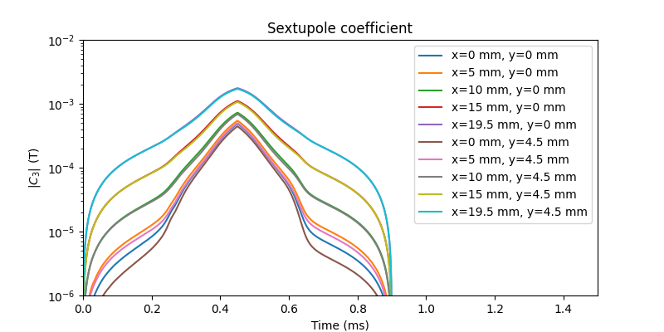
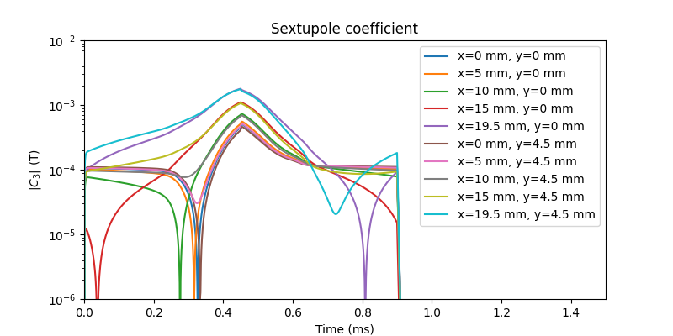
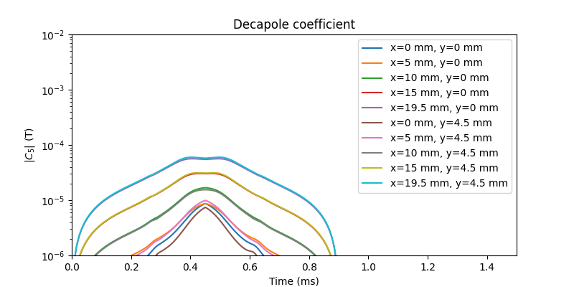
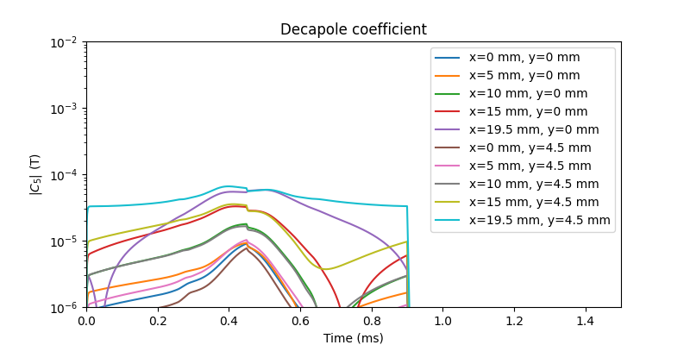
Beam pipe affecting field quality
Without beam pipe:
With beam pipe:
Unwanted
multipole coefficients
are larger on average.
Similar peak values.

Slide 13
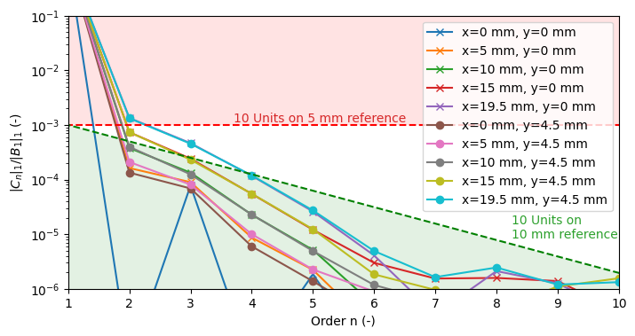
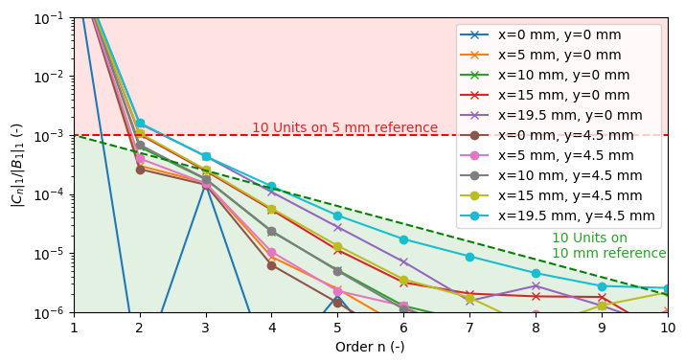

Relative multipole coefficients
Relative multipole coefficients: $\frac{{\left|\left|C_{n}\right|\right|}_{1}}{{\left|\left|B_{1}\right|\right|}_{1}}=\frac{∫\left|C_{n}\right|dt}{∫\left|B_{1}\right|dt}=R_{n}\left(r=5mm\right)$
Requirement: 10 Units on 10 mm reference circle $⇔R_{n}\left(r=10mm\right)<{10}^{−4}$
  $R_{n}\left(r=5mm\right)={\left(\frac{5mm}{10mm}\right)}^{n−1} R_{n}\left(10mm\right)< {\left(\frac{1}{2} \right)}^{n−1}{10}^{−4}$ Green region
Strong quadrupole and sextupole coefficients: Shim design recommended / ongoing
Without beam pipe:
With beam pipe:

Slide 14
Outline
Time-domain analysis of normal-conducting magnets
  Field quality evaluation
  Excitations with higher duty cycles
Frequency-Domain Analysis & Equivalent Circuit Modeling
  Frequency- Domain Loss Evaluation Method
  Equivalent Circuit & Nonlinear Dynamic Modeling
  Cross-Validation :Simplified Time-Harmonic & High-Fidelity Transient FEA Model

Slide 15
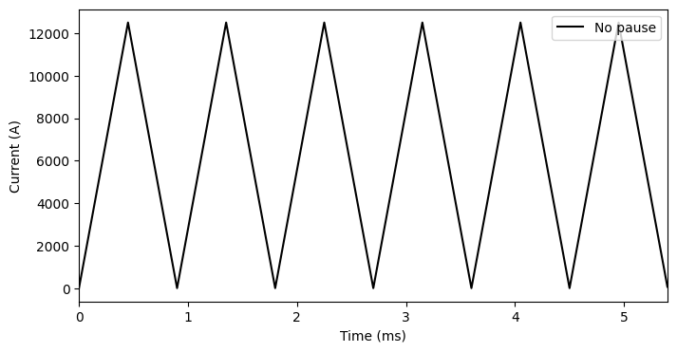
Excitations with higher duty cycles
Time domain analysis:
+ Captures all details
- Too slow for optimization routines
Frequency domain analysis:
+ Fast heuristic
- Assumes finite number of significant
frequencies
  Requires larger duty cycles
Duty cycle: 0.9ms/200ms <0.5%
Duty cycle: 0.9ms/1.8ms =50%
Duty cycle: 100%
How much does magnet behavior differ for these excitations?

Slide 16
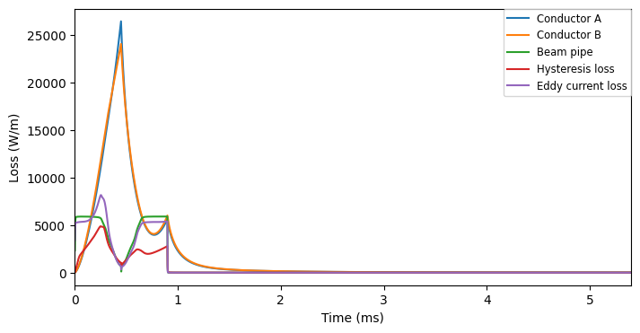
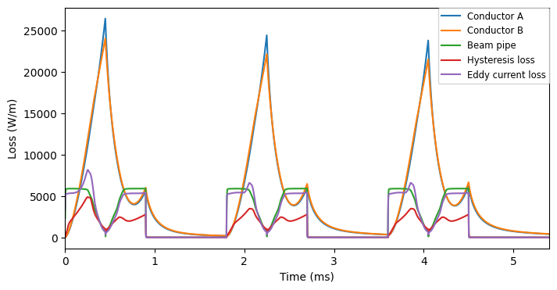
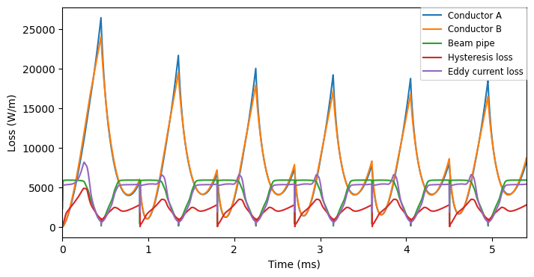
Losses per period
Copper loss: 75.93 J/m
Titanium loss: 16.46 J/m
Iron loss: 25.11 J/m
  Hysteresis: 8.76 J/m
Copper loss: 69.21 J/m
Titanium loss: 16.43 J/m
Iron loss: 22.89 J/m
  Hysteresis: 7.48 J/m
Copper loss: 48.24 J/m
Titanium loss: 16.31 J/m
Iron loss: 22.69 J/m
  Hysteresis: 7.41 J/m

Slide 17
Outline
Time-domain analysis of normal-conducting magnets
  Field quality evaluation
  Excitations with higher duty cycles
Frequency-Domain Analysis & Equivalent Circuit Modeling
  Frequency- Domain Loss Evaluation Method
  Equivalent Circuit & Nonlinear Dynamic Modeling
  Cross-Validation :Simplified Time-Harmonic & High-Fidelity Transient FEA Model

Slide 18
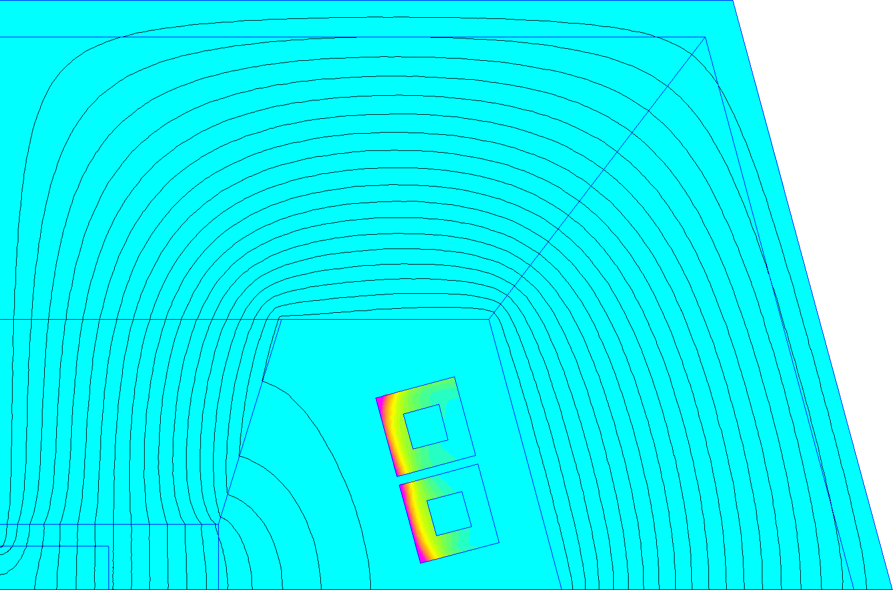
Problem Statement
Pulsed operation of Normal Conducting magnets leads to additional losses such as :
  Magnetic losses in the ferromagnetic yokes
  Joule losses in windings (skin & proximity effects)
Accurate loss evaluation is critical for:
  Global efficiency & Magnet Thermal design
A dynamic magnet model or equivalent circuit is essential for:
  Power converter sizing
  Current pulse control strategy development

Slide 19
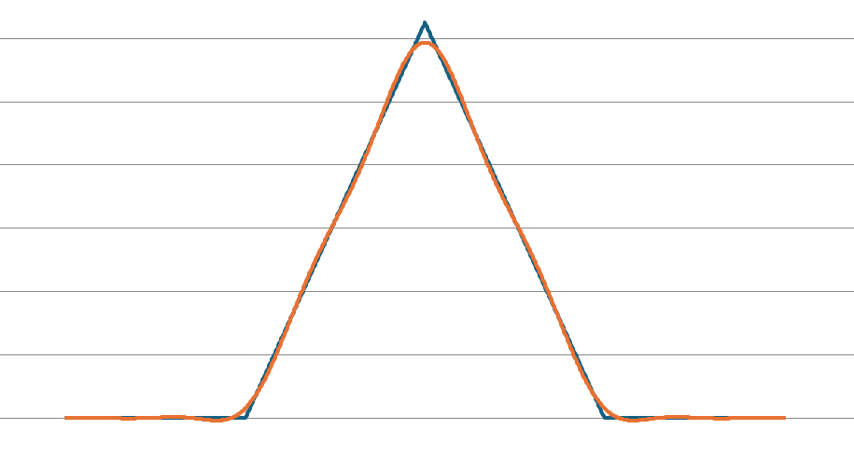
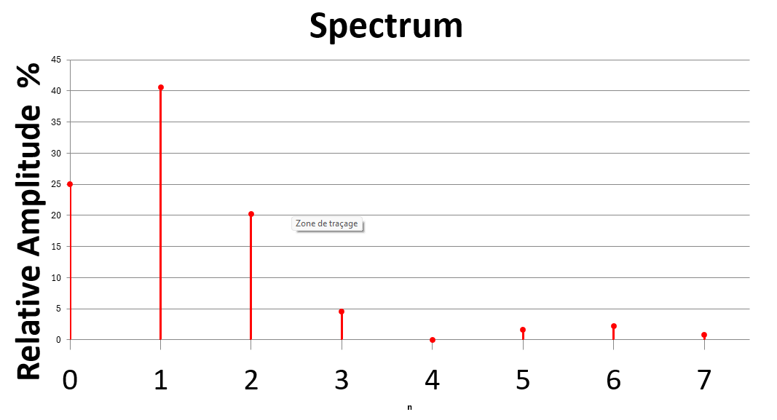


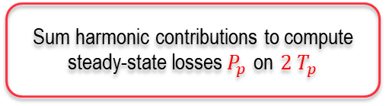
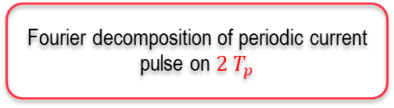


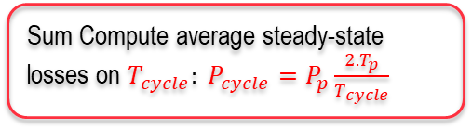

Frequency- Domain Loss Evaluation Method
Objective: Balance accuracy& computational speed for loss estimation in pulsed steady-state regimes with Time-harmonic FEA for efficient iterative optimal design
Fourier decomposition of periodic current pulse on ${2 T}_{p}$
Steady-state obtained on on $2T_{p}$with Transient FEA
Real & Reconstructed Signal
(𝑛=0 - 7 ) on $2T_{p}$
Time-harmonic FEA for each harmonic 𝑛=0 - 7
$$2T_{p}$$
$$T_{p}$$
Sum harmonic contributions to compute steady-state losses${ P}_{p}$ on ${2 T}_{p}$
$$2T_{p}$$
Sum Compute average steady-state losses on $T_{cycle}: {P_{cycle}=P}_{p}\frac{{2.T}_{p}}{T_{cycle}}$

Slide 20
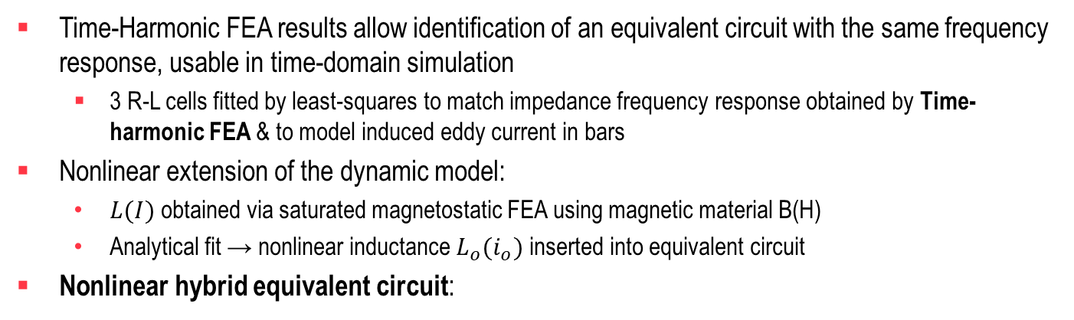
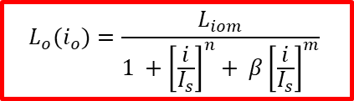
Equivalent Circuit & Nonlinear Dynamic Modeling
Time-Harmonic FEA results allow identification of an equivalent circuit with the same frequency response, usable in time-domain simulation
  3 R-L cells fitted by least-squares to match impedance frequency response obtained by Time-harmonic FEA & to model induced eddy current in bars
Nonlinear extension of the dynamic model:
  $L(I)$obtained via saturated magnetostatic FEA using magnetic material B(H)
  Analytical fit → nonlinear inductance $L_{o}(i_{o})$inserted into equivalent circuit
Nonlinear hybrid equivalent circuit:
$$L_{o}(i_{o})=\frac{L_{iom}}{1 +{\left[\frac{i}{I_{s}}\right]}^{n}+ β{\left[\frac{i}{I_{s}}\right]}^{m}}$$

Slide 21

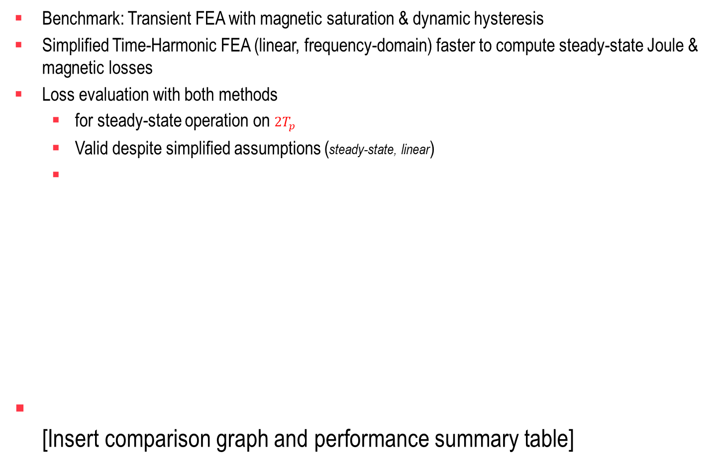
Cross-Validation Between Simplified Time-Harmonic and High-Fidelity Transient FEA Model
Benchmark: Transient FEA with magnetic saturation & dynamic hysteresis
Simplified Time-Harmonic FEA (linear, frequency-domain) faster to compute steady-state Joule & magnetic losses
Loss evaluation with both methods
  for steady-state operation on $2T_{p}$
  Valid despite simplified assumptions (steady-state, linear)
[Insert comparison graph and performance summary table]
$$2T_{p}$$

Slide 22
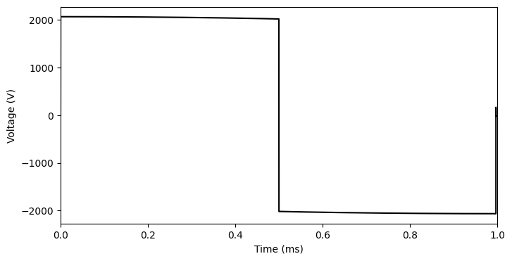
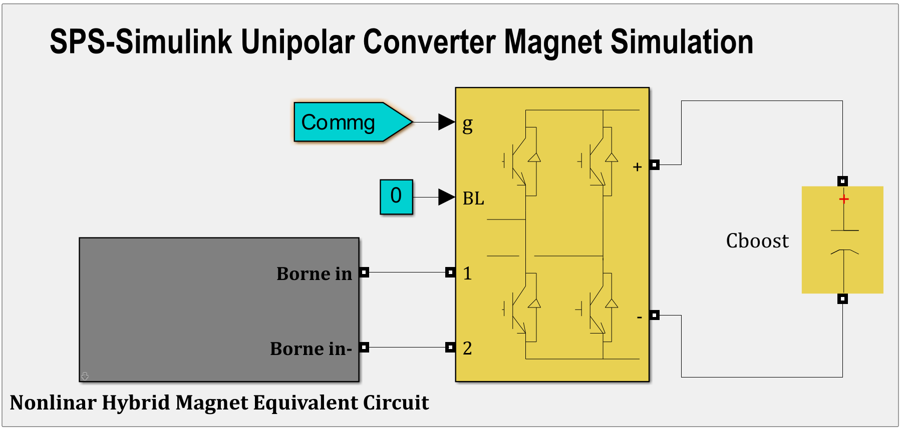
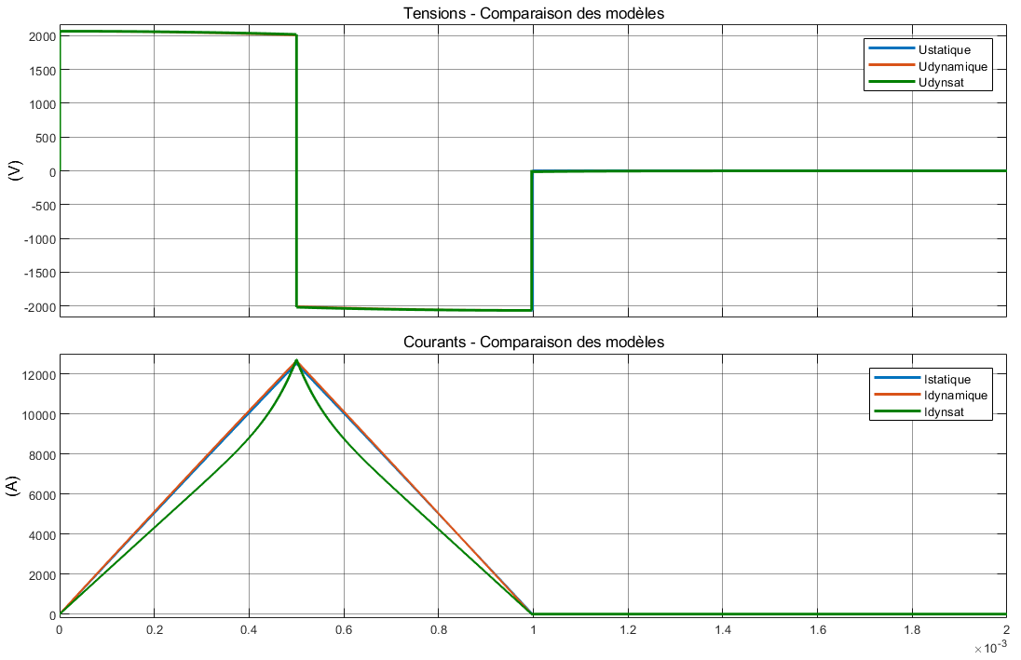
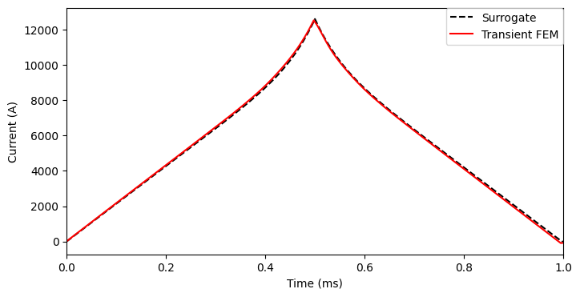
Cross-Validation Between Simplified Time-Harmonic and High-Fidelity Transient FEA Model
Dynamic Validation of the Equivalent Circuit Using Transient FEA
Validation scenario:
  Nonlinear hybrid equivalent circuit model driven by pulsed power converter in Simulink
  Simulated input magnet voltage applied to Voltage supplied full Transient FEA model
Agreement on Current waveform reproduction
Transient FEA
Voltage
Current Pulse
Simulink
Transient FEA
SPS-Simulink

Slide 23
Conclusion & Perspectives
High-Fidelity Transient FEA Magnet Model with saturation for:
  accurate dynamic loss estimation under pulsed regime
  spatial field quality analysis
Simplified Time Harmonic FEA Methodology :
  for loss computation under steady-state pulsed regime
  for identification of nonlinear hybrid equivalent circuit model usable in circuit simulations & Magnet-converter-control co-design
  suitable for implementation in iterative design optimization with computational efficiency
Cross-validation with acceptable accuracy
High-fidelity &simplified FEA models are complementary tools used at different levels of modeling complexity within an integrated CAD & simulation environment.

Slide 24


