Slide 1
Magnetic and mechanical design of large aperture HTS superconducting dipole for the Muon Collider accelerator ring
L. Alfonso¹, L. Balconi^{2,3}, A. Bersani¹, L. Bottura⁴, B. Caiffi¹, S. Fabbri⁴, S. Farinon¹, A. Gagno¹, F. Levi ¹, T. Maiello¹, F. Mariani^{2,5}, S. Mariotto^{2,3}, D. Novelli^{1,5}, A. Pampaloni^{1,5}, C. Santini², S. Sorti^{2,3}, M. Statera²
¹ INFN – Genova, ² INFN – Milano, ³ University of Milan, ⁴ CERN, ⁵ Sapienza Università di Roma

Slide 2
Outline:
Requirements on the accelerator dipole
Cable assumption
Magnetic design and analysis
Magnetization analysis
Mechanical design and analysis
Heat loads
Warm-cold transitions
Future developments
L. Alfonso¹, L. Balconi^{2,3}, A. Bersani¹, L. Bottura⁴, B. Caiffi¹, S. Fabbri⁴, S. Farinon¹, A. Gagno¹, F. Levi ¹, T. Maiello¹, F. Mariani^{2,5}, S. Mariotto^{2,3}, D. Novelli^{1,5}, A. Pampaloni^{1,5}, C. Santini², S. Sorti^{2,3}, M. Statera²
¹ INFN – Genova, ² INFN – Milano, ³ University of Milan, ⁴ CERN, ⁵ Sapienza Università di Roma

Slide 3
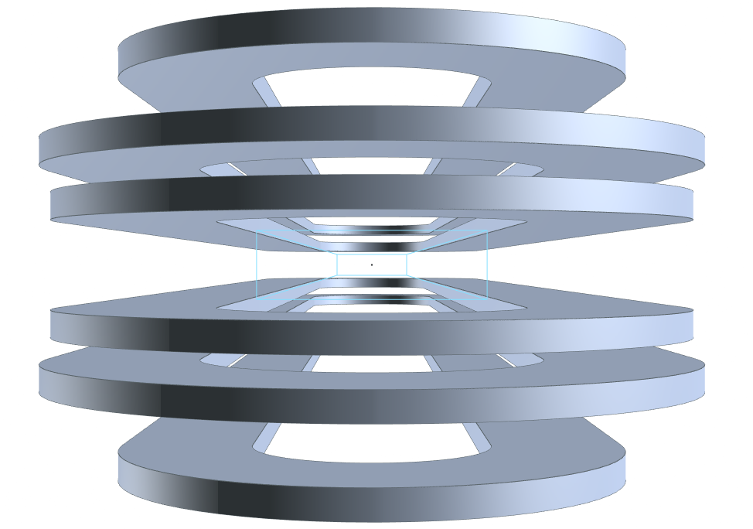
Requirements for the SC Dipoles
Main characteristics:
Open midplane dipole to avoid deposition of the radiation from muon decay.
10 T of central field.
Rectangular aperture of 100 mm x 30 mm.
Magnetic length of about 1.3 m.
Proposed solution:
Magnet design based on metal insulated
HTS racetracks.
$$\sim 1.3 m$$
Aperture
30 mm
100 mm

Slide 4
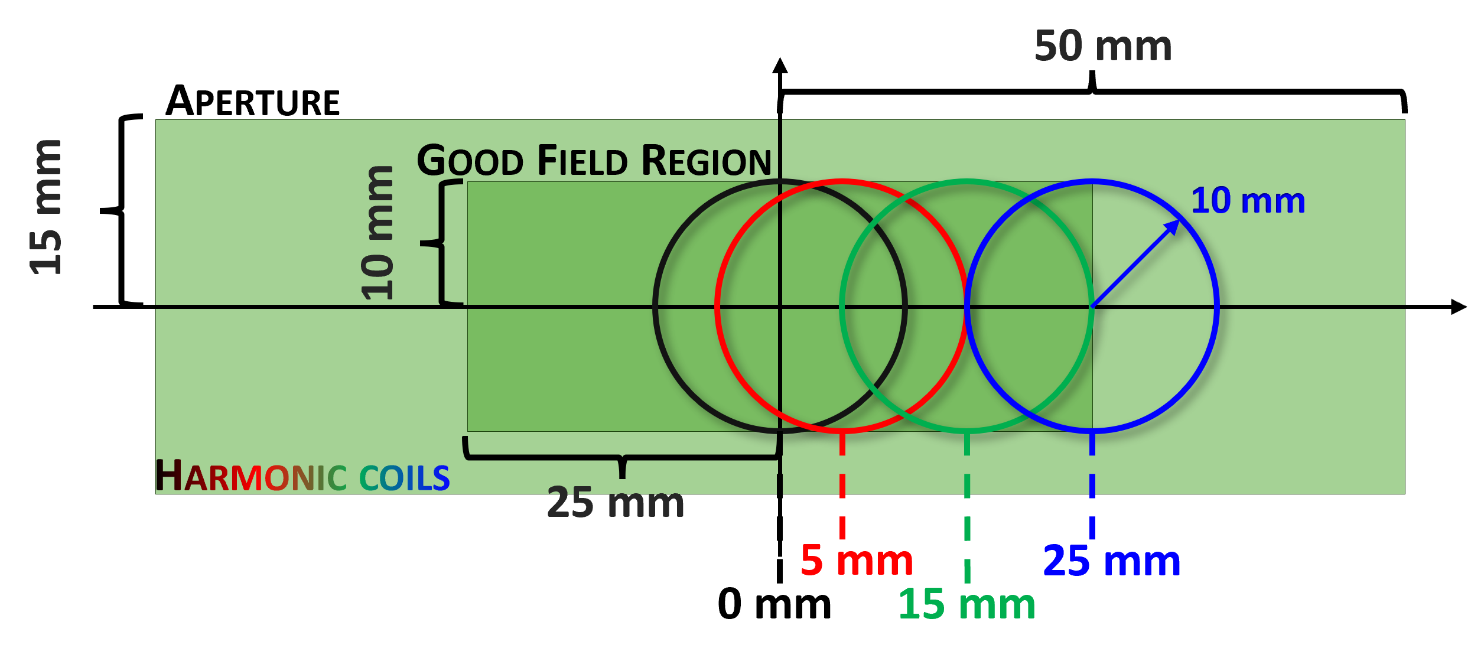
Requirements for the SC Dipoles
Field quality requirements:
Rectangular aperture of 100 mm x 30 mm.
Field quality: $b_{n}<10$ units in beam radius of 10 mm.

Slide 5
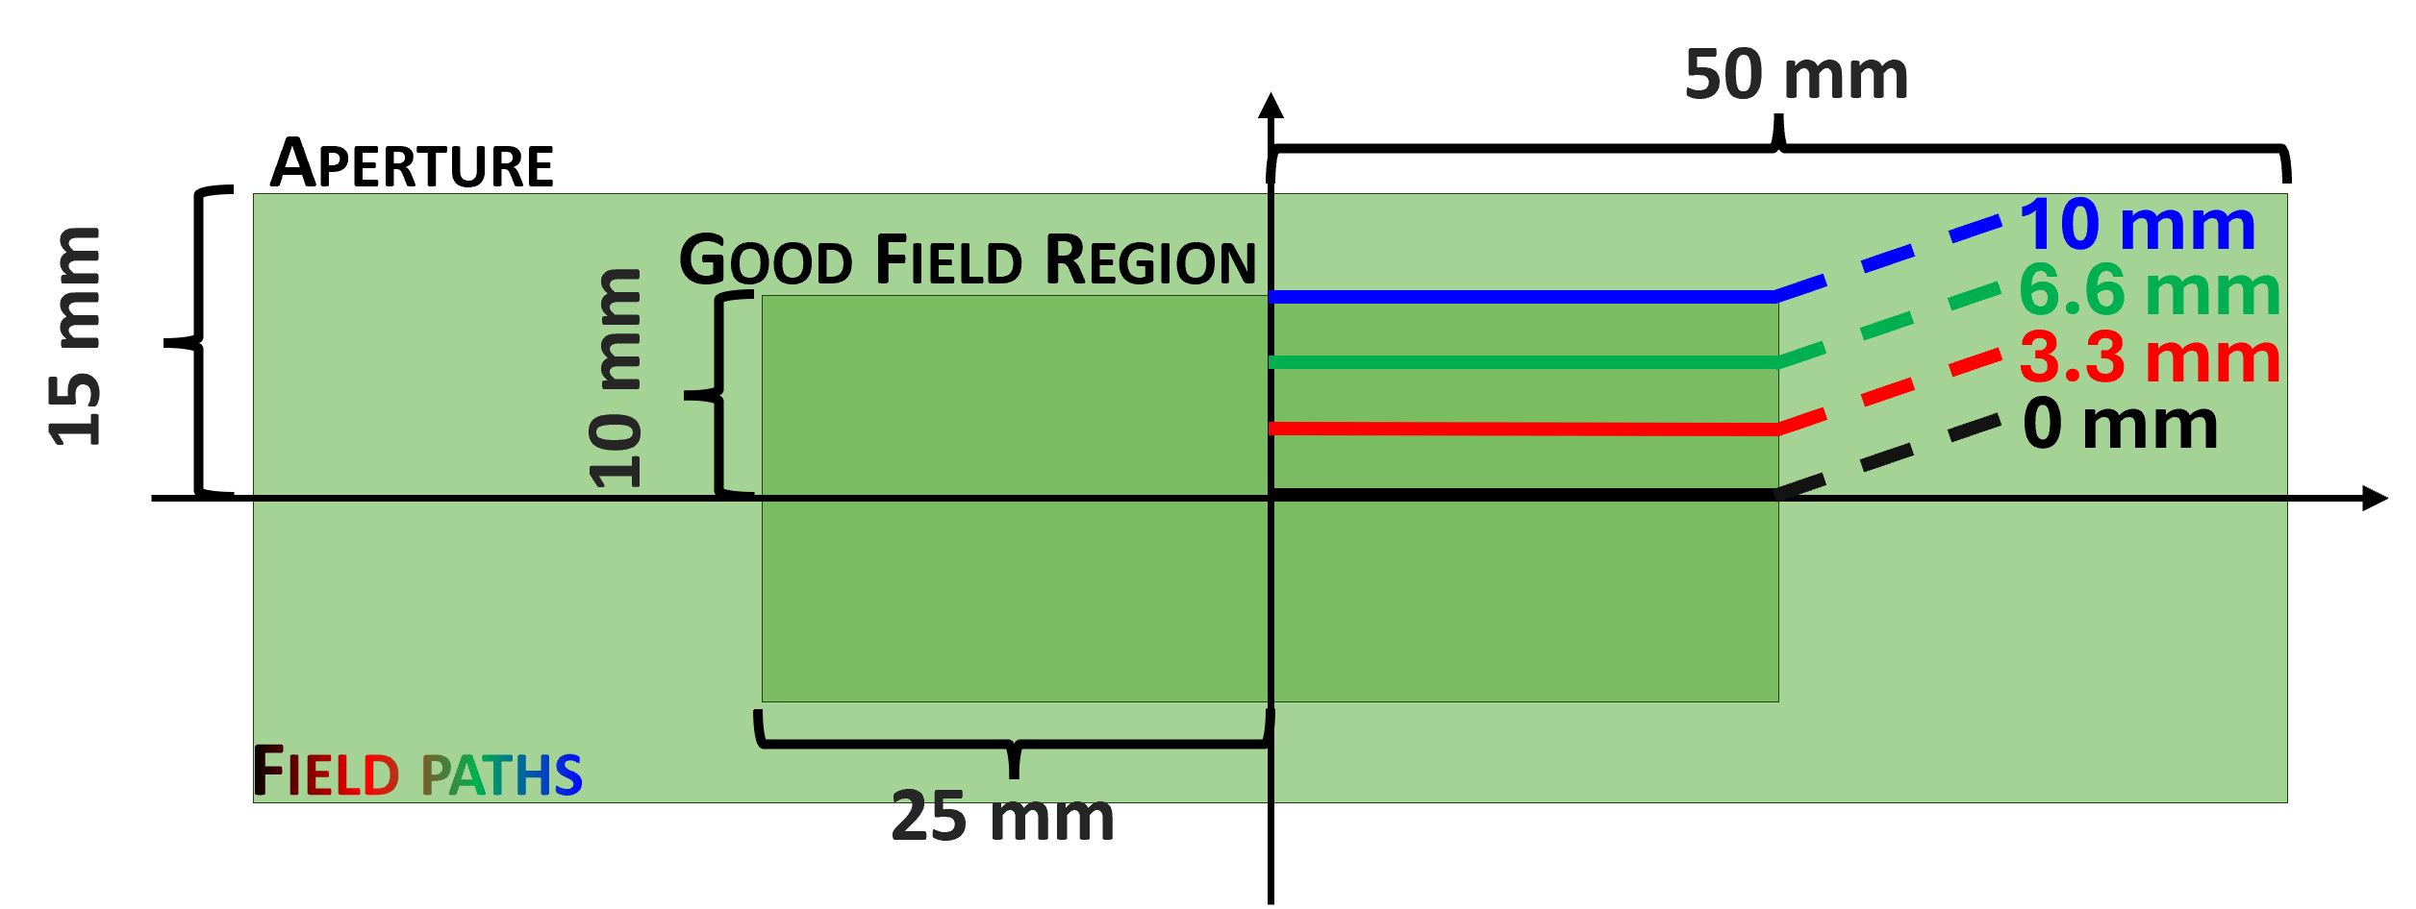
Requirements for the SC Dipoles
Field quality requirements:
Rectangular aperture of 100 mm x 30 mm.
Field homogeneity $≤$ 1% in the good field region.

Slide 6
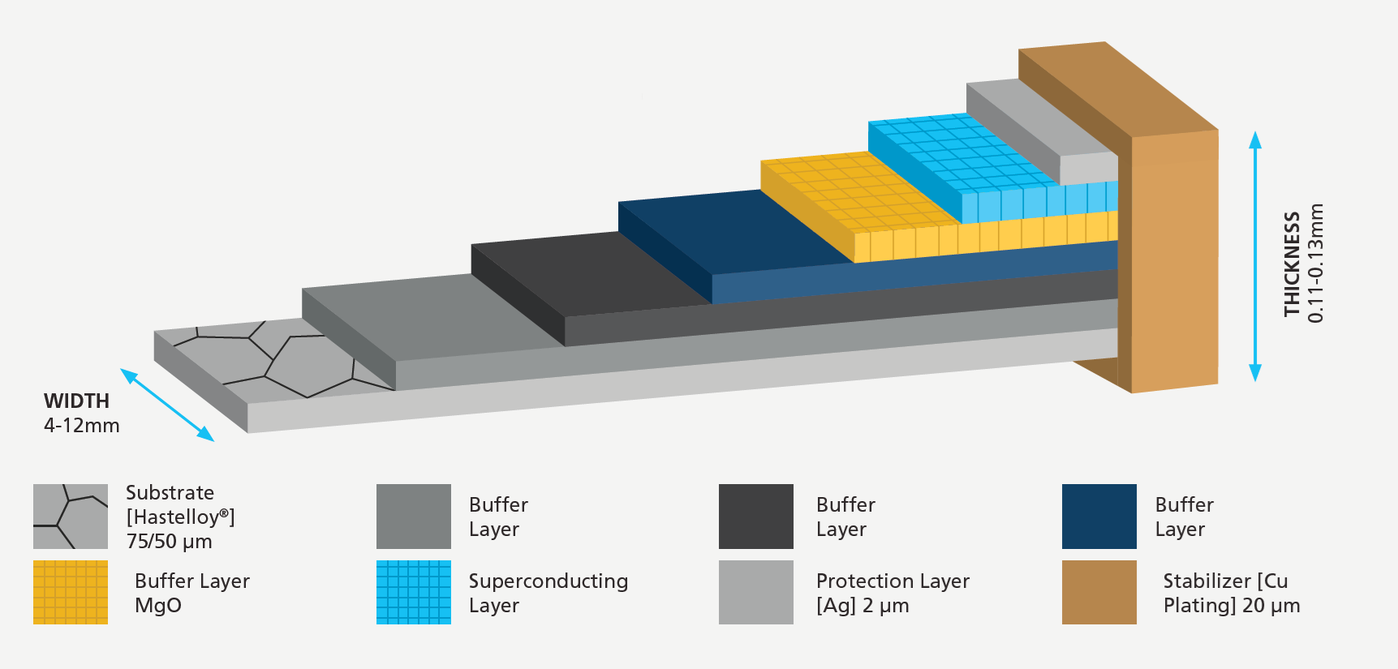
Cable Assumptions
Same assumption as for the collider studies
The conductor consists of two tapes and one $50 μm$ SS strip.
The SC is based on a commercial YBCO tape from Fujikura.
$$20 μm$$
Cu
SC
$$2.5 μm$$
Ag
$$2 μm$$
Substrates
$$110 μm$$
SS strip
$$50 μm$$
$$12 mm$$
$$A_{tot}=3.24 mm^{2}$$
$$A_{SC}=0.0598 mm^{2}$$
$$A_{Cu}=0.9656 mm^{2}$$

Slide 7
Magnetic Design
Three identical racetracks.
Alignment of racetracks for easier mechanical design.
Use of the sectors to reduce stress.
I [A] | J_{eng} $\left[\frac{A}{mm^{2}}\right]$ | B₀ [T] | B_{p} [T] | T_{op} [K] | T margin [K]
2381.13 | 734.92 | 10.00 | 12.32 | 20 | ≥ 2.5
Mag length [m] | Mec length [m] | Yoke radius [mm] | Cost $\left[\frac{k\text{€}}{m}\right]$
~1.3 | ~1.6 | 300 | 196.24
3
2
# racetrack | # cond. left | # cond. right | # tot. cond.
1 | 47 | 158 | 205
2 | 45 | 160 | 205
3 | 46 | 159 | 205
1
Notes:
Yoke outer radius

Slide 8
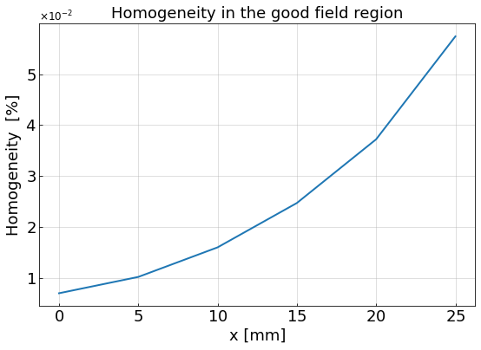
Field Quality and Homogeneity
All harmonics greatly less then 10 units.
The harmonics higher than the 7th order less than 0.003 units.
The field homogeneity evaluated at x = 25 mm is about 0.06%.

Slide 9
Magnetization Analysis
Using T-A formulation, it is possible to make a model that simulates the charging phase of the magnet.
$$J_{x}=0$$
$$J_{y}=0$$
$$T_{y}=0$$
$$T_{z}=0$$
Assumptions which are at the basis of the theory:
The charging phase is characterized by a slope of 20 $\frac{A}{s}$ until the peak current of $I_{max}=2399.48 A$ and the current stays constant for $9000 s$.
$$q_{tot}=\text{4}9.35 \frac{kJ}{m}$$
$$q_{peak}=\text{878.85} \frac{W}{m}$$

Slide 10
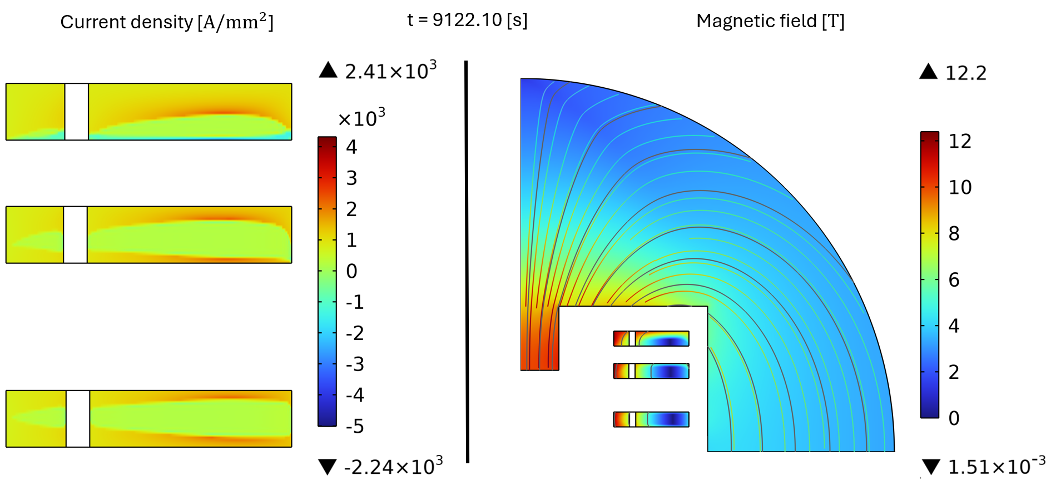
Magnetization Analysis
Magnetization of the cable causes a different current distribution that generates a different magnetic field map

Slide 11
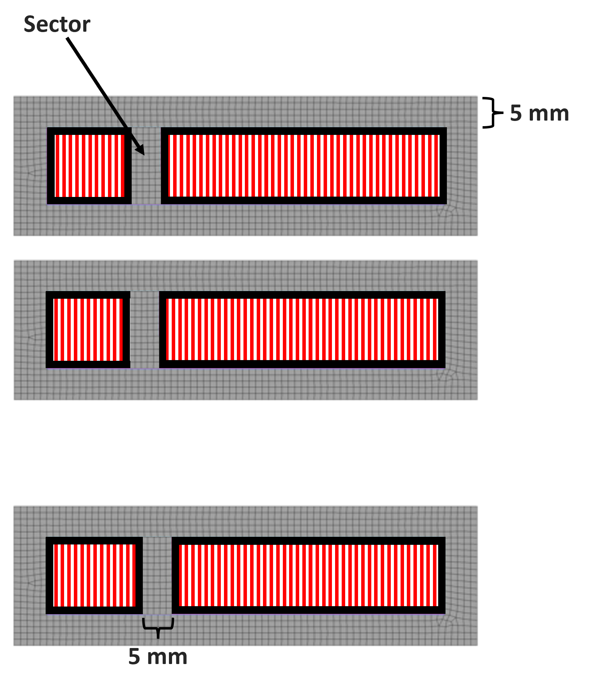
Mechanical Performance
Only Lorentz forces effect evaluation:
This very simple model has the aim of evaluate the stress associated to the Lorentz forces, not for the dimensioning of the mechanical structure.
Infinitely rigid structure.
Homogenous material for racetracks:
$E=150 GPa$
$ν=0.3$
Frictionless system.
Maximum horizontal stress 400 MPa and maximum vertical stress 100 MPa.
To reduce the stresses inside the conductors 5 mm thick infinitely rigid sectors were inserted which split the coils in two smaller coils.
¹
¹ Value taken from “Electro-mechanical properties of REBCO coated conductors from various industrial manufacturers at 77 K, self-field and 4.2 K, 19 T”
https://iopscience.iop.org/article/10.1088/0953-2048/28/4/045011

Slide 12
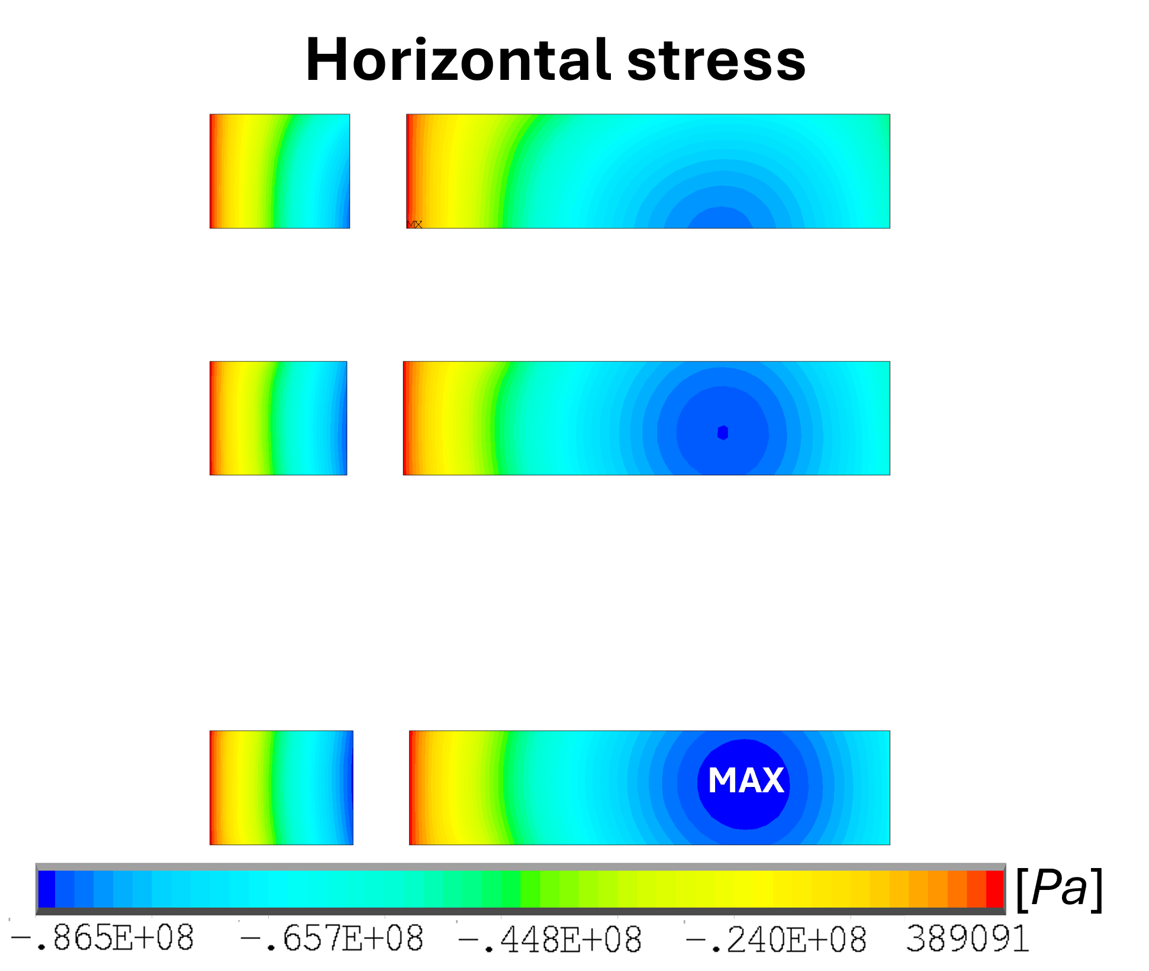
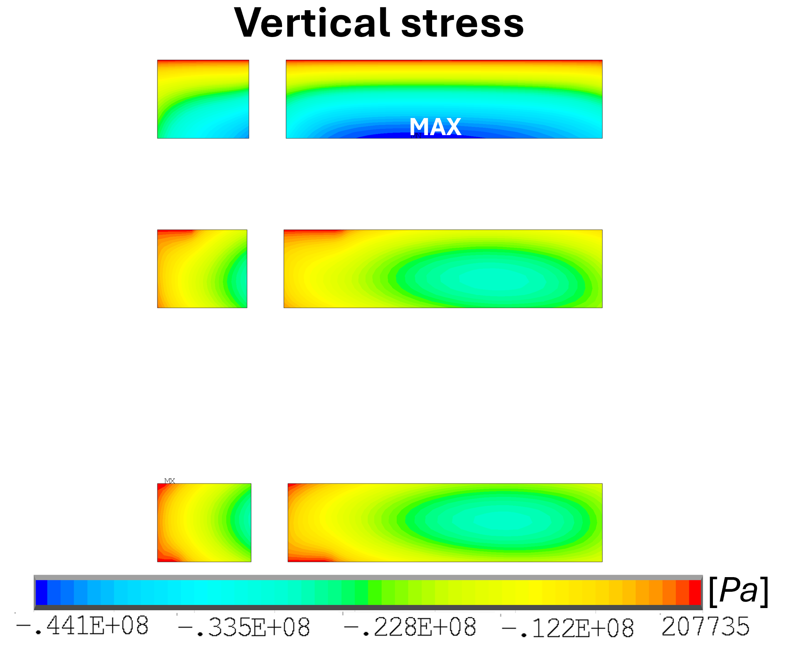
Mechanical Analysis
Racetrack | F_{x} $\left[\frac{kN}{m}\right]$ |  | F_{y} $\left[\frac{kN}{m}\right]$
1 | 1019 | 799 | 23 | 95
2 | 993 | 698 | -93 | -378
3 | 927 | 632 | -418 | -1797
tot | 5068 |  | -2568
MAX
Racetrack | Peak $σ_{1,x} [MPa]$ |  | Peak $σ_{2,y} [MPa]$ |  | Peak $σ_{VM} [MPa]$
1 | -85.60 | -86.55 | -25.98 | -26.86 | 76.07 | 76.73
2 | -83.71 | -84.85 | -25.89 | -27.06 | 74.24 | 75.09
3 | -82.80 | -82.27 | -41.23 | -44.12 | 71.71 | 71.27

Slide 13
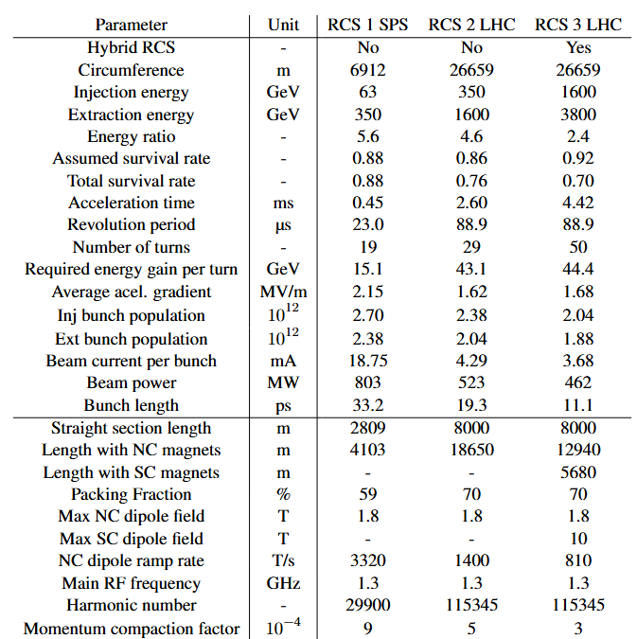
Heat Loads (CERN siting)
1. $N\left(t\right)=N_{0}e^{−\frac{t}{γτ}}, \frac{dN}{dt}=\frac{{−N}_{0}}{γτ}e^{−\frac{t}{γτ}}$ (where $τ$ is the muon mean lifetime (2.2 $μ$s), and $γ$ is changing)
2. $N_{0} = 2.7(10^{12})$
3. $P_{e^{+}e^{−}}=0.35P_{μ}$
For reference, collider average power from $e^{+}e^{−}$ $→$500 W/m
 | Acceleration time [ms] | % lost | Peak Power over accel. time [W/m] | Avg. Power at 5 Hz [W/m]
RCS1 | 0.45 | 11.9 | 1976 | 4.45
RCS2 | 2.6 | 16.1 | 517 | 6.7
RCS3 | 4.42 | 13.1 | 647 | 14

Slide 14
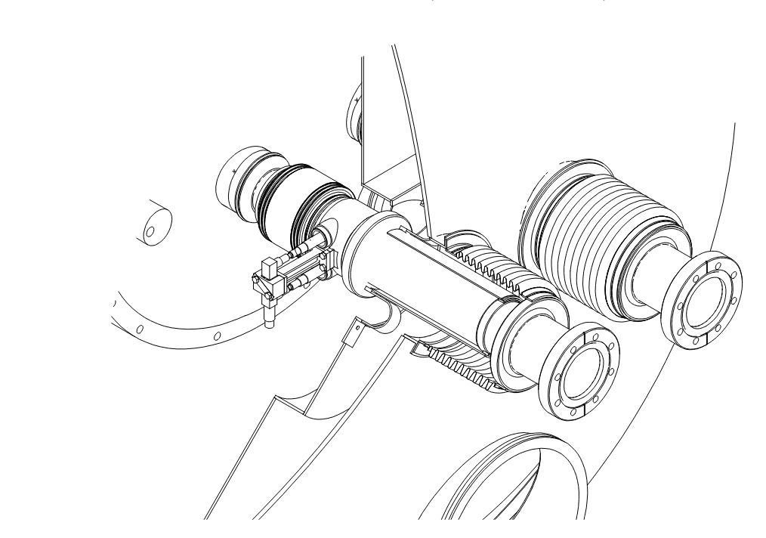
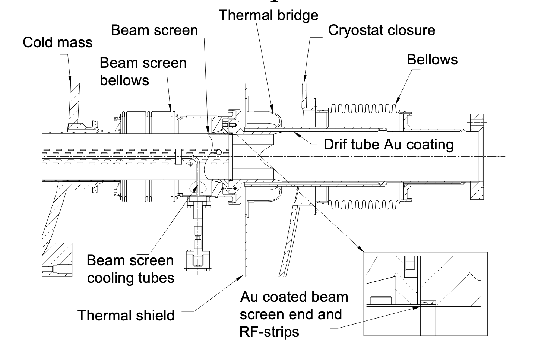
Warm-Cold transitions
https://accelconf.web.cern.ch/e04/PAPERS/WEPKF015.PDF
Cold mass (1.9 K)
Room temperature (300 K)

Slide 15
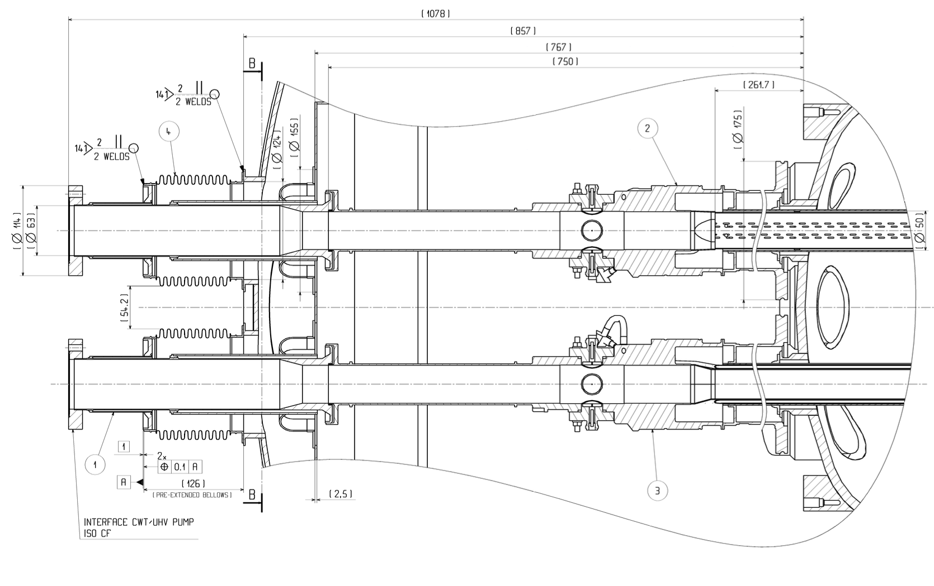
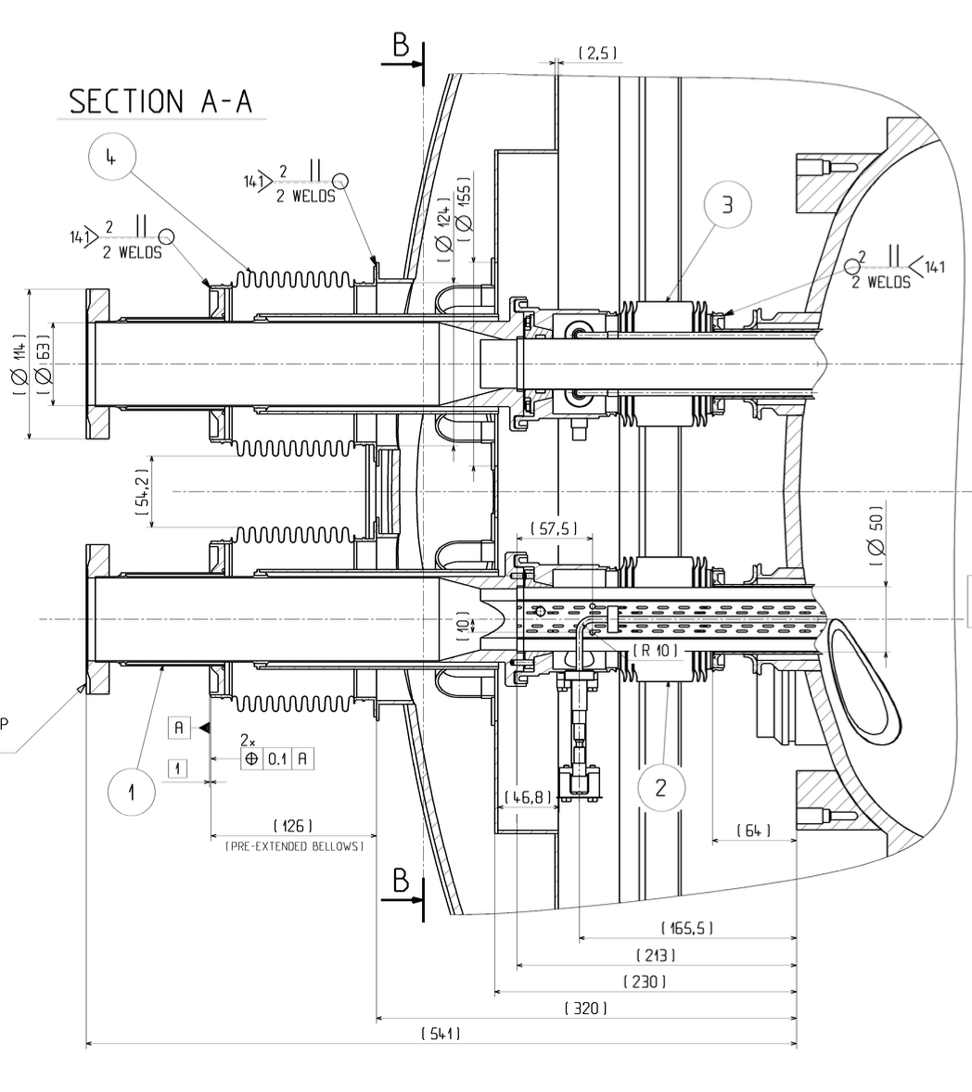
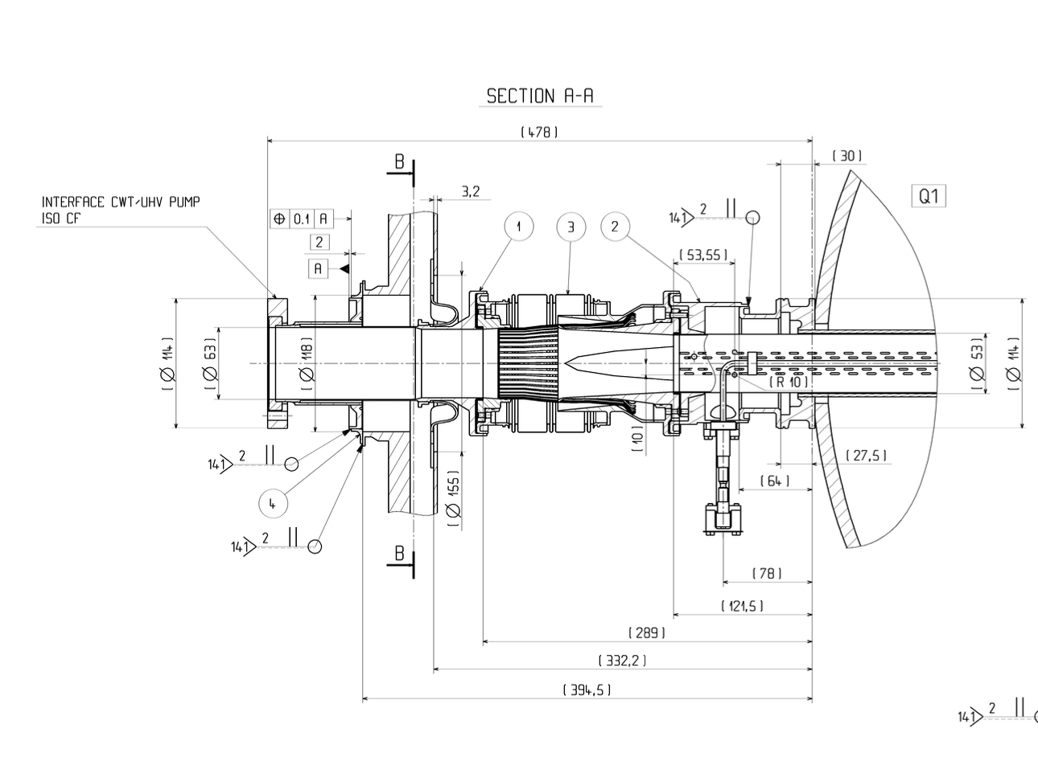
Warm-Cold transitions
Part ID | Location | Length (mm)
LHCLVTB_008 | C/W Transition CB50 Assembly type I | 1078
Part ID | Location | Length (mm)
LHCLVTB_001 | C/W Transition CB50 Assembly type C | 541
Part ID | Location | Length (mm)
LHCLVTL_001 | C/W Transition CB53 Assembly type A | 394.5
NOTE: distance is given from the end of the cold mass dome to the end of the warm flange

Slide 16
Warm-Cold transitions
W/C transition in the LHC are 400 mm long. To this length, we need to add:
Distance from the end of the cold magnet (end of the magnetic length) to the end of the cold mass dome: approximately 400 mm
Distance from the warm flange to the beginning of the warm magnet (beginning of the magnetic length): approximately 200…300 mm ?
$→$The field-free region at each W/C transition will be of the order of 1 m
Some optimization required and possible:
Interconnects (current, fluids) will likely exit laterally
Operation at 20 K will ease design and shorten W/C thermo-mechanical transition

Slide 17
Conclusions and Future Developments
Conclusions:
A solid 2D magnetic design is ready and it fulfils all the requirements:
Good field quality and homogeneity over large aperture
Large margin at high temperature (20 K, with T_{margin} $≥$ 2.5 K)
A strategy to mitigate the effect of the Lorentz Forces has been studied, through stress management concept using sectors.
The value of hysteretic losses is around 50 $\frac{kJ}{m}.$
Peak heat loads can be on the order of 2000 W/m in RCS1
Field-free region at each W/C transition will be of the order of 1 m
Next steps to be studied:
A detailed and optimized 2D and 3D mechanical design.
A 3D electromagnetic design.
An evaluation of the effect of persistent currents on the field quality.
Thermal analysis concerning both a more refined magnetization model and the effects of quench.

Slide 18
Thanks for your attention
L. Alfonso¹, L. Balconi^{2,3}, A. Bersani¹, L. Bottura⁴, B. Caiffi¹, S. Fabbri⁴, S. Farinon¹, A. Gagno¹, F. Levi ¹, T. Maiello¹, F. Mariani^{2,5}, S. Mariotto^{2,3}, D. Novelli^{1,5}, A. Pampaloni^{1,5}, C. Santini², S. Sorti^{2,3}, M. Statera²
¹ INFN – Genova, ² INFN – Milano, ³ University of Milan, ⁴ CERN, ⁵ Sapienza Università di Roma

Slide 19
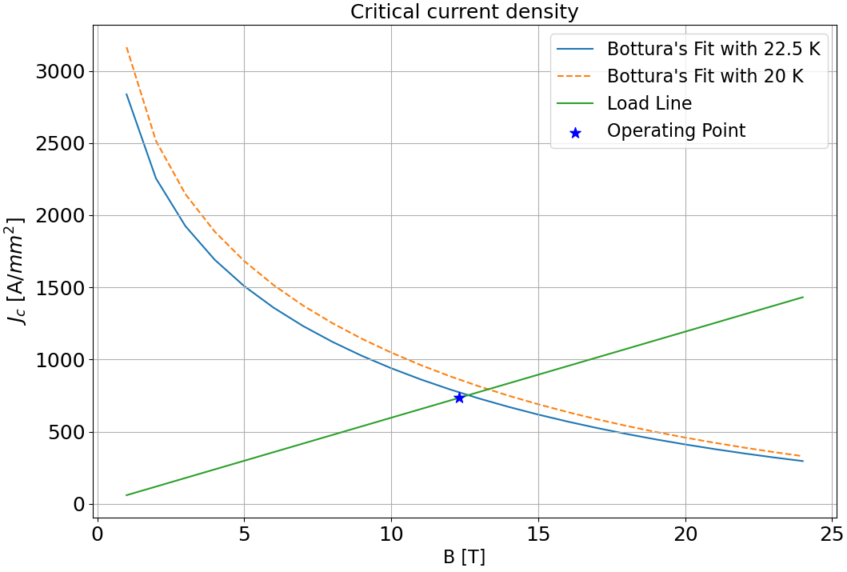
Margin in Temperature
The temperature margin requirement of ≥ 2.5 K is met
$$J_{c}\left(T,|B|\right)$$

Slide 20
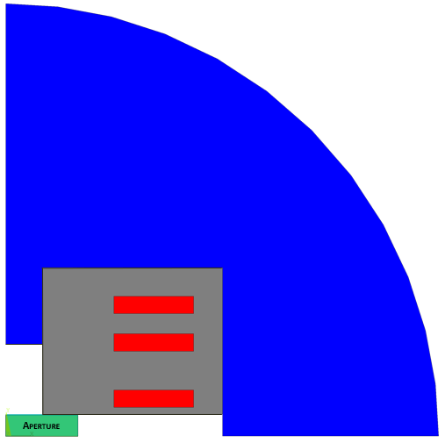
Costs
${Cost}_{TOT}=(∑A_{x}ρ_{x}C_{x}$) + 20 $\frac{k\text{€}}{m}$
 | $$ρ\left[\frac{kg}{m^{3}}\right]$$ | $$C\left[\frac{\text{€}}{kg}\right]$$
Cond. | 8000 | 2500
Iron | 7800 | 8
SS | 7800 | 10
$$\left\{\begin{aligned}A=area [m^{2}] \\ ρ=density\left[\frac{kg}{m^{3}}\right] \\ C=cost density\left[\frac{k\text{€}}{kg}\right]\end{aligned}\right.$$
Assembly
Cost
Conductor [k€/m] | 159.41
Iron yoke [k€/m] | 13.65
Mechanical structure [k€/m] | 3.18
Assembly [k€/m] | 20.00
Total cost [k€/m] | 196.24

Slide 21
T-A Formulation
Using T-A formulation, it is possible to make a model that simulates the charging phase of the magnet.
Equation which are at the basis of the theory:
$J_{c}=$ $J_{c}(T,|B|)$
$$ρ_{HTS}=\frac{E_{0}}{J_{c}\left(T_{op},\left|B\right|\right)}{\left(\frac{\left|\vec{J}\right|}{J_{c}\left(T_{op},\left|B\right|\right)}\right)}^{n}$$
$$E_{0}={10}^{−4} \left[\frac{V}{m}\right]$$
$$n=40$$
$$\vec{J}= \vec{∇}×\vec{T}$$
$$ρ_{HTS}\vec{J}=\vec{E}$$
$$\vec{∇}×\vec{E}=−\frac{∂\vec{B}}{∂t}$$
$$\vec{B}=\vec{∇}×\vec{A}$$
$$\vec{I}=\iint_{S}{\vec{J}} dS=\iint_{S}{\vec{∇}}×\vec{T} dS=\int_{C}{\vec{T}} dL$$
$$\left[\frac{A}{m^{2}}\right]$$
Assumptions which are at the basis of the theory
$$J_{x}=0$$
$$J_{y}=0$$
$$T_{y}=0$$
$$T_{z}=0$$

Slide 22
Magnetization Analysis
Due to magnetization the requirement of field quality, in the good field region, of ${|b}_{n }|$ $≤$ 10 units is not met
Notes:
After the ramp..

