Slide 1
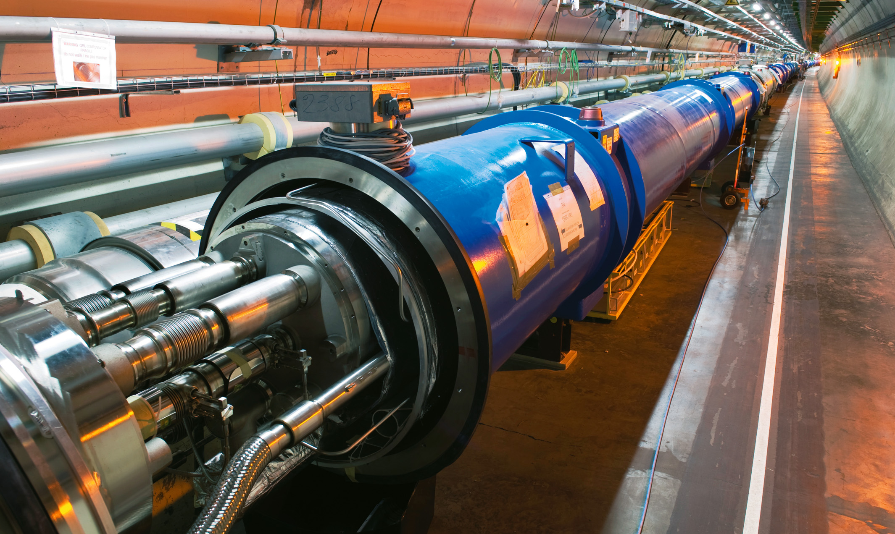
System design and shock wave
phenomena in a liquid Pb target
IMCC Annual Meeting 2025 – DESY
Luca Tricarico¹
C. Carrelli²
¹Università di Bologna, ²ENEA - FSN

Slide 2
Outline
Intro
ENEA’s previous solutions
Current studies:
Shockwave and cavitation
Preliminary simulations
Conclusions:
General considerations
Future steps

Slide 3
About me
PhD student at University of Bologna: DMSAI program.
Master thesis in Energy Engineering: Applications of Liquid Metals for Particle Accelerators. CFD study on IMCC ENEA’s target solution and BDF thermal analysis.
CFD Investigations on Heavy Liquid Metal Alternative Target Design for the SPS Beam Dump Facility; Calviani, M.; Carrelli, C.; Cervone, A.; Cioli Puviani, P.; Di Piazza, I.; Esposito, L.S.; Manservisi, S.; Mazzola, G.; Tricarico, L.; Franqueira Ximenes, R. Energies 2024, 17, 2952. https://doi.org/10.3390/en17122952.

Slide 4
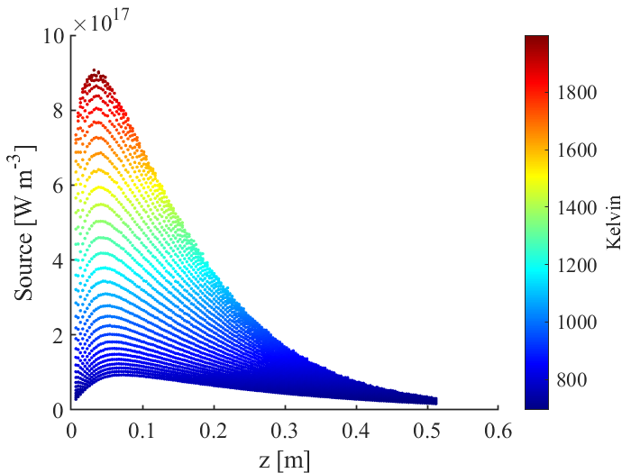
Intro
Beam Intercepting devices (BIDs) characteristic
Hight volumetric thermal power deposition up to 1e18 W/m^3.
Beam deposition: 2 ns at 5 Hz.
Magnetic field: 20 T.
Geometrical limitations.
Radiation risk.
Hight performance for long period.
Power deposition – z axis
Contour of temperature into the liquid lead.
(data source CERN (2023), 2 MWs target)

Slide 5
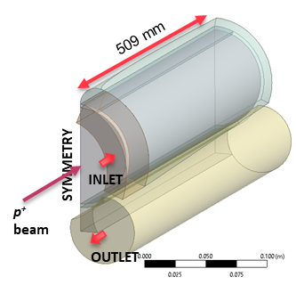
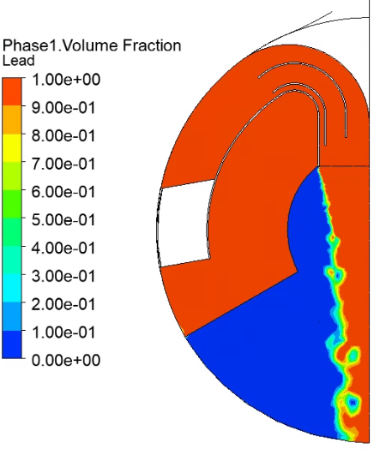
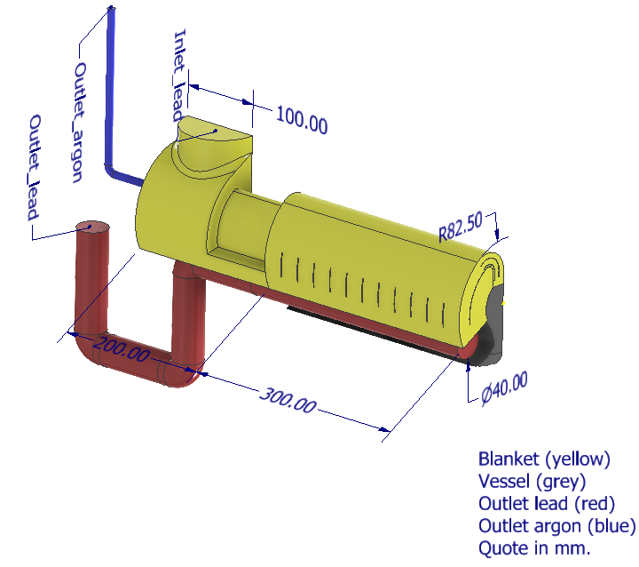
Intro: ENEA’s previous solutions
ENEA’s previous solutions
Studies on the 2MW beam option with 3cm diameter of interaction.
Hydraulic modelling using Volume of Fluid model Argon-Lead phase.
Problems
Hight mass flow rate.
Low muon production (CERN).
P. Cioli Puviani, C. Carrelli. Enea 2023.
L. Tricarico, P. Cioli Puviani, C. Carrelli. Enea 2024

Slide 6
Current studies: Shockwave and cavitation
Physical model: scope
Identify the pressure and velocity peaks.
Quantify the characteristic parameters of the ongoing phenomena.
Hypothesis
The beam doesn’t give a momentum to the target.
The beam deposition happens at constant volume into the interaction region.
Beam
Thermal Source
Shockwave
MHD
Lead Argon
FSI

Slide 7
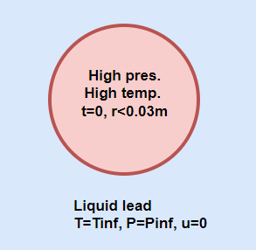
Current studies: Shockwave and cavitation
Physical model: initial condition t=0
Mie Gruneisen EOS: overpressure calculation into the interaction region
$$p=p_{ref}+\frac{γ}{V}\left(E−E_{ref}\right)$$
Tait EOS: lead compressibility
$$ρ=ρ_{ref}{\left(\frac{p+B}{p_{ref}+B}\right)}^{1/n}$$

Slide 8
Current studies: Shockwave and cavitation
Shockwave and cavitation: stet up
Over pressure of 5GPa resulting from 1e18 [W m^-3] pick deposition – (data source CERN (2023), 2 MWs target).
Patch pressure at 5GPa into the interaction zone.
Compressible liquid lead according to Tait EOS.
Cavitation model for liquid lead under 10 Pa.
Incompressible argon and lead vapour.
Isothermal VOF model.
Time step 10ns.
Shock and velocity front into liquid lead with cover gas in argon.

Slide 9
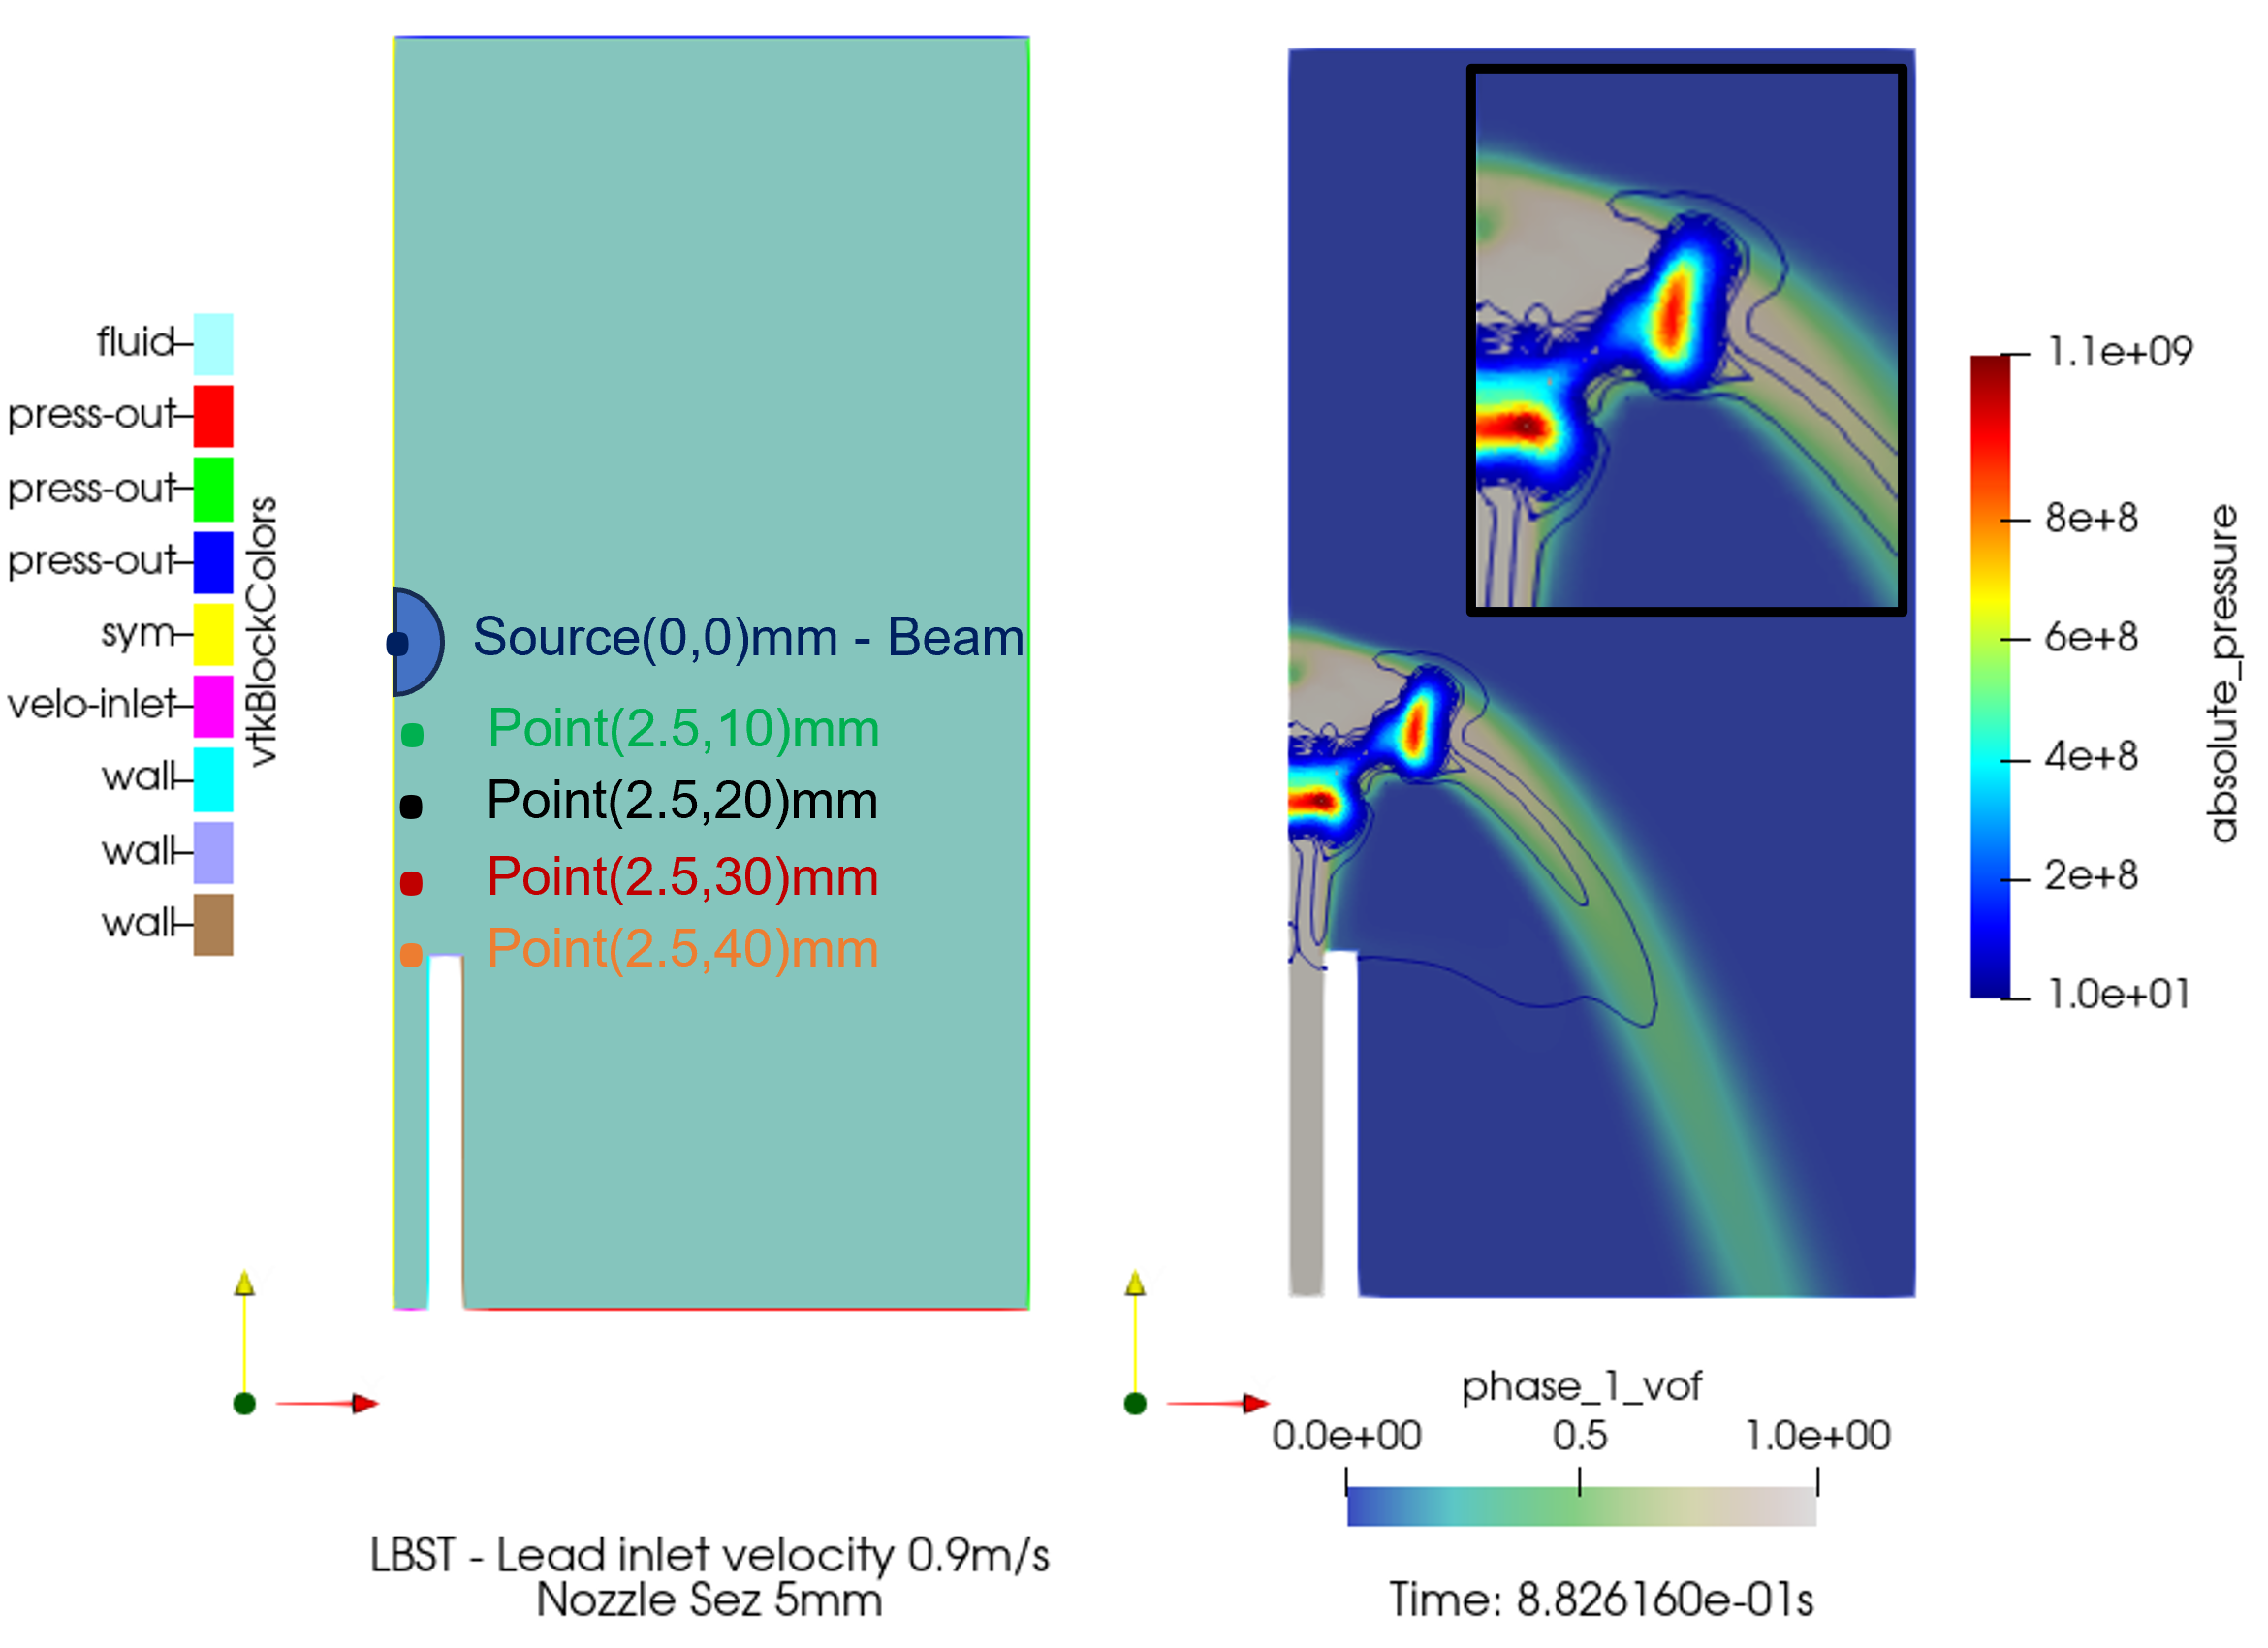
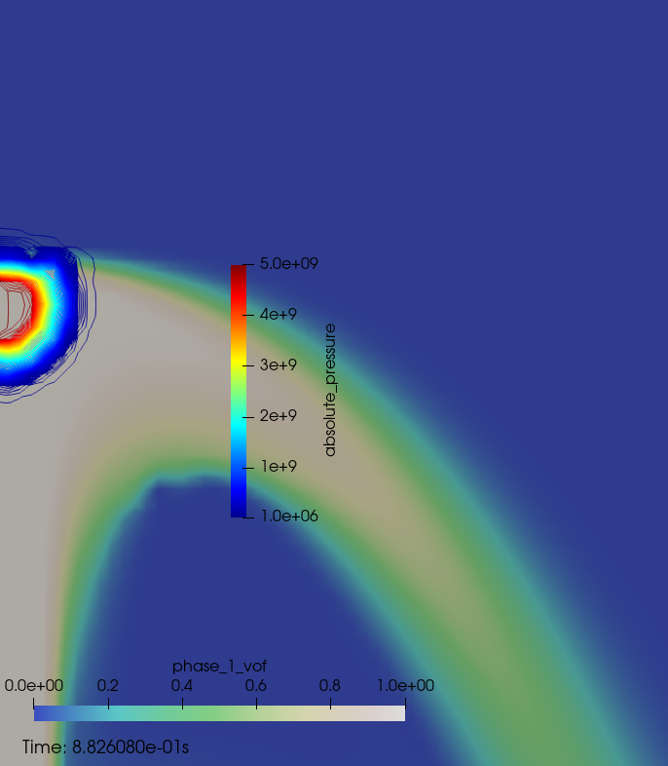
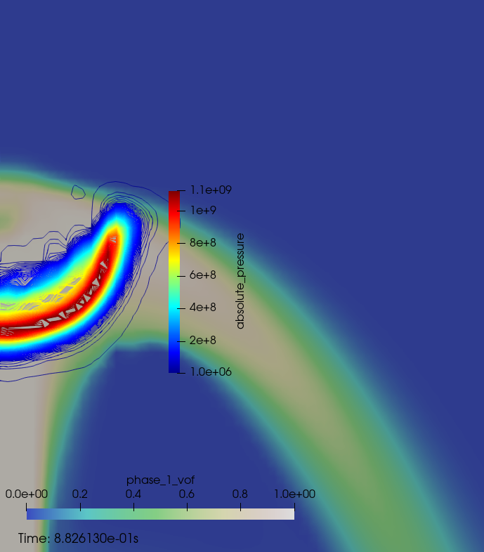
Current studies: Shockwave and cavitation
Preliminary simulations: Lead Bottom Stream Target (LBST)
Liquid lead jet target with inlet velocity of 0.9 m/s.
Nozzle section of 5mm.
Inlet
Simulation of shock wave into liquid lead with argon.

Slide 10
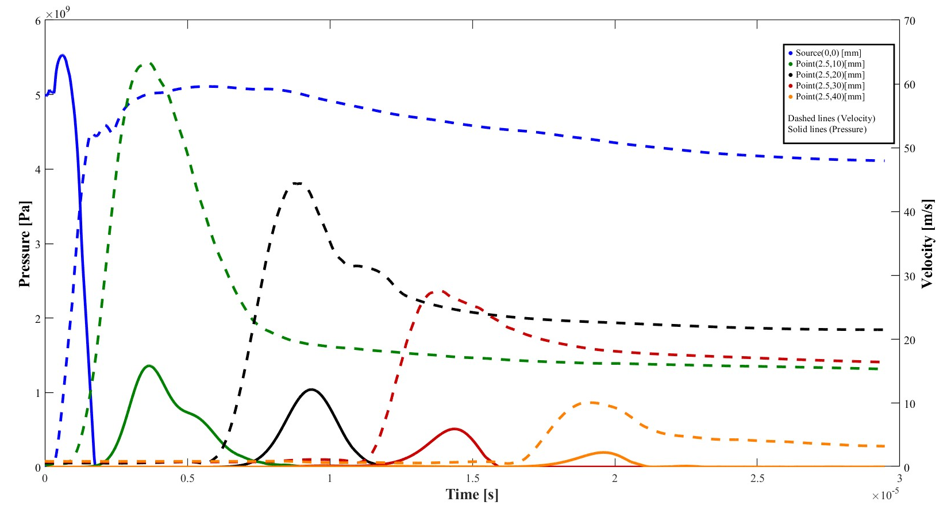
Current studies: Shockwave and cavitation
Preliminary simulations: Lead Bottom Stream Target (LBST)
Shock wave and velocity profile into the target.
Shock front into liquid lead.

Slide 11
Current studies: Shockwave and cavitation
Preliminary simulations: Lead Bottom Stream Target (LBST)
Current calculation: same case fine mesh
LBST fine mesh.

Slide 12
Conclusion: General considerations
General considerations
The hight power energy pulse generates shock waves with a magnitude of several GPa and period of 1e-5s.
An argon buffer is preferred between the interaction zone and structure: the hight compressibility of argon decries the magnitude of the shock wave.
It is important to ensure a minimum distance between the beam interaction zone to reduce the magnitude of the shock wave.
It is important to reduce the mass flow rate for the system loop point of view.
It is important to reduce the volume of hight density material around the beam interaction zone to ensure higher muon production.

Slide 13
Conclusion: future steps
Future steps
Implement a fully compressible VOF model.
Develop a cavity model for vaporization and condensation depending on pressure and temperature.
Integrate other physical phenomena.
Beam
Thermal Source
Shockwave
MHD
Lead Argon
FSI

Slide 14
Thanks for the attention
luca.tricarico@studio.unibo.it

