Slide 1
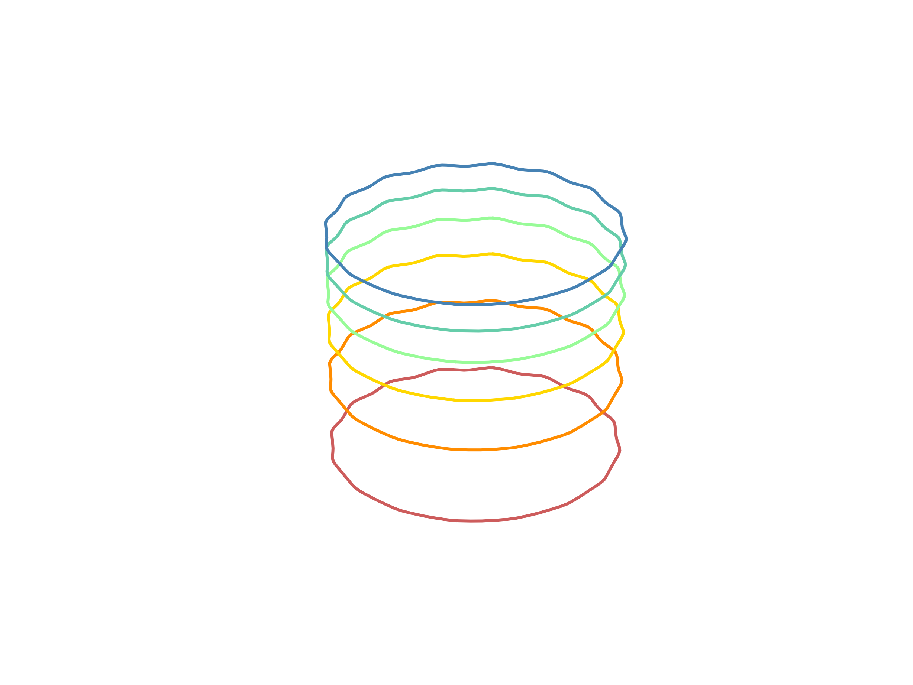
Update of vFFA Study
Max Topp-Mugglestone
max.emil.topp-mugglestone@cern.ch

Slide 2
Contents:
Introduction to the vFFA
What is a vertical-excursion Fixed-Field Accelerator?
Why are we interested?
Parameter studies of the vFFA for muon acceleration
Remaining design objectives
Further concepts

Slide 3
RCS challenges
A brief (non-exhaustive) list of problems:
Ramping magnets
Rate of ramping can be limiting factor on muon survival
Ramping requires normal-conducting magnets
Construction and distribution of power converters, storing energy, etc..
Changing path length (hybrid RCS)
Changing time of flight → requirement for tunable RF ?
What if we didn’t have to deal with any of these?
4.2 kT/s ramp rate in RCS1!

Slide 4
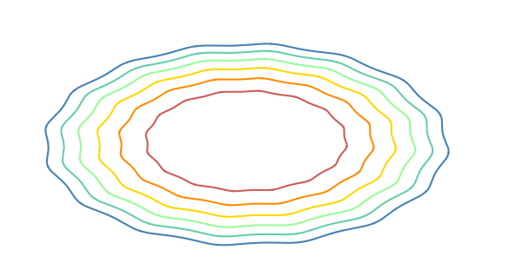
Fixed Field Accelerators
“Conventional” horizontal-excursion FFA (hFFA):
Orbits move outwards with increasing energy
Fields increase radially
Time-independent magnetic fields means…
No ramp times
Rate of acceleration limited only by RF
Mitigates engineering challenges of designing and powering fast-ramping dipoles
All magnets can be superconducting
Orbit position moves when energy changes
Spatial dependence of magnetic fields allows tune control
Energy
For hFFA options for muon acceleration see presentation by J. Scott Berg in 2023 IMCC meeting

Slide 5
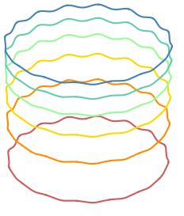
Vertical-Excursion Fixed Field Accelerators
Vertical-excursion FFA (vFFA):
Orbits move upwards with increasing energy
Fields increase vertically
Vertical-excursion FFA (vFFA):
Higher energy orbits are vertically translated copies of lower energy orbits
Zero chromaticity if fields increase with vertical coordinate ($Z$) following scaling law
$$B={B_{0}e}^{mZ}$$
Zero path length difference means…
$→$ Zero momentum compaction factor $α_{c}$
$→$ Transitionless
$→$ Quasi-isochronous for relativistic particles
→ on-crest acceleration can be used
Energy

Slide 6
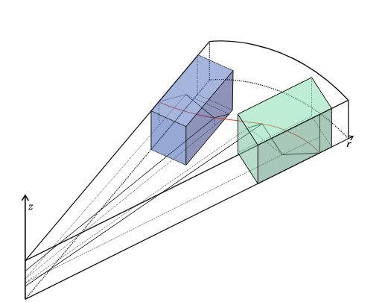
Properties of the vFFA
Non-planar closed orbit
Intrinsically coupled optics
Scaling laws → optics determined by closed orbit and field index m
Diagram of a vFFA FODO lattice half-cell
F-magnet is shaded in green; D-magnet is shaded in blue.
Analytic model of vFFA has been developed
“Scaling Fixed Field Accelerators: theory and modelling of horizontal- and vertical-excursion accelerators” – PhD thesis 2024

Slide 7
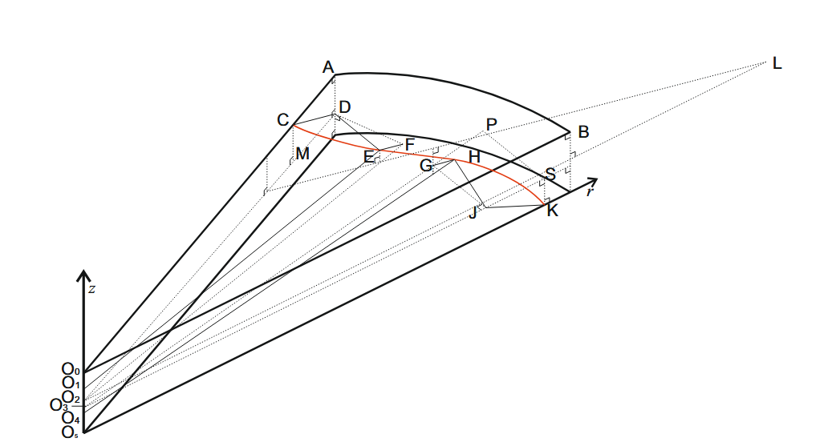
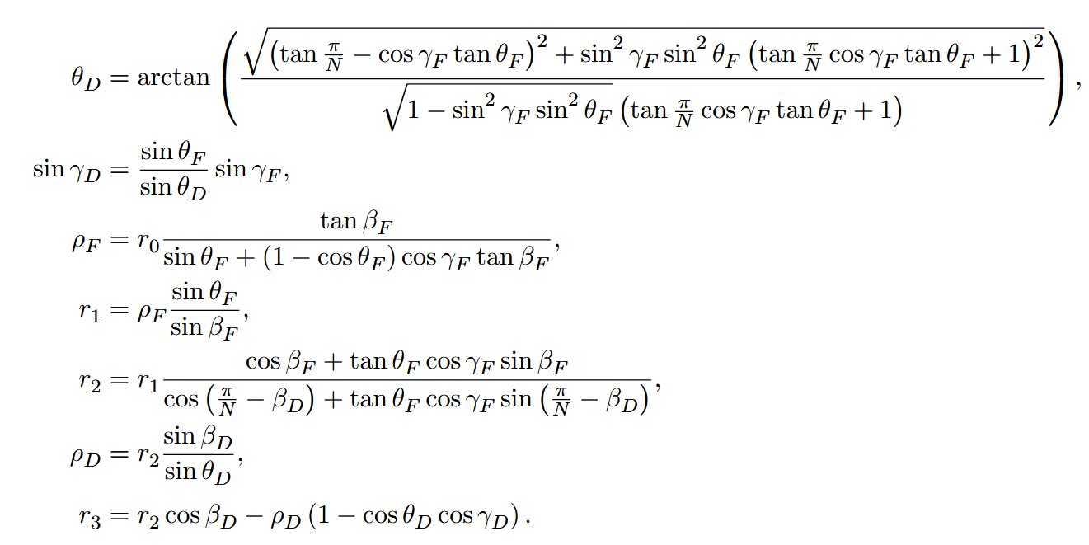
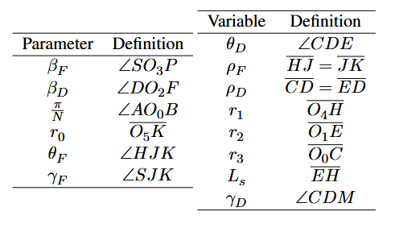
Properties of the vFFA
Closed orbit
Geometric constraints can be used to determine closed orbit from input parameters
Some important variables for each magnet: $ρ, γ, r$
(radius of curvature, inclination of plane of curvature, radius wrt machine centre)

Slide 8
Properties of the vFFA
Magnet body Hamiltonian
$m$ is a constant around the ring
→ Sign of focusing terms can only be changed if sign of $ρ$ changes
→ reverse bends are required
Hamiltonian has normal quad + skew quad + geometric terms
$x,z$ : horizontal and vertical transverse coordinates
$m$ : normalised field gradient
$ρ$: radius of curvature
$γ$ : inclination (angle of the plane of curvature in magnet)

Slide 9
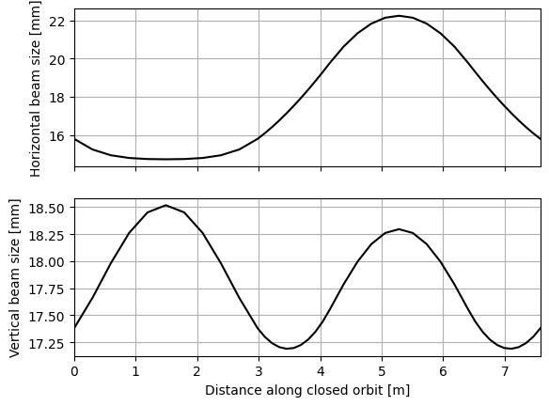
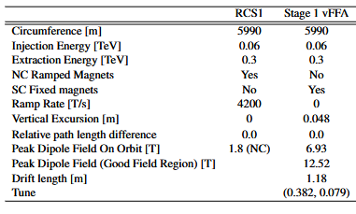
vFFA parameter study (stage 1)
Analytic model of vFFA used to develop proposal for equivalent vFFA FODO ring to RCS1
Constraints:
Footprint no larger than RCS1
Peak field on orbit <8T
Drift lengths > 1m
Excursion < 5 cm
MuCol Milestone 17 Report - WP5 - Tentative design of the FFA (2025)

Slide 10
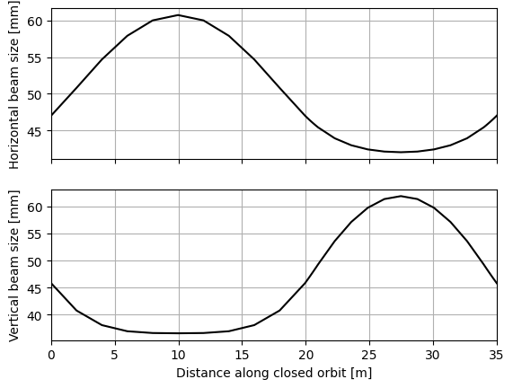
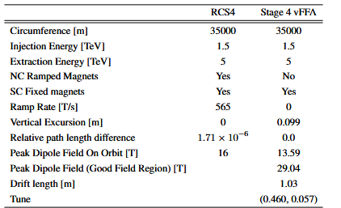
vFFA parameter study (stage 4)
Equivalent vFFA FODO ring to RCS4
Constraints:
Footprint no larger than RCS4
Peak field on orbit <16T
Drift lengths > 1m
Excursion < 10 cm
MuCol Milestone 17 Report - WP5 - Tentative design of the FFA (2025)

Slide 11
vFFA parameter study conclusions
Simple vFFA FODO lattices have been proposed based on analytic formalism
Equivalent vFFA lattices to RCS1, RCS4 exist with
No ramped magnets
Fully SC $∙$ No issues for power converter, energy storage
No requirement for RF frequency ramping
Zero momentum compaction
Fixed tunes
Possibility of on-crest acceleration (potential $\sqrt{2}$ improvement in accelerating voltage for given cavity power)
Excursion less than: 5 cm (vFFA1), 10 cm (vFFA4)
On-orbit dipole fields less than: 7 T (vFFA1), 13.6 T (vFFA4)

Slide 12
Remaining Design Objectives
Longitudinal behaviour of the vFFA has not been studied in this regime
How will bunch structure change after passing through isochronous machine?
Is there a need to perturb isochronicity to preserve longitudinal properties of bunch?
6D simulation is needed
Large change in orbit position can be problematic for acceleration
High-frequency RF cavities have limited aperture
Off-axis beam in RF cavities will excite high order modes (HOMs)
Coupling between transverse and longitudinal planes
Increases need for distributed RF
High normalized field gradient $m$ → rapid growth of fields away from axis
Coupled optics → how do we design an extraction system?
Two takeaways:
Full 6D numerical simulation of vFFA lattices must be completed
Are there ways to mitigate some of the other problems?
Number of turns
RCS1 : 17
RCS4 : 55

Slide 13
vFFA1 Simulation
vFFA1 has been simulated using the FFA code FIXFIELD
Analytic model was able to predict closed orbit, position magnets, and identify valid lattice in previously untested region of parameter space
Disagreement between analytic model and simulation on range of stable m-values → excursion of simulation is larger than analytic model (m ~21/m numerical, m ~30/m analytic)
However, demonstrated success of analytic model for finding new lattices and use of analytic model insights to optimize lattice
6D tracking studies now underway!
vFFA1 simulation to be used as testbed for of further concepts

Slide 14
Coupling in the vFFA
Magnet body Hamiltonian
geometric terms – always present
skew quad term – proportional to $\cos{γ}$
normal quad term – proportional to $\sin{γ}$
If $γ=90°$, we can remove the coupling in this Hamiltonian!
However… cells need at least 2 magnets.
Closed orbit equations
$γ_{F}=γ_{D}$ only if $θ_{F}=θ_{D}$

Slide 15
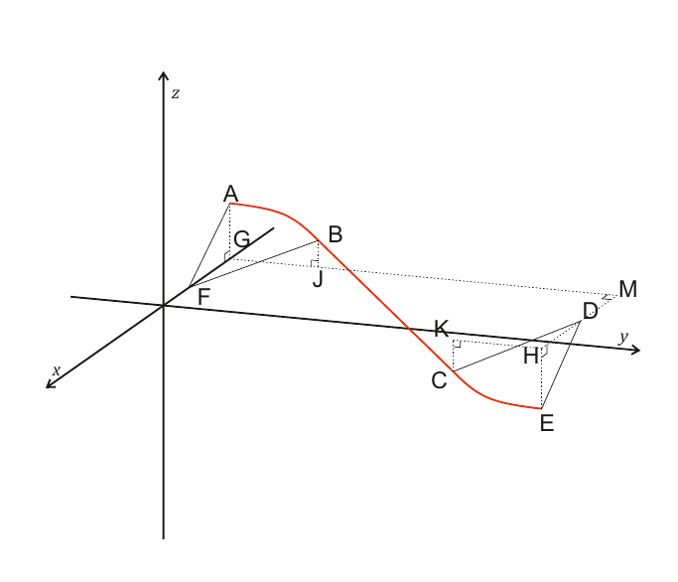
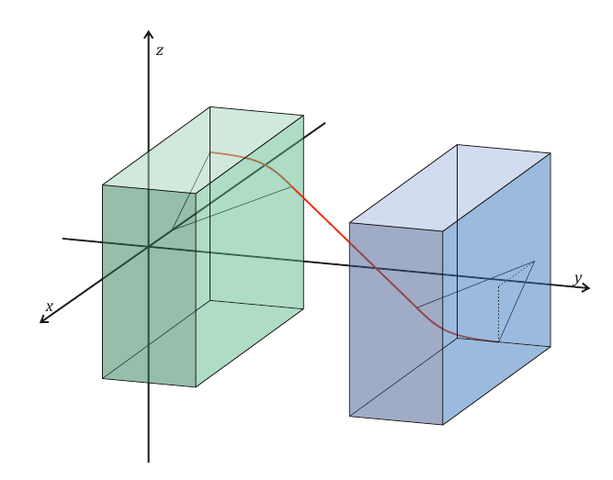
Decoupled insertions
Inclination of both magnets can be $90°$if the net bending angle of the cell is zero
A straight insertion with a $90°$ inclination enables the complete negation of coupling over the length of the straight
Analytic theory for vFFA straight cell design has been completed
N.B. a vFFA FODO straight with a $90°$ inclination is equivalent to an hFFA FODO straight – hFFA straight cells have been tested experimentally (J.-B. Lagrange, Study of zero-chromaticity in FFAG accelerators. PhD thesis, Kyoto U., 2012.)

Slide 16
Decoupled insertions
When optics are decoupled:
Orbit can be kicked/bumped in one plane without affecting the other
→ Injection and extraction design becomes much less restrictive
Betatron oscillations can be induced in the dispersive plane
→ Possibility of mitigating transverse/longitudinal issues from RF by tuning cell phase advance between cavities
→ Enables design of dispersion suppressors

Slide 17
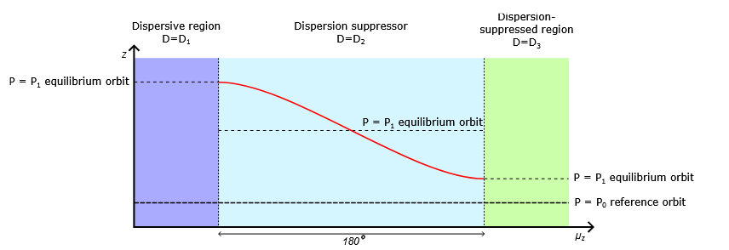
Dispersion suppression
In a decoupled straight:
3 regions with different dispersions $D_{Z}= \frac{1}{m}$
Initial region: $D_{1}$ is at nominal value for arcs
Target region : $D_{3}$ is at desired value (can be zero)
Dispersion suppressor : $D_{2}=(D_{1}+D_{3})/2$
Allows separation of arc excursion from RF constraints:
More freedom in choice of arc parameters $∙$ lower demands on aperture of RF $∙$ lessen severity of HOM issues

Slide 18
Conclusions
vFFA equivalents to RCS1, RCS4 have been proposed using analytic model
vFFA RCS1 equivalent has been simulated numerically
vFFA FODO rings can be built with
Equivalent footprint to RCS designs$∙$ Achievable dipole fields$∙$ Fully superconducting magnets$∙$ Small orbit excursion
…for an energy-efficient, zero-chromatic, isochronous accelerator
Coupling effects can be negated in straights
Could help solve injection/extraction issues + dispersion suppression
Use of dispersion suppression allows
Dispersion-suppressed RF insertions $∙$ Increased freedom in choice of normalised field index in arcs (possibility to lower peak fields)

Slide 19
The future
vFFA offers promising alternative to RCS
Able to circumvent a number of key issues
Analytic design tool enables development of new lattices
Further development of the concept is needed
Tradeoffs and potential mitigation strategies have been identified
End-to-end 6D simulation must be completed
Fully SC energy-efficient rapid acceleration is possible !!

Slide 20
The future
(Saint-Genis Pouilly in 2050 when we build the muon vFFA )

