Slide 1






Magnet Design for the first demo cell of the 6D cooling (B5-like)
G. Scarantino, L. Bottura, M. Castoldi, S. Fabbri, L. Rossi, M. Statera
14/05/2025

Slide 2
Outline
B5-like Demonstrator Cell Layout
Solenoid Optimization Methods
Coil Layout – Winding & Assembly
Configurations Studied
  “B5 DEMO MAG 2.3”
  “B5 DEMO MAG 2.4”
First Cell and Stand-Alone Mode
Coil Charging Transient: EM-TH Analysis
Conclusions and Next Steps
Conclusions and Next Steps

Slide 3
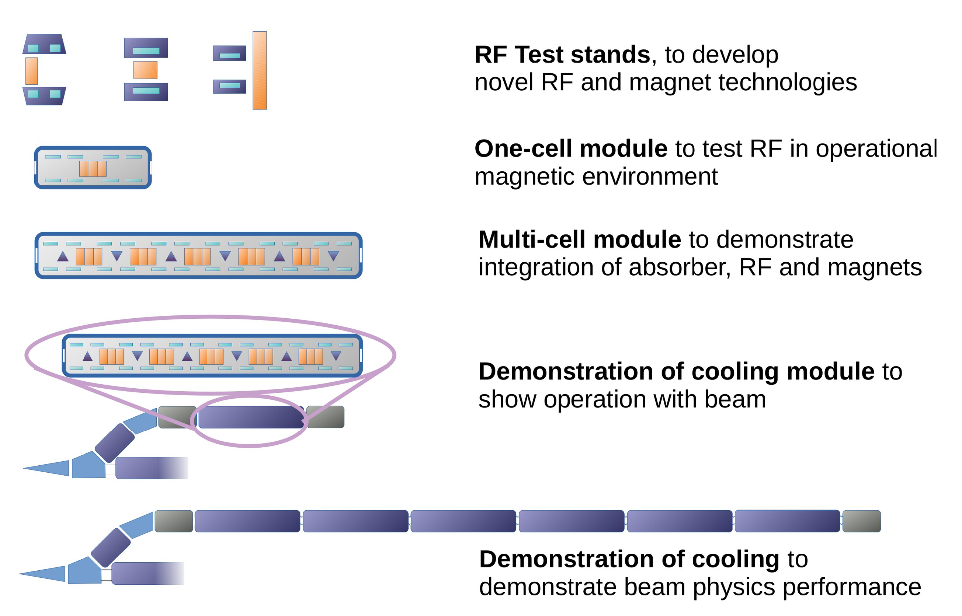
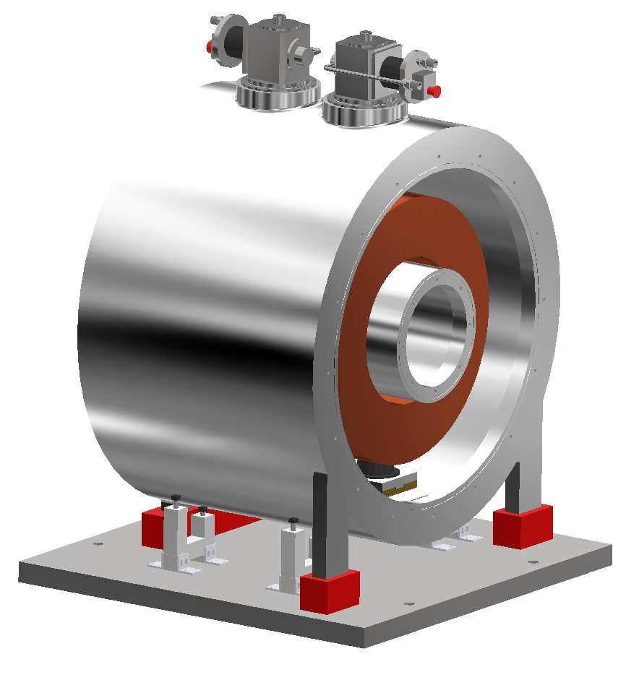
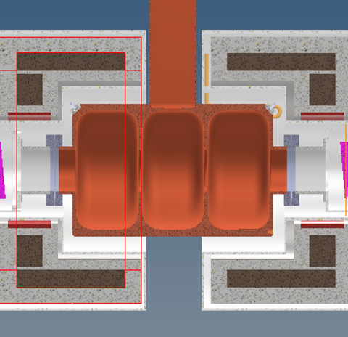
Muon Cooling Demonstrator: Overview
Radio Frequency in Magnetic Field Test Facility (“RFMFTF”)
B5-like DEMO Cell
Credits: C. Rogers

Slide 4
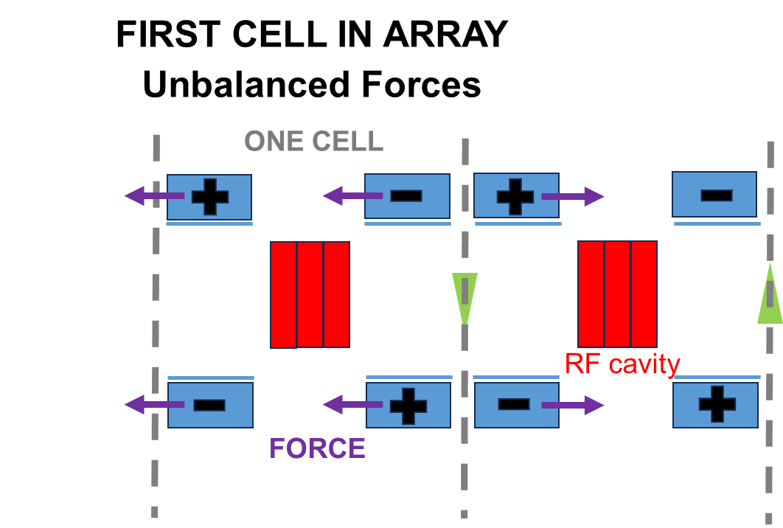
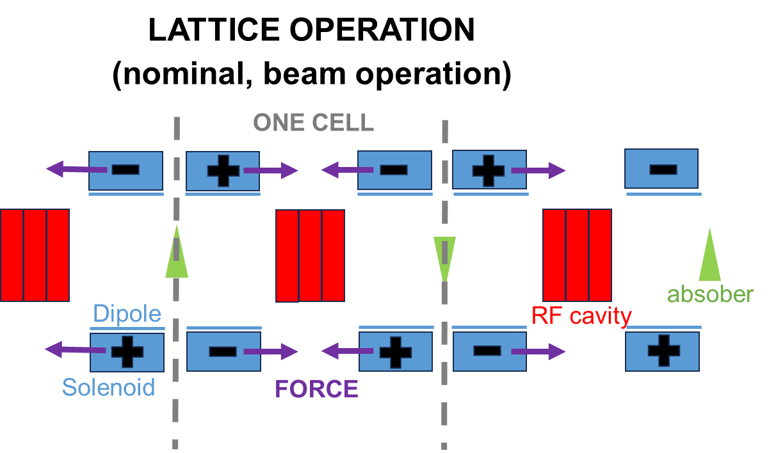
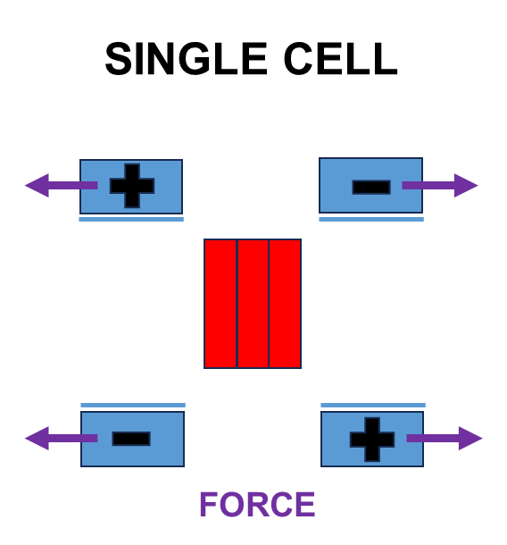
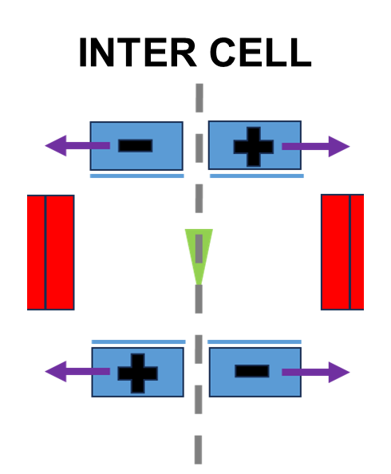
B5 DEMO Cell Magnets: Operational Modes
Different operating conditions in the magnets of the first cell in the array:
unbalanced forces, no field screening on the begin-of-array side.
Nominal conditions:
periodic cell array, magnets with alternated polarity.
Test of each cell at full field.
A magnet design fulfilling both operative conditions looks challenging!
Test of each inter-cell module in stand-alone mode:
Axial Forces increase / Invert their direction
Can it be avoided?

Slide 5
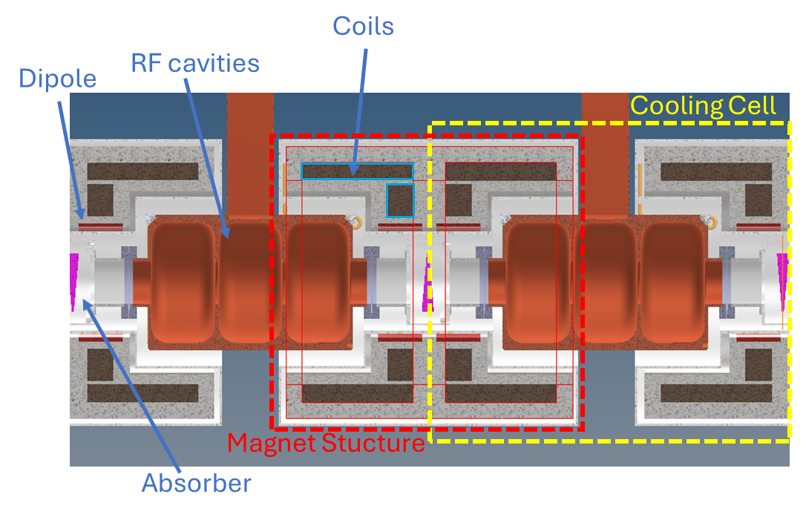
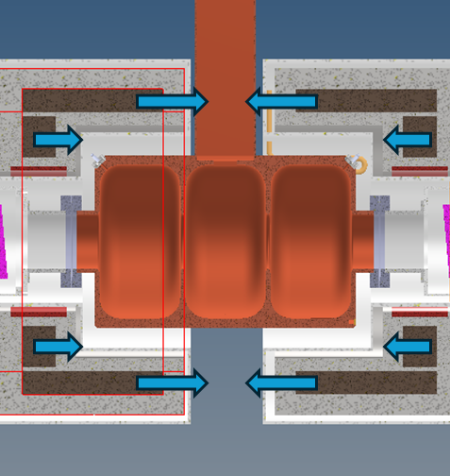
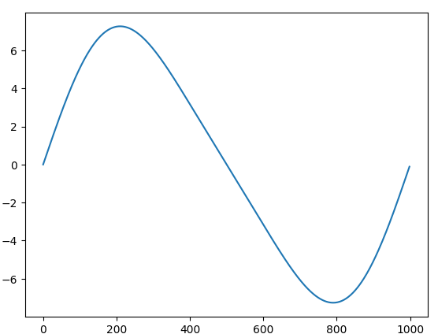
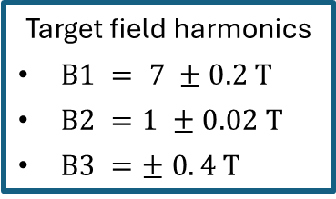
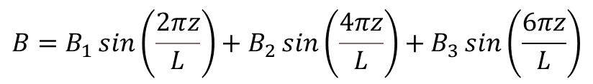
B5 DEMO Cell Layout: “Inter-Cell Cryostat”
Cooling Cell
Axial forces on coils
(lattice operation)
z
Input for the magnet design
Target field on axis for a 1 m cell
Target Field - Longitudinal Harmonics Expansion
Target field harmonics
$B1 = 7 ±0.2 T$
$B2 =1 ±0.02 T$
$B3 =± 0. 4 T$
$$B=B_{1}\sin\left(\frac{2πz}{L}\right)+B_{2}\sin\left(\frac{4πz}{L}\right)+B_{3}\sin\left(\frac{6πz}{L}\right)$$

Slide 6






B5 DEMO Cell – Coil Space Constraints
Space available for magnets
Space for magnet structure, thermal shield, vessel.
200 mm
Coil 1
Power in
Coil 1
Vertical space for magnet structure. For Coil2: consider space for dipole.
30 mm
$$400 mm$$
Alternate configuration
255 mm
Coil 2
3 cavities
Outer of RF + 5 mm gap for cryostat
50 mm
135 mm
130 mm
45 mm
$$310 mm$$
45 mm
Absorber
337 mm
Coil 2
30 mm
*>30 mm
Outer of RF
163 mm
$R_{i}=285$ mm
163 mm
$$73 mm$$
Considering also the 5 mm gap from 130 mm absorber radius to the inner radius of the cryostat (135 mm).
$$L_{cell}=1 m$$
45 mm
45 mm
$R_{i}=185$ mm

Slide 7
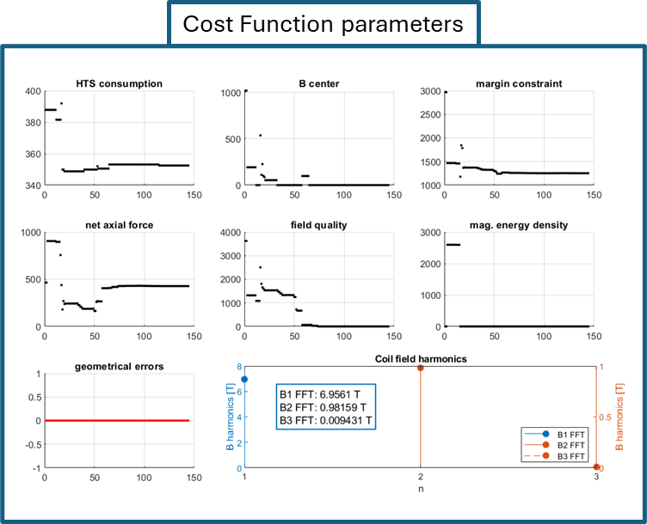
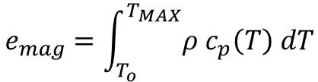
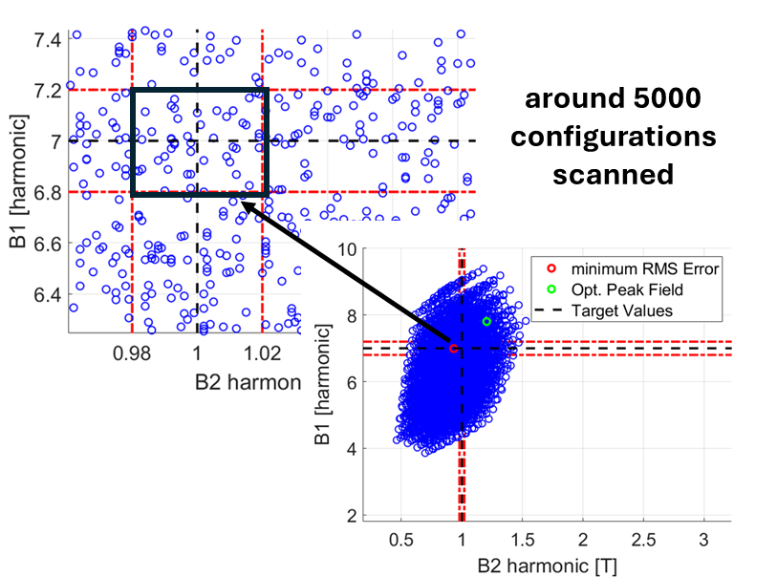
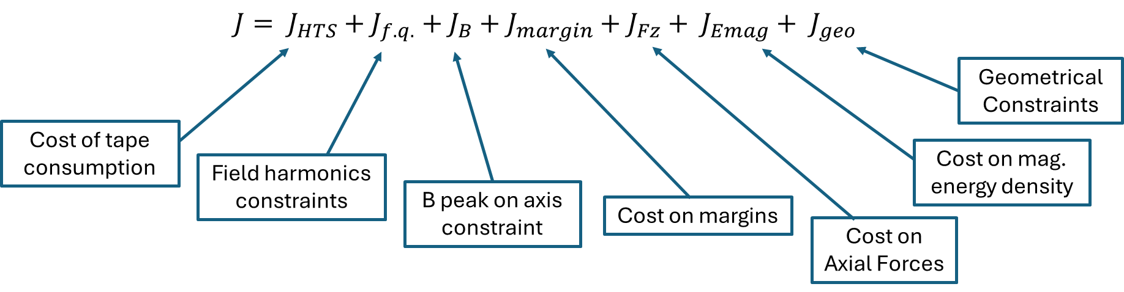
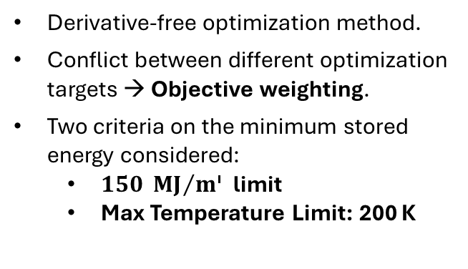
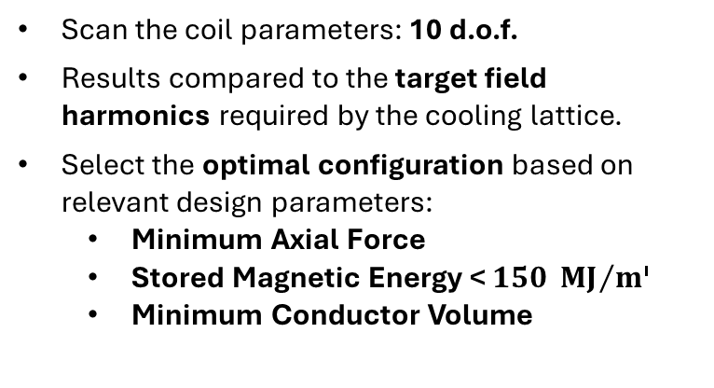
B5 DEMO Cell: Magnets Design Approaches
Grid-based Approach
Pattern Search Optimization Method
Scan the coil parameters: 10 d.o.f.
Results compared to the target field harmonics required by the cooling lattice.
Select the optimal configuration based on relevant design parameters:
  Minimum Axial Force
  Stored Magnetic Energy < $150 {MJ}/{m^{3}}$
  Minimum Conductor Volume
Derivative-free optimization method.
Conflict between different optimization targets → Objective weighting.
Two criteria on the minimum stored energy considered:
  $150 {MJ}/{m^{3}}$ limit
  Max Temperature Limit: 200 K
Coil Configuration Search Assuming 6D Cooling Lattice Operation!
Cost Function Definition
Computationally Expensive: only coarse grids scanned
Converge to the optimal solution in much fewer steps!

Slide 8
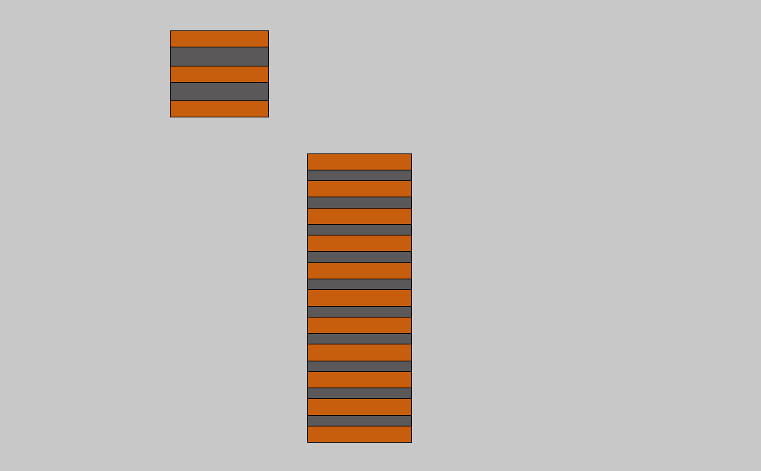
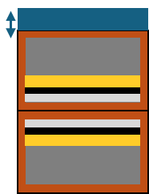

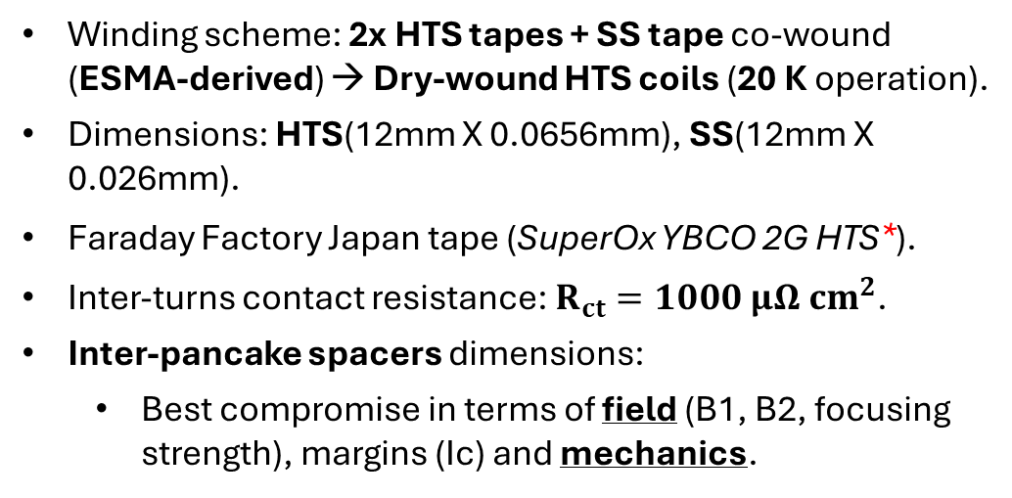
Coil Layout: Winding & Assembly
Winding scheme: 2x HTS tapes + SS tape co-wound (ESMA-derived) → Dry-wound HTS coils (20 K operation).
Dimensions: HTS(12mm X 0.0656mm), SS(12mm X 0.026mm).
Faraday Factory Japan tape (SuperOx YBCO 2G HTS*).
Inter-turns contact resistance: $R_{ct}=1000 μΩ{ cm}^{2}$.
Inter-pancake spacers dimensions:
  Best compromise in terms of field (B1, B2, focusing strength), margins (Ic) and mechanics.
SS Spacer
HTS coil
Coil 1
Coil 2
SS tape: $26 μm$
SS spacer dimensions:
Coil 1: > 2 mm
Coil 2: > 2 mm
HTS
Conductor Section
*Tape data from: [University of Victoria Wellington, Robinson HTS critical current database, SuperOx YBCO 2G HTS data. https://htsdb.wimbush.eu]
HTS

Slide 9
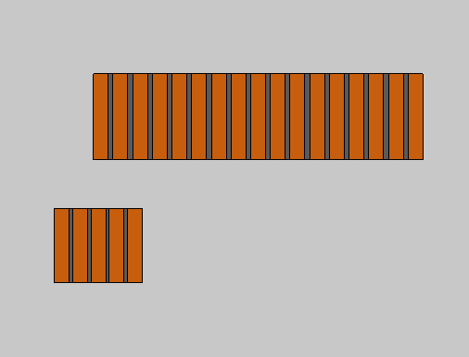
Configurations Studied
“B5 DEMO MAG 2.3”
“B5 DEMO MAG 2.4”
Coil 1
Coil 1
Coil 2
Coil 2
Configuration considered in current integration studies (Grid-Based Coil Scan)
Better Optimized Version (Pattern Search Optimization)

Slide 10
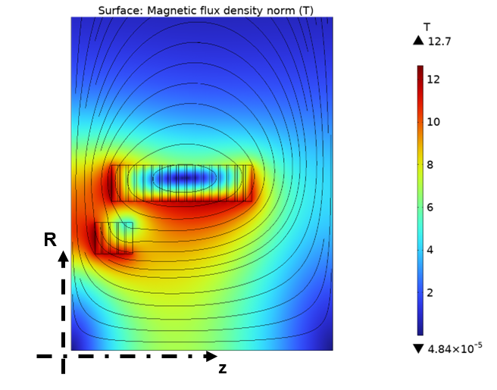
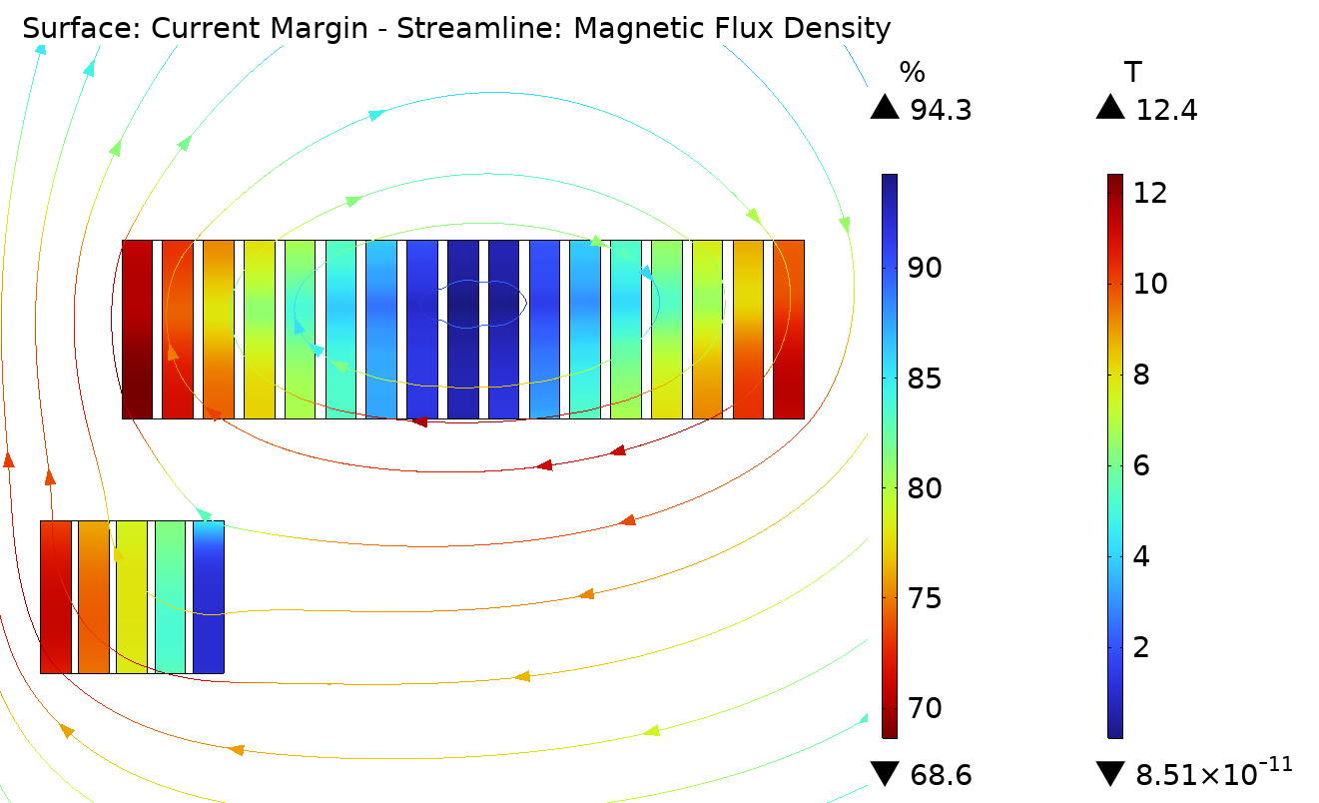
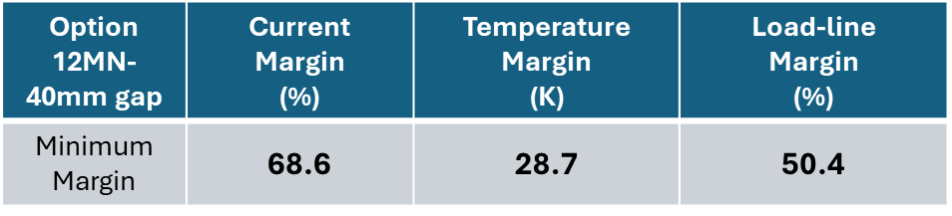
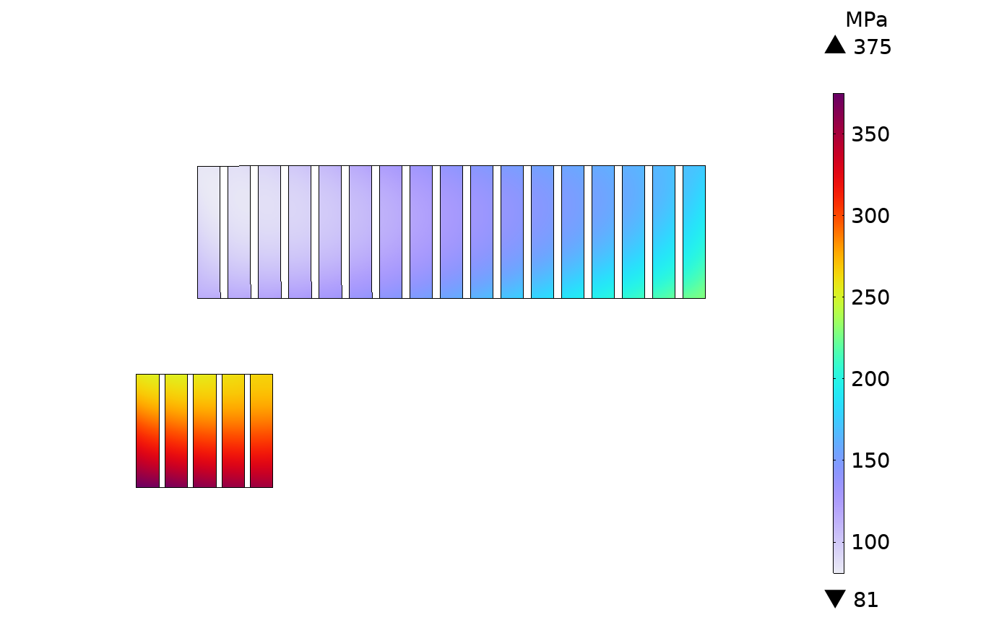
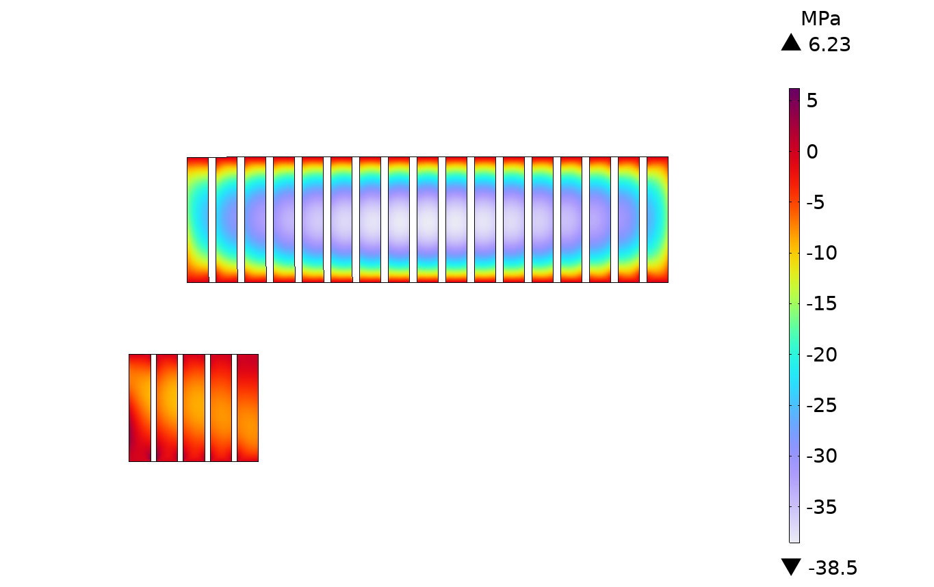
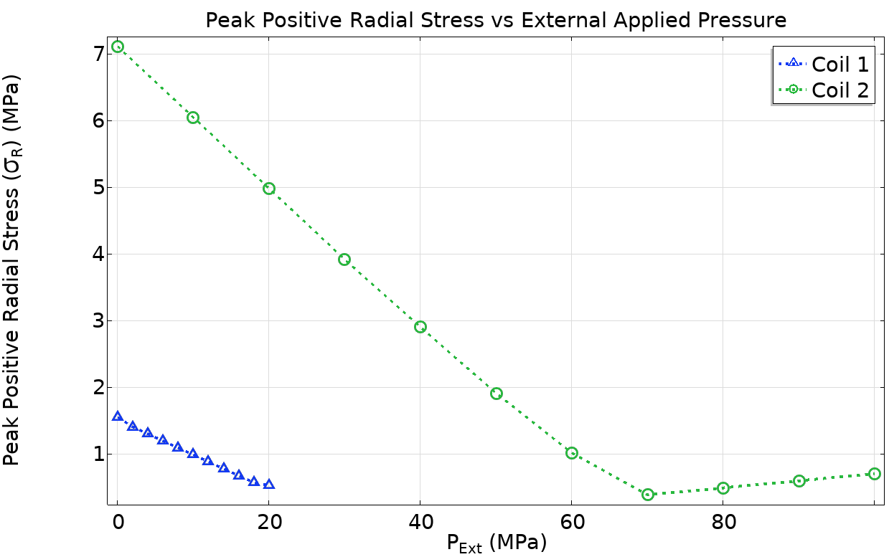


B5 DEMO MAG 2.3 Configuration - Results
EM analysis
$$\left|B\right|$$
Mag. Energy Density in Lattice (Coil1 / Coil2)
149 MJ/m3 / 92.9 MJ/m3
Total Mag. Energy - full cell
12.2 MJ
Magnetc energy density values within target limit.
Resulting axial forces: 4.12 MN, 8.25 MN
Exceedingly high margins:
not optimized!
$$Ic margin=\left(1−\frac{I}{I_{c}}\right) \%$$
Mechanical Analysis
Minimum ext. pressure:
Radial stress < 1MPa,
Hoop stress > 0 in operation
Radial pressure applied on the external coil boundary:
10 MPa on Coil1
60MPa on Coil2
Resulting Stresses:
176 MPa peak hoop
0.98 MPa peak positive radial stress
Coil Hoop Stress
Coil Radial Stress

Slide 11
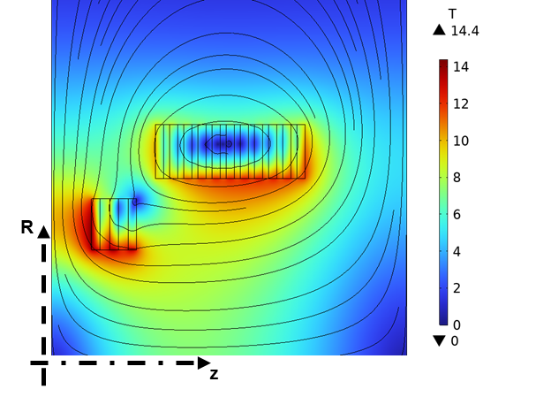
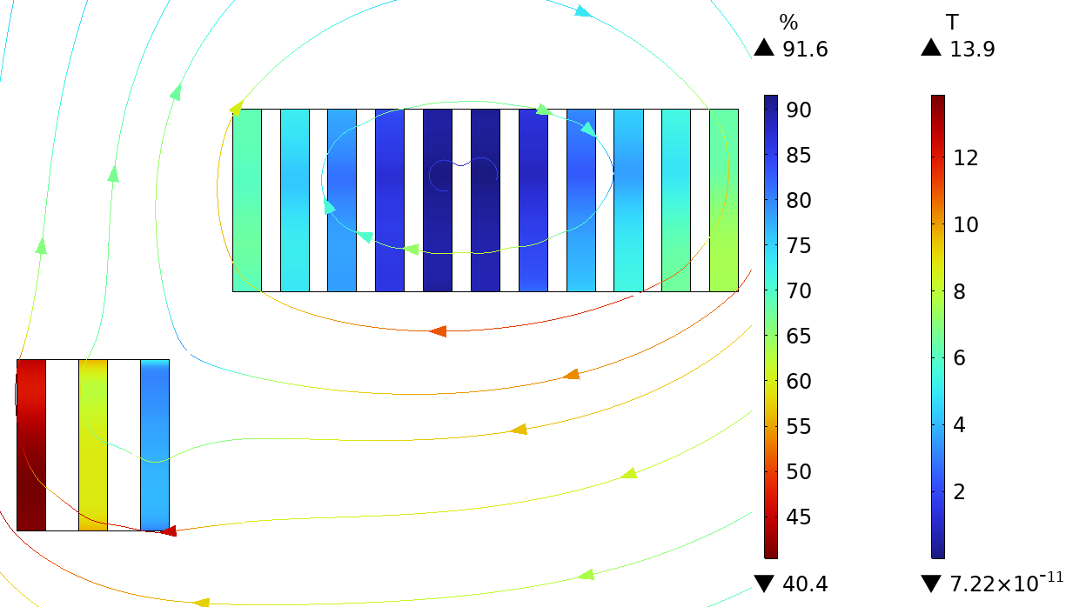
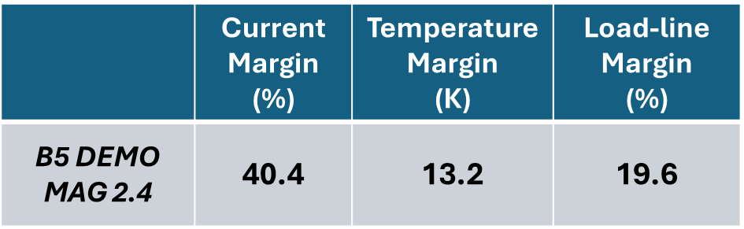
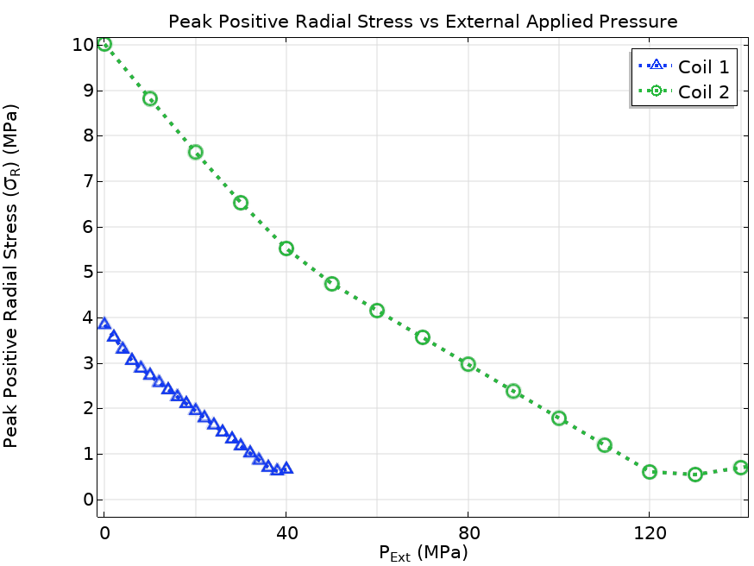
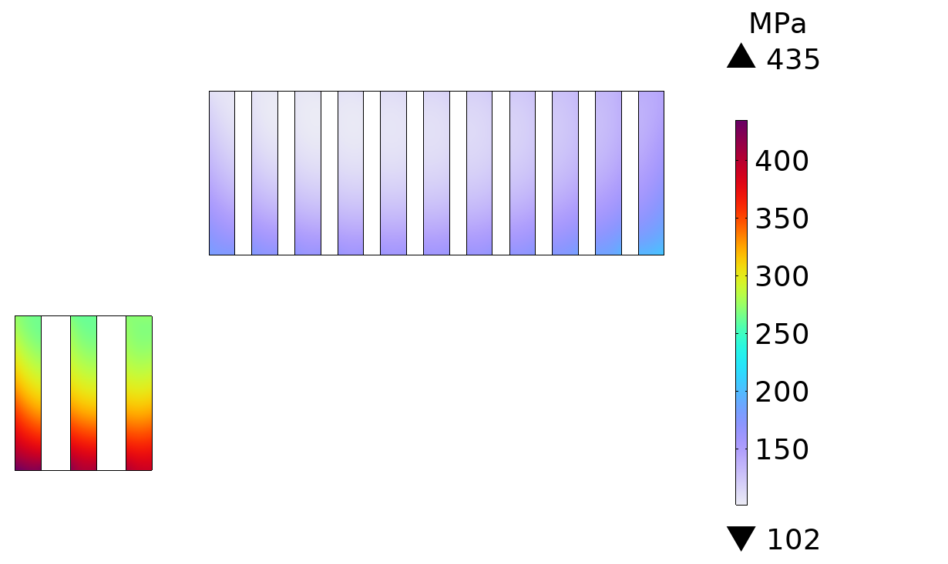
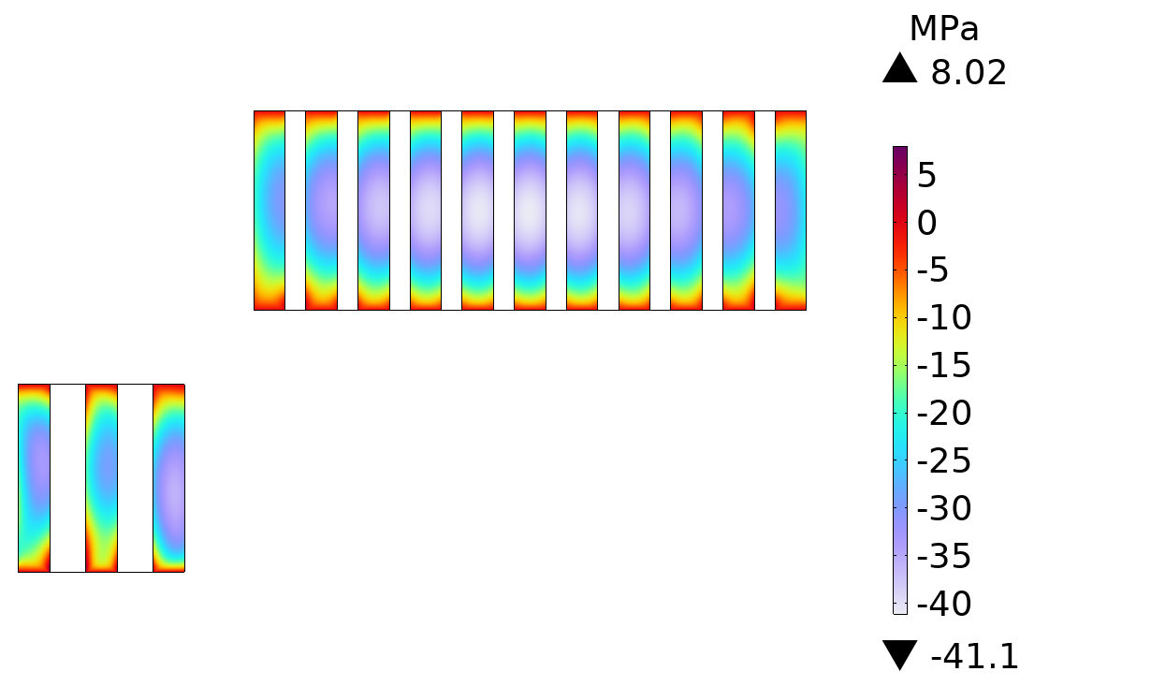
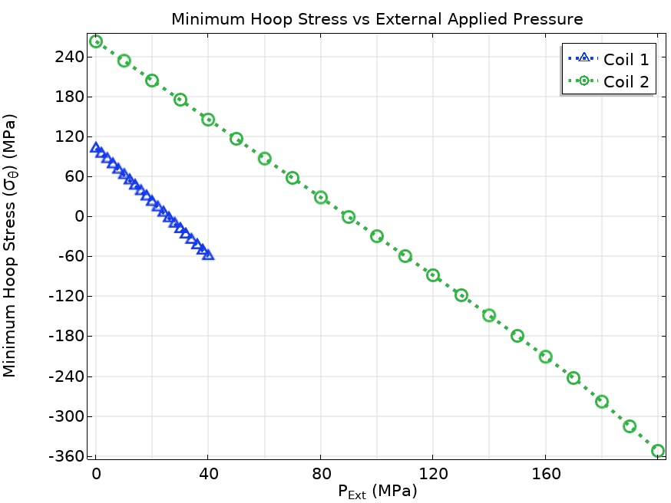


B5 DEMO MAG 2.4 Configuration - Results
EM analysis
$$\left|B\right|$$
Mag. Energy Density (Coil 1 / Coil 2)
152 MJ/m3 / 147 MJ/m3
Total Mag. Energy - full cell
11.8 MJ
Magnetc energy density values within target limit.
Resulting axial forces: - 4.61 MN, 11.7 MN
Acceptable margin values!
→ Better conductor usage
$$Ic margin=\left(1−\frac{I}{I_{c}}\right) \%$$
Minimum ext. pressure:
Radial stress < 1MPa,
Hoop stress > 0 in operation
Mechanical Analysis
Note: not possible to reduce meet the requirement on the radial stress:
98 MPa peak hoop
2.4 MPa peak positive radial stress
Radial pressure applied on the external coil boundary:
- 24 MPa on Coil1
- 90 MPa on Coil2
Coil Hoop Stress
Coil Radial Stress

Slide 12
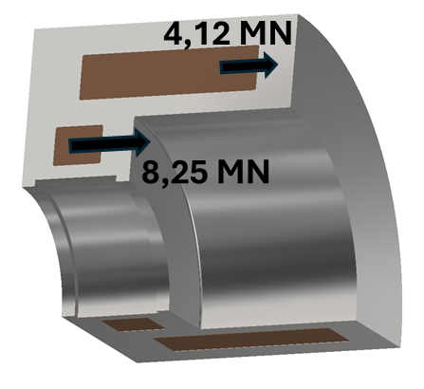
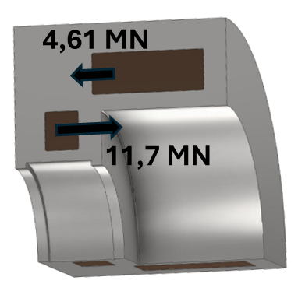
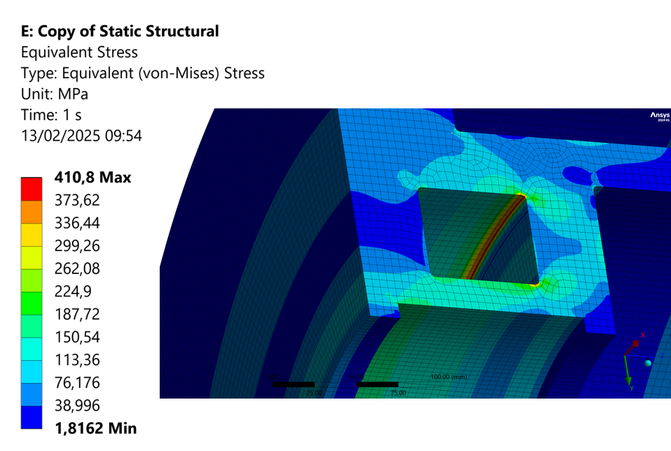
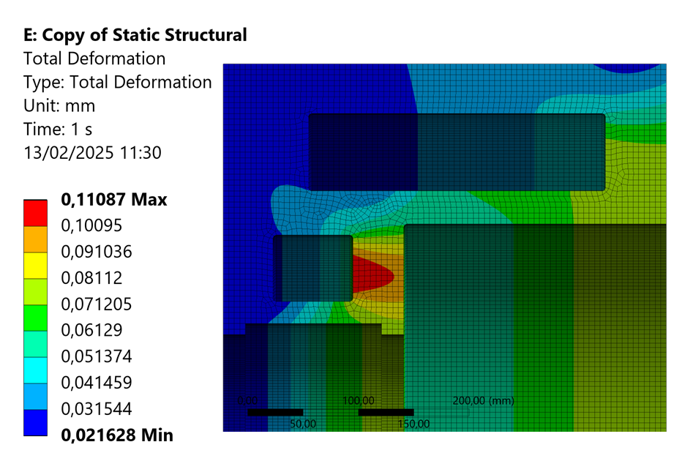
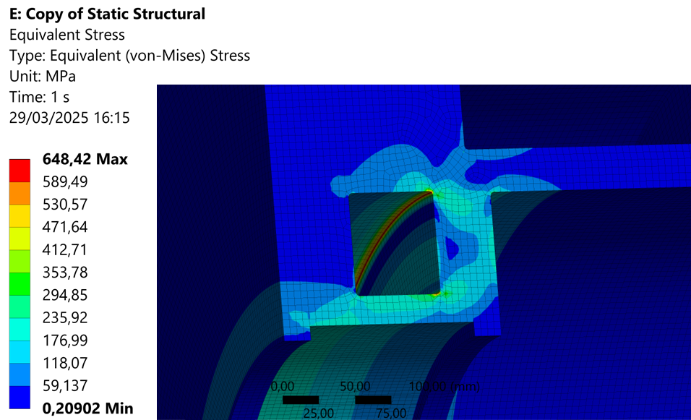
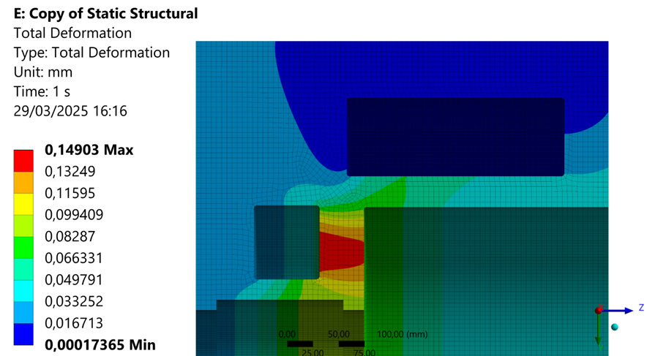
Coil Support Structure: Mechanical Analysis
B5 DEMO MAG 2.3
B5 DEMO MAG 2.4
Symmetry Plane
AISI 316LN steel structure
Intercept the load between the pancakes or apply axial precompression.
0.59 MN*m bending moment
Stress concentration on the inner Coil 2 corner:
410 MPa peak.
0.32 MN*m bending moment
Stress concentration on the inner Coil 2 corner:
648 MPa peak.
Total Deformation
Total Deformation
Von Mises Stress
Von Mises Stress

Slide 13
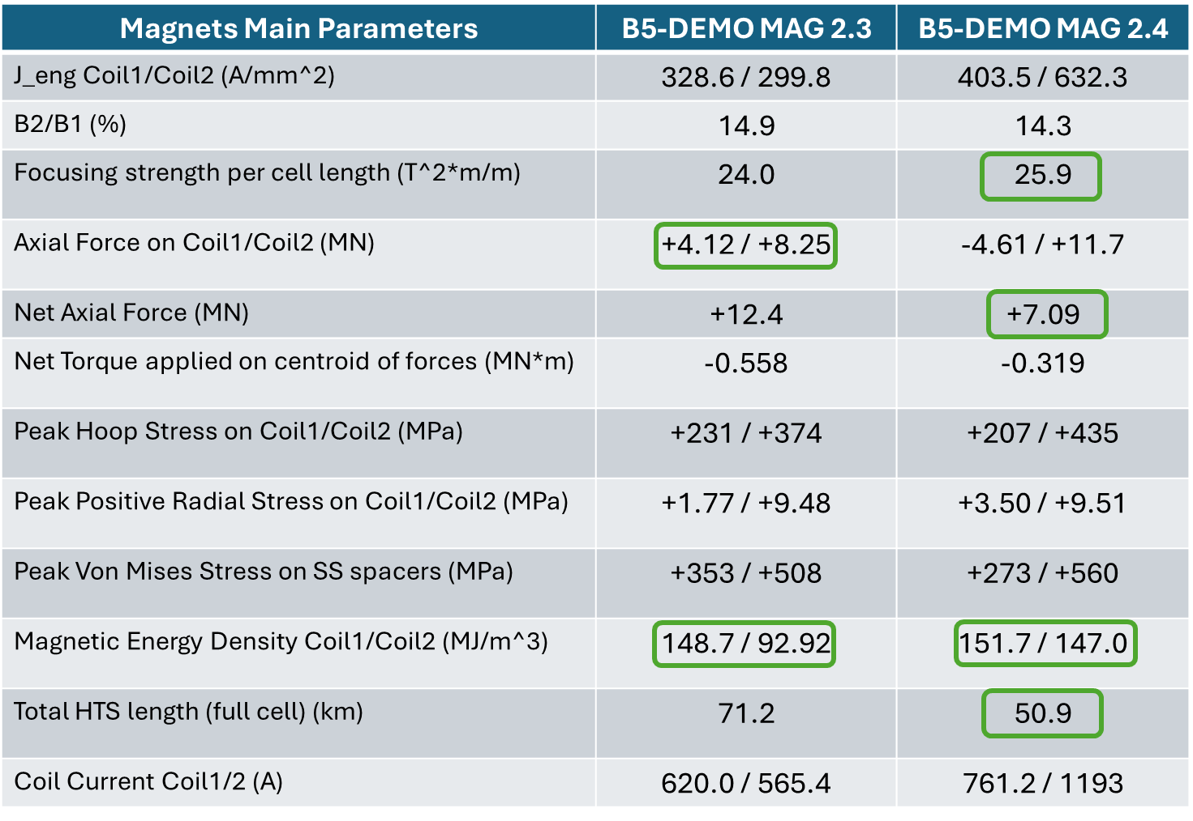
Summary Table
B5 DEMO MAG 2.4 option: improved performances compared to the currently integrated 2.3 design.
Significant reduction in total superconductor length.
Force direction between Coil1/Coil2 inverted in the 2.4 design: higher peak stresses on the shell structure.

Slide 14
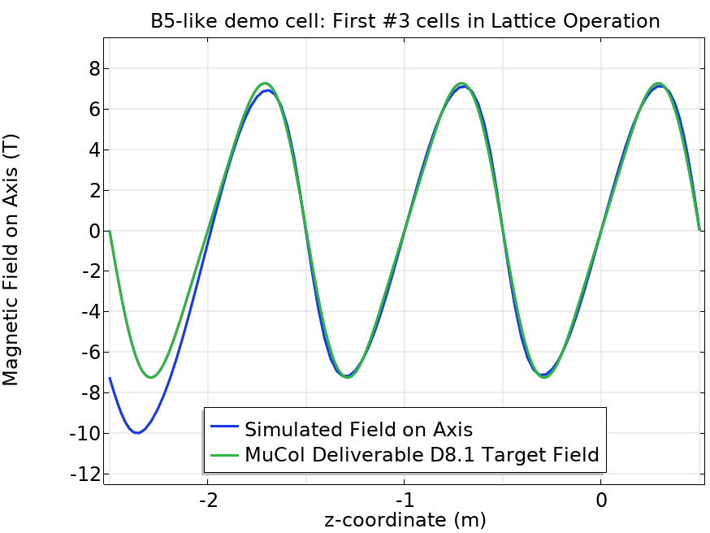
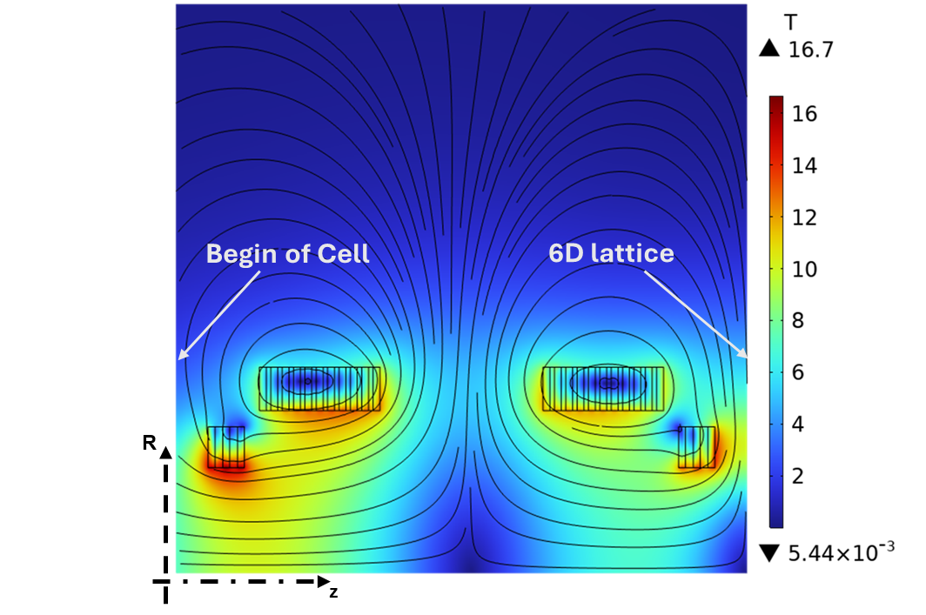
First Stage Evaluation
Design of the first stage in the cell array still to be considered.
Running magnets at full current results in 10 T peak field on axis. → 25% current reduction to match the peak field on axis.
Note: unbalanced forces in the first two inter-cell units!
Adiabatic matching?
At full current:
Peak Field >> Target
Separate design of the first stage structure (first two inter-cells) needed
Begin of Cell
6D lattice

Slide 15
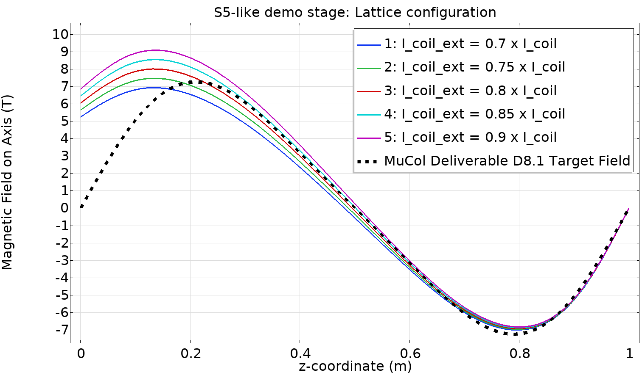
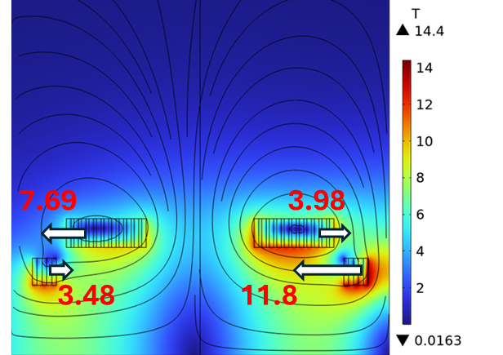
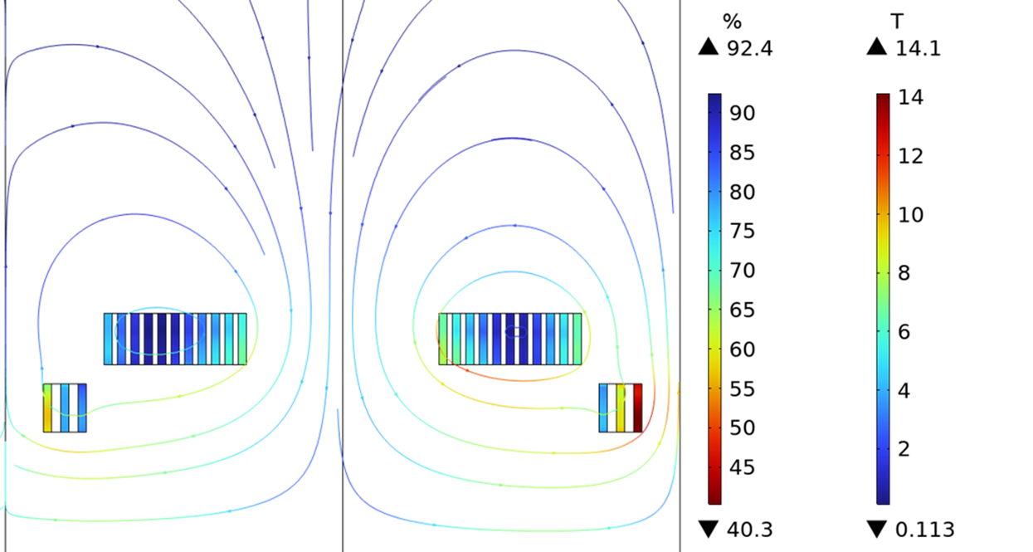

First Stage Evaluation
Design of the first stage in the cell array still to be considered.
Running magnets at full current results in 10 T peak field on axis. → 25% current reduction to match the peak field on axis.
Note: unbalanced forces in the first two inter-cell units!
Adiabatic matching?
~ Target Peak Field
Margins are not critical: 25% current reduction; change in field-tape angle not critical.
Coil structure support feet need to be designed to withstand force unbalance of the order of 1 MN.
$$Ic margin=\left(1−\frac{I}{I_{c}}\right) \%$$
Need to be supported
< 1 MN Unbalance
Separate design of the first stage structure (first two inter-cells) needed

Slide 16
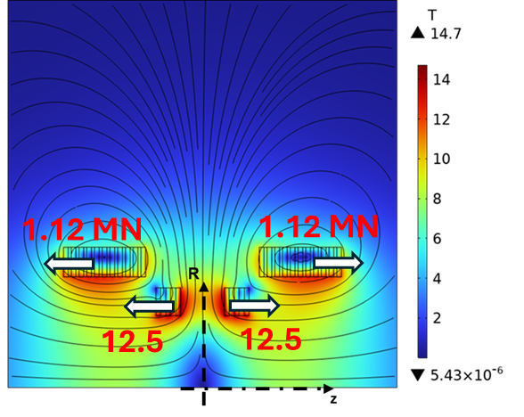
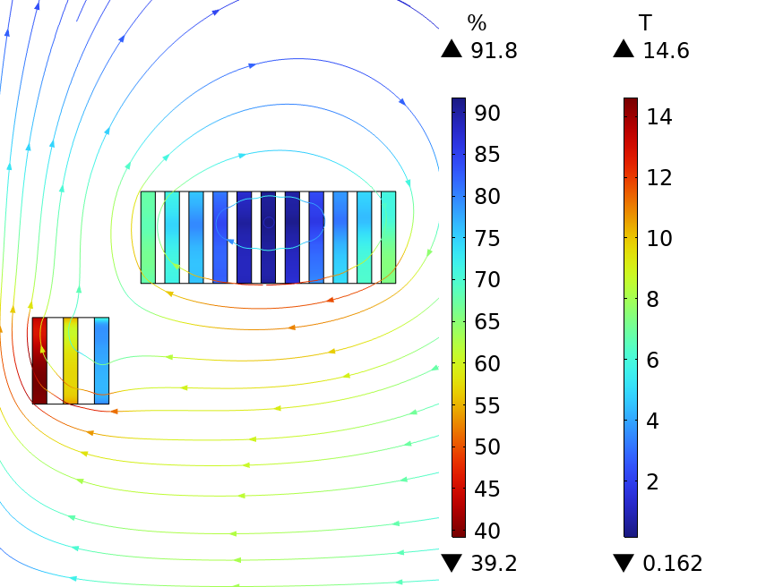
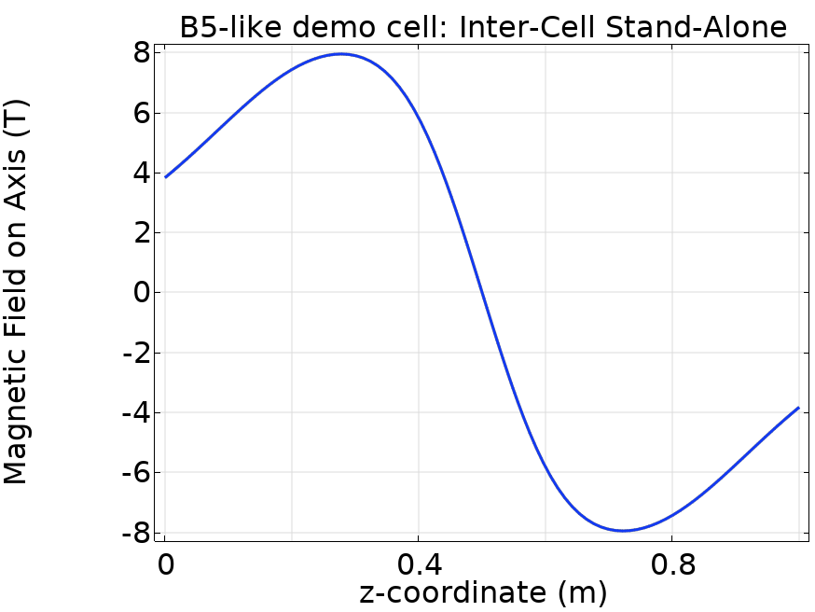

Inter-Cell Magnets - Stand-Alone Operation
Could we test the inter-cell modules in stand-alone mode?
1% decrease in minimum current margins
Axial Forces:
Coil 1: 1.12 MN
Coil 2: 12.5 MN
(Pointing in outward inter-cell direction)
20% increase in the coil peak hoop stress
Coil Hoop Stress

Slide 17


Inter-Cell Magnets - Stand-Alone Operation
Peak Von Mises Stress: 687 MPa
Increase of the peak Von Mises Stress on the structure.
Peak stress still within the material limits.
Loads intercept between each pancake?

Slide 18


B5 DEMO MAG 2.4: Coil Charging Transient
Transient Simulation of the charging of two separated non-insulated coils: magnetization loss effects accounted.
Tuning of the ramp rates in the two coils to match the same ramping time.
Characteristics time in the two magnets are very different (factor 8 difference): around 1h delay time in Coil 1.
Assumed 6h charging time: 4h current ramp in Coil 1.
Conduction cooling of the two magnets via cryocoolers*.
Critical current fraction during charging
Assumption: periodic field conditions
→ all similar magnets are ramped at the same time
* Cryocooler data from:
SHI SRDK 500B2 technical specification sheet, https://shicryogenics.com/product/rdk-500b2-20k-cryocooler-series/.

Slide 19




B5 DEMO MAG 2.4: Coil Charging Transient
Transient Simulation of the charging of two separated non-insulated coils: magnetization loss effects accounted.
Tuning of the ramp rates in the two coils to match the same ramping time.
Characteristics time in the two magnets are very different (factor 8 difference): around 1h delay time in Coil 1.
Assumed 6h charging time: 4h current ramp in Coil 1.
Conduction cooling of the two magnets via cryocoolers*.
6.5 W Peak Losses in Coil1
Maximum local Jc fraction: 80%
Coil 1
32 K temperature peak in Coil1:
2 K temperature margin!
Consider longer ramp times (e.g., 6h ramp time).
Coil 2
* Cryocooler data from:
SHI SRDK 500B2 technical specification sheet, https://shicryogenics.com/product/rdk-500b2-20k-cryocooler-series/.

Slide 20
Conclusions and Next Steps
Engineering design of the B5-like cooling cell demonstrator magnets is proceeding. Converging to a design satisfying all the possible operational modes is challenging. Tight space constraints are limiting.
Inter-cell cryostat layout offers significant improvements in the assembly and magnet integration: strong repulsing forces sustained by a solid AISI 316LN structure.
B5 DEMO MAG 2.4 option offers a reduction in the total amount of conductor needed, with comparable stored magnetic energy within the target 150 MJ/m^3 limit.
However, axial force distribution in this configuration result in higher peak stress values on the coil structure: → design the coil supports to intercept the axial load between pancakes or apply axial precompression.
Design of the first-cell-in-array still to be considered. Is the field produced with a 25% current reduction good enough for the optics?
EM and thermal analyses of the coil charging transient showed a charging time > 6h if cryogen-free cooling option is considered.
Evaluate performances with gas-cooling with He @ 20 K.
Quench simulations are of prior importance:
  interesting dynamics during fast discharge (See T. Mulder presentation tomorrow).
  Be aware of the induced currents (hence stresses) on the RF cavities!

Slide 21
Thank you for your attention!
giuseppe.scarantino@mi.infn.it

Slide 22
BACKUP

Slide 23





B5 DEMO MAG 2.3: EM Analysis Results
$$\left|B\right|$$
$$Ic\left(T,B,θ\right)$$
angular dependence considered
$$4.12 MN$$
Mag. Energy Density in Lattice (Coil1 / Coil2)
149 MJ/m3 / 92.9 MJ/m3
Total Mag. Energy - full cell
12.2 MJ
R
$$Ic margin=\left(1−\frac{I}{I_{c}}\right) \%$$
$$8.25 MN$$
z
 | Coil 1 | Coil 2
Total Radial Resistance [mΩ] | 30.6 | 12.0
Coil Inductance (lattice op.) [H] | 29.2 | 3.39
Characteristic Time [s] | 954 | 282.6
Power dissipated @ charging [W] (ramp rate: 0.1 A/s) | 278 | 9.58
Margins exceedingly high: non-optimal conductor usage with the selected winding layout (2x 12mm HTS tape + SS tape) considering the coil protection limit (maximum stored magnetic energy density < 150 MJ/m^3).

Slide 24





B5 DEMO MAG 2.3: Mechanical Analysis Results
Free radial expansion
Coil Hoop Stress
Coil Radial Stress
Von Mises Stress SS spacers
Minimum ext. pressure:
Radial stress < 1MPa,
Hoop stress > 0 in operation
Radial precompression
Radial pressure applied on the external coil boundary:
10 MPa on Coil1
60MPa on Coil2
Coil Hoop Stress
Coil Radial Stress
Von Mises Stress SS spacers

Slide 25



B5 DEMO MAG 2.4: EM Analysis Results
$$Ic\left(T,B,θ\right)$$
angular dependence considered
Mag. Energy Density (Coil 1 / Coil 2)
152 MJ/m3 / 147 MJ/m3
Total Mag. Energy - full cell
11.8 MJ
$$Ic margin=\left(1−\frac{I}{I_{c}}\right) \%$$
z
 | Coil 1 | Coil 2
Total Radial Resistance [mΩ] | 22.05 | 8.308
Coil Inductance (lattice op.) [H] | 15.84 | 0.7721
Characteristic Time [s] | 718.5 | 92.94

Slide 26





B5 DEMO MAG 2.4: Mechanical Analysis Results
Free radial expansion
Coil Hoop Stress
Coil Radial Stress
Von Mises Stress SS spacers
Minimum ext. pressure:
Radial stress < 1MPa,
Hoop stress > 0 in operation
Radial precompression
Radial pressure applied on the external coil boundary:
- 38 MPa on Coil1
- 130 MPa on Coil2
Von Mises Stress SS spacers
Coil Hoop Stress
Coil Radial Stress

Slide 27
B5 DEMO MAG 2.4: Mechanical Analysis Results
Free radial expansion
Minimum hoop stress values
Coil Hoop Stress
Coil Radial Stress
Von Mises Stress SS spacers
Minimum ext. pressure:
Radial stress < 1MPa,
Hoop stress > 0 in operation
Radial precompression
Radial pressure applied on the external coil boundary:
- 38 MPa on Coil1
- 130 MPa on Coil2
Von Mises Stress SS spacers
Coil Hoop Stress
Coil Radial Stress

Slide 28

B5 DEMO MAG 2.3: Coil Support Structure
Mechanical analysis of 1/8 shell support structure: lattice magnet operation.
Shell material: AISI 316LN steel.
Lorentz force density input from EM analysis.
0.59 MN*m bending moment on structure.
4,12 MN
Total Deformation
8,25 MN
Von Mises Stress
Mechanical analysis of the coil support structure in lattice operation.
Stress concentration on the inner Coil 2 corner:
410 MPa peak.

Slide 29

B5 DEMO MAG 2.4: Coil Support Structure
Mechanical analysis of 1/8 shell support structure: lattice magnet operation.
Shell material: AISI 316LN steel.
Lorentz force density input from EM analysis.
0.32 MN*m bending moment on structure.
4,61 MN
Total Deformation
11,7 MN
Von Mises Stress
Peak stresses on the coil structure still within the material limits.
Consider the possibility to intercept the loads between each pancake to reduce the stresses on the structure.
Stress concentration on the inner Coil 2 corner:
648 MPa peak.

Slide 30




B5 DEMO MAG 2.4: Local Stress Components
Coil#1.11
Coil#2.1
Coil#1.11
Free radial expansion
Pre-compression
Evaluate the local stress components on the most loaded coils.
Coil#2.1

Slide 31

Lorentz force distribution on the coil pancakes
Coil 1.1
Coil 1.11
Coil 2.1
Coil 2.3
5.55 MN
-6.28 MN
R
7.16 MN
z

Slide 32


Coil Assembly: Powering and Cooling Considerations
Each Inter-Cell module will be a self-standing unit → need to integrate electrical connections and cooling system in a tight configuration.
Conduction cooling proposal: SHI RDK 500B2 cryocoolers* considered for their optimal capacity (50W @ 20K) and cost.
Cold head interface
Cu Electrical Connections
NI HTS Coil
Cu cooling plates terminations
Coil 1
Coil 1
Coil 2
Coil 2
Cu Cooling Plate
SS support + Insulating Layer
* Cryocooler data from:
SHI SRDK 500B2 technical specification sheet, https://shicryogenics.com/product/rdk-500b2-20k-cryocooler-series/.

