Slide 1






Dipole magnet designs for the Muon Collider
S. Mariotto^{1,2}, L. Alfonso³, A. Bersani³, B. Caiffi³, S. Farinon³,
F. Mariani^{2,4}, D. Novelli^{3,4} , A. Pampaloni³, T. Salmi⁵ , L. Bottura⁶
¹University of Milan, ²INFN – Milan, ³INFN – Genoa, ⁴Sapienza University of Rome, ⁵Tampere University, ⁶CERN
Funded by the European Union (EU). Views and opinions expressed are however those of the author only and do not necessarily reflect those of the EU or European Research Executive Agency (REA). Neither the EU nor the REA can be held responsible for them.

Slide 2
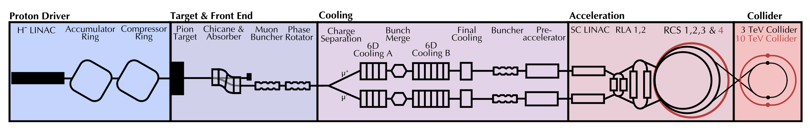
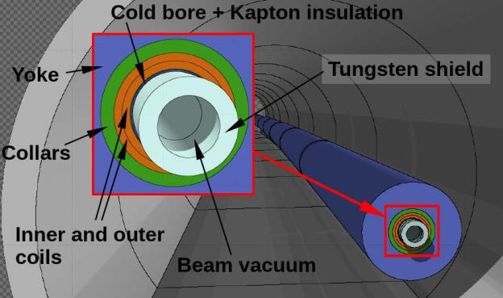
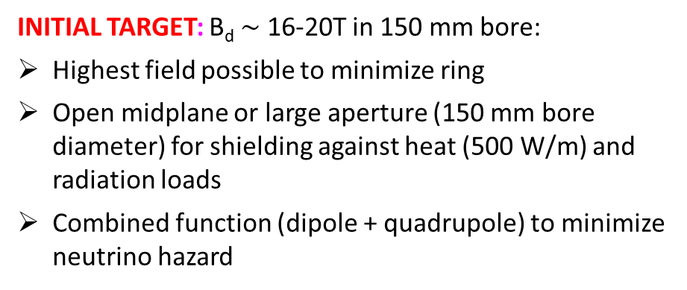
Collider Ring Magnets
Task 7.4 Collider Ring Magnets (INFN)
Motivation:
Analyze realistic technical design options for the development of superconducting magnets for the 10 TeV Muon Collider main ring
Identify technical challenges limiting magnet performance and propose innovative technologies to be further developed in the R&D phase following the ongoing feasibility study.
INITIAL TARGET: B_{d} $\sim$ 16-20T in 150 mm bore:
Highest field possible to minimize ring
Open midplane or large aperture (150 mm bore diameter) for shielding against heat (500 W/m) and radiation loads
Combined function (dipole + quadrupole) to minimize neutrino hazard

Slide 3
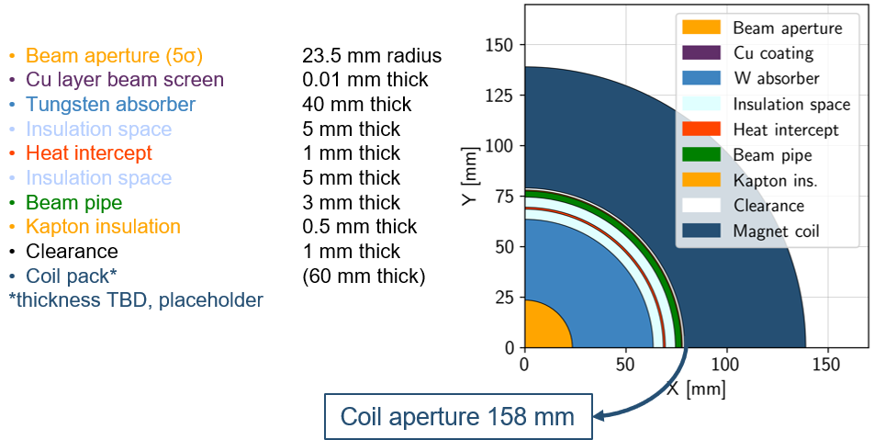
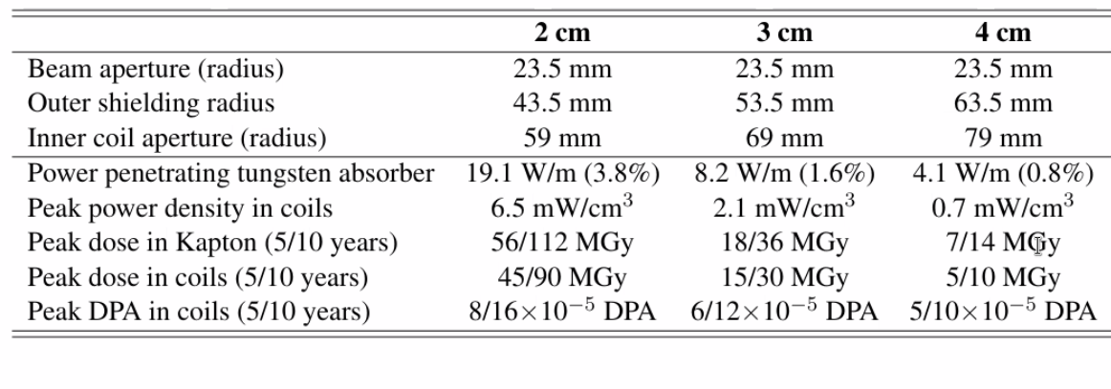
Interaction with other WPs
Courtesy of Patricia Borges de Sousa
https://indico.cern.ch/event/1250075/contributions/5357594/
Collection of requirement and constraints coming from other WP studies to select most challenging magnet configuration for technical design study:
Beam Lattice design:
  Magnet type / Field / Aperture
Cryogenic studies:
  Operating Temperature, Thermal Insulation thickness
Radiation heat loading/degradation
  Shielding thickness, Radiation heat load, radiation dose
Radial build
N.B bore_{magnet}= beam aperture (23.5 mm) + [Cu layer beam screen,+ Insulation space & heat intercept + beam pipe + Kapton insulation + clearence] (15.5 mm ) + W_{abs} (30-40 mm)
ARC Magnet Shielding assumption:
T_{op} < 10 K:
W_{abs} = 4 cm (P<5 W/m) / 160 mm aperture
T_{op} = 20 K:
W_{abs} =3 cm (P<10 W/m) / 140 mm aperture
Courtesy of Anton Lechner – IPAC24 Conference
https://cds.cern.ch/record/2912945

Slide 4
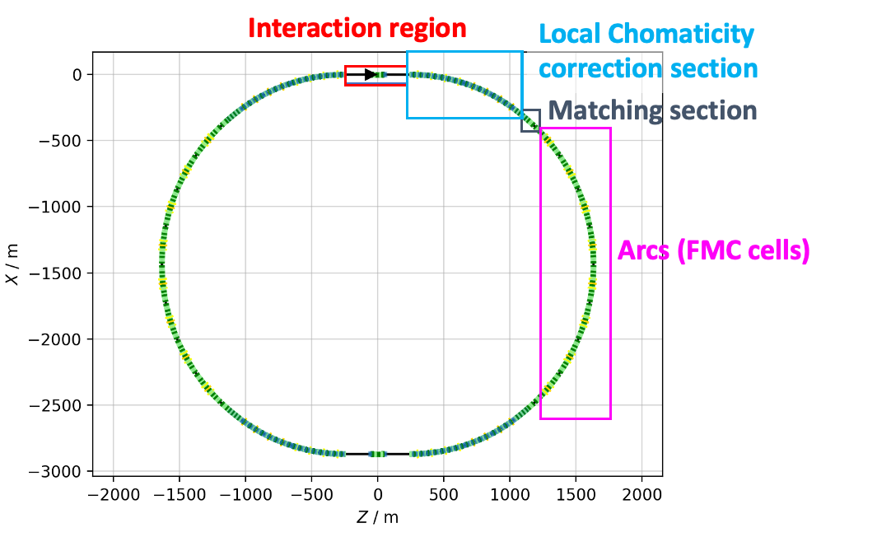

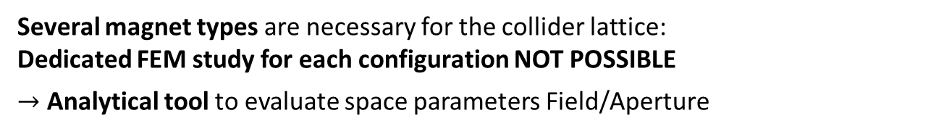
Different Magnet Options:
Specs from Beam Optic Studies
ARC[1]
Interaction region[2]
Dipole:
B_{d}=16 T in 138 mm bore aperture
Combined magnets:
B_{d}=8 T, G1=+-320 T/m bore in 130 mm bore aperture
Name | L [m] | Magnet aperture diameter [mm] | B[T]
IB2 | 6 | 320 | 8.1
IB1 | 10 | 320 | -9.7
IB3 | 6 | 320 | 8.1
Name | L [m] | Magnet aperture diameter [mm] | G [T/m]
IQF2 | 6 | 280 | 85.2
IQF2_1 | 6 | 266 | 85.2
IQD1 | 9 | 290 | -115.4
IQD1_1 | 9 | 290 | -115.4
IQF1B | 2 | 204 | 205.1
IQF1A | 3 | 172 | 241.8
IQF1 | 3 | 140 | 302.2
Courtesy of:
C. Carli, K.Skoufaris , M. Vanwelde
Chromatic Correction
Dipole[1]:
B_{d}=16 T in 138 mm bore aperture
Combined magnets:
B_{d}=4 T, G1=+-240 T/m in 170 mm bore aperture
B_{d}=4 T, G2=+-330 T/m² in 130 mm bore aperture
[1] K. Skoufaris et al. ``Update on collider optics design'', IMCC Annual Collaboration Meeting 2024 https://indico.cern.ch/event/1325963
[2] M. Vanwelde et al., `` Status of the 10 TeV center-of-mass collider lattice and IR design'', IMCC Detector and MDI workshop 2024 https://indico.cern.ch/event/1402725
Several magnet types are necessary for the collider lattice:
Dedicated FEM study for each configuration NOT POSSIBLE
$→$ Analytical tool to evaluate space parameters Field/Aperture

Slide 5
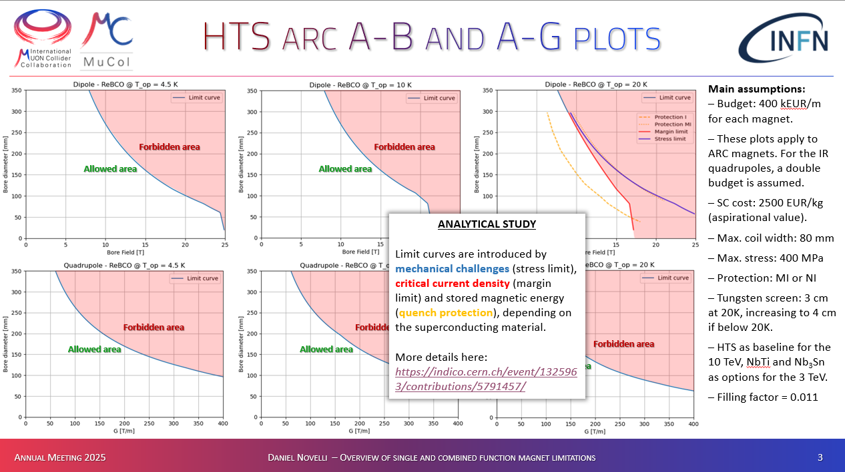
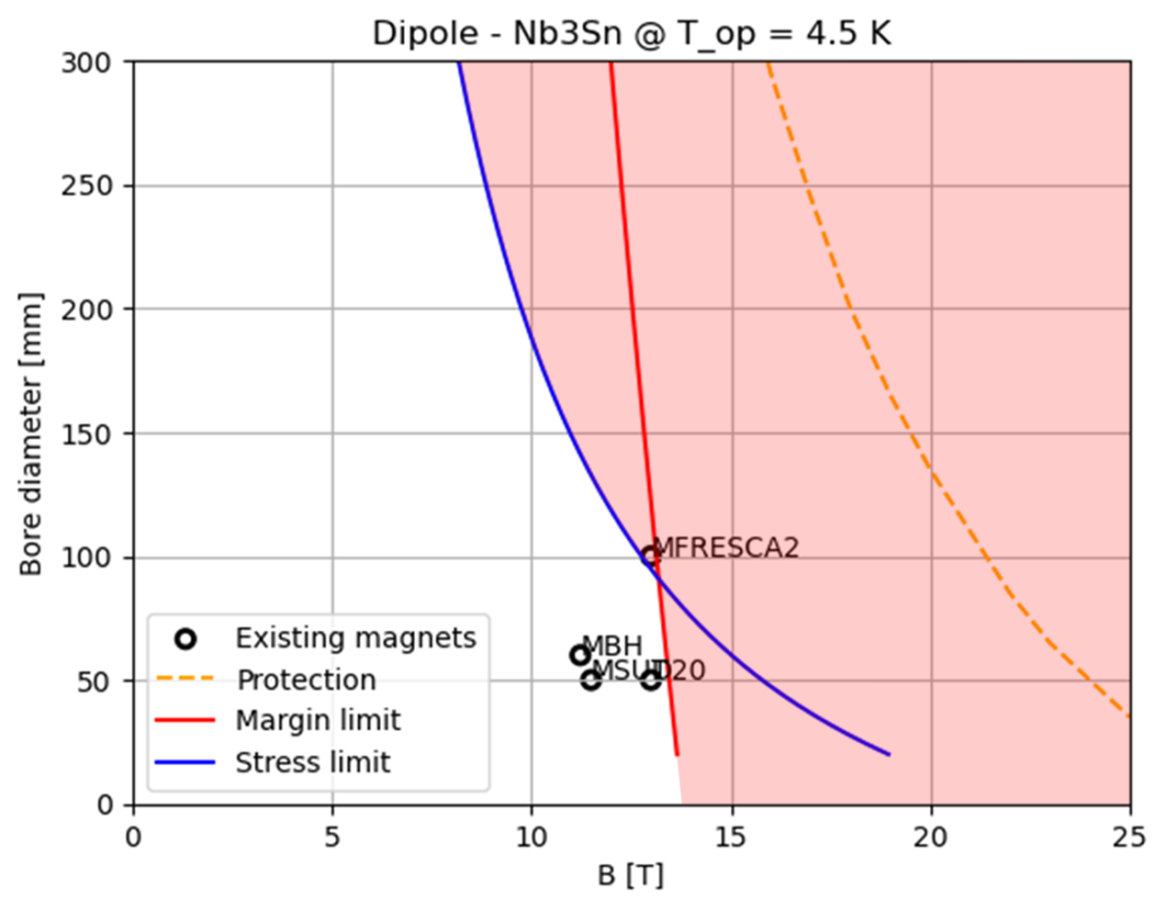
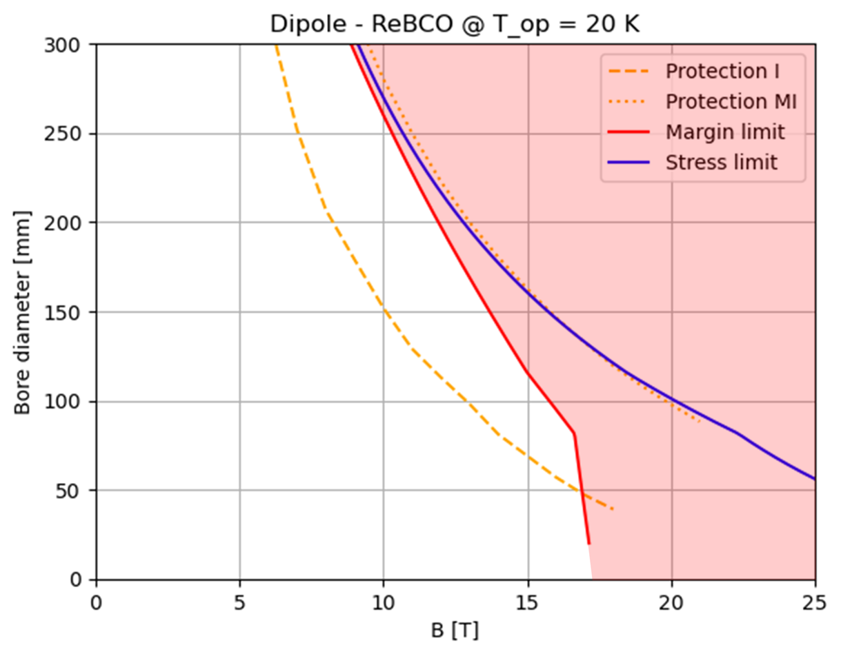
Working Point for FEM Models
Courtesy of D. Novelli @ IMCC-2025
https://indico.desy.de/event/45968/contributions/186264/
Courtesy of D. Novelli @ IMCC-2024
https://indico.cern.ch/event/1325963/contributions/5837724/
14 T/140 mm
Selection of interesting design configuration using A-B plots for the ARC DIPOLE collider magnets in parallel with phase space exploration
Main outcome from Analytical exploration:
Nb₃Sn limited by operating margin and Peak stress for B >14 T
HTS (ReBCO) limited by Cost and protection.
  Metal insulated (MI) or Not Insulated (NI) coils must be used.
FEM DESIGN
High Field Large Bore
HTS Dipoles

Slide 6
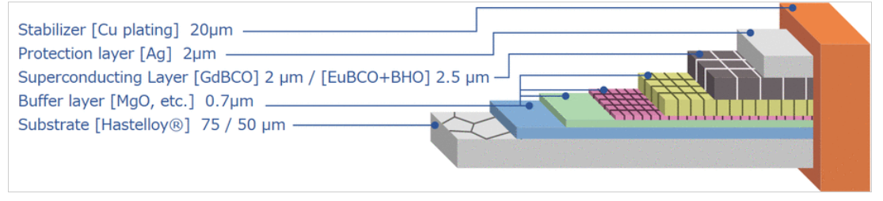
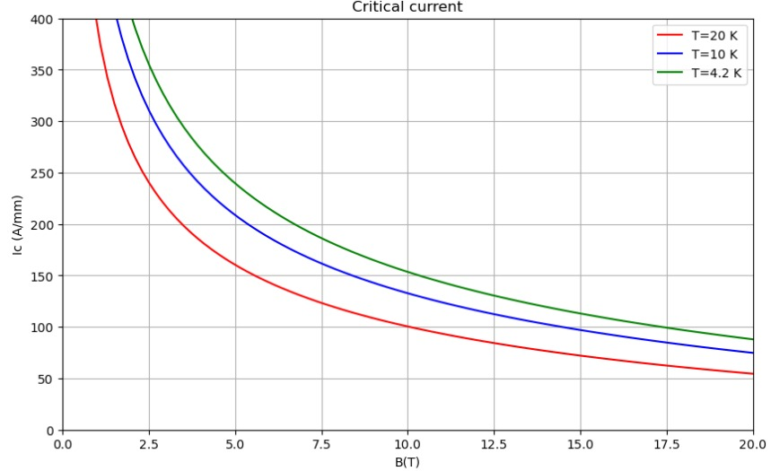
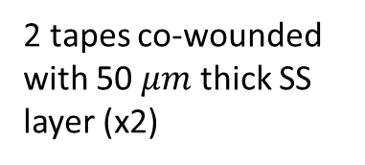
HTS Cable Assumptions
We want to use not twisted stacked tapes cable.
Twist and transposition not effective in reducing the AC losses for coated conductors [2], while increasing cost and complexity
Fujikura FESCH-12 AP tape [1]
2 tapes co-wounded with 50 $μm$ thick SS layer (x2)
[1] https://www.fujikura.co.uk/netalogue/pdfs/Fujikura%20Superconductor%20Guide.pdf
[2] D. Uglietti at al. “Non-twisted stacks of coated conductors for magnets: Analysis of inductance and AC losses“ https://doi.org/10.1016/j.cryogenics.2020.103118
0.54 mm
0.05 mm
0.11 mm
0.11 mm
12 mm
Maximum allowable stresses (only tape without metal layer):
X-direction: σ_{MAX} = -100 MPa
Y-direction: σ_{MAX} = -400 MPa
XY-direction: σ_{MAX} > 19 MPa

Slide 7
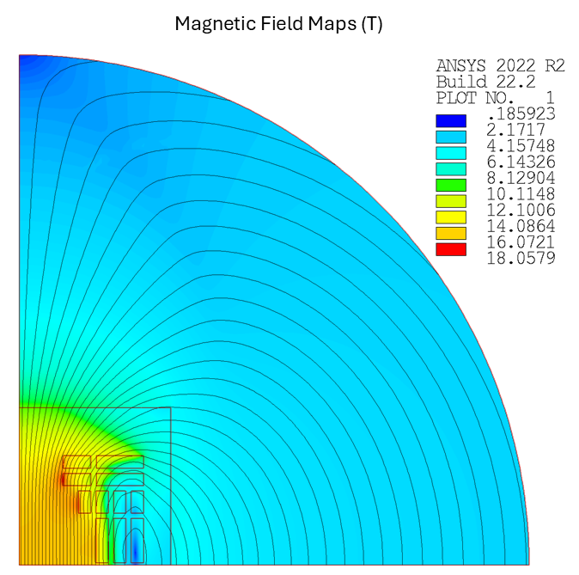
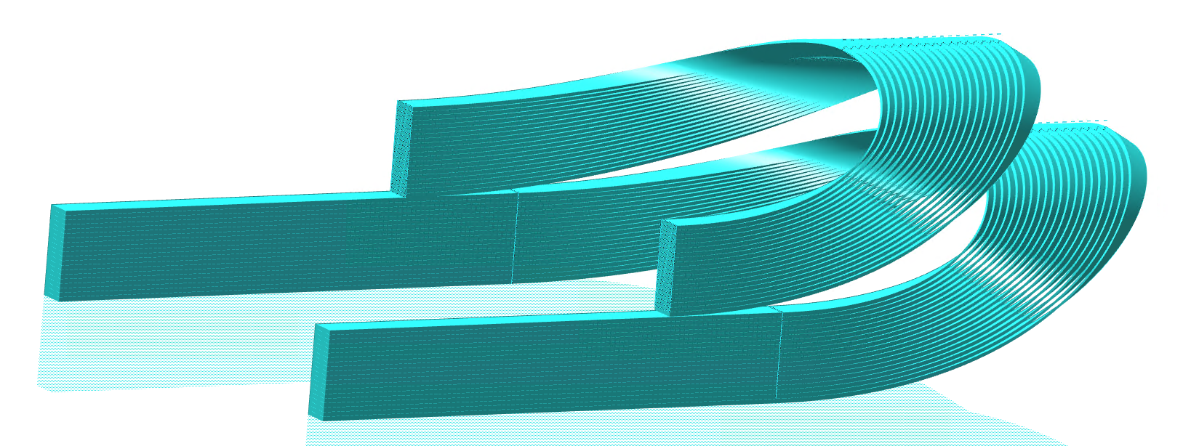
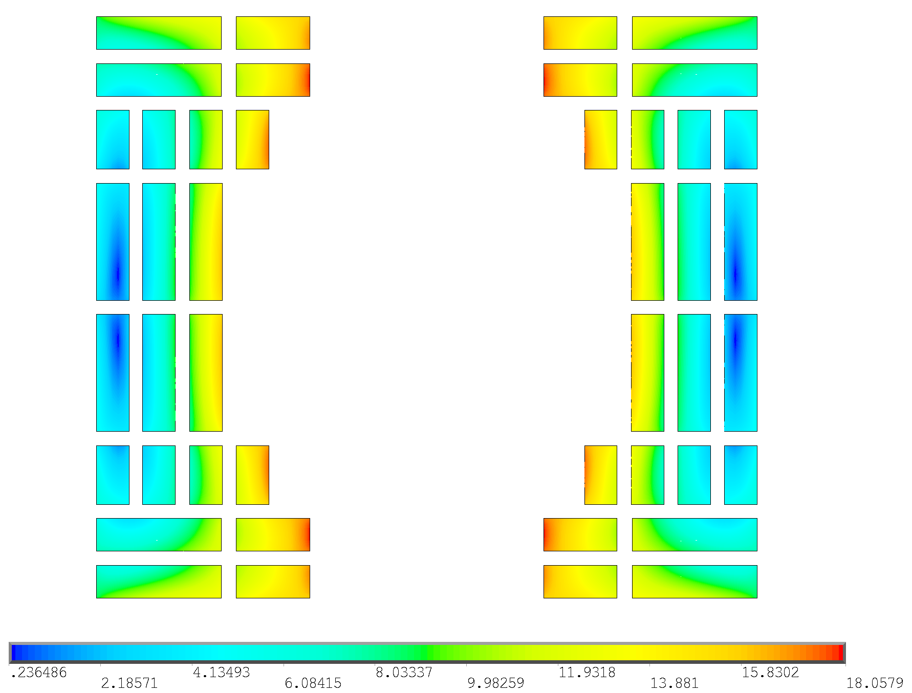

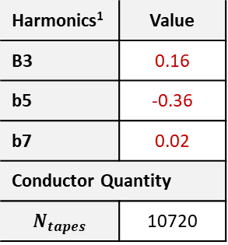
Electromagnetic Design:
Block-coil Layout
Development of two Different magnet design: Block-Coil vs Cos-theta layout
Block-coil advantages:
Cable configuration suitable to coil geometry winding
Better Lorentz forces stress management
Disadvantages:
Field quality optimization more difficult
Iron Yoke
Coil Layout
$$B_{peak}=18.06 T$$
Bore Aperture
Parameter | Value | U.M.
I_{OP} | 3515 | A
J_{ENG} | 542 | A/mm²
J_{COPPER} | 1820 | A/mm²
B₁ | 16 | T
B_{PEAK} | 18.06 | T
T_{OP} | 20 | K
Parameter | Value | U.M.
∆T_{MARGIN} | 2.5±1% | K
Aperture | 140 | mm
E_{STORED}/V | 0.3 | J/mm³
E_{STORED}/L | 5.3¹ | MJ/m
L | 853¹ | mH/m
Harmonics¹ | Value
B3 | 0.16
b5 | -0.36
b7 | 0.02
Conductor Quantity
$$N_{tapes}$$ | 10720
Block-Coil
Courtesy of L. Alfonso @ IMCC-2025
https://indico.desy.de/event/45968/contributions/185355/
¹HTS persistent current effect NOT considered

Slide 8
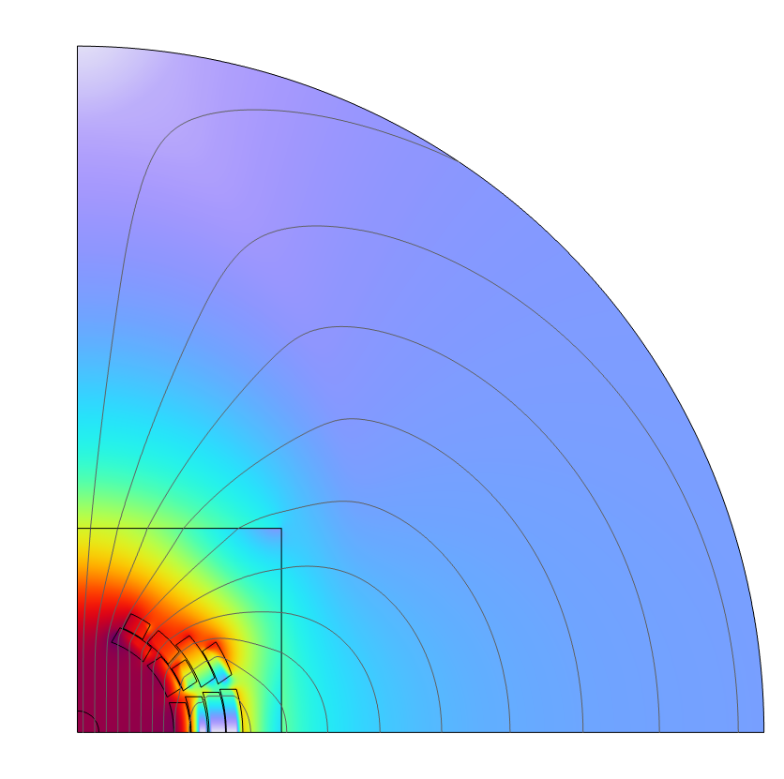
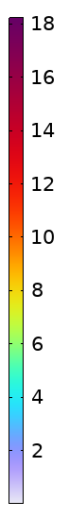
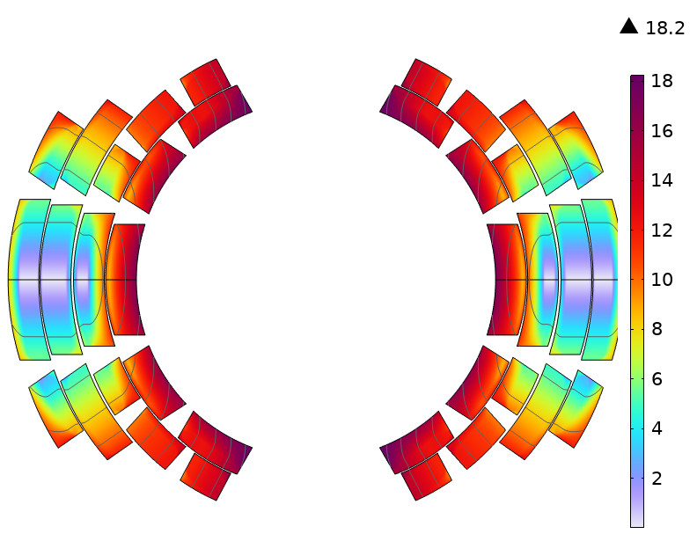

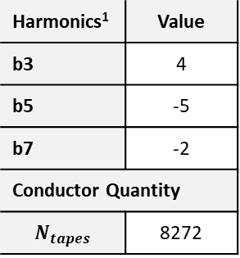

Electromagnetic Design:
$cos\left(θ\right)$ Layout
$B$[T]
Development of two Different magnet design: Block-Coil vs Cos-theta layout
Costheta Advantages
Minimization of conductor quantity in coil cross-section
Better field quality optimization (here considering also HTS persistent current)
Costheta Disadvantages
Stress management (layer supports still to be implemented)
Parameter | Value | U.M.
I_{OP} | 3700 | A
J_{ENG} | 571 | A/mm²
J_{COPPER} | 1916 | A/mm²
B₁ | 16 | T
B_{PEAK} | 18.2 | T
T_{OP} | 20 | K
Parameter | Value | U.M.
∆T_{MARGIN} | 2.5±1% | K
Aperture | 140 | mm
E_{STORED}/V | 0.29 | J/mm³
E_{STORED}/L | 3.9 | MJ/m
L | 534 | mH/m
Harmonics¹ | Value
b3 | 4
b5 | -5
b7 | -2
Conductor Quantity
$$N_{tapes}$$ | 8272
Cos-Theta
Courtesy of F. Mariani @ IMCC-2025
https://indico.desy.de/event/45968/contributions/185356/
¹HTS persistent current effect considered

Slide 9
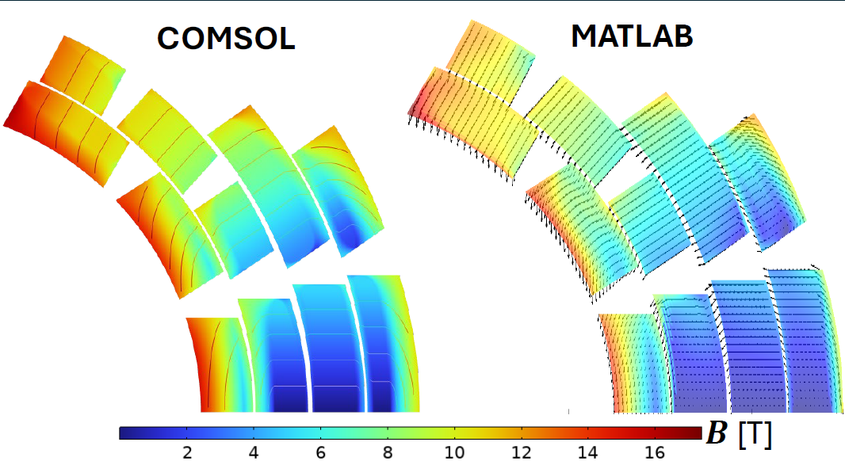
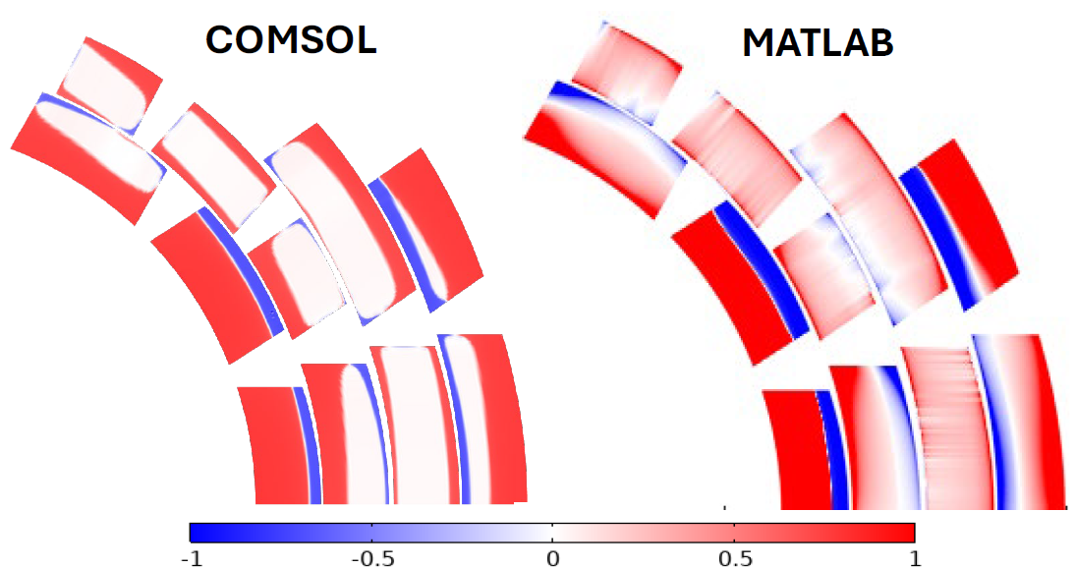
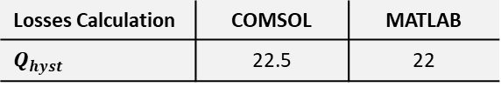
Persistent Current Models
Courtesy of F. Mariani @ IMCC-2025
https://indico.desy.de/event/45968/contributions/185356/
Development of electromagnetic modelling for FAST persistent current simulation in HTS magnet cross-section:
Tape orientation optimization
Induced peak lorentz forces on conductor estimation
Analytical Model in MATLAB (Brandt) or FEM Model (COMSOL)
Compatible results on hysteretic losses
Losses Calculation | COMSOL | MATLAB
$$Q_{hyst}$$ | 22.5 | 22
Harmonic | COMSOL | MATLAB
b3 | 3 | 4
b5 | -7 | -0.2
b7 | -3 | -0.05
Harmonic content strongly affected by critical current saturation in tape cross-section

Slide 10
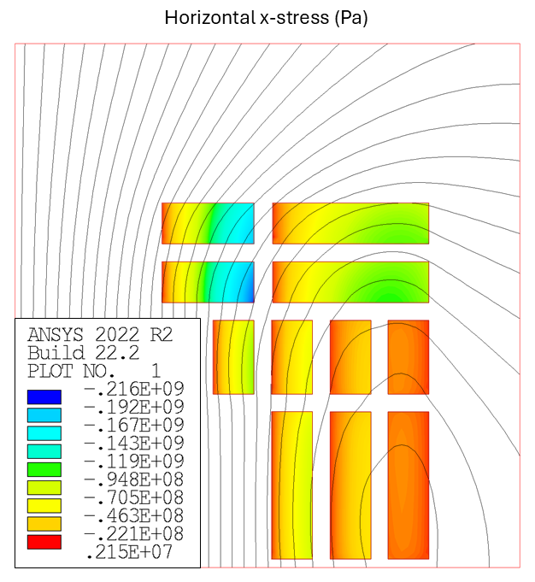
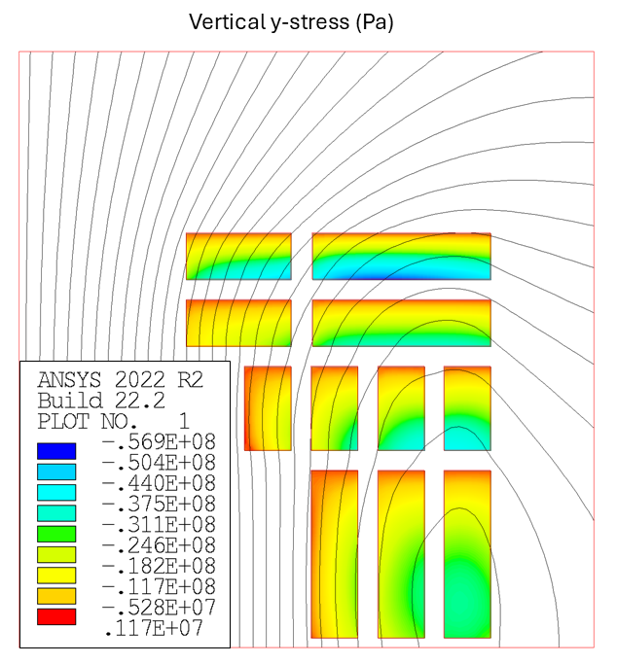
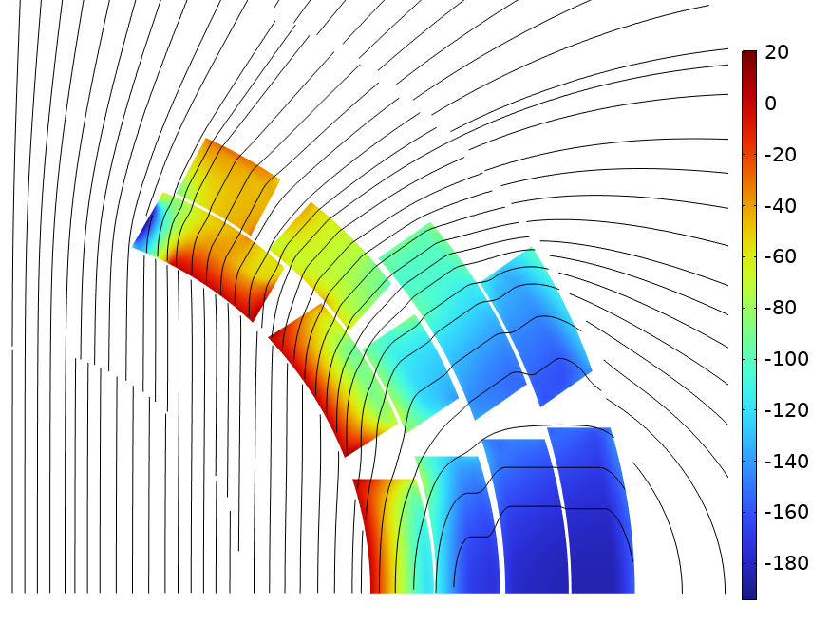
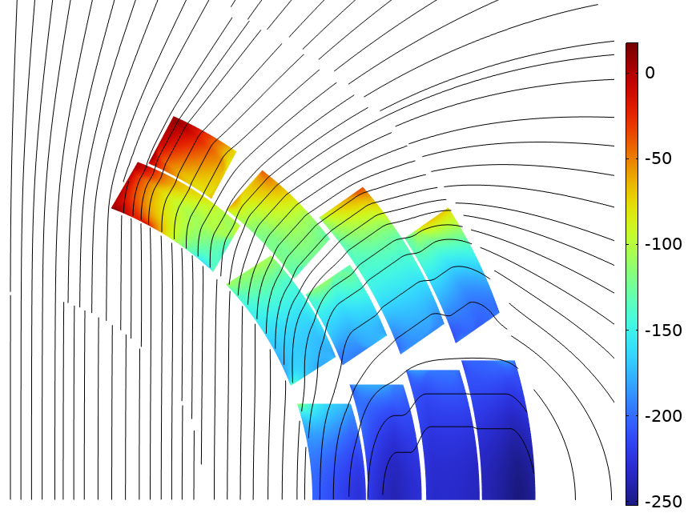
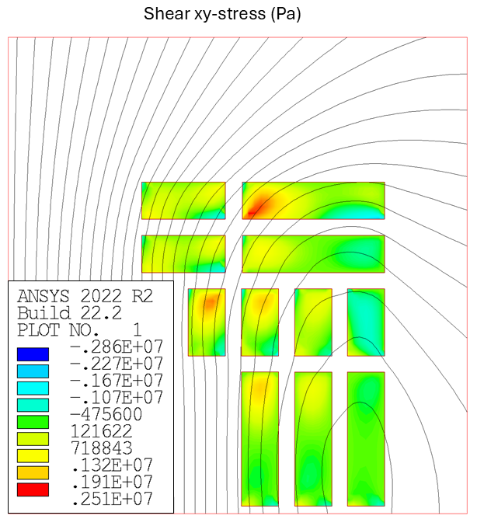
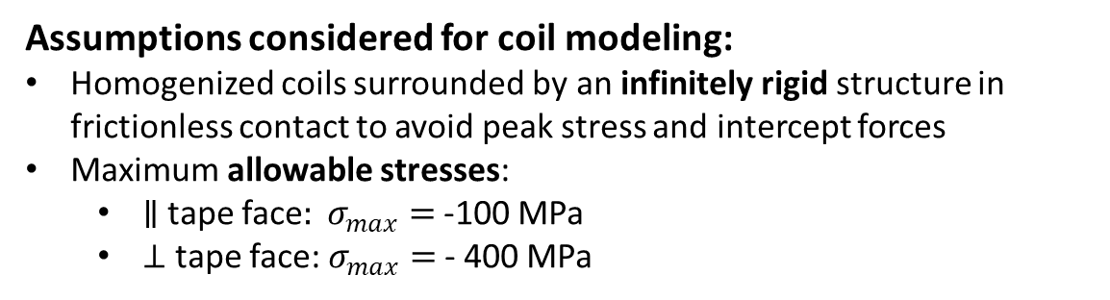
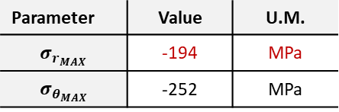
Mechanical Design
Uniform current distribution
Assumptions considered for coil modeling:
Homogenized coils surrounded by an infinitely rigid structure in frictionless contact to avoid peak stress and intercept forces
Maximum allowable stresses:
  $∥$tape face$: σ_{max}=$-100 MPa
  $⊥$ tape face: $σ_{max}=$- 400 MPa
Non-uniform current distribution due to magnetization
Parameter | Value | U.M.
σ_{X_MAX} | -216 | MPa
σ_{Y_MAX} | -56.9 | MPa
|σ_{XY_MAX}| | 2.86 | MPa
Block-coil stress values are below the maximum allowable limits
Parameter | Value | U.M.
$$σ_{r_{MAX}}$$ | -194 | MPa
$$σ_{θ_{MAX}}$$ | -252 | MPa
E_{COIL} = 174 Gpa ¹ , ν_{COIL} = 0.3
¹ Barth, Christian & Mondonico, G & Senatore, C. (2015). Superconductor Science and Technology. 28. 045011. DOI: 10.1088/0953-2048/28/4/045011.

Slide 11
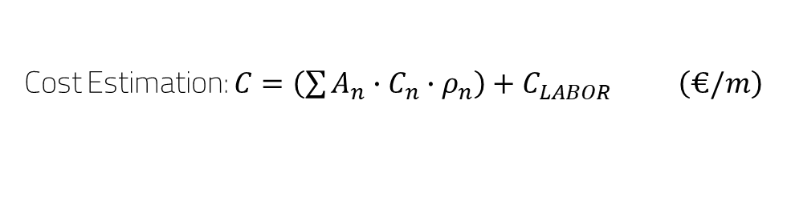
Cost Estimation Check
Block Coil Design
Material | Value | U.M.
ReBCO tape | 281 | k€/m
Stainless Steel | 17 | k€/m
Iron | 43 | k€/m
Labor | 20 | k€/m
Total Cost | 361 | k€/m
Same Cost Model previously used for the evaluation of entire collider magnet total cost
Modified cost model presented at IMCC (see B. Caiffi talk) still to be implemented in the evaluation
Compatible results with analytical prediction and scaling
Costheta magnet evaluation to be updated after stress management optimization
Costheta Design
Material | Value | U.M.
REBCO tape | 217 | k€/m
Stainless Steel | 17 | k€/m
Iron | 43 | k€/m
Labor | 20 | k€/m
Total Cost | 297 | k€/m
Cost Assumption (C)
Density Assumption (ρ)
Material | Value | U.M.
ReBCO tape | 2500 | €/kg
Stainless Steel | 10 | €/kg
Iron | 8 | €/kg
Labor | 20000 | €/m
Material | Value | U.M.
ReBCO tape | 8000 | kg/m³
Stainless Steel | 7800 | kg/m³
Iron | 7800 | kg/m³
Cost Estimation: $C=\left(\sum{A_{n}∙C_{n}∙ρ_{n}}\right)+C_{LABOR} \left(€/m\right)$

Slide 12
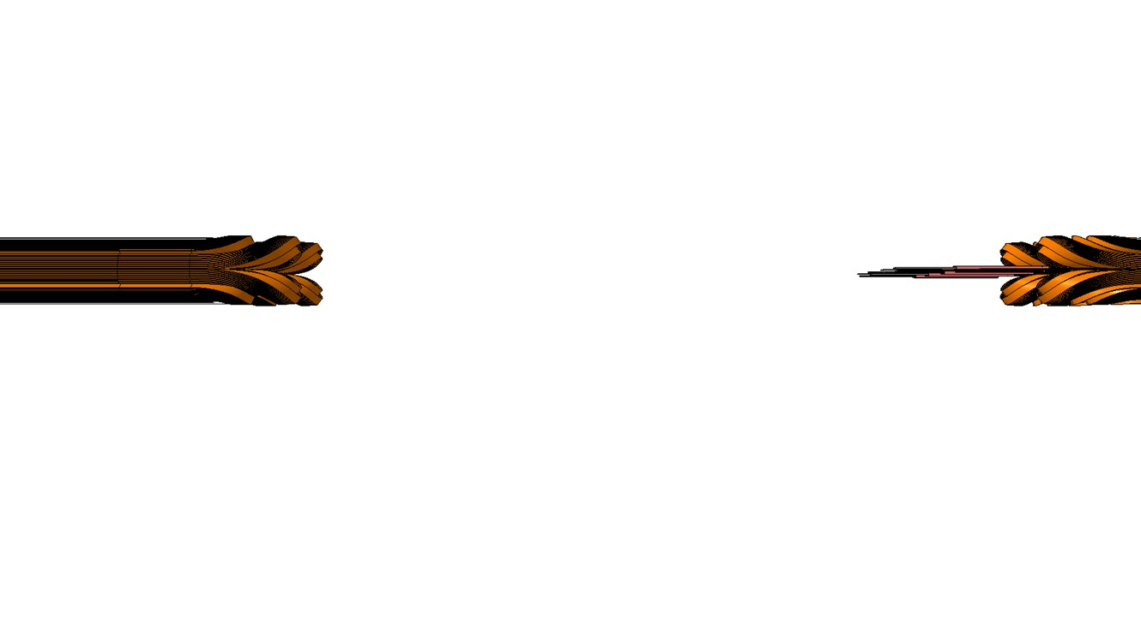
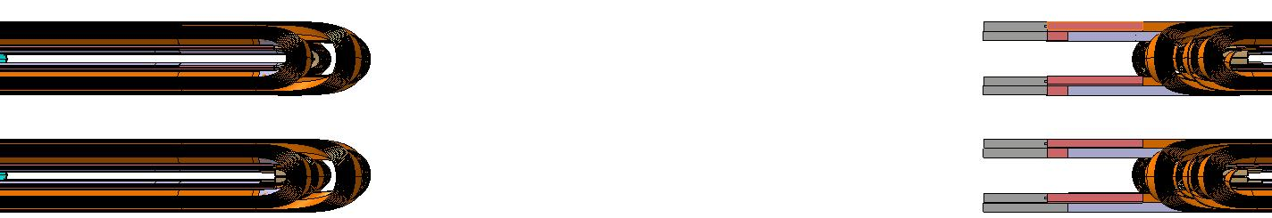
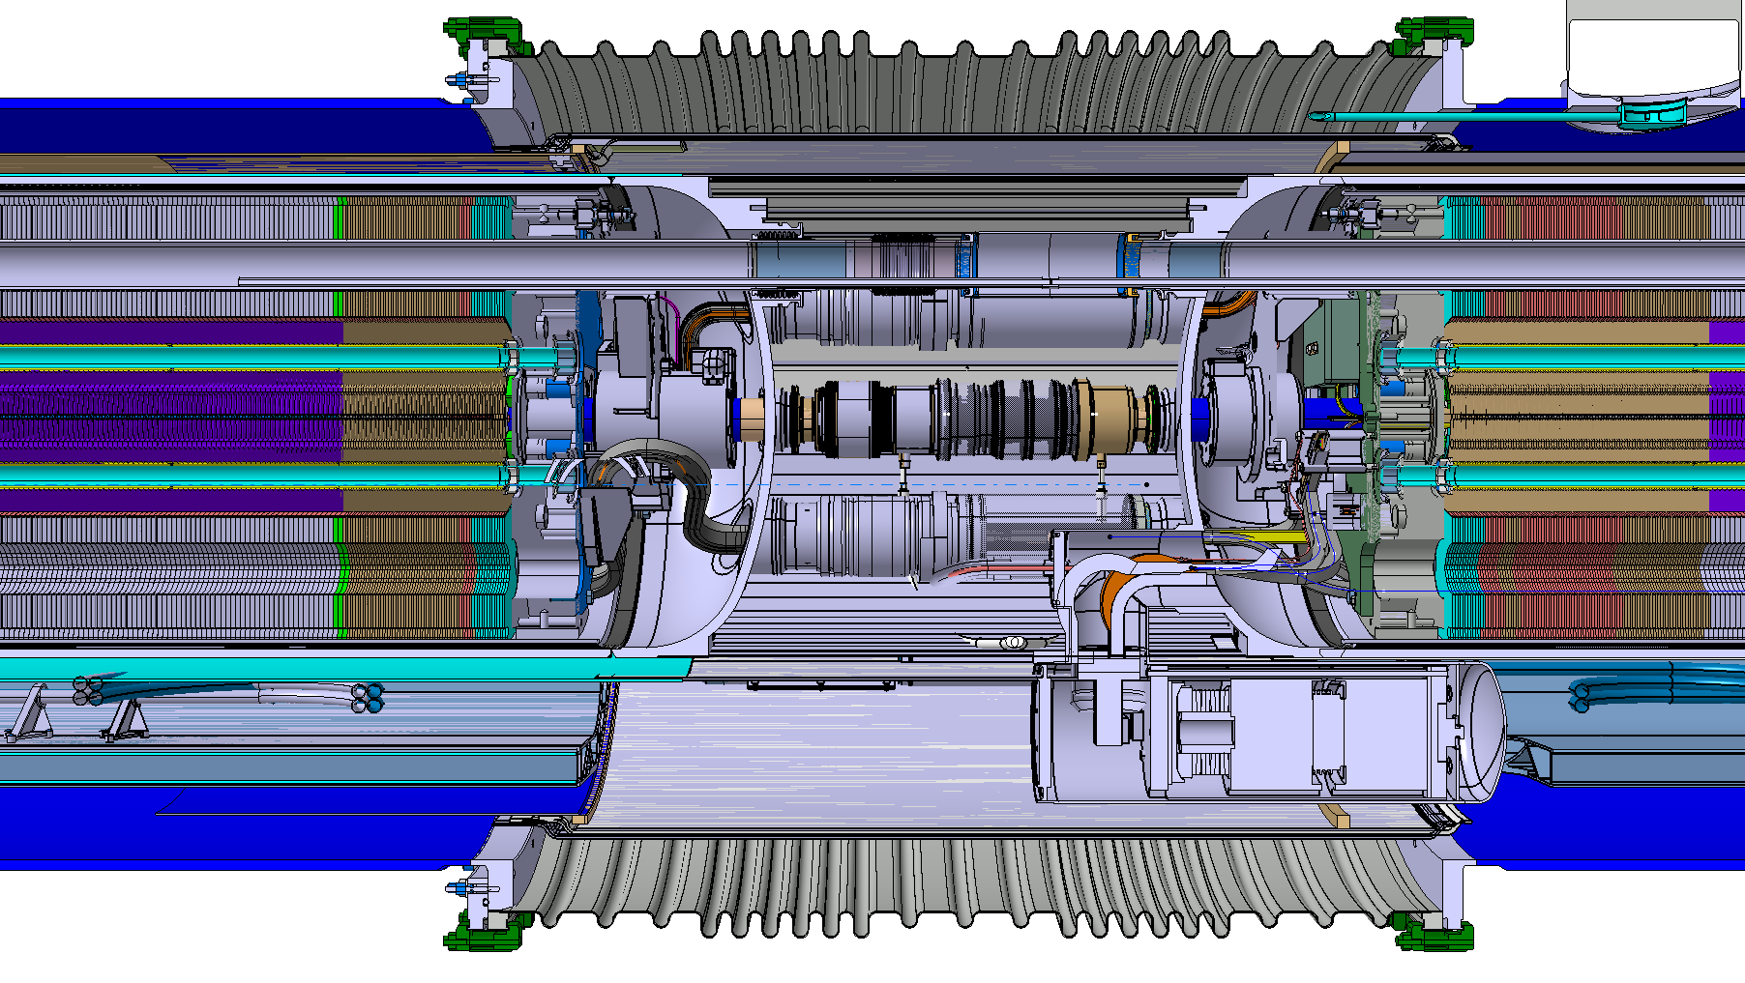
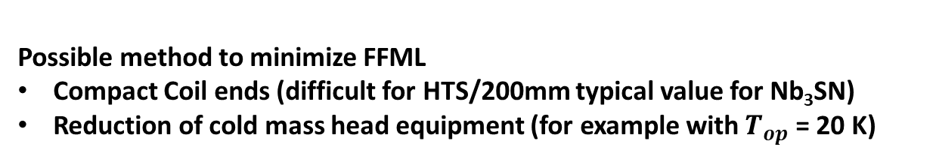


Field Free Magnetic Length
Coil heads on the connection side (CS)
Coil heads on the non connection side (NCS)
Recap from H. Prin presentation @ mmWG 13th June 2024:
Collection of superconducting magnet connection between two different cryostat and within the same cryostat interface.
LHC MB (NbTi, 1.9 K) 1200/1300 mm (LHC L_{d-d}=1.36 m)
  Coil Length - Magnetic Length = 236 mm
  CSpoolpiece corrector: 176 mm
  Magnet End Plate/Cold mass: 226.5 mm
MQXFa/b for the HL-LHC project (Nb3Sn, 1.9 K) Q2A/Q2B L= 2090 mm
  Coil Length - Magnetic Length = 109 mm
  CSpoolpiece corrector: NA
  Magnet End Plate/Cold mass: 228 mm
Splices
NbTi leads
Magnetic Filed
ML
Nb₃SN coil leads
ML
Mag. Length
FFML
L_{head/e}
L_{s/head}
Possible method to minimize FFML
Compact Coil ends (difficult for HTS/200mm typical value for Nb₃SN)
Reduction of cold mass head equipment (for example with $T_{op}$ = 20 K)
$$ΔL=−100/300 mm$$
$L_{FFML}>1000$/1200 mm
E. Todesco, "Optimizing the filling factor in high energy colliders"
P. Ferracin, MQXF Design Overview - HL-LHC/LARP Review

Slide 13
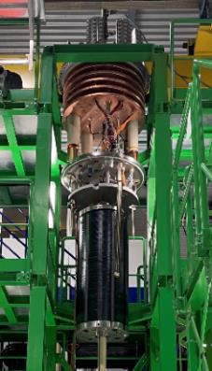
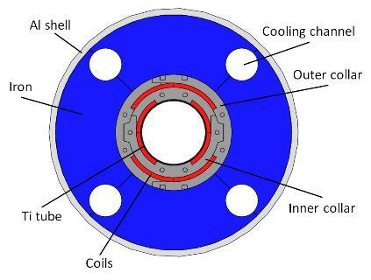
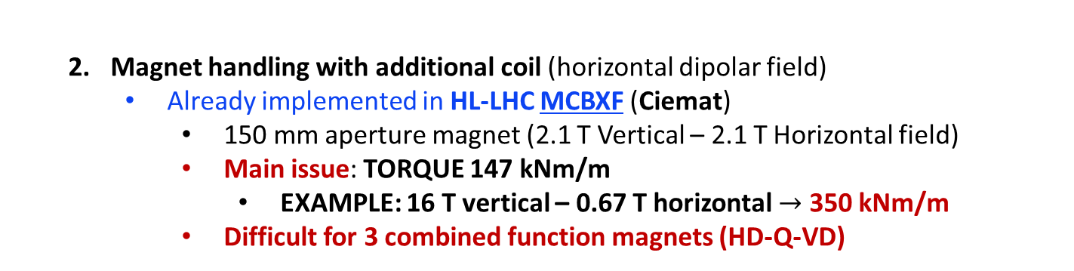
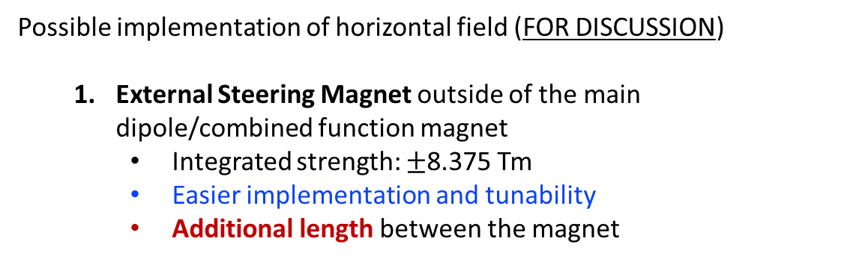
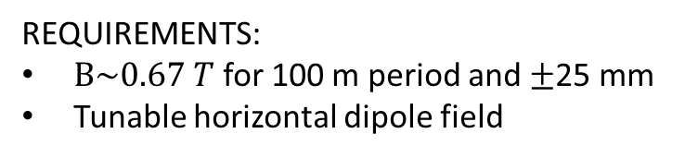
Muon Beam Wobbling
Possible implementation of horizontal field (FOR DISCUSSION)
  External Steering Magnet outside of the main dipole/combined function magnet
    Integrated strength: $±$8.375 Tm
    Easier implementation and tunability
    Additional length between the magnet
REQUIREMENTS:
$B\sim 0.67 T$ for 100 m period and $±$25 mm
Tunable horizontal dipole field
  Magnet handling with additional coil (horizontal dipolar field)
    Already implemented in HL-LHC MCBXF (Ciemat)
      150 mm aperture magnet (2.1 T Vertical – 2.1 T Horizontal field)
      Main issue: TORQUE 147 kNm/m
        EXAMPLE: 16 T vertical – 0.67 T horizontal $→$ 350 kNm/m
      Difficult for 3 combined function magnets (HD-Q-VD)
  Fixed magnet position with additional coil
    Larger bore aperture/inner elliptical tungsten layout (horizontal thickness >vertical thickness)
Courtesy of F. Toral

Slide 14
Conclusions
Finite element models for large aperture high field HTS dipoles have been started and are being presently developed to address technological challenges to be solved during the R&D phase of superconducting magnet development
Analytical/FEM models for persistent current simulation already implemented for costheta magnet layout used to address HTS dynamic effects during magnet operation and evaluate impact on field quality and losses
Stress management design must be further studied including peak stress at conductor level
  Block coil design more suitable for stress management configuration
  Costheta magnet layout to be implemented
Field free magnetic length > 1 m are like to be considered depending on connection scheme
Additional horizontal field in collider magnet to be further developed
  Separate magnet layout / nested solution

Slide 15
Thank you for the attention
Funded by the European Union (EU). Views and opinions expressed are however those of the author only and do not necessarily reflect those of the EU or European Research Executive Agency (REA). Neither the EU nor the REA can be held responsible for them.

