Slide 1


IMCC & MuCol
Annual Meeting, DESY, Hamburg, 15.05.2025
Final cooling beam physics
Bernd Stechauner^{1,2}, Bernardo Bordini², Jose Ferreira Somoza², Tim Mulder²,
Chris Rogers³, Jochen Schieck^{1,4}, Daniel Schulte² & Rebecca Taylor²
¹Technische Universität, Vienna
²CERN, Geneva
³STFC Rutherford Appleton Laboratory, Didcot
⁴Institute of High Energy Physics (HEHPY), Vienna

Slide 2
Overview
Beam dynamics of a single final cooling cell.
Inclusion of significant technical components.
Thesis results and outlooks.

Slide 3
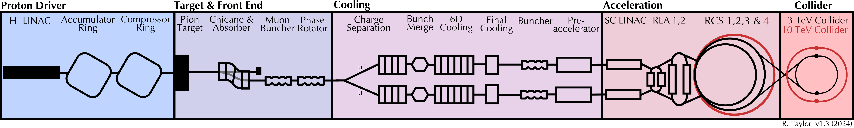
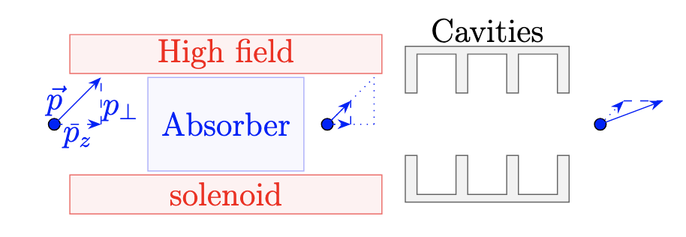

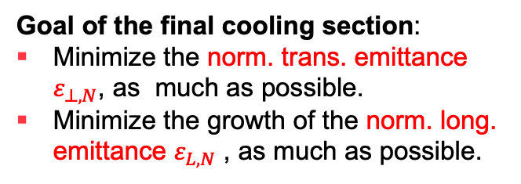
Transverse ionization cooling
Goal of the final cooling section:
Minimize the norm. trans. emittance $ε_{⊥,N}$, as much as possible.
Minimize the growth of the norm. long. emittance $ε_{L,N}$ , as much as possible.
Final cooling section
Small but powerful, ~100 m
One part of a final cooling cell
Transverse ionization cooling:
Absorber and cavities reduce the beam divergence.
The solenoid suppresses the increase of $ε_{⊥,N},$caused by multiple Coulomb scattering.

Slide 4
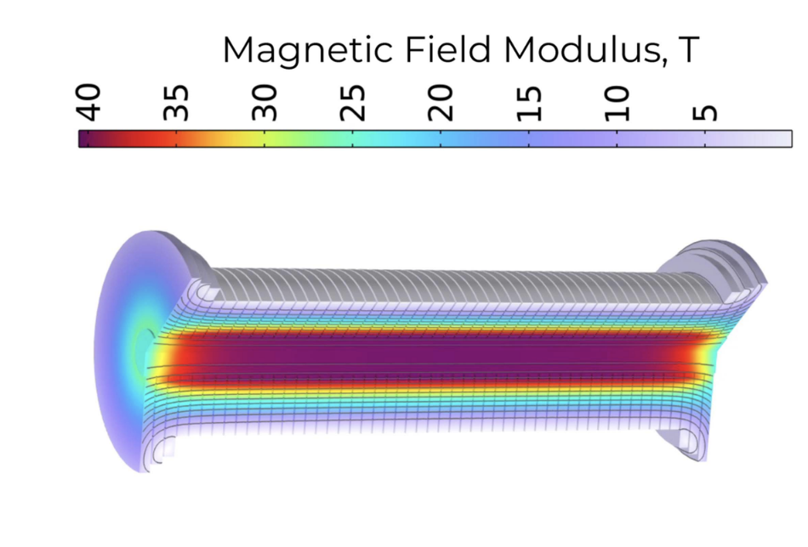
High field solenoid in the final cooling
Effective cooling requires strong solenoid fields to counteract the emittance heating caused by scattering.
The solenoid's field must be homogeneous at the absorber location.
G4BL simulated field
Technical design with pancake modules [1]. See Bernardo’s talk!
Three corrector pancakes are added at both the entrance and exit of the solenoid.

Slide 5
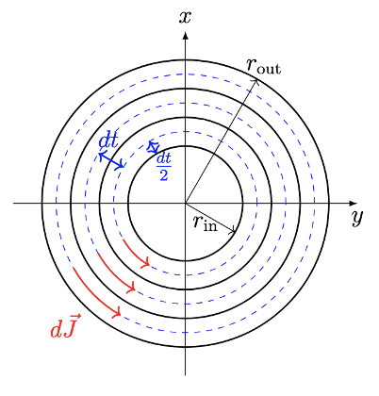


Muon transport into a high-field solenoid + absorber system
Matching condition of a solenoid.
Requirements:
Low-field (~4T) solenoid transport lines.
Matching coils are introduced between low-field and high-field solenoids.
Free parameters of a solenoid
High field solenoid
Low field solenoid
Low field solenoid
Outer radius
Current density
Position
Inner radius
µ
Absorber
Matching coil
Matching coil

Slide 6



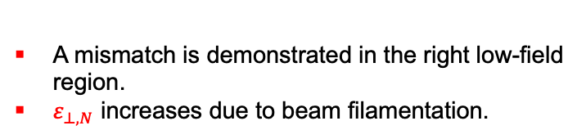
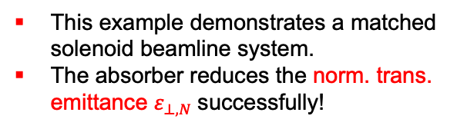
Why correct beam matching is significant
Accurate solenoid matching is essential for the final cooling optics design. Without proper matching, the emittance reduced in the absorber will increase again.
$ε_{⊥,N}$ blow up
Absorber
Beam dynamics evaluated with G4Beamline [3]
Low field
Low field
mismatched
High field
Matchers
matched
Matchers
matched
A mismatch is demonstrated in the right low-field region.
$ε_{⊥,N}$ increases due to beam filamentation.
This example demonstrates a matched solenoid beamline system.
The absorber reduces the norm. trans. emittance $ε_{⊥,N}$successfully!

Slide 7
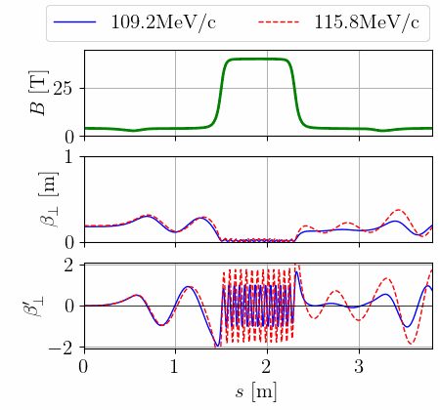
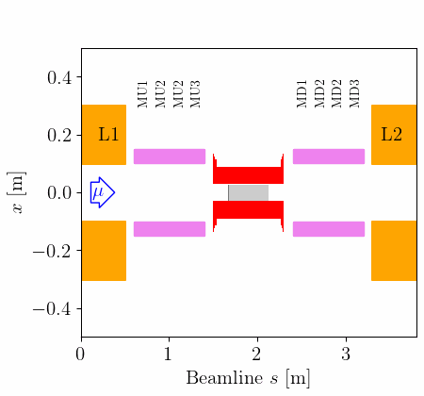
Beam matching
ref. particle 2 = 115.8 MeV/c
µ-Bunch
ref. particle 1 = 109.2 MeV/c
Optimization by varying the outer coil radius of the matching coils.
Technical advantages:
Constant currents in matching coils.
No spacing between matching coils.
While adjusting the physical size of a solenoid in a computer simulation is straightforward, making such changes in the actual machine will be significantly more challenging.

Slide 8
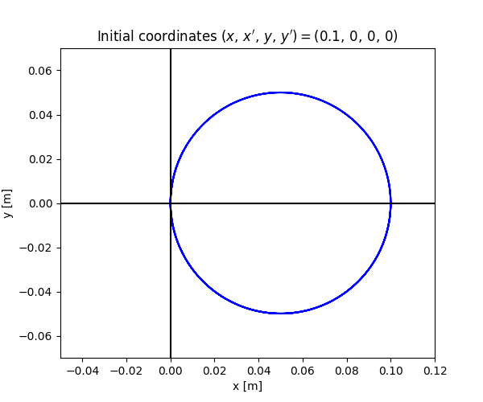
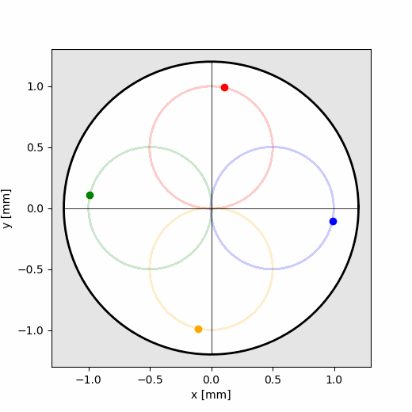
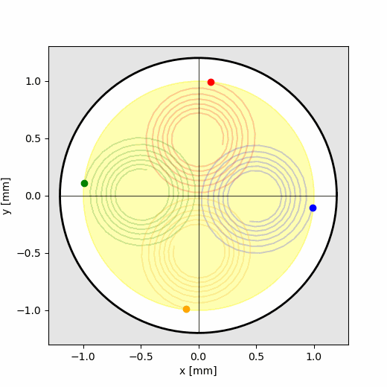
Coupled and single beam dynamics in final cooling
Larmor center moves to the beam axis.
Single particle dynamics in solenoids:
With absorbers: Larmor radii decrease.
The helices shrink to lines for infinite beam line and without scattering.

Slide 9
Coupled and multiple particle dynamics
Field flipped solenoids
Normalized canonical angular momentum [4]
Can. angl. mom. decrease focusing in the solenoids.
Less focusing -> less ionization cooling:
Better cooling with field flips

Slide 10
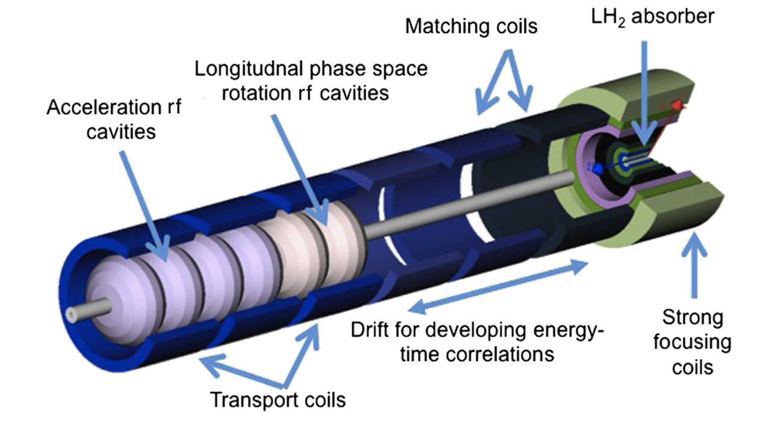

RF systems in the final cooling
RF
RF
RF
The energy spread can be controlled using phase-rotating cavities.
This minimizes the growth of the norm. long. emittance $ε_{L,N}$.
RF cavities can be positioned between the matching coils.
Low field
µ-beam
Low field
High field
Matchers
Previous design:
Cavities inside solenoids [5].

Slide 11
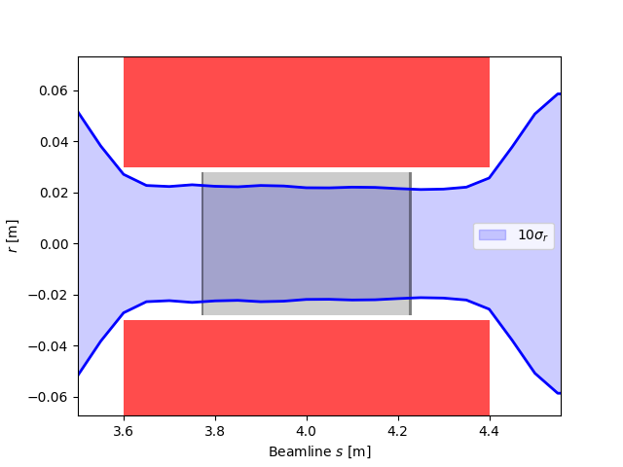
Absorber studies with windows
High pressure has a significant impact on the design of the final cooling channel.
To reduce pressure within the absorbers after a muon beam passes, the initial hydrogen pressure and density must be adjusted.
As a result, some absorbers may transition from a liquid to a vapor state.
µ-beam
solenoid
Minimize Coulomb scattering by utilizing thin windows.
Choose window materials with a low atomic number (Z).
LiH and Si₃N₄ are promising material options.
Liquid
hydrogen
µ-beam
See Jose’s & Valentina’s talk!
LiH window, 5mm thick

Slide 12
Final cooling cell summary
A single final cooling cell consists of two window-hydrogen-window configurations within a high-field solenoid.
These configurations are separated by field-reversed solenoids.
Alternating RF cavities and matching coils are positioned between to the high-field solenoids.
Beam windows and density adjusted hydrogen absorbers are significant components.
An overview of the acceleration between two final cooling cells will be discussed during the poster session.

Slide 13
Multiple final cooling cells
9 final cooling cells
Transverse emittance of 27 µm was reached.
After each cell, a new beam was generated in this design.

Slide 14
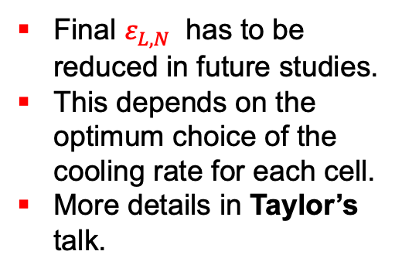
Outlook
A very high performance of transmission was achieved.
Liquid H used from Cell 1-4.
Vapor H used from Cell 5-9
Final $ε_{L,N}$ has to be reduced in future studies.
This depends on the optimum choice of the cooling rate for each cell.
More details in Taylor’s talk.

Slide 15
Reference list
[1] B. Bordini et al., “Conceptual design of a ReBCO non/metal-insulated ultra-high gield solenoid for the Muon Collider“, 2024.
[2] J. Nelder and R. Mead, „A simplex method for function minimization“, 1965.
[3] T. Roberts, „G4Beamline users guide“, 2022.
[4] G. Penn et al., „Beam envelope equation for cooling of muons in solenboid fields“, 2000.
[5] H. Sayed et al., „High field - low energy ionization cooling “, 2015.

Slide 16


Thank you for your attention

