Slide 1
Neutrino-induced radiation
from the collider ring
IMCC Annual meeting, DESY, Hamburg
15th May 2025
J. Mańczak,
C. Accetura, C. Ahdida C. Desponds, C. Carli, N. Guilhaudin,
G. Lerner, A. Kolehmainen, Y. Robert, D. Schulte, M. Vanwelde

Slide 2
Outline
The effect of machine movers on the neutrino-induced radiation.
Muon beam divergence in the collider arcs and its expected effect on neutrino-induced dose evaluation.
FLUKA simulations for a geometry representing a conservative exposure in potentially inhabited areas.

Slide 3
The effect of machine movers
Above-ground building structure
Neutrino-induced dose with the movers applied
Controlled periodic vertical deformation of the muon beam trajectory on a closed orbit
Arc beamline components would be equipped with actuated movers that periodically displace the ring structure in small increments introducing vertical beam deflections within a ± 1 mrad range.
More details in the talk by A. Kolehmainen and C. Accettura
Neutrino-induced dose from a pencil muon beam

Slide 4
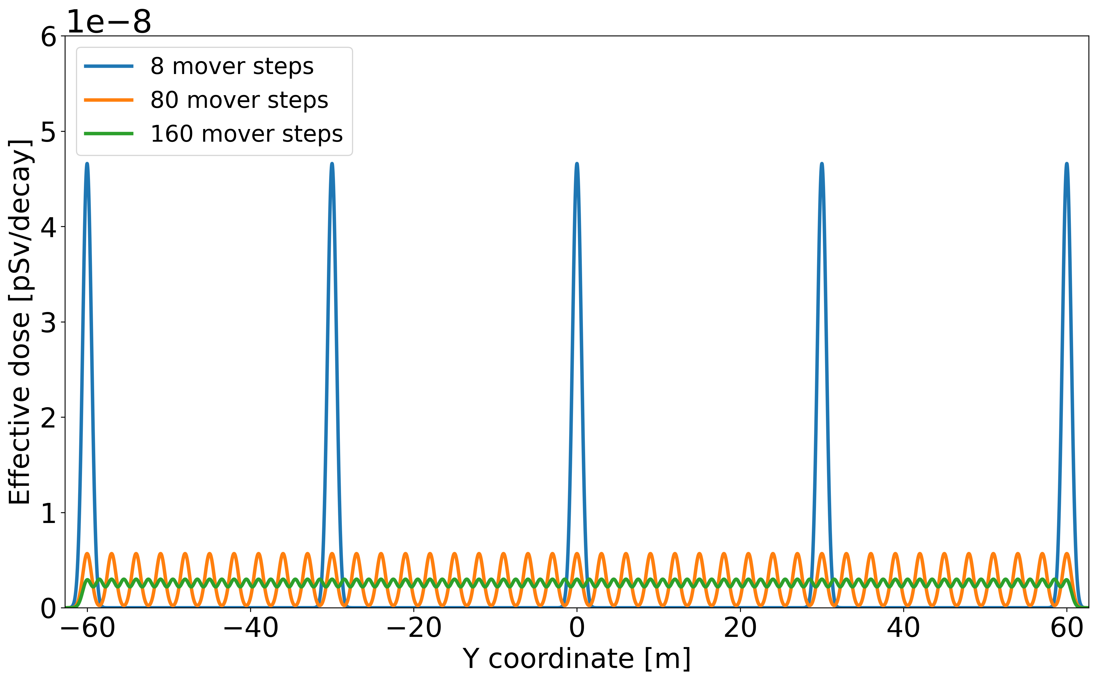
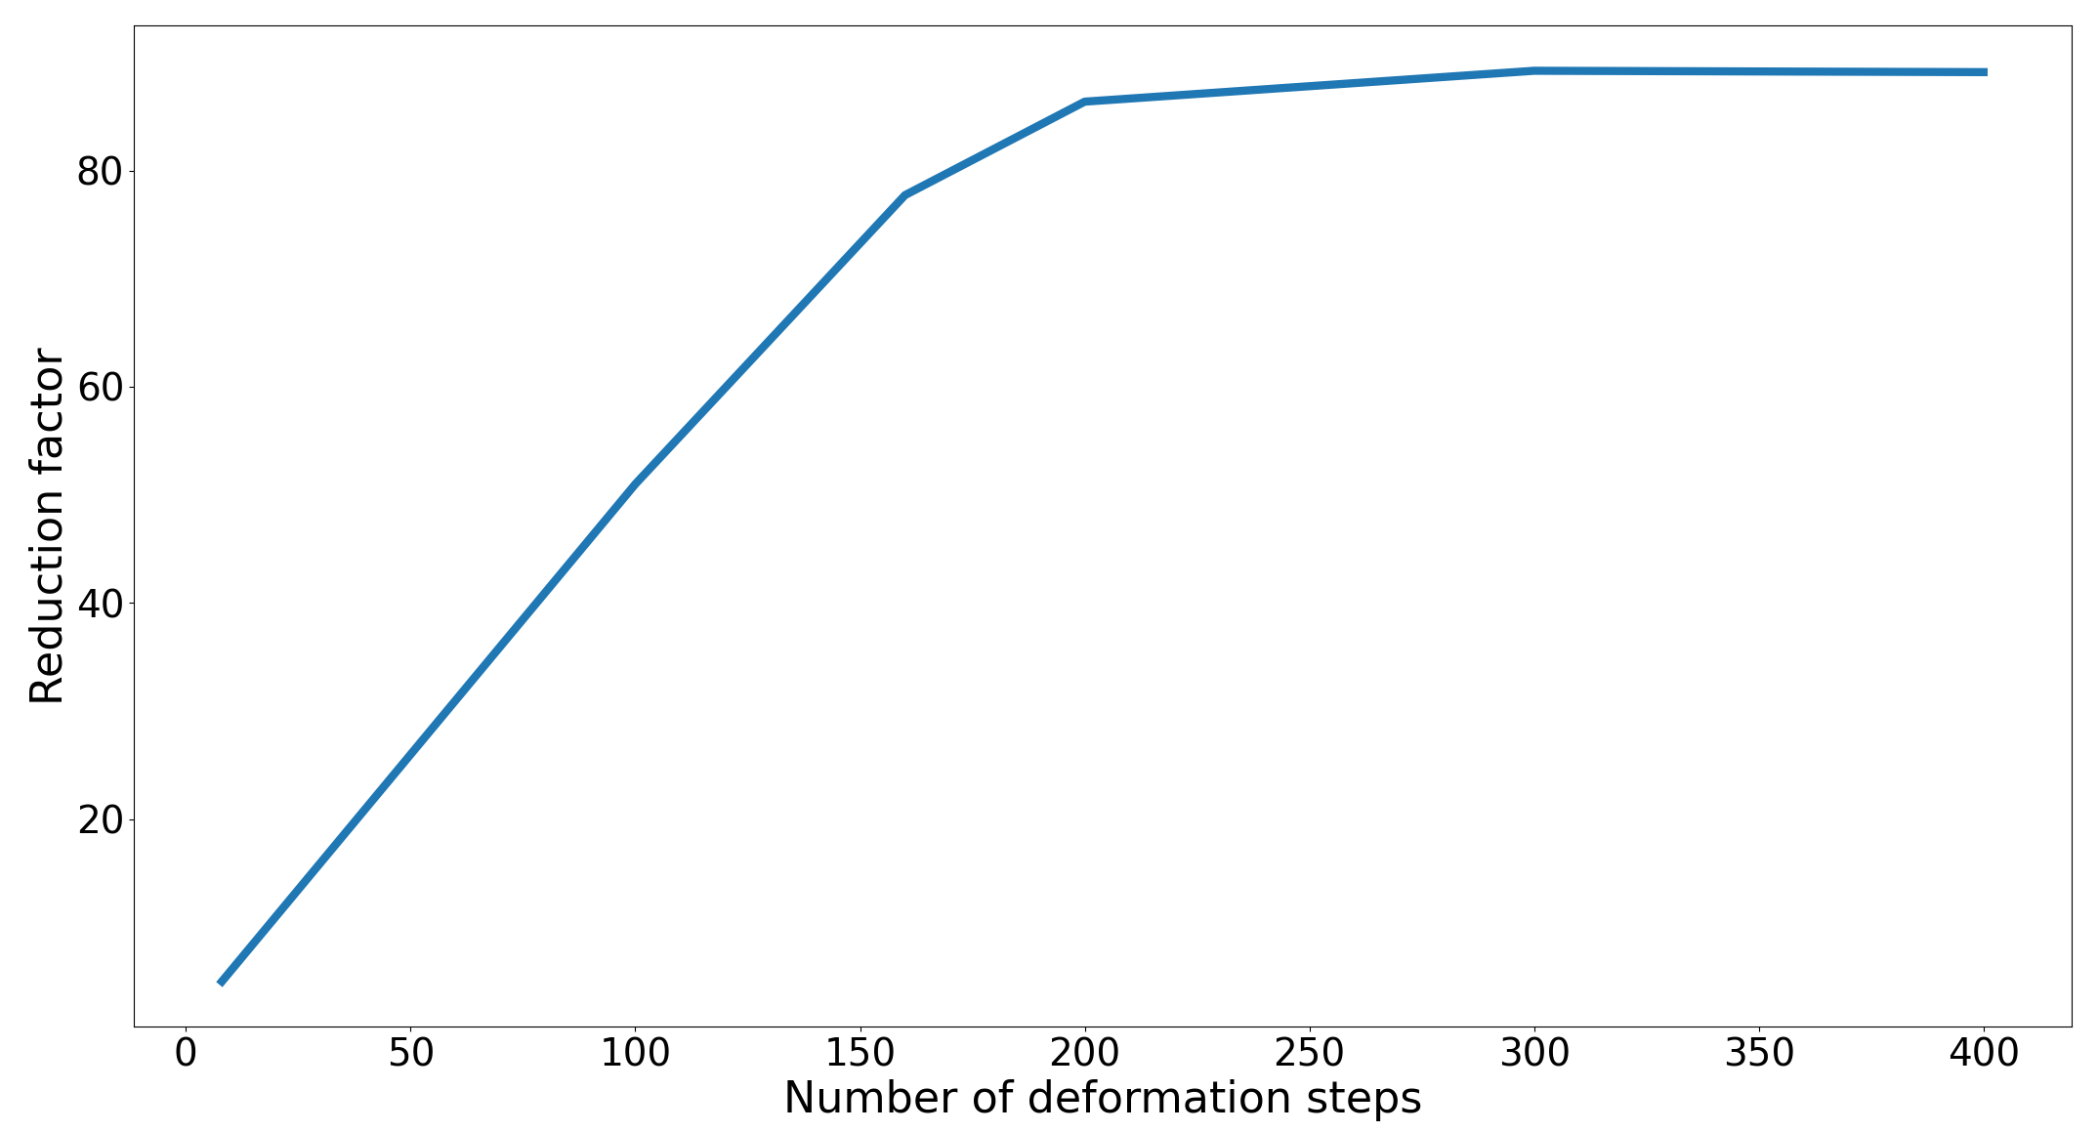
The effect of machine movers
The peaks in the plot are individual Gaussian dose kernels and the whole distribution is normalized to the total irradiation time.
Dose reduction due to the movers depends on the number of discrete steps and the neutrino cone width (effectively the distance from the collider)
The dose reduction saturates when the individual kernels completely overlap

Slide 5
The effect of machine movers on dose kernels
The muon beam energy is 5 TeV
Effective dose of neutrino-induced radiation in soil at different baseline distances from the muon decay after the beamline displacement by the movers is applied. The reduction factor is the ratio between the peak dose value of the corresponding dose kernel and the dose value mitigated by the movers (w/o the impact of more realistic geometries and exposure scenarios).

Slide 6
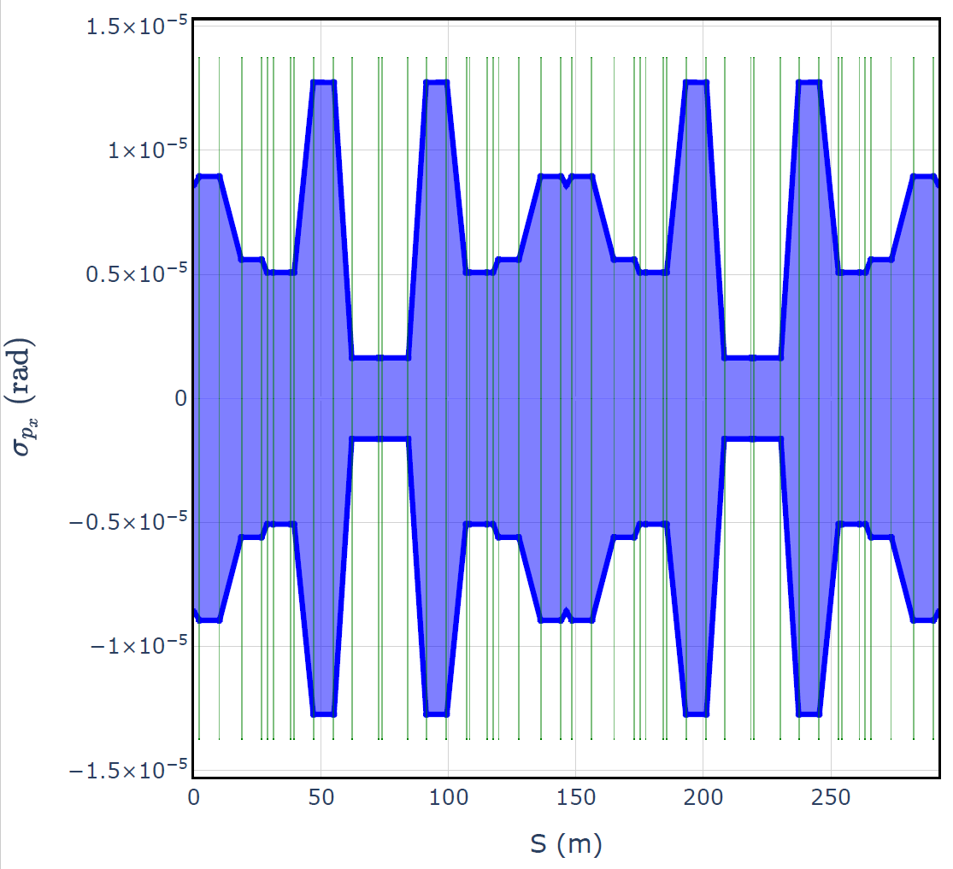
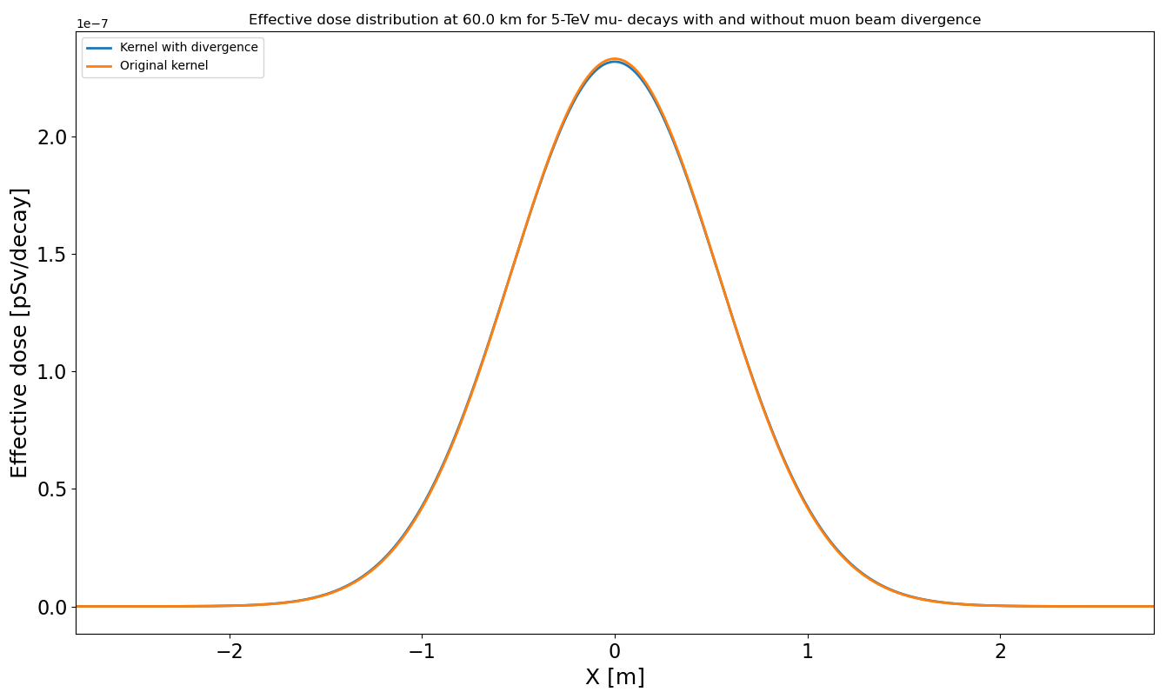
Muon beam divergence in the arcs
Plot by M. Valvende
lattice
v7
The movers act only in the Y direction so the kernel broadening in X due to beam direvgence is much more important for dose reduction.
Eventually might introduce a second order correction
To be conservative in our estimates, we take the minimum divergence as the baseline case.
No observable effect
Max X divergance
60 km
Min X divergance
60 km

Slide 7
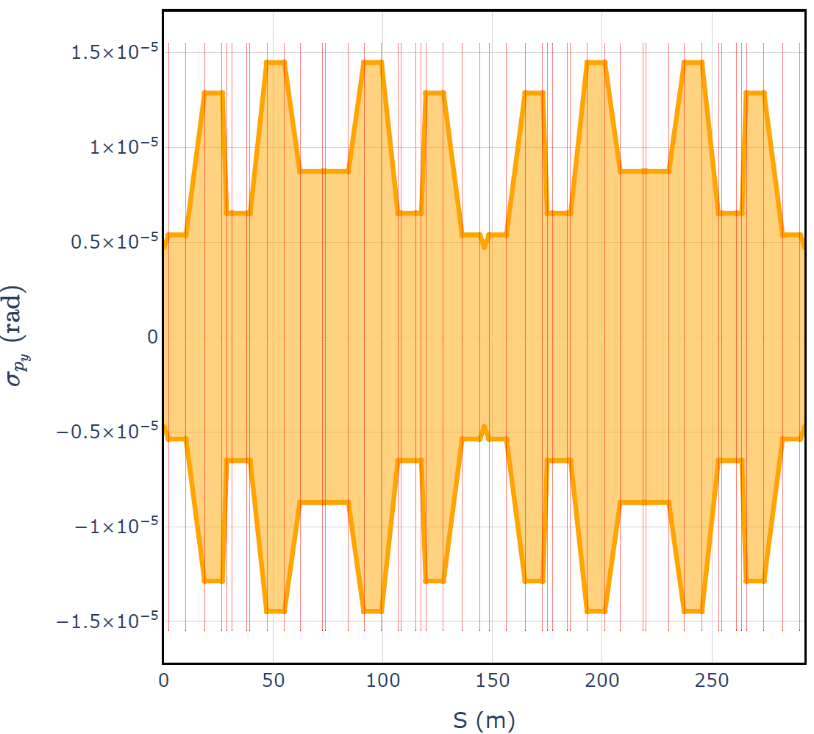
Muon beam divergence in the arcs
Plot by M. Valvende
The effect of the muon beam divergance in Y direction is completely overshadowed by the effect of the machine movers!
Min Y divergance
15 km
lattice v7
The impact of divergence in Y could help reducing the number of wobbling steps, if necessary, the effect however would be rather small

Slide 8
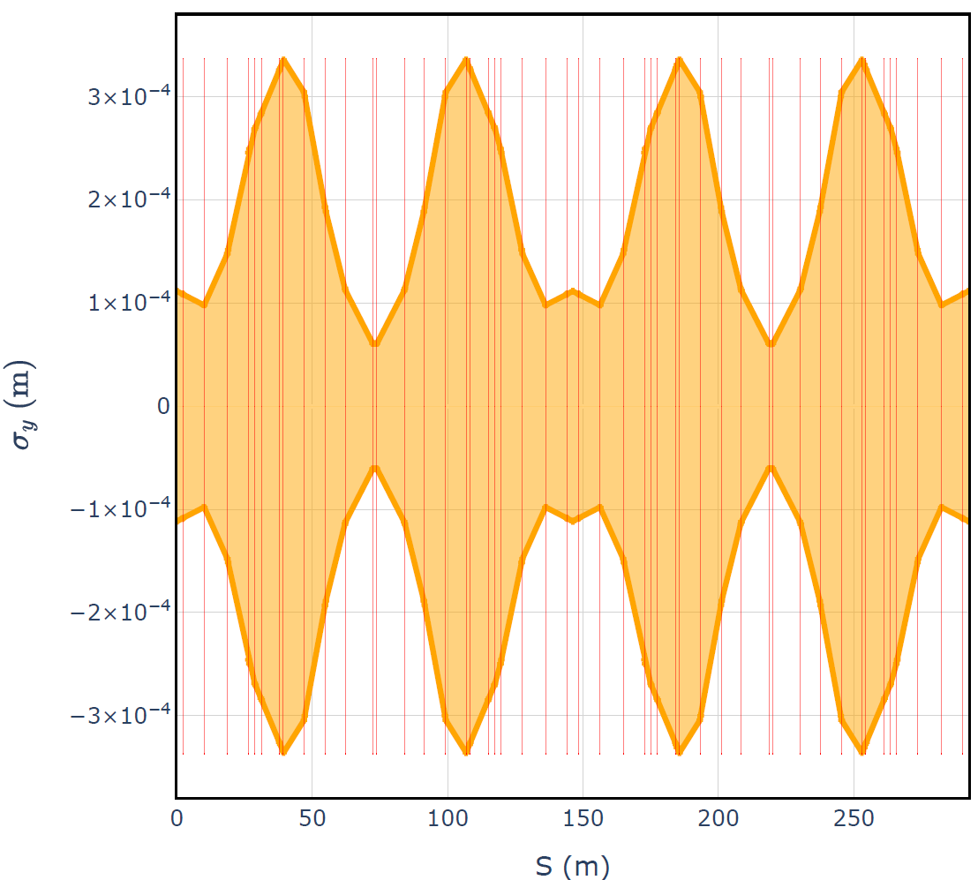
Muon beam size in the arcs
Plots by M. Valvende
lattice v7
The effect of the muon beam size is negligible, max size in both directions ~0.03 cm whereas the effective dose kernel width varies from 10 to 60 cm for the distances of our interest.

Slide 9
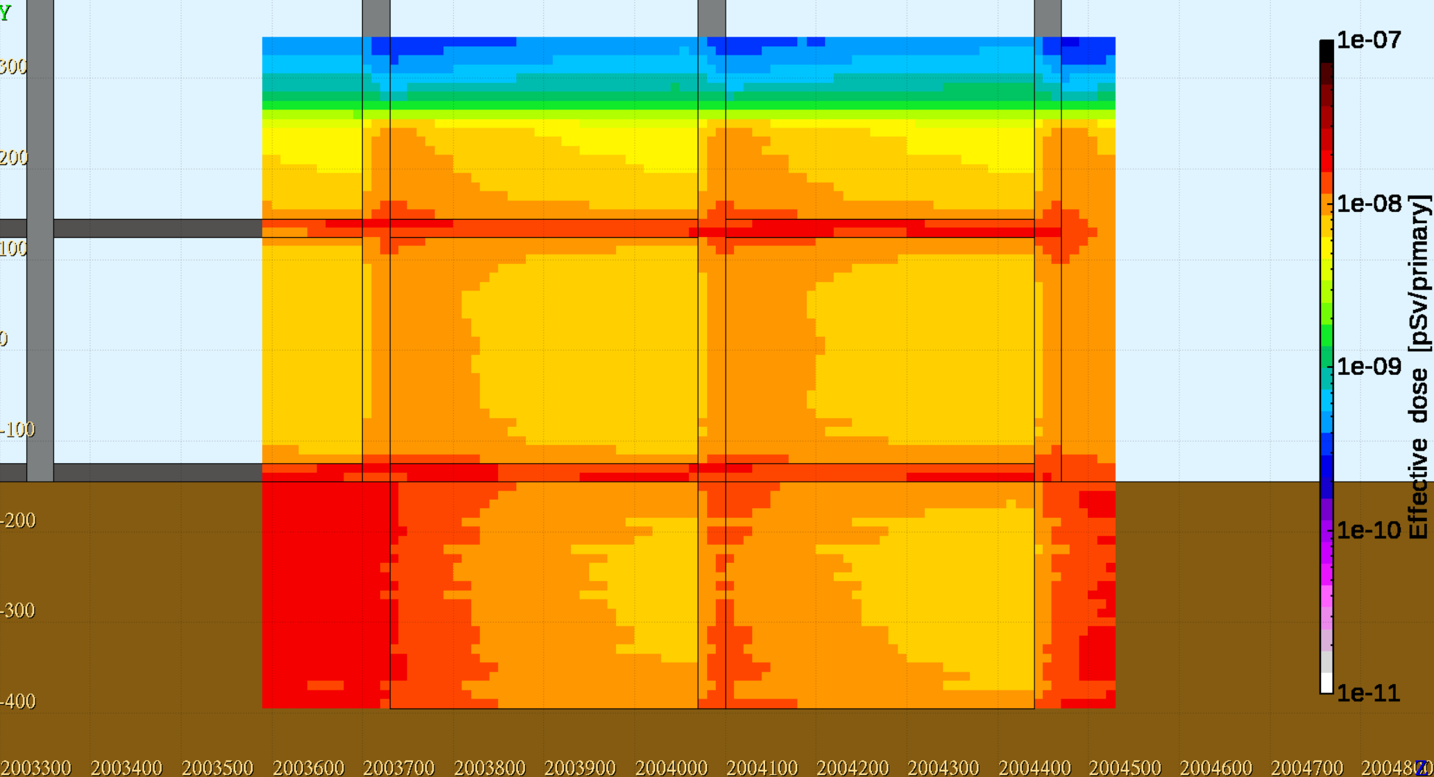
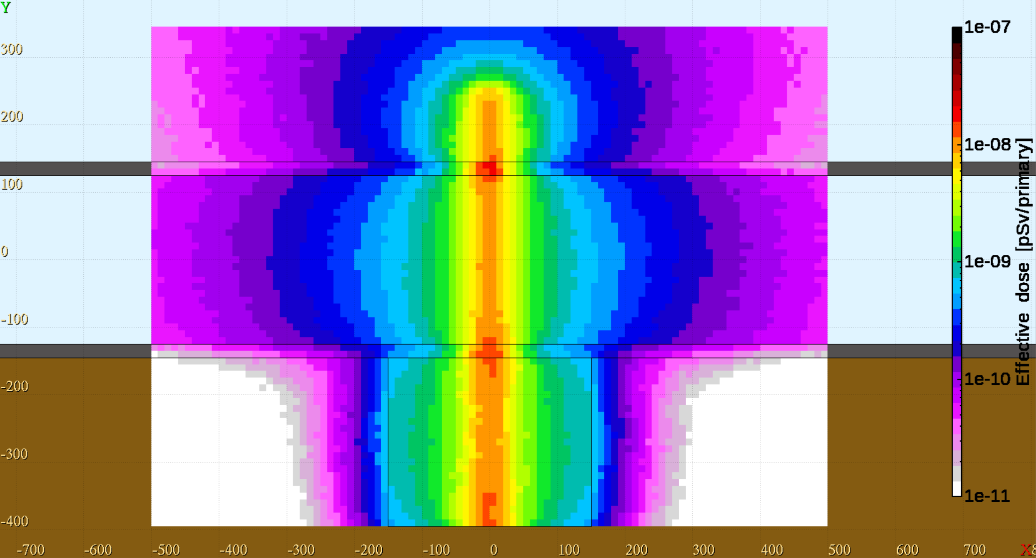
Double cellar – 20 km distance, wobbled source, μ⁻
This boundary is artificial
Here, the contributions to the effective dose from neutrino interactions in soil, the central wall and the slabs are merged!
The neutrino vertices are generated uniformly over the Y-axis to reproduce the effect of the dose kernel smearing from the machine wobbling. The distribution was centred at Y = -245 cm with the width of +/- 5 m. The result is then renormalized by 5 m / distance*0.001.
Compared to the kernel source study, slabs had to be considered as one of the primary interaction materials.
-1 m
Beam center
In X, interaction vertex distributed according to the real distribution extrapolated from the decay point
In Y, interaction vertex distributed uniformly

Slide 10
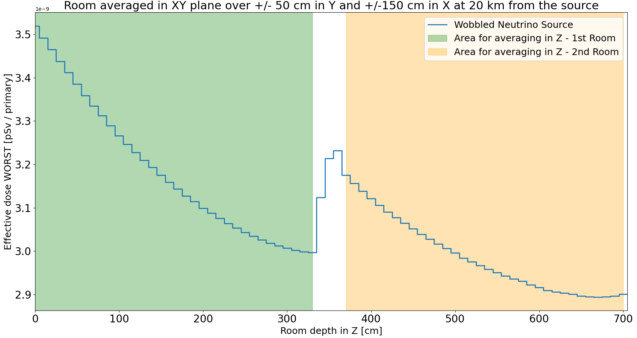
Double cellar – 20 km distance, wobbled source, μ⁻
Average exposure – 16h per day
Peak value 2.1e-8
3.19e-09
2.99e-09
100 cm
The contributions to the effective dose from neutrino interactions in soil, the central wall and the slabs are merged together!
300 cm

Slide 11
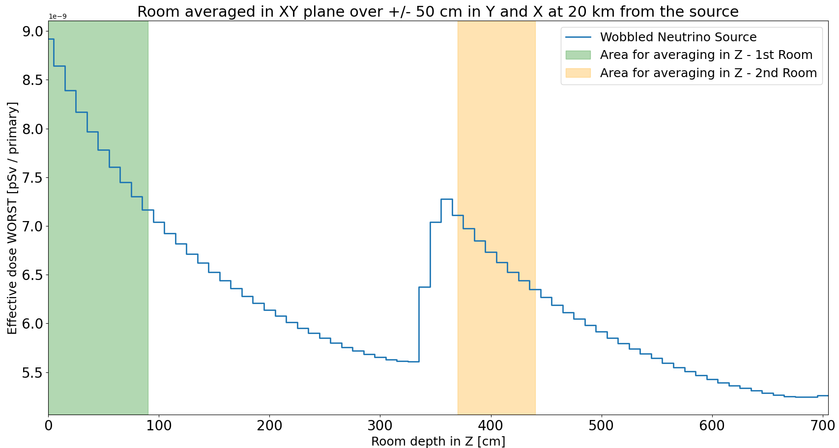
Double cellar – 20 km distance, wobbled source, μ⁻
Worst exposure – 8h per day
Peak value 2.1e-8
8.03e-09
6.75e-09
100 cm
The contributions to the effective dose from neutrino interactions in soil, the central wall and the slabs are merged!
100 cm

Slide 12
Average daily dose
8.03e-09
Worst exposure for 8/24h
+
Average between two rooms for the remaining 16/24h
100 cm
100 cm
3.19e-09
2.99e-09
100 cm
300 cm

Slide 13
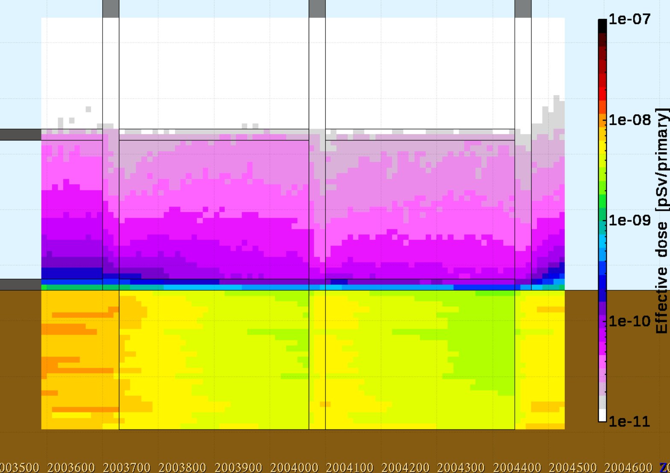
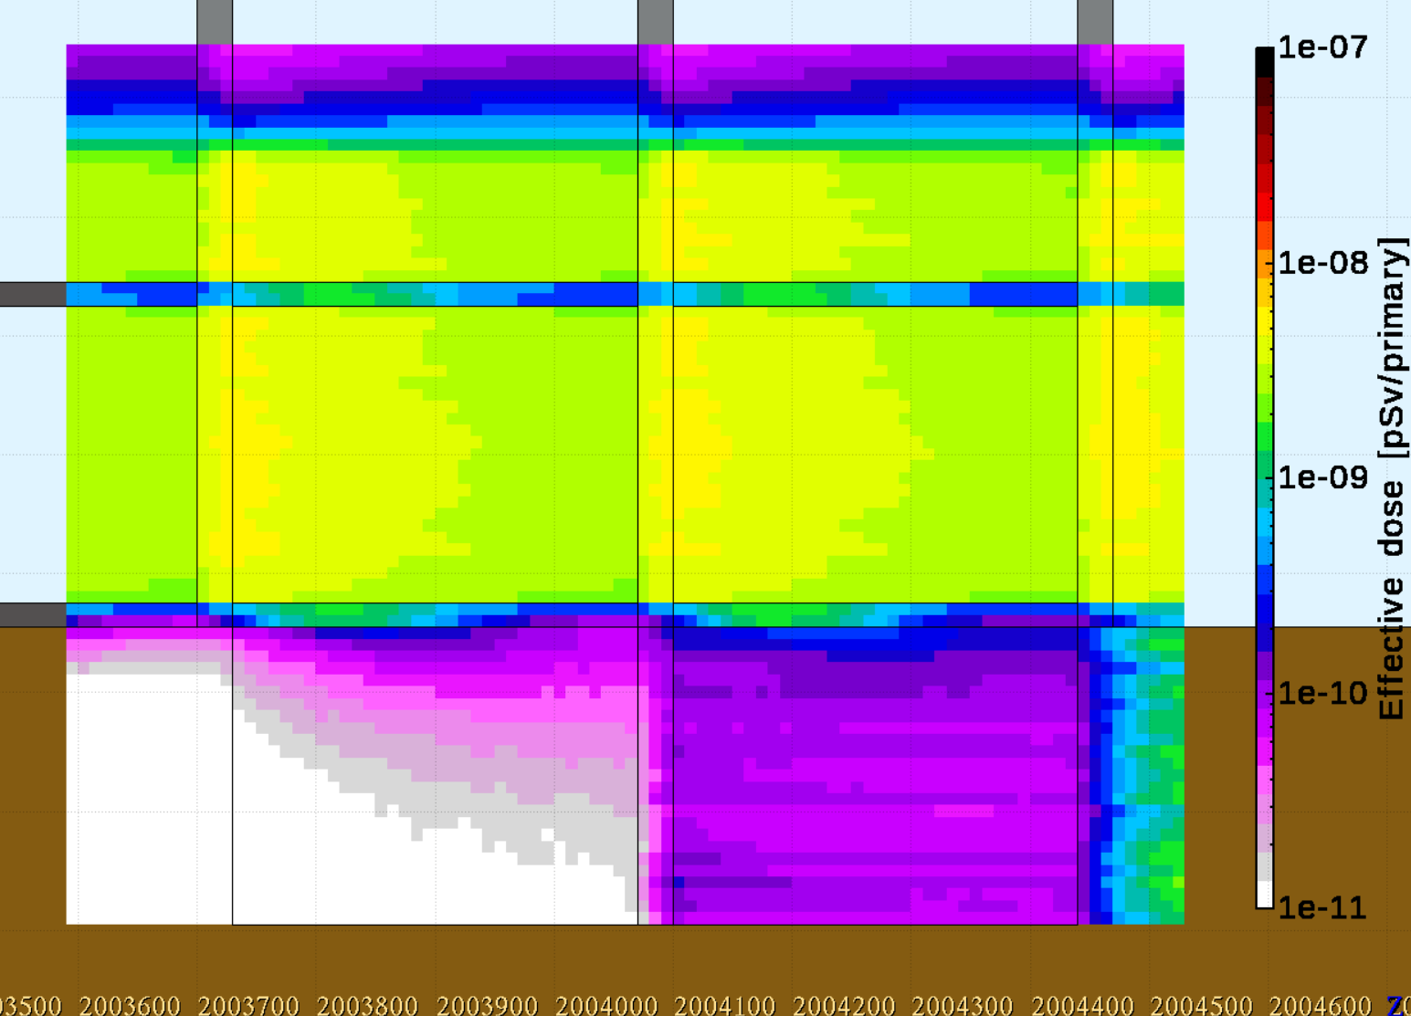
Double cellar – 20 km distance - contributions breakdown
${\overline{ν}}_{e}$in slabs
Neutrino interaction start from far before the scoring so that the shower can fully saturate.
${\overline{ν}}_{e}$in soil
${\overline{ν}}_{e}$in the wall
The vertex distribution in Y is +/- 5 m from Y = -245 cm
this is sufficient for our study and saves computing time.
Interactions in soil are the most important, but slabs and walls still give a non-negligible contribution.

Slide 14
ESPPU input
Calculated as the average daily dose for the double cellar geometry.
The distances were chosen based on the study of the distance to a potentially inhabited area.
On top of these numbers, an additional factor must be added to address the impact of the bending sections.

Slide 15
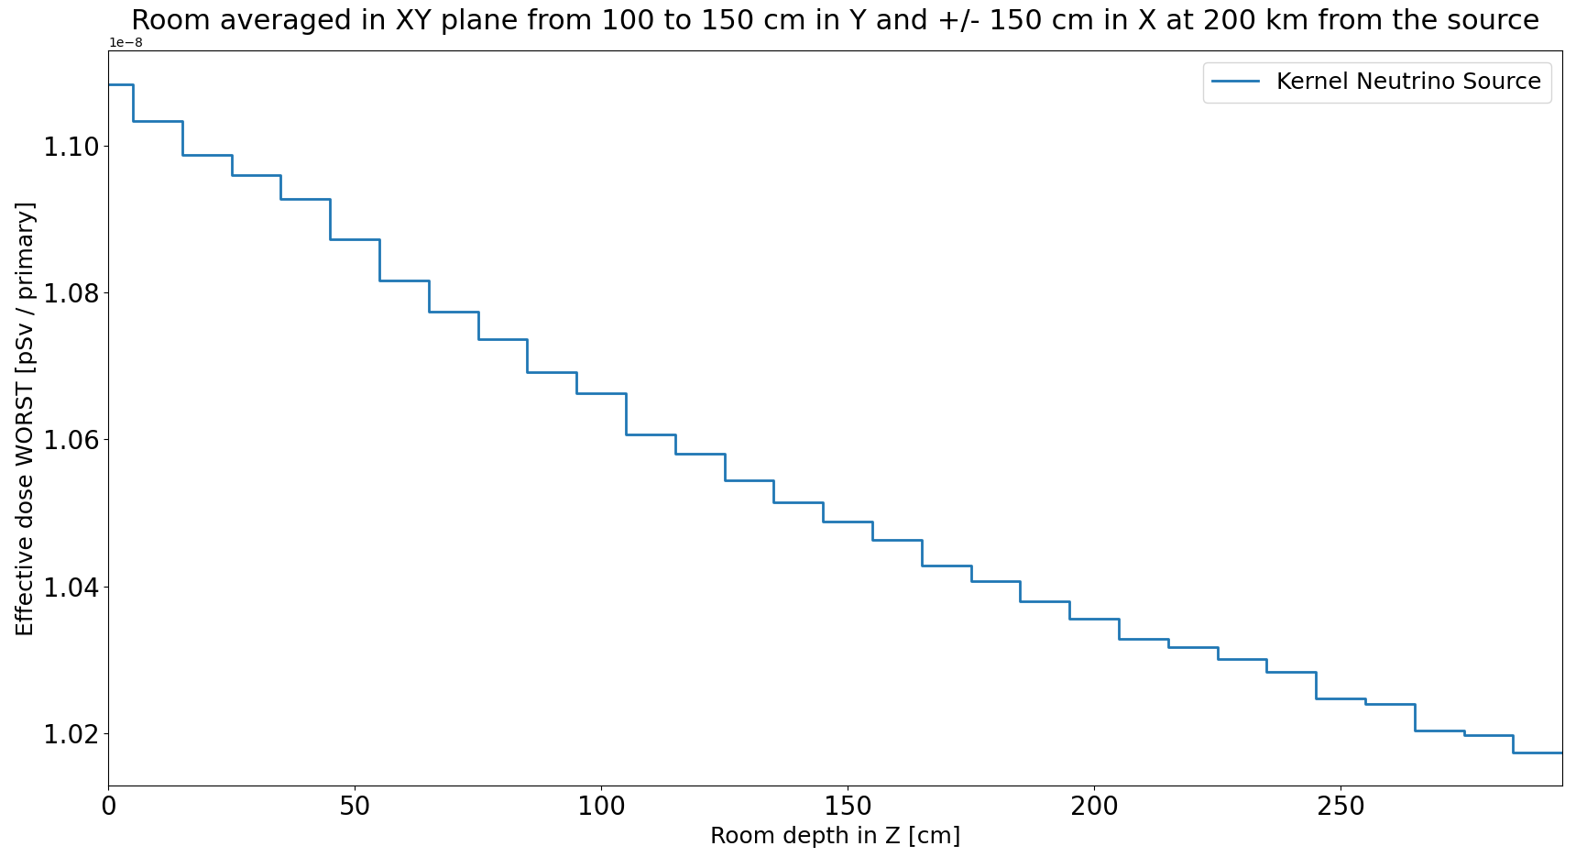
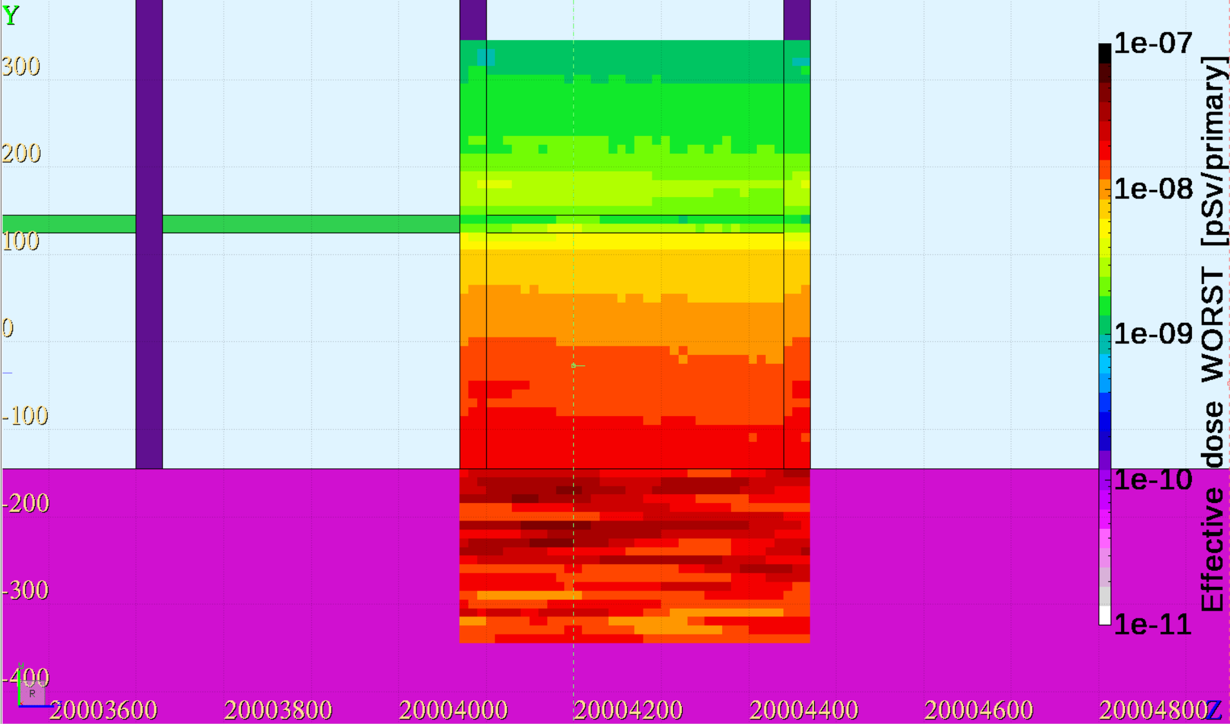
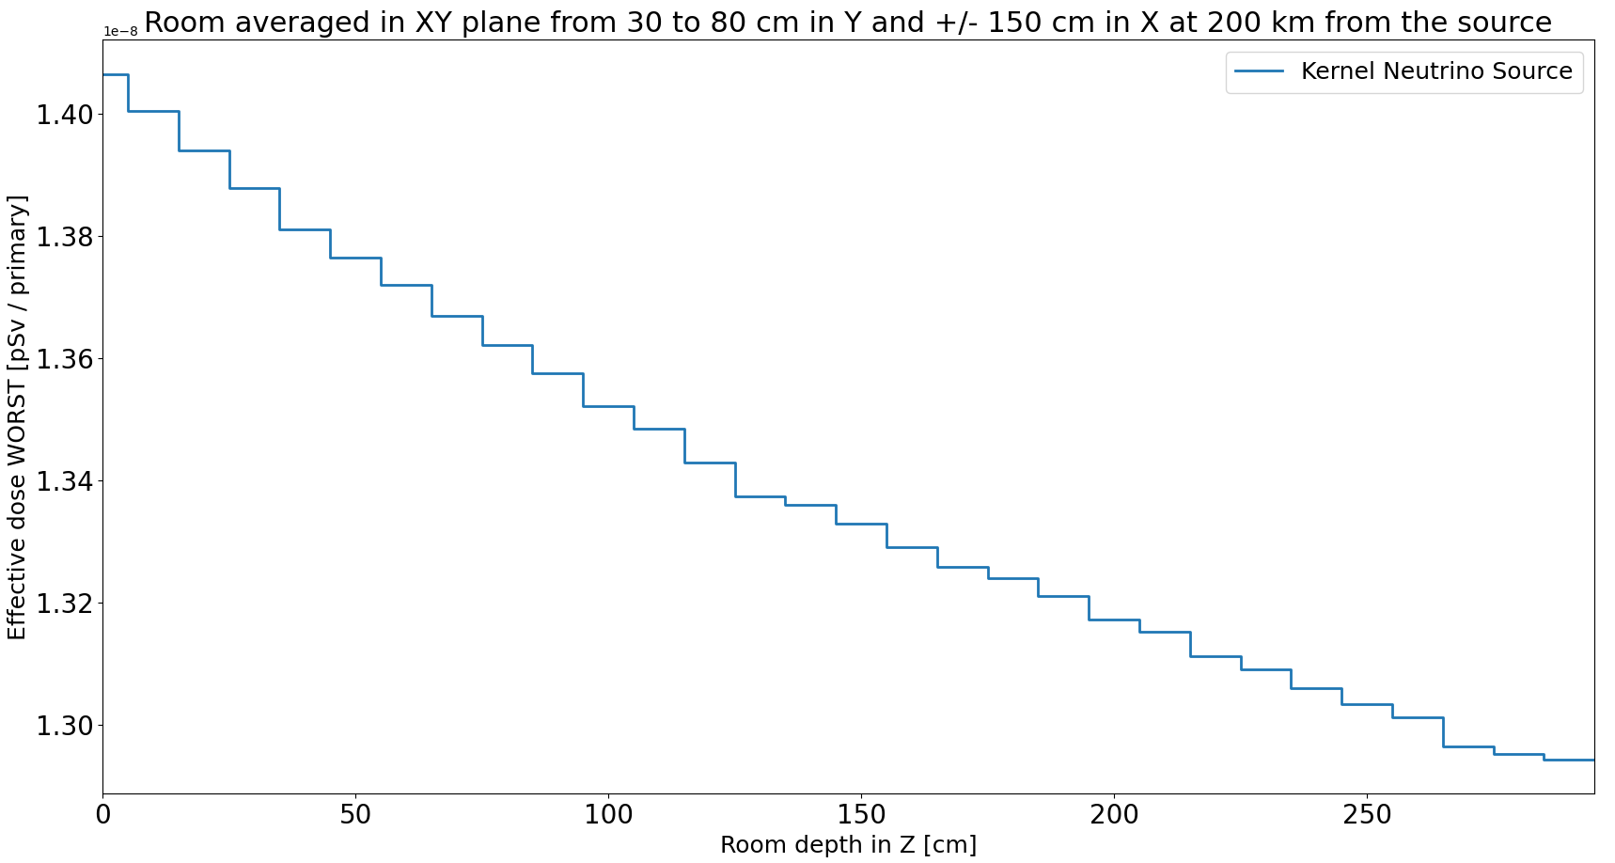
Above ground geometry – no movers
200km, μ⁻
1e-8
1.05e-8
No beam divergenace considered!
1e-8
1.34e-8
Averaged dose =
1.34e-8/3 + 1.05e-8*2/3 = 1.15e-08 (~half of the peak kernel value)

Slide 16
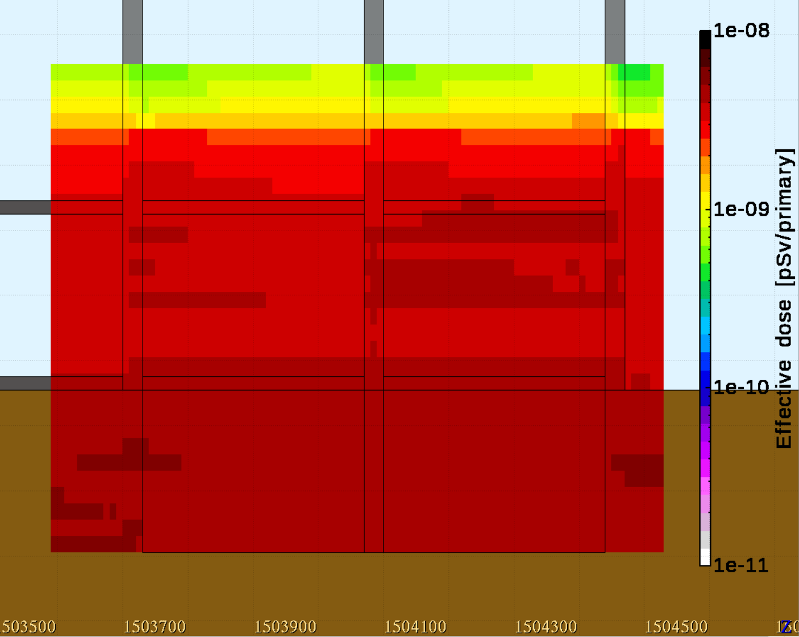
Horizontal smearing 5 TeV muons
Neutrino interactions are smeared uniformly in X and Y to mimic the effect of a bending section with machine movers. In the simulations the X and Y location is sampled +/- 5 meters around the centre of the cellar.
Y
X
The numbers presented here are only illustrative; to properly calculate the actual dose distribution we would need to know bending strength of a bending section (the real neutrino spread in X)
Here it is assumed that neutrinos are smeared uniformly in X (constant dipole field) and in Y (the effect of the movers)
Y
Z

Slide 17
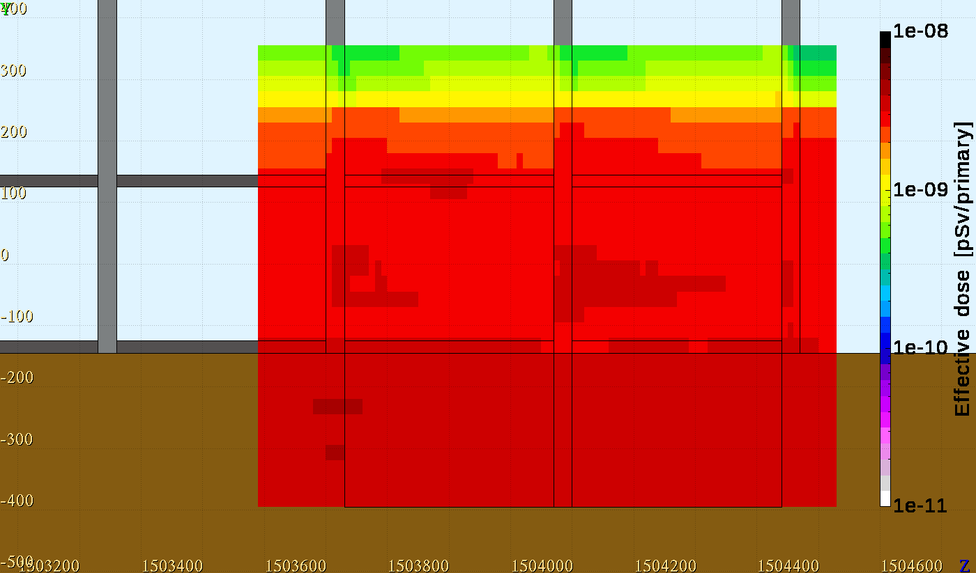
Horizontal smearing 3.8 TeV muons
Neurtrino interactions are smeared uniformly in X and Y to mimic the effect of a bending section with machine movers. In the simulations the X and Y location is sampled +/- 5 meters around the center of the cellar.
Y
X
The numbers presented here are only illustrative; to properly calculate the actual dose distribution we would need to know bending strength of a bending section (the real neutrino spread in X)
The dose is expected to scale with E²_{μ}
Y
Z

Slide 18
Horizontal smearing 5 TeV
The dose in the cellar due to the horizontally smeared neutrino source changes only by a small factor along Z. The choice of averaging region should therefore have little impact
As the first approximation
4.60e-09 is taken as reference
This value can be interpreted as pSv/decay, but keeping in mind that the geometrical factor of the neutrino vertex uniform distribution was not applied yet and the numbers must be re-scaled according to the distance from the collider

Slide 19
Horizontal smearing 3.8 TeV
The choice of averaging region should therefore have little impact
As the first approximation
2.77e-09 is taken as reference
Dose ratio 2.77 / 4.6 = 0.6
Muon energy ratio
3.8² / 5² = 0.58
This value can be interpreted as pSv/decay, but keeping in mind that the geometrical factor of the neutrino vertex uniform distribution was not applied yet and the numbers must be re-scaled according to the distance from the collider

Slide 20
Geometrical model for the dose calculation from bending section
D
ds
$$L= \sqrt{D^{2}+R^{2}}$$
ϴ = K/L
ds = R*ϴ
K
ϴ
L
R
L
D – distance from the collider at which the kernel was calculated
R – collider radius
K – distance between the tangent lines representing the kernel extrapolation from the collider ring
L – radius of the big circle drawn by the kernel distance
ds – straight section length equivalent
The circles drawn by the 2D-Gaussian effective dose kernels are in principle not in the same plane, but it does not matter for the result given the dimensions we are dealing with.
The collider ring (perfect circle)

Slide 21
Bending section of an ideal circle
We can also approach the problem from a perspective of a perfect circle and completely neglect the presence of straight sections. In this case, we fix the affected window in X at 10 m (the same as simulation FLUKA simulation range) and check what is the length ds of the collider fraction contributing to the radiation in that window. If we take the total length of all the bending magnets from a collider lattice file, we get R = 1355.65 m
Now we can re-do the calculation with the new assumptions, for the example of 20 km distance
$$ds=\frac{RK}{L}=\frac{RK}{\sqrt{D^{2}+R^{2}}}=\frac{1355.65 m ×10 m}{\sqrt{({20000 m)}^{2}+{(1355.65 m)}^{2}}}≈0. 68m$$
Two beams crossing
$$4.60∙{10}^{−9}\left[\frac{pSv}{decay}\right]×\frac{5 m}{20 m}×2 ×0.68 m×\left[\frac{\frac{decays}{meter}}{year}\right]$$
Vertical uniform distribution factor (distance dependent)

Slide 22
Summary
The effect of vertical muon beam deformation with machine movers was evaluated.
A conservative exposure scenario was simulated with FLUKA to provide dose estimates for short straight sections in the collider arcs.
Expected radiation impact of bending magnets in the collider arcs was quantified.
Ongoing work on evaluation of dose distributions in long straight sections.

Slide 23
Backup slides

Slide 24
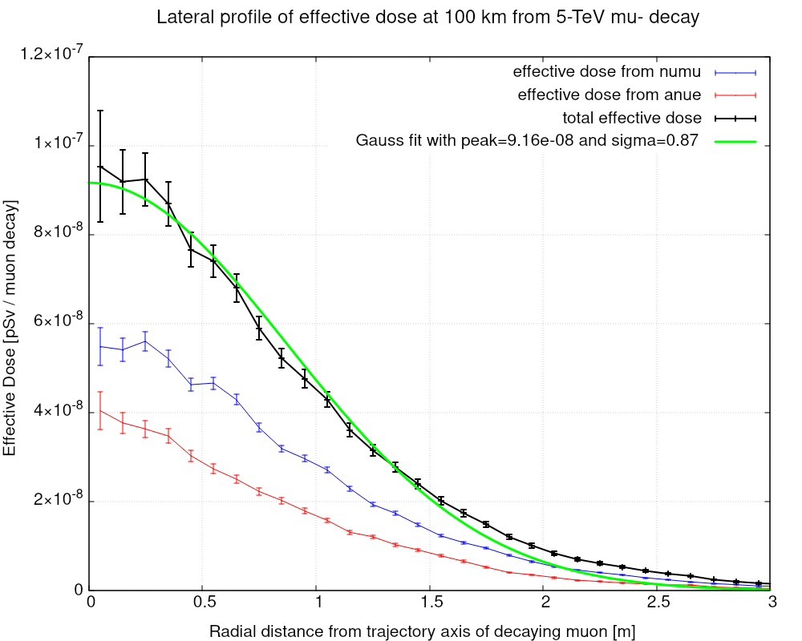
Effective dose kernel calculation: effective dose vs R
1D projection of the effective dose vs R at the plateau in soil
The profile is modeled by a Gaussian fit (not accurate in the tails) yielding:
Peak dose [pSv / µ decay]
Dose width [σ, in meters]
To obtain the effective dose kernel we extract these two parameters for different muon signs, energies, and baseline distances from the decay point

Slide 25
The normalization factor for FLUKA results
Interval in Z along which the neutrino vertices are uniformly spread in the simulation (it changes between different interaction materials to ensure proper dose saturation!)
All the FLUKA results are multiplied by this factor
Length of the actual vertical spread in Y direction,
d = distance from the source * 1e-4 (1 mrad)
$$N=σ×L×5 m/d$$
Macroscopic neutrino interaction cross section per neutrino flavuor and charge, varies between interaction materials
Distance in Y over which the neutrino vertices are smeared in the simulation, it should be big enough to account for the contributions from all directions
This normalization factor is needed because neutrino interactions are forced in the simulation!
To obtain a single number representative number for the average dose, the results are first averaged over predefined boxes and then multiplied by a straight section length and the number of muon decays per meter

Slide 26
Dose ratios
Ratio | 3.8 TeV / 5 TeV beam energy | 1.5 TeV / 5 TeV beam energy
Bending magnet dose | 0.60 | no data
Beam energy ratio | 0.76 | 0.3
Beam Energy² ratio | 0.58 | 0.09
Peak dose kernel at 15 km | no data | 0.01
The dose from bending magnets seems to be roughly scaling with the square of muon beam energy!
Kernel peak dose ratios scale between E³_{μ} and E⁴_{μ} (expected from the literature)

