Slide 1
RF breakdown studies
Juliette Plouin
Guillaume Ferrand, Claude Marchand, Sophie Pierron
CEA-Saclay

Slide 2
3-D cavity design
Field emission in an elliptical cavity
Further studies on breakdown phenomena

Slide 3
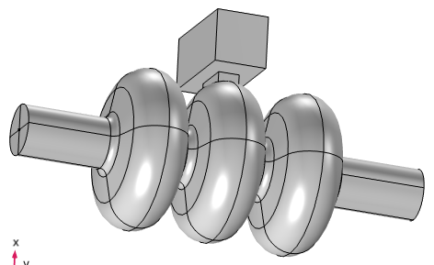
3 cells cavity based on electric coupling
Task 6.2
In parallel, a 3-cells cavity has been designed by CEA, based on electric coupling, in order to allow comparison with magnetic coupling structure. A main advantage is to avoid the presence of metallic sheet (beryllium or any other metal) between the cells.
adapted to the MuCol stage B5 requirement in a π-mode
R. Zhu et al., Phys. Rev. Accel. Beams 28, 041003
$$β=0.884, f=704 MHz$$
$$L_{cell}=\frac{βλ}{2}=188 mm$$
$$E_{0}=26.3 MV/m$$

Slide 4
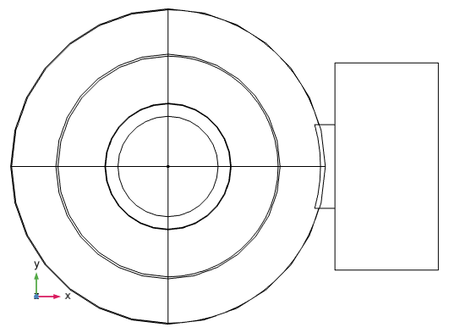
Cavity geometry
Inner cell | R_{eq} | 0.1874
 | R_{iris} | 0.06
 | a₁ | 0.06716
 | b₁ | 0.065171
 | a₂ | 0.019031
 | b₂ | 0.017366
Outer cells | R_{eq} | 0.1885
 | R_{iris} | 0.06
 | a₁ | 0.067582
 | b₁ | 0.066989
 | a₂ | 0.016716
 | b₂ | 0.020453
tube | radius | 0.06
Coupler port | hole_{A} | 0.05
 | hole_{B} | 0.1
 | W_{H} | 0.2
 | W_{A} | 0.123825
 | W_{B} | 2 x W_{A}
Vérifier a/b
W_{A}
W_{B}
hole_{A}
hole_{B}
Coupler port
b₁
W_{H}
a₁
b₂
R_{eq}
a₂
R_{iris}
$$L_{cell}$$
$$L_{acc}$$
$$β=0.884, f=704 MHz$$
$$L_{cell}=\frac{βλ}{2}=188 mm$$
$$L_{acc}=\frac{3 βλ}{2}=565 mm$$
Standard WG975
*The tube length is not defined: it has been chosen to be long enough so that the boundary conditions at ends doesn’t modify the RF parameters

Slide 5
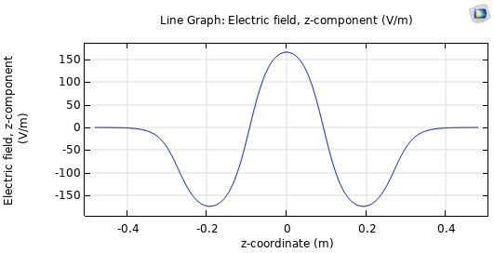
Cavity RF parameters
Freq | MHz | 704.2
TTF |  | 0.674
R/Q | Ω | 287
E_{peak}/E_{acc} |  | 1.95
E_{peak}/E_{acc} | mT/(MV/m) | 7.48
Q₀ (copper) |  | 36500
L_{acc} | m | 0.565
E₀ | MV/m | 26.3
E_{acc} | MV/m | 17.7
V₀ | MV | 14.9
V_{cav} | MV | 10
P_{diss} | MW | 9.6
E_{peak} | MV/m | 34.5
Peak field is crucial for breakdown issue
Cavity shape is also important: in a cavity with non-parallel walls, the surface density of emitted electrons arriving on a cavity wall could be decreased due to the walls angle. Elliptical cavities could then be a good choice for lowering the breakdown issues.
Ez (a. u.)

Slide 6
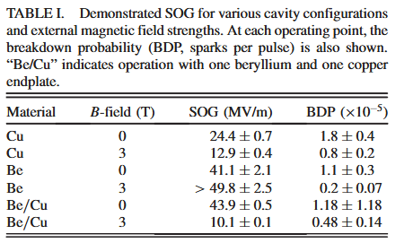
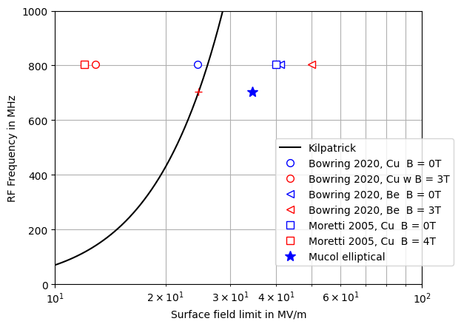
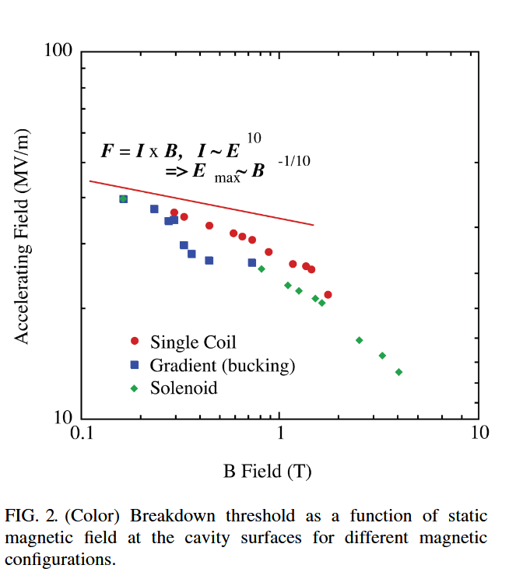
Kilpatrick…
D. Bowring et al., Phys. Rev. Accel. Beams 23, 072001
0,94
0,49
1,58
1,91
Kilpatrick ratio
704 MHz
A. Moretti et al., Phys. Rev. ST Accel. Beams 8, 072001
Kilpatrick ratio
24.7 MV/m
34.5 MV/m
Kilp @ 704 MHz | MV/m | 24.7
$$Mucol E_{0}$$ | MV/m | 26.3
$$Mucol E_{peak}$$ | MV/m | 34.5
Kilp ratio |  | 1.40

Slide 7
3-D cavity design
Field emission in an elliptical cavity
Further studies on breakdown phenomena

Slide 8
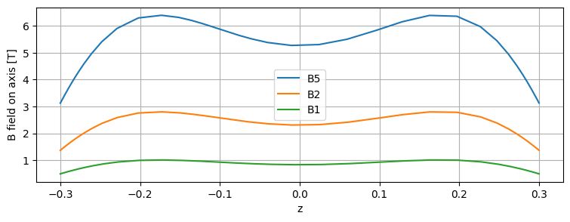
DC magnetic field generated by solenoids
Distance between solenoids 0,64 m
Lcav=0,565 m
Solenoid radius = 0,35 m
CST M static solver

Slide 9
RF electromagnetic field for the π-mode
$${×10}^{7}$$
E0 [MV/m] | 30.0
Eacc [MV/m] | 21.6
V0 [MV] | 17
Vcav [MV ] | 12
Pdiss [MW] | 12
Epk [MV] | 39.3
Stored energy | 100
*Old values
CST eigensolver

Slide 10
Electron emission from surface
Model : DC emission
Emission point area ~ 1 mm²
Initial e- energy : some eV
CST PIC Solver
Emission from 3 points in the iris region of the cavity (where the E field is max)

Slide 11
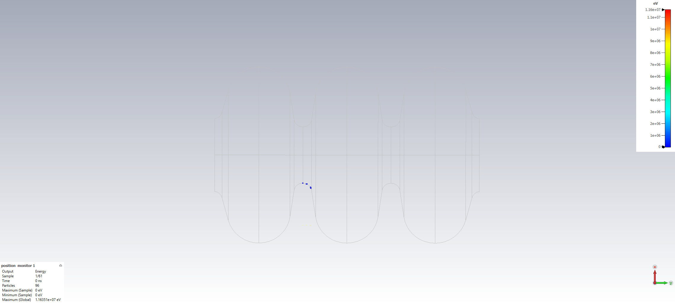
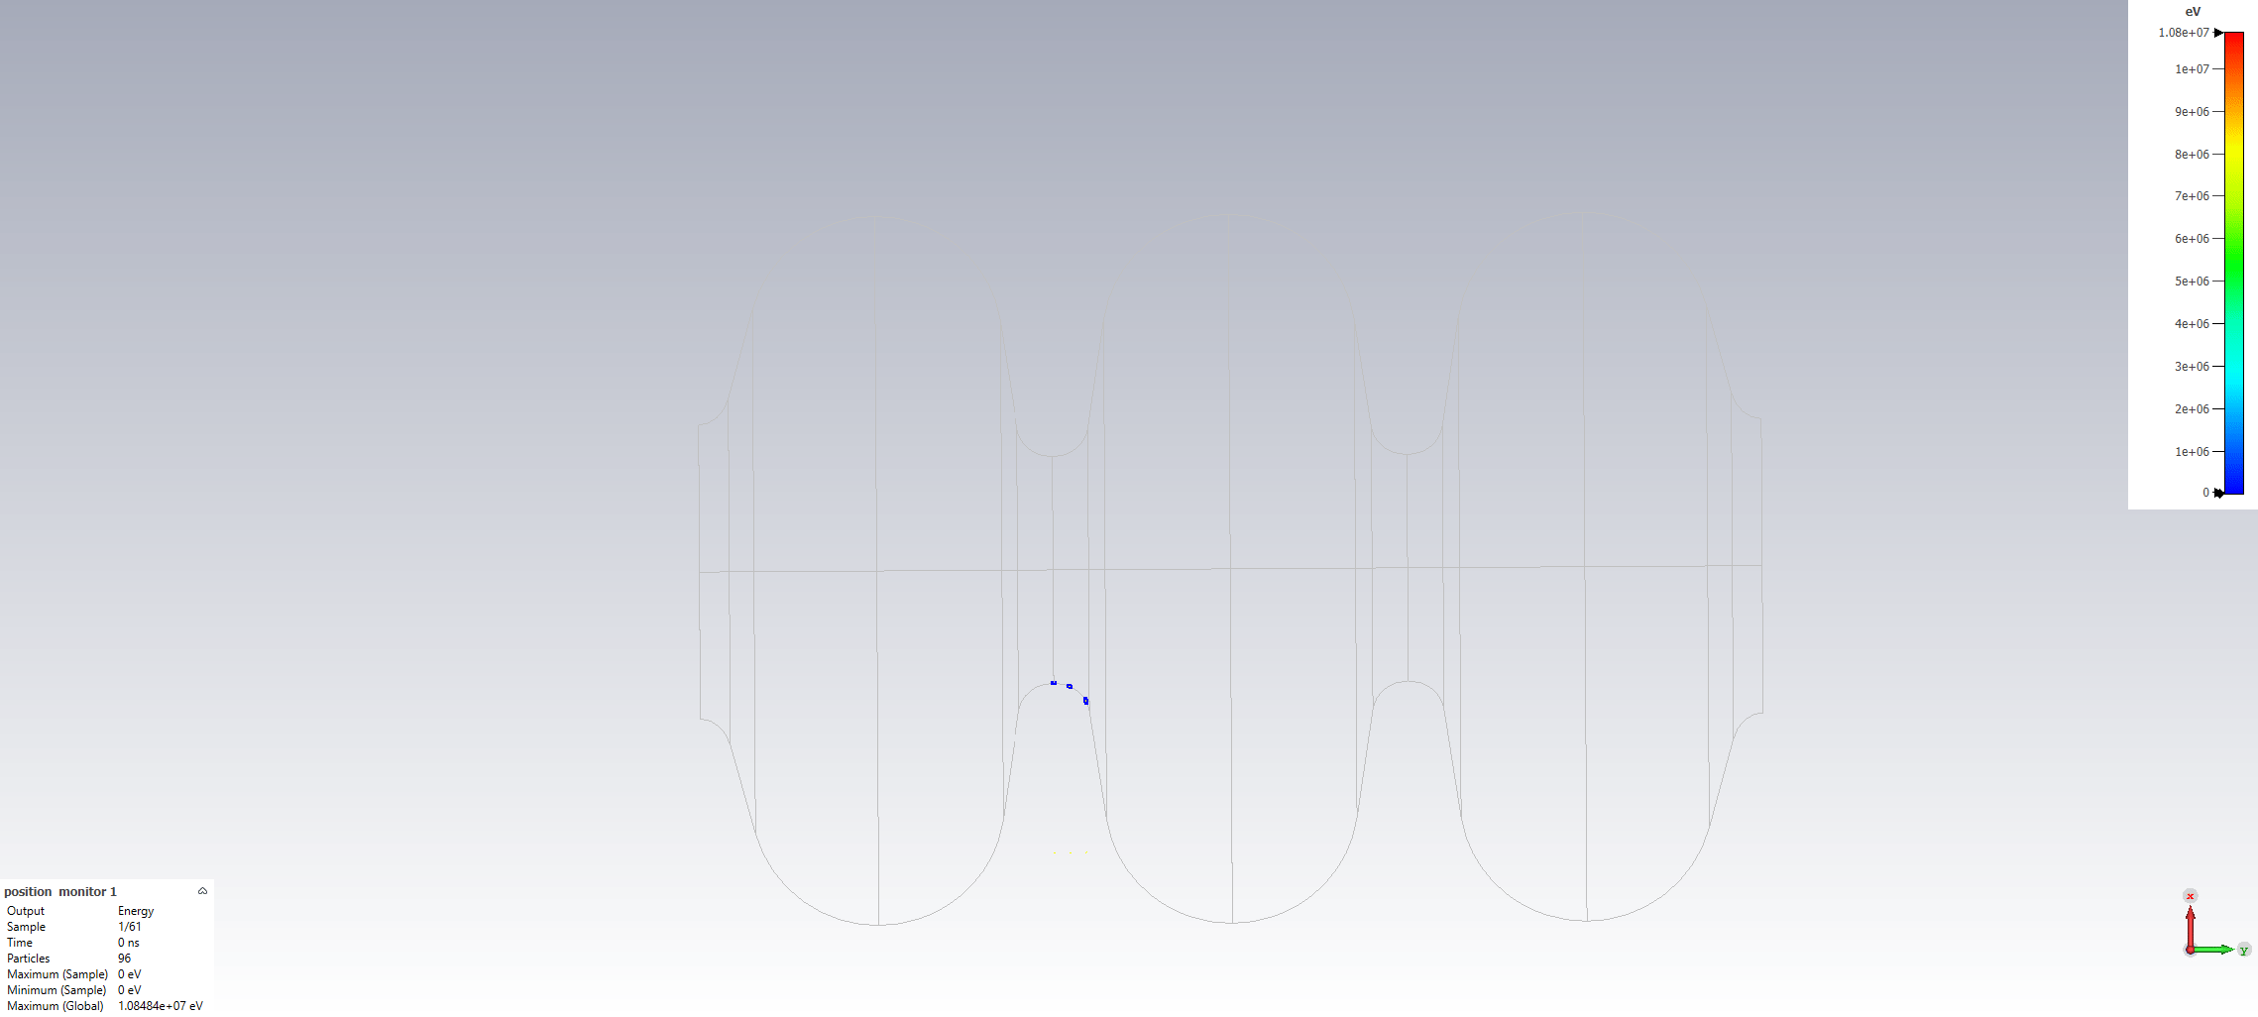
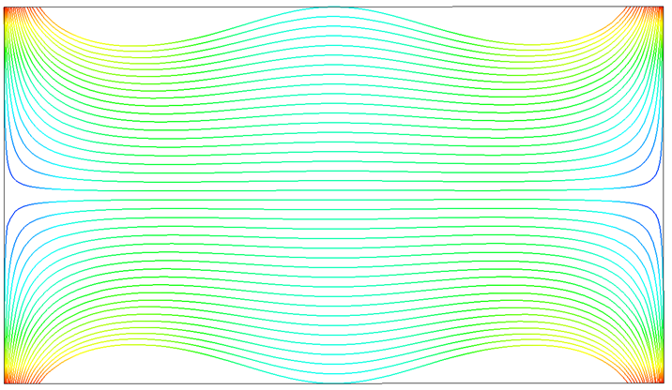
Electron emission with DC magnetic field and RF field
CST PIC solver with importation of M static and eigenmode solvers.
Without DC magnetic field
Electron max energy is 10 MeV (velocity close to c)
With DC magnetic field (superimposed)
Result is the same from B = 1 T
The electrons follow exactly the DC field lines.
Here, most electrons hit the facing iris, and some electron fly up to the window…

Slide 12
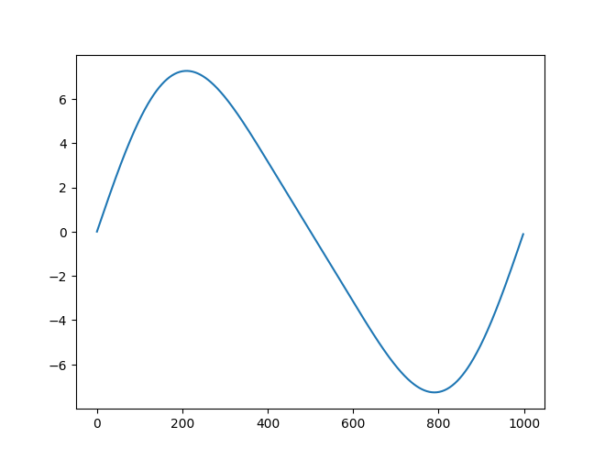
Solenoid orientation
Our simulation
Solenoid current
B field on axis
B field lines followed by electrons
From Lucio Rossi
Lattice cell
B field on axis (T)
?
Electron trajectory calculation to be done

Slide 13
3-D cavity design
Field emission in an elliptical cavity
Further studies on breakdown phenomena

Slide 14
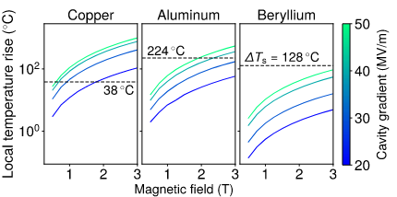
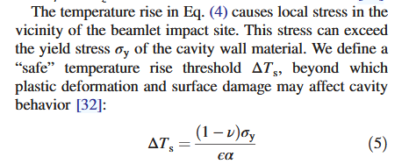
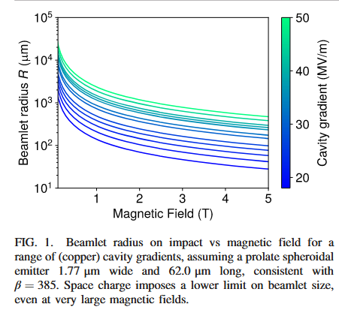
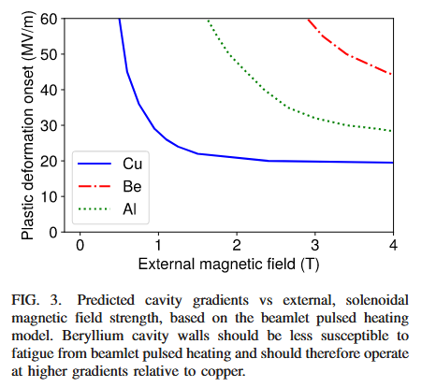
B field influence on the electron beamlet size
This formula gives a temperature rise.
Calculation of spatial temperature gradient could be of interest?
D. Bowring et al., Phys. Rev. Accel. Beams 24, 072001

Slide 15
B field influence on the initial emission itself
What is the nature of ejected matter in breakdown phenomena?
Electrons ?
Plasma ?
Liquid metal ?

Slide 16
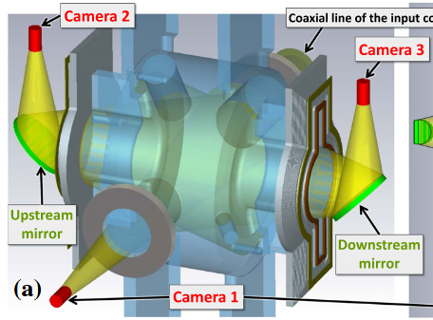
« Fireball » emission from emitter, Abe et al.
No B field
RF cavity (509 MHz) equipped with high speed camera
From temperature meas (IR camera) they conclude that the flying object is not copper
Movie : https://www2.kek.jp/accl/eng/topics/topics190122.html
< Figure 7 > […] A flying bright object appeared near the downstream end plate (right image), moving upstream, and impacted the upstream end plate (left image) at t = 0.081 s. Breakdown occurred at the moment of impact (t = 0.081 s) […]
T. Abe et al., Phys. Rev. Accel. Beams 21, 122002
Fireballs speed ~few m/s, not driven by electrical field

Slide 17
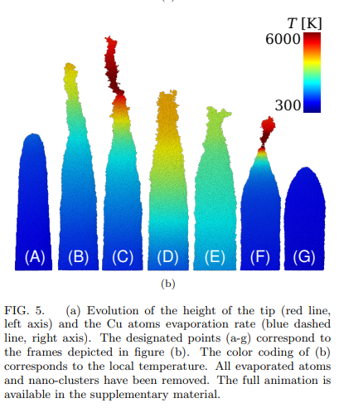
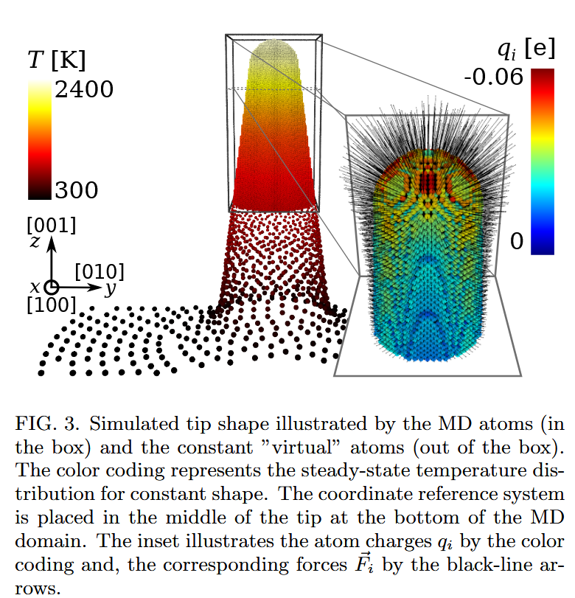
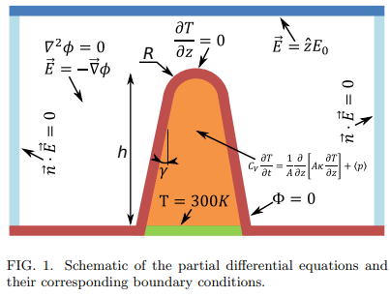
Atoms ejection from an emitter, Kyritsakis et al.
“In this article, we give insights to the atomic scale
processes taking place in metal nanotips under intense field emission conditions. […]. We find that when a sufficiently high electric field is applied to the tip, the emission-generated heat partially melts it and the field-induced force elongates and sharpens it.”
No B field
Molecular dynamics simulations
Formation of Taylor cones
Static E field
Heat transfer
A Kyritsakis et al, J. Phys. D: Appl. Phys. 51 225203

Slide 18
Magneto hydrodynamical simulations from an emitter in presence of RF field and DC magnetic field
Liquid metal
Cavity
RF E,B field
Cavity
RF E,B field
Cavity
RF E,B field
B_{DC}
B_{DC}
B_{DC}
time
Possible scenario ?
Effect of RF ?
Effect of B field ?
Study to be developed by a Master Student at CEA

Slide 19
RF test facility with magnets …few considerations
cavity
Bfield on axis
Single solenoid
Cavity diagnostics
Dismountable plates for post mortem analysis
Faraday cups
Photomultipliers
Cameras
Pressure sensors
….
Lattice pair of solenoids
cavity
Bfield on axis
Should be considered ?

Slide 20
Thank you
for attention

