Slide 1
Magnets
Timeline, Cost and R&D Plan
L. Bottura¹, F. Boattini¹, B. Bordini¹, B. Caiffi², S. Fabbri¹, S. Mariotto^{3,4}, M. Statera³
¹ CERN ,² INFN – Genova, ³ INFN – Milano, ⁴ University of Milan

Slide 2
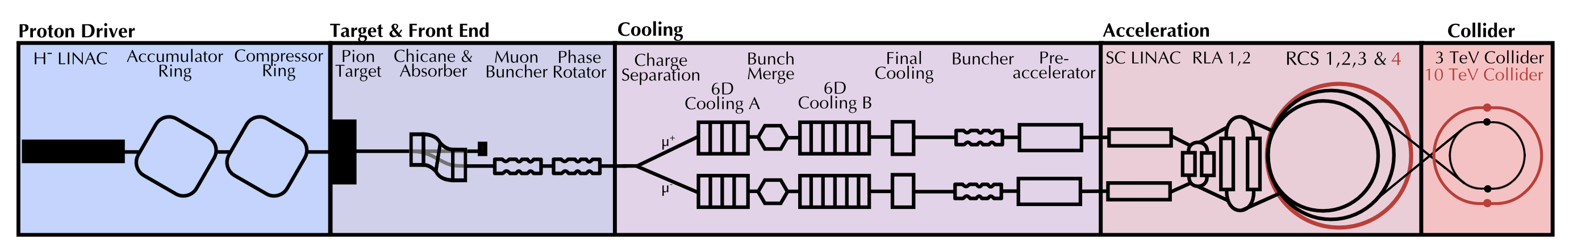
Outline
References
Magnet timeline
R&D plan
Cost evaluation
Summary and discussion points

Slide 3
Outline
References
Magnet timeline
R&D plan
Cost evaluation
Summary and discussion points

Slide 4
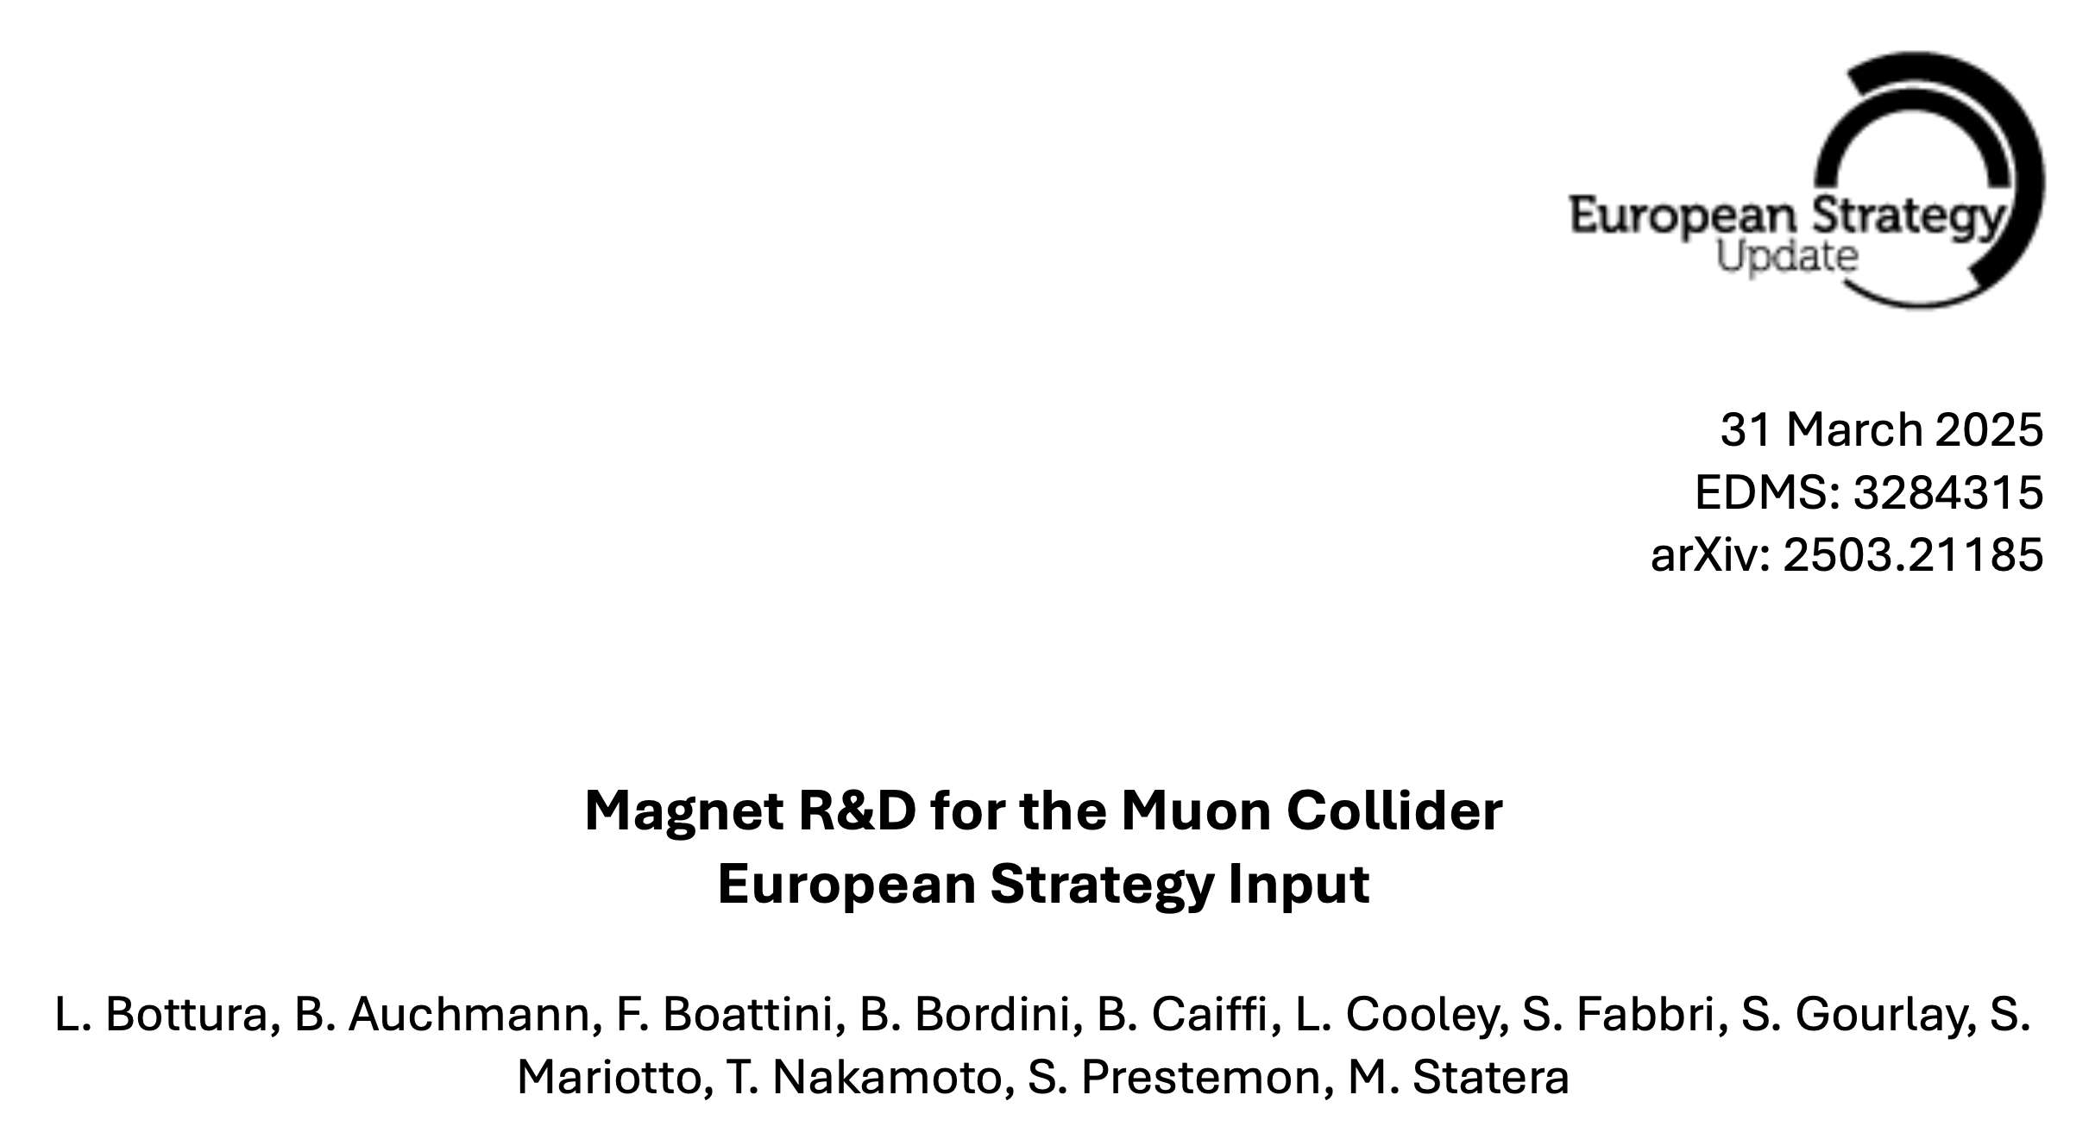
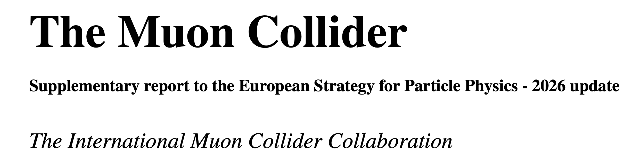
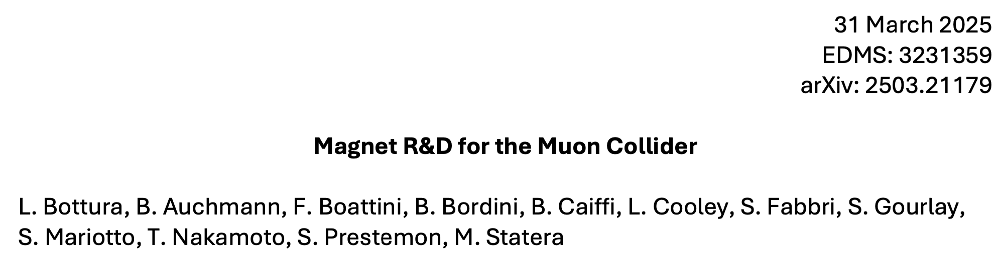
References
402 pages
The material presented here is detailed and discussed extensively in the documents prepared for submission to the 2026 ESPPU process
Much space and attention was given to building a bottom-up and analytical R&D program
11 pages
42 pages

Slide 5
Outline
References
Magnet timeline
R&D plan
Cost evaluation
Summary and discussion points

Slide 6
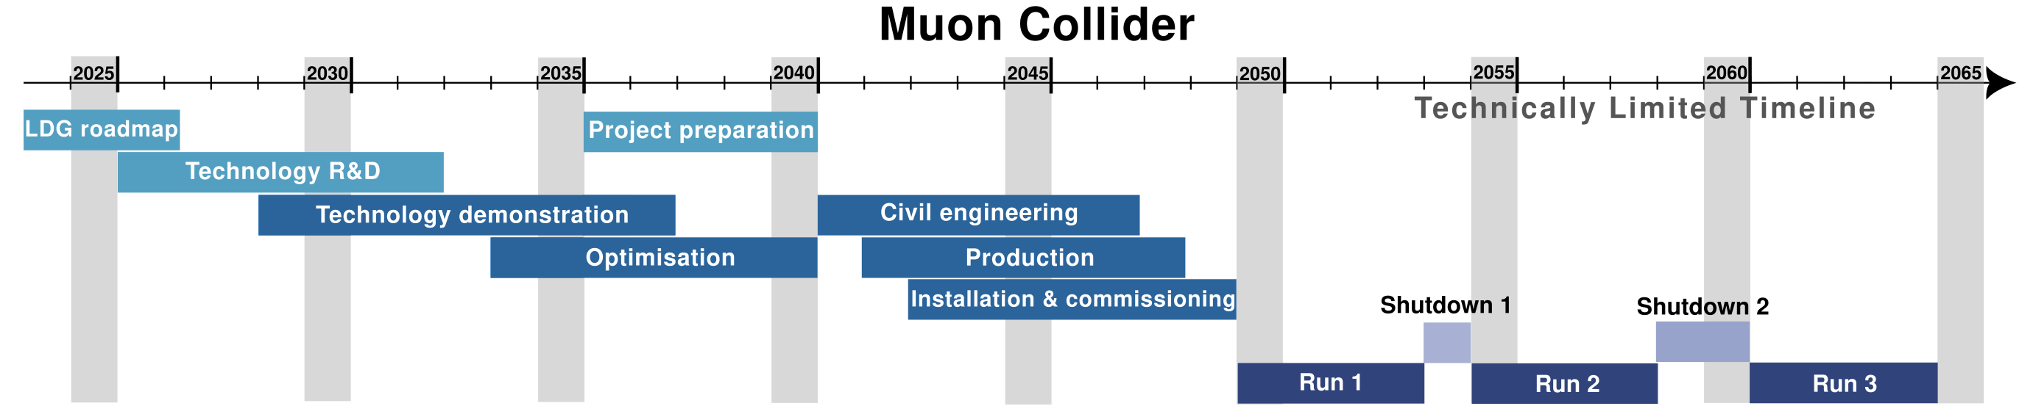
Project Timeline
Technology R&D completed: 2032
Demonstrators built and tested: 2037
Prototypes and industrialization (Optimisation): 2040
Production completed: 2048

Slide 7
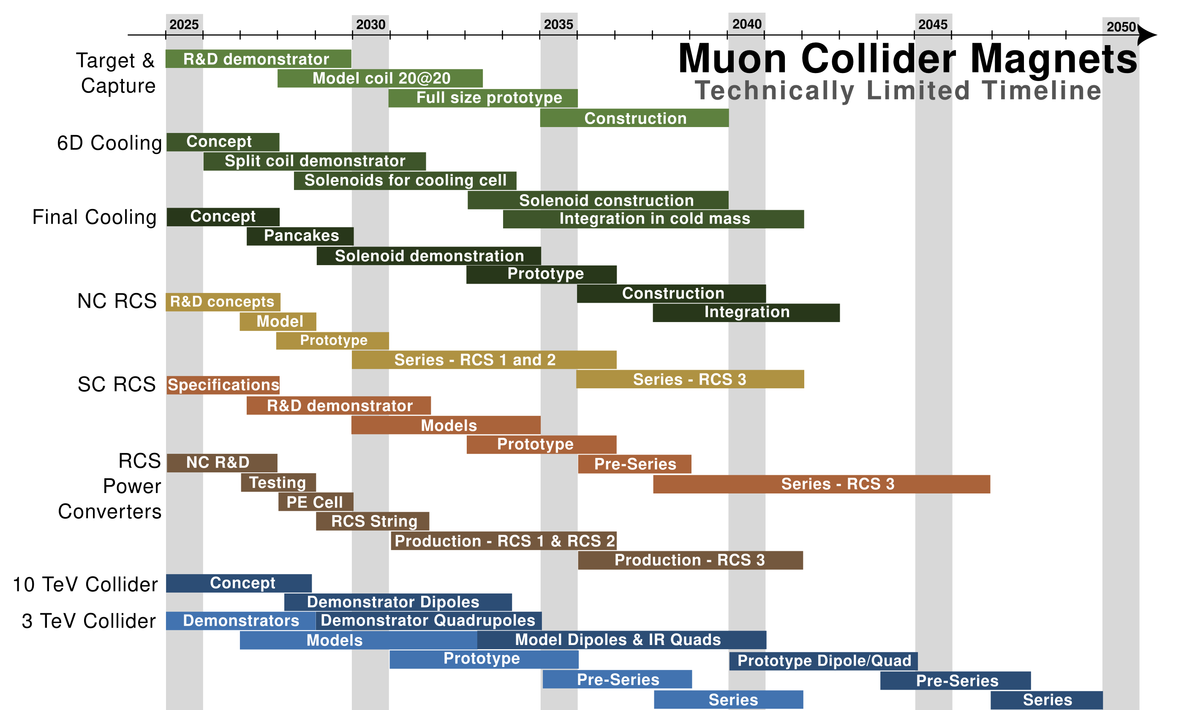
Prototypes and Industrialization
Technology R&D
Demonstrators
Production
This is one of the possible plans, prepared as a technically limited timeline
Most magnet milestones are well aligned with the overall plan of the project
A 3TeV option (consisting of HTS solenoids, NC RCS1+RCS2 and Nb-Ti collider) appears to be feasible with contingency by the desired start in 2050
A 10TeV option (HTS solenoids, NC RCS1+RCS2, HTS HCS3 and HTS collider) misses the desired milestones by 2…3 years, with no contingency

Slide 8
Outline
References
Magnet timeline
R&D plan
Cost evaluation
Summary and discussion points

Slide 9

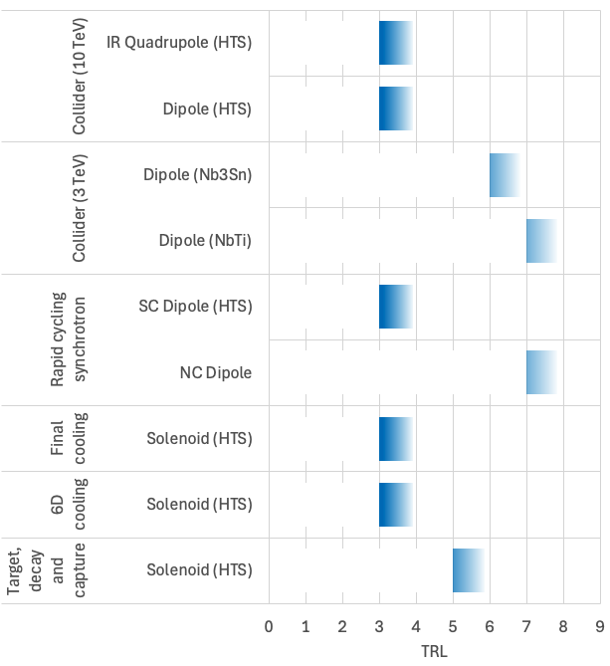
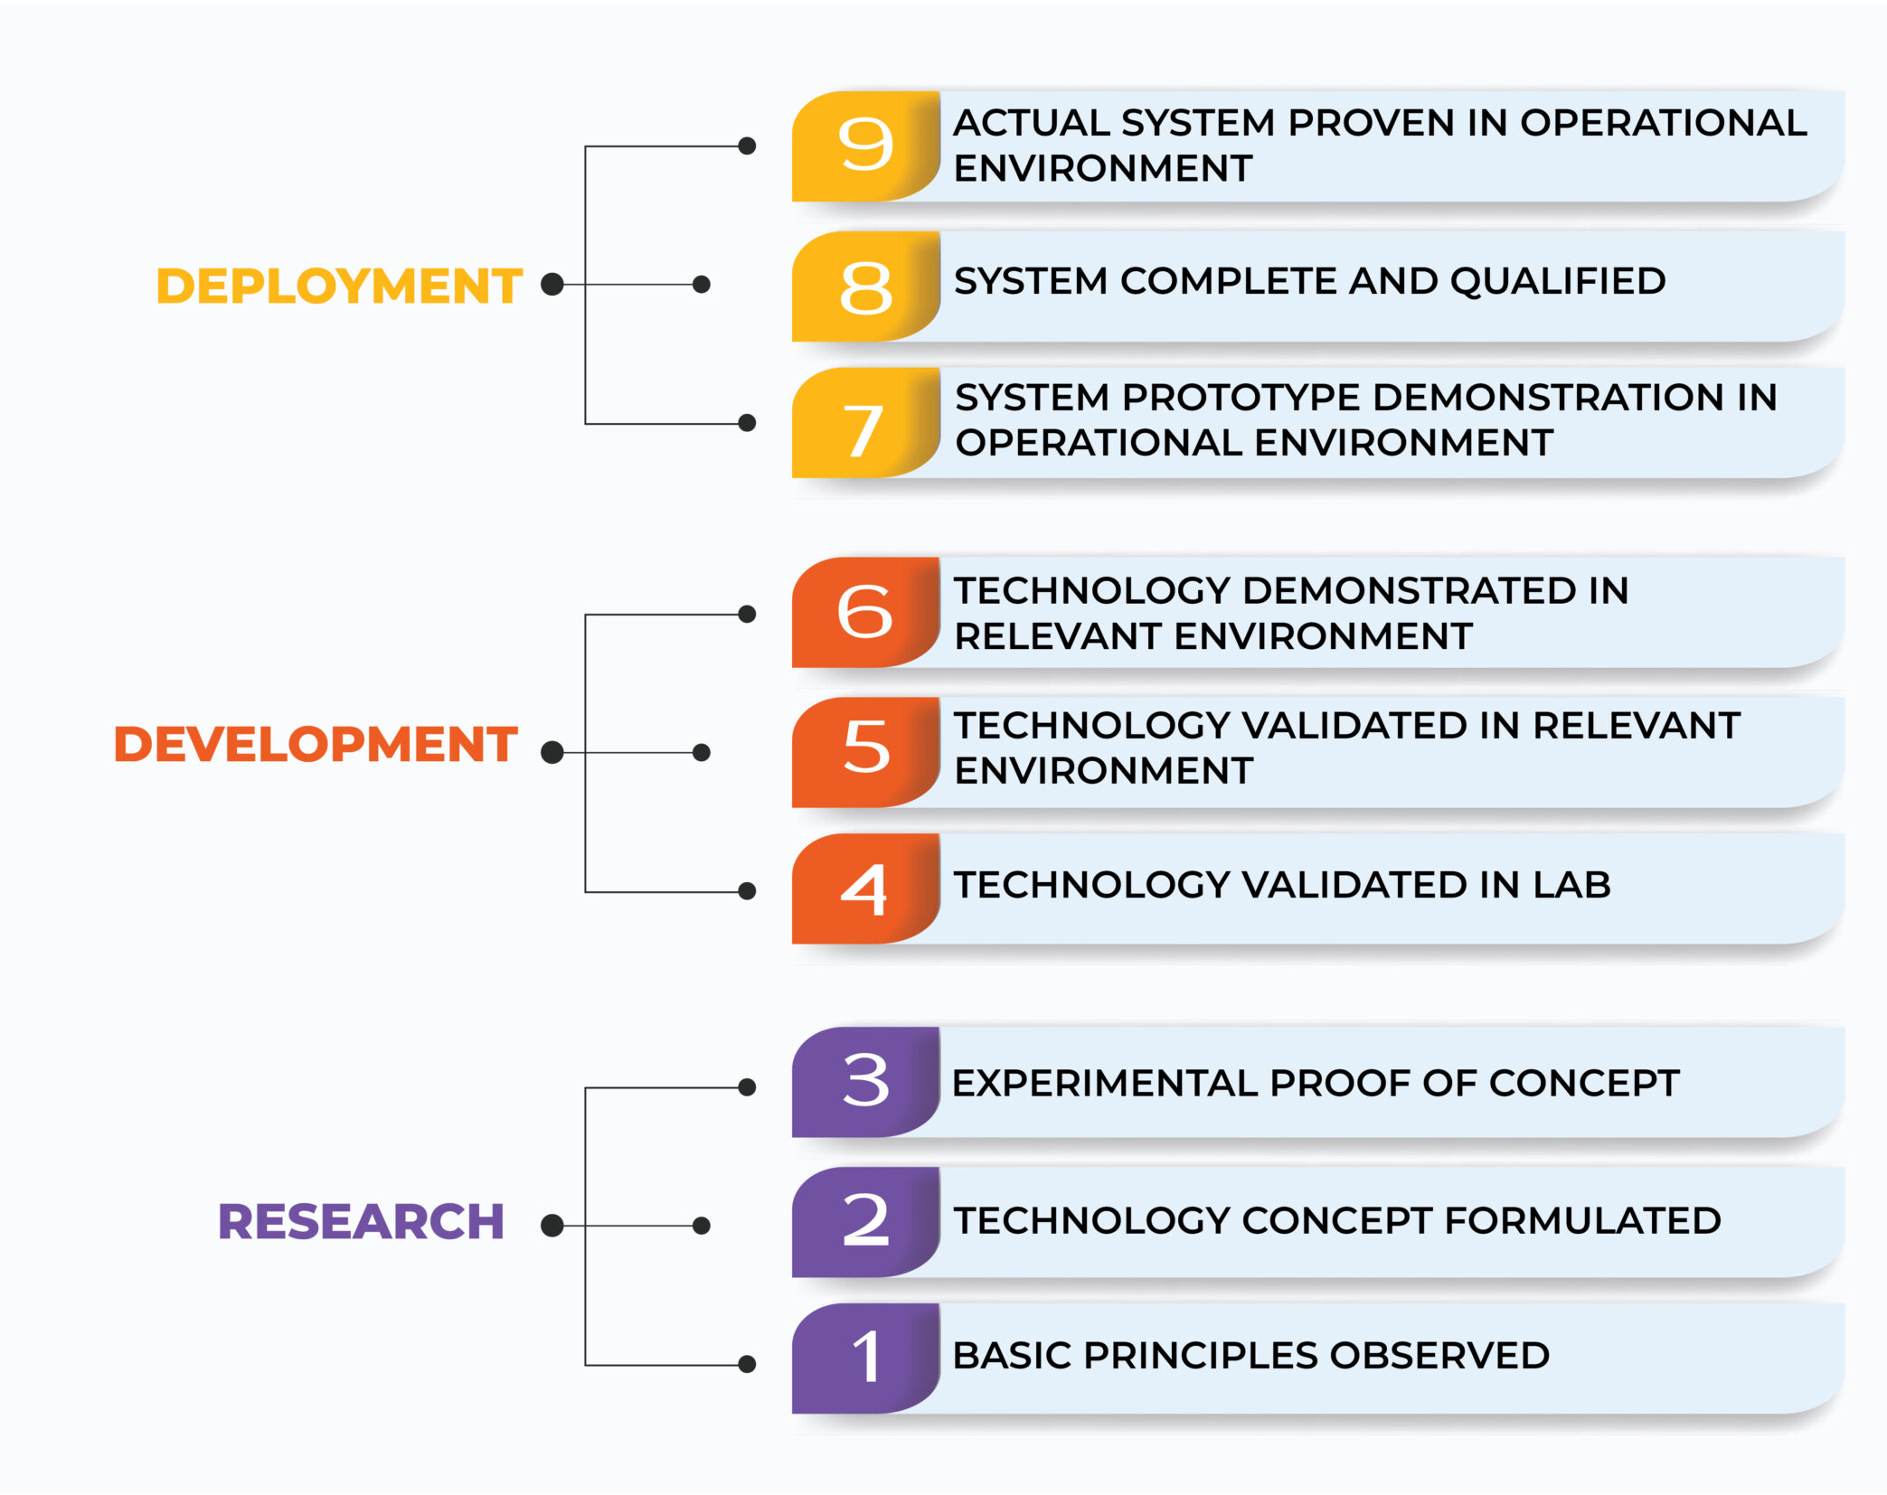
TRL Drives the R&D
We wish to reach a TRL 6 for the decision of construction, the level of readiness appropriate to enter the industrialization

Slide 10
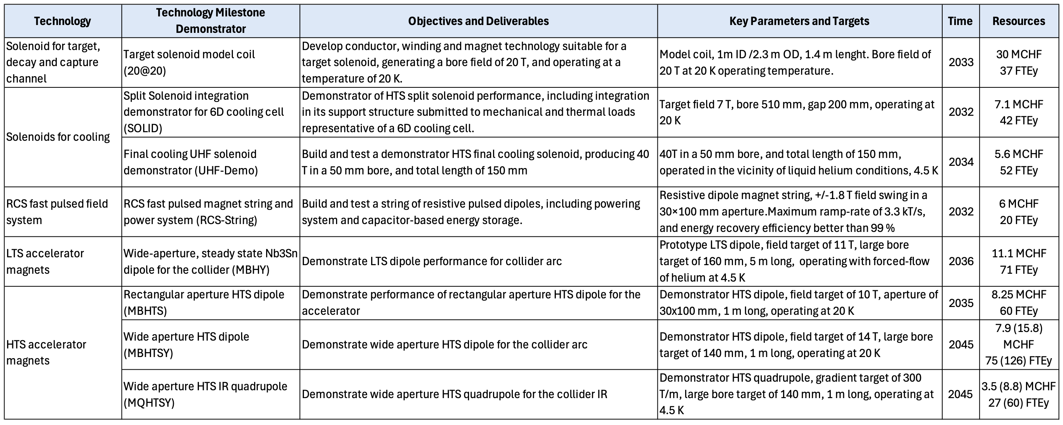
R&D Technology Milestones

Slide 11
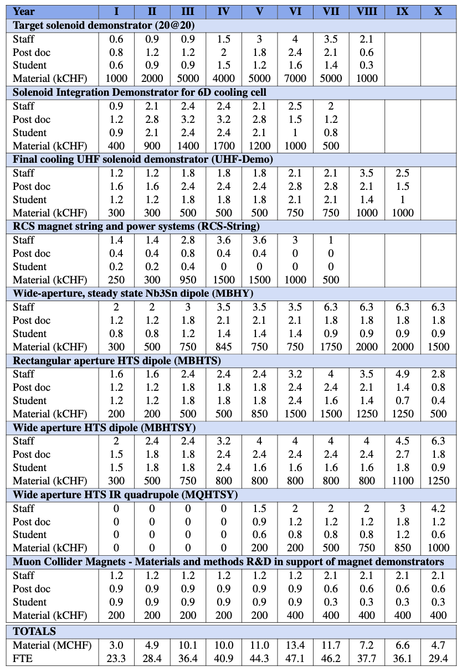
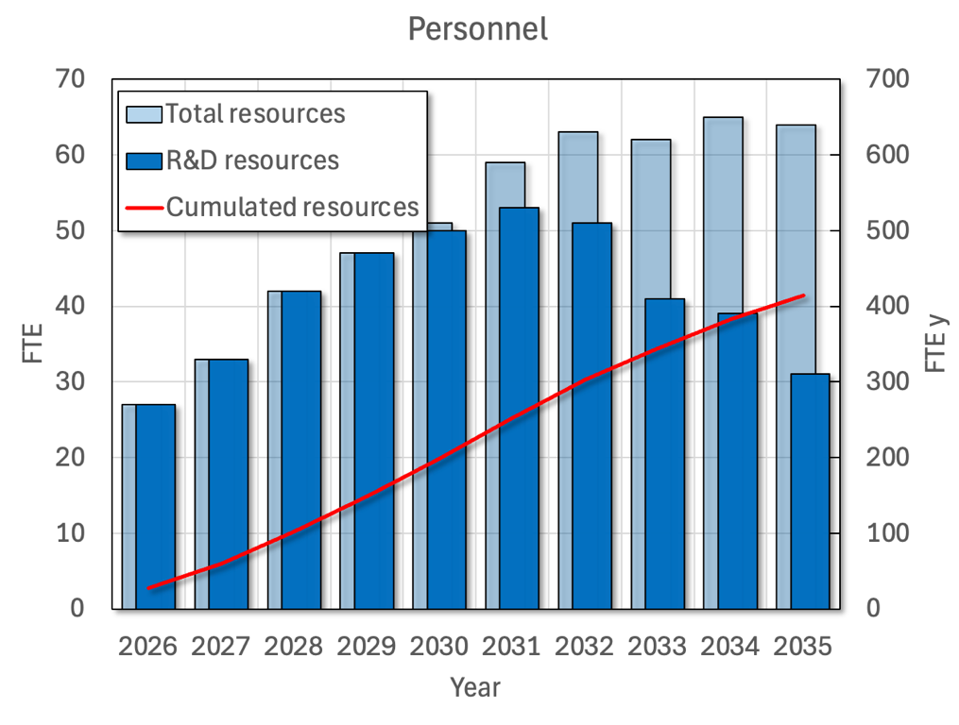
R&D Resources - Personnel
414FTEy

Slide 12
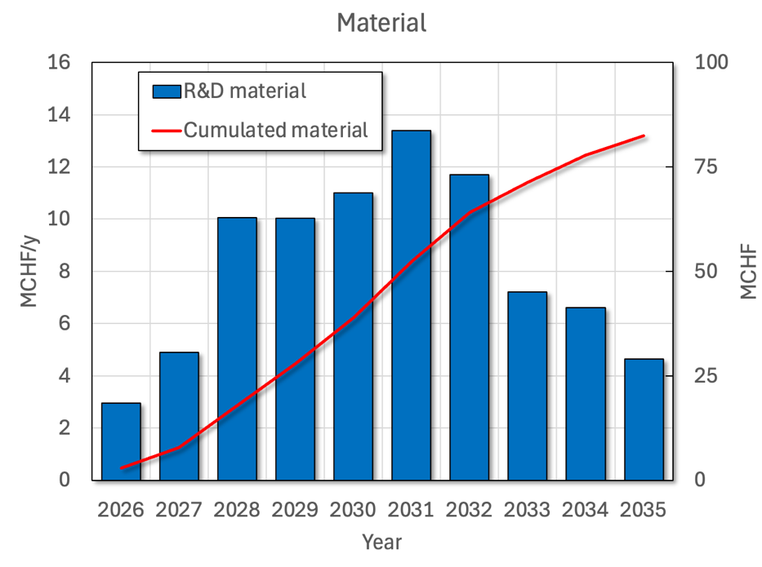
R&D Resources - Material
82.5MCHF

Slide 13
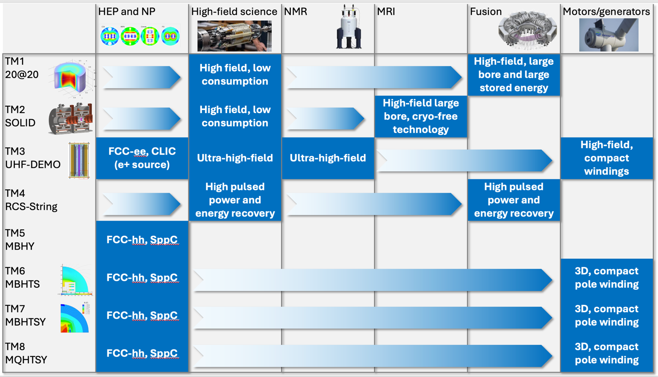
R&D Impact

Slide 14





Practical Impact Examples
Fusion for Energy (ITER EU Domestic Agency)
  Framework agreement and first addendum in final negotiation
  Contribution to the design of the HTS target solenoid, relevant to the central solenoid of DTT
EUROFusion (next step European fusion reactor)
  Framework agreement signed in 2023, first addendum signed in 2024
  Contribution to the design of the HTS target solenoid, relevant to the magnets of a Volumetric Neutron Source proposed as next step in the European fusion strategy
Gauss Fusion (one of the leading EU fusion start-ups)
  Consultancy agreement signed in 2023
  CERN contribution to the design of the LTS/HTS GIGA stellarator magnets, based on advances in the HTS target solenoid
ENI (oil and gas energy giant)
  Framework agreement and first addendum signed in 2024
  Collaboration on the conceptual design and project proposal for the CERN construction of a large bore HTS solenoid (20@20 model coil) relevant to the muon collider and fusion
IFAST-2 proposal to INFRA-2025-TECH-01-02 (CERN, INFINEON, PSI)
  Proposal of fast pulsed power cell + magnet system sent to IFAST-2 coordination for ranking at TIARA
  Industrial interest in rapidly pulsed and large energy/power supplies

Slide 15
Outline
References
Magnet timeline
R&D plan
Cost evaluation
Summary and discussion points

Slide 16
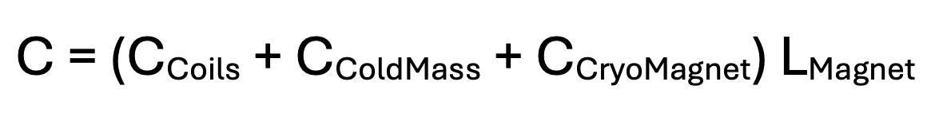


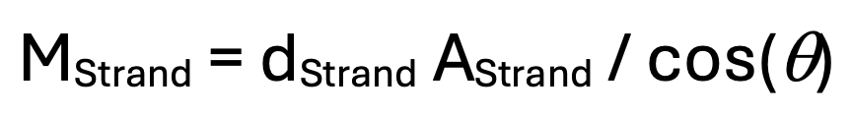


Cost Model
PROPOSAL

Slide 17
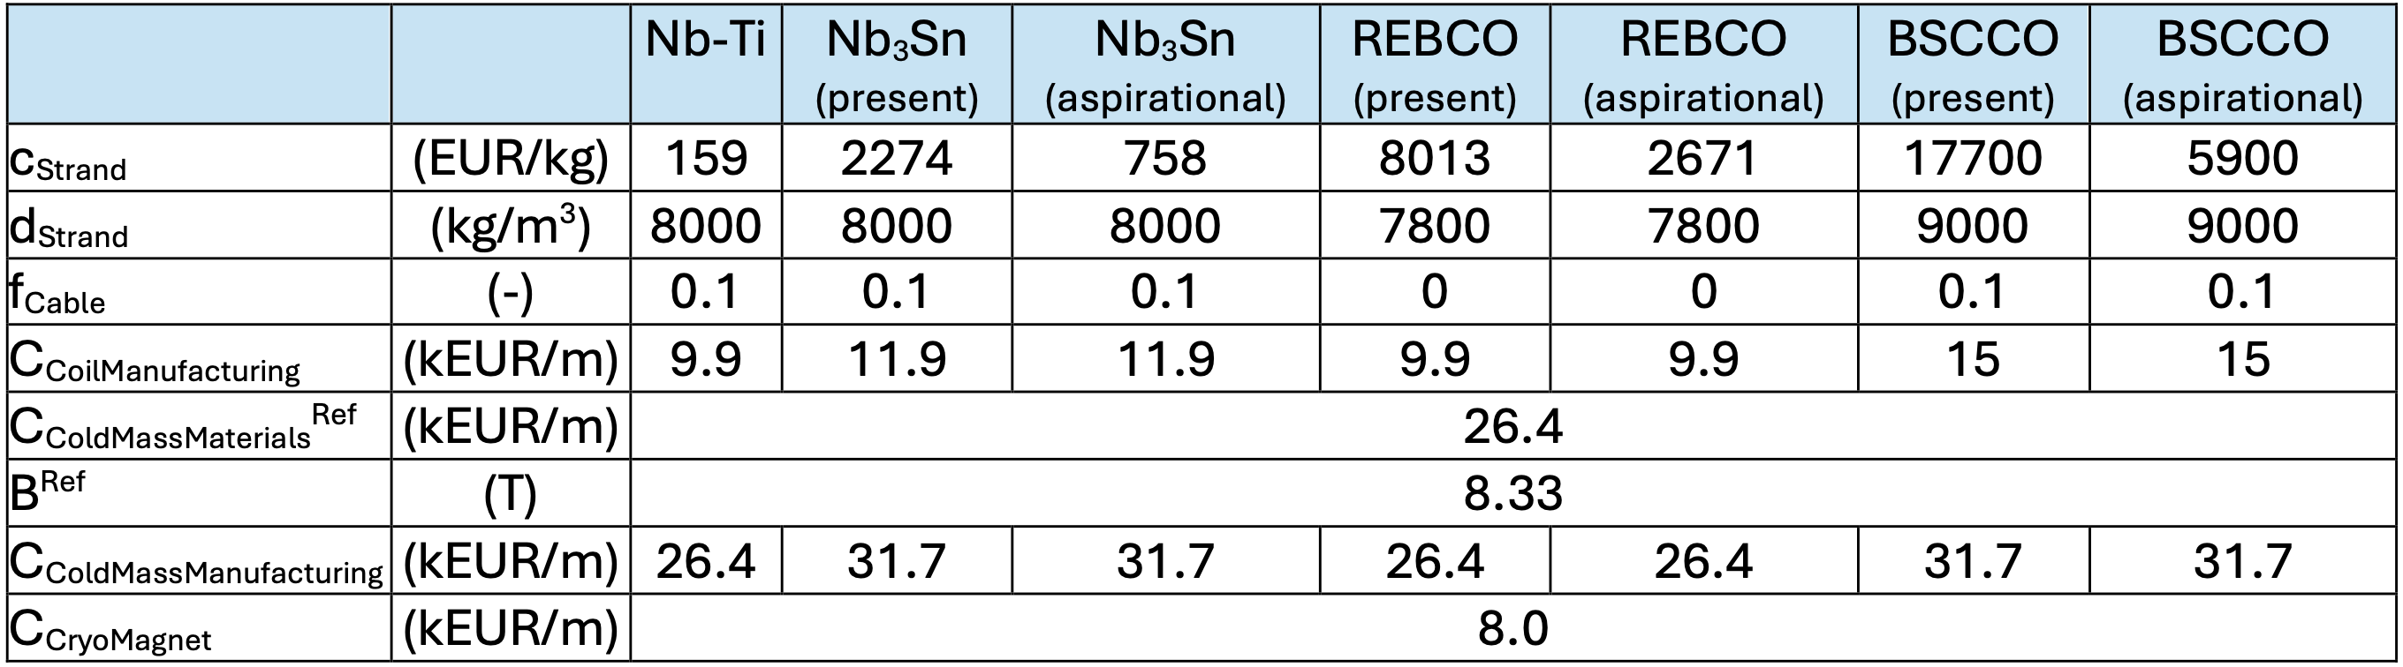
Cost Model

Slide 18
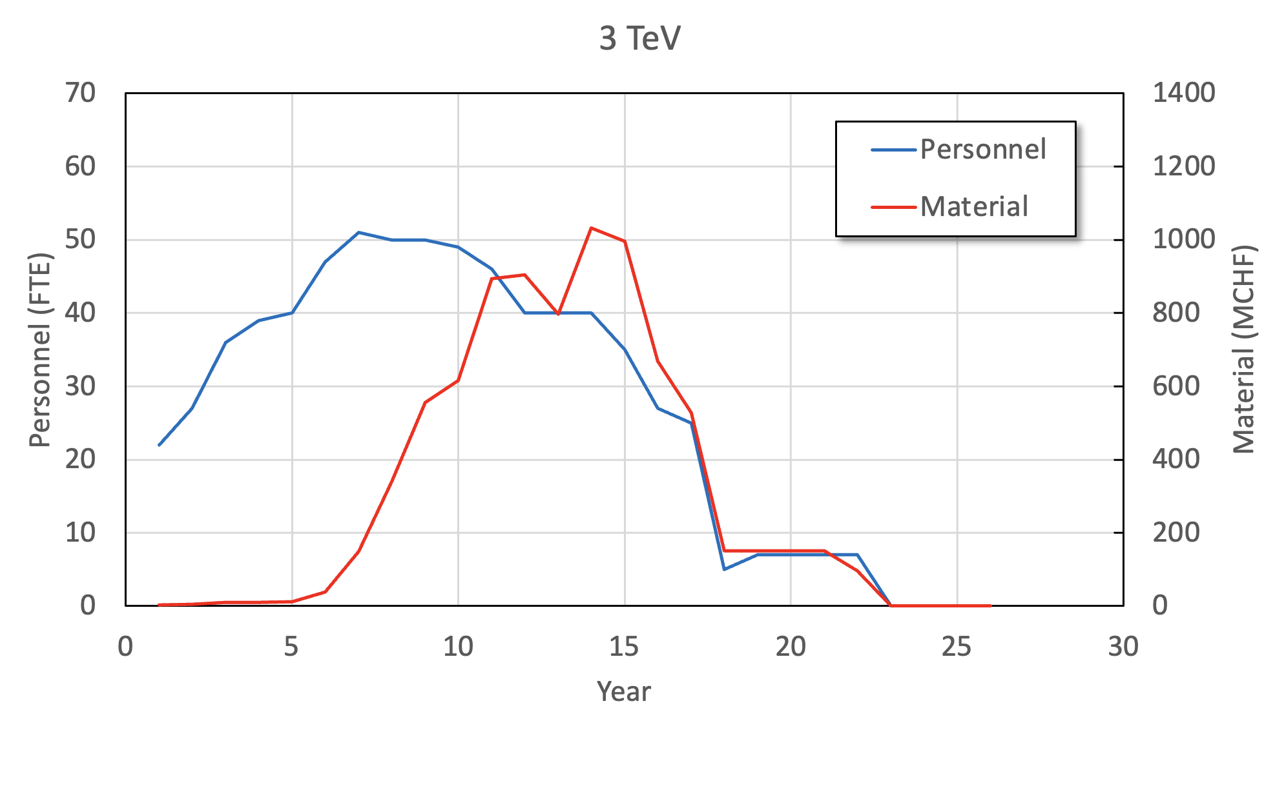
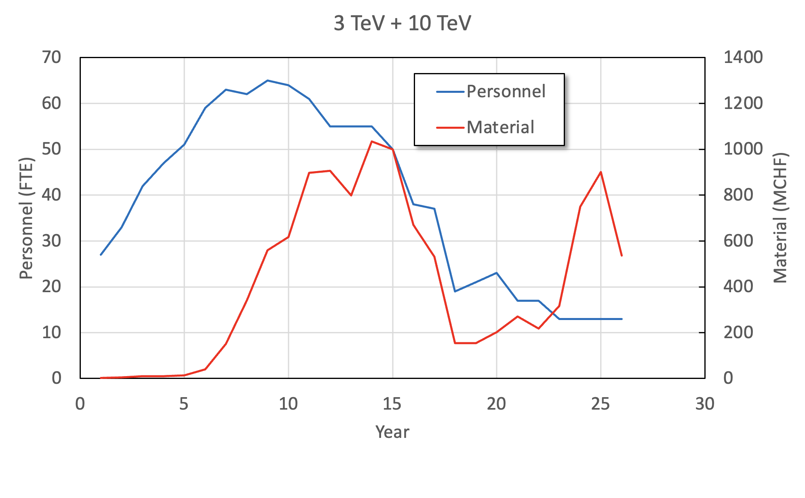
Cost Estimate Examples
700 FTEy
8.2 BCHF
1000 FTEy
11 BCHF
CAVEAT: THIS IS ONLY AN ESTIMATE
WORK IN PROGRESS

Slide 19
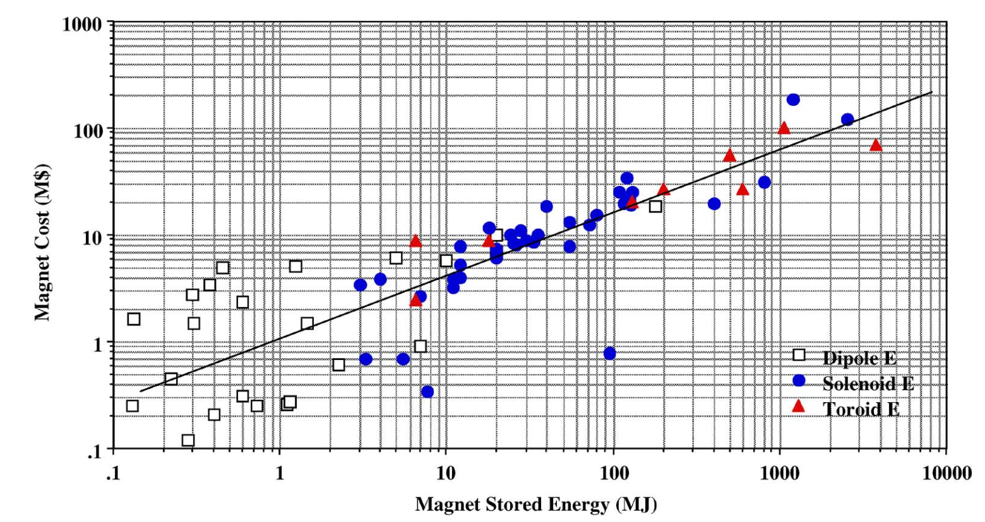
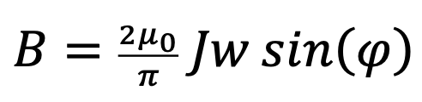
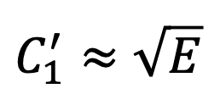
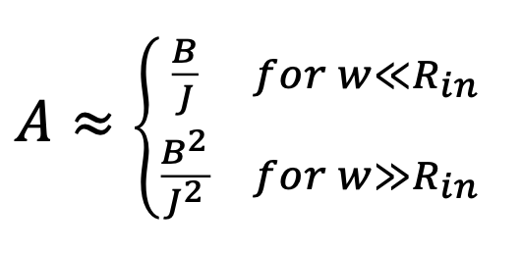
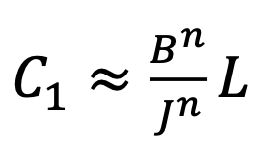
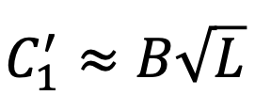
Cost Scaling Expectation
M.A. Green, B. Strauss, IEEE TAS, 18(2), 248-251, 2008
Sector dipole
Material cost per unit length is proportional to coil cross section
Magnet stored energy is proportional to B² and length
Green-Strauss scaling does not apply to accelerator magnets

Slide 20
Outline
References
Magnet timeline
R&D plan
Cost evaluation
Summary and discussion points

Slide 21
Summary and Discussion Points
NOTE: while the R&D plan is rather self-consistent (R&D review), the present plan to completion is a basis for discussion
  Q1: Is the cost evaluation method shared and agreed ? And, assuming resources available, is the timeline credible and agreed ?
  Q2: Which scenario should we recommend as a baseline ?
    Nb₃Sn – is it worth maintaining a line on this R&D ?
      HFM is working on this technology, but not at the right aperture, nor specification
      Is there a secured future for this technology ?
    Nb-Ti – should we propose a demonstrator ?
      Can be realized with relatively modest effort
      Could bring a strong image impact
    HTS for the various parts of the complex
      Is it credible ? Is it too ambitious ?
  Q3: Which R&D do we miss ?
    Combined function magnets
  Q4: are there means to simplify, standardize, and reduce cost ?

Slide 22

HIC SVNT LEONES

Slide 23
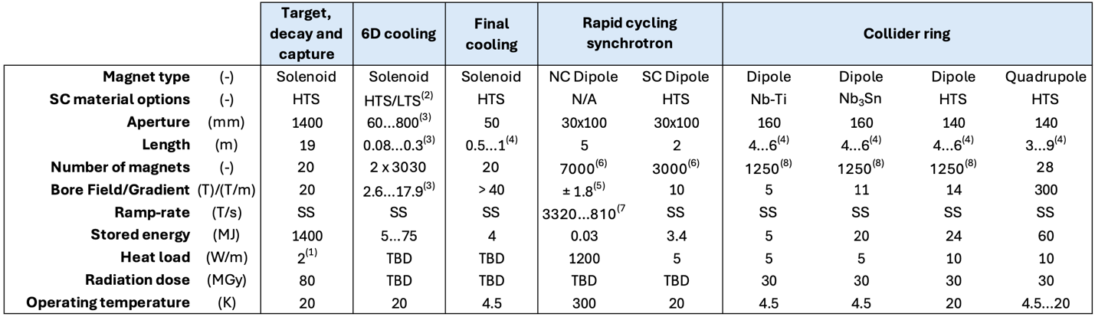
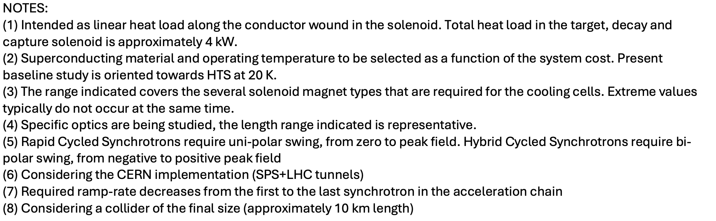
Magnet R&D Targets

Slide 24
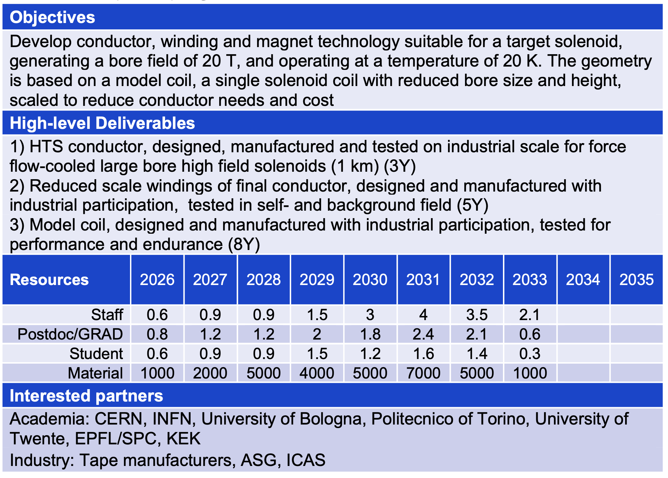
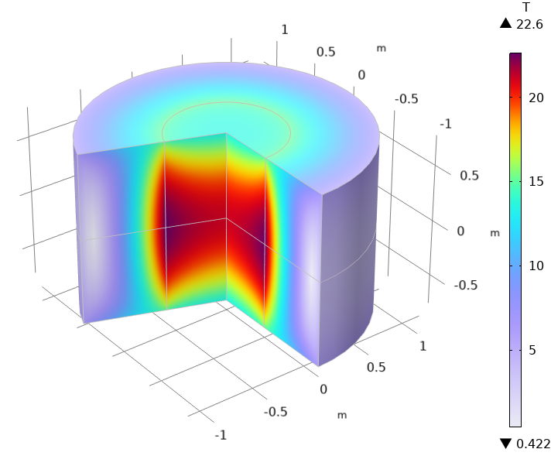
TM1 – 20@20

Slide 25
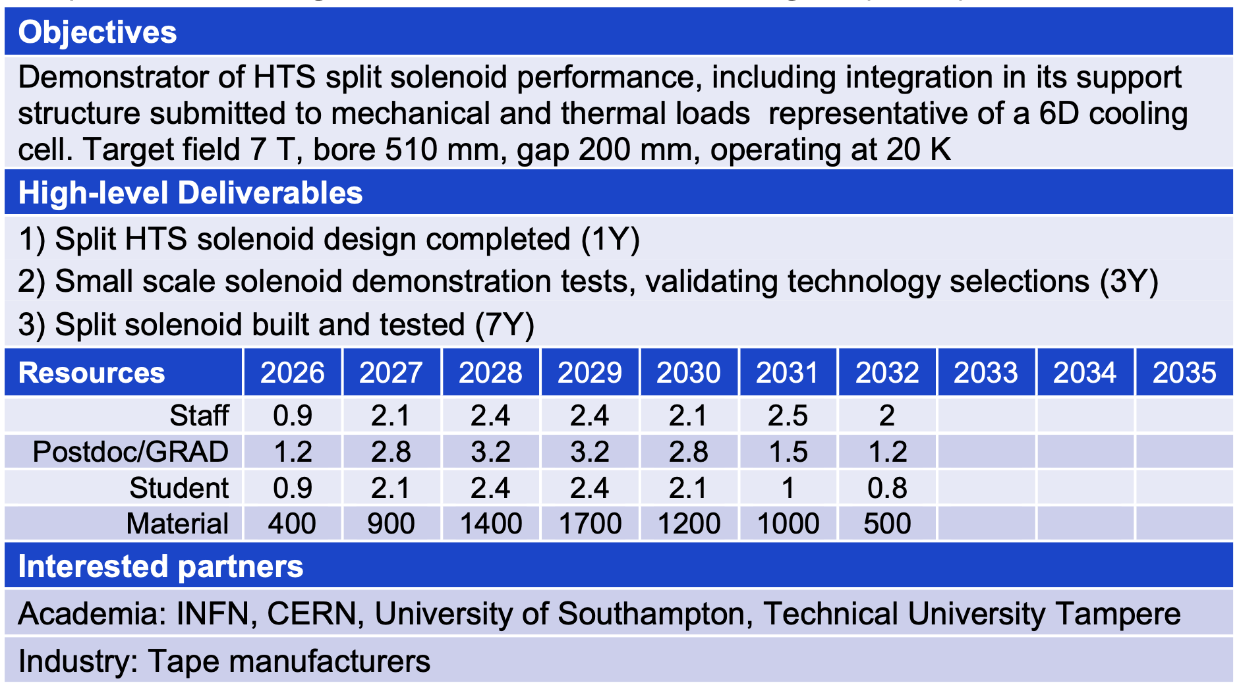
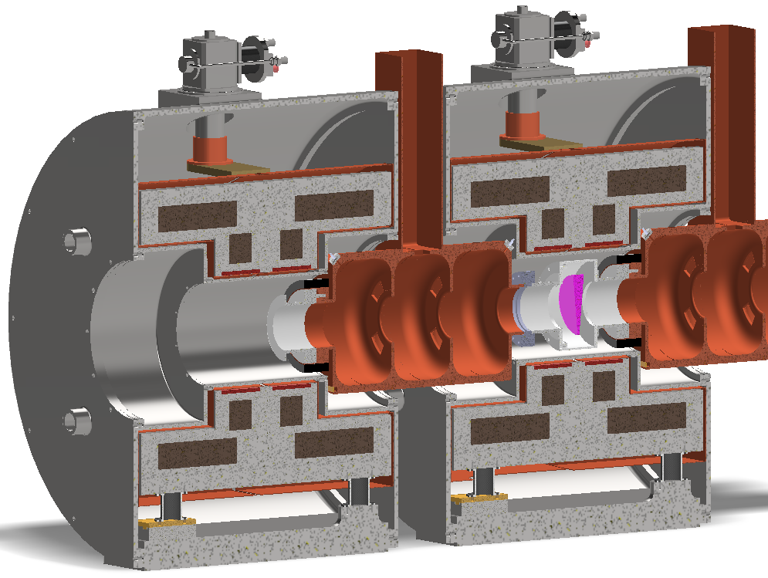
TM2 – SOLID

Slide 26
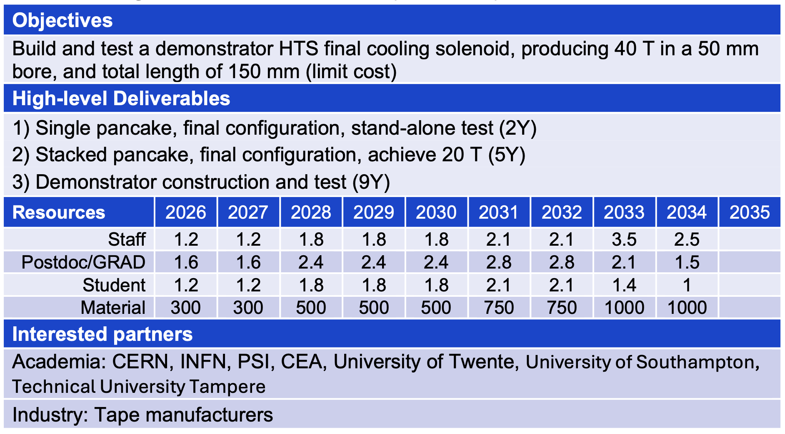
TM3 – UHF-Demo

Slide 27
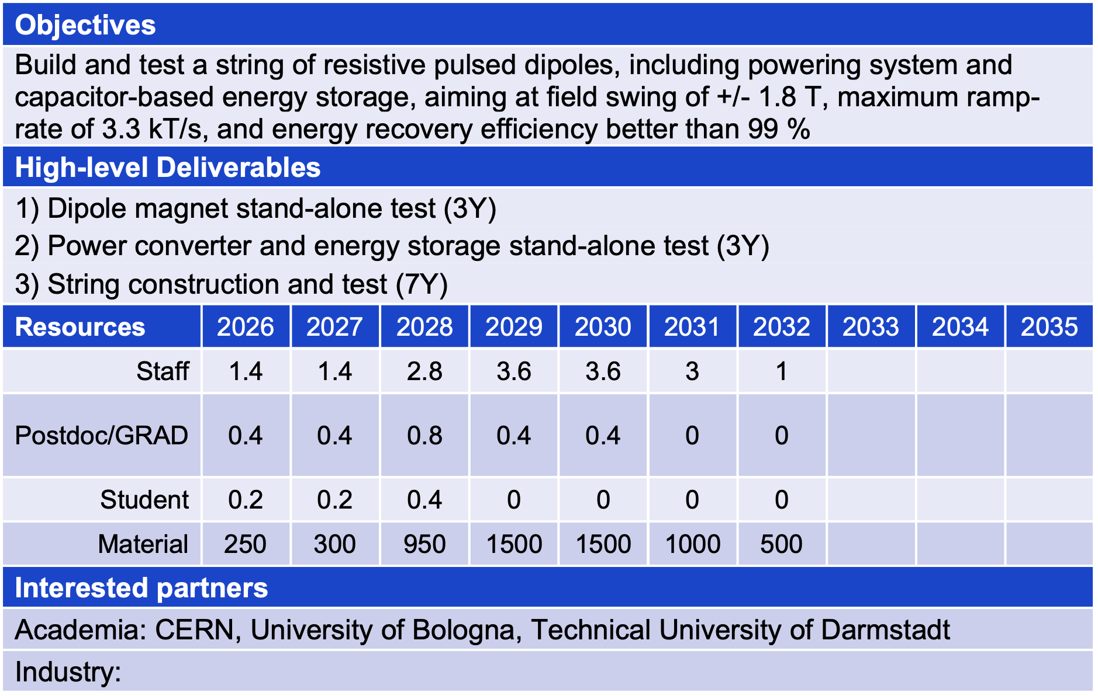
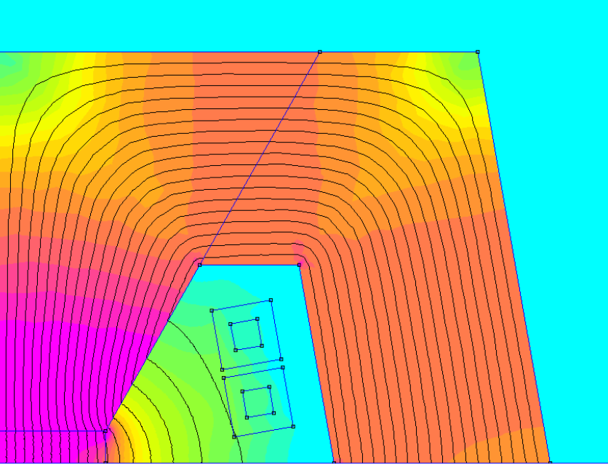
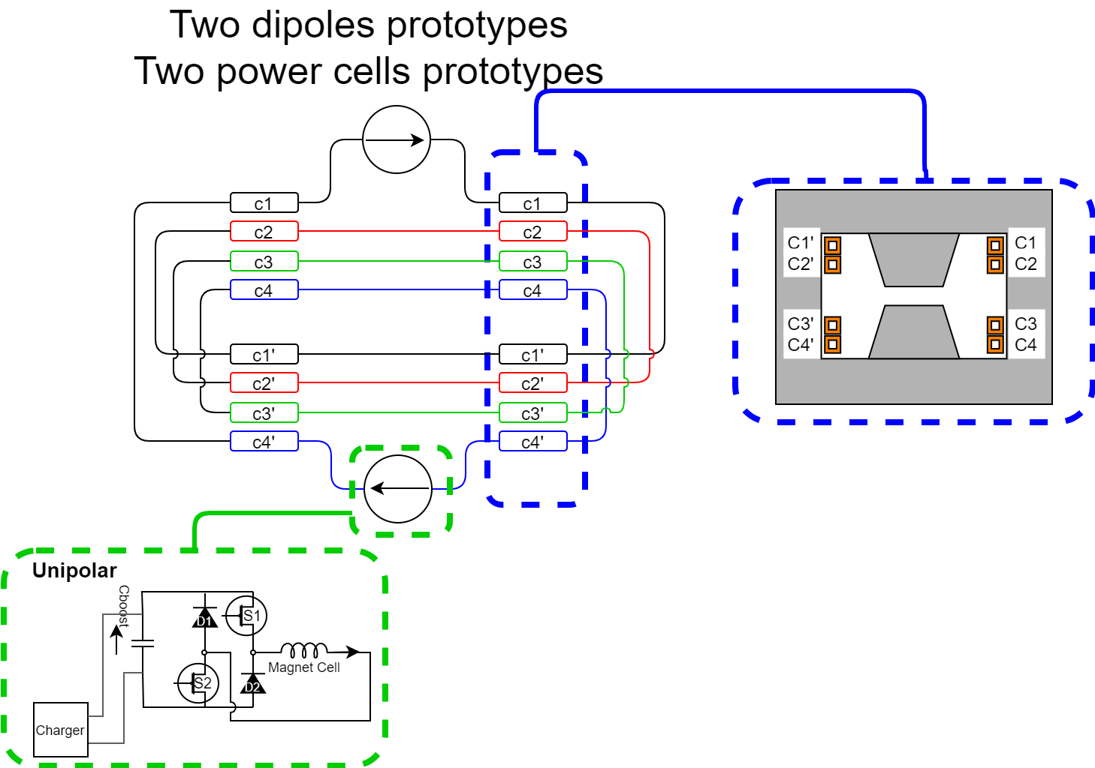
TM4 – RCS-String

Slide 28
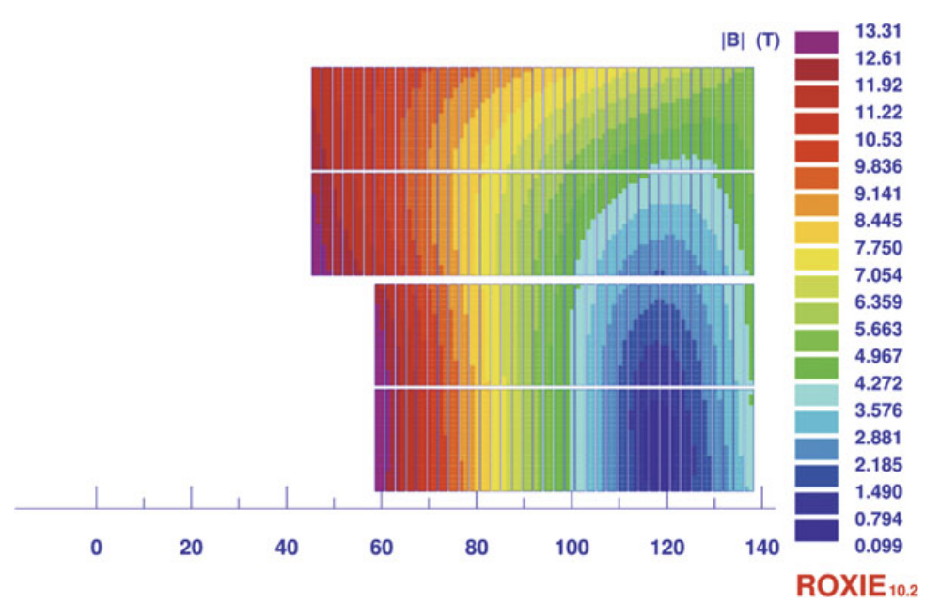
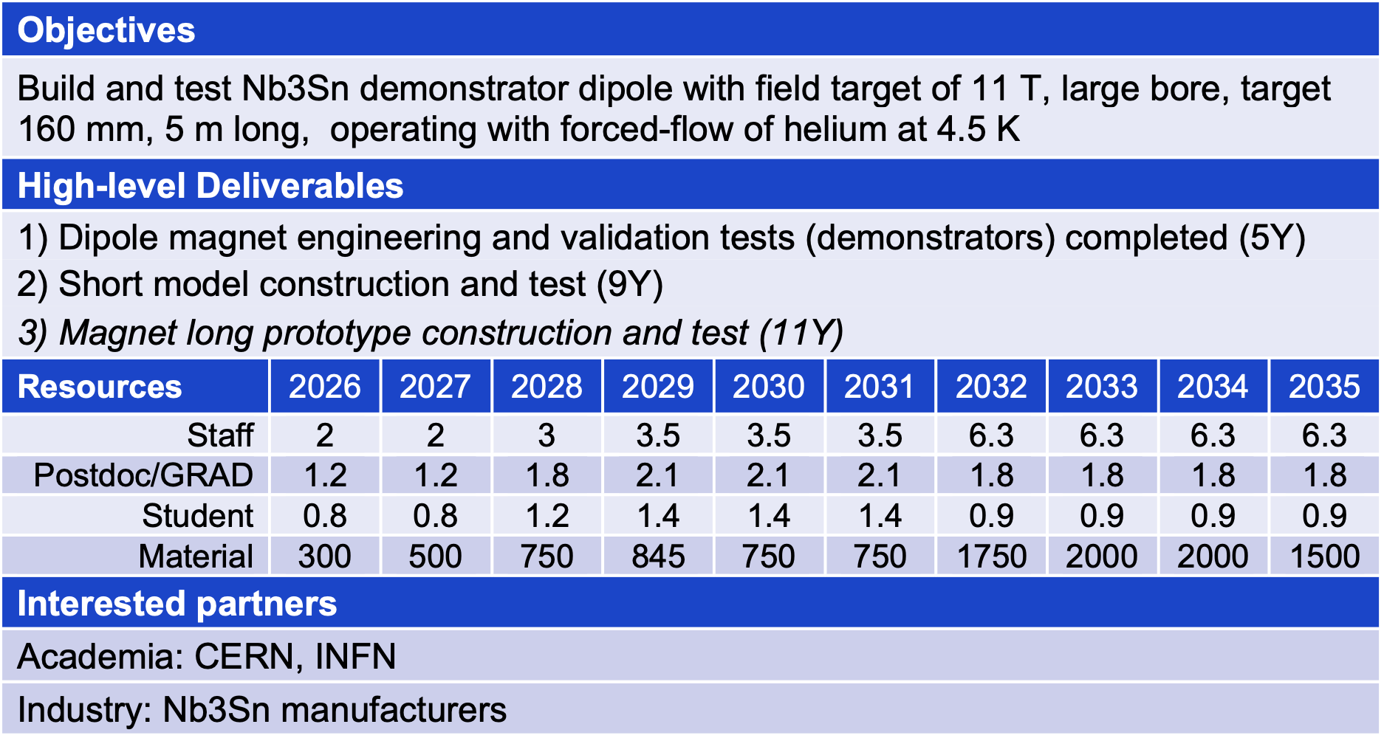
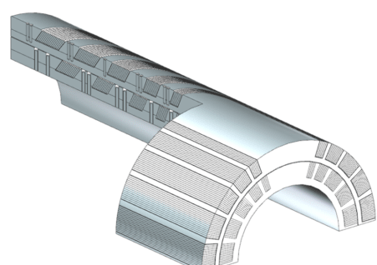
TM5 – MBHY

Slide 29
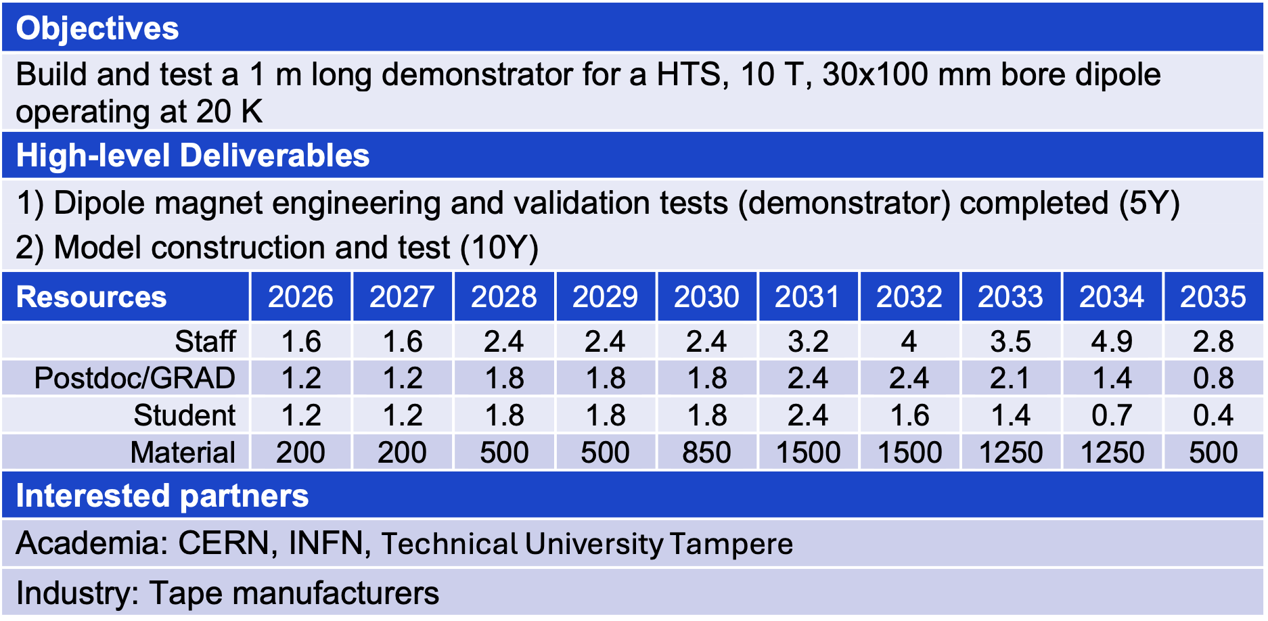
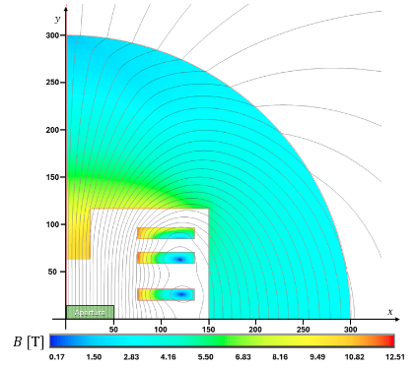
TM6 – MBHTS

Slide 30
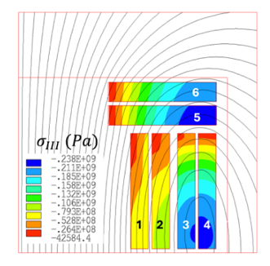
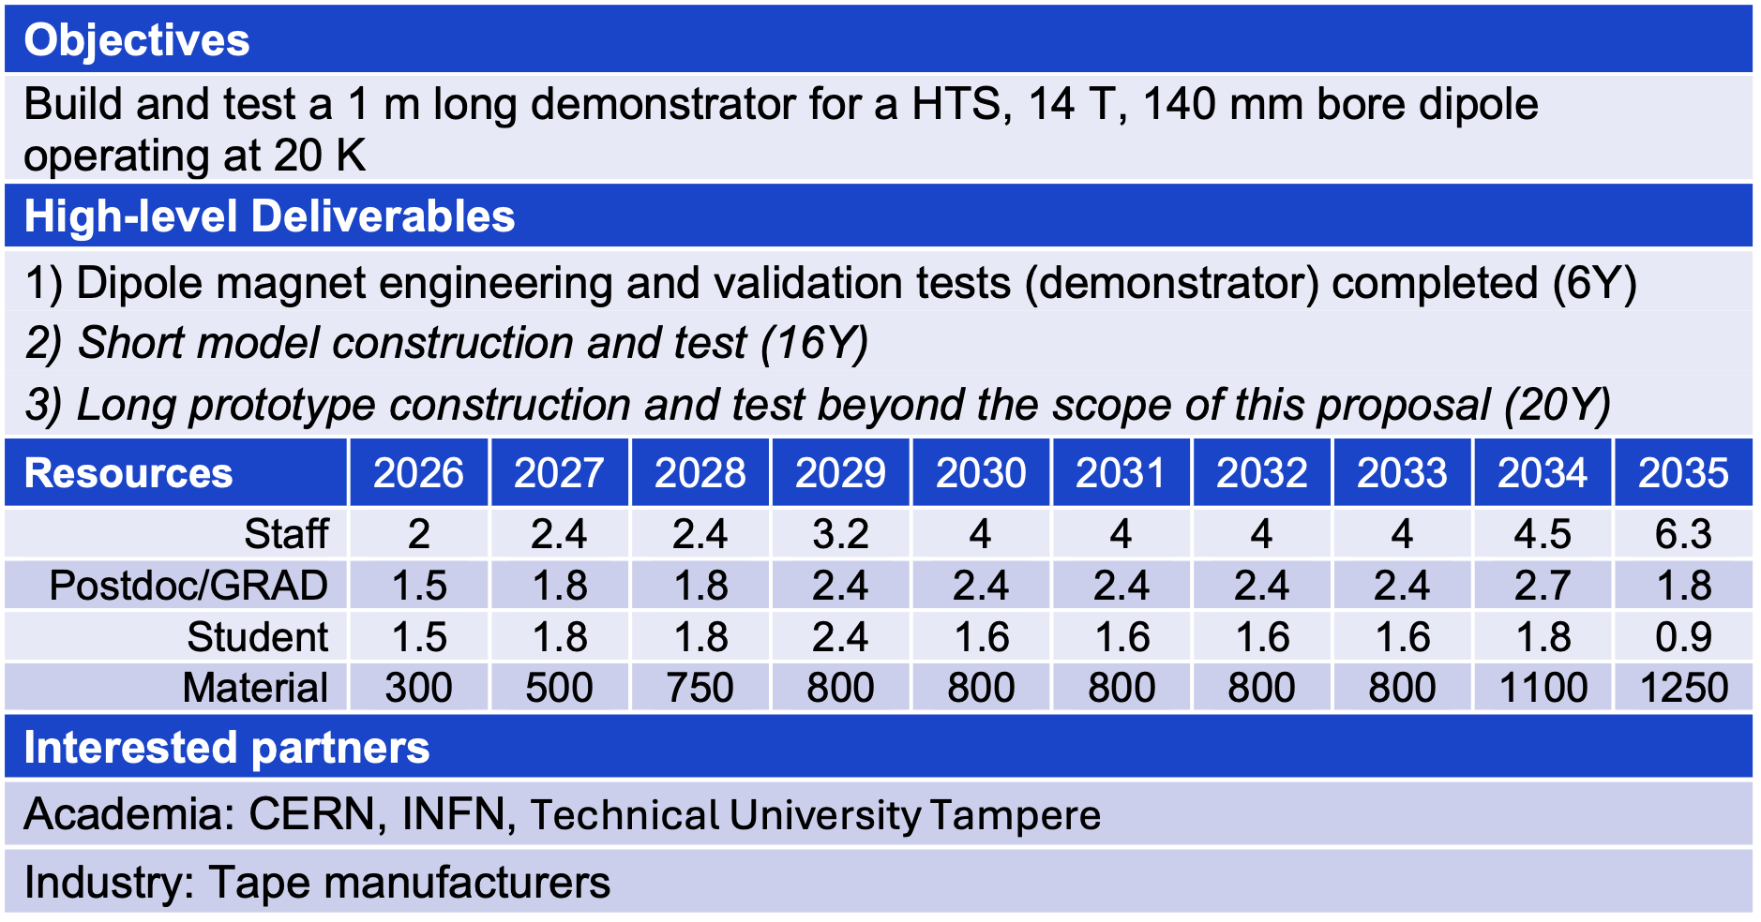
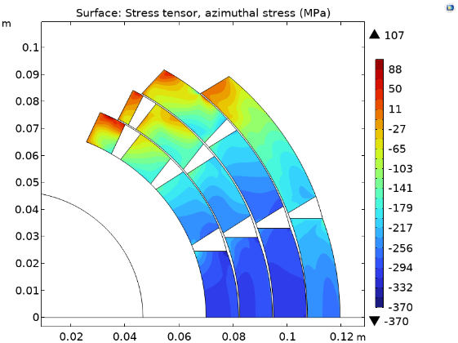
TM7 – MBHTSY

Slide 31
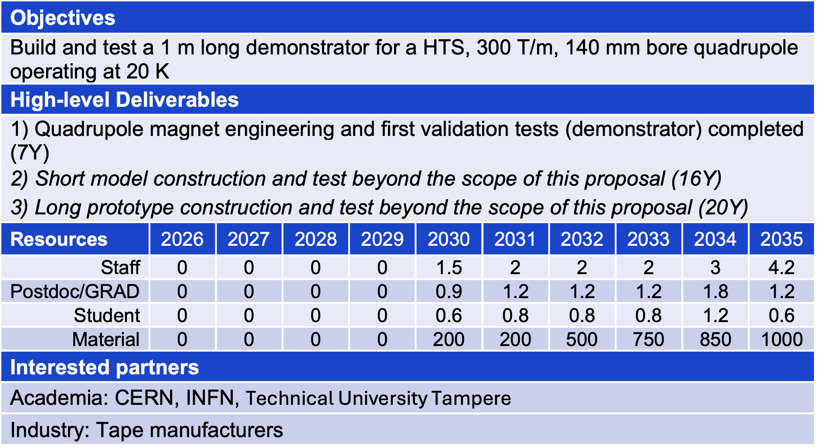
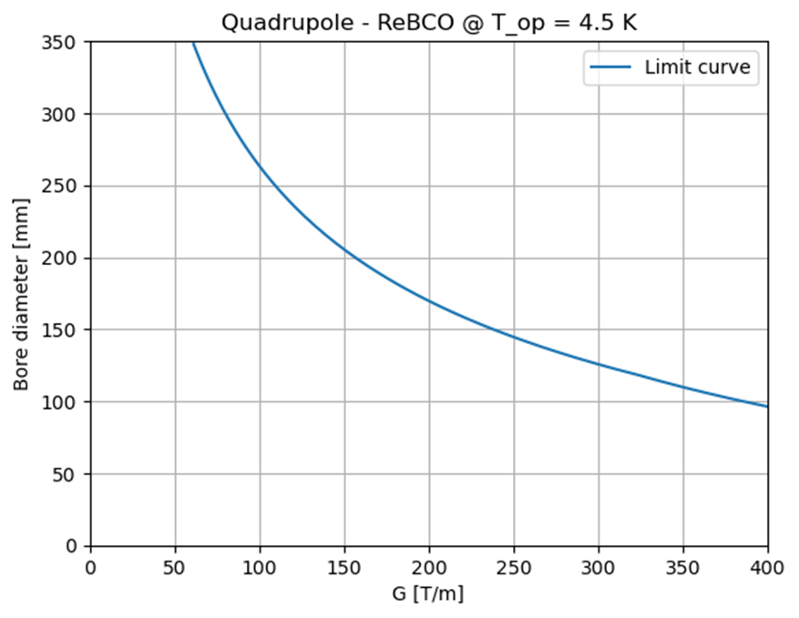
TM8 – MQHTSY

Slide 32
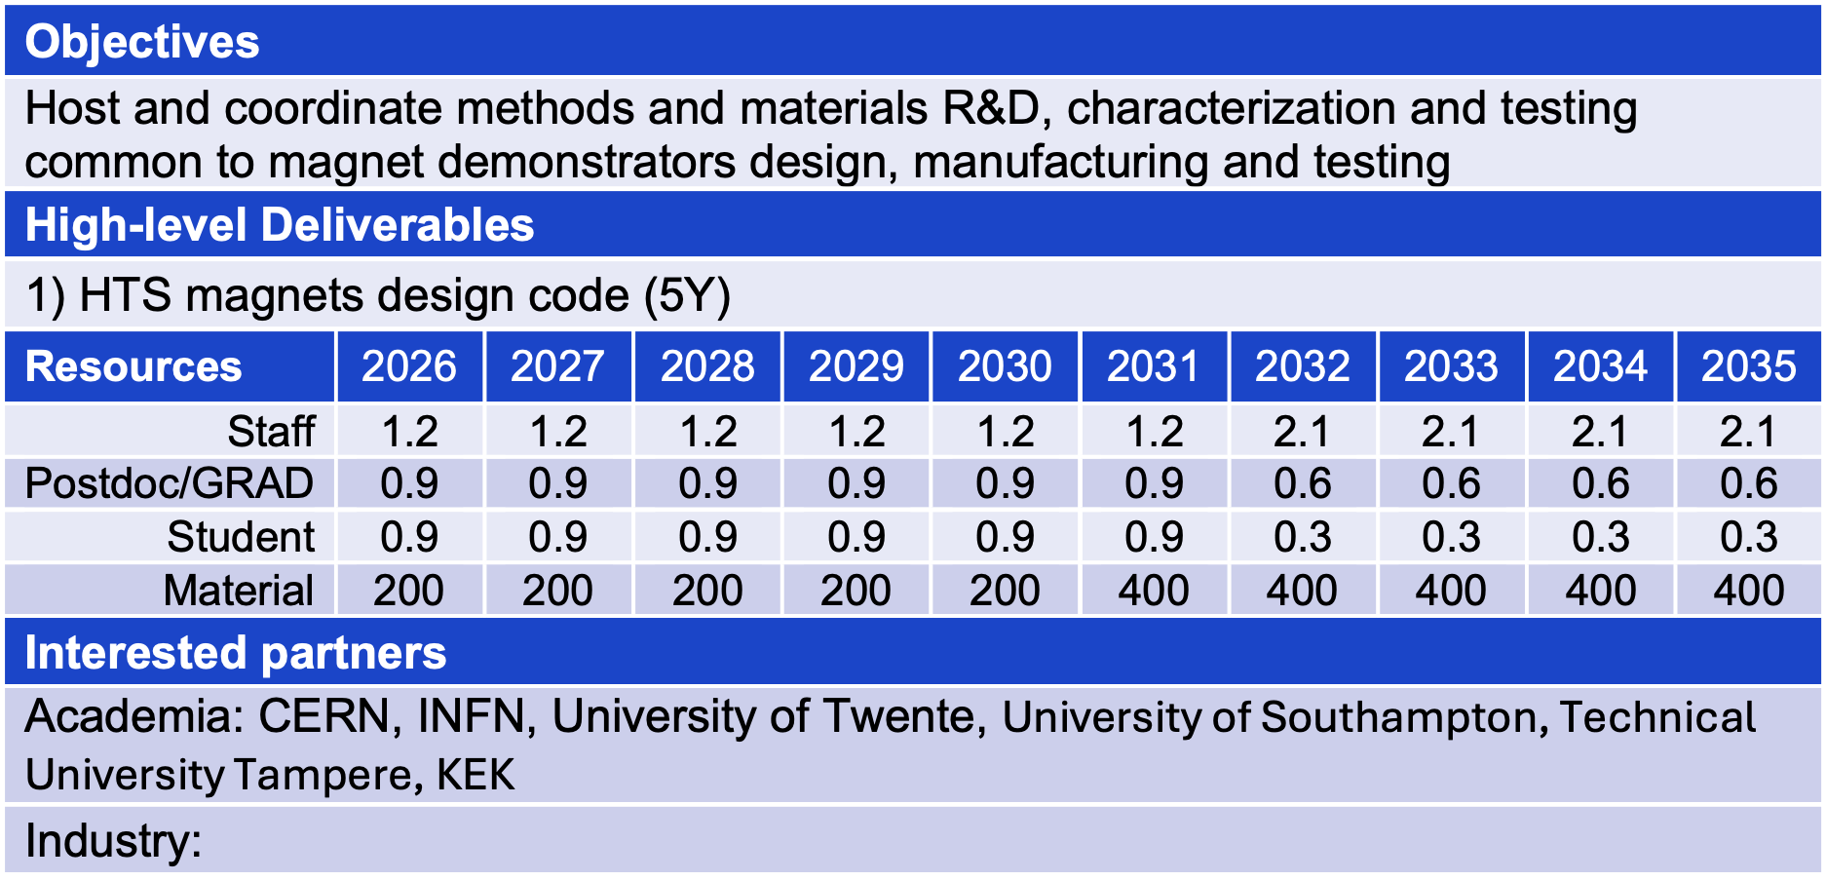
Materials and Methods R&D
High-field measurement of transport properties of REBCO conductors, also necessary to define scaling laws required for the design and analysis of the magnet demonstrators;
Micrography, Micro-structure and mechanical properties of REBCO conductors and winding;
Radiation effects in REBCO conductors;
Tailored experiments to establish design rules for HTS magnets, e.g. allowable hot-spot temperature, or allowable peak stress and strain;
Multi-physics modeling of transient electromagnetics, mechanics and thermal fields in HTS magnets, relevant to the electro-mechanical design, operation and quench protection of NI HTS magnets.

