Slide 1
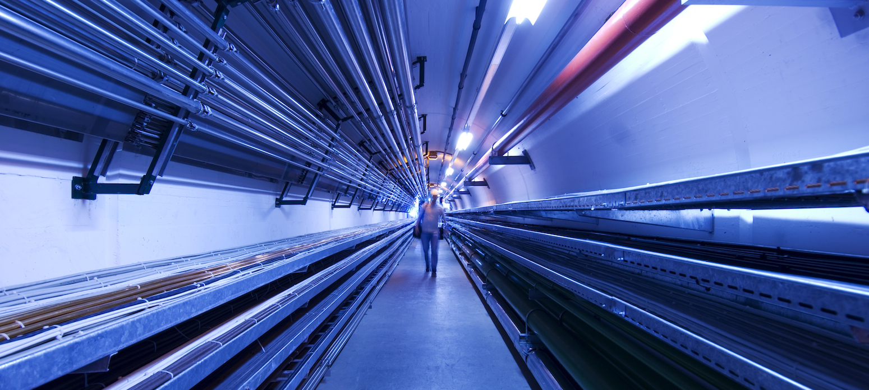
R&D Programme – Neutrino
C. Ahdida, C. Accetura, C. Desponds, C. Carli, N. Guilhaudin, G. Lerner, J. Manczak, A. Kolehmainen, Y. Robert, D. Schulte, M. Vanwelde
IMCC and MuCol annual meeting 2025 12-16 May 2025, DESY

Slide 2
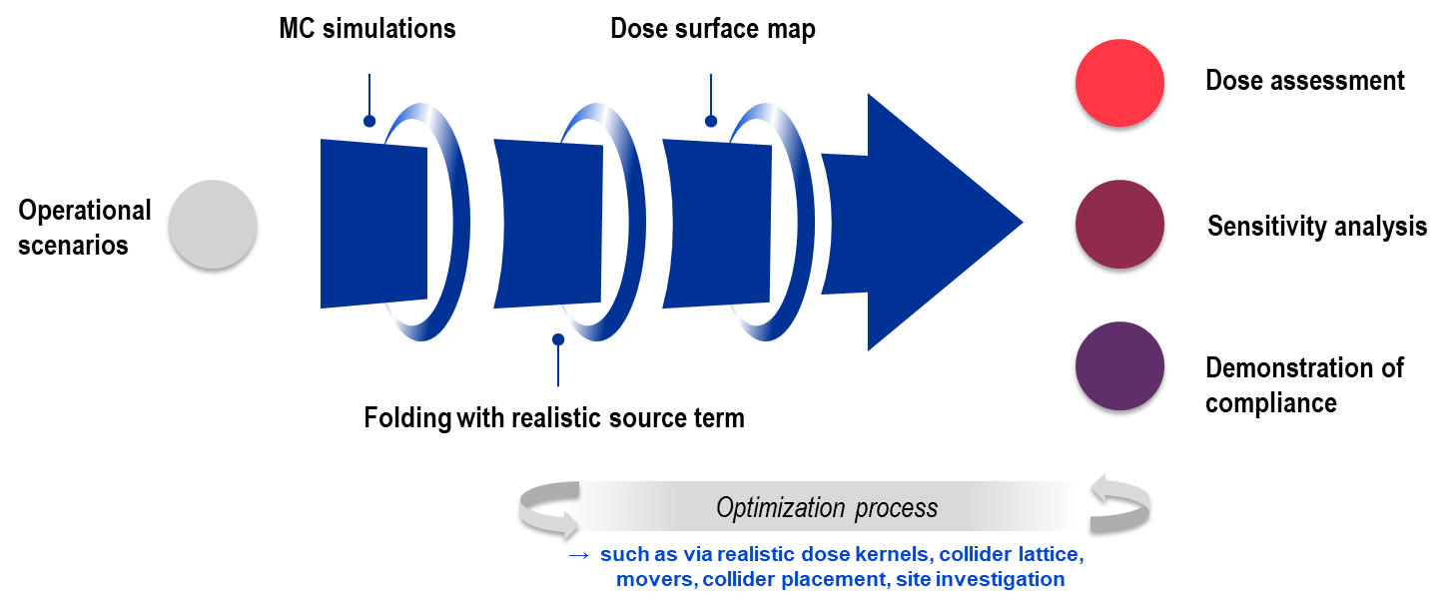
Introduction
Decays of µ± in the collider may lead to large local neutrino flux in the collider ring plane reaching the Earth’s surface
Rare single events of these high-energetic neutrinos create secondary particle showers
The goal is to ensure that the environmental impact of the neutrino-induced showers expressed in terms of effective dose to members of the public will be is negligible, i.e. an effective dose of the order of 10 μSv/year
A refined dose model for an accurate estimation of neutrino-induced doses is being developed and used for an optimisation to minimise the effective doses to members of the public to a negligible level
3 TeV, 7.6 TeV, 10 TeV
100 rem = 1 Sv

Slide 3
Objectives and Deliverables
Objectives
Develop a comprehensive, site-independent dose assessment model to optimize collider ring designs
Develop a mature concept of the neutrino flux mitigation technology
Assess the neutrino flux mitigation for an implementation of the collider in the Geneva area or elsewhere
High-level Deliverables
Assess the dose and a plan to demonstrate compliance
Verification that the proposed mitigation method does not comprise beam operation
Perform a collider placement optimization in the Geneva area
Complete the specification and the design of the mover system
Validation of a two-magnets mover demonstrator

Slide 4
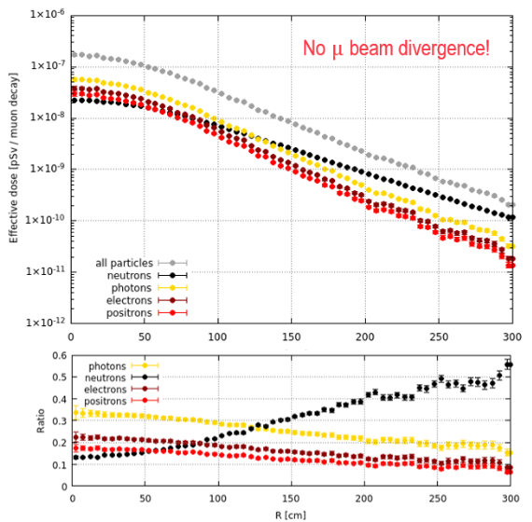
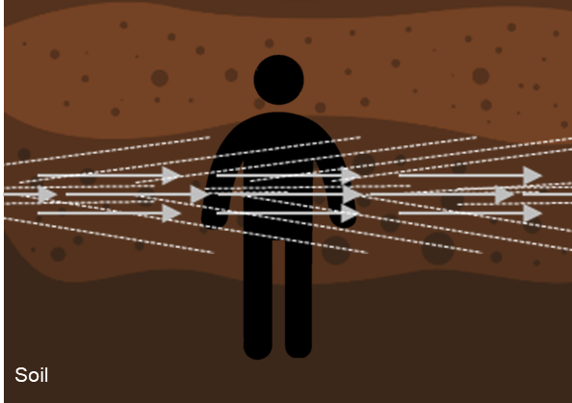
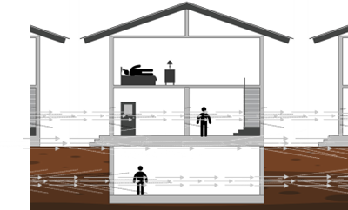
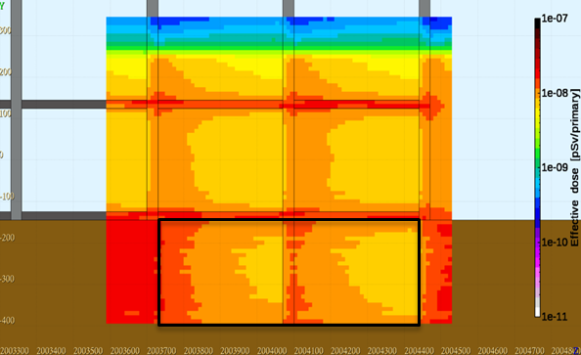
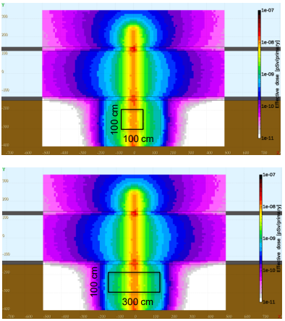
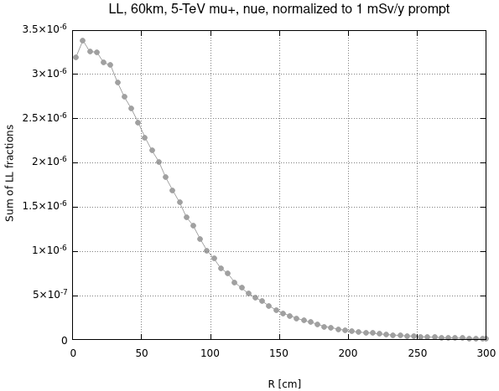
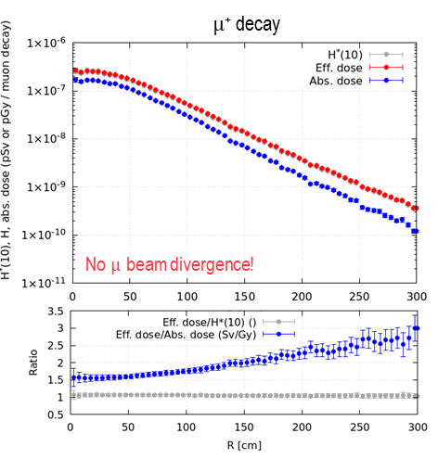
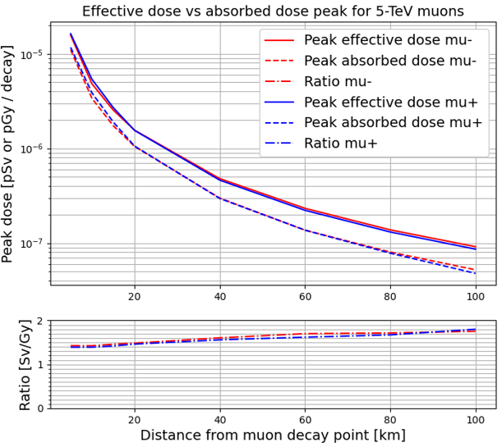
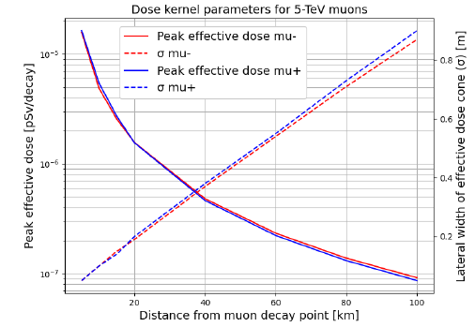
MC simulations
Goal: evaluate the main parameters for the dose predictions
Study of secondary particle spectra and activation risks – C. Ahdida
Ongoing study of more realistic geometries and exposure scenarios – J. Manczak
ν$e$ from 5 TeV $µ$⁺ (60 km)
Main contribution from electro-magnetic and neutron components
In-soil
More realistic scenarios
Effective dose kernels
Dosimetric quantities
Collider lattice effects
Investigation of different geometries with averaging for more realistic exposure scenarios
Soil activation – Example for $ν_{e}$
Exposure of the public due to ν-induced activation is negligible
Dose distribution for different distances assuming secondary particle equilibrium (i.e. inside Earth) – G. Lerner
>5 orders of magnitude below radioactive waste limit for 1 mSv/y prompt effective dose!
Differences of possibly relevant dosimetric quantities – C. Ahdida, G. Lerner
Ongoing study of collider lattice effects on dose predictions – J. Manczak
See tomorrow’s talk by J. Manczak, Neutrino Radiation Studies
Dose distributions
With moves
Without moves
5 TeV
(also 1.5 TeV)
Secondary particle spectra
Investigation of mover effects on dose distributions
Study of required steps based on saturated peak dose kernels
Study of dose distributions from bending sections
Dose saturation after a few m of soil and rapid decrease in soil-air transition
Dose widening due to lateral shower extension is very small compared to the ν-flux angular divergence effect
Good agreement with simplified analytical expressions
Realistic geometries
Energy- and distant-dependent differences in conversion from absorbed to effective dose due to differences in secondary particle shower
Factor 1.4-1.8 for peak doses at 5 TeV and increase for the tails
See tomorrow’s talk by J. Manczak, Neutrino Radiation Studies

Slide 5
MC simulations plans
Continuation of ongoing studies on lattice effects, including refinement of mover steps requirements for realistic geometries
Plans:
Potentially intercomparison of the FLUKA simulations with other advanced Monte Carlo codes
Realistic geometries
Systematic Uncertainties
Inter-comparison of MC codes
Collider lattice effects
Explore further realistic geometries (e.g. above-ground structures) of relevance for the collider arcs and the interaction points (IPs) at all relevant distances and beam energies
Investigation of systematic uncertainties such as. material densi-ties and compositions

Slide 6
Collider lattice
Goal: Fold collider lattice with MC simulations to evaluate dose distributions for a realistic neutrino source term and optimize the lattice for a dose reduction
IP region
μ⁻
Interconnection region
μ⁺
Bending region
Identification of critical regions (high ν flux areas) and of adequate mitigation methods, such as placement optimization and source term optimization (e.g. movers, wobbling)
Interaction Point regions
Interconnection regions
Bending regions
μ⁺
μ⁻

Slide 7
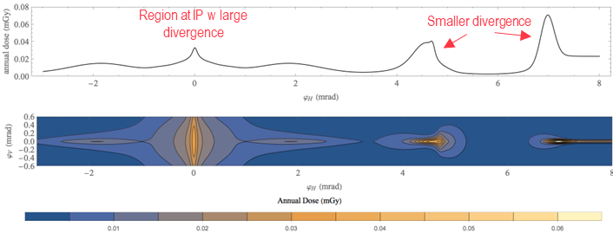
Collider lattice – IP regions
Interaction Point regions
Mitigation via collider placement (Geoprofiler tool)
IP region
Owned land
Single exit points of limited size that can be owned by the organization and fenced (possibility for experiment)
Dose estimation with 3 TeV MAP lattice IP region – C. Carli, Mitigation methods from machine side
2. Distance land of low occupancy
Distant exit points with sufficiently low occupancy, such as the ocean or a desert
Findings: beam divergence relatively large at IP and higher dose from regions with smaller vertical/horizontal divergence
Plans: Use collider lattice to determine of impacted area size and internal flux distribution, and eventually further optimize lattice

Slide 8
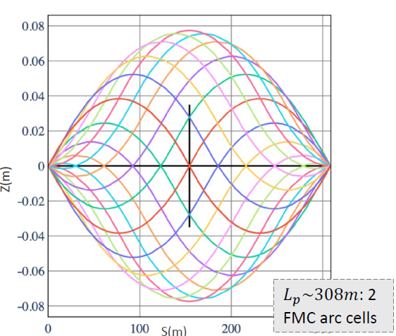
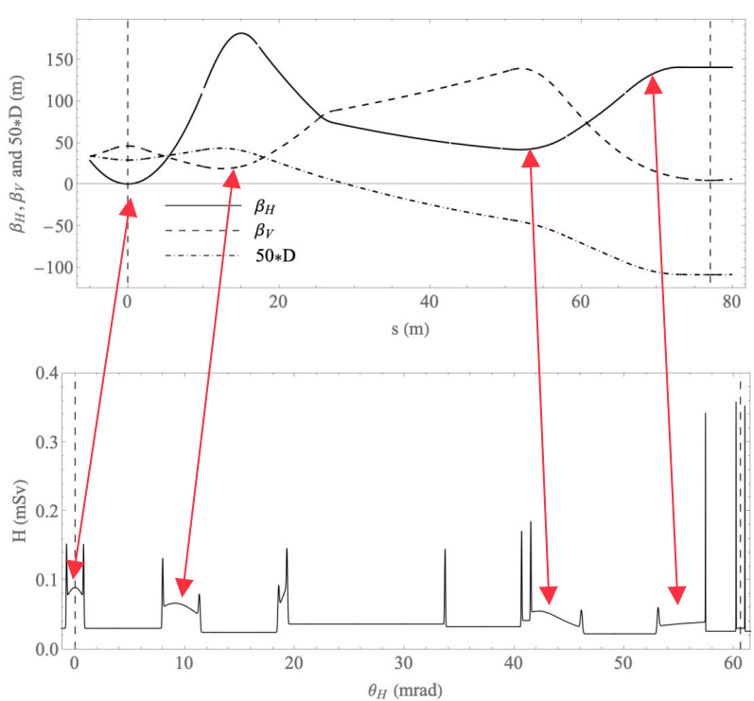
Collider lattice – Interconnection and bending regions
Interconnection and bending regions
Mitigation via mover system inducing periodic variation of the beam trajectory in the vertical plane (±1 mrad) distributing the neutrino flux over a larger surface area (reduction factor 80-90 for dose kernels)
Interconnection region
Bending region
Plans:
Evaluate mover system impact on beam dynamics and performances
Integrate realistic length and bending fields of interconnection regions once available
Investigate horizontal closed orbit deformations
Neutrino Flux mitigation via movers
Dose estimation 10 TeV lattice (06/23) arc region – C. Carli, “10 TeV com Collider Ring Parameters and Requirements
Preliminary beam studies on movers
D. Schulte, Roadmap Goal for the Muon Collider
Promising results in the FMC arc cells, but CC & MS sections to be studied
Findings: peaks for small interconnection sections (30 cm) and increased doses for reduced field sections
C. Carli, On Muon Collider Wobbling
See tomorrow’s talk by M. Vanwelde, Muon collider ring

Slide 9
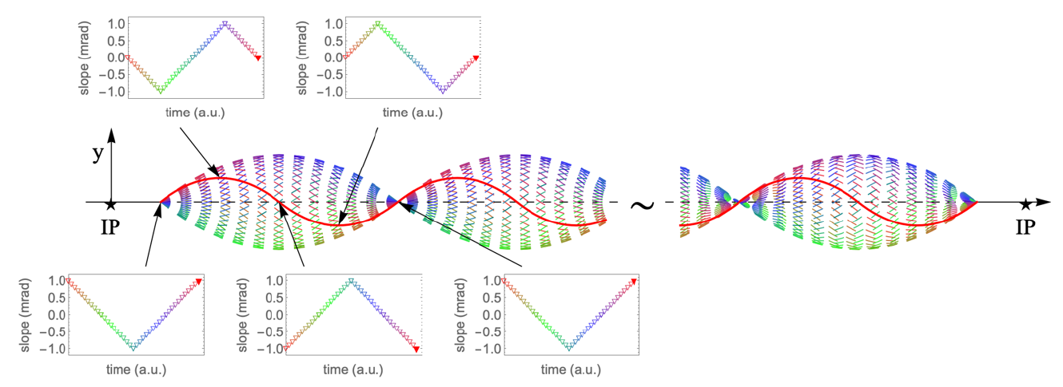
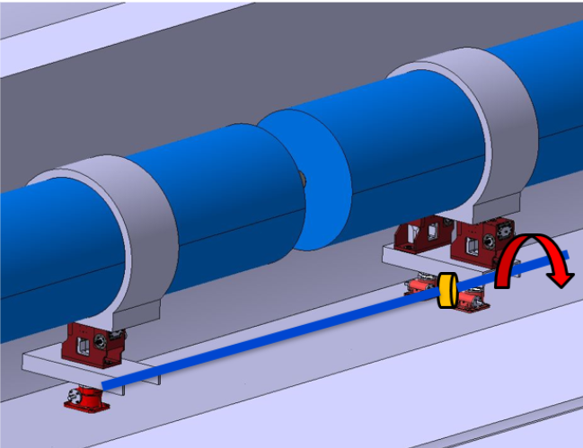
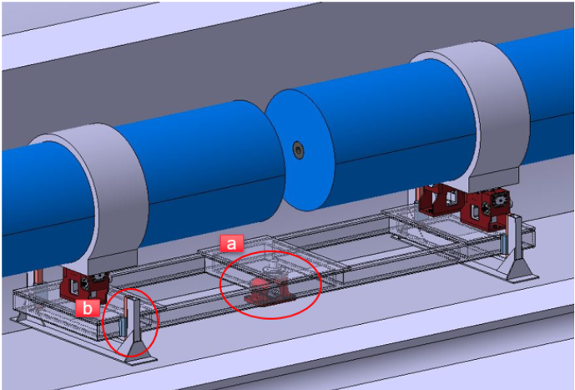
Movers
Goal: Develop and validate a support and actuation system for the collider magnet
Plans:
Step 1: Specification and Design
Define mechanical and actuation specifications
Design jacks and sensor integration
Perform mechanical simulations
Step 2: Prototyping & Integration
Manufacture 3 motorized jacks
Integrate control and sensor systems
Test on a dummy magnet mass
Step 3: System Validation
Full system test: 6 jacks with 2 magnet mass simulators
Evaluate synchronized actuation, accuracy, and robustness
Manufacturability optimisation and scalability studies
Initial studies on movers – C. Accettura, A. Kolehmainen, F. Bertinelli, T. Räty
Vertical beam deformation within ± 1 mrad
Two jacking systems proposals
Periodical displacement of the arcs ring structure in small steps, altering the muon beam trajectory over time, and thus effectively lowering the cumulative neutrino flux at any surface exit point
Initial studies assessed feasibility and clarified certain parameters, but a comprehensive, systematic analysis with precision evaluation is required
See tomorrow’s talk by C. Accettura, Plans for the mover system

Slide 10
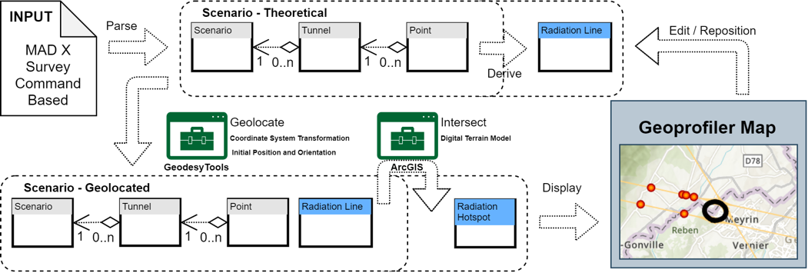
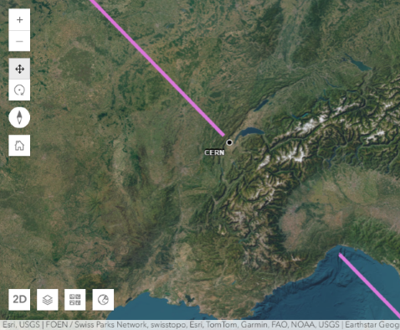
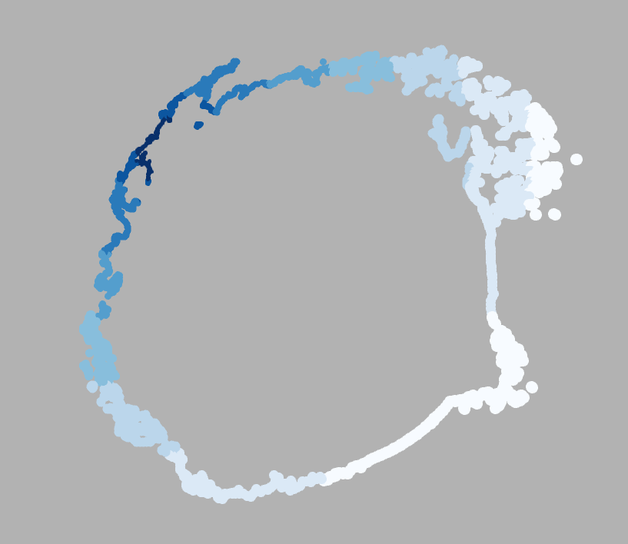
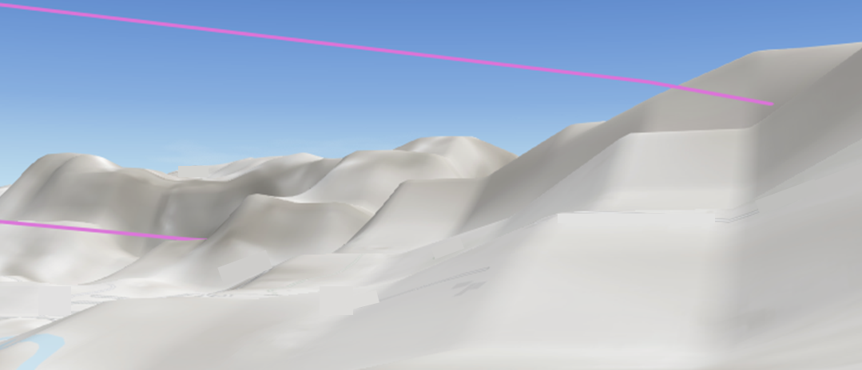
Dose surface map - GeoProfiler
Goal: Geolocate neutrino flux affected surface for a given accelerator scenario and optimize collider placement for a dose minimization
GeoProfiler tool
GeoProfiler – C. Desponds, N. Guilhaudin, Y. Robert
Plans: Further improvements of tool including
Analysis of area impacted by IPs
Visualization of bands from arc bending sections
Evaluation of potential overlaps in short straight sections, especially in critical areas
Surface model improvements
Implementation of height–depth clearance
Assessment of uncertainties
GeoProfiler tool available to study a specific collider placement
Identification of exit points for IPs and interconnection regions
Capability to study effect from mover system
IP locations
Interconnect. regions
Unrealistic exit point sizes
See tomorrow’s talk by C. Desponds, GeoProfiler
3D views
Effect from movers

Slide 11
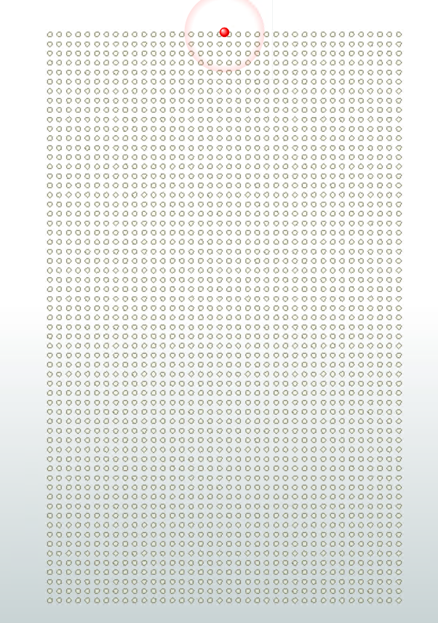
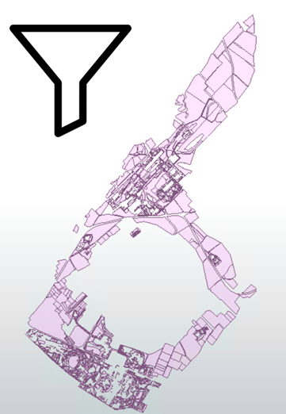
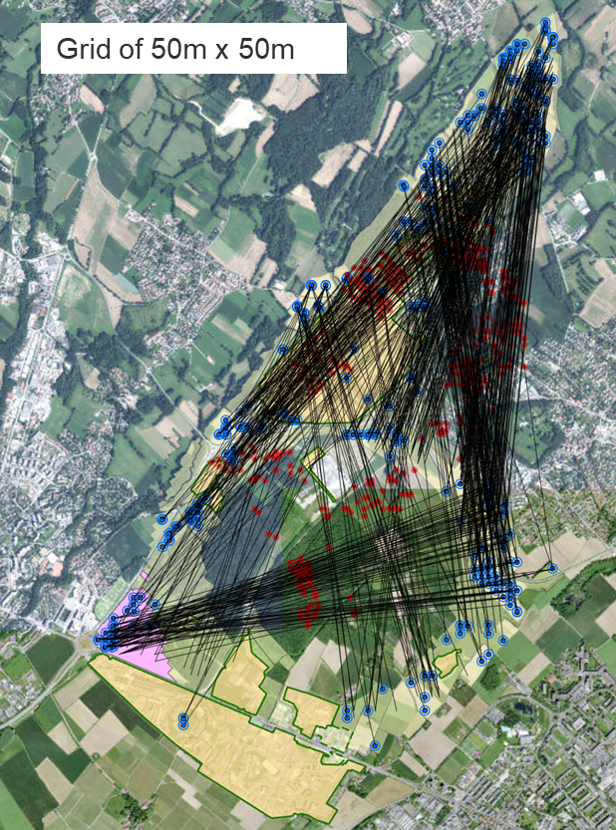
Dose surface map – Placement optimization
Goal: Geolocate neutrino flux affected surface for a given accelerator scenario and optimize collider placement for a dose minimization
Placement optimization tool
Placement optimization tool – C. Desponds, N. Guilhaudin, Y. Robert
Plans: Further improvements of analysis including
Investigation of resulting options including optimization of the exit points from the arcs
Potential adaptation of current inclination constraints (currently ±3%)
Analyze the impact of reducing parameter constraints (e.g. IP shafts outside CERN domain)
Tool for collider placement optimization within a predefined area, e.g. CERN domain
Potential configurations are filtered via preset parameters, such as non-built land, fixed IP shaft distance, max. depth, max. inclination, single exit points from IPs, distance of IP exit points, etc.
See tomorrow’s talk by C. Desponds, GeoProfiler

Slide 12
Dose Assessment, Sensitivity, and Compliance Plans
Dose assessment
Sensitivity analysis
Final dose assessment to be based on represent-tative persons from the public in combination with the dose surface maps
Uncertainties of dose estimate to be defined based on the various underlying parameters and assumptions
Demonstration of compliance
Only direct external exposure pathway relevant as activation negligible
Exposures to biota, i.e. animals and plants, are orders of magnitude below reference levels, and thus negligible
Evaluate means to demonstrate compliance of the dose estimates, both at the source (emission) and impact side (immission)
Source side
Impact side
Measure muon beam parameters (e.g. divergence)
Design suitable monitoring instrumentation for measuring the dose from the secondary particles
C. Ahdida, Overview of Neutrino Radiation Studies, IMCC Annual Meeting ‘24

Slide 13
R&D Resources
Resource estimates for the R&D plans related to neutrinos
Resources | 2026 | 2027 | 2028 | 2029 | 2030 | 2031 | 2032 | 2033 | 2034 | 2035
Staff | 0.55 | 0.55 | 0.55 | 0.55 | 0.55 | 0.45 | 0.45 | 0.45 | 0.45 | 0.45
Postdoc/ GRAD | 2 | 2 | 2 | 2 | 2 | 0.75 | 0.75 | 0.75 | 0.75 | 0.75
Material | ~650k over the next 4 years (~25% material, 75% personnel) |  |  |  | - | - | - | - | - | -
Resource profiling reflects stronger focus in the initial years of the R&D phase to reach sufficient maturity for the dose assessment model and the neutrino flux mitigation technology

Slide 14
Thank you
for your attention!

Slide 15
Legislation
Dose Limit
According to international RP safety standards, the effective dose limit for a member of the public for the exposure of all regulated sources is 1 mSv/year (see ICRP 103, 5.10 paragraph 245).
Dose Constraint
“A dose constraint is a prospective and source related value of individual dose (dose constraint) or risk (risk constraint) that is used in planned exposure situations as a parameter for the optimisation of protection and safety for the source, and that serves as a boundary condition in defining the range of options in optimization.” ”[It] is a level of dose above which it is unlikely that protection is optimized” (IAEA GSG-8, paragraphs 2.23 and 2.24). A generic dose constraint is assuming the exposure of a person to 3 sources at the same time, resulting in 0.3 mSv/year (for details see IAEA GSG-9, A-2).
Dose Optimisation
Next to the limitation, personal doses and collective doses must be optimized and be kept as low as reasonably achievable (ALARA). According to IAEA GSG-9, paragraph 5.32: “When the projected doses to members of the public are of the order of 10 μSv per year or below, a process for optimization should not normally be required, on the basis that the efforts for further dose reduction would generally not fulfil the requirement for optimization.”
100 rem = 1 Sv

