Slide 1
Magnets
Timeline, R&D Plan and Cost
L. Bottura¹, F. Boattini¹, B. Bordini¹, B. Caiffi², S. Fabbri¹, S. Mariotto^{3,4}, M. Statera³
¹ CERN ,² INFN – Genova, ³ INFN – Milano, ⁴ University of Milan

Slide 2
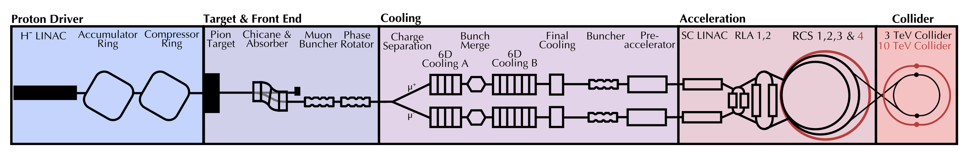
Outline
References
Magnet timeline
R&D plan
Cost evaluation
Summary

Slide 3
Outline
References
Magnet timeline
R&D plan
Cost evaluation
Summary

Slide 4
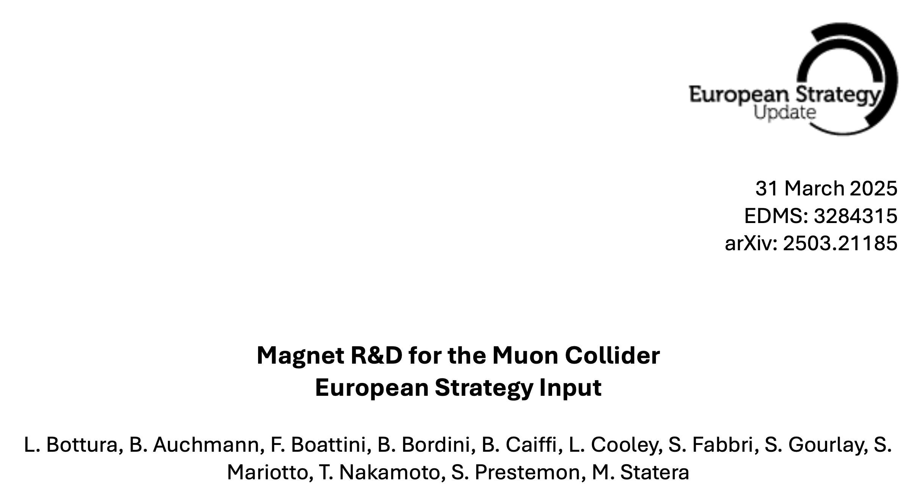
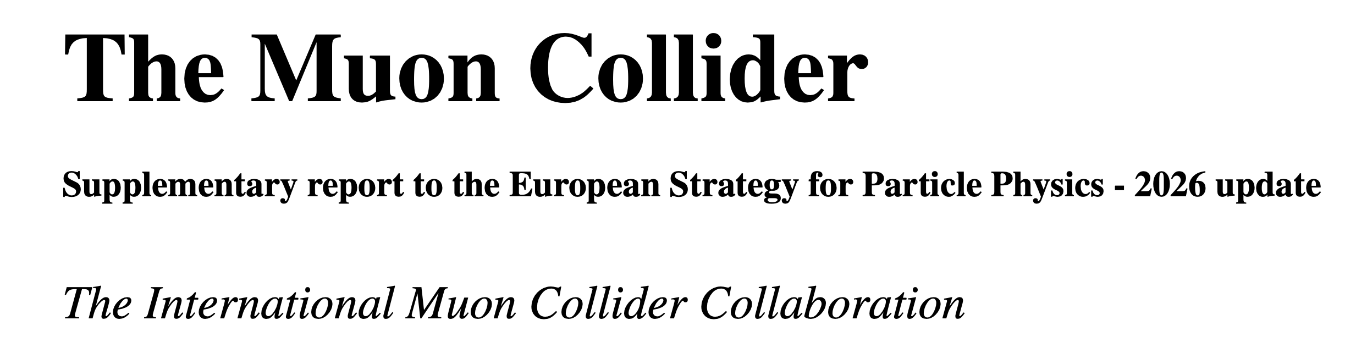
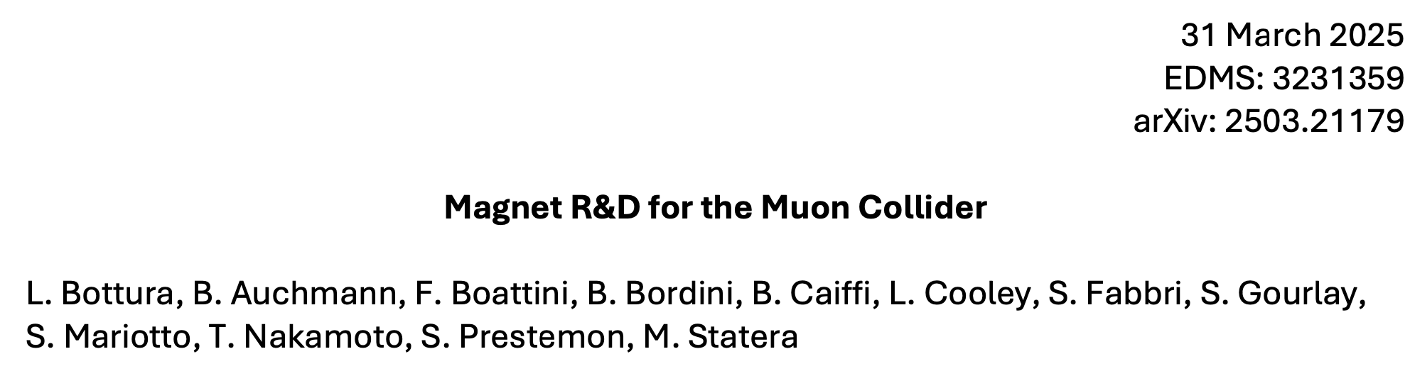
References
402 pages
The material presented here is detailed and discussed extensively in the documents prepared for submission to the 2026 ESPPU process
Much space and attention was given to building a bottom-up and analytical R&D program
11 pages
42 pages

Slide 5
Outline
References
Magnet timeline
R&D plan
Cost evaluation
Summary

Slide 6
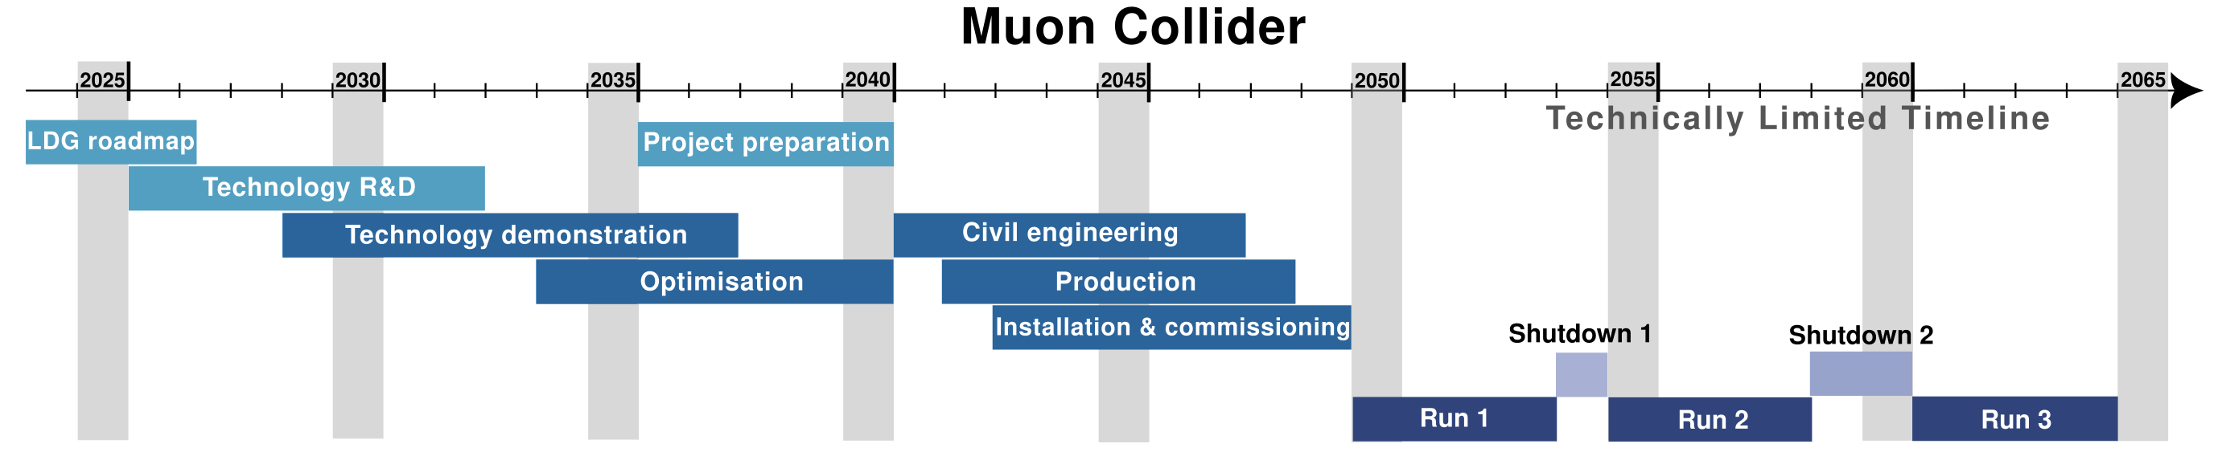
Project Timeline
Technology R&D completed: 2032
Demonstrators built and tested: 2037
Prototypes and industrialization (Optimisation): 2040
Production completed: 2048

Slide 7
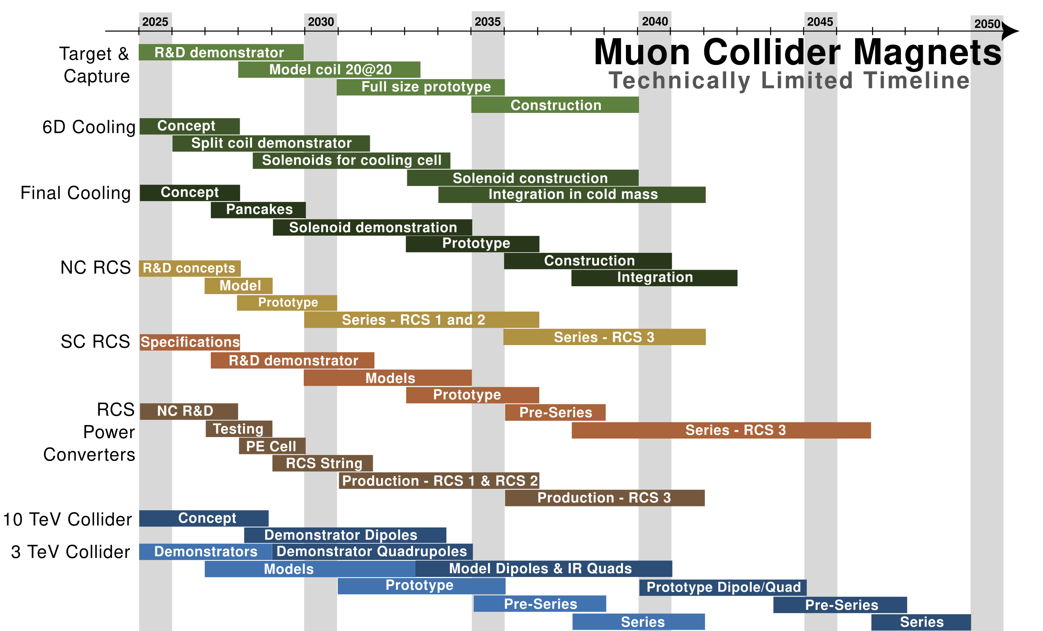
Prototypes and Industrialization
Technology R&D
Demonstrators
Production
This is one of the possible plans, prepared as a technically limited timeline
Most magnet milestones are well aligned with the overall project plan
A 3TeV option (consisting of HTS solenoids, NC RCS1+RCS2 and Nb-Ti collider) appears to be feasible with contingency by the desired start in 2050
A 10TeV option (HTS solenoids, NC RCS1+RCS2, HTS HCS3 and HTS collider) misses the desired 2050 milestones by 2…3 years

Slide 8
Outline
References
Magnet timeline
R&D plan
Cost evaluation
Summary

Slide 9

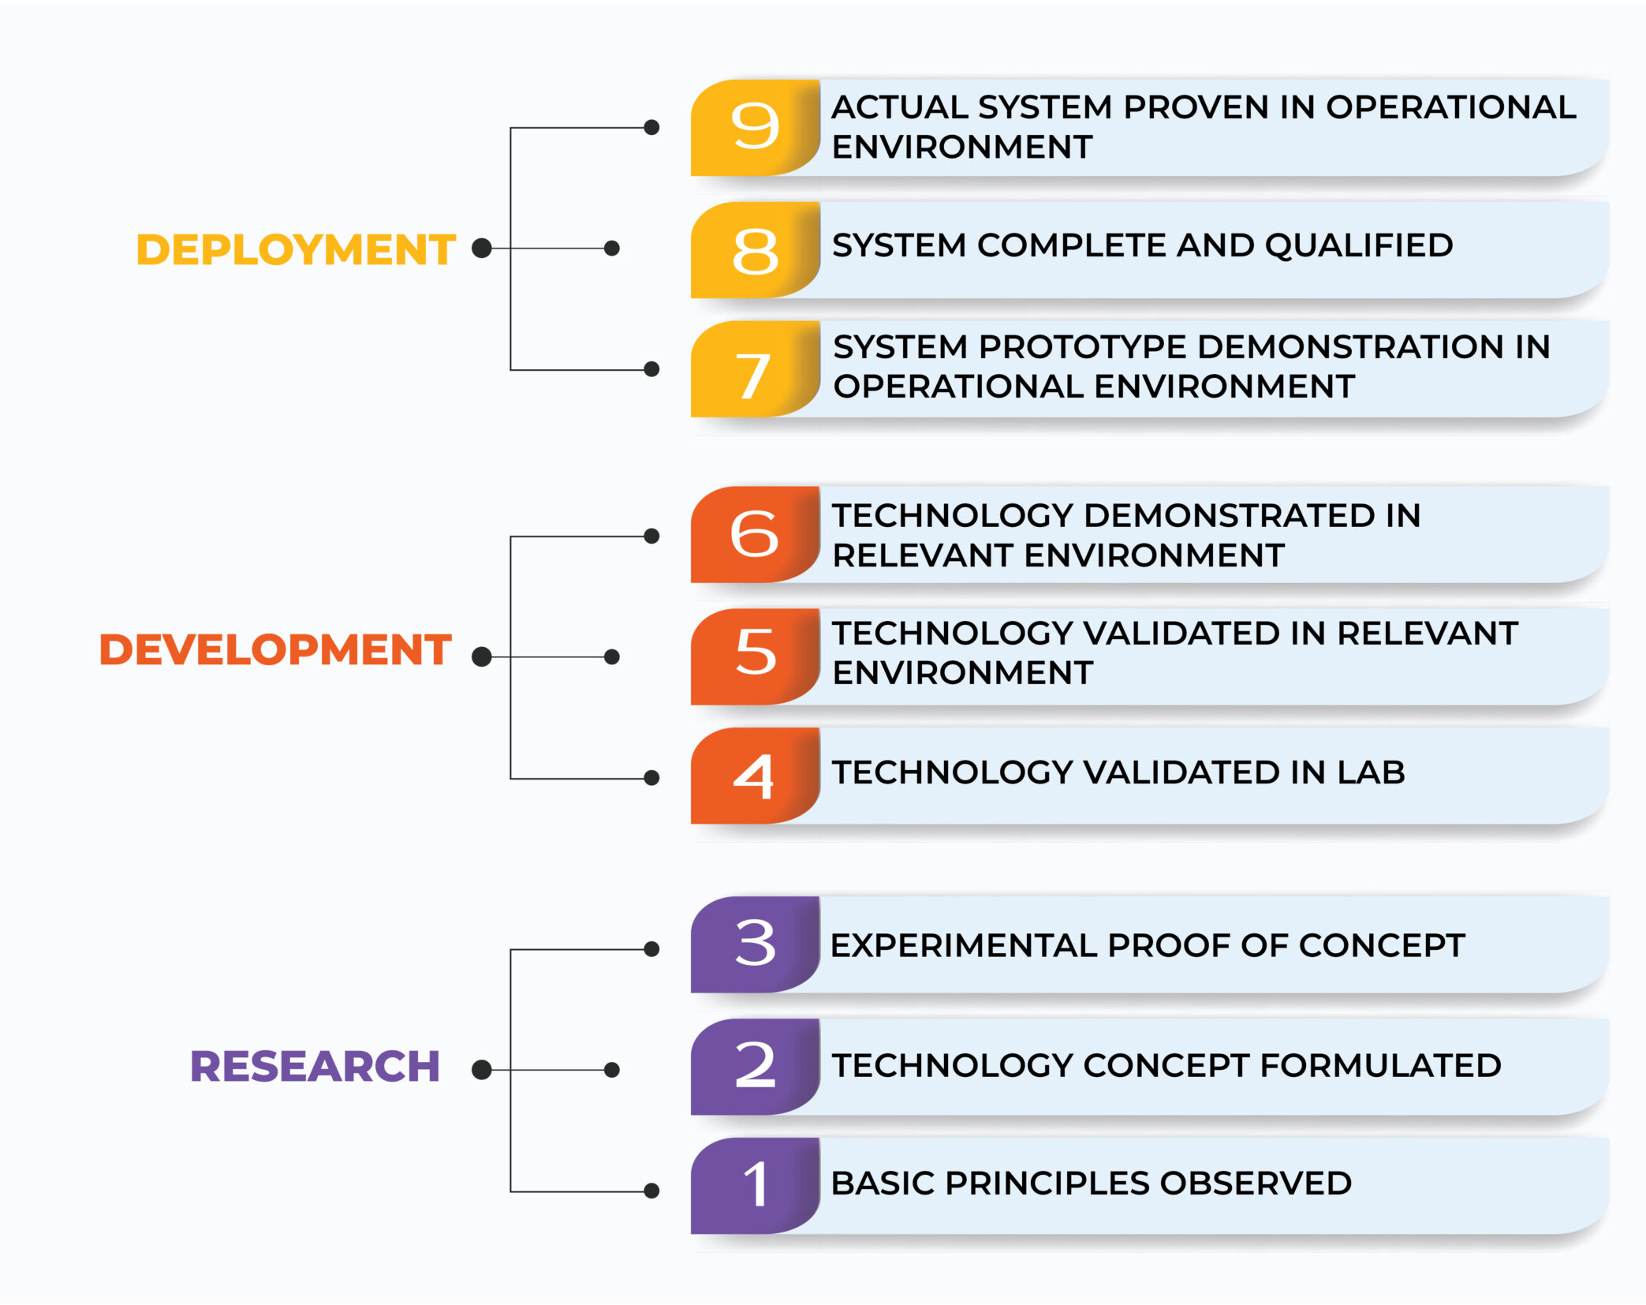
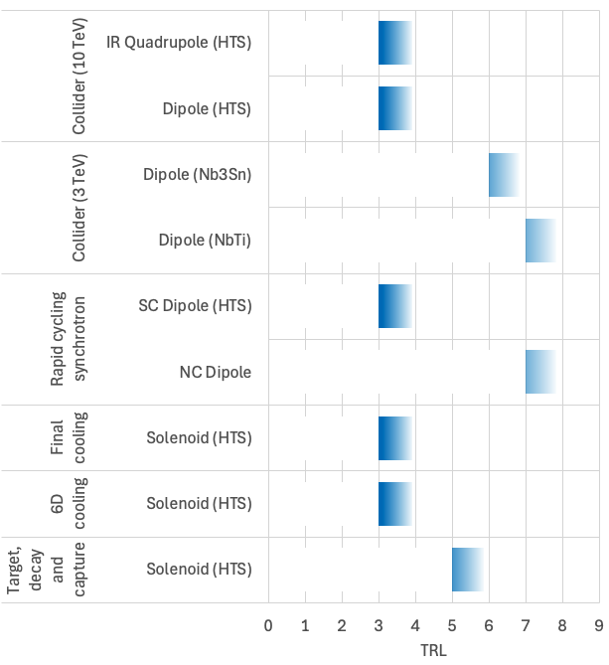
TRL Drives the R&D
We wish to reach TRL6 to de-risk cost and timeline, as required for project decision
TRL6 is appropriate to initiate industry prototype engineering and construction

Slide 10
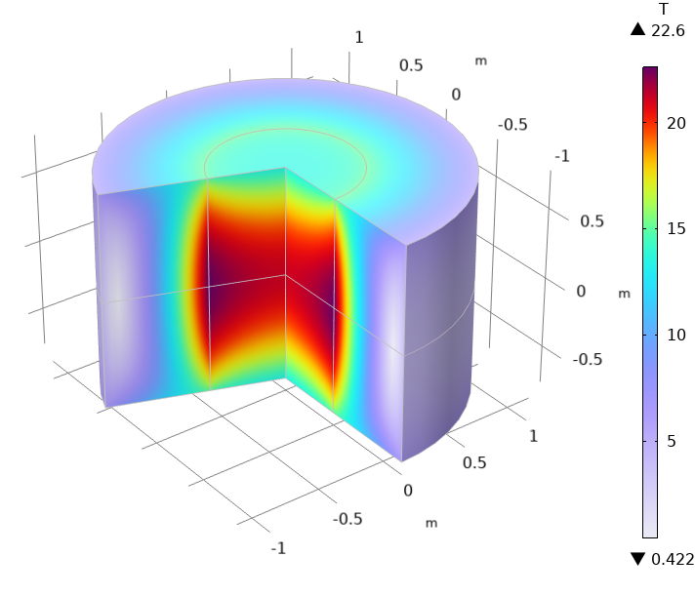
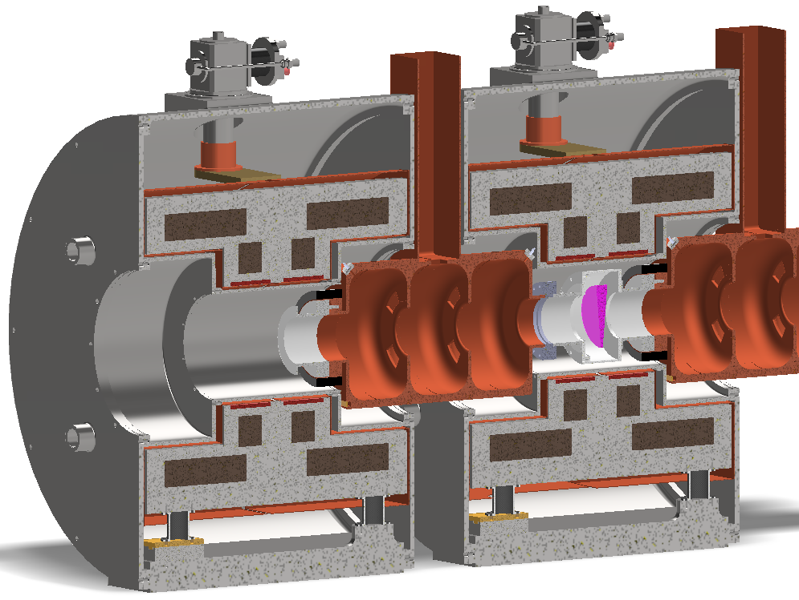
R&D Technology Milestones - 1/3
Technology: Target solenoid model coil (20@20)
Objectives: Develop conductor, winding and magnet technology suitable for a target solenoid, generating a bore field of 20 T, and operating at a temperature of 20 K.
Time: 2033
Resources: 30 MCHF, 37 FTEy
Technology: Split Solenoid integration for 6D cooling cell (SOLID)
Objectives: Demonstrator of HTS split solenoid performance, including integration in its support structure submitted to mechanical and thermal loads representative of a 6D cooling cell.
Time: 2032
Resources: 7.1 MCHF, 42 FTEy
Technology: Final cooling UHF solenoid (UHF-Demo)
Objectives: Build and test a demonstrator HTS final cooling solenoid, producing 40 T in a 50 mm bore, and total length of 150 mm.
Time: 2034
Resources: 5.6 MCHF, 52 FTEy

Slide 11
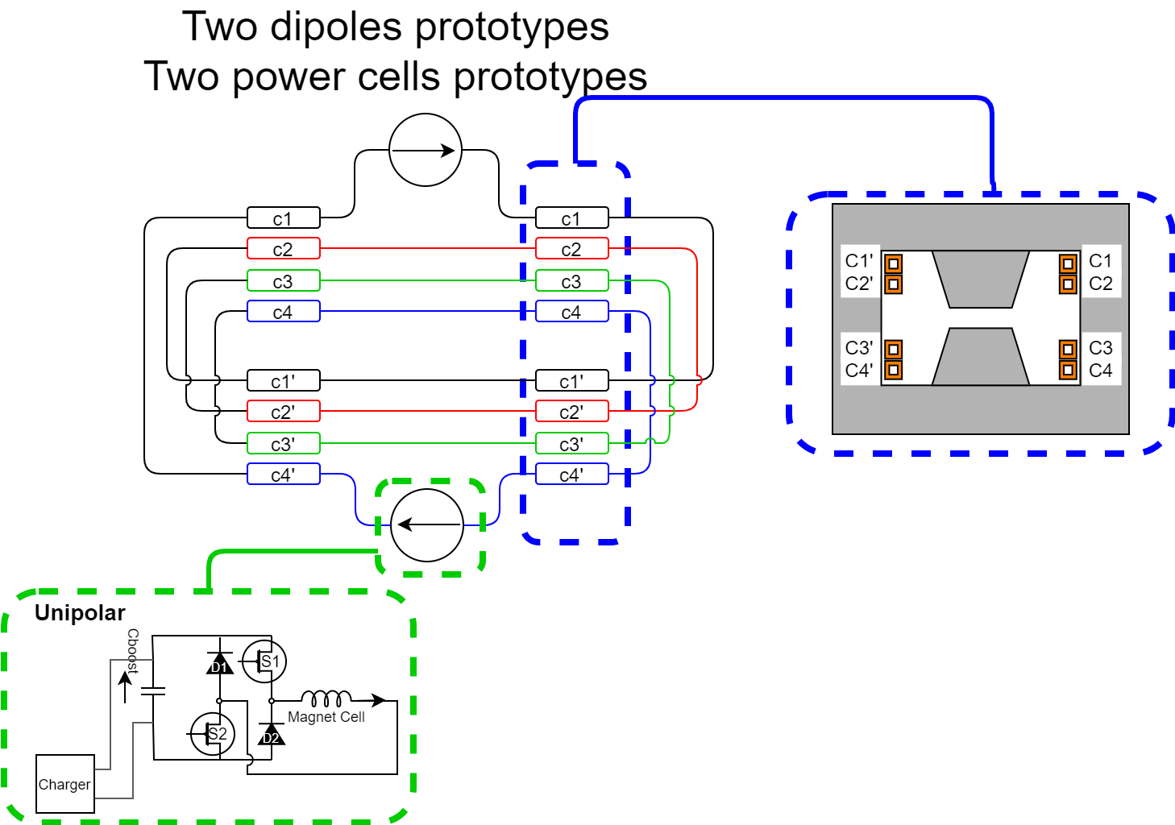
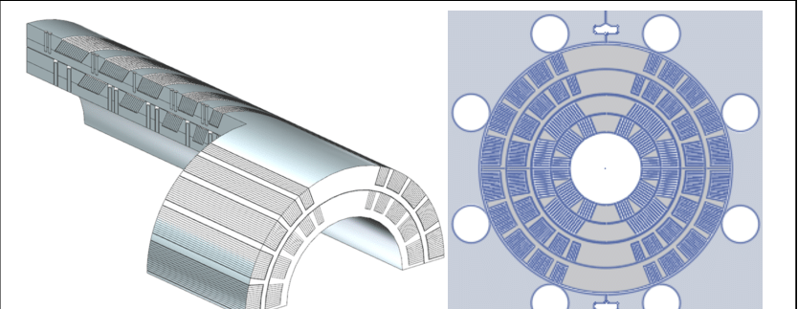
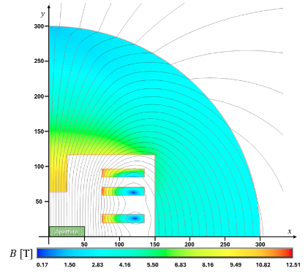
R&D Technology Milestones - 2/3
Technology: RCS fast pulsed magnet string and power system (RCS-String)
Objectives: Build and test a string of resistive pulsed dipoles, including powering system and capacitor-based energy storage.
Time: 2032
Resources: 6 MCHF, 20 FTEy
Technology: Wide-aperture, steady state Nb₃Sn dipole for the collider (MBHY)
Objectives: Demonstrate LTS dipole performance for collider arc.
Time: 2036
Resources: 11.1 MCHF, 71 FTEy
Technology: Rectangular aperture HTS dipole (MBHTS)
Objectives: Demonstrate performance of rectangular aperture HTS dipole for the accelerator.
Time: 2035
Resources: 8.3 MCHF, 60 FTEy

Slide 12
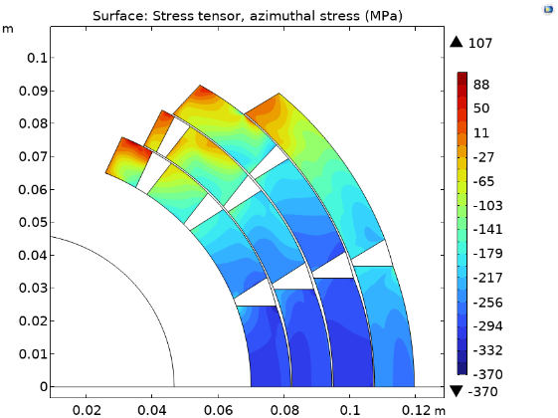
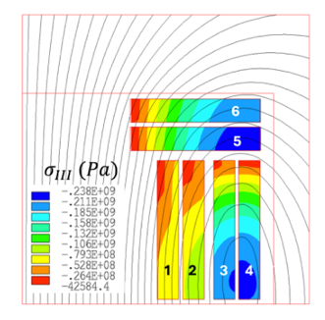
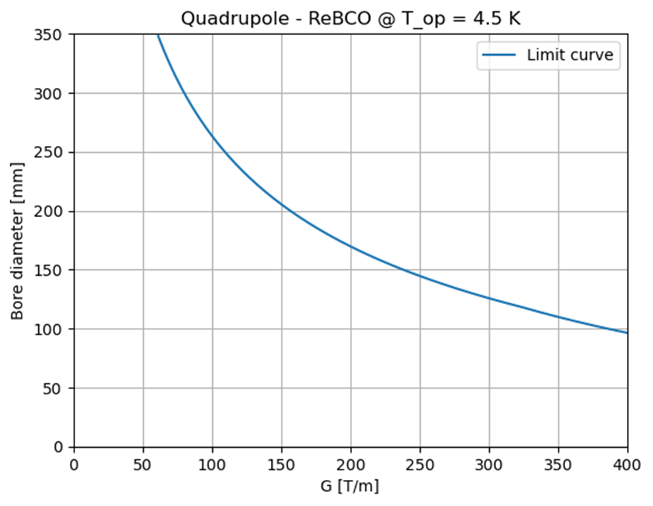
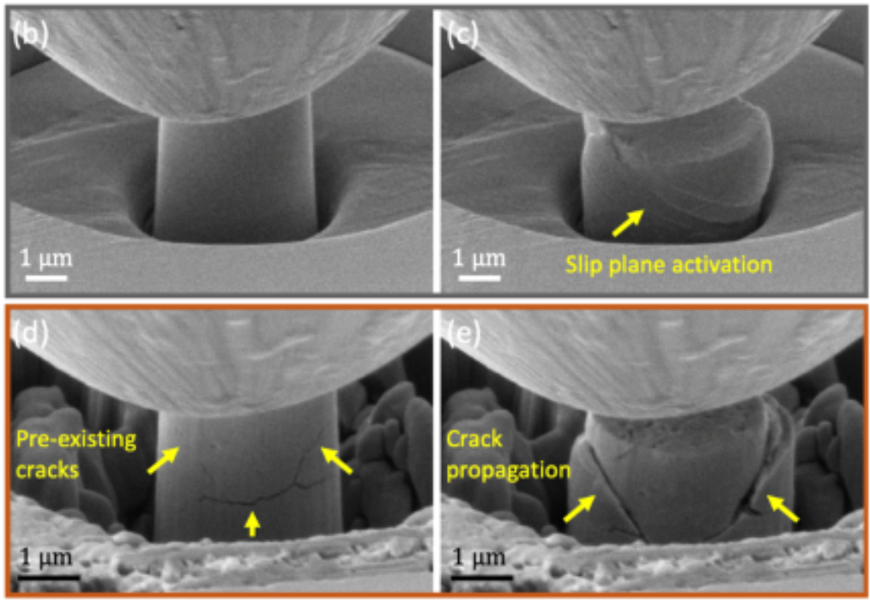
R&D Technology Milestones - 3/3
Technology: Wide aperture HTS dipole (MBHTSY)
Objectives: Demonstrate wide aperture HTS dipole for the collider arc.
Time: (2045)
Resources: 7.9 (15.8) MCHF, 75 (126) FTEy
Technology: Wide aperture HTS IR quadrupole (MQHTSY)
Objectives: Demonstrate wide aperture HTS quadrupole for the collider IR.
Time: (2045)
Resources: 3.5 (8.8) MCHF, 27 (60) FTEy
Materials and Methods
Objectives: Host and coordinate methods and materials R&D, characterization and testing common to magnet demonstrators design, manufacturing and testing.
Time: 2035
Resources: 3 MCHF, 30 FTEy

Slide 13
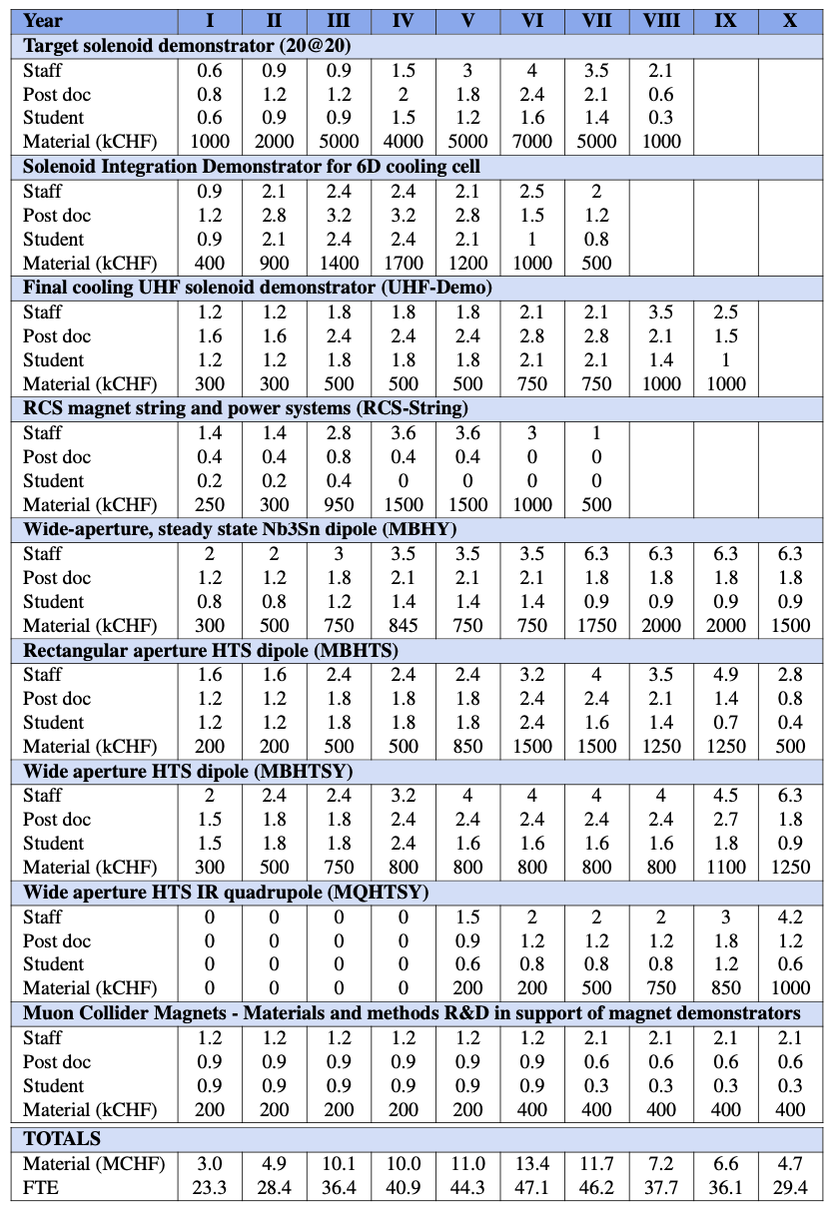
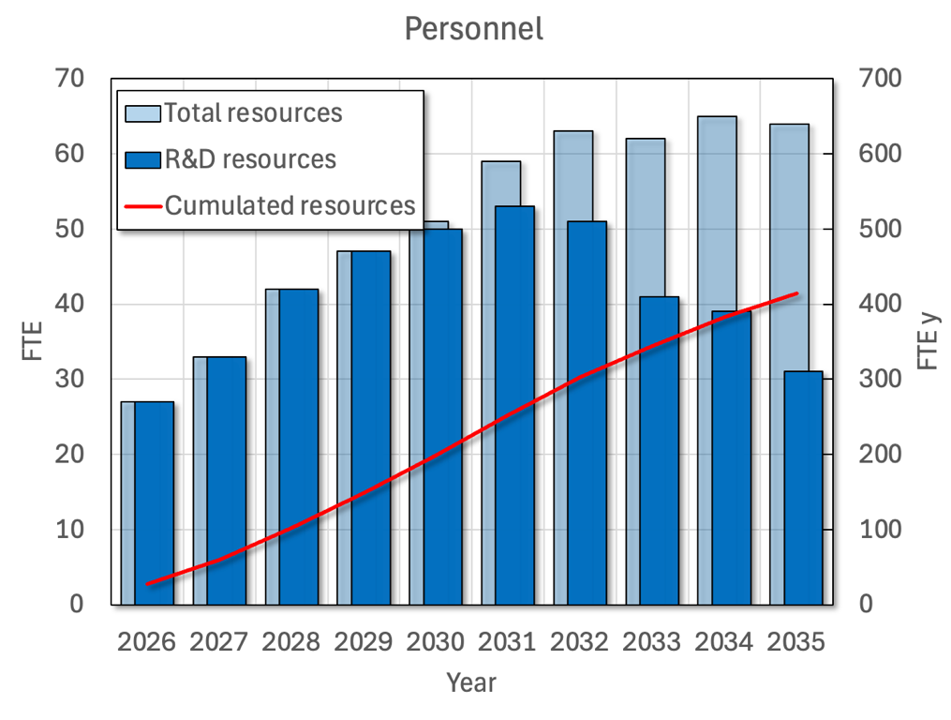
R&D Resources - Personnel
414FTEy

Slide 14
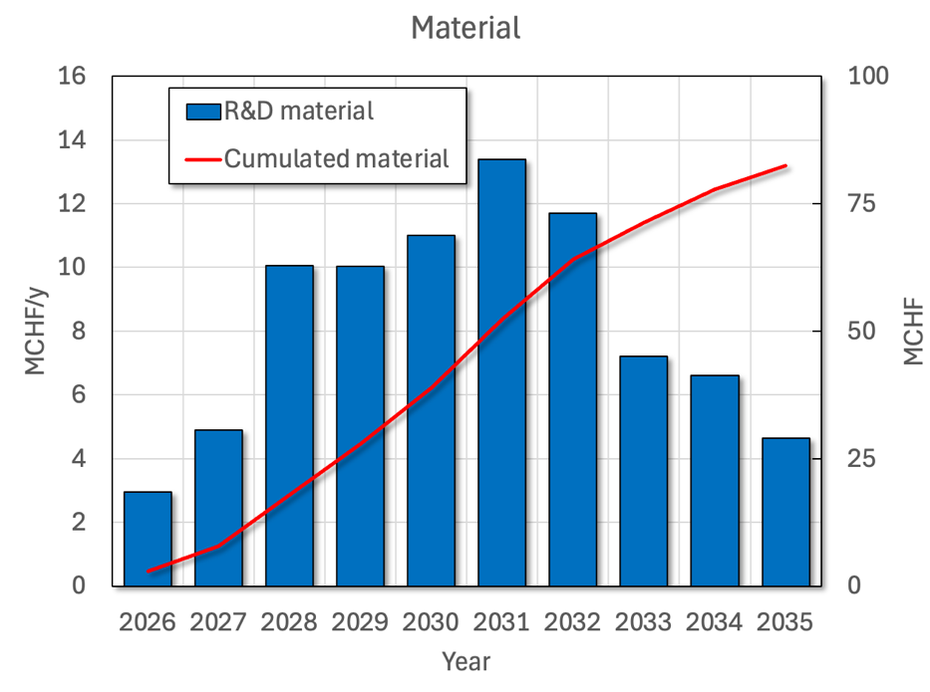
R&D Resources - Material
82.5MCHF

Slide 15
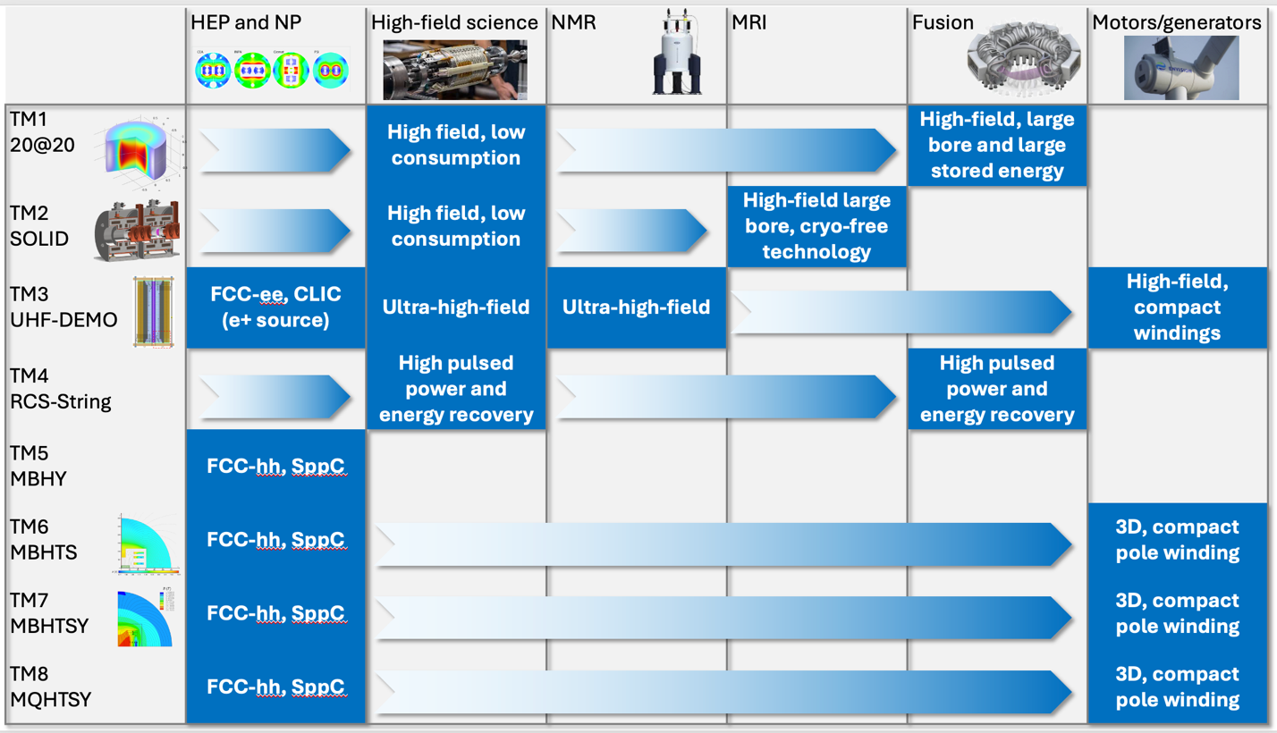
R&D Impact

Slide 16





Practical Impact Examples
Fusion for Energy (ITER EU Domestic Agency)
  Framework agreement and first addendum in final negotiation
  Contribution to the design of the HTS target solenoid, relevant to the central solenoid of DTT
EUROFusion (next step European fusion reactor)
  Framework agreement signed in 2023, first addendum signed in 2024
  Contribution to the design of the HTS target solenoid, relevant to the magnets of a Volumetric Neutron Source proposed as next step in the European fusion strategy
Gauss Fusion (one of the leading EU fusion start-ups)
  Consultancy agreement signed in 2023
  CERN contribution to the design of the LTS/HTS GIGA stellarator magnets, based on advances in the HTS target solenoid
ENI (oil and gas energy giant)
  Framework agreement and first addendum signed in 2024
  Collaboration on the conceptual design and project proposal for the CERN construction of a large bore HTS solenoid (20@20 model coil) relevant to the muon collider and fusion
IFAST-2 proposal to INFRA-2025-TECH-01-02 (CERN, INFINEON, PSI)
  Proposal of fast pulsed power cell + magnet system sent to IFAST-2 coordination for ranking at TIARA
  Industrial interest in rapidly pulsed and large energy/power supplies

Slide 17
Outline
References
Magnet timeline
R&D plan
Cost evaluation
Summary

Slide 18
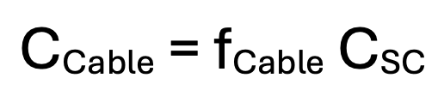
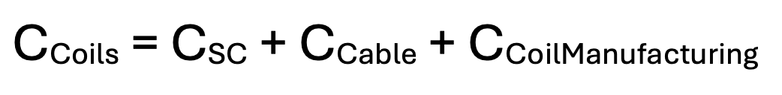

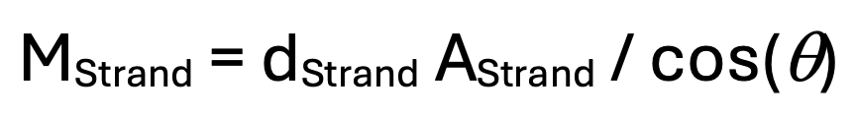
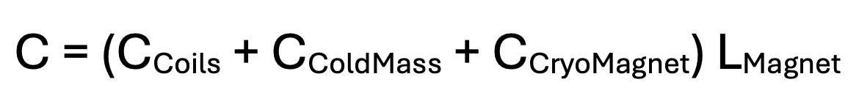
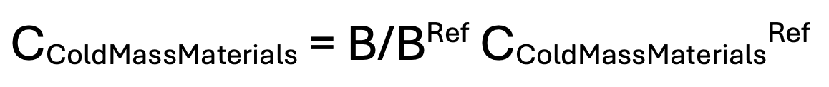
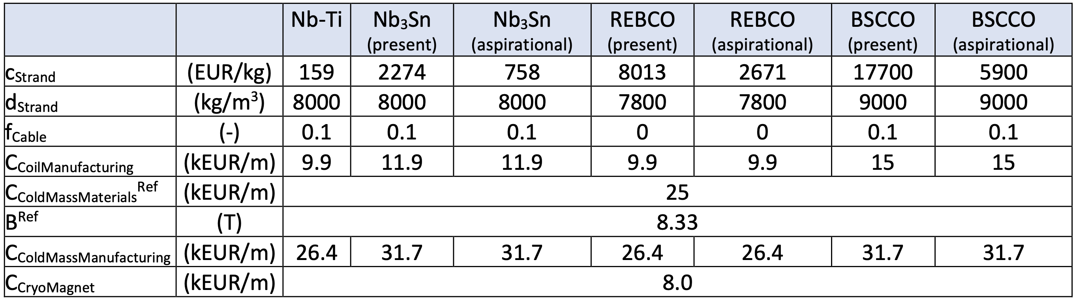
Cost Model
The cost is evaluated analytically, for all magnets and systems as:
(Cost of material + Cost of manufacturing) * Quantity
Example for accelerator magnets:

Slide 19
Remarks on Cost Model
The costing has uncertainty that will reduce thanks to the results of the R&D. The cost, hopefully, as well
The result of the costing exercise has already brought focus on R&D of the most expensive items, besides the most challenging ones
There is a strong focus on HTS in the R&D because of the present evolution of magnet science and technology, as well as clear market potential

Slide 20
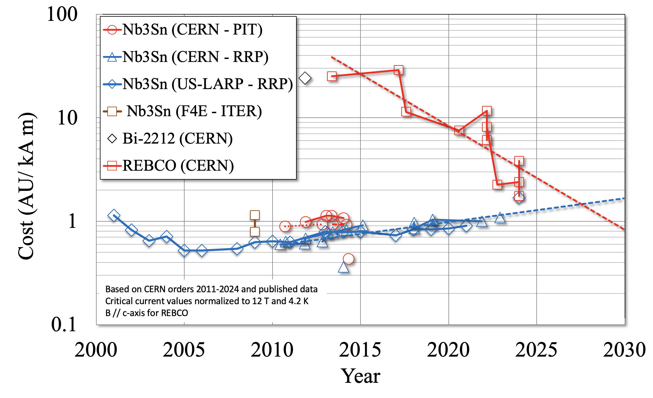
Cost of Superconductors

Slide 21
Outline
References
Magnet timeline
R&D plan
Cost evaluation
Summary

Slide 22
Summary
A challenging program of R&D is proposed for the muon collider magnets, with the intention to:
  Develop and de-risk the magnet and powering technology critical for a project decision, by advancing TRL from present values of TRL3…4 to TRL6
  Reduce timeline and cost uncertainty, making the 2050 first light target for the muon collider possible
  Profit from synergies and produce impact on multiple other fields of scientific and societal applications
The magnet technology selected is largely based on HTS because of the present evolution of magnet science and technology, as well as clear market potential
The R&D milestones in the years 2032-2035 will allow control and revision, as necessary to adapt to the results and new demands (e.g. combined function demonstrator magnet)

Slide 23

HIC SVNT LEONES

Slide 24
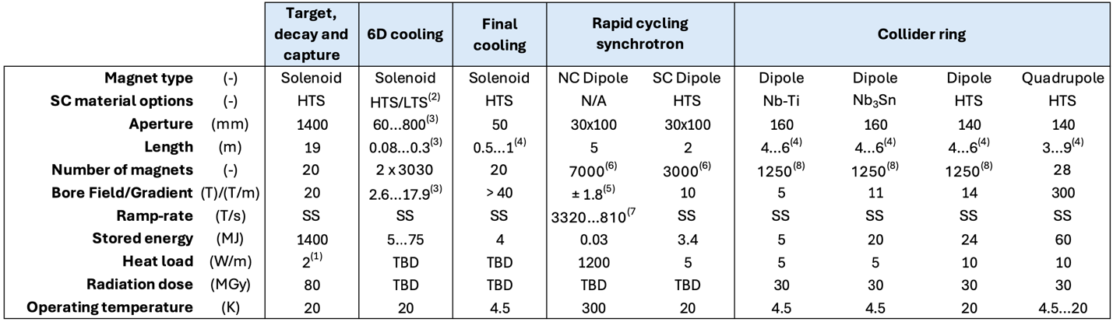
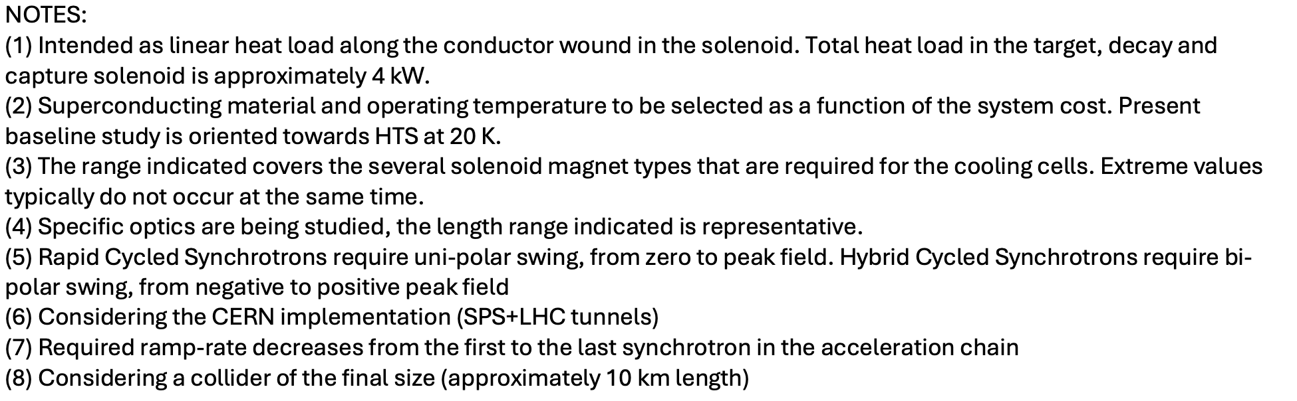
Magnet R&D Targets

Slide 25
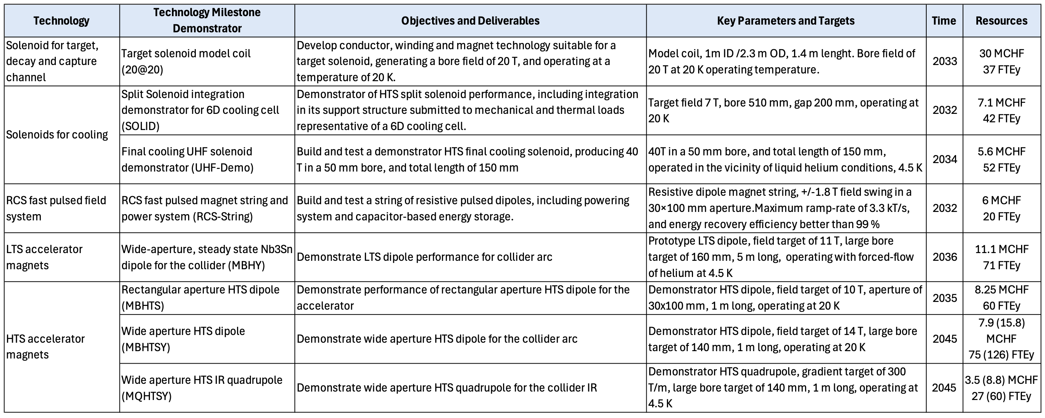
R&D Technology Milestones

Slide 26
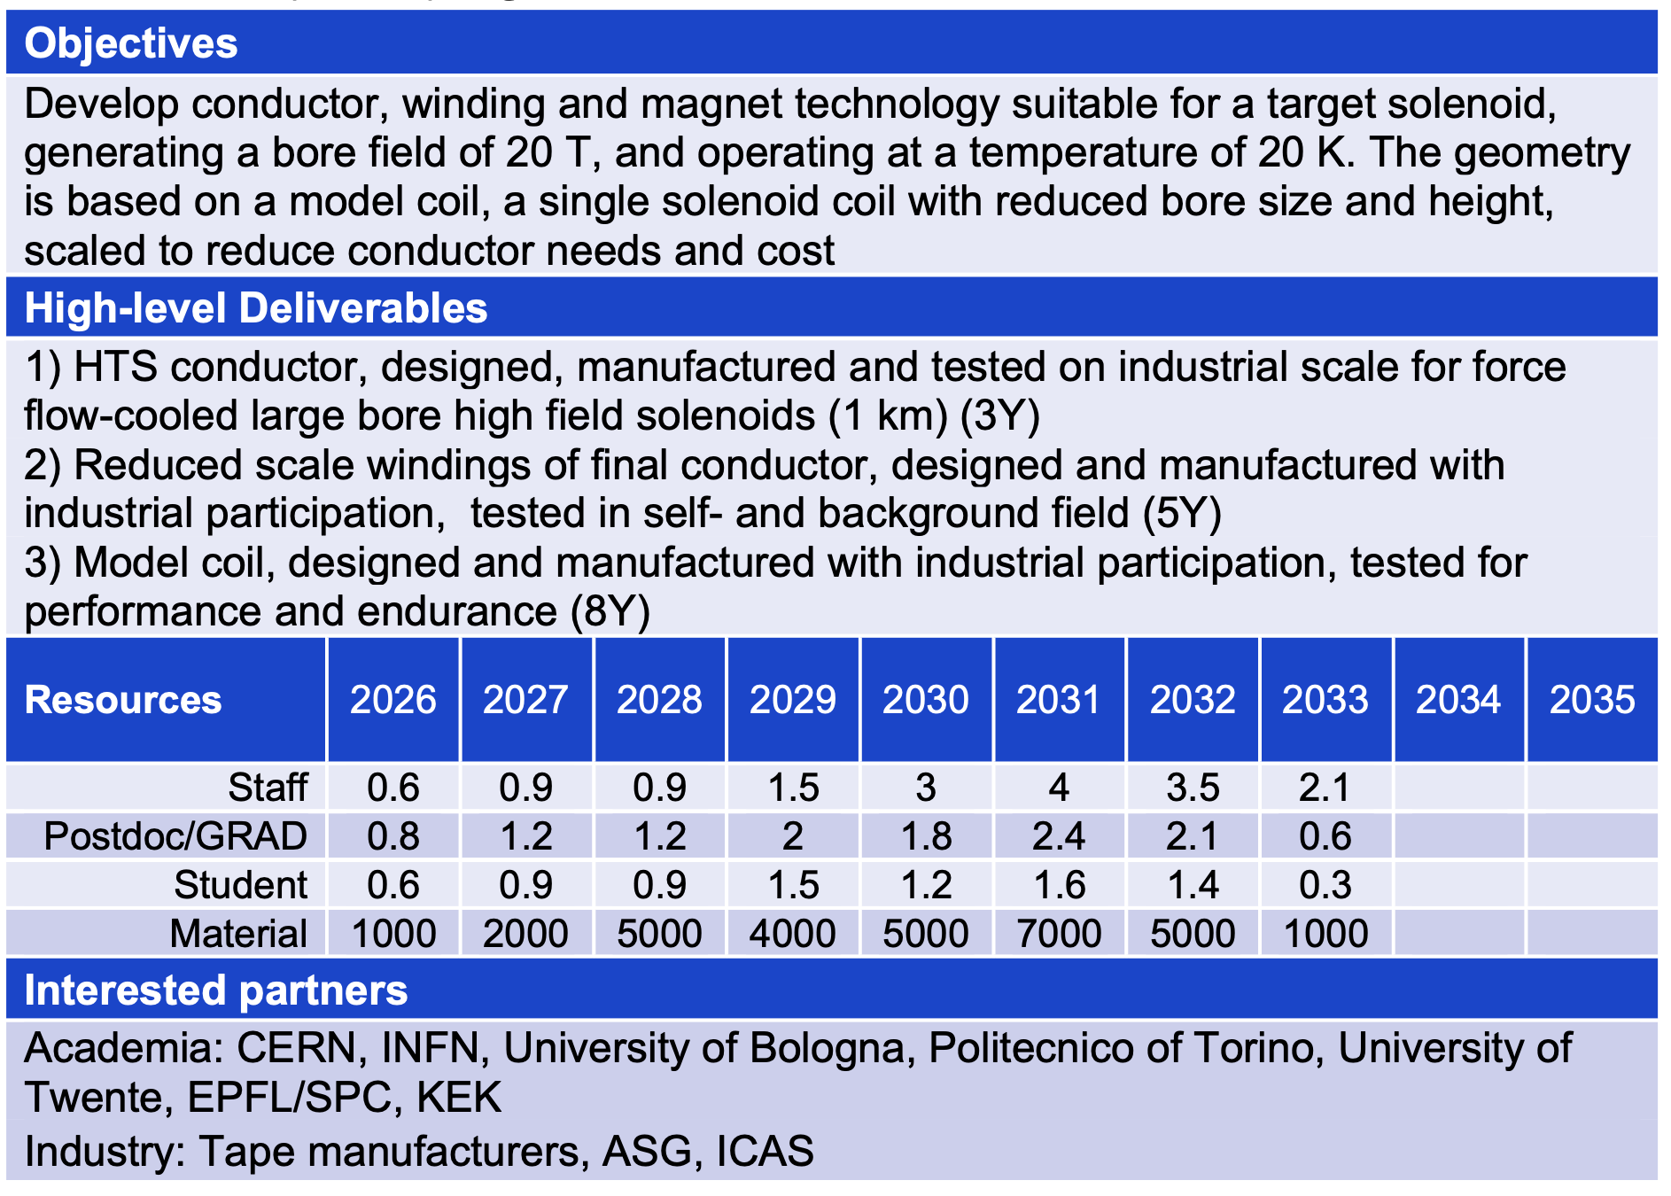
TM1 – 20@20

Slide 27
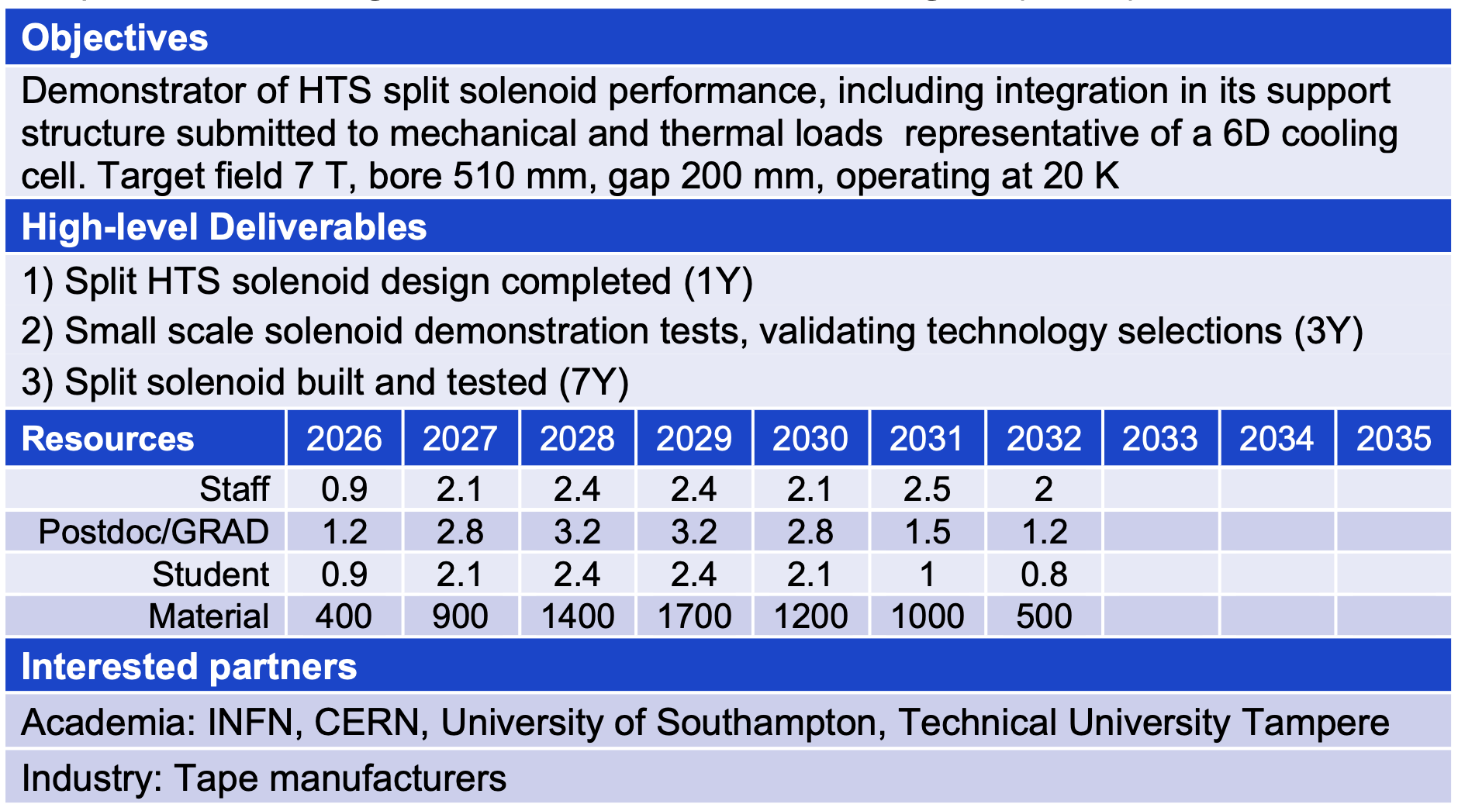
TM2 – SOLID

Slide 28
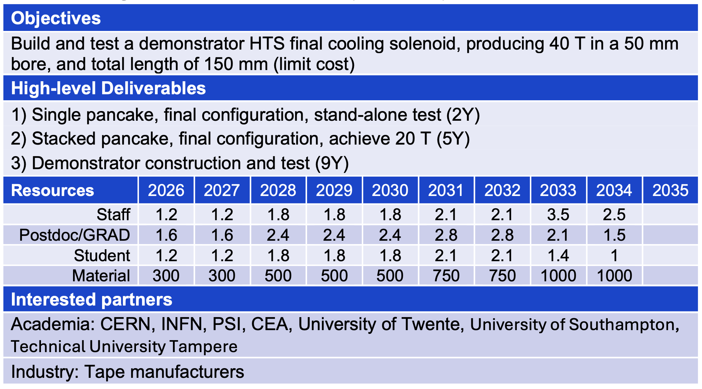
TM3 – UHF-Demo

Slide 29
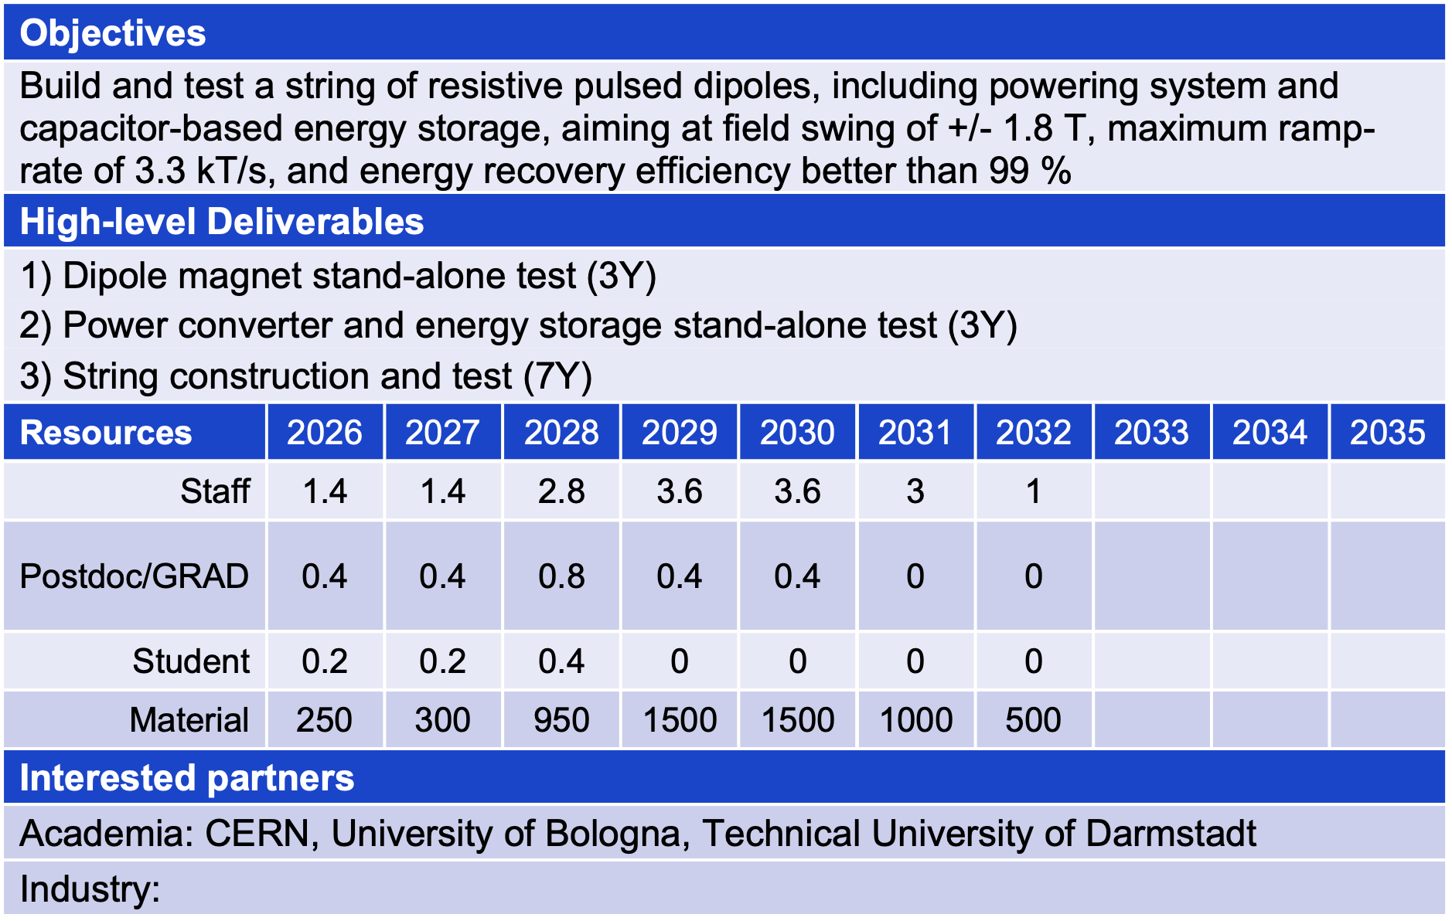
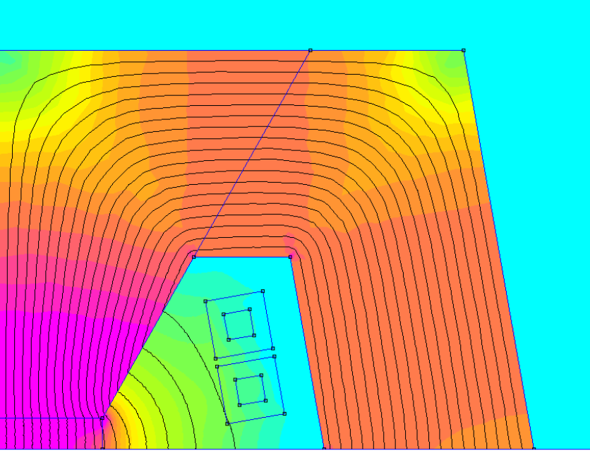
TM4 – RCS-String

Slide 30
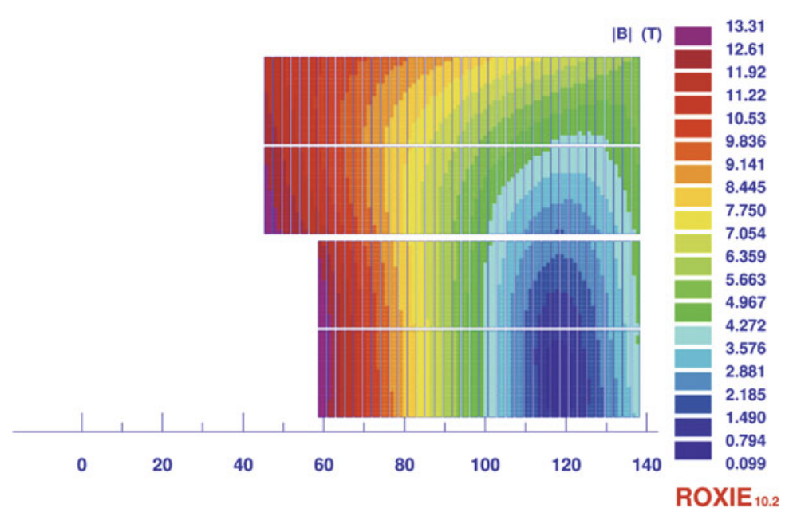
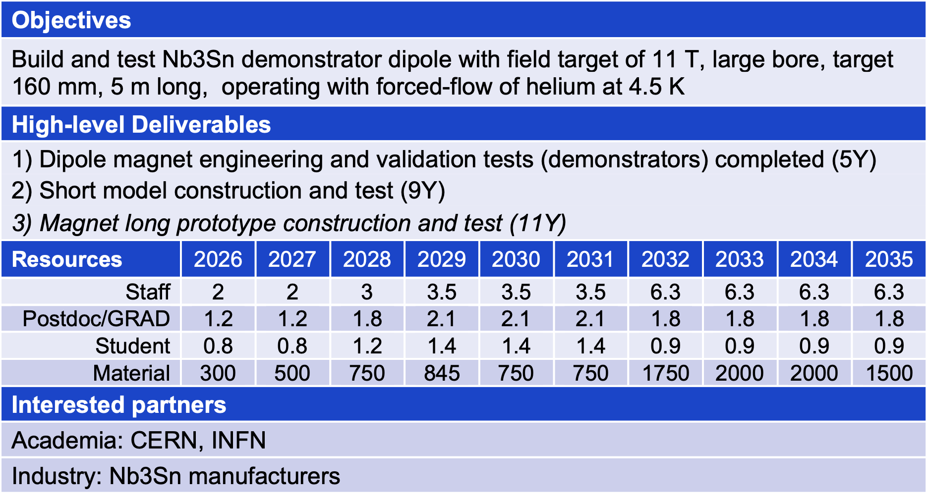
TM5 – MBHY

Slide 31
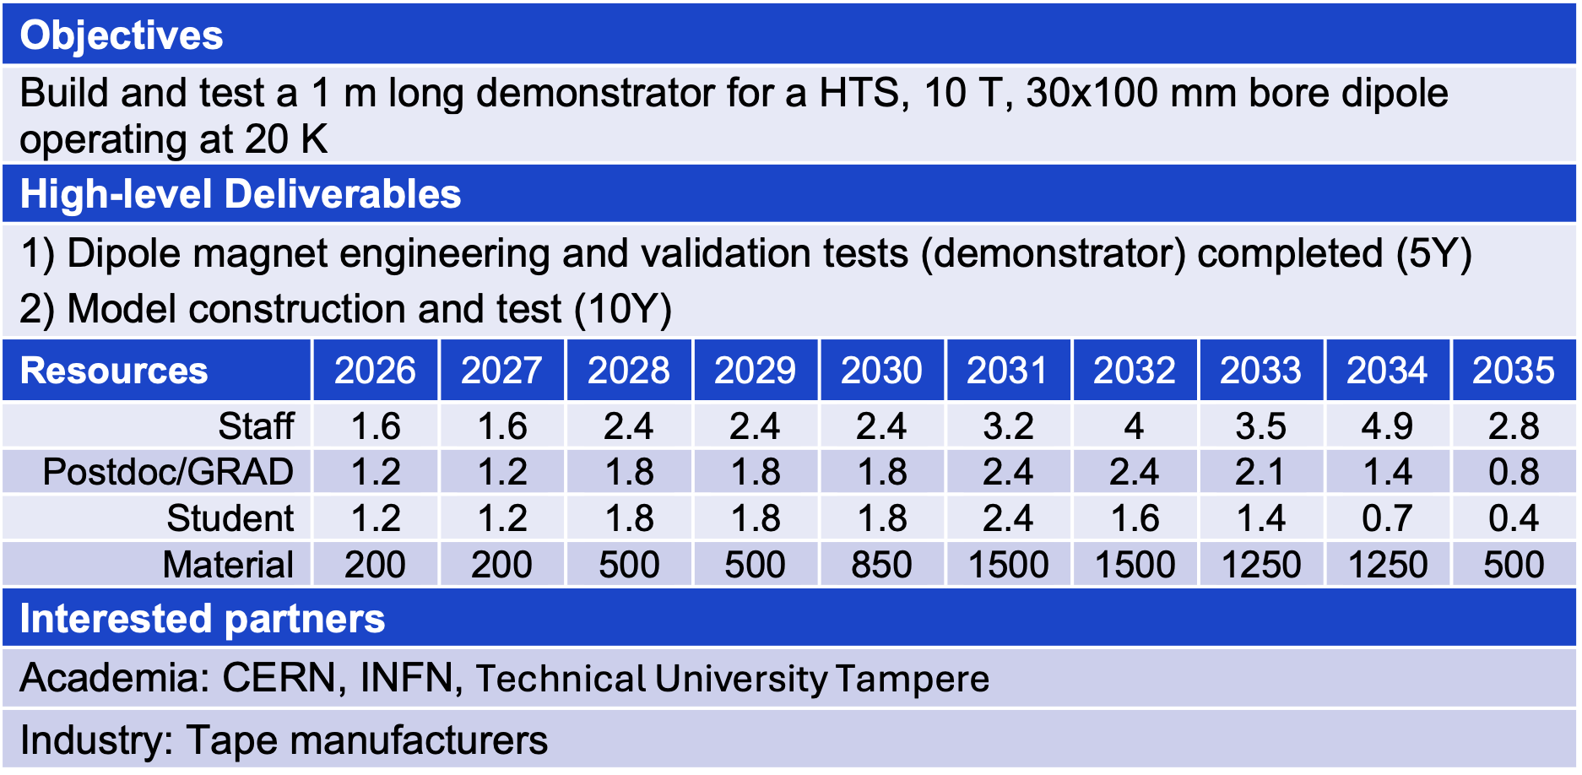
TM6 – MBHTS

Slide 32
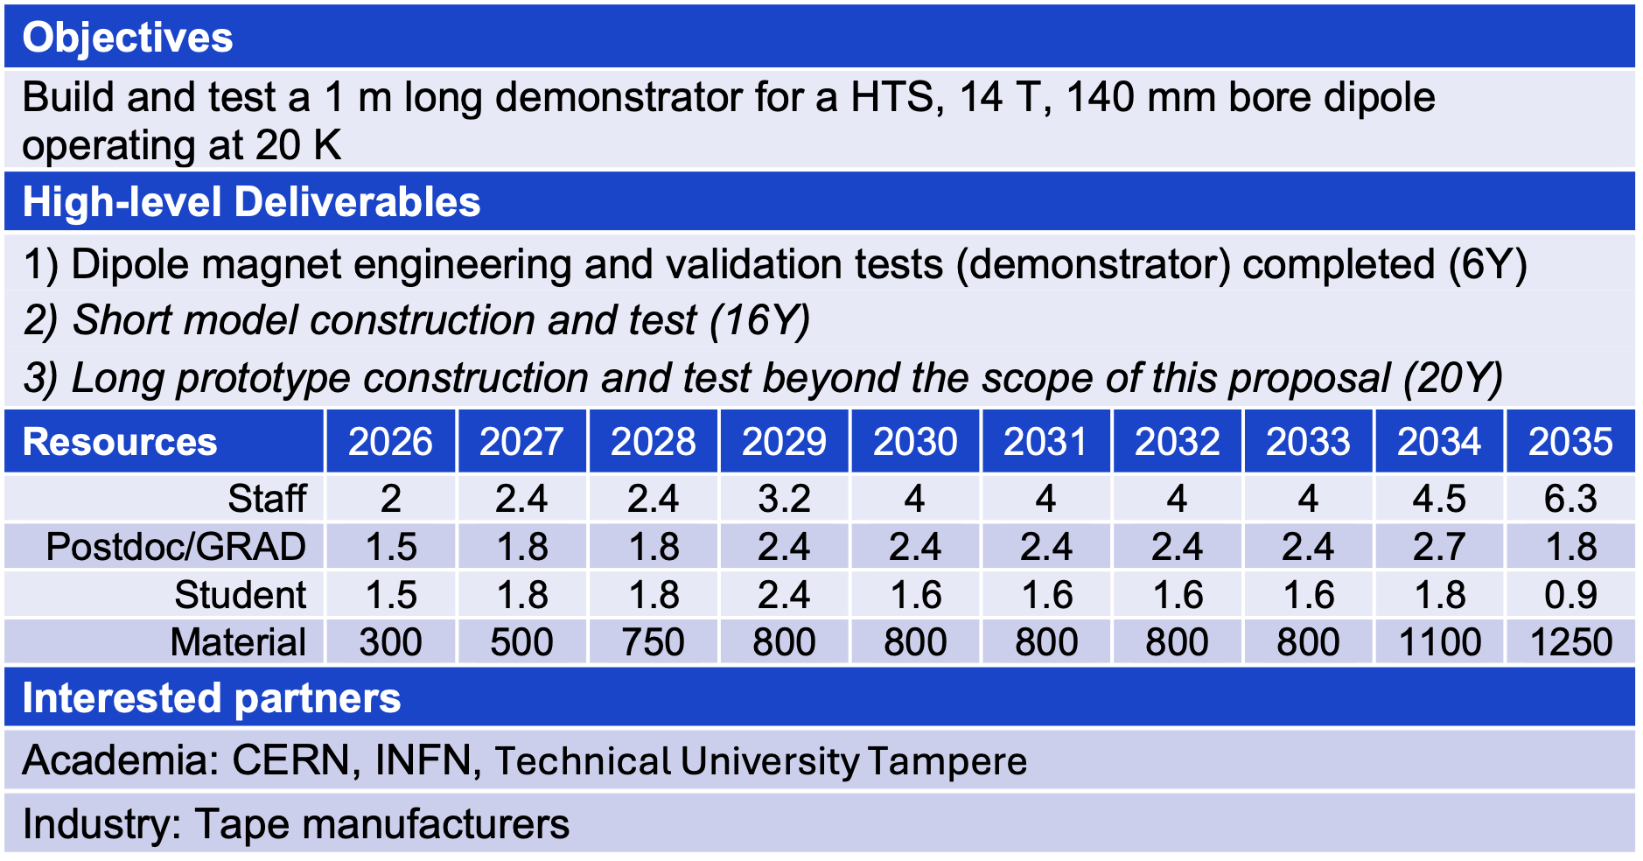
TM7 – MBHTSY

Slide 33
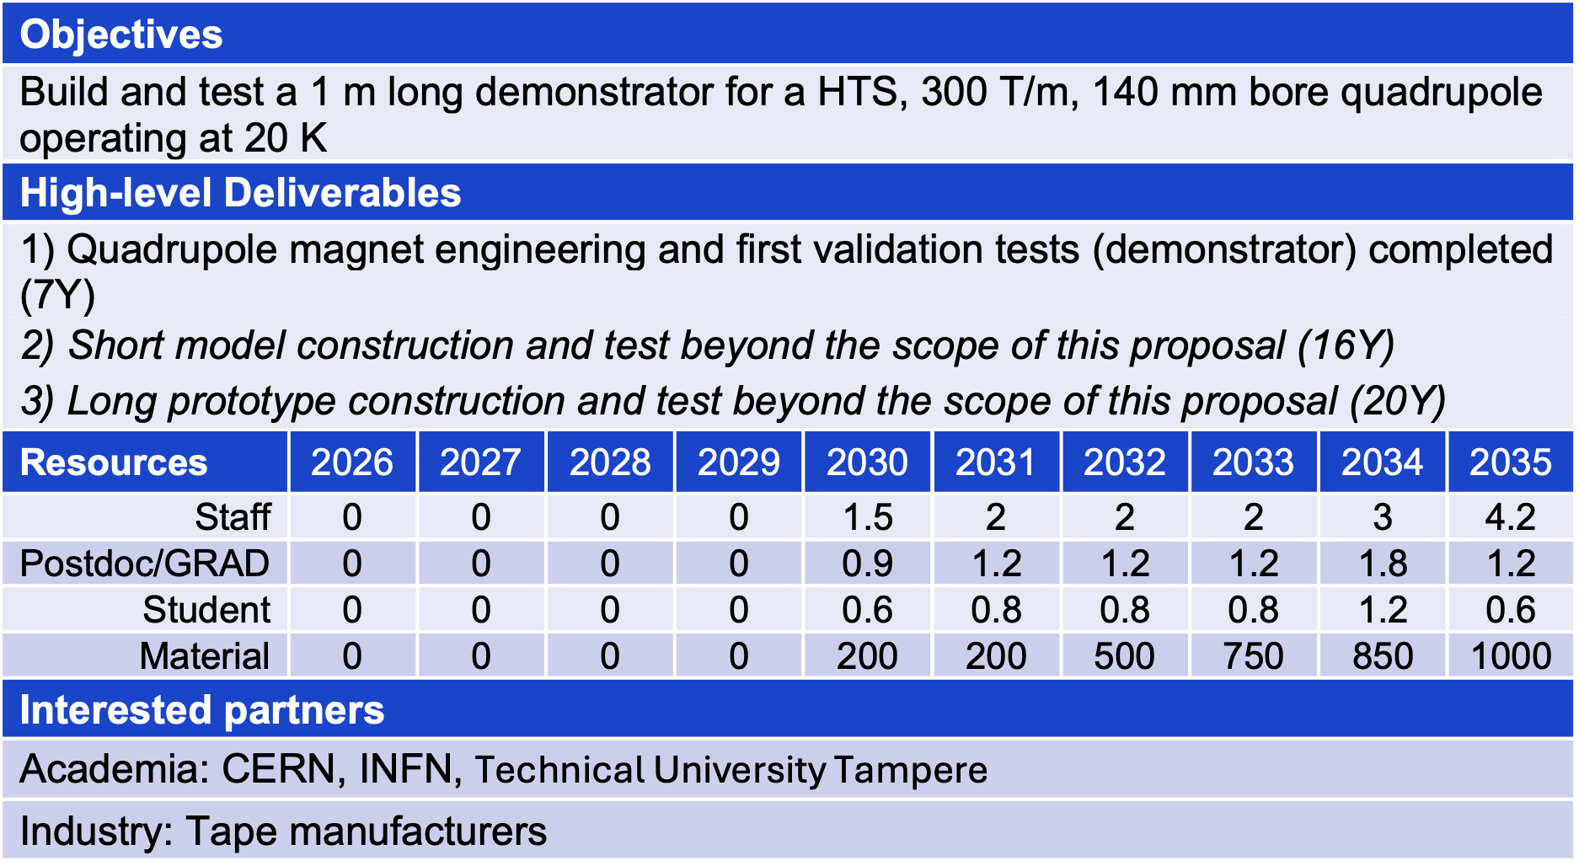
TM8 – MQHTSY

Slide 34
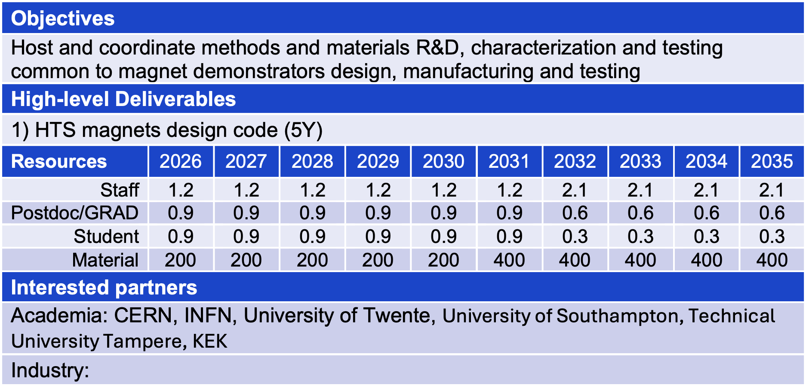
Materials and Methods R&D
High-field measurement of transport properties of REBCO conductors, also necessary to define scaling laws required for the design and analysis of the magnet demonstrators;
Micrography, Micro-structure and mechanical properties of REBCO conductors and winding;
Radiation effects in REBCO conductors;
Tailored experiments to establish design rules for HTS magnets, e.g. allowable hot-spot temperature, or allowable peak stress and strain;
Multi-physics modeling of transient electromagnetics, mechanics and thermal fields in HTS magnets, relevant to the electro-mechanical design, operation and quench protection of NI HTS magnets.

Slide 35
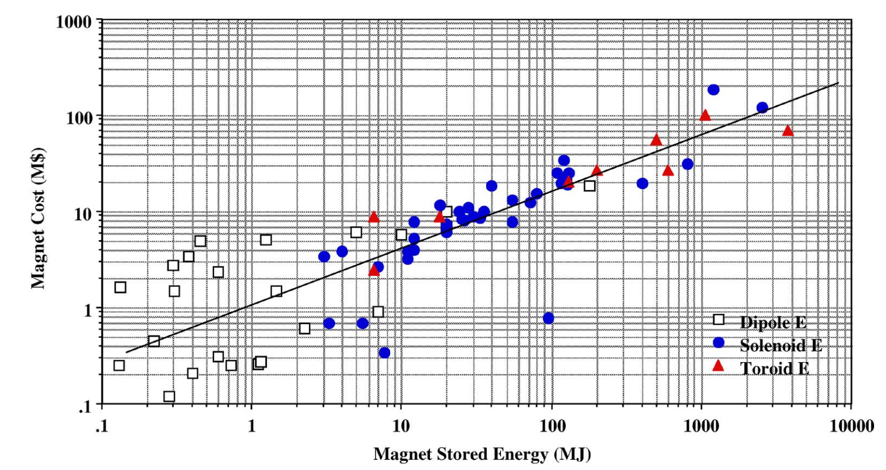
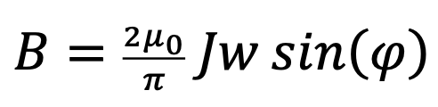
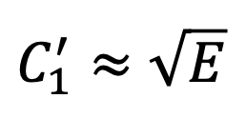
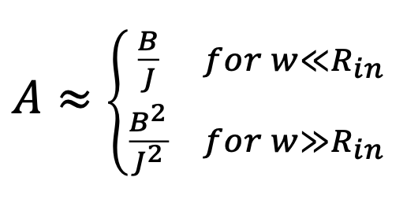
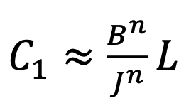
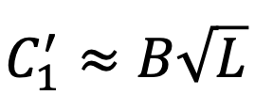
Cost Scaling Expectation
M.A. Green, B. Strauss, IEEE TAS, 18(2), 248-251, 2008
Sector dipole
Material cost per unit length is proportional to coil cross section
Magnet stored energy is proportional to B² and length
Green-Strauss scaling does not apply to accelerator magnets

Slide 36
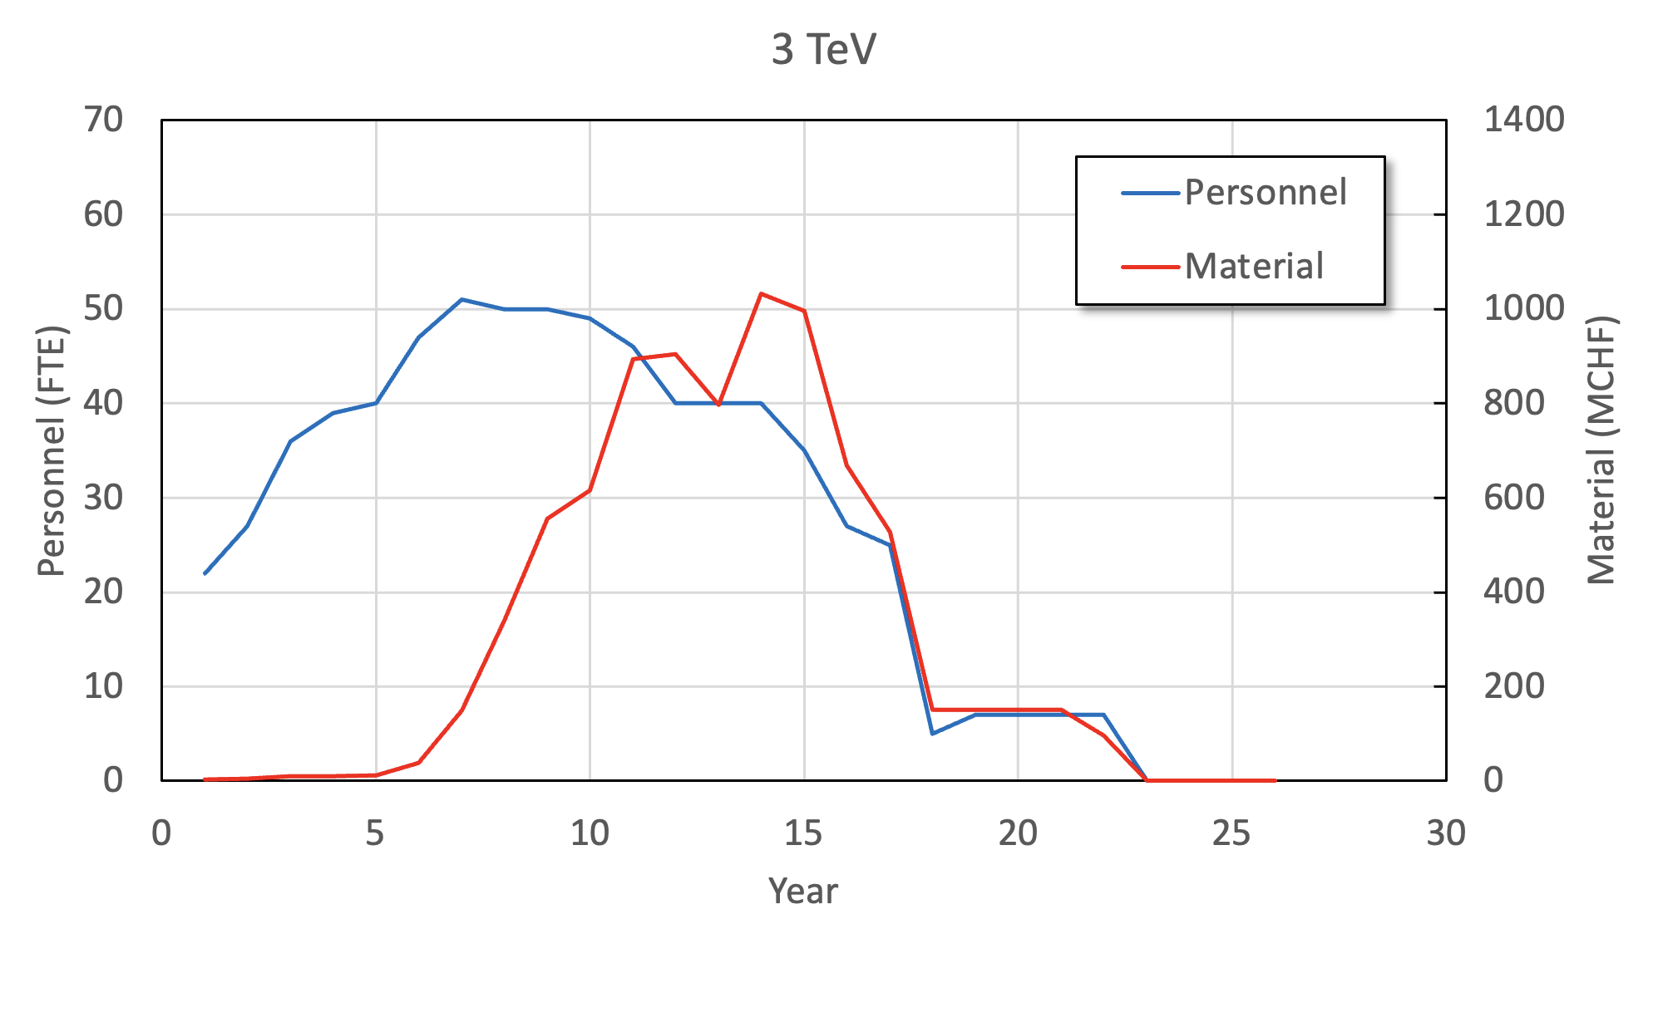
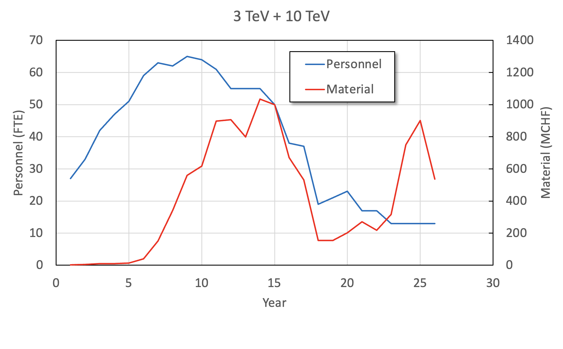
Cost Estimate Examples
700 FTEy
8.2 BCHF
1000 FTEy
11 BCHF
CAVEAT: THIS IS ONLY AN ESTIMATE
WORK IN PROGRESS

