Slide 1

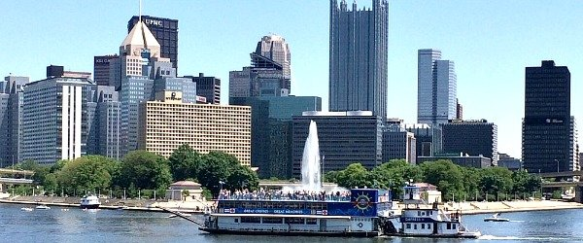

Physics Overview:
1-Year Progress
Tao Han
Pitt PACC, University of Pittsburgh
IMCC & MuCol Annual Meeting 2025
May 12, 2025, DESY, Hamburg

Slide 2




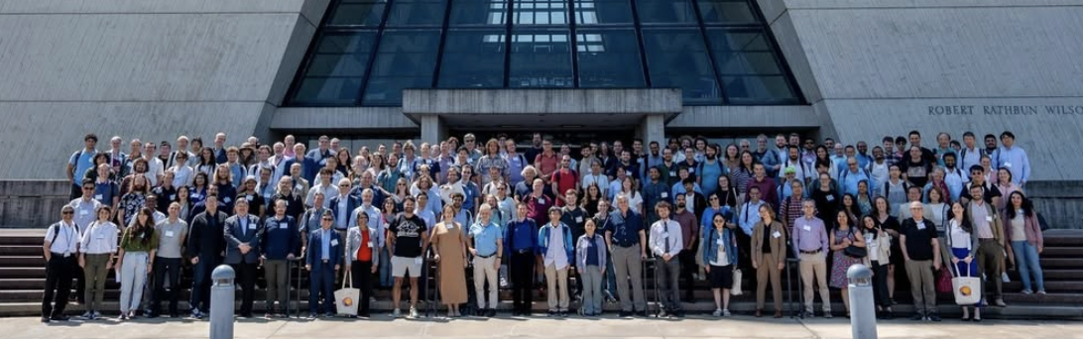

US Muon Collider Collaboration
Great 𝝁C Community
Documents & Contributions to ESPPU:
Interim Report for IMCC: https://arxiv.org/pdf/2407.12450
MuCol Milestone Report #5: https://arxiv.org/abs/2411.02966
The muon collider: https://arxiv.org/abs/2504.21417
USMCC White paper: https://arxiv.org/abs/2503.23695

Slide 3

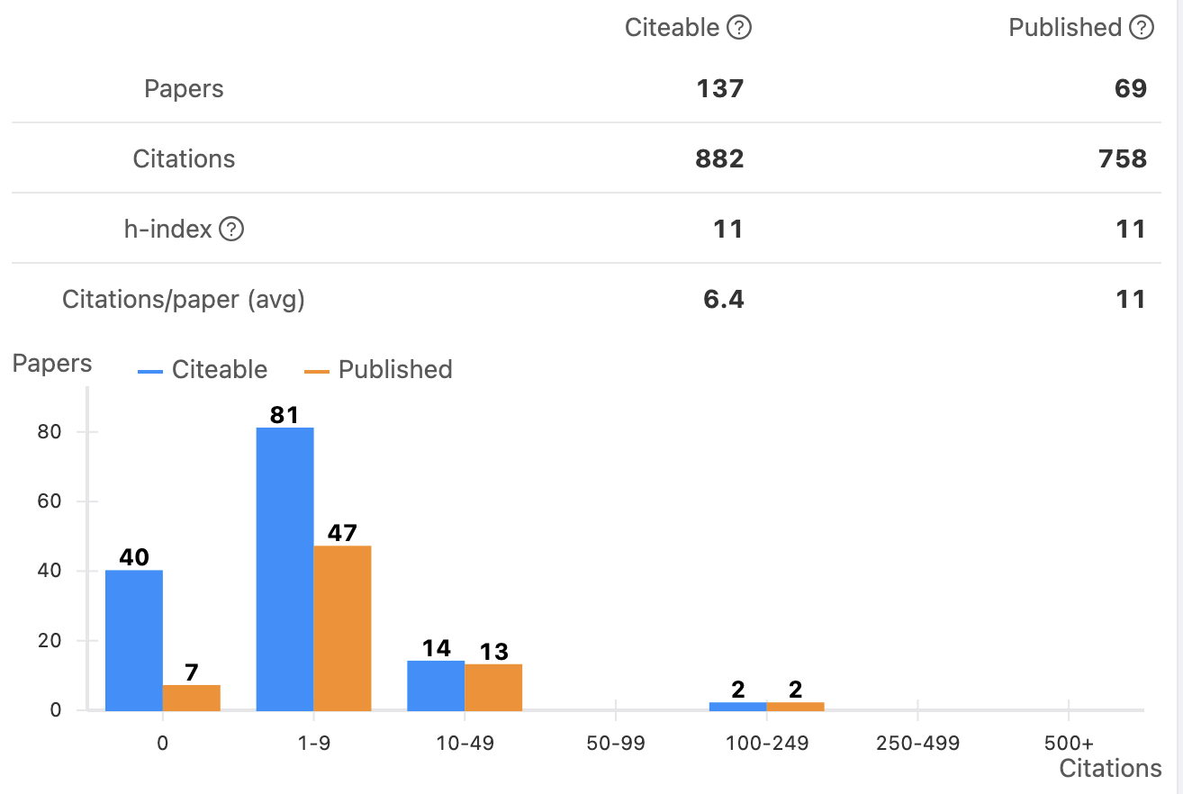
Last Year’s Publications (ti muon & collider)
Physics / Phenomenology:
BSM @ Energy Frontier (~8)
SM / top / Higgs (~6)
Dark Sector/Neutrinos (~2)
Neutrino Osc. / 𝝂Storm (~2)
EIC / 𝝁IC (~3)
Cosmo/GW (~2)
ML / QI (~4) … …
→ Will show some selected results (apologies for the incompleteness!)

Slide 4
Reflection of Main Futures:
𝞵⁺𝞵⁻ Annihilation +VBF at Once
Typical SM processes:
𝞵⁺𝞵⁻
Annihilations
(dotted)
VBF / EW partons
(dashes)
𝞵⁺𝞵⁻ annihilation opens new energy threshold.
EW partonic processes provides a variety of channels.
J.M. Chen, TH & B. Tweedie, arXiv:1611.00788; TH, Ma, Xie, arXiv:2203.11129.

Slide 5

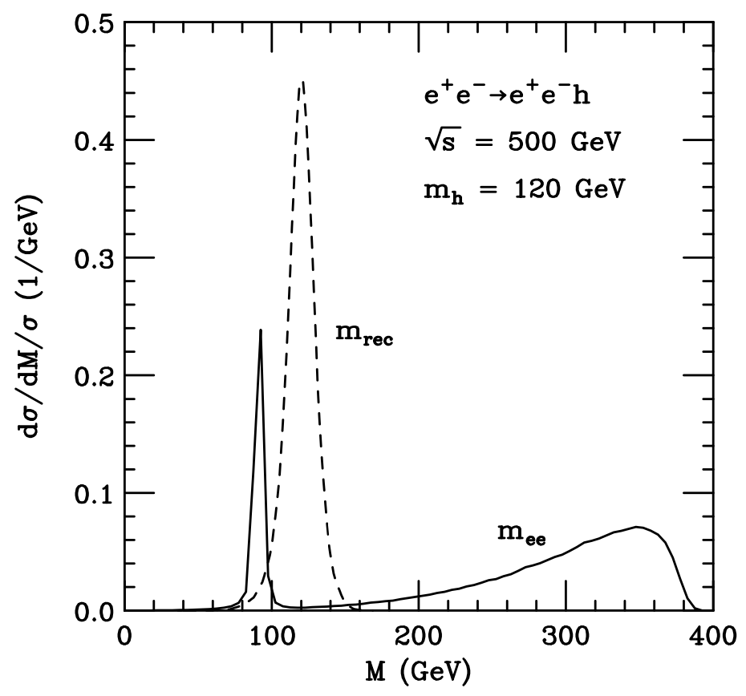
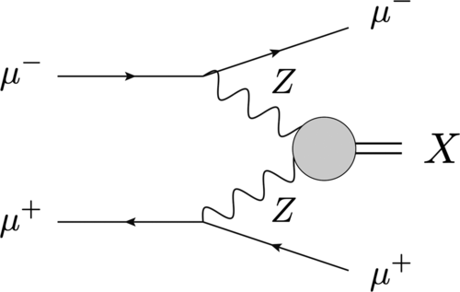

Kinematically Separable:
𝞵⁺𝞵⁻anni
VBF
VBF
𝞵⁺𝞵⁻anni
Recoil mass:
rec

Slide 6
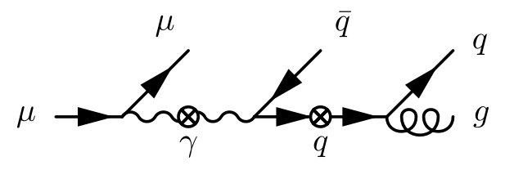
EW Physics @ Very High Energies
Splitting: the dominant phenomena
Power corrections suppressed:
Log corrections (RGE) large:
EW “partons” dynamically generated
EW shower/jets:

Slide 7
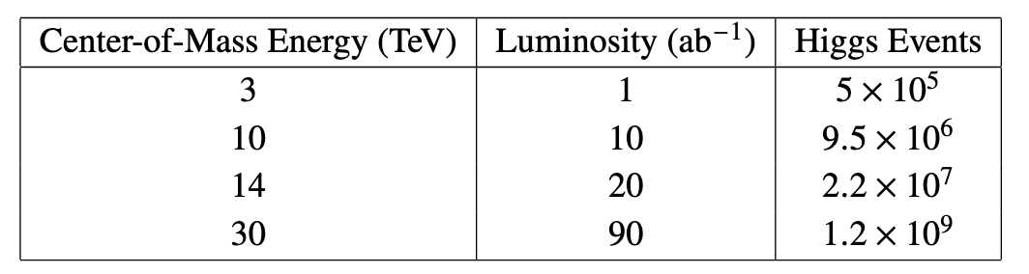
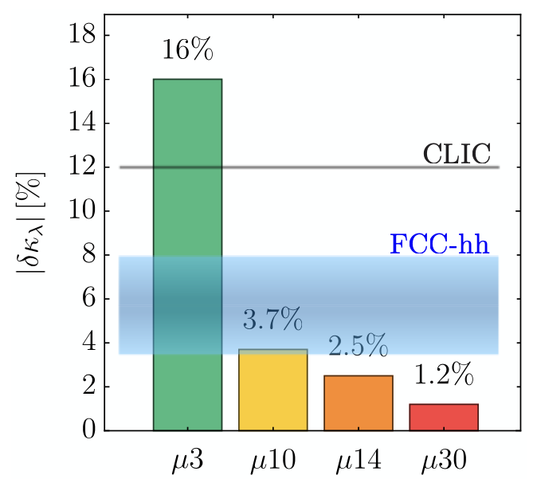
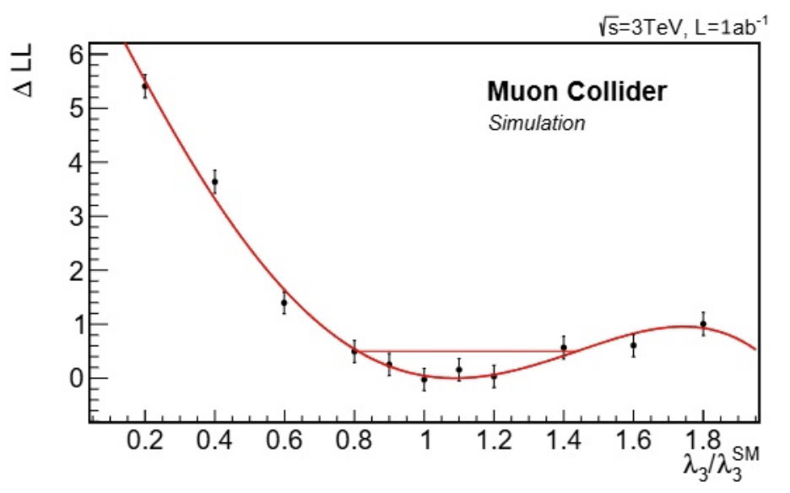
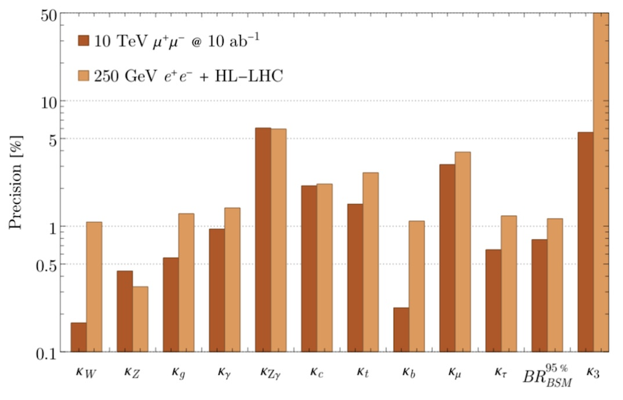

2. Most Wanted: Precision Higgs physics
H³ self-coupling → EW phase transition & early universe cosmology!
HH
1000
3.5x10⁴
1x10⁵
6x10⁶
TH, D. Liu, I. Low, X. Wang, arXiv:2008.12204,
Interim Report for IMCC, arXiv:2407.12450v2
Recent updates:
detector simulation plus BIB
w/o SM assumption
P. Andreetto et al., arXiv:2405.19314
M. Forslund, P. Meade, arXiv:2308.02633
≈ sub % → M > 2 TeV

Slide 8
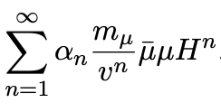
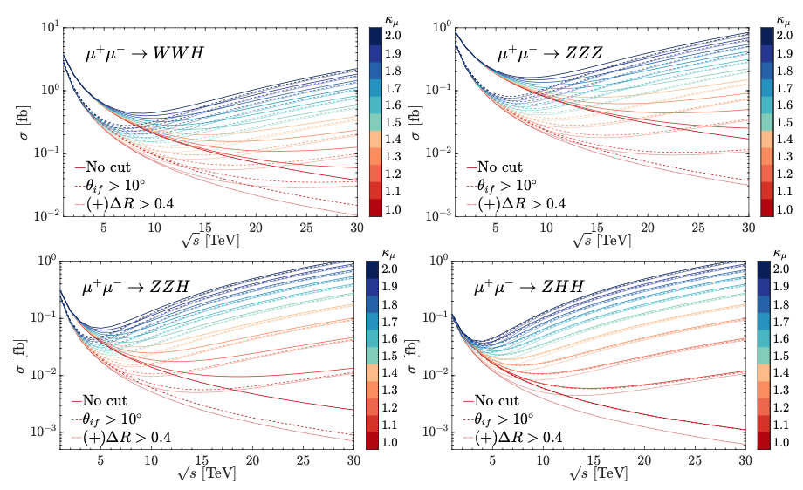
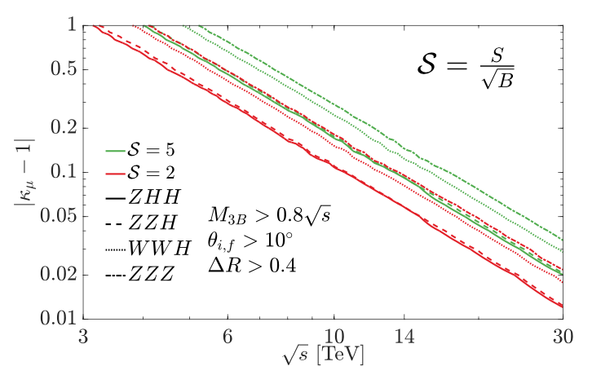
3. Most direct probe: 𝝁 Yukawa coupling:
Y_{𝛍} = 𝛋_{𝛍}Y_{𝛍}SM _{plus}
New physics modification of SM leads to notable deviation. Multiple gauge boson/Higgs production can be highly enhanced, and eventually saturate perturbative unitarity.
TH, Wolfgang Kilian, Nils Kreher, Yang Ma, Juergen Reuter, Tobias Striegl and Keping Xie: arXiv:2108.05362; E. Celada et al., arXiv:2312.13082

Slide 9
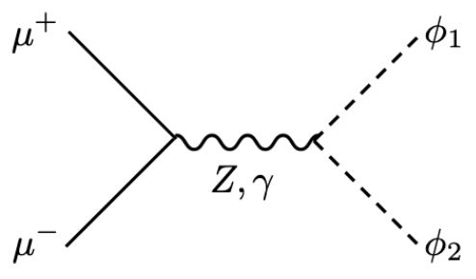
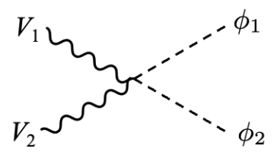
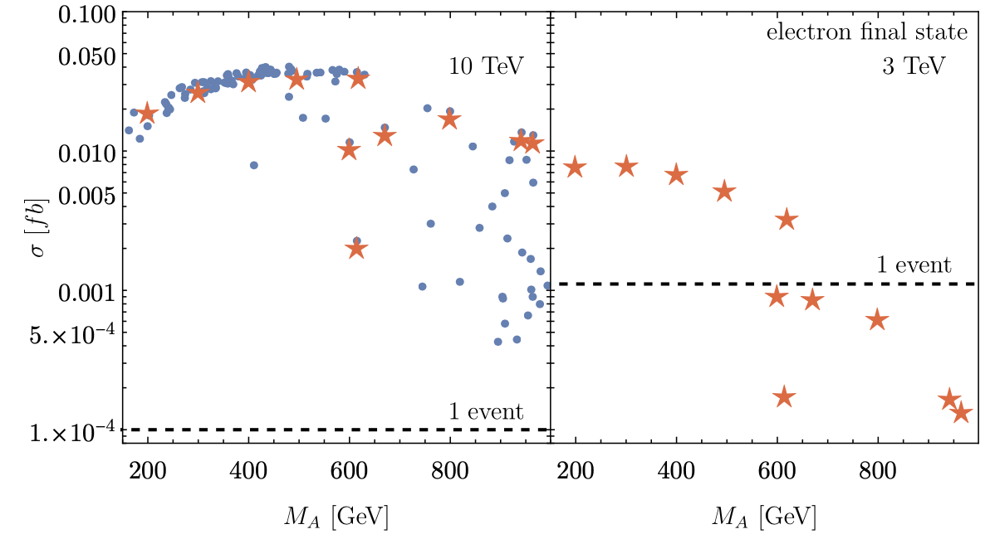
4. Heavy Higgs Boson Production
TH, S. Li, S. Su, W. Su, Y. Wu, arXiv:2102.08386.
annihilation
VBF
Reach the kinematic limit M ~ E_{cm}/2.
“Inert Higgs Doublet”
(no SM fermion couplings)
J. Braathen, M. Gabelmann, T. Robens, P. Stylianon, arXiv:2411.13729.

Slide 10
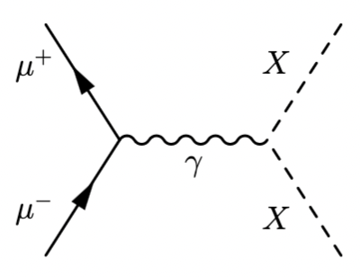
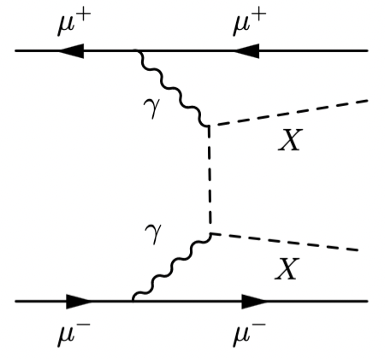
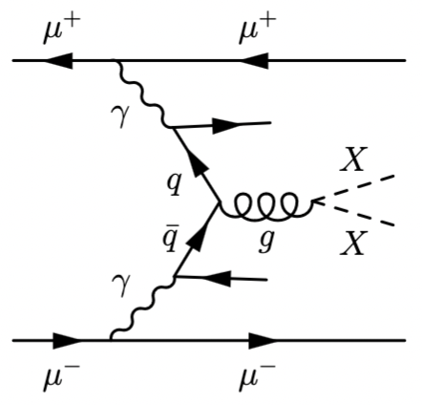
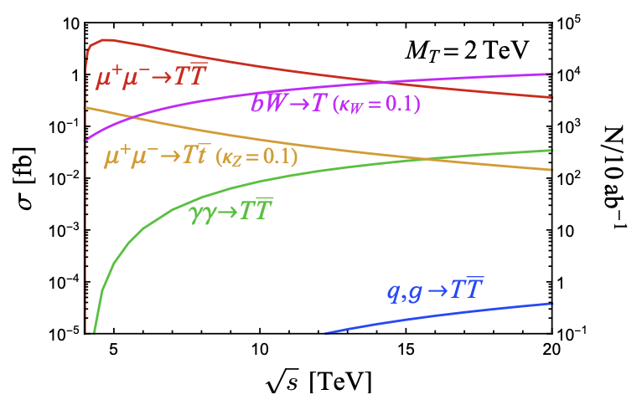
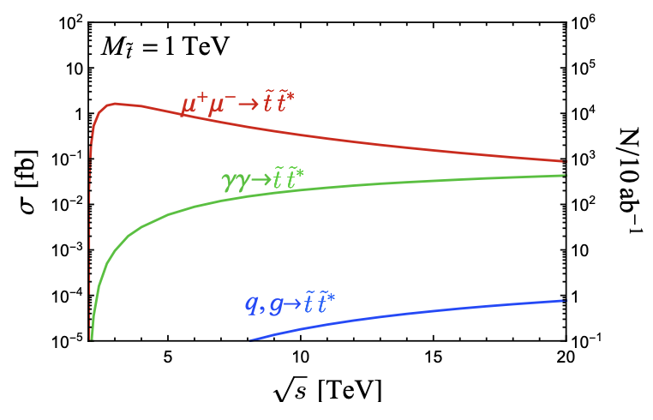
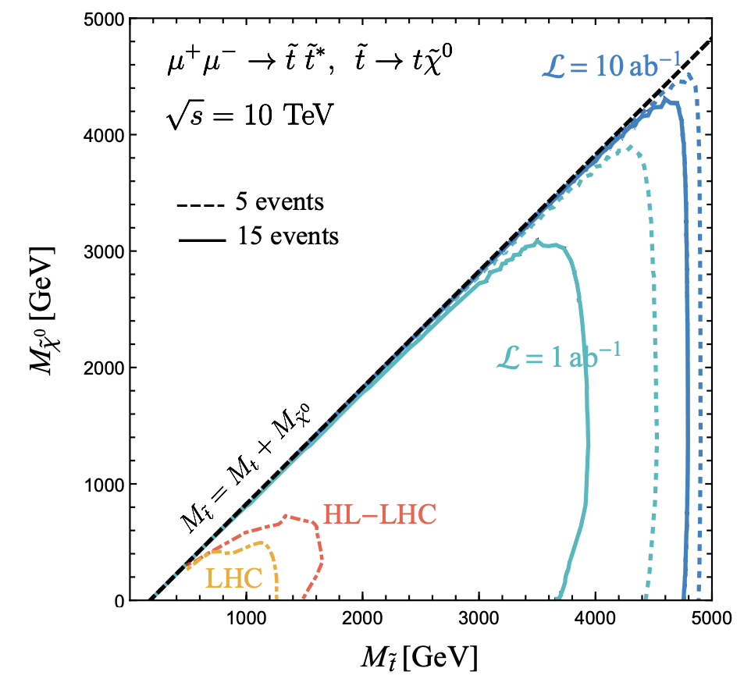
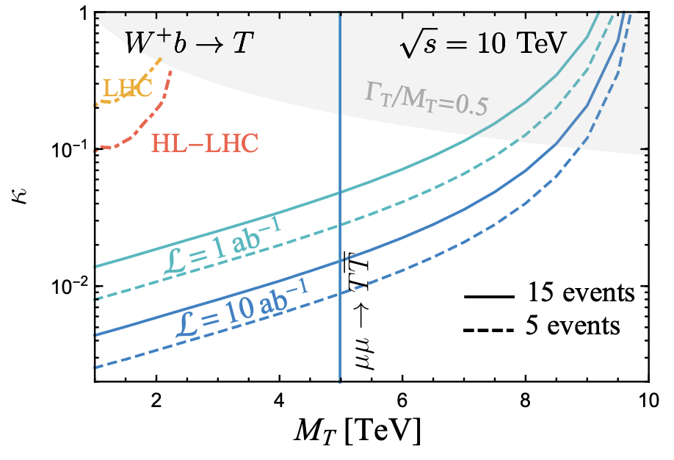
5. “Colorful” Particle Production
Most wanted: Top-quark partners
TH, M. Low, T. A. Wu,
K. Xie: arXiv:2502.20443;
Belyaev et al, 2306.00197;
J.Z.Han et al., 2501.01026.
annih.
fusion
The reach:

Slide 11
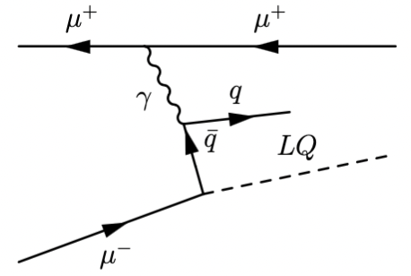
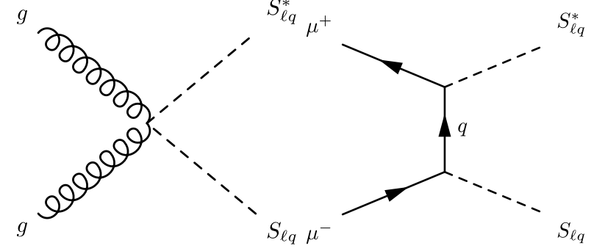
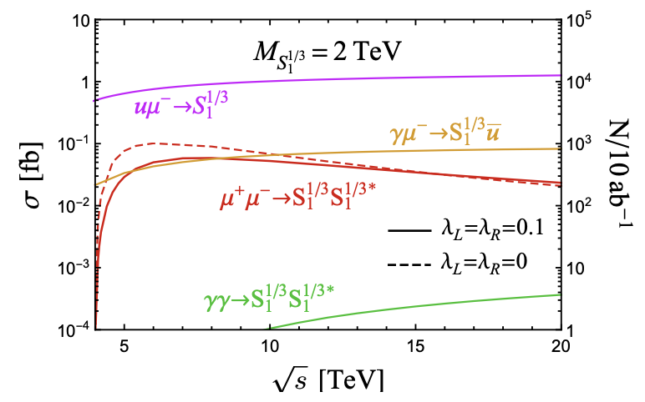
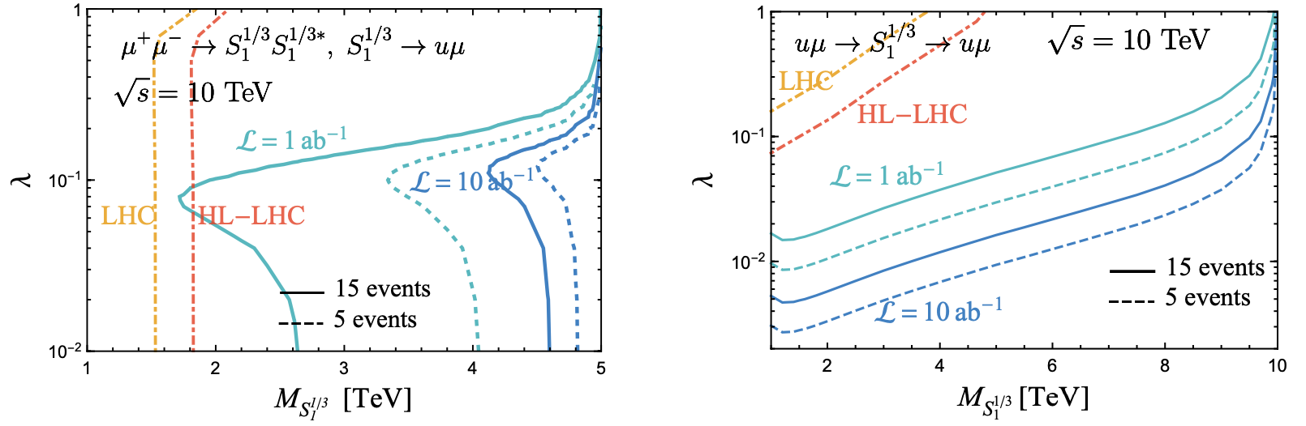
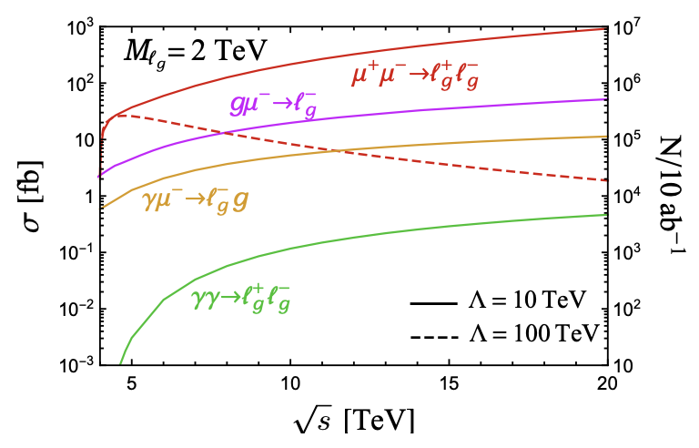
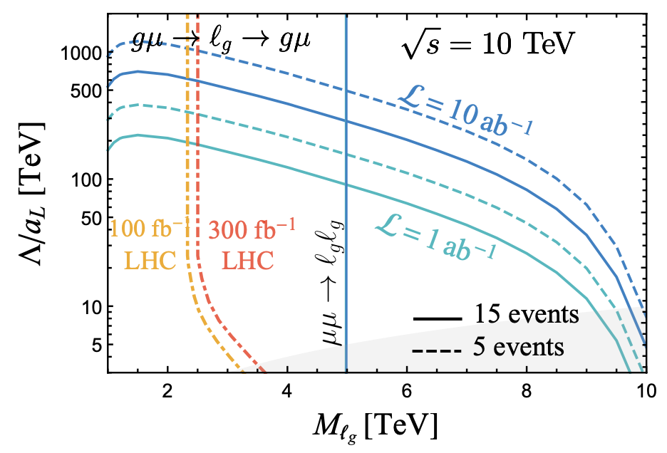
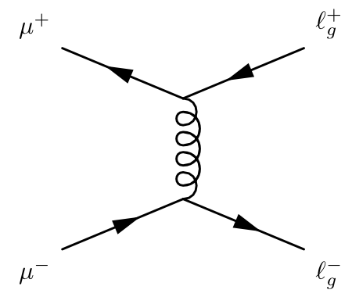
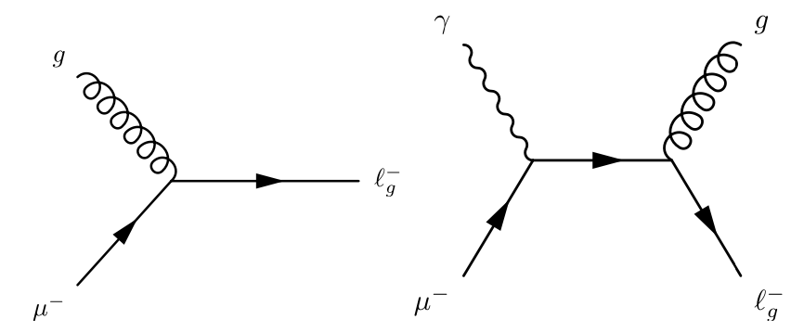
Lepto-quark & lepto-gluon
N. Ghosh et al., 2309.07583; TH, M. Low, T. A. Wu,
K. Xie: arXiv:2502.20443
Lq cross section:
The reach:
Lg production

Slide 12
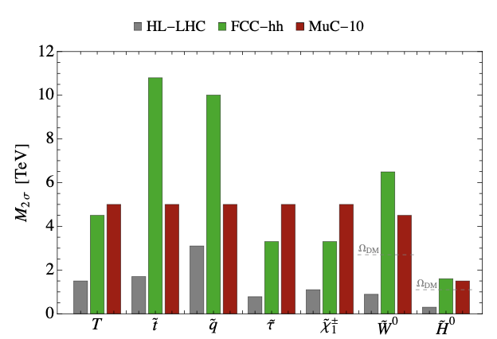
General Physics Reach
The Muon Collider (IMCC),
arXiv:2504.21417.
M ~ E_{cm}/2
TH, S. Li, S. Su, W. Su, Y. Wu, arXiv:2102.08386.
Radiative return to extend the reach
Reach M ~ E_{cm}!

Slide 13
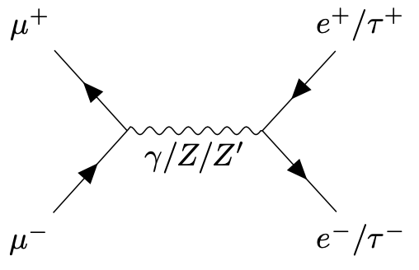
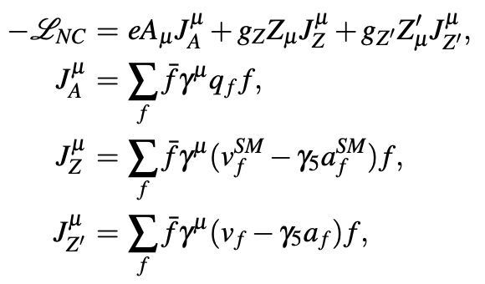
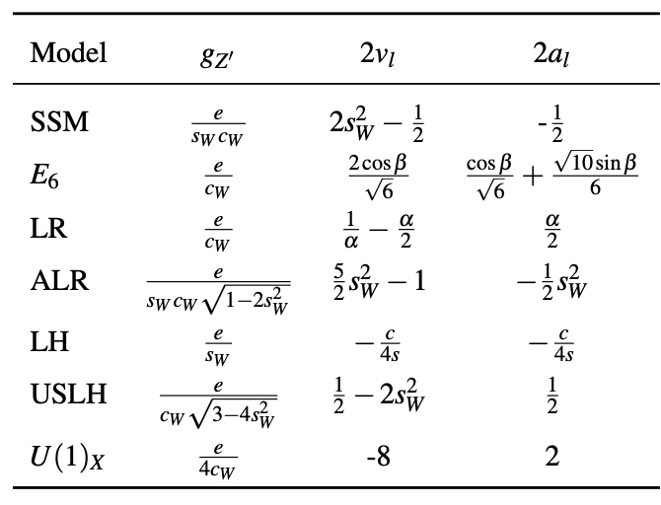
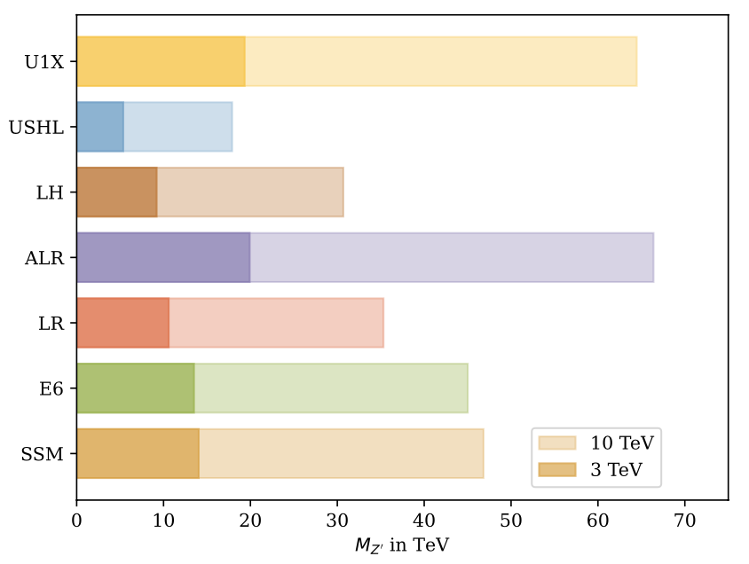
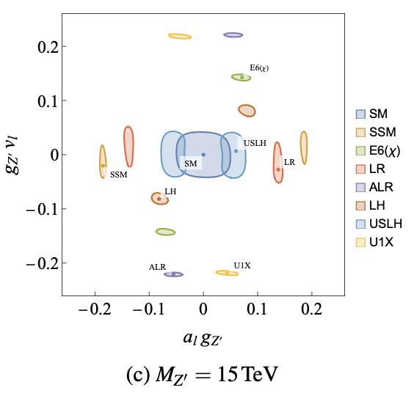
6. Discrimination Power on Z’ Couplings
A common BSM extension
K. Korshynska, M. Loschner, M. Marinichnko, K. Mekala, J. Reuter, arXiv:2402.18460.

Slide 14
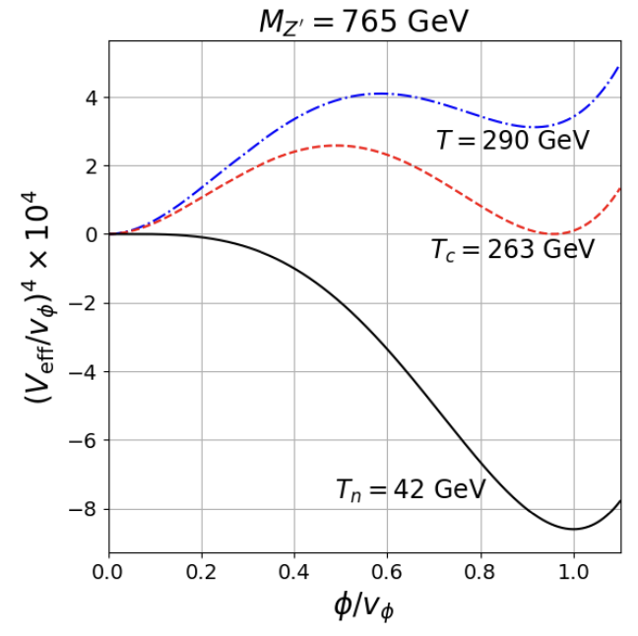
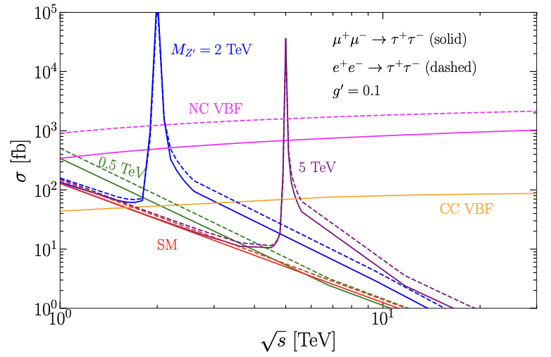
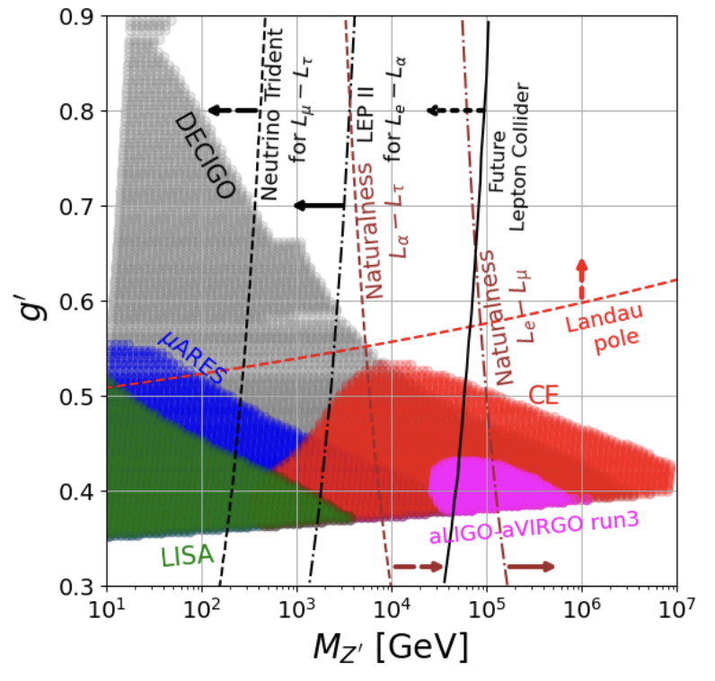
7. Connection to Cosmology / GW
Spontaneous symmetry breaking → cosmo phase transition
Strong 1st order phase transition → Rich physics + GWs
Complementary signals: Colliders ←→ GWs
A leptophilic Z’ example:
at muC
A. Dasgupta, B. Dev, TH, R. Padhan, S. Wang, K. Xie, arXiv:2308.12804

Slide 15
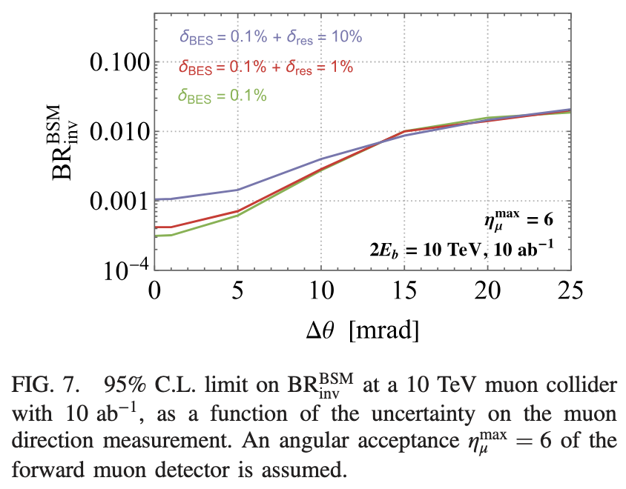
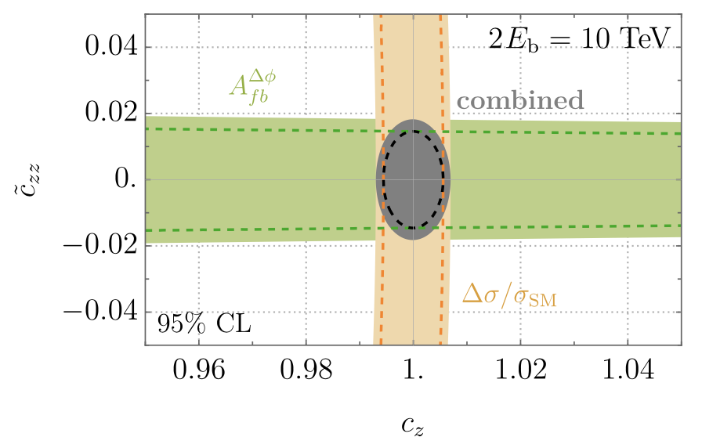
8. Forward Muon Detection
Forward muon detection: 2.44 < 𝜼 < 6
Single out HZZ coupling
Invisible H decay
Reconstruct missing mass
…
(CP-odd)
(CP-even)
P. Li, Z. Liu, K. Lyu, arXiv:2401.08756; M. Ruhdorfer, E. Salvioni, A. Wulzer, arXiv:1910.04170; arXiv:2411.00096.

Slide 16
9. Continuing / Future Efforts:
EW @ high energies; EW corrections
Connection to neutrino physics
Connection to flavor physics / CPv
Connection to cosmology / astro-particle
Phenomenology of 𝝁IC; 𝝁⁺𝝁⁺ collider …
Y. Ma, D. Pagani, M. Zaro., arXiv:2409.09129 … …
P. Jurj, nuStorm, ICHEP2024 (2025) 825; MuCol-𝜈 ;
J. Adhikary, K. Kelly, F. Kling, S. Trojanowski, arXiv:2412.10315.
D. Acosta, et al., arXiv:2203.06258; H. Davoudiasl, H. Liu,
R. Marcarelli, Y. Soreq, S. Trifinopoulos, arXiv:2412.13289;R. Kitano et al.
Exciting exploration in the coming years!

Slide 17
Back ups

Slide 18
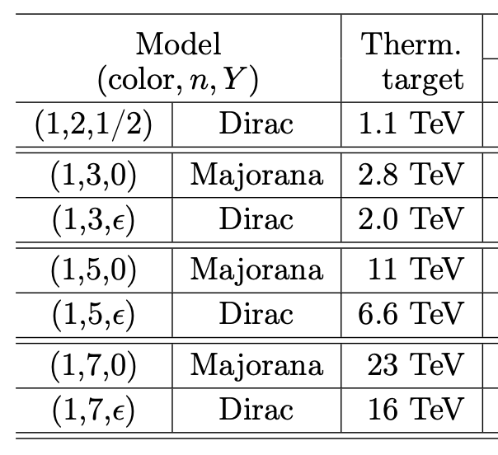
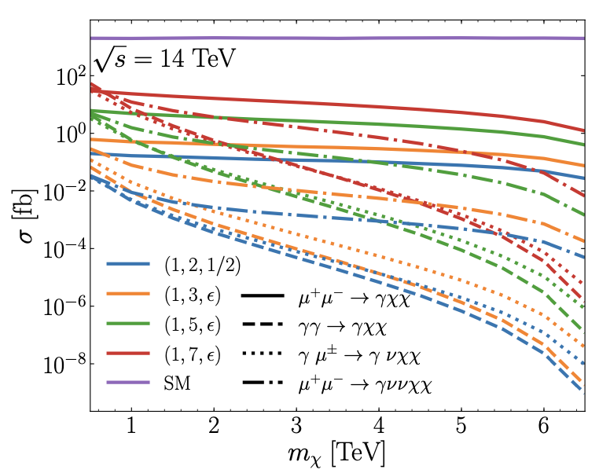
EW Minimal Dark Matter:
Generic EW (degenerate) multiplets
M. Cirelli, N. Fornengo, A. Strumia,
hep-ph/0512090; 0903.3381.
TH, Z. Liu, L.-T. Wang, X. Wang, arXiv:2009.11287.

Slide 19
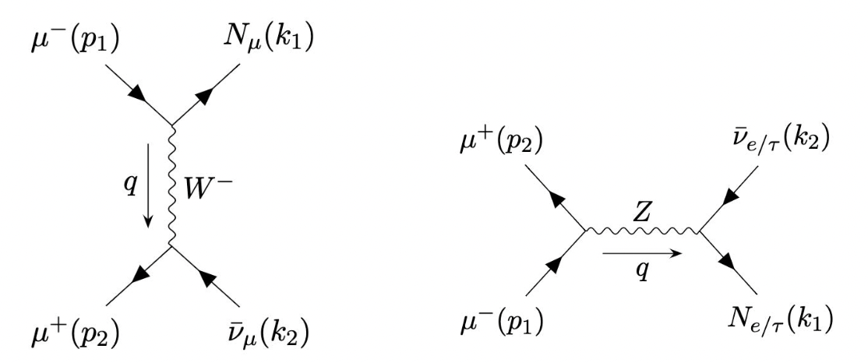
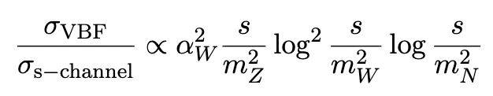
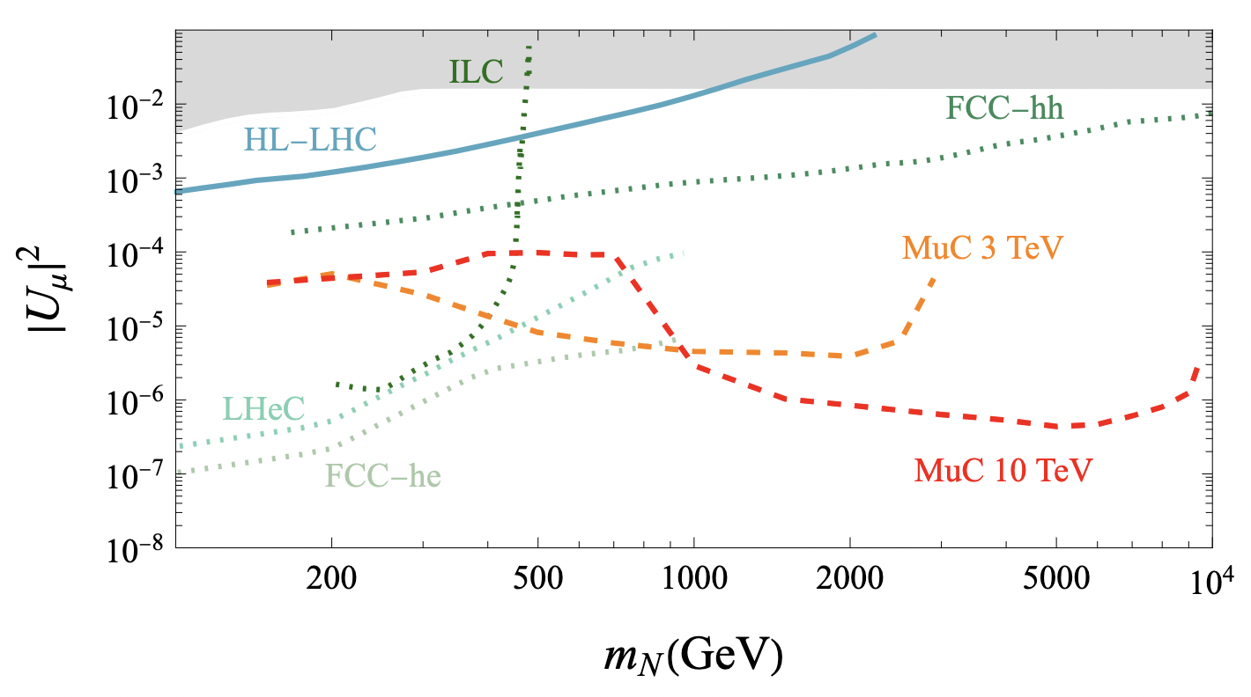
Heavy Neutral Lepton @ muC
P. Li, Z. Liu, K. Lyu, arXiv:2301.07117
(more work needed!)

Slide 20
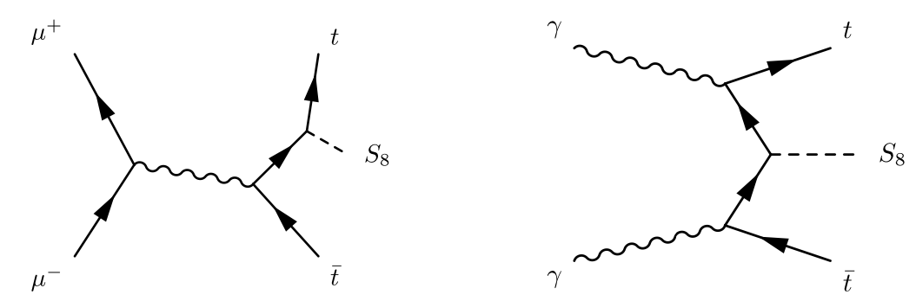
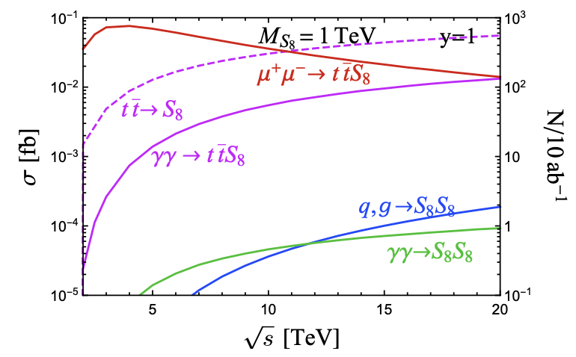
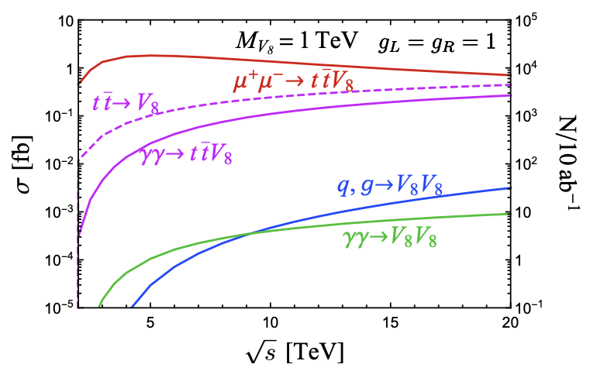

Color-octet scalar/vector (𝞹_{TC}, 𝞺_{TC})
TH, M. Low, T. A. Wu, K. Xie: arXiv:2502.20443;
D. Liu, L. Wang, 2312.09117
Scalar:
Vector:
Cross section:
Reach:
∼
[Color-octet fermion gluino (𝙜) not show ]

