Slide 1





Electroweak Symmetry Restoration
@ High Energies
-- Muon Collider as a Case Study
Tao Han
Pitt PACC, University of Pittsburgh
IMCC @ DESY, May 13, 2025

Slide 2

Electroweak Symmetry Breaking:
The Longitudinal & Goldstone Bosons
For an on-shell vector:
+ O(M_{W}/E)
trivial “scalarization”
(for any vector state)
symmetry breaking
residual
Goldstone-boson Equivalence Theorem
At high energies E>>MW, the longitudinally polarized gauge bosons behave like the corresponding Goldstone bosons. (They remember their origin!)
At high energies:
W^{i}_{L} → Correspond to the broken generators
“incomplete representation”:
nothing to say about the “Higgs boson”
→ The Higgs mechanism DOES NOT require a Higgs boson!
Lee, Quigg, Thacker (1977); Chanowitz, Gailard (1984); J. Chen, TH, B. Tweedie,
arXiv:1611.00788; Coumo, L. Vecchi, A. Wulzer, arXiv:1911.12366

Slide 3
High-energy behavior: V_{L} & the role of H
bad high-energy behavior!
Higgs boson save the day:
“UV complete”
D. Dicus & V. Mathur (1973);
Lee, Quigg, Thacker (1977).

Slide 4
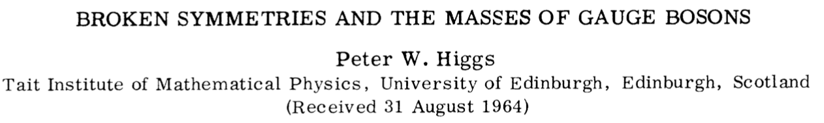
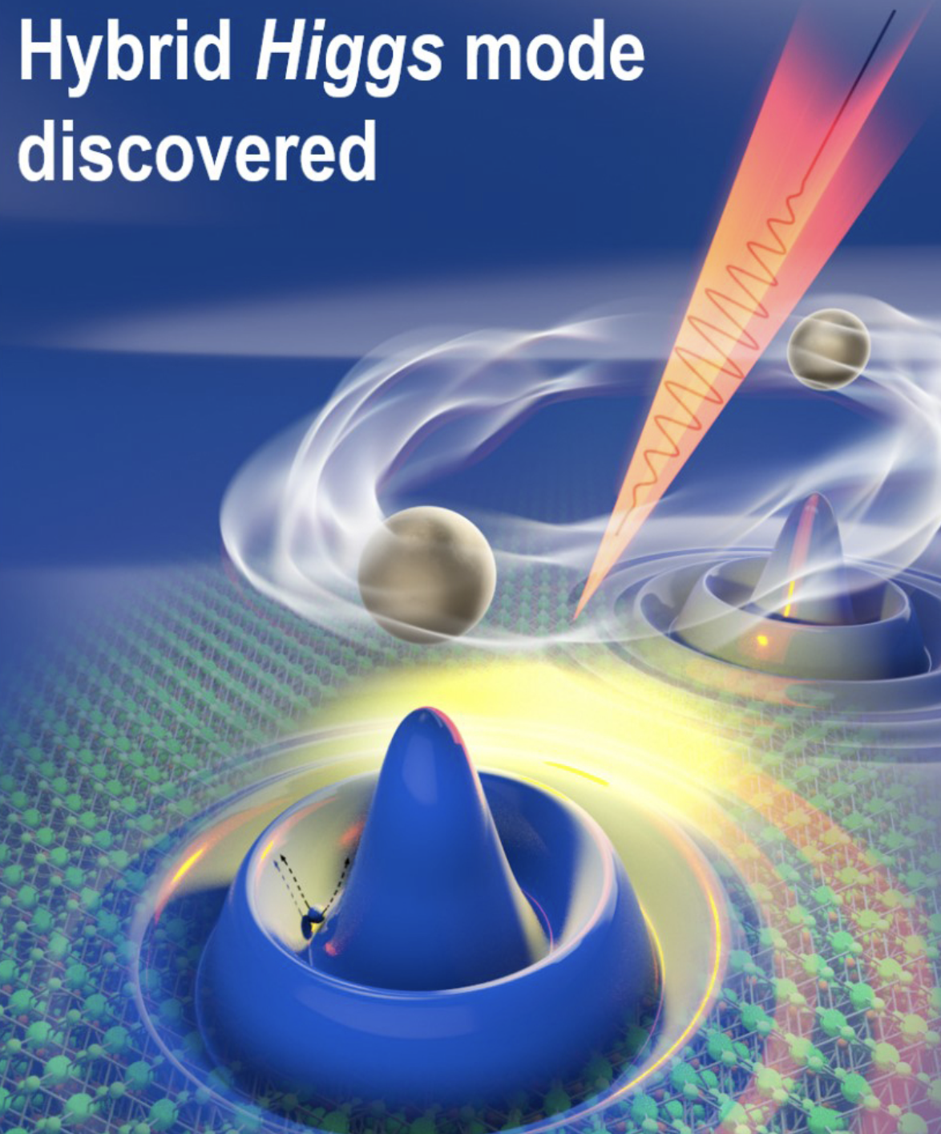
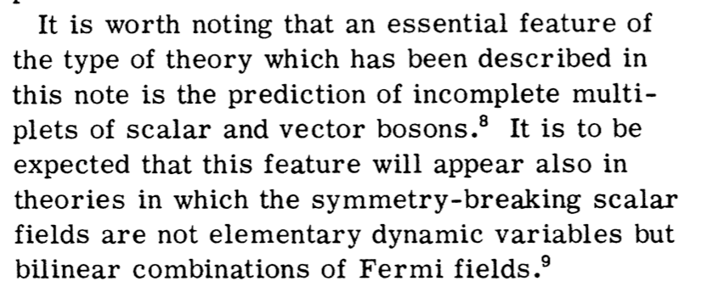
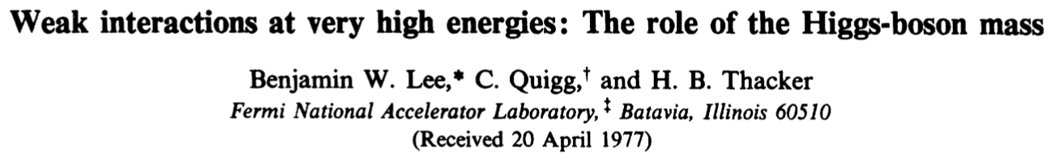
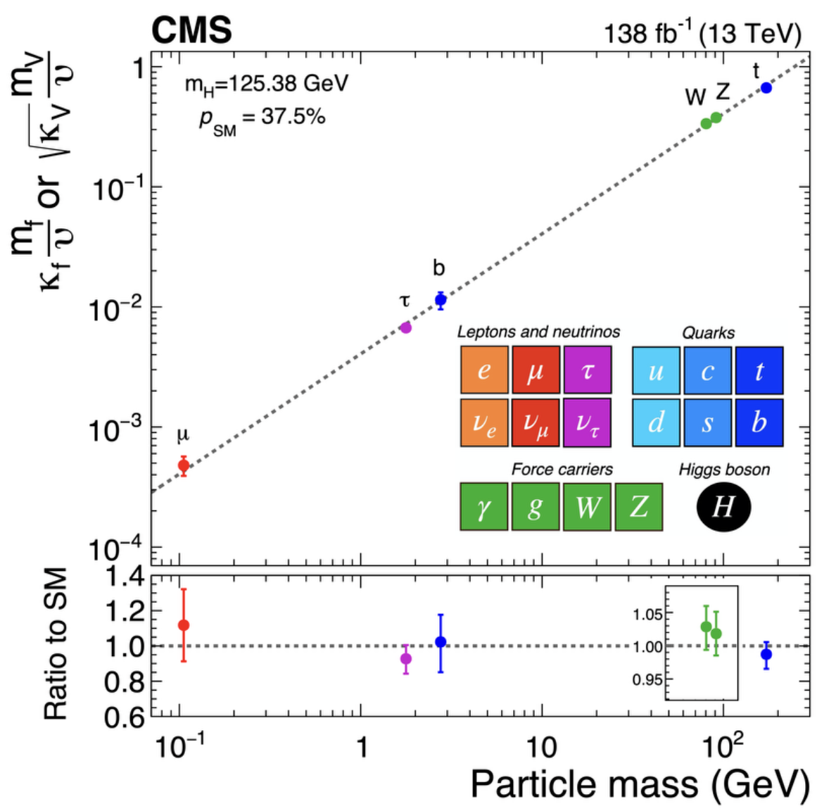
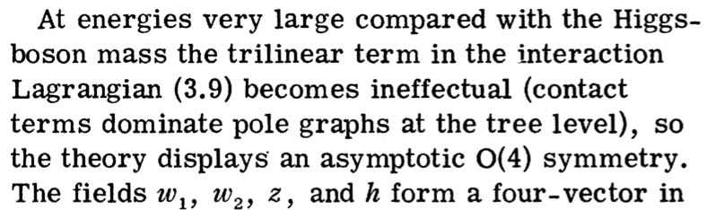

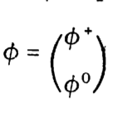
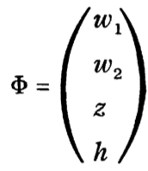
The Higgs Boson
Laser @ 10¹² Hz (2021, Ames Lab)
or

Slide 5
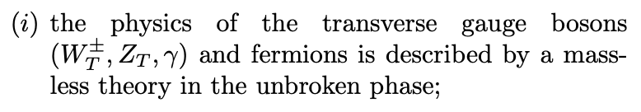

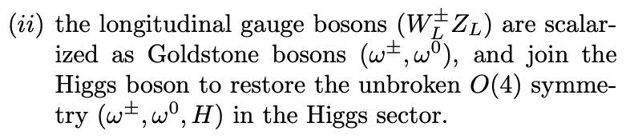
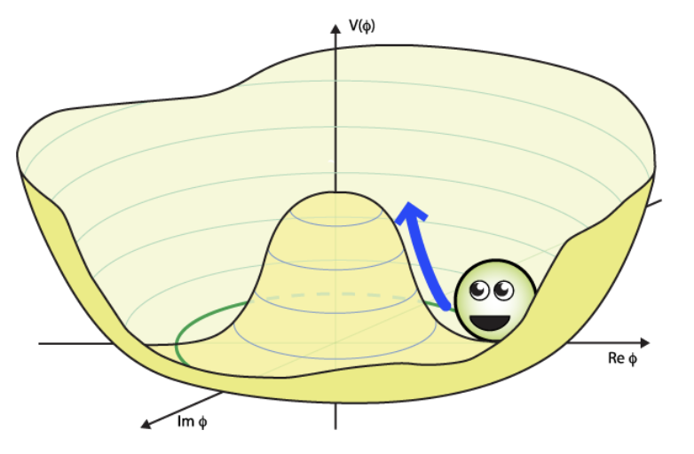
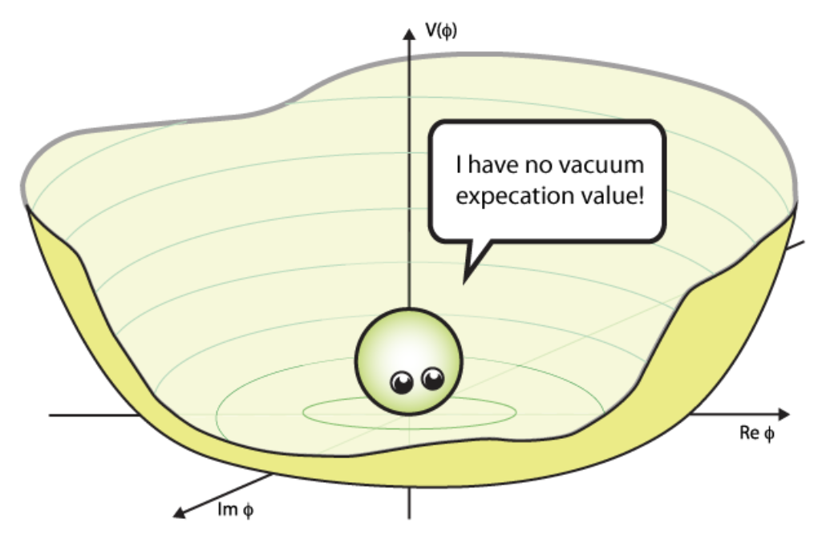
EW Symmetry Restoration (EWSR)
parametrically measured by:
R. Capdevilla, TH, arXiv:2412.12336;

Slide 6
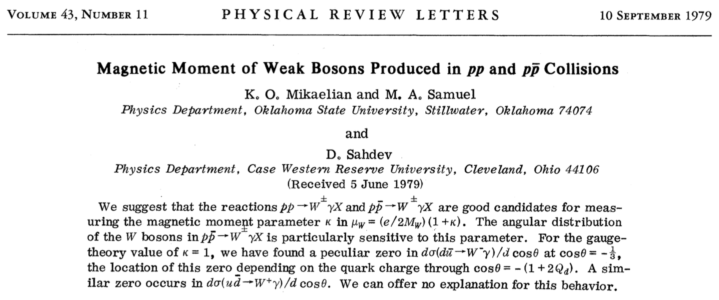
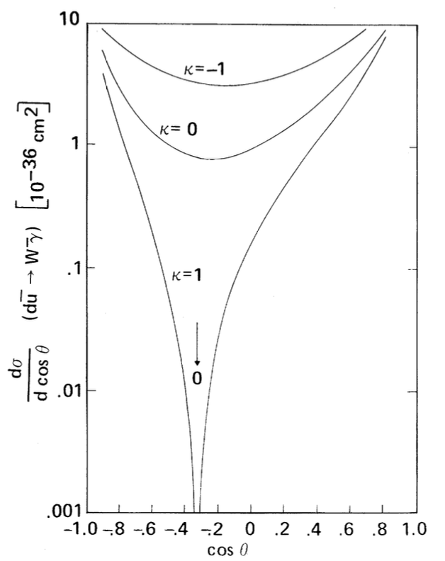
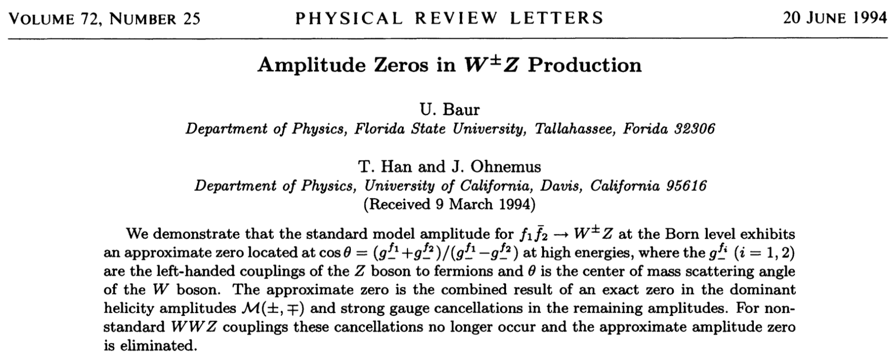
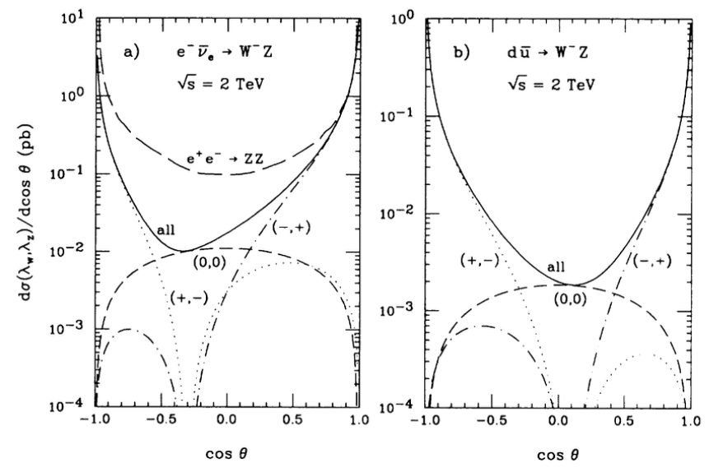
Radiation Amplitude Zeros (RAZs)

Slide 7
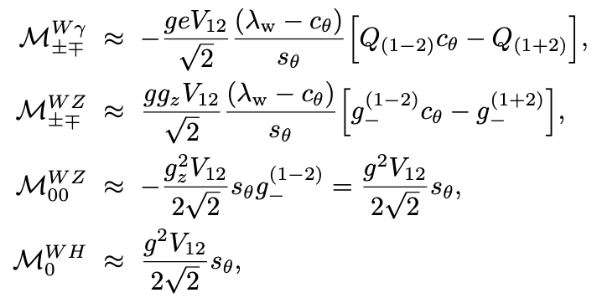
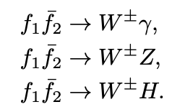
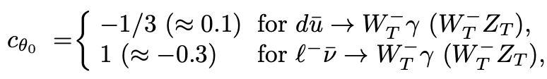
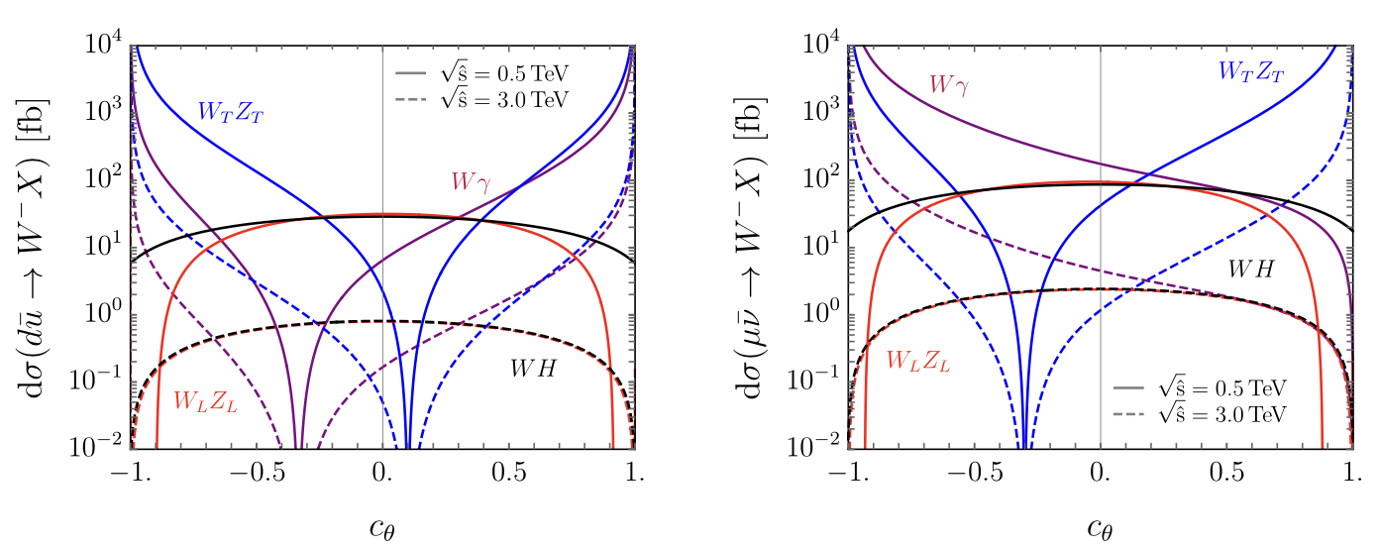
Gauge / scalar separation:
R. Capdevilla, TH, arXiv:2412.12336
Gauge sector: Radiation Amplitude Zeros (RAZs)
EM: ; EW (transverse):
Mikaelian, Samual (1979)
U. Baur, TH, JO, (1994)
Higgs scalar sector:

Slide 8
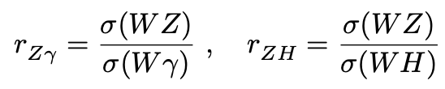
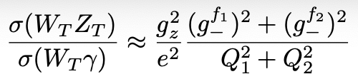


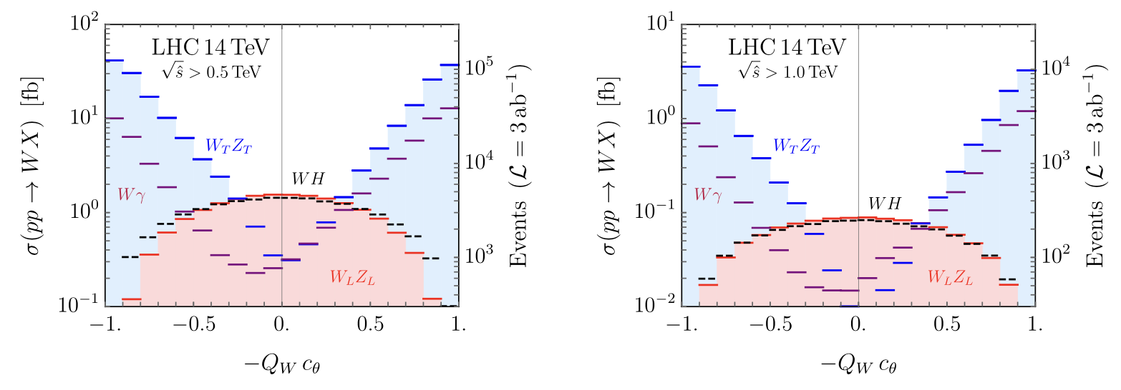

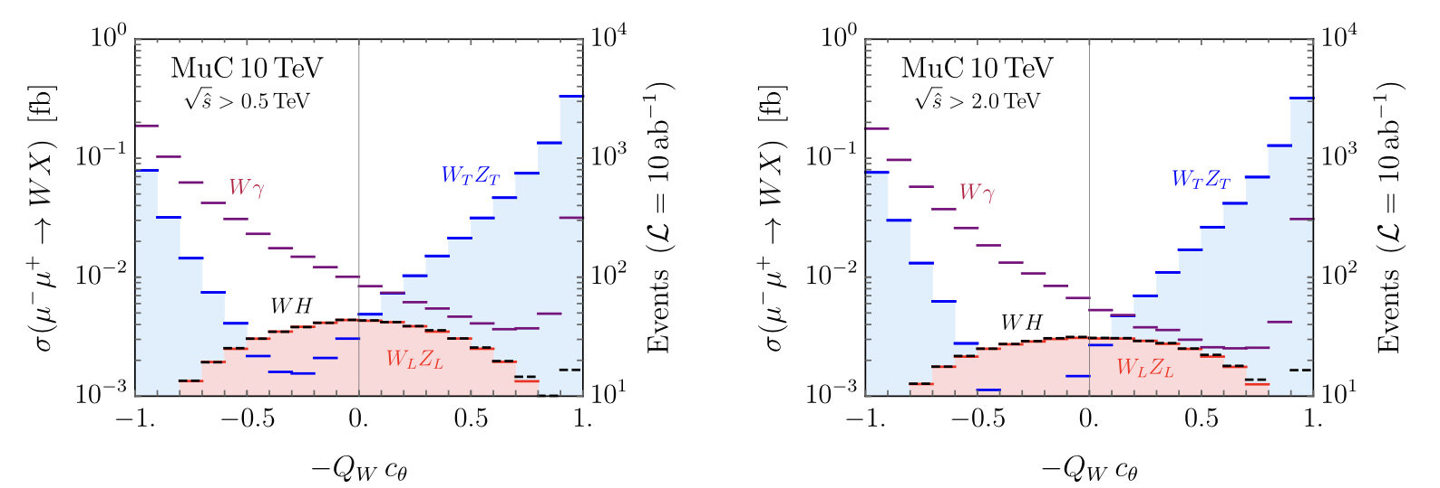
Test EWSR @ LHC / muon Collider
R. Capdevilla, TH, arXiv:2412.12336; Huang, Lewis, Lane, Liu, arXiv:2009.09429
Massless gauge sector & Higgs sector:
For 𝛅 = M_{W}/2E << 1:

Slide 9
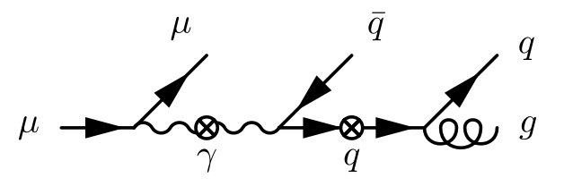
Other Aspects of EWSR
Splitting: the dominant phenomena
For the factorization to be valid:
Power corrections suppressed:
Log corrections (RGE) large:
EW “partons” dynamically generated
EW shower/jets:

Slide 10
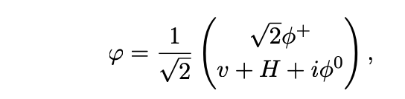
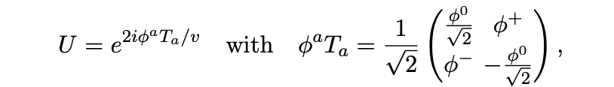
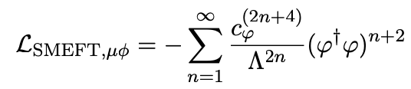

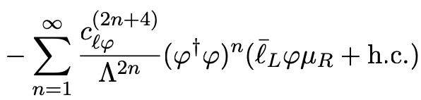
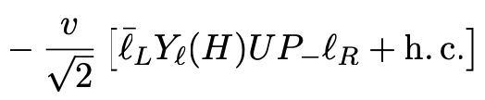
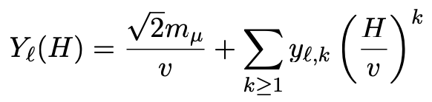
What do we learn in testing EWSR?
“endlessly confirm the correctness of SM” ?!
- Carlo Rubia
SMEFT BSM vs. HEFT BSM
weakly coupled (SUSY) strongly coupled (composite)
new scale ~ 𝞚 nearby scale ~ 4𝛑 𝞄
At the LHC: Higgs coupling SM-like ~ 10%
(light) Fermion Yukawa’s wide open:
E. Celada, TH et al., arXiv:2312.13082

Slide 11
A Few Remarks
Goldstone boson Equivalence Theorem:
→ process-dependent & need to be quantified:
parametrically measured by
Goldstone couplings g₂ , y_{t} … and y_{f} … >> 𝛿 = M_{W}/2E !
GET Violation in fermion splitting f -> f V_{L}:
Analogous to QCD:
Theoretical treatment in symmetric phase q, g
→ observation in broken phase massive hadrons.
Theoretical treatment in symmetric phase W^{0,1,2}, B
→ observation in broken phase W±, Z, 𝛾 ; (t, b) (e, 𝜈 ) …
Perhaps, only at the high-T environment (e.g., in the early universe) would we experience the (real) EW symmetry restoration.

Slide 12

Further Remarks
In approaching EWSR,
how much the SM UV completion tells us?
QED is UV complete, but doesn’t go beyond O(GeV):
e.g. (g-2)_{e} versus (g-2)_{𝛍}
QCD is UV complete, could be dynamically
extrapolated to an exponentially high scale Q:
but new physics comes in at
The SM with the Higgs IS UV complete,
--- to be tested by EWSR
but what confidence do we have to extrapolate it to O(M_{PL})?
UV completion needs NOT to be a completion!
i.e. Go for BSM & beyond EWSR!

Slide 13
Back up slides

Slide 14
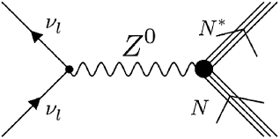
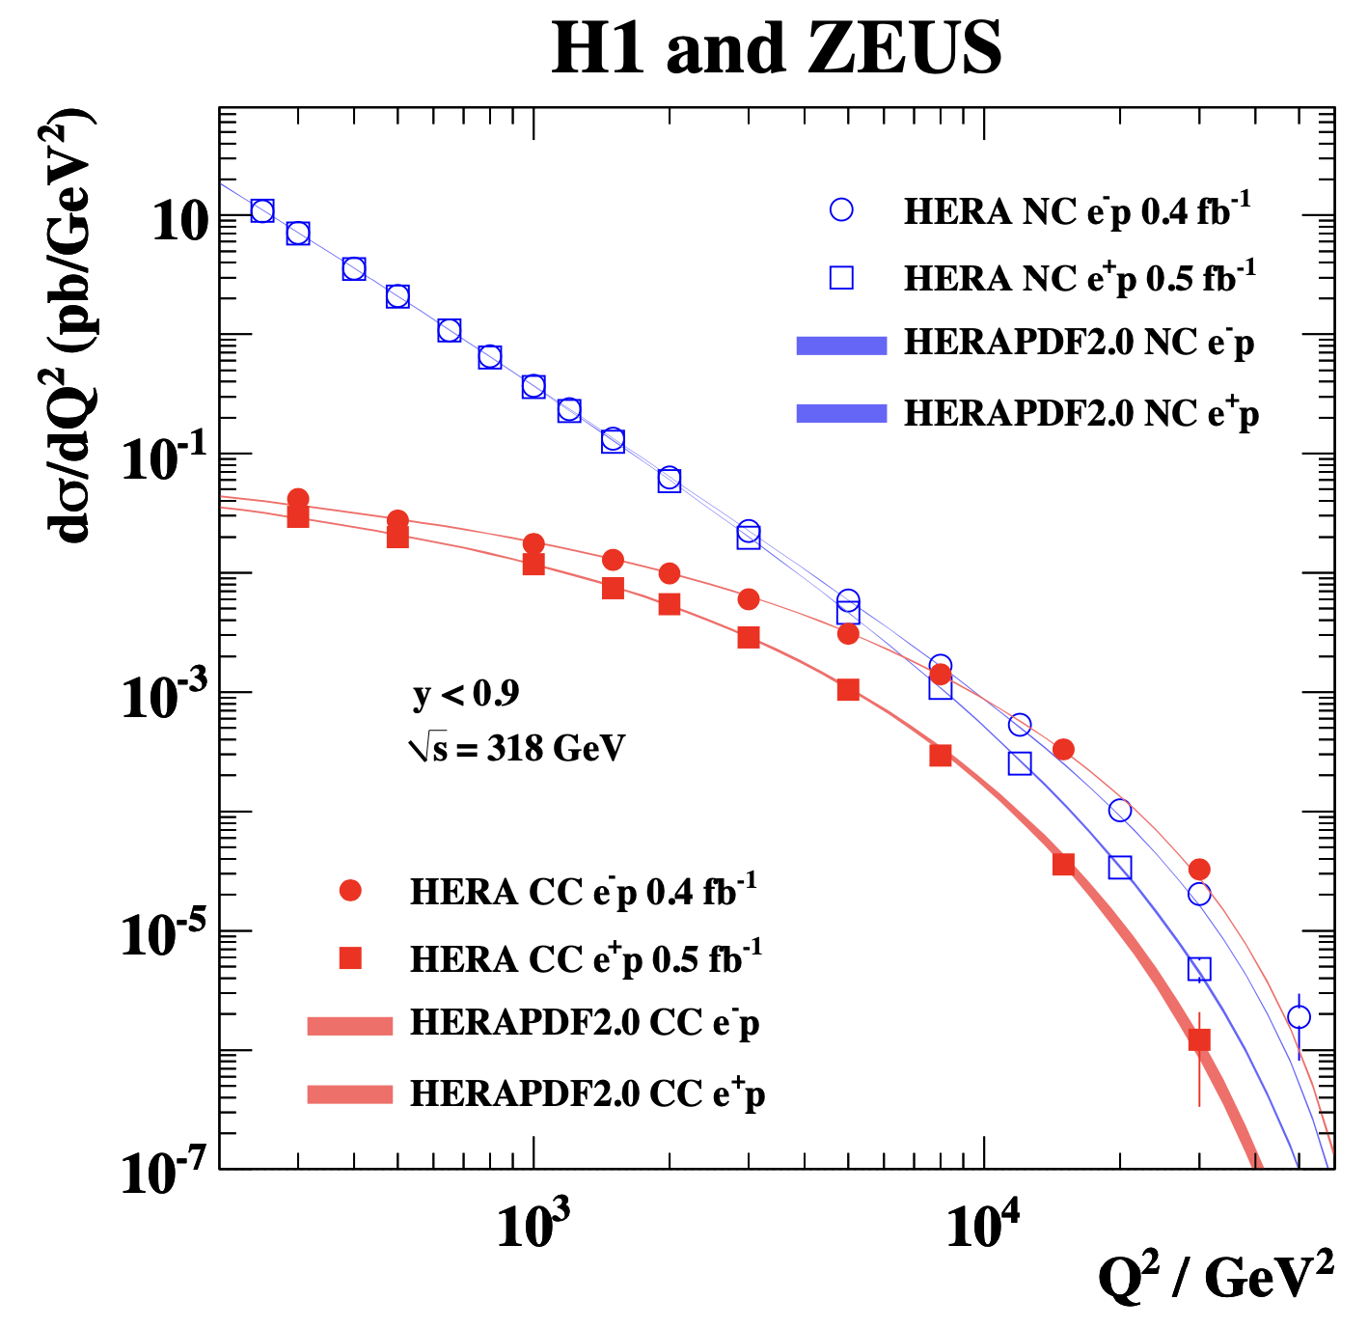
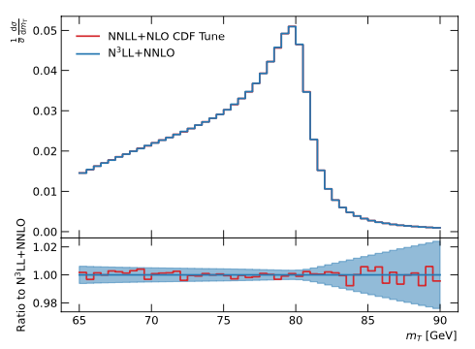
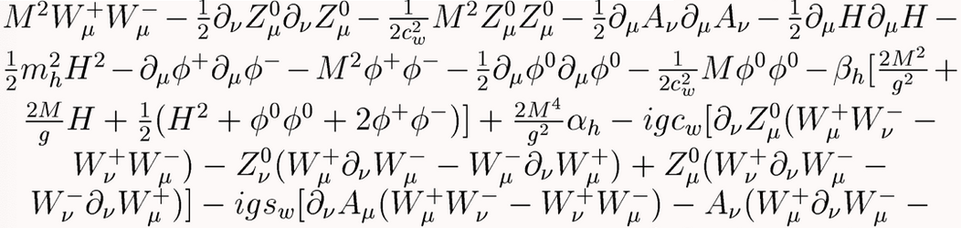
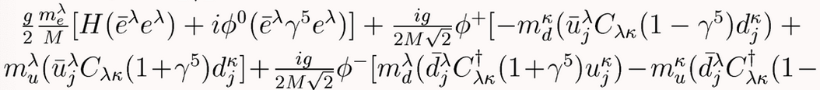
Electroweak Gauge Theory
In our daily life, we live in a deeply broken phase,
no sign of EW gauge symmetry! The “weak” force:
More discoveries:
Weak neutral current (1973):
EW unification: HERA
W±,Z⁰ discovery: SppS (1983)
LEP, Tevatron, LHC …
EW Gauge Theory at Work:
Non-Abelian gauge structure
Gauge coupling universality
EW precision ~ 10⁻³
@100 GeV, still a broken/superconducting phase:
London penetration depth
(the Meissner effect):
𝚫M_{w}/M_{w} ~10⁻⁴

Slide 15
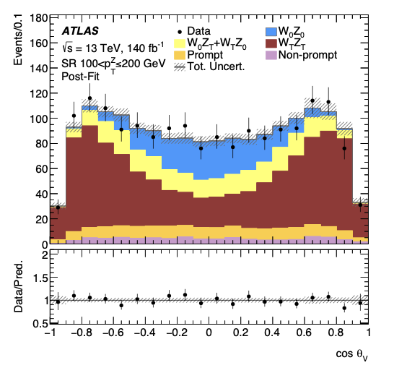

Longitudinal Gauge Boson & its Mass
Observation of W_{L} , Z_{L}?
first from the top decay t → W⁺b:
- W_{L}± Z_{L} at the LHC in high energies:
W±W±→ W±W± observed @ LHC,
but only for W_{T}W_{T}
ATLAS: arXiv:1906.03203, CMS: arXiv:2009.09429
V_{L} wavefunction for a massive vector :
ATLAS: arXiv:2402.16365
trivial “scalarization”
(for any vector state)
symmetry breaking
residual

Slide 16
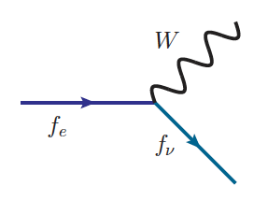
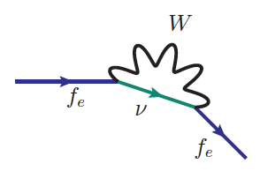
EW Evolution beyond Leading Log
W⁻
e⁻ 𝛎_{e}
Z/W⁻
𝛎_{e}
Incomplete cancellation for non-inclusive process in SU(2):
SU(2) “color” (e,𝝂) distinguishable, unlike QCD!
Bloch-Nordsieck theorem violation!
“Factorization theorem”:
sufficiently inclusive processes,
and infrared safe-observables
Not there yet! Much more to learn @ HE !

